Slide 1




Efficient Laser Spectroscopy of Actinide Molecules at Low Temperature -Les Houches 2026-
A. Claessens, R. Ferrer, Harshithbabu, W. Saelens, L. M. Arndt, R. de Groote, Ch.E. Düllmann, G. Neyens, A. Raggio, D. Renisch, J. Stricker, P. Van Duppen and P. Van den Bergh
Notes:
Rather bold title, I come from the heavy element

Slide 2
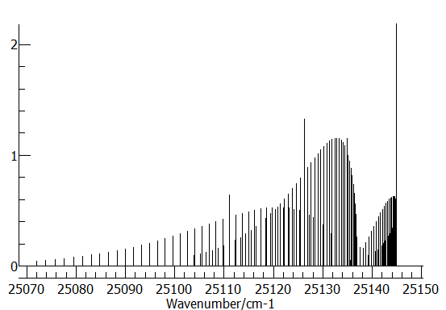
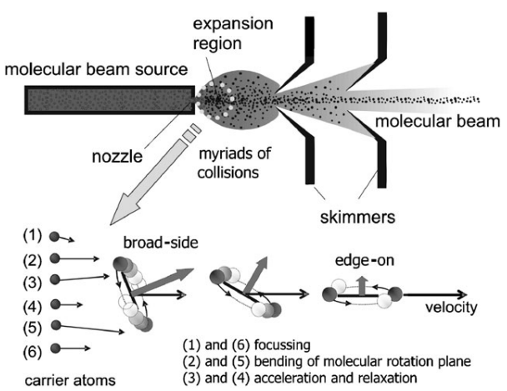
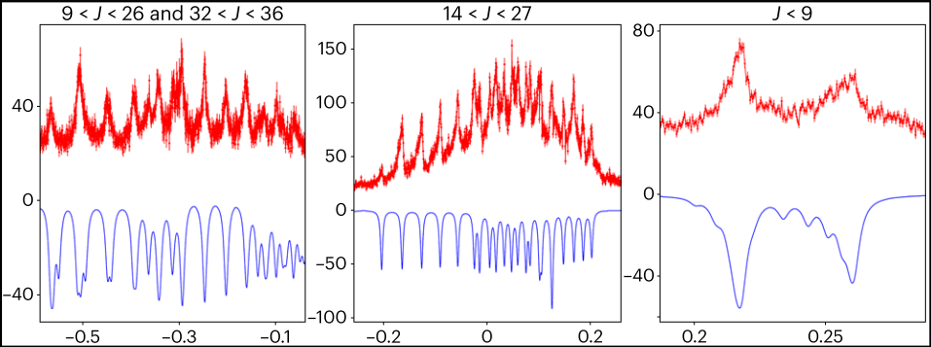
Radioactive molecules: challenges
Cooling
Efficiency
Resolution
Simulated spectra (Pgopher) ThO
²²⁶RaF @CRIS ISOLDE
T_{rot} = 300K
Spectral resolution: ~200MHz
On-line conditions are hot!
Efficiency? ~10⁻⁸?
Talk: M. Au
Talk: R. F. Garcia Ruiz
V. Aquilanti et al. Phys. Chem. Chem. Phys., 2005, 7 , 291–300.
S. Udrescu et al., Nature Physics 20,202-207 (2024)

Slide 3
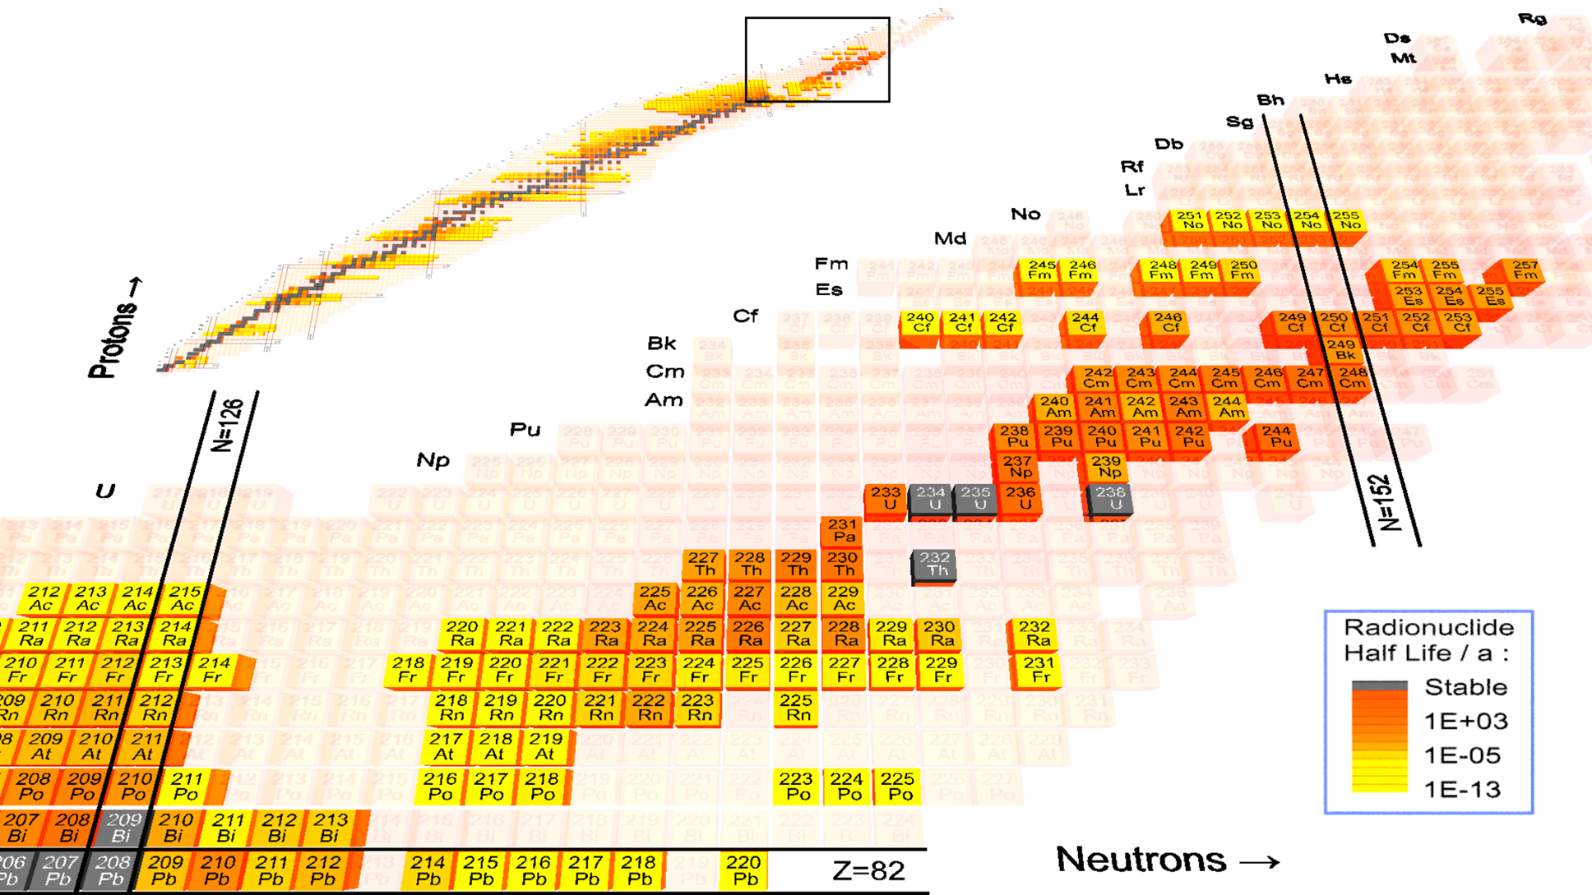
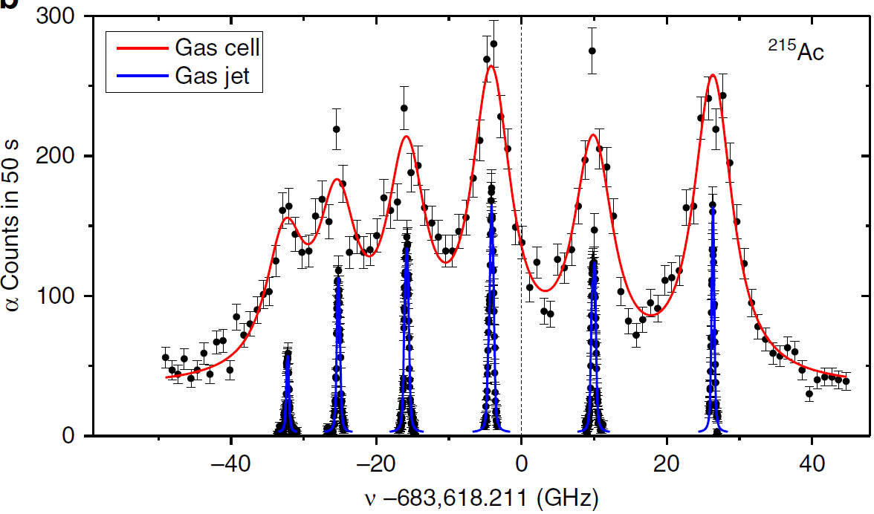
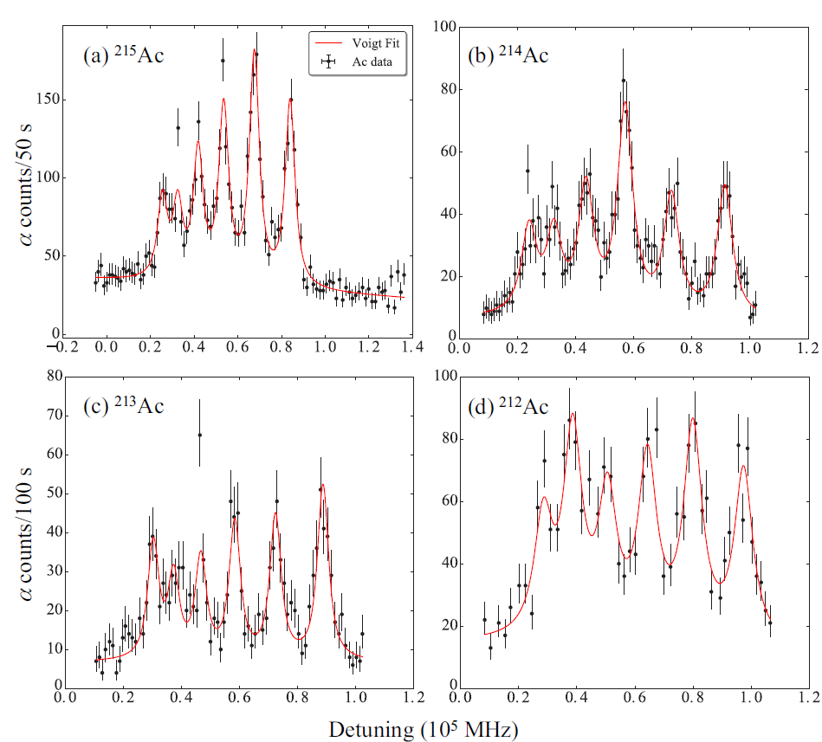
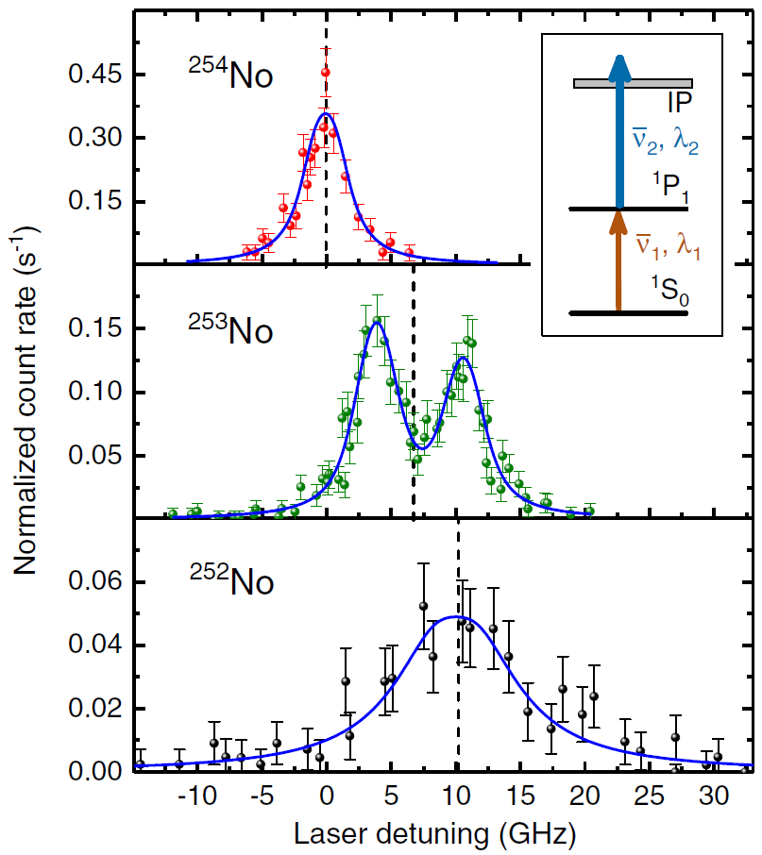


Laser Spectroscopy on Actinides
Challenges:
Laser spectroscopy on products of fusion evaporation reactions at ~ MeV energy (excluding long-lived actinides)
Low cross sections/Thin targets: Low production rates
GSI
²¹⁵Ac
²¹⁴Ac
LISOL
230
Ac
→ In-Gas Cell methods (e.g. RADRIS, LISOL)
²¹³Ac
²¹²Ac
Spectral resolution (3-4 GHz) gives access to Isotope
shift (d<r²>), partial hyperfine splitting (μ)
$σ \sim 1$mbarn
$σ \sim 2 −0.1 μ$barn
Reduction of collisional and Doppler broadening effects in low ρ and T gas jet provides complete hyperfine structure: μ, Q, I
Adjusted from M.Block. M. Laatiaoui, S. Raeder, Prog. Part. Nucl. 116 (2021) 103834
C. Granados et al., Phys. Rec. C, 96, 054331 (2017)
R. Ferrer. et al., Nature Comm. 8 14520 (2017)
M. Laatiaoui et al., Nature 538, 495 (2016) S. Raeder et al., Phys. Rev. Lett., 120, 232503 (2018)

Slide 4
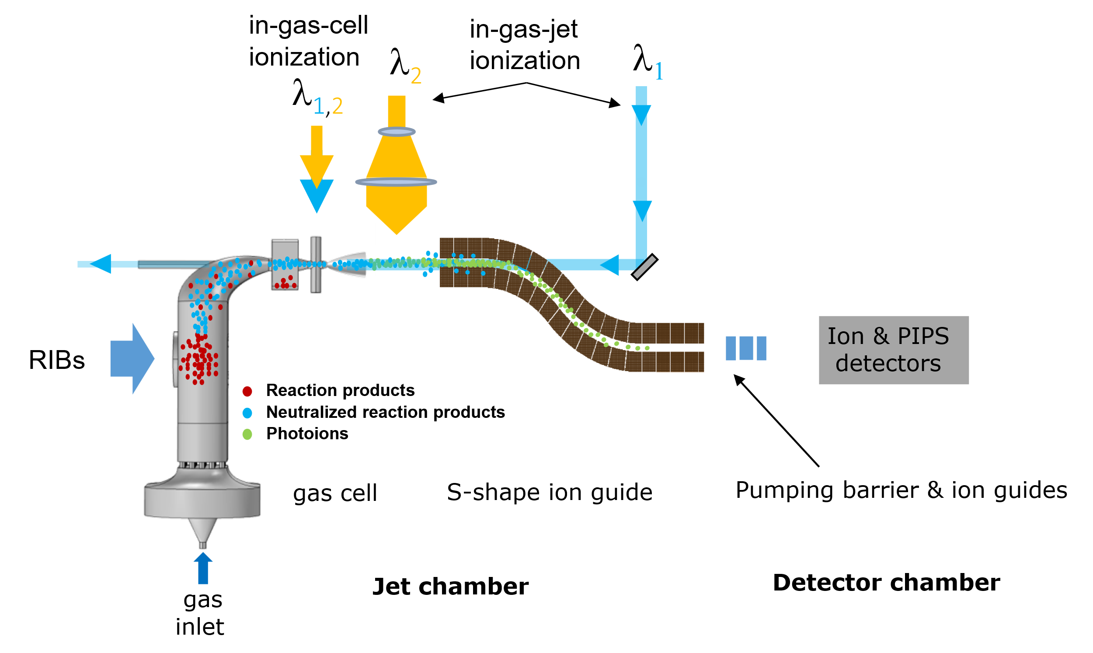
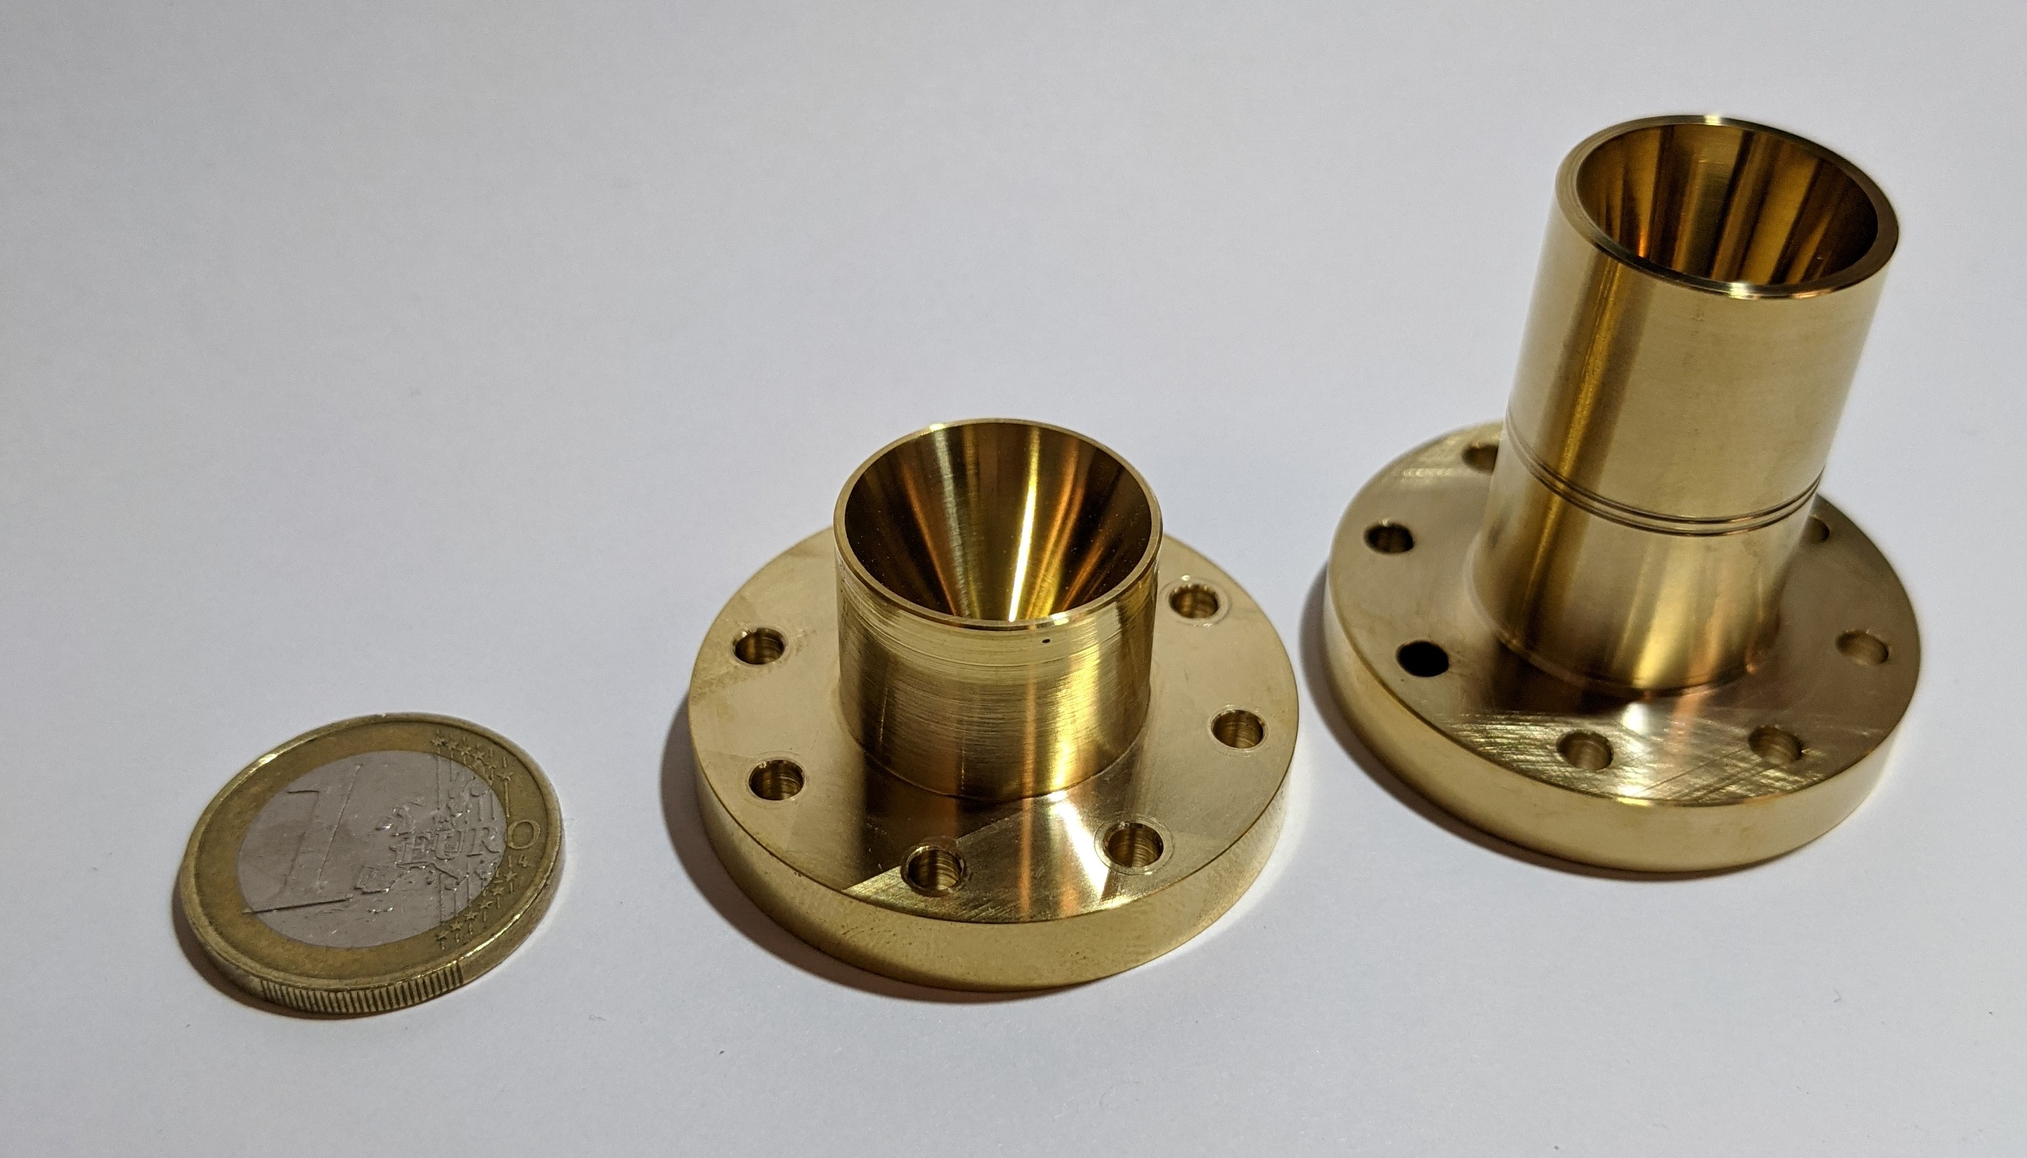
In-gas laser ionization & spectroscopy (IGLIS)
Laser sheet
Hypersonic nozzles
High-P₀
Low-P₀
125-500 mbar
40-100 mbar
In-gas-jet
Mach 8 or higher (550m/s)
Spectral resolution (~200MHz)
Doppler ( jet temp. ~15K)
Collisional ( jet pressure)
Efficiency (~ 0.1%)
Homogeneous
Collimated (61.5mm)
R. Ferrer, et al., Phys. Rev. Research 3, 043041 (2021)
Notes:
So how do you perform iglis?
So a general IGLIS layout looks as follows:
-we have a gas cell filled with high-purity argon gas.
-our atoms of interest are stopped and thermalized coming from an accelerator or another production method
-the argon flow carries the atoms through a convergent-divergent nozzle
-the adiabatic expansion created a cold, low density uniform gas jet
Laser spec is done with two or more lasers, photoions are separated from the flow via rfq and possibly mass separated and counted
Work horse are these two de Laval nozzles, one for low P0 and one for high P0
So why different nozzles?
They need to provide spectral resolution

Slide 5
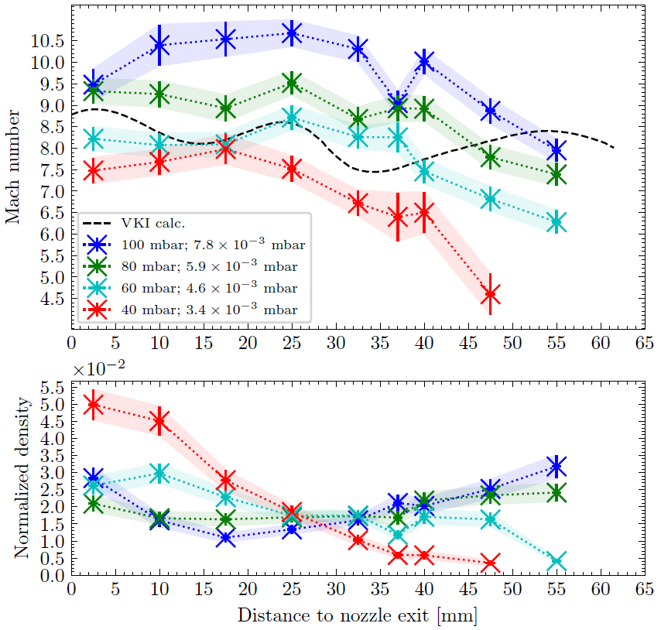
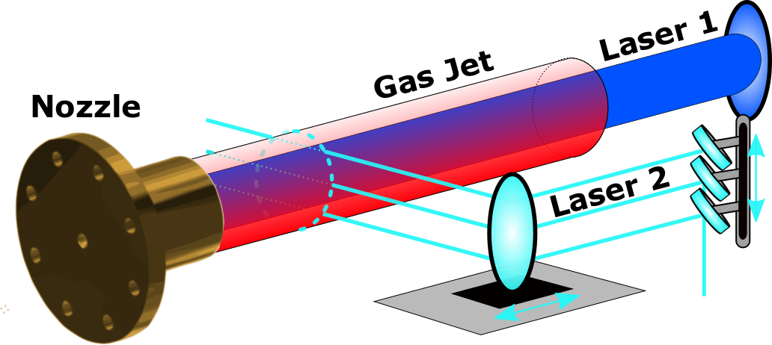
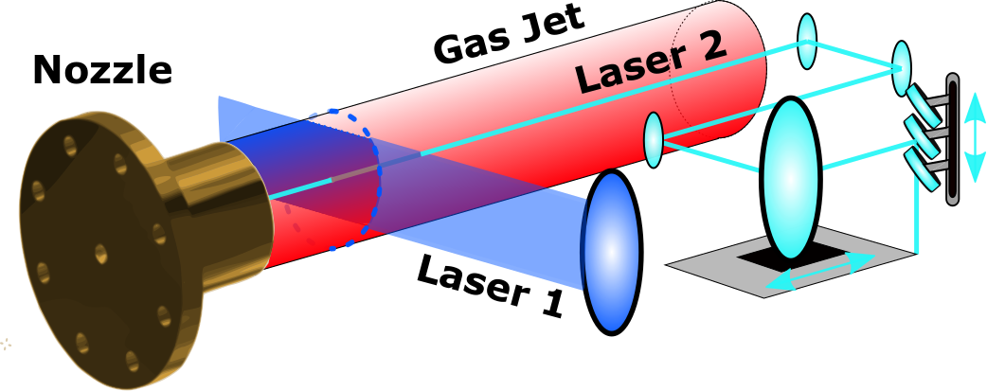
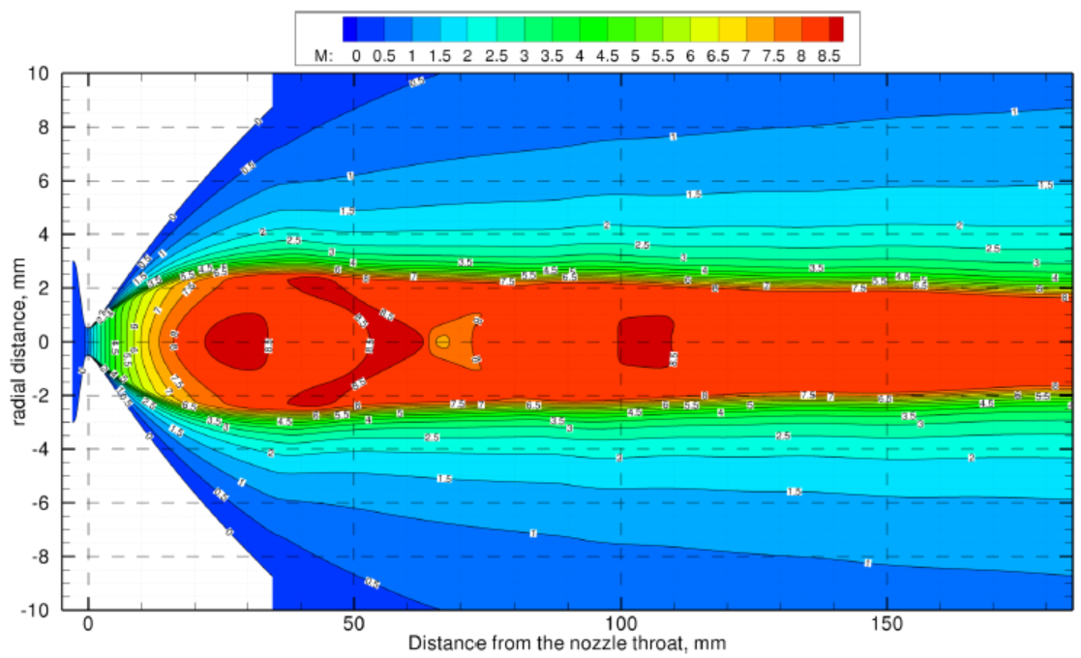
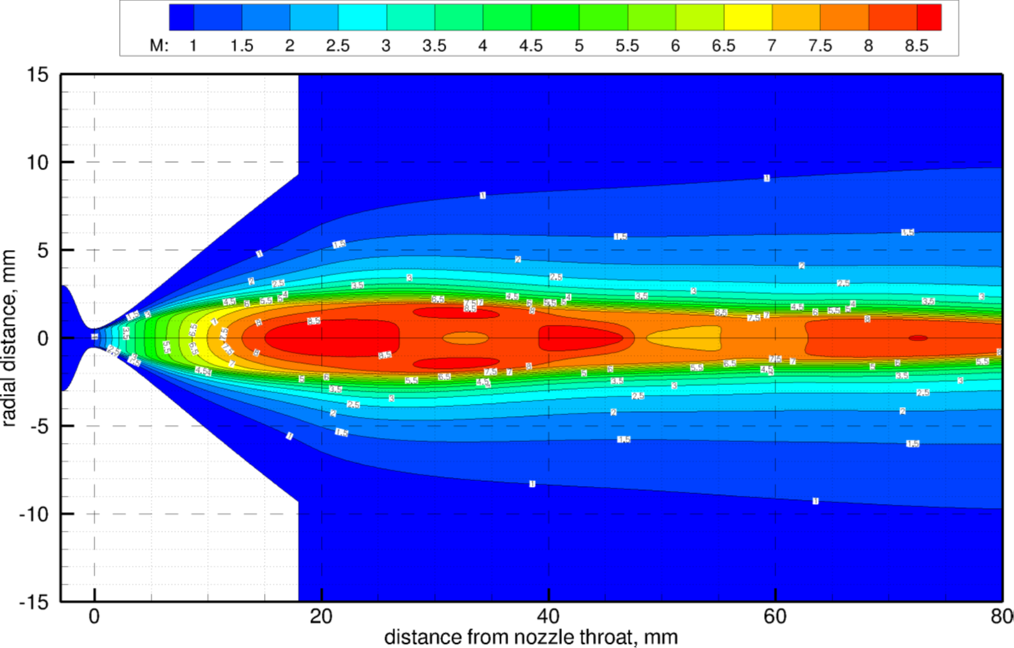
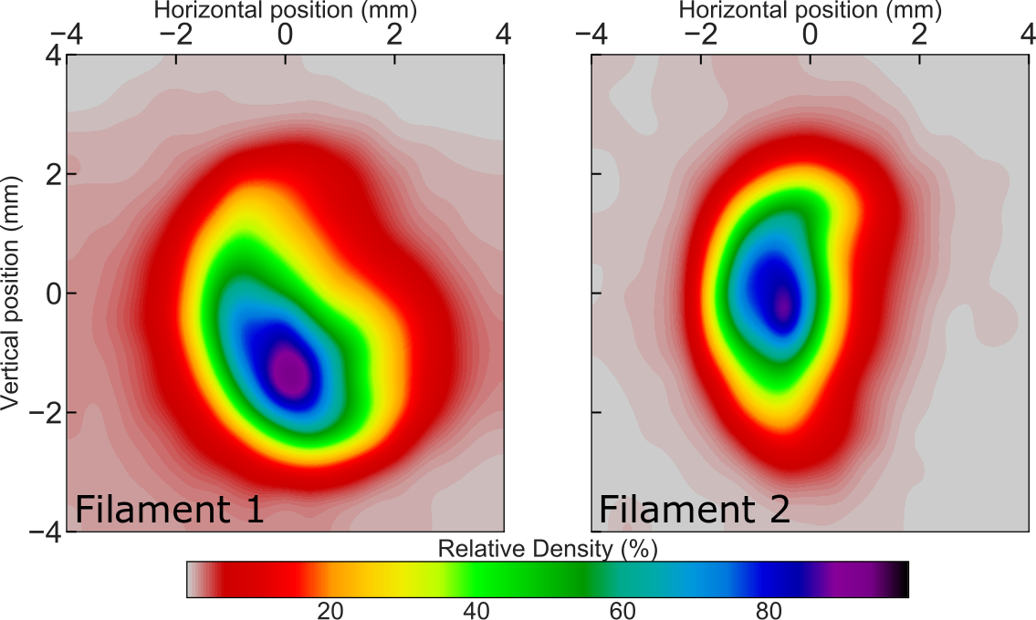
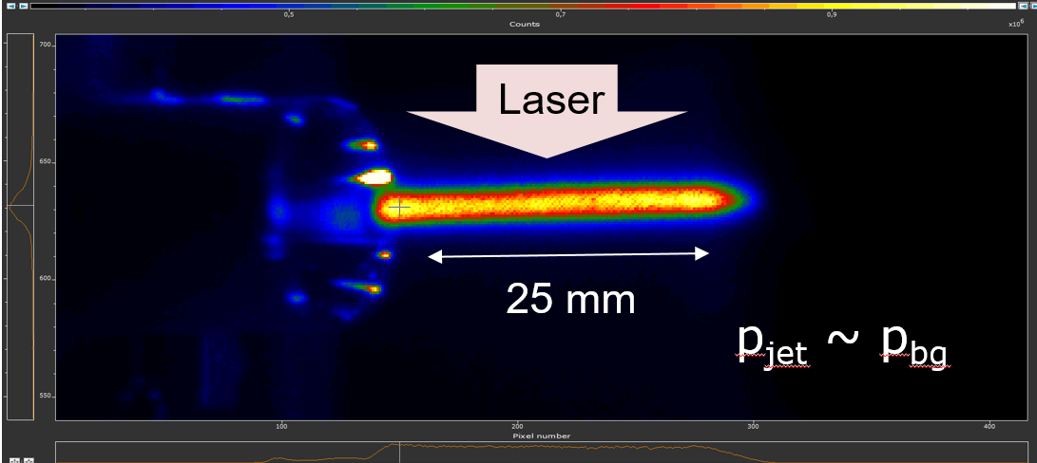
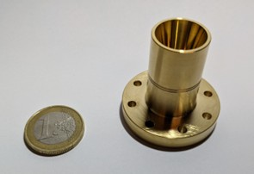
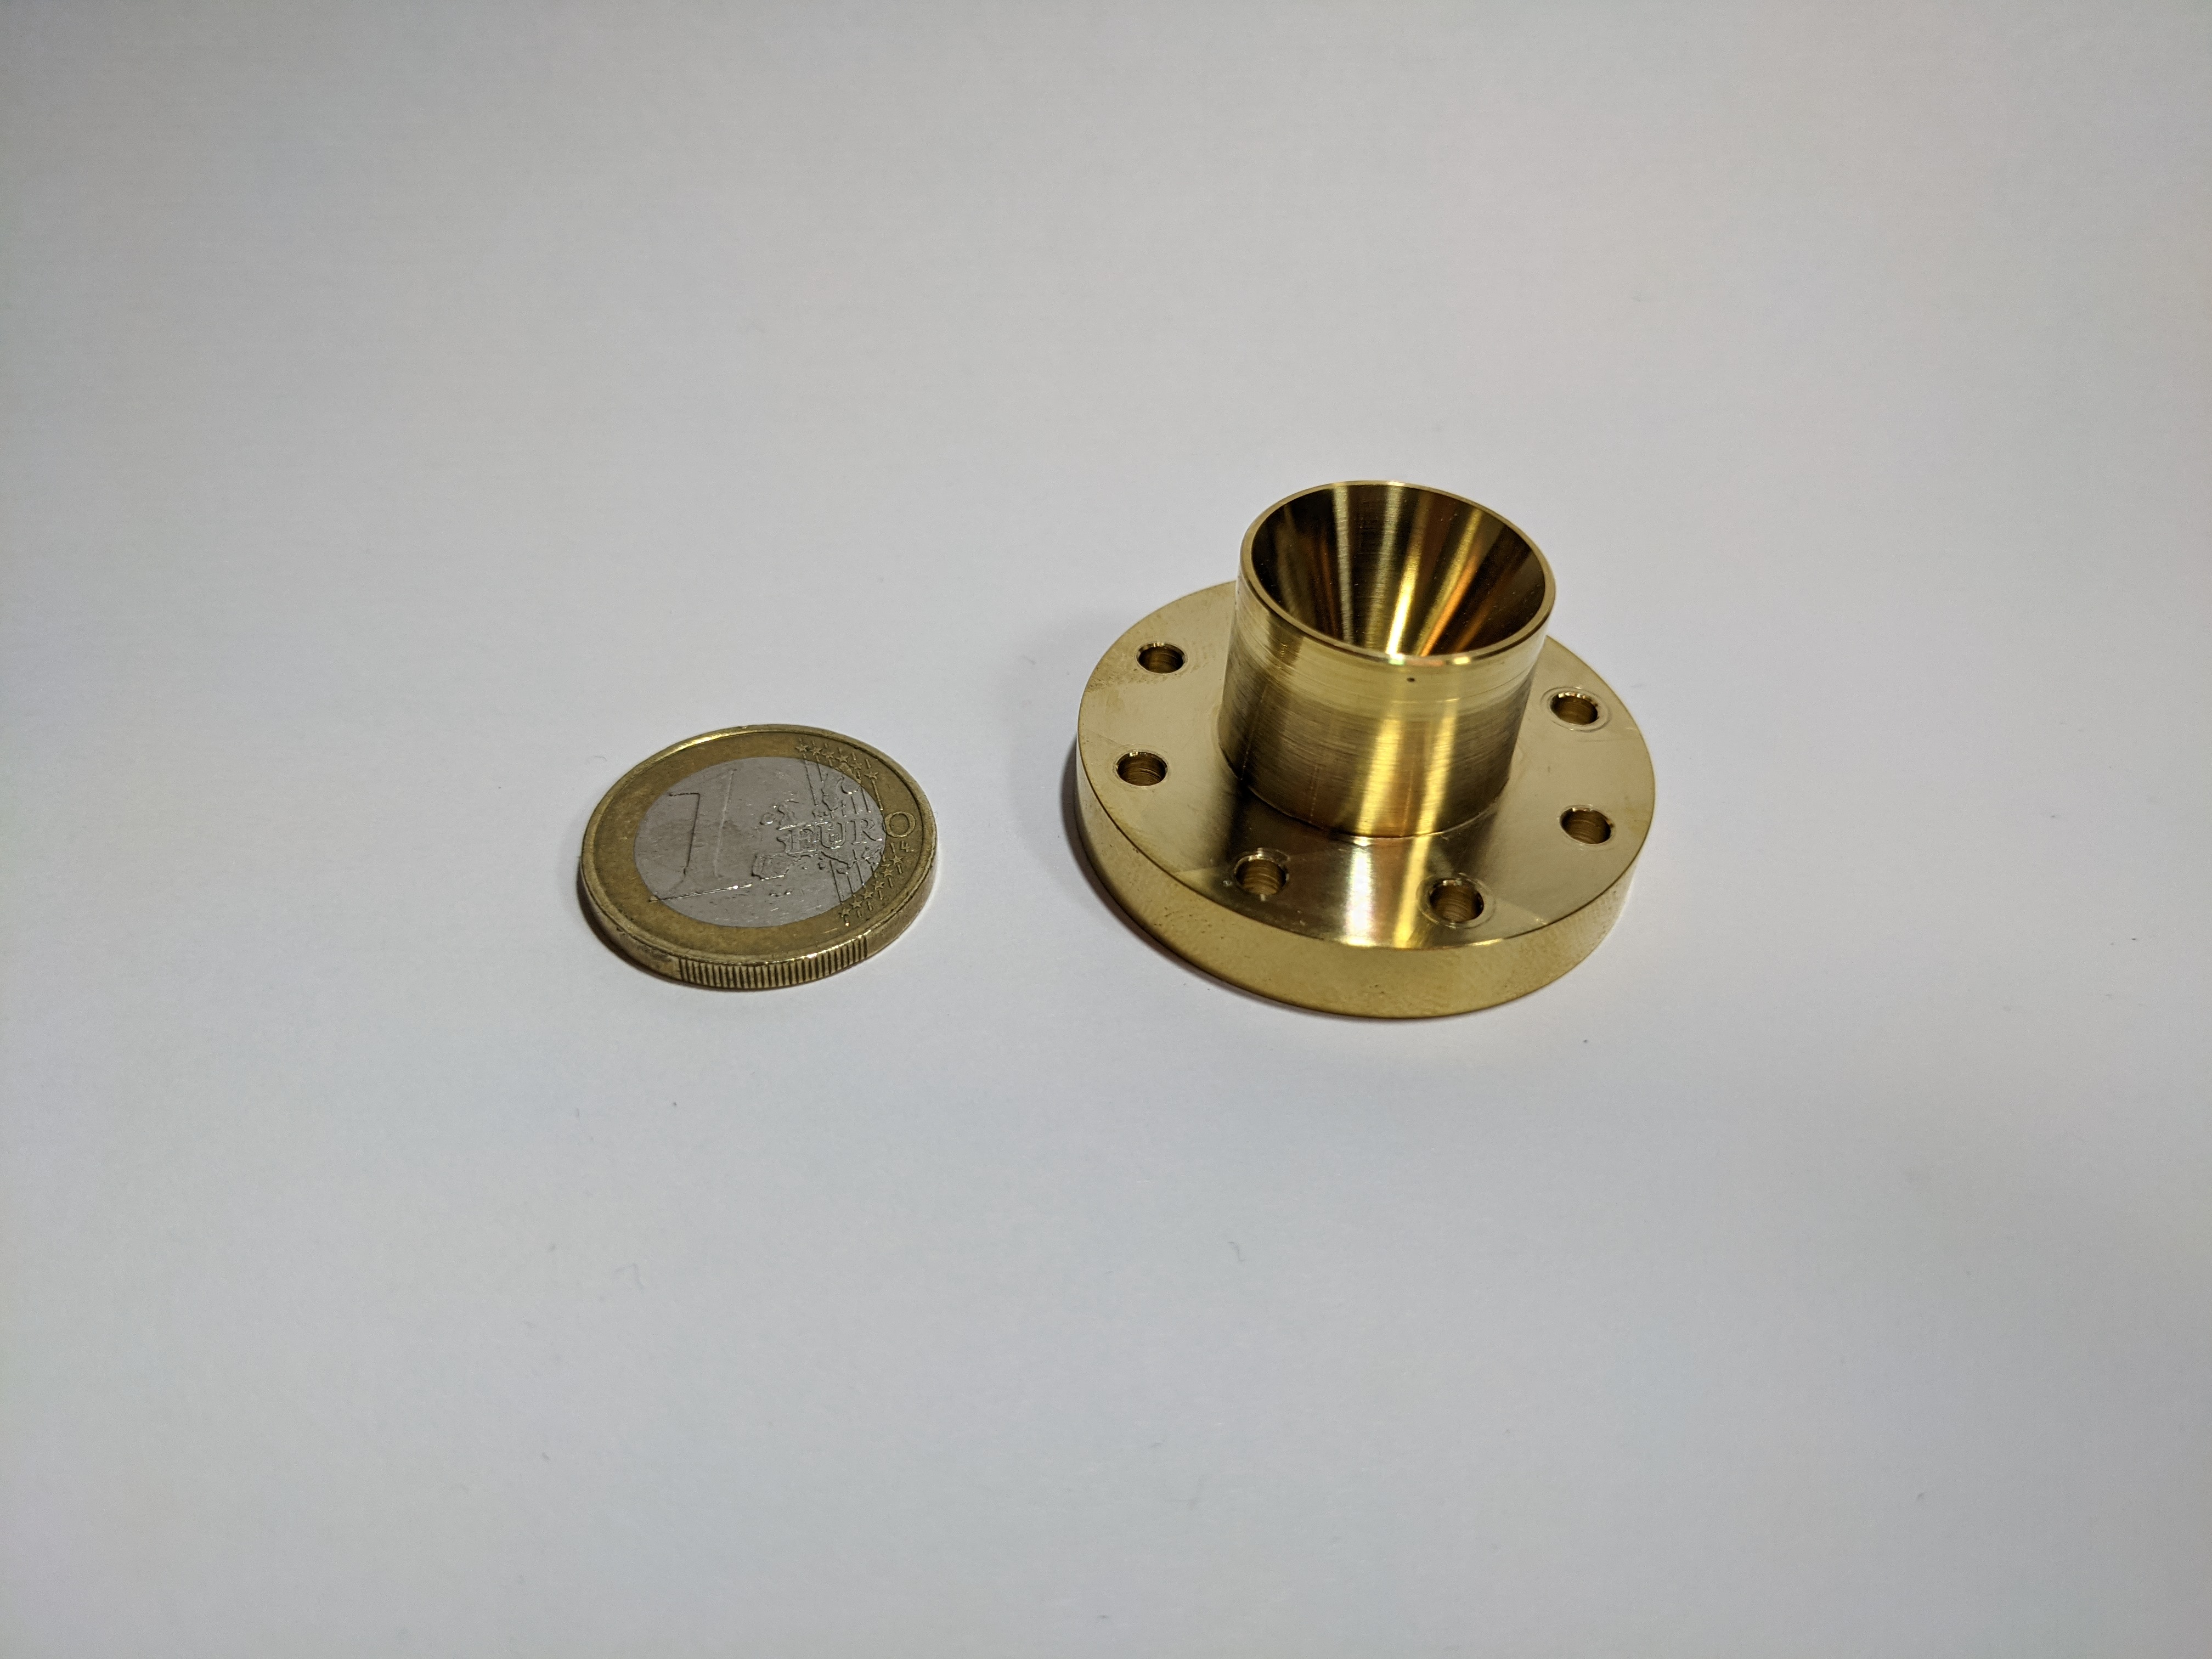
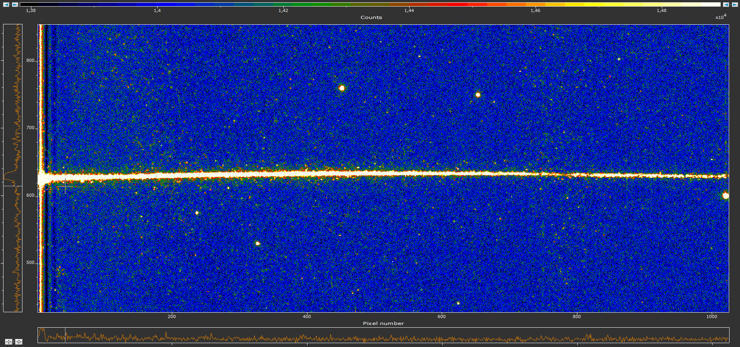
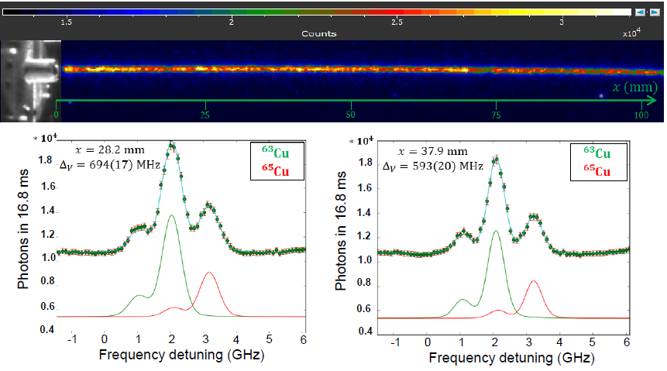
Design & characterisation of Hypersonic Nozzles
Spectroscopy-based flow mapping techniques
High stag. pressure nozzle
Designed by VKI
Low stag. pressure nozzle
Designed by VKI
Transverse & longitudinal
Radial
Mach 8.5, P₀ = 200-500 mbar
Mach 8.5, P₀ = 40-100 mbar
Computational Fluid Dynamics (CFD) simulations
Computational Fluid Dynamics (CFD) simulations
V
H
Motorized platforms
Δν_{c} → v_{jet}
FWHM → T_{jet}
Amp. → ρ_{jet}
M = 8.72(35)
~ 200MHz for No
M = 7.52(43)*
< 200MHz for Th¹⁺
CNC precision machining
CNC precision machining
~37 mm
Laser
100 mm
R. Ferrer, et al., Phys. Rev. Research 3, 043041 (2021)
A. Claessens. PhD Thesis, KU Leuven (2024)

Slide 6
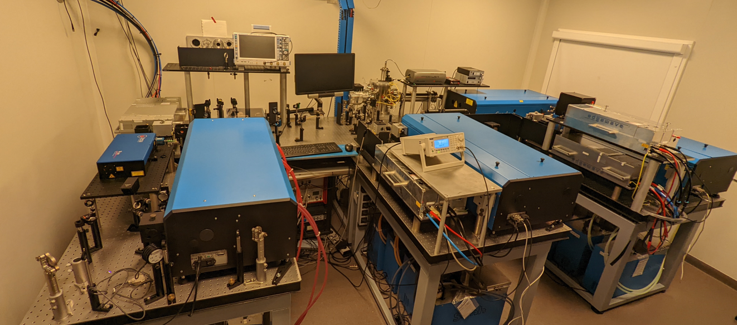
Nd:YAG pumped dye laser system @ KU Leuven
ABU
Wavemeter
Dye laser 1
SLM pump
He-Ne
Pump 1
CW seed
laser
Dye laser 3
Dye laser 2
Pulsed
Dye
Amplifier
Pump 2
Pump 3

Slide 7

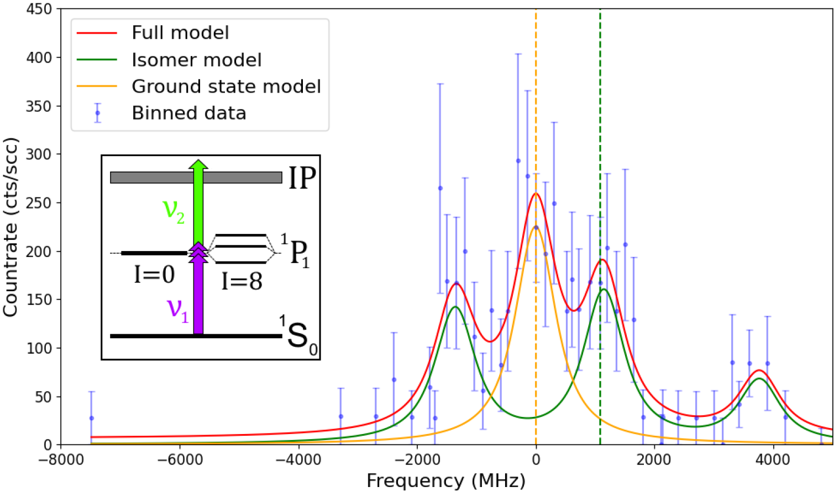
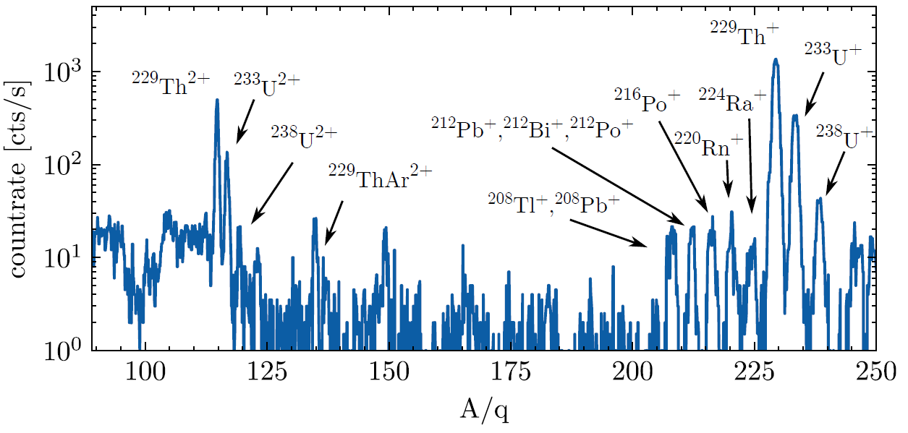
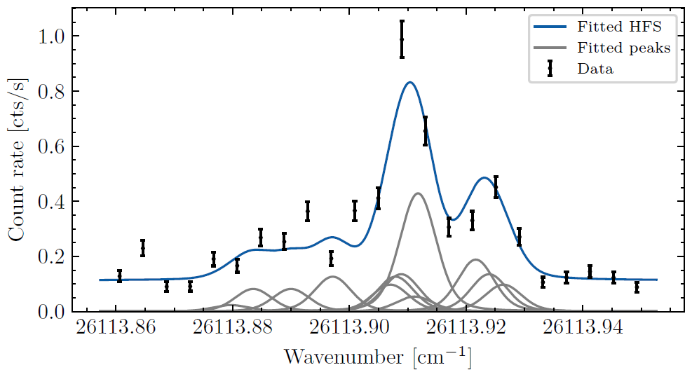
Validation IGLIS performance with μbarn RIBs
@ GSI
IGLIS@ KU Leuven
Mass spectrum ²³³U recoil sources from C. Düllmann et al. (Mainz)
^{254m,g}No
(T_{1/2}=265 ms)
preliminary
In-gas-jet ²²⁹Th spectrum
JetRIS results unambiguously assign two-qν $\frac{9}{2}−\left[734\right]\text{n}⨂\frac{7}{2}+[624]$_{ν} configuration
20 years long-standing debate resolved!
High efficiency/ sensitivity and good spectral resolution (FWHM=240 MHz )
J. Lantis, A. Claessens, D. Münzberg et al., et al., Phys. Rev. Res., 2024.
Claessens, F. Ivandikov et al. Phys. Rev. A. 112, 052810 (2025)
F. Ivandikov PhD Thesis, KU Leuven 2025

Slide 8
Hypersonic molecular beams
Cooling is different for the different degrees of freedom! (translation, vibration, rotation)
Cooling, efficiency, resolution?
V. Aquilanti et al. Phys. Chem. Chem. Phys., 2005, 7 , 291–300.

Slide 9
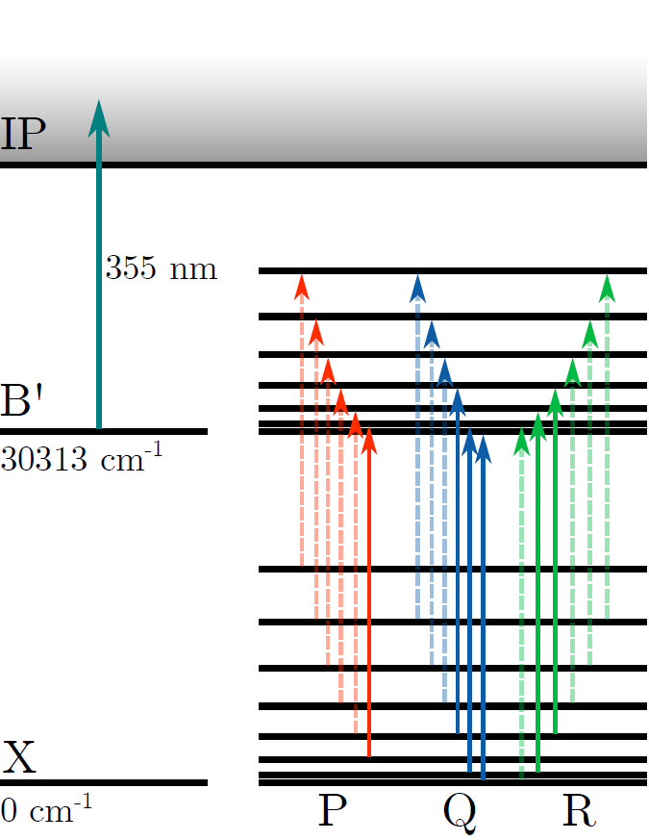
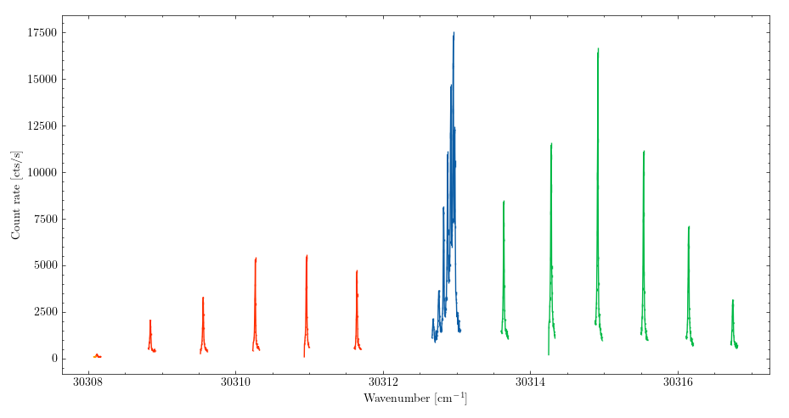
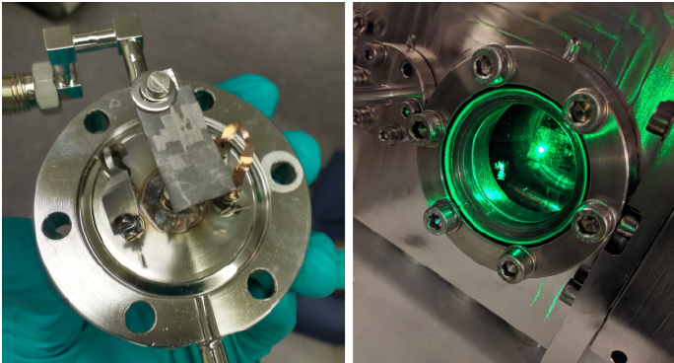
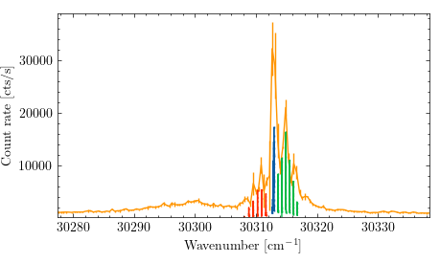


IGLIS on ThO: B’-X 0-0
Ablation metallic Th
$$Ω=1$$
Q-Branch
R-Branch
$$Σ^{+}$$
P-Branch

Slide 10
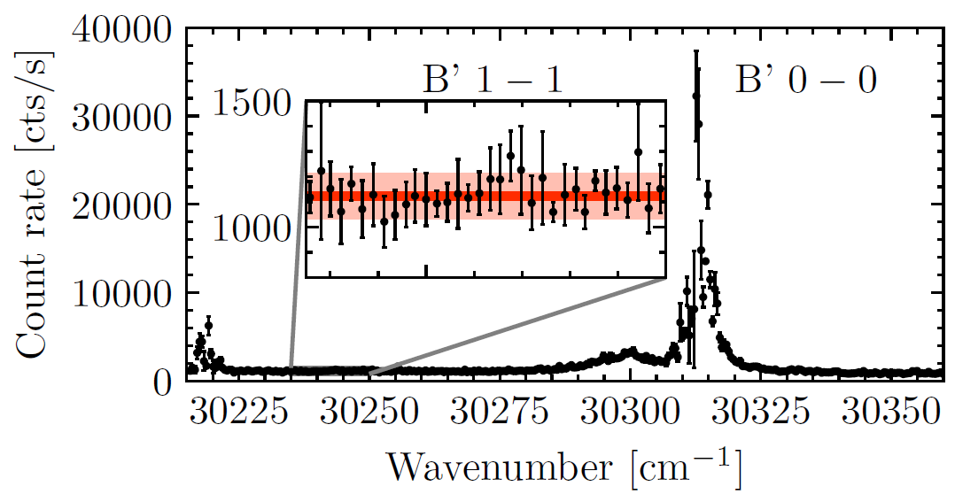
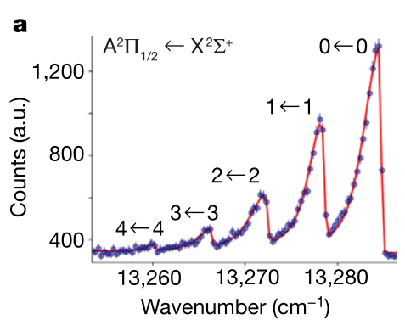
Broadband ²³²ThO: vibrational
²³²ThO
²²⁶RaF
Effective T_{vibration} >1000K
T_{vibration}<250K
R. F. Garcia Ruiz et al. Nature, 581, 396-400 (2020)
A. Claessens, R. Ferrer, et al. In preparation

Slide 11
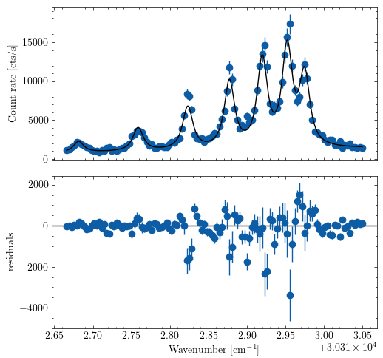
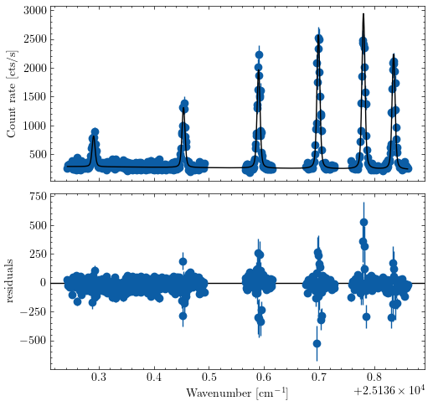
Rotational temperature
Q-branch B’-X 0-0
Q-branch U-X 0-0
preliminary
preliminary
7.39(18)K
6.85(16)K

Slide 12
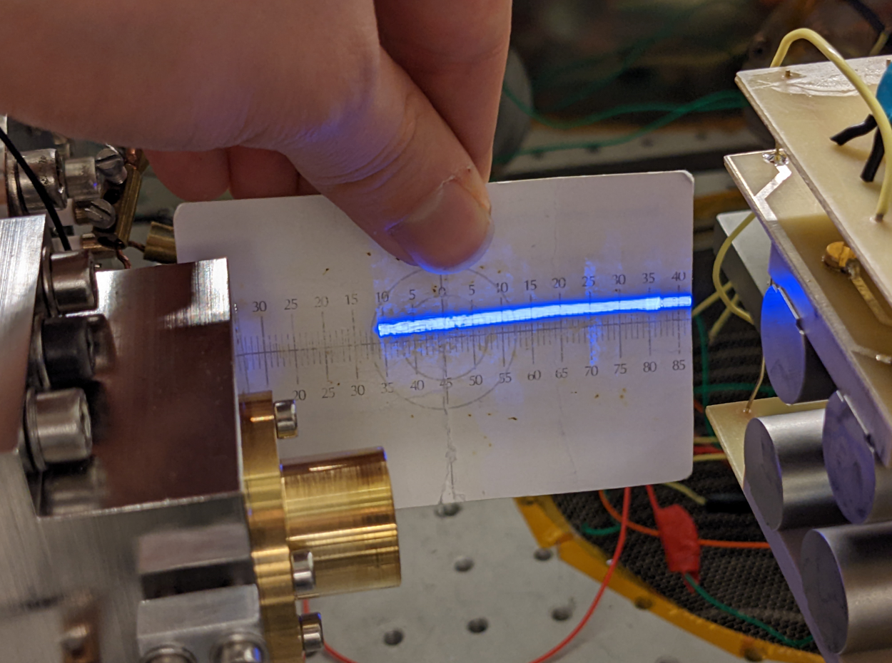
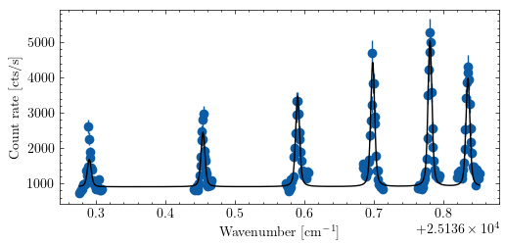
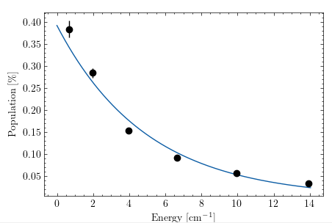
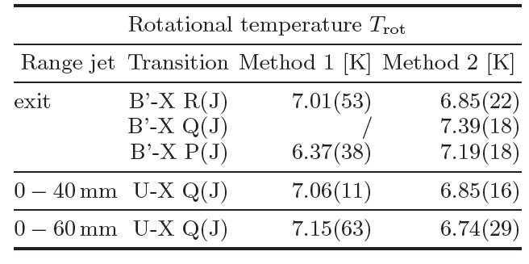
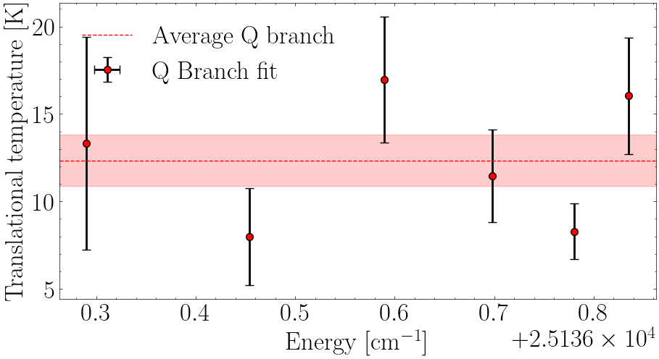
Rotational & translational temperature
Q-branch U-X 0-0
Laser sheet
preliminary
preliminary
preliminary
T_{trans}=12.3(15)K
~200 MHz
T_{rot}=7.2(6) K
A. Claessens, R. Ferrer, et al. In preparation

Slide 13
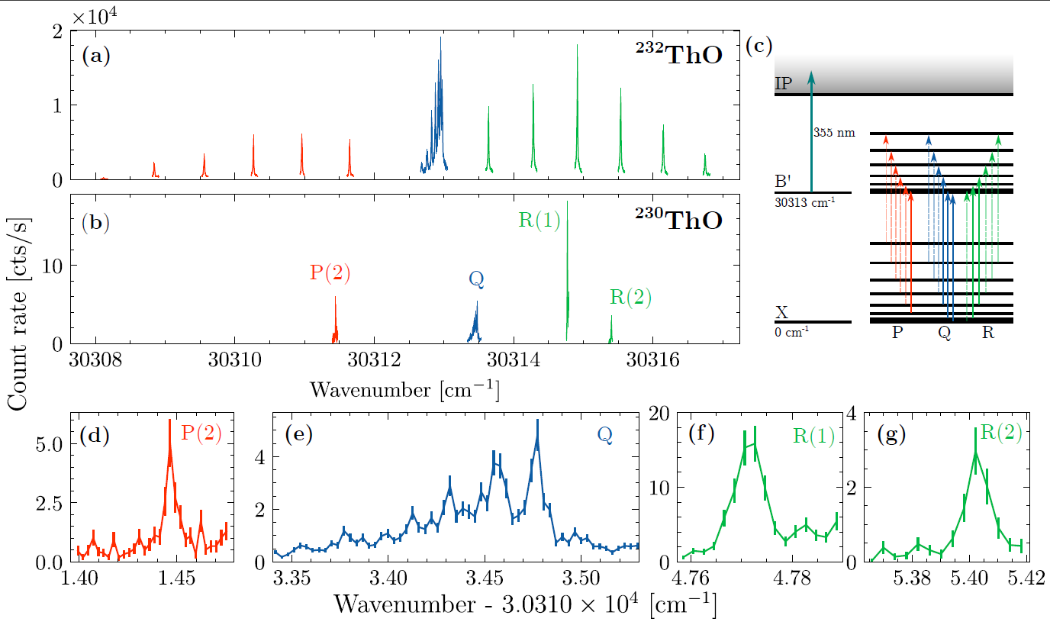
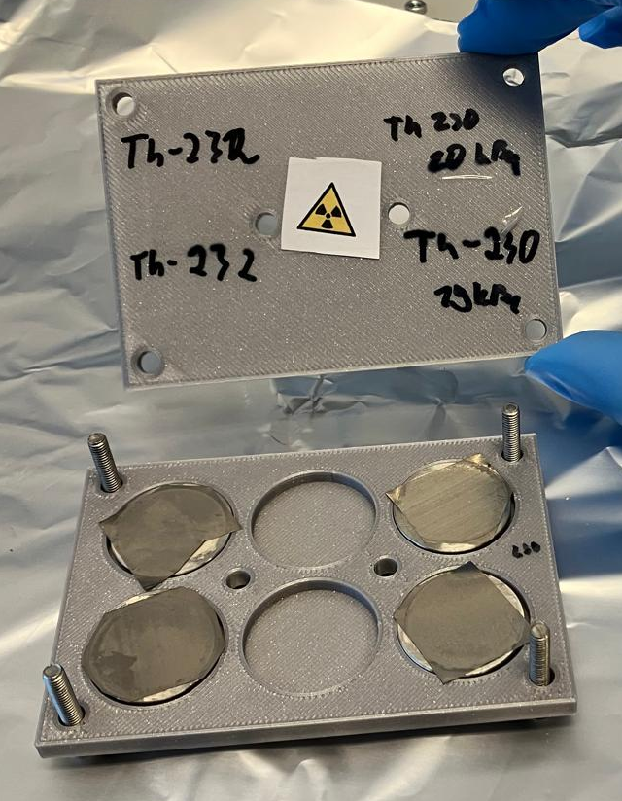


^{230,232}ThO: B’-X 0-0
Triflate-based ThO sources
Prepared at Mainz
By group of Ch. E. Düllmann
preliminary
$$Ω=1$$
preliminary
$$Σ^{+}$$
Th-232: ~ 2 mg 1.7 Bq, (2.0 ± 0.4) µm
Th-230 mix Th-232: 1.95 mg, 20 kBq
Th-230 mix Th-232: 1.32 mg, 19 kBq
(26 µg or 7 X 10¹⁶of 230Th per target)
A. Claessens, R. Ferrer, et al. In preparation
J. Stricker et al., Phys. Rev. A 112, 012821 (2025)

Slide 14
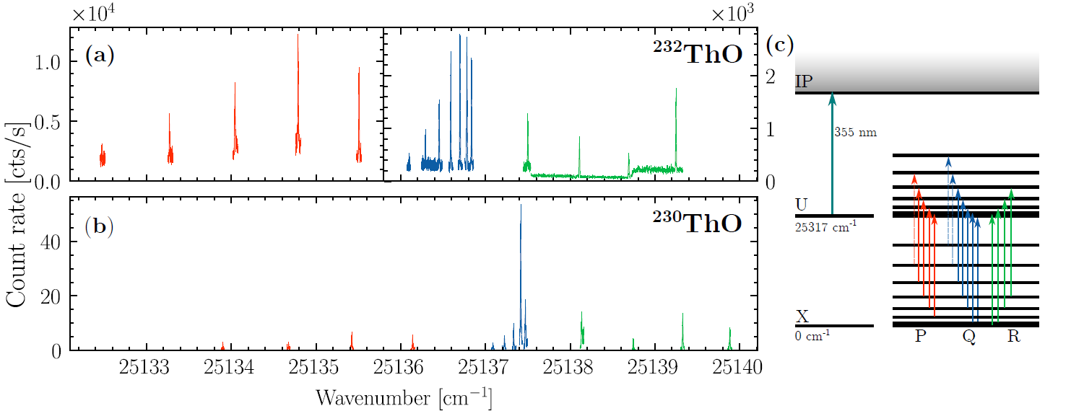
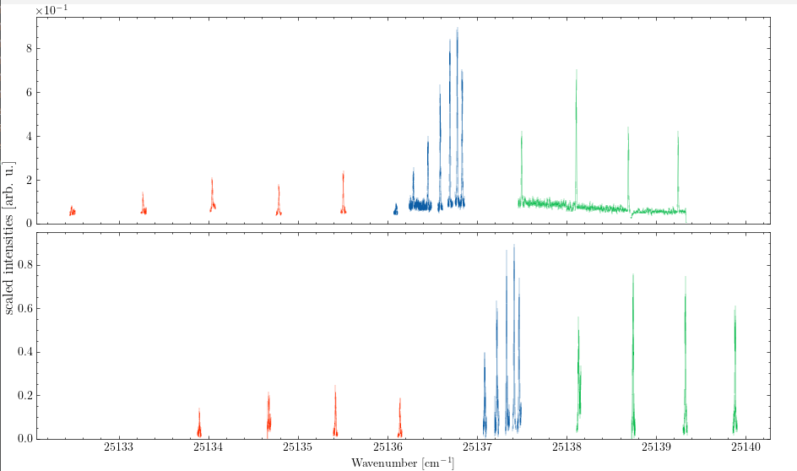
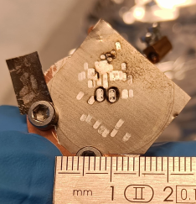
U-X 0-0
preliminary
preliminary
Temperature scaled
Ablation sources
Full study done with fraction of one 20kBq (10¹⁷ atoms) target!
Isotopologue shift:
Δv₍₂₃₀₋₂₃₂₎ ≈ -19.01(5) GHz
ε > 10⁻⁹

Slide 15
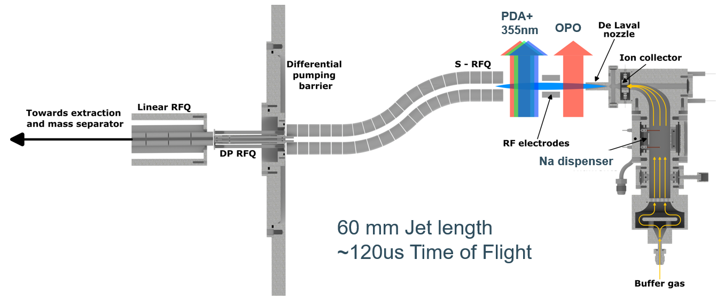
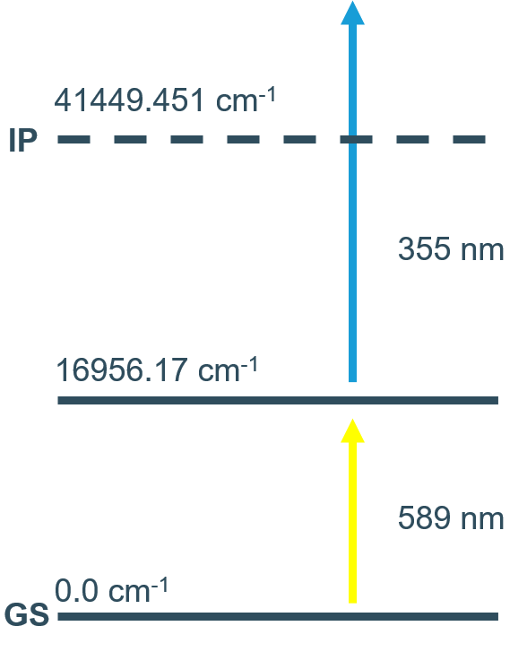
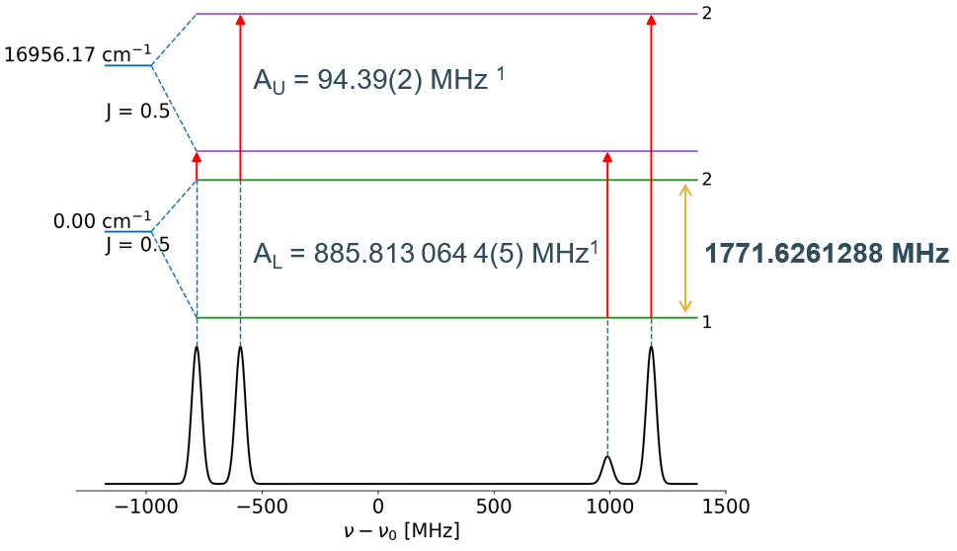
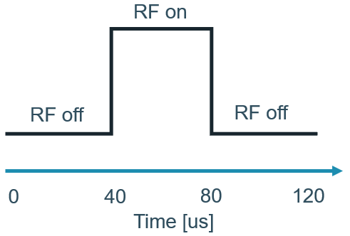
Laser Radiofrequency Double-Resonance
spectroscopy at KU Leuven
Probe
Pump
CW
RF excitation
Pump on
Probe (RIS) on
Na I
W.J. Childs, Phys. Reports 211, No.3 (1992) 113
Allegrini, M. et al., Journal of Physical and Chemical Reference Data 51, no. 4 (2022)

Slide 16
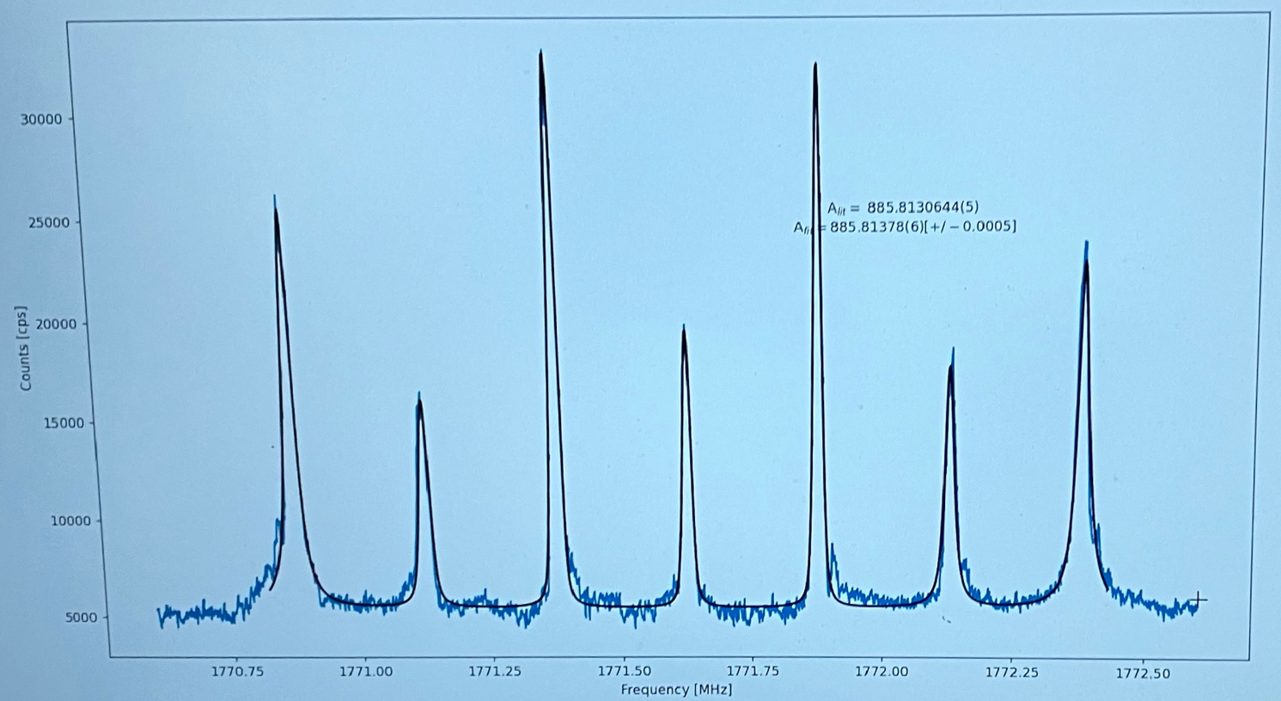
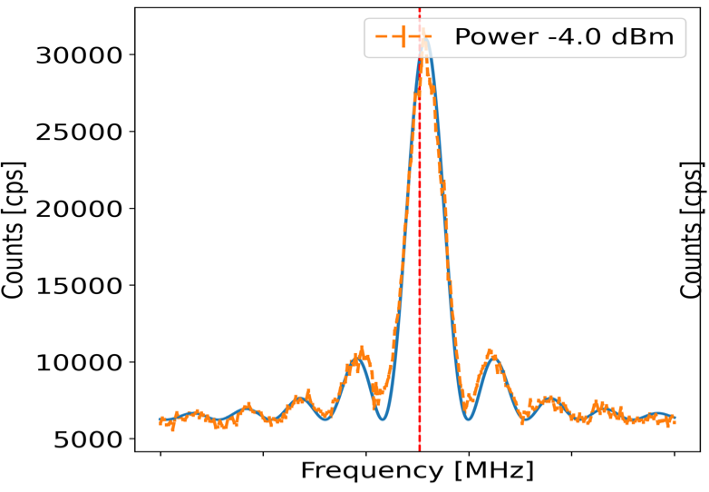

Ground-State Hyperfine Splitting in Na
A_{exp} with ~1 kHz accuracy
~ 10⁴ increase in spectral resolution
with resp. to optical transitions
Hyperfine anomalies
Moments
Molecular spectroscopy
Rabi oscillations→ coherent control
FWHM ~ 20 kHz
Multiple peaks due to Zeeman splitting of g.s. hyperfine levels
Central peak is 0→0 transition between Zeeman sublevels, independent
of magnetic field (field compensation coils foreseen)
Rel. efficiency RF to RIS signal gives good prospects for application on RIBs
A. Raggio, R de Groote et al.

Slide 17


Conclusions and Outlook
IGLIS offers good efficiency and spectral resolution for the study of fusion evaporation products with low production rates (μbarn towards ~100s nbarn)
Nozzle development led to well-collimated and cold jets for experiments with only-flow and electrical gas cells at heavy-ion accelerator facilities such as S3-LEB (GANIL) and JetRIS (GSI), and at offline setups such as KU Leuven, Harvard, FRIB, etc..
Prospects for high efficiency molecular spectroscopy with relatively simple spectra and good resolution:
T_{vib} of 250 K, T_{rot} ~7 K, T_{trans} ~12K (consistent with atoms) in 60 mm-long full jet
Proof of principle with first isotopologue shift of Th molecules: upcoming
campaign to study hyperfine structure in ²²⁹ThO
Possible increase in spectral resolution (~ kHz) by RF-IGLIS (Λ, Ω doublets, moments,
hyperfine anomalies,…..)
Molecular formation and state preparation superheavy molecules ^{254,253}NoX (X=F, O, …)

Slide 18
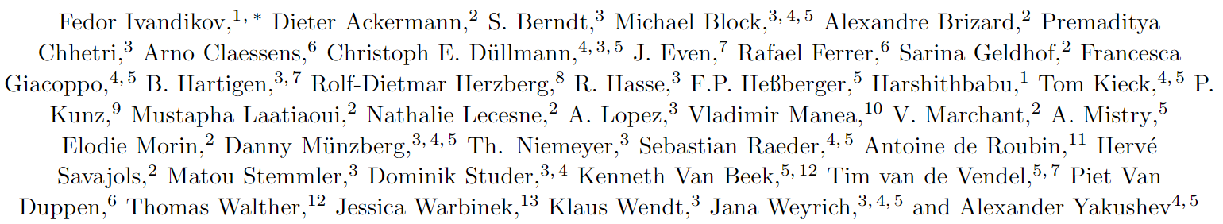




JetRIS collaboration

