Slide 1
Plans to Search for a Low-Lying Nuclear State of ²²⁹Pa Using Two Complementary Techniques at FRIB
March 5, 2026
EDMs2026: WE-Heraeus Workshop
École de Physique des Houches
Maggie Tseng*, Aiden Boyer, Catherine Burcklen, Marie-Anne Descalle, Stephan Friedrich, Alyssa Gaiser, Paul Gueye, Inwook Kim, Chang Lee, Prottoy Samir, Stefan Schwarz, Jaideep Taggart Singh
*tseng@frib.msu.edu
LLNL-PRES-2016080

Slide 2
Different sources of T n EDM of different systems
Light Ion Storage Rings
“effective” short range
nucleon EDM
neutron: 2.2x10⁻²⁶ e cm (2020, PSI)
θ_{QCD}
ILL-PNPI
JPARC
PanEDM
LANL
PSI
TUCAN
isoscalar
nucleon-nucleon
coupling
Hg-199: 0.74x10⁻²⁹ e cm (2016, UW)
Xe-129 (LANL/ASU/UM)
Yb-171 (USTC)
Ra-225 (ANL/MSU)
RaX (MIT/Caltech/Harvard)
isovector
nucleon-nucleon
coupling
Physics Beyond the
Standard Model
nuclear spin-dependent
electron-nucleus coupling
²⁰⁵TlF: 6.5x10⁻²³ e cm (1991, Yale)
CeNTREX (ANL/JHU/CU/UMass)
ThO: 1.1x10⁻²⁹ e cm (2018, ACME)
HfF⁺: 0.5x10⁻²⁹ e cm (2023, JILA)
YbF (Imperial College)
BaF (VSI/VUA ; York)
Cs (Penn St.)
Fr (CYRIC ; TRIUMF)
nuclear spin-independent
electron-nucleus coupling
RMP 91
015001
(2019)
lepton EDM
Muon Storage Ring

Slide 3
Different sources of T n EDM of different systems
neutron: 2.2x10⁻²⁶ e cm (2020, PSI)
E. Segarra, K. Michielsen (PSI)
ILL-PNPI
JPARC
PanEDM
LANL
PSI
TUCAN
“effective” short range
nucleon EDM
θ_{QCD}
isoscalar
nucleon-nucleon
coupling
Hg-199: 0.74x10⁻²⁹ e cm (2016, UW)
Xe-129 (LANL/ASU/UM)
Xe-129 (Mainz/Juelich/Heidelberg)
Yb-171 (USTC)
Ra-225 (ANL/MSU)
RaX (MIT/Caltech/Harvard)
Eu-153 (Toronto/UCSB)
Hg-199 (Bonn)
S. Vanbergen (TRIUMF)
T. Chupp (UM)
U. Schmidt (Heidelberg)
isovector
nucleon-nucleon
coupling
T. Xia (USTC)
Physics Beyond the
Standard Model
B. Nima (Toronto)
R. Garcia Ruiz (MIT)
S. Stellmer (Bonn)
nuclear spin-dependent
electron-nucleus coupling
²⁰⁵TlF: 6.5x10⁻²³ e cm (1991, Yale)
CeNTREX (ANL/JHU/CU/UMass)
D. Kawall (UMass)
ThO: 1.1x10⁻²⁹ e cm (2018, ACME)
HfF⁺/ThF⁺: 0.5x10⁻²⁹ e cm (2023, JILA)
YbF (Imperial College)
BaF (Groningen)
SrF (York)
Cs (Penn St. ; Paris-Saclay)
Fr (CYRIC ; TRIUMF)
BaF (INFN)
S. Y. Park (JILA)
nuclear spin-independent
electron-nucleus coupling
E. Hessels (York)
E. Wursten (Imperial)
G. Carugno (INFN)
S. Hoekstra (Groningen)
RMP 91
015001
(2019)
lepton EDM
P. Schmidt-Wellenburg (PSI)
D. Comparat (Paris-Saclay)
Muon EDM

Slide 4
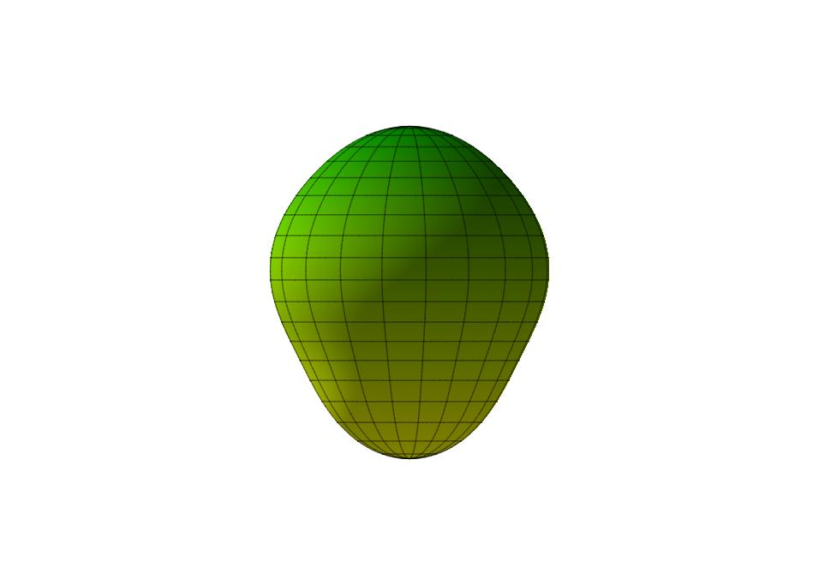
Nuclear Schiff Moment in the lab frame
Engel ARNPS 75:129 (2025)
Body-frame Schiff moment – large when there are intrinsic nuclear deformations
Difference in lab-frame nuclear energy levels
The P and T physics that we seek (unknown & common to all isotopes)
Example of large
intrinsic Schiff moment:
Pear-shaped nucleus in the “body-frame”

Slide 5
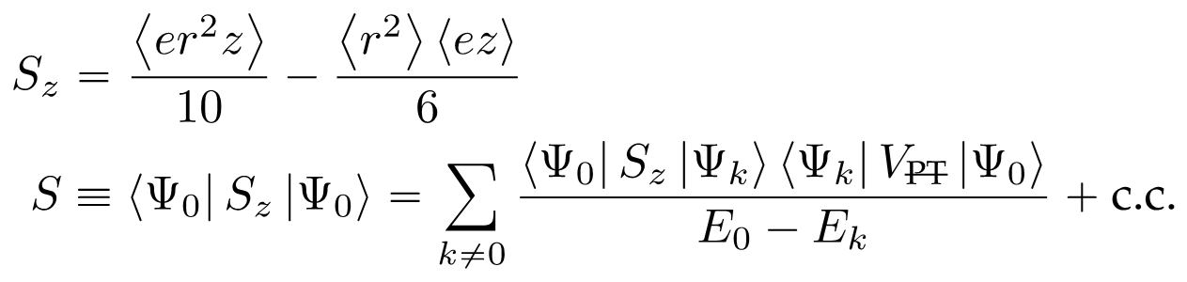

²²⁹Pa *may* be unusually sensitive!
Parity Doublet
Engel ARNPS 75:129 (2025)
P and T physics
Choose isotope to maximize prefactor
 | ²²⁵Ra | ²²⁹Pa
Pear for EDM? | best case known | probably....???
ΔE (keV) | (55.16) | (0.06 +/- 0.05)?
sens. rel. to ¹⁹⁹Hg | 10³ | 10⁶ ?
t_{1/2} (d) | 14.8 | 1.55
atoms (20 kW) | >10¹² | >10¹³
atoms (400 kW) | >10¹³ | >10¹⁴
ΔE
Lots of Pa-229 will be made at the Facility for Rare Isotope Beams (FRIB)!

Slide 6

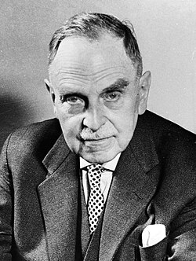
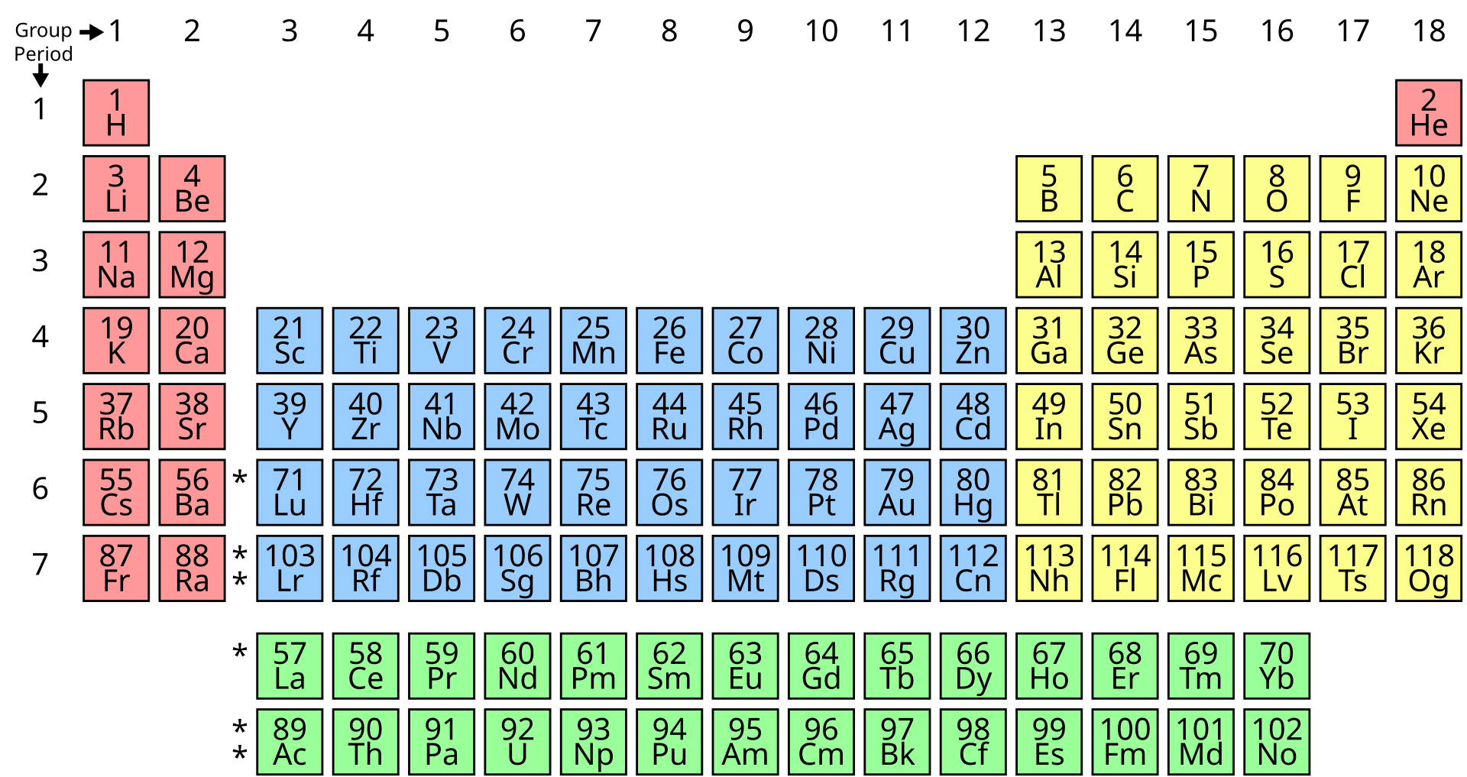
What is protactinium?
Lise Meitner and Otto Hahn
²³¹Pa (1917/18)

Slide 7
What questions need to be addressed?
Is ²²⁹Pa octupole deformed?
Does ²²⁹Pa have a low-lying nuclear state (10-100 eV scale)?
If so, what is that state’s spin and parity? Does it form a parity doublet with the ground state (5/2+)?
How can an “EDM” experiment be done?

Slide 8
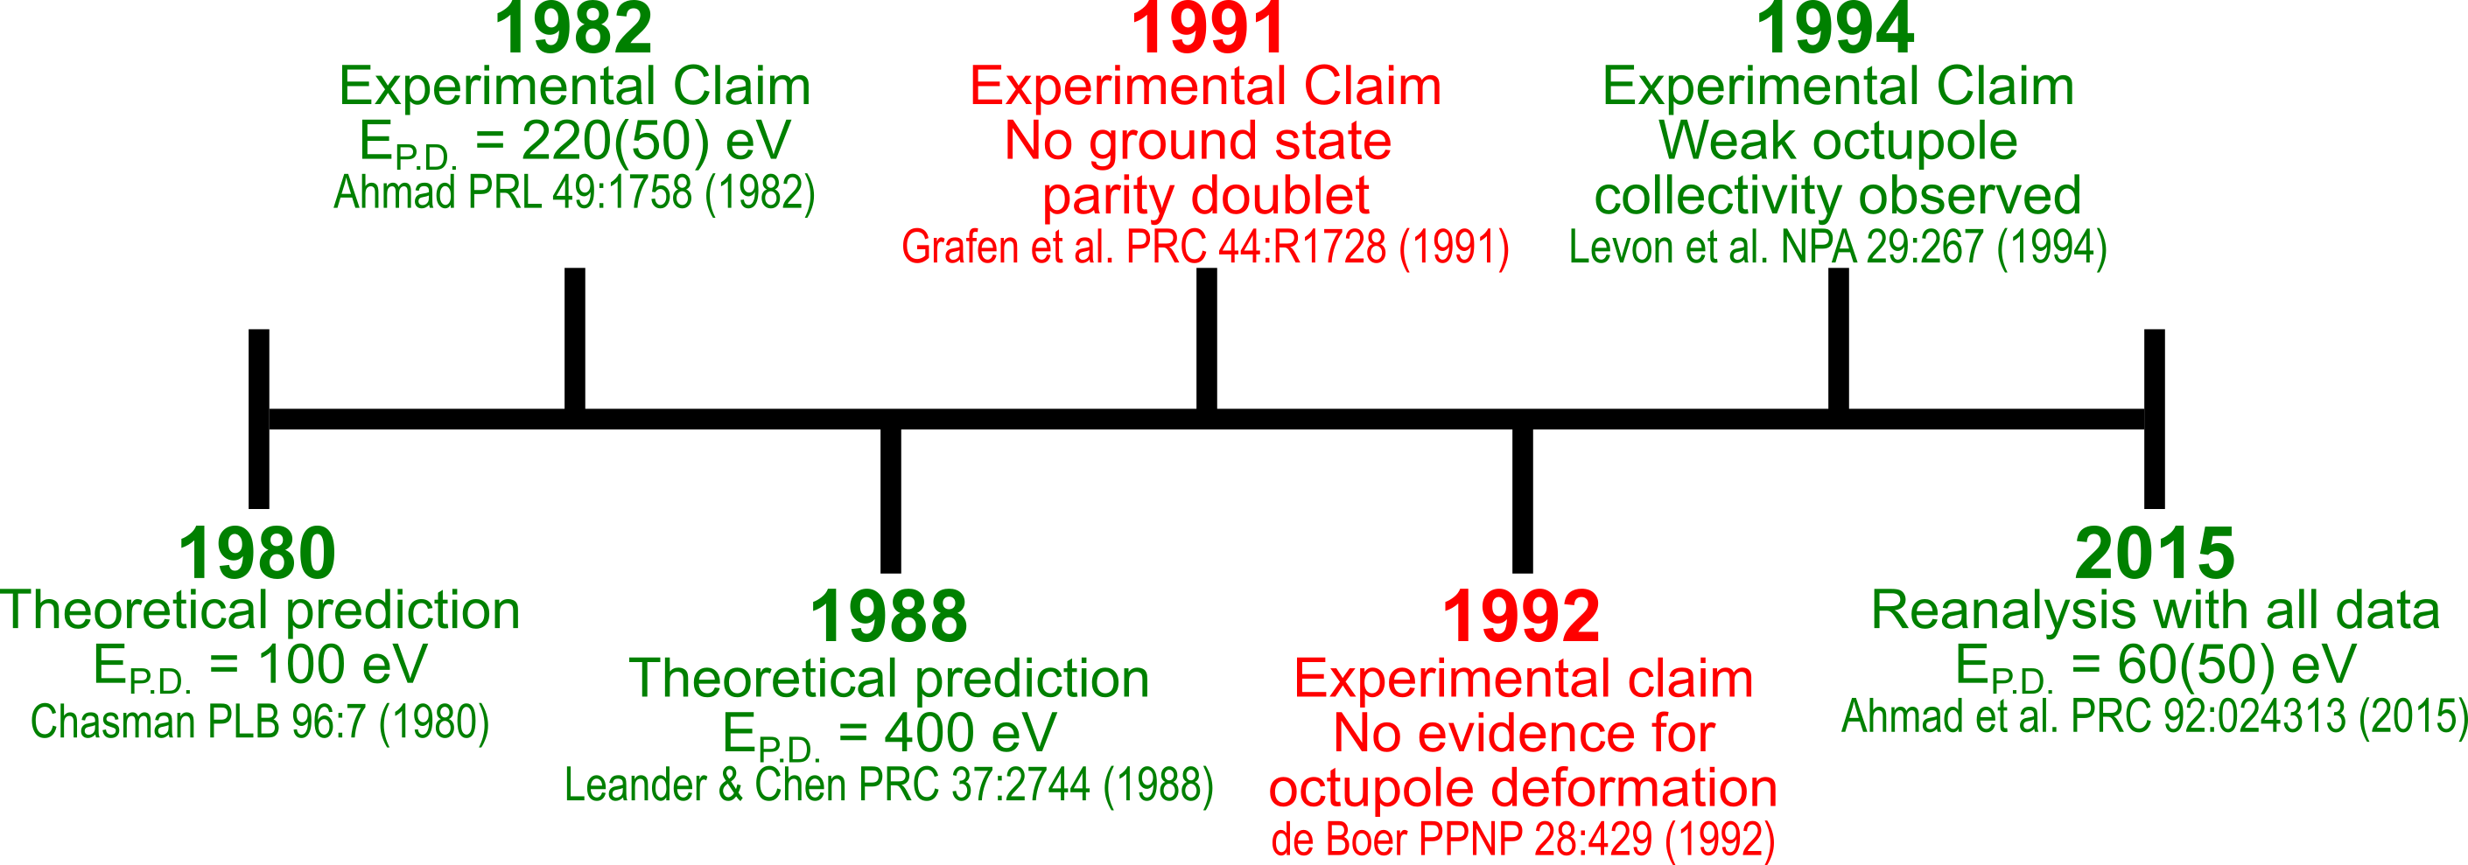
The known literature of ²²⁹Pa presents a muddled history
Levon et al. NPA 576:267 (1994)
Current Status:
Original claim of 220 eV conversion electrons is gone.
If there is a ground state parity doublet, then the energy splitting is consistent with <100 eV.

Slide 9
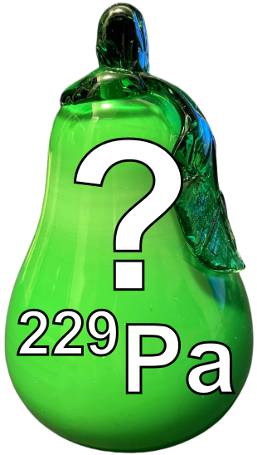
There are no definitive measurements to confirm if ²²⁹Pa is octupole deformed but there is circumstantial evidence that it is
Leander & Sheline argue that the following criteria are generally considered to be evidence of octupole deformation
Leander & Sheline NPA 413:375 (1984)
1. Parity doubling (PD) is a “necessary but not sufficient criterion for octupole deformation.” The size of the energy splitting “does not provide a useful measure of the amount of octupole deformation nor its stability…”
2. Enhanced E3 matrix elements
3. Enhanced intrinsic (“body-frame”) electric dipole moment:
4. “Decoupling factors” of the same magnitude and opposite sign for PD states
5. Alpha decay transitions to both parity bands of the daughter should be allowed with close to equal probability
6. Magnetic moment g-factors should be the same for both members of the PD

Slide 10
There are no definitive measurements to confirm if ²²⁹Pa is octupole deformed but there is circumstantial evidence that it is
Leander & Sheline argue that the following criteria are generally considered to be evidence of octupole deformation
Leander & Sheline NPA 413:375 (1984)
1. Parity doubling (PD) is a “necessary but not sufficient criterion for octupole deformation.” The size of the energy splitting “does not provide a useful measure of the amount of octupole deformation nor its stability…”
Status in ²²⁹Pa: Looks good!
Ahmad et al. PRC 92:024313 (2015)
2. Enhanced E3 matrix elements
Status in ²²⁹Pa: Looks good! Indirect measurements and many theory predictions
Dobaczewski et al. PRL 121, 232501 (2018), Chasman PLB 96:7 (1980), Leander and Chen PRC 37:2744 (1988)
3. Enhanced intrinsic (“body-frame”) electric dipole moment:
Status in ²²⁹Pa: Indirect evidence from measurements on ²²⁸Th core?
Chishti et al. Nat Phy 16:853 (2020)
4. “Decoupling factors” of the same magnitude and opposite sign for PD states
Status in ²²⁹Pa: Looks good!
Levon et al. NPA 576:267 (1994)
5. Alpha decay transitions to both parity bands of the daughter should be allowed with close to equal probability
Status in ²²⁹Pa: Looks good!
Sheline PRC 48:1003 (1993)
6. Magnetic moment g-factors should be the same for both members of the PD
Status in ²²⁹Pa: Not measured

Slide 11
What questions need to be addressed?
Is ²²⁹Pa octupole deformed?
Does ²²⁹Pa have a low-lying nuclear state (10-100 eV scale)?
If so, what is that state’s spin and parity? Does it form a parity doublet with the ground state (5/2+)?
How can an “EDM” experiment be done?

Slide 12
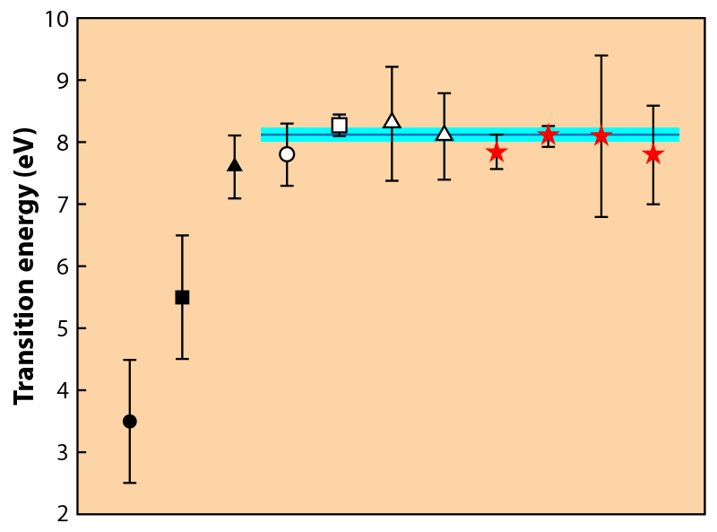
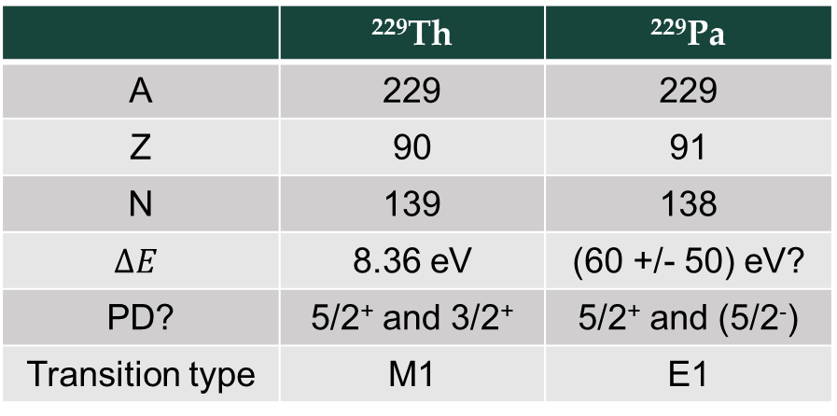
It is now possible to search for ultra low energy nuclear states! Example: ^{229m}Th
Helmer & Reich PRC 49:1845 (1994)
Guimarães-Filho & Helene PRC 71:044303 (2005)
Beck et al. PRL 98:142501 (2007)
Beck et al. LLNL-PROC-415170 (2009)
Seiferle et al. Nature 573:243 (2019)
Yamaguchi et al. PRL 123:222501 (2019)
Sikorsky et al. PRL 125:142503 (2020)
 | ²²⁹Th | ²²⁹Pa
A | 229 | 229
Z | 90 | 91
N | 139 | 138
$$∆E$$ | 8.36 eV | (60 +/- 50) eV?
PD? | 5/2⁺ and 3/2⁺ | 5/2⁺ and (5/2⁻)
Transition type | M1 | E1
Wense Physics 13:152 (2020)

Slide 13
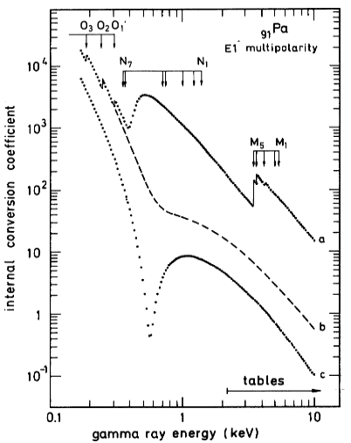
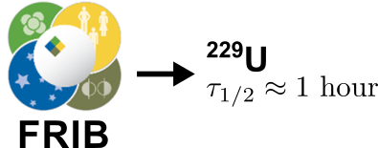
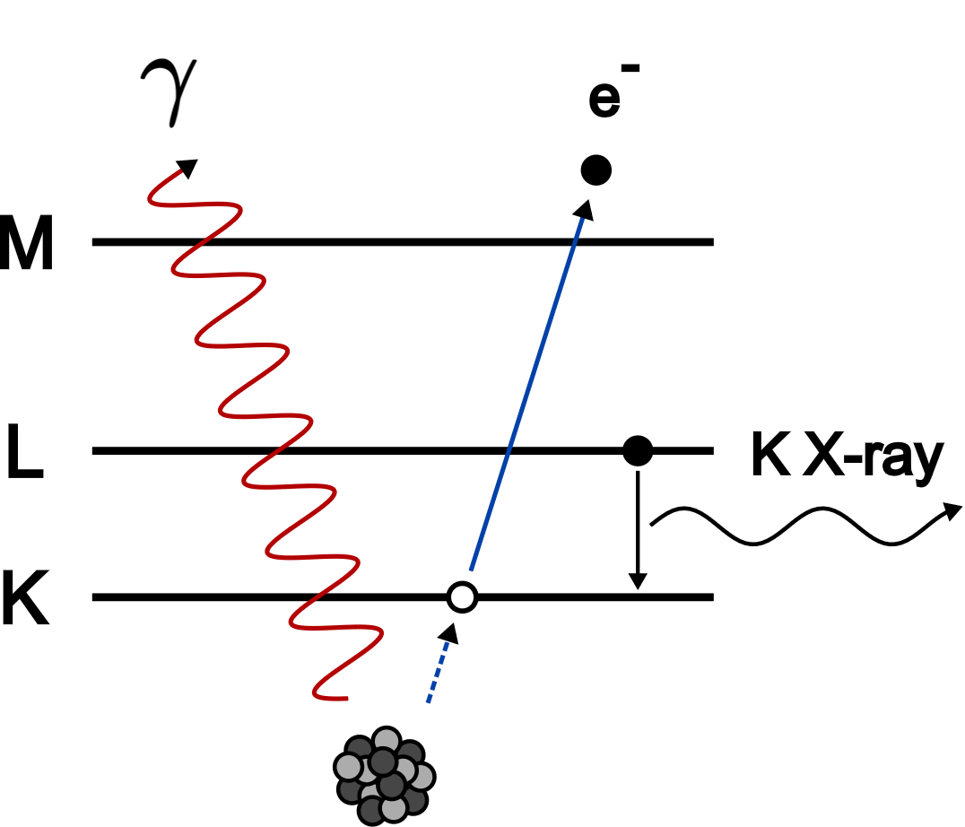

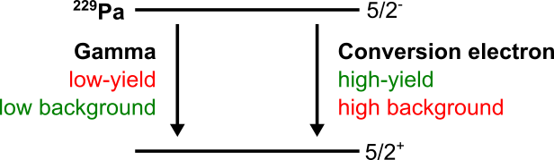

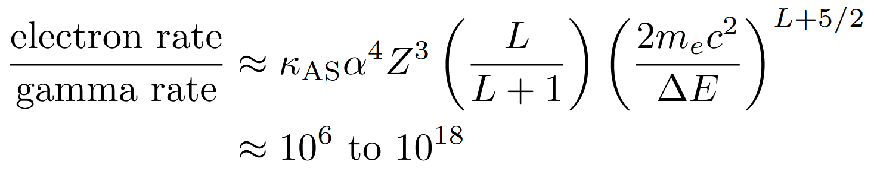
We would like to confirm or deny the existence of a low-lying nuclear state in ²²⁹Pa using two complementary techniques
Dragoun et al. PRC 47:870 (1993)
excited state
Aiden Boyer
MSU PhD Student
ground state
Maggie Tseng
MSU PhD Student

Slide 14
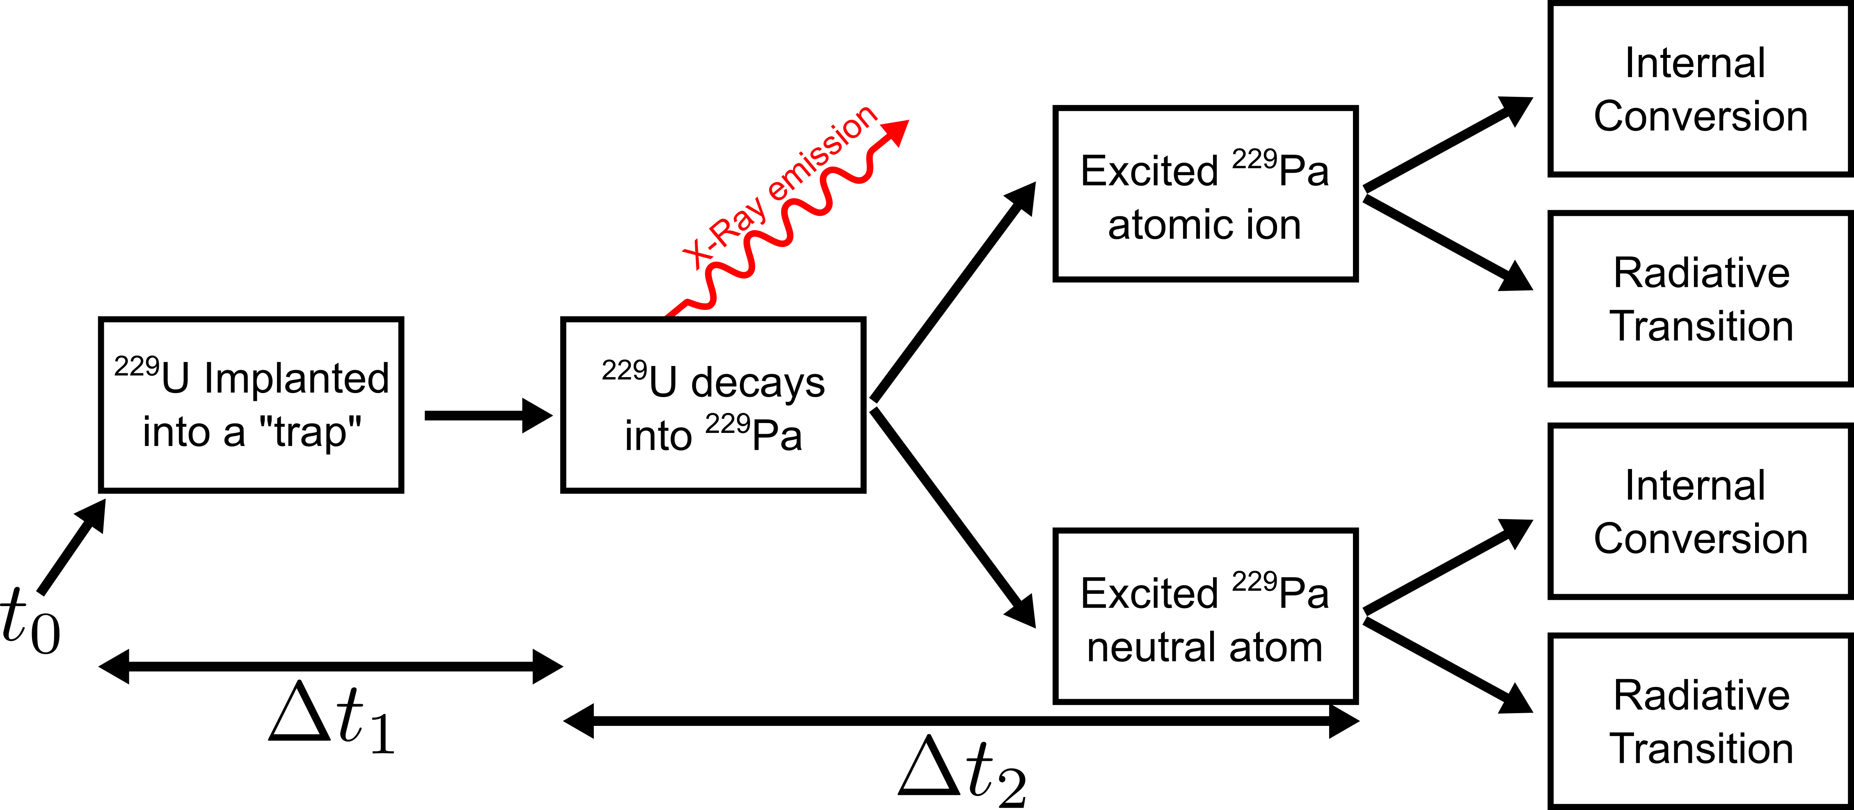



How can we search for a low-lying nuclear state through both decay modes?
87% - 92 or 96 keV
(or)
80% EC
(or)
(or)
83.4 minutes
We have a very rough estimate of this

Slide 15
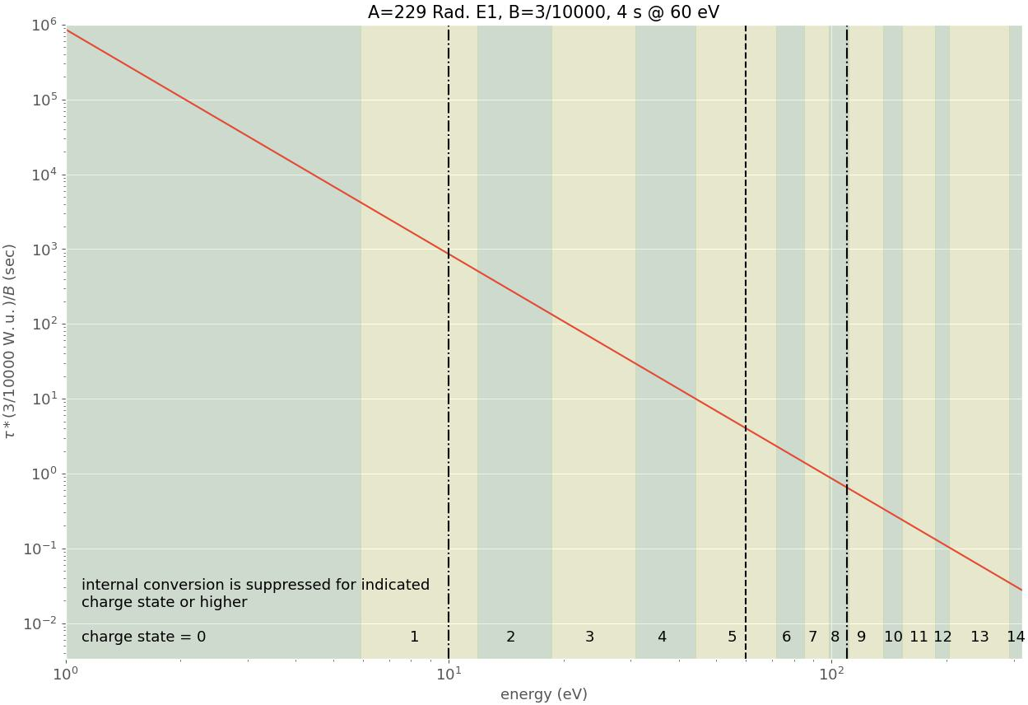
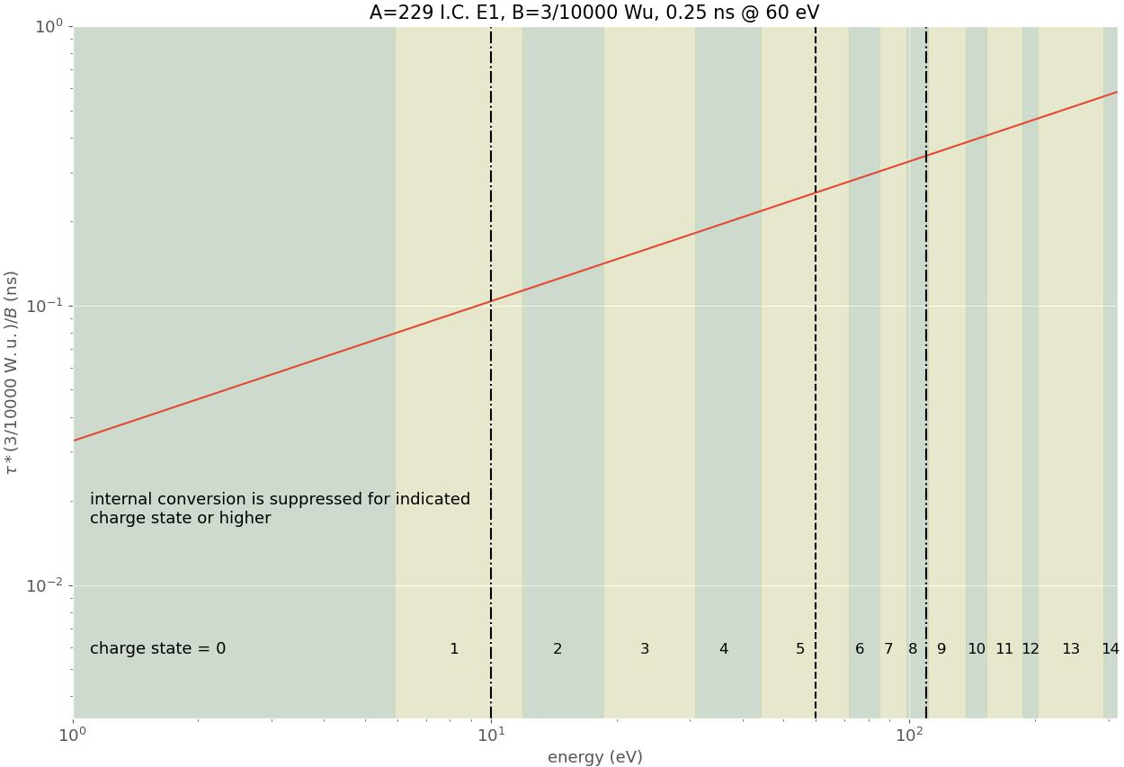
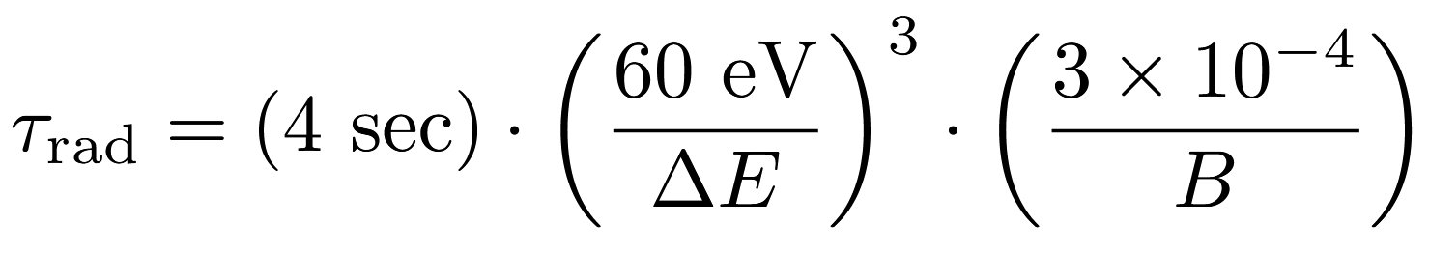
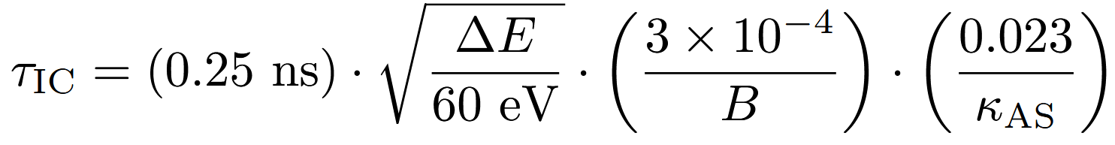
The lifetime of the excited state transition in ²²⁹Pa could constrain the phase space of detectors compatible with our energy range
E1 radiative lifetime of ²²⁹Pa
E1 internal conversion lifetime of ²²⁹Pa

Slide 16
The lifetime of the excited state transition in ²²⁹Pa could constrain the phase space of detectors compatible with our energy range
E1 radiative lifetime of ²²⁹Pa

Slide 17
The lifetime of the excited state transition in ²²⁹Pa could constrain the phase space of detectors compatible with our energy range
E1 radiative lifetime of ²²⁹Pa
Transition Edge Sensors (TES)
Superconducting Nanowire Single Photon Detectors (SNSPD)
Superconducting Tunnel Junction (STJ) Detectors

Slide 18
The lifetime of the excited state transition in ²²⁹Pa could constrain the phase space of detectors compatible with our energy range
E1 radiative lifetime of ²²⁹Pa
Transition Edge Sensors (TES)
Superconducting Nanowire Single Photon Detectors (SNSPD)
Superconducting Tunnel Junction (STJ) Detectors
Magnetic Microcalorimeters (MMC) Detectors

Slide 19
The lifetime of the excited state transition in ²²⁹Pa could constrain the phase space of detectors compatible with our energy range
E1 radiative lifetime of ²²⁹Pa
Transition Edge Sensors (TES)
Superconducting Nanowire Single Photon Detectors (SNSPD)
Superconducting Tunnel Junction (STJ) Detectors
Magnetic Microcalorimeters (MMC) Detectors

Slide 20
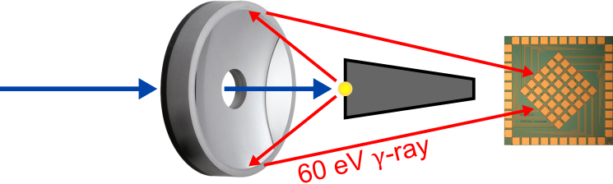
The plan for gamma detection with LLNL: high detection efficiency and low background
1:
²²⁹U beam (FRIB)
3:
EUV Optic
2:
Beam Stop
4:
STJ Detector
Approach:
²²⁹U decays to ²²⁹Pa ⇒ Produces 60 eV gamma
Beam stop blocks direct radiation onto STJ ⇒ Low background
EUV optic reflects ~60 eV gamma (only!) onto STJ ⇒ High collection efficiency
STJ detects gamma of interest ⇒ High resolution

Slide 21
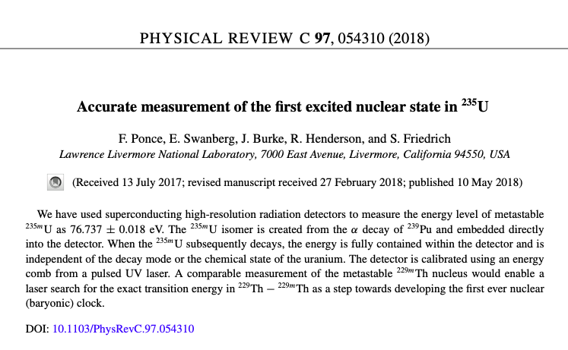
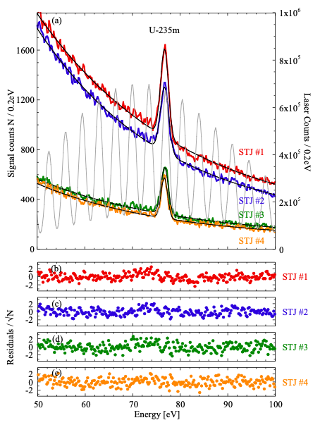
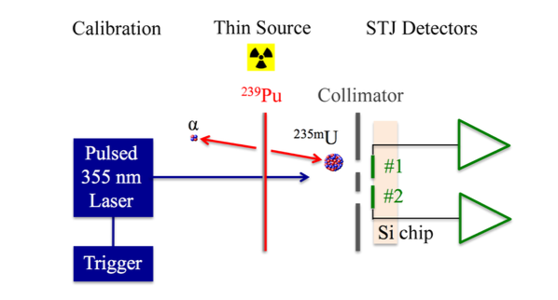
Superconducting tunnel junctions (STJs) have been used to do high precision nuclear physics at this energy scale
^{235m}U: 76.737 ± 0.018 eV

Slide 22

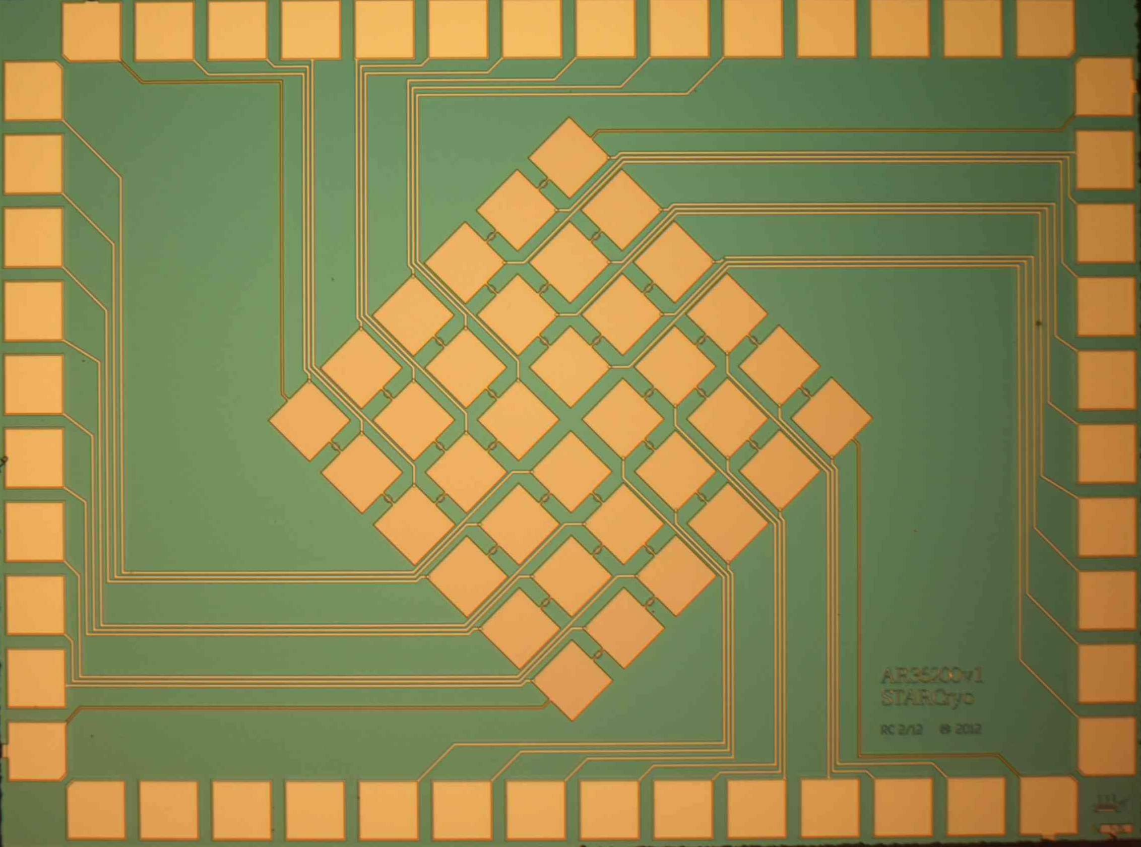
STJ detectors for high resolution and low background
High Energy Resolution
Coincidence Vetoing Reduces Background
~2 eV FWHM resolution at low energy
Gamma and muon background can be vetoed

Slide 23
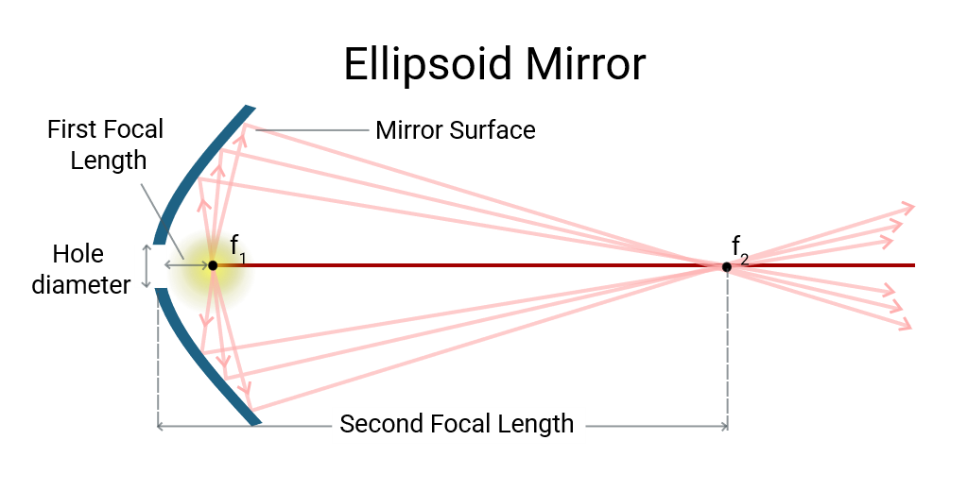
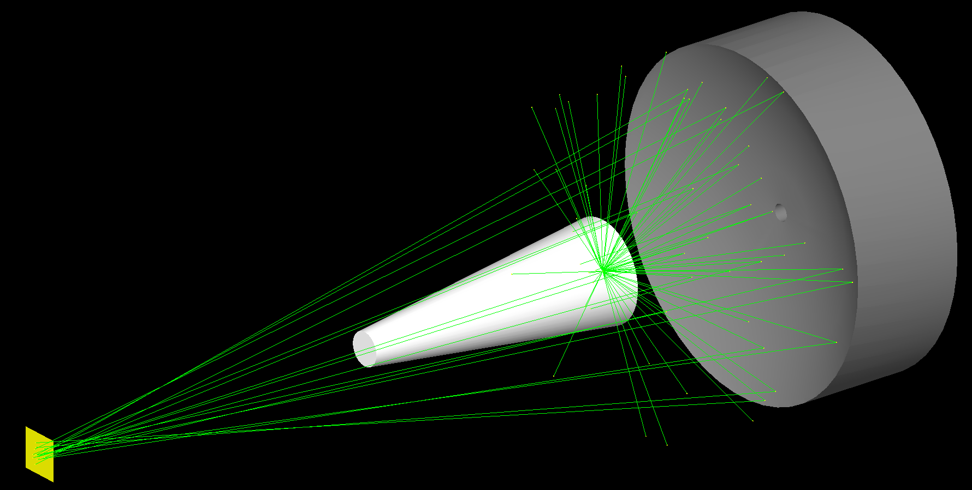
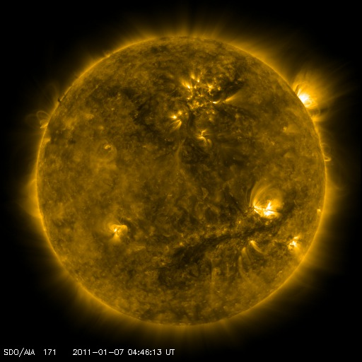
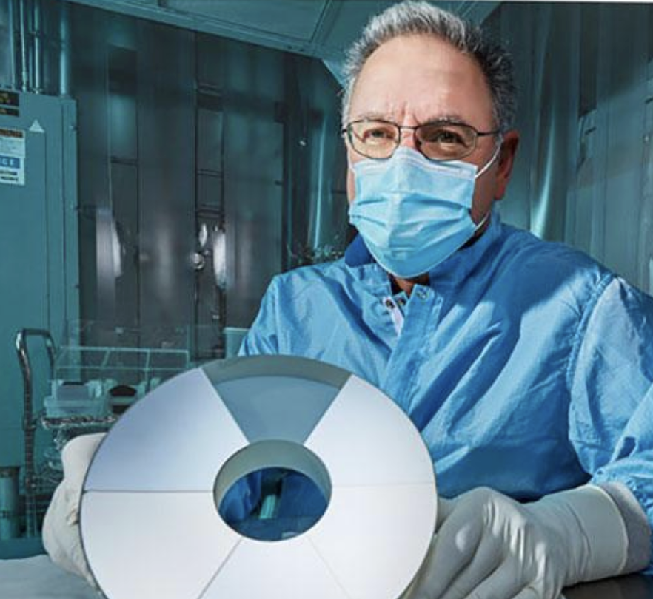
LLNL: EUV optic with large solid angle and high reflectivity
https://www.meetoptics.com/academy/ellipsoidal-mirrors#what-are-ellipsoidal-mirrors
50
40
30
20
10
0
Atomically
flat multilayer
171Å Mo/Si
Measured
Model
Reflectivity [%]
5 nm
65
73
82
Photon Energy [eV]

Slide 24
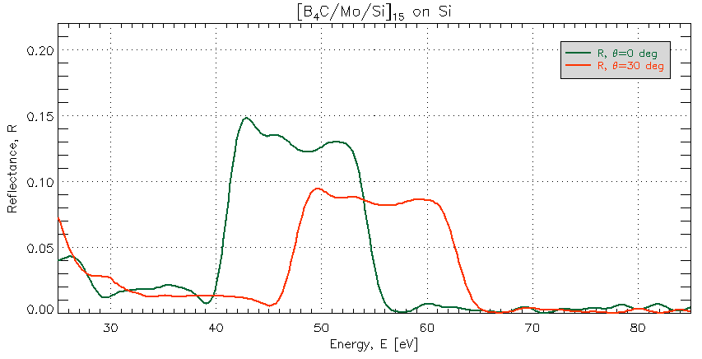
LLNL: EUV optic simulation and design are ongoing
EUV Optic Design – Simulated Reflectivity
Preliminary
Broad energy range → lower reflectivity

Slide 25
The plan for internal conversion electron spectroscopy: can we use the same detectors and techniques used for ²²⁹Th?
The precise knowledge of the low-lying nuclear state in ^{229Th} is the result of 20+ years of experimental efforts using:
Ge and Si(Li) detectors
Microcalorimeter spectrometers
Direct spectroscopy of recoil ions from ²³³U parent
Internal conversion electron sprectroscopy
Helmer & Reich PRC 49:1845 (1994)
Guimarães-Filho & Helene PRC 71:044303 (2005)
Beck et al. PRL 98:142501 (2007)
Beck et al. LLNL-PROC-415170 (2009)
Seiferle et al. Nature 573:243 (2019)
Yamaguchi et al. PRL 123:222501 (2019)
Sikorsky et al. PRL 125:142503 (2020)
 | ²²⁹Th | ²²⁹Pa
A | 229 | 229
Z | 90 | 91
N | 139 | 138
$$∆E$$ | 8.36 eV | (60 +/- 50) eV?
PD? | 5/2⁺ and 3/2⁺ | 5/2⁺ and (5/2⁻)
Transition type | M1 | E1
Wense Physics 13:152 (2020)

Slide 26
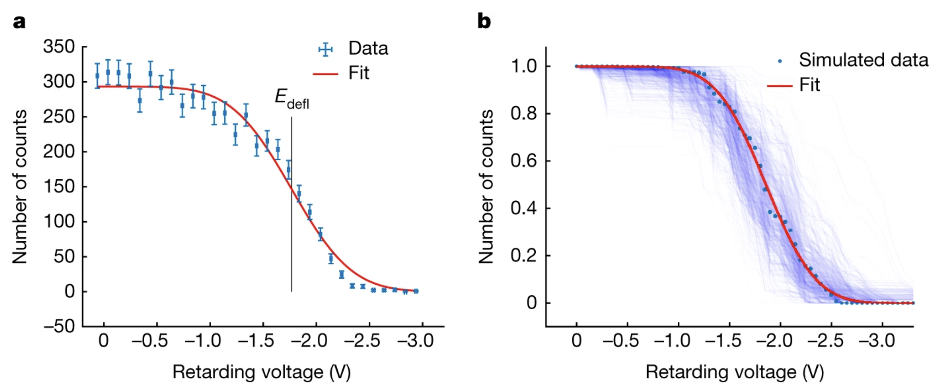
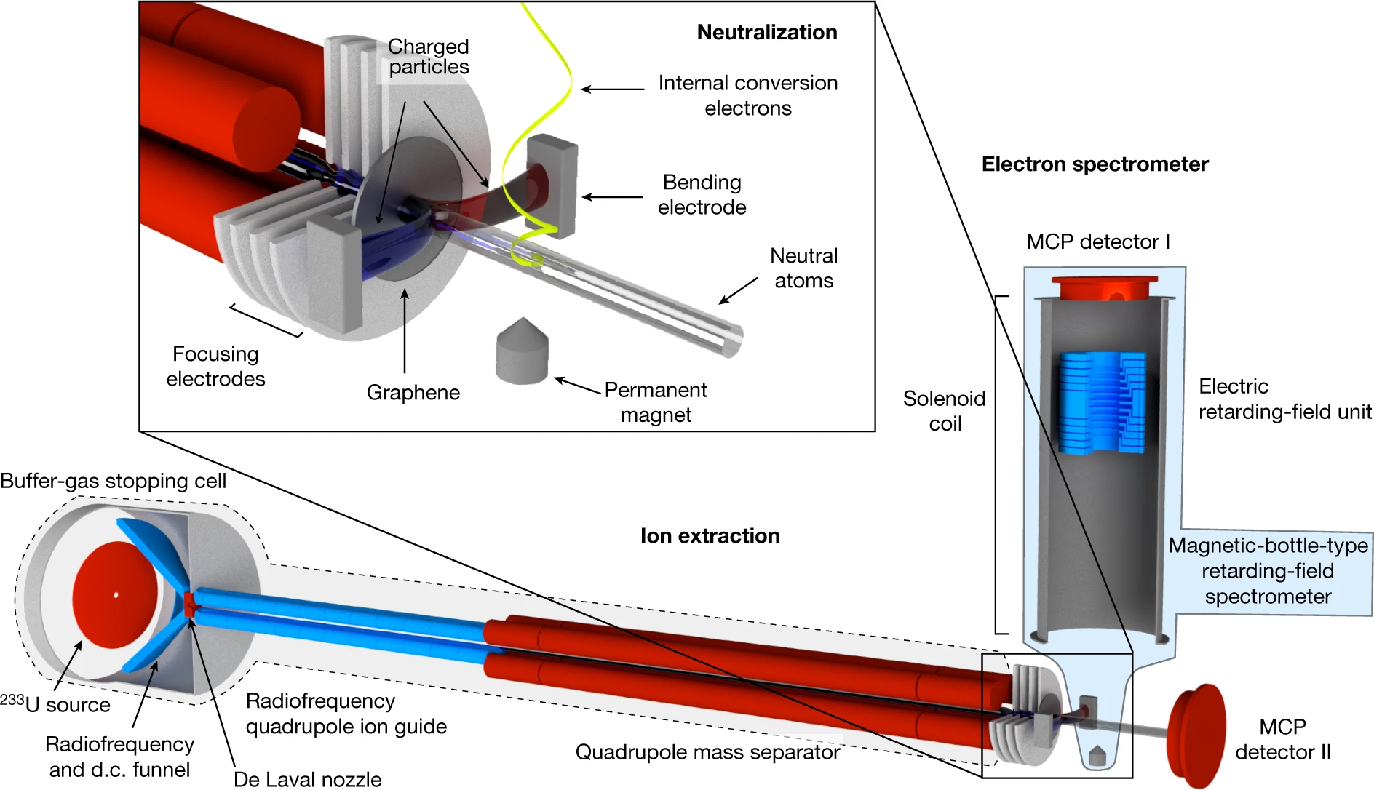
The plan for internal conversion electron spectroscopy: one instrument used for the analogous ²²⁹Th measurement
Seiferle et al. Nature 573:243 (2019)
atomic binding effects (~7 eV)

Slide 27
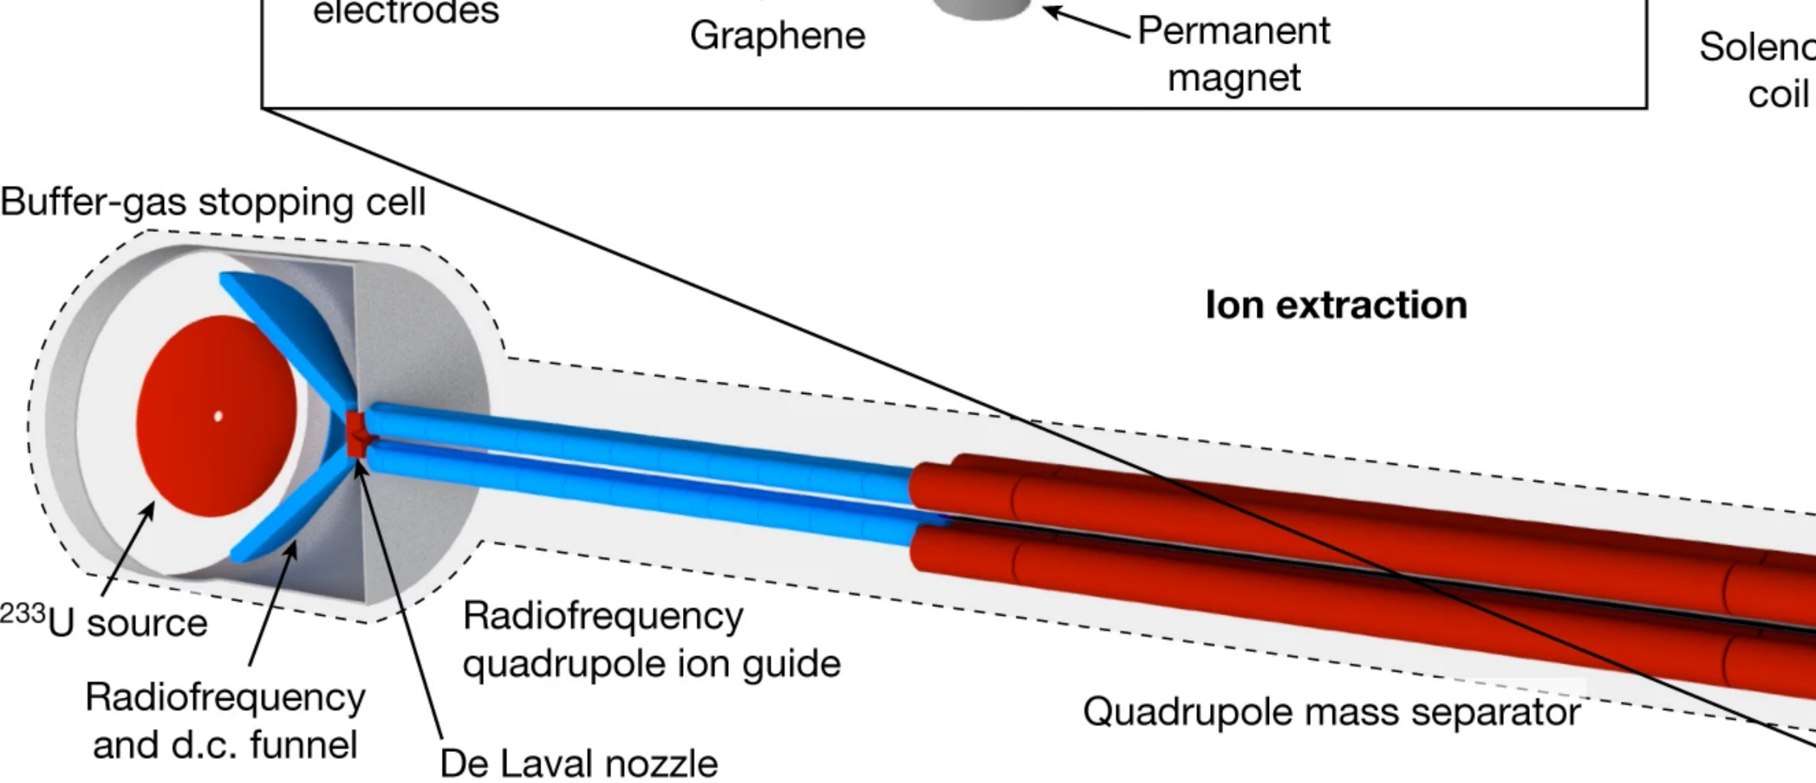
The plan for internal conversion electron spectroscopy: major redesigns needed to adapt this for ²²⁹Pa
Seiferle et al. Nature 573:243 (2019)
The entire front end must be redesigned for an FRIB experiment
atomic binding effects (~7 eV)

Slide 28
What questions need to be addressed?
Is ²²⁹Pa octupole deformed?
Does ²²⁹Pa have a low-lying nuclear state (10-100 eV scale)?
If so, what is that state’s spin and parity? Does it form a parity doublet with the ground state (5/2+)?
How can an “EDM” experiment be done?

Slide 29
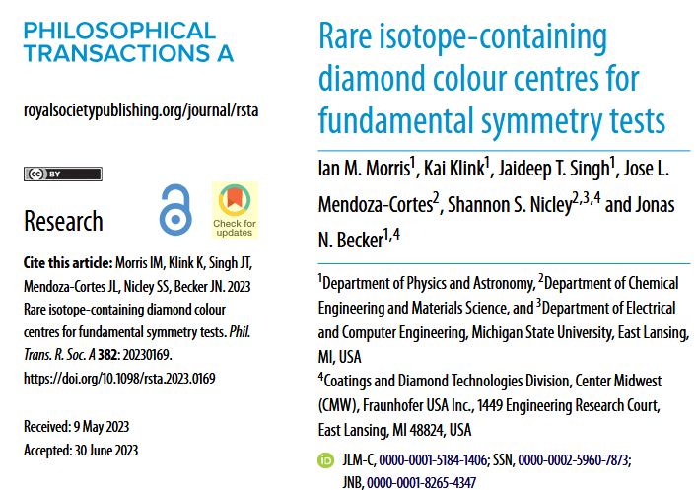
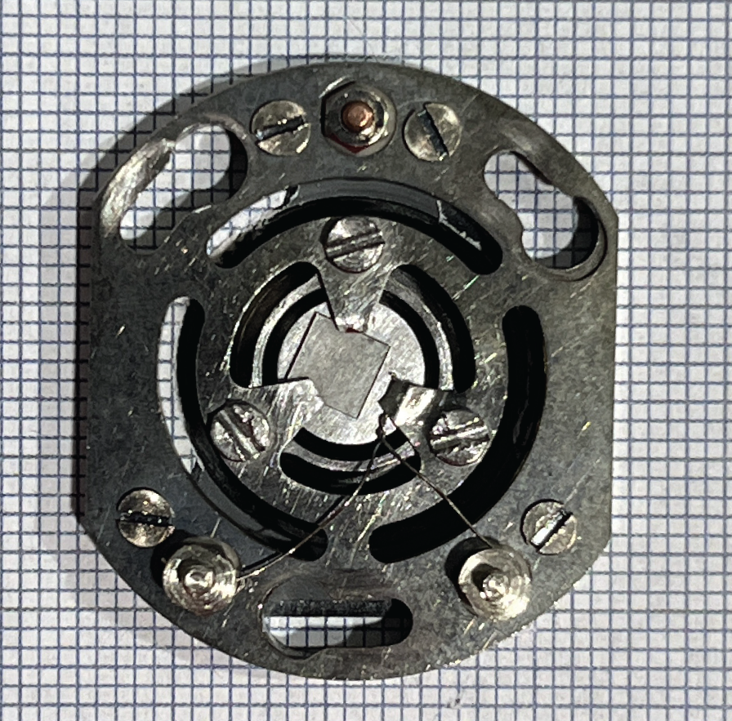
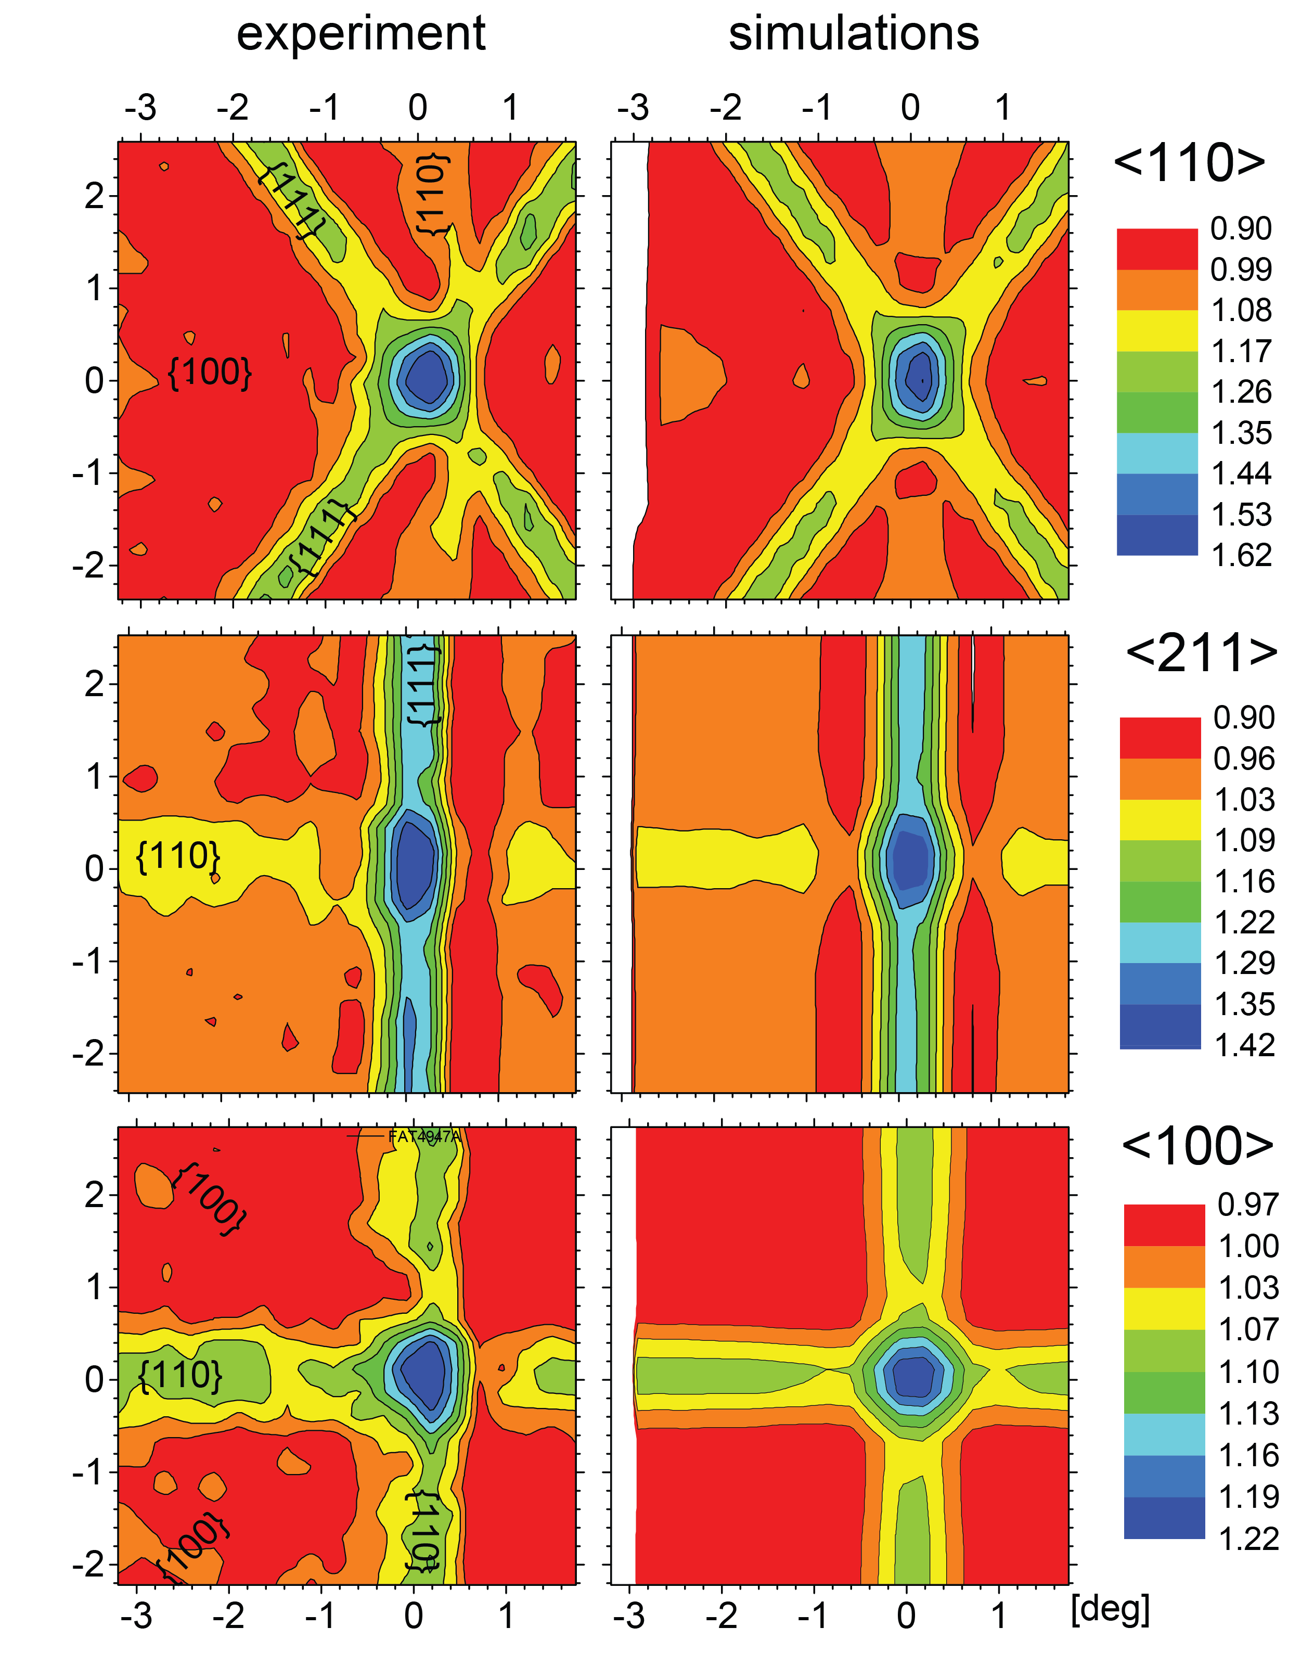
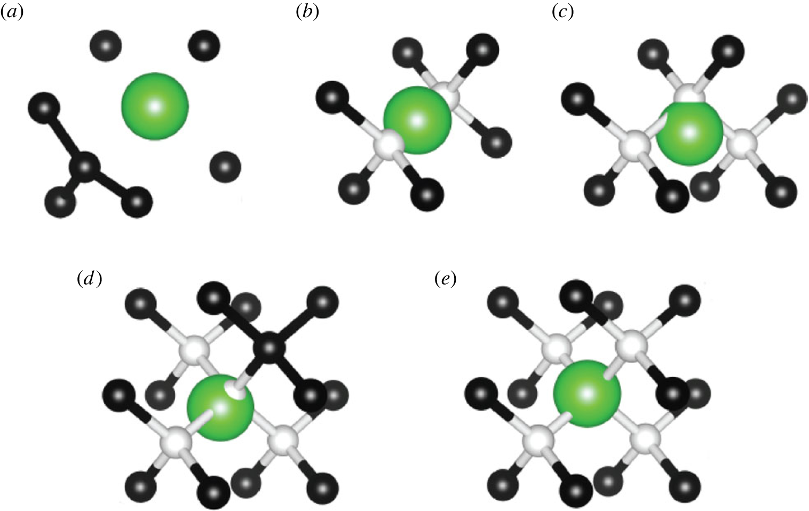

In progress: ²³¹Pa in diamond as a pathfinder null experiment
1 inch
Plots & picture provided by Lino da Costa Pereira
The defect we are interested in:
²²⁹PaV₂
Lino da Costa Pereira
(KU Leuven)
Want to hear more?
Speak to Kirill Danilov
& Lino da Costa Pereira
2023: Team theoretically predicted existence of several rare isotope defects in diamond
Unfunded student class project
NOW: First ion implantations and emission channeling experiments at ISOLDE motivated by our paper (collaborators: Lino da Costa Pereira, KU Leuven)

Slide 30
Status: What is the sensitivity of ²²⁹Pa to new physics?
Is ²²⁹Pa octupole deformed?
• Review of the nuclear structure literature ongoing
• We need new nuclear structure experimental efforts
Does ²²⁹Pa have a low-lying nuclear state (10-100 eV scale)?
Low energy gamma spectroscopy (Funded! Spinlab & LLNL, PCLB)
Internal conversion electron spectroscopy (Funded! Spinlab, Moore Foundation)
How can an “EDM” experiment be done?
Single 229Pa containing molecular ion in an ion trap (Funded! Andrew Jayich, DOE ECA)
229Pa atomic ions implanted in transparent cryogenic solids
Proposal for ²²⁹Pa in YSO: Hyp. Int. 240:29 (2019)
Proposal for Eu in YSO (Toronto): PRA 108, 012819 (2023) and PRA 112, L030801 (2025)
Diamonds (Proposal: Phil. Trans. R. Soc. A.382: 20230169 (2024); funded! Jonas Becker, MSU SPG)
Optical crystals (Funded! Spinlab (Moore Foundation), Amar Vutha, Andrew Jayich)
B. Nima (Toronto)

Slide 33
²²⁹Pa has many challenges but it is still interesting
Property | Status
Availability | Short-lived, (half-life ~ 1.5 days) No long-lived generator – need a rare isotope facility (FRIB)
Chemical extraction | Aqueous extraction protocol: need significant R&D Solid extraction protocol: ideas exist, but R&D still needed
Spin | 5/2⁺ ground state, sensitive to higher order systematic effects, atoms not laser coolable
Nuclear structure | Poorly known
Possible sensitivity to T physics | 10⁶ improvement over ¹⁹⁹Hg?
²²⁹Pa is worth investigating!

Slide 34
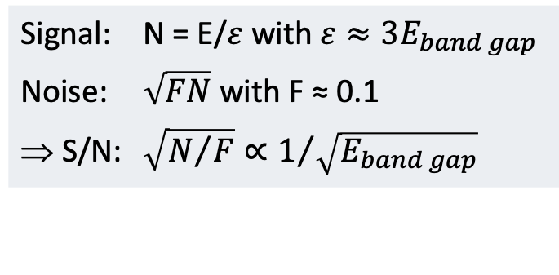
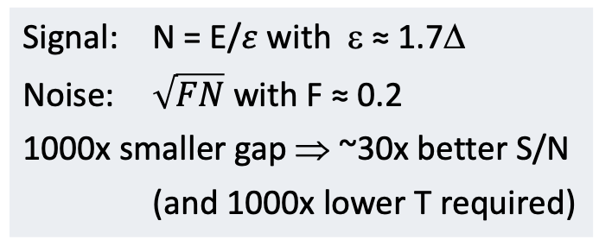
Superconducting Tunnel Junction Detectors
Semiconducting Detector
Slide provided by Stephan Friedrich
Superconducting Detector
Conduction band (empty)
Photon
(Energy E)
Photon
(Energy E)
E_{band gap} ≈ 1 eV
Δ ≈ 1 meV
Valence band (full)
Valence band (full)
V ≈ 1 kV
V ≈ 100 µV
Signal: N = E/$ε$ with $ε≈3E_{band gap}$
Noise: $\sqrt{FN}$ with F ≈ 0.1
⇒ S/N: $\sqrt{N/F}∝1/{\sqrt{E_{band gap}}}$
Signal: N = E/$ε$ with ε ≈ 1.7Δ
Noise: $\sqrt{FN}$ with F ≈ 0.2
1000x smaller gap ⇒ ~30x better S/N
(and 1000x lower T required)

Slide 35
Superconducting Tunnel Junction Detectors
STJ Cross Section
Slide provided by Stephan Friedrich
STJ Operating Principle
Radiation
Al₂O₃
Ta Absorber
Al
Al
Ta
SiO
2
Si Substrate
100×100 μm²
Small superconducting energy gap (Δ ≈ 1meV) ⇒ (Relatively) high resolution (<10 eV FWHM)
Short excess charge lifetime (~µs) ⇒ (Relatively) high count rate (>10,000 counts/s)

Slide 36
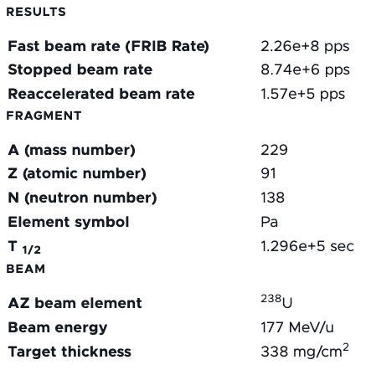
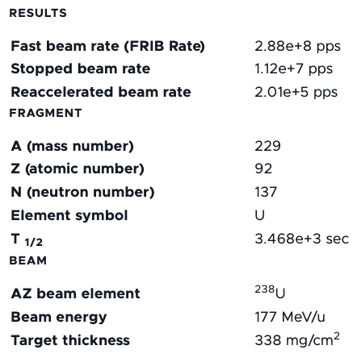
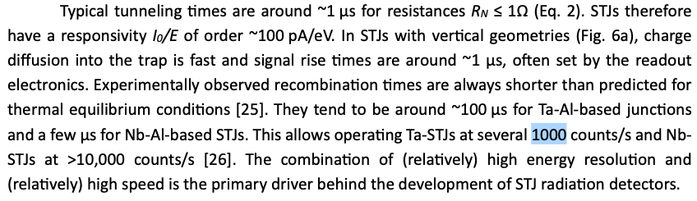
Why can’t we deposit a ²²⁹Pa or ²²⁹U beam directly into our superconducting tunnel junction?
https://frib.msu.edu/user-facilities/frib/calculator
Stephan Friedrich, STJ Tutorial

Slide 37
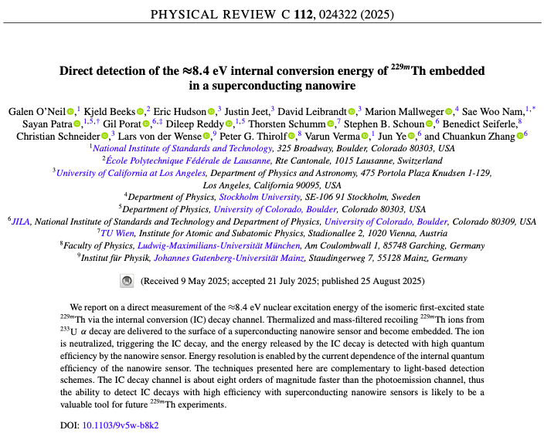
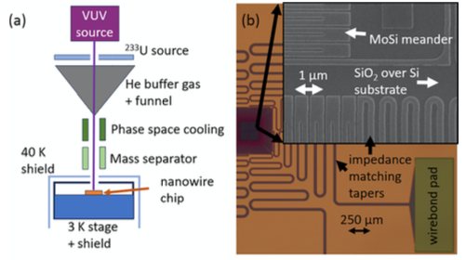
The plan for internal conversion electron spectroscopy: another instrument located @ NIST that could be adapted
Major redesign required:
Changing ²³³U to ²²⁹U Source
We have been in contact with the NIST team
who are open to sending us their instrument if
we can demonstrate it would be useful

Slide 38
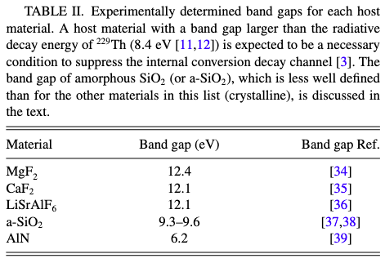
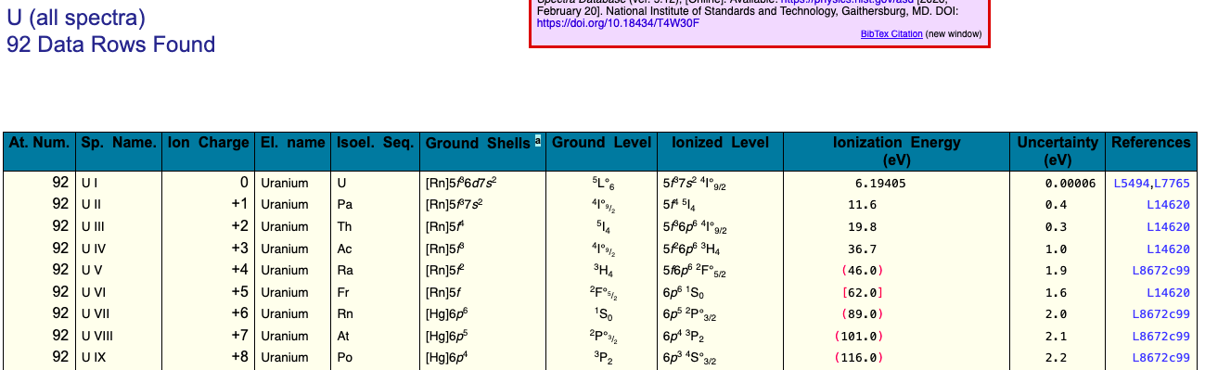
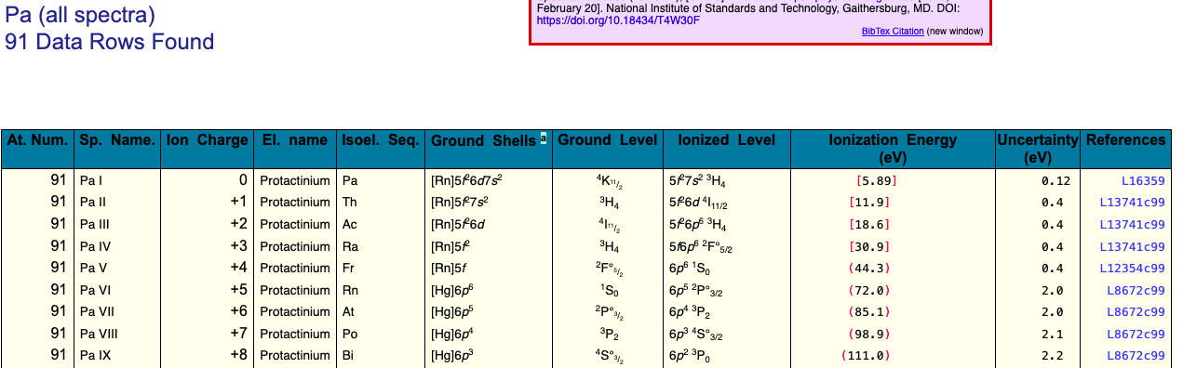
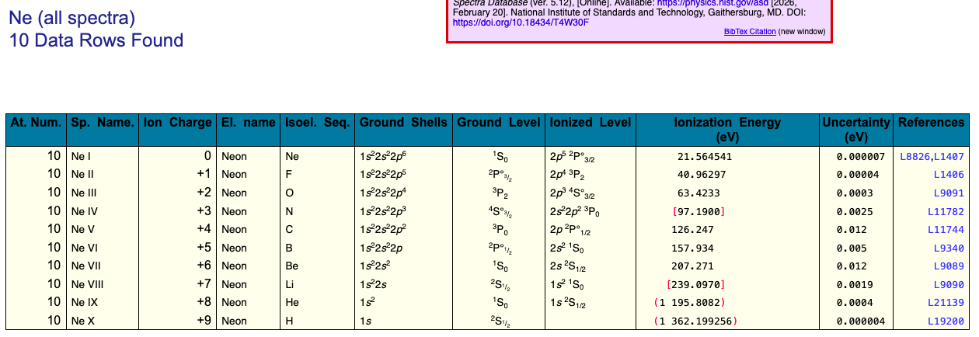
Can we suppress internal conversion using different materials?
NIST ASD – Ionization Energies
Pineda et al. PRR 7:013052 (2025)
In optical crystals: no
In noble gas films: maybe?
In noble gas cells: maybe?

Slide 39
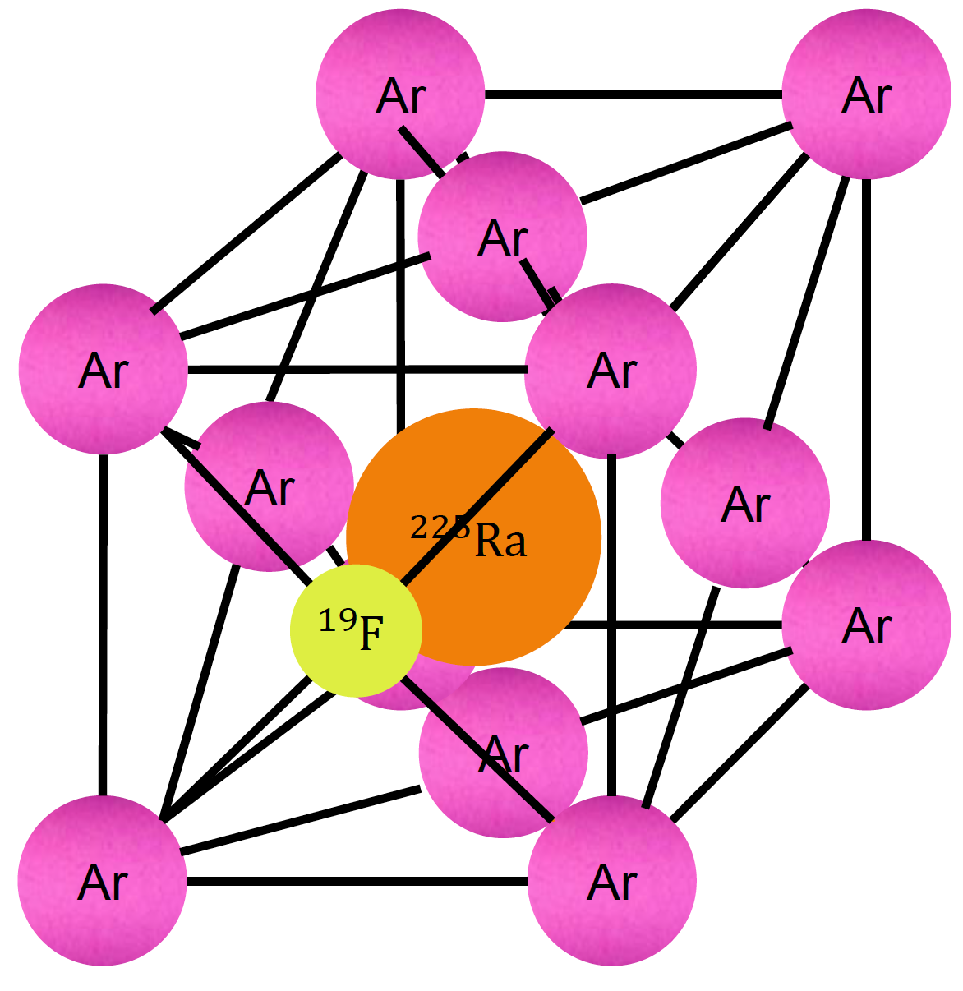
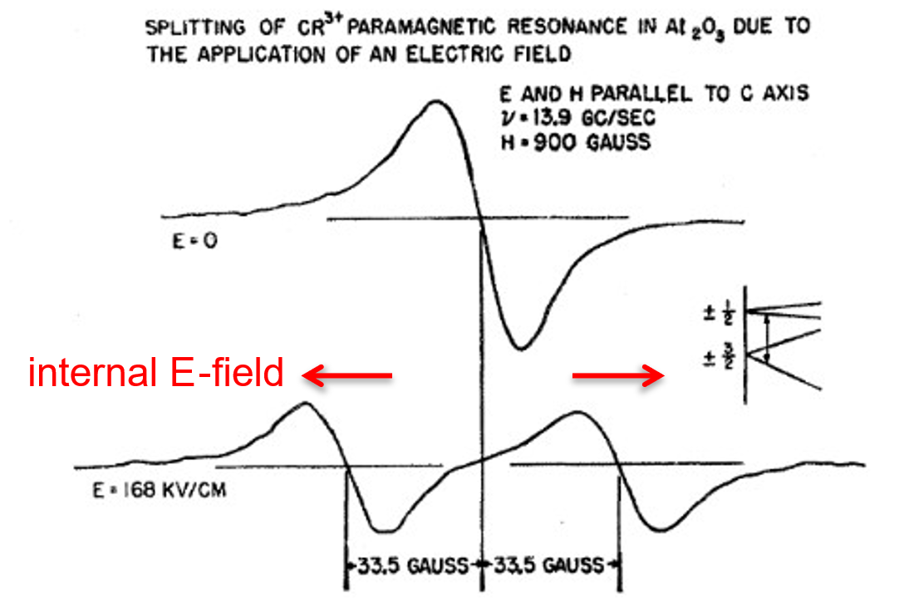
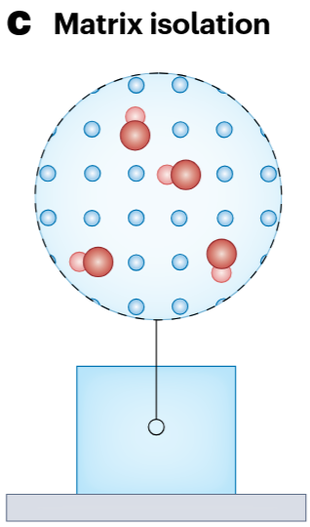
Towards a search for new symmetry violating physics: atoms and molecules in solids as a trapping technique
Statistics Enhancements
Systematic Effect Control
Electric
field
number of
detected particles
integration
time
interrogation
time
Royce & Bloembergen PR 131:1912 (1963)
Spinlab @ MSU: Radioactive molecules in noble gas solids (FRIB-EDM³) and atomic ions in optical crystals or diamonds (Jonas Becker, Lino da Costa Pereira)
Inspired by EDM³ Eric Hessels (York) and Amar Vutha (Toronto)
Molecules:
Large internal electric field
Additional degrees of freedom provide opportunities for control of systematic effects
Solids:
Efficient trapping of a wide variety of species
Very high number densities (10¹³ stuff per mm³)
Stable and chemically inert confinement
Transparent in the optical regime for optical probing
Spinlab @ MSU has lots of experience growing noble gas matrices: Loseth et al. PRC 99:065805 (2019)
Systematic control
Molecules: orientation locking with polar molecules along principal axes Measured in BaF:Ne, see Li et al. NJP 25:082001 (2023) Predicted for BaF:Ar, see Vutha et al. PRA 98:032513 (2018)
Atomic ions: non-inversion symmetric defect sites with oppositely directed E-field
Spinlab has been actively pursuing heavy, pear-shaped polar molecules in solids since 2018 (FRIB-EDM³)
Ions implanted in optical crystals or diamonds allowing for optically-addressable nuclear spins
See Singh HPI 240:29 (2019), Morris et al. PTRSA 382:20230169 (2024), and Ramachandran & Vutha PRA 108:012819 (2023)
DeMille et al. NP 20:741 (2024)

Slide 40
Rare isotopes in diamonds – why diamonds?
Why diamonds?
Radiation hardness Bauer et al. NIMA 367:207 (1995), Zou et al. AIPA 10:025004 (2020)
Wide band gap (5.5 eV) Zaitsev Optical properties of diamond: a data handbook (2013)
Diamond can be engineered spin-free Chakborty et al. PRM 3:065205 (2019), Das et al. JPDAP 55:333002 (2022)
Nitrogen vacancies in diamond can be used for in situ comagnetometry Hong et al. MRSB 38:155 (2013)
Short-lived nature of ²²⁹Pa greatly complicates developing experimental schemes, a stable surrogate is needed. ¹⁴¹Pr is an excellent candidate:
¹⁴¹Pr is isoelectronic with ²²⁹Pa
¹⁴¹Pr also has 5/2 nuclear spin
¹⁴¹Pr is not toxic or radioactive
The defect we are interested in:
²²⁹PaV₂
Goal: “..to identify electronic structures featuring ground and excited state spin and orbital configurations leading to qualitatively identical interaction, splitting patterns and optical transitions for both ¹⁴¹PrV₂ and ²²⁹PaV₂ so that the stable ¹⁴¹PrV₂ defect can be used as a test bed for method development.”
2023: Team theoretically predicted existence of several rare isotope defects in diamond
Unfunded student class project

Slide 41


²²⁵Ra and ²²⁹Pa are high sensitivity EDM/NSM candidates that are also favorable cases for FRIB production and radiochemistry
²²⁵Ra: | Dobaczewksi et al. PRL 94:232502 (2005)
¹⁹⁹Hg: | Ban et al. PRC 82:015501 (2010)
²²⁹Pa: | Ahmad et al. PRC 92:024313 (2015)
Atoms: | Abel et al. JPG 46:100501 (2019)
Nuclear Schiff Moment (NSM) $=$
CPV Source
 | ²²⁵Ra | ²²⁹Pa
pear? | best case known? | probably....???
ΔE (keV) | (55.16) | (0.06 +/- 0.05)?
sens. rel. to ¹⁹⁹Hg | 10³ | 10⁶ ?
t_{1/2} (d) | 14.8 | 1.55
atoms (20 kW) | >10¹² | >10¹³
atoms (400 kW) | >10¹³ | >10¹⁴
Engel ARNPS 75:129 (2025)
Parity Doublet
Choose isotope to maximize prefactor
Nearly degenerate parity doublet
Haxton & Henley PRL 51:1937 (1983)
Large intrinsic Schiff moment due to octupole deformation
Auerbach, Flambaum, & Spevak PRL 76:4316 (1996)
EDM (²²⁵Ra) / EDM (¹⁹⁹Hg)
Skyrme Model | Isoscalar | Isovector
SIII | 300 | 4000
SkM* | 300 | 2000
SLy4 | 700 | 9000
ΔE

