Slide 1

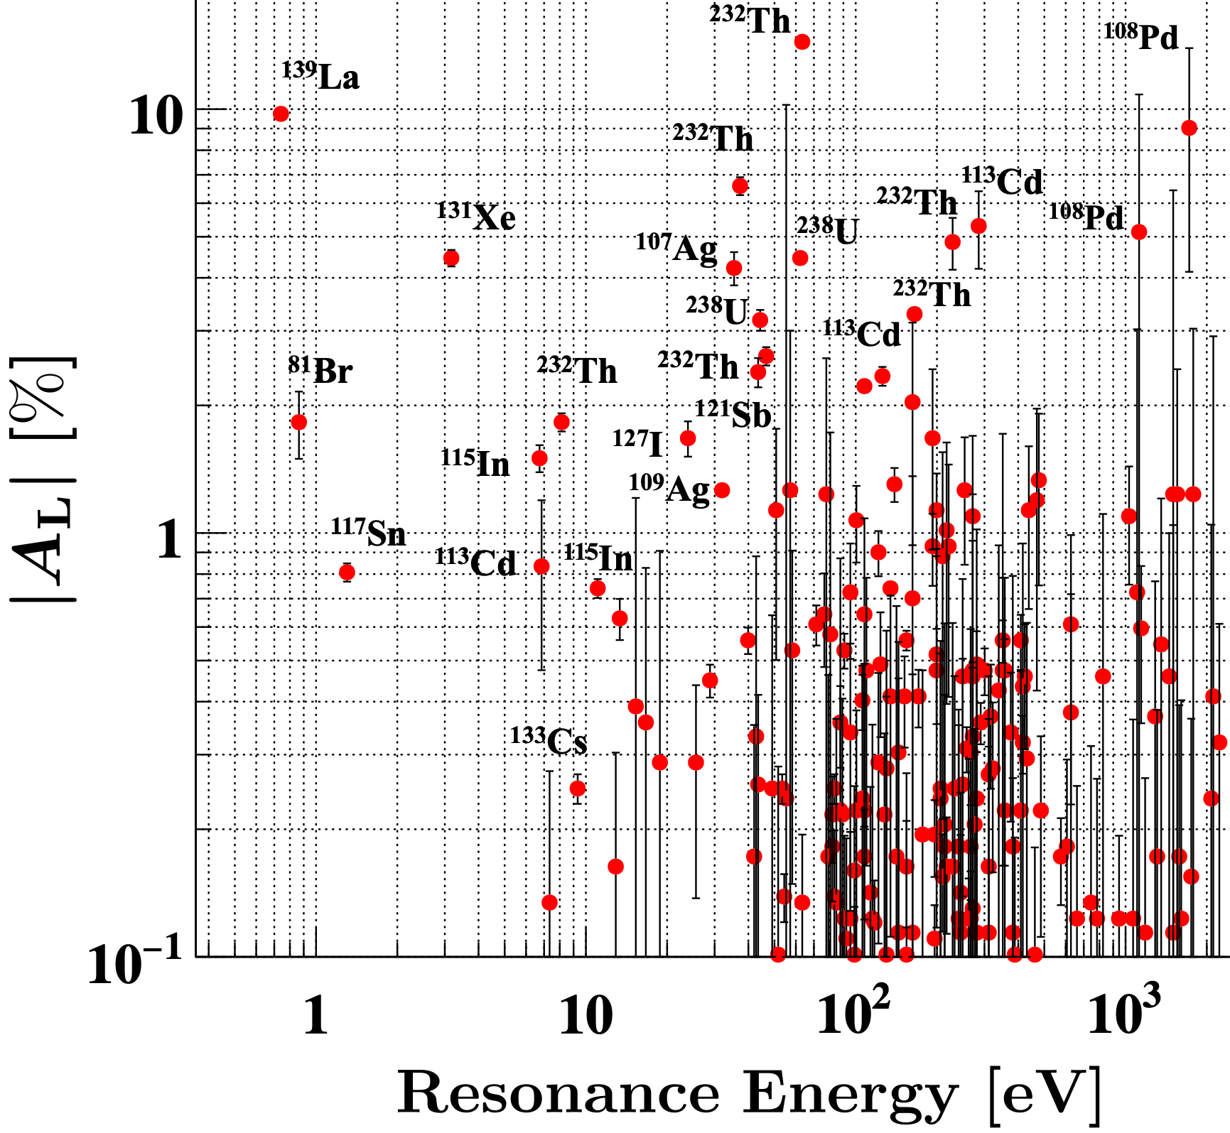

Research and Development of the NOPTREX Experiment
Christopher Crawford University of Kentucky for the NOPTREX Collaboration
EDMs2026 WE-Heraeus Workshop
Les Houches, France 2026-03-05
~
Image by vwalakte on Freepik

Slide 2
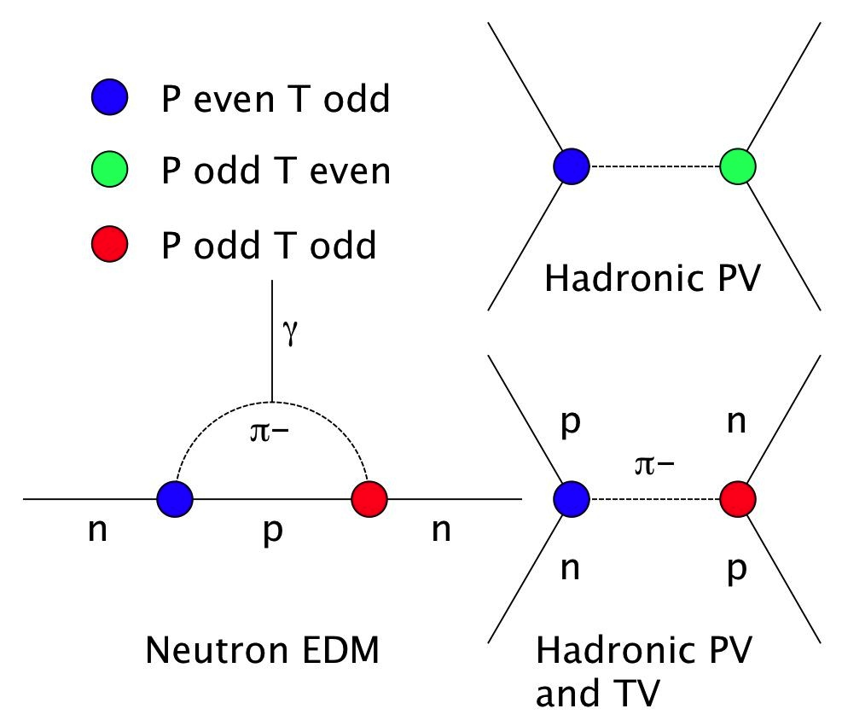
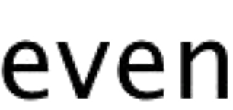
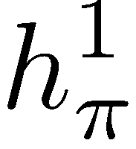
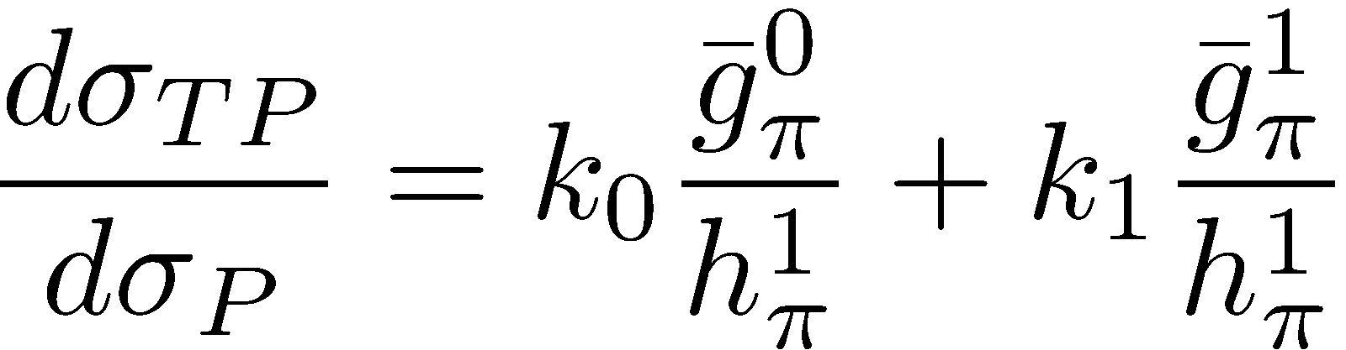
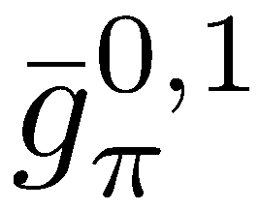
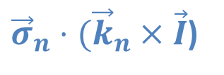


Relation between Hadronic PV/TRIV and EDMs
Tree level diagrams
Other similarities
FSI-free null measurement
linear global analysis
[nuclear] spectroscopy
high amplification factor
Bowman, Gudkov, PRC 90, 065503 (2014)
$$1$$
${\vec{σ}}_{n}⋅ {\vec{k}}_{n}$
${\vec{σ}}_{n}⋅({\vec{k}}_{n}×\vec{I}$)
2

Slide 3
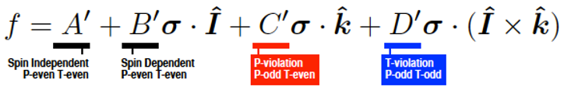
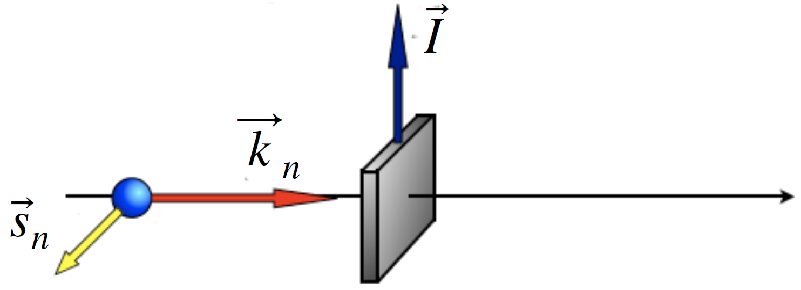
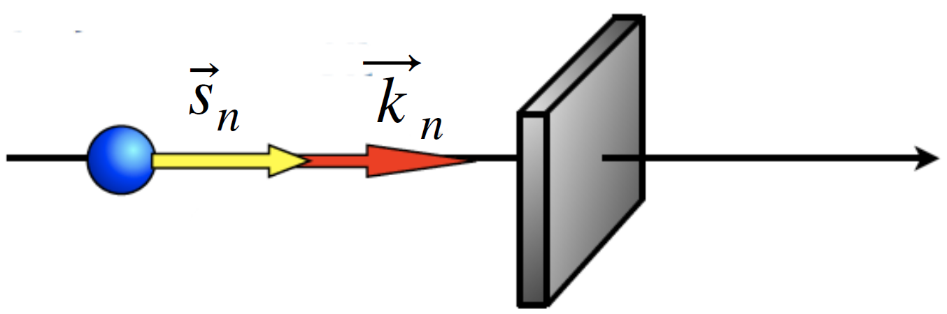
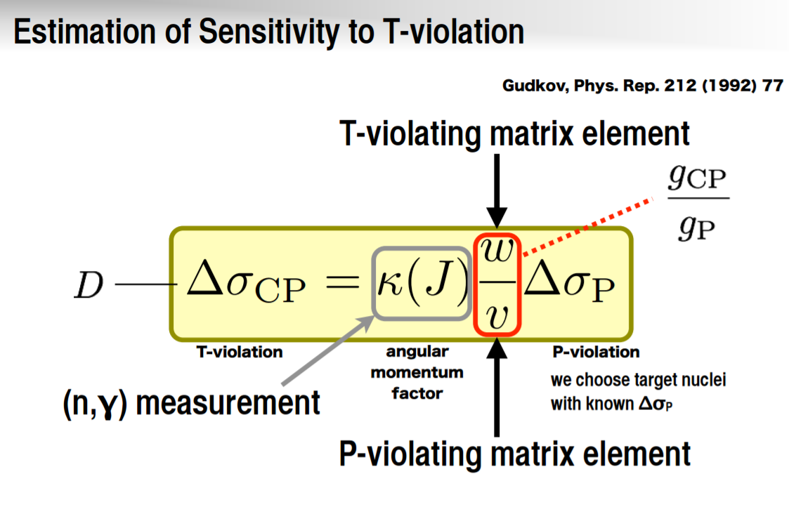
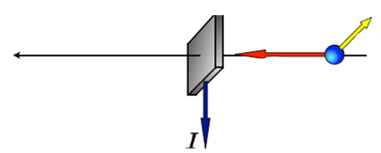

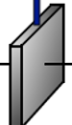
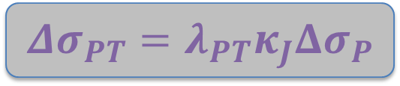



Observable – Forward Scattering Amplitude
$$f(0)=A^{′}+B^{′}σ⋅I+C^{′}σ⋅\hat{k}+D^{′}σ⋅(\hat{I}×\hat{k})$$
Gudkov, Phys. Rep. 212 (1992) 77
$$≡λ_{PT}$$
$$D$$
$$C$$
Ryndin theorem (1964): Without TRIV , swapping incoming/outgoing spin–momentum configuration leaves the f(0) invariant.
$${Δσ}_{PT}=λ_{PT}κ_{J}Δσ_{P}$$

Slide 4

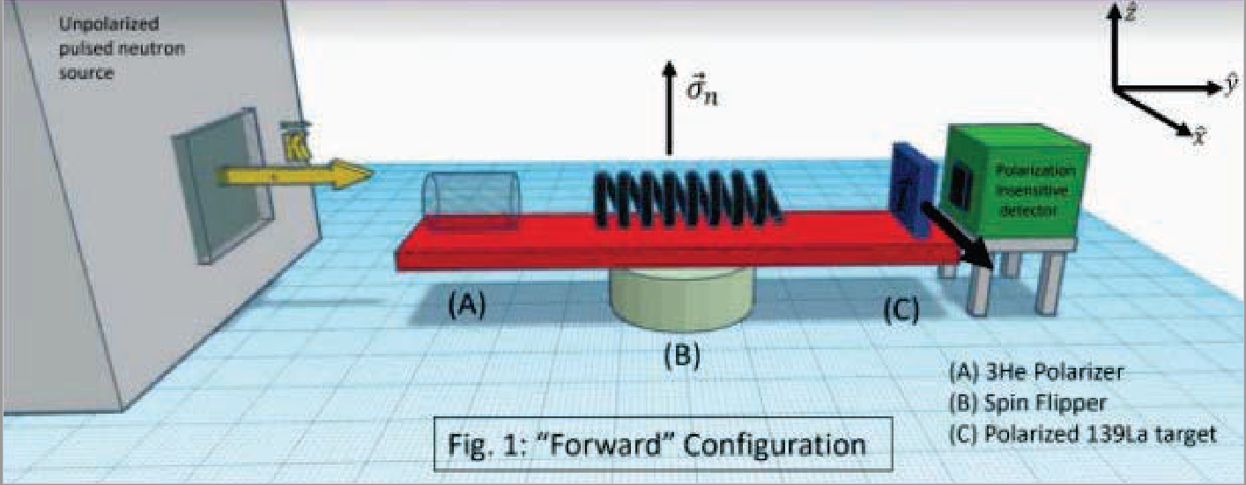
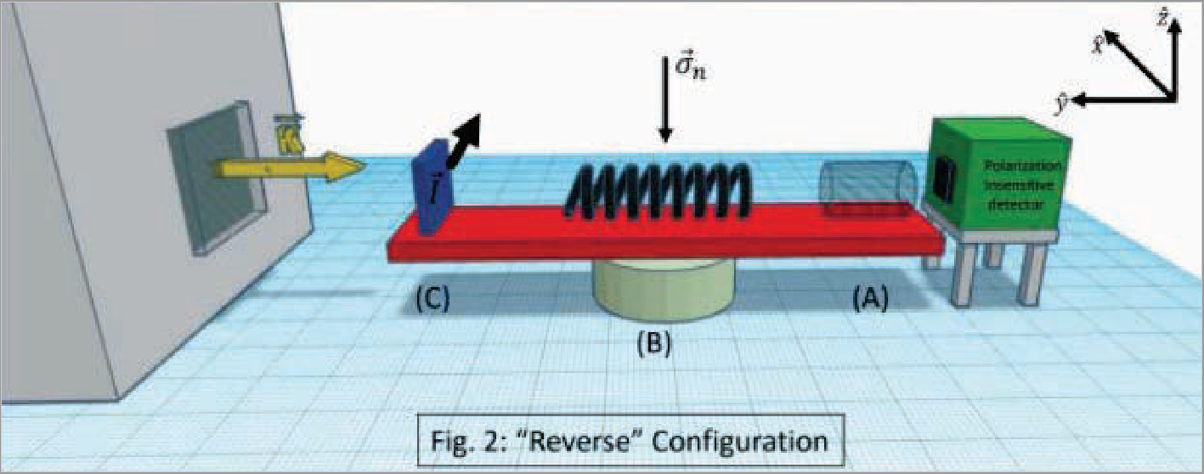
Total Absorption Asymmetry is a Null Test of TRIV
Forward scattering amplitude free of final state interactions (FSI)
Accessible by total absorption via the optical theorem
Asymmetry w/r to fast neutron spin flip is also odd under neutron polarizer ³He cell and nuclear target spin reversal
To reverse neutron momentum, rotate polarizer/analyzer order keeping source, detector, and collimation fixed
Kabir, PRD 37 (1988) 1856
Bowman, Gudkov, PRC 90, 065503 (2014)
$${Δσ}_{PT}=λ_{PT}κ_{J}Δσ_{P}$$

Slide 5



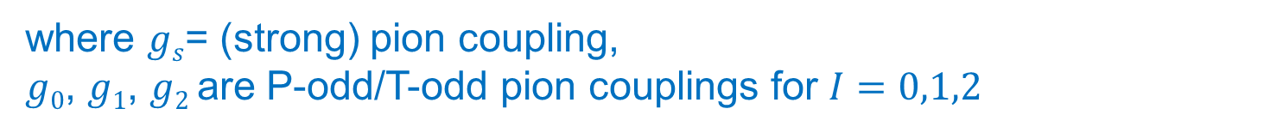
Expressions of $λ_{PT}$ from different BSM sources
where $gs$= (strong) pion coupling,
$g0$, $g1$, $g2$ are P-odd/T-odd pion couplings for $I=0,1,2$
in terms of 𝜃_{QCD}
in terms of quark
chromo-EDMs
present limit from EDM experiments
V. V. Flambaum and A. J. Mansour, Phys. Rev. C 105, 015501 (2022).
P. Fadeev and V. V. Flambaum, Phys. Rev. C 100 (2019).
N. Yamanaka, B. K. Sahoo, N. Yoshinaga, T. Sato, K. Asahi, and B. P. Das, Eur. Phys. J. A 53, 54 (2017).
S. Mantry, M. Pitschmann, and M. J. Ramsey-Musolf, Phys. Rev. D 90, 054016 (2014).
Y. V. Stadnik, V. A. Dzuba, and V. V. Flambaum, Phys. Rev. Lett. 120, 013202 (2018).
$${Δσ}_{PT}=λ_{PT}κ_{J}Δσ_{P}$$

Slide 6

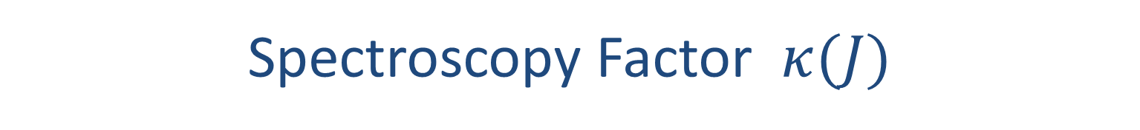


Spectroscopy Factor $κ(J)$
$$J=ℓ+s+I$$
$P$ transformation acts on $L=0,1$ $T$ transformation acts on $S=I±1/2$
$$j$$
$$S$$
n entrance
spin
channel
spin
Spin-weighted linear combination
of p-wave resonance widths in the j=1/2 and j=3/2 channels
Must be measured
$${Δσ}_{PT}=λ_{PT}κ_{J}Δσ_{P}$$

Slide 7
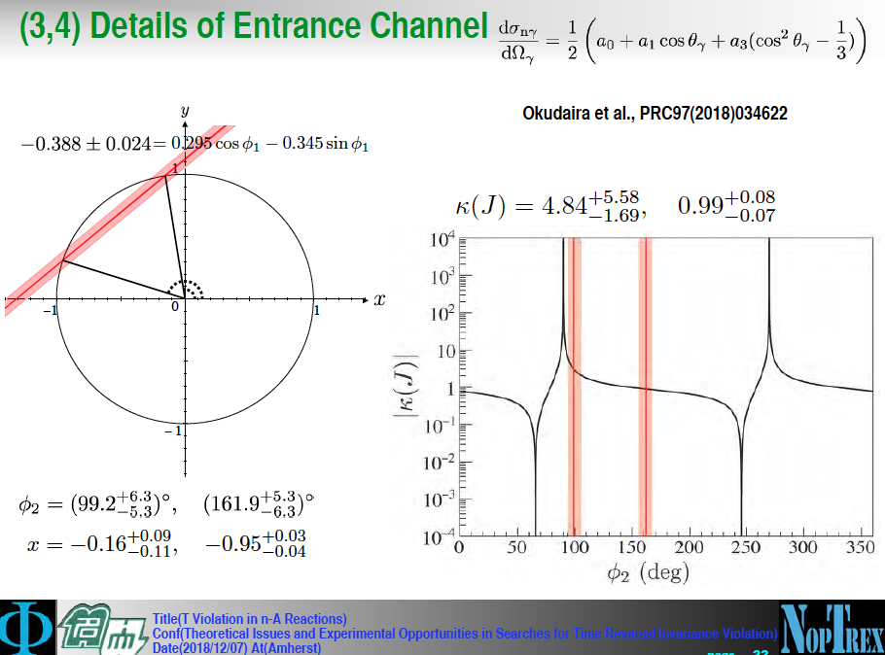

Spectroscopy Factor $κ(J)$
The ratio of sensitivities, $κ$, for ¹³⁹La, was measured at J-PARC by the angular distribution in $(n,γ)$ capture on the same 0.739 eV resonance.
Okudaira et al., Phys. Rev. C 97 (2018) 03462
Nakabe et al., arXiv:2312.06115 [nucl-ex]
$${Δσ}_{PT}=λ_{PT}κ_{J}Δσ_{P}$$

Slide 8
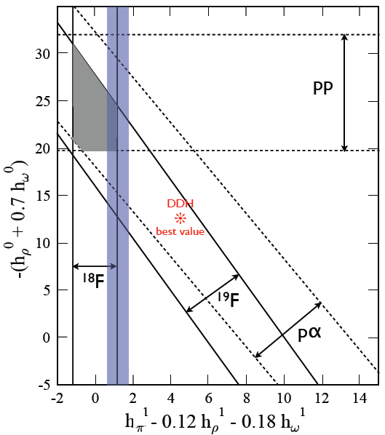

HWI Example: 1) global analysis of linear couplings
x 10⁻⁷
 | np A_{γ} | nD A_{γ} | n³He A_{p} | np φ | nα φ | pp A_{z} | pα A_{z}
f_{π} | -0.11 | 0.92 | -0.18 | -3.12 | -0.97 |  | -0.34
h_{r}⁰ |  | -0.50 | -0.14 | -0. 23 | -0.32 | 0.08 | 0.14
h_{r}¹ | -0.001 | 0.10 | 0.027 |  | 0.11 | 0.08 | 0.05
h_{ρ}² |  | 0.05 | 0.0012 | -0.25 |  | 0.03
h_{ω}⁰ |  | -0.16 | -0.13 | -0. 23 | -0.22 | -0.07 | 0.06
h_{ω}¹ | 0.003 | -0.002 | 0.05 |  | 0.22 | 0.07 | 0.06
Haxton & Holstein, PPNP 7, 1851 (2013)
J. Wasem, Phys. Rev. C 85, 022501(R) (2012)
Petschlies et al, arXiv:2306.03211
Adelberger, Haxton, A.R.N.P.S. 35, 501 (1985)
Viviani (PISA), [n-³He] P.R.C. 82, 044001 (2010)
PV observables are LINEAR in weak couplings
Spin asymmetry in gamma transitions: np, nd
Circular polarization of gamma transitions: np, nd
Spin asymmetry in charge exchange: n³He
Neutron spin rotation in nuclear medium: np, nd, n$α$
Analyzing power in elastic scattering: pp, pd, p$α$
LQCD
$${Δσ}_{PT}=λ_{PT}κ_{J}Δσ_{P}$$

Slide 9
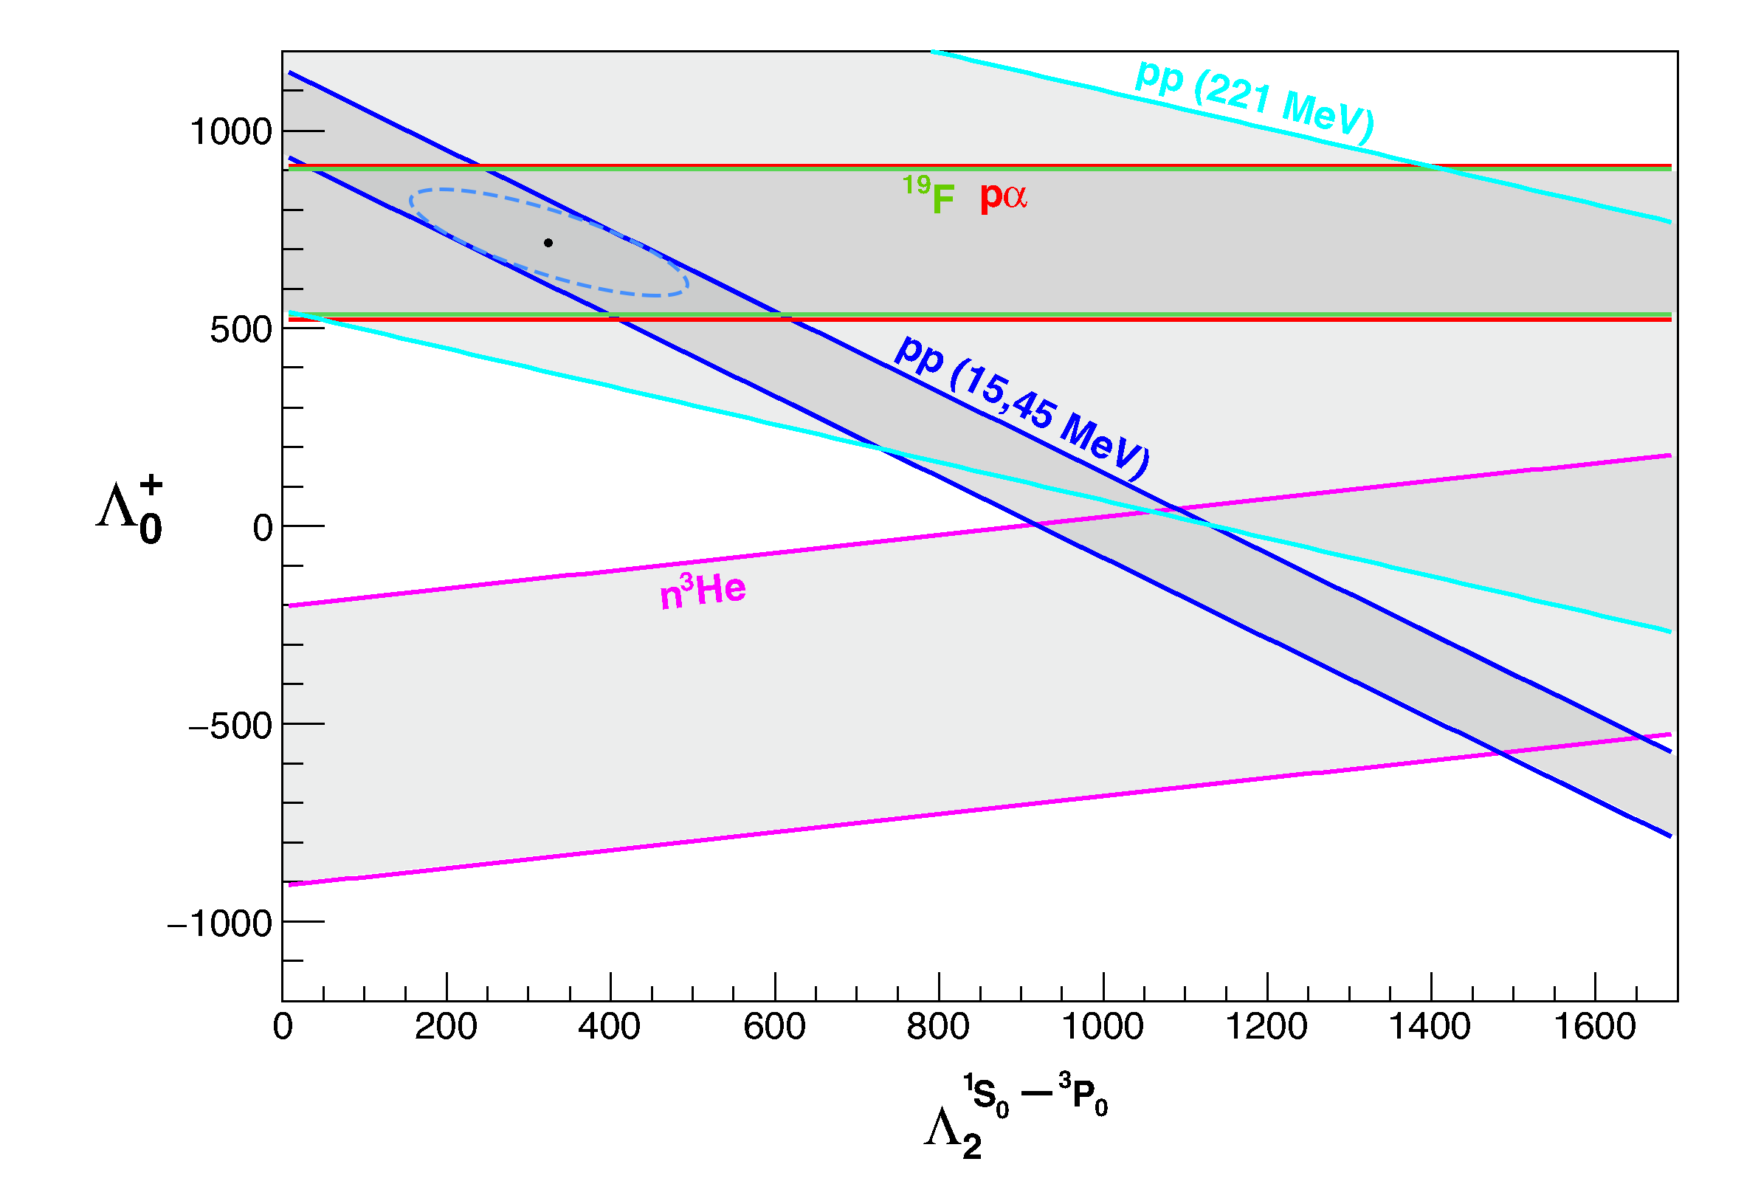
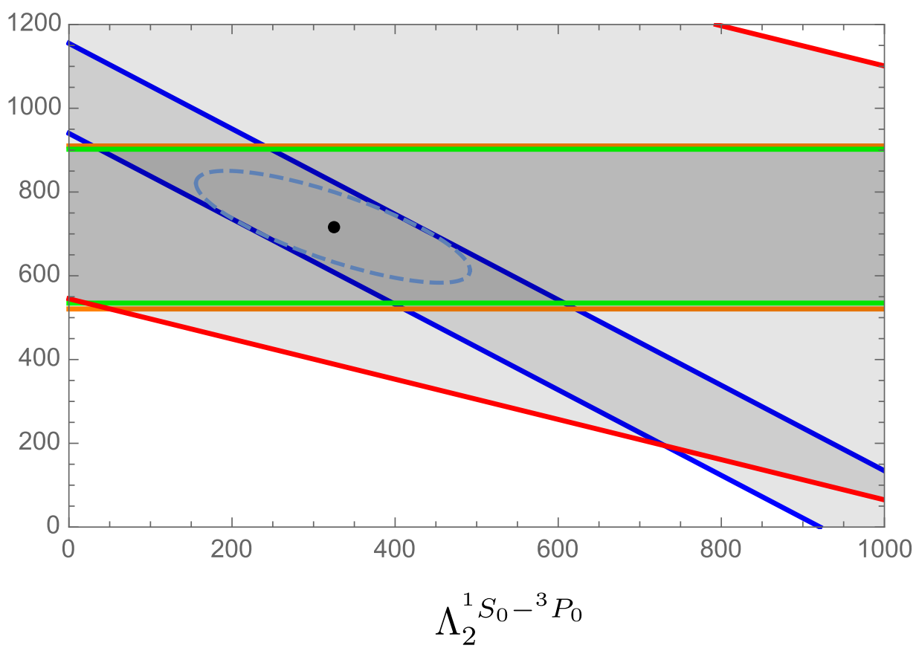
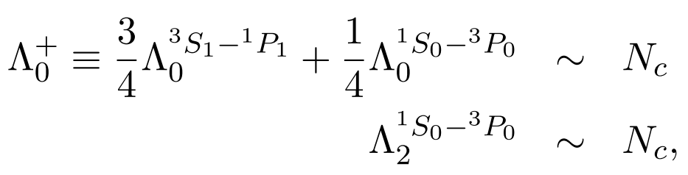
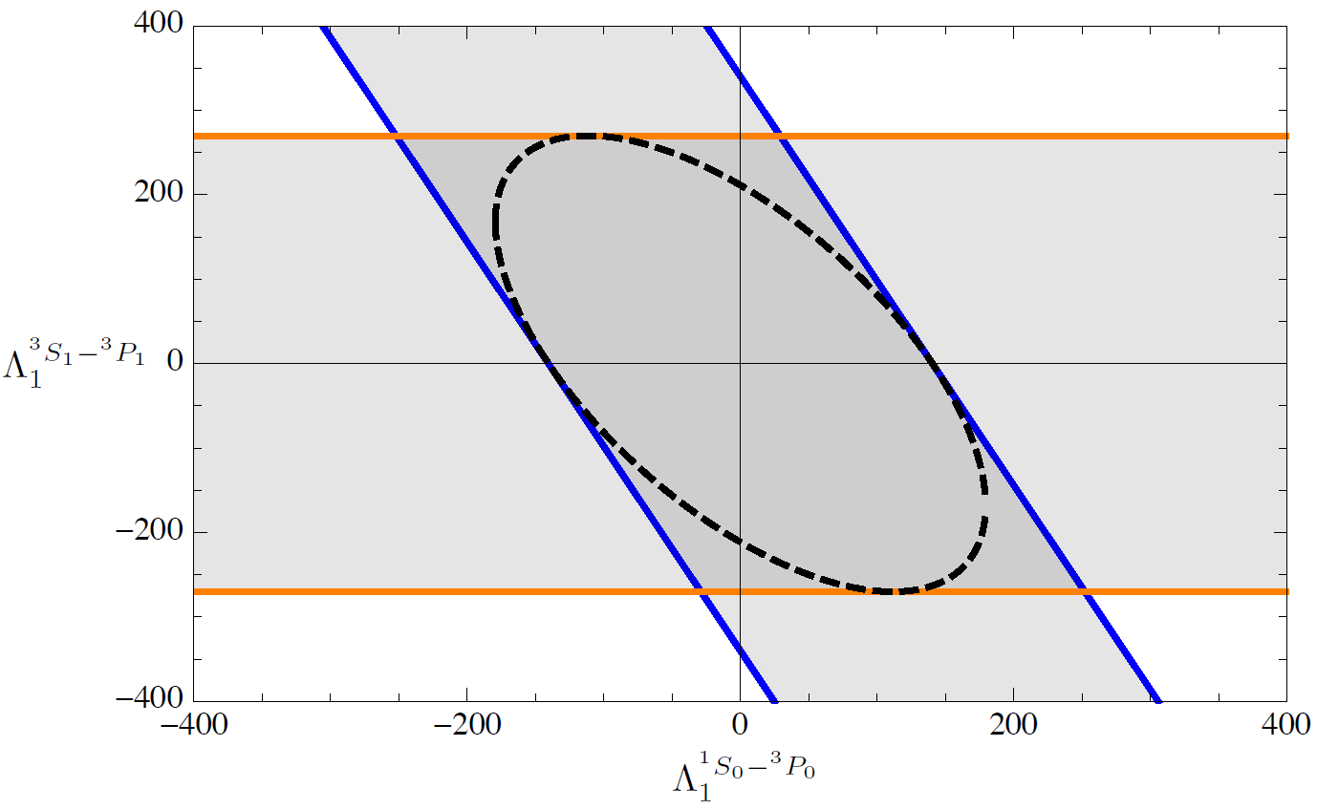
HWI Example: 2) NPDGamma and n³He vs. $N_{c}≫1$
pp (220 MeV)
pp (15, 45MeV)
pα
NPDGamma
¹⁹F
¹⁸F
NPDGamma
projected
Gardner, Haxton, Holstein, ARNPS 67, 69 (2017)
$${Δσ}_{PT}=λ_{PT}κ_{J}Δσ_{P}$$

Slide 10
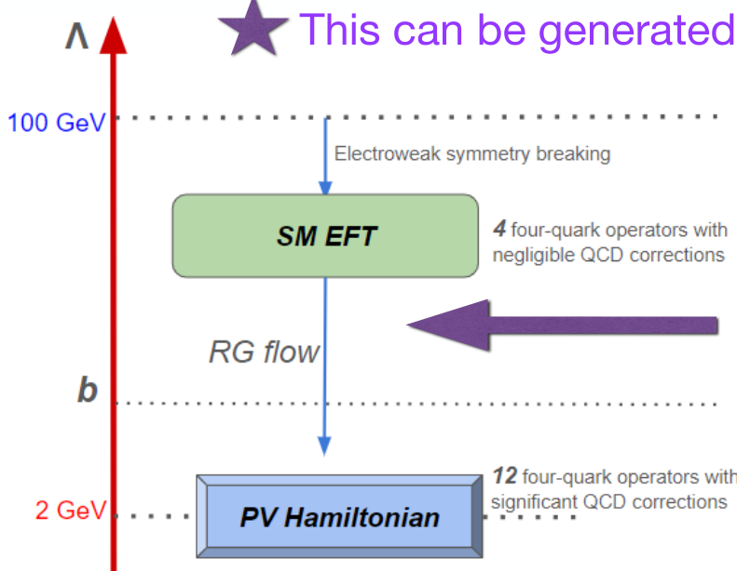
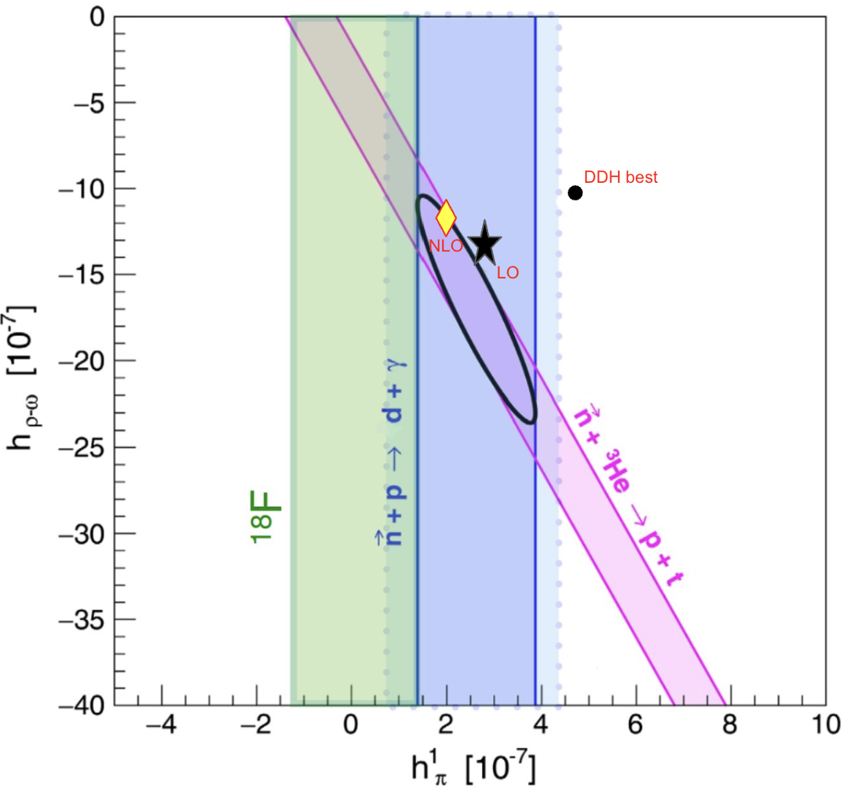
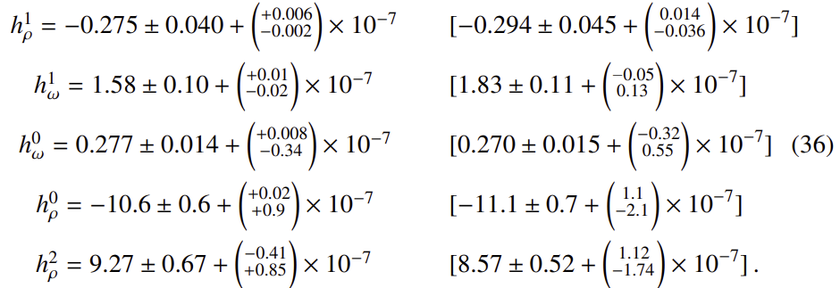
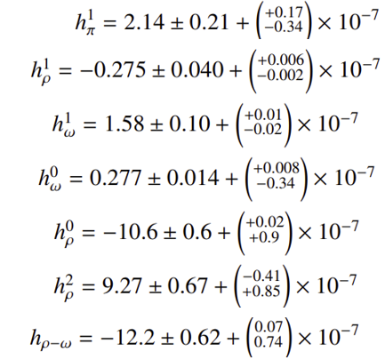

HWI Example: 3) refined EFT+QCD analysis of HPV
Muralidhara & Gardner, Phys. Lett. B 849 (2024)
Gardner & Muralidhara, Phys.Rev.C 107 (2023) 5, 055501
Gardner & Muralidhara, Phys.Lett.B 833 (2022) 137372
$${Δσ}_{PT}=λ_{PT}κ_{J}Δσ_{P}$$

Slide 11

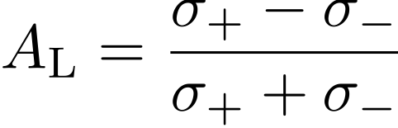


Amplification of $A_{PV}$ in p-wave n-A resonance
Helicity dependence of the p-p scattering cross section
-(1.7±0.8)×10⁻⁷ @ E=15 MeV
Interaction between nucleons: 10⁻⁷ P-violation
0.74eV
Helicity dependence of cross section in neutron transmission ¹³⁹La (Dubna, Alfimenkov 1982)
0.097±0.003 @ En=0.739 eV
Compound nucleus: 10⁻¹ P-violation
P-odd amplitude can be enhanced by ~10⁶ in a compound nucleus. Measured over 40 years ago.
$${Δσ}_{PT}=λ_{PT}κ_{J}Δσ_{P}$$
Notes:
Next, let me explain the parity violation in nuclear interactions. In nucleon-nucleon interactions, the strong interaction is dominant, but there is also a very small effect of the weak interaction. Since the strong interaction does not break parity, we can isolate the effect of the weak interaction between nucleons through parity violation.
In an experiment to measure the scattering cross section of a polarized proton to an unpolarized proton target, cross section difference depending on the direction of proton polarization .The size of the difference is 10-7. This means that P-violation of about 10-7 occurs due to weak interactions between nucleons and nucleons.
In the case of the reaction in which a nucleus absorbs a polarized neutron and forms a compound state, there is a difference of the neutron absorption cross section with the size of about 10-1 depending on the direction of neutron polarization. This is a 10^6 times larger asymmetry than that of the proton-proton interaction, even though both interaction are dominated by strong interactions. This indicates that the very small party violation caused by the weak interaction is amplified by a factor of 10^6 through the process of compound nuclear resonance.
次に原子核相互作用におけるparity violationについて説明させてください。核子同士の相互作用では強い相互作用が支配的ですが、弱い相互作用の効果も僅かに存在します。強い相互作用はparityを破らないので、Parity violationを通して、核子間に働く弱い相互作用の効果を測定することができます。無偏極陽子に対する偏極陽子の散乱断面積を測定するという実験において、陽子の偏極方向によって断面積が10-7程度程度変化するという結果が報告されています。これは核子核子間で弱い相互作用により10-7程度P-violationが起きているということを意味しています。
今度は原子核に偏極中性子を吸収させる反応を考えると、中性子偏極方向によって断面積の差が10-1程度存在するという現象が報告されています。陽子陽子相互作用と複合核反応は共に強い相互作用が支配的であるにもかかわらず、これは10^6倍大きな非対称度です。これは10-7程度だったParty violationが複合核共鳴という過程を通して10^6倍まで増幅しているということを示しています。

Slide 12
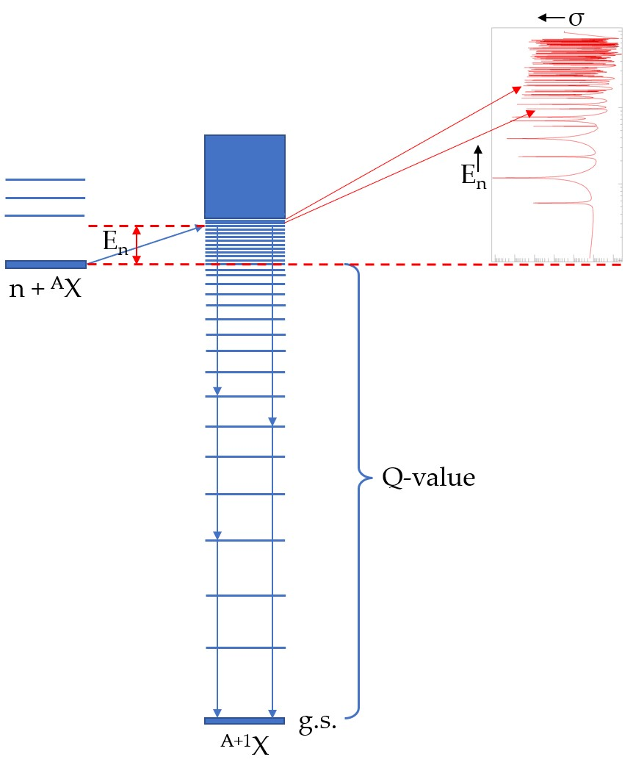

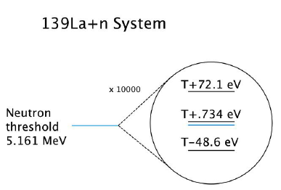

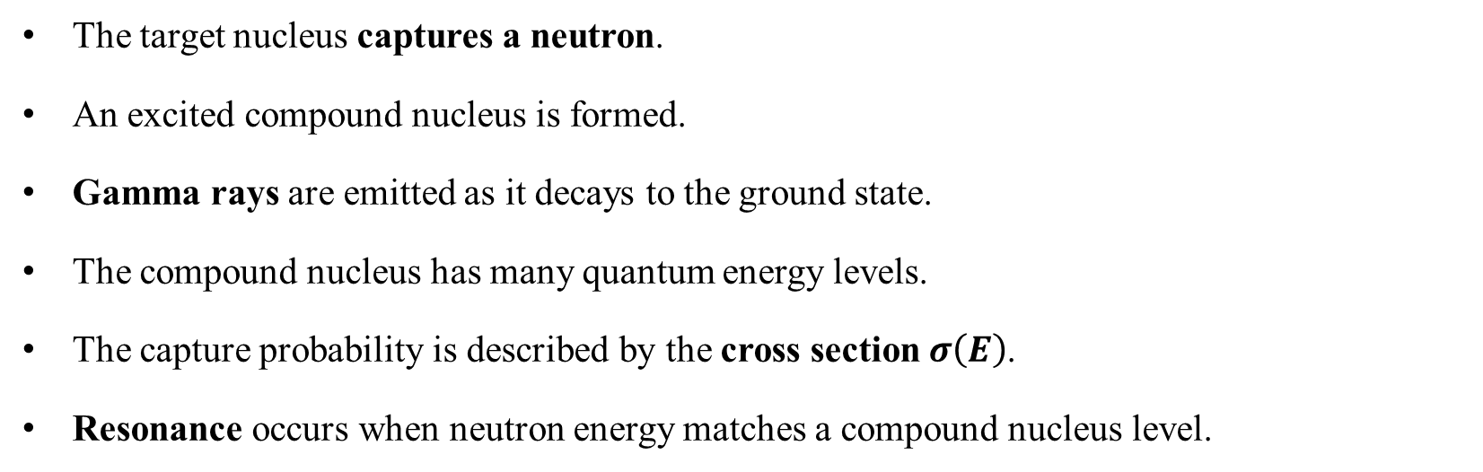



Neutron capture radiative decay
n
Target CN
$${}_{Z}^{A}X$$
$${}_{Z}^{A+1}X∗$$
$${}_{Z}^{A+1}X$$
Prompt $γ$
The target nucleus captures a neutron.
An excited compound nucleus is formed.
Gamma rays are emitted as it decays to the ground state.
The compound nucleus has many quantum energy levels.
The capture probability is described by the cross section $σ\left(E\right)$.
Resonance occurs when neutron energy matches a compound nucleus level.
$${Δσ}_{PT}=λ_{PT}κ_{J}Δσ_{P}$$
NOPTREX NA Collaboration Meeting (2026) - Ahmad Taninah

Slide 13
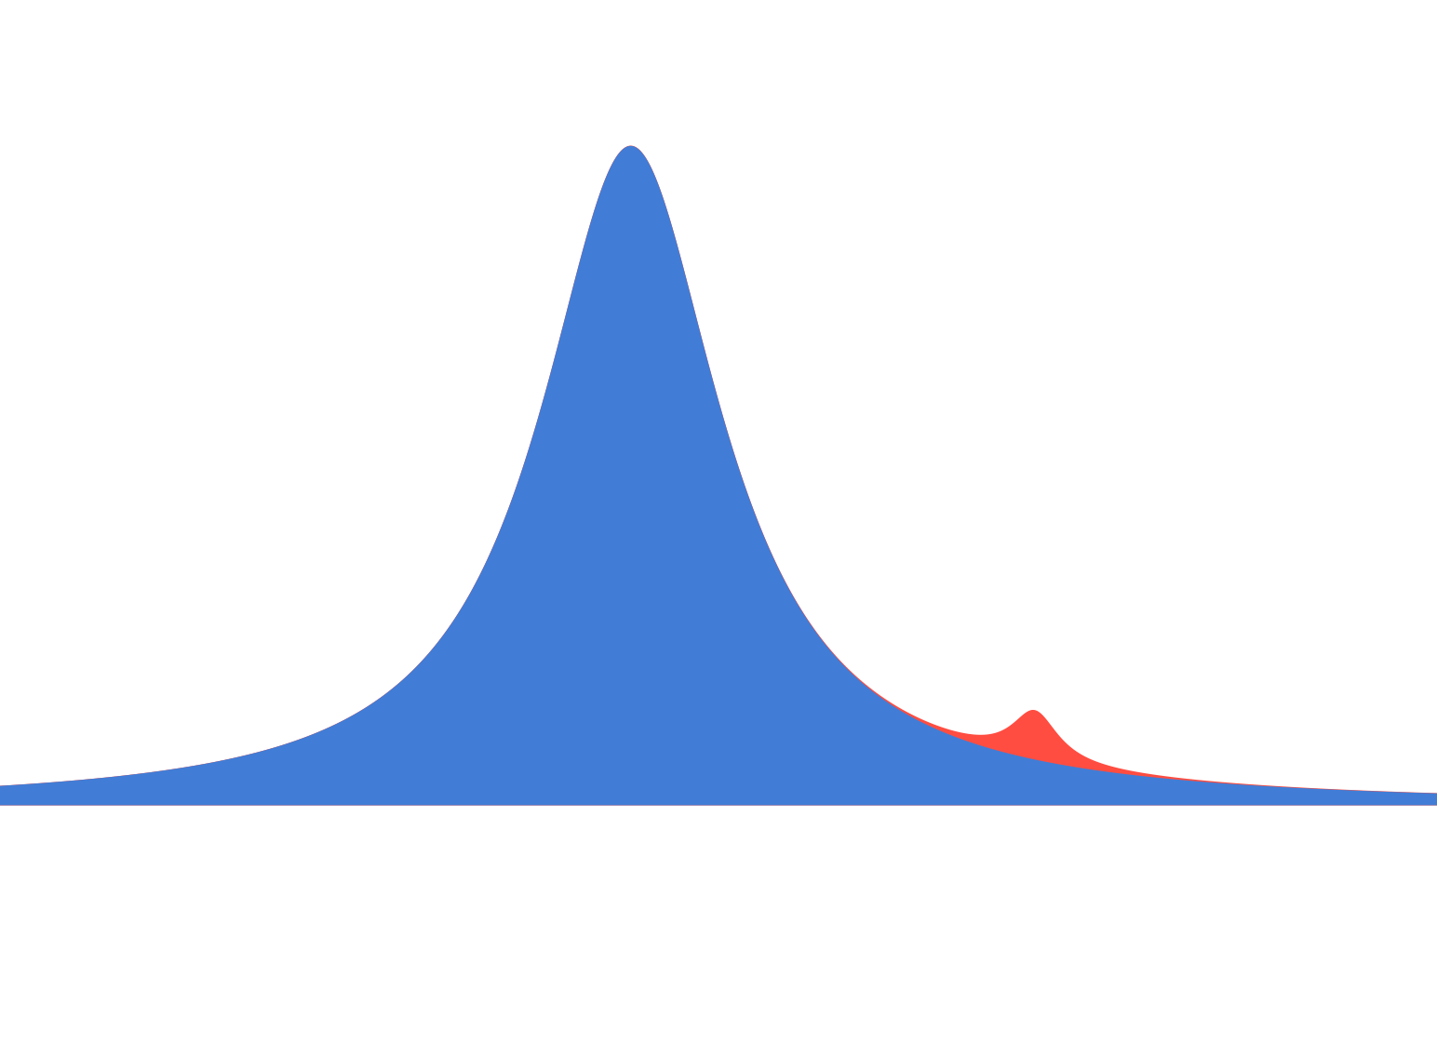


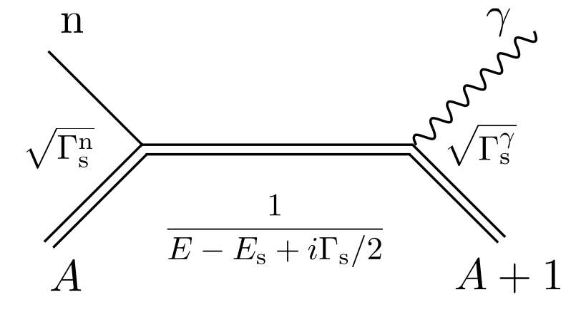
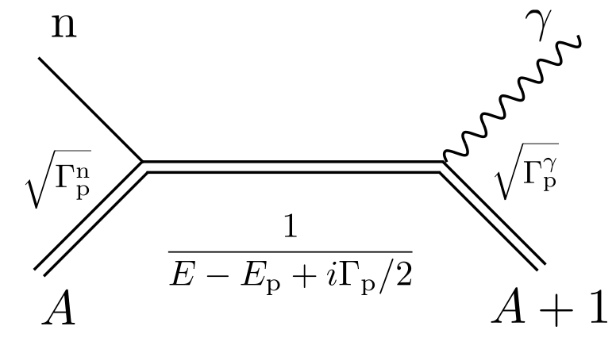





HPV Enhancement mechanism: s-p resonance mixing
s-wave resonance
Enhancement of P-violation is observed in a p-wave resonance located near a s-wave resonance
Cross section
Cross section
s-wave resonance : Parity + L=0
p-wave resonance : Parity - L=1
p-wave resonance
Neutron energy
$$l=0$$
$$l=1$$
s-wave
p-wave
Consider simple case with nuclear spin I=0 and for (n,𝛾) reaction
In absence of P-odd mixing that can change L, amplitudes are given by the diagrams on the right
Total angular momentum of neutron
Total angular momentum of neutron
$${Δσ}_{PT}=λ_{PT}κ_{J}Δσ_{P}$$
Notes:
This amplification is known to occur when a p-wave resonance is located at the tail of a large s-wave resonance. An s-wave resonance is a resonance in which the neutron is absorbed with an orbital angular momentum of 0, while a p-wave resonance is a resonance in which the neutron is absorbed with an orbital angular momentum of 1. The diagram of these reactions looks like this, where the angular momentum of the neutron is j=1/2 for the s-wave and j=1/2 or 3/2 for the p-wave.
この増幅は大きなs波共鳴のすそのにp波共鳴が位置している時に起きていることがわかっています。ここでs波共鳴とは中性子が軌道角運動量0で吸収される共鳴, p波共鳴の場合は軌道角運動量1です。これらの反応のダイアグラムを書くとこのようにかけて、この時中性子の角運動量としてはs波においてはj=1/2, p波においては軌道角運動量j=1/2もしくは3/2取ることができます。

Slide 14
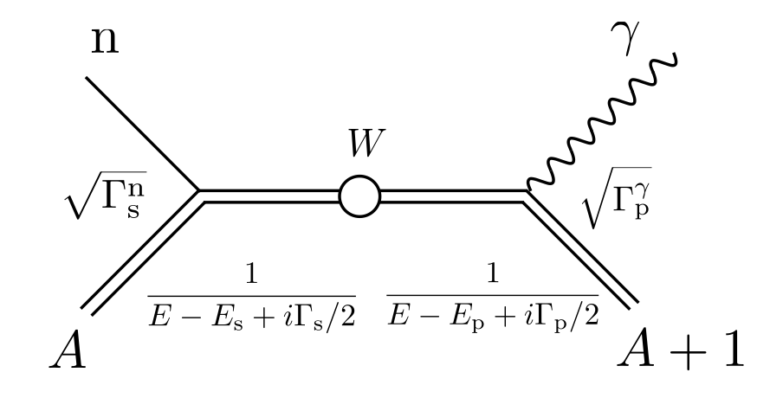
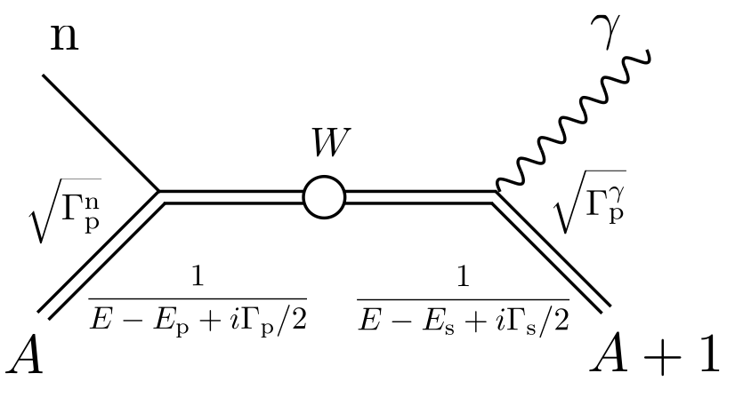
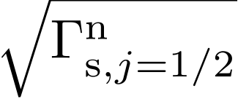
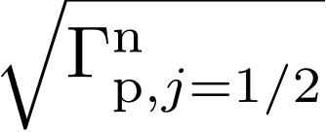

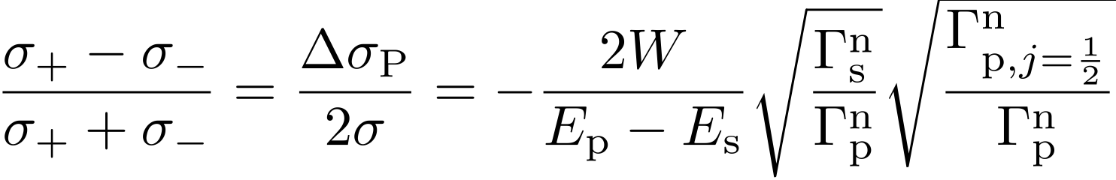


HPV Enhancement mechanism: s-p resonance mixing
P-odd amplitude W mixes j=1/2 component of s-wave and j=1/2 component of p-wave
s-wave
p-wave
p-wave
s-wave
P-odd
interaction
P-odd
interaction
With P-odd mixing W that can change L, M² has an interference of amplitudes given by the diagrams on the left with a pure s-wave
For neutron energy E at the p-wave resonance E_{p}, the P-odd asymmetry is
Partial neutron width
j=1/2 component
~0.6 PRC 109 (2024) 4, L041602
“Complexity”
Enhancement
“Structural" Enhancement
$$\sqrt{{Γ_{s}}/{Γ_{p}}}≈{10}^{3}$$
$${Δσ}_{PT}=λ_{PT}κ_{J}Δσ_{P}$$
$$\sqrt{N}≈{10}^{3}$$
Notes:
Theoretically, this enhancement is understood that the s-wave and p-wave states interferences for long-time in the compound nuclear resonance state and j=1/2 component of the s-wave state and the j=1/2 component of the p-wave state mixes by weak interaction, then the parity violation is enhanced. This is called s-p mixing and can be represented by a Feynman diagram like this.
Using this process, we can describe the asymmetry of the cross section and find two amplification mechanisms: Dynamic enhancement, which is caused by the high level density of the compound state, and Structural enhancement, which is caused by the large cross section difference of the s-wave and p-wave. Each has a 10^3-fold amplification effect, which explains the 10^6-fold amplification. The magnitude of the neutron partial width of the j=1/2 component of the p-wave state then emerges, which has never been measured for most nuclides.
この増幅効果は複合核共鳴状態でのs波状態のj=1/2成分とp波状態のj=1/2成分が長時間干渉し、混合することにより、起きると考えられています。これをs-p mixingと呼びこのようなファインマンダイアグラムで表すことができます。
この過程を用いて、断面積のアシンメトリを書き下すとDynamic Enhancementと呼ばれる、複合核の準位密度の高さに由来する増幅機構と、Structual enhancementと呼ばれるs波とp波の断面積の大きさに由来する増幅機構が現れます。それぞれが10^3倍の増幅効果があるので、10^6倍の増幅を説明することができます。この時、p波状態のj=1/2成分の中性子部分幅の大きさが出てくるのですが、これはほとんどの核種で測られたことがありません。

Slide 15
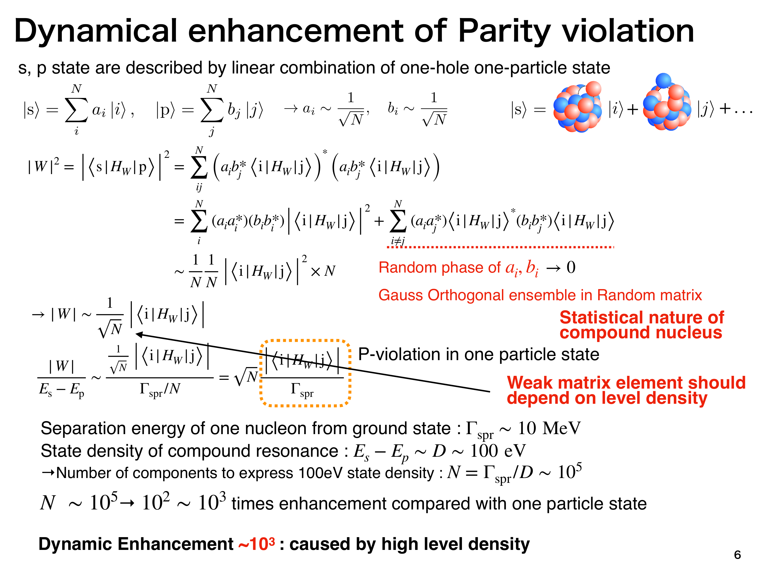
Dynamical Enhancement of Parity Violation
$${Δσ}_{PT}=λ_{PT}κ_{J}Δσ_{P}$$
Notes:
Compound s&p Wave resonance wavefunctions are in chaotic superpositions of N Single-particle-hole basis states.

Slide 16
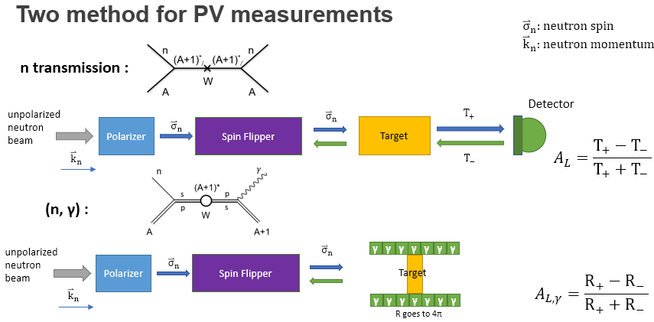
Parity-odd Asymmetry Measurement Methods
$${Δσ}_{PT}=λ_{PT}κ_{J}Δσ_{P}$$

Slide 17
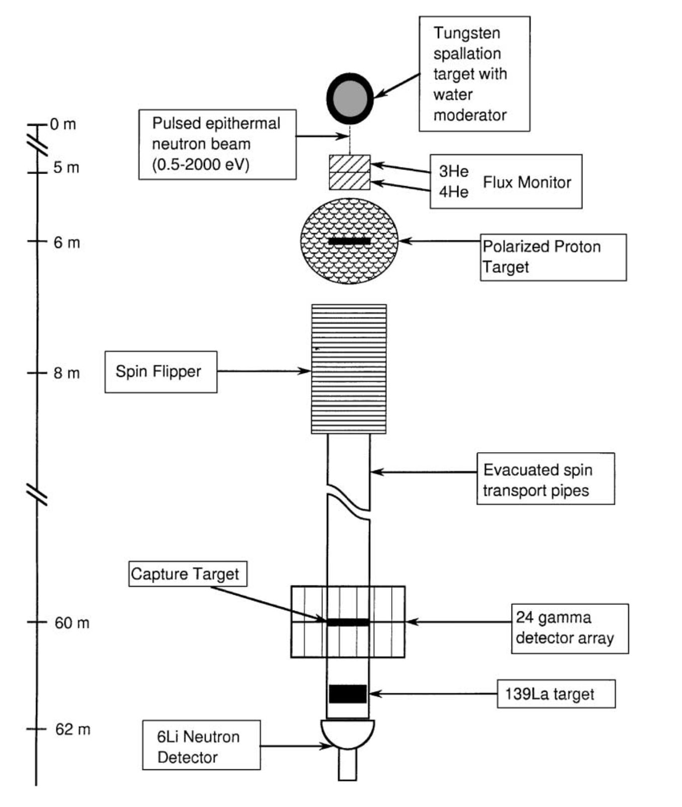
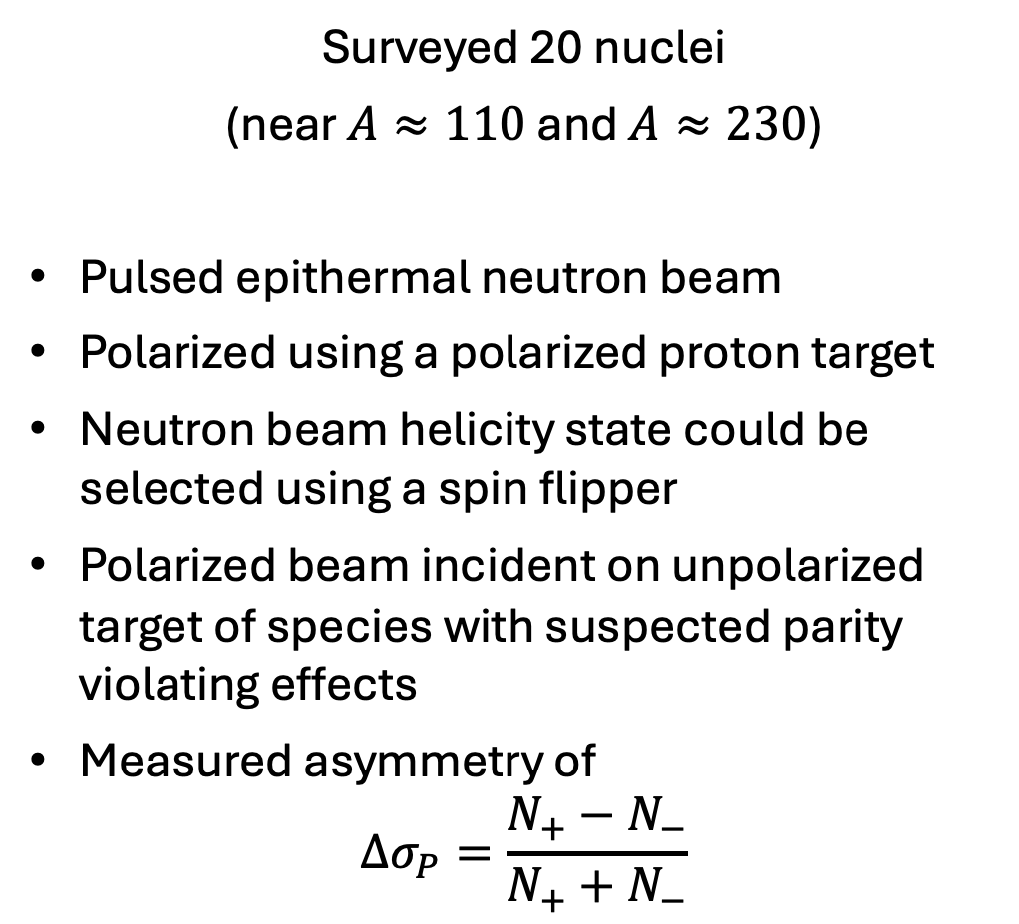
TRIPLE: Parity Violation in Compound Nuclei
(LANSCE, Los Alamos, 1990s – 2000s)
$${Δσ}_{PT}=λ_{PT}κ_{J}Δσ_{P}$$

Slide 18
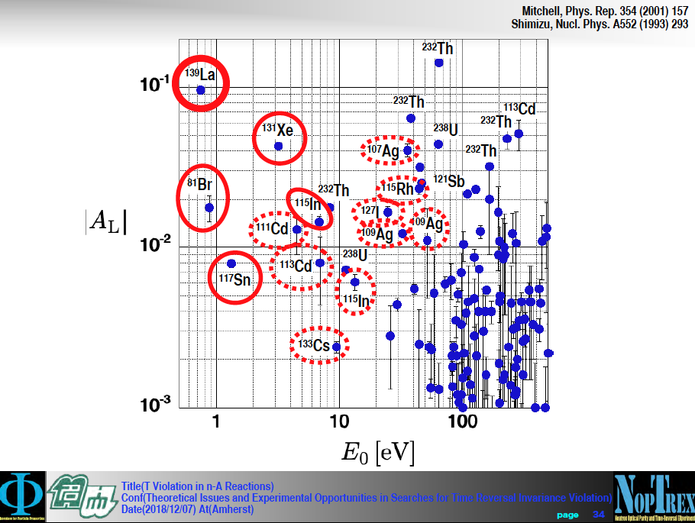
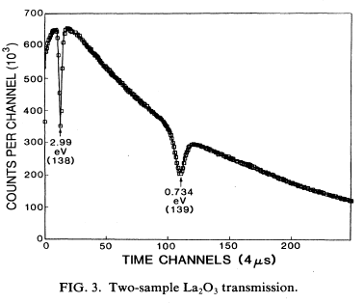

¹³⁹La is the best nucleus!
First PV: n+¹¹³Cd ~10⁻⁴ Abov, PL 12:25 (1964)
Parity Violation in n+ ¹³⁹La at 0.734 eV Δσ/σ =0.097±.005 10⁶ enhancement!
Larger $A_{L}$ and lower $E_{0}$ resonance energy is better for NOPTREX
s-wave resonance
p-wave resonance

Slide 19

NOPTREX/IRES Collaboration 2026
NOPTREX: C. Auton¹⁶, E. Babcock²⁹, M. Barlow³⁰, L. Barron-Palos²⁷, L. Charon-Garcia⁴², E. Chekmenev³², A. Couture²⁰, C. Crawford¹⁹, B. Crider³⁹, K. Dickerson²⁹, D. Eigelbach²⁰, S. Endoh^{1,3}, R. Fan^{15,38}, J. Fry²⁴, H. Fujioka⁷, B. Goodson²², V. Gudkov¹⁷, C. Haddock²¹, K. Hagino¹¹, H. Harada³, P. Hautle²⁸, L. Hebenstiel¹⁶, M. Hino¹¹, K. Hirota¹, I. Ide¹, M. Iinuma⁶, H. Ikegami¹⁰, T. Ino⁴, R. Ishiguro¹³, S. Ishimoto⁴, K. Ishizaki¹, T. Iwata⁹, P. Jahn²², C. Jiang¹⁸, W. Jiang¹⁵, K. Kameda⁷, S. Kawamura¹, G. Kim¹⁴, A. Kimura³, P. King²³, M. Kitaguchi¹, Y. Kiyanagi¹, J. Koga², H. Kohri⁸, A. Komives³¹, S. W. Lee¹⁴, Q. Lu^{15,38},G. Luan³⁴, M. Luxnat¹⁶, T. Matsushita¹, M. McCrea³⁶, J. Mills²⁴, K. Mishima⁴, Y. Miyachi⁹, T. Momose⁵, T. Morishima¹, T. Mulkey⁴⁵, Y. Niinomi¹, I. Novikov²⁵, J. O’Mahar¹⁹, T. Okudaira¹, M. Okuizumi¹, K. Ogata⁸, T. Oku³, G. Otero¹⁶, J. Palomino³⁹ , S. Penttila¹⁸, A. Perez-Martin²⁷, A. Petrilla²², B. Plaster¹⁹, X. Ruan³⁴, K. Sakai³, S. Samiei¹⁶, M. Sarsour⁴⁵ , D. Schaper¹⁶, M. Scott⁴⁶, R. Shchepin³³ ,T. Shima⁸, H. Shimizu¹, Z. Siraj²², W. Snow¹⁶, D. Spayde³⁵, H. Tada¹, J. Tang³⁷, Z. Tang²⁰, Y. Tani⁷, S. Takada², Y. Takahashi¹¹, D. Takahaski¹², K. Taketani⁸, A. Taninah⁴⁰, K. Tateishi¹⁰, X. Tong¹⁵, T. Uesaka¹⁰, N. Vassilopoulos¹⁵, M. Veillette²⁶, G. Visser¹⁶, N. Wada¹, M. Wan⁴³, Y. Wang¹⁹, D. Wei⁴¹ , H. Wijerante⁴⁵, J. Winkelbauer²⁰, T. Yamamoto¹, Y. Yamagata¹⁰, H. Yan⁴³, H. Yoshikawa⁸, T. Yoshioka², M. Yosoi⁸ , L. Zanini⁴⁴, M. Zhang^{15,16}, Q. Zhang³⁴
IRES: D. Bishop¹⁶, J. Britt²⁴, B. Edwards²⁵, M. Hamilton²⁴ , S. LeRose¹⁹, E. Myers²⁶, N. Niemotka³⁵, N. Palley⁴⁶, L. Potts²⁵, J. Purnell¹⁹, L. Richter³⁵, E. Shipp¹⁶, A. Smyrichinsky¹⁶, K. Swafford²⁴, J. Traywick³⁹, D. Waxley²⁶, M. Wilson²⁶, A. Winterman¹⁹
¹Nagoya, ²Kyushu, ³JAEA, ⁴KEK, ⁵British Columbia, ⁶Hiroshima, ⁷Tokyo Inst. Tech., ⁸Osaka, ⁹Yamagata, ¹⁰RIKEN, ¹¹Kyoto, ¹²Ashikaga, ¹³Japan Women’s, ¹⁴Kyungpook, ¹⁵CSNS, ¹⁶Indiana, ¹⁷South Carolina, ¹⁸ORNL, ¹⁹Kentucky, ²⁰LANL, ²¹Phase III Physics, ²²Southern Illinois, ²³Ohio, ²⁴Eastern Kentucky, ²⁵Western Kentucky, ²⁶Berea, ²⁷UNAM, ²⁸PSI, ²⁹Juelich, ³⁰Nottingham, ³¹DePauw, ³²Wayne State, ³³SDSM&T, ³⁴CIAE, ³⁵Hendrix, ³⁶Manitoba, ³⁷USTC, ³⁸IHEP, ³⁹Mississippi, ⁴⁰LSU/Shreveport, ⁴¹Tech. Inst. Phys. Chem., ⁴²TRIUMF, ⁴³ Ningbo, ⁴⁴ ESS, ⁴⁵ Georgia State, ⁴⁶Centre
IRES: International Research
Experiences for Students
One experiment: Five neutron sources

Slide 20


Three scientific goals of NOPTREX
Understand P violation in nA interactions
Quantify mean square weak matrix element <M²> in heavy nuclei
Compare with statistical theory of P violation in heavy nuclei
New p-wave resonances in 140<A<200: data taken, under analysis
Ongoing (n, 𝛄) spectroscopy for TRIPLE data reanalysis
Search for P-odd/T-odd nA interactions
Discover new source of P-odd/T-odd interaction
¹³⁹La polarized to >35% by dynamic nuclear polarization
³He polarizer cell highest figure of merit for epithermal neutrons
Collected Phase 1 experiment collected data at JPARC!
Search for P-even/T-odd nA interactions – see Sepehr’s talk
Discover new source of P-even/T-odd interaction
Aid interpretation of P-odd/T-odd electric dipole moment (EDM) searches
$${Δσ}_{PT}=λ_{PT}κ_{J}Δσ_{P}$$
$${Δσ}_{PT}=λ_{PT}κ_{J}Δσ_{P}$$

Slide 21


Goal (1) Understand P violation in heavy nuclei
Source | Instrument | Experiment | Time / Schedule
CSNS | GTAF | n spec. of ¹⁰⁵Pd, ¹⁰⁶Pd, ¹¹³Cd | 600 hr / 3 years
JPARC | ANNRI | spin memory on ¹⁰³Rh, ¹²⁷I | 18 days (now)
JPARC | ANNRI | spin memory on ¹¹⁵In, ¹¹⁷Sn | 9 days / May 2026
JPARC | ANNRI | Phase 2: n+¹³⁹La
LANSCE | FP12 | PV 140 < A < 180 nuclei | Fall 2026
LANSCE | DANCE | ¹³⁹La spectroscopy
2026 instrumentation development
BaF₂ gamma detectors (WKU, IU)
Pure CsI detectors (WKU/IU NSF MRI proposal)
³He SEOP for LANSCE FP12 (IU et al.)
SABRE development (SIU)
¹⁰B scintillator neutron detector on CSNS Back-n
Polarized beam on CSNS Back-n
DANCE (BaF2, Los Alamos)
GTAF-2 (BaF2, CSNS)

Slide 22

HPV measurements at LANSCE FP12
³He polarizer
DC spin flipper
NaI gamma array
⁶Li neutron counter

Slide 23


Accurate Neutron-Nucleus Reaction measurement Instrument – ANNRI beam line at J-PARC
(n,γ)反応を測定することでκ(J)を決定する
BL04 ANNRI
Beam stopper
BL04 Ge Detectors
Ge detectors
Disk chopper
Cluster detector
Filter
T0 Chopper
A
Target
Collimator
21.5m
2 Cluster Detector (up・down) 7ch ×2 : 14ch
8 Coaxial Detector (side) 8ch
Total 22ch
Coaxial detector

Slide 24


Goal (2) Search for P-odd/T-odd nA interactions
Phased $\vec{n}+{}_{}^{139}{\vec{La}}$ total absorption cross section measurement program at JPARC
$${Δσ}_{PT}=λ_{PT}κ_{J}Δσ_{P}$$

Slide 25

Phase 1 — ANNRI beamline configuration

Slide 26

Phase 1 — ³He polarizer cell
Largest opacity 3He SEOP neutron spin filter ever constructed (J-PARC group).
Produces large neutron polarization at 0.7 eV (details to be published).

Slide 27


Phase 1 — Preliminary $\vec{n}+{}_{}^{139}{\vec{La}}$ Asymmetry!
${A∼σ}_{n}⋅I$ Shiori Kawamura

Slide 28

Phase 2 — Polarized ¹³⁹La target development

Slide 29





Conclusions
$$A_{P}≈{\vec{s}}_{n}⋅{\vec{k}}_{p}$$
Is a parity odd pseudoscalar!
Hadronic TRIV common features with EDMs
Yukawa-like interaction $g_{πNN}$
FSI-free null measurement
linear global analysis
[nuclear] spectroscopy
high amplification factor
Amplifications of ~10⁶ available in HPV
Complexity enhancement - nuclear structure
Structural enhancement – narrow p-resonance
$κ(J)$ – same enhancement in TRIV searches
Approved 2-phase search for TRIV at J-PARC
Phase 1 – low ¹³⁹La polarization, poor alignment
Phase 2 – high sensitivity search with DNP target
$$A_{T}≈{\vec{s}}_{n}⋅{\vec{k}}_{p}×\vec{I}$$
Violates time reversal!
Madison
Spencer

