Slide 1

NOPTREX: Neutron Optics Parity and Time REversal eXperiment
Sepehr Samiei
Les Houches 2026
Thx for slides: M. Snow, A. Taninah, J. Palomino, R. Fan, L.Hebensteil, S. Kawamura,V. Skoy, V. Gudkov, Y. Uzikov, …
NSF PHY-2209481
NSF PHY-1913789

Slide 2
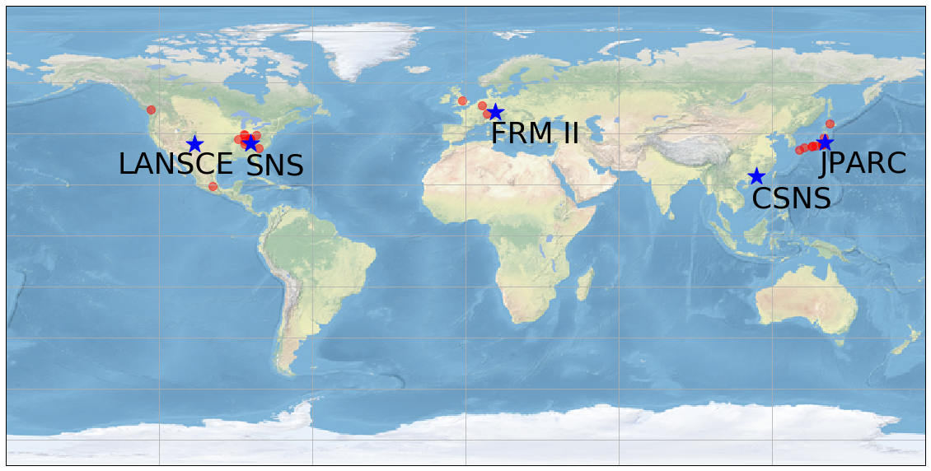
NOPTREX/IRES Collaboration 2026
NOPTREX: C. Auton¹⁶, E. Babcock²⁹, M. Barlow³⁰, L. Barron-Palos²⁷, L. Charon-Garcia⁴², E. Chekmenev³², A. Couture²⁰, C. Crawford¹⁹, B. Crider³⁹, K. Dickerson²⁹, D. Eigelbach²⁰, S. Endoh^{1,3}, R. Fan^{15,38}, J. Fry²⁴, H. Fujioka⁷, B. Goodson²², V. Gudkov¹⁷, C. Haddock²¹, K. Hagino¹¹, H. Harada³, P. Hautle²⁸, L. Hebenstiel¹⁶, M. Hino¹¹, K. Hirota¹, I. Ide¹, M. Iinuma⁶, H. Ikegami¹⁰, T. Ino⁴, R. Ishiguro¹³, S. Ishimoto⁴, K. Ishizaki¹, T. Iwata⁹, P. Jahn²², C. Jiang¹⁸, W. Jiang¹⁵, K. Kameda⁷, S. Kawamura¹, G. Kim¹⁴, A. Kimura³, P. King²³, M. Kitaguchi¹, Y. Kiyanagi¹, J. Koga², H. Kohri⁸, A. Komives³¹, S. W. Lee¹⁴, Q. Lu^{15,38},G. Luan³⁴, M. Luxnat¹⁶, T. Matsushita¹, M. McCrea³⁶, J. Mills²⁴, K. Mishima⁴, Y. Miyachi⁹, T. Momose⁵, T. Morishima¹, T. Mulkey⁴⁵, Y. Niinomi¹, I. Novikov²⁵, J. O’Mahar¹⁹, T. Okudaira¹, M. Okuizumi¹, K. Ogata⁸, T. Oku³, G. Otero¹⁶, J. Palomino³⁹ , S. Penttila¹⁸, A. Perez-Martin²⁷, A. Petrilla²², B. Plaster¹⁹, X. Ruan³⁴, K. Sakai³, S. Samiei¹⁶, M. Sarsour⁴⁵ , D. Schaper¹⁶, M. Scott⁴⁶, R. Shchepin³³ ,T. Shima⁸, H. Shimizu¹, Z. Siraj²², W. Snow¹⁶, D. Spayde³⁵, H. Tada¹, J. Tang³⁷, Z. Tang²⁰, Y. Tani⁷, S. Takada², Y. Takahashi¹¹, D. Takahaski¹², K. Taketani⁸, A. Taninah⁴⁰, K. Tateishi¹⁰, X. Tong¹⁵, T. Uesaka¹⁰, N. Vassilopoulos¹⁵, M. Veillette²⁶, G. Visser¹⁶, N. Wada¹, M. Wan⁴³, Y. Wang¹⁹, D. Wei⁴¹ , H. Wijerante⁴⁵, J. Winkelbauer²⁰, T. Yamamoto¹, Y. Yamagata¹⁰, H. Yan⁴³, H. Yoshikawa⁸, T. Yoshioka², M. Yosoi⁸ , L. Zanini⁴⁴, M. Zhang^{15,16}, Q. Zhang³⁴
IRES: D. Bishop¹⁶, J. Britt²⁴, B. Edwards²⁵, M. Hamilton²⁴ , S. LeRose¹⁹, E. Myers²⁶, N. Niemotka³⁵, N. Palley⁴⁶, L. Potts²⁵, J. Purnell¹⁹, L. Richter³⁵, E. Shipp¹⁶, A. Smyrichinsky¹⁶, K. Swafford²⁴, J. Traywick³⁹, D. Waxley²⁶, M. Wilson²⁶, A. Winterman¹⁹
¹Nagoya, ²Kyushu, ³JAEA, ⁴KEK, ⁵British Columbia, ⁶Hiroshima, ⁷Tokyo Inst. Tech., ⁸Osaka, ⁹Yamagata, ¹⁰RIKEN, ¹¹Kyoto, ¹²Ashikaga, ¹³Japan Women’s, ¹⁴Kyungpook, ¹⁵CSNS, ¹⁶Indiana, ¹⁷South Carolina, ¹⁸ORNL, ¹⁹Kentucky, ²⁰LANL, ²¹Phase III Physics, ²²Southern Illinois, ²³Ohio, ²⁴Eastern Kentucky, ²⁵Western Kentucky, ²⁶Berea, ²⁷UNAM, ²⁸PSI, ²⁹Juelich, ³⁰Nottingham, ³¹DePauw, ³²Wayne State, ³³SDSM&T, ³⁴CIAE, ³⁵Hendrix, ³⁶Manitoba, ³⁷USTC, ³⁸IHEP, ³⁹Mississippi, ⁴⁰LSU/Shreveport, ⁴¹Tech. Inst. Phys. Chem., ⁴²TRIUMF, ⁴³ Ningbo, ⁴⁴ ESS, ⁴⁵ Georgia State, ⁴⁶Centre
IRES: International Research
Experiences for Students
One experiment: Five neutron sources

Slide 3
The outline of NOPTREX TVPC talk:
(1) Theoretical Motivation
-Why do TVPC search in NN interactions?
(2) Heavy nuclei enhancement?
-What are the boosts in n-A resonances that an
experiment can benefit from?
(3) How we intend to do the experiment?
-Our progress toward implementing the experiment.
Notes:
We want to extract effective hadronic weak interaction strength inside a chaotic, many-body nucleus and see if it follows the gaussian orthogonal ensemble (GOE) prediction of nuclear statistical theory.

Slide 4
Toward A Search for P-even/T-odd NN interactions in n-A resonances
2 ways to violate T (+conserve CPT): P-odd/T-odd , P-even/T-odd
MANY search for P-odd/T-odd (EDMs,…), VERY few for P-even/T-odd
P-odd/T-odd effect can come from: (1)BSM P-odd/T-odd or (2) [BSM P-even/T-odd][SM P-odd]
If one sees an EDM in a nuclear system: how to disentangle the two options?
It would be valuable to experimentally bound P-even/T-odd NN interactions well enough to rule our interpretation (2) for a nuclear EDM observation
Experimental limits on P-even/T-odd NN interactions are quite poor
Neutron optics on n-A resonances could improve limits by ~10²-10³
This would be good enough to rule out (2) in the case of the smallest-expected SM P-odd NN effect

Slide 5


What About P-even/T-odd NN interactions?
No P-even/T-odd effects in Standard Model: CKM, 𝛉 both P-odd/T-odd
[Herczeg Nucl. Phys. 75, 655 (1966), Simonius PLB 58, 147 (1975)]
Lowest mass meson exchange from 𝛒^{+/-} [C-odd, J≥1]. For meson exchange (Haxton 1994):
VERY few experiments:
Detailed balance: [E. Blanke et al PRL 51, 355 (1983); J. P. French et al PRL 54, 2313 (1985)]: g_{𝛒}<2x10⁻¹
Charge symmetry breaking [Simonius PRL 78, 4161(1997)]: g_{𝛒}<7x10⁻³
N transmission aligned Holmium (P. R. Huffman et al, PRC 55, 2684 (1997): g_{𝛒}<6x10⁻²
Direct constraints on P-even/T-odd NN interactions are poor
Y. Uzikov

Slide 6
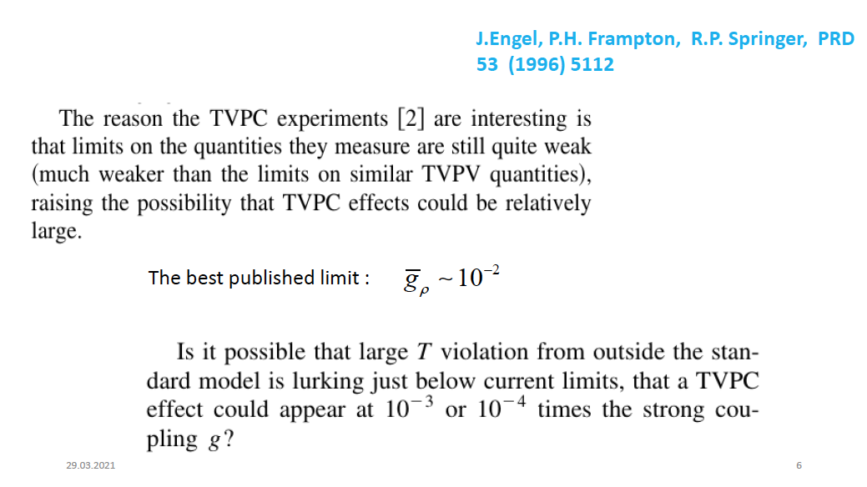
Y. Uzikov

Slide 7
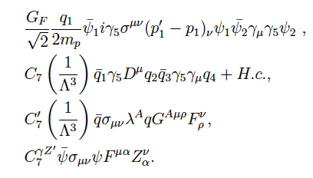
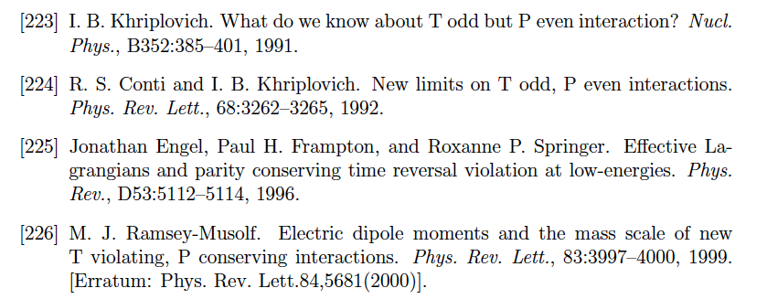
(Some) P-even/T-odd Theory Work to use EDMs to constrain P-even/T-odd
Much theory work has used EDM limits to indirectly constrain P-even/T-odd interactions
Haxton et al 1994 derived g_{𝛒}<2x10⁻⁴ from neutron EDM: stringent, but (1) indirect, (2) “uses up” an EDM limit.
Ramsey-Musolf 2000 derived g_{𝛒}<10⁻¹² from other D=7 operators, but assumed parity is restored below P-odd-T-even scale: in other case there is no constraint!
Later work (Kurylov et al PRD 2001, El Menoufi et al PLB 2017) uncovered loopholes in previous constraints
C₇ terms on the left violate chirality, so would need another Higgs field in SMEFT, so are “really” D=8
Some operators considered
in previous work:

Slide 8
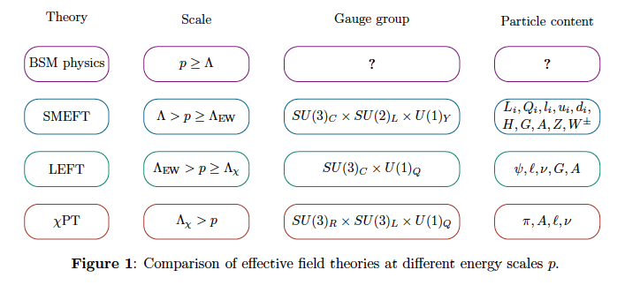

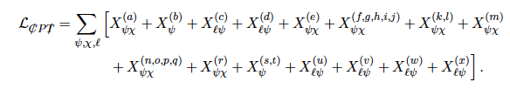
P-even/T-odd Operators in LEFT, up to D=8
LEFT=low-energy effective field theory developed for momenta between QCD and electroweak scale
Akdag et al: classify P-even/T-odd terms in LEFT, match to chiral EFT
Proved no P-even/T-odd terms in LEFT below D=7. At D=7, get
Get 15 terms in chiral EFT:
+ MANY D=8 terms
H. Akdga, B. Kubis, A. Wirzba, JHEP 06,154 (2023) arXiv:2212.07794

Slide 9
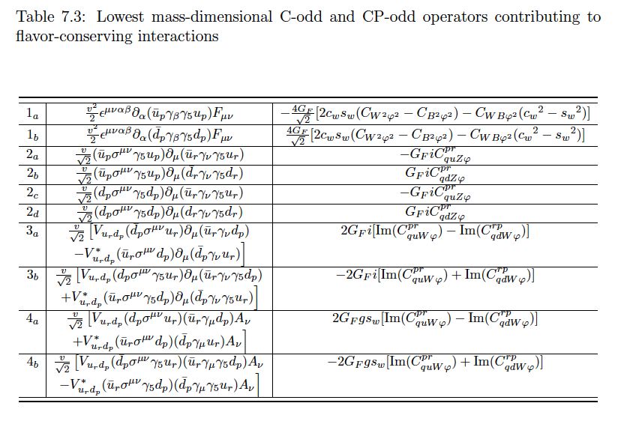
P-even/T-odd in SMEFT (flavor conserving)
New terms exist which have not been
considered in the literature
J. Shi. PhD thesis, U Kentucky (2020)
J. Shi and S. Gardner, in preparation

Slide 10
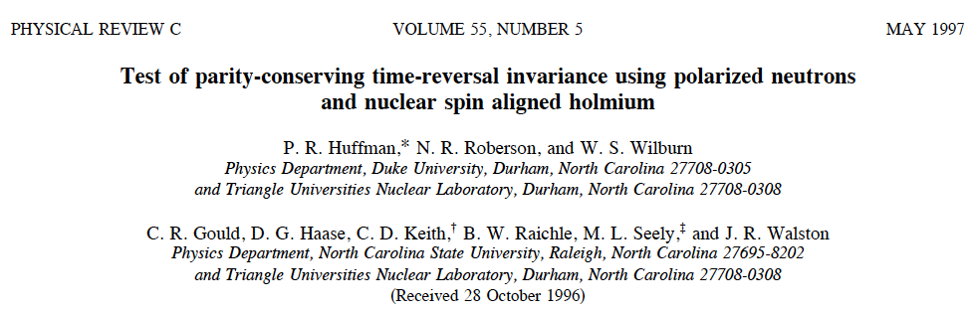

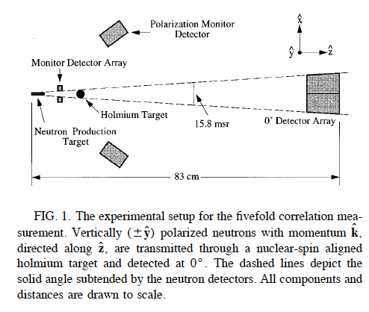
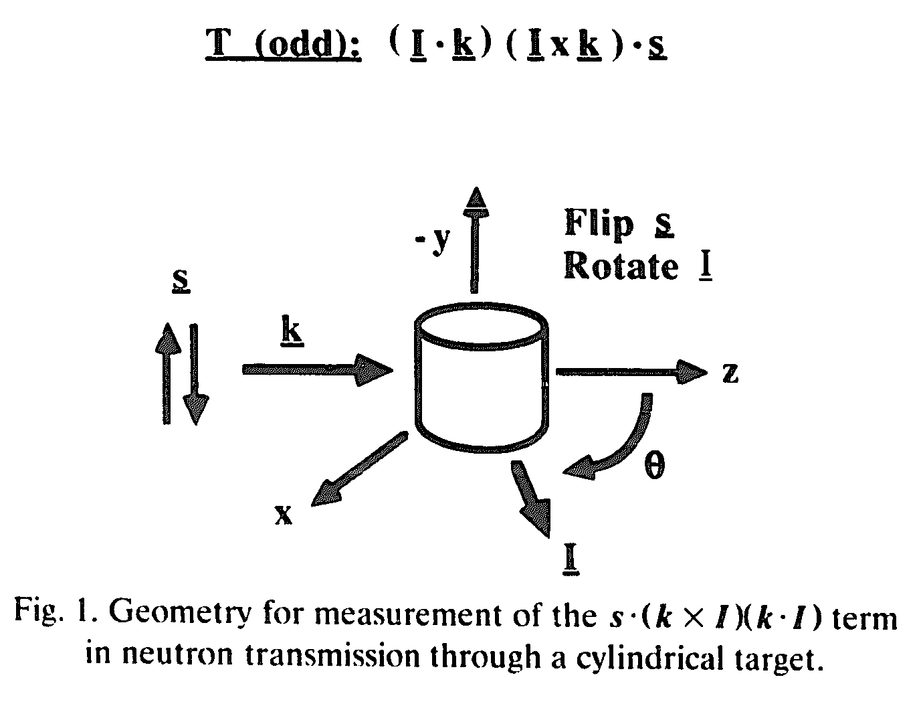
5-fold correlation term in forward
transmission is P-even and T-odd
Experiment requires polarized beam
and tensor-aligned target
MeV polarized neutrons, ¹⁶⁵Ho target
P-even/T-odd coupling bound: g_{𝛒}<6x10⁻²
IF experiment can improve by ~10³
then [BSM P-even/T-odd][SM P-odd NN] ~[10⁻⁵][10⁻⁷] ~10⁻¹² compared
to strong NN amplitude
Can we take advantage of
n-A resonance amplification
to improve sensitivity?

Slide 11
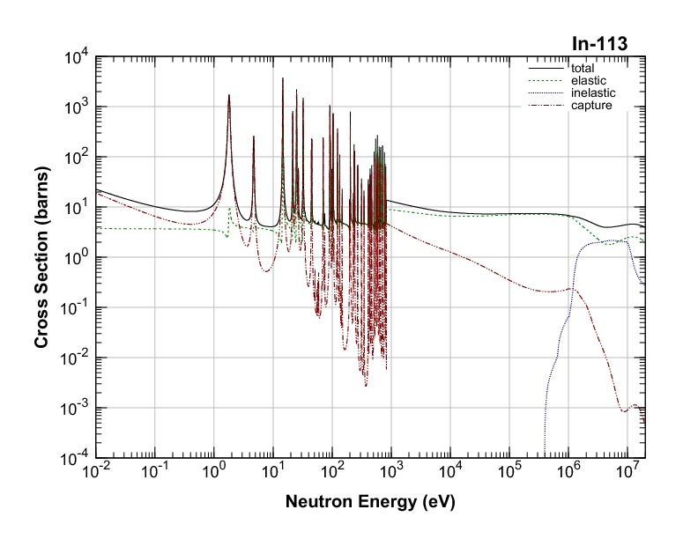
Very dense set of resonances just above neutron separation energy
mainly L=0 resonances, but lots of L=1 resonances
P-odd interaction can mix L=0 and L=1 states
P-even/T-odd interactions can mix pairs of different L=1
Resonances
Resonance occurs when neutron energy matches a compound nucleus level.
Compound Neutron-Nucleus Resonances
High level density
Neutron Energy
…
…
6.8 eV
3.8 eV
1.4 eV
¹¹³In+n
¹¹³In+n
6.512 keV
6.8 MeV
Width ~100meV
…
High level density
272 keV
Ground state
¹¹⁴In
Notes:
This is an example of neutron absorption cross section of In, but many such very sharp resonance states is about have been observed for 1eV to keV neutrons. The width of the resonance is 100meV, this sharp width indicate the long life time

Slide 12
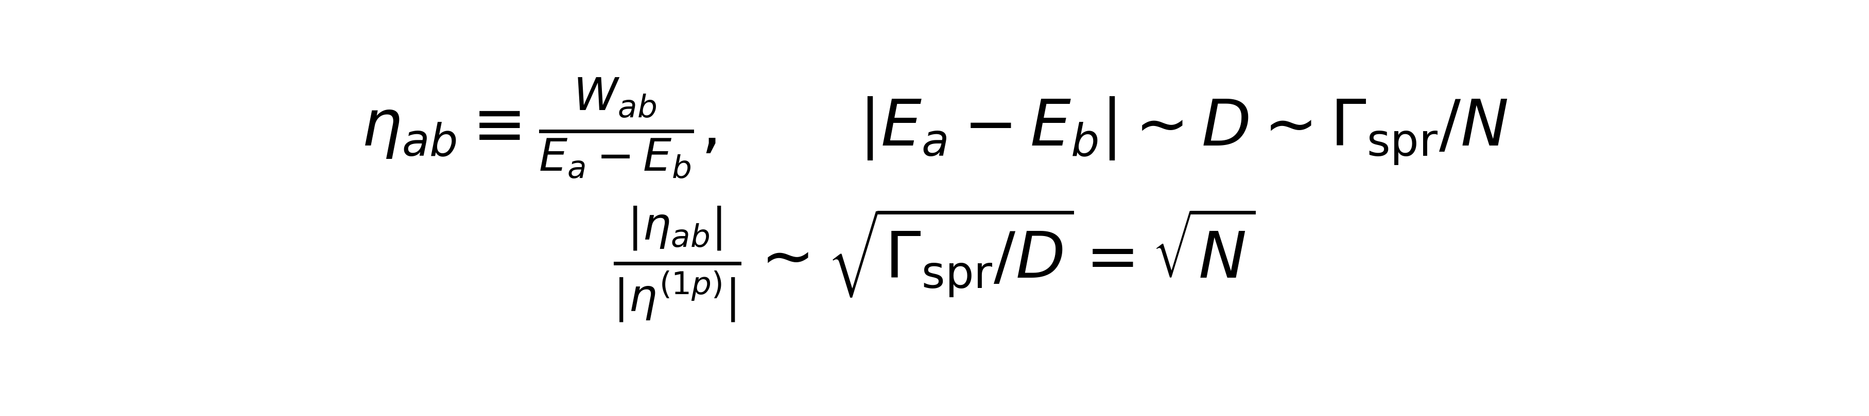

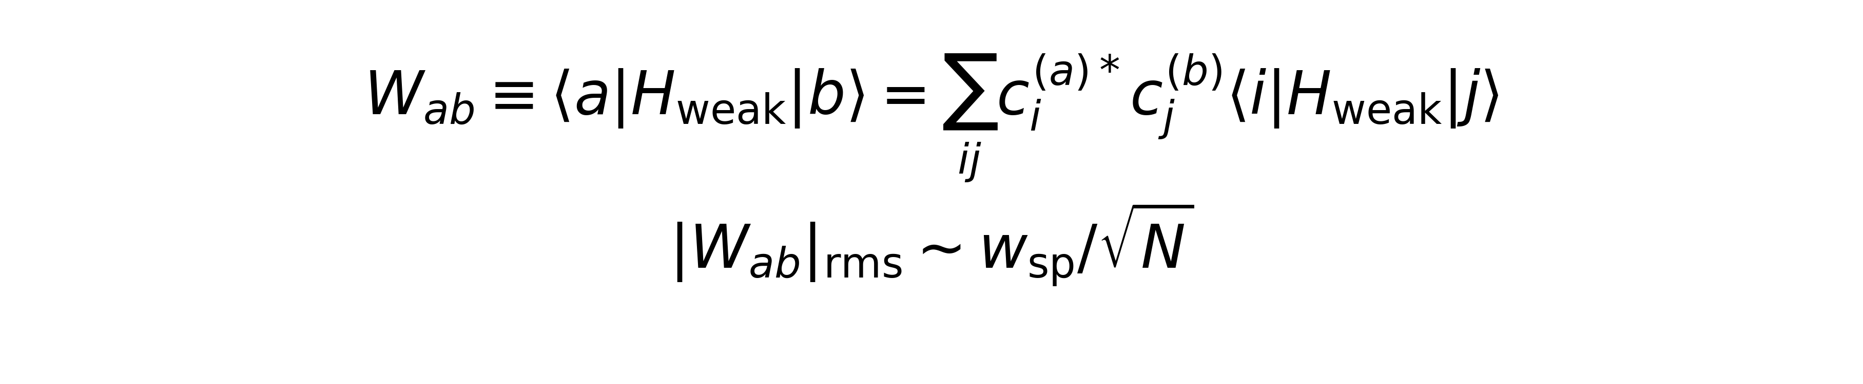
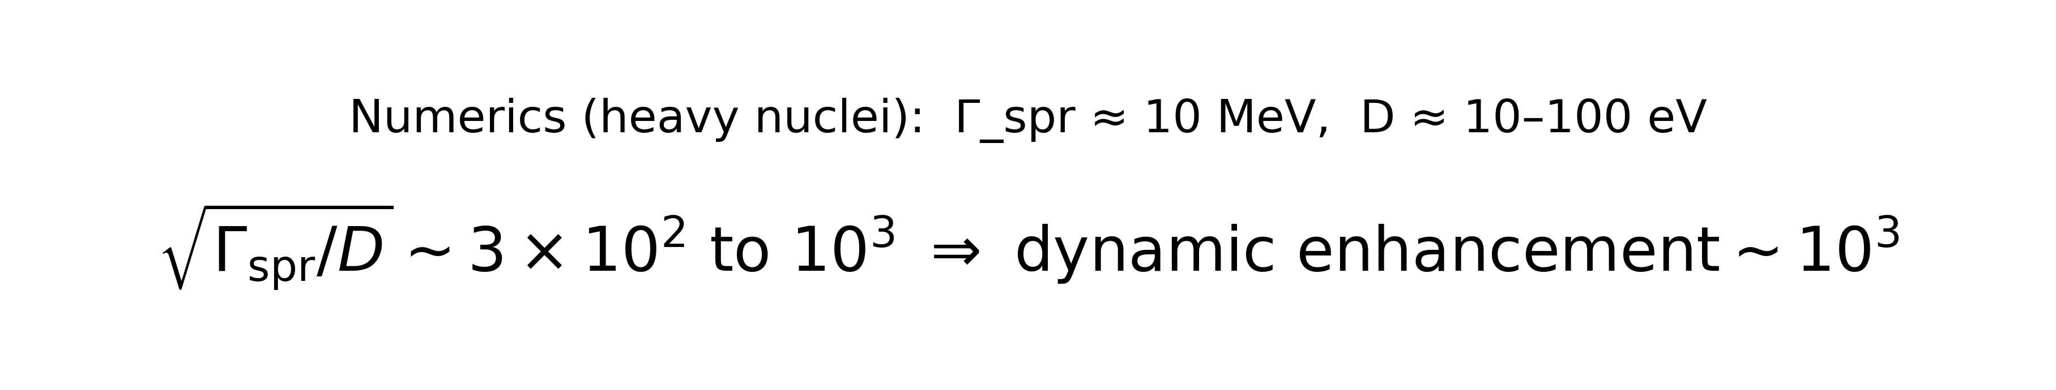
Dynamical enhancement of weak mixing in a compound nucleus
PV: s–p mixing • TVPC: p–p mixing (same dynamical factor)
1) Compound resonances are complex superpositions
2) Weak/TVPC matrix element is not huge by itself
3) Enhancement arises in the mixing amplitude η = W/ΔE
• Basis states |i⟩: 1p–1h, 2p–2h, …
• Components spread over
Γ_{spr} (~10 MeV)
• Neighbor spacing within same J^π: D (~10–100 eV)
• Many components → typical |c| ~ 1/√N
• Weak operator acts between basis configs
• Sum over many components cancels
(random-walk behavior)
• Result: |W_ab| is suppressed by 1/√N
• w_sp sets the single-particle scale
• Mixing parameter: η_ab = W_ab/(E_a − E_b)
• For neighboring resonances: ΔE ~ D ~ Γ_spr/N
• So: η gains a factor √N
• This is the dynamical enhancement (~10^3)
Dynamic enhancement ~ √(Γ_spr / D) = √N
Key assumption:
components have mostly uncorrelated
phases/signs → incoherent addition.
Complexity alone reduces W_ab.
The enhancement comes from the
energy denominator (next panel).
Same dynamical factor √(Γ_spr/D) multiplies both.
PV vs TVPC (where the same enhancement enters)
PV: H_{w}
p₁
TVPC: V_{T}
p₂
Note: Only incoherent addition due to uncorrelated phases.
s (+)
p (-)
Notes:
“Here’s the key reason weak interactions can look big in neutron compound resonances: the mixing amplitude is $η=W/ΔE$, and $ΔE$is incredibly small in a compound nucleus.”
“First, what is a compound resonance? It’s a highly excited nuclear eigenstate. In practice it’s a superposition of many simpler many-body configurations—think shell-model particle–hole excitations $\left.∣i\right\rangle$: $1p \text{⁣}− \text{⁣}1h$, $2p \text{⁣}− \text{⁣}2h$, etc. Because the strong residual interaction spreads these components over an energy band called the spreading width $Γ_{spr}∼$MeV, while the actual level spacing between neighboring compound resonances is tiny, $D∼10$–$100$ eV, the number of significant components is $N∼Γ_{spr}/D∼{10}^{5}$. Normalization then gives typical coefficients $c∼1/\sqrt{N}$.”
The matrix element between two compound states is a double sum over those components. But the terms don’t add coherently: their phases/signs fluctuate. So the sum behaves like a random walk. That’s why the compound-to-compound matrix element is actually suppressed.

Slide 13
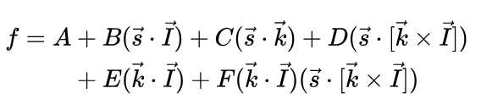
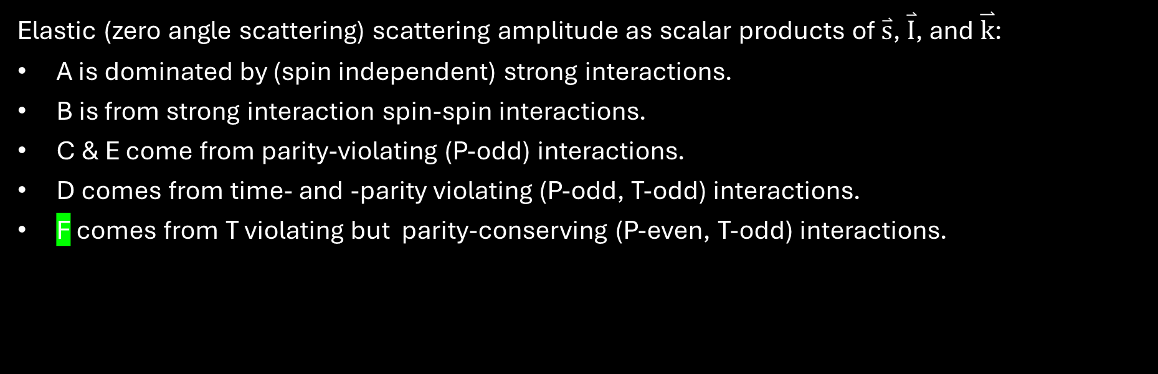



Neutron-Nucleus forward scattering amplitude
13
Neutron spin
$$\overset{⃑}{I}$$
$$\overset{⃑}{s}$$
Nuclear spin
$$\overset{⃑}{k}$$
Neutron momentum
Elastic (zero angle scattering) scattering amplitude as scalar products of $\overset{⃑}{s}$, $\overset{⃑}{I}$, and $\overset{⃑}{k}$:
A is dominated by (spin independent) strong interactions.
B is from strong interaction spin-spin interactions.
C & E come from parity-violating (P-odd) interactions.
D comes from time- and -parity violating (P-odd, T-odd) interactions.
F comes from T violating but parity-conserving (P-even, T-odd) interactions.
Beda and Skoy, “Current Status of Research on T Invariance in Neutron-Nuclear Reactions.”

Slide 14

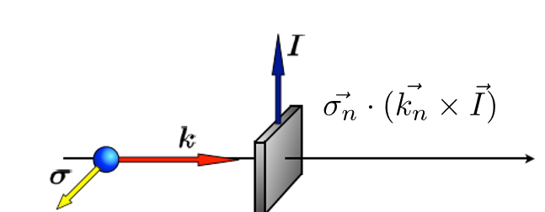
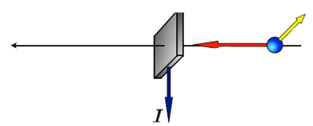

Why C, D & F, Are Null Tests
For forward scattering initial and final state coincide, so any observable odd under P or T must vanish unless the corresponding symmetry is broken.
The difference of total cross sections between appropriate spin states can isolate different coefficients in forward scattering amplitude using optical theorem.
Ryndin theorem: In the absence of TRIV , swapping the incoming and outgoing spin–momentum configuration leaves the forward transmission probability unchanged. Any non‑zero D,F is direct symmetry violation (Ryndin 1964, Gudkov & Bowman 2014).
A null test for T: no “final state effects”

Slide 15
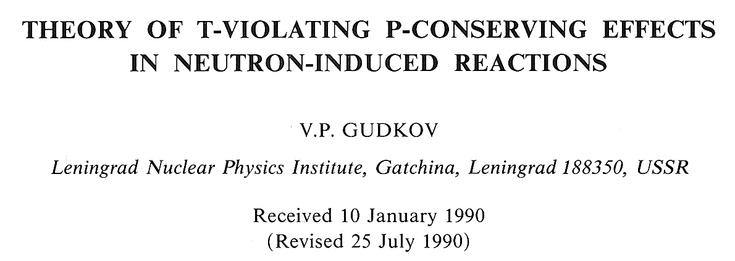
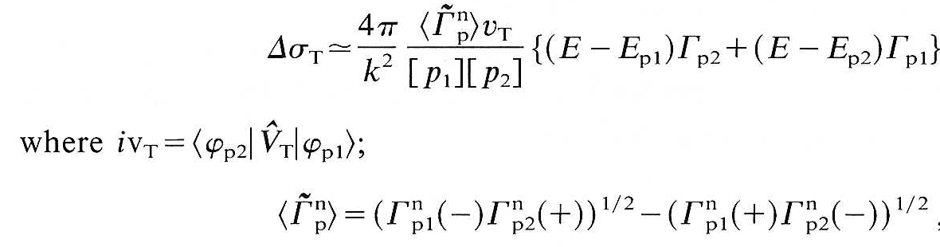
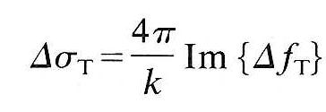
Forward transmission ⇒ null test for T violation
Enhancement of asymmetry from high level density~10³
P even-T-odd NN interactions mix different p-wave resonances (operator in 5-fold correlation is rank 2 tensor)
Gives neutron spin-dependent cross section difference through aligned target
𝚪_{p} (+) and 𝚪_{p} (-) = 𝚪_{p} (J=I±½)

Slide 16
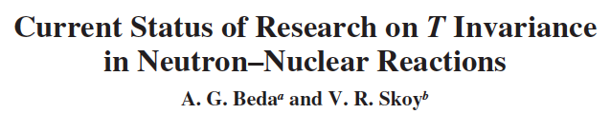



F term is
P-even/T-odd
Need polarized neutrons (p)
and aligned nuclear target (p₂)
¹²¹Sb, ¹²³Sb, ¹²⁷I have large electric quadrupole moments AND have many p-wave resonances
Can be aligned by electric field gradients in crystals at low T
Need 𝚪_{p} (J=I±½) resonance parameters in ¹²¹Sb, ¹²³Sb, ¹²⁷I , but not measured!

Slide 17

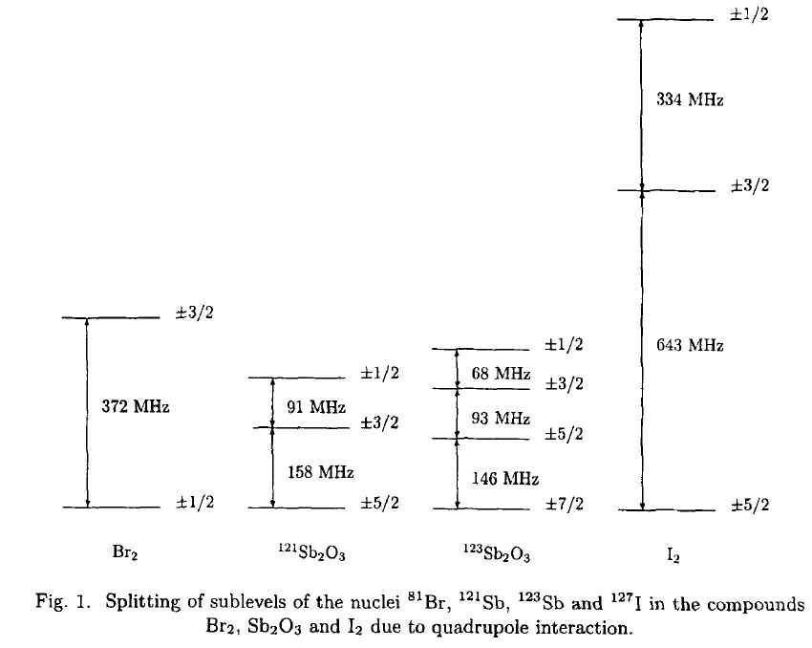

Electric Quadrupole Moment and Alignment: a Reminder
“alignment” parameter
Let Q=coupling strength of electric quadrupole moment of nucleus with a local E field gradient.
Then energy levels of m spin sublevels of nucleus are:
¹²⁷I, ¹²¹Sb, ¹²³Sb can possess large tensor alignment at mK temperatures in crystals with electric field gradients
Notice m² dependence. This interaction gives zero polarization
Studied for many decades in condensed matter physics (“nuclear quadrupole resonance”)

Slide 18
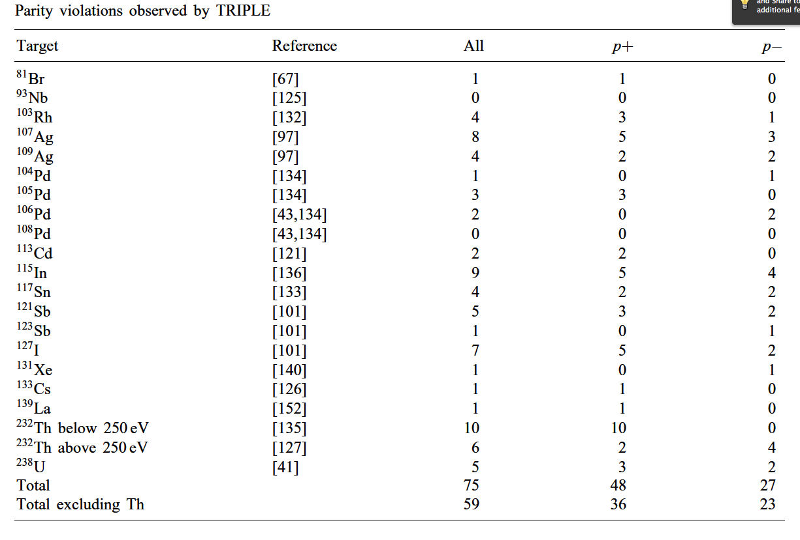
P-odd Asymmetries on p-wave Neutron Resonances
G. E. Mitchell, J. D. Bowman, S. I Penttila, E. I. Sharapov, Phys. Rep. 354, 1 (2001).
¹²¹Sb, ¹²³Sb, ¹²⁷I p-wave resonances were discovered and measured by TRIPLE collaboration.
To prepare the experiment: need (a) measurement of
angular momentum quantum
numbers of the relevant p-wave resonances, (b) development of a cryogenic tensor-aligned target.
we concentrate on ¹²⁷I

Slide 19
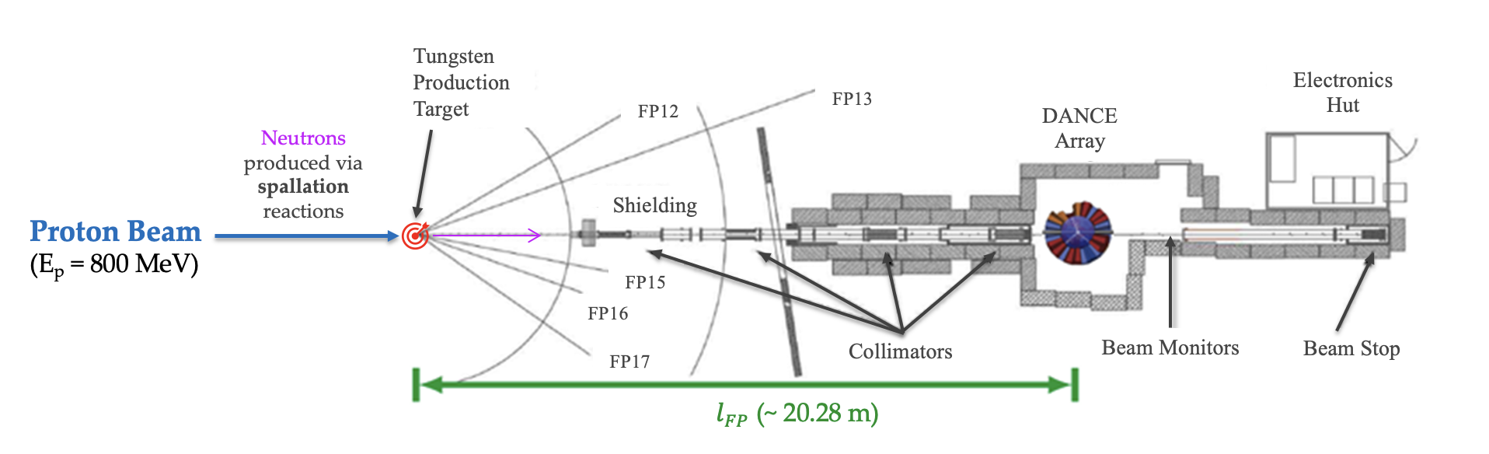
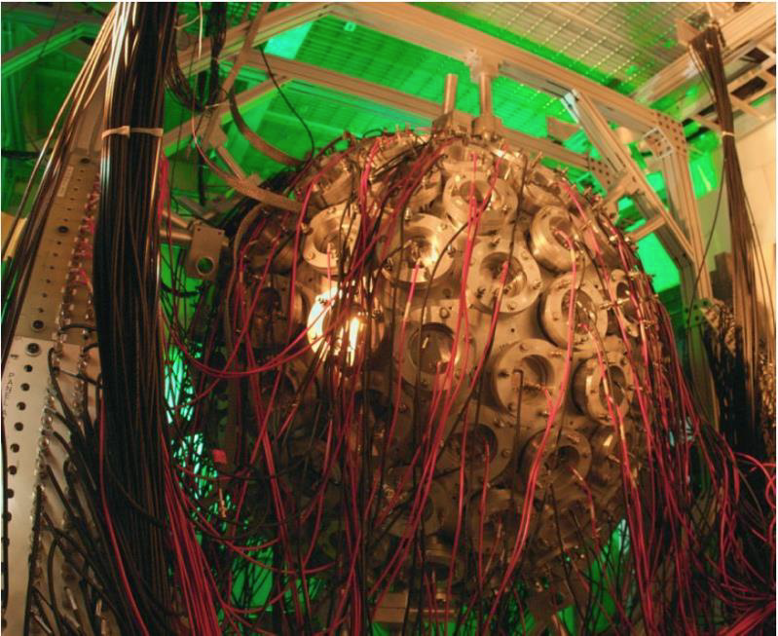

¹²⁷I (n, 𝛾) Resonance Spectroscopy with DANCE BaF₂ array
Target is thin piece of La-139 (579 mg)
To minimize s-wave saturation and maximize counts for p-wave
Neutrons are created from proton beam interacting with tungsten target
Use TOF method to determine neutron energy:
$$E_{n}=\frac{1}{2}mv2=\frac{1}{2}mn\frac{l_{Fp}^{2}}{t_{TOF}^{2}}$$
Total energy measurement:
$E_{tot}=E\left(γ_{1}\right)+E\left(γ_{2}\right)+…+E(γ_{n})$
Neutron beam allowing measurement across wide neutron energy range from 0.01 eV to ~500 keV
160 detectors (BaF2 crystals) in a close-packed ~ 3.5 𝜋 solid angle designed for high-efficiency detection of gamma rays.
Epithermal neutron beam allowing measurement across wide neutron energy range from 0.01 eV to ~500 keV
Can measure resonance energies/widths/angular momenta

Slide 20
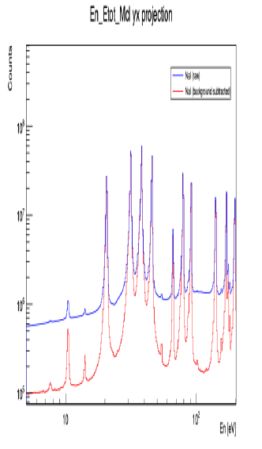
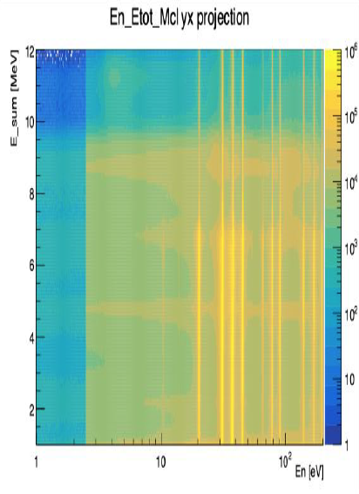
127I (n, 𝛾) Spectroscopy Data from DANCE
Measure resonance widths 𝚪_{p} of p-waves in ¹²⁷I
Scattered neutron-induced gamma background measured
using carbon target
Analysis in progress (A. Taninah)

Slide 21
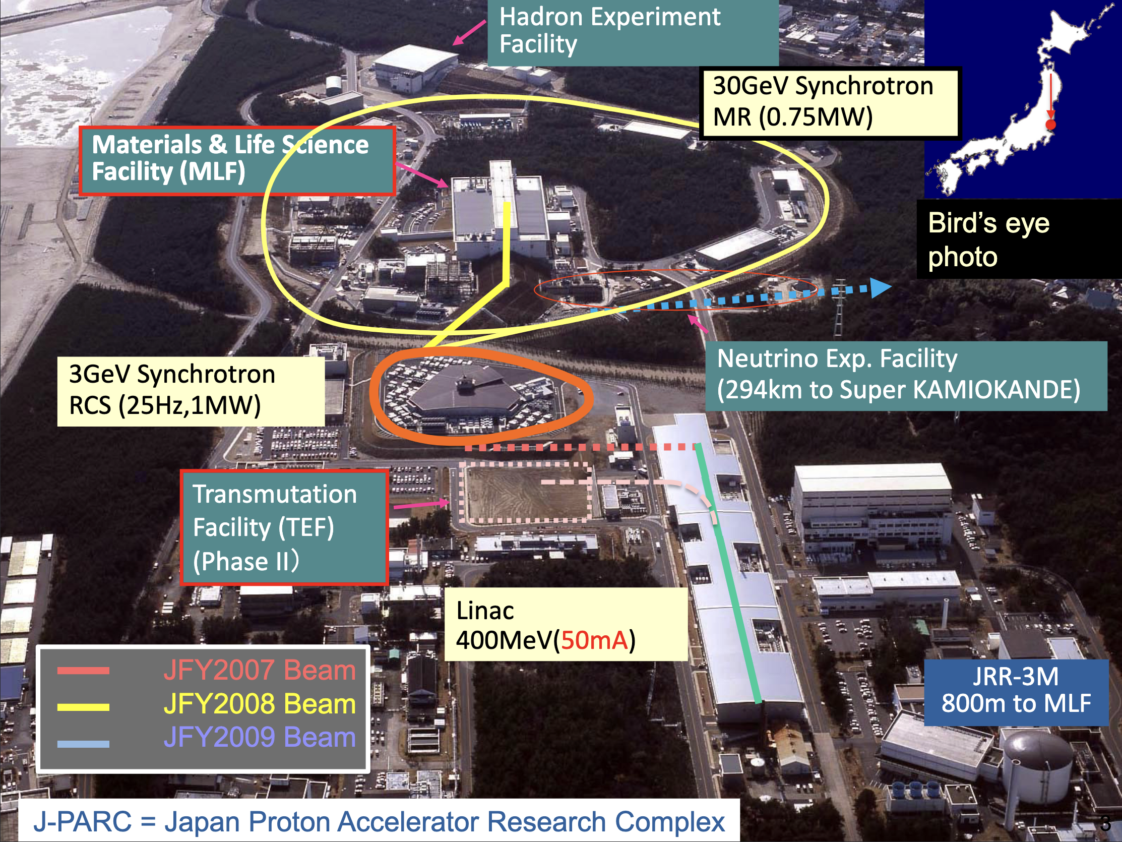
¹²⁷I (n, 𝛾) Resonance Spectroscopy
with ANNRI Ge array at JPARC

Slide 22
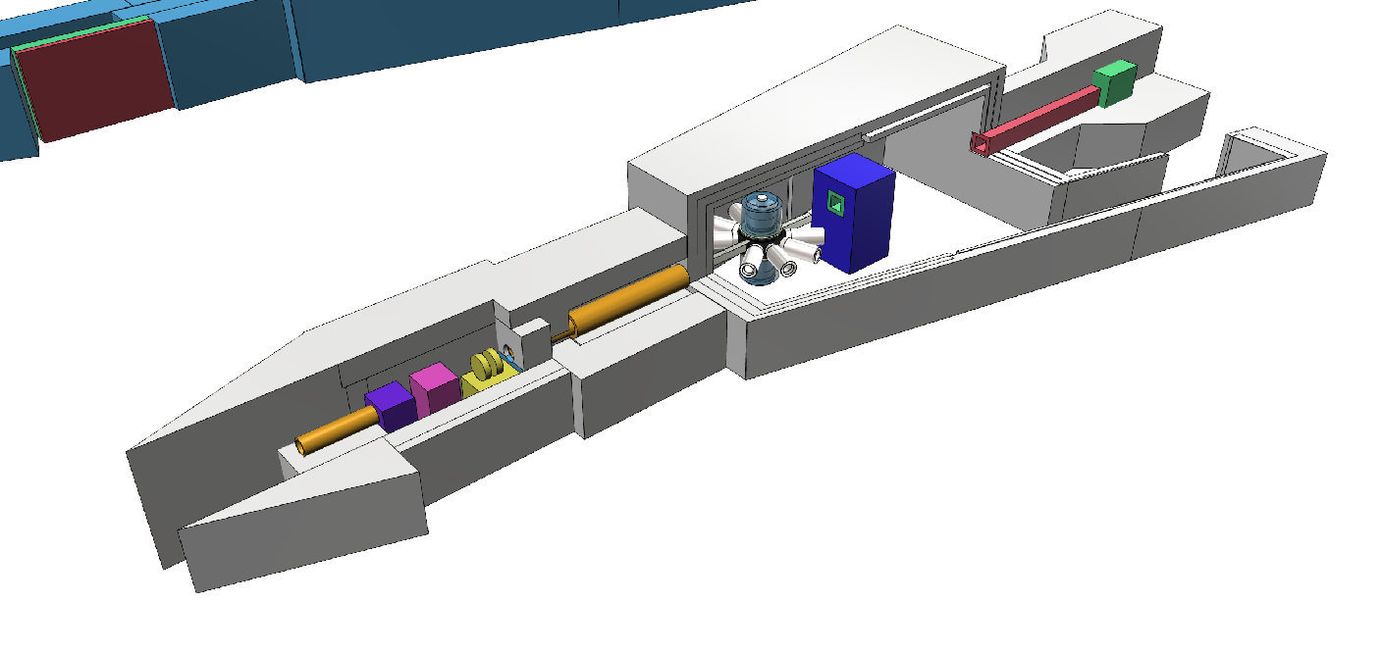
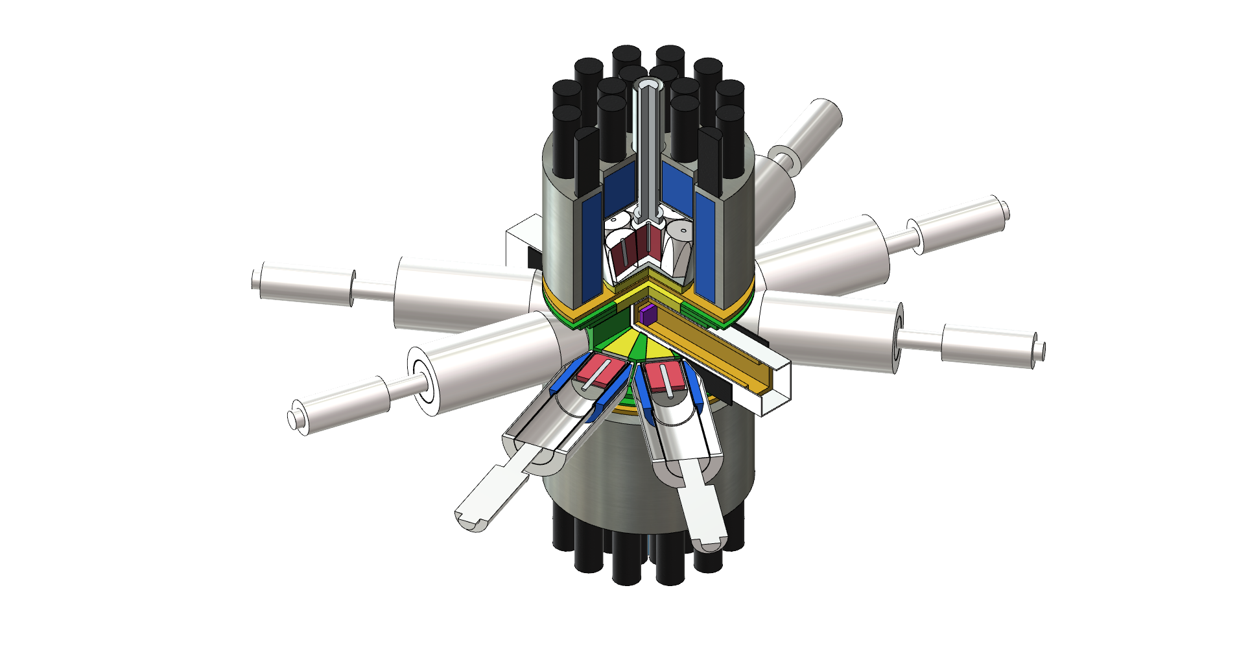
Accurate Neutron-Nucleus Reaction measurement Instrument beam line in J-PARC
(n,γ)反応を測定することでκ(J)を決定する
BL04 ANNRI
Beam stopper
BL04 Ge Detectors
Ge detectors
Disk chopper
Cluster detector
Filter
T0 Chopper
A
Target
Collimator
21.5m
2 Cluster Detector (up・down) 7ch ×2 : 14ch
8 Coaxial Detector (side) 8ch
Total 22ch
Coaxial detector

Slide 23
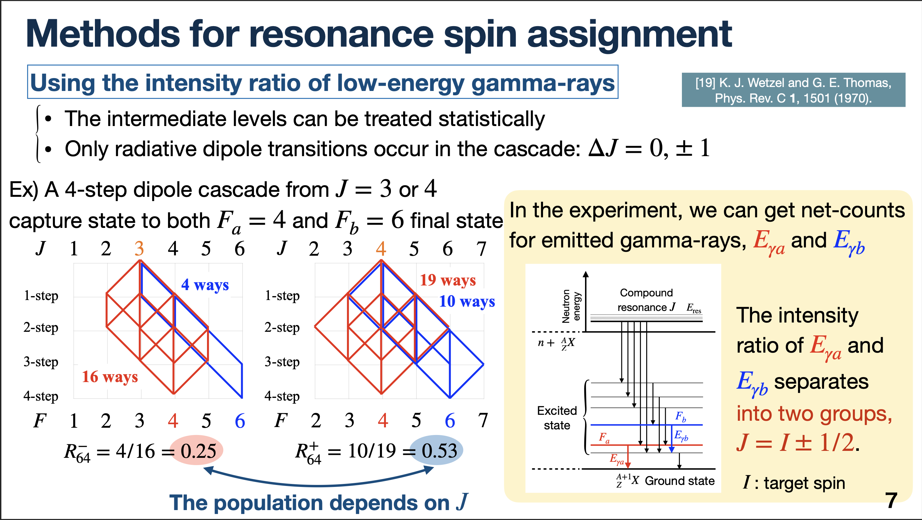
”Spin Memory Effect”
Slide from S Kawamura

Slide 24
NOPTREX institutions in China
Technical Institute of Physics and Chemistry (IPC)
China Institute of Atomic Energy (CIAE)
Shandong University (SDU)
University of Science and Technology of China(USTC)
Ningbo University (NBU)
China Spallation Neutron Source (CSNS)
Great Bay University(GBU)

Slide 25

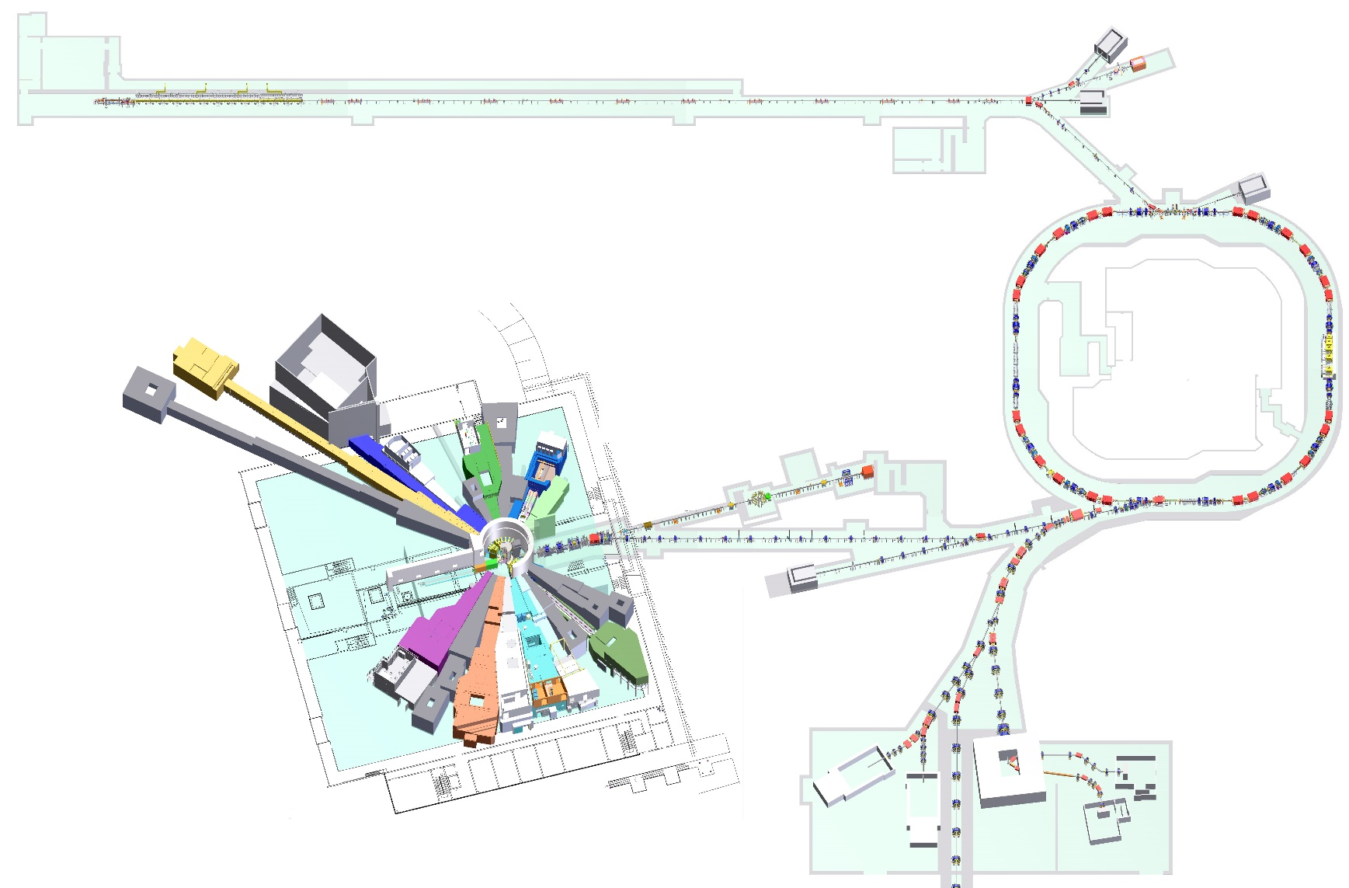
Back-n Epithermal Neutron Beam at Chinese Spallation Neutron Source
Ion source
Linac
The 1.6 GeV proton beam hits the tungsten target with a 15◦ deflection.
White neutron source
<~300 MeV neutron
Synchrotron
The Back-n is a white neutron beam line that is opposite to the target station direction. It started running in 2018 for nuclear data measurements.
Notes:
Before the protons hit the target, a dipole magnet here deflects the protons by 15°. Since there are no obstructions in the path of the protons to the target, the energy of the white neutrons is also very high. Unlike thermal neutron tunnels, which all face the moderator, the white neutron tunnel directly faces the neutron target.

Slide 26
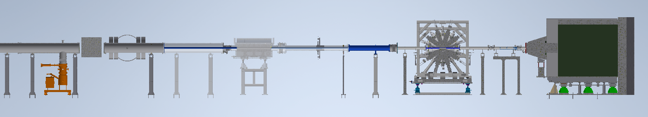
Polarized eV Neutron system upgrade on Back-n at CSNS
Spin Flipper
ES#2
³He Polarizer
Magnet field guide
¹³⁹La parity violation measured on 0.7 eV p-wave resonance in (n, 𝛾) channel using the GTAF-II BaF₂ array and ³He SEOP spin filter. Submission under review

Slide 27






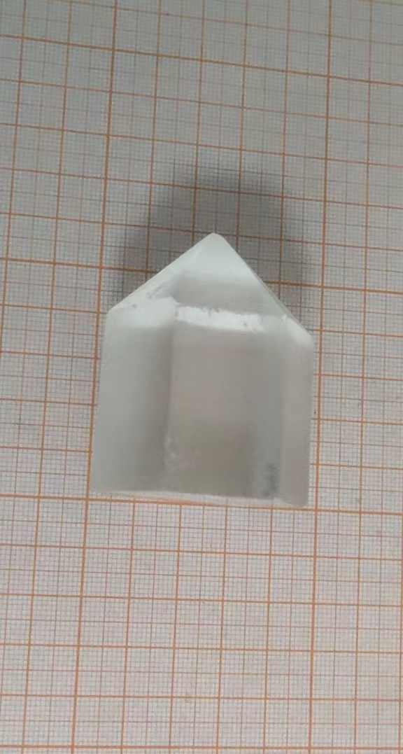
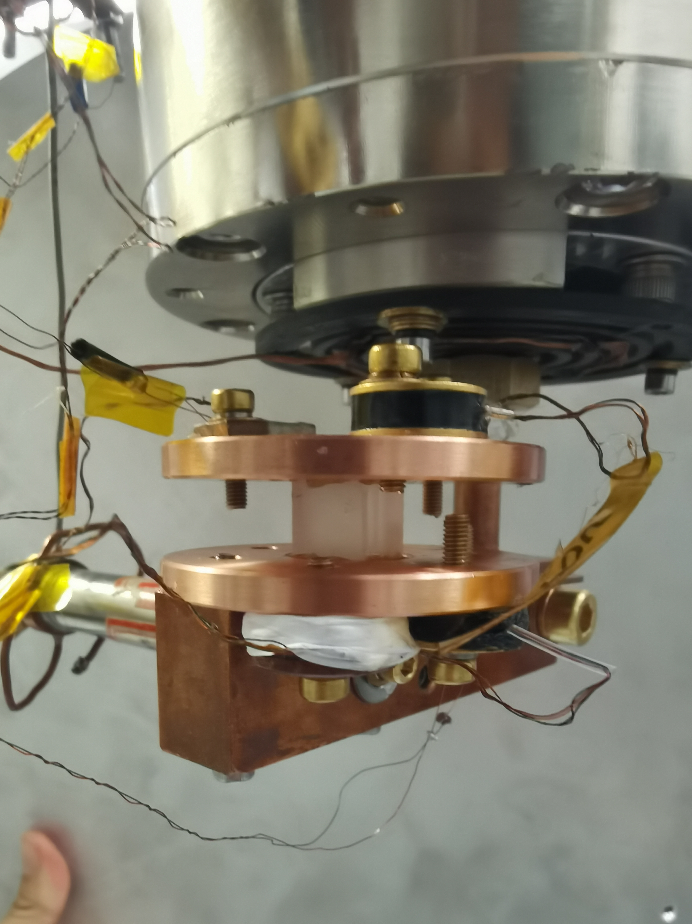
Low T xtal characterization for P-even T-odd search in ¹²⁷I
Tensor alignment target
θ
Polarizer
Spin flipper
Unpolarized neutron
6Li
The target LiIO3 crystal needs to be cooled and maintained at a low temperature of mK level during the experiment for tensor alignment
There are currently no data on the thermal conductivity and heat capacity of LiIO₃ crystals, only limited data on LiCuVO₄, Li₂B₄O₇
Thermal conductivity and heat capacity measurements in progress at IPC/Beijing

Slide 28
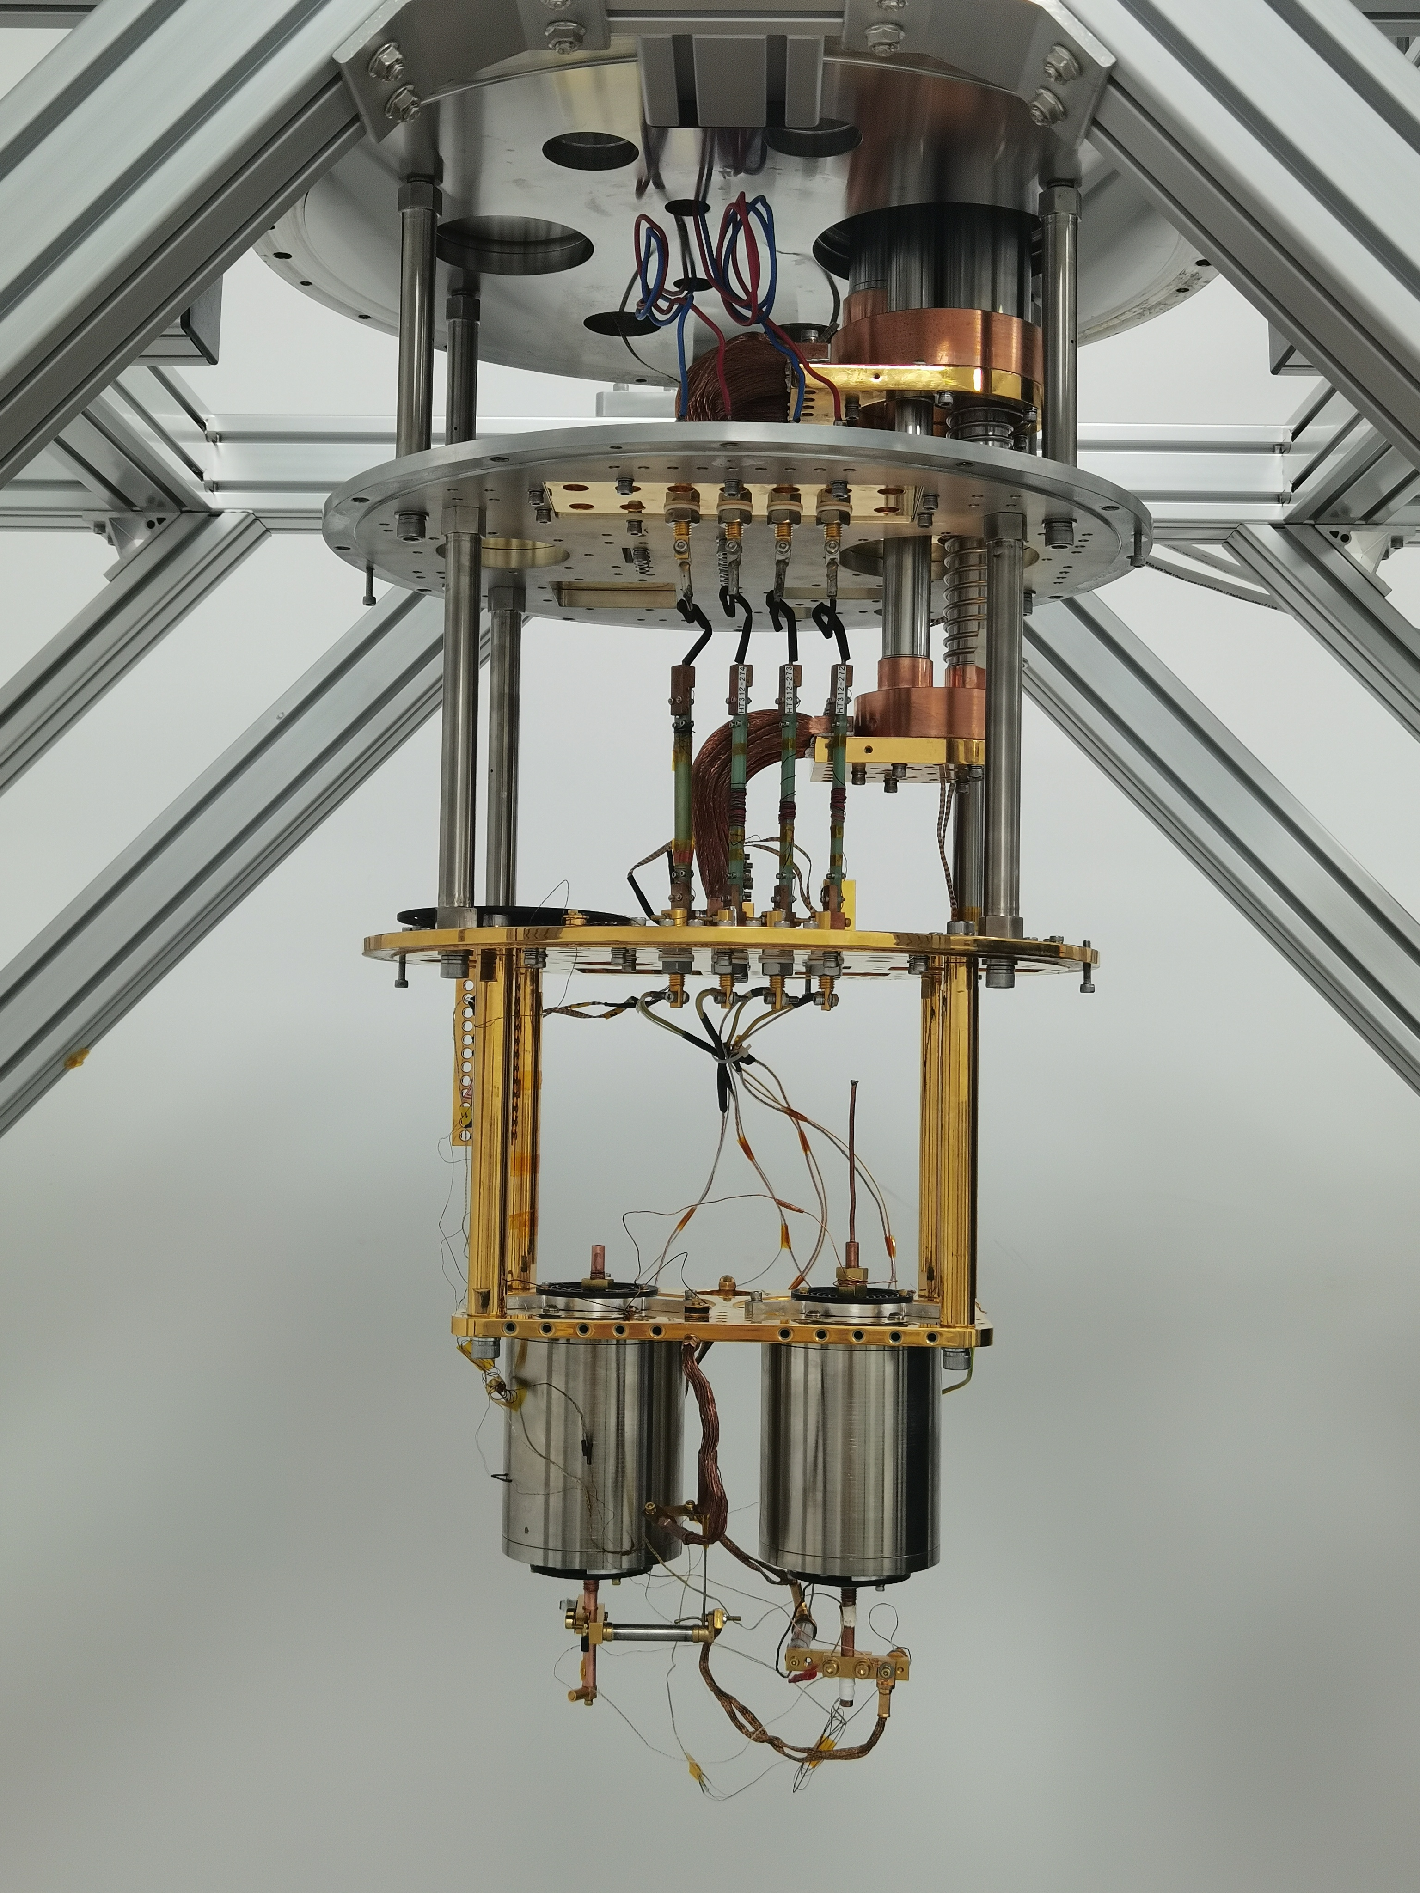
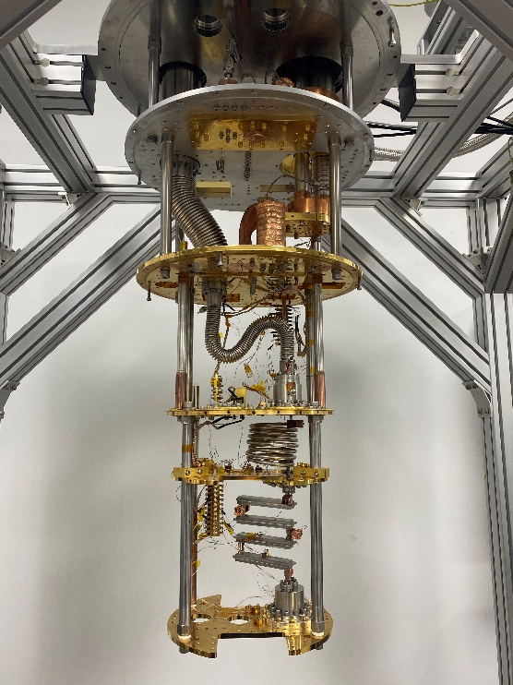
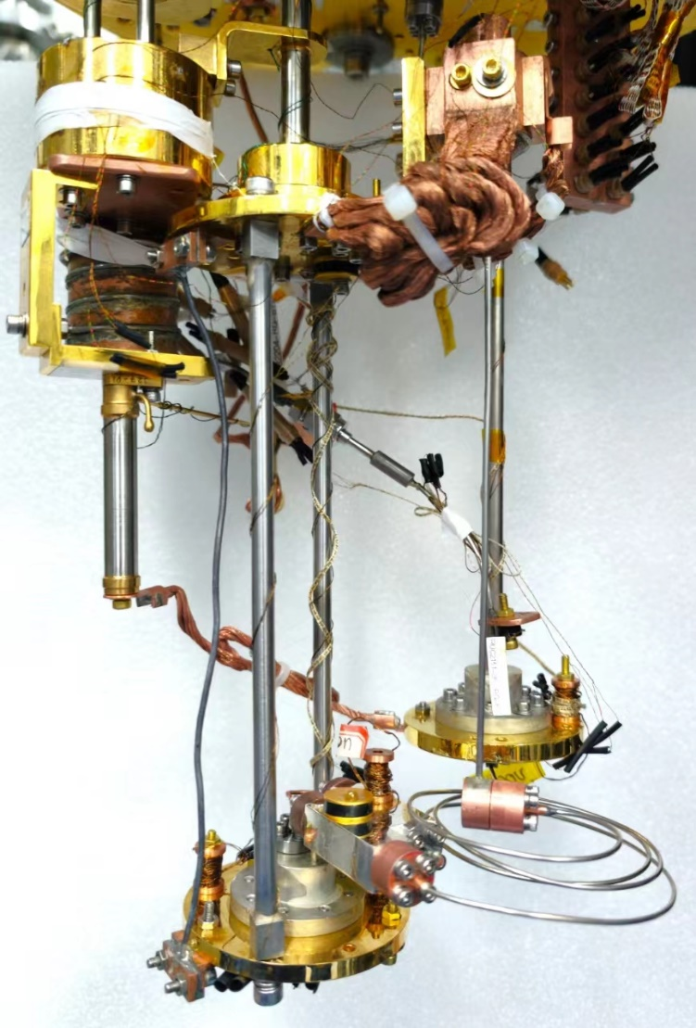
Cooling Platform Development at IPC/Beijing
DR and ADR, Comparison of cooling power, compactness, etc
A Condensation-driven DR
<45mK, 8.4μW@100mK
A Two stage ADR
<30mK, hold 24 hours@100mK
A conventional DR
<20mK, 300μW@100mK

Slide 29
Conclusions
2 ways to violate T (+conserve CPT): P-odd/T-odd , P-even/T-odd
MANY search for P-odd/T-odd (EDMs,…), VERY few for P-even/T-odd
P-odd/T-odd effect can come from: (1)BSM P-odd/T-odd or (2) [BSM P-even/T-odd][SM P-odd]
If one sees an EDM in a nuclear system: how to disentangle the two options?
It would be valuable to experimentally bound P-even/T-odd NN interactions well enough to rule our interpretation (2) for a nuclear EDM observation
Experimental limits on P-even/T-odd NN interactions are quite poor
Neutron optics on n-A resonances could improve limits by ~10²-10³
This would be good enough to rule out (2) in the case of the smallest-expected SM P-odd NN effect
NOPTREX working towards a polarized eV neutron transmission search in tensor-aligned ¹²⁷I

Slide 30
Thanks!

Slide 31
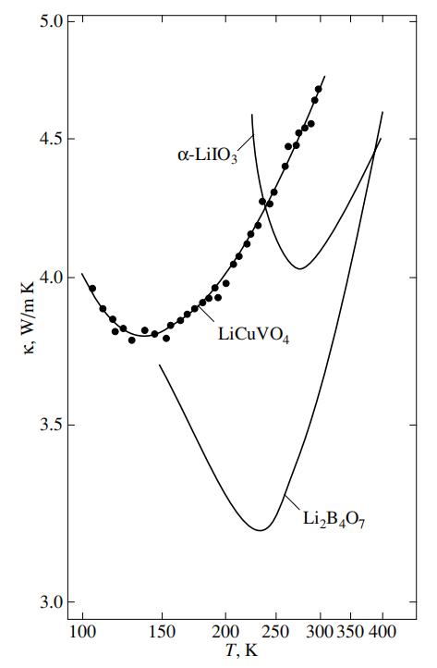
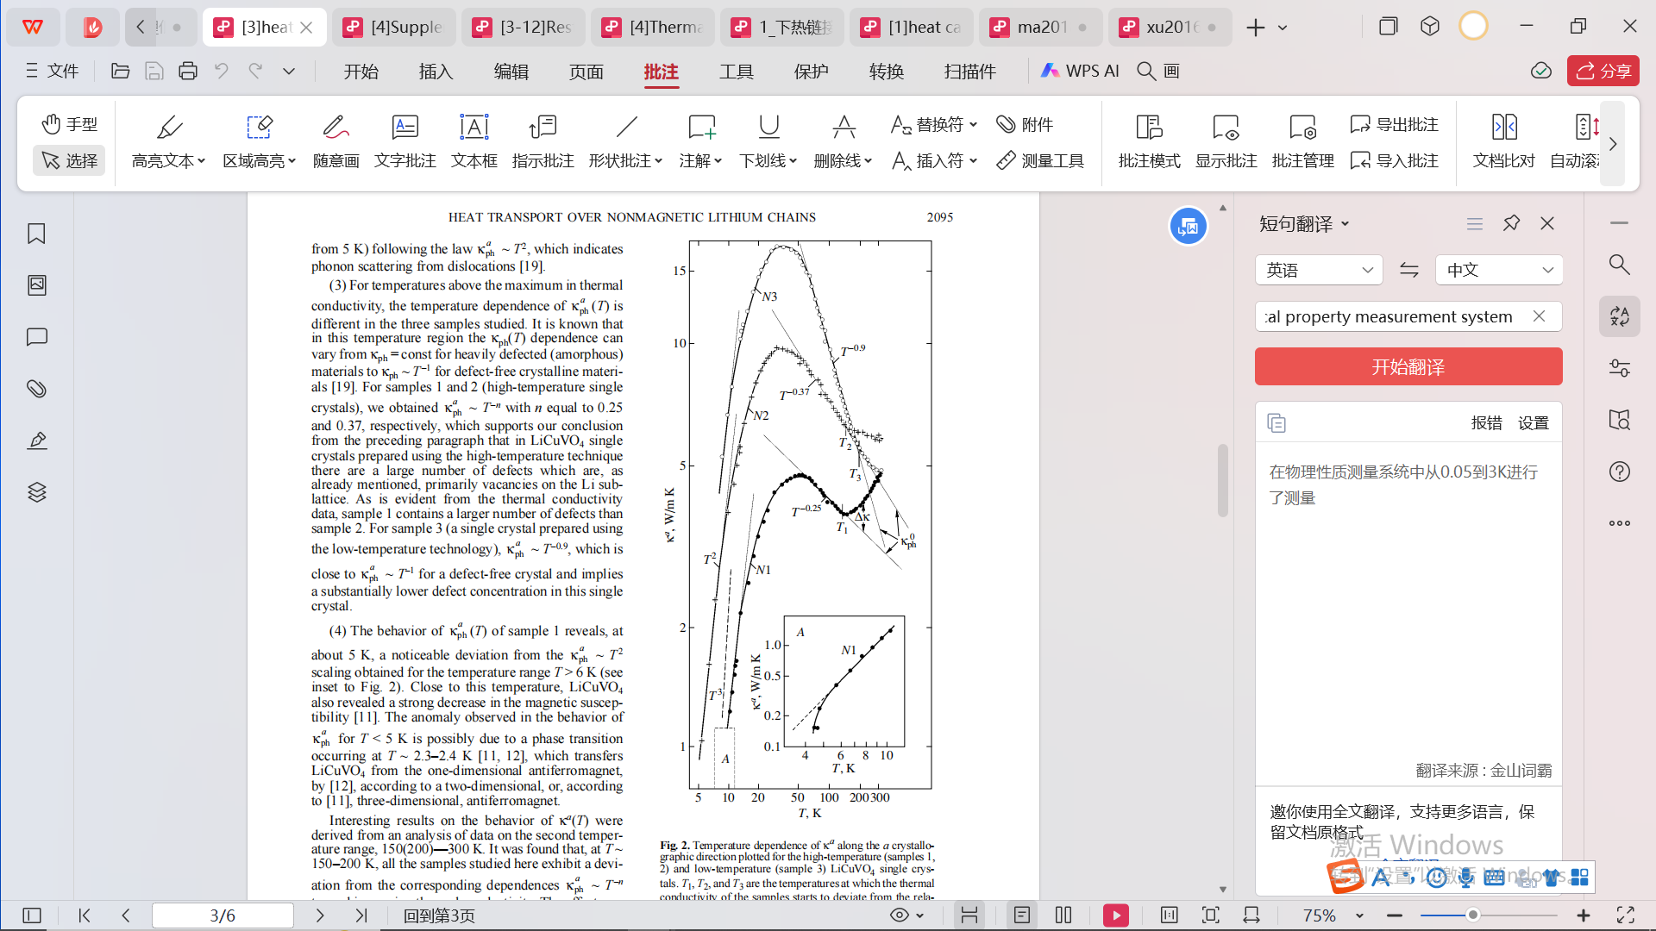
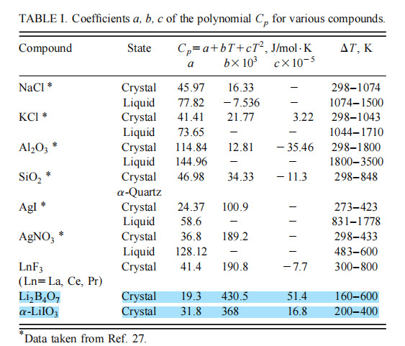
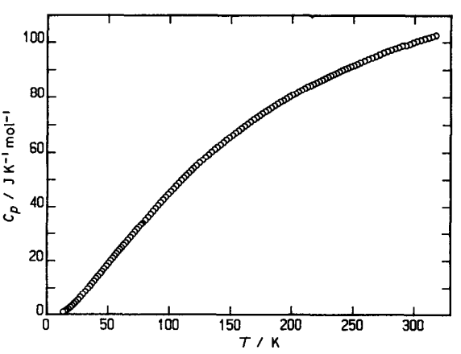
Low-temperature thermal properties measurements of LiIO₃ crystals
Tensor alignment target
θ
Polarizer
Spin flipper
Unpolarized neutron
6Li
Thermal conductivity
Heat capacity
The target LiIO3 crystal needs to be cooled and maintained at a low temperature of mK level during the experiment for tensor alignment
There are currently no data on the thermal conductivity and heat capacity of LiIO₃ crystals, only limited data on LiCuVO₄, Li₂B₄O₇
For smart use/design of refrigerator,
no Brutal Force!

Slide 32
Low-temperature thermal properties measurements of LiIO₃ crystals
Tensor alignment target
θ
Polarizer
Spin flipper
Unpolarized neutron
6Li
Thermal conductivity
Heat capacity
The target LiIO3 crystal needs to be cooled and maintained at a low temperature of mK level during the experiment for tensor alignment
There are currently no data on the thermal conductivity and heat capacity of LiIO₃ crystals, only limited data on LiCuVO₄, Li₂B₄O₇
For smart use/design of refrigerator,
no Brutal Force!

Slide 33
NOPTREX TVPC: Present Status
(1) Search for P-even/T-odd nA interaction
-Cryogenic R & D work in China for tensor alignment in ¹²⁷I crystal. Experiment planned for Chinese Spallation Neutron Source (CSNS)
Notes:
We want to extract effective hadronic weak interaction strength inside a chaotic, many-body nucleus and see if it follows the gaussian orthogonal ensemble (GOE) prediction of nuclear statistical theory.

Slide 34

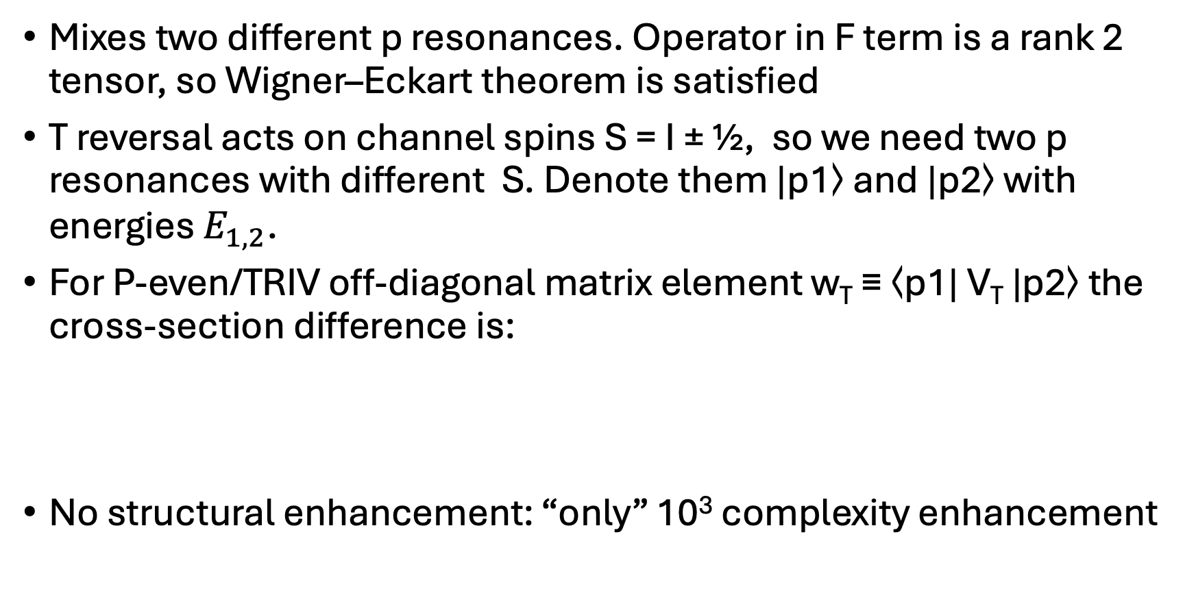
P-even/T-odd
Mixes two different p resonances. Operator in F term is a rank 2 tensor, so Wigner–Eckart theorem is satisfied
T reversal acts on channel spins S = I ± ½, so we need two p resonances with different S. Denote them |p1⟩ and |p2⟩ with energies $E_{1,2}$.
For P-even/TRIV off-diagonal matrix element w_{T} ≡ ⟨p1| V_{T} |p2⟩ the cross-section difference is:
No structural enhancement: “only” 10³ complexity enhancement

Slide 35
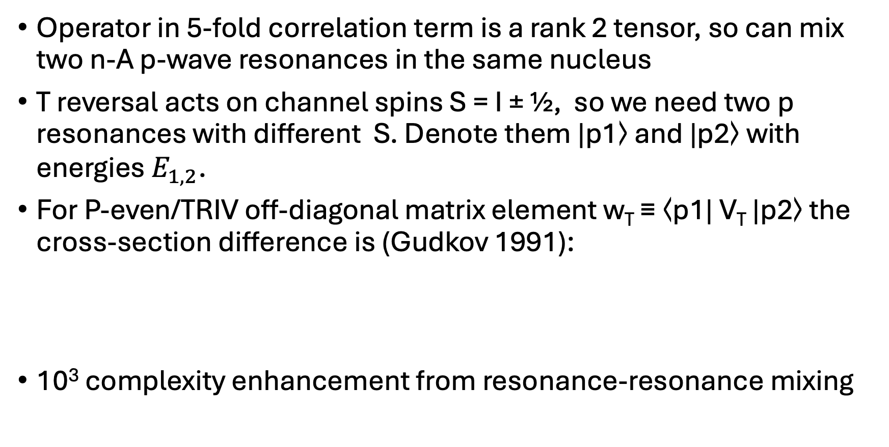
P-even/T-odd search in n-A resonances
Operator in 5-fold correlation term is a rank 2 tensor, so can mix two n-A p-wave resonances in the same nucleus
T reversal acts on channel spins S = I ± ½, so we need two p resonances with different S. Denote them |p1⟩ and |p2⟩ with energies $E_{1,2}$.
For P-even/TRIV off-diagonal matrix element w_{T} ≡ ⟨p1| V_{T} |p2⟩ the cross-section difference is (Gudkov 1991):
10³ complexity enhancement from resonance-resonance mixing

Slide 36
TVPC in n–A scattering
Mechanisms and what NOPTREX-type transmission targets
TVPC “mechanisms” (where the TVPC operator is inserted)
What a NOPTREX-type transmission experiment is optimized for
1) Compound stage: TVPC mixes SAME-parity compound states → near p-wave region, dominant resonant enhancement is p–p mixing.
2) Decay stage: TVPC sits in the decay operator (best isolated when tagging specific exit channels).
3) Direct (potential) scattering: TVPC appears as a small, smoother background in the scattering potential.
4) Doorway/valence enhancement: special nuclear structure can boost the effective TVPC matrix element (often amplifying #1).
Forward transmission through an aligned/oriented target (nuclear spin I).
Looks for a T-odd, P-even spin–momentum–alignment correlation in the forward amplitude.
Scan across p-wave resonances → resonant enhancement + distinctive energy dependence.
Primary sensitivity: compound-nucleus p–p mixing (Mechanism #1).
Diagnostics: structured resonance-like signal vs smoother direct backgrounds.
Signature correlation (T-odd, P-even):
(σ · [k × I]) (k · I)
P conserved ⇒ mixes SAME-parity states → in the p-wave region the leading resonant channel is p–p mixing.
Mental model: n + A → [compound pᵢ] —(TVPC)—→ [compound pⱼ] ⇒ forward transmission asymmetry / spin rotation near p-wave resonances

Slide 37
Neutron-Nucleus Resonances
Heavy nuclei possess
a very dense set of
resonances just above the neutron separation energy
No Coulomb barrier
-> neutrons can
easily excite them
Mainly L=0 resonances, but lots of L=1 resonances
P-even/T-odd interactions can mix pairs of different L=1
resonances

Slide 38
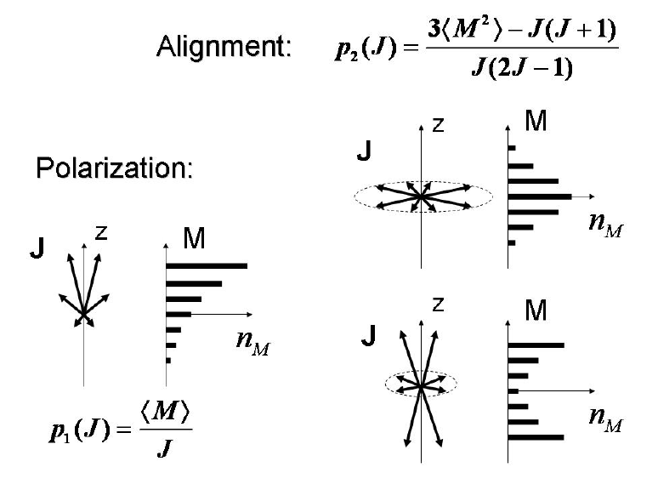

Polarization and Alignment
F term is a rank-2 irreducible tensor built from two copies of the target-spin vector
Clebsch–Gordan coupling of two rank-1 tensors (the spherical components of ):
quadrupole order: spins prefer the 𝑧 but may point both up and down equally (think of a cigar vs. a pancake distribution)
Can be created in deformed nuclei with a large electric quadrupole moment acted on with a crystal-generated electric field at low T

Slide 39
TVPC mechanisms
TVPC acting on the compound-nucleus stage (resonance–resonance mixing)
TVPC in the decay (capture) stage of a compound resonance
TVPC in direct (potential) scattering
Valence-nucleon / single-particle mechanism

Slide 40
Levels of Electric Quadrupole in E gradient
Let Q=electric quadrupole moment of nucleus.

