Slide 1
Atelier Accélérateur Recherche et Société
ML Gallin-Martel mlgallin@lpsc.in2p3.fr
LPSC, Grenoble March 25th-27th 2026

Slide 2
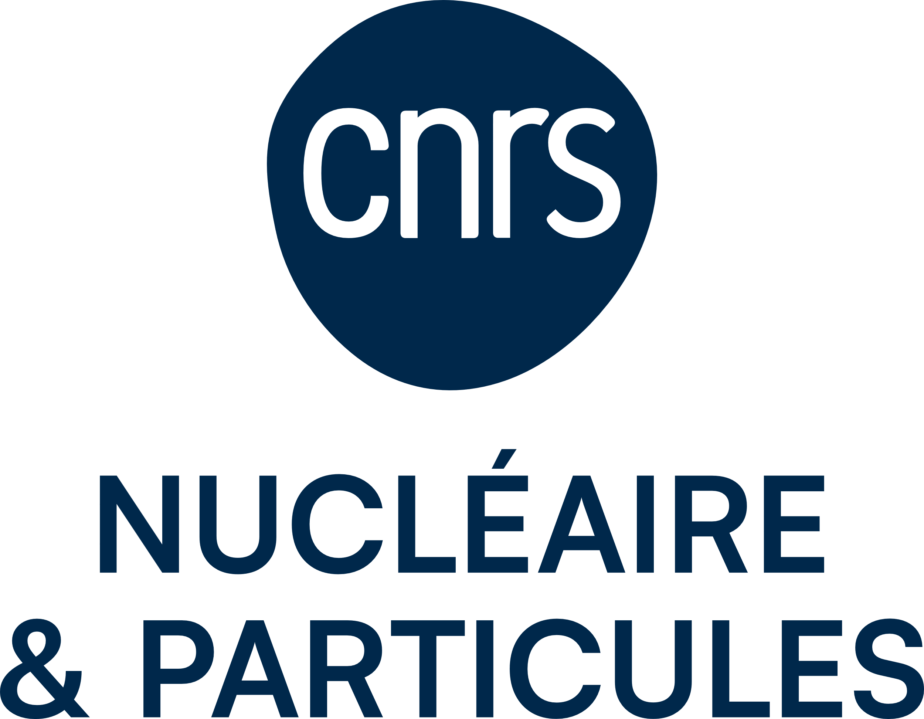
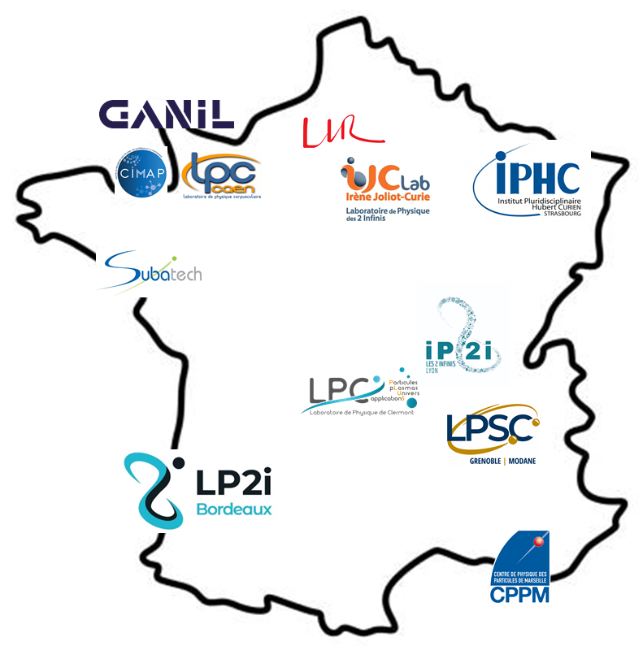
GDR MI2B
The GDR MI2B: a scientific coordination research group
Open to CNRS- Biology teams (deputy management), but also to CNRS Engineering, CNRS Physics, CNRS Computer Sciences, Inserm, ASNR, …
36 partner teams, including:
  12 IN2P3 (CNRS Nuclear & Particle Physics)
    + platforms:
    AIFIRA (Bordeaux) – CYRCÉ (Strasbourg) – ALTO (Orsay) – Arronax (Nantes) – GANIL (Caen)
  11 CNRS Biology
  => ~280 subscribers to the mailing list

Slide 3
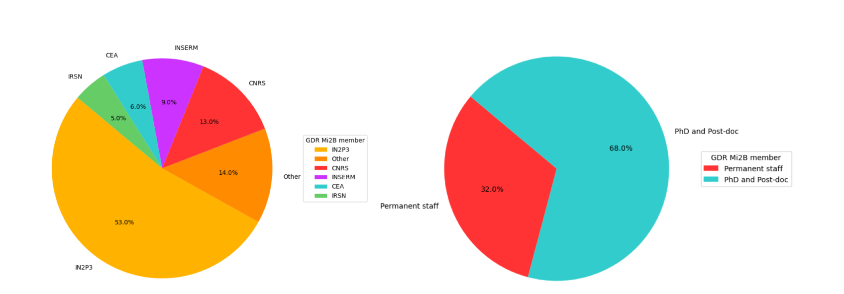
GDR MI2B members
Largely open to other institutes working in the field of health, with a majority from IN2P3 which initiated its creation

Slide 4
Research Areas and Cross-cutting Themes
4 Key Research Areas or Domains
Methods and Instruments in Biomedical Imaging
Tools and Physical Methods for Innovative Radiotherapies
Effects of Radiation on Living Organisms
Radionuclides for Imaging and Therapy

Slide 5
Research Areas and Cross-cutting Themes
Methods and Instruments in Biomedical Imaging
High-sensitivity multimodal diagnostic imaging (PET, PET/CT and PET/MRI, X-ray PC-CT, 3-gamma imaging, …) Treatment planning (proton tomography) Image-guided therapy (prompt gamma imaging for dose delivery monitoring in hadron therapy, intraoperative imaging in surgery) Preclinical imaging (demonstrators, multimodal platforms, simultaneous hybrid imaging, intracranial probes for imaging in awake animals)

Slide 6
Research Areas and Cross-cutting Themes
Tools and Physical Methods for Innovative Radiotherapies
Improving the therapeutic index of radiation treatments
⇒ Increase the probability of tumor control without increasing complications to healthy tissues.
Quality control of treatment delivery
Innovative dose delivery methods (energy, position, timing)
Optimization of treatment planning

Slide 7
Research Areas and Cross-cutting Themes
Effects of Radiation on Living Organisms
Understanding the mechanisms involved in low-dose exposure
Contributing to the challenges of modeling living systems and associated predictive models
Studying radiolysis of water and biomolecules
Assessing changes at different scales (molecular, cellular, whole body)
Understanding the mechanisms involved in therapeutic exposures
Optimizing conventional radiotherapy protocols and developing innovative therapies
Estimating radiation risk associated with each modality

Slide 8
Research Areas and Cross-cutting Themes
Radionuclides for imaging and therapy
The challenge is to stimulate research related to innovative radionuclides in a theranostic approach (combining imaging and therapy). The main questions addressed in this context are: Which innovative radionuclides should be promoted? Which biological agents are suitable for selective delivery? How can we produce these radionuclides with suitable purity and quantity for medical applications How can the radionuclide be stably attached to the biological vector?

Slide 9
Research Areas and Cross-cutting Themes
4 Key Research Areas or Domains
Methods and Instruments in Biomedical Imaging
Tools and Physical Methods for Innovative Radiotherapies
Effects of Radiation on Living Organisms
Radionuclides for imaging and therapy
Understanding the mechanisms involved in low-dose exposure Contributing to the challenges of modeling living systems and associated predictive models Assessing changes at different scales (molecular, cellular, whole body) Understanding the mechanisms involved in therapeutic exposures Optimizing conventional radiotherapy protocols and developing innovative therapies Estimating radiation risk associated with each modality
Improving the therapeutic index of radiation treatments
⇒ Increase the probability of tumor control without increasing complications to healthy tissues.
Quality control of treatment delivery
Innovative dose delivery methods (energy, position, timing)
Optimization of treatment planning
The challenge is to stimulate research related to innovative radionuclides in a theranostic approach (combining imaging and therapy). The main questions addressed in this context are: Which innovative radionuclides should be promoted? Which biological agents are suitable for selective delivery? How can we produce these radionuclides with suitable purity and quantity for medical applications? How can the radionuclide be stably attached to the biological vector?
High-sensitivity multimodal diagnostic imaging (PET, PET/CT and PET/MRI, X-ray PC-CT, 3-gamma imaging, …) Treatment planning (proton tomography) Image-guided therapy (prompt gamma imaging for dose delivery monitoring in hadron therapy, intraoperative imaging in surgery) Preclinical imaging (demonstrators, multimodal platforms, simultaneous hybrid imaging, intracranial probes for imaging in awake animals)
Biology
Clinical Application
5 crossing themes
Computing & Monte Carlo Modeling
Instrumentation
Irradiation Platforms

Slide 10
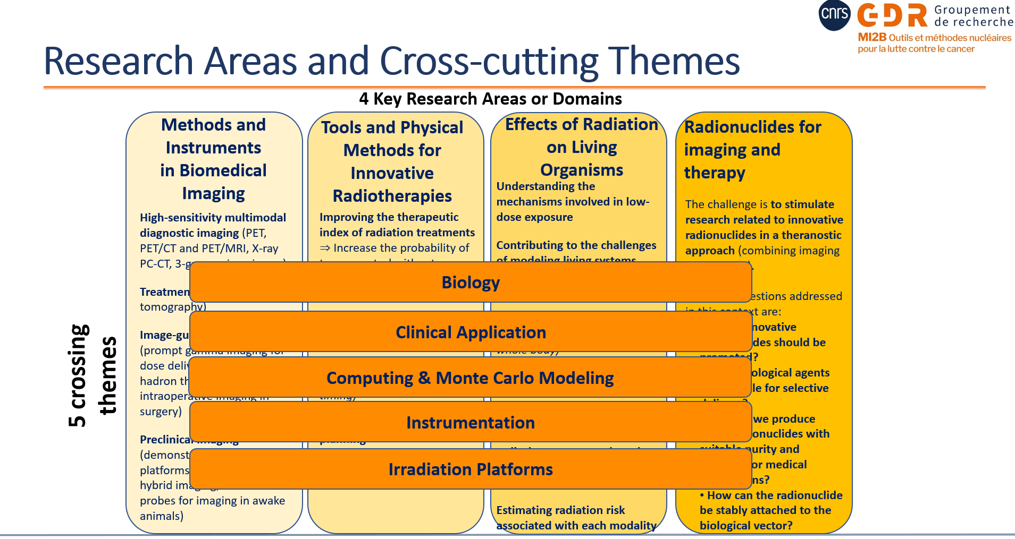
GDR MI2B Governance
Direction
Marie-Laure Gallin-Martel
(LPSC – IN2P3)
Lucie Sancey
(IAB – CNRS Biology)
Division Heads
Imaging
Marc-Antoine Verdier (IJClab- IN2P3)
Mathieu Dupont (CPPM – IN2P3)
Radiotherapies
Rachel Delorme (LPSC-IN2P3)
Jean-Michel Letang (CREATIS CNRS-Engineering)
Radiation Effects
Mathilde Badoual (IJClab – IN2P3), Michael Beuve (IP2I Lyon – IN2P3), Patrick Vernet (LPCA-IN2P3), Lucie Sancey (IAB – CNRS Biology)
Radionucleides
Ferid haddad (SUBATECH-IN2P3 / GIP ARRONAX)
Ali Ouadi (IPHC – IN2P3)
Cross-cutting Themes
Biology
Lucie Sancey (IAB- CNRS Biology), François Paris (Inserm)
Clinical Applications
Juliette Thariat (LPC-IN2P3/CHB Caen)
Computing
Lydia Maigne (LPCA – IN2P3), Jean-Michel Letang (CREATIS- CNRS Engineering)
Instrumentation
Mathieu Dupont (CPPM-IN2P3)
Irradiation Platform
Charbel Koumeir (GIP ARRONAX)
External Relations
SFPM SFBR Inserm
Ludovic Ferrer Julie Costanzo Jean-François Paris

Slide 11
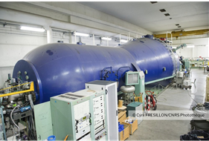
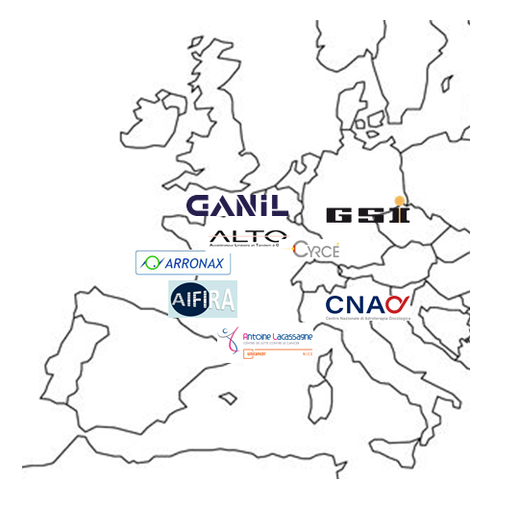
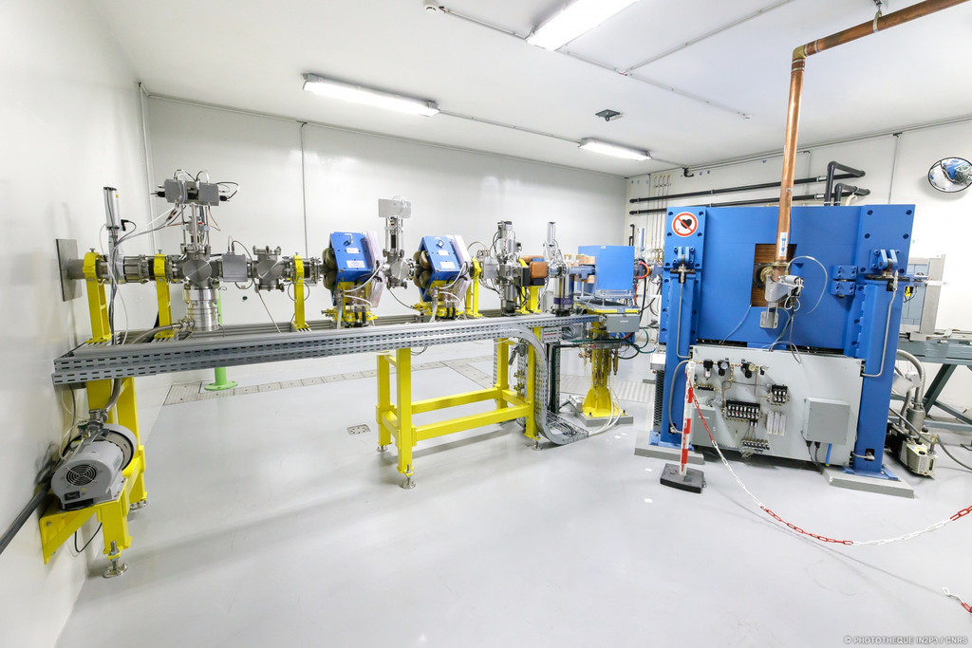
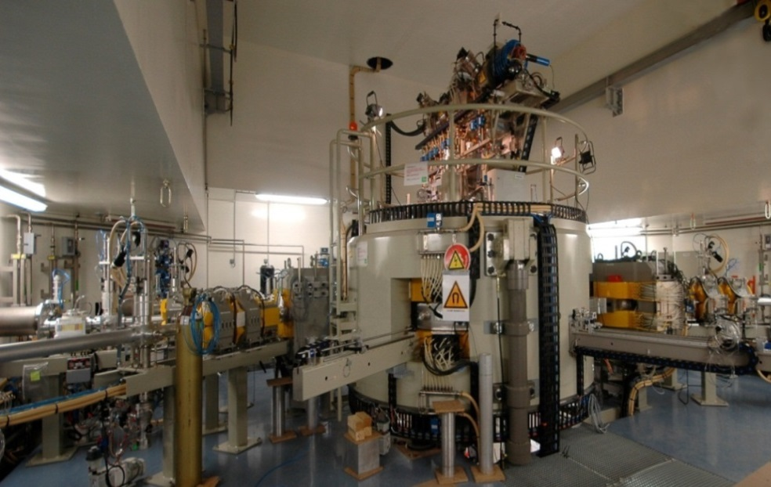
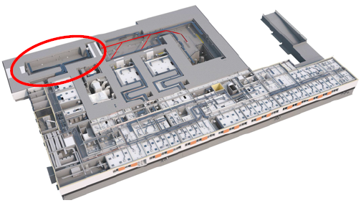
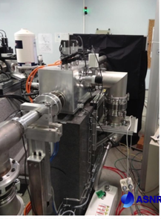
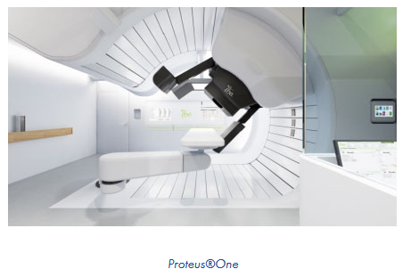
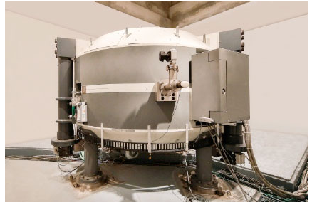
Irradiation platforms
GANIL
ALTO
CYRCé
ARRONAX
C400, carbon beams
With dedicated « research rooms »
= on-going discussion with IN2P3 and others partners!
CNAO
AIFIRA
CAL, Nice

Slide 12
GDR MI2B members
Predominant role played by non-permanent staff – mainly Young Scientists
Role of GDR: education and training
Young researchers present at AGs (oral/poster)
Thematic schools:
  “Physics for Radiobiologists” (Aussois 2024, Corrençon en Vercors 2026 ) is to be repeated every two years starting in 2026.
  Alternating with a similar initiative: “Radiobiology for Physicists”, inspired by the 2024 Joliot-Curie school in Oléron (potential partners: RADIOTRANSNET, SFBR, …).

Slide 13
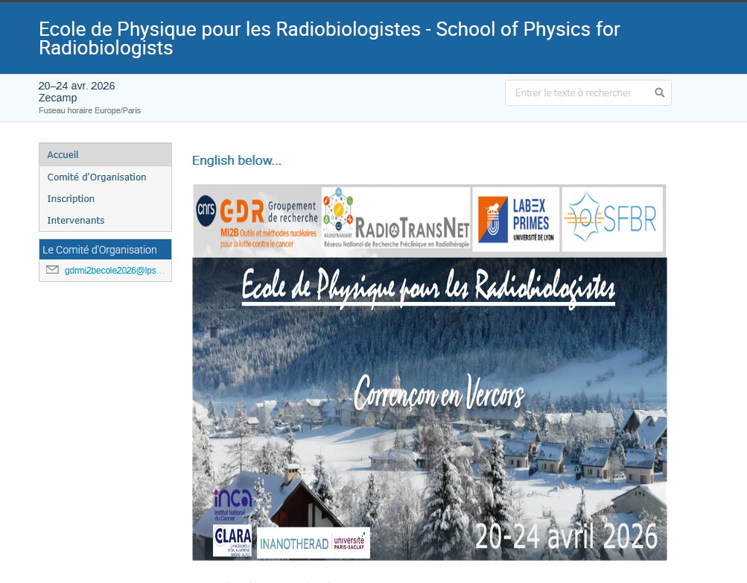
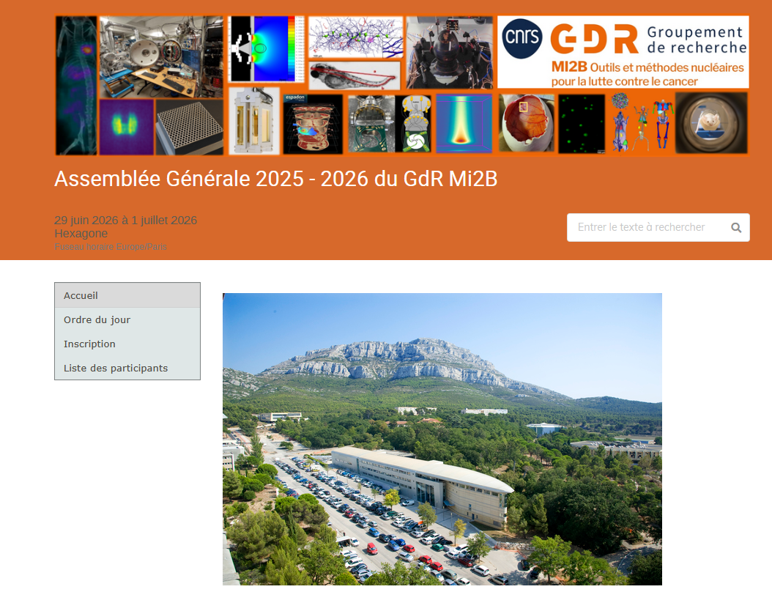
Fothcoming events

Slide 14
Thanks for your attention

