Slide 1


Delayed Molecular Hydrogen Production in Portlandite Under Irradiation: Reaction Mechanisms and Consequences for the Storage of Radioactive Waste
Thibaut Herin, Stéphane Poyet, Pascal Bouniol, Sophie Le Caër
CEA/Saclay, 91191 Gif-sur-Yvette, France
sophie.le-caer@cea.fr
1

Slide 2
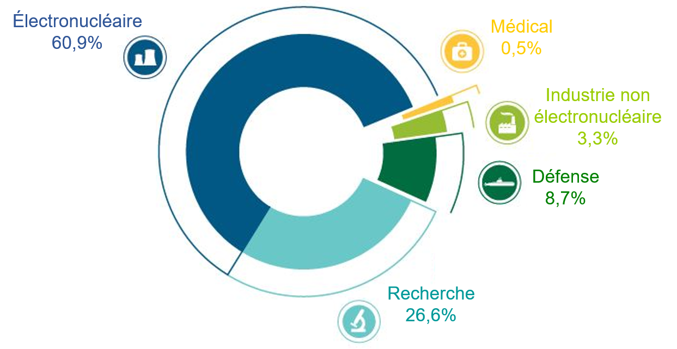
Background to the study
Every year, France produces significant amounts of radioactive waste (60 000 m³).
70% of electricity is generated by nuclear power
Nuclear deterrence, naval nuclear propulsion, radiotherapy, research centers, etc.
Different sources of radioactive waste in France
Medical
0.5%
Nuclear power
60.9%
In 2021, the volume of radioactive waste is estimated at 1.76 million m³
Equivalent to 3 French stadiums
Different types of radioactive waste
Other industries
3.3%
Defense
8.7%
Research
26.6%
2

Slide 3
Types of radioactive waste
Several types of radioactive waste classified by activity and lifetime
Low and medium activity short-lived
Radioactivity: 0.12
Long-lived low-level activity (LLL-LL)
Radioactivity: 0.01
Long-lived average activity (LLA)
Radioactivity: 2.7
55.7 %
5.9 %
2.2%
0.2%
High activity (HA)
Radioactivity: 97.2
35.9 %
Short life (less than 300 years): surface storage
Long life (several hundred thousand years): deep disposal
Very low activity (VLA)
Radioactivity: 0.0004
Breakdown of radioactive waste by volume
3

Slide 4
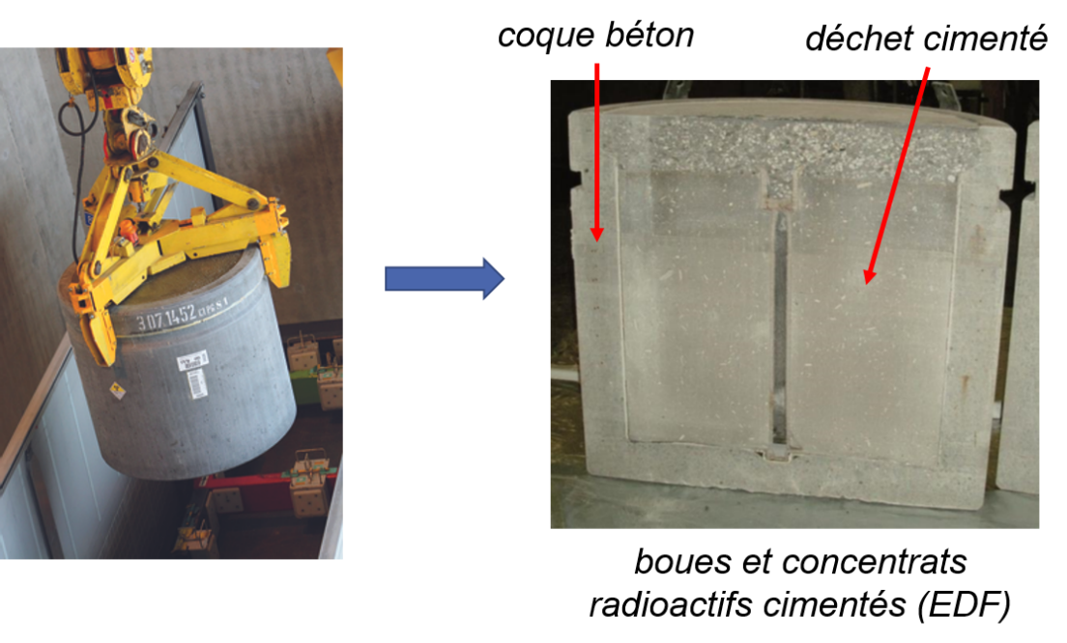
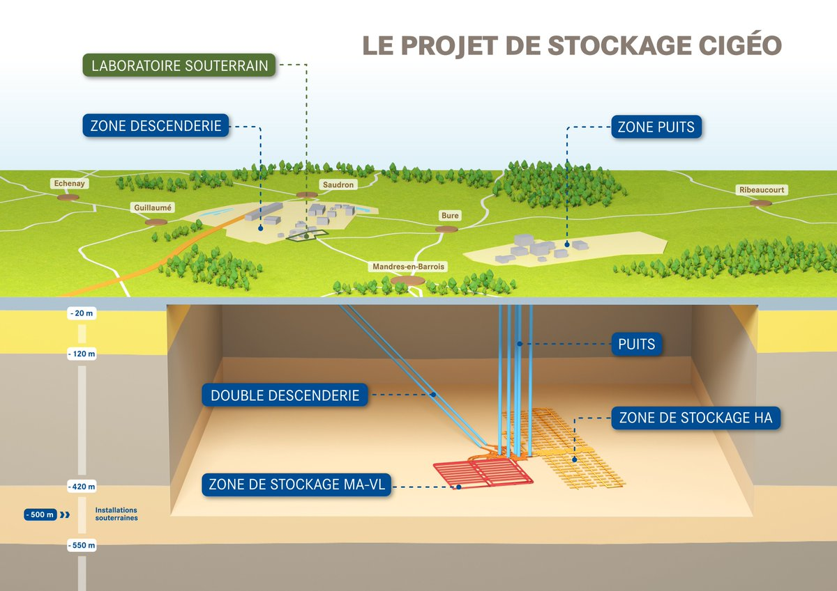

Solution chosen for LLA and HA waste
Packaging of LLA waste
Deep geological disposal
Concrete shell
Cemented waste
Cemented sludge and radioactive concentrates (EDF)
Cementitious materials:
Low-cost materials
Well-known materials
Radiation-resistant materials
Basic environment
Objective: isolate waste for several millions years
4

Slide 5

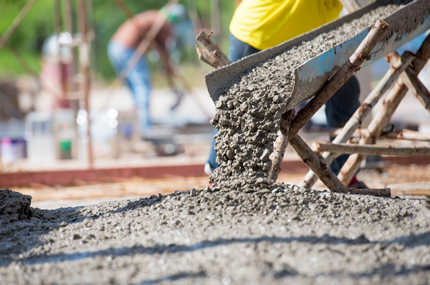
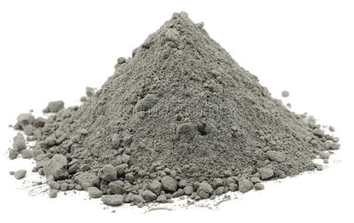
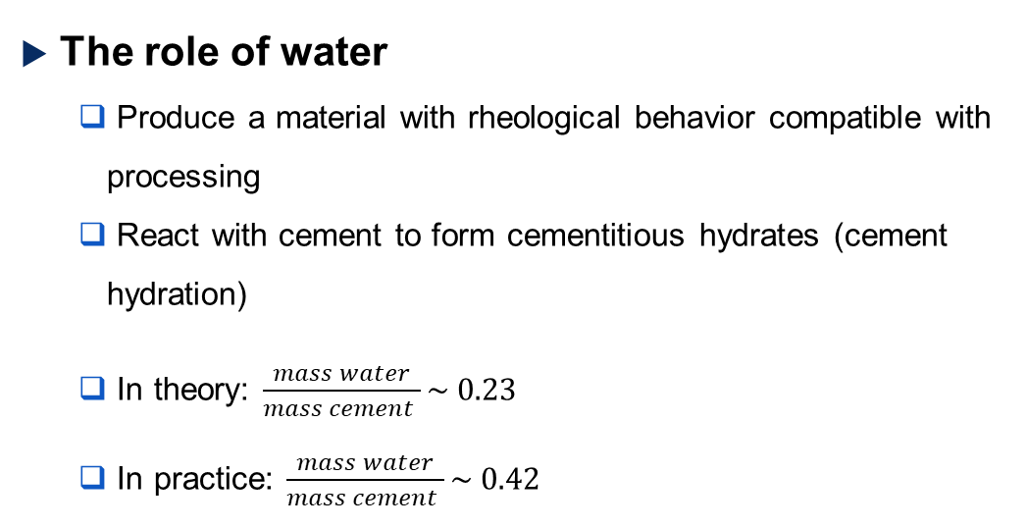
Water in cement
Portland cement
The role of water
Produce a material with rheological behavior compatible with processing
React with cement to form cementitious hydrates (cement hydration)
In theory: $\frac{mass water}{mass cement }\sim 0.23$
In practice: $\frac{mass water}{mass cement }\sim 0.42$
Free water
(45 %)
Chemically bound water (55 %)
Water distribution in cement paste
5

Slide 6

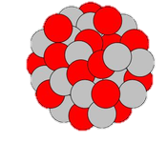
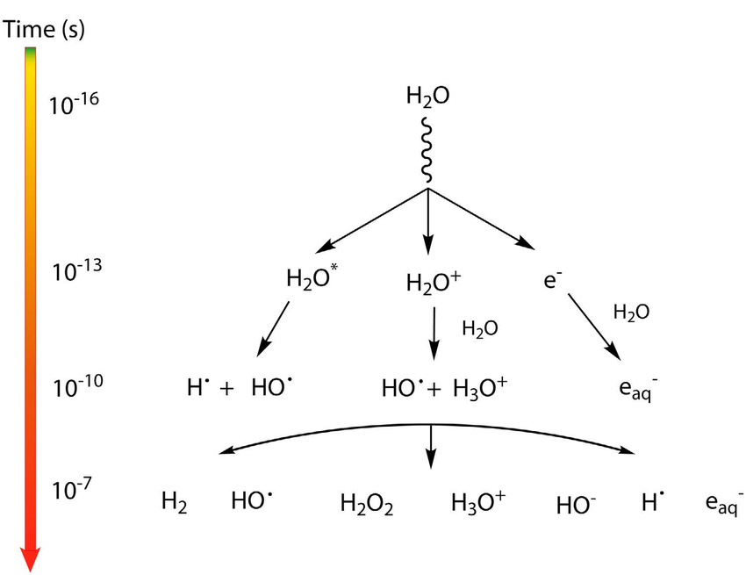

Interaction of water with ionizing radiation
Unstable parent nucleus
Daughter nucleus
proton
α
$${}_{2}^{4}{{He}^{2+}}$$
γ
photon
β
or
neutron
Ionizing radiation
Time (s)
Lousada et al, Scientific Reports, 2016
water
Ionizing radiation
6

Slide 7
The dihydrogen risk
Why is H₂ potentially problematic?
A potentially explosive gas under certain conditions
Explosive limit of H₂ in air: 4% by volume
Need to assess the various H₂ source terms
Packaging of LLA radioactive waste
Ionizing radiation
45 %
Free water
H₂
!
H₂ risk quantified
Cementitious matrix
+
radioactive waste
Ionizing radiation
Water
!
Chemically bound water
H₂ production?
Additional source of H₂?
55 %
7

Slide 8
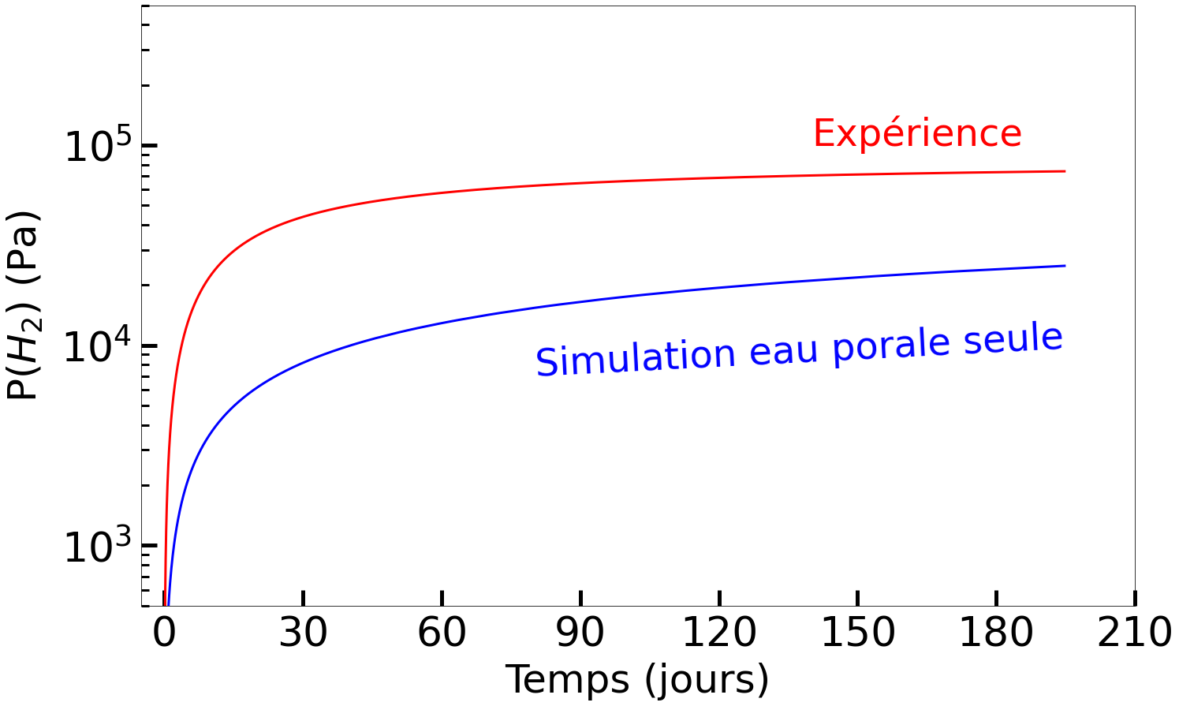
State of the art
Systemic study by Bouniol (2022)
Comparison of experimental H₂ production (hydrated and irradiated C₃S paste) and theoretical production
Study results
Radiolysis of free (pore) water alone does not account for the H₂ production observed.
Radiolysis of solid phases must exist
Experiment
Simulation of pore water only
Time (day)
Bouniol P. J Adv Concr Technol. 2022;20(2):72-84
8

Slide 9
Controlling the surface state of materials
Solid with adsorbed water
Solid with no adsorbed water
Ionizing radiation
H₂
H₂
adsorbed water
Ionizing radiation
H₂
solid
solid
Two contributions to H₂
Radiolysis of adsorbed water
Radiolysis of the solid phase
Overestimation of H₂ production from solid phases
Selected study configuration
10

Slide 10
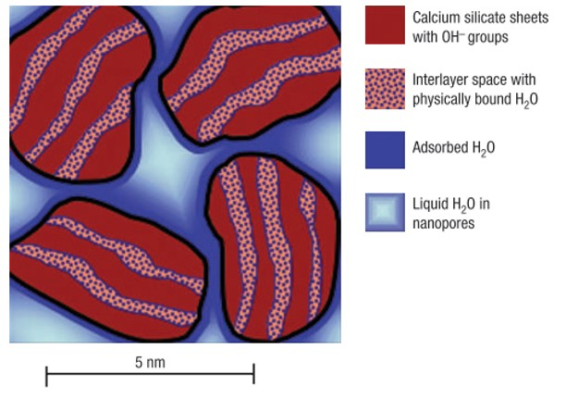
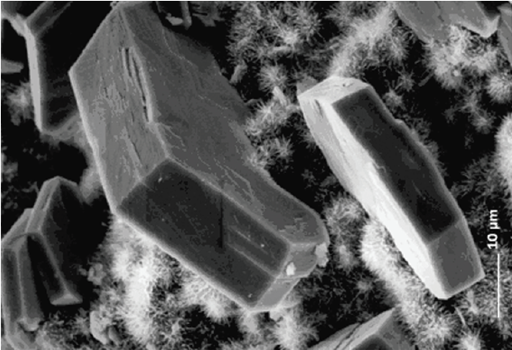
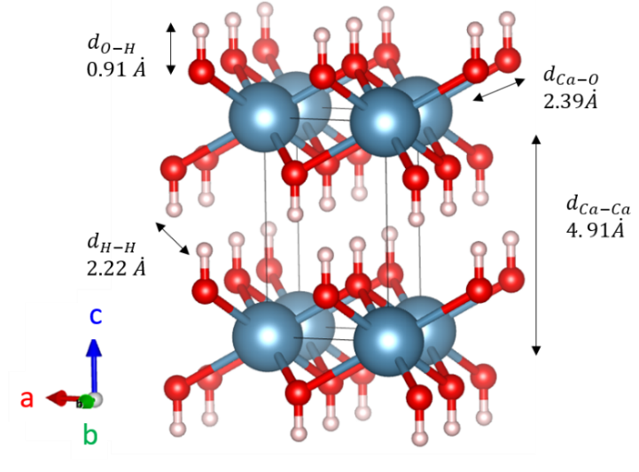
Modeling cement paste
Portland cement
composition
+ water
Portlandite: Ca(OH)₂
C-S-H: (CaO_{1.70})SiO₂ (H₂O)_{1.80}
50 - 65 % Ca₃SiO₅
15 - 20 % Ca₂SiO₄
5 - 15 % Ca₃Al₂O₆
5 - 10 % Ca₂AlFeO₅
C-S-H cement
Ca(OH)₂
Nonat A. Chapter 2: Hydration of cements. In: La durabilité des bétons (2e Edition). Presses de l'Ecole Nationale des Ponts et Chaussées; 2008. p. 35.
Allen A.J., Thomas J.J., Jennings H.M. Composition and density of nanoscale calcium - silicate - hydrate in cement. Nat Mater VOL 6. 2007;6:311-6.
11

Slide 11
Water re-adsorption kinetics
Adsorbed water
Desorption treatment
Solid particle
Solid particle
12

Slide 12
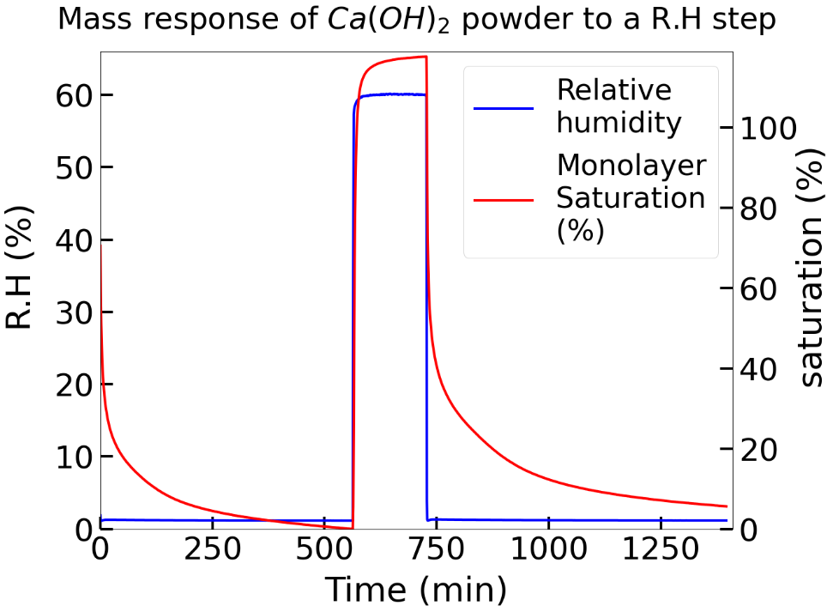
Water re-adsorption kinetics
Air exposure
Adsorbed water
Adsorbed water
Desorption treatment
Solid particle
Solid particle
Solid particle
Measurement of water re-adsorption kinetics
Use of vapor sorption dynamics (VSD)
Exposure of samples to a range of relative humidity 0-60%.
Measuring mass change
13

Slide 13
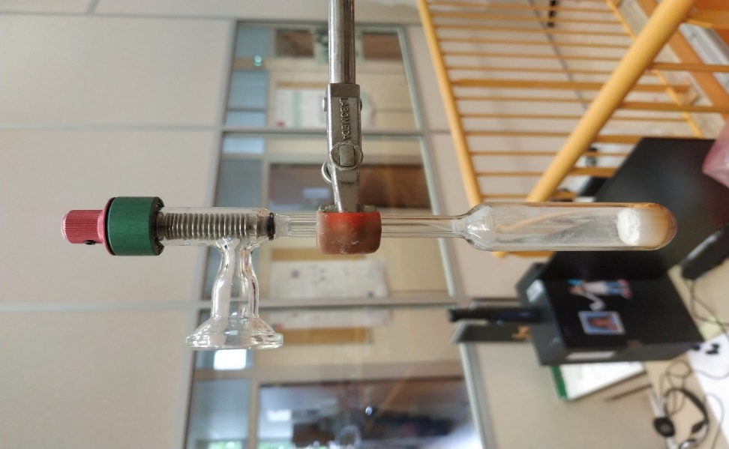
Measurement of H₂
Sample preparation
Minerals in powder form
Desorption and irradiation treatment in the same ampoule
Possibility of sampling ampoule atmosphere after irradiation
Measurement of H₂ production by gas-phase micro-chromatography (µ-GC)
Tightly-closed valve
Ampoule
in glass
1.6 bar
argon
powder
Sample storage in glove box
with ultra-pure argon & H₂O content < 0.5 ppm
14

Slide 14
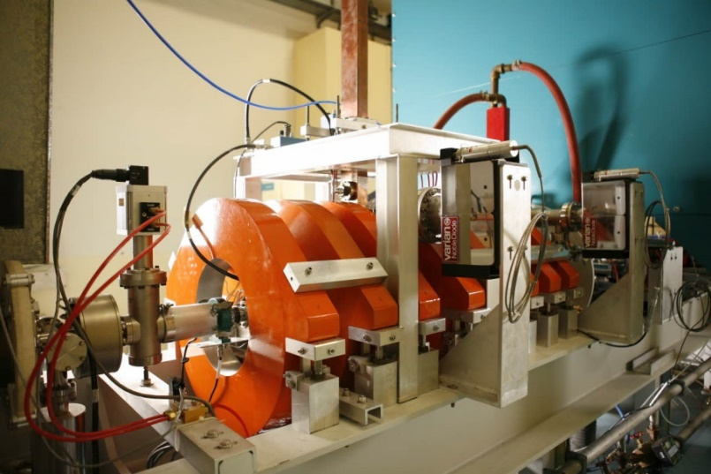
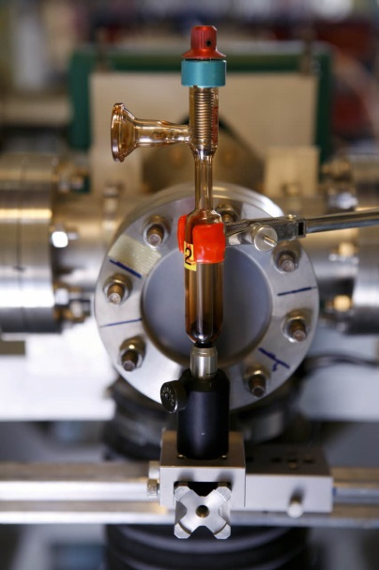
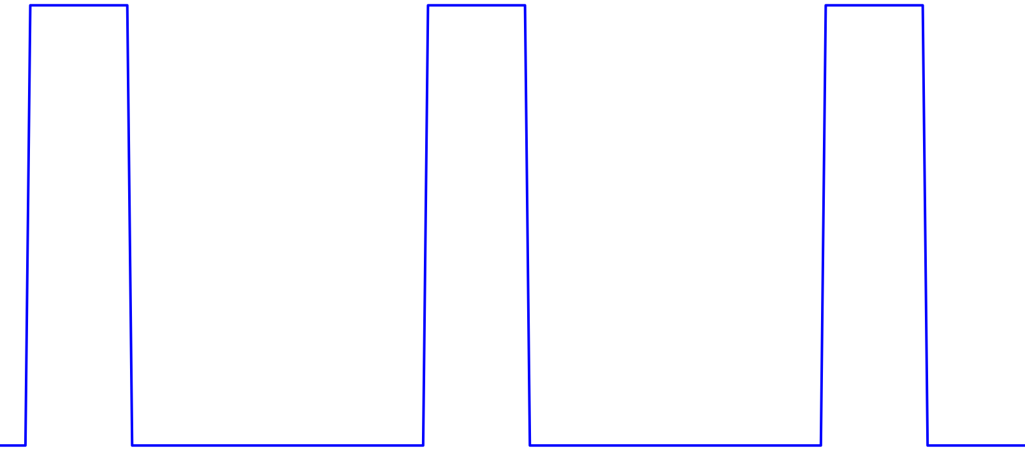
The ALIENOR linear electron accelerator
Irradiation with Jorge VIEIRA
Ampoule positioning
10 MeV electrons
Pulse duration: 10 ns
Repetition frequency: 1-10 Hz
Dose: 20 Gy/pulse
Dose rate: 2 ×10¹⁰ Gy/s
dose
10 ns
10 ns
10 ns
time
15

Slide 15
Removal of adsorbed water from portlandite
Using radiolysis to check for the presence of adsorbed water
H₂
H₂
H₂
H₂
Ca(OH)₂ particle
Ca(OH)₂ particle
Ca(OH)₂ particle
Adsorbed water
Mineral alteration and removal of chemically bound water
Solid radiolysis + adsorbed water
(high production of H₂)
Production of H₂
Desorption plateau
(stable H₂ production)
Unlikely
Mineral containing adsorbed water
Unaltered mineral with no adsorbed water
Probable
Altered mineral
Heat treatment intensity
16

Slide 16
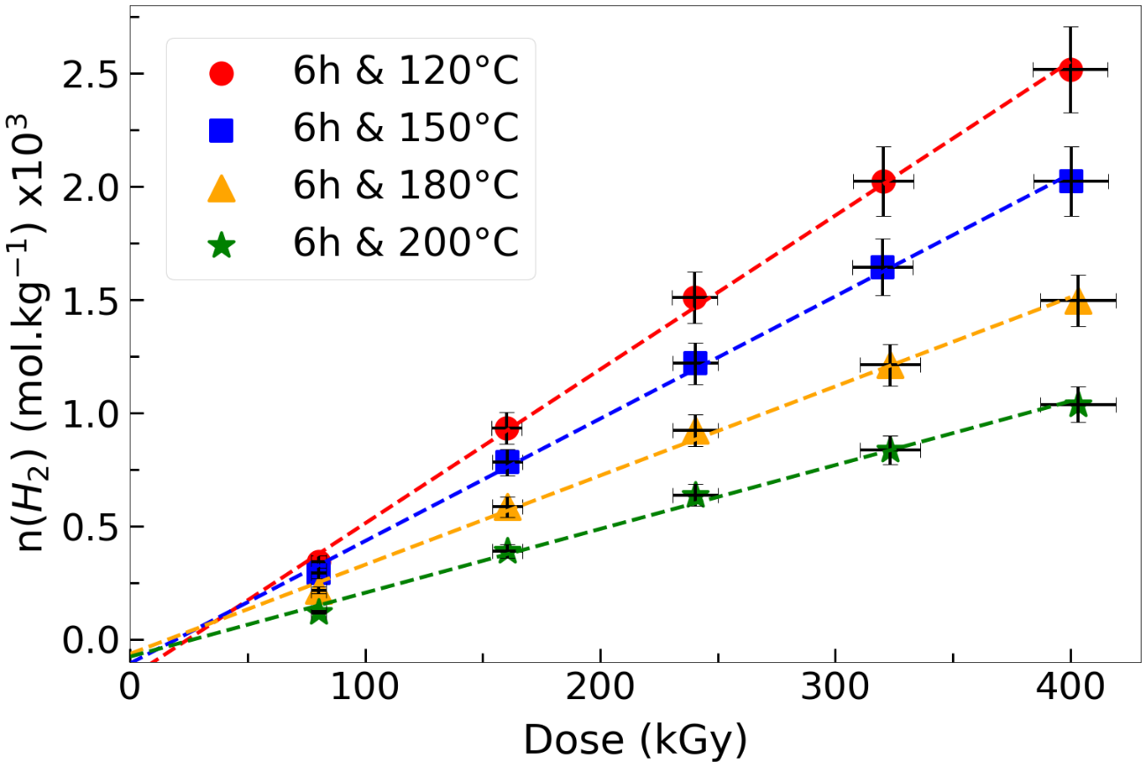
Removal of adsorbed water from portlandite
Desorption treatment
Water removal by heat treatment under primary vacuum (0.1 - 1 mbar)
Treatment of increasing intensity
Measuring H₂ radiolytic yield
Time/temperature mapping
Temperature Time | 120°C G(H₂) (mol.J⁻¹) ×10⁹ | 150°C G(H₂) (mol.J⁻¹) ×10⁹ | 180°C G(H₂) (mol.J⁻¹) ×10⁹ | 200°C G(H₂) (mol.J⁻¹) ×10⁹
6 h | 6.8 ± 0.7 | 5.4 ± 0.5 | 3.9 ± 0.4 | 3.0 ± 0.3
16 h | 4.9 ± 0.5 | 4.8 ± 0.5 | 3.5 ± 0.4 | 3.6 ± 0.4
64 h | 5.5 ± 0.5 | 3.6 ± 0.4 | 3.0 ± 0.4 | 3.4 ± 0.4
Herin et al., Rad. Phys. Chem., 243, 113715 (2026)
17

Slide 17
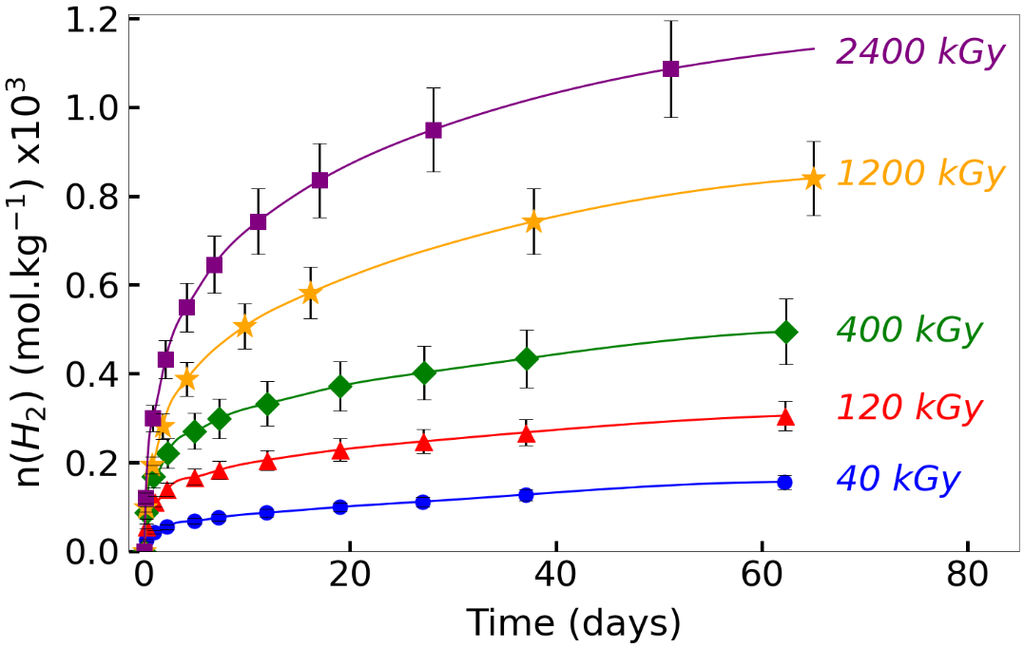
Delayed production of H₂ in portlandite
After initial irradiation, portlandite progressively releases H₂
Ionizing radiation
Directly accessible
Immediate H₂ production
Ca(OH)₂ samples
Delayed H₂ production
Gradual release
Delayed production of H₂
Similar phenomenon demonstrated on aluminum oxy(hydroxides) by Kaddissy (2016)
H₂ not directly accessible
Delayed production increases with the initial dose delivered
Herin et al., J. Phys. Chem. C, 127, 20245 (2023)
18

Slide 18
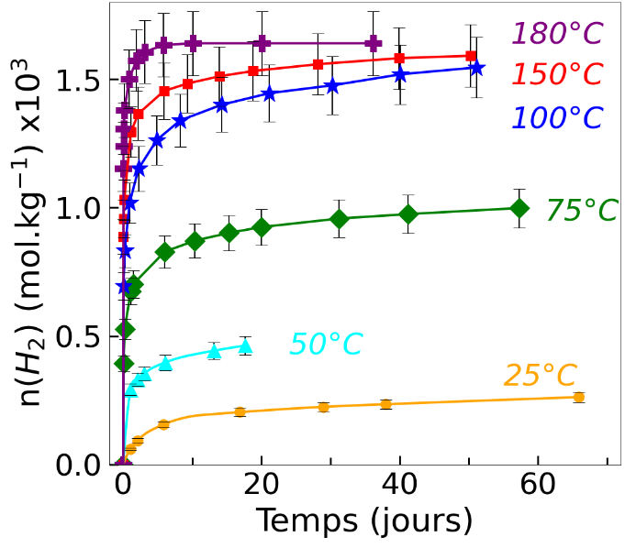

Influence of temperature on delayed H₂
Delayed production is heat-activated
Irradiation at 400 kGy and delayed production monitoring for several temperatures
Convergence at temperatures above 100°C
Time (days)
Type of H₂ considered | G(H₂) (mol.J⁻¹)
Immediate | 3.0 ×10⁻⁹
Immediate + delayed | 1.2 ×10⁻⁸
Time (days)
Herin et al., J. Phys. Chem. C, 127, 20245 (2023)
19

Slide 19
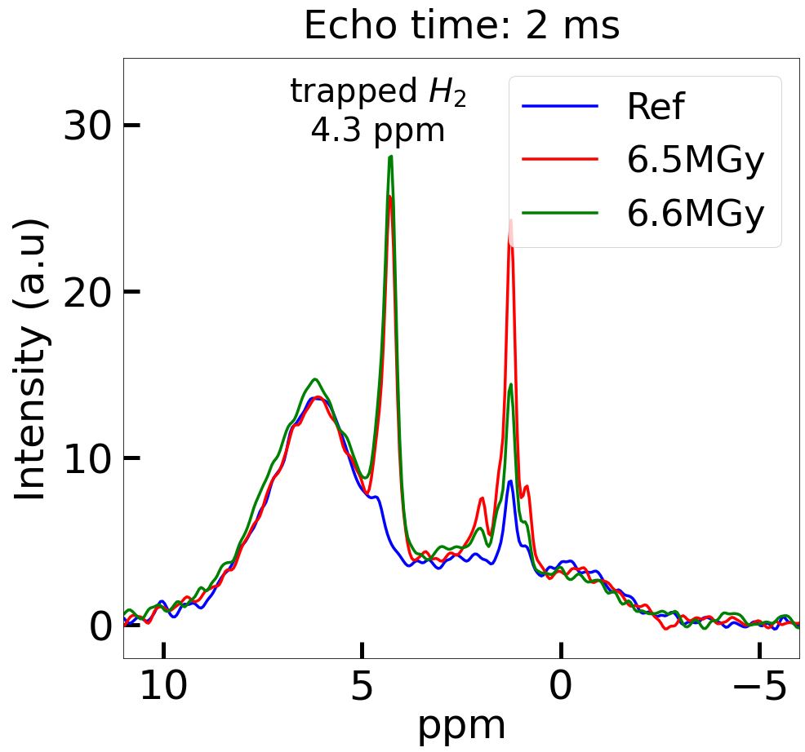
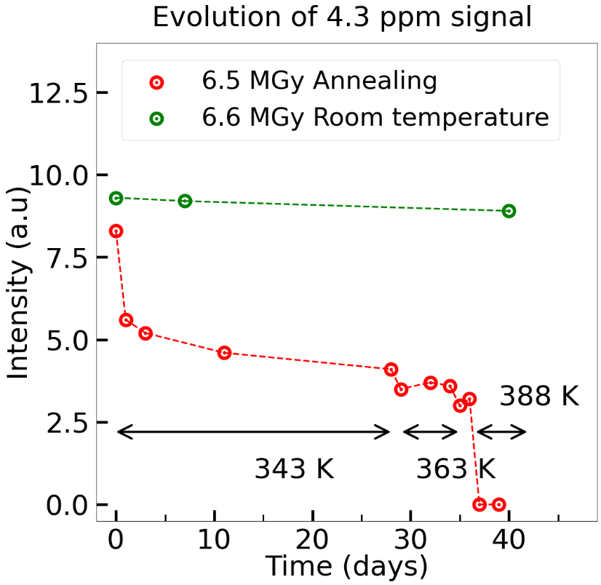
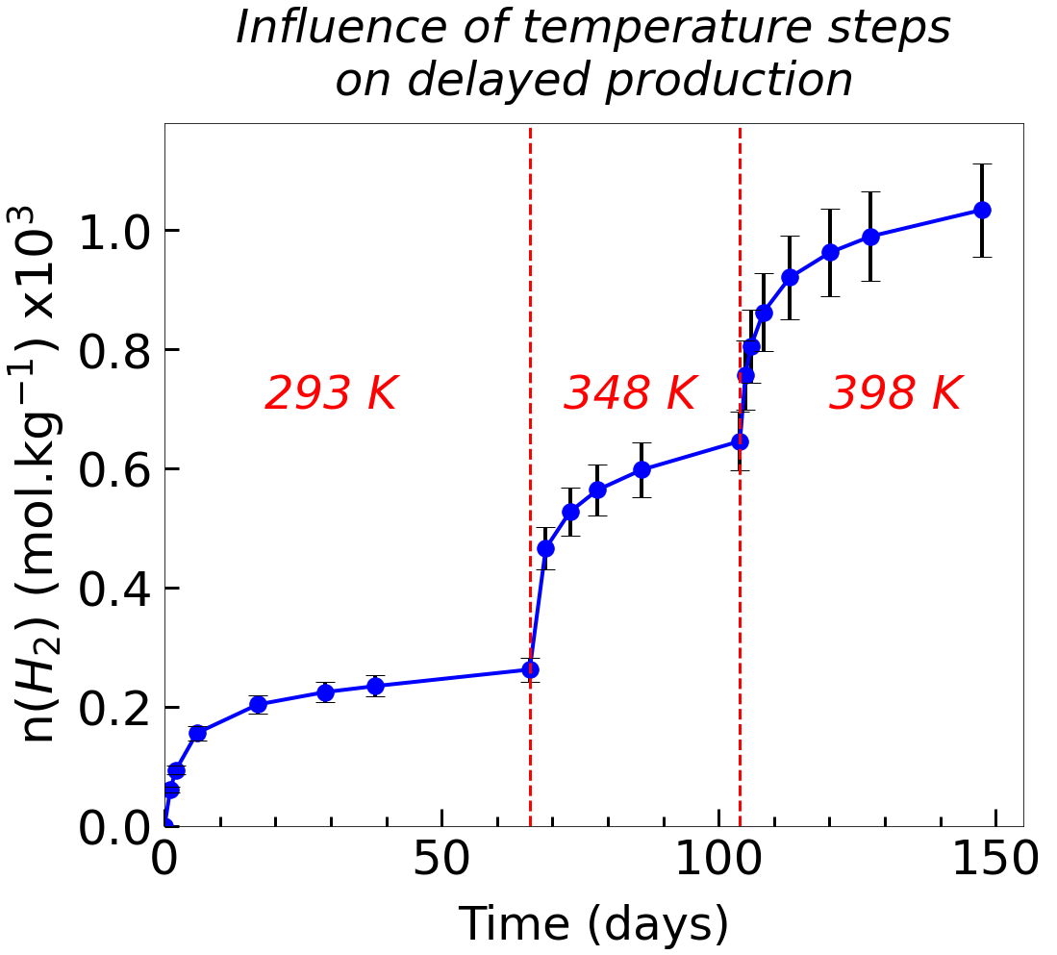
Origin of delayed H₂
¹H NMR analysis of irradiated portlandite samples
Appearance of a signal at 4.3 ppm in irradiated samples (trapped H₂)
Tracking the intensity of the 4.3 ppm peak with temperature
In collaboration with Thibault Charpentier (CEA Saclay/NIMBE/LSDRM)
Good correlation with μ-GC measurements
Herin et al., J. Phys. Chem. C, 127, 20245 (2023)
20

Slide 20
Electron paramagnetic resonance analysis of Ca(OH)₂
Electron paramagnetic resonance (EPR) spectroscopy
Method for detecting radical (paramagnetic) species formed during irradiation
Irradiation of Ca(OH)₂ samples in liquid nitrogen at 20 kGy and EPR detection at -150°C
In collaboration with Antonino Alessi (CEA Saclay/LSI)
Zoom
Presence of paramagnetic species: ${CaO}^{•}$ (in the volume),${ e}_{trapped}^{−}$ (on the surface) and $H^{•}$
Herin et al., J. Phys. Chem. C, 128, 19529 (2024)
21

Slide 21

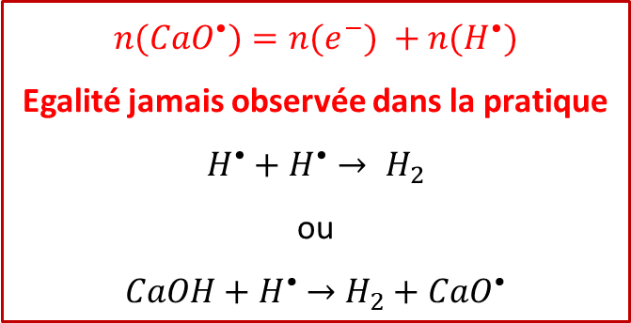
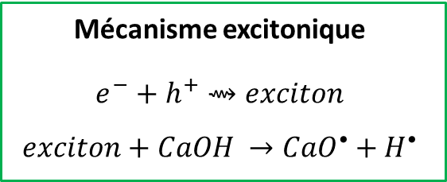
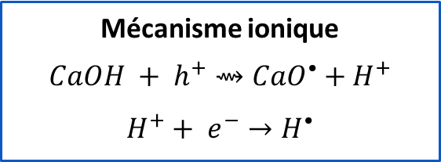
Mechanism of H₂ production in portlandite
The presence of ${CaO}^{•}$ is an argument in favour of radiolysis of CaO-H bonds
Ionic mechanism
$$CaOH + h^{+}⇝{CaO}^{•}+H^{+}$$
$$H^{+}+ e^{−}→H^{•}$$
$${n(CaO}^{•})=n(e^{−}) +n(H^{•})$$
Equality never observed in practice
$$H^{•}+H^{•}→ H_{2}$$
or
$CaOH+H^{•}$ $→H_{2}+{CaO}^{•}$
Primary event
$$\text{Irradiation} ⇝h^{+}+e^{−}$$
Excitonic mechanism
$e^{−}$ $+ h^{+}⇝exciton$
$$exciton+CaOH →{CaO}^{•}+H^{•}$$
Herin et al., J. Phys. Chem. C, 128, 19529 (2024)
22

Slide 22

Mechanisms of H₂ production in portlandite
Surface
Immediate H₂
$$H_{surface}^{•}+ H_{surface}^{•}→ H_{2\left(g\right)}$$
$$e^{−}→e_{ trapped}^{−}$$
$$H^{+}+ e_{trapped}^{−}→ H_{surface}^{•}$$
$$H_{surface}^{•}+ Ca{OH}_{surface}→ H_{2(g)}+CaO_{surface}^{•}$$
Ca(OH)₂
H₂ (total)
Volume → surface transport
Ionic (and excitonic) mechanism
$$H_{2\left(trapped\right)}$$
$$H^{•}+ {CaO}^{•}→CaOH$$
Volume
Delayed H₂
$$H^{•}+ CaO−OCa→ CaO^{•}+CaOH$$
Recycling
$$H_{2(trapped)}+ {CaO}^{•}⇄CaOH+H^{•}$$
Herin et al., J. Phys. Chem. C, 128, 19529 (2024)
23

Slide 23
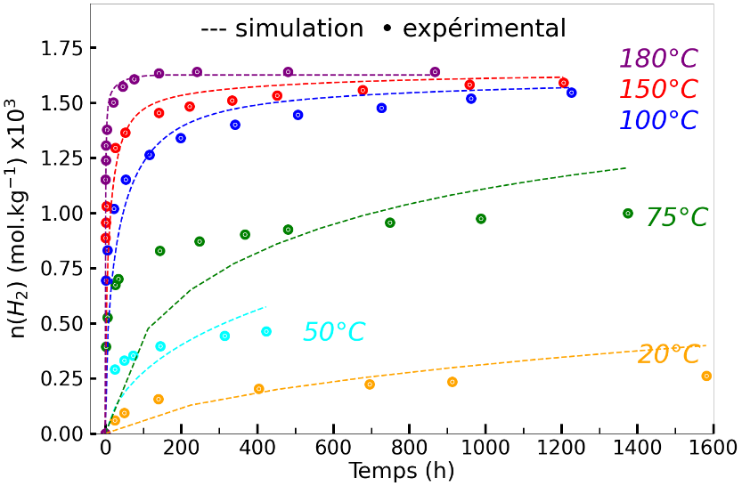
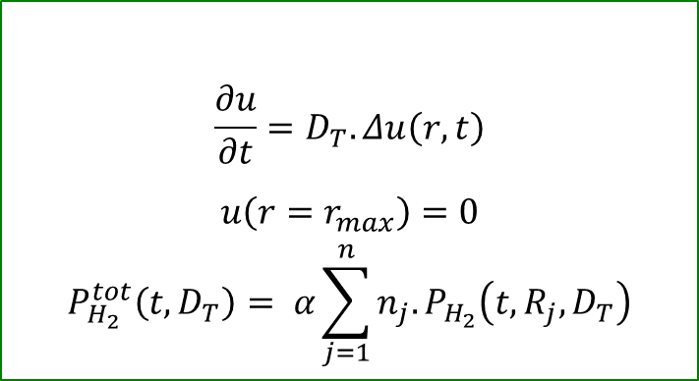
Simulation of delayed H₂ production after irradiation of portlandite
Diffusion model assumptions
Spherical particles
Isotropic diffusion with radial geometry
Fickian diffusion
Homogeneous initial concentration
Equations of the diffusion model
$$\frac{∂u}{∂t}=D_{T}.Δu\left(r,t\right)$$
$$u\left(r=r_{max}\right)=0$$
$$P_{H_{2}}^{tot}\left(t,D_{T}\right)= {α\sum_{j=1}^{n}{n_{j}.}P}_{H_{2}}\left(t,R_{j},D_{T}\right)$$
Time (h)
Problems
Poor model convergence at low temperatures
At least one of the hypotheses is false
27

Slide 24
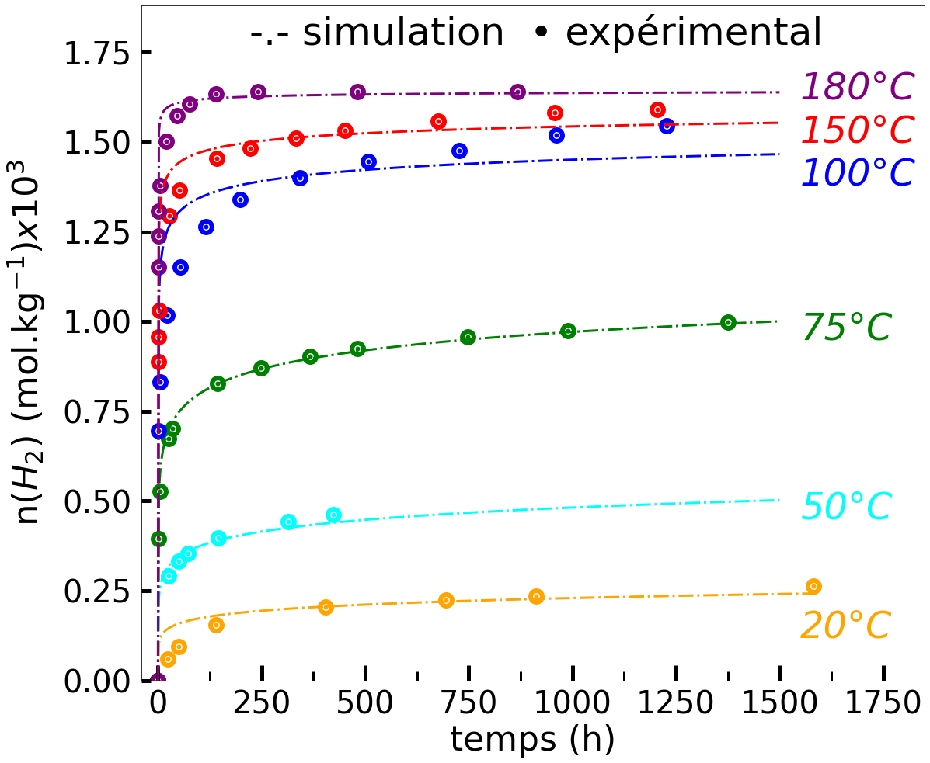
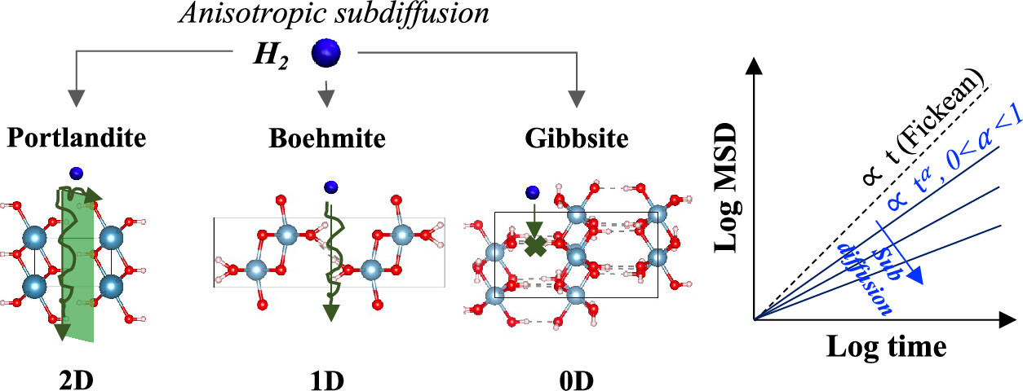
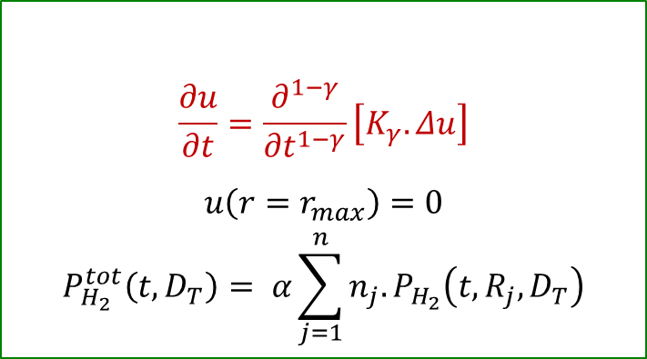
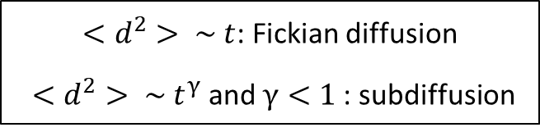
Sub-diffusion modeling
H₂ transport in portlandite is a sub-diffusive process
Evidenced by Honorio de Faria and Trifa using molecular dynamics calculations
$<d^{2}> \sim t$: Fickian diffusion
$<d^{2}> \sim t^{γ}$ and $γ<1$: subdiffusion
experiments
Subdiffusion model equations
$$\frac{∂u}{∂t}=\frac{∂^{1−γ}}{∂t^{1−γ}}\left[K_{γ}.Δu\right]$$
$$u\left(r=r_{max}\right)=0$$
$$P_{H_{2}}^{tot}\left(t,D_{T}\right)= {α\sum_{j=1}^{n}{n_{j}.}P}_{H_{2}}\left(t,R_{j},D_{T}\right)$$
Time (h)
Honorio et al., J. Phys. Chem. C, 128, 19085 (2024)
28

Slide 25
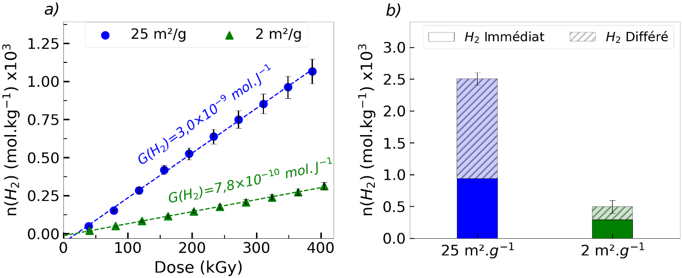
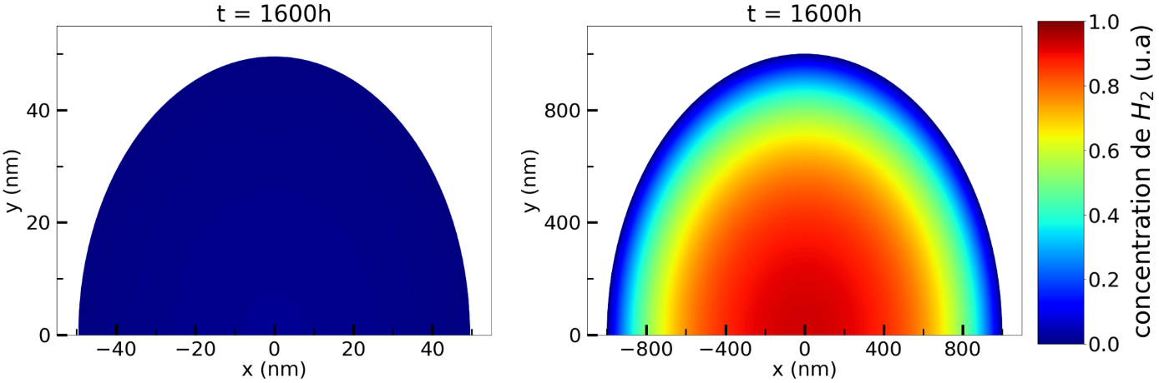
Using a more "realistic" portlandite
In cement, portlandite crystals are micrometric (1 to 100 μm).
Ca(OH)₂ (standard)
Thermal cycling in a hydrothermal reactor
Ca(OH)₂ (recrystallized)
Typical size: 100 nm
Specific surface area: 25 m².g⁻¹
Typical size: 1-2 μm
Specific surface area: 2 m².g⁻¹
Immediate H₂
Delayed H₂
Simulation of the H₂ concentration profile in portlandite particles
R = 50 nm
R = 1000 nm
H₂ concentration (a.u.)
29

Slide 26

Conclusions
Study assumptions
Cement can be assimilated to tricalcium silicate (Ca₃SiO₅)
$$6 {Ca}_{3}{SiO}_{5}+{18 H}_{2}O →{Ca}_{11}{Si}_{6}O_{20}(OH)_{6} .8H_{2}O+{7 Ca\left(OH\right)}_{2}$$
• The total absence of adsorbed water is necessary to study the radiolysis of bound water without any parasitic contribution.
• The notion of radiolytic yield can be rather tricky in the case of a solid.
Production delayed over several days (and specific surface area effects....)
• The immediate production of H₂ is due to surface phenomena.
• The delayed production of H₂ is due to dihydrogen molecules trapped in the crystalline structure, which diffuse slowly towards the surface via sub-diffusion.
• EPR spectroscopy can be used to propose reaction mechanisms for irradiated portlandite by identifying radiation-induced defects.
• High H₂ retention capacity for micrometric particles
30

Slide 27
Thank you for your attention

Slide 28
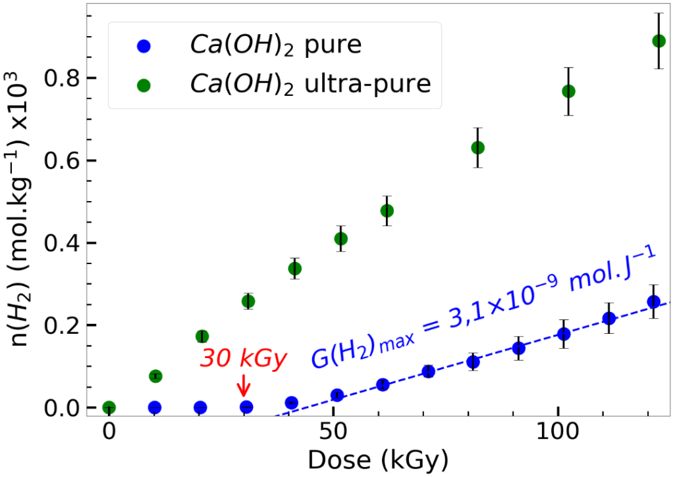
Influence of portlandite purity
Ca(OH)₂ pure | Ca(OH)₂ ultrapure
CaO (99.95% purity) | CaO (99.998% purity)
Irradiation of high-purity portlandite
Disappearance of dose offset
Higher H₂ production
EPR analysis of standard portlandite
Irradiation at 20 kGy at room temperature
Decrease in Cr³⁺ and Mn²⁺ with irradiation
32

Slide 29
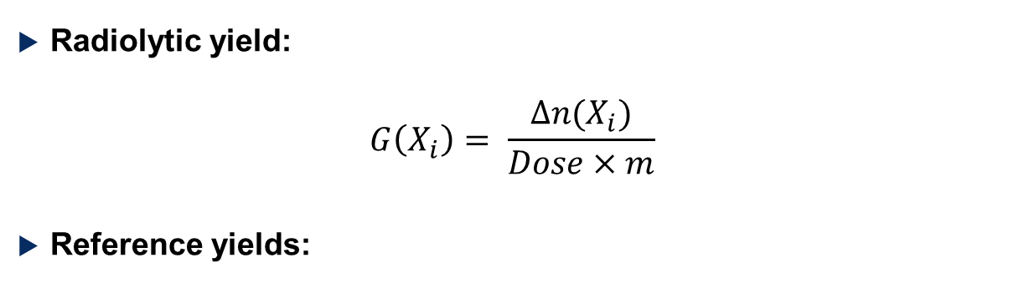
State of the art
Radiolytic yield:
$$G\left(X_{i}\right)= \frac{Δn(X_{i})}{Dose×m}$$
Reference yields:
Δn(X_{i}): quantity produced/destroyed (mol)
Dose: Gray (J.kg⁻¹)
m: irradiated mass (kg)
Measuring radiolytic yields on cement paste
Author | Treatment prior to irradiation | G(H₂) (mol.J⁻¹) × 10⁸
Yin et al (2019) | *R.H. = 30%. | 3.6
 | Lyophilization | 3.3
Le Caër et al. (2017) | T = 110°C + R.H. = 11% | 1.3 – 2.3
 | T = 110°C + R.H. = 0% (0°C) | 0.3 – 0.5
Ishikawa et al (2019) | T = 40°C | 1.4
 | T = 120°C | 0.06
Irradiation with free water
Attempt to remove adsorbed water
* Relative humidity
9

Slide 30
Extrapolation to a real material
Results
Radiolysis of solid phase and production of H₂
Proposition of production mechanisms
Portlandite stores some of the H₂ produced
Laboratory materials
ALIENOR Accelerator
Portlandite: Ca(OH)₂
Laboratory results are difficult to transpose to an operational context
Use of an irradiation source with a more realistic dose rate
How much H₂ should be counted for portlandite?
Is the portlandite used representative of the portlandite in a cementitious matrix?
24

Slide 31
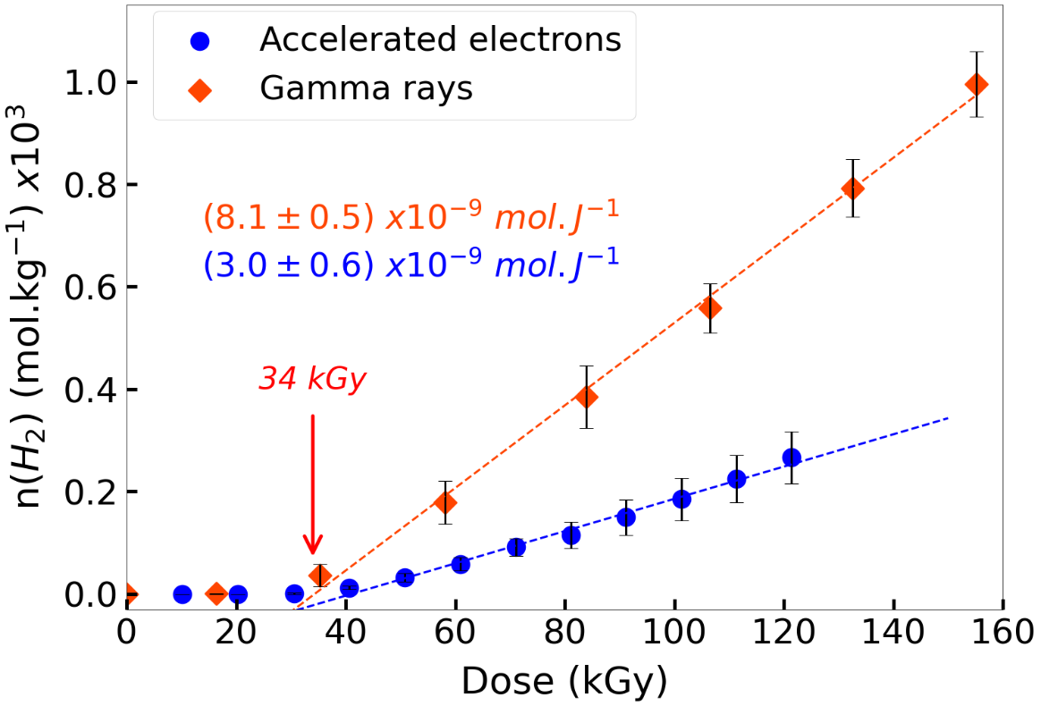
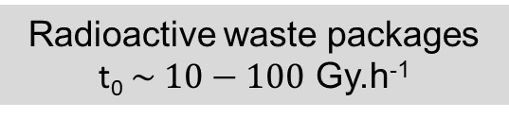
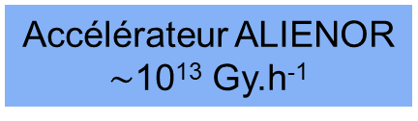
Influence of dose rate
Operating context
Laboratory
Radioactive waste packages
t₀ $\sim 10−100$ Gy.h⁻¹
ALIENOR Accelerator
10¹³ Gy.h⁻¹
Gamma source ¹³⁷Cs
270 Gy.h⁻¹
« Immediate » H₂ production
Ca(OH)₂
Molecular hydrogen production follows the same trend regardless of whether the irradiation is done with gamma rays or accelerated electrons;
The H₂ radiolytic yield is 2 to 3 times higher with gamma irradiation, despite its dose rate being several orders of magnitude lower than that of electron irradiation.
25

Slide 32
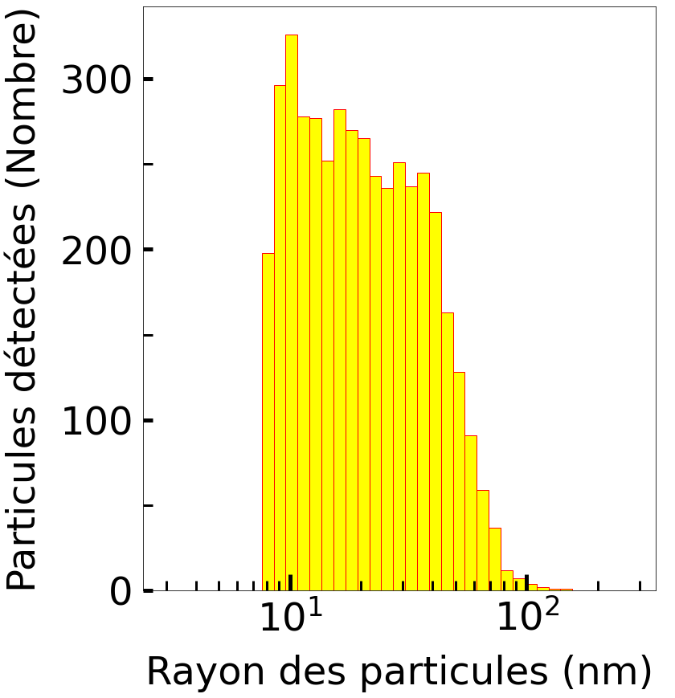
How much H₂ should be considered in portlandite? Can we model H₂ transport?
Modeling delayed H₂ transport
Determination of portlandite particle size
Observation by TEM (Transmission Electron Microscopy)
Image analysis to obtain particle size distribution
Processing
Number of detected particles
Radius of the particles (nm)
26

