Slide 1
EuCARD RF-Tech Meeting
2 December 2010, PSI
WP10-SRF
SC RF technology for higher intensity proton
accelerators & higher energy electron linacs

Slide 2
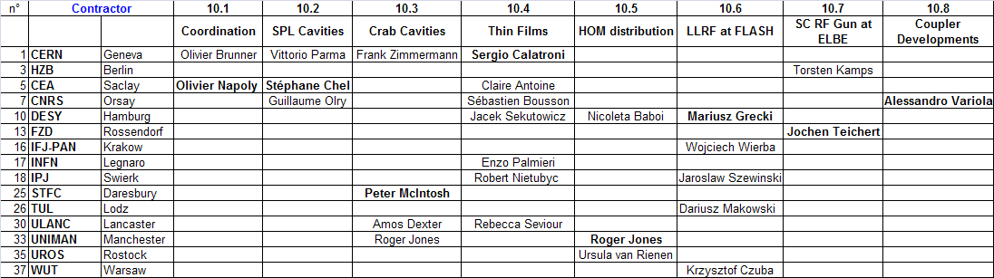
SRF Task Matrix
Walid Kaabi
Task Coordinators
SRF Deputy and Task Contact Persons

Slide 3
SRF EC Budget
EC Subsidies over 4 years : April 2009 – March 2013

Slide 4
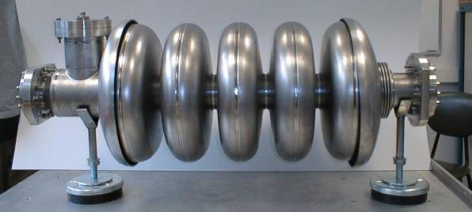
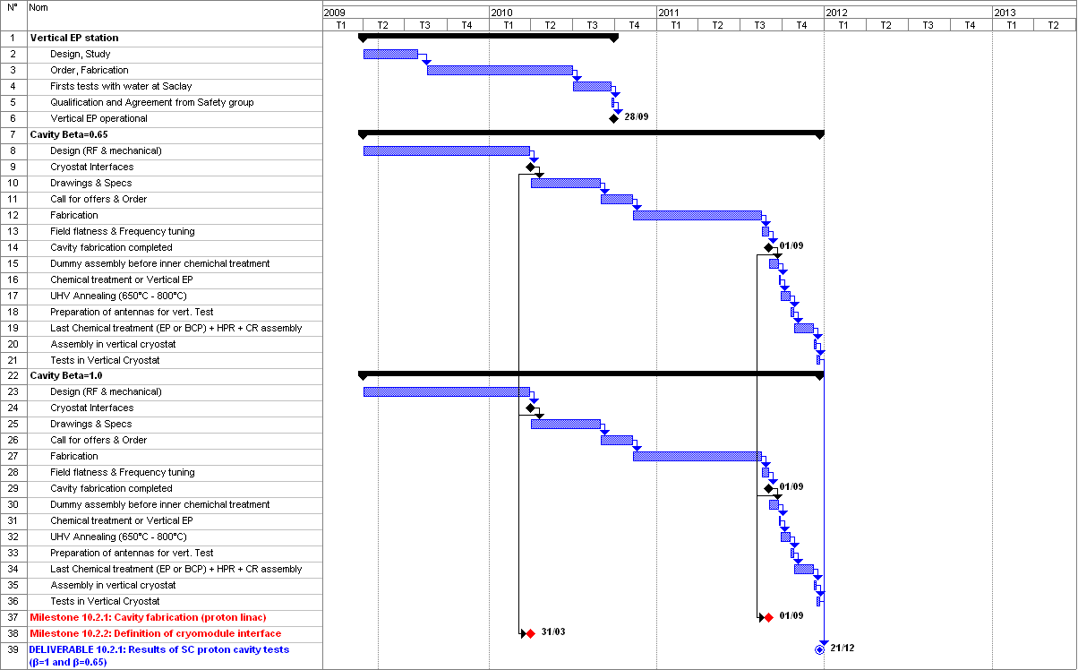
WP10.2: Proton Linac Cavities

Slide 5
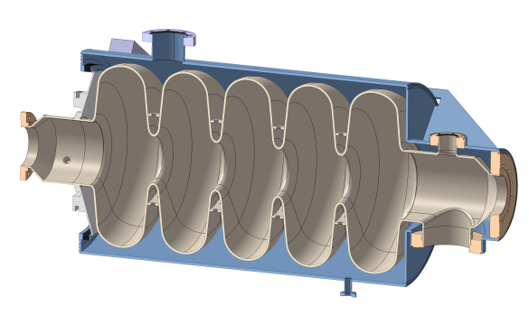
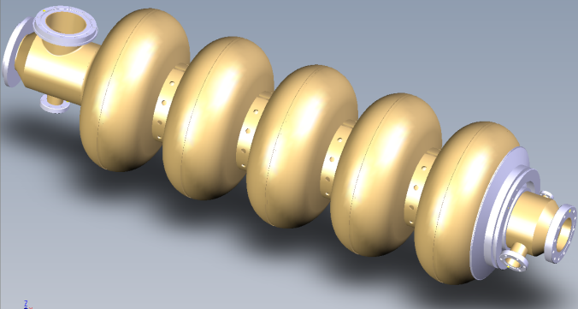
WP10.2: Proton Linac Cavities
704 MHz Cavities
3D-model of the β=0.65 - 704 MHz
Nb cavity with helium tank
3D-model of the β=1 - 704 MHz Nb cavity
IPN/Orsay and CEA/Saclay decided to standardize the beam end-pipes in order to perform qualification tests in the horizontal cryostat CryHoLab of their common platform SUPRATech.
Both helium tanks are made of titanium and, on one side, are equipped with the same titanium thick disk welded on cavity end-tube on which fits the lateral tuner already developed (Saclay IV type with one piezo actuator).
Technical specifications are almost ready, and documents for the calls for tender are in preparation. Technical specifications are almost ready, and documents for the calls for tender are in preparation.

Slide 6
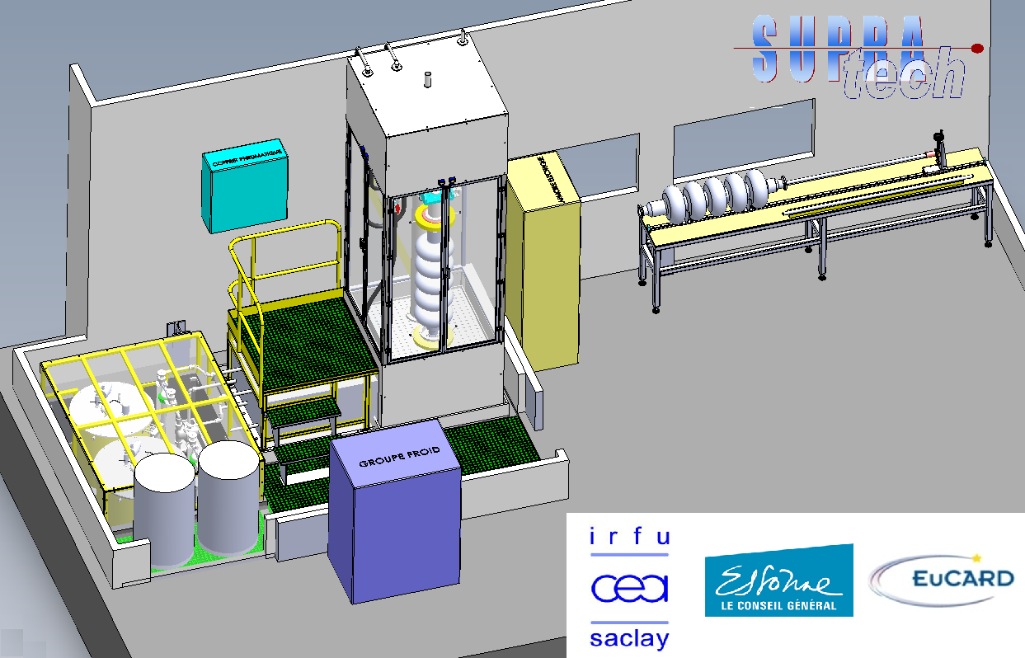
WP10.2: Proton Linac Cavities
Vertical EP Station
The technical study of this new ‘vertical EP station’ is now completed.
The order for fabrication is being placed.

Slide 7
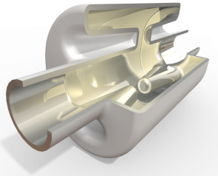
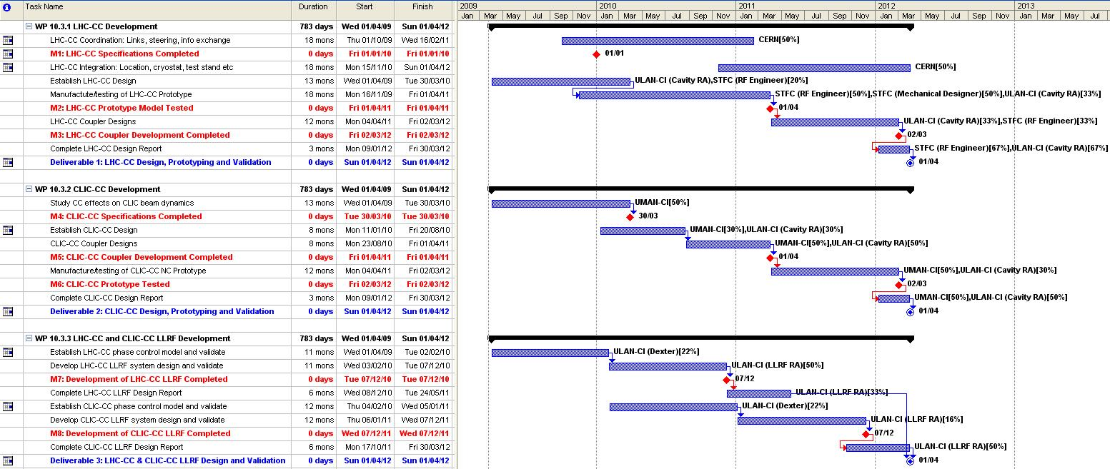
WP10.3: Crab Cavities

Slide 8
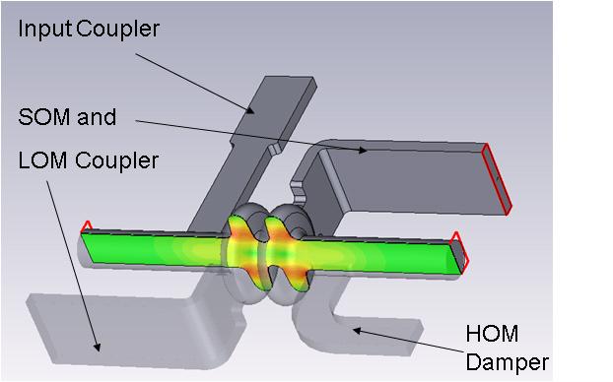

WP10.3: Crab Cavities : LHC
Milestone M10.3.1 LHC-CC Specification report issued in M14.
Two alternative cavity options developed:
  An 800 MHz elliptical cavity
  A compact TEM 400 MHz cavity,
At LHC-CC09 Workshop at CERN in Sept 2009, decision made to focus international efforts on compact cavities for both local and global crossing schemes.
EUCARD compact SRF cavity is a four-rod design using a parallel bar transmission line, based on an existing CEBAF RF deflector.
Rod separation has been increased to accommodate the larger LHC beam aperture, and also stiffened to avoid microphonics.
Cavity has a maximum surface magnetic field of 62 mT at a transverse gradient of 3 MV/m.
800 MHz Elliptical
400 MHz Compact TEM

Slide 9
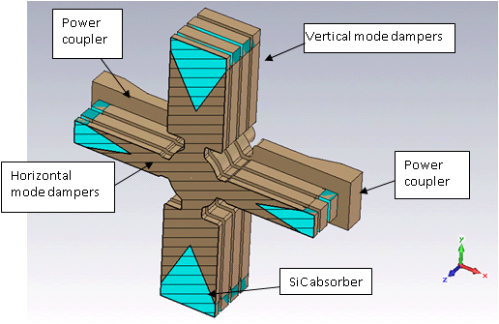
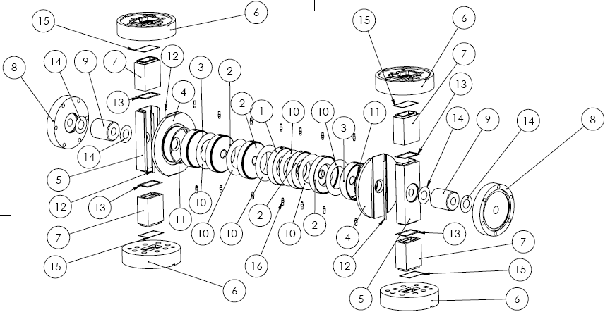
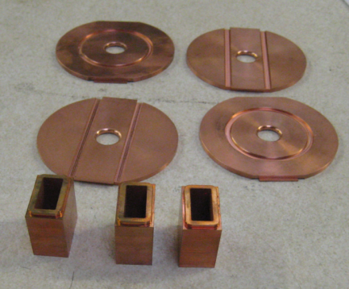

WP10.3: Crab Cavities : CLIC
Milestone M10.3.4 CLIC-CC Specification report issued in M15.
For CLIC-CC phase synchronization (~0.020º) highly stable matched cavities driven from the same klystron proposed.
For adequate amplitude stability (~1.5%), a high energy flow through the cavity is needed so that beam loading becomes a temporary transient as energy quickly propagates out of the structure.
Wakefields managed by using large iris apertures, minimum number of cells, strong damping for transverse modes (Q_{ext}~40) and moderate damping for longitudinal modes (Q_{ext}~1400).
Various damping schemes investigated, with a preference for waveguide damping.
Reducing the number of cells is a complex optimisation process between available klystron power, maximum surface field and energy flow through the structure for amplitude stability.
A prototype structure to provide this data is currently being manufactured in UK industry.
LLRF circuits have also been designed and constructed for accurate phase measurement during the 156 ns RF pulse.

Slide 10
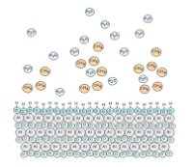
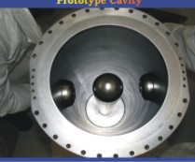
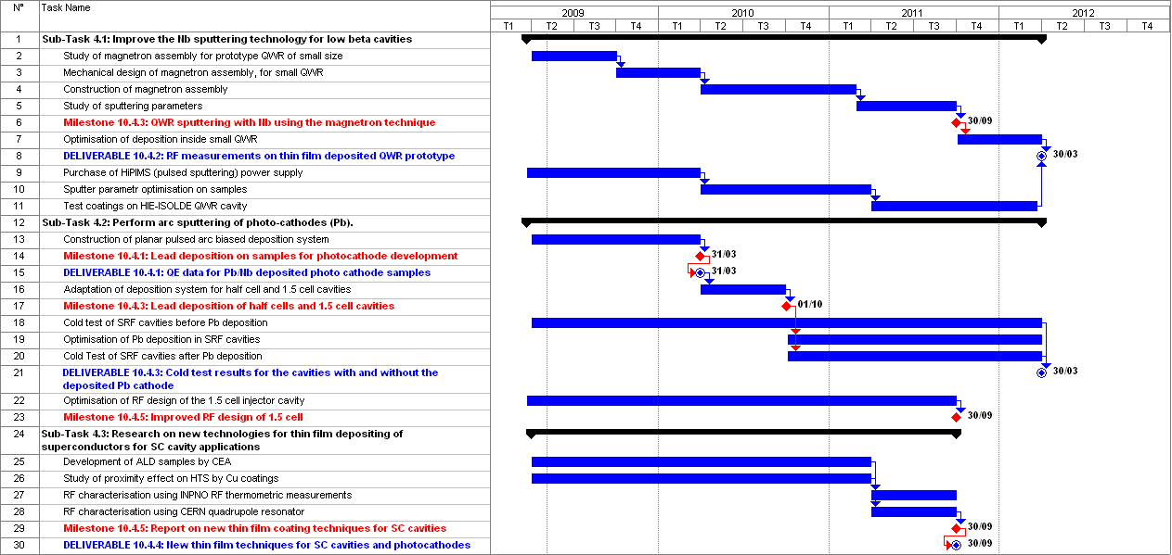
WP10.4: Thin Films

Slide 11
WP10.4: Thin Films
Supporting pictures showing the progress over the first 18 months of EuCARD:
First (CERN) magnetron coated HIE-ISOLDE cavity
HIPIMS (High impulse power magnetron sputtering) output signals during a Nb test coating on samples
Pb/Nb photocathodes by arc plasma coating and RF results
TE011 RF measurements with thermometry technique
NbN/MgO/Nb layered sample Hc1 measurement

Slide 12
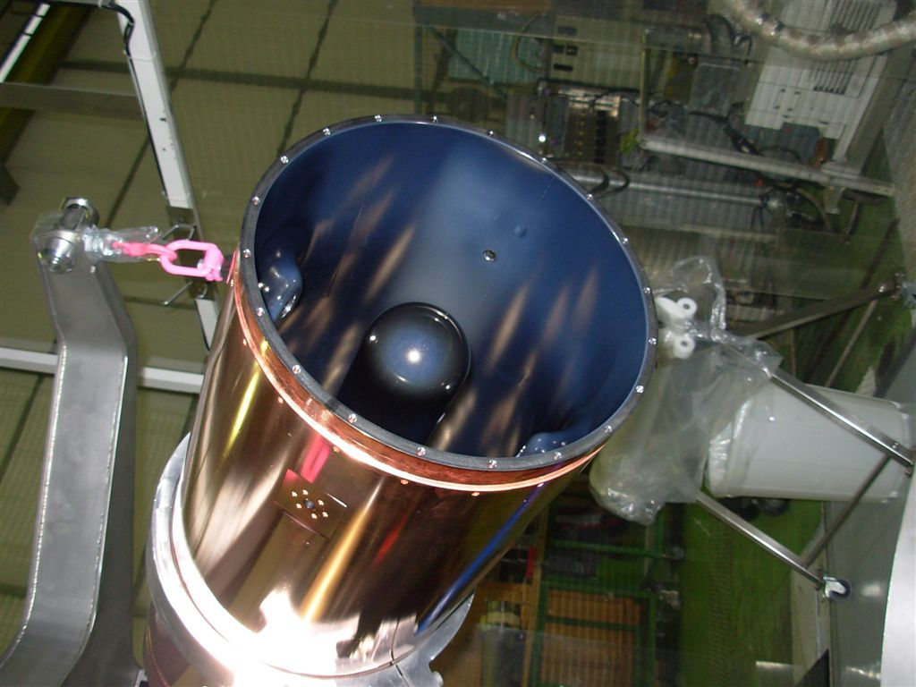
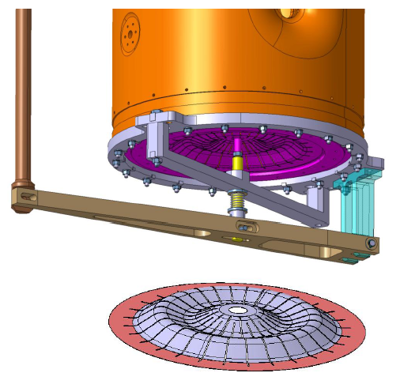
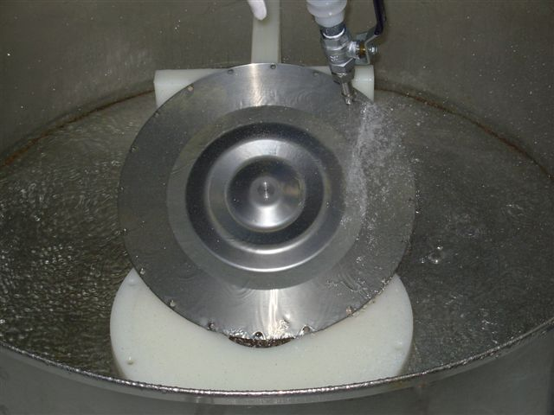
WP10.4: Thin Films
First QWR HIE-ISOLDE cavity coated with cylindrical magnetron at CERN

Slide 13
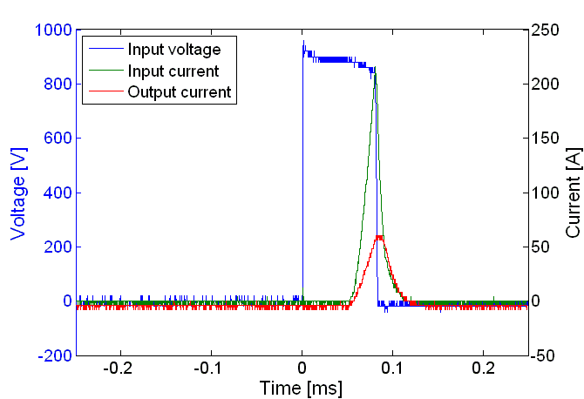
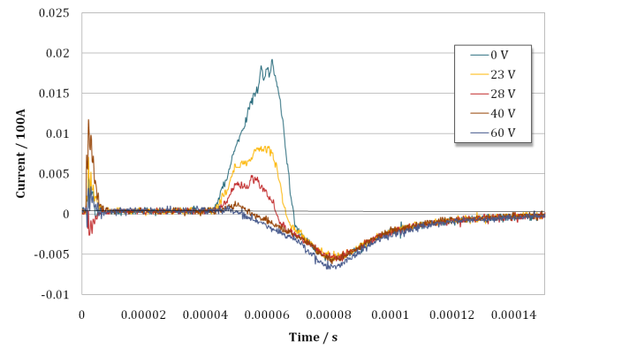
WP10.4: Thin Films
Quarter Wave Resonator
Example of pulse shape for HiPIMS setup Peak power is here 160 kW | Output current at different bias voltages: Nb ions are captured and e- repelled at higher bias voltage

Slide 14
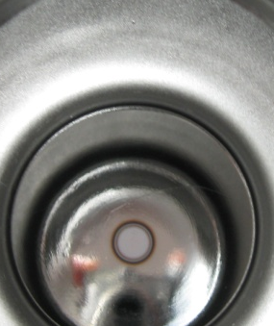
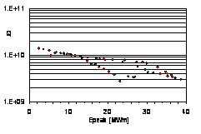
WP10.4: Thin Films
Pb/Nb photocathodes
 | Pb spot (10 mm diameter) on 1.6-cell cavity | Two Q(E_{peak}) measurements of DESY1 cavity with Pb coating
A second 1.6-cell cavity was coated for the QE and beam quality tests at BESSY, which are scheduled for the end of this year

Slide 15
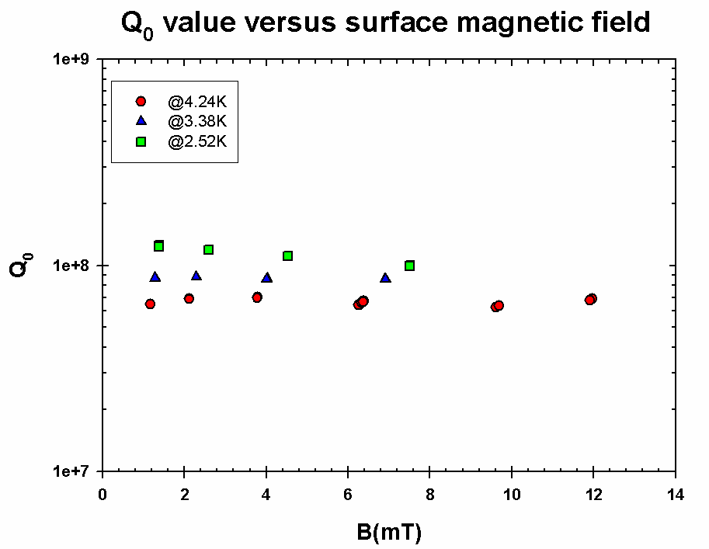
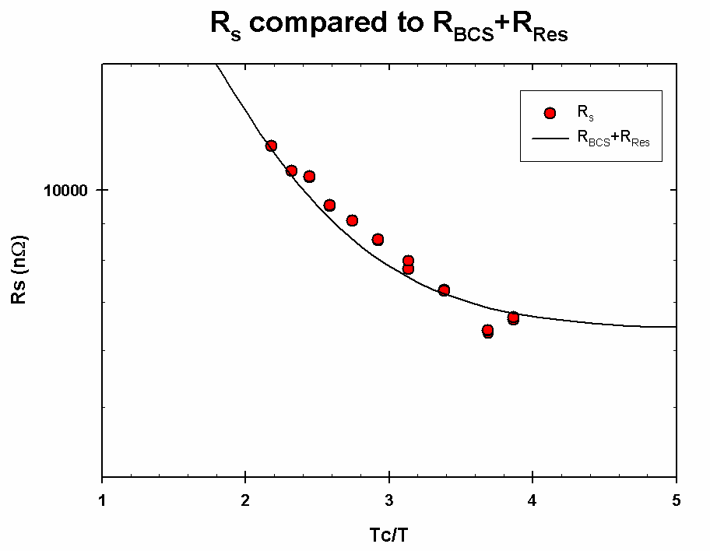
WP10.4: Thin Films
Novel Techniques
TE011 cavity has been commissioned: first results show that the expected sensitivity by thermometric method is reached.
The cavity is practically ready for measuring samples from associated laboratories.
Q0 factor versus peak magnetic field on the Nb sample | Surface resistance versus Tc/T

Slide 16
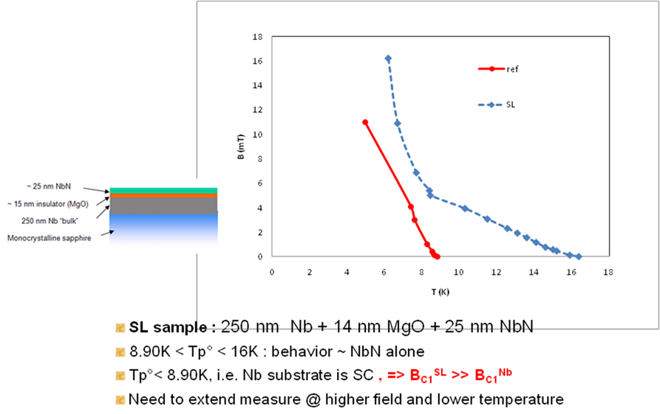
WP10.4: Thin Films
Novel Techniques

Slide 17
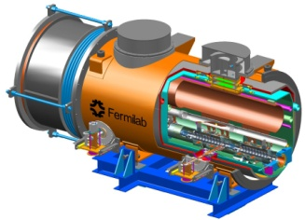
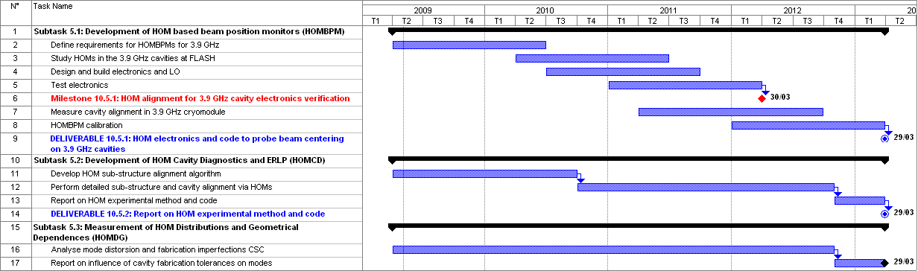
WP10.5: HOM Distribution

Slide 18
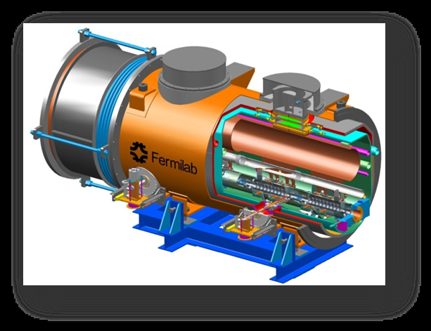
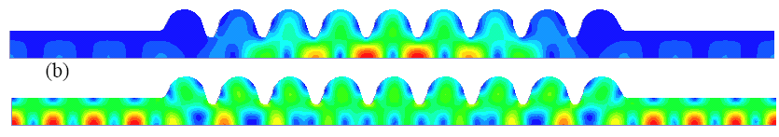
WP10.5: HOM Distribution
Description of the Work
Task 5.1 : HOM Beam Based Position Monitor
Major Advance:
FNAL 3.9 GHz module cold test successful.
First measurement of HOM at 2K at DESY.
Task 5.2 : HOM Cavity Diagnostics
Design Work: HOM passbands (monopole, dipole and sextupole) calculated.
Fabrication errors
modelled to study
influence on field flatness
Task 5.3 : HOM Distribution and Geometrical Dependencies
Preparation Work: code developments (Mathematica, CST) for Coupled S-Parameter Calculation (CSC)

Slide 19
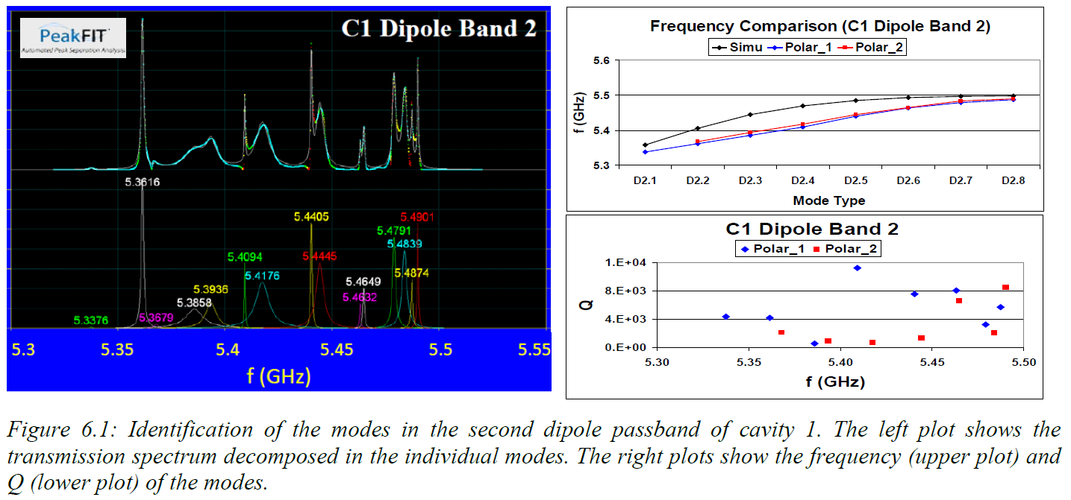
WP10.5: HOM Distribution
Dipole Passband of first 3.9 GHz Cavity

Slide 20
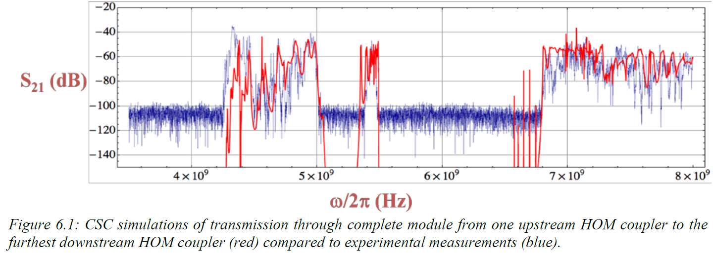
WP10.5: HOM Distribution
Transmission though the entire 4-cavity module:

Slide 21
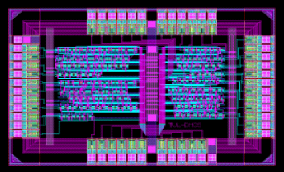
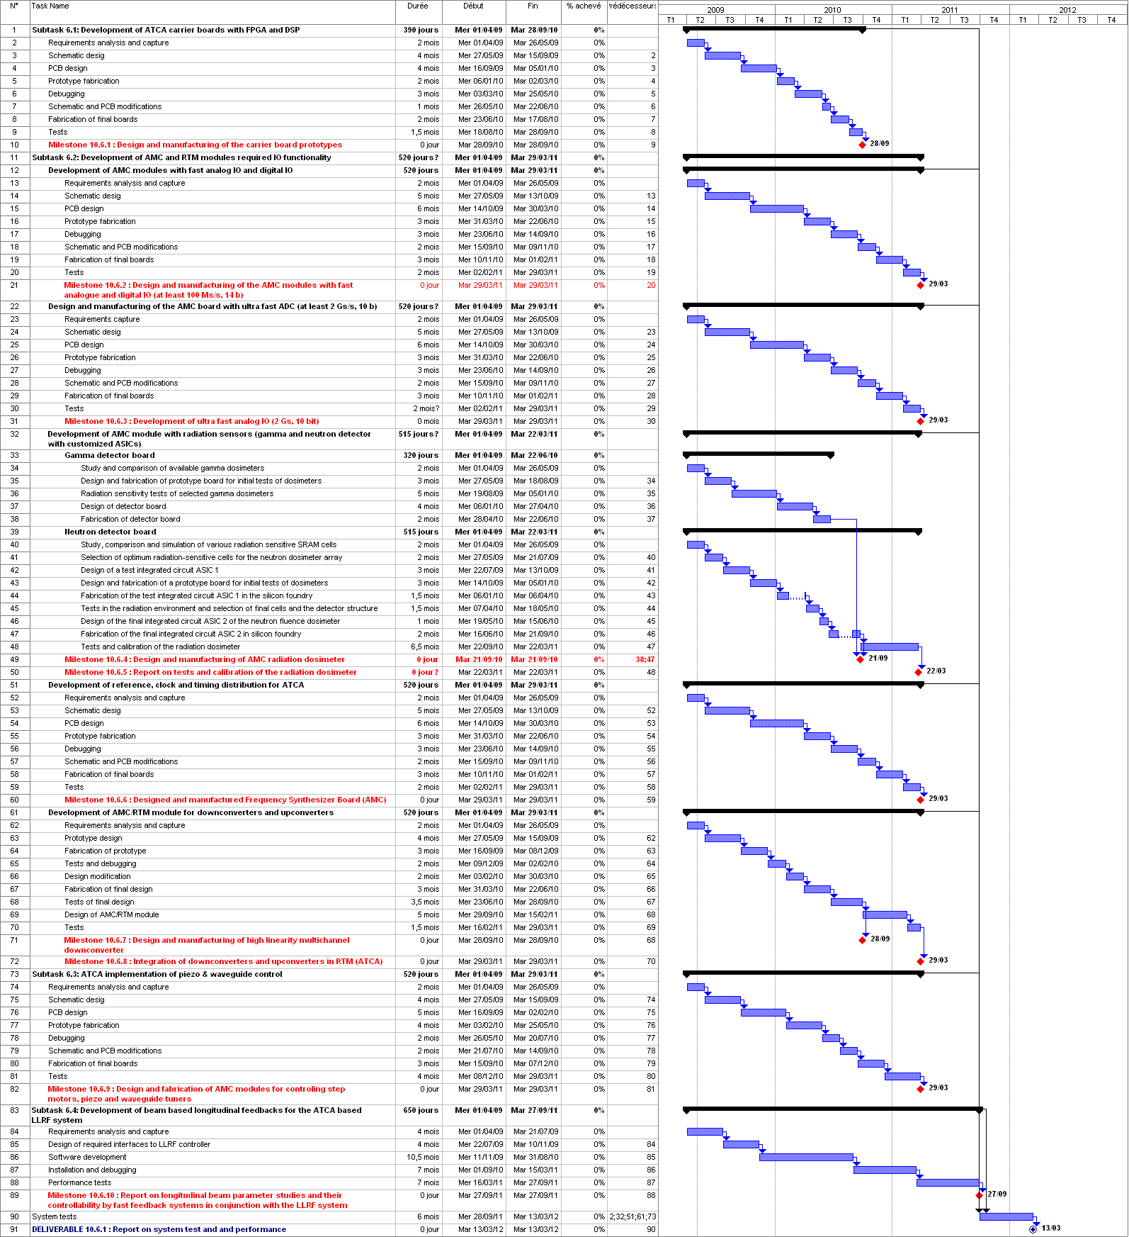
WP10.6: LLRF at FLASH

Slide 22
WP10.6: LLRF at FLASH

Slide 23
WP10.6: LLRF at FLASH
M10.6.1 : Assembled PCB of Carrier Board

Slide 24
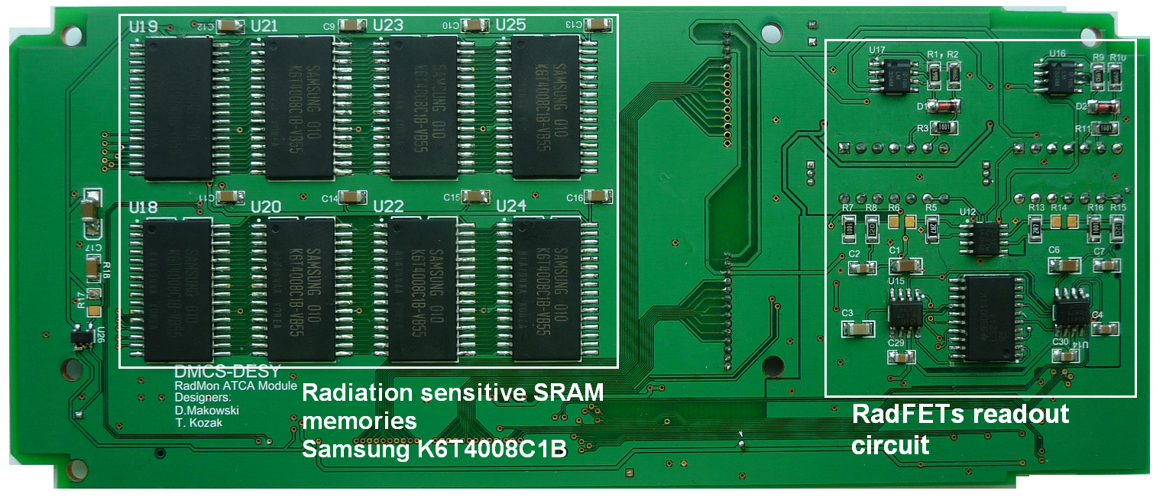
WP10.6: LLRF at FLASH
M10.6.4: Assembled AMC Radiation Dosimeter

Slide 25
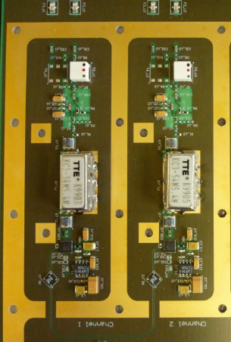
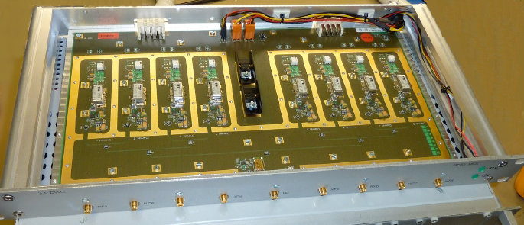
WP10.6: LLRF at FLASH
M10.6.7: High Linearity Multichannel Down Converter
Down Converter module
DWC cells

Slide 26
WP10.6: LLRF at FLASH
Preparation to performance tests of the ATCA based LLRF system at FLASH
  second revision of carrier board and AMC modules (VM, Timing) developed and fabricated
  high linearity multichannel downconverter designed, fabricated and characterized
  AMC radiation monitoring module developed
  firmware and software developed and debugged
Installation and commissioning of beam based feedback at FLASH
Software development at FLASH

Slide 27
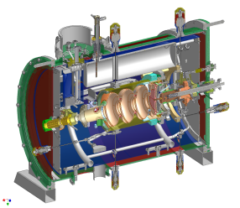
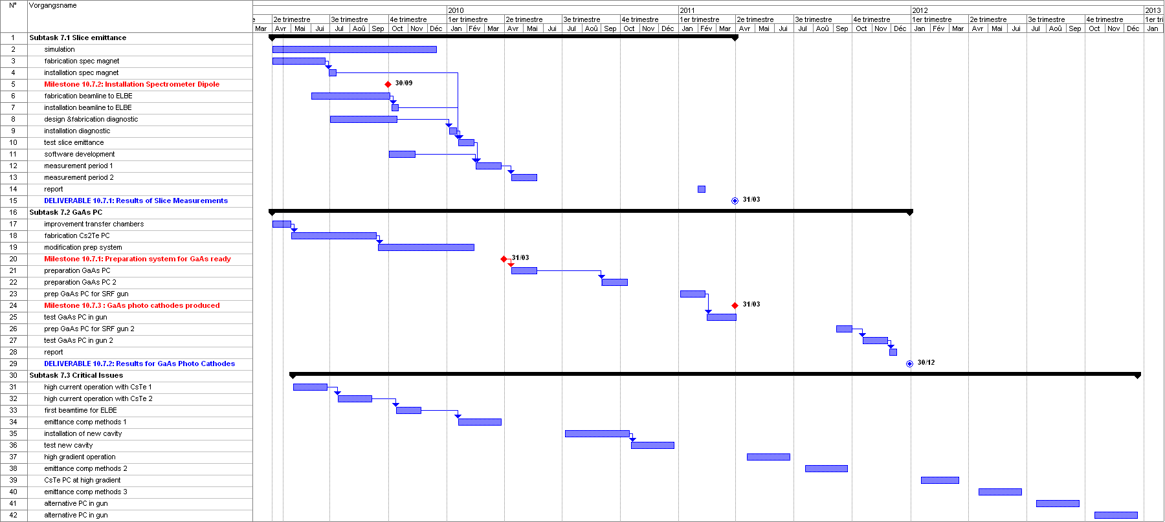
WP10.7: SC RF Gun at ELBE

Slide 28
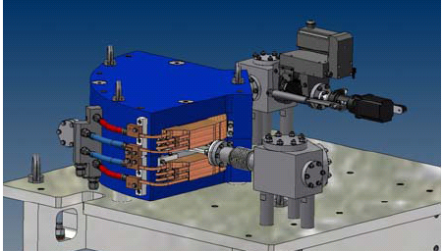
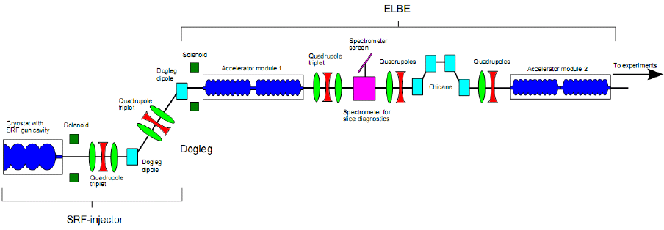
WP10.7: SC RF Gun at ELBE
Description of the Work
Task 7.1 : Slice Emittance Measurements
Major Advance: the spectrometer magnet is designed
and under fabrication at RI.
Optimal location on ELBE beam line identified.
Task 7.2 : GaAs Photo-cathodes
Preparation work: repair of the cathode transfer system (vacuum)
Fabrication of the GaAs preparation chamber (with DALINAC)
Task 7.3 : Critical Issues for SRF Gun Operation
Preparation work: first beam operation of diagnostic tool for transverse (slit mask) and longitudinal (streak camera) profiles.

Slide 29
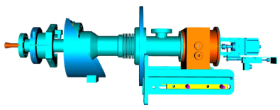
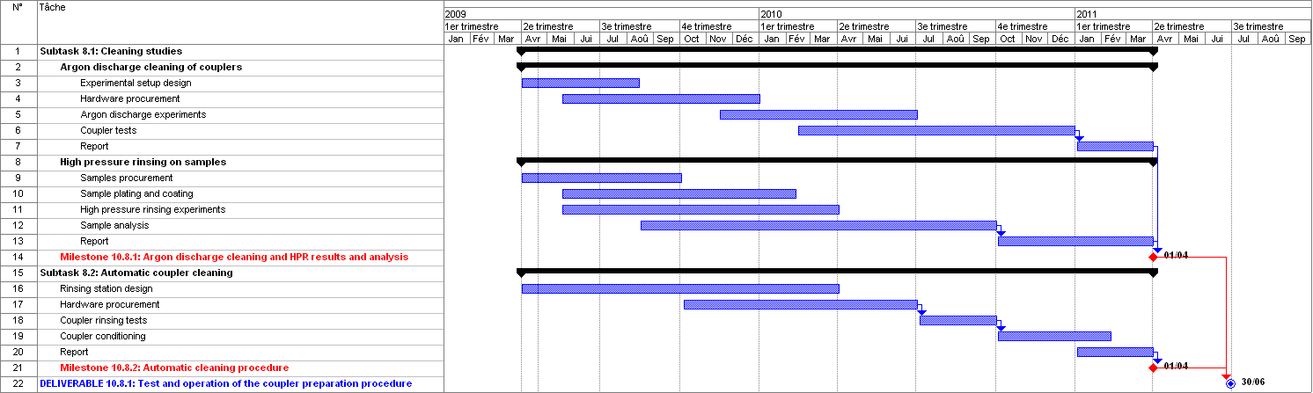
WP10.8: Coupler Development at LAL

Slide 30
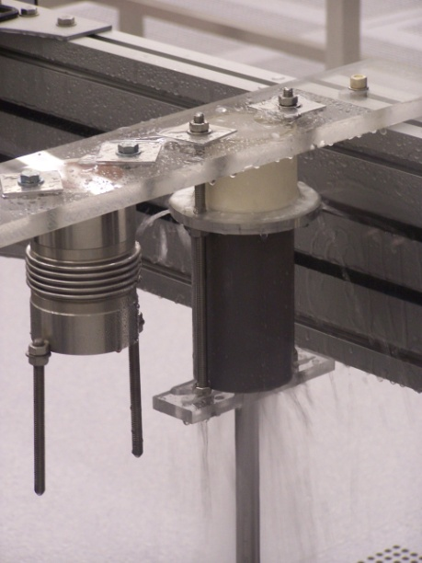
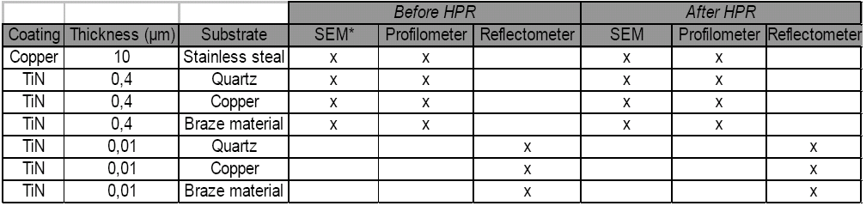
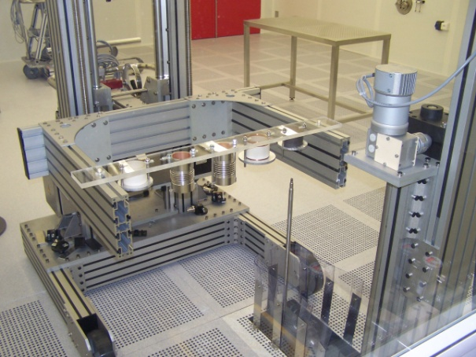
WP10.8: Coupler Development at LAL
Description of the Work
Task 8.1 : Cleaning Studies
Experimental Work: HPR cleaning of samples is going on, in collaboration with IPN-Orsay.
An experimentation programme worked out.
Task 8.2 : Automatic Coupler Cleaning
Design work: conceptual design of the cleaning robot, and detailed cleaning procedure worked out.

Slide 31
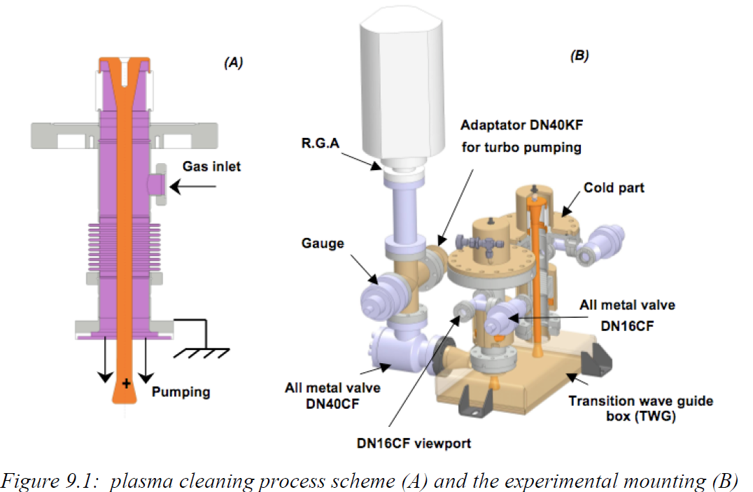
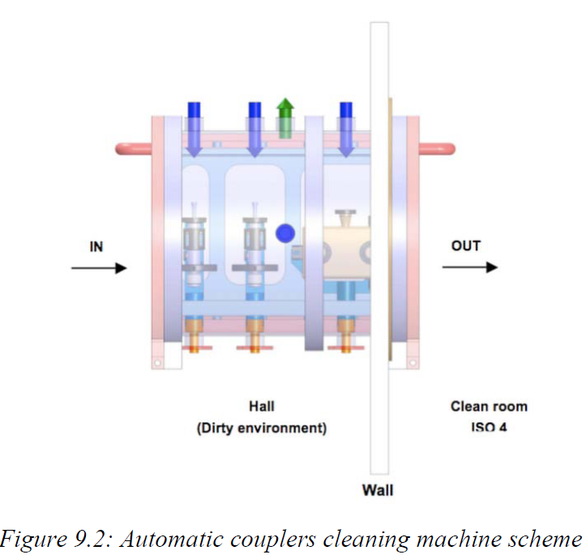
WP10.8: Coupler Development at LAL
Task 8.2 : Automatic Coupler Cleaning
Design work: conceptual design of the cleaning robot
Task 8.1 : Argon Discharge cleaning of coupler surface.

