Slide 1
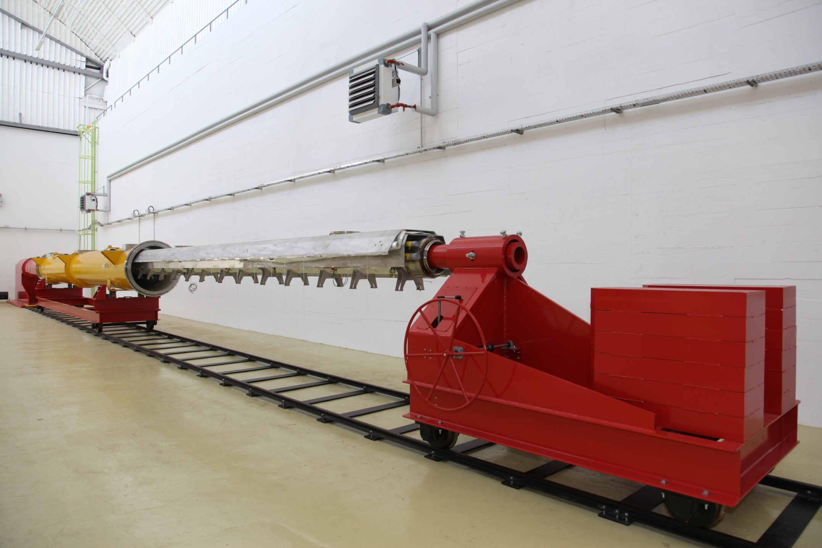
Status of E-XFEL Module Assembly at Saclay
O. Napoly, CEA-Saclay, IRFU/SACM

Slide 2
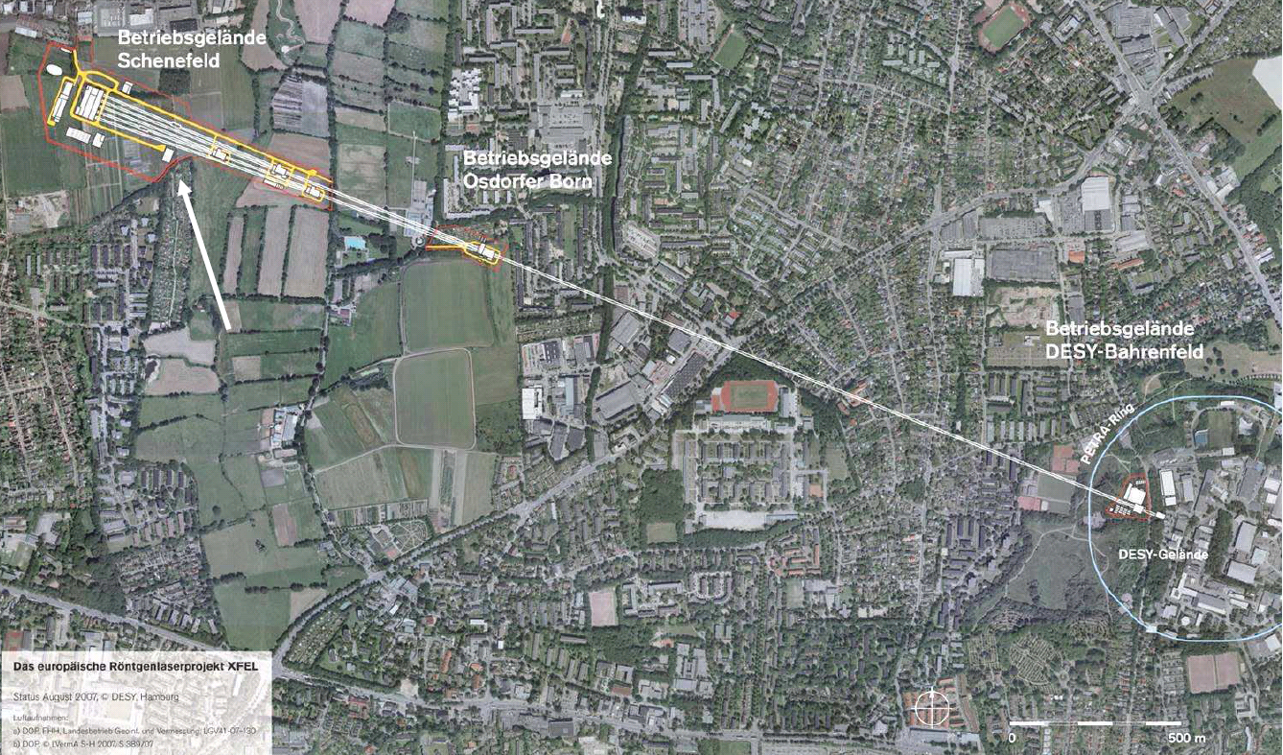
European XFEL Layout
2

Slide 3
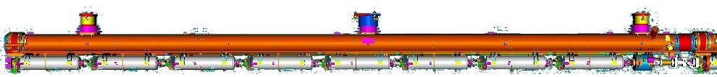





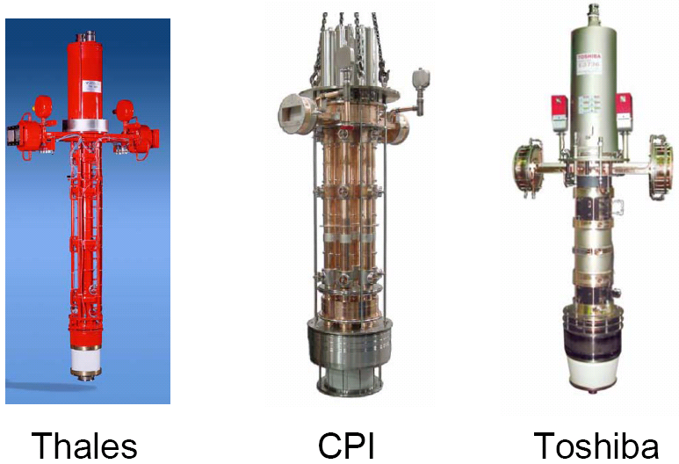
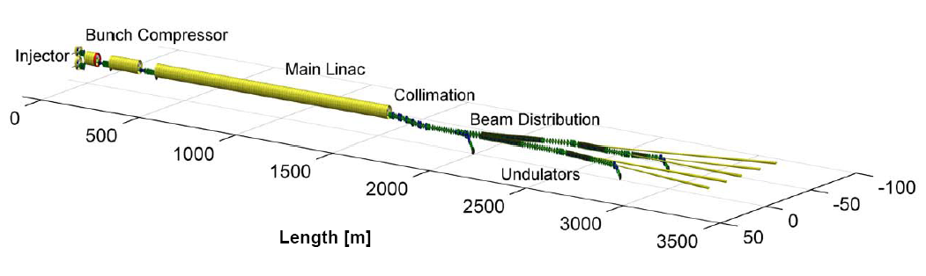
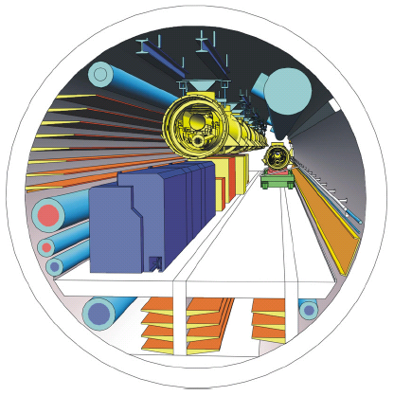
Superconducting Linear Accelerator
1+80 cryomodules
8+640 cavities
1.3 GHz / 24.3 MV/m
648 RF couplers
120 kW @ 5 mA
20 RF stations (10 MW) operating at 5,2 MW
1
1
5
18-38 m underground
1 cryogenic sector : 120 W @2K, 204 W @5-8K, 1,4 kW @40-80K

Slide 4
CEA contributes to the
XFEL Cold Linac construction through
Cavity String Assembly (WP9) and Module Assembly (WP3)
↓
Accelerator Module Assembly of 3+80 accelerator modules with 1 per week throughput ! operated by an industrial contractor on the Saclay site.

Slide 5
Project Timeline
Our effort develops over the 3 phases:
Phase 1: Preparation of Infrastructure and Tooling
→ April 2010
Phase 2: Training and Commissioning of XFEL Village at Saclay with XFEL Prototype Modules (PXFEL2 and PXFEL3)
August 2010 → end 2011
leading to Restricted Call for Tender for Assembly Contract
by Q2-2011
Phase 3: XFEL module assembly by ind^{ial}. contractor
Q1-2012 → Q3-2014

Slide 6
Industrialization Baseline
Build the Assembly Tool adapted to the goal of 1 module/week
  normal mode → 7 workstations for 7 week assembly time
  degraded mode → doubling of most workstations
Review assembly procedures to avoid variations and other sources of man errors
→ long training phase with prototype modules
→ pre-industrialization phase with pre-series modules
→ optimize procurement of pre-fabricated parts
Implement personnel safety regulations ahead of contract.

Slide 7
Optimisation Rationale
Comply with XFEL project schedule and DESY procedures
→ limited room for unproven innovation
Tailored to Saclay pre-existing hall layout
→ three buildings around a central courtyard
Optimized for cost (manpower) effectiveness
→ 7 (maybe 6) week total assembly time
Optimized for assembly fluidity
→ alternating workstation occupation
Adaptive facility towards future projects
→ maximum module length = 15 m

Slide 8
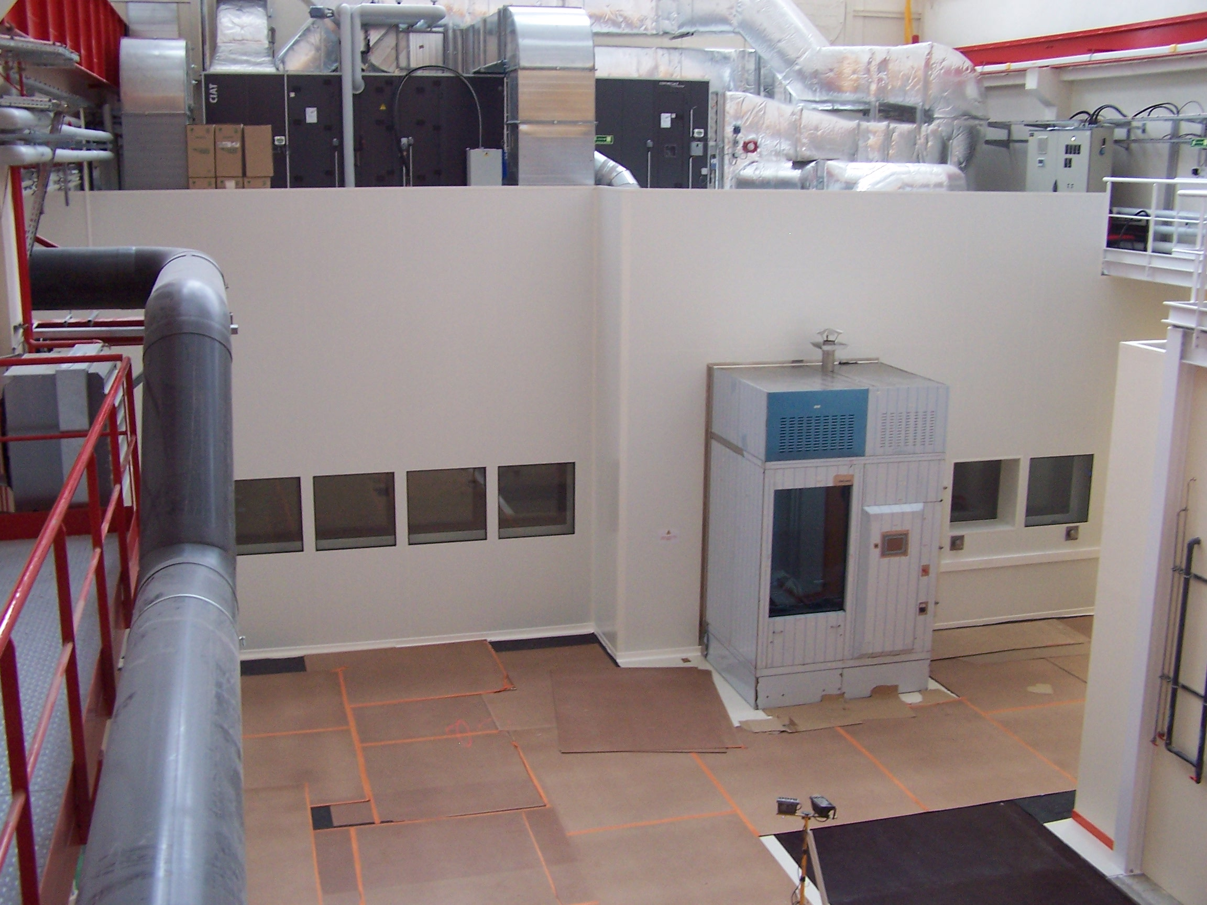
Phase 1: Preparation of Infrastructure and Tooling

Slide 9
Overview of the Assembly Buildings
XFel Village
Clean rooms
7
6
4
Bldg 124 North
25x15 m²
CourtYard
3
2
Assembly halls
Bldg 126 North
40x11 m²
5
1
8
Bldg 126 South 30x17 m²
Offices
6b
Warehouse
©GoogleMap

Slide 10
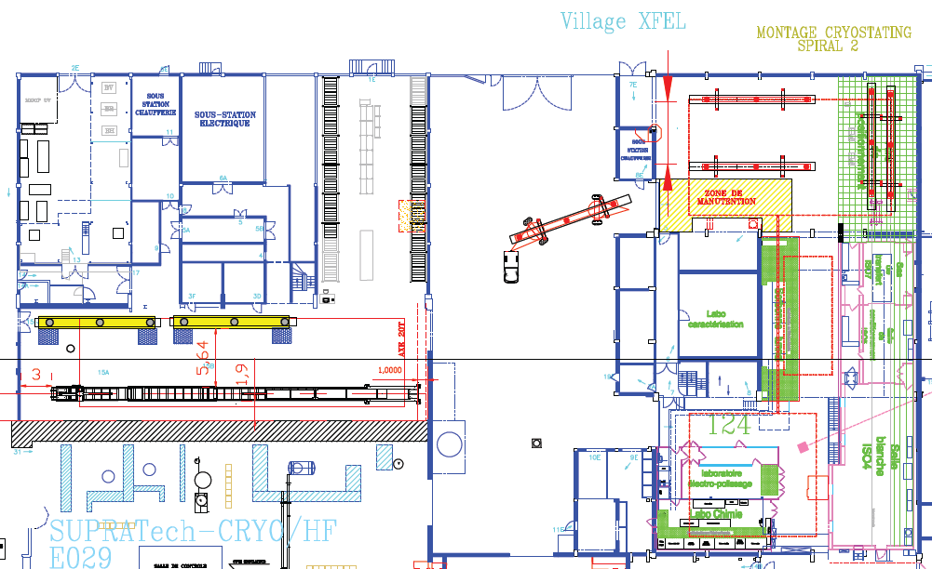
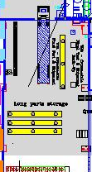
Assembly Hall : Workstations
RO-WS1+2
AL-WS1+2
Ware
house
CO-WS1
CO-WS2
CA-WS1
SH-WS1+2

Slide 11
Organisation of Work Stations
Clean Room Cold Coupler Area (IS04-CC-WS1)
  Cold coupler assembly
Clean Room String Assembly Area (ISO4-SA-WS1, ISO4-SA-WS2)
Roll-out Area (RO-WS1, RO-WS2)
  HOM adjustment, magnetic shielding, tuners,…
  2Ph-tube welding, cold-mass/string connection
Alignment Area (AL-WS1, AL-WS2)
  Cavity and quadrupole fine alignment
  Coupler shields and braids, tuner electric tests
Cantilever Area (CA-WS1)
  Welding of 4K and 70 K shields, super insulation
  Insertion into vacuum vessel and string alignment
Coupler Area (CO-WS1, CO-WS2)
  Warm couplers + coupler pumping line
  Quad current leads
Shipment Area (SH-WS1, SH-WS2)
  Instrumentation
  Control operations (electrical, RF), “acceptance test”
  End-caps closing, N-insulation, loading.

Slide 12
Clean Room : Work Stations
Unpacking / packing and cleaning pieces
ISO4-SA-WS1
Cavity string assembly
(1 string / week)
ISO4-SA-WS2
2nd week string assembly
Cavity storage
Cavity washer
ISO4-CC-WS1
Coupler cold part assembly
(8 cavities / week)

Slide 13
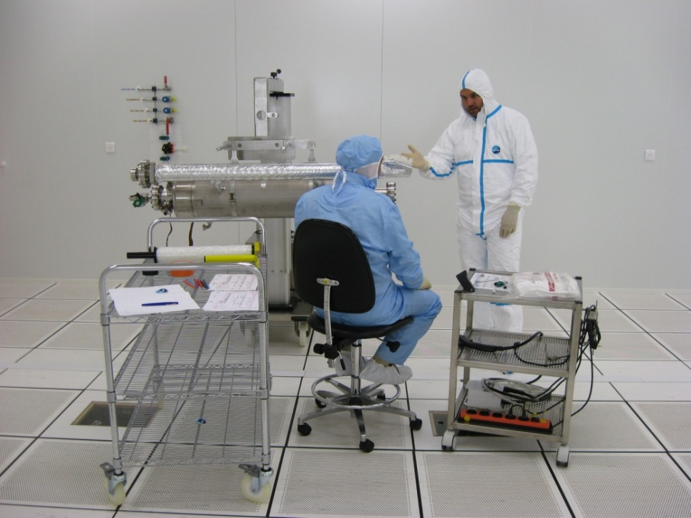
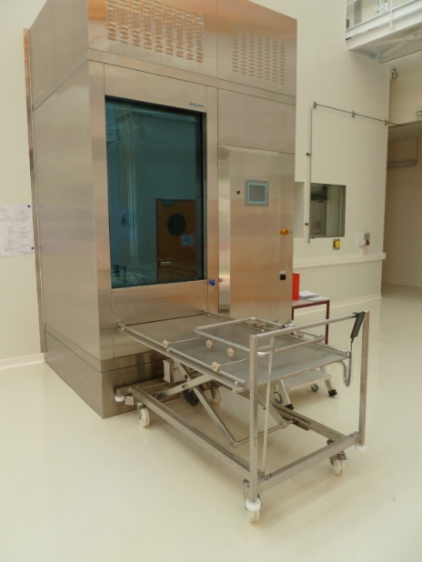
Clean Room Layout
ISO 7
(class 10 000)
28 m²
5.92 m x 4.72 m
ISO 5
(class 100)
38 m²
7.72 m x 4.72 m
ISO4 (Class 10)
112 m²
7.8 m x (6.6+7.8) m
15.6 m

Slide 14
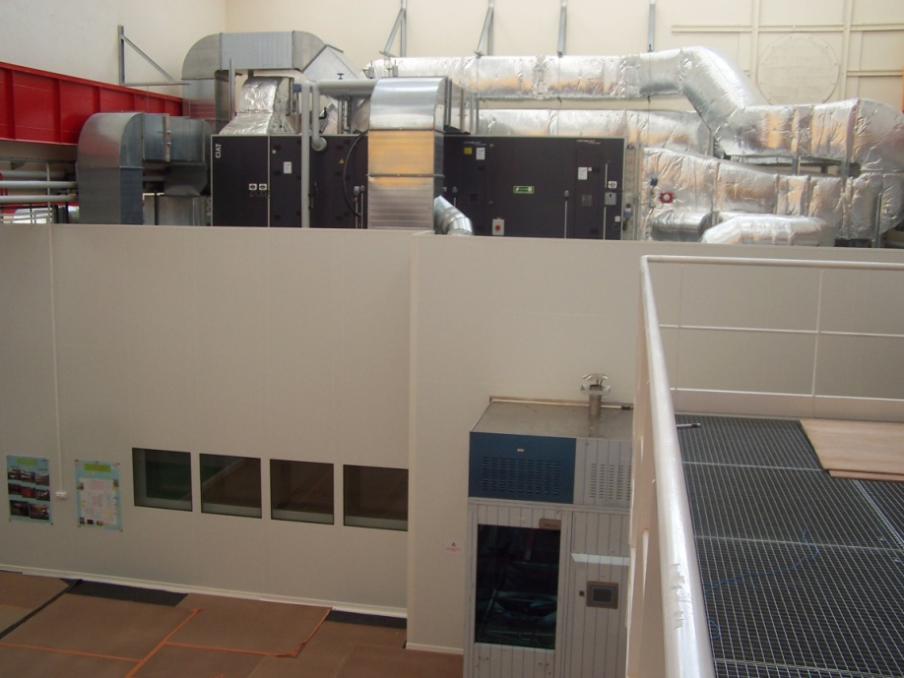
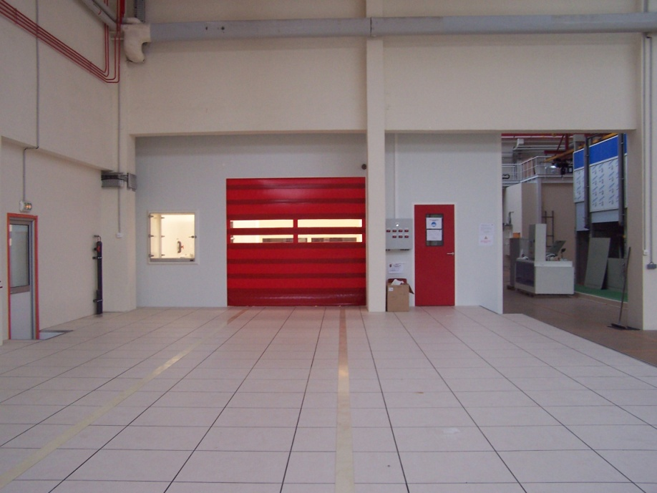
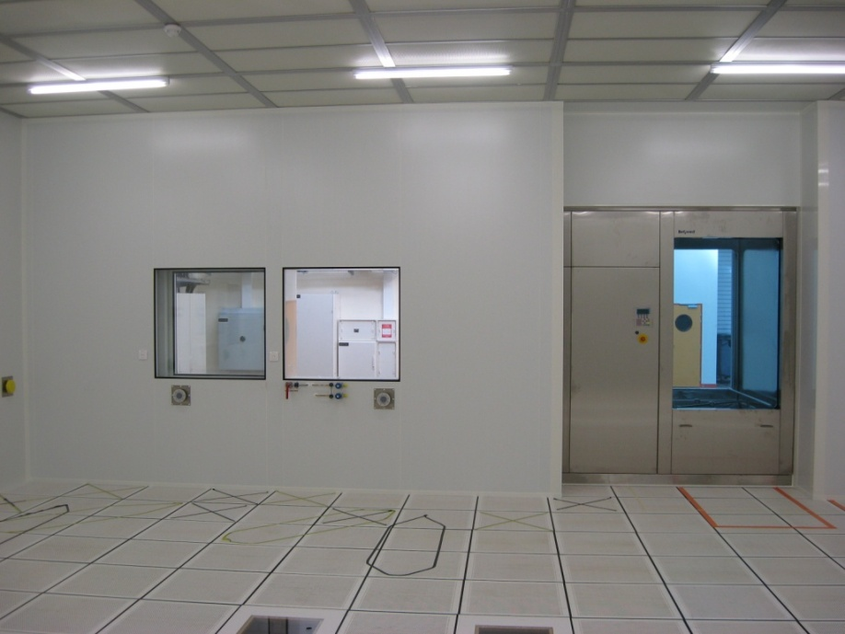
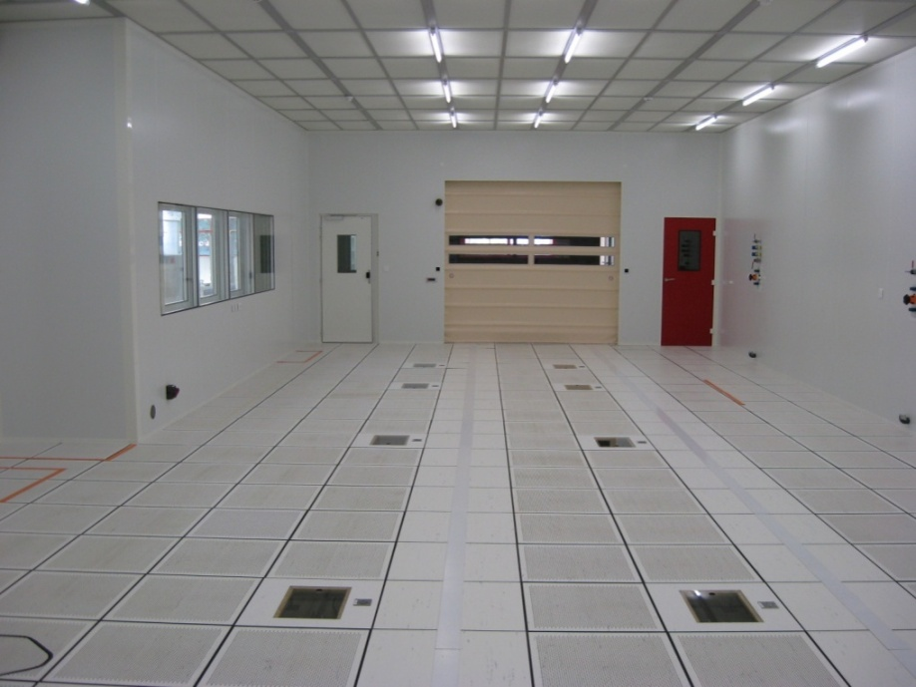
Clean Room constructed (Sept’09)

Slide 15
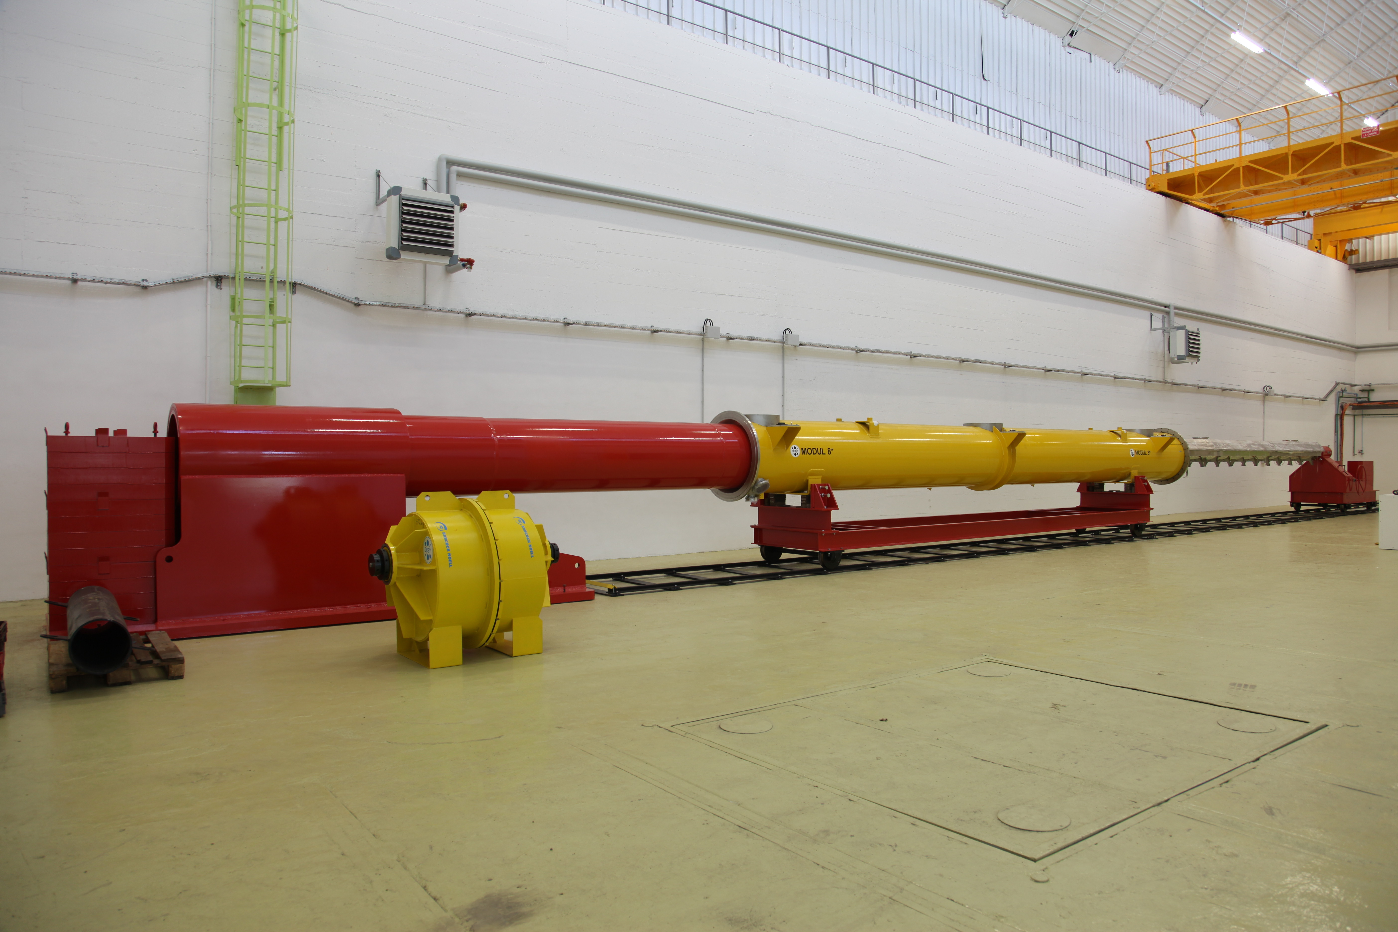
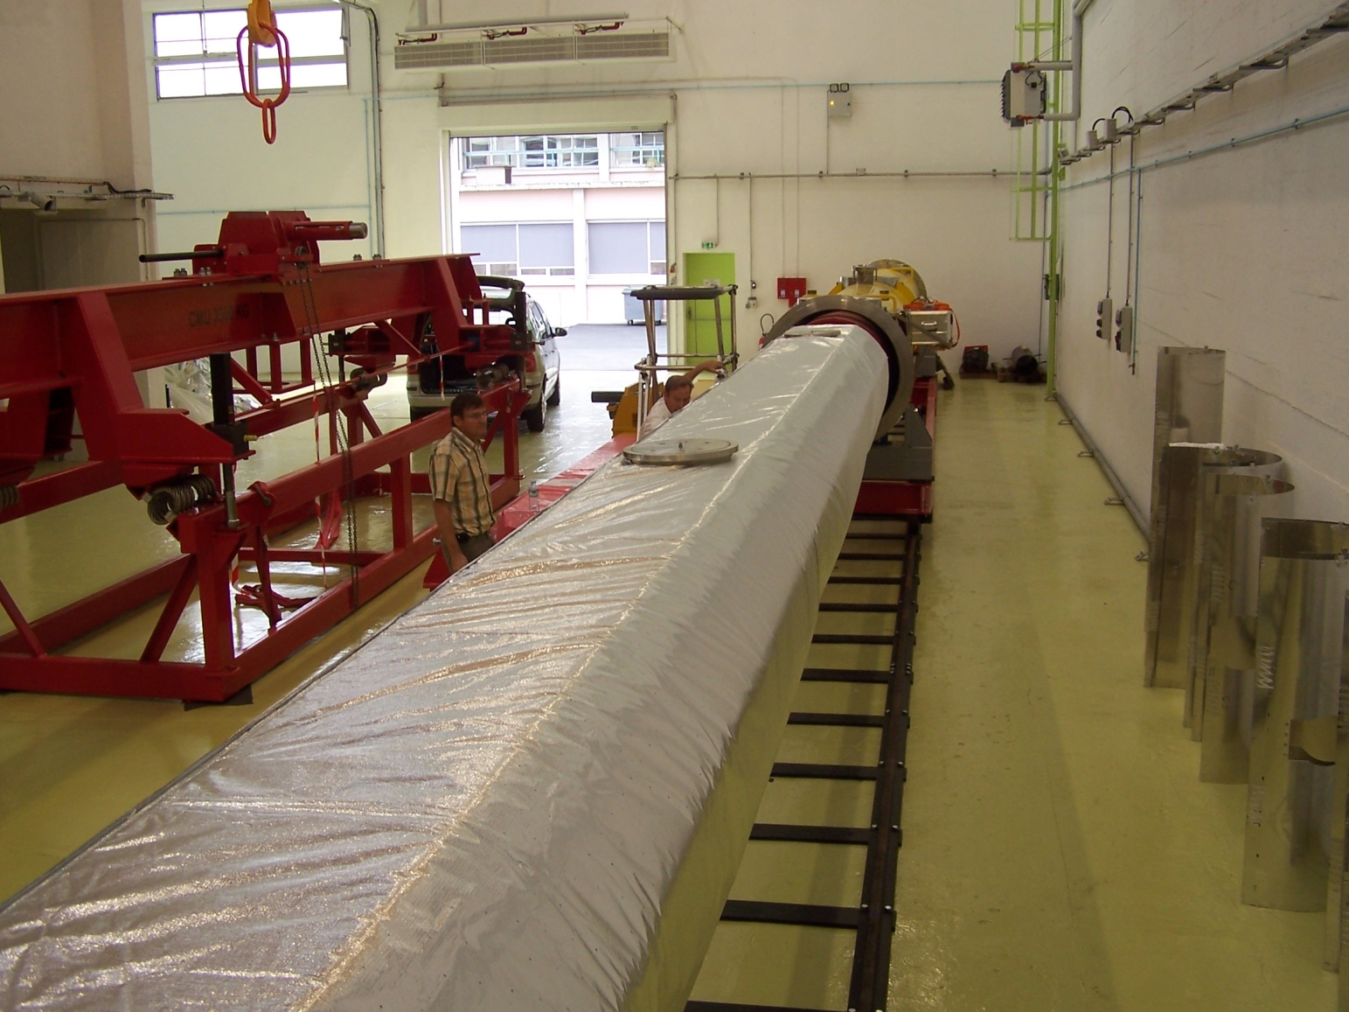
Big Tools Fabrication
«INFN-DESY» Cantilever system and «FNAL» transfer frame
with M8* (no string), May 2010 with PXFEL2, October 2010
(left) (right)

Slide 16
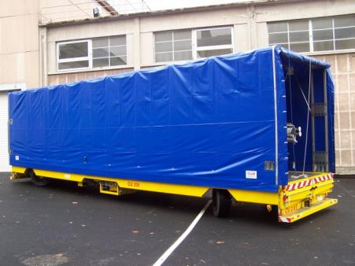
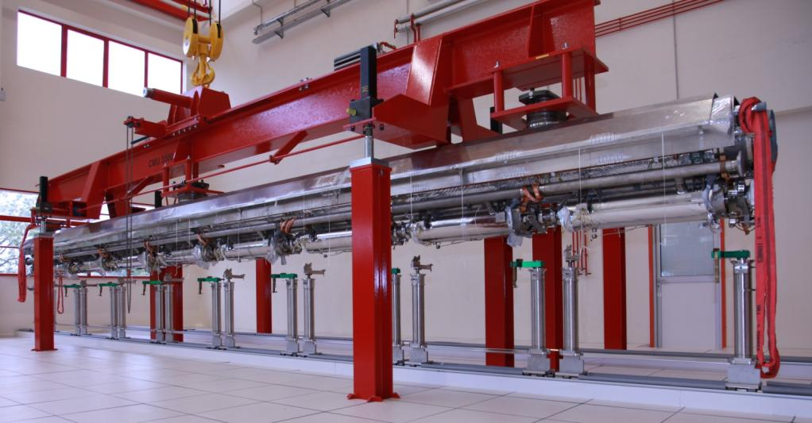
Big Tools Fabrication
«CEA» transfer carriage «INFN-DESY» red girder
with PXFEL2 cold mass and cavity string (october 2010)
First girder (out of 3 units) + 4 sets of pillars + transfer frame
delivered to Saclay in June 2010.
Electric transfer carriage delivered to Saclay in Nov. 2010.

Slide 17
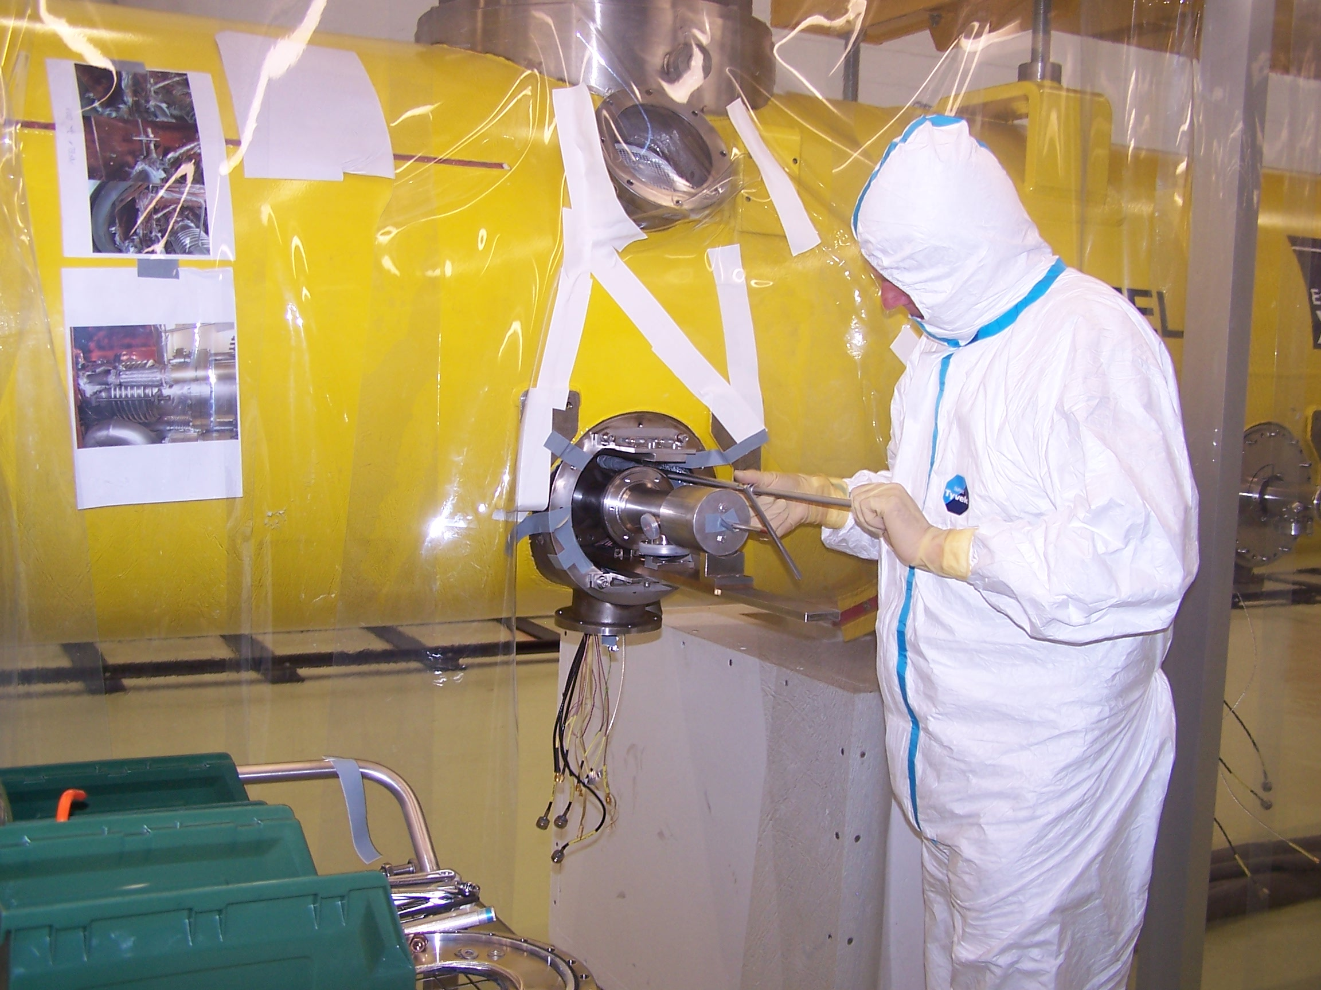
Phase 2:
“XFEL Village” Commissioning with Prototype Modules
(PXFEL 2, PXFEL3)

Slide 18
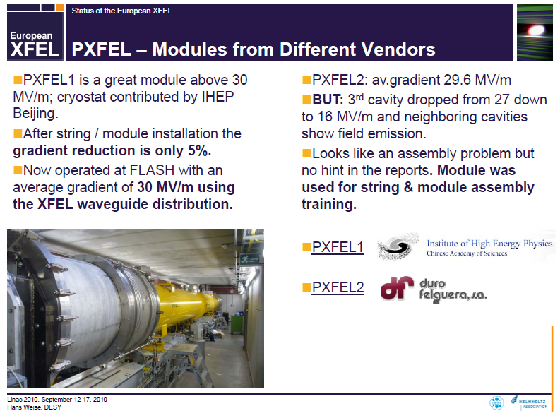
2008-2009 : Assembly Training at DESY
About two years of observation and participation to the assembly operations on M3***, M8**, PXFEL1-3 at DESY by Saclay staff, including HH-Saclay-HH transports.
From Hans Weise’s LINAC’10 presentation:
Actually not correct:
First training to string assembly (clean room) authorized for PXFEL3.
Observation only on PXFEL2 string assembly.

Slide 19
Assembly prototyping at Saclay
Assembly of XFEL prototype cryomodules (PXFEL2 and
PXFEL3) at Saclay aims at:
  Completing the training of the Saclay team;
  Commissioning the infrastructure (XFEL Village)
The team (~10 persons) has started the disassembly of PXFEL2 on August 24th, with ∼continuous help of DESY staff.
Current status on PXFEL2 disassembly and re-assembly:
  Cavity string rolled-in and out of the clean room
  Tuners assembly on October 28th
  String to cold mass (week 45)
  Cavity alignment (week 50)
PXFEL3 assembly from “kit” foreseen for beginning of 2011

Slide 20
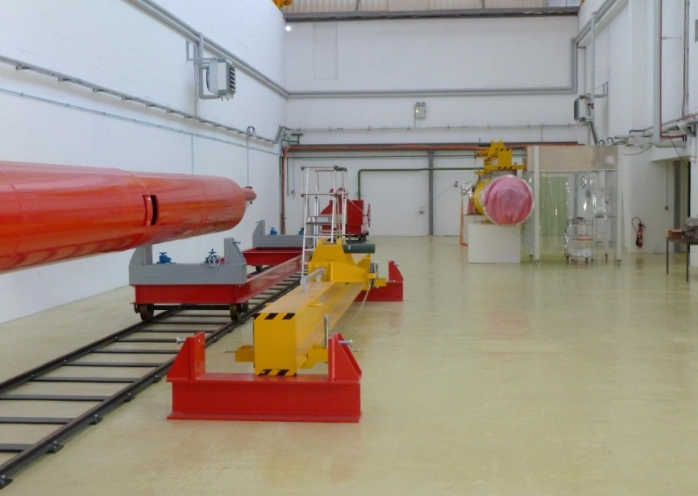
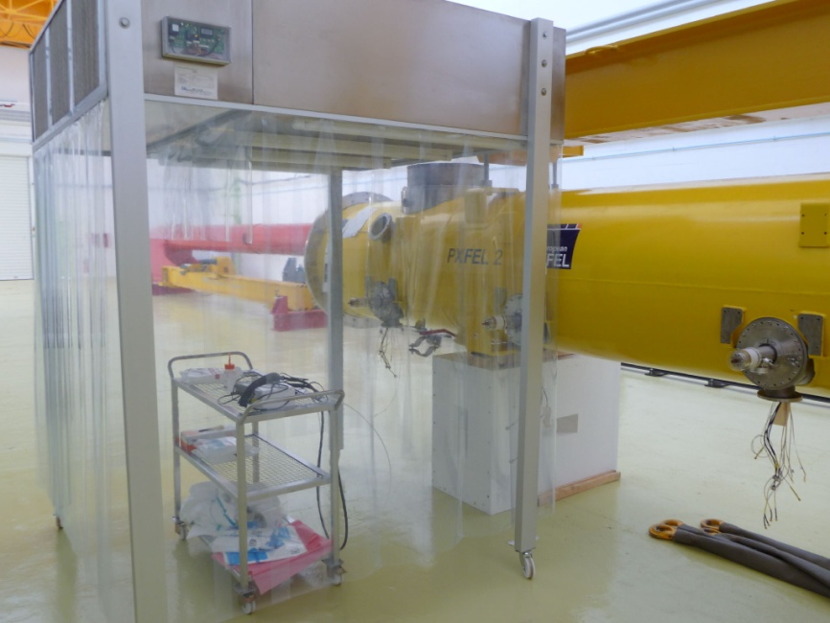
Assembly prototyping at Saclay
Venting of cavity string
Coupler dis-assembly

Slide 21
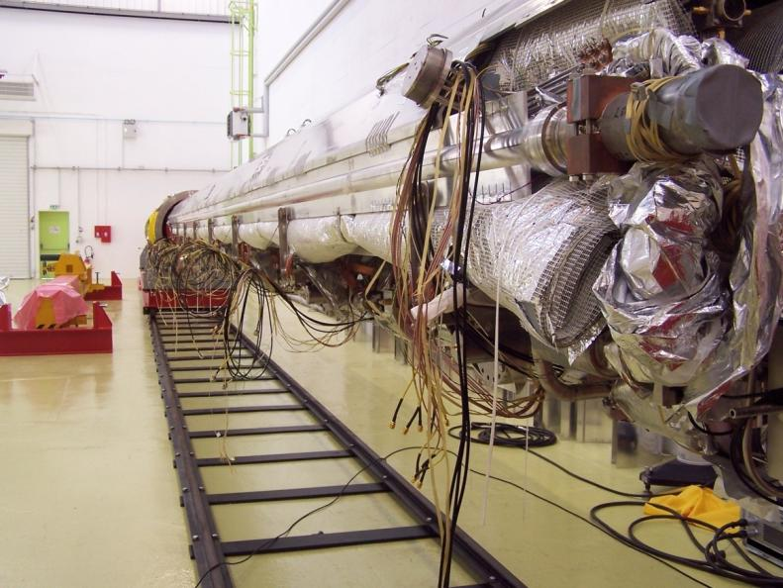
Assembly prototyping at Saclay
Vacuum vessel roll-outs and roll-ins
Cutting of Al thermal shields

Slide 22
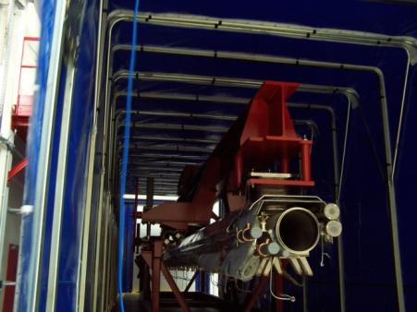
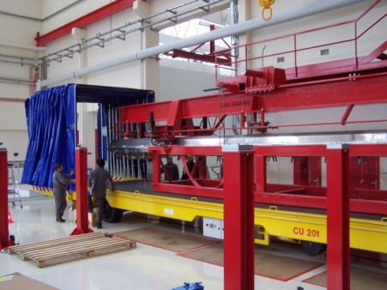
Assembly prototyping at Saclay
Transfer of cold mass + cavity string to clean room hall.
(electrical transfer vehicle due next week)

Slide 23
Assembly prototyping at Saclay
Transfer of cold mass + cavity string on Roll-out Area
(cavity posts from DESY)

Slide 24
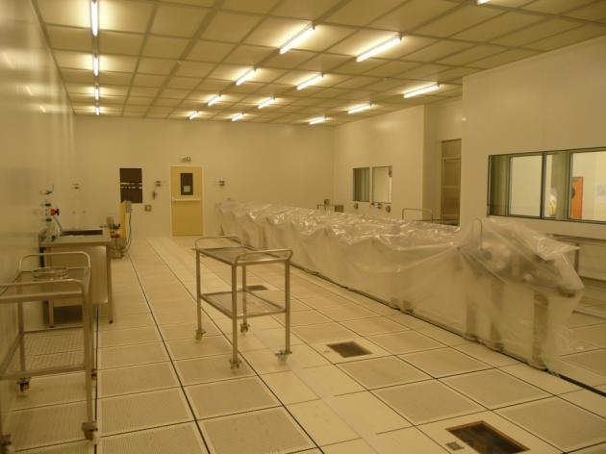
Assembly prototyping at Saclay
Roll-in of cavity string in IS04 Area

Slide 25
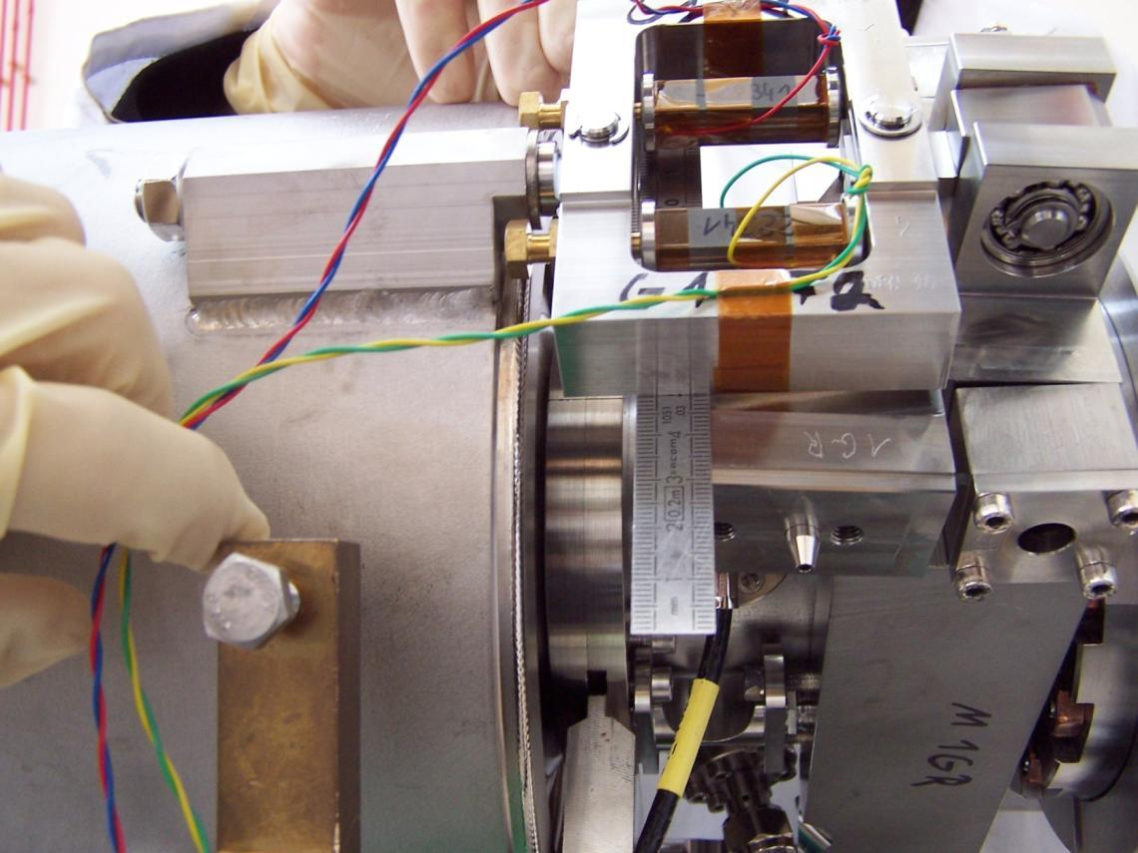
Assembly prototyping at Saclay
Tuner assembly

Slide 26
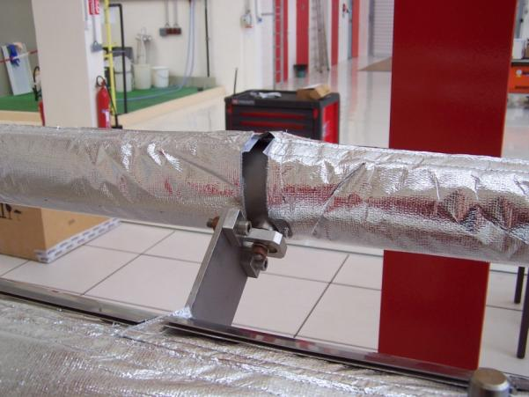
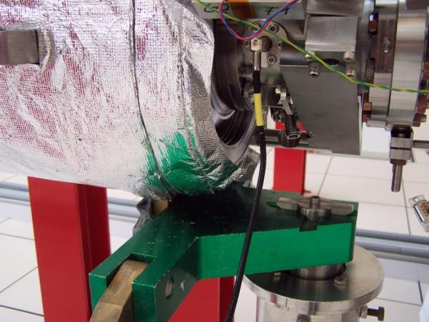
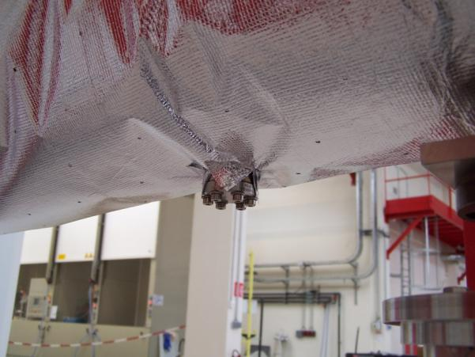
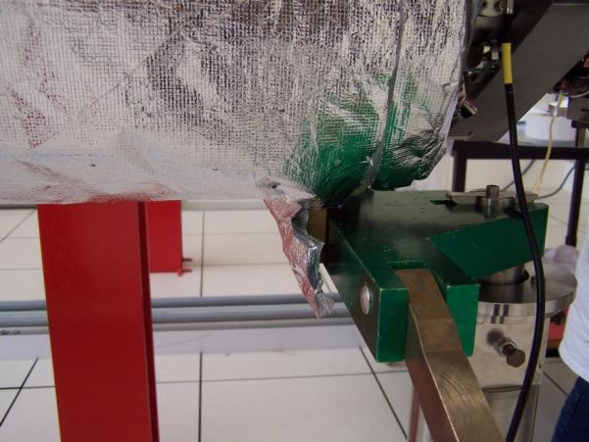
Assembly Prototyping at Saclay
Superinsulation blankets try-on

Slide 27
Phase 3:
XFEL Module Assembly by an
Industrial Contractor

Slide 28
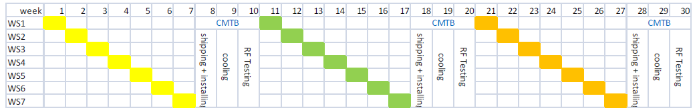
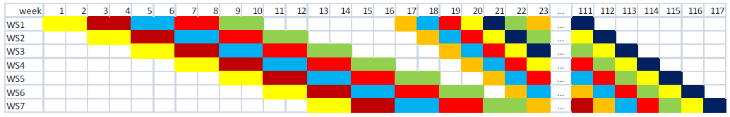
Ramping up industrial assembly
P1: assembly of 3 pre-series modules in sequence for training of the first ½ teams by CEA and DESY personnel, assuming 7 week assembly interleaved by 3 weeks for CMTB qualification.
P2: assembly of 5 modules in parallel during a ramp-up period (P2) for training of the second ½ teams by the first ½ teams, assuming 2 week assembly per module.
P3: assembly 75 modules in parallel at the rate of 1 module/week.
Period 1: assembly of 3 pre-series modules, in sequence, interleaved with CMTB tests
Period 2: parallel assembly of 5 modules Period 3: // assembly of 75 modules 1/week

Slide 29
Summary
Christmas early this year, plenty of new toys !

Slide 30
Acknowledgments
Considerable help received from DESY, thanks to
C. Engling, K. Jensch, W. Maschmann & Cie
A. Matheisen, M. Schmöckel & Cie
and M. Schlösser, H. Weise, …
and from FNAL, thanks to T. Arkan
Thanks to my CEA colleagues: S. Berry, J.P. Charrier,
P. Contrepois, S. Cozette, M. Fontaine, C. Madec,
Y. Sauce, T. Vacher, B. Visentin, and A. Daël, …

Slide 31
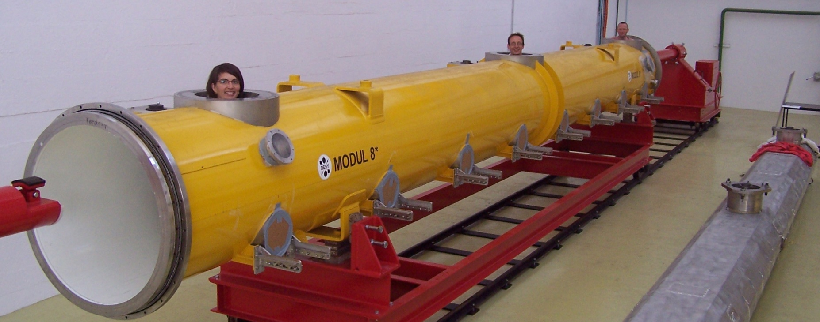
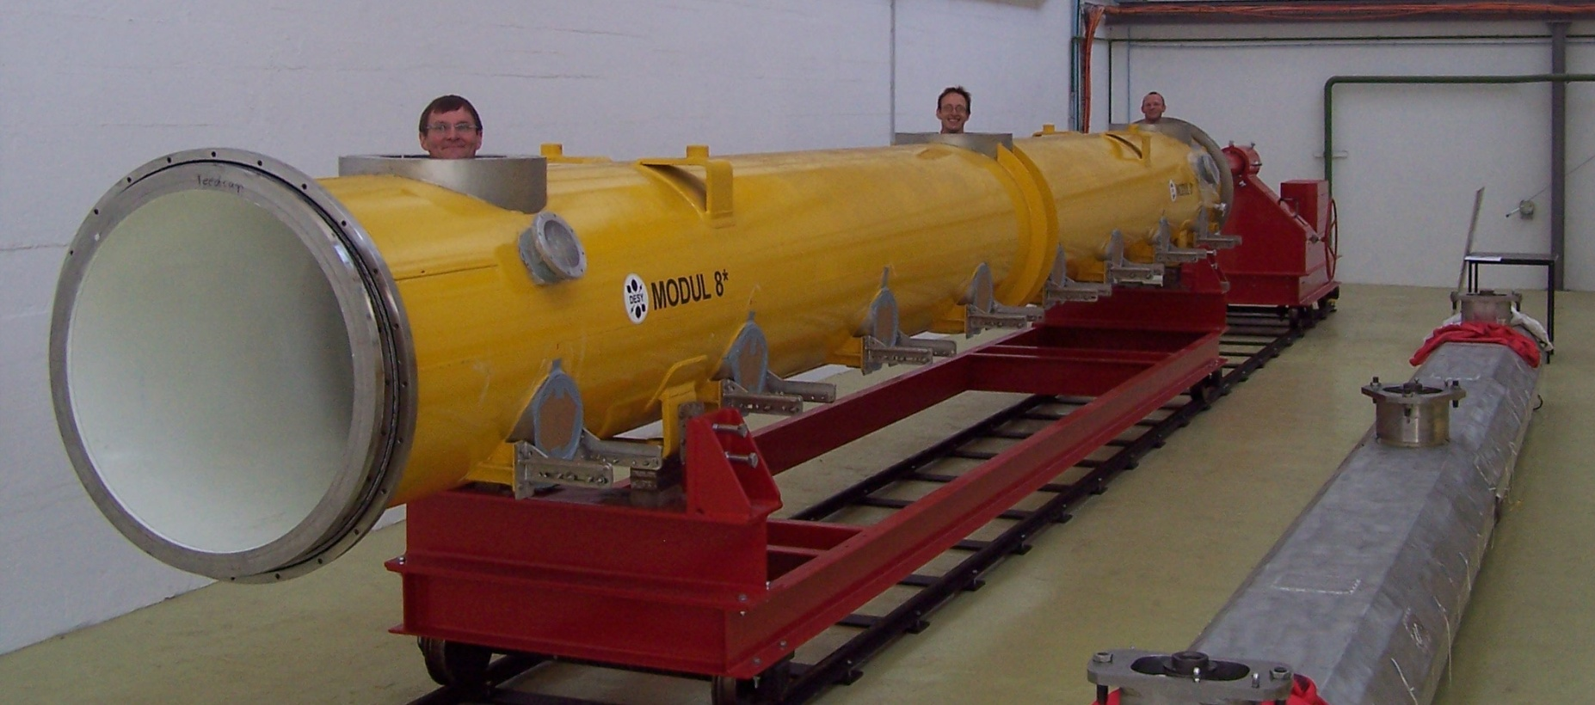
Acknowledgments

