Slide 1
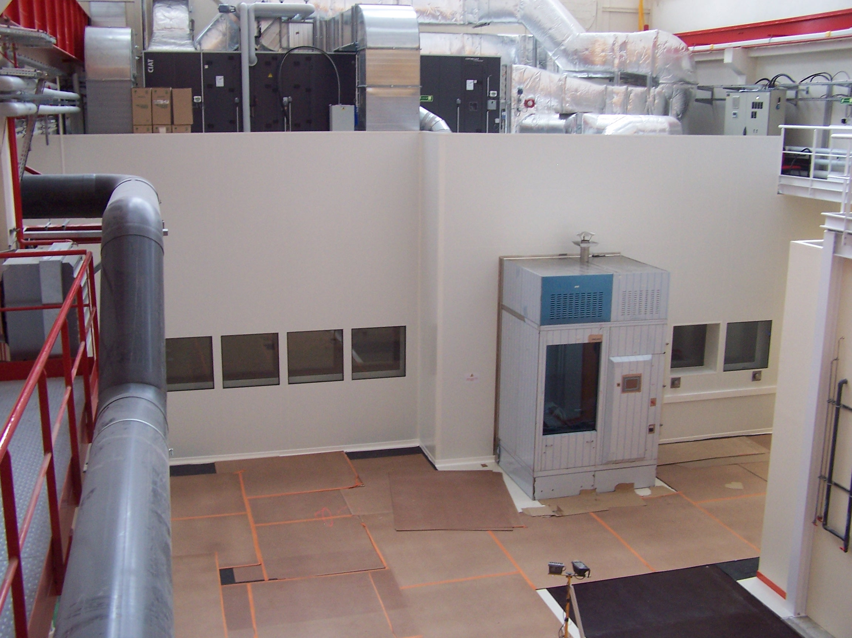
Saclay Test Facilities

Slide 2
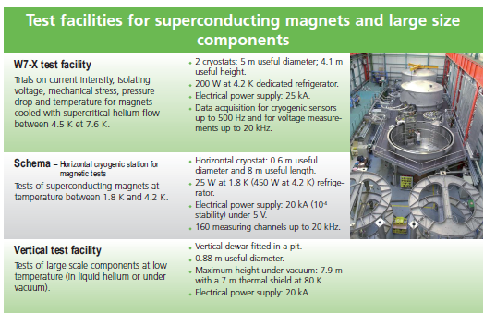
Cryomagnetism

Slide 3
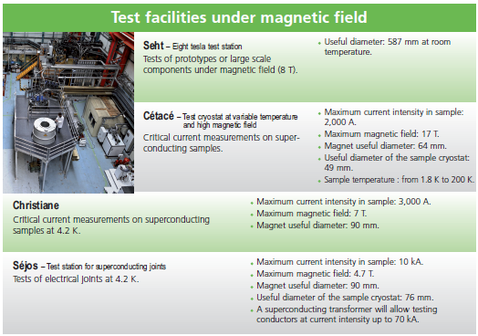
Cryomagnetism

Slide 4
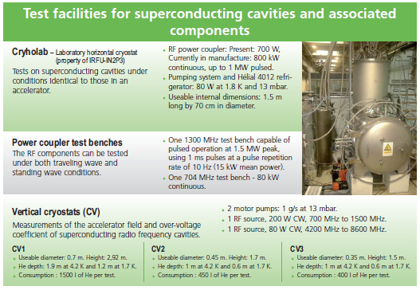
Superconducting RF

Slide 5
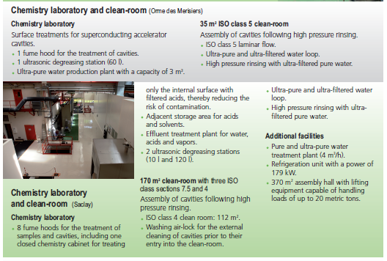
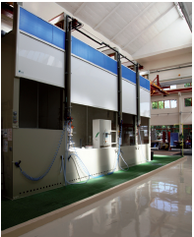
Superconducting RF

Slide 6
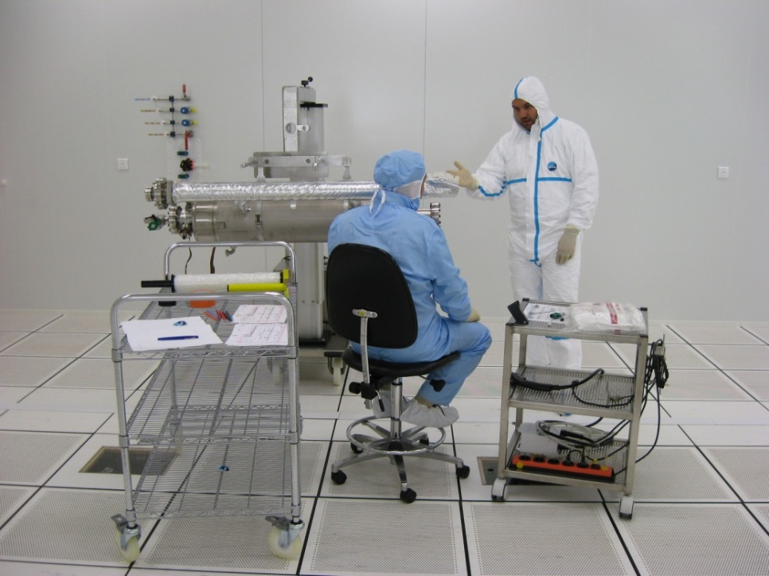
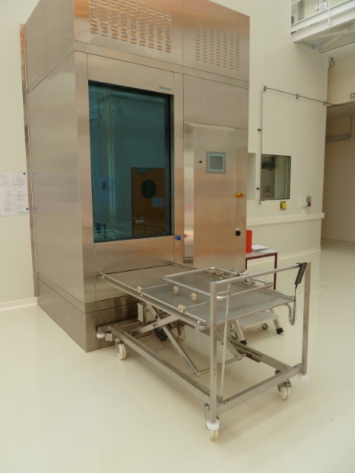
Clean Room Layout
ISO 7
(class 10 000)
28 m²
5.92 m x 4.72 m
ISO 5
(class 100)
38 m²
7.72 m x 4.72 m
ISO4 (Class 10)
112 m²
7.8 m x (6.6+7.8) m
15.6 m

Slide 7
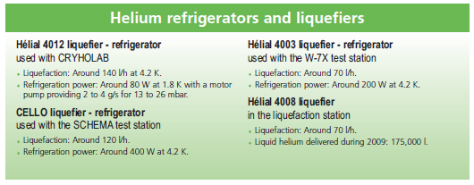
Cryogenics

Slide 8
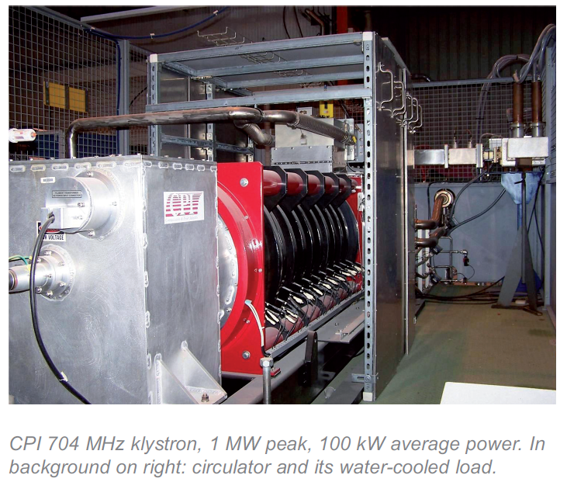
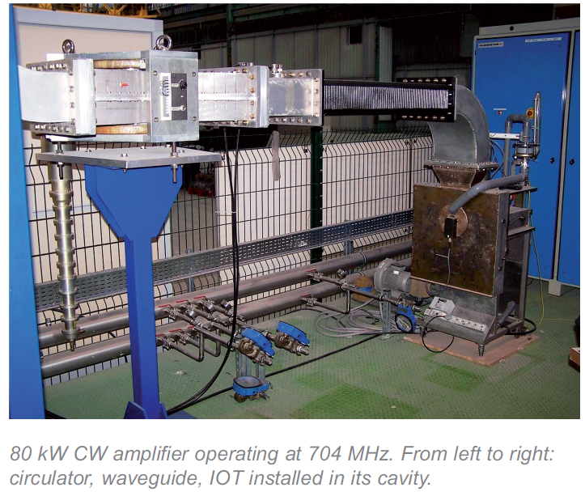
High RF Power
Two 352 MHz klystrons of 1 MW CW (LEP) on loan from CERN
One 1.3 GHz klystron, 1.5 MW, 1ms 10Hz pulsed (Thales)
One 704 MHz klystron, 1MW pulsed (CPI)
One 704 MHz IOT, 80 kW CW

