Slide 1


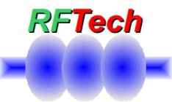

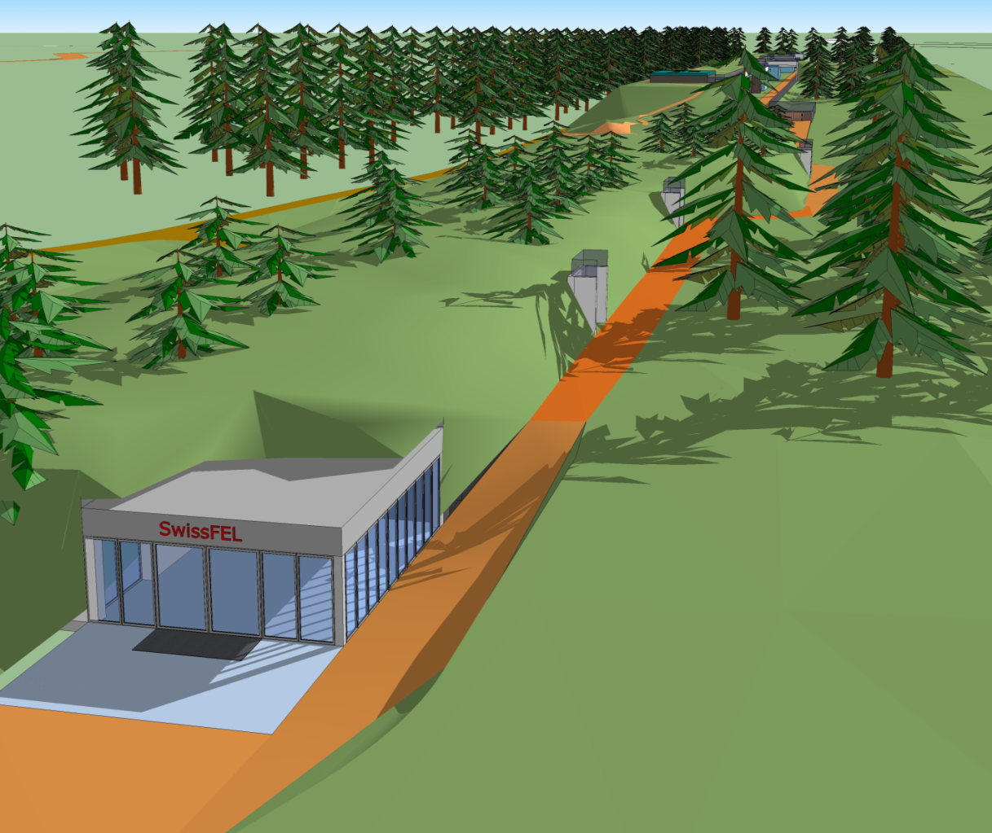
RF Tech Workshop
SwissFEL
Hans-H. Braun

Slide 2
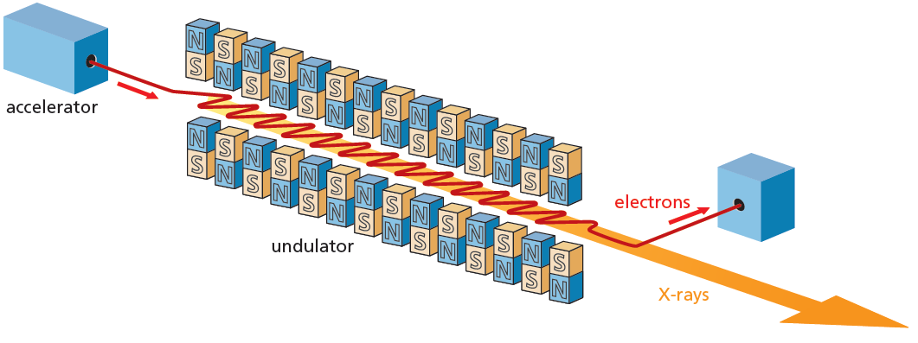
SwissFEL, the next large facility at PSI
  SwissFEL parameters
  Wavelength from 1 Å - 70 Å
  Pulse duration 1 fs - 20 fs
  e⁻ Energy 5.8 GeV
  e⁻ Bunch charge 10-200 pC
  Repetition rate 100 Hz
  FEL principle
  Electrons interact with periodic magnetic field
  of undulator magnet to build up an
  extremely short and intense X-ray pulse.

Slide 3
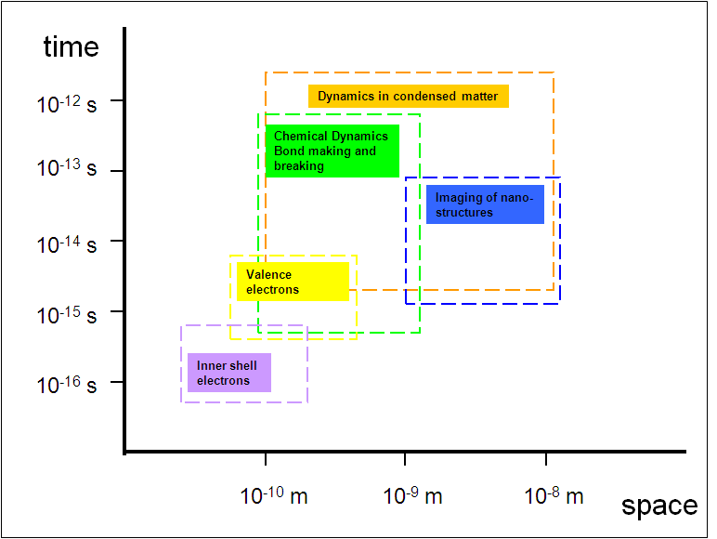
Time- and length scales of the nano world
SwissFEL
pulse-
length
SwissFEL wavelength range
Understand dynamics of fundamental processses
for chemistry, biology, condensed matter physics and material science

Slide 4
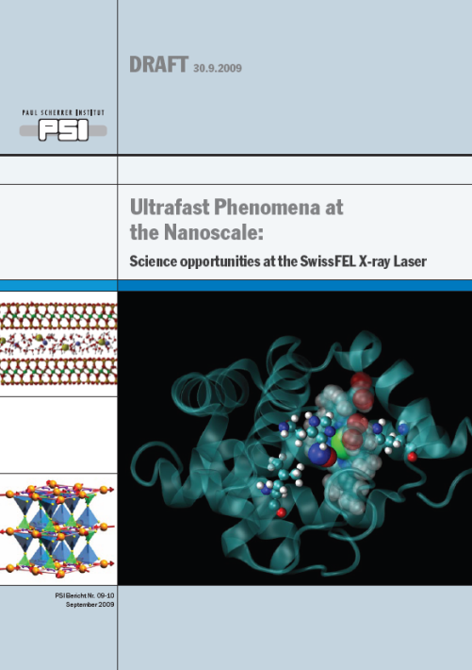
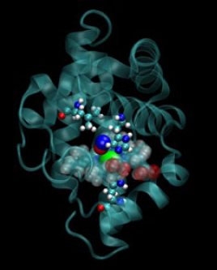
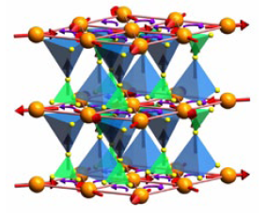
SwissFEL Science Case
Magnetism: materials and processes for tomorrow‘s information technology
Catalysis and solution chemistry: for a clean environment and a sustainable energy supply
Coherent diffraction: flash photography of matter
Science report at
http://www.swissfel.ch
Biochemistry:
shedding light on the prpcesses of life
Correlated electrons:
the fascination of new materials

Slide 5
SwissFEL Rational I
Research capabilities of X-ray FEL ideal complement for PSI’s existing synchrotron light source and spallation neutron source research facilities
European XFEL will not provide enough beam time for all users
Europe has with FLASH, FERMI@ELETTRA and maybe SPARX, NLS
already good coverage for soft X-ray FEL’s
hard X-ray FEL
⇒

Slide 6
SwissFEL Rational II
SwissFEL is build as a national facility in a small country
Total cost have to fit in a limited framework
Lowest beam energy technically possible
Small period undulators with low K values
Low q_{B} charge
Normal conducting linac technology

Slide 7
SwissFEL Rational III
SwissFEL 1st phase build 2012-2015
Robust baseline design with components based on proven technologies.
⇒ Scientific focus rather on good time resolution than on photon hungry experiments

Slide 8
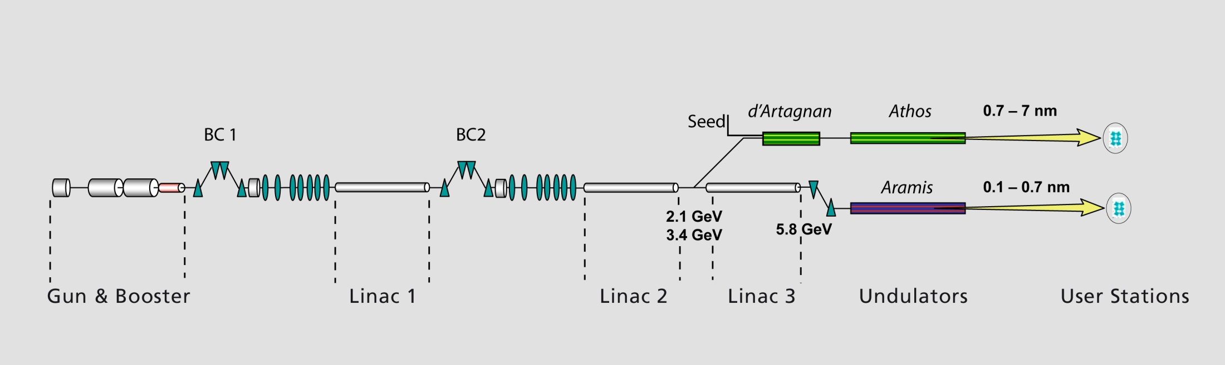
SwissFEL baseline
S-band & X-band
C-band
C-band
C-band
715 m
Aramis:
1-7 Å hard X-ray SASE FEL,
In-vacuum , planar undulators with variable gap.
Athos:
7-70 Å soft X-ray FEL for SASE & Seeded operation .
APPLE II undulators with variable gap and full polarization control.
D’Artagnan:
FEL for wavelengths above Athos, seeded with an HHG source. Besides covering the longer wavelength range, the FEL is used as the initial stage of a High Gain Harmonic Generation (HGHG) with Athos as the final radiator.

Slide 9
SwissFEL key parameters
Parameters for lasing at 1Å | Operation Mode
 | Long Pulses | Short Pulses
Charge per Bunch (pC) | 200 | 10
Beam energy for 1 Å (GeV) | 5.8 | 5.8
Core Slice Emittance (mm.mrad) | 0.43 | 0.18
Peak Current at Undulator (kA) | 2.7 | 0.7
Repetition Rate (Hz) | 100 | 100
Undulator Period (mm) | 15 | 15
Effective Saturation Power (GW) | 2 | 0.6
Photon Pulse Length at 1 Å (fs, rms) | 13 | 2.1

Slide 10
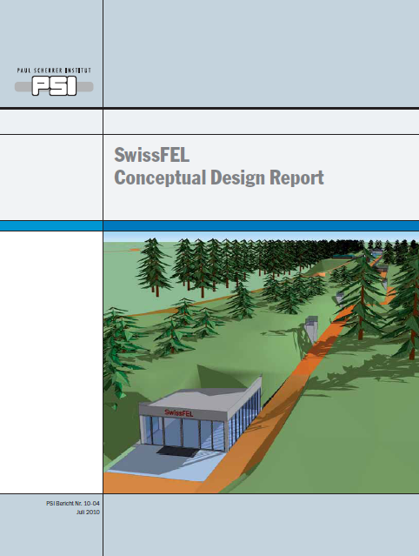
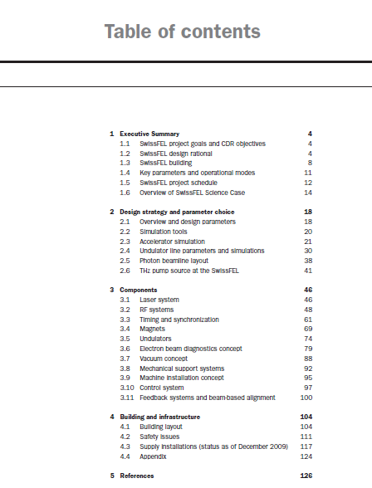
SwissFEL CDR
PDF at http://www.psi.ch/swissfel/

Slide 11
SwissFEL in comparison with the other hard X-ray FEL projects
Project | Start of operation | Beam energy | λ_{min}
 |  | GeV | Å
LCLS, USA | April 10 2009 ! | 13.6 | 1.5
SCSS, Japan | 2011 | 8 | 1.0
European X –FEL, Hamburg | 2014 | 17.5 | 1.0
SwissFEL | 2016 | 5.8 | 1.0
SwissFEL has lowest beam energy
Advantages: Compact and affordable on national scale
Challenges : More stringent requirements for beam quality,
mechanical and electronic tolerances

Slide 12
First existing part of SwissFEL: 250 MeV Injector
715m
First beam to dump 9.8.2010

Slide 13
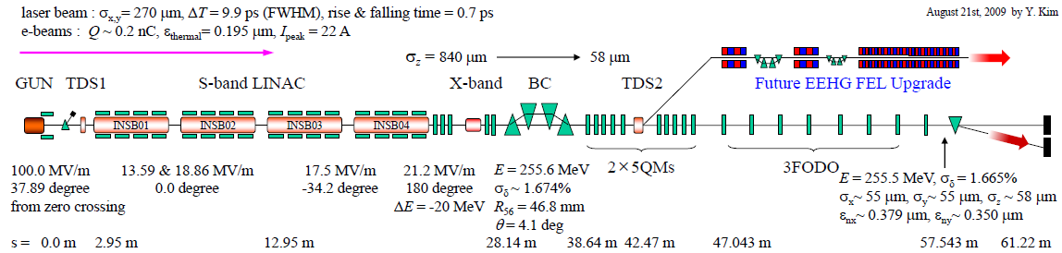
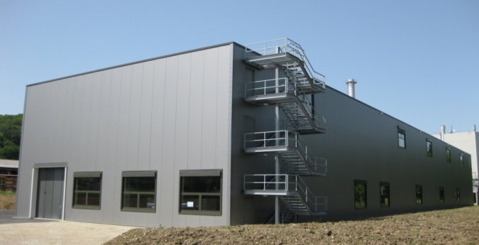
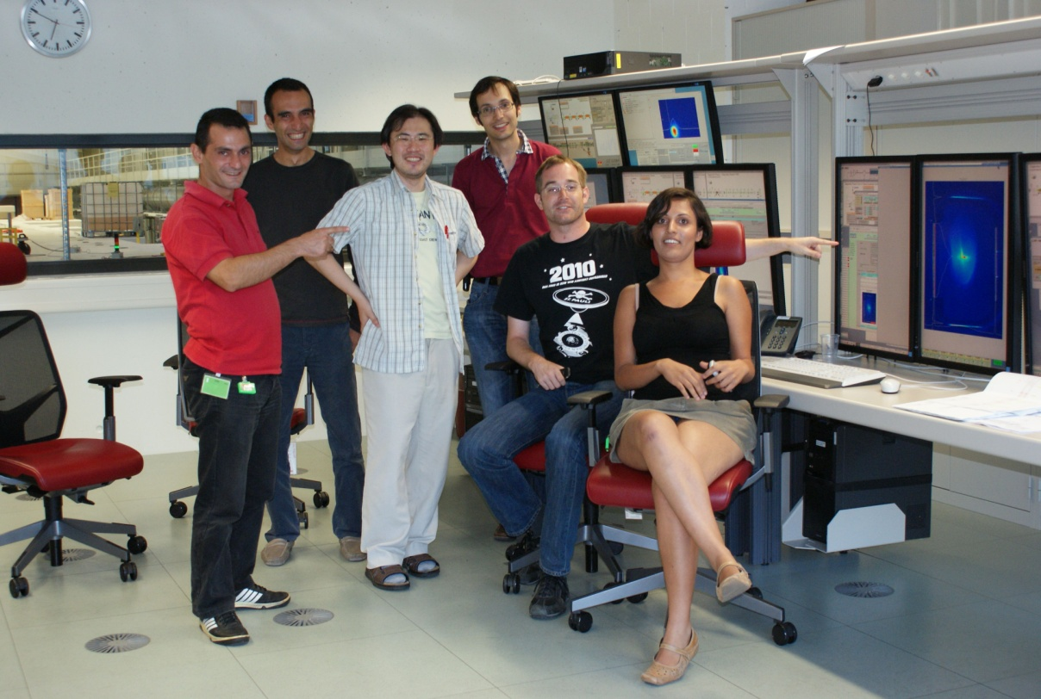
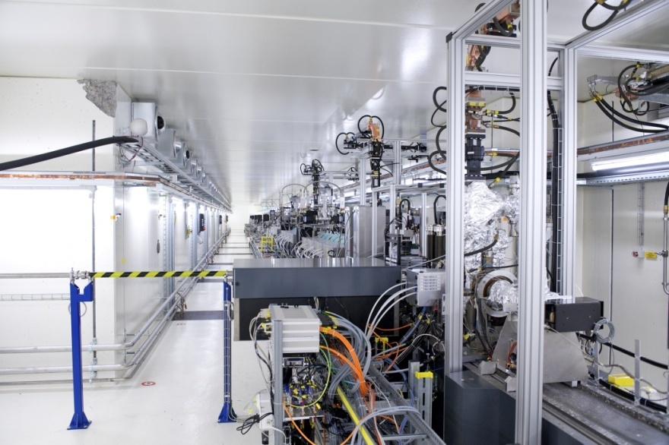
Inauguration SwissFEL first stage, 24.8.2010
Injector building
Commissiong crew with first beam
Beamline seen from gun end

Slide 14

SwissFEL Milestones
Gun laser
2010 250 MeV Injector facility
2014 Building completed
Gun laser
2.1 GeV
3.4 GeV
5.8 GeV
ARAMIS FEL 1-7 Å
Exp1
Exp2
Exp3
2016 SwissFEL Phase I
Accelerator and hard X ray FEL
Laser pump
Gun laser
2.1 GeV
3.4 GeV
5.8 GeV
ARAMIS FEL 1-7 Å
Exp1
Exp2
2018 SwissFEL Phase II
Soft X-ray FEL
ATHOS FEL 7-70 Å
Exp1
Exp3
Seed laser
Exp2
Laser pump
Exp3
THz pump

Slide 15
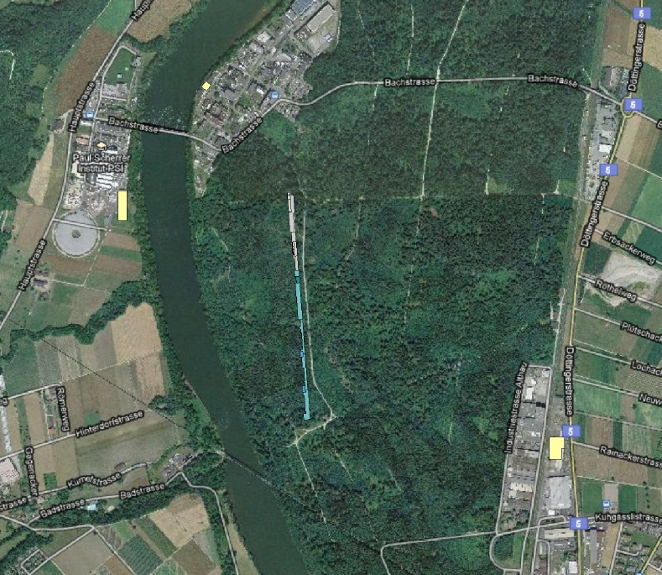
SwissFEL geographics
OBLA
C-band
test stand
PSI-East
PSI-West
WLHA
250 MeV
Injector
SwissFEL
Aare river
assembly hall

Slide 16
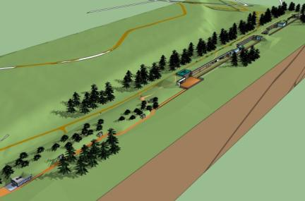
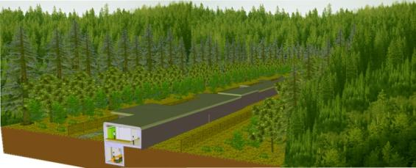
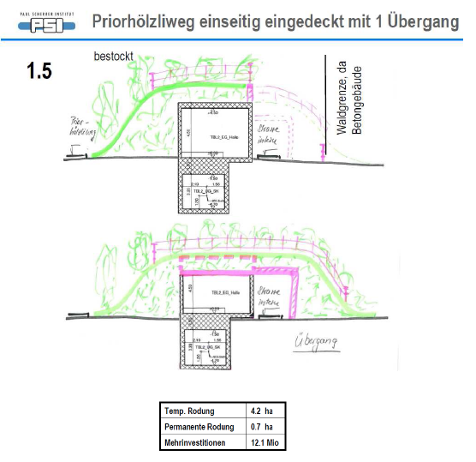
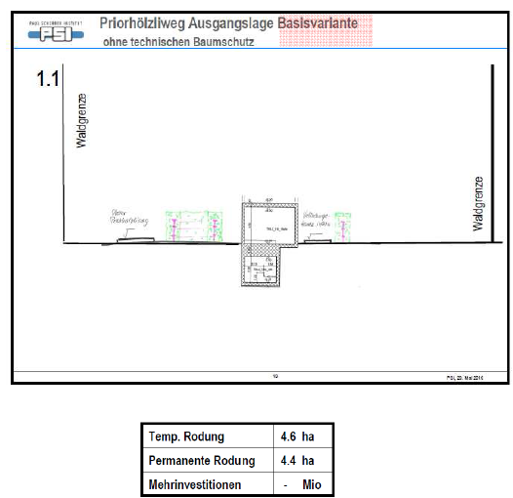
AG Wald
1st meeting
5th meeting

Slide 17
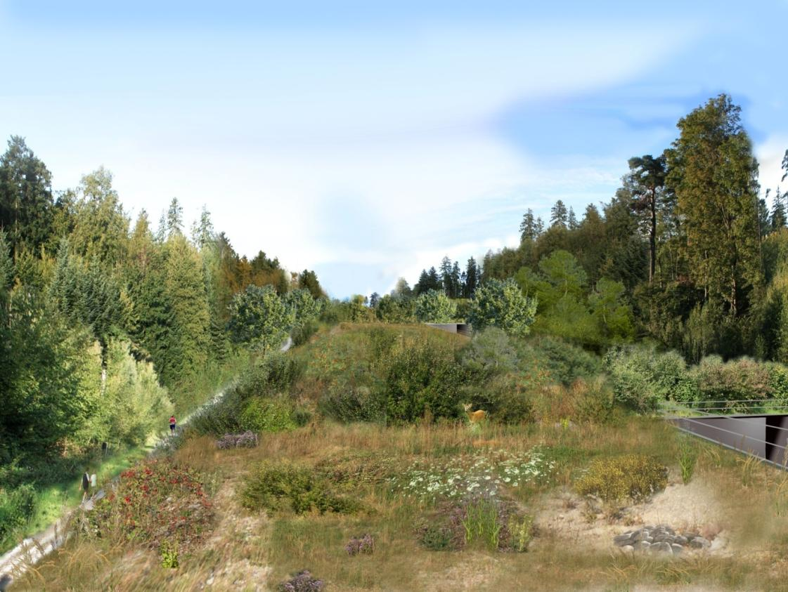
looking across technical buildings

Slide 18
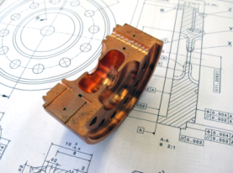
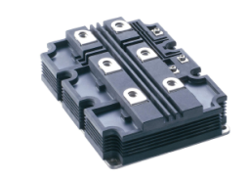
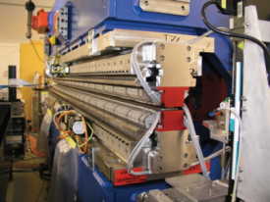
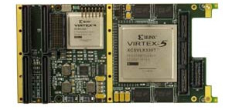
SwissFEL technical R&D for key items with Industry
Item | RF structures | Pulsed High voltage for RF sources | Undulator magnet systems | Real time data analysis and compression
Key technologies | Ultra precision machining Ultra clean, ultra precision bonding | High current, high voltage switching technology Precision voltage measurement & control | Heavy load precision positioning Precision machining of large support structures | FPGA electronic design and programming Fast algorithms
Status | Industry study for a production line with ultra precision machining and brazing furnace | Collaboration agreement . | Engineering studies Contracts for functional model partly placed | Design study completed Contract for prototype placed

Slide 19
RF topics for SwissFEL
RF systems with three different frequencies at S-band, C-band and X-band
P.S.I. RF gun
Development of C-band linac module optimized for space and power economy
Extreme phase tolerance specs require sophisticated synchronization and LLRF

Slide 20
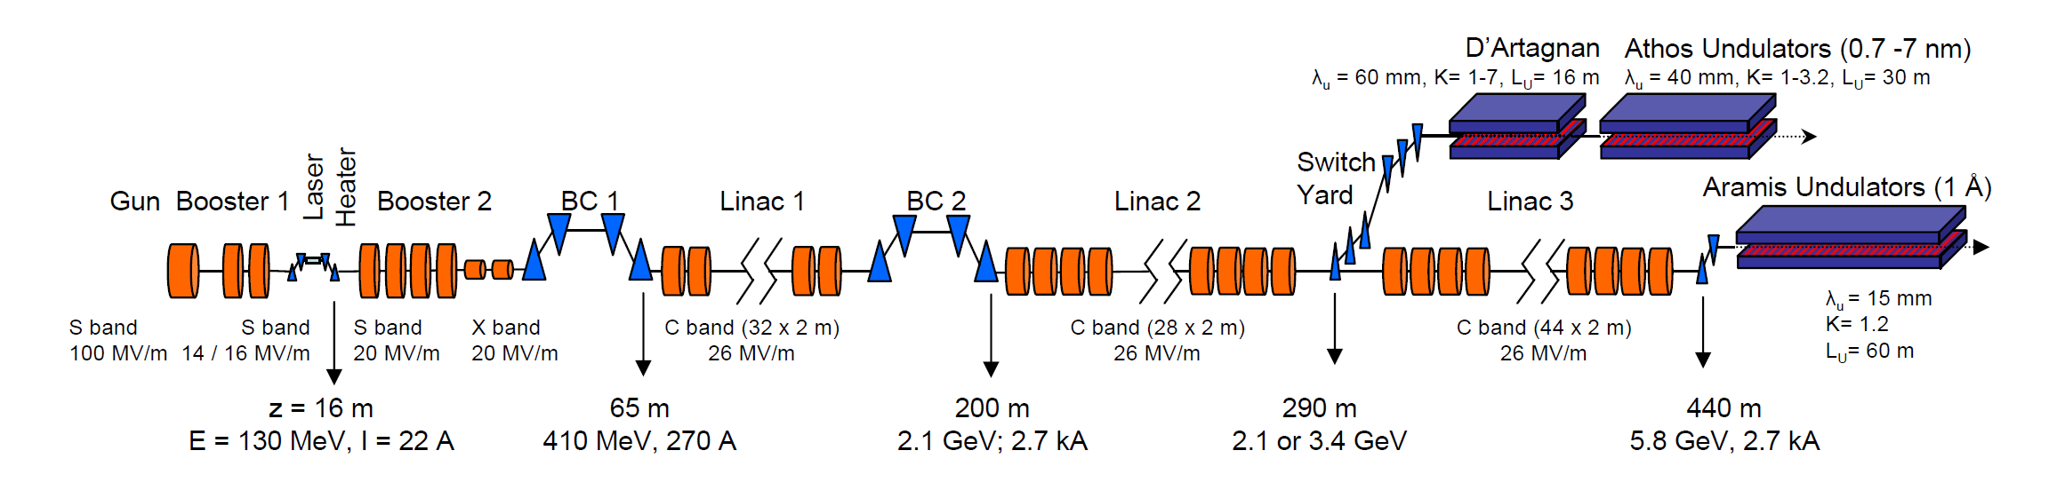
Frequencies
SwissFEL Injektor
2998.8 MHz
11995.2 MHz
Main C-band LINAC
5712 MHz

Slide 21
Frequencies cont.
proposed solution
 |  | „European“ | „American „ | f_{b}=142.8
Injector | S-Band | 2997.912 most parts already delivered | 2856 | 2998.8 (21xf_{b})
 | X-Band | 11991.648 most parts on order | 11424 | 11995.2 (84xf_{b})
Main linac | C-Band | 5998.524 requires development of klystron with PSI as only customer | 5712 klystron available almost “off the shelf” Spring8, KEK, LNF are already customers | 5712 (40xf_{b})

Slide 22
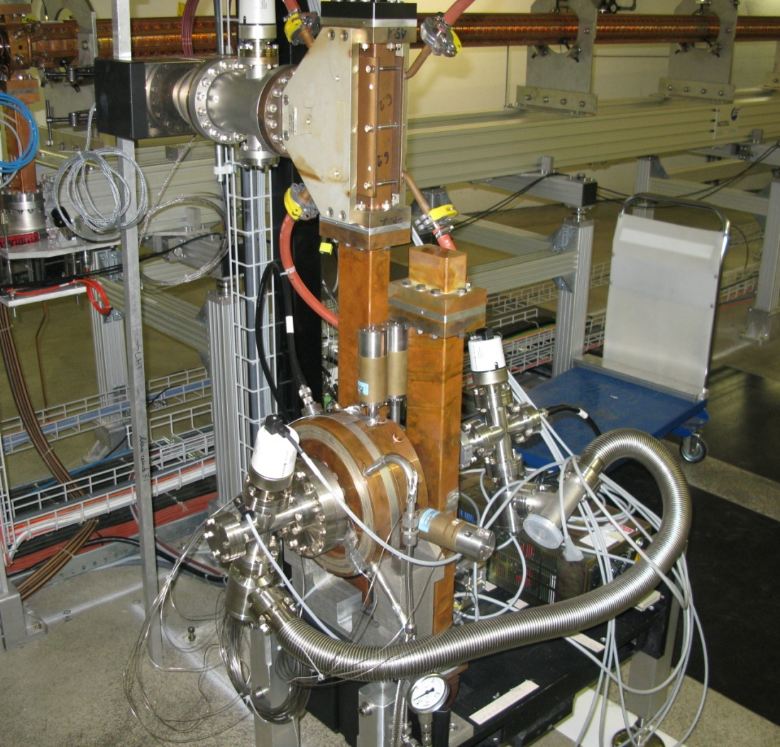
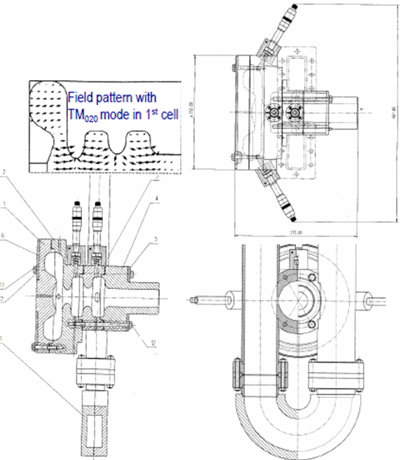
S-band RF gun
Initial RF gun used for inkjector test CTF gun 5
designed by M. Dehler and R. Bossart at CERN, beginning of the nineties
Pumping-T
Tuner
Faraday-Cup
Pickup (one per cell)
Vacuum gauge
Water connectors

Slide 23
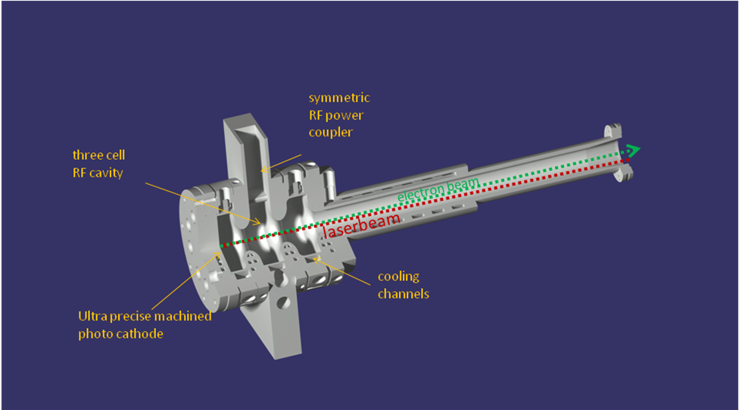
New SwissFEL gun for test in 250 MeV injector 2011

Slide 24
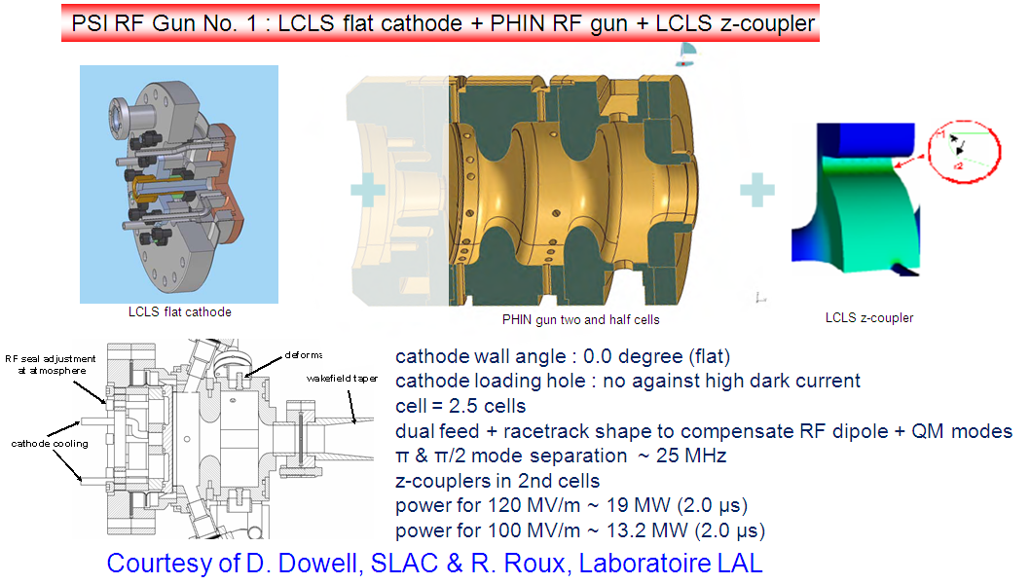
PSI RF Gun

Slide 25
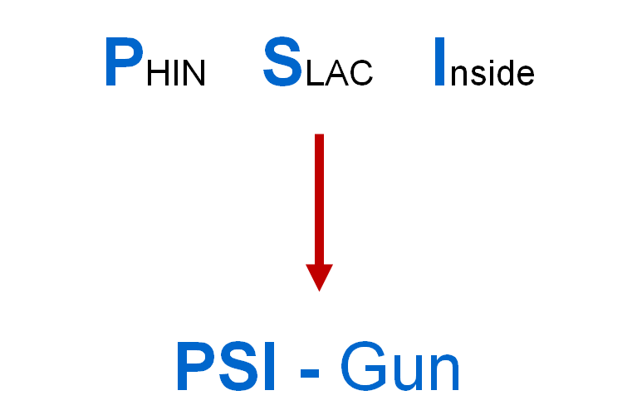
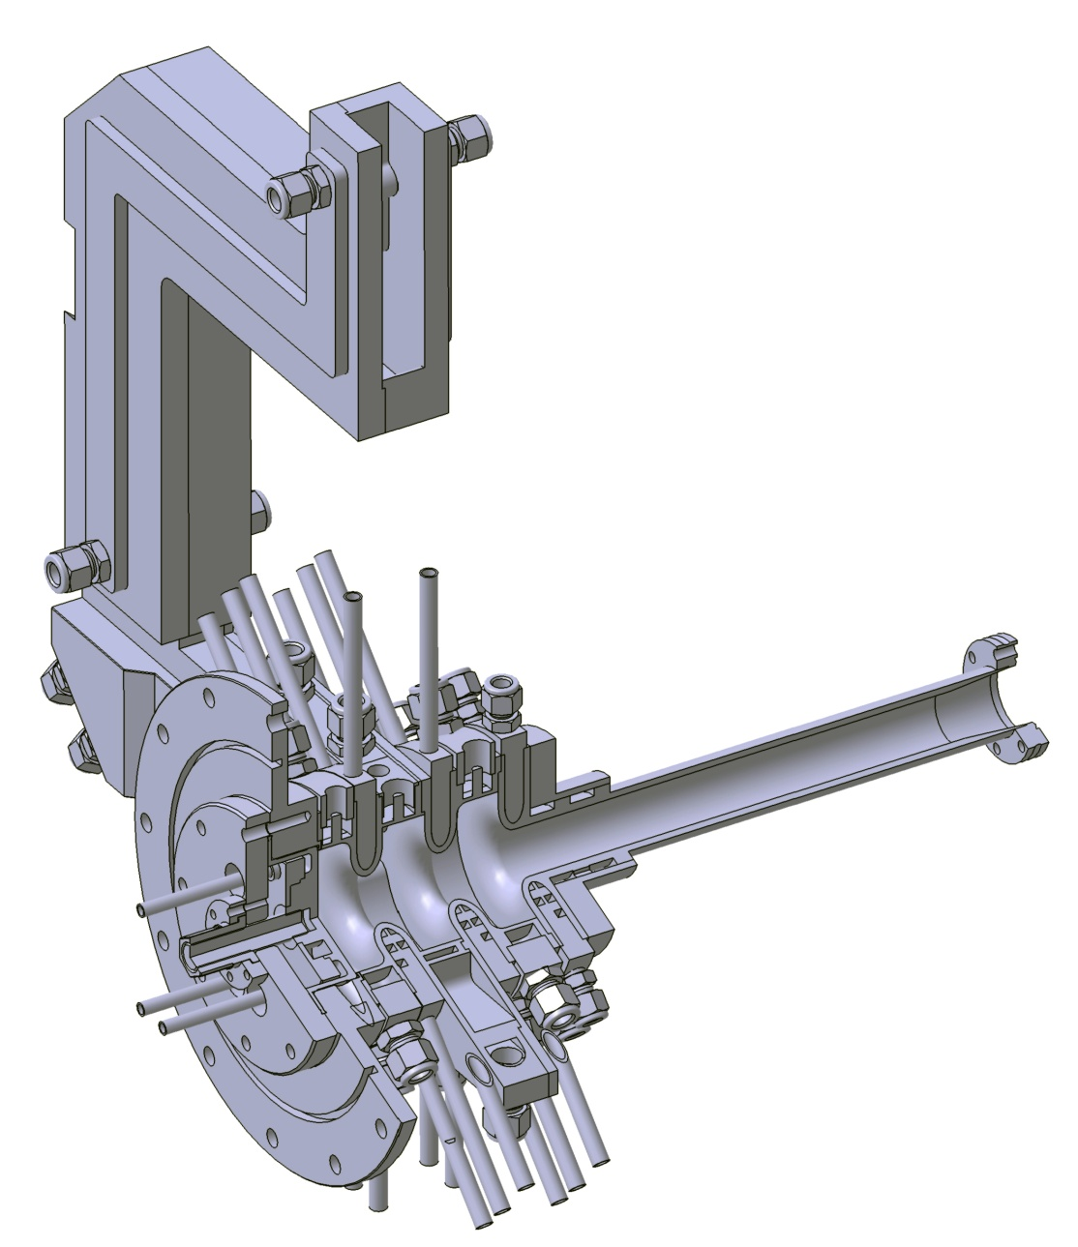

Slide 26
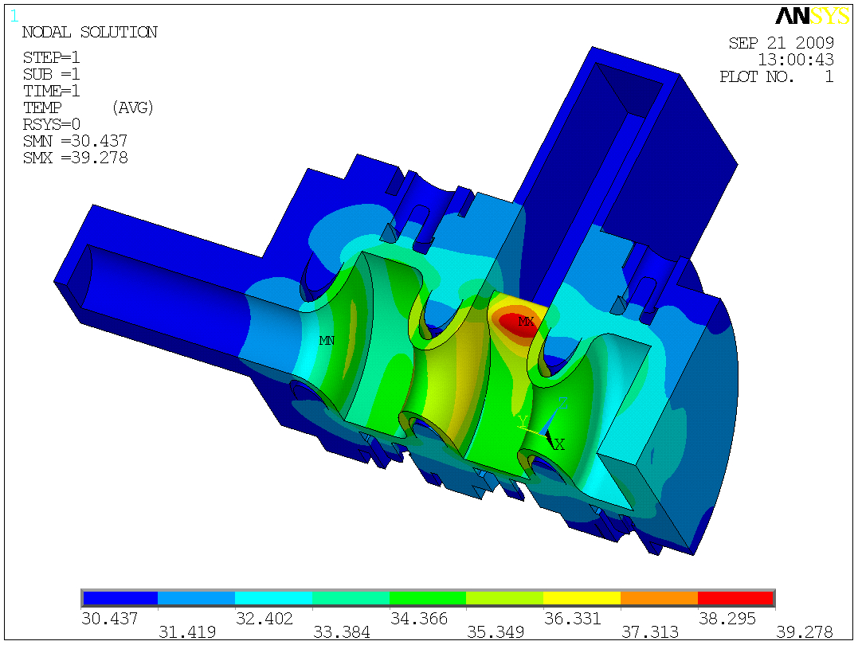
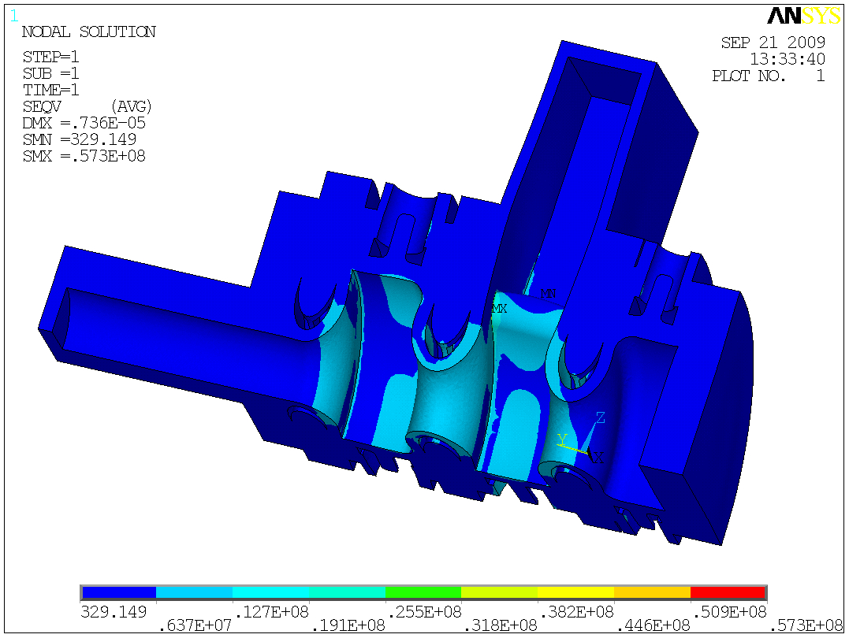
Temperature
Stress close to the limits !
Power: 3.3 kW avg.
αk: 7500 W/m2K /
Water inlet 30°C
120 MV/m; 100 Hz; 2 μs
400 Hz seems very difficult

Slide 27
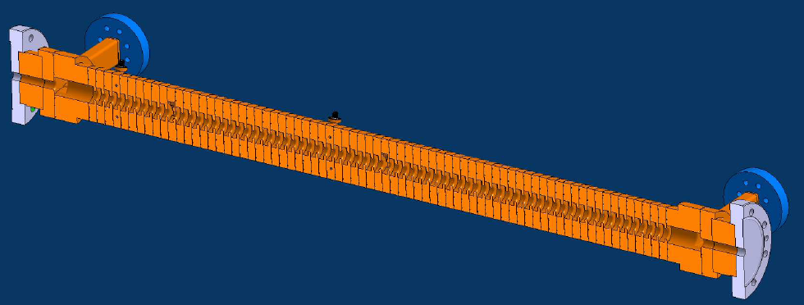
X-band harmonic cavity -> Micha Dehler’s talk
Collaboration between PSI - CERN - FERMI @ ELETTRA
Klystron from SLAC
Frequency (MHz) | 11991.65
Number of cells | 72
Cell phase advance | 5/6π
Iris aperture range (mm) | 4.993 - 4.107
Active length (m) | 0.75
Nominal decelerating voltage (MV) | 29
PSI: Cell procurements
CERN: Assembly brazing
ELETTRA: Wake analysis & support
All: tuning & RF LLE analysis
Mode launcher (coupler)
HFFS simulated fields
Cell 36 and 63 equipped with WG couplers for dipole mode monitoring

Slide 28
Cost comparison e⁻-linac technologies
Technology | Linac investment cost w/o building | Typical gradient | Electric consumption
Pulsed n.c. with SLED | <10 M€/GeV | 20 MV/m (S-band) 30 MV/m (C-band) | 0.5 MW/GeV
Pulsed superconducting | ≈20 M€/GeV | 24 MV/m | 0.5 MW/GeV
c.w. superconducting | ? 30 M€/GeV ? | 15 MV/m | 5 MW/GeV
Beware!
This is not exact science !

Slide 29
cost optimization pulsed n.c. linac
Cost vs. gradient for S-band with 45 MW klystron,
S-band with 80MW klystron
and C-band with 50 MW klystron
Advantage of C-band is in real-estate needs and electricity consumption

Slide 30
Linear space requirements
Active length S-band acceleration 24 m
Active length C-band acceleration 208 m
ARAMIS string of undulators 60 m
Other beam line elements 273 m
Photon beam transport 100 m
Experiment halls 50 m
Total facility length 715 m
⇒ No strong motivation for very high gradients !

Slide 31
C-band LINAC Module
Modulator
LLRF
116 MW
Main LINAC | #
LINAC modules | 26
Modulator | 26
Klystron | 26
Pulse compressor | 26
Accelerating structures | 104
Waveguide splitter | 78
Waveguide loads | 104
50 MW, 3.0 µs max.
40 MW, 3.0 µs for operation
BOC Pulse-
Compressor
120 MW, 0.5 µs
30.8 MV/m
30.8 MV/m
30.8 MV/m
30.8 MV/m
2m
Courtesy Hansruedi Fitze

Slide 32
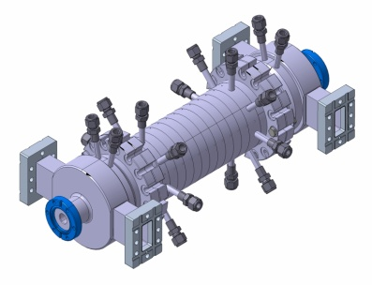
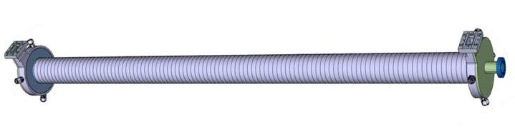
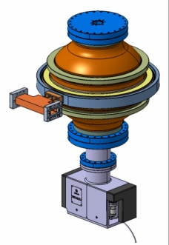
C-band development
Courtesy Hansruedi Fitze

Slide 33



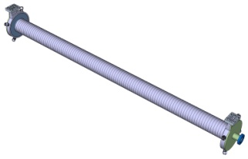
Road map of C-band structure development/production
Short Structures
2m Structures
Pulse Compressor
2 Double rounded
(incl. 2 special cells)
2 Single rounded
(incl. 2 special cells)
? Ev. disk loaded prototypes
2 Mode launcher output/input
Prototype(s)
Pre series
Series production
One structure consists of
2 J-coupler and 110 cells
1-2 Prototype(s)
26 Series production
Utilities
Cooling / Tuning; Supports ev. Girder; Vacuum; Beam dump
Courtesy Hansruedi Fitze

Slide 34

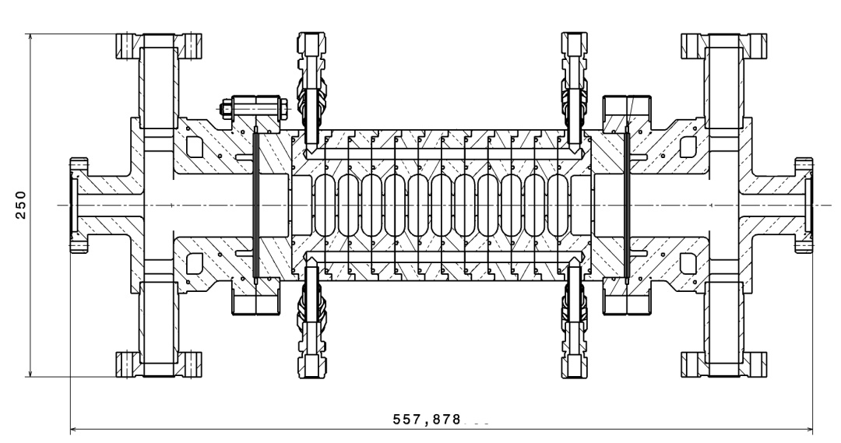
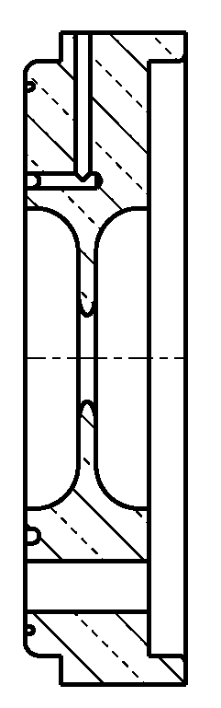
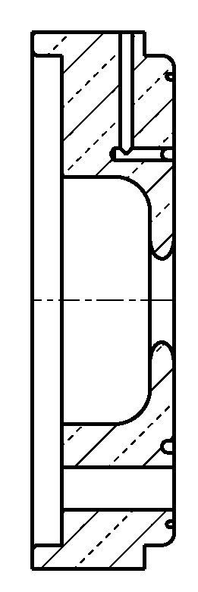
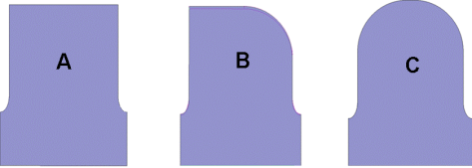
Short structures
Test Stacks
3 different cup designs
(different performances, mechanical design and brazing)
2011, Aug
RF Power tests
Short (cheap) test structure (10-20 identical cups; up to ~350 mm) to be produced and vacuum brazed in PSI.
For the power test (P_{average}< 1kW; P_{peak}~40 MW) special removable couplers “mode launchers” have been designed.
Courtesy Hansruedi Fitze

Slide 35
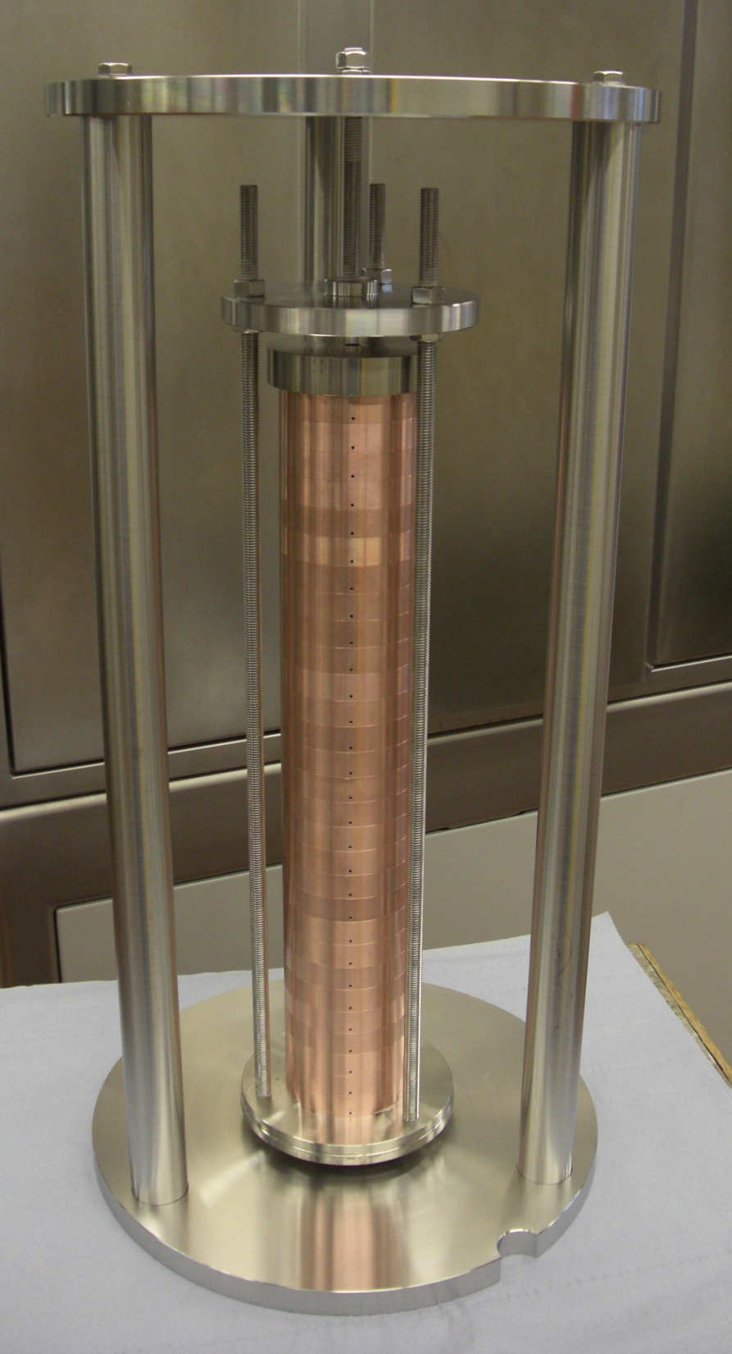
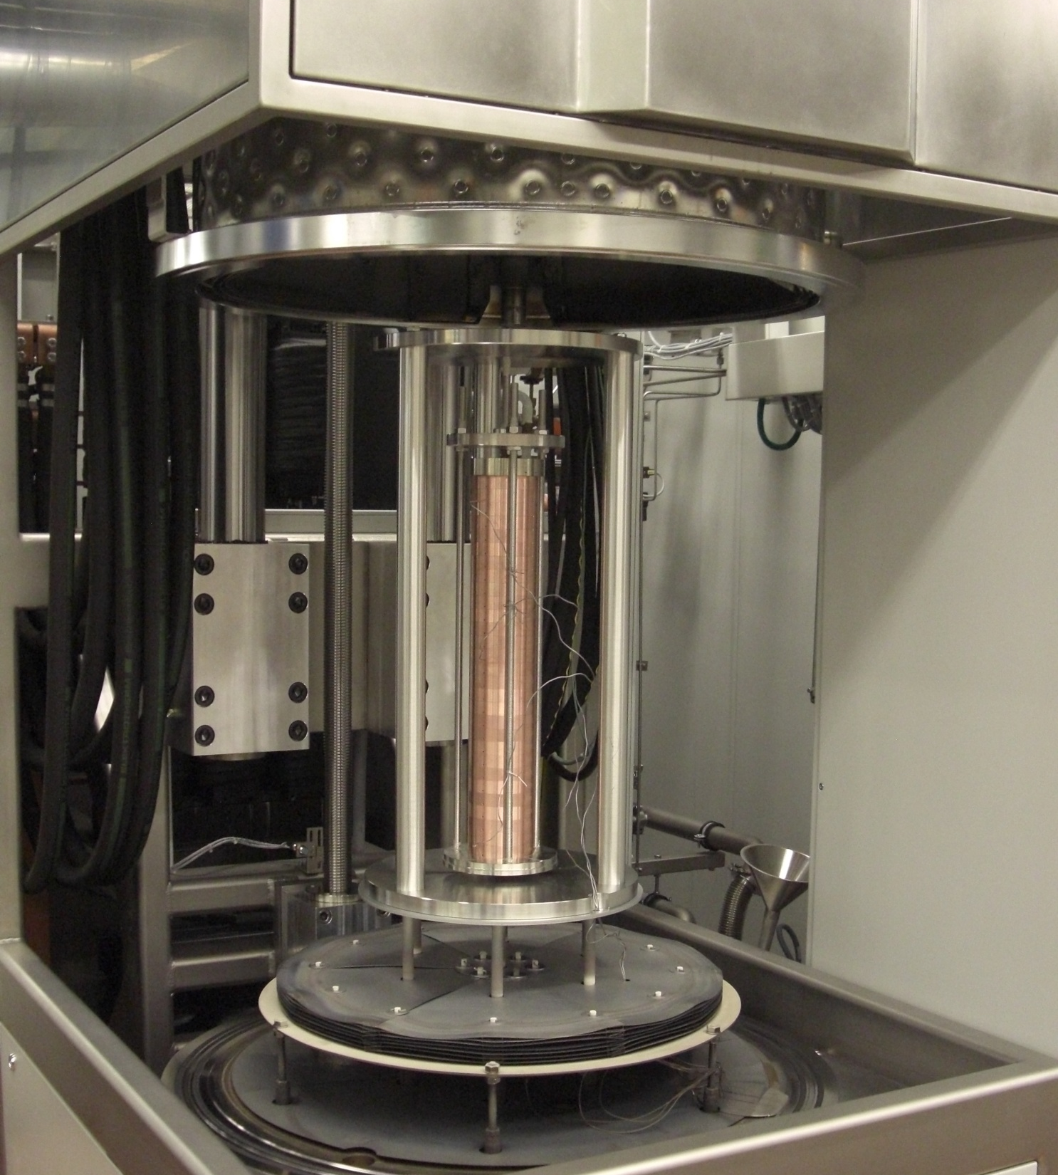
Courtesy Hansruedi Fitze

Slide 36

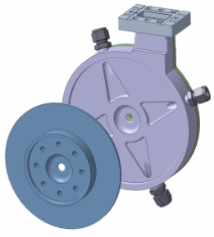
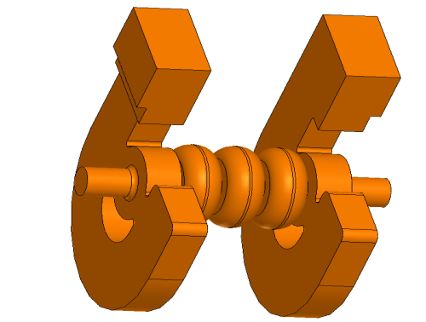
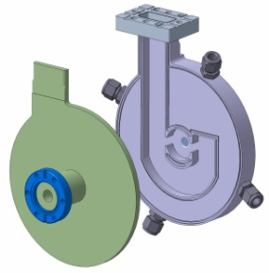
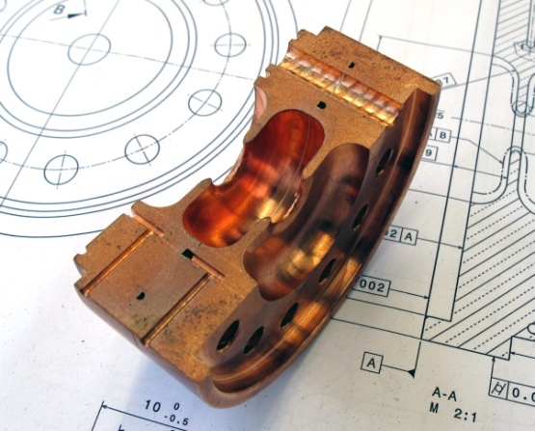
Full scale structure
J-Coupler input
2012, Dec
Conclusive test results in OBLA
2013, Jan
Start series production
J-Coupler output
L = 2050 mm
cooling
110 cells
Courtesy Hansruedi Fitze

Slide 37
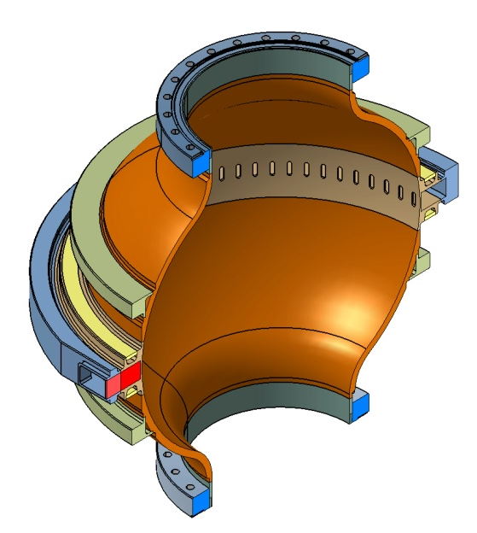
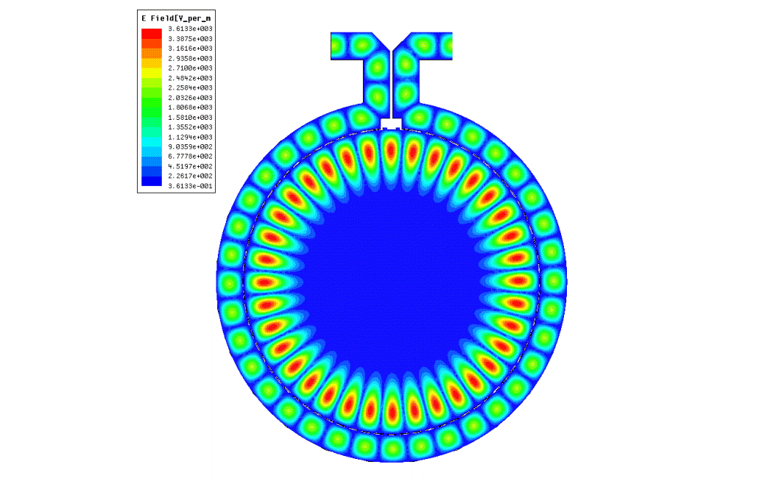

RF pulse compressor, derived from BOC of I. Syratchev/CERN
The pulse compressor is a storage device (Q~220000);it accumulates the energy of the incoming “long” pulse and releases a short pulse. The tuning and phase stability (temperature stability ~0.01 C°) of the BOC is very challenging due to the large Q
Power in
Power out
A 180° phase jump kicks off the output power
The working mode is the TE18,1,1. The coupling (β~10) is provided by 70 slots. The travelling wave in the WG must be in phase with the rotating resonance.
PROTOTYPE
STATUS: RF design ready; mechanical design well advanced
GOAL: prototype ready for summer 2011, measured and tuned September/October 2011
Courtesy Riccardo Zennaro

Slide 38

Klystron
Two Klystrons ordered from Toshiba
 | E37202 | E37210
Peak Power | 50 MW | 50 MW
RF Pulse Width | 3 us | 3 us
Repetition Rate | 60 Hz | 100 Hz
Avg. RF Power | 7.7 kW | 15 kW
Collector Power | 35 kW | 78 kW
Delivery Date | May 2011 | Feb 2012
One E37202 is orderd for startup of test stand
Delivery May 2011
Upgrade Programm in Execution
E37210 to be delivered early 2012
Courtesy Jürgen Alex

Slide 39


Modulator: Scandinova
At 250 MeV Injector in total 7 Scandinova
Modulators are ordered
  3 are in operation
  3 are in commissioning
  Last modulator for X-Band will be
  delivered end of 2010
First operational experience in the 250 MeV
injector indicate usefulness of ScandiNova
solid state modulators, but upgrade
programm necessary
  Mechanical and electrical design has flaws.
Strategy
  Discussion with Scandinova ongoing.
  If succesfully, PSI will order prototype of upgraded modulator for C-Band test stand.
But: Delivery will be to late for starting up first Toshiba klystron
Courtesy Jürgen Alex

Slide 40



10pC Layout
Modified layout based on the original 200pC case. With some fine-tuning in the RF parameters.
The matching of the S-band chirp with the longitudinal wakes in Linac 1 is not done here due to the lower charge.
Booster 2:
-17.8 deg
18 MV/m
X-Band:
270 deg
21.2 MV/m
Linac 1:
-16.7 deg
26.5 MV/m
Linac 2/3:
0 deg
26.5 MV/m
3.82 deg
2.15 deg
head
tail
40

Slide 41
10pC Tolerances
 | arrival time | peak current | energy
goals: | 5 fs | 15 % | 0.05 %
S-Band Phase [deg] | 0.033 | 0.11 | 0.54
S-Band Voltage [rel] | 0.00018 | 0.00019 | 0.0019
X-Band Phase [deg] | >10* | 0.044 | 1.5
X-Band Voltage [rel] | 0.00081 | 0.0017 | 0.0095
Linac 1 Phase [deg] | 0.045 | 0.098 | 0.74
Linac 1 Voltage [rel] | 0.00024 | 0.0037 | 0.0049
Linac 2 Phase [deg] | Not critical | 33 | Not critical
Linac 2 Voltage [rel] | 0.0038 | 0.13 | 0.0052
Linac 3 Phase [deg] | Not critical | 27 | Not critical
Linac 3 Voltage [rel] | 0.0029 | 0.15 | 0.0039
Charge [pC] | 3.4 | 0.47 | 71
initial arrival time [fs] | Not critical | 44 | Not critical
Initial Energy [rel] | 0.0002 | 0.00039 | 0.0023
BC1 angle [rel] | > 0.01* | 0.00069 | 0.022
BC2 angle [rel] | > 0.01* | 0.0011 | 0.035
Courtesy Bolko Beutner

Slide 42
Ultra-stable Sync System Requirements
Most critical issues for sync system:
Jitter (RMS, 10Hz..10MHz) between two clients and long term drift (hours)
Typical FEL client is using ref. (RF, opt.) directly or for locking a PLL
Gun laser: ≈30fs expected (goal: towards 10fs), measure with BAM (beam arrival time monitor)
Most critical RF stations: goal is “0.02° phase jitter at 3GHz“ for SwissFEL
RF system contributes >10fs (far out) intrinsic jitter, <5fs (diff. mode) req. from sync
Experiment (pump-probe) lasers: <10fs (optical sync combined w. BAM for sorting of jittery experimental data)
Seeding laser: <10fs (optical sync combined w. BAM for drift FB)
E/O sampling: <50fs
BAM (opt. sync only): approx. 6fs timing resolution/stability (down to 10pC)
“Differential mode jitter“ betw. stations is critical, “common mode jitter“ (all clients jittering w. ref.) is less critical.
Actual injector drift requirement: some 100fs over hours, will be tightened in the future probably down to <10fs.
10fs is equivalent to 3um in air!
Courtesy Stefan Hunziker

Slide 43
Hybrid Layout for FEL: High Flexibility, Reasonable Cost
FEL subsystems need phase reference: generic layout
Courtesy Stefan Hunziker

Slide 44

compact design → many possible sites

Slide 45
Backup Slides

Slide 46

THz source, two prone approach
High field pump source for experiments
Bend radiation from compact e⁻ accelerator
THz radiation with B > 1 T
Collaboration with KIT Karlsruhe for
FLUTE THz source
Key diagnostic tool for X-ray timing
and pulse length diagnostic
(pioneered at FLASH/DESY, Nature Photonics 3 (2009), 523 )
Laser generated THz
→ avoids synchronization problem for pump
probe experiments. THz is produced from
same laser beam as laser pump pulse

Slide 47
Plans for seeding experiments
Ingredients:
Sven Reiche as international expert on FEL theory and simulation (internat. FEL Prize 2010!)
CSL laser group of Christoph Hauri (SNF Professorship EPFL)
ID group of Thomas Schmidt
SwissFEL 250 MeV injector test facility
Collaboration with DESY under discussion
Program:
Develop laser system with HHG chain in dedicated laser hutch of 250MeV injector building
Establish a versatile experimental seeding beamline in 250MeV injector
Test EEHG,HHG and hybrid seeding schemes 2013-2014
Get best seeding scheme for SwissFEL-ATHOS line
BPM
Profile monitor
Seeding test in 250 MeV injector
Dipole magnet
undulator
40mm period
40 cm (10 periods)
R56=1.5mm
undulator
40mm period
40 cm (10 periods)
undulator
15mm period
4m (266 periods)
R56=0.3mm
Experiment ?
50nm radiation
seed laser
First optic element
radiator

Slide 48

Undulator Strategy
hard x-ray:
small period
small gap
in-vacuum undulators
high harmonics
soft x-ray:
variable polarization
circular and inclined
APPLE II
standard, fixed gap
SPring-8
BESSY
Continuous development from SLS ID’s
U15, gap > 4mm, length 4m
UE40, gap 6.5mm, length 4m
Undulator Strategy for SwissFEL

Slide 49


LEG Low Emittance Electron gun, alternative injector concept
Anode
RF Cavity:
2 Cells, 1.5 GHz
e⁻ injector with novel configuration
Pulsed 500 kV HV diode
Laserdriven photocathode
Optional upgrade to FEA photocathode
2 cell, 1.5 GHz RF cavity for acceleration to 6 MeV
Commissioning started January ‘09.
Goal: reach e⁻ brigthness better than
RF gun achievements
(ε_{N} < 0.4μm for 200 pC)
Photo-cathode
Laser
Pulsed Voltage
500 kV in 200ns
0 to 6 mm Gap

Slide 50

Diode – RF gun combination
Hollow cathode Geometry:
- DLC Coating
- Exchangeable Cathode Insert (Al, Cu, Mo, Nb,…, FEA)
DLC coated
Hollow Cathode
(> 300 MV/m)

Slide 51





SwissFEL photocathode drive laser
transverse beam shaping
cathode
15 m
temporal pulse shaping
PSI-PULSAR: 20 mJ, 20 fs, 100 Hz
long-term pulse energy stability
0.25% rms
0.8% P2P
UV pulse stretcher
UV Dazzler

Slide 52

Laser wavelength tuning range

Slide 53
Intrinsic Emittance versus Laser Wavelength
261 nm: 0.68 mm.mrad / mm
272 nm: 0.54 mm.mrad / mm
282 nm: 0.41 mm.mrad / mm
Φ_{Cu}= 4.35 eV
Exp. Cond.:
Q < 1 pC; 5.2 MeV
σ_{t,laser}= 4 ps rms; 25 MV/m
Copper Cu
Solenoid Scan
With F_{eff} = 25 MV/m

Slide 54




Field emitter arrays as alternative cathode
Gate-1 controls field emission current
Gate-2 controls beamlet divergence
Screen
D
-86 V
V_{c}

Slide 55



Field Emitter Array (FEA) in Diode - RF Gun Test Stand
250 keV; 5 ns FWHM
3 pC; 3 mm.mrad
FEA electron beam
Ø_{FEA} = 2 mm; 10⁵ Tip
FEA beam (5ns) + Photo-electron beam (6 ps; 3 µJ; Ø_{laser}=1mm; 266 nm)
FEA sustain 30 MV/m surface gradient
Field Emission with Electrical Pulses 100 V, 5 ns FWHM
FEA illuminated with laser: Photo-electron beam + FEA beam

Slide 56
Collaborations
MoU with DESY, May 2008, as
framework for collaborative activities
Present items
LLRF
Bunch compressor design
MoU with ELETTRA, May 2008, as framework for collaborative activities
X-band cavities
MoU with INFN-LNF, July 2008, as framework for collaborative activities
Present items
deflecting cavities
MoU with SLAC, October 2008, as framework for collaborative activities
Present items
X-band klystrons
LCLS gun
MoU with SINAP, Shanghai, October 2010
Present items
C-band technology
X-band klystron
MoU with CERN, April 2009 as framework for collaborative activities
Present items
X-band cavity and klystron
Girder design studies
Cavity and RF component fabrication
techniques
Membership in EU-FP7 IRVUX consortium s March 2009
Collaboration with CANDLE/Armenia
beam dynamics
FEL physics studies
Collaboration with European XFEL
Cavity BPM’s
PIXEL detectors
MoU with SPRING 8, October 2006
undulator development

Slide 57
Summary
The design for the SwissFEL aims for a compact 1 Å X-ray FEL source affordable on the scale of a national laboratory and well suited to the scientific interests of the PSI user community. Technical limits are given by state of the art electron sources and undulator technology.
Present planning foresees start of operation of first phase 2016
and second phase 2018
The first commissioning phase of the 250 MeV Injector has just started.

