Slide 1
A European SRF test infrastructure for R&D and test of sc cavities and cryomodules – do we need it?
Wolfgang Weingarten – CERN
The work is co-funded by the European Commission within the Framework Programme 7 Capacities Specific Programme, Grant Agreement 227579 - EuCARD

Slide 2
Outline
History
A look back to 1st RFTech meeting
Overview of SRF funding schemes
Examples of successful funding actions and consortia creation
My personal view on SRF for accelerator application
What to do next?
Conclusion
SRF = Superconducting RF

Slide 3
History

Slide 4
History
Letter of chairman of TTC to CERN Council Strategic Planning Group
Series of meetings in preparation for call by EU
Compendium of European SRF test infrastructure equipment
Decision on EuCARD (with RFTech being a part):
http://eucard.web.cern.ch/EuCARD/index.html

Slide 5
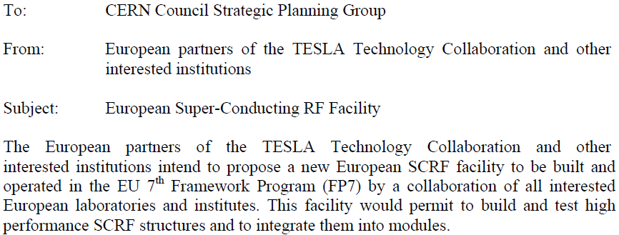
Letter of Intent about a European SC RF Facility¹

Slide 6
Letter of Intent about a European SC RF Facility²
…

Slide 7
RFTech goals
The goals of RFTech are to provide a network for information exchange and close collaboration between the European, and worldwide, experts on accelerator RF systems. The scientific objectives are the improvements of RF cavity design, superconducting RF (equipment for R&D and test of cavities and cryomodules), low-level and high-power RF systems, and costing tools.

Slide 8
RFTech Objective
i.e. the main objective of the “SRF sub-task” consists in intensifying a collaborative effort between European accelerator labs with the aim of planning and later providing for European accelerator users a multi-purpose state-of-the art network of equipment for R&D and test of SRF cavities and cryo-modules within 2 years, to be presented to the funding agencies

Slide 9
A look back to 1st RFTech meeting https://indico.desy.de/conferenceDisplay.py?confId=2831

Slide 10
A look back to 1st RFTech meeting Conclusion on lessons learnt ¹
1st lesson
The SRF community is relatively small and well known to each other. If need is, arrangements are taken between labs with focus on a specific project of mutual interest.
2nd lesson
The SRF community is well integrated in supra-national integrative attempts (partly providing resources).
3rd lesson
Universities played an important role for scientific innovations
Large scale applications in technology and engineering mostly done in research centers
Reproducibility mostly achieved in close interaction between industry and research centers

Slide 11
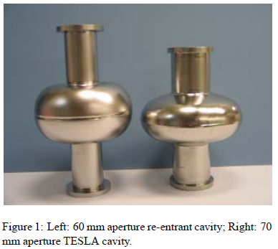
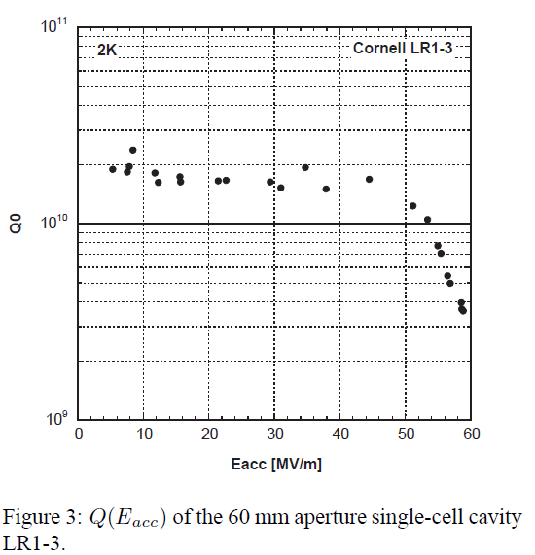
A look back to 1st RFTech meeting Conclusion on lessons learnt ²
4th lesson
The Nb technology touches its (predicted) theoretical limits; however issues such as reproducibility of high gradient performance and cost reduction issues are still challenging.
About four decades R&D efforts passed up till obtaining the theoretical limit of the Nb SRF technology - more years are ahead up till obtaining reproducible results
The innovation most promising in the future consists in (classical) high Tc superconductors, such as Nb₃Sn
Cornell - KEK collaboration

Slide 12
A look back to 1st RFTech meeting EuCARD Deliverable
EDMS No. D4.3.2:
https://edms.cern.ch/nav/CERN-0000077769/CERN-0000077787\
Strategy/result for SRF test infrastructures
Due delivery month 24 (March 2011)

Slide 13
A look back to 1st RFTech meeting https://indico.desy.de/conferenceDisplay.py?confId=2831
My personal opinion is that the SRF community is organized world-wide, exchanges information efficiently, and practices fruitful collaboration, whenever need is.
De facto there exists already a distributed network of infrastructures for R&D and test of sc cavities and cryomodules, possibly to be completed by specific equipment.

Slide 14
Examples of successful funding actions and consortia creation

Slide 15
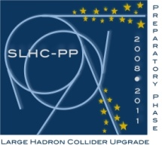
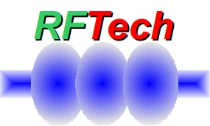
Overview of SRF funding/consortia schemes
International (European) funding (FP ⁶⁾ Consortia)
Principles (cf. CORDIS ⁷⁾ pages of the EU)
CARE¹⁾ - SLHC-PP²⁾ - EuCARD ³⁾ - ILC Highgrade - TIARA ⁸⁾ - CRISP⁴⁾ (current request to EU) – HL-LHC (all under the auspices of ESGARD ⁵⁾)
Marie Curie Early Stage Trainee
LARP
National funding
CERN: Trainee program (F, P, Sp), Doctoral students from (A, D), and other special programs
Physics at the Terascale Initiative (D)
BMBF (D) Initiative (22 Oct 2008) and others
Bilateral funding
Special contribution of France to CERN
Other International Networks
TESLA Technology Collaboration
¹⁾ Coordinated Accelerator Research in Europe
²⁾ Large Hadron Collider upgrade Preparatory Phase
³⁾ European Co-ordination for Accelerator Research & Development
⁴⁾ Cluster of Research Infrastructures for Synergies in Physics
⁵⁾ European Steering Group on Accelerator R&D
⁶⁾ Framework Program of the European Union
⁷⁾ Community Research and Development Information Service
⁸⁾ Test Infrastructure and Accelerator Research Area

Slide 16
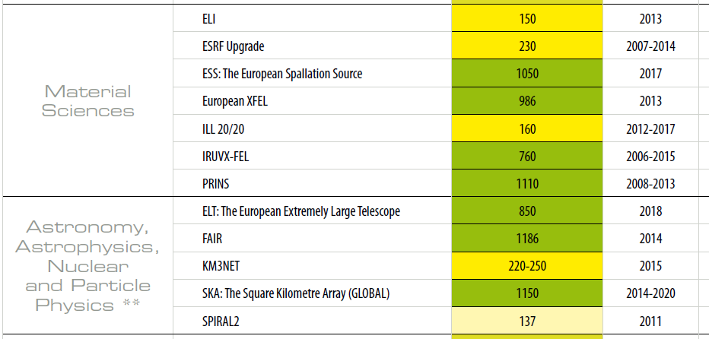
ESFRI-projects¹

Slide 17
ESFRI-projects²

Slide 18
My personal view on SRF for accelerator application

Slide 19
My personal view on SRF for accelerator application ¹
Startup at several places and driven by high energy and nuclear physics needs
Continuously increasing application for accelerator projects
Stanford e⁻-linac - Urbana microtron - heavy ion accelerator (Argonne ATLAS, Legnaro ALPI) - Cornell synchrotron - Karlsruhe p-linac - Karlsruhe /CERN particle separator - Recyclotron (S-DALINAC , CEBAF) - e⁻ ring/collider application (PETRA, SPS, HERA, TRISTAN, CESR, LEP, LHC…) - FEL (Stanford, Darmstadt, XFEL) - ERLs - Linear e⁺/e⁻- collider (ILC)
R&D oriented versus specific project: steady improvement of performance of niobium cavities up till theoretical limits
“Niche” R&D on Nb/Cu cavities for LEP, LHC, ALPI, HIE-ISOLDE

Slide 20
My personal view on SRF for accelerator application ²
Very successful development, but reaching technical and financial limits
Cost of niobiumNb sheets (520 €/kg in 2010, 350 in 2008, 270 in 2006¹)
¹) G. Olry private communication, 5th SPL collaboration meeting
Problem of reproducibility of performance (quality control)
Waiting for LHC results before decision on next high energy physics accelerator will be taken
Very long development time until theoretical limits ( ~ 40 years)
No real understanding of theoretical and experimental performance limitations of Nb accelerating cavities
BUT: identification of cures by experiment to improve performance
AND: large SRF test infrastructure and synergies between laboratories were created

Slide 21
My personal view on SRF for accelerator application³
Ongoing R&D activities for
ILC (worldwide effort): improve reproducibility
Proton driver (ADS, SPL study @ CERN): construct cryomodule
Heavy ion accelerators (e.g. HIE ISOLDE with improved Nb coating methods): reduce costs and avoid quench limitation
LHC upgrade (Crab cavities, LeHC)
Energy Recovery Linac (ERL)
…
concentrated around research centres with no or little interaction with Universities (as it was in the past)

Slide 22
My personal view on SRF for accelerator application
The SRF field is a victim of its own success: Spectacular technological progress was often achieved by trial and error and did only partially keep track with the theoretical understanding of the physics behind.

Slide 23
What to do next?

Slide 24
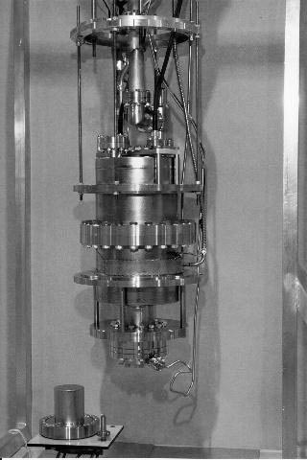
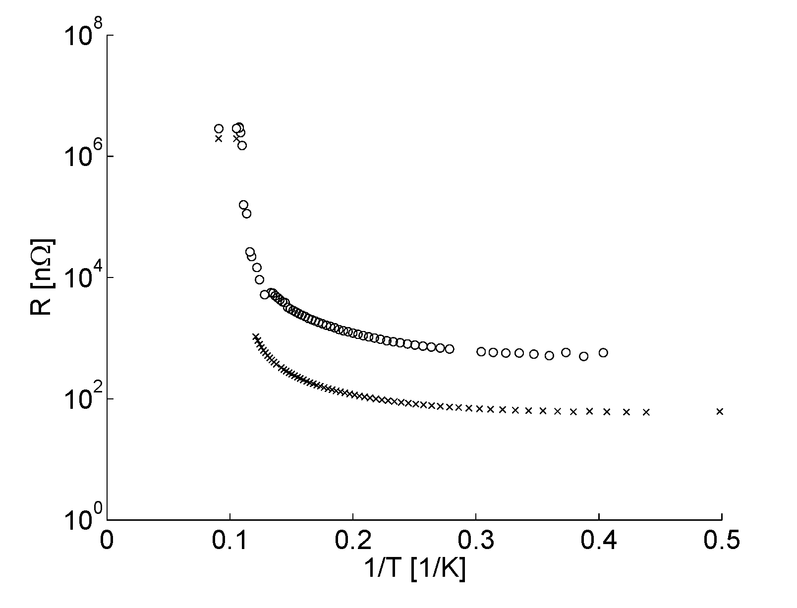
Nb
Understand fundamental limitations of Nb (Q-slope, Q-drop, max magnetic field under RF, residual resistance, …) both for bulk niobium cavities and for Nb film cavities.
Courtesy T. Junginger
1200 MHz
400 MHz

Slide 25
Nb/Cu
State-of-the-art at 1500 MHz – 1.7 K – single cell
0 45 90
H_{surf} [mT]
Courtesy Sergio Calatroni - 25.11.2010
5th SPL Collaboration Meeting
Q = 3x10⁹ @ 20 MV/m
Q = 1x10¹⁰ @ 15 MV/m
28 MV/m reached in a large LEP cryostat (He evaporation at large power)

Slide 26
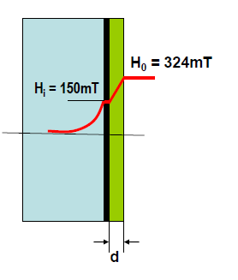
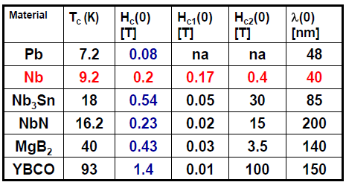
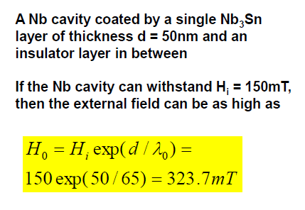
A15, etc.
Continue the study of classical high T_{c} supraconductors such as Nb₃Sn or NbN with their high potential of operating at higher temperature than Nb with low RF losses and larger critical magnetic field;
Study “multilayers” of a thin film of, say, Nb₃Sn, on a Nb substrate which should result in a large critical magnetic field
Source: S. Calatroni, A. Gurevich

Slide 27
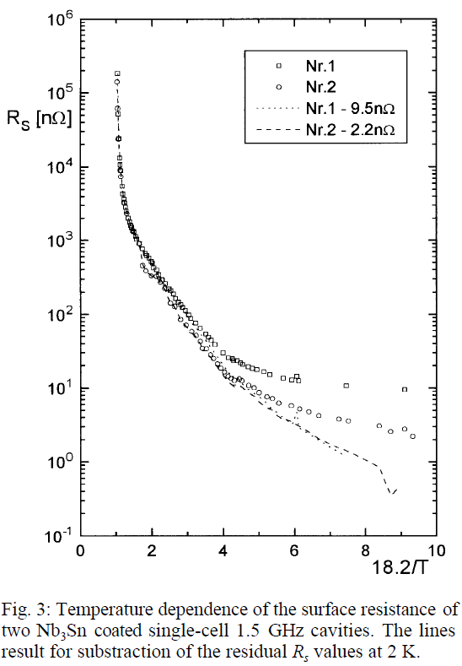
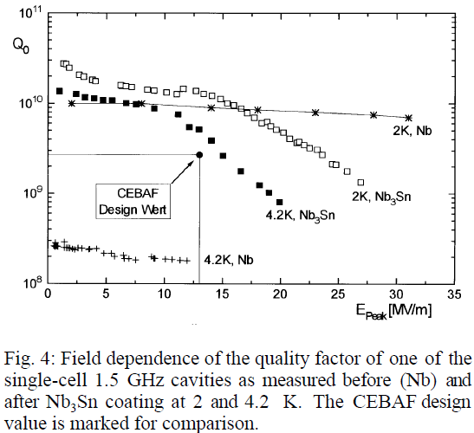
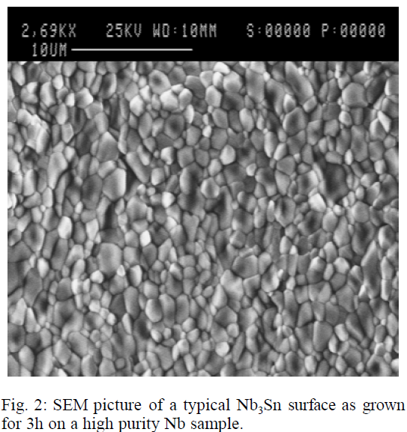
A15, etc.

Slide 28
What to do next?
There are plenty of ideas to develop the field of SRF into a bright future: deeper and more thorough understanding of the physics of Nb, including Nb films, classical high T_{c} supraconductors and multi-layers of sc materials.
In my opinion we need a continuous funding and stronger links with non-accelerator institutes, including universities.
Possibly a SRF R&D activity could go under the umbrella of a new EU program (EuCARD 2?).

Slide 29
Conclusion
SRF is nowadays a widely applied technology for accelerator application.
The SRF community practices fruitful collaboration, whenever need is. De facto there exists already a distributed network of infrastructures for R&D and test of sc cavities and cryomodules.
SRF with niobium as base metal risks to attain its theoretical limits.
However, the experimental performances have a large scatter and lack physical explanation.
Hence if we want to pursue the SRF technology for accelerator application further, in view of the long development times, we should propose a vigorous R&D program to the EU now, possibly under the umbrella of a new EU program.

Slide 30
Thank you for your attention
Men do not stumble over mountains, but over mole hills - Confucius -

Slide 31
Spare slides

Slide 32
Compendium of SRF test equipment in European acc. labs¹
Laboratory | Mechanical manufacture | Surface treatment | Clean rooms
CERN | Several EB welding machines (1 with p<10⁻⁵ mbar in preparation) Spinning facility | Cu-CP(LEP-LHC cavity size) Cu-EP(1.3÷1.5 GHz cavities) | class10 15x4m² class 100 3x5m² class 100 8x5m²
DESY |  | closed-circuit Nb-CP in class 10000 closed-circuit Nb-EP | class 100 ~15x8m² 2xclass 10 3x4m²
FZ Rossendorf
BESSY Berlin
University of Darmstadt
CEA-Saclay
IPN-Orsay
Cockcroft Institute |  |  | class 1000 7x9m² 3x4m²
INFN Legnaro
DRAFT

Slide 33
Compendium of SRF test equipment in European acc. labs²
Laboratory | Ultrapure water rinsing | Surface coating equipment | UHV furnace
CERN | 100 bar, 18 MOhm.cm 6 bar, 18 MOhm.cm | Nb coating facilities for 1.3÷1.5 GHz cavities Nb coating facilities for LHC cavities
DESY | 100 bar, 18 MOhm.cm in class 100 clean room for 9-cell cavity 150 bar, 18 MOhm cm, 3-cell cavity horizontal dry-ice cleaning of 3-cell
FZ Rossendorf
BESSY Berlin
University of Darmstadt |  |  | High temperature annealing of samples and small size cavities
CEA-Saclay
IPN-Orsay
Cockcroft Institute
INFN Legnaro
DRAFT

Slide 34
Compendium of SRF test equipment in European acc. labs³
Laboratory | Test places/cryostats | RF | Cryo-installation
CERN | Horizontal: 14m 1MW 352MHz 4.5K 14m 300kW 400MHz 4.5K Vertical:2x2.5m/1.1mdiameter 2x4.2m/1.1m diameter cryostat for 1.3÷1.5 GHz 1.8K |  | 6 kW @ 4.5 K, liquefaction capacity of 26 g/s helium pumping units of 18 g/s at 3 kPa
DESY |  | 900 W @ 4.5 K, ~200 W at 1.8K 60W @ 4.5 K
FZ Rossendorf
BESSY Berlin | HoBiCaT test facility for high and low power operation of fully equipped cavity systems at 1.8-2.2 K Cavity tests at 1300 MHz Coupler tests at 1300 MHz
University of Darmstadt
CEA-Saclay | SUPRATECH: 88, 352, 704, 1300 MHz power coupler tests Vertical tests of SRF cavities of different size Horizontal cryostat for high power RF tests at 2.0 K (CryHoLab) Electro-polishing of niobium High temperature annealing furnace (900 °C)
IPN-Orsay
Cockcroft Institute |  | 20 kW 1.3 GHz IOT 300 W 1.3 GHz 250 kW 500 MHz Klystron 6 MWpk(12 kWavg) 2998 MHz Klystron (6μs pulse) | 150W @ 1.8 K 120W @ 4.5 K
INFN Legnaro
DRAFT

Slide 35
Compendium of SRF test equipment in European acc. labs⁴
Laboratory | Sample characterization | Access to beam test facilities
CERN | Quadrupole resonator (400(1200)MHz sample diameter 7.5cm >2K)
DESY |  | XFEL infrastructure and TESLA TEST FACILITY
FZ Rossendorf
BESSY Berlin
University of Darmstadt
CEA-Saclay
IPN-Orsay
Cockcroft Institute |  | XPS/SEM
INFN Legnaro
DRAFT

Slide 36
Calls from the EU of relevance for SRF
o INFRA-2011-2.3.4: Implementation of common solutions for a cluster of ESFRI infrastructures in the field of "Physics and Analytical Facilities".
A project under this topic should aim at synergies in the development of key critical components common to the ESFRI Infrastructures in the field of Physics and Analytical Facilities such as, for example, accelerator elements, targets, detectors, or radiation protection and safety components, that are needed for their implementation.

