Slide 1
RF Power Sources and Related Issues
... and some non-related ...

Slide 2
Outline
RF Power source issues (presented at Linac10 and IWLC10)
The RF activities inside EuCARD-NCLinac
The planned RF activities in TIARA
The planned RF activities in “HiLumi LHC” DS
A possible Network activity in EuCARD 2?

Slide 3
RF Power Source Issues
Power — Efficiency — Complexity — Reliability — Cost

Slide 4
The Need for Power
HEP:
Future e⁺e⁻ colliders (ILC, CLIC, …)
Plasma-Wakefield accelerator (drive beam)
Proton driver for Muon-collider, Neutrino-factory (Project-X, …)
Non-HEP:
Spallation neutron sources, (SNS, ESS, …)
Irradiation Facility (IFMIF, …)
ADS

Slide 5
The Need for Power
Many large future projects need large scale RF!
This is true for both average and peak powers.
 | IFMIF | ESS | SPL II | ILC .5 TeV | CLIC 3 TeV
Frequency | 175 MHz | 704 MHz | 704 MHz | 1300 MHz | 1000 MHz
Technology | Grid tubes | klystrons | klystrons | MBK | MBK
Total AC power |  | 38 MW | 40 MW | 230 MW | 415 MW
Modulator output | 60 MW | 17.8 MW | 26.5 MW | 135 MW | 255 MW
Power source output | 25 MW | 8.9 MW | 10.7 MW | 88 MW | 180 MW
Drive beam power |  |  |  |  | 140 MW
Acc. structure input | 15 MW | 6.5 MW | 7.8 MW | 67 MW | 101 MW
Total beam(s) power | 10 MW | 5 MW | 4 MW | 21.6 MW | 28 MW
Efficiency |  | 13.5 % | 10 % | 9.4 % | 6.7 %

Slide 6
The Need for Efficiency
Overall AC to beam efficiency about 10%!
Increased efficiency would
reduce the environmental impact,
reduce the size of the installed power,
reduce the size of the necessary cooling,
decrease the electricity bill:
Example:
CLIC @ 3 TeV, 415 MW AC consumption,
5,000 h operation per year, 40 $/MWh:
Annual electricity bill of 91 M$.
Assume that this is for a klystron efficiency of 65 %.
With a klystron efficiency increase by 1 % (66 %), you would save 1.4 M$ every year in electricity alone.

Slide 7
Issue Complexity/Cost
Some of these projects cost ≈ 10 G$ or beyond.
RF sources may be important cost drivers (G$).
Clearly, when optimizing efficiency, one must not compromise on low cost. Solutions with potential easy mass production are preferred.
Large complexity will also complicate operation/maintenance.
For many small units, methods to implement graceful degradation may be implemented.

Slide 8
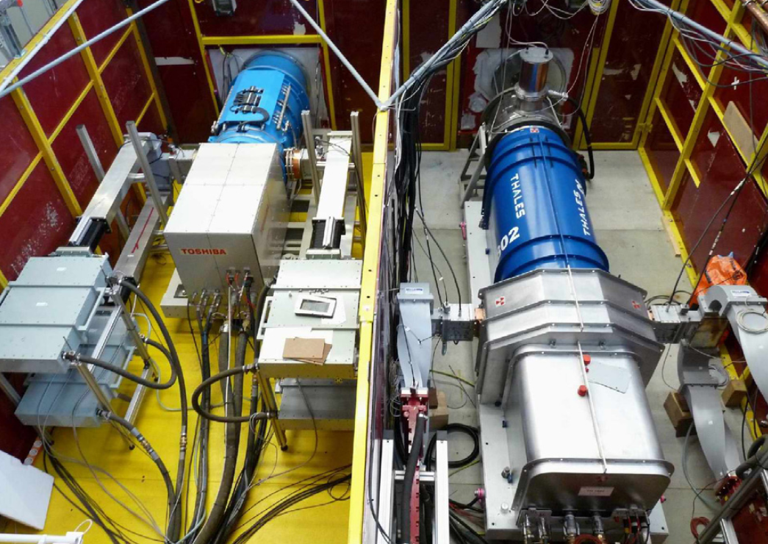
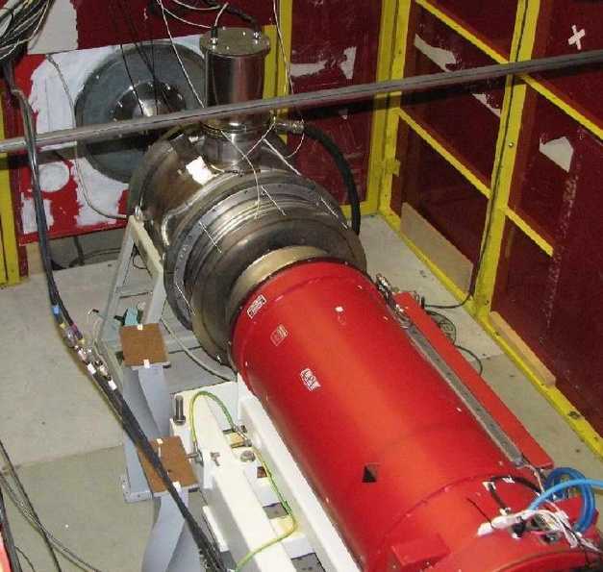
Example of the State of the Art
Toshiba: E3736 (6 beam): 1.3 GHz, 10.4 MW, 10 Hz, 66 %, 49 dB gain
Thales: TH 1801 (7 beam): 1.3 GHz, 10.1 MW, 10 Hz, 63 %, 48 dB gain
CPI: VKL-8301B (6 beam): 1.3 GHz, 10.2 MW, 10 Hz, 66.3 %, 49.3 dB gain
1.
2.
3.

Slide 9
Where to go from here?
The R&D for the ILC/X-FEL MBK’s was very successful.
However, the ideal power source may not be obtain from extrapolation of this concept.
Optimization is complex:
more beamlets increase complexity and size,
higher voltage will have impact on modulator
higher current
... but it may pay off:

Slide 10
Return on R&D Investment

Slide 11
Potential high η RF sources
Conventional (pencil beam) klystrons
Multi-beam klystrons MBK’s
Sheet beam klystrons (SBK)
Klystrons with MDC (multi-stage depressed collector)
IOT’s?
Magnetrons?
other – more exotic (Gyrocon?, ...)
Different methods of lost energy recovery (from RF, thermal, ...)

Slide 12
The RF activities inside EuCARD-NCLinac

Slide 13
RF related tasks in NCLinac:
High Gradient Cavities
PETS
HOM Damping
Breakdown Simulation
Precise Assembly
Diagnostics
Stabilisation
Beam Delivery System
Drive Beam Phase Control
Low impedance phase pick-up
Bunch Arrival Time monitor

Slide 14
NCLinac 9.2.1 PETS
PETS STUDY
Aim: design and build a double length PETS (Power Extraction and Transfer Structure) for CTF3

Slide 15
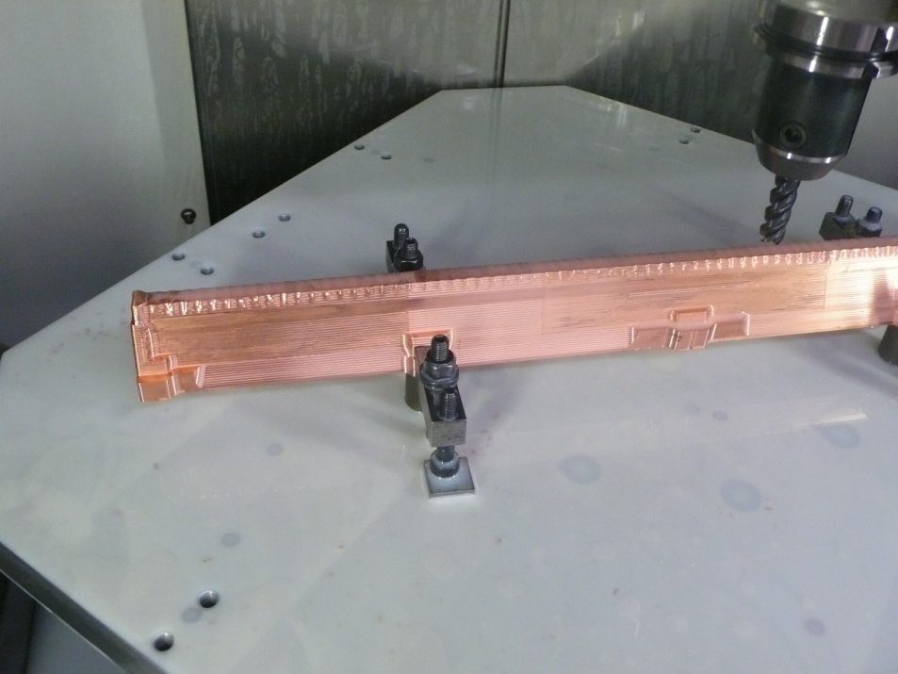
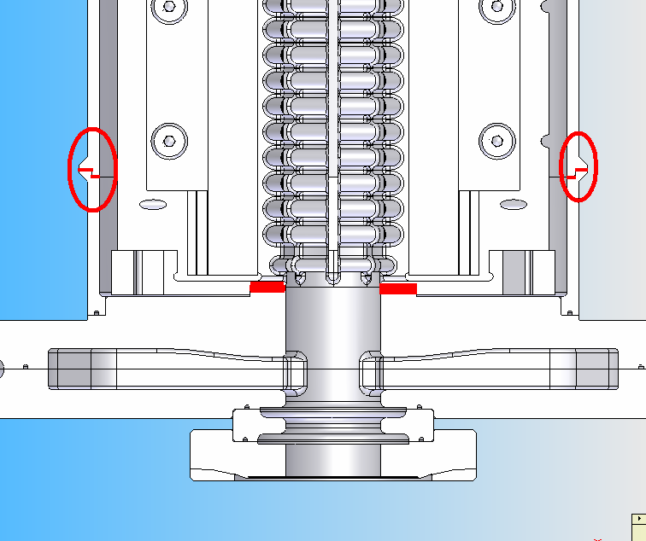
NCLinac 9.2.1 PETS
Fabrication of the first copper rod by DMP (Spain) about to finish.
Two stress relieve treatments (2h @ 180ºC) performed to achieve the requested tolerances +/- 15 μm.
Dimensional control of the first copper rod to be carried out at DMP, using a fully automatic 3-D measurement machine.
Absorber material ordered.
Vacuum tank and vacuum ports will be made of stainless steel and TIG welded.

Slide 16
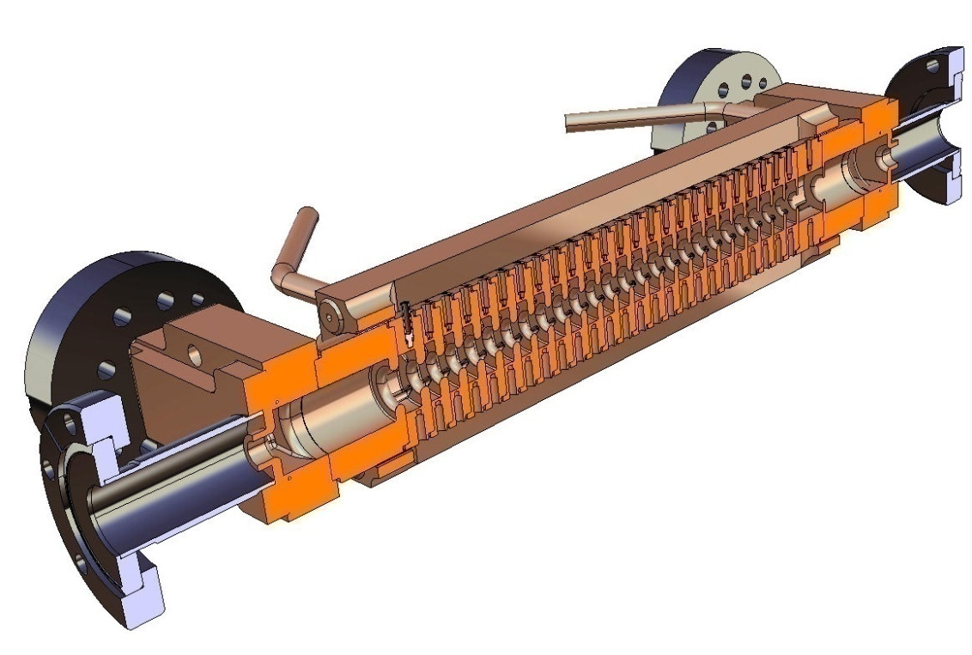
NCLinac 9.2.2 HOM Damping
Aim: Design an alternative CLIC accelerating structure with manifold damping and strong detuning (DDS)
Cutaway-view
Prototype disc

Slide 17
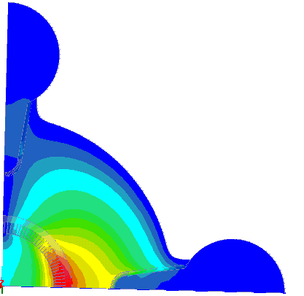
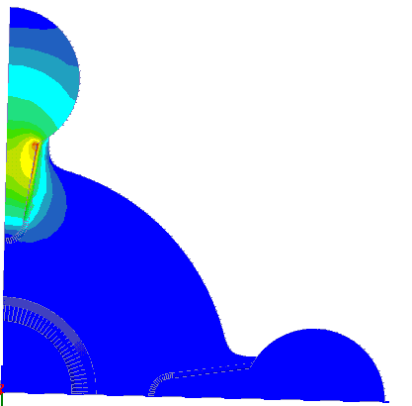
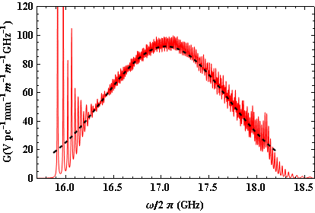
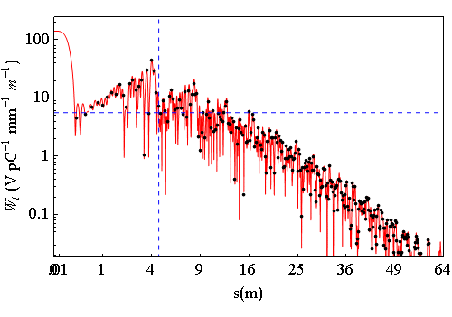
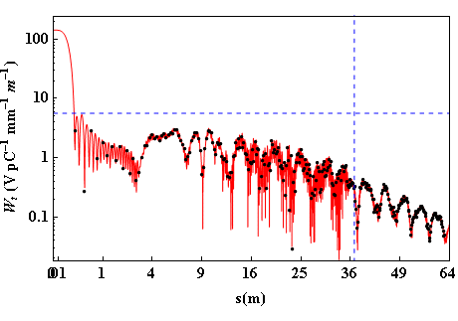
NCLinac 9.2.2 DDS
Manifold
∆f=3.6 σ
=2.3 GHz
∆f/fc=13.75%
Coupling slot
192 cells
8-fold interleaving
Meets
design
Criterion?
∆fmin = 65 MHz
∆tmax =15.38 ns
∆s = 4.61 m
∆fmin = 8.12 MHz
∆tmax =123 ns
∆s = 36.92 m
192 cells
8-fold interleaving
24 cells
No interleaving

Slide 18
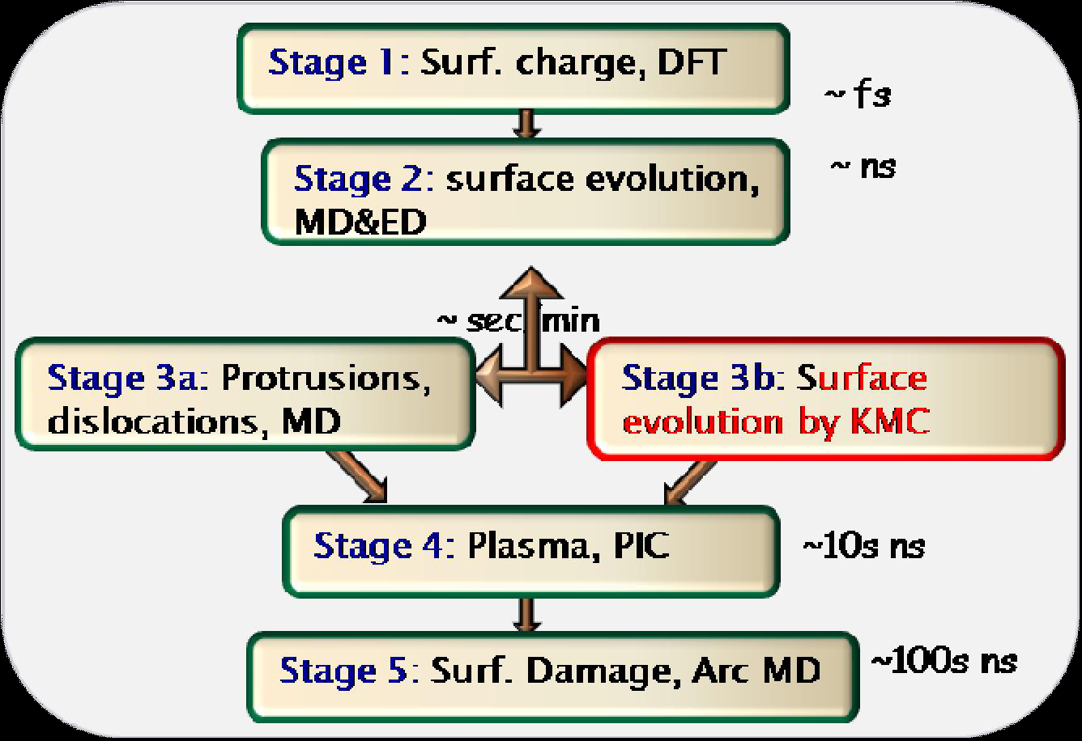
NCLinac 9.2.3 BD Simulation
Aim: Simulate breakdown phenomena to help understand the physics
DFT: Density Functional Theory
MD: Molecular Dynamics
ED: Electrodynamics
KMC: Kinetic Monte-Carlo
PIC: Particle In Cell

Slide 19
NCLinac 9.2.3 BD Simulation
SEM photo
Simulation

Slide 20
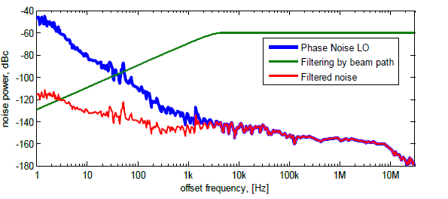
NCLinac 9.5: Phase control
Aim: Design PU to detect phase of CLIC drive beam to better than 20 fs precision

Slide 21
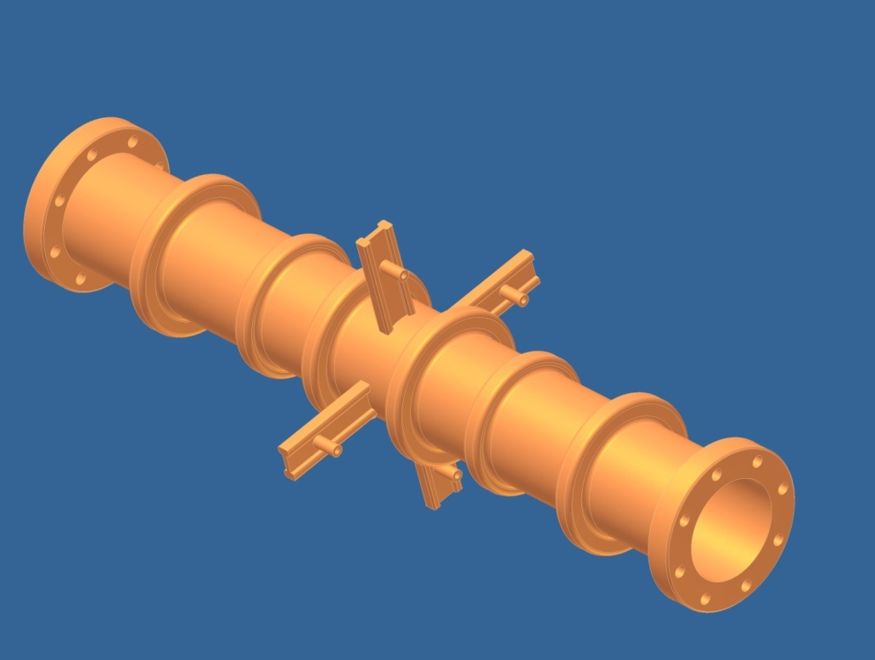
NCLinac 9.5.1: Low Z Phase PU
12 GHz
notch
filter
12 GHz
notch
filter
Beam induced signal
Beam signal
pick-up
RF noise
RF noise
beam
reflected
reflected
12 GHz resonating volume

Slide 22
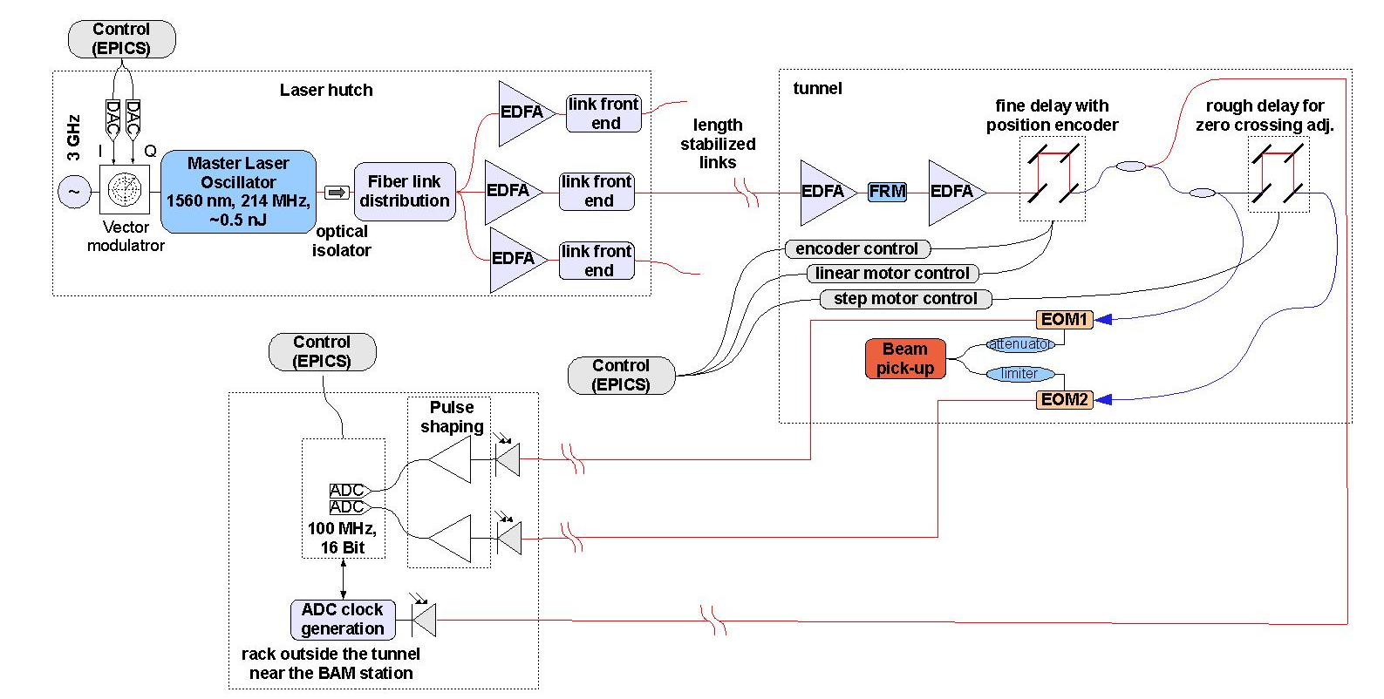
NCLinac 9.5.2: BAM
BAM: Bunch Arrival Monitor

Slide 23
The planned RF activities in TIARA
Test Infrastructure and Accelerator Research Area
http://www.eu-tiara.eu/

Slide 24
TIARA-pp Goals and Partners
Objectives:
The main objective of TIARA (Test Infrastructure and Accelerator Research Area) is the integration of national and international accelerator R&D infrastructures into a single distributed European accelerator R&D facility.
This will include the implementation of organisational structures to enable the integration of existing individual infrastructures, their efficient operation and upgrades, and the construction of new infrastructures as part of TIARA.
TIARA will enable full exploitation of the complementary features and expertise of the individual member infrastructures, maximizing the benefits for both the owners of these infrastructures and their users.
This unique distributed facility will also support the development of an integrated R&D programme embracing the needs of many different fields, as well as medical and industrial sectors, both on technical and human resource aspects.
Besides a world-level state-of-the-art distributed R&D facility, TIARA will develop means for establishing and supporting joint accelerator R&D programming, joint education and training programmes and strengthened collaboration with industry.
Partners:
CEA ,CERN, CNRS, CIEMAT, DESY, GSI, INFN, PSI, STFC, UU, IFJ-PAN

Slide 25
TIARA-pp Work Packages
Management (CEA)
Governance (CEA)
R&D Infrastructures (CERN)
Joint R&D Programming (INFN)
Education and Training (STFC)
Small Vertical Emittance Tuning (CERN)
Ionisation Cooling Test Facility (STFC)
High Gradient Acceleration (INFN)
Test Infrastructure for High Power Accelerator Components (CNRS)

Slide 26
RF activities in TIARA
In WP7, a Diacrode® based, pulsed 200 MHz, 2...3 MW amplifier for a MICE upgrade (ICTF) will be studied (Task 7.3).
WP8, High Gradient Acceleration, will design C-band accelerating structures for a SPARC energy upgrade to 200MeV (Tasks 8.1 & 8.3) and a digital LLRF system (Task 8.2).

Slide 27
The planned RF activities in HiLumi LHC DS
LHC Crab Cavities:

Slide 28
HiLumi LHC DS
HL-LHC is a major CERN recognized project and has a scope of enabling LHC to attain in 10-12 years (about 2020 - 2030) an integrated luminosity of 3 ab⁻¹!
All hadron colliders of the World have produced so far about 10 fb⁻¹ in total; LHC will deliver in its first 10-12 years (hopefully) about 200-300 fb⁻¹.
HiLumi LHC is the “Design Study” part of HL-LHC, the FP7 proposal was sent 25-Nov-2010 to Brussels.

Slide 29
HiLumi LHC Work Packages
Management & Coordination
Accelerator Physics and Performance
Magnet Design
Crab Cavities
IR Collimation
Cold Powering
HiLumi LHC WP4 will build on the success of EuCARD WP10.3 and RFTech.
More details: Talk by Rama Calaga this morning

Slide 30
A possible Network activity in EuCARD 2?
Back to my initial subject “High efficiency, high power RF sources”

Slide 31
EuCARD 2 (?)
EuCARD 2 (working name) is in the planning phase (2011 call) ...
UU and others identified the need for “Sustainable and energy efficient RF”; I have suggested to include a Network Activity focused on “High Efficiency RF Power Generation”.
This Network would connect people interested in the field and working on “waste less power” in RF power generation.
Initial reaction was very positive.
... à suivre ...

Slide 32
Thank you very much!

