Slide 1


Événements monojet: voyage au centre du Modèle Standard et au delà
Pierre-Hugues Beauchemin
University of Oxford
Grenoble, 10 Février, 2011

Slide 2
A signature-based search
Outline
Introduction
  How to look for new physics
How to look for new phenomena:
  One possible idea: Large Extra Dimensions
  A powerful device: the LHC accelerator and the ATLAS detector
  Understand the ATLAS detector and rediscover Standard Model
  Observe deviation with respect to Standard Model predictions
Data-driven estimate of background in monojet events
Model-independence: not sticking to LED
Search for new physics with monojet events
  CDF results
  ATLAS prospect
Conclusion

Slide 3
INTRODUCTION

Slide 4
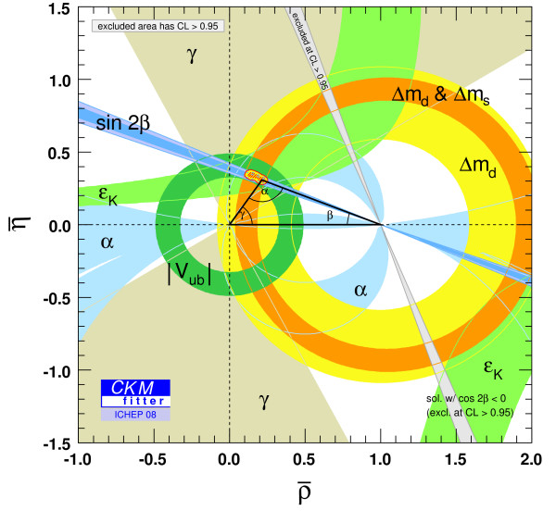
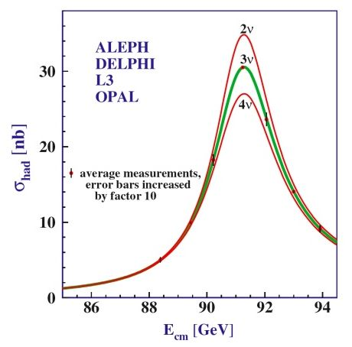
A signature-based search
Standard Model success…
SM provides an accurate description of the HEP data collected … so far!
EWK parameters
Anomalous magnetic moment (g-2)
Top and W mass
The Standard Model has withstood against the large spectrum of really precise experiments that tested it:
  Ingenuity is required to go beyond SM
  SM constitutes a powerful tool to allow to go beyond it…
CKM angles
Z⁰ width
α_{s} running

Slide 5
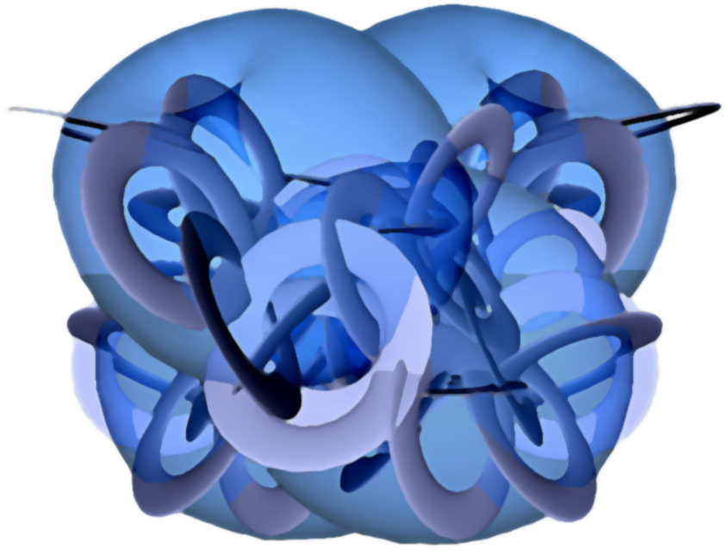
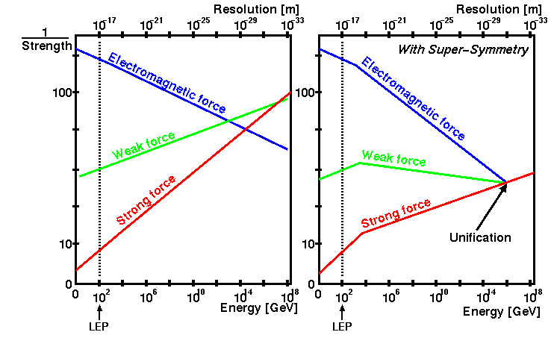
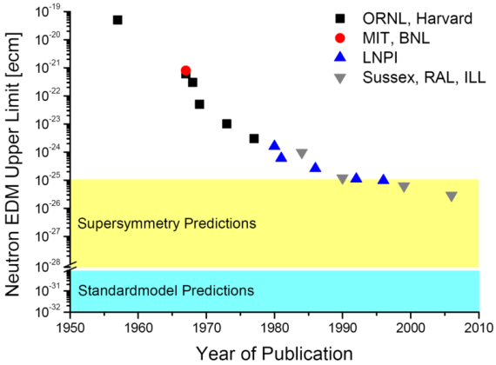
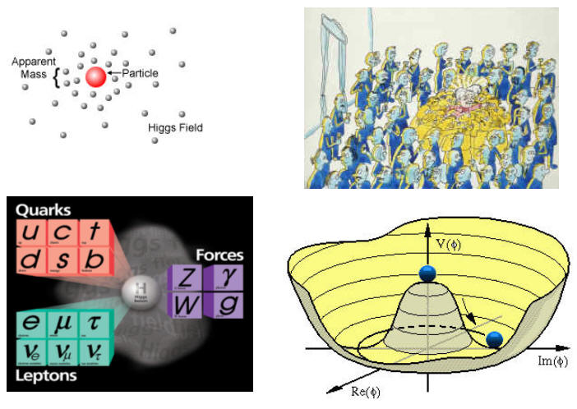
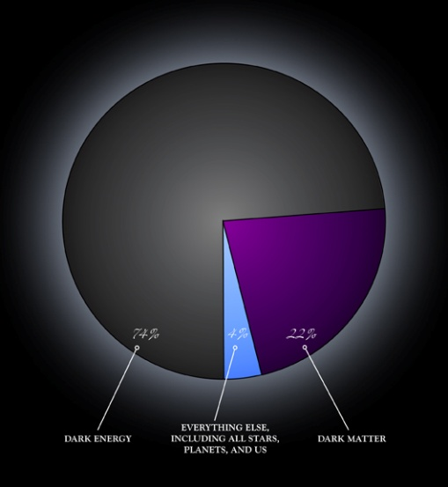
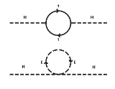

A signature-based search
… and its limitations
… But the SM cannot be the end of the story for it leaves many unanswered questions.
Need to find New Physics!
Space-time Structure
& Gravity
Strong-CP problem
Unification
Fine tuning
Hierarchy Problem
Dark Matter
Dark Energy
ElectroWeak Symmetry Breaking

Slide 6
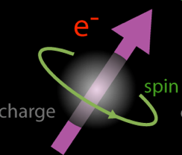
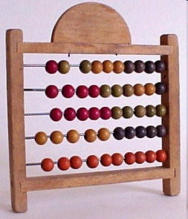
A signature-based search
The quest for New Physics!
In order to solve some of these problems and make a giant step in our understanding of Nature:
Find new phenomena
  new particles
  new behaviour of the known particles
Characterize the new phenomena
  Eg: mass, charge or spin of new particles
  Production and decay rates → coupling
Integrate this experimental information in an extension of the theory
S = ∫L

Slide 7

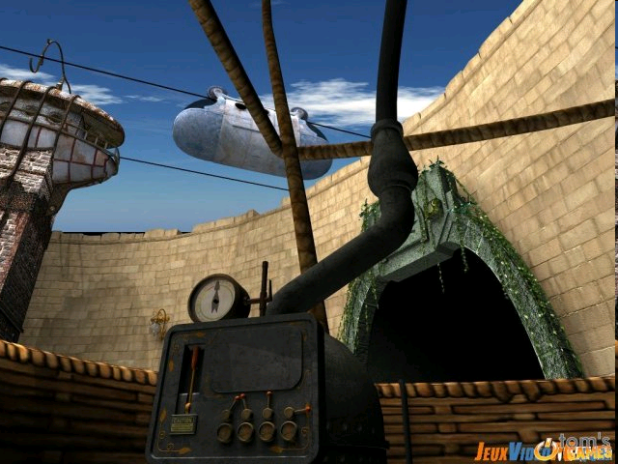
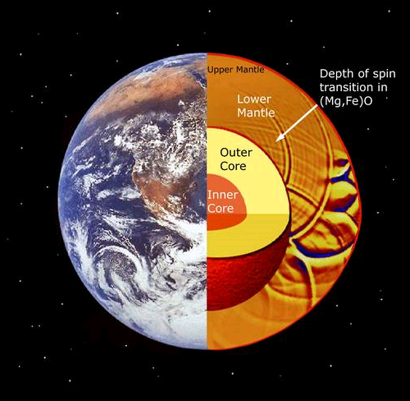
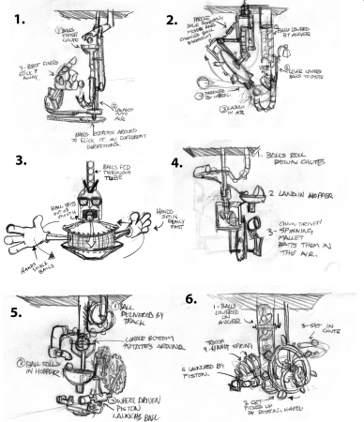

How to look for new phenomena
A signature-based search
Need new ideas
  hint on what to look for
Powerful devices
  see phenomena inaccessible before
Understand well how the device works
  Calibrate apparatus,
  understand its systematic effects
  re-discover known phenomena
Find inexplicable deviations with respect to accepted theories
  Deviations = new phenomena

Slide 8
A signature-based search
In today’s presentation
We will illustrate all this process with one specific example:
Search for Large Extra Dimensions
Pretext to see:
  How well the ATLAS detector is doing
  How works data-driven background estimates
  How current best LED limits have been obtained

Slide 9
How to look for new phenomena?
1- A new Idea:
Large Extra Dimensions

Slide 10
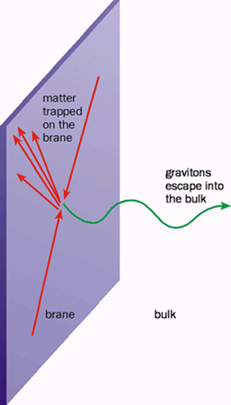
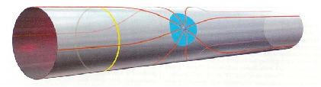
A signature-based search
Extra Dimensions
ED proposed in the late 90’s as a potential solution to the hierarchy problem
Since then, ED have been used as an ingredient to many unsolved problems of the SM
  EWSB, Dark Matter, Dark Energy, SUSY breaking, etc...
ED must be somehow hidden or we would have already observed them
  compactified
We use the ADD model to set limits

Slide 11
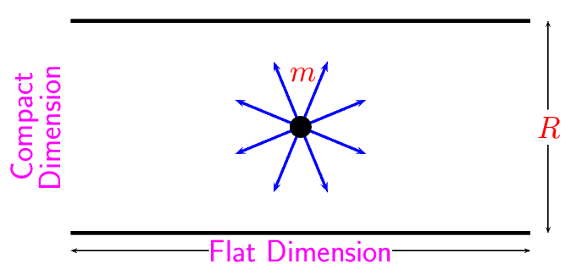
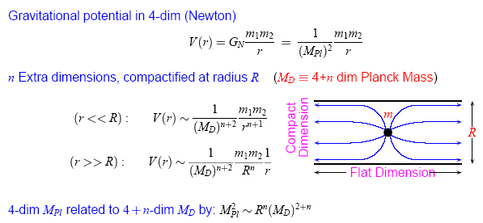
A signature-based search
Gravity in Large Extra Dimensions
Gravitational potential in 3D
(Newton)
Gravitational potential in 3+n
Spatial dimensions
(compactified at radius R)
r R:
r > R:

Slide 12
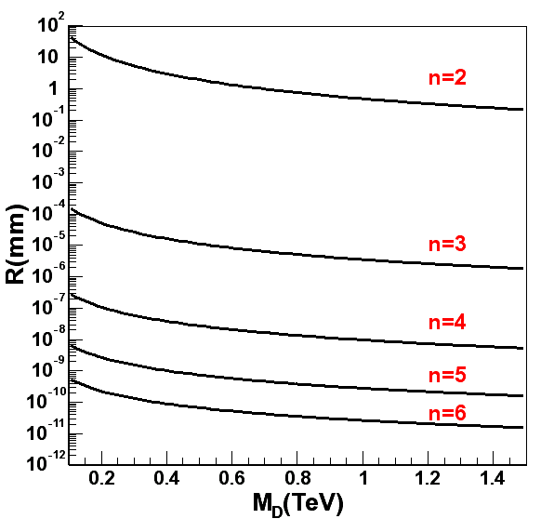
Gravity in Large Extra Dimensions
Setting M_{D} = 1 TeV
  (n = 1) → R ~ 10¹³ m
    Excluded by astronomical data
  (n = 2) → R ~ 400 μm
    Same order as current limits from direct probes of gravity
  (n = 3-6) → R ~ x - 10⁻¹³ m
    Accessible only at high energy colliders
Three parton-level processes for graviton emission
  qq → gG, qg → qG, gg → gG
  Gravitons “escape” in bulk of extra dimensions undetected
  Results in a final state with a single jet and missing E_{T}

Slide 13
How to look for new phenomena?
2- Powerful devices:
The LHC accelerator and the ATLAS detector

Slide 14

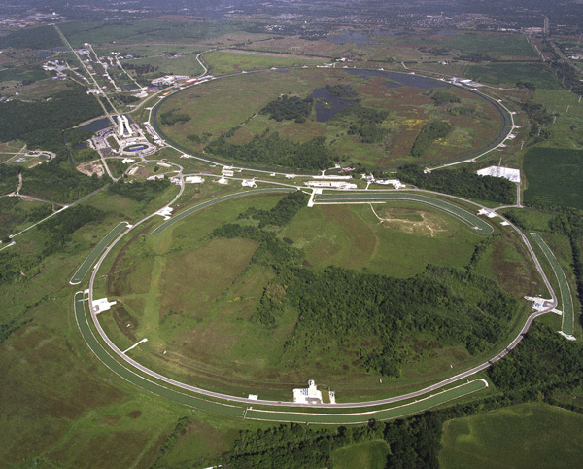
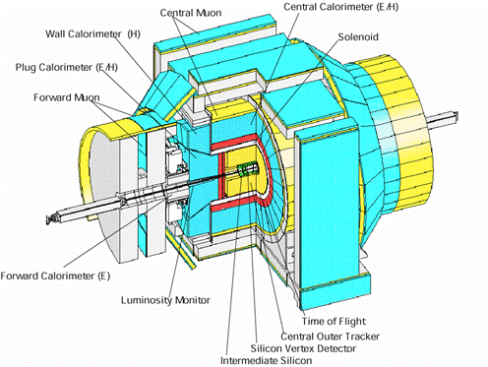

A signature-based search
CDF at the Tevatron
CDF has recorded over 8 fb⁻¹ of data!
  Will stop running at the end of 2011
Improving key precision measurements, e.g.: W & top masses
P
P
1.96 TeV
Tevatron
Main Injector

Slide 15
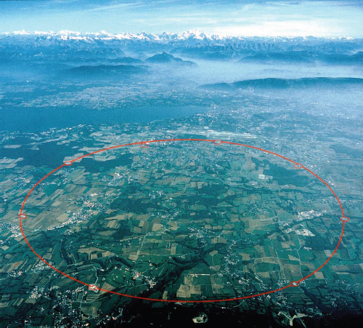
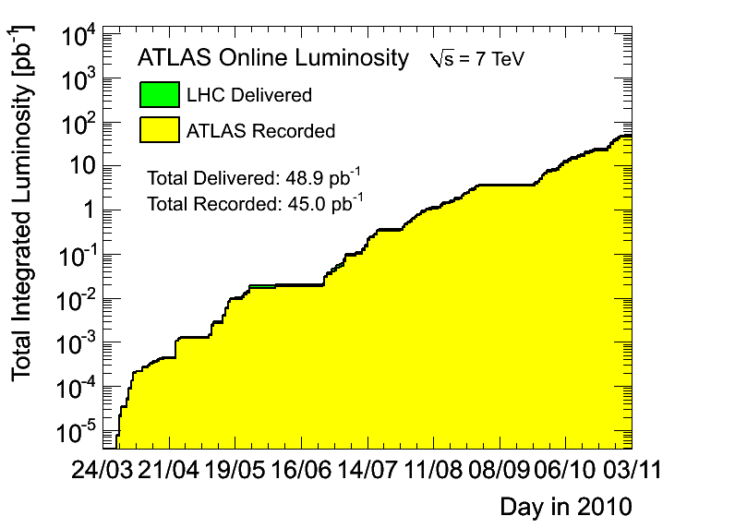
A signature-based search
A new energy frontier: the LHC
With 27km long, the LHC is largest particle accelerator in the world
  Achieved 7 TeV of CoM energy in 2010
  Peak L of 2.1E32 cm⁻²s⁻¹

Slide 16
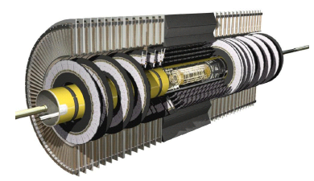
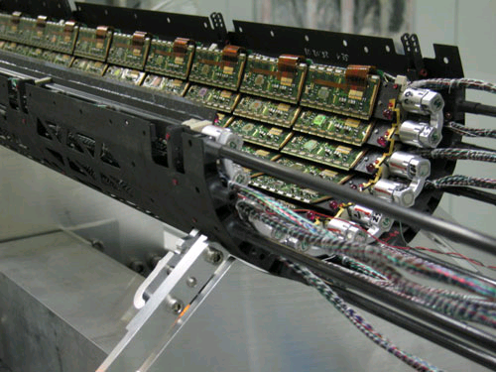
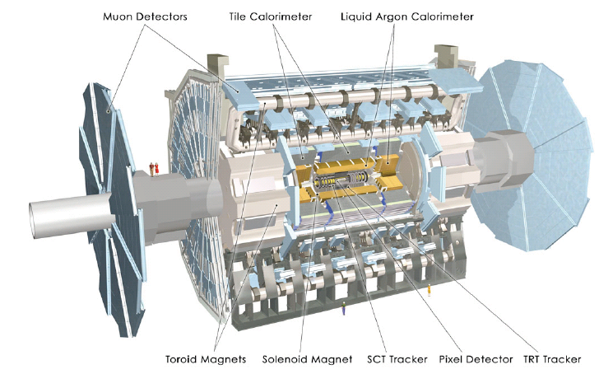
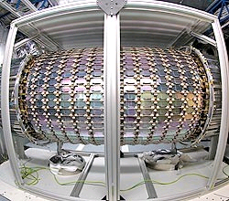
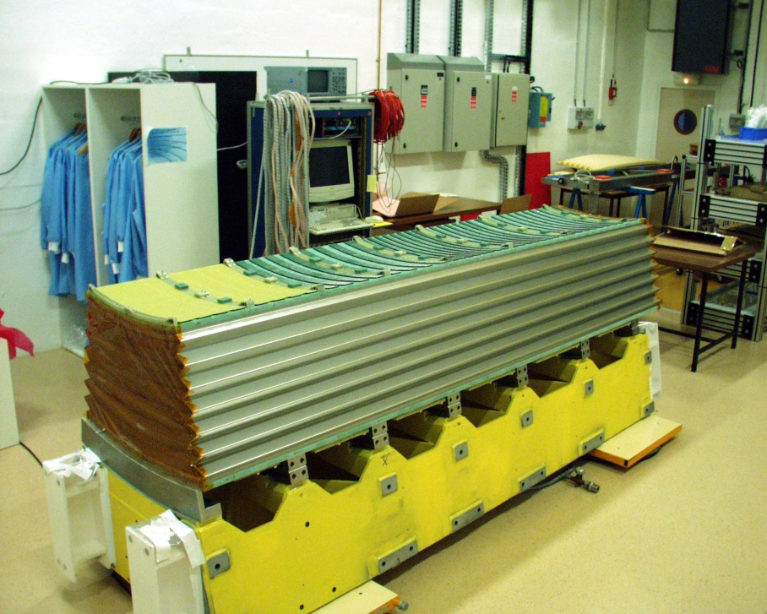
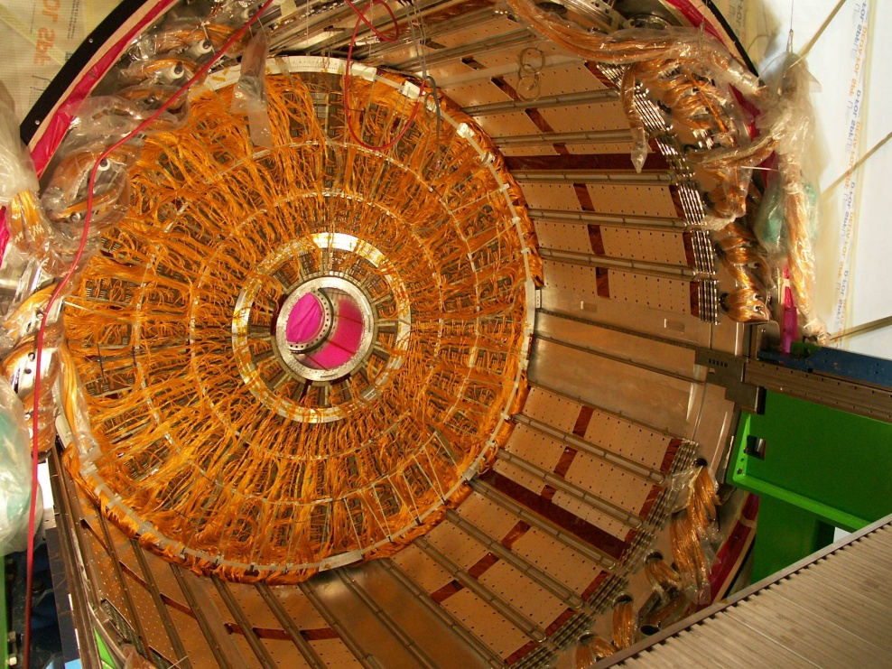
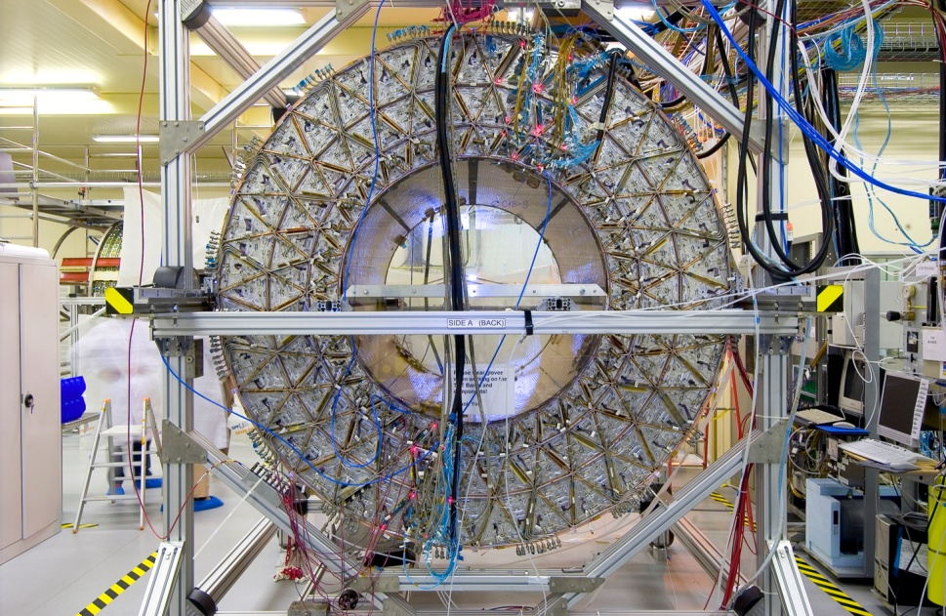
A signature-based search
The ATLAS detector
Electromagnetic calorimeter
Pixel detector
Inner detector
One EM barrel module
EM calorimeter end-cap
Transient radiation tracker
Silicone tracker detector

Slide 17
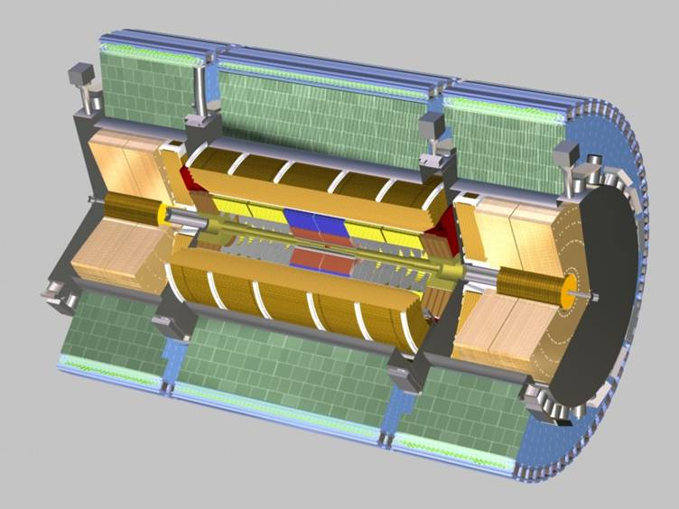
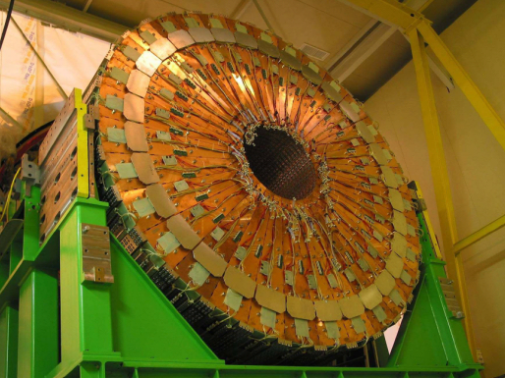
A signature-based search
The ATLAS detector
Hadronic end-cap
Calorimeter
Tile calorimeter module
Forward calorimeter

Slide 18
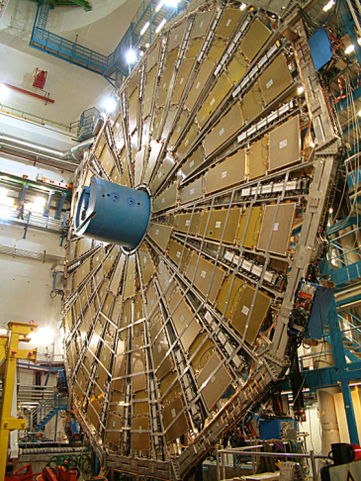
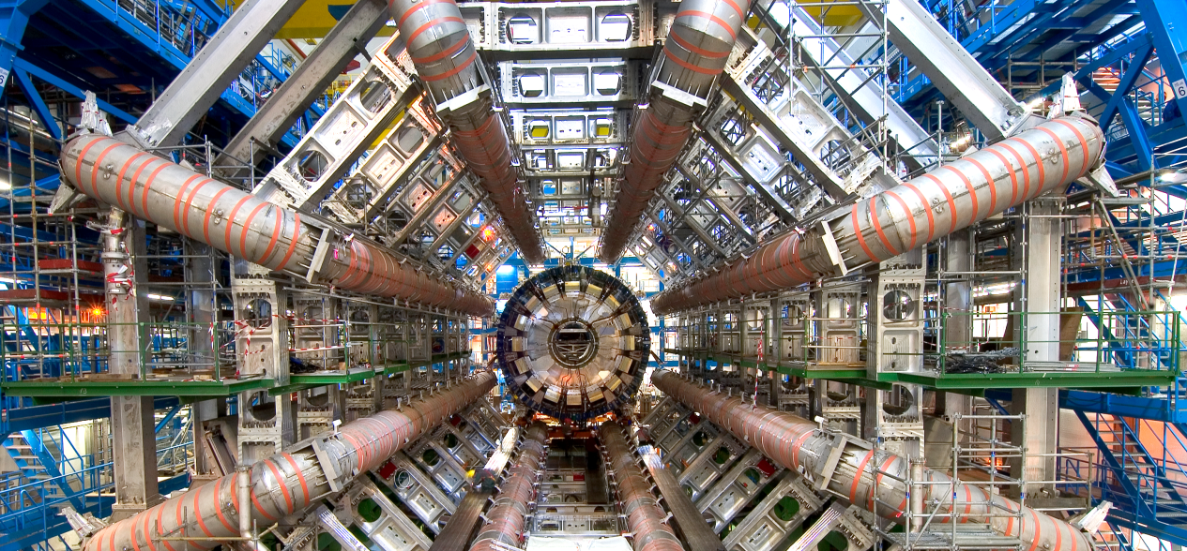
A signature-based search
The ATLAS detector
Muon spectrometer
Toroid magnet system

Slide 19
How to look for new phenomena?
3- Understand the ATLAS detector and rediscover the Standard Model

Slide 20
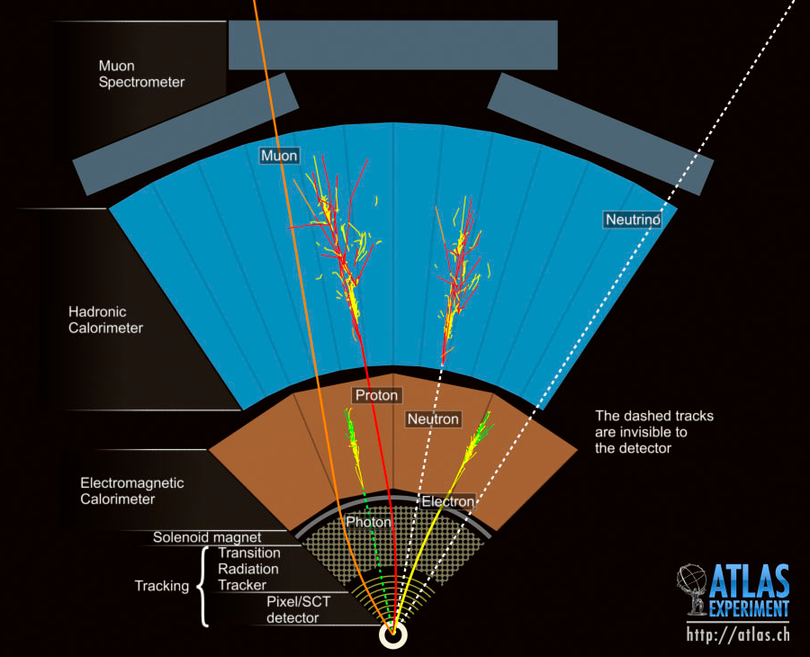

A signature-based search
Detecting known particles
Each known “stable” particle give a distinctive signal in the detector
⇒ need to be well understood
SM and new physics properties are inferred from kinematic study of know particles
Jets
They are all used
in the monojet
Analysis…

Slide 21
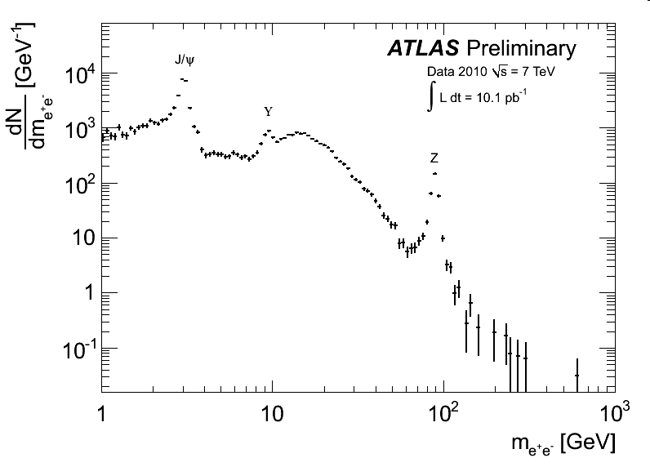
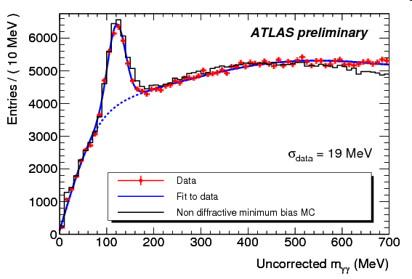
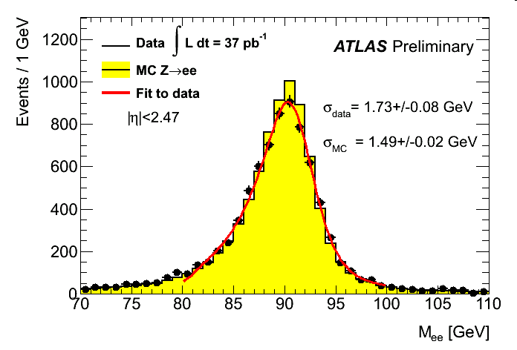
A signature-based search
Electrons and photons
Precise measurement of invariant masse of electron/photon pairs:
  detector response to electrons and photons well modelled by simulation
  the reconstruction and identification algorithms are efficient
π⁰→γγ
Z⁰→e⁺e⁻

Slide 22
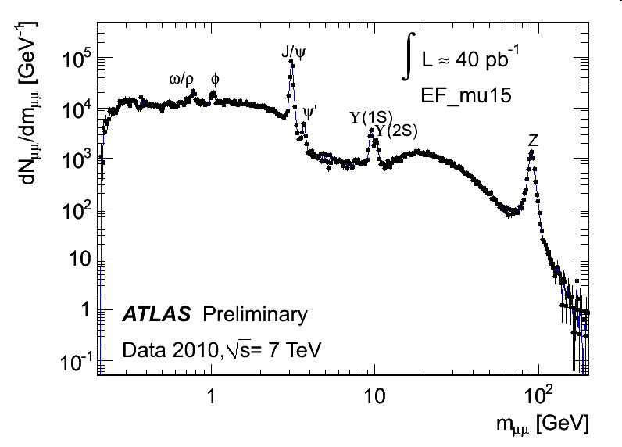
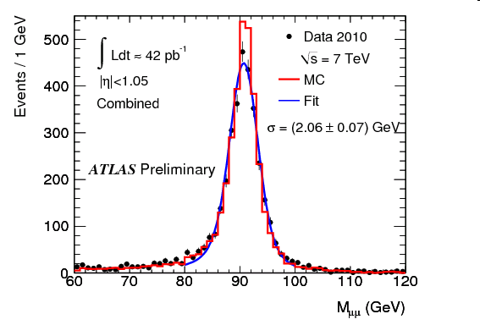
A signature-based search
Muons
In ATLAS has two distinct trackers to measure muons momentum
  Good momentum resolution for a large range of P_{T}
  Reduce background

Slide 23
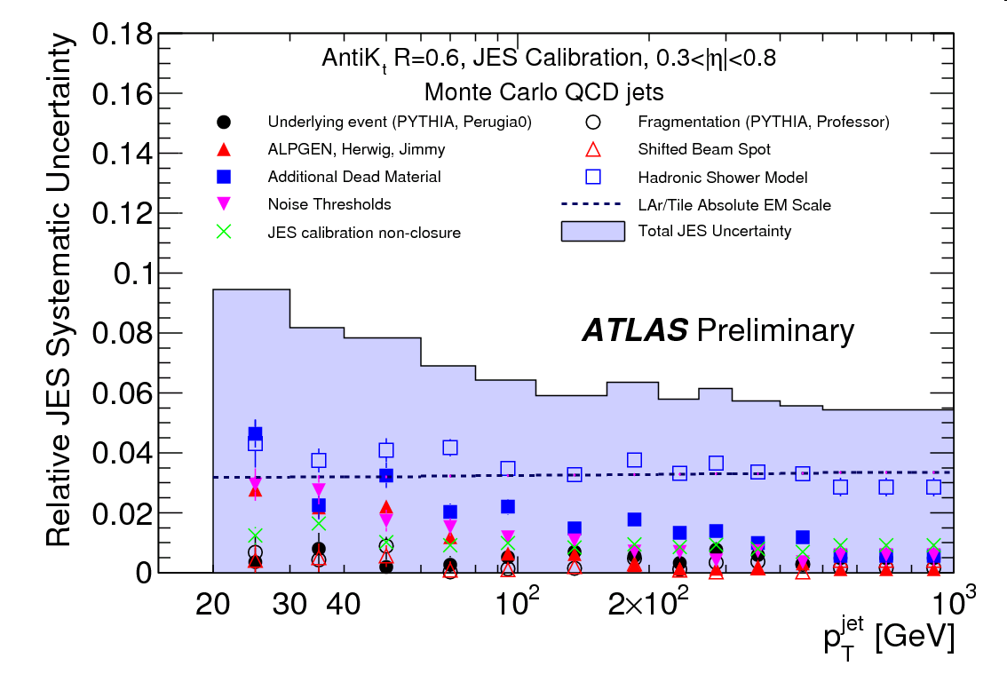
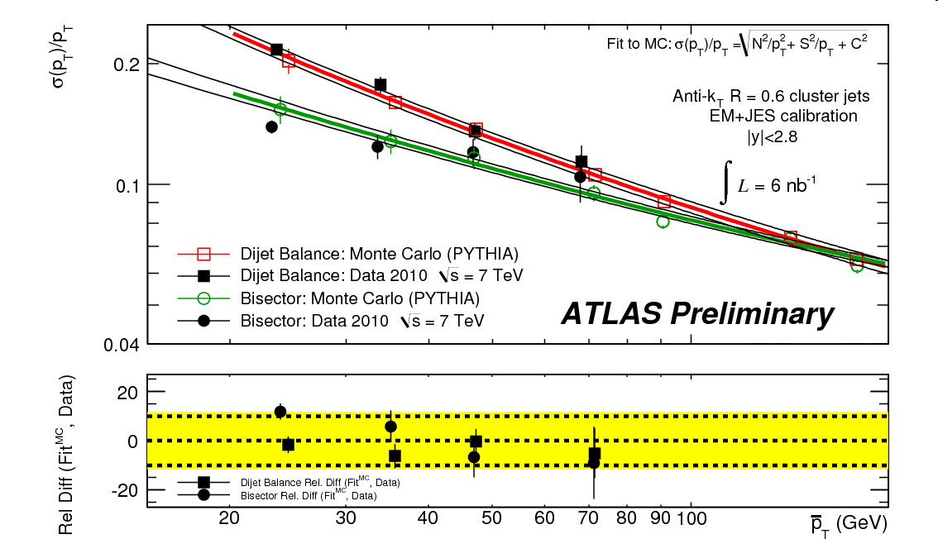
A signature-based search
Jets
Understanding jets means that simulation successfully describes:
  Jet Energy Resolution
    Calorimeter response to jets of hadrons
  Jet Energy Scale
    Difficult to calibrate jets
  ⇒ Largest systematic uncertainty
Jet energy scale obtained from MC
⇓
Will use γ+jets, Z+jets and top data events

Slide 24
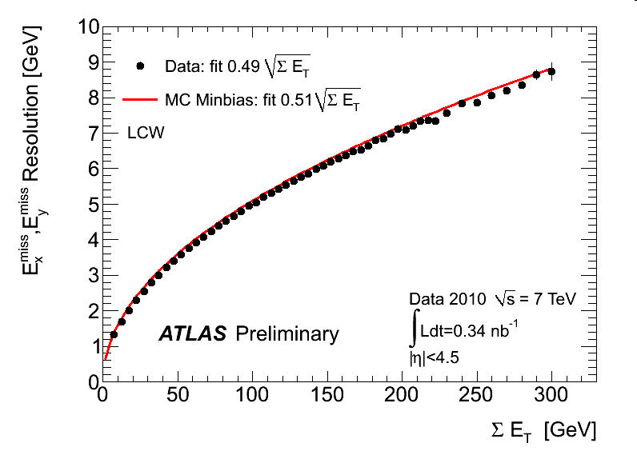
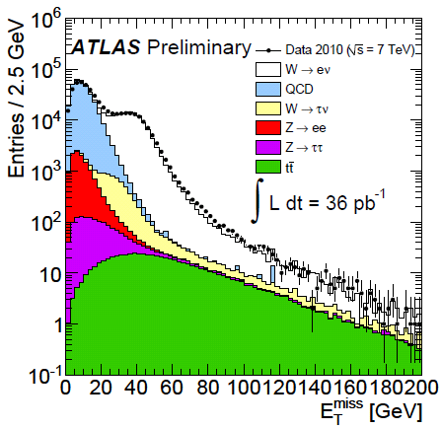
A signature-based search
Missing transverse energy
E_{T}^{miss} is a global quantity:
depends on the whole calorimeter energy depositions
  Good data to MC agreement = overall, calorimeter behaves as expected.
E_{T}^{miss} resolution
(minbias events)
E_{T}^{miss} distribution
(W→eν candidate events)

Slide 25
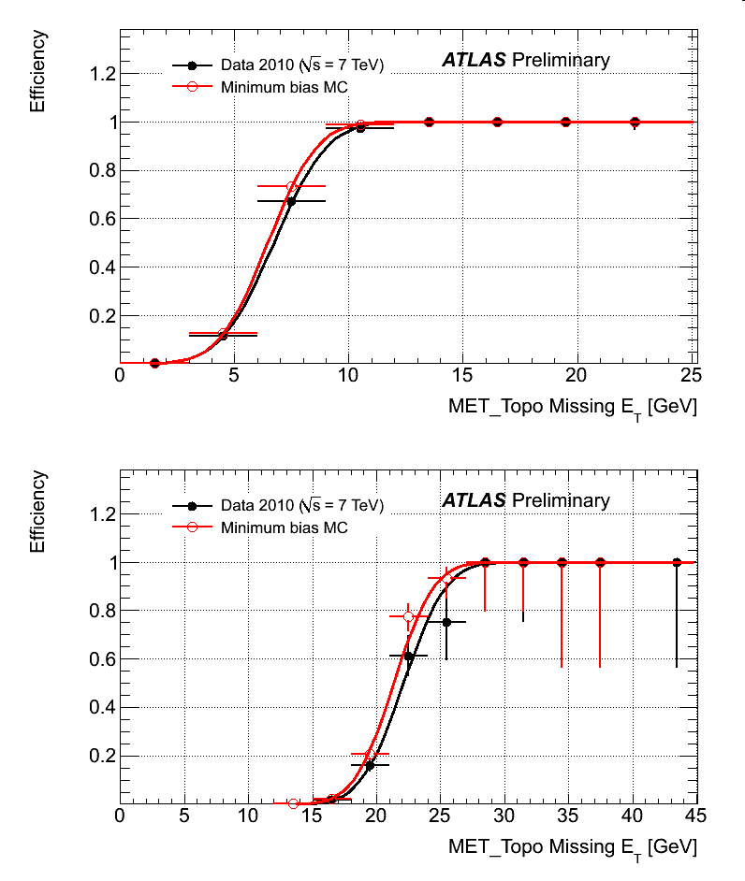
A signature-based search
Trigger
ATLAS can only keep ~0.005% of events yield in LHC collisions
  2010 peak luminosity of 2.1E32 cm⁻²s⁻¹ ≈ 5M events/second
  Can write on disk and process (Tier0) ~200-400 events/second
Challenging to trigger on monojet events
  Jets trigger rate impose really P_{T} threshold
   Use E_{T}^{miss} trigger!
    Well described in MC
    Trigger algorithm highly efficient

Slide 26
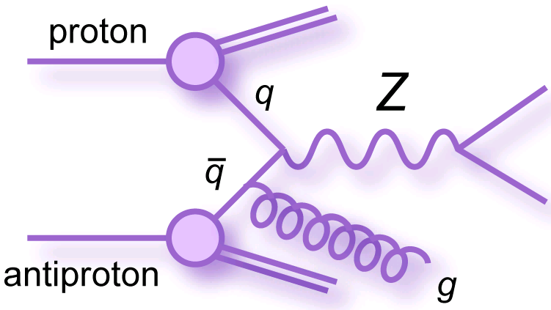
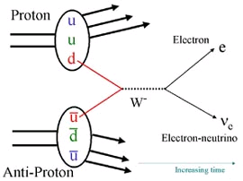
A signature-based search
W/Z+jets events (I)
All the particles that can be reconstructed in the detector need to be well understood to perform good W/Z+jets measurements
μ⁻
μ⁺

Slide 27
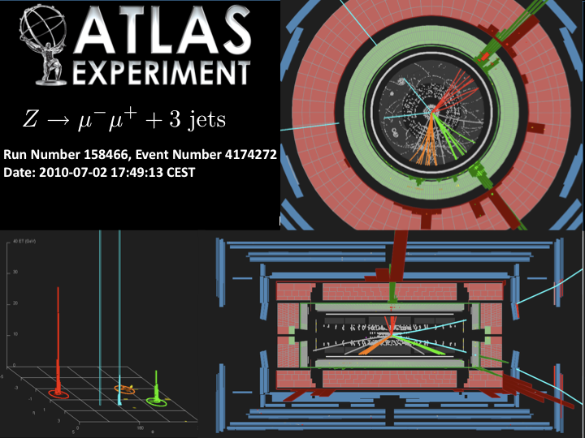
A signature-based search
W/Z+jets events (II)
Muon
Jet
Muon
Jet
Jet

Slide 28
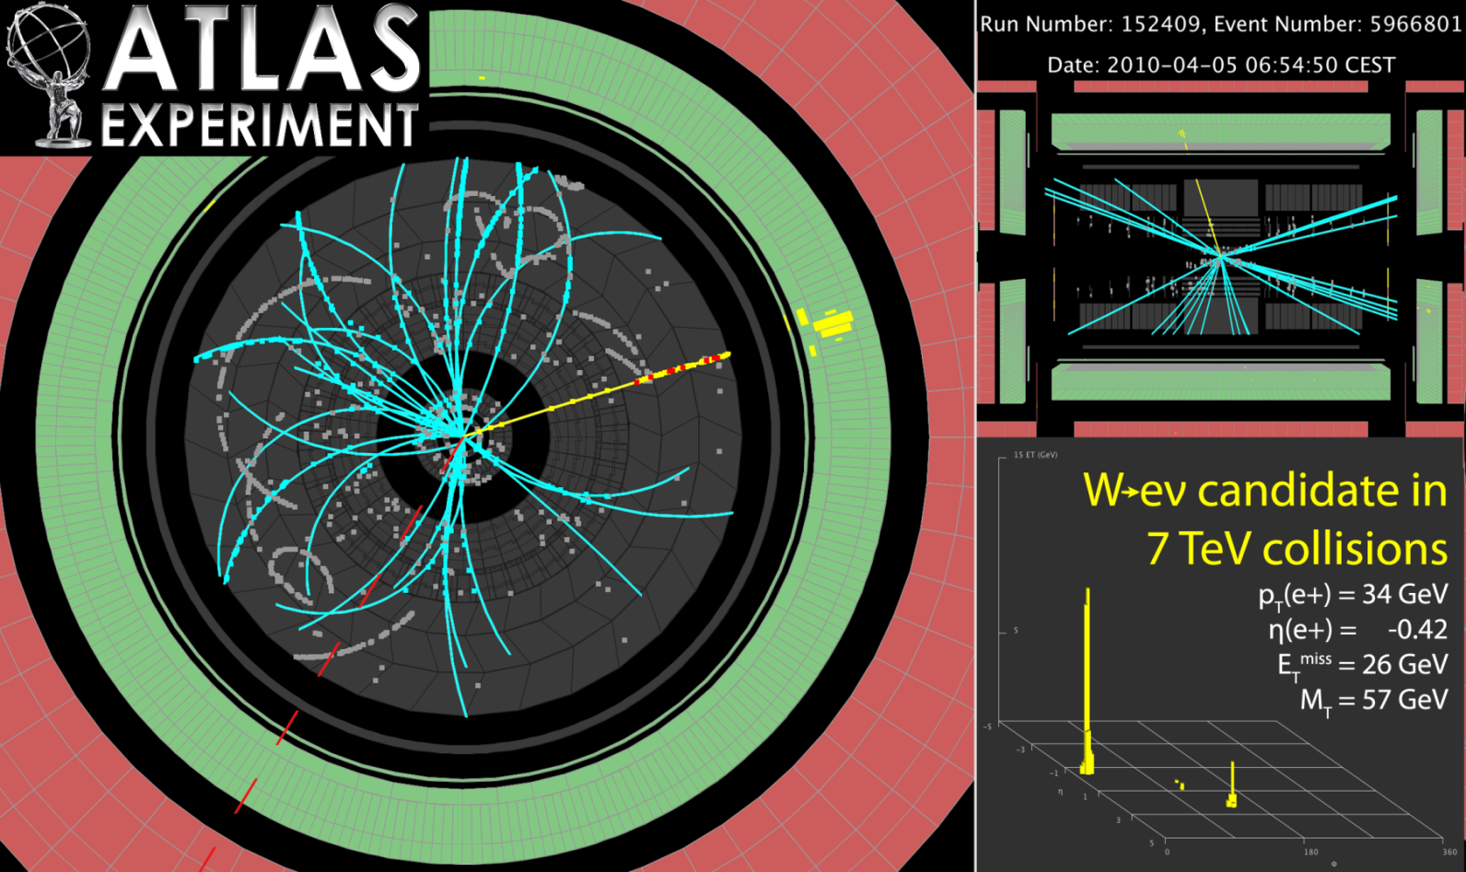
A signature-based search
W/Z+jets events (III)
No real jets in this W→eν event
Electron
Large E_{T}^{miss} indicates neutrino

Slide 29
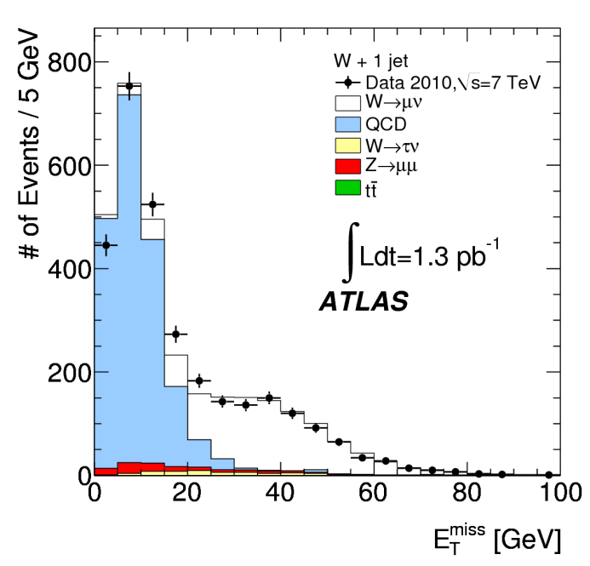
A signature-based search
W/Z+jets events (IV)
To have a good agreement between W/Z+jets cross section measurements and theoretical predictions:
  Good description of detector response to jets, leptons and E_{T}^{miss}
  ► Unfolding
  Precise estimate of the lepton reconstruction and identification algorithms
  ► Efficiency estimates
  Good background predictions
  ► Data-driven estimate of QCD
  background to W→eν

Slide 30
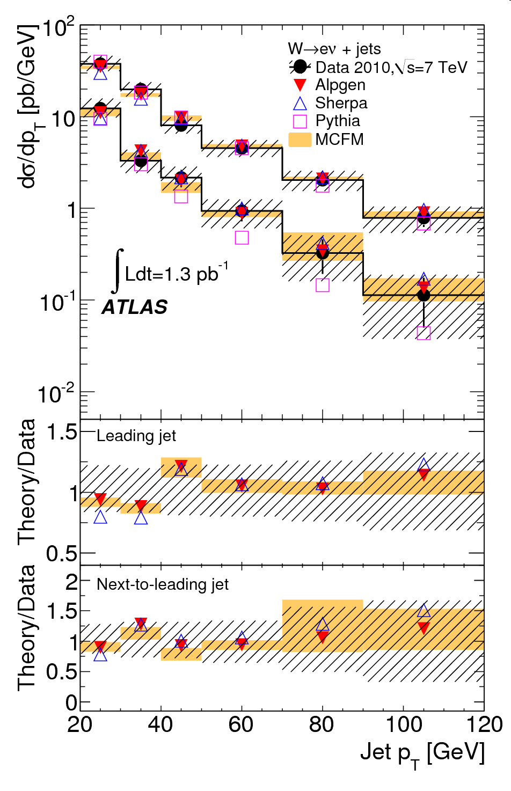

A signature-based search
W/Z+jets events (V)
After background subtraction, efficiency correction and unfolding:
Compare with theoretical predictions
    Different generator
    Jet multiplicity distribution
    Jet P_{T} distribution
ATLAS rediscovered the Standard Model with good precision
These SM results
can be used to find
new physics
30

Slide 31
How to look for new phenomena?
4- Observe deviations with respect to Standard Model predictions

Slide 32



A signature-based search
The SM prediction
In a counting experiment:
Determine how many SM events should pass the selections defining the chosen final state
⇒ predict production rate:
⇒ predict selection efficiency:
ν
q
+
ν
q
Irreducible bkg.
reducible bkg.
understand
distributions

The sensitivity to new phenomena depends on:
  The relative amount of new physics and SM contribution
  The systematic uncertainty on the SM expectations
The key is to control systematic uncertainties

Slide 33

A signature-based search
Monte Carlo based estimate
Use theory / simulations to estimate production rate and model detector effects on efficiency of events selections
⇒ Systematic uncertainty from approximation and
inaccuracy in modeling of:
  Jet and E_{T}^{miss} energy scale and resolution
  Lepton energy scale and resolution
  Trigger, Pile up and luminosity
  Fragmentation/hadronization
  ISR/FSR effects
  Underlying events
  Parton Distribution Function
  Matrix Element calculation

Slide 34




A signature-based search
Data-driven technique 101 (I)
Reduce systematic uncertainty by replacing MC distribution with well understood data distribution closed to the process of interest to avoid bias
e⁻
ν
e⁺
ν
Stat error only
Simulation
Data
ν
ν

Slide 35
Data-driven techniques 101 (II)
In practice, to produce a data-driven predictions, we can:
  1- Reverse one (few) signal selection(s)
    Avoid signal contamination
Set of selections defining
signal (eg: monojet)
Set of events from a data stream
Event cut 1
Event cut 2
…
Event cut N-1
Event cut N
Y:
All other
selections
Data model
of the signal
Signal
events
Selections
to reverse
Y
X:
Z ⊆ ¬X
X
  2- Count the number of events in the Y∧Z (Z ⊆ ¬X) sample
  3- Compute the mapping factor giving the right normalization
If X is unbiased with respect to Y,
than Y∧Z provide a good model for Y∧X

Slide 36
Data-driven estimate of backgrounds in monojet events

Slide 37
SM background to Monojet events
Electroweak background:
  Z→νν + jets (largest and irreducible background)
  W → lν + jets where the lepton is not observed in the detector
  In this case, the reversed cut X is the lepton veto
QCD:
  Met originating from mismeasured jet energies
In this case, the reverse cut X is the number of jets in the event
We can use Z → ll + jets and W → lν + jets events with
reconstructed leptons to estimate these backgrounds
Estimated using multi-jet events in which E_{T}^{miss} points
along the direction of one of the jets

Slide 38

Electroweak bkg estimate (I)
Jets observables present similar distributions
Z→νν + 1-jet
e
Z→ee + 1-jet
Met
e
Before being used for a prediction, such distribution must be properly normalized
E_{T}^{miss} can similarly be obtained after
removing the two charged leptons

Slide 39
Electroweak bkg estimate (II)
Jet selections are directly modelled in data (N_{cand}), but:
Final predictions need corrections for lepton acceptance (A_{lep}), efficiency (ε_{lep}) and background (N_{bkg})
Mapping factor also account for:
  Different in Z→νν and Z→ll branching ratio
  2nd order jet phase space corrections due to:
    Jet-electron overlap removal
    Extra jets produced by charged lepton radiation
→ Correction included in the mapping factor (A_{corr} ~4-10%)
From theory

Slide 40
Electroweak bkg estimate (III)
Similarly, W→lν + jets with a well reconstructed lepton are used to estimate the W+jets background to monojet events
  Need to estimate the probability to survive to lepton veto
From MC
(only a ratio!)
* Obtain independent predictions from electrons and muons

Slide 41

Electroweak backgrounds (IV)
Can also estimate of Z→νν + jets background from high statistics W→lν + jets events
  Use the theoretical prediction for
⇒ 4 statistically independent predictions for the Z→νν + jets
background!
Calculations performed at NLO (MCFM program)
  Uncertainty much smaller on R (ratio) than on individual cross sections

Slide 42

QCD backgrounds (I)
Sources of QCD contribution:
  2-jets events for which one of the jets is lost (dominate)
  3-jets events for which two jets are lost (smaller)
To estimate the 2-jets contribution:
1- Select 2-jets events with E_{T}^{miss} toward the less energetic jet
2- Extrapolate 2nd jet E_{T} below energy threshold (loose a jet)
3- Background prediction
=
area under the fit in the extrapolated region
2-jets events
_{Extrapolated}
_{region}

Slide 43
QCD backgrounds (II)
There is an electroweak contamination in the E_{T} distribution of the smallest jet
  ⇒ tends to overestimate the QCD background
To remove this contamination, we need from data:
  The shape of the smallest jet E_{T} for this EWK contamination
  The right normalization
Need to account for the smaller (n+m)-jets contribution
  Contribution estimated from Monte Carlo ≈ (20 ± 20) %

Slide 44
Model-Independence

Slide 45





A signature-based search
Signatures-based searches
Except for choice of monojet signature, reference to LED models hasn’t been used
  Kinematic regions can be optimised for LED models
Different models can contribute to the same phenomena
  Toy/simpler models are often used
  Often difficult to disentangle them
  In case of discovery, interpretation will only be speculative
⇒ No good reason to favour a
model over another

Slide 46

A signature-based search
Model-Independence!
Don’t want to miss unexpected new physics because of our selections…
  No optimization for a particular model
Look for excess in different phase space volumes;
  Different sensitivity to S/B.
If no significant signal is found:
severe constraints can be set on a
benchmark models for comparison:
  Eg: Large Extra Dimensions
The price to pay for model-independence is a potential
loss of sensitivity to some benchmark models

Slide 47
The CDF results: search for new physics with monojet events

Slide 48

Basic Selection Cuts
Jet definition:
  JETCLU reconstruction algorithm
  with cone size of 0.7 and E_{T}>15 GeV
Event Cleanup (good vertex, EM energy)
Jet Cleanup
  Matching charged tracks
  Not located in un-instrumented regions of the calorimeter
    Crack or service regions
  Not pointing along the direction of the Met
Lepton veto (no EM jets, no isolated tracks)
→ Suppress QCD
→ Suppress W+jets
Clean-up cuts are essential for removing large
background from non-collision sources!

Slide 49

Example of Cosmic event (I)
Appears to be good single jet plus Met event

Slide 50


Example of Cosmic event (II)
Tracking views clearly indicate that jet originates from cosmic ray which passes far away from overlapping collision vertex

Slide 51
Monojet events selections
Monojet event selections
Three kinematic regions based on Met and leading jet E_{T}:
  Met > 80 GeV & Jet E_{T} > 80 GeV
  Met > 120 GeV & Jet E_{T} > 150 GeV
  Met > 150 GeV & Jet E_{T} > 180 GeV
No 2nd jet with E_{T} > 30 GeV (60 GeV if Jet E_{T} > 150 GeV)
  No 3rd jet with E_{T} > 15 GeV
  Asymmetric cuts to increase signal acceptance (ISR/FSR)
E_{T}
150
120
80
0
80
150
180
Jet 1 E_{T}(corr)
Use 1 fb⁻¹ of data from JET100 and MET45 triggers
  JET100 trigger is fully efficient for Jet E_{T} > 150 GeV
  MET45 trigger is fully efficient for Met > 80 GeV

Slide 52


Most Energetic Monojet Event
Jet E_{T} = 419 GeV, Missing E_{T} = 417 GeV

Slide 53

Monojet Results
Background | 80/80 | 150/120 | 180/150
Z→νν + jet | 3203 ± 137 | 390 ± 30 | 141 ± 17
W→τν + jet | 2010 ± 69 | 187 ± 14 | 58 ± 5
W→μν + jet | 1570 ± 54 | 117 ± 9 | 35 ± 3
W→eν + jet | 824 ± 28 | 58 ± 4 | 18 ± 2
Z→ll + jet | 87 ± 3 | 6 ± 1 | 2 ± 0
QCD | 708 ± 146 | 23 ± 20 | 12 ± 12
γ + jet | 209 ± 41 | 17 ± 5 | 8 ± 3
Non-collision | 52 ± 52 | 10 ± 10 | 3 ± 3
Predicted | 8663 ± 332 | 808 ± 62 | 277 ± 30
Observed | 8449 | 809 | 319
Results are consistent with SM in all three kinematic regions
Our measurement is really just a number (table). This is a check
to see if it would worth to do a further investigation with shapes

Slide 54

Monojet events selections
Limit on Large Extra Dimensions
* The 150/120 analysis provides the best sensitivity for LED scenario.
Signal Upper limits (95% CL) for 150/120 = 125 events
Limits on the 4+n dimensional Planck scale M_{D} and on the radius R of the extra dimensions
n | M_{D} (TeV) | R (mm)
2 | > 1.33 | < 2.7 E-01
3 | > 1.09 | < 3.1 E-06
4 | > 0.99 | < 9.9 E-09
5 | > 0.92 | < 3.2 E-10
6 | > 0.88 | < 3.1 E-11
Eöt-Wash limit: R < 1.3 × 10⁻¹ mm (n=2)

Slide 55
Monojet events selections
Perform a SM measurement too!
The precision of the lowest kinematic region is ~3.8%
⇒ can measure N_{ν}, Γ_{Z}(inv)!
LEP: 2 types of measurements
  Indirect: lineshape → really precise
  Direct: γ+Met topology → less precise
Fewer theoretical assumptions in direct measurement.
Tevatron:
  Expect similar sensitivity to LEP direct
  Even fewer theoretical inputs
  Completely independent of LEP measurements
Background | 80/80
Z→νν + jet | 3203 ± 137
W→τν + jet | 2010 ± 69
W→μν + jet | 1570 ± 54
W→eν + jet | 824 ± 28
Z→ll + jet | 87 ± 3
QCD | 708 ± 146
γ + jet | 209 ± 41
Non-collision | 52 ± 52
Predicted | 8663 ± 332
Observed | 8449

Slide 56
Monojet events selections
Invisible width of the Z⁰
Assuming the PDG value for Γ_{Z}(ll), 83.984 ± 0.086 MeV:
Γ_{Z}(inv) = 466 ± 14 ± 40 MeV
Experiment | Γ_{Z}(inv) MeV | N_{ν}
CDF | 466 ± 42 | 2.78 ± 0.26
L3 | 498 ± 17 | 2.98 ± 0.06
OPAL | 539 ± 31 | 2.69 ± 0.17
ALEPH | 450 ± 48 | 2.86 ± 0.09
DELPHI | --- | 2.84 ± 0.21
LEP comb. | 503 ± 16 | 2.92 ± 0.06
LEP indirect | 499.0 ± 1.5 | 2.984 ± 0.008
Comparing this value with SM expectation gives the number of light ν types:
N_{ν} = 2.78 ± 0.08 ± 0.25

Slide 57
CONCLUSION

Slide 58
The LHC delivered a sufficient amount of data in 2010 for
  a good understanding of the ATLAS detector
  a rediscovery of many aspects of the Standard Model.
These Standard Model measurements can then be used to make background predictions for new physics searches
  Data-driven background estimates improve the sensitivity to new physics by keeping systematic uncertainties low
Techniques specific to searches for new physics in jets+E_{T}^{miss} events have been developped
  Limits on monojet events constrain Large Extra Dimensions models
  LHC expect to double Tevatron limits with only 35pb⁻¹ of data
We are now surfing in new territory!

