Slide 1


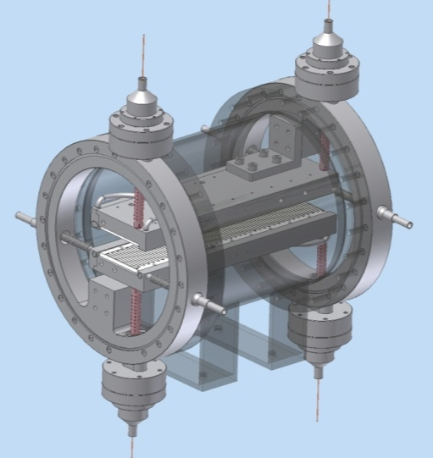
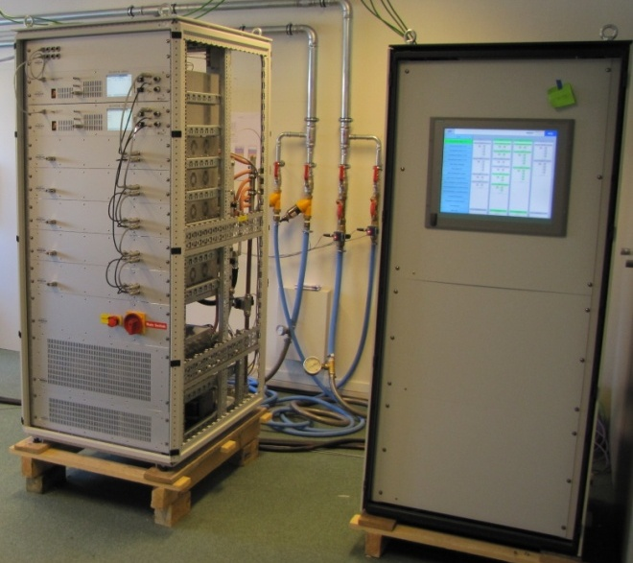
Rostock, Dec 12th 2011, RFTech 3rd Workshop
Status of the RF SYSTEMS
of the Spiral2 accelerator
Marco Di Giacomo
Linac RF System coordinator

Slide 2
Contents
Project status
Remind of main RF systems and choices
Rebuncher Cavity
Solid State Amplifiers
Single Bunch Selector (fast chopper)

Slide 3
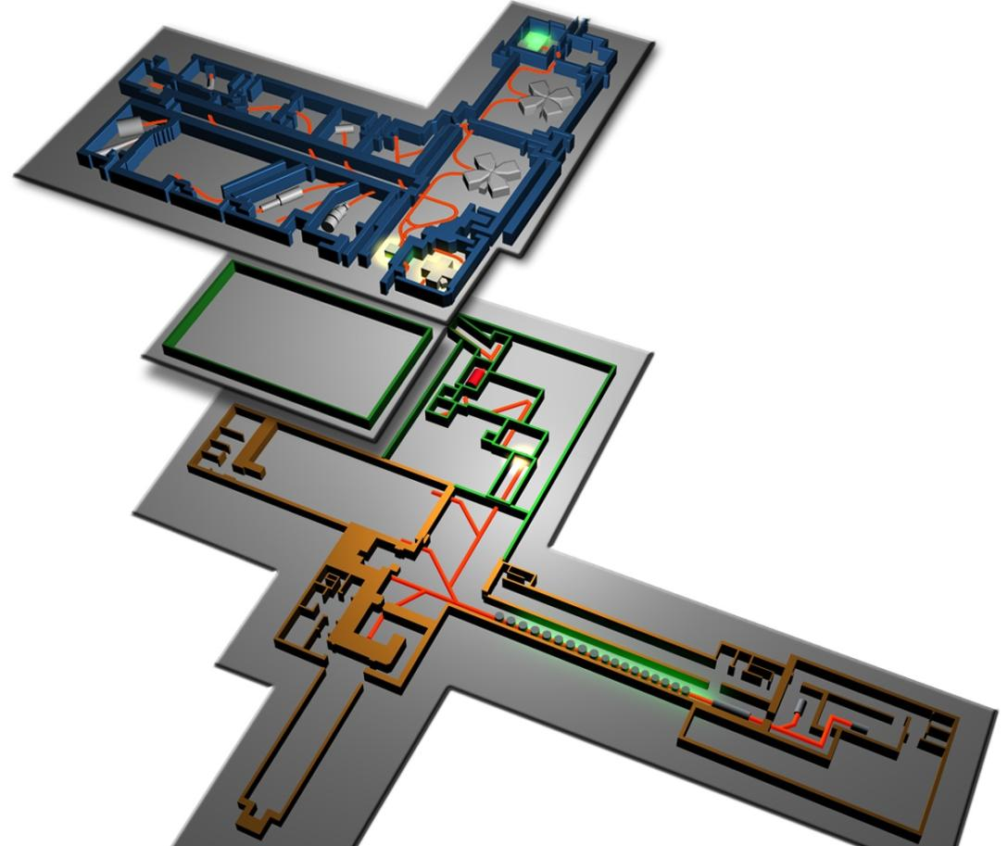
The SPIRAL2 Project
SPIRAL2 is one of the ESFRI list projects (most important EU research infrastructure projects)
Existing Exp. Areas
Stable beams and RIBs
C01,C02,CSS1,CSS2 (since 1982)
Stable beams : C…Uranium < 96 Mev/A
CIME cyclotron
Radioactive beams (SPIRAL1) 1999
+ Radioactive beams (SPIRAL2) 2013
CIME cyclotron
Radioactive beams (SPIRAL1) 1999
DESIR
Low Energy RIBS
RIB Production
S3
SC LINAC
RFQ
A/q=3 HI ECR
A/q=1;2 LI ECR
NFS
A/q=6 option

Slide 4
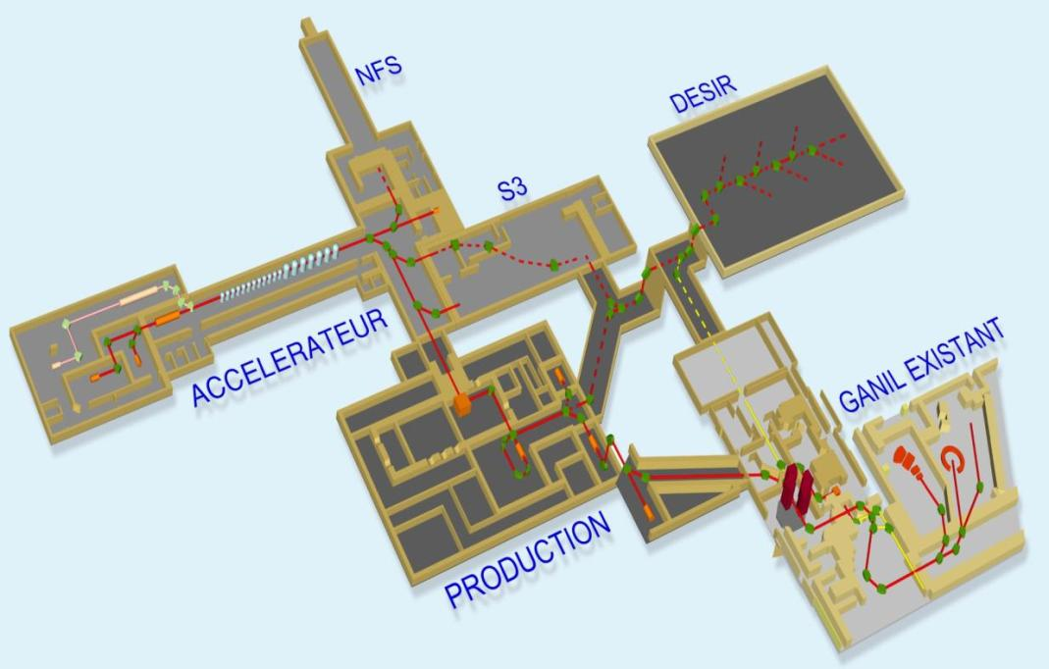
The SPIRAL2 Project
Schedule
Construction in 2 phases
due to the different design status between the driver accelerator and the RIB production systems
First beam Phase 1: end 2013
First beam Phase 2: being postponed (> 2015) due to budget problems …
Phase 1
Phase 2

Slide 5
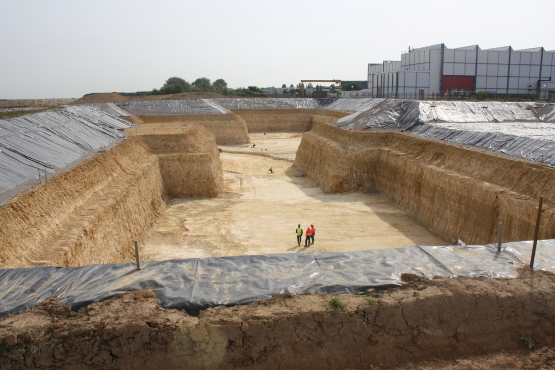
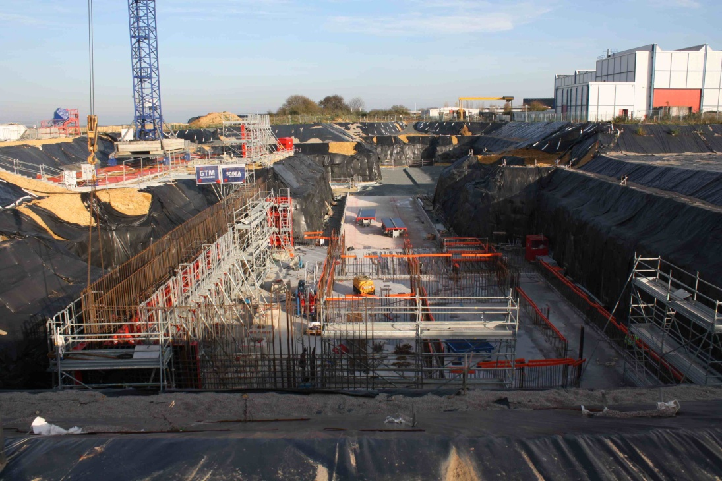

Project Status: Phase 1 building
20 Mai 2011
15 Nov 2011
Building underground halls completed by July 2012
=> Begin installation of beam line devices.
Building ground floor completed by March 2013
=> Installation of ancillary systems, interconnections, beam commissioning

Slide 6
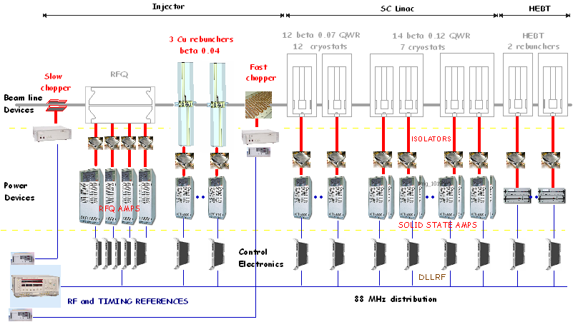
Linac RF : Remind of main systems and choices

Slide 7
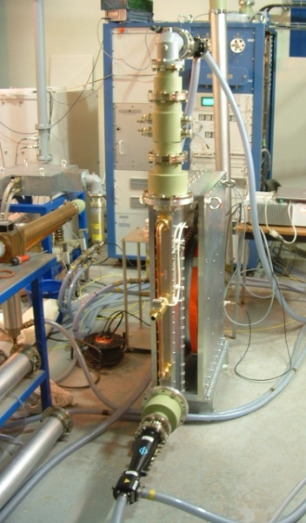
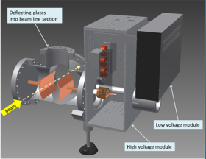
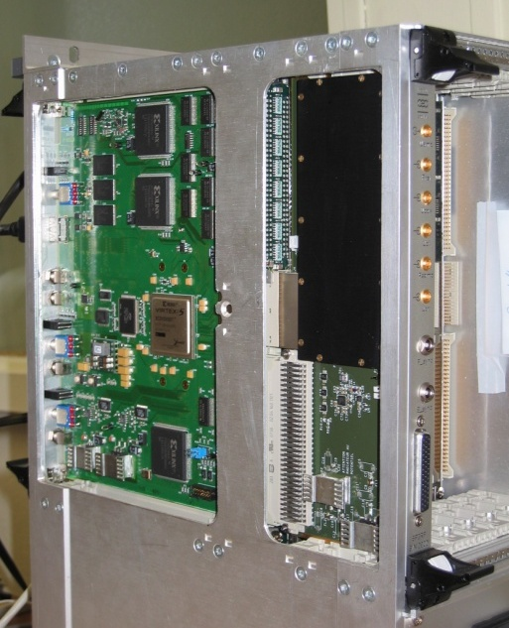
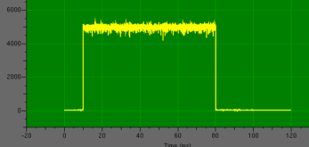
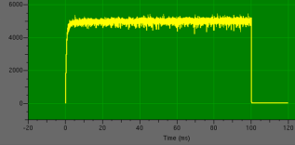
RF Systems Status
Slow chopper commissioned on LEBT line at Saclay (11/2012)
Single Bunch Selector design study in progress
MEBT Rebuncher first cavity commissioned
RFQ amplifiers delivered and used for circulator commissioning
Circulators delivered
Solid State Amps first units delivered.
DLLRF first prototype tested
MO and Timing specifications being frozen

Slide 8
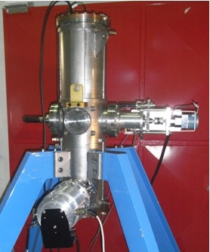
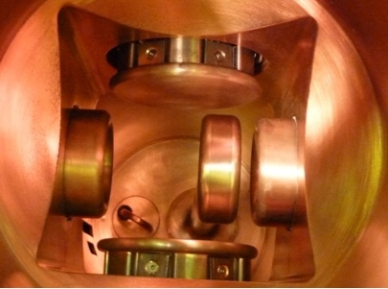
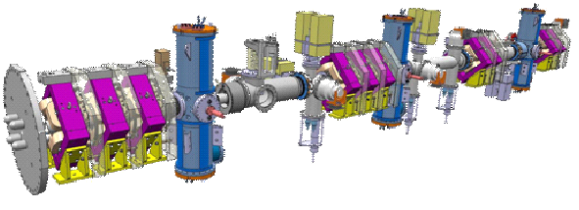
MEBT Line rebunchers
3-gap cavity
Single
bunch selector
MEBT line - Beta 0,04

Slide 9
Cavity requirements
Frequency: 88,0525 MHz
Minimum beam voltage
  All cavities: 20 kV (for proton beam)
Maximum beam voltage
  R1: 120 kV in CW for normal operation
  190 kV pulsed for bunch length measurement
  R2: 60 kV (1/6)
  R3: 120 kV (1/6)
Vacuum pressure : 1·10⁻⁷mbar
Alignment precision : <±0.5 mm on x and y

Slide 10
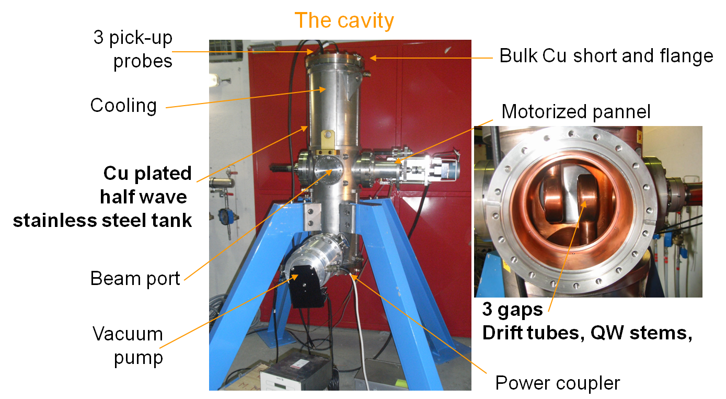
Cavity description
5kW @120 kV cw

Slide 11
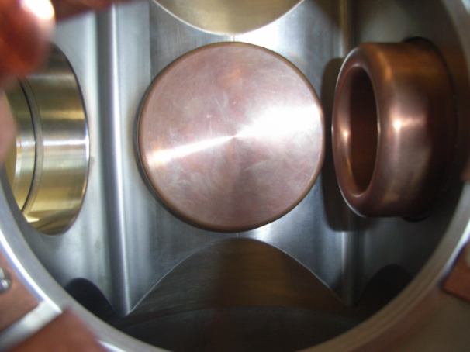
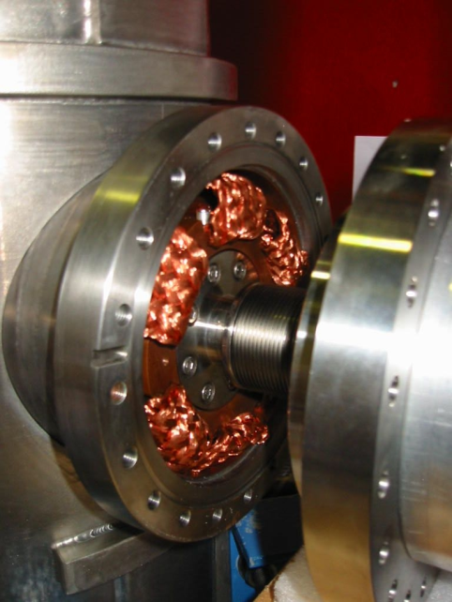
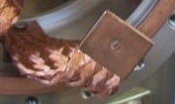
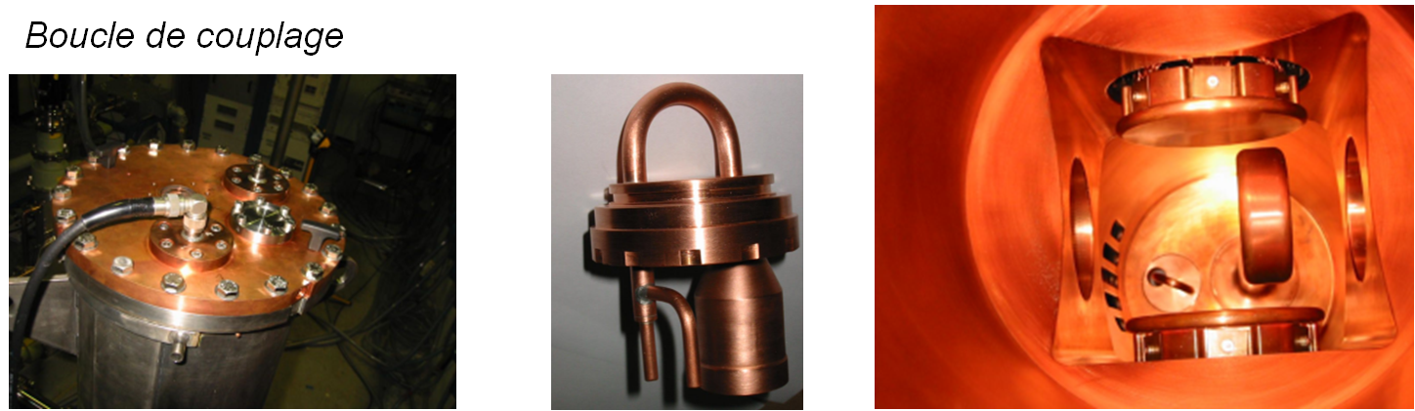
Technology
First Cu plated cavity at Ganil
Technology:
Cu plated chamber,
Solid Cu for all other parts
Water cooled stems and chamber
Drift tubes, beam port and trimmers cooled by conduction
Cu braids for RF (short stroke) and thermal conduction
Helicoflex joints for RF and vacuum
Inductive power-coupler and probes

Slide 12
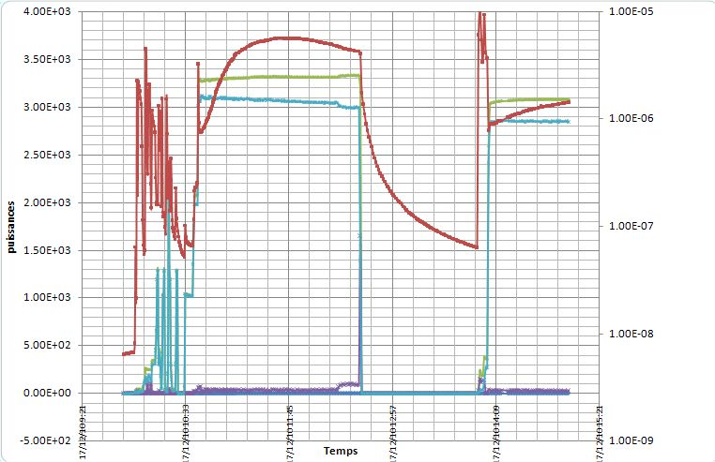
Problem remind
Power range (50-800W) of mismatching but RF voltage still there
(Multipactor?)
Vacuum pressure increasing too much with power
pressure
power

Slide 13
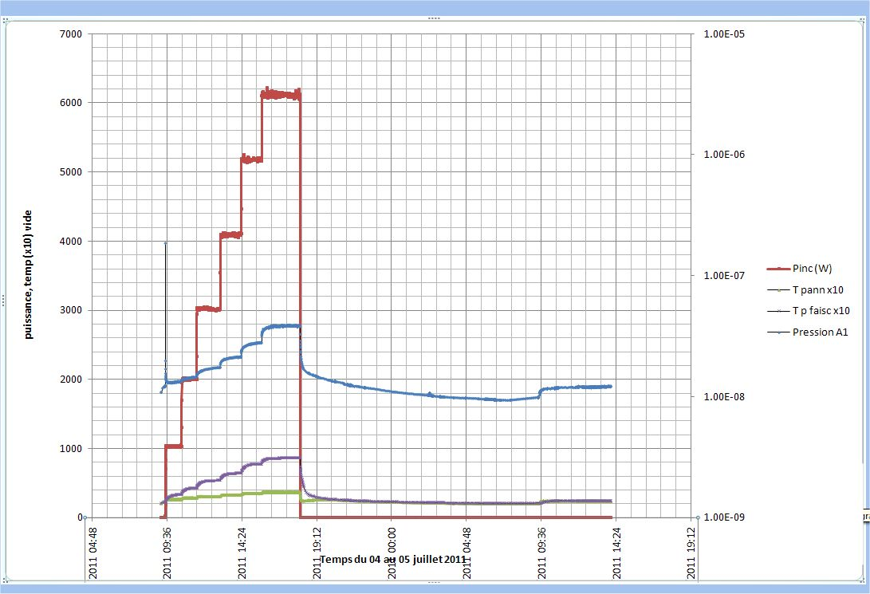
Problem solution
The vacuum increase was due to the temperature of the panels.
Lesson: very bad thermal contact at Cu/ Stainless steel interface
As soon as the panels have been water cooled, it has been possible to process the multipactor at high power and the problem has disappeared.

Slide 14
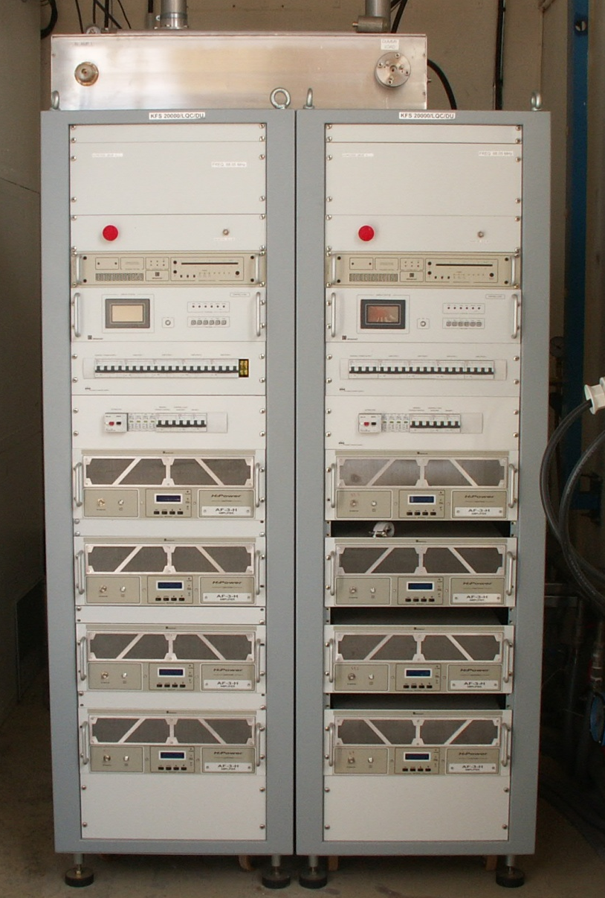
Solid State Amplifiers
SD2942
400W
Class C
BLF578
> 900W
Class AB
2005
Class C, FM modules
> 10 kW / cabinet
2011
Class AB modules
> 25 kW / cabinet

Slide 15
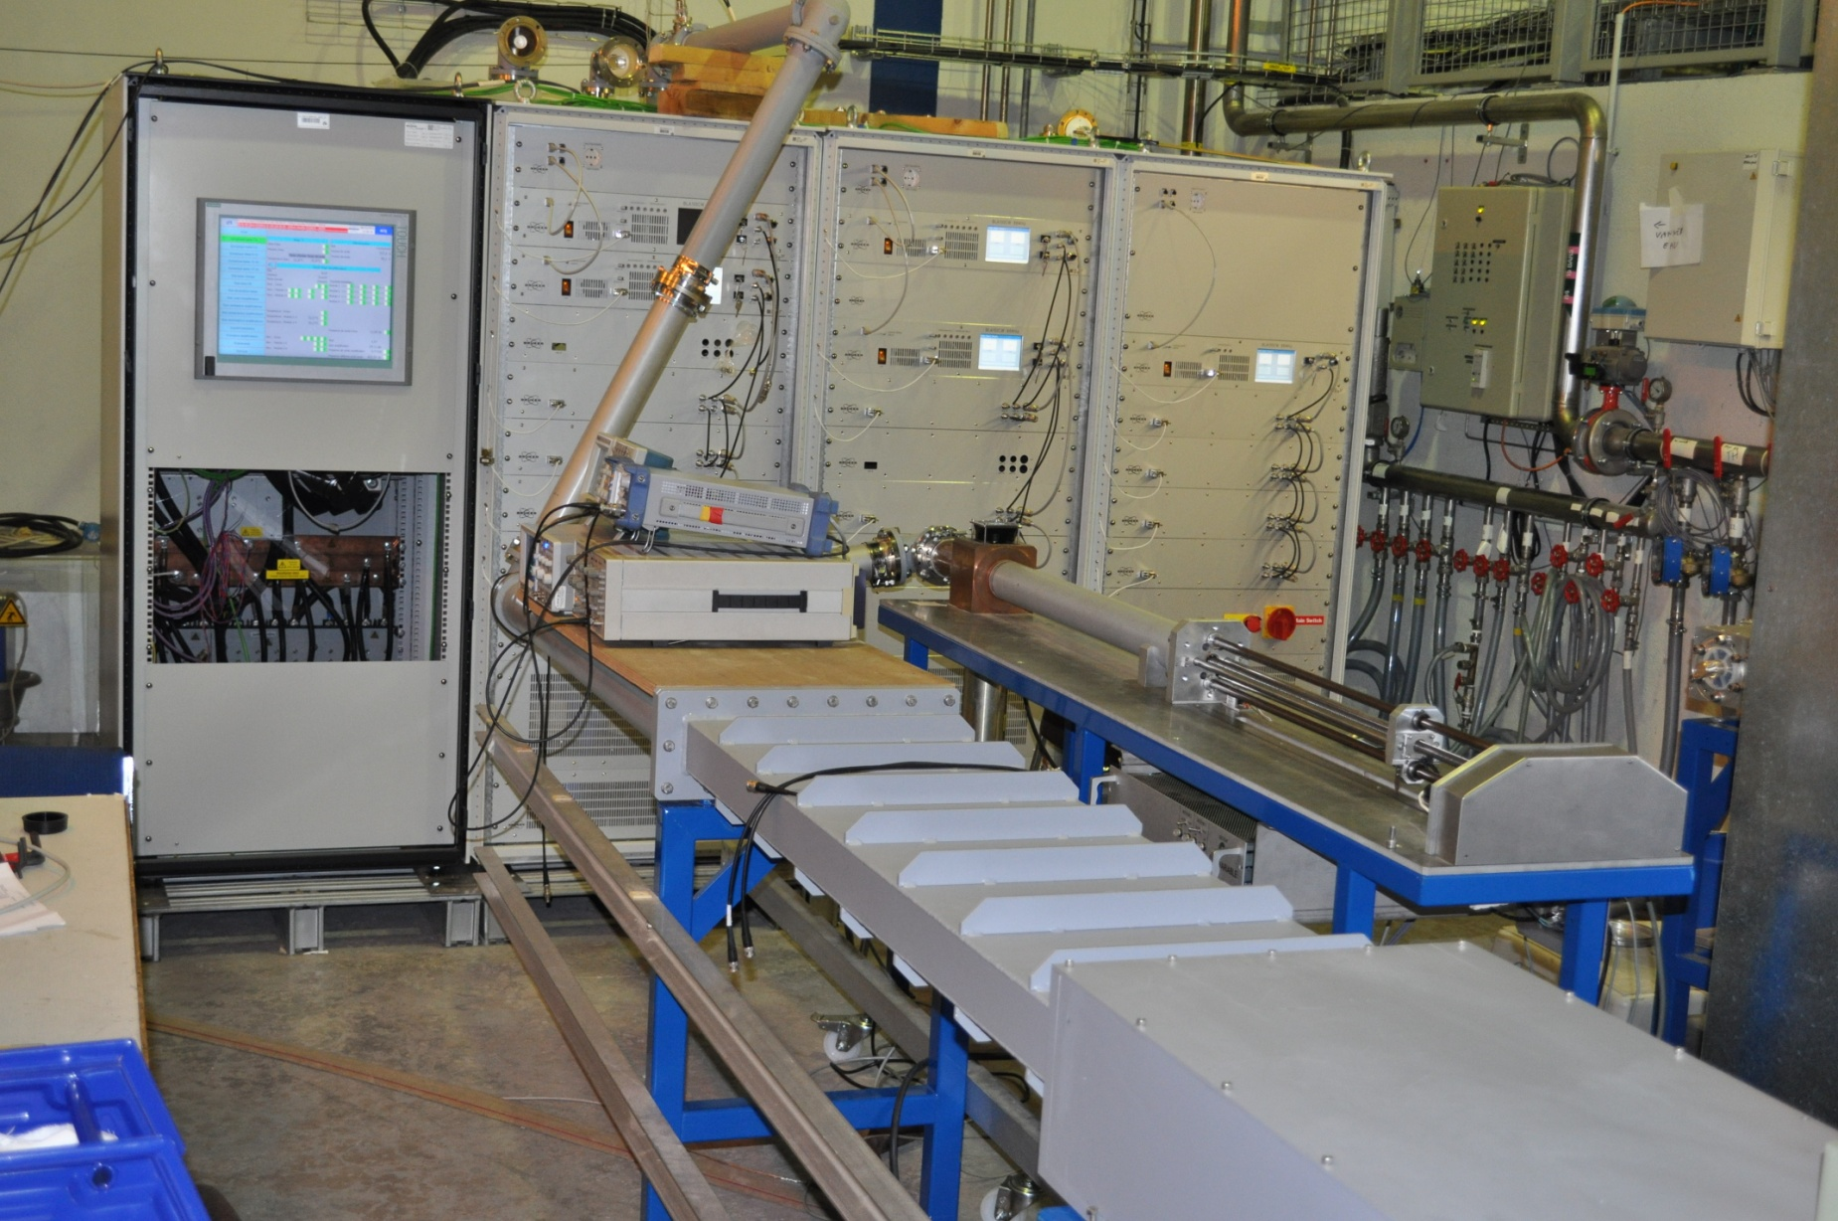
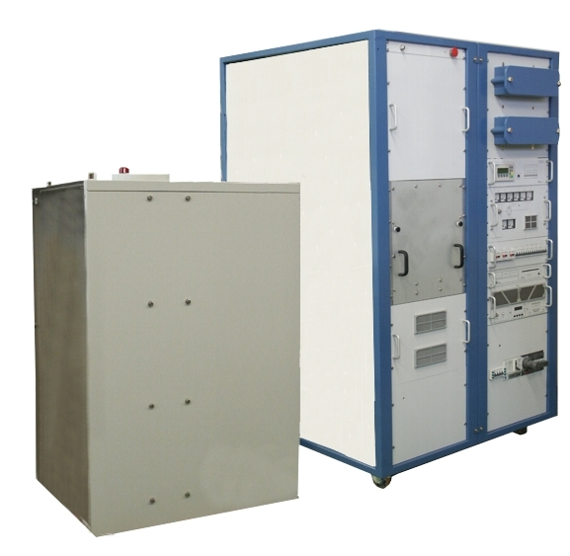
88 MHz SSA - 25-30 kW (cw) per cabinet
75 kW of solid state CW RF power stay on a surface of 2.4x1.2 m
Roughly the same area of the 65 kW tube amplifier for the RFQ!

Slide 16
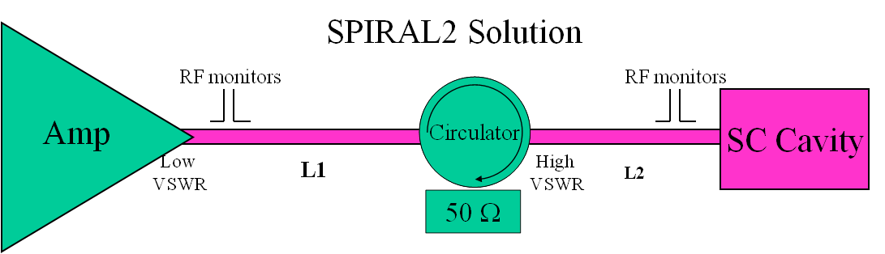
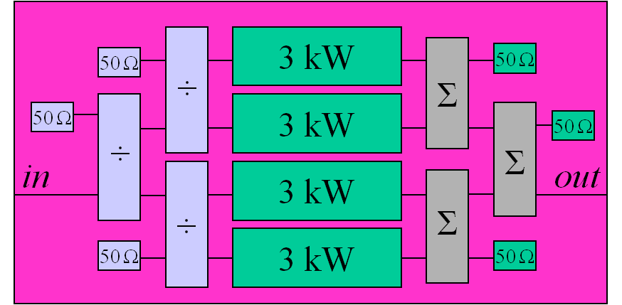
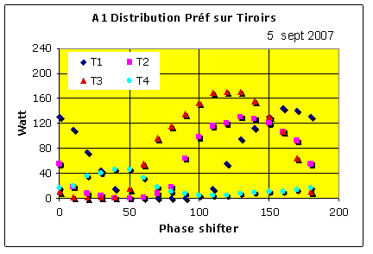
SSA – Préf redistribution vs architecture + L1
Class C modules (for higher efficiency in 2005)
90°, isolated combiners
Forward and Reverse powers available for each module
Reverse power not uniformly distributed among the four modules
Not easy to find a good working length for L1.

Slide 17
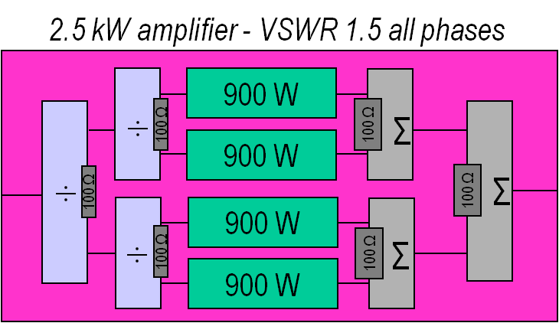
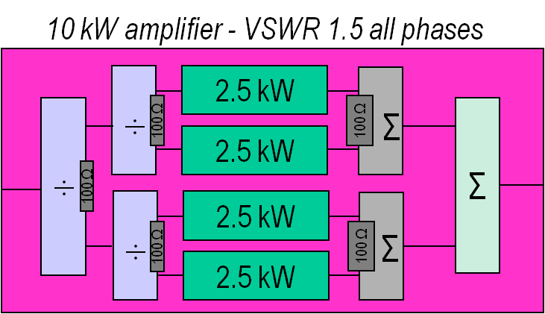
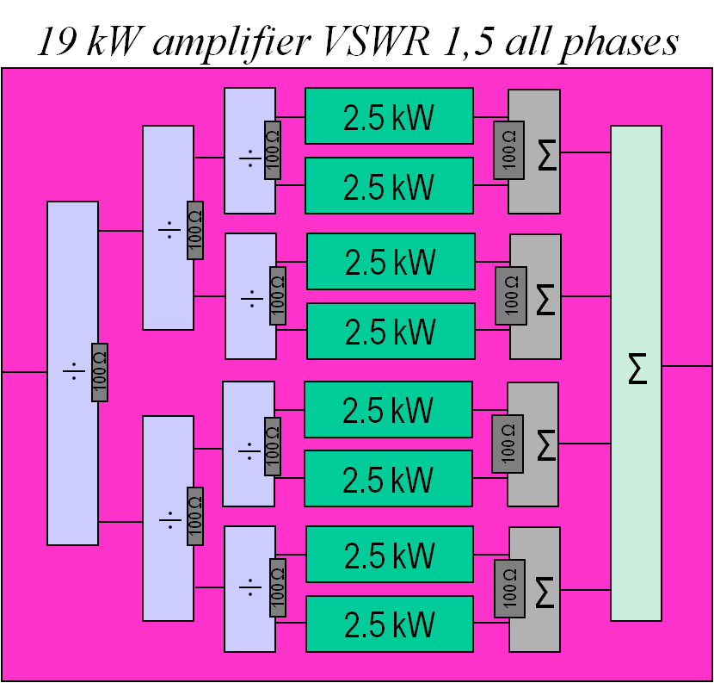
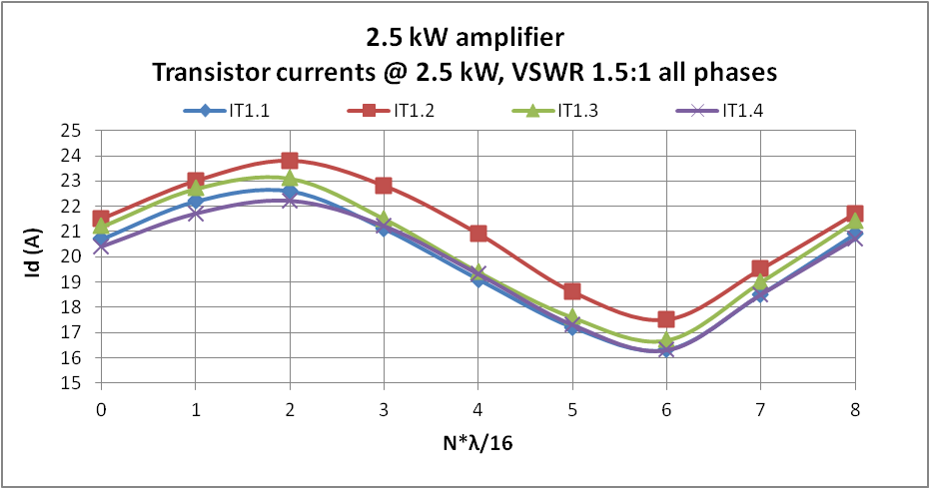
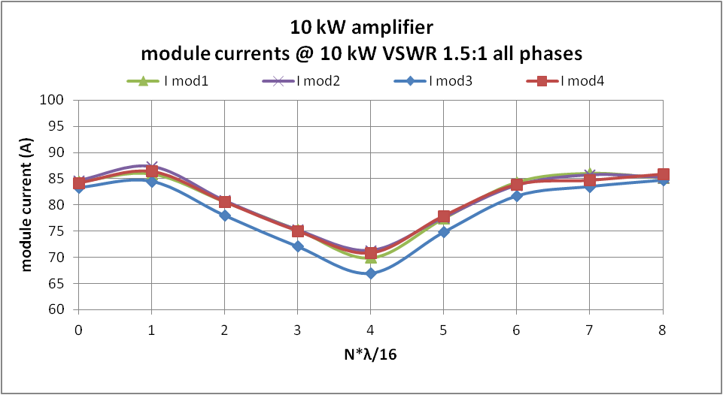
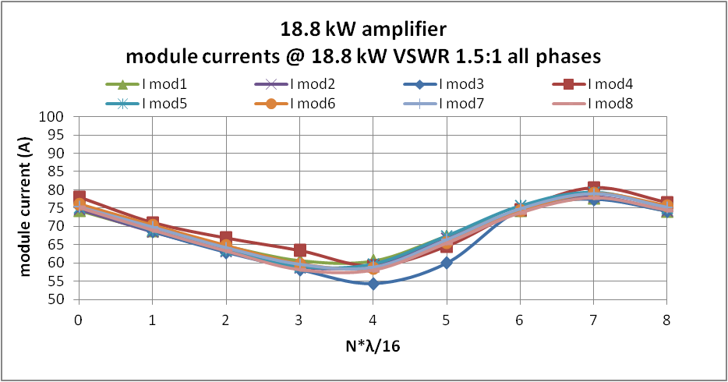
SSA – Préf redistribution vs architecture + L1
Class AB pallets
0°, isolated combiners (Wilkinson) up to 5 kW,
simple star combiner after
No direct monitoring of the reverse power. Only drain and power supply currents available
For all transistors, same modification of the current vs L1 at constant VSWR.

Slide 18
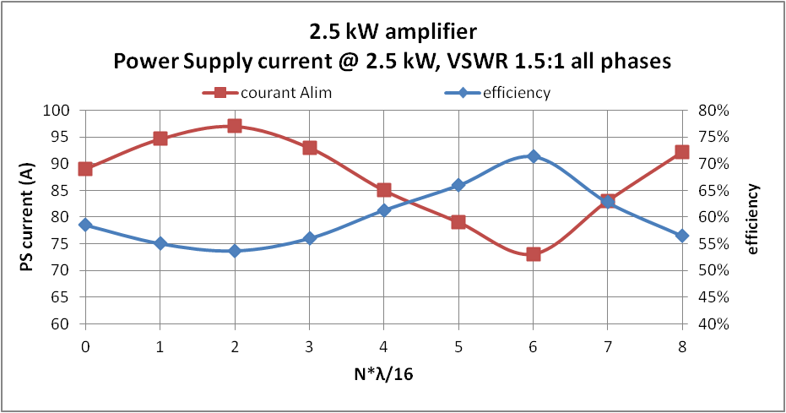
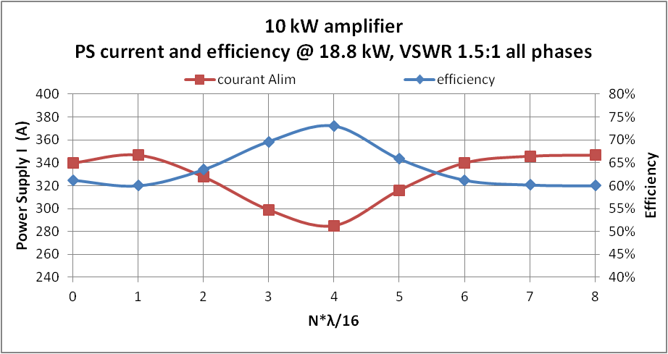
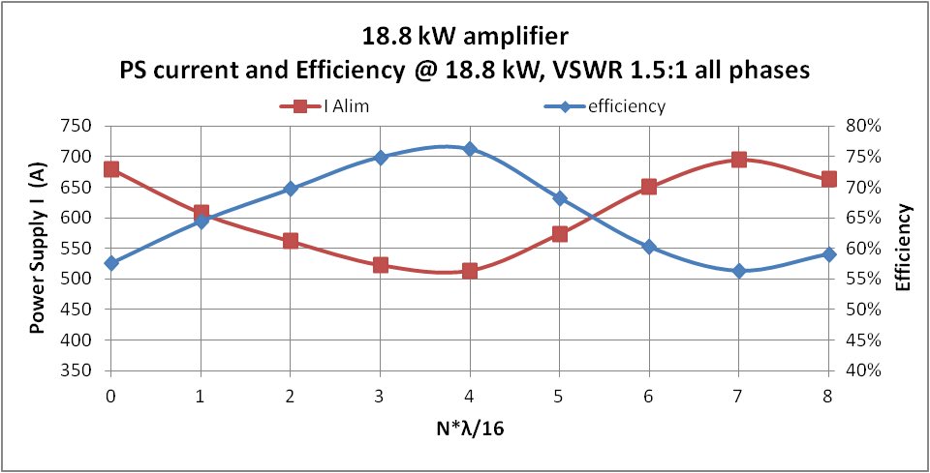
SSA – Efficiency figures
The L1 operating length can be chosen to have maximum efficiency .
Figure of all amplifiers up to 20 kW > 65%
Results due to the high efficiency of power combiners and of new (2011) MosFet (BLF 578 in our case):
Class AB modules, > 800 W pallets for CW, >75% efficiency
Operating power limited by the manufacturer to 700W
to withstand SWVR of 1.5 : 1, all phases at the output of the amplifier.

Slide 19
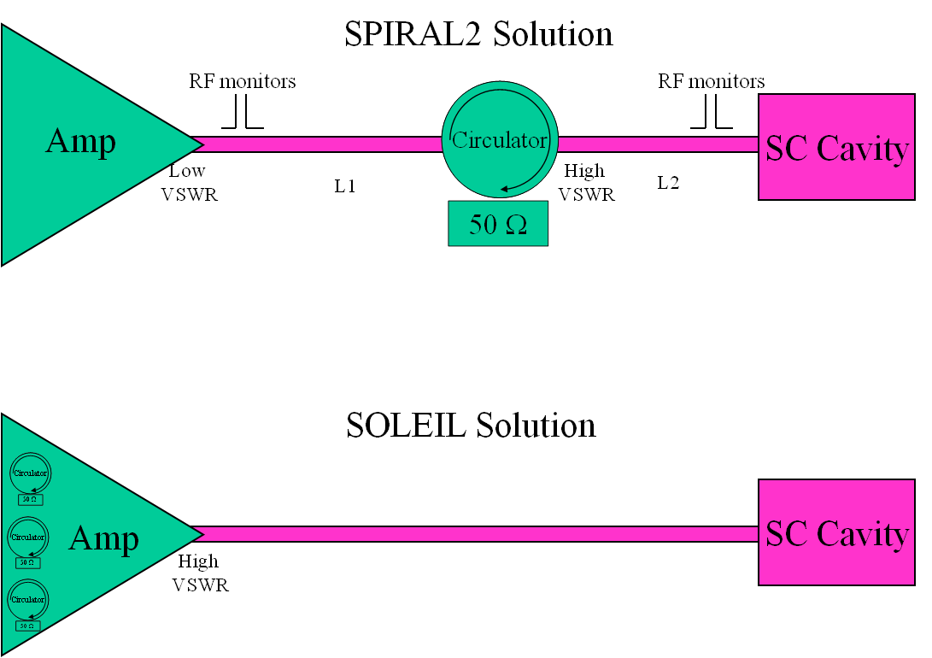
SSA - external and internal circulators
Circulator at the output
of each transistor
Probably soon an obslete discussion with the new bullet-proof MosFets
accepting VSWR = 65:1 !!!!

Slide 20
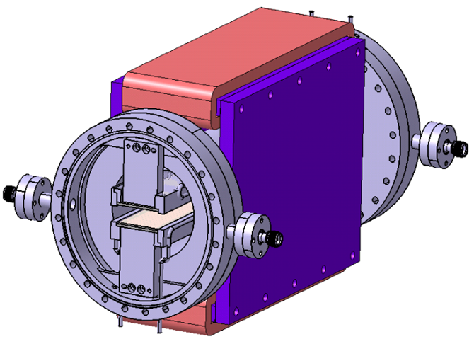
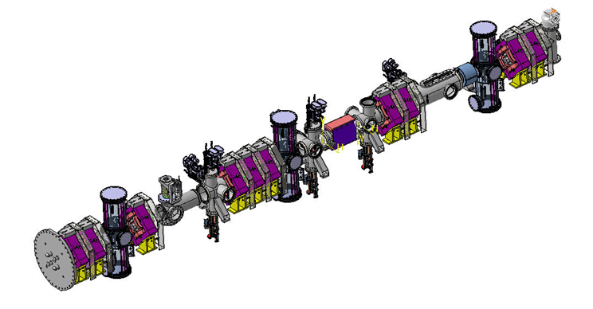
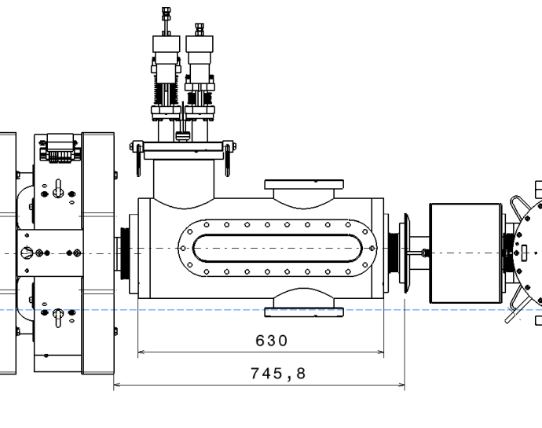
Single Bunch Selector
SBS
DC steerer + pulsed electrodes
Beam stop
MEBT line - Beta 0,04

Slide 21
SBS - Physics requirements and technical issues
Physics requirements in CW ion accelerators:
Reduce the bunch rate at the experimental target:
Bunch rate 1/100 to 1/10000 ~ 10 kHz to 1 MHz.
Technical issues
Only one bunch at time => Fast transient time: < 6ns (to change level in between two bunches)
High rep. rate, fast transient times, high voltage (2 kV)
=> low beta (4%), travelling wave structures: meander line
Low impedance structures: Maximum realistic Zc= 100 Ohm
  P ≈ duty-cycle* V²/Zc (duty~99%)
  Deuterons only: ± 720 V, 5 to 10 kW depending on Zc (100 or 50 Ω)
  Heavy ions too: ± 2250 V, 50 to 100 kW depending on Zc (100 or 50 Ω)

Slide 22
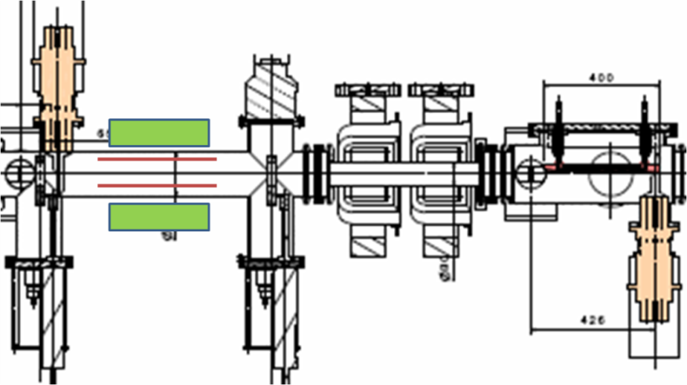
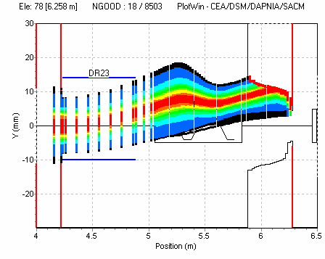
SBS - Inverted duty cycle solution
fd
Eurisol DS (2007) proposal: INVERTED DUTY CYCLE
Advantages:
  RF power reduced by ~80
    Pulser and device costs
    Plate cooling achievable (5 to 10% RF power)
  Safer operating mode:
    Beam permanently stopped
    Beam deviation relying on magnet
    and supply reliability
  Constant length pulse
Disadvantages
  Beam dynamics issues

Slide 23
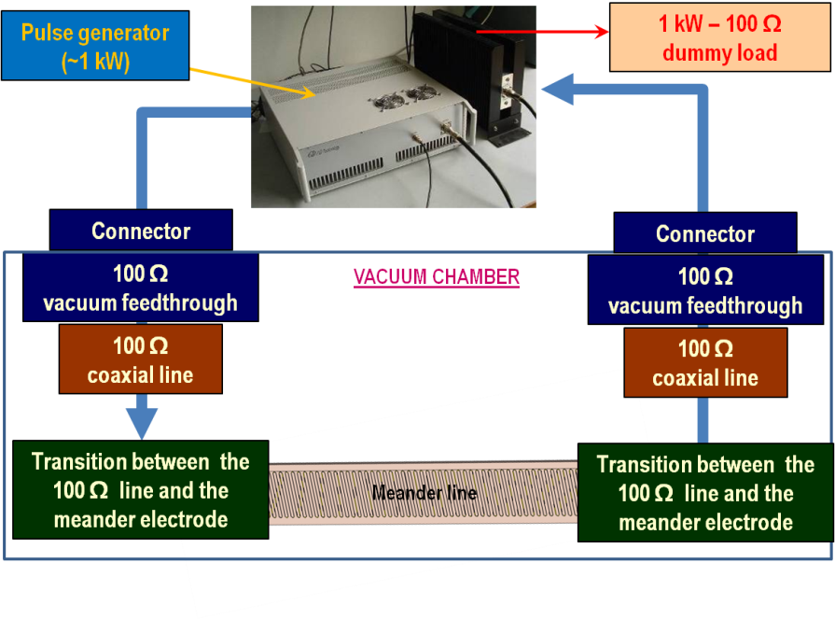
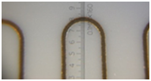
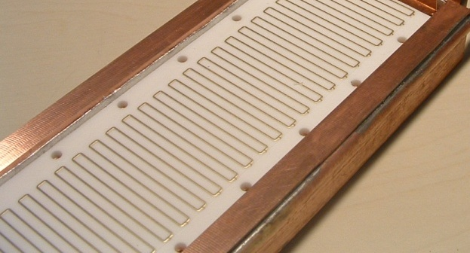
SBS - 100 Ω :custom components
ELECTRODES :
Ceramics is required to
to reduce meander width (steerer entrefer)
to dissipate RF and beam losses
(SNS experience)
to be radiation resistant
Meander plate on housing first U bend (Cern like)
Modified U bend
to avoid burning at corners

Slide 24
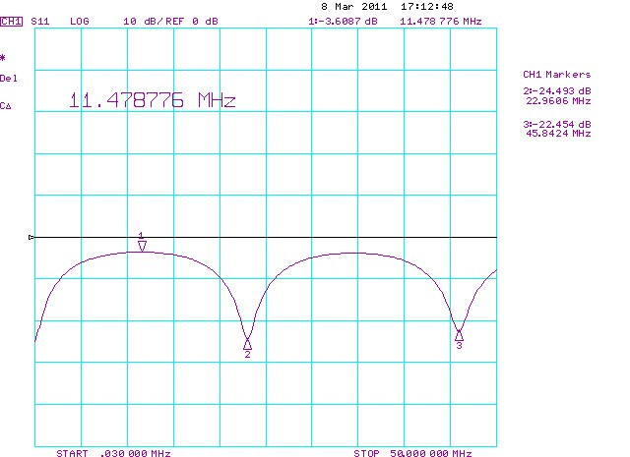

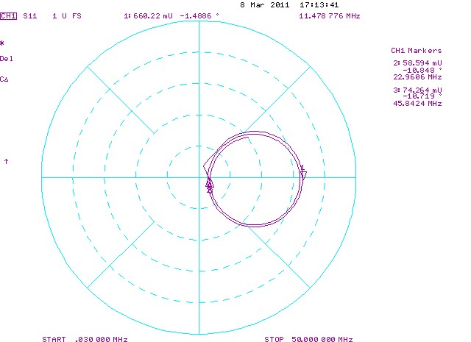
SBS - 100 Ω measurements
Measured values higher than expected:
Still looking for an explanation
Several other methods tested
β = 2L_{ml} Δf /c
Method | Zml | Beta
S₁₁ - 50 Ω load | 117 | 0.0417
S₁₁ - meas/model fitting | 112 | 0.042
S₁₁ - 50 Ω NA port2 | 109 | 0.042
S₁₁ - open/short | 115 | 0.0415
S₁₁ - minimum reflection | 114
S_{12 –} phase difference |  | 0.043
Numerical deembedding in progress
Impedance and beta Measurements (Réf: TUPS075 IPAC2011)

Slide 25

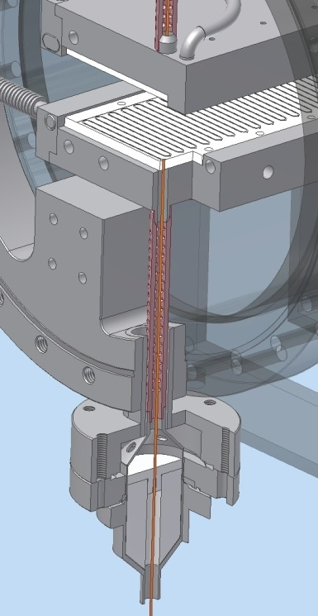
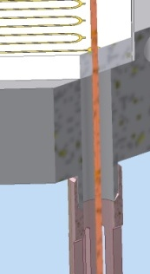


SBS - Next Step: Vacuum chamber and feed-through
Transition to meander
Water cooled housing
Water inlet
Pumping holes in the outer coaxial to avoid sparks.
Alumina window
External connections to coax cables
Vacuum chamber and electrode housing : designed and ordered
Feed-through: several geometry compared. Designed (TUP277 Pac 2011) and ordered.
Measurement beginning of 2012:
  Vacuum (dependence on ceramics temperature)
  RF response
  Thermal
  Pulse transit

Slide 26
ACKNOWLEDGEMENTS
B. Ducoudret, Solid State Amplifier team leader (GANIL)P.
A. Caruso: Single Bunch Selector (SBS) INFN-LNS team leader
P. Balleyguier (CEA –DAM), F. Consoli (INFN-LNS):
SBS - RF simulations and measurements analysis
J.F. Leyge: MEBT rebuncher team leader (GANIL)
For their every-day work, producing material for this talk.

Slide 27
END
Thank you for your attention
and for this interesting WS in Rostock

Slide 28



RFQ, CMA, CMB
RFQ prototype
section
Low beta cryomodule
High beta cavities and cryomodule

