Slide 1
Minimizing the field tilts in superconductive cavities
Results from 2011 ILC tests at FLASH, DESY
Julien Branlard
RFTech, 3rd Workshop
Rostock, Dec. 12th 2011

Slide 2
Overview
Problem statement and historical background
Why do we care about individual flat gradients?
What solutions were offered to achieve flat gradients with beam loading?
What can we actually implement at FLASH?
The Feb.’11 study at FLASH
What approach have we followed during the FLASH test studies?
Results of the P_{K} |Q_{L} studies
Conclusions and prospects
Approach limitations
Improvements

Slide 3
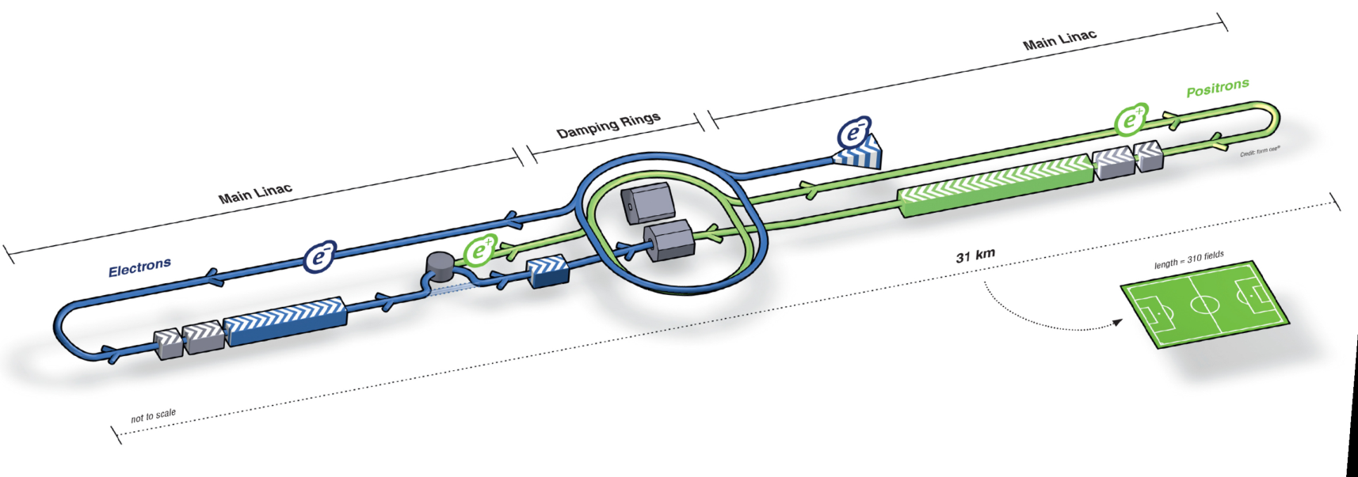
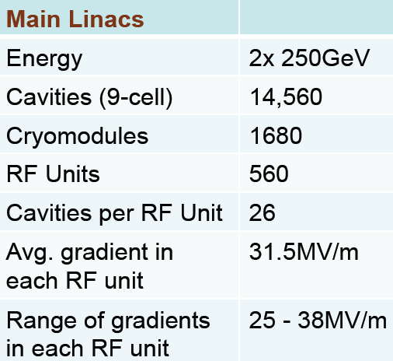
I. Introduction: ILC
The International Linear Collider
Accel. Params | ILC | FLASH | Unit
Cavity tech. | SC | SC
RF freq. | 1.3 | 1.3 | GHz
Rep. rate | 5 | 5-10 | Hz
Beam current | 9 | 1-9 | mA
Average gradient | 31.5 | 26 | MV/m
RF station | 10 MW klystron for 26 cavities | 10 MW klystron for 16 cavities

Slide 4
I. Introduction: FLASH
FLASH
ACC67

Slide 5
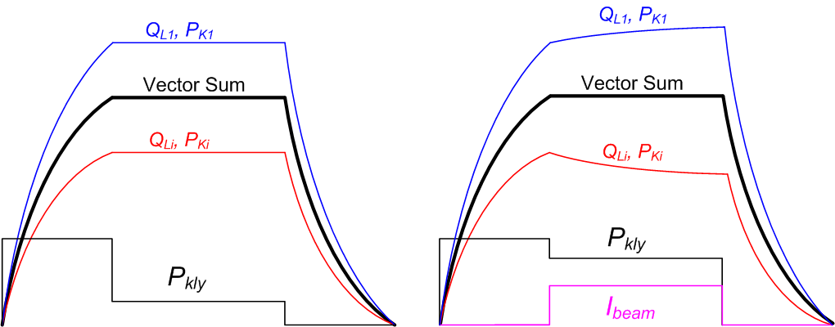
I. Introduction: problem statement
Why do we care about individual flat gradients?
“Effect of Cavity Tilt and RF Fluctuations to Transverse Beam Orbit Change in ILC Main Linac” K. Kubo, Jan. 2010
Beam loading
BEAM OFF
BEAM ON

Slide 6
I. Introduction: problem statement
Beam loading tilts scale linearly with beam current
Simulated tilts for ACC6 at FLASH, with 800 usec flat top

Slide 7
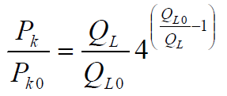
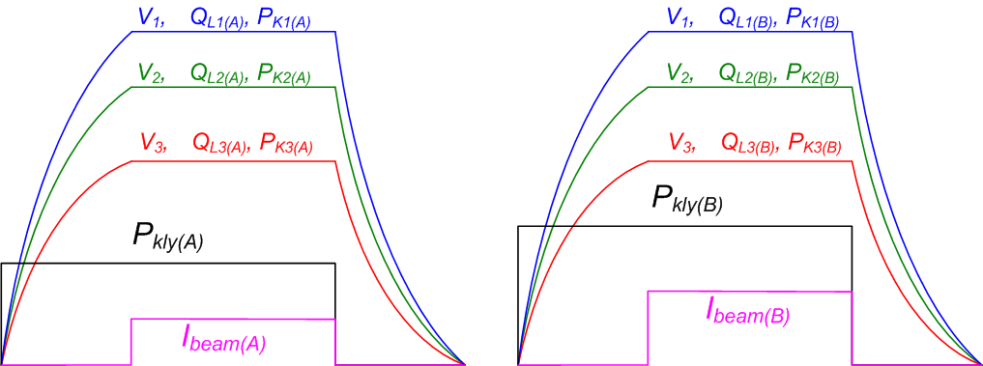
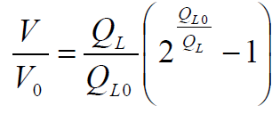
I. Introduction: problem statement
“Solutions” to flat cavity gradient with beam
“RF Distribution Optimization in the Main Linacs of the ILC”, Bane, Adolphsen, Nantista – PAC07
“Optimal Coupler and Power Settings for Superconductive Linear Accelerators”, Branlard, Chase - LINAC08
“PkQl-like control for ACC6/7 at FLASH”, Michizono, unpublished 2010
“RF Distribution Optimization in the Main Linacs of the ILC” Bane, Adolphsen, Nantista - WEPMS037.pdf, 2007
→ Assumes a square forward power pulse
→ Assumes adjustable P_{K}’s

Slide 8
I. Introduction: problem statement – FLASH working space
Focus on ACC6 and ACC7
Motorized couplers (Q_{L} adjustments, limited range)
Fixed power distribution (i.e. P_{K}), except for 3dB hybrid
Motorized slow tuners
Dynamic cavity resonance control with piezo

Slide 9
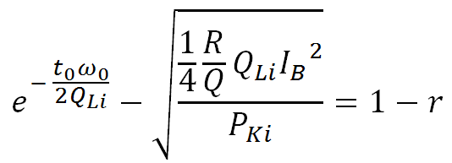
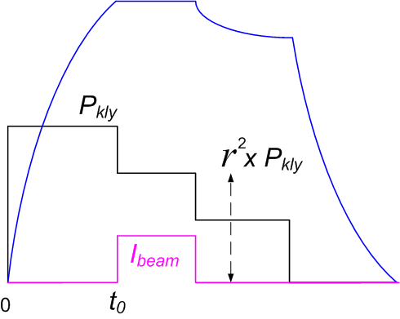
II. Analytical approach
Analytical ‘solution’ for optimal Q_{L}
→ assumes “perfect” tuning
→ solve for Q_{Li} when possible
cavity i loaded Q
cavity i forward power during fill time [W]
DC beam current [A]
fill time (∼ beam arrival time) [s]
fill time to flat top voltage ratio (including beam compensation)

Slide 10
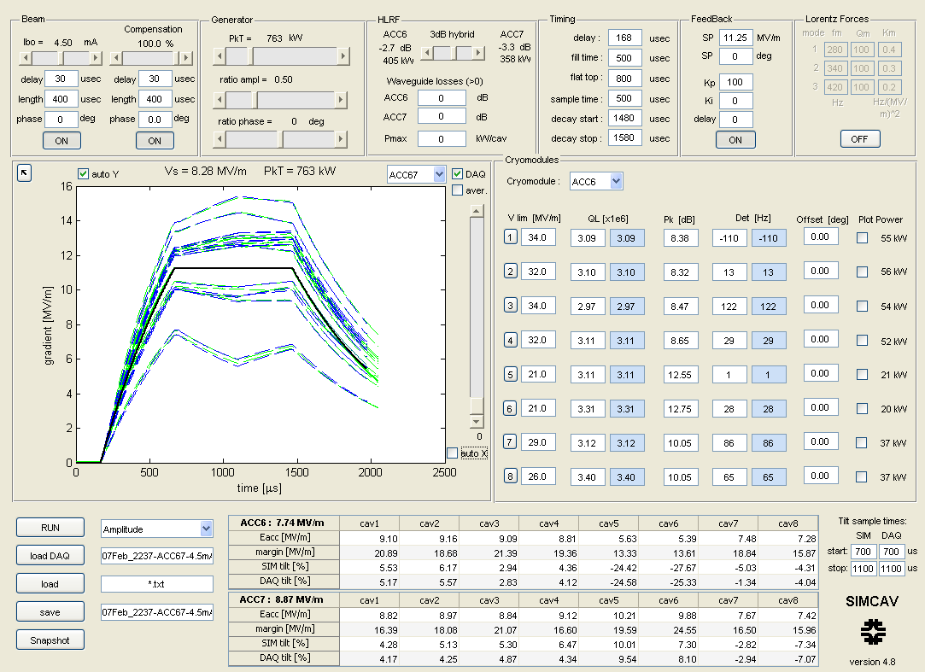
II. SIMCAV: Cavity simulator

Slide 11
II. SIMCAV: Cavity simulator

Slide 12
II. Calibration procedure
DAQ data: Feb. 07 2011, 22:37
Load V_{cav} from DAQ
Compute actual Q_{L} , P_{K} and Δ_{f} from DAQ data
Type in Q_{L}, P_{K} and Δ_{f} into simulator
Check agreement between simulated and FLASH data
Adjust Q_{L} in simulator to flatten tilts
Implement Q_{L} corrections in FLASH
Check gradient flatness
FLASH DAQ data
I_{b} = 4.5 mA
Notes:
How did we proceed to flatten individual cavity gradients: knobs we used are: adjusting QLs and setting cavity on resonance
Step 1: load DAQ data, decay measurement

Slide 13
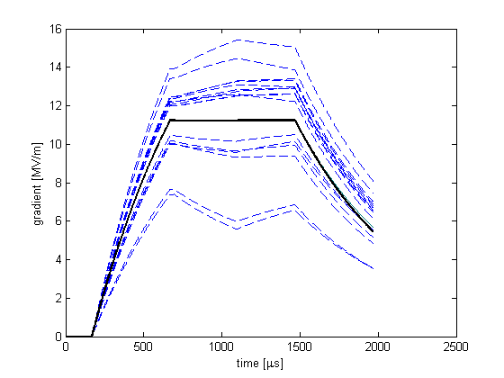
II. Calibration procedure
Load V_{cav} from DAQ
Compute actual Q_{L} , P_{K} and Δ_{f} from DAQ data
Type in Q_{L}, P_{K} and Δ_{f} into simulator
Check agreement between simulated and FLASH data
Adjust Q_{L} in simulator to flatten tilts
Implement Q_{L} corrections in FLASH
Check gradient flatness
simulated data
vector sum
Notes:
Step 2: simulate

Slide 14
II. Calibration procedure
Load V_{cav} from DAQ
Compute actual Q_{L} , P_{K} and Δ_{f} from DAQ data
Type in Q_{L}, P_{K} and Δ_{f} into simulator
Check agreement between simulated and FLASH data
Adjust Q_{L} in simulator to flatten tilts
Implement Q_{L} corrections in FLASH
Check gradient flatness
FLASH DAQ data
simulated data
vector sum
Notes:
Check agreement between simulation and experimental data

Slide 15
II. Calibration procedure
Load V_{cav} from DAQ
Compute actual Q_{L} , P_{K} and Δ_{f} from DAQ data
Type in Q_{L}, P_{K} and Δ_{f} into simulator
Check agreement between simulated and FLASH data
Adjust Q_{L} in simulator to flatten tilts
Implement Q_{L} corrections in FLASH
Check gradient flatness
simulated data
vector sum
Notes:
Adjust QL using simulator “by eye”

Slide 16
II. Calibration procedure
Load V_{cav} from DAQ
Compute actual Q_{L} , P_{K} and Δ_{f} from DAQ data
Type in Q_{L}, P_{K} and Δ_{f} into simulator
Check agreement between simulated and FLASH data
Adjust Q_{L} in simulator to flatten tilts
Implement Q_{L} corrections in FLASH
Check gradient flatness
simulated data
vector sum
Notes:
Adjust QL using simulator “by eye”

Slide 17
II. Calibration procedure
Load V_{cav} from DAQ
Compute actual Q_{L} , P_{K} and Δ_{f} from DAQ data
Type in Q_{L}, P_{K} and Δ_{f} into simulator
Check agreement between simulated and FLASH data
Adjust Q_{L} in simulator to flatten tilts
Implement Q_{L} corrections in FLASH
Check gradient flatness
simulated data
vector sum
Notes:
Note that while adjusting the QL flattens cavity gradients during beam time, it also introduces a tilt when beam is OFF

Slide 18
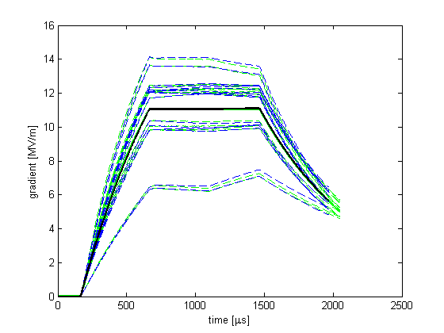
II. Calibration procedure
Load V_{cav} from DAQ
Compute actual Q_{L} , P_{K} and Δ_{f} from DAQ data
Type in Q_{L}, P_{K} and Δ_{f} into simulator
Check agreement between simulated and FLASH data
Adjust Q_{L} in simulator to flatten tilts
Implement Q_{L} corrections in FLASH
Check gradient flatness
FLASH DAQ data
simulated data
vector sum
Notes:
Verify benefits (in tilts) of the Ql change (retune cavity after QL adjustments)

Slide 19
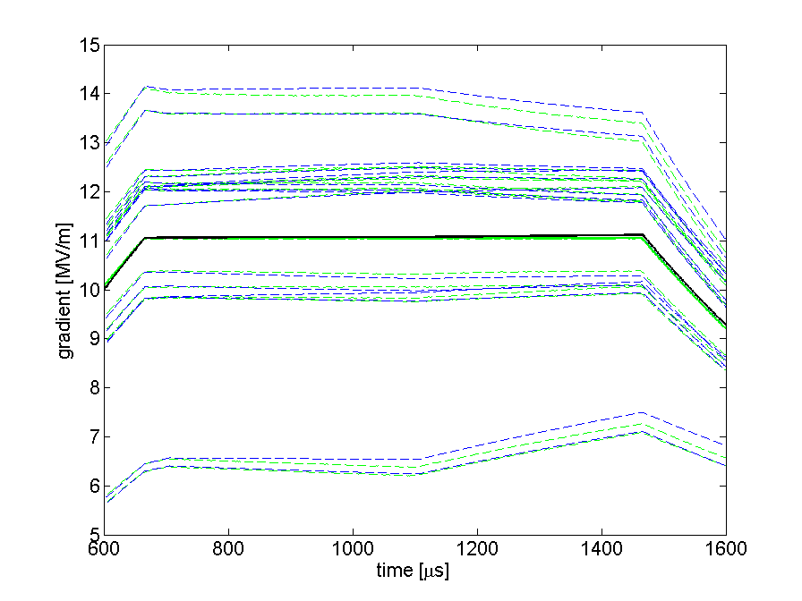
II. Calibration procedure
Load V_{cav} from DAQ
Compute actual Q_{L} , P_{K} and Δ_{f} from DAQ data
Type in Q_{L}, P_{K} and Δ_{f} into simulator
Check agreement between simulated and FLASH data
Adjust Q_{L} in simulator to flatten tilts
Implement Q_{L} corrections in FLASH
Check gradient flatness
FLASH DAQ data
simulated data
vector sum
Notes:
Close up on simulation vs. experiment data: discrepancies are due to:
Inaccuracy in assessing power distribution
Inaccuracy in the Ql estimate “by eye”
Inaccuracy in setting up the Ql (settings + measurement)
Inaccuracy in cavity tuning (static + dynamic)

Slide 20
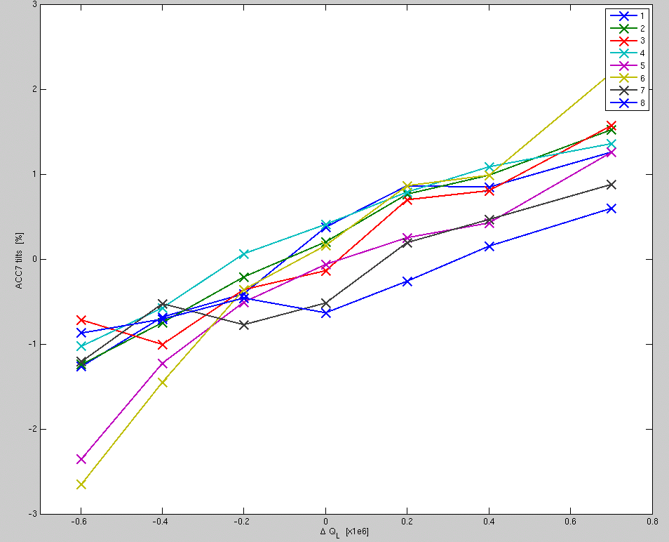
II. Assessing the accuracy of the method
Q_{L} scan
→ Keep beam current constant but walk Q_{L}’s around optimized value
I_{B} scan
→ Keep optimized Q_{L}’s but ramp beam up/down
3
2
1
0
-1
-2
-3
gradient tilts [%]
-0.6 -0.4 - 0.2 0 0.2 0.4 0.6 0.8
ΔQ_{L} [ x 10⁶ ]
Notes:
Checking if the Ql settings are indeed optimal

Slide 21
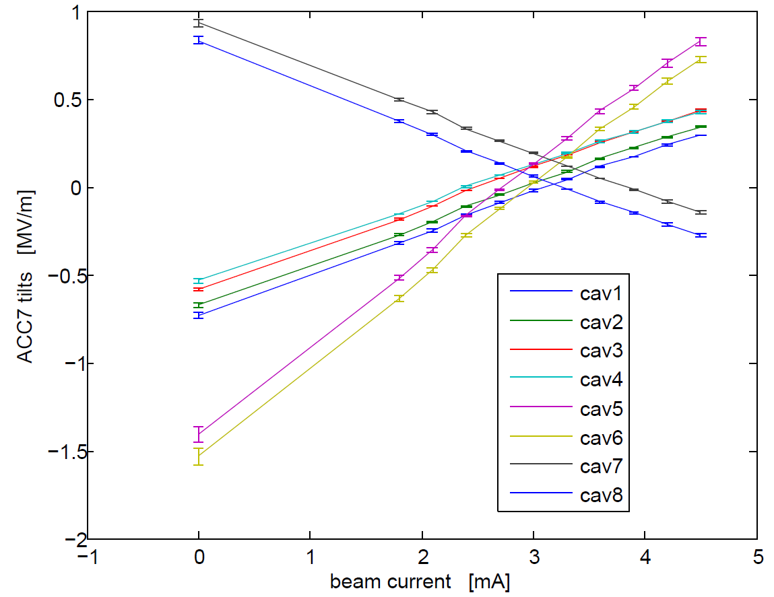
II. Assessing the accuracy of the method
Q_{L} scan
→ Keep beam current constant but walk Q_{L}’s around optimized value
I_{B} scan
→ Keep optimized Q_{L} but ramp beam up/down
Notes:
Checking the impact of beam change on tilts (Qls are optimized for 1 beam current, not any other beam current)

Slide 22
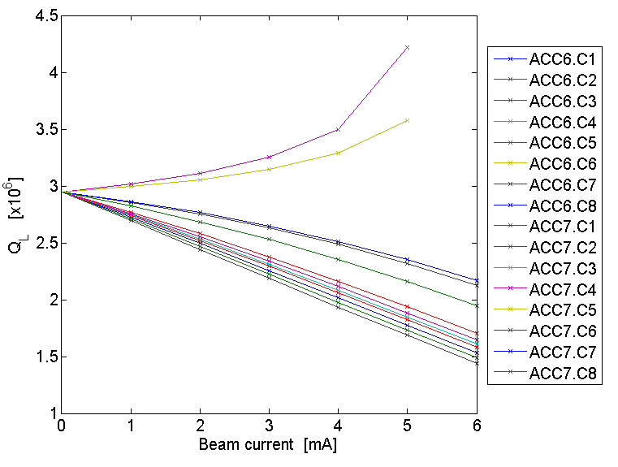
II. Assessing the accuracy of the method
Q_{L} settings are limited
ILC specs : 9 mA !

Slide 23
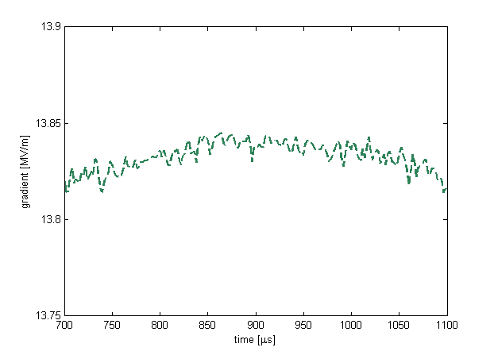
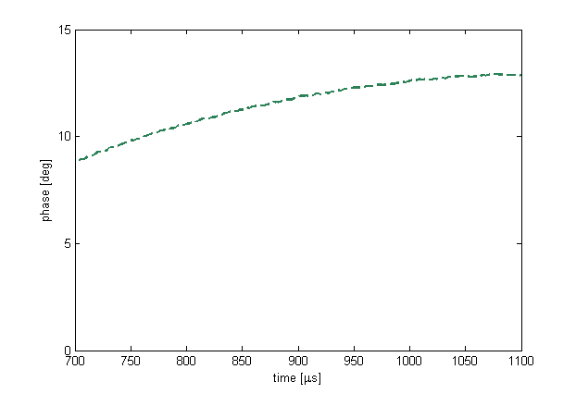
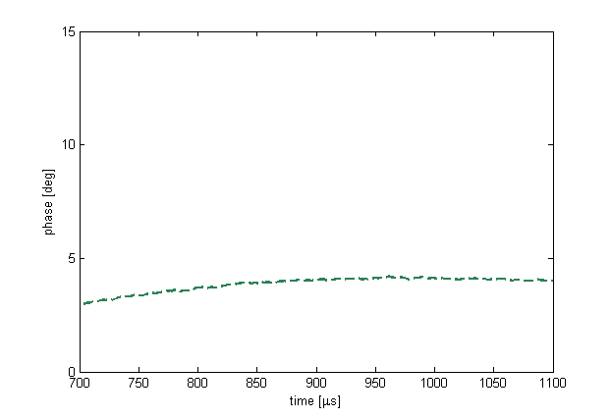
II. Impact of cavity frequency tuning
Before freq. tuner adjustments
After freq. tuner adjustments
AMPLITUDE
AMPLITUDE
~ 0.1 MV/m
Q_{L} = 1.58x10⁶
Q_{L} = 1.58x10⁶
PHASE
PHASE
Δf = 70 Hz

Slide 24
III. Study insights
What went well
Motorized couplers / tuners
Analytical approach proved to be useful
Predicted optimized Q_{L} values were accurate → to 0.2e6
Successfully implemented the tuning plan → tilts < 0.1MV/m
What we’ve learnt
Cavity resonance control is crucial for gradient tilts
Limitations to the analytical approach:
How accurately can we compensate for LFD OR include in model?
How accurately can we measure and set Q_{L}’s → +/- 2 to 5%
What is still unanswered
No proposed solution for high beam currents (>6mA) implementable at FLASH
There is not always a solution to flatten all cavities (especially when gradient spread is large)
No solution to bring up the machine at its highest gradient

Slide 25
III. Conclusions and prospects
Machine automation
Automatic Q_{L} settings
Automatic quench detection
Machine operation scenarios
Tuning strategies
How to ramp up the beam
How to recover from a quench
Next study time
February 2012
Thank You!

