Slide 1
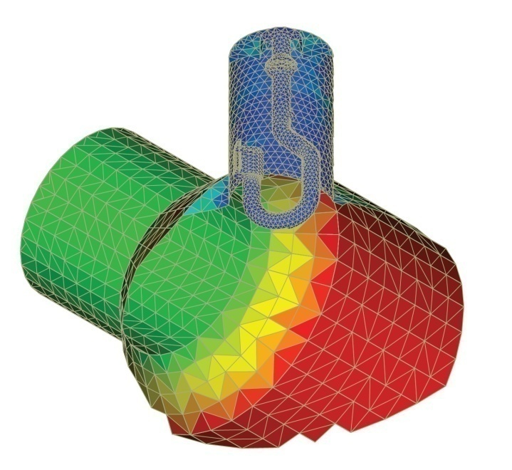
Implementation and Investigation of a Local Time Stepping Scheme Based on DG-FEM
Kai Papke
12.12.2011

Slide 2
Outline
Introduction
Discontinuous Galerkin FEM
Numerical Integration
Local Time Stepping Scheme
Example: Lossless Rectangular Resonant Cavity
Example: Higher-Order-Mode Coupler
Summary

Slide 3
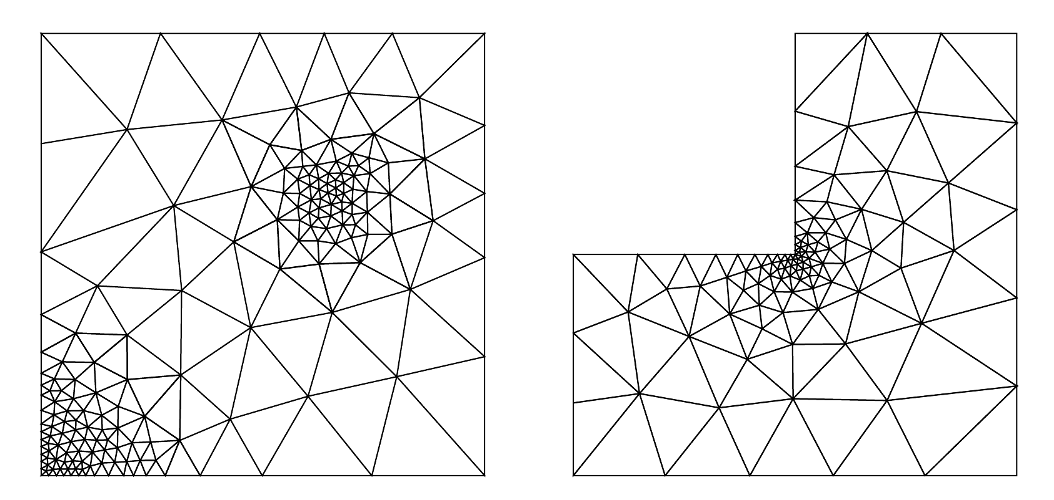
Introduction
Numerical methods to solve Maxwell’s equations usually lead to spatial and temporal discretization of the problem.
Problem: tiny geometrical structures cause small step sizes thus strongly limiting the maximal stable time step for the time integration scheme ➔ computation time increases accordingly

Slide 4
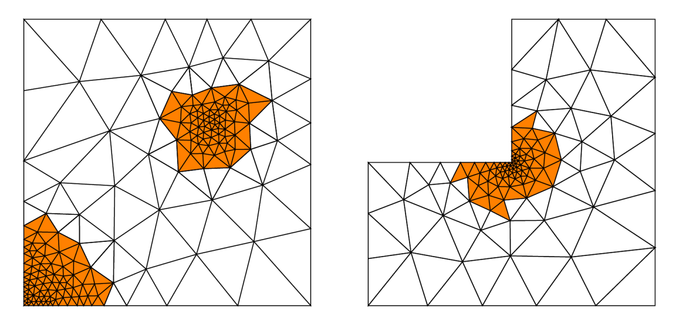
Introduction
Numerical methods to solve Maxwell’s equations usually lead to spatial and temporal discretization of the problem.
Problem: tiny geometrical structures cause small step sizes thus strongly limiting the maximal stable time step for the time integration scheme ➔ computation time increases accordingly
Δt1
Δt2 > Δt1
Δt2
Solution approach: local time stepping scheme

Slide 5
Introduction
Implementation of a local time stepping scheme (LTS) in NUDG++¹
Implementation architectures: CPU and GPU
Some developers of NUDG++:
  Nigel Nunn, Tim Warburton, Nico Gödel, Carsten Potratz, Christian Rüdiger Bahls
Information on NUDG++:
  http://www.caam.rice.edu/~timwar/NUDG/Software/NUDG++.html
  http://www.nudg.org/
¹ Nodal Unstructured Discontinuous Galerkin in C++

Slide 6
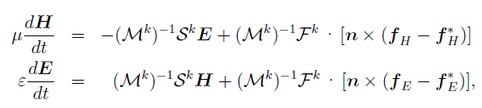
Spatial Discretization
Discontinuous Galerkin FEM
Semi-discrete formulation of Maxwell’s equations based on DG-FEM
Application of explicit time integration schemes is beneficial since equations for the temporal derivatives are given in an explicit manner
Very suitable for the implementation on massively parallel architectures ➔ GPU
M – Mass matrix
S – Stiffness matrix
F – Surface integration
matrix
separately computable for each element
coupling of adjoining elements

Slide 7
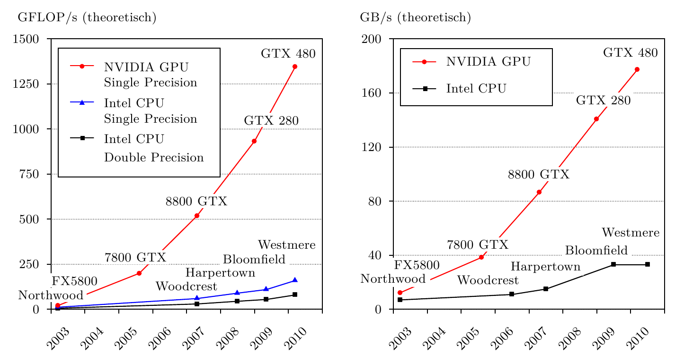
Spatial Discretization
Discontinuous Galerkin FEM
Motivation for implementation on GPUs:
Sources:
http://theinf2.informatik.uni-jena.de/Lectures/Programming+with+CUDA/SS+2011.html
http://www.gpureview.com/database.php

Slide 8

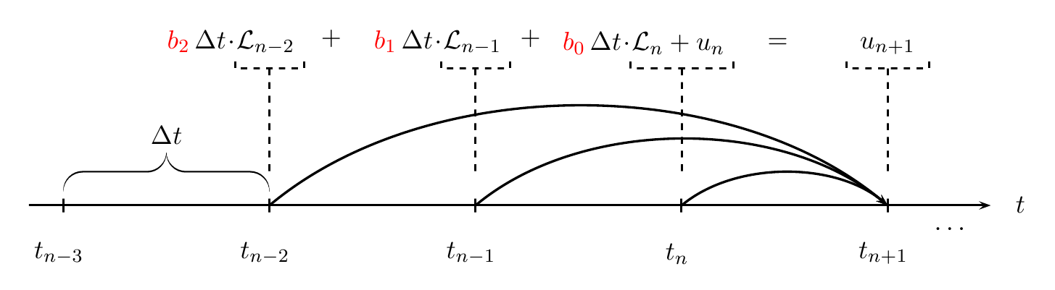
Numerical Integration
Explicit linear multistep methods
Problem:
Solution algorithm: Adams-Bashforth with three steps

Slide 9
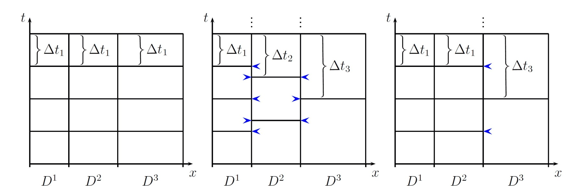
Local Time Stepping (LTS)
Concept
Different time steps in accordance with element size
Time-synchronous evaluation of numerical flux → additional temporary information required (blue arrows)
Arrangement of elements in classes with constant time steps

Slide 10
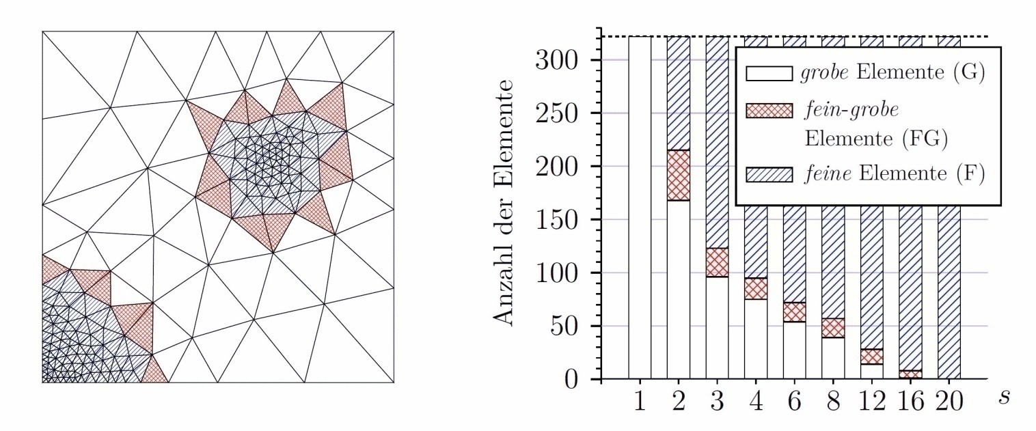
Local Time Stepping (LTS)
Classification
Grid partitioning in sub-regions which contain only fine or coarse elements
Two different time steps (micro step / macro step)
Coupling between the sub-grids realized by the numerical flux
number of elements
coarse elements (C)
fine-coarse elements (FC)
fine elements (F)
macro micro
step ratio

Slide 11
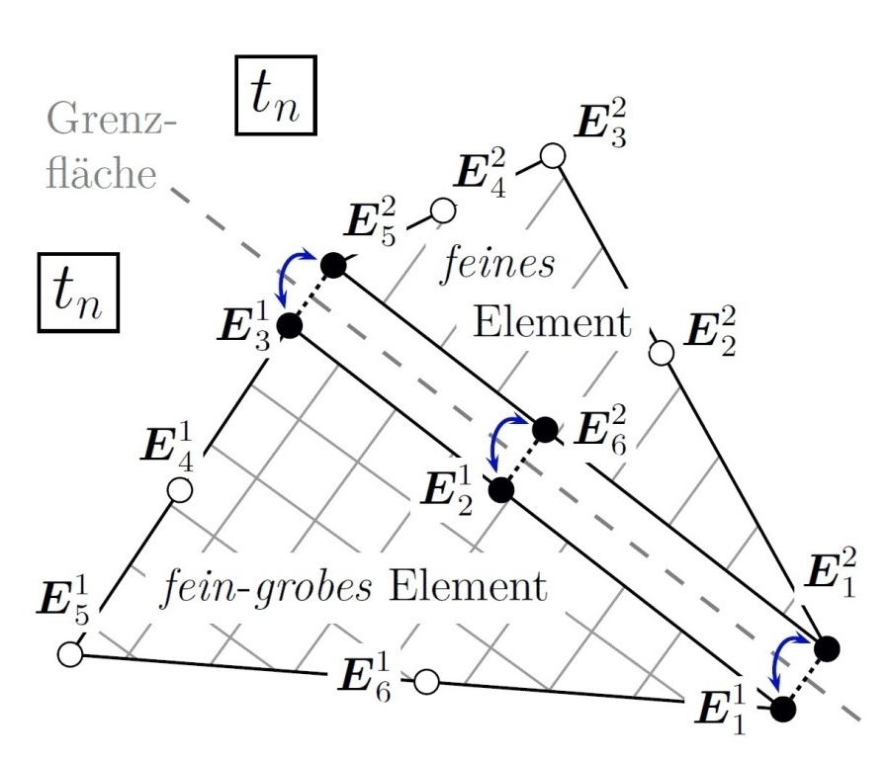
Local Time Stepping (LTS)
Algorithm
Evaluation of spatial derivatives at time t_{n} for coarse and fine sub-grid, respectively
Storage of results:
interface
fine
element
fine-coarse element
s – macro micro
step ratio

Slide 12
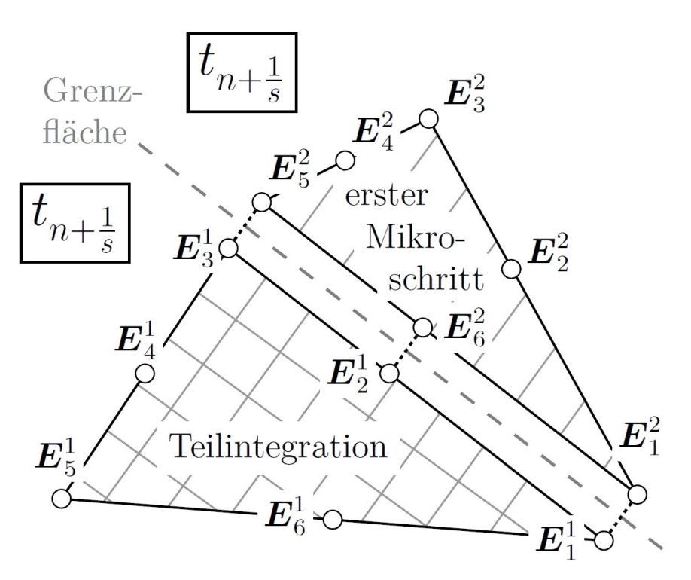
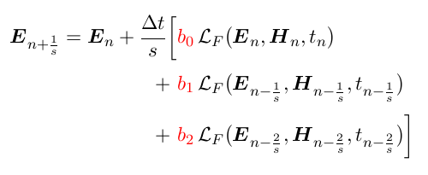
Local Time Stepping (LTS)
Algorithm
Time integration with respect to fine and fine-coarse elements by micro step Δt/s
Example: Discretized Ampere‘s Law on fine elements
interface
1st micro
step
partial time integration
s – macro micro step ratio

Slide 13
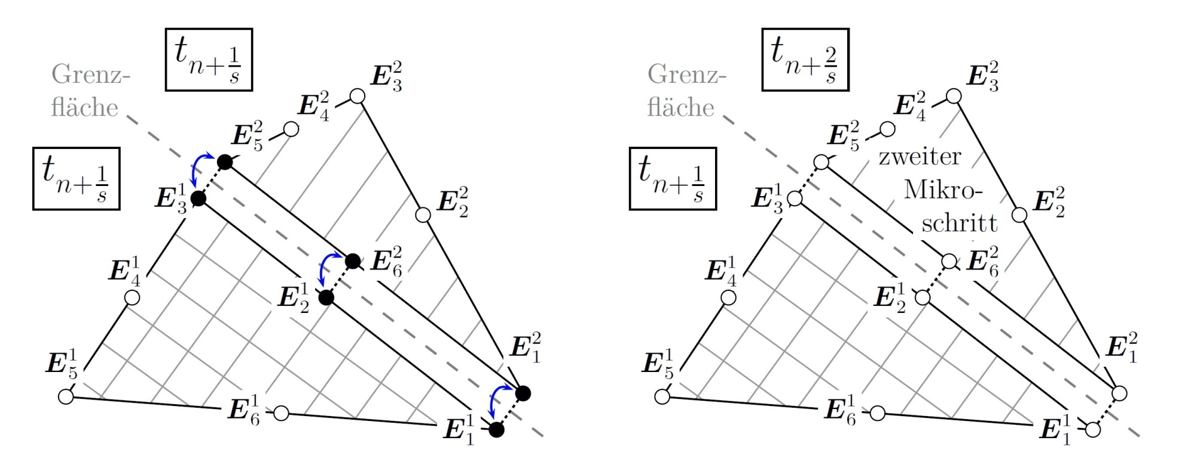
Local Time Stepping (LTS)
Algorithm
Computation of spatial deviations at time t_{n+1/s} for the fine sub-grid
Storage of results:
interface

Slide 14
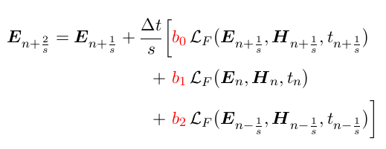
Local Time Stepping (LTS)
Algorithm
Time integration with respect to fine elements by second micro step Δt/s
Example: Discretized Ampere‘s Law on fine elements
interface
2nd micro
step
s – macro micro step ratio

Slide 15
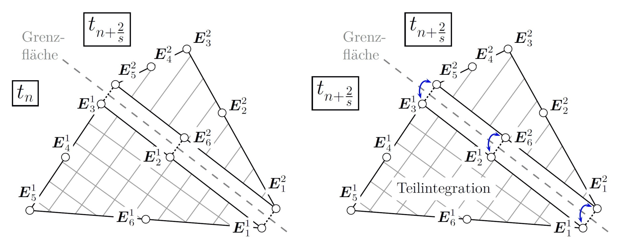
Local Time Stepping (LTS)
Algorithm
Field coefficients of fine-coarse elements restored at time t_{n}
interface
s – macro micro step ratio

Slide 16
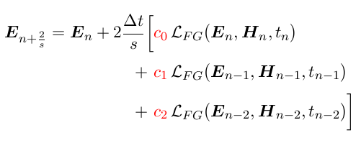
Local Time Stepping (LTS)
Algorithm
Field coefficients of fine-coarse elements restored at time t_{n}
Time integration with respect to the fine-coarse elements by a time step 2⋅Δt/s
Example: Discretized Ampere‘s Law on fine-coarse elements
interface
partial time integration
s – macro micro step ratio

Slide 17
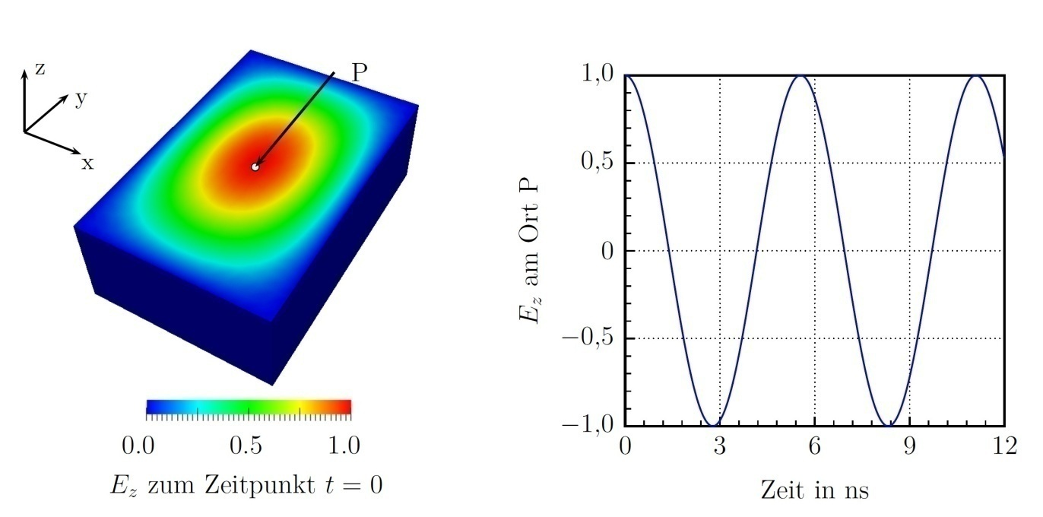
Example: Lossless Rectangular Resonant Cavity
Simulation model
Helmholtz equation for this geometry can be solved analytically
Size: 1m x 1,5m x 0,5m --- material: ε₀, μ₀
Fundamental mode:
Ez located in P
E_{z} at time t = 0
time in ns

Slide 18
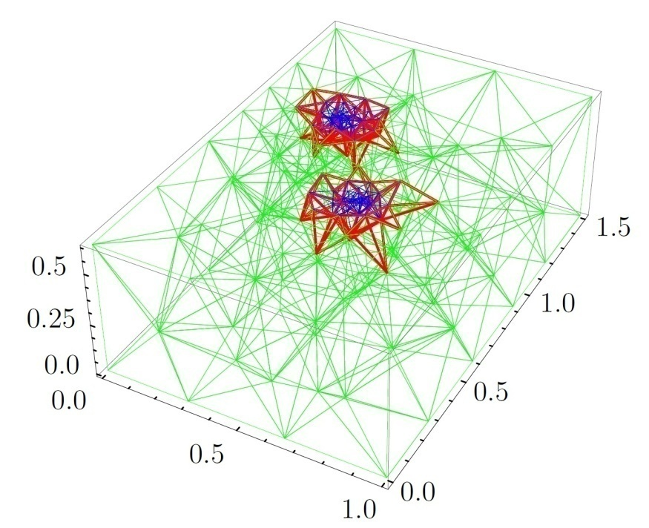

Example: Lossless Rectangular Resonant Cavity
Time required for the integration procedures
Four grids with different optimal macro micro step ratios s:
  Grid A: s = 2 Grid B: s = 4 Grid C: s = 8 Grid D: s = 16
coarse elements (C)
fine-coarse elements (FC)
fine elements (F)
Mesher: NETGEN

Slide 19
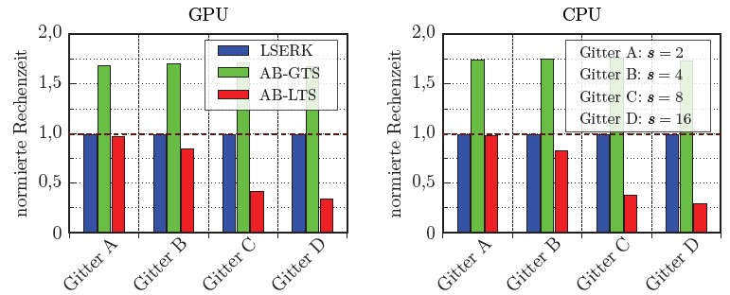
Example: Lossless Rectangular Resonant Cavity
Time required for the integration procedures
Four grids with different optimal macro micro step ratios:
Compared: Runge-Kutta (LSERK), Adams-Bashforth global (AB-GTS) and local (AB-LTS)
calculation time (relatve)
calculation time (relatve)
Grid A: s = 2
Grid B: s = 4
Grid C: s = 8
Grid D: s = 16
Grid A
Grid B
Grid C
Grid D
Grid A
Grid B
Grid C
Grid D
Computation time: TAB-LTS ∼ 0.3 ⋅ TLSERK (s = 16) TAB-GTS ∼ 1.7 ⋅ TLSERK

Slide 20
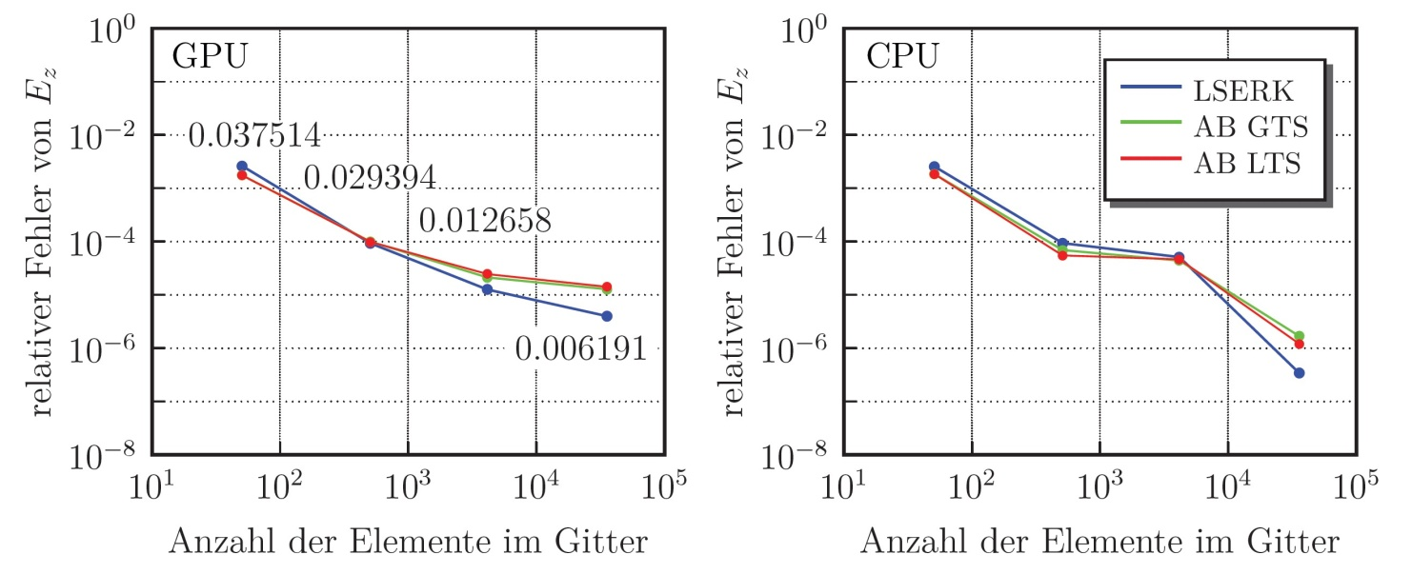
Example: Lossless Rectangular Resonant Cavity
Convergence
Consider: E_{z}-component of fundamental mode in P
Compared: Runge-Kutta (LSERK), Adams-Bashforth global (AB-GTS) and local (AB-LTS)
relative error of Ez
relative error of Ez
Error is averaged
over 10 periods
number of elements in grid
number of elements in grid
Minimum of relative error ∼ 10⁻⁵ (GPU)

Slide 21
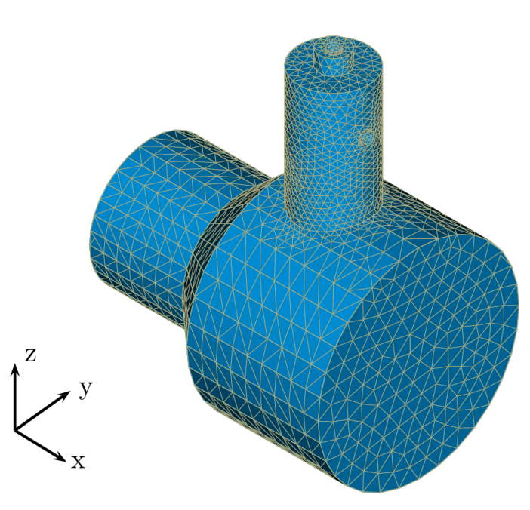
Example: Higher-Order-Mode Coupler (HOM-Coupler)
Simulation model
Design: tapered beam pipe with Higher-Order-Mode Coupler
Coupling antenna provides damping of beam-induced fields in cavities of particle accelerator
Coax port
HOM
Coupler
Port 1
Port 2
Construction by Carsten Potratz, Mesher: Salome

Slide 22
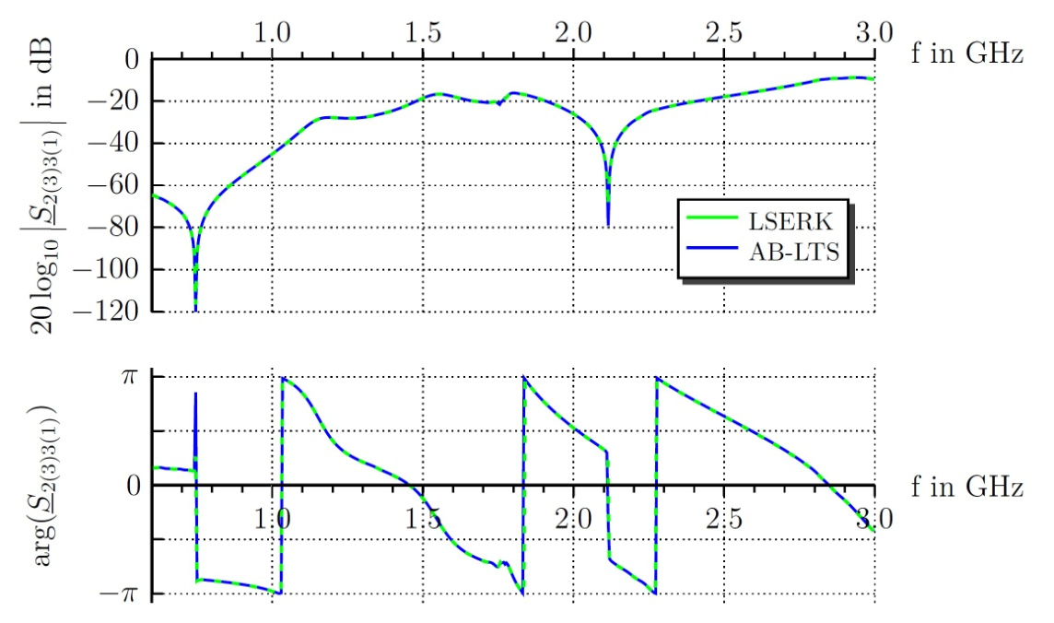
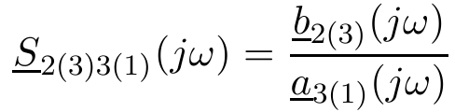
Example: Higher-Order-Mode Coupler (HOM-Coupler)
Scattering parameters (S-Parameter)
Design of HOM coupler is a typical application of numerical field computation in time domain
S-Parameters describe the transmission and reflection characteristics as a function of frequency
Example: S2(3)3(1) – Transmission of TEM-mode of the incident wave at port 3 to the TM₀₁-mode of the scattered wave at port 2

Slide 23
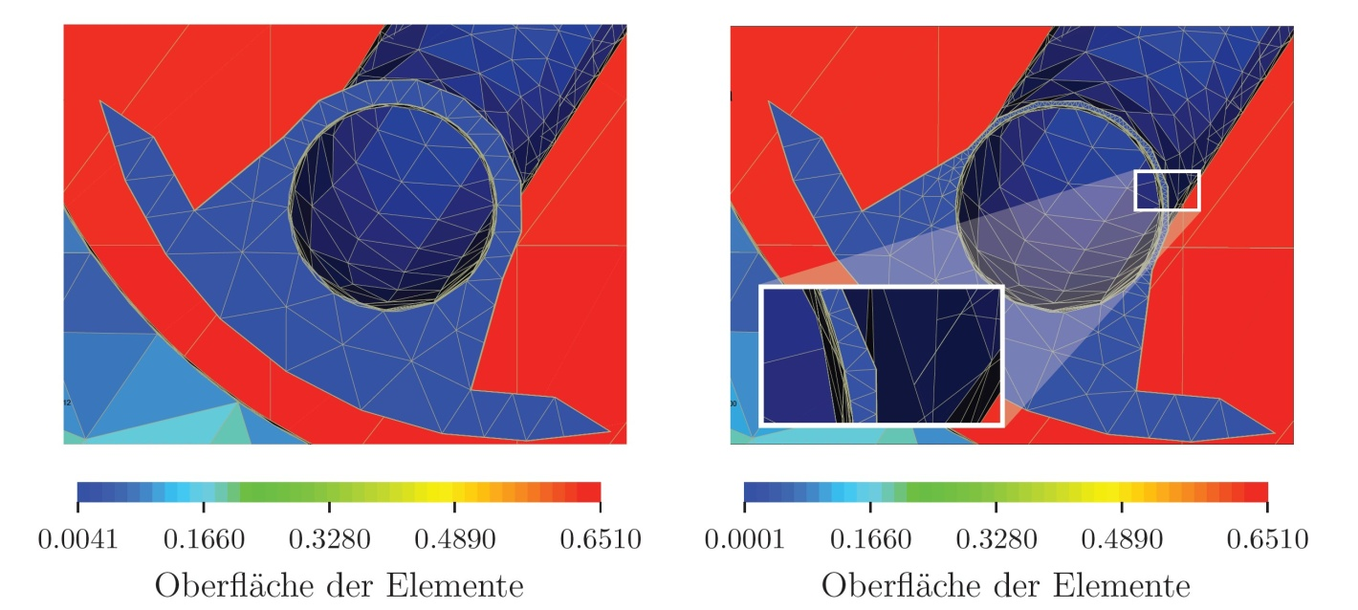
Example: Higher-Order-Mode Coupler (HOM-Coupler)
Comparison of Runge-Kutta and local Adams-Bashforth procedures
Two geometries with different macro micro step ratios s:
s = 4
s = 8
element surface
element surface
computation time:
TAB-LTS ∼ 0.71 ⋅ TLSERK
TAB-LTS ∼ 0.45 ⋅ TLSERK

Slide 24
Summary
Implementation of local Adams-Bashforth procedure on CPU and GPU
Example – rectangular cavity: Investigation of accuracy, convergence, computation time in comparison with other time integration schemes
  Relative error: ∼ 10⁻³ bis 10⁻⁵
  computation time: TAB-LTS ∼ 0,3 ⋅ TLSERK for a grid with s = 16
Practical application: Design of Higher-Order-Mode coupler
  Reduction of computation time by 30% or 55% according to Runge-Kutta
Certainly the local time stepping scheme is only suitable for discretized geometries with high aspect-ratio (Δx_{max}/Δx_{min})
Δx – characteristic element size

