Slide 1
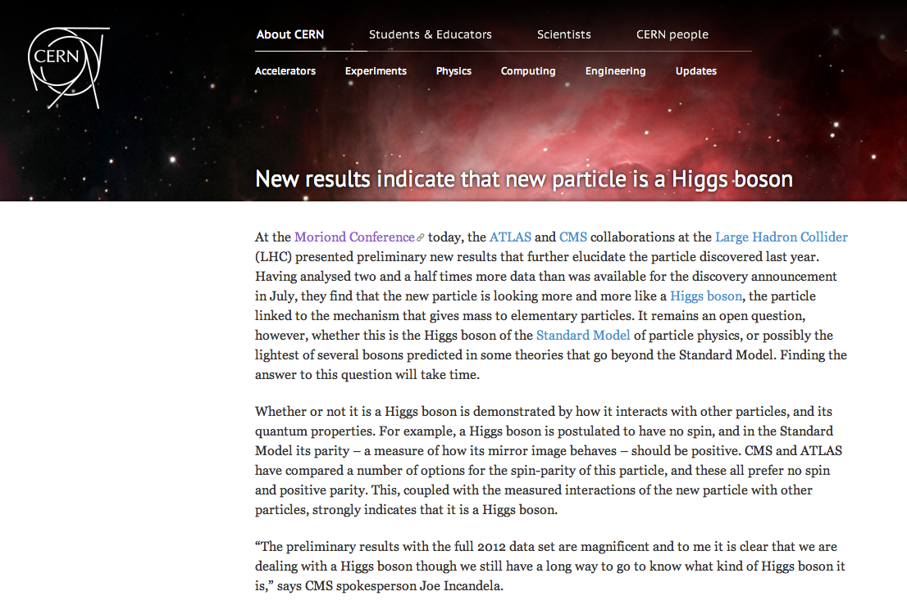
14/03/2012

Slide 2
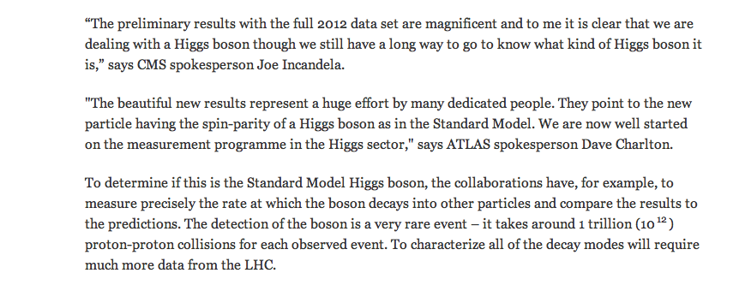

Slide 4
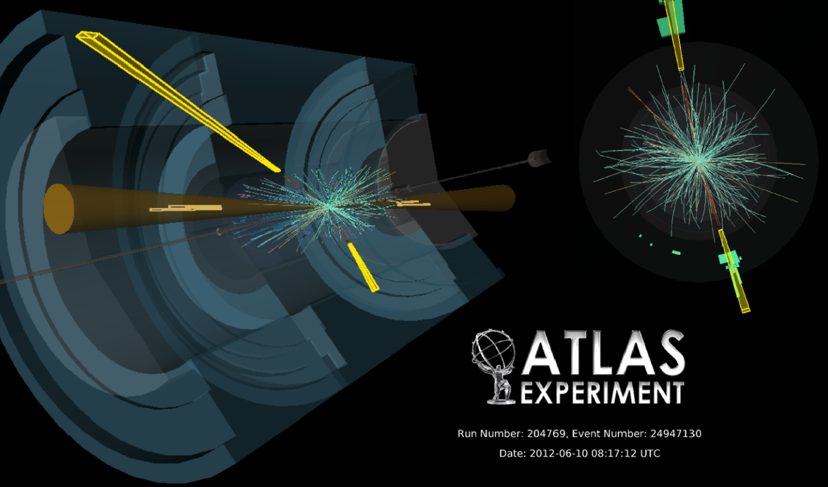
H → γγ Update
Since “Discovery Paper” PLB 716
ATLAS-CONF-2013-012
γγ channel basic facts sheet :
Signal (SM_{126 GeV}) | Signal purity s/b | Main backgrounds | Production | 7 & 8 TeV
~450 | 2% - 20% | γγ,γj and jj | Hgg, VBF, VH | 4.9 & 20.7 fb⁻¹

Slide 5
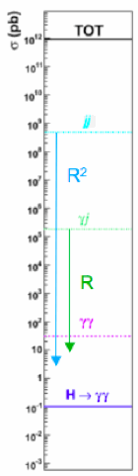
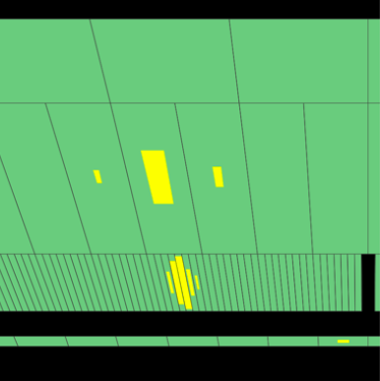
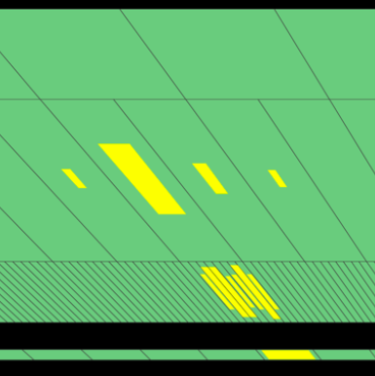
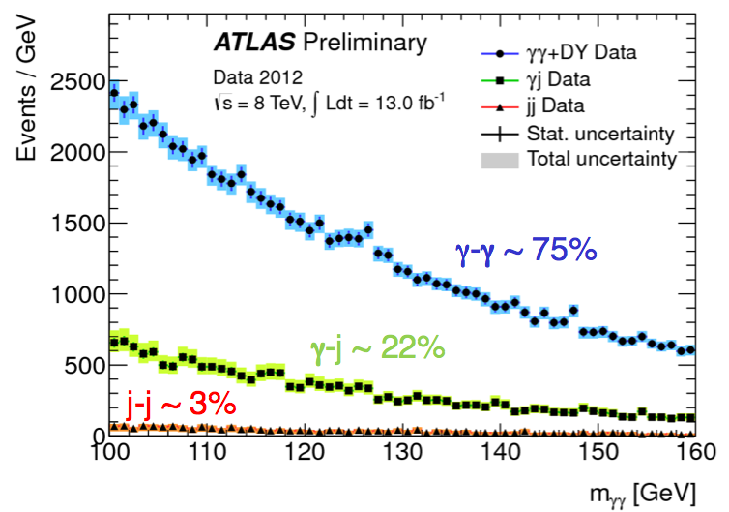
Key features :
    Background rejection…
    Invariant mass resolution
    (PV reconstruction important: IP spread of 5.6 cm, assuming (0,0,0) adds ~1.4 GeV in mass resolution)
Benefiting from the highly granular EM calorimeter :
jet rejection ~ 8000
γ
π⁰
~ 500 μb
~ 200 nb
~ 30 pb
~ 65% irreducible γγ
~ 25% γ-jet, di-jet
(Not used in the final result)
m_{γγ}
~ 45 fb

Slide 6

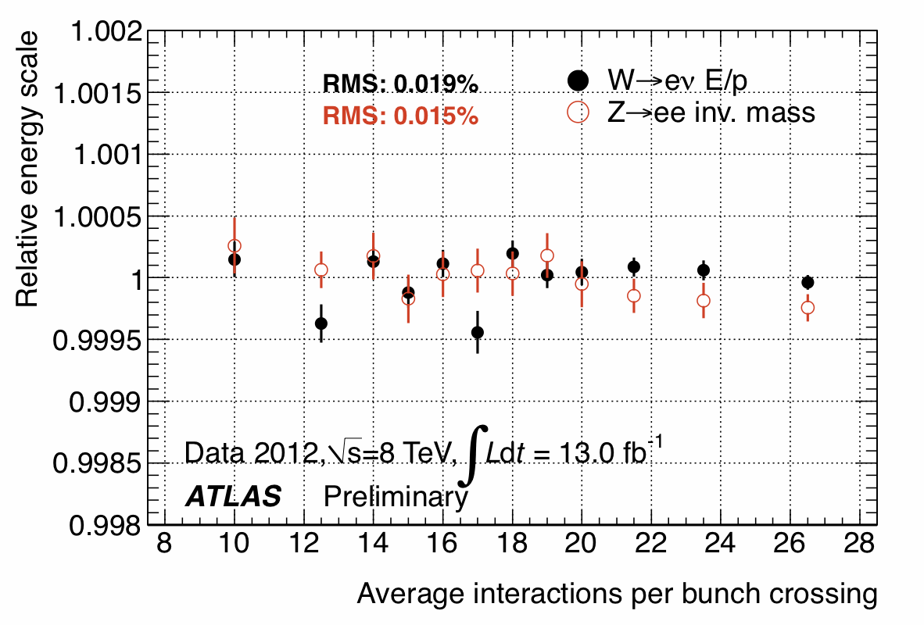
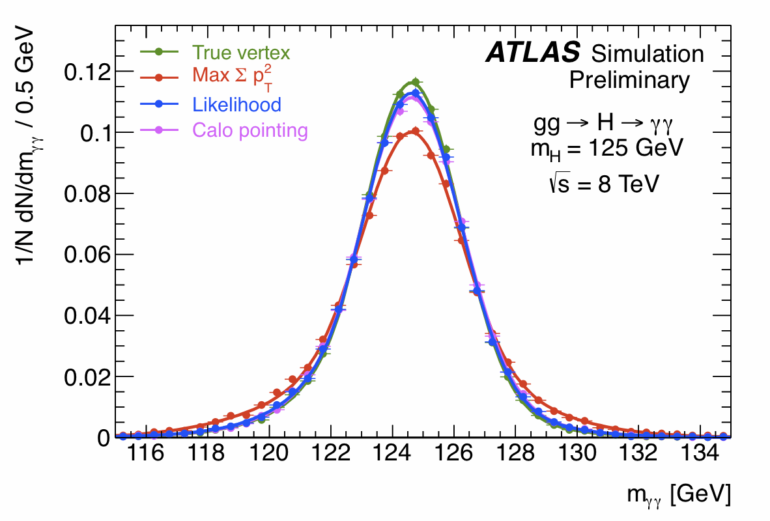
The mass (m_{γγ}) estimation :
- Requires a precise photon energy scale : from Z → e⁺e⁻ data and extrapolation e → γ
require excellent material budget knowledge
(+ control from radiative decays Z → e⁺e⁻γ,
limited by statistics and to low energy)
Also very good stability w.r.t.
Number of interactions / bunch crossing
- accurate direction :
pile-up ! ~ 20 soft interactions overlaid and longitudinal beam spot size ~ 45 mm
have to choose the right interaction point (PV)…
calorimeter pointing (longitudinal segmentation) +
photon conversion (if any) + recoiling tracks
If no measured PV, would add ~ 1.3 GeV/c²
to the mass resolution
instead : negligible contribution from direction
to mass resolution
driven by energy resolution
(sampling term ~ 10%/√E +
constant term ~ 1% not at design yet)

Slide 7
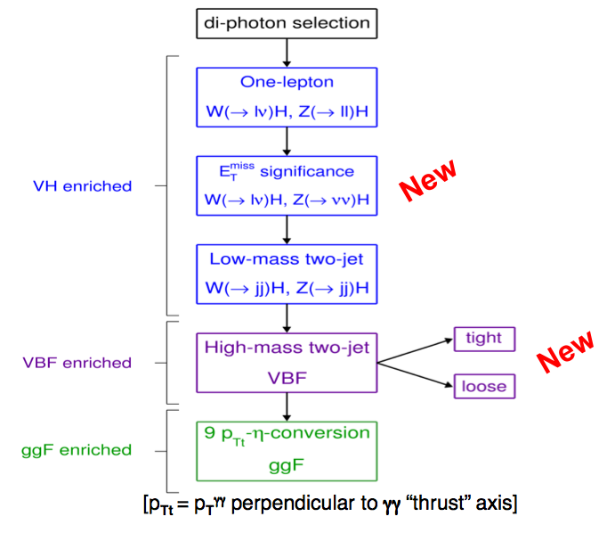
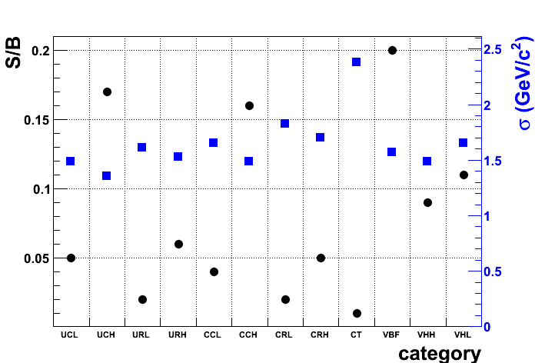
Improving inclusive search with categorisation
Events with rather different purity are mixed together
⇒ sorting them in different categories can increase the sensitivity
- 9 (central/forward and converted/not converted photons, p_{Tt} (γγ)) Council 2011
- 10 (tagging jets disentangling VBF) ICHEP 2012
- 12 (low mass di-jet, lepton, disentangling VH) Council 2012
- 14 (+MET and 2 2-jet VBF categories MVA) Moriond 2013 New!
High p_{T} and di-jet tag : are at higher S/B
New!
New!

Slide 8
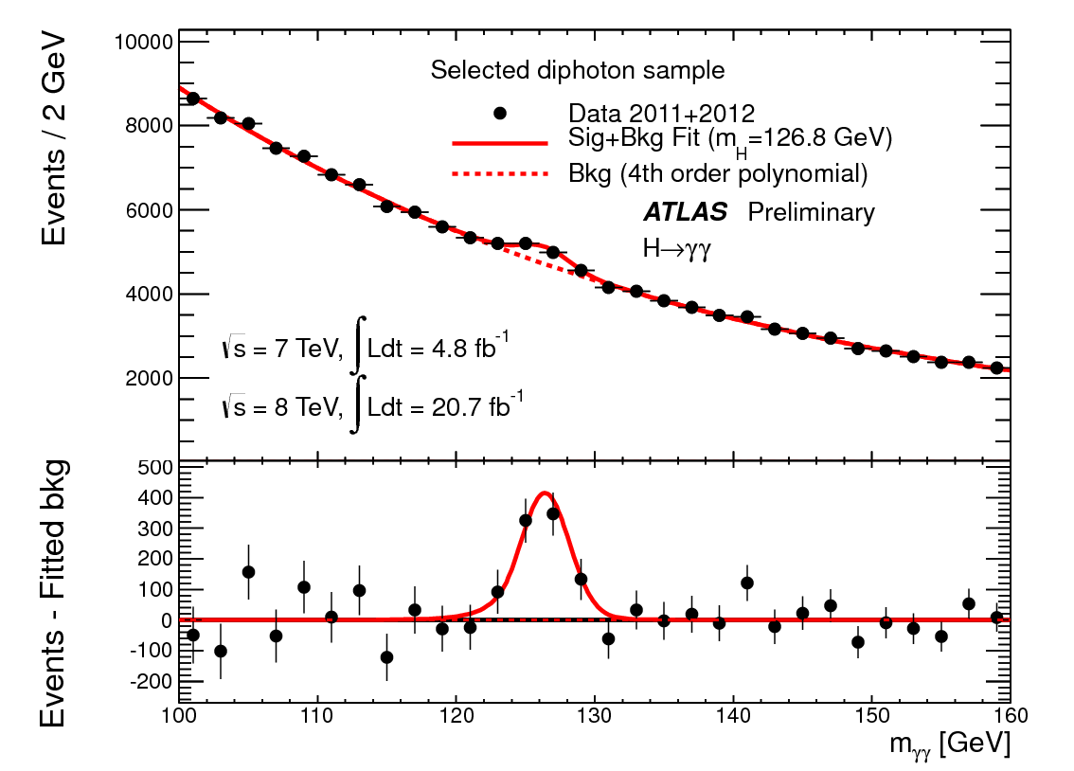
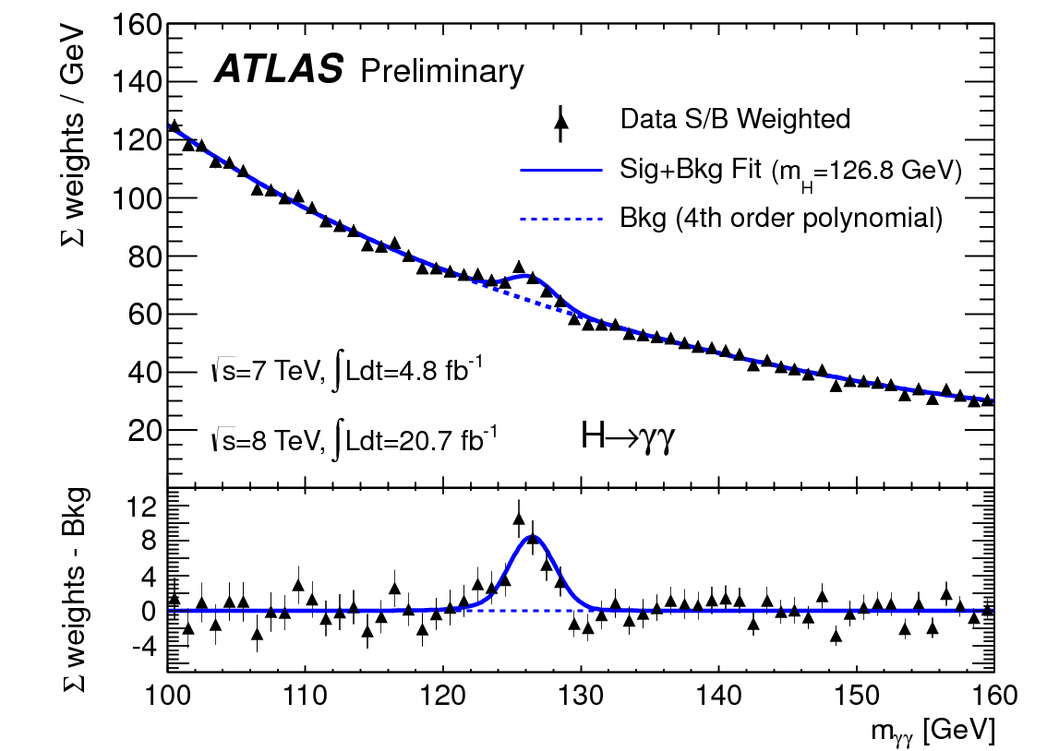
Illustration of the Impact of Categories
Unweighted
Weighted
Clearly visible signal

Slide 9
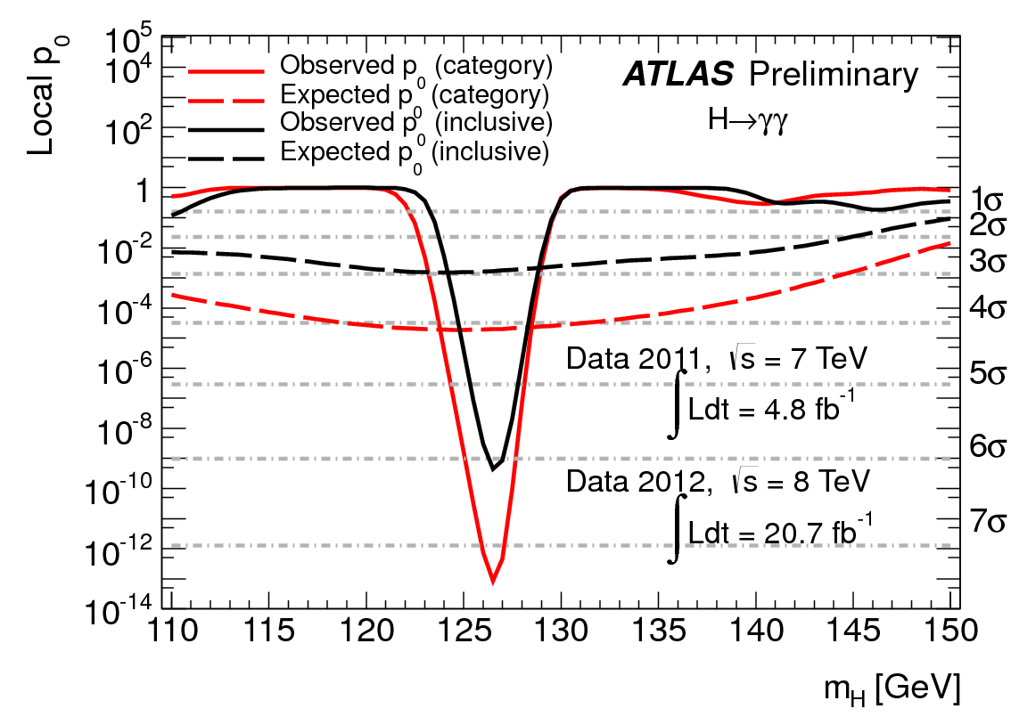
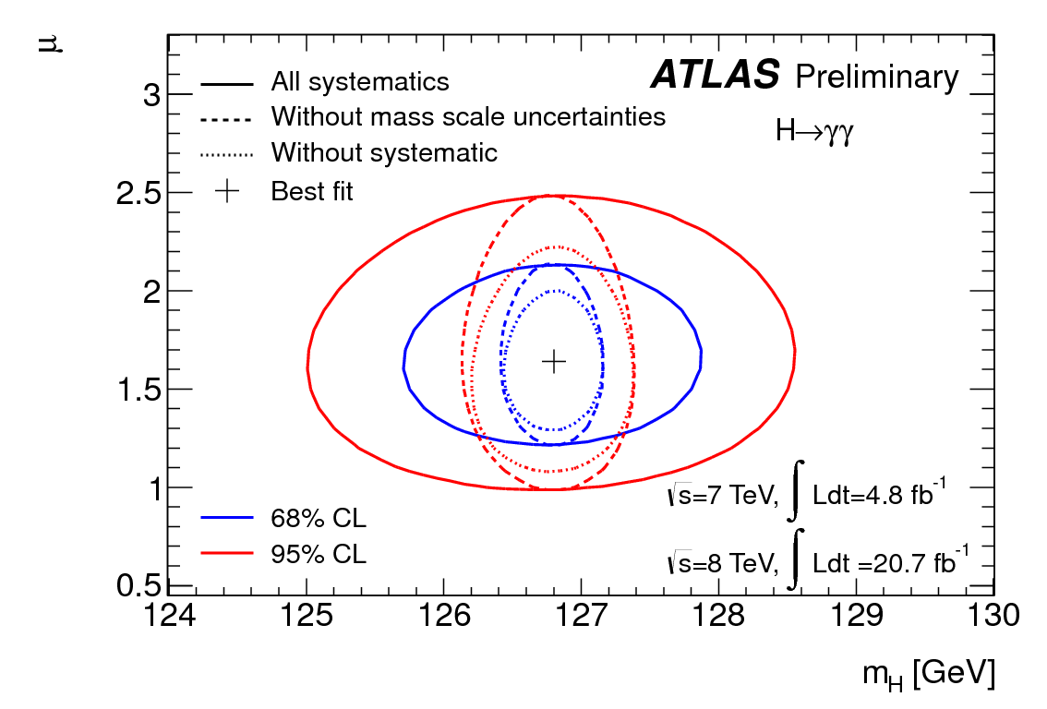

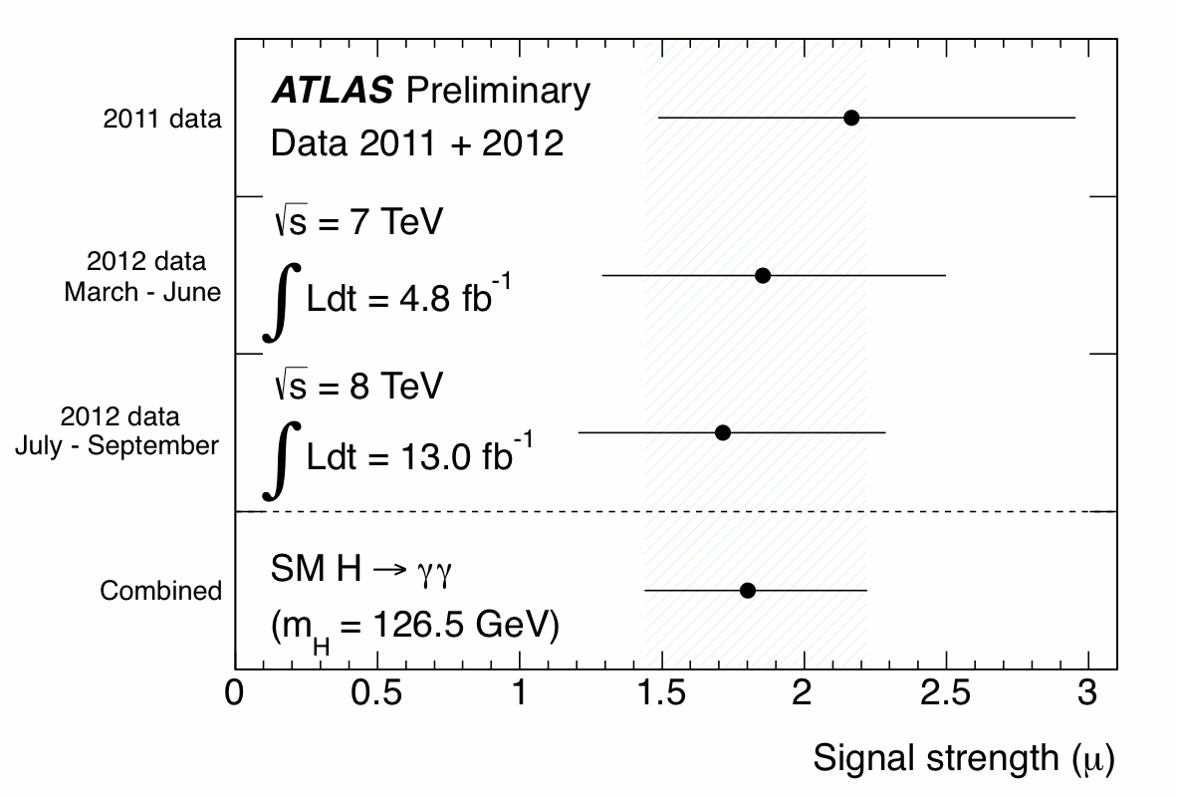

~ 7.2σ local significance (4.1σ expected) at m_{H} = 126.5 GeV/c² ⇒ standalone discovery !
@ 126.6 GeV/c²
Council 2012
Best fit value of μ ~ 2.4σ above the SM hypothesis,
a feature ~ constant in time

Slide 10
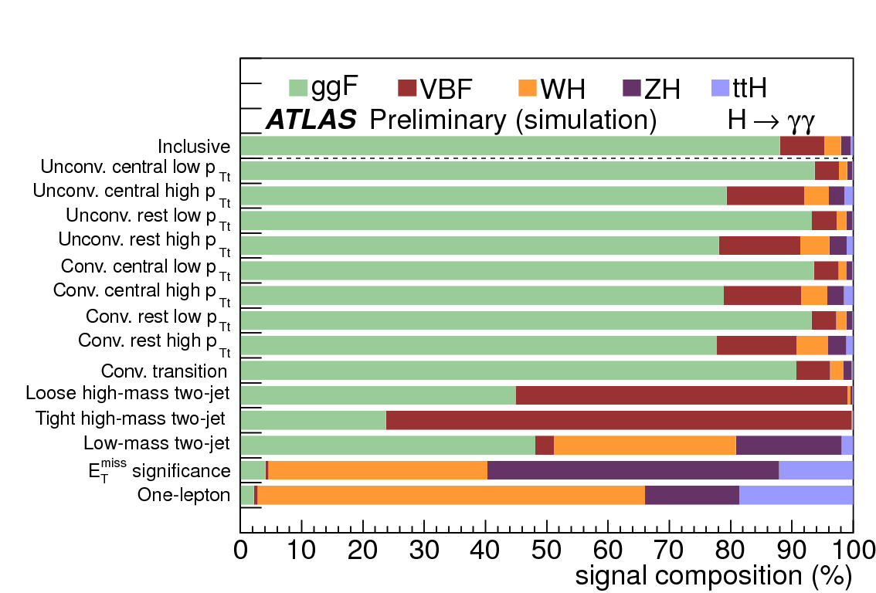
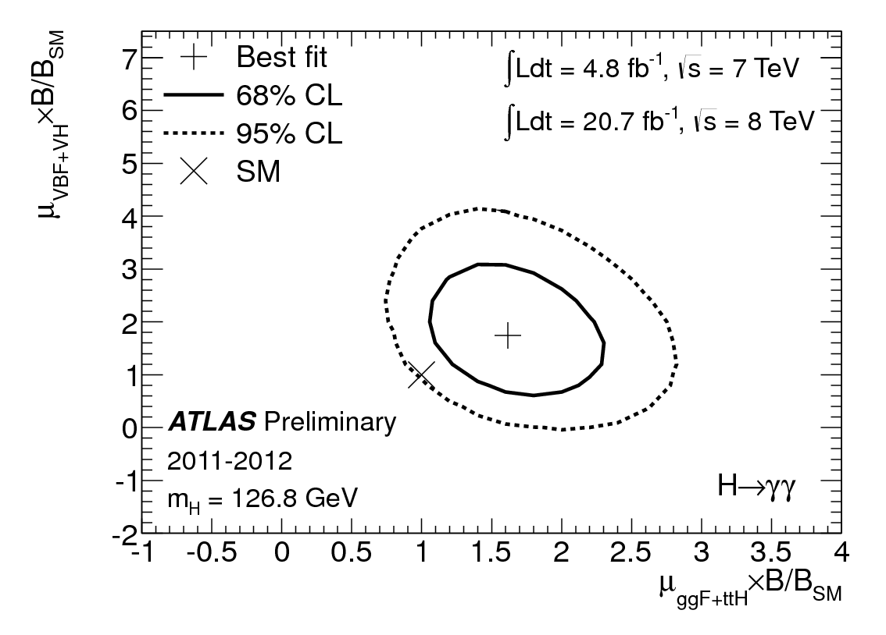
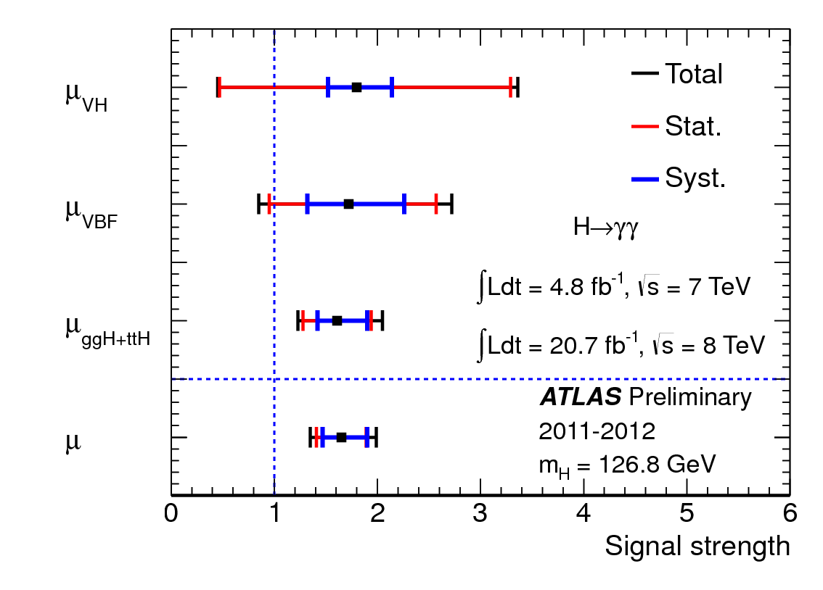
Impact of Categories
Fitting VBF+VH and ggH+ttH

Slide 11
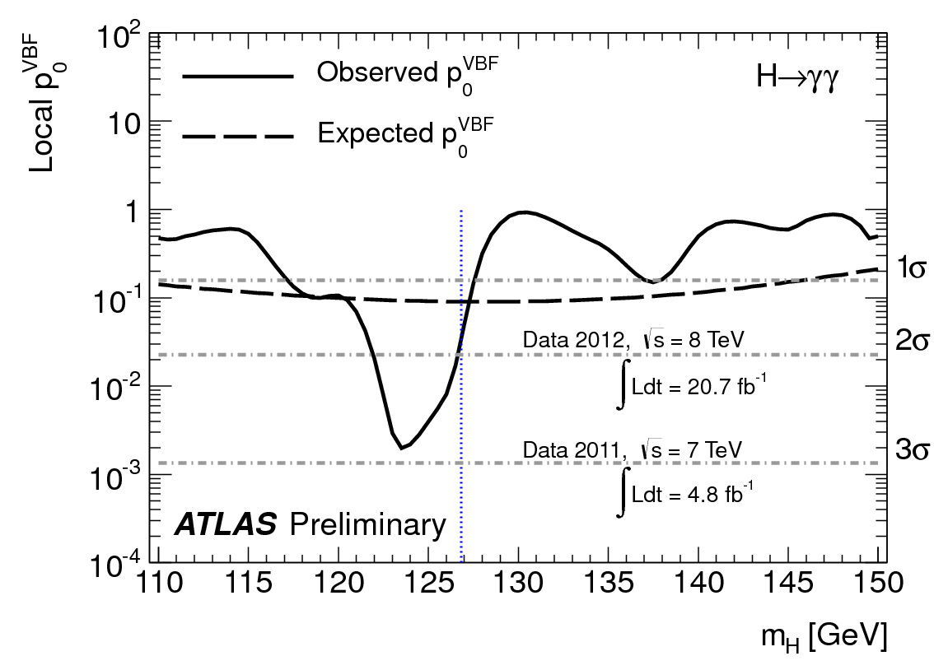
Impact of Categories
Fitting VBF alone

Slide 12
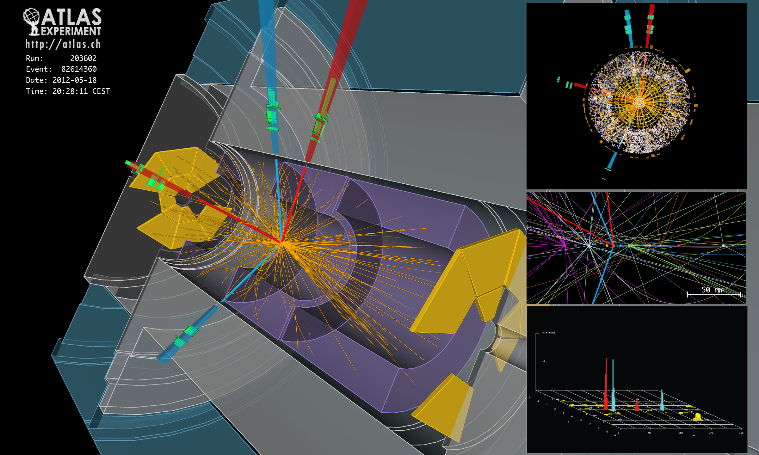
H → 4e candidate (m_{4e} ~ 124 GeV)
4l channel basic facts sheet :
Signal | Signal Purity s/b | Main backgrounds | Production | 7 & 8 TeV
~16 | ~1.5 | ZZ, Z+jets, top | ggH, VBF & VH | 4.9 & 20.7 fb⁻¹

Slide 13
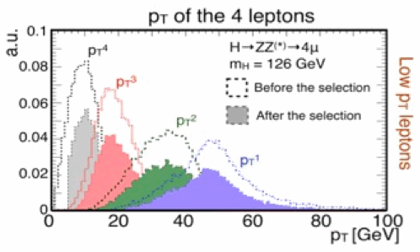
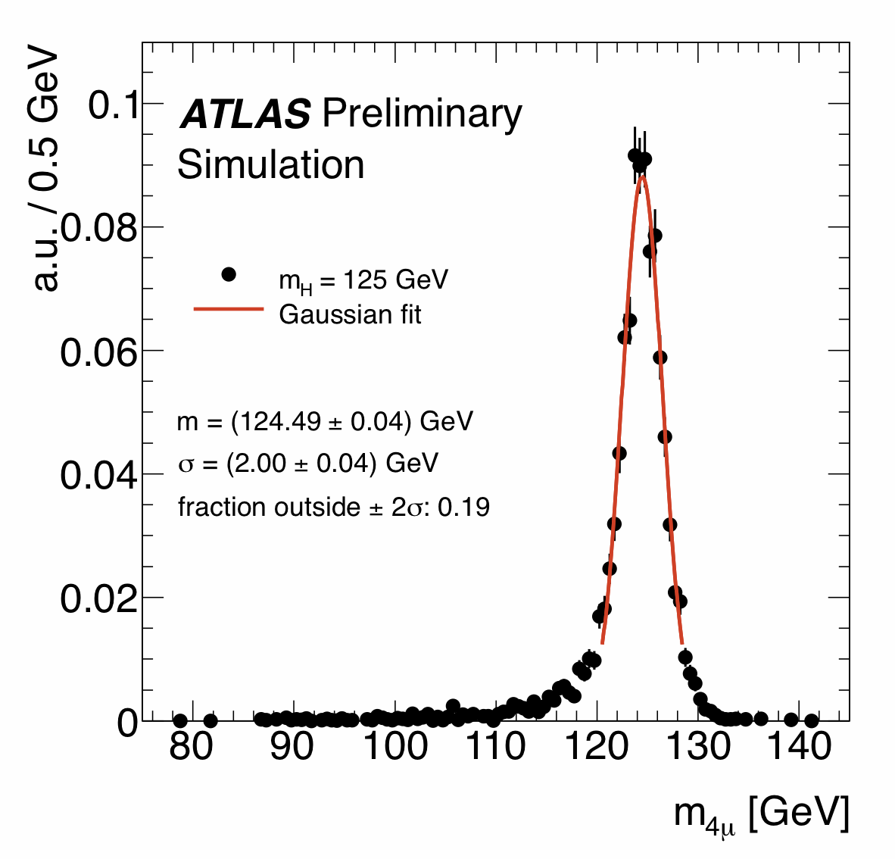
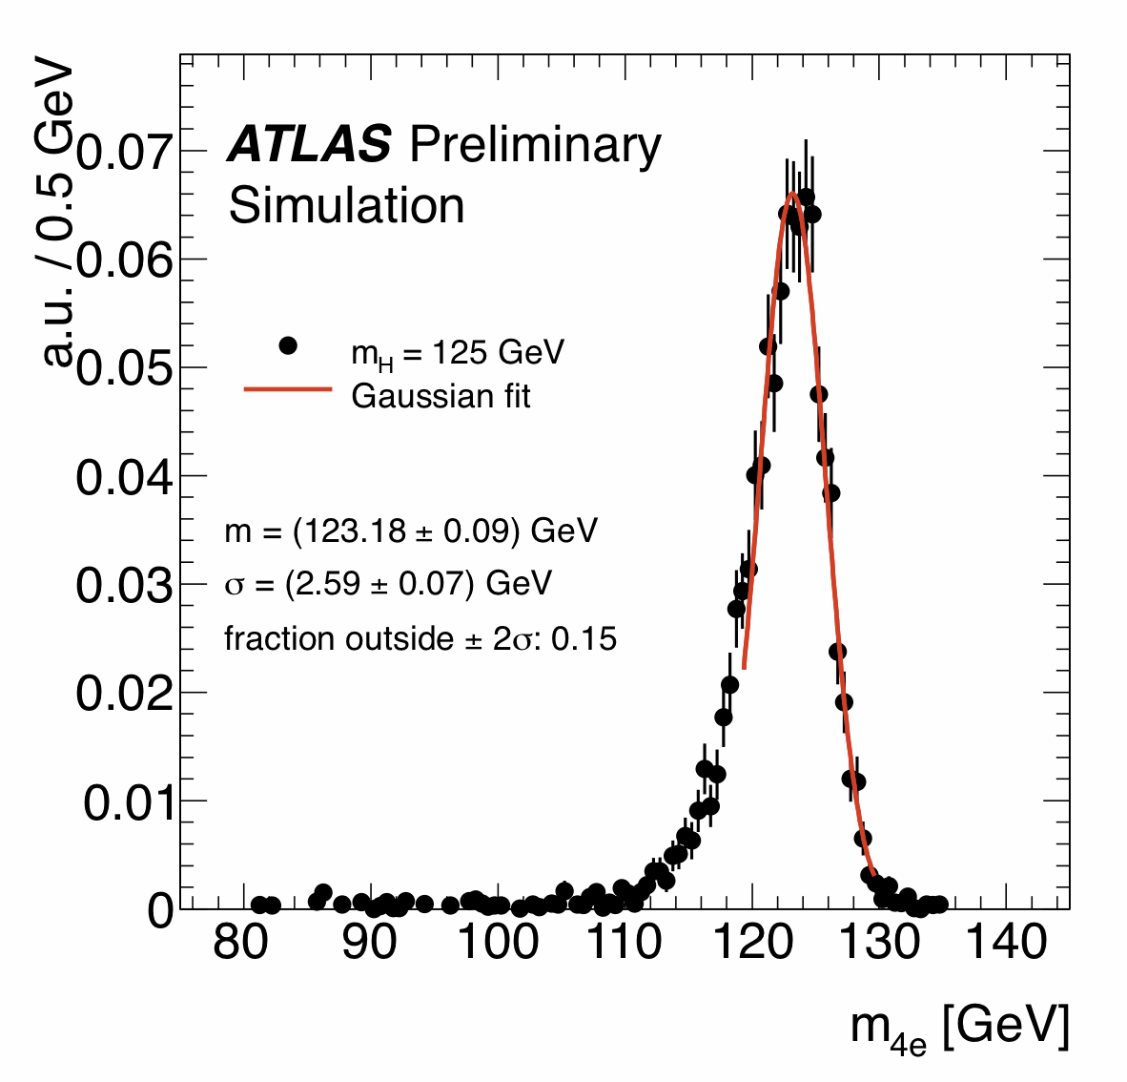
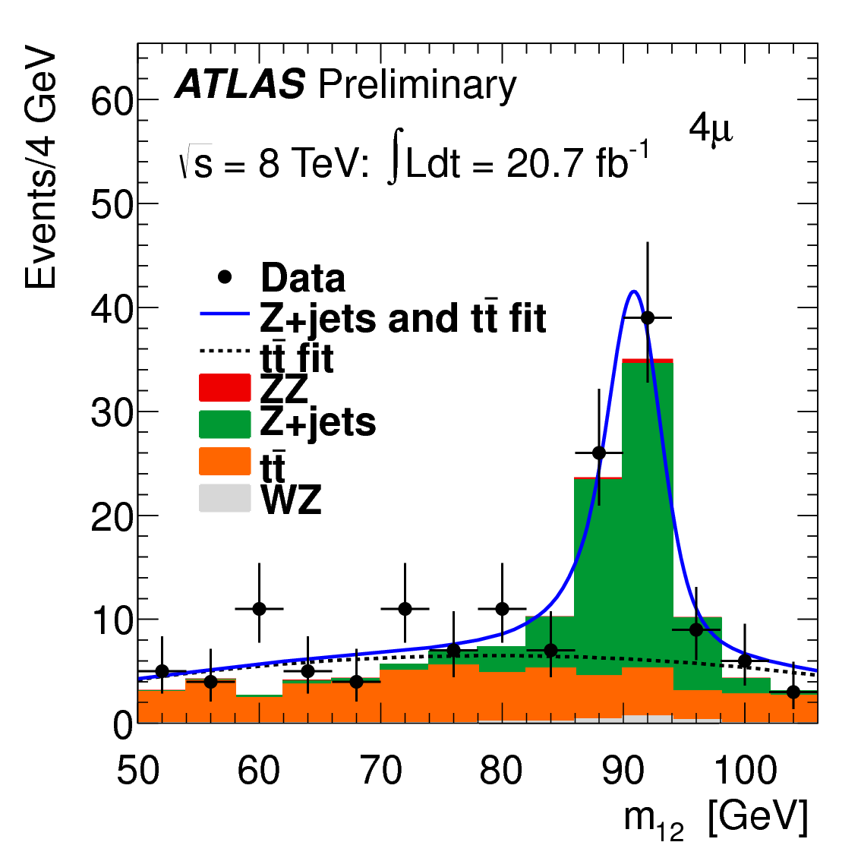
Key features :
Small yield : < 1 evt / fb⁻¹ but small bkg
Excellent mass resolution (tracking+calo)
Low p_{T} lepton identification
New pairing
FSR reconstruction
Mass constraint (re-) applied
New Categories VBF (loose cuts) and VH (5-leptons)
Reducible bkg from b/c → l reduced using isolation (sensitive to pile up) + impact parameter
Data driven simultaneous estimation of tt and Z+jets determination in ll +μ⁺μ⁻
Control region
(w/o isolation, reversing IP)
Scaling factor applied on MC
σ_{4μ} ~ 2.0 GeV
σ_{4e} ~ 2.7 GeV
… Then extrapolated
to signal region

Slide 14
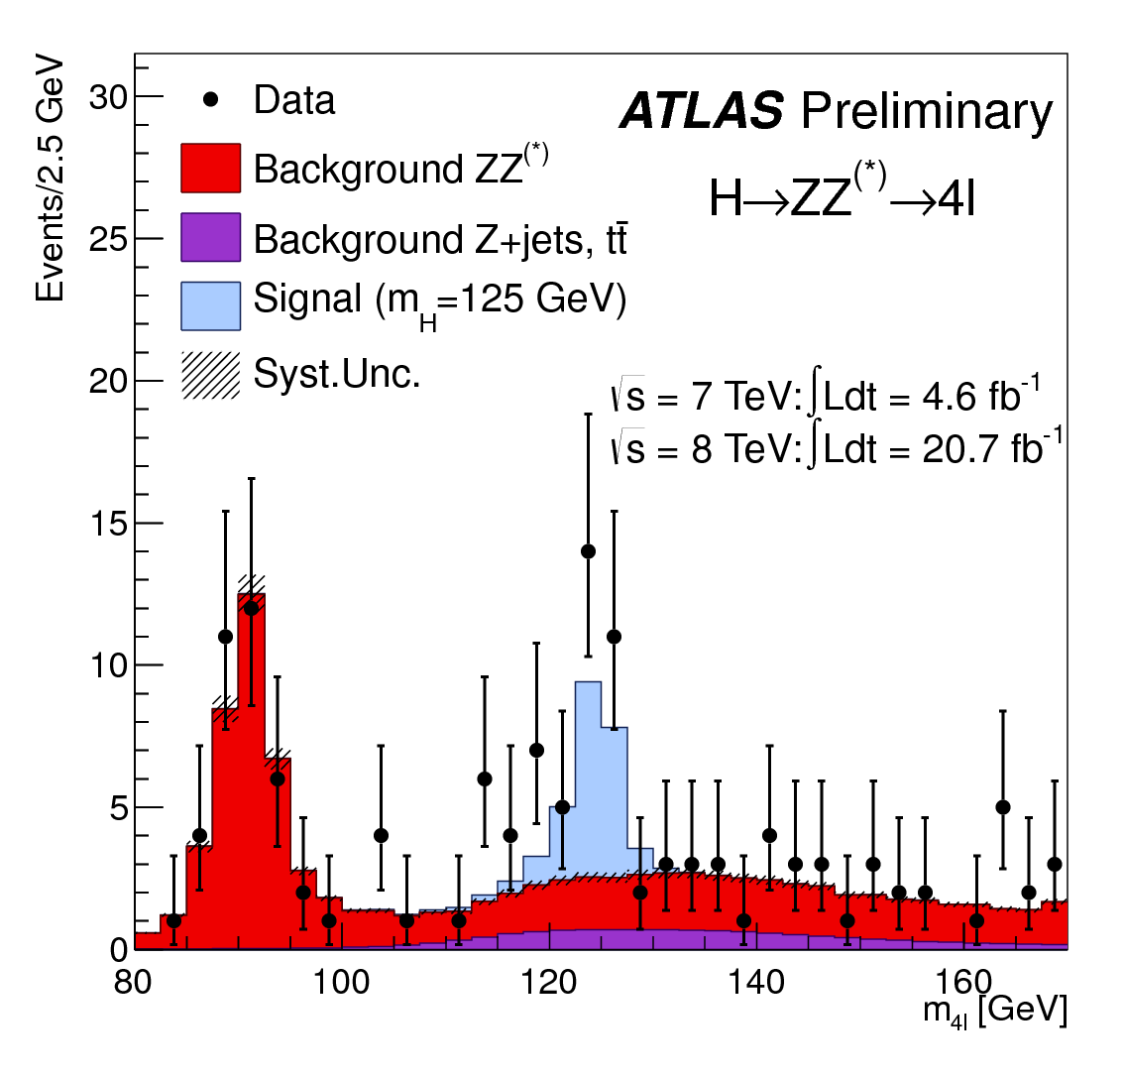
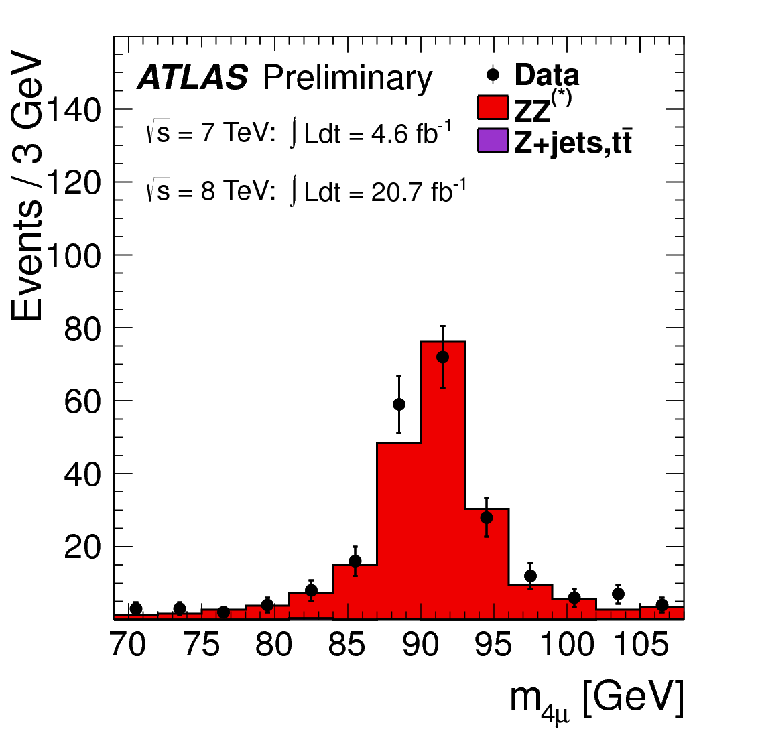
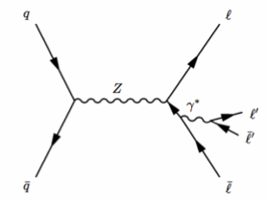
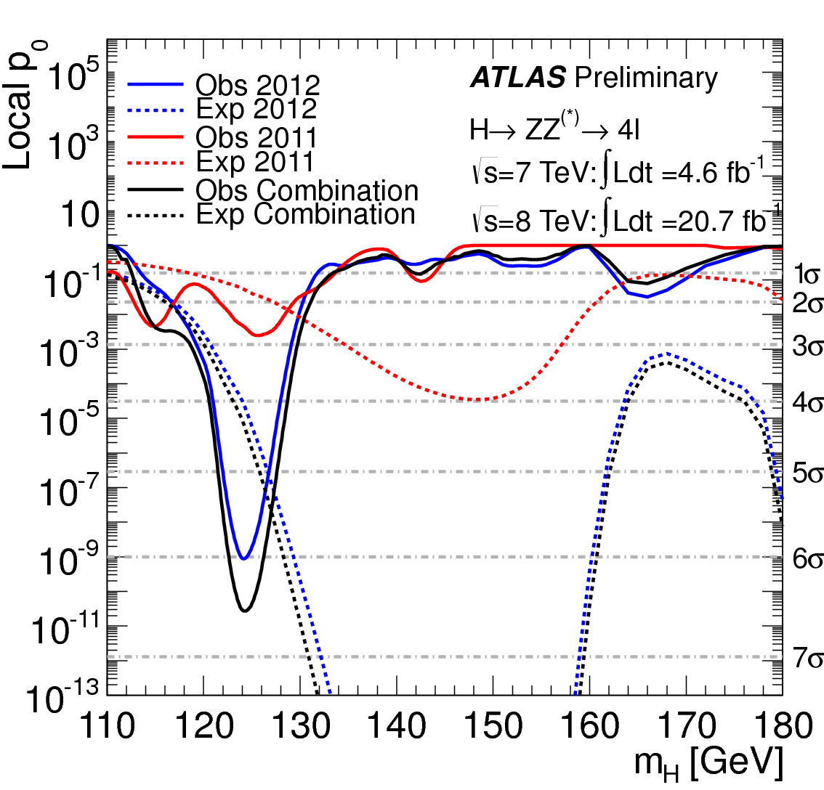
Control of the single resonant process :
In the signal region 125 ± 5 GeV
Observed 32 events
Expected from bkg only 11 ± 0.3
Expected from SM Higgs 16 ± 1.3
Observed local significance:
Expected local significance:

Slide 15
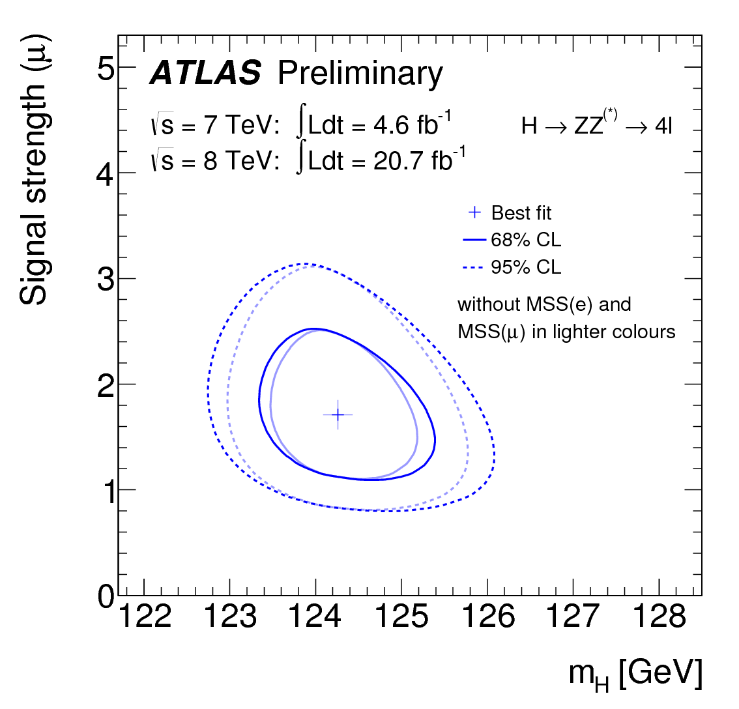
H → 4l Mass and Signal Strength Measurements
H → 4l Update
ATLAS-CONF-2013-013
Measurement of signal strength
@ 124.3 GeV
@ 125.5 GeV
H → 4e candidate (m_{4l} = 131 GeV)

Slide 16
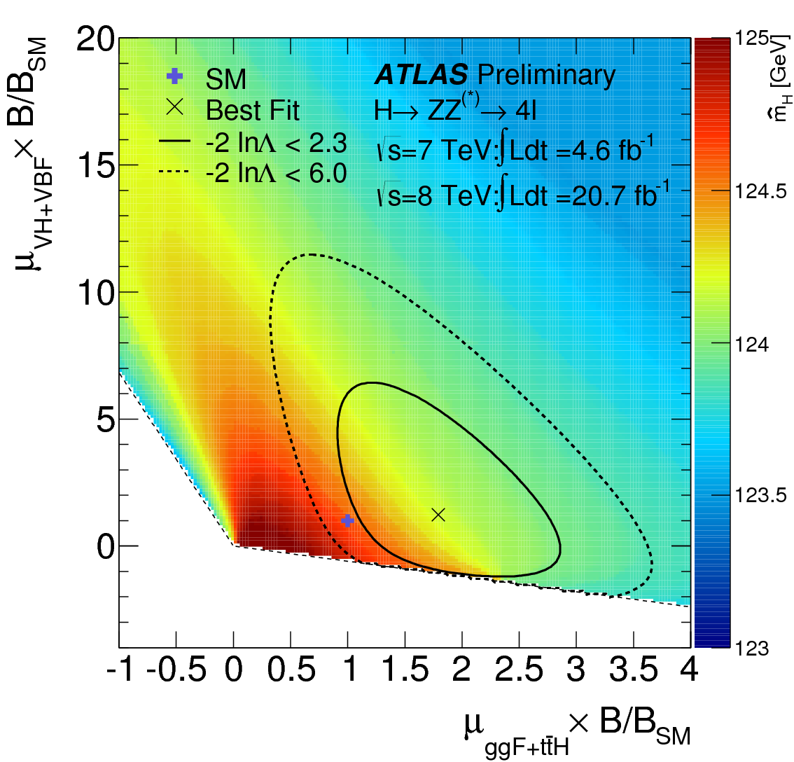
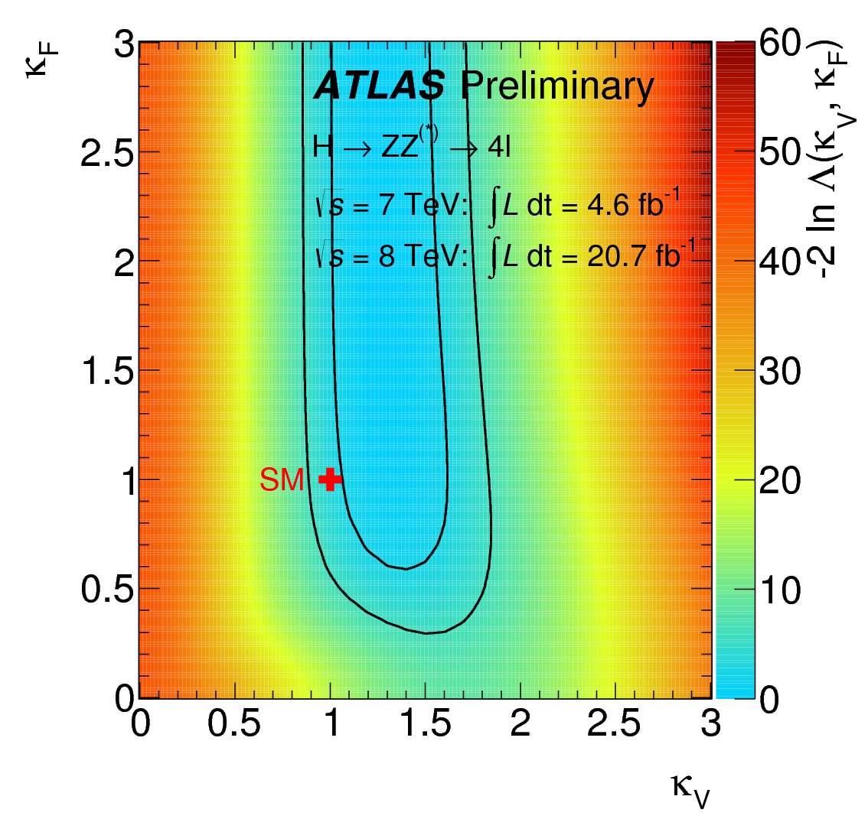
H → 4l Update
H → 4l Categories and Couplings

Slide 17
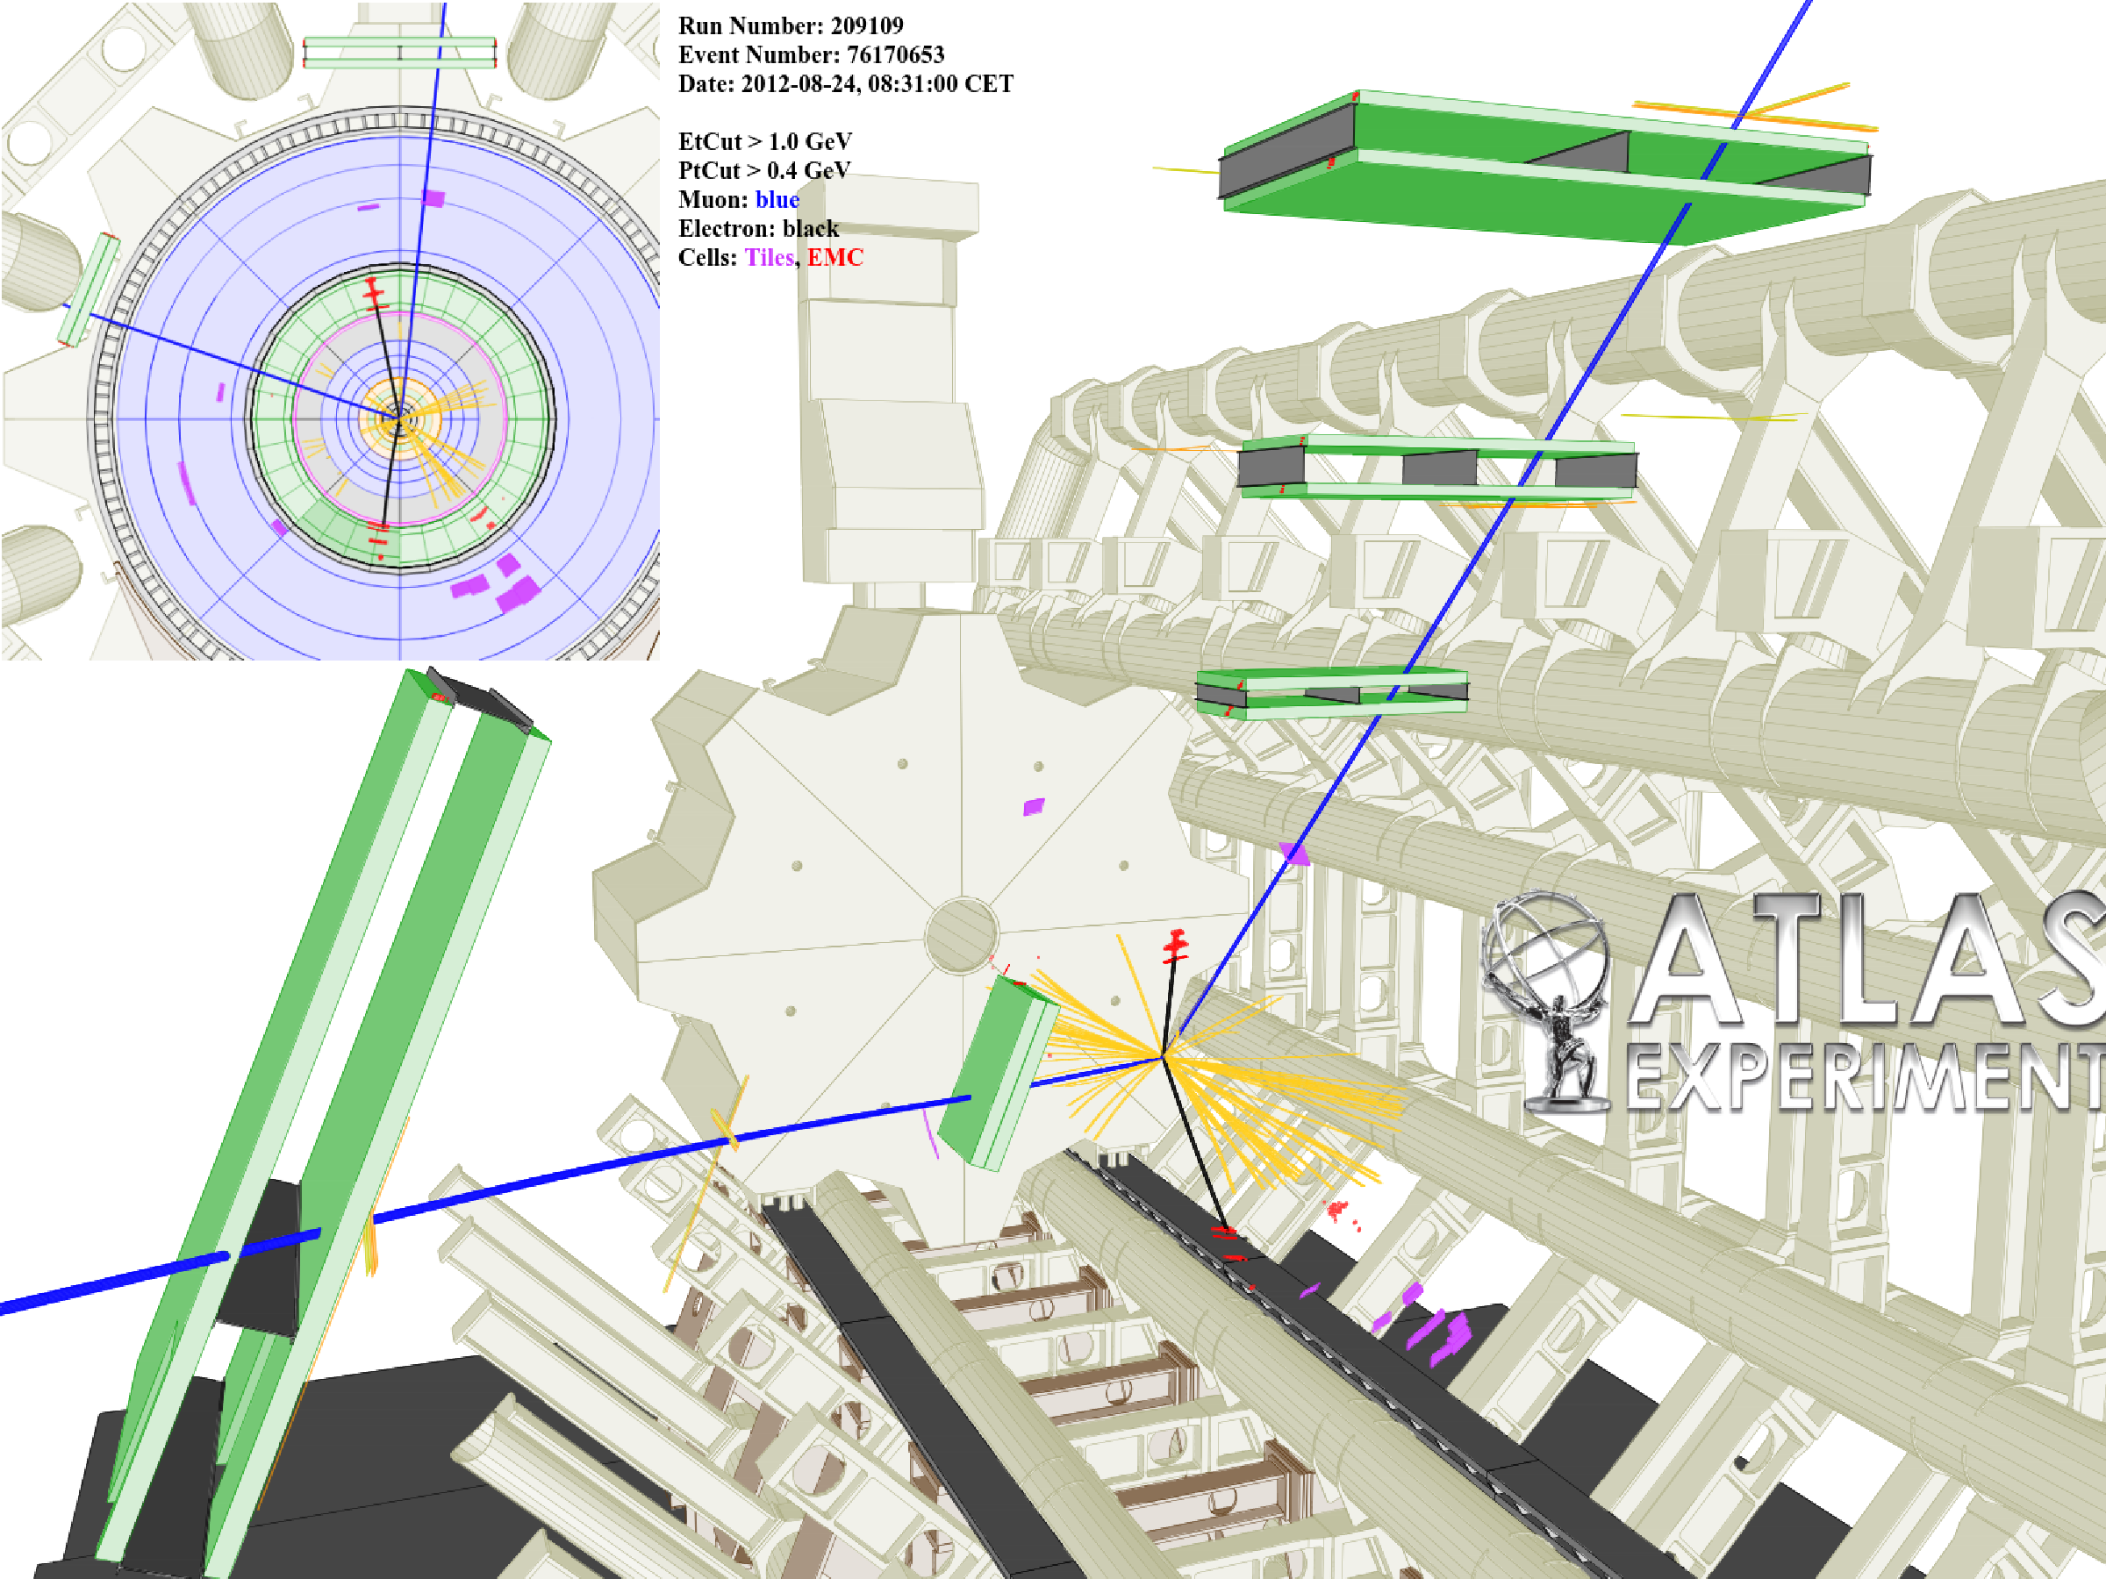
H → 4l Single Highest Purity Candidate Event (2e2μ)
H → 4l Update

Slide 18
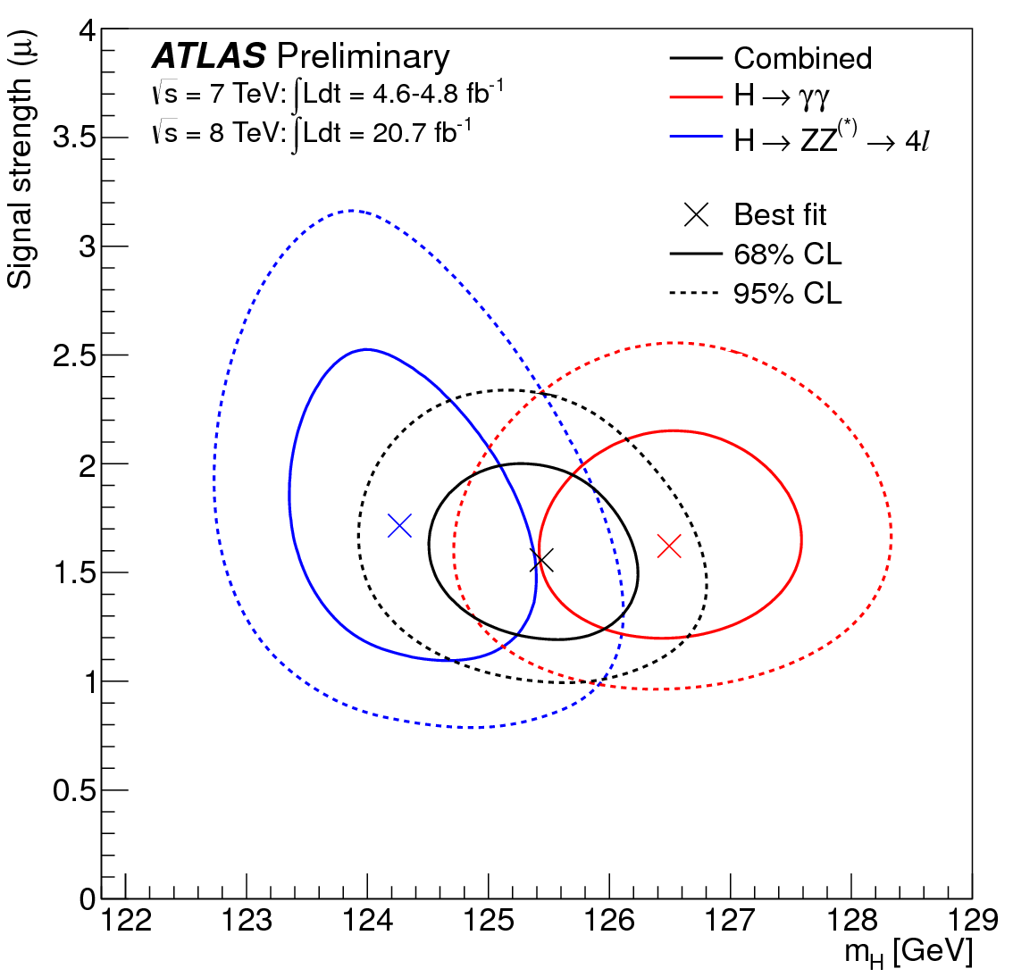
H → 4l Update
ATLAS-CONF-2013-014
H → γγ and H → 4l Combination
Best fit signal strength
Combined Mass Measurement :
Taking mass scale systematic uncertainties and their correlations into account the compatibility of the two measurements is estimated to be at the 2.4σ level
(2.7σ previously)
H → 4e candidate (m_{4l} = 131 GeV)
An alternative treatment of systematic uncertainties yields a compatibility at the level of 8%

Slide 19
H → γγ and H → 4l Mass Scale Systematic Uncertainties
Main Mass Scale systematic uncertainties (considered in also ICHEP studies) :
Further investigation and extensive checks lead to find additional sources of systematic uncertainties :
- LAr Strips relative calibration (0.2%)
- Photon energy resolution (0.15%)
- Calibration of the high gain (0.15%)
- Mis-classification due to fake conversions (0.13%)
- Backgound modeling (0.1%)
- Lateral shower development simulation (0.1%)
- Effect of PV choice (0.03%)
Main 4l Mass Scale systematic uncertainties :
Further investigation and extensive checks have not lead to additional substantial sources of systematic uncertainty :
- Measurement with MS and ID alone
- Local detector biases checked event by event
- Local resolution effects checked using event- by-event error;
- kinematic distributions in agreement with expectation
- FSR simulation
- Different mass reconstruction using Z-mass constraint (+400 MeV shift)
Source | Relative Mass Scale Effect
Absolute Energy scale calibration from Z | 0.3%
Upstream material simulation inaccuracies | 0.3%
Pre-Sampler energy scale | 0.1%
Source | Relative Mass Scale Effect
Absolute Energy scale calibration from Z | 0.4%
Low transverse energy electrons | 0.2%
Muon momentum scale | 0.2%

Slide 20
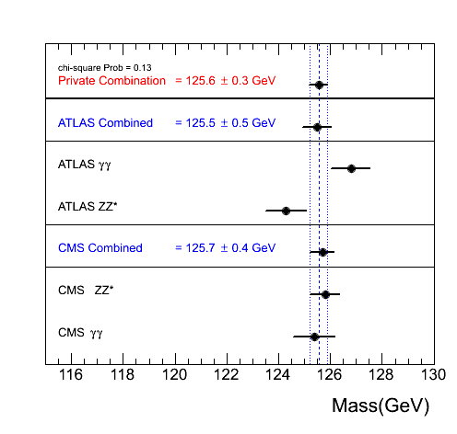
H → 4l Update
H → γγ and H → 4l Combination
Review of mass measurements across channels and experiments
Completely unofficial back of the post-stamp combination
H → 4e candidate (m_{4l} = 131 GeV)

Slide 21
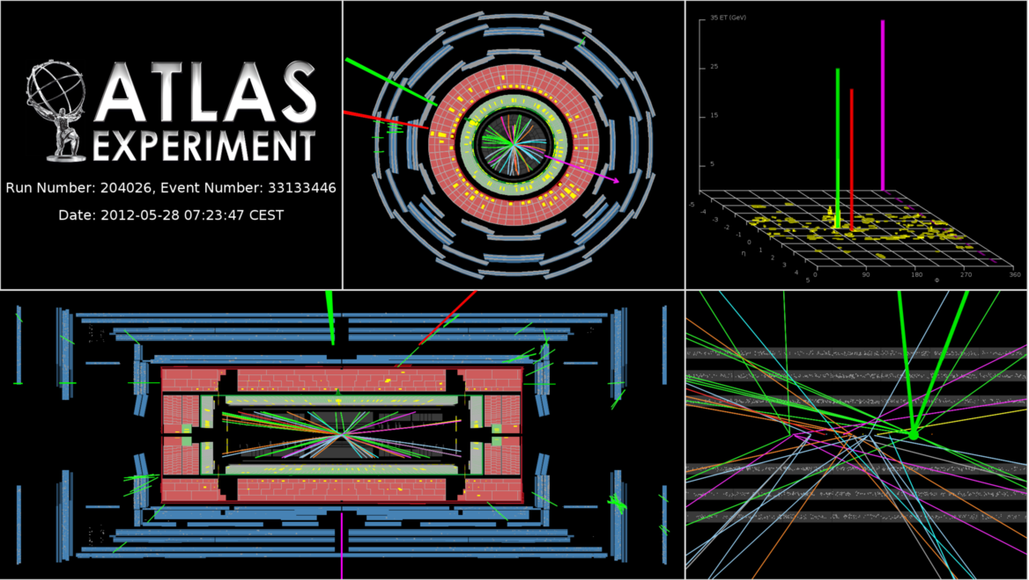
H → WW⁽*⁾
ll + 2ν
0,1, 2 jet Channel
ATLAS-CONF-2013-030
WW channel basic facts sheet :
Signal | Signal purity s/b | Main backgrounds | Production | 7 &8 TeV
~250 | ~5%-40% | WW, W+jets, top, etc… | ggH & VBF | 25fb⁻¹

Slide 22
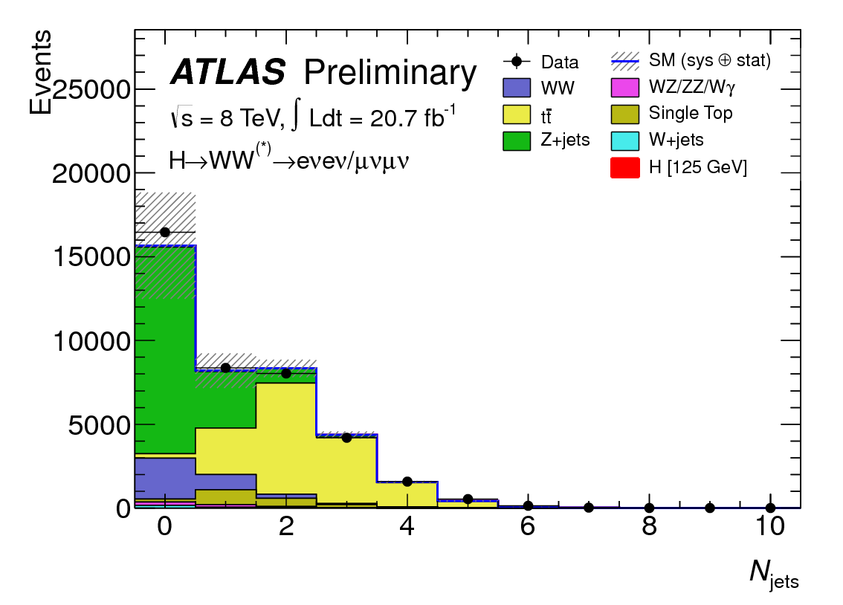
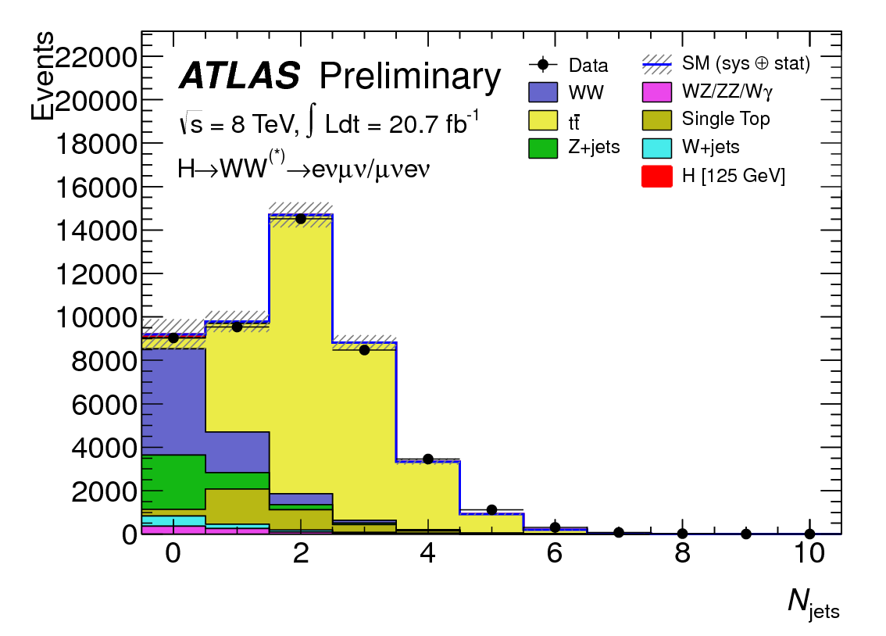
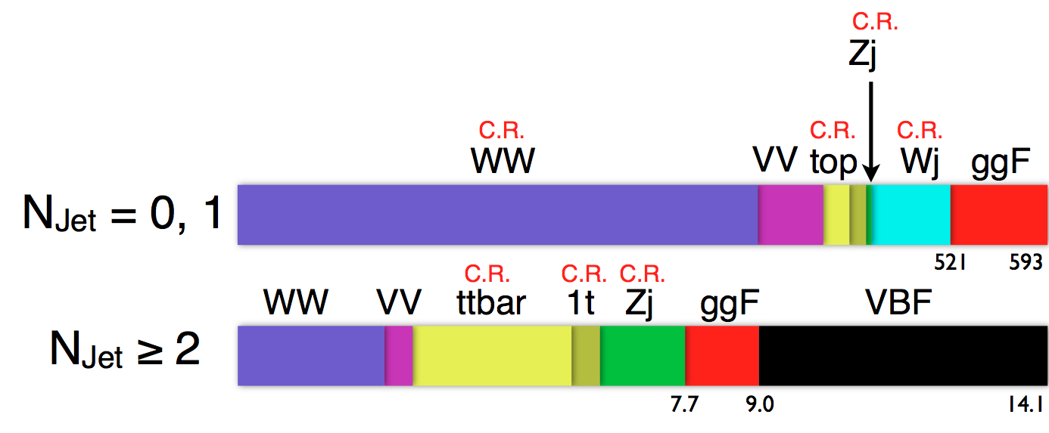
H → WW⁽*⁾ → lvlv
Complete 7 and 8 TeV re-analysis !
ATLAS-CONF-2013-030
Key features :
Sizable even yield and reasonable signal purity
Excellent MET (good simulation of irreducible backgrounds)
Estimate of backgrounds in control regions
Add 2-jet VBF category
Complete 2011 and 2012 Re-analysis
Added Same flavor
Reoptimization of control and signal regions
Main discrimination with: m_{ll}, Δf_{ll}, m_{T}
Main backgrounds estimated from control regions

Slide 23
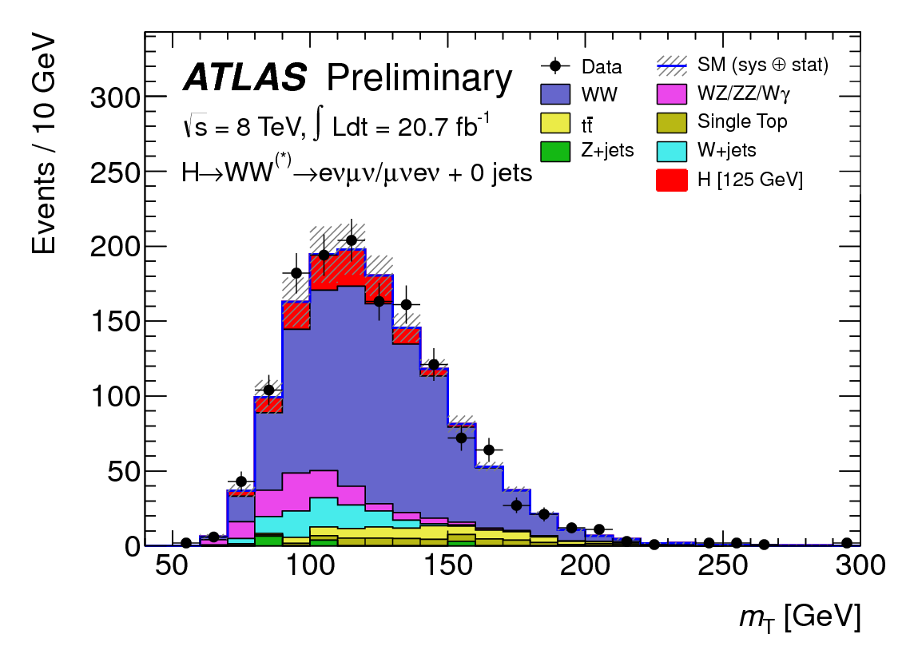
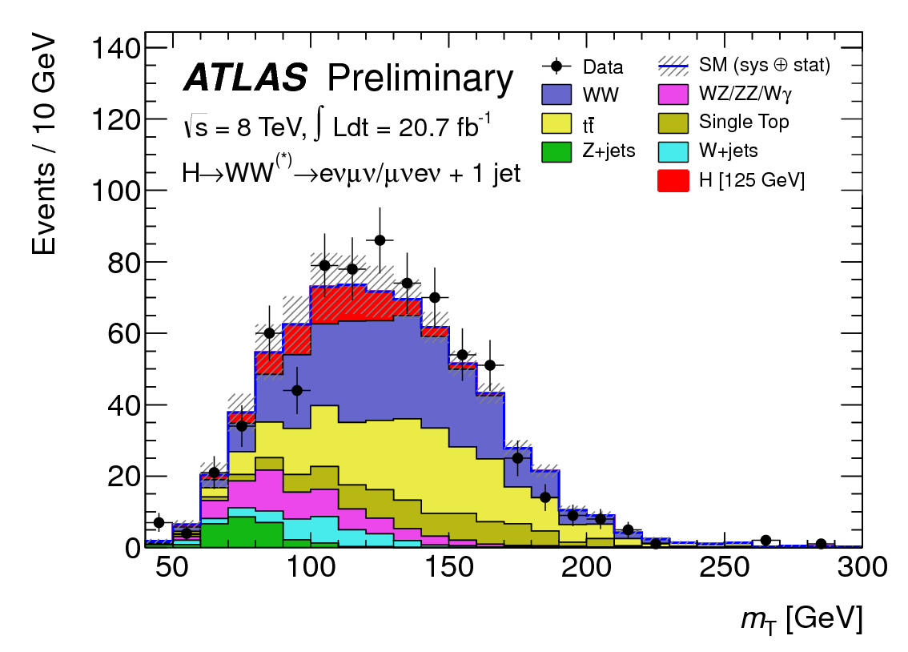
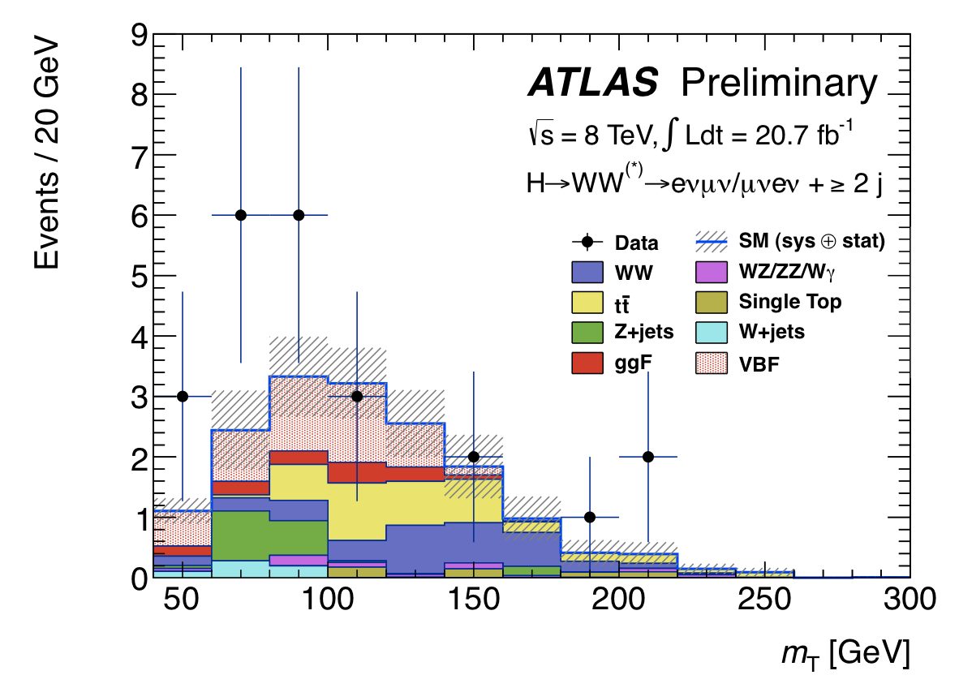
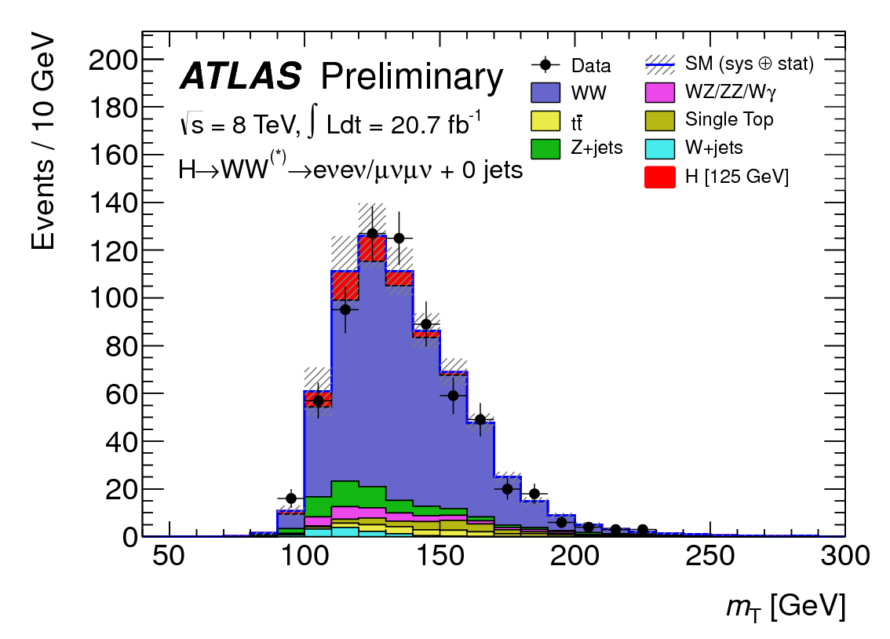
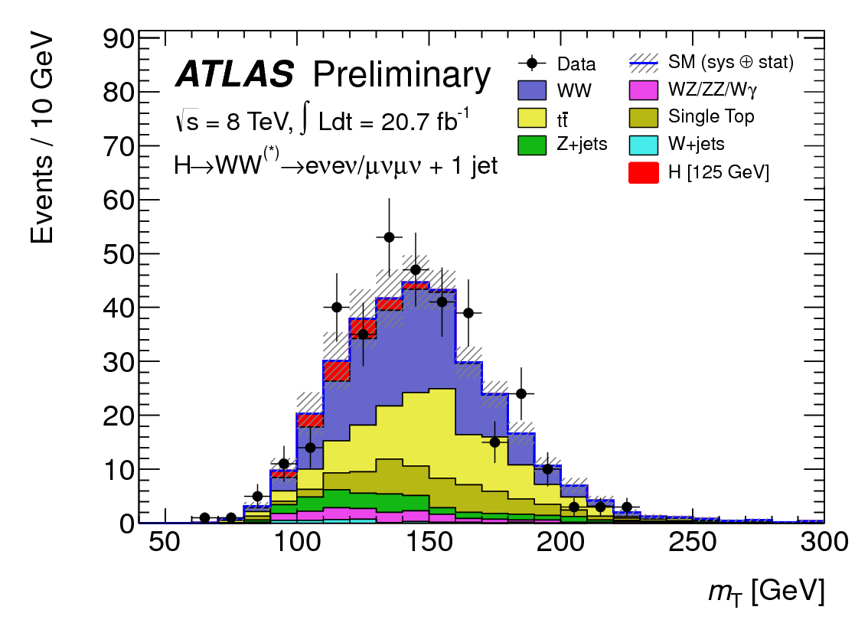
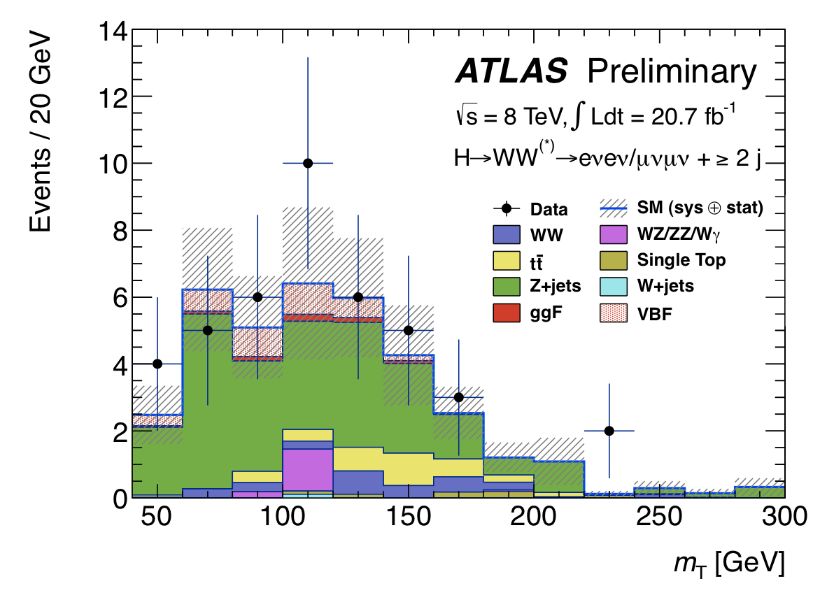
H → WW⁽*⁾ Main discriminant distributions
Complete 7 and 8 TeV re-analysis !

Slide 24
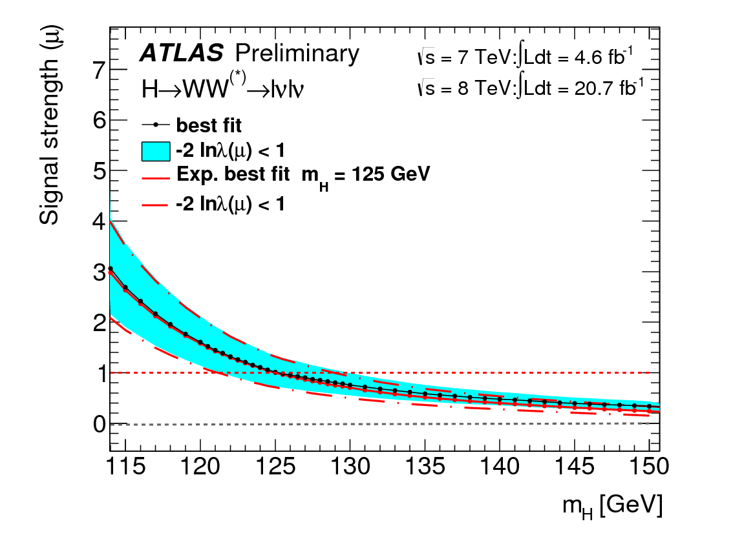
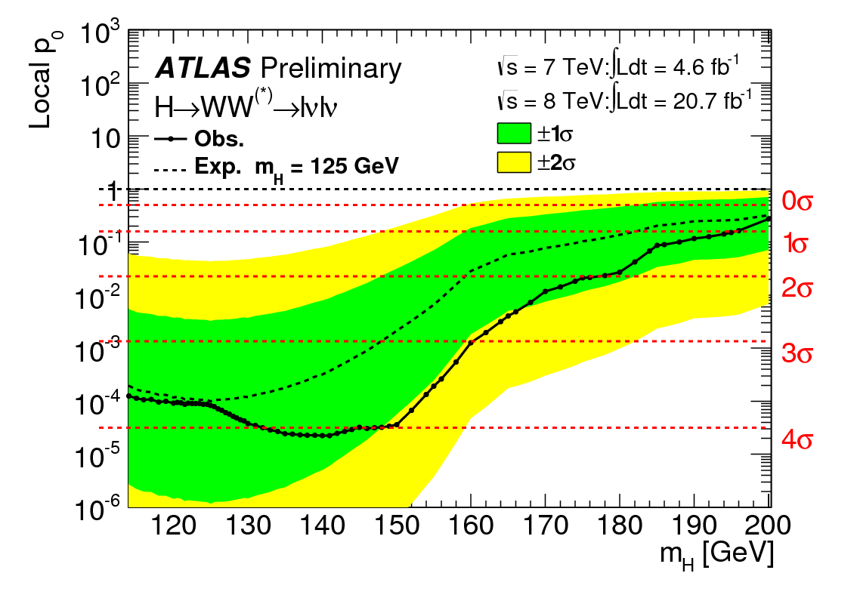
Observation of a Higgs boson in the WW (lvlv) channel
Signal strength at 125 GeV :
Observed Significance (125 GeV): 3.8σ
Expected Significance : 3.7σ

Slide 25
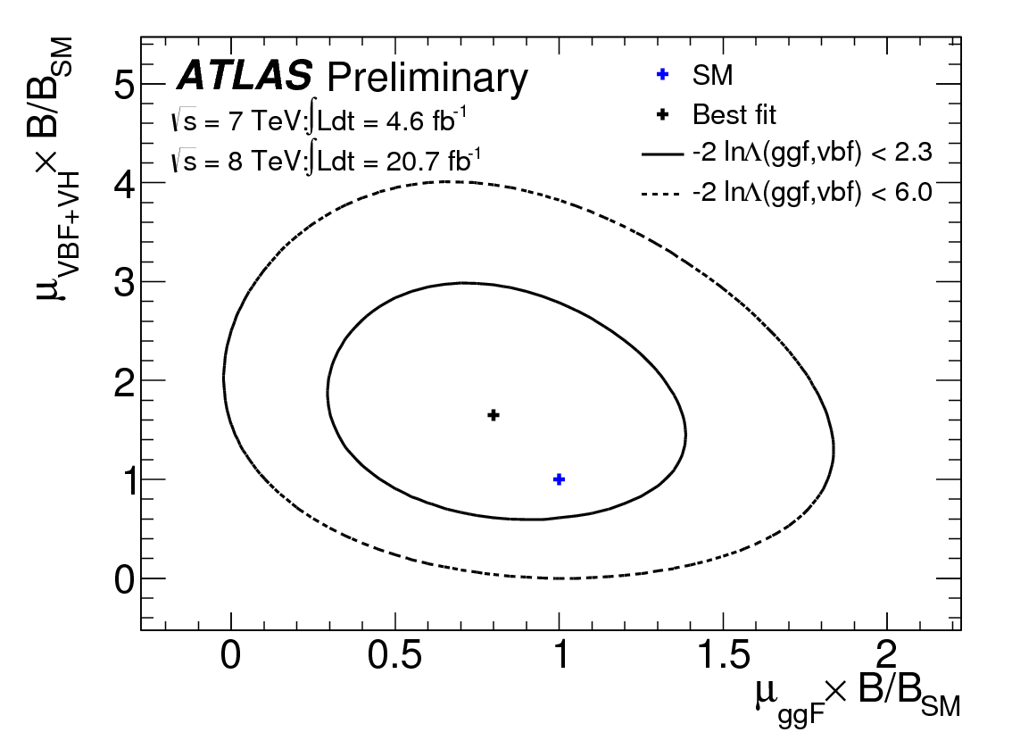
VBF+VH vs ggH+ttH

Slide 26
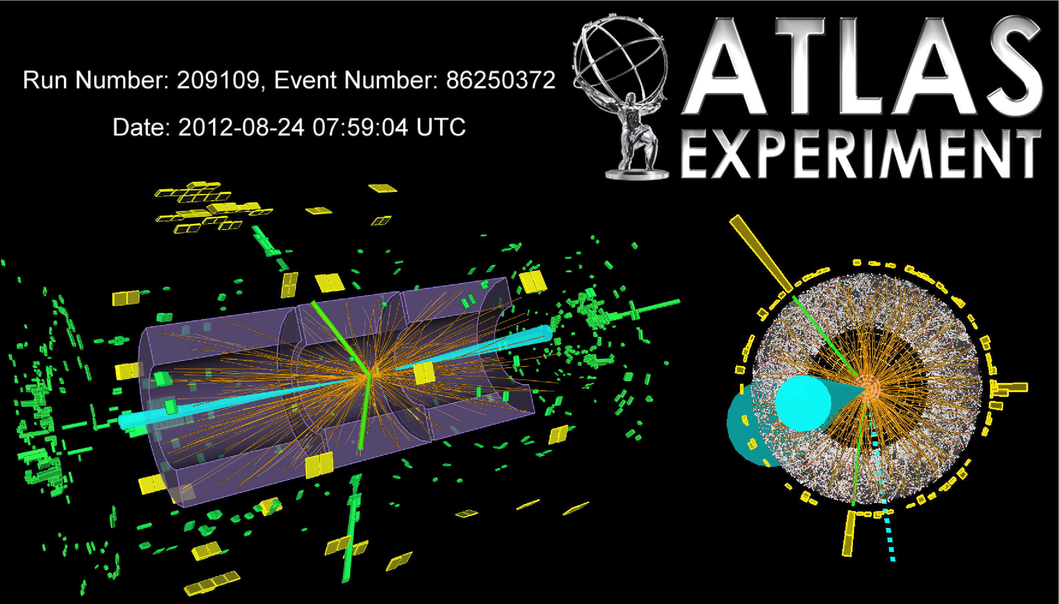
H → ττ
Reoptimised 7+8 TeV analysis
ATLAS-CONF-2012-160
H → τ_{had}τ_{had} candidate in VBF channel (m_{MMC} = 131 GeV)
ττ channel basic facts sheet :
Signal (SM) | Signal purity s/b | Main backgrounds | Production | 7 & 8 TeV
~330 | 0.3% - 30% | ZZ, Z+jets, top | VBF, Hgg, VH | 4.9 & 13 fb⁻¹

Slide 27
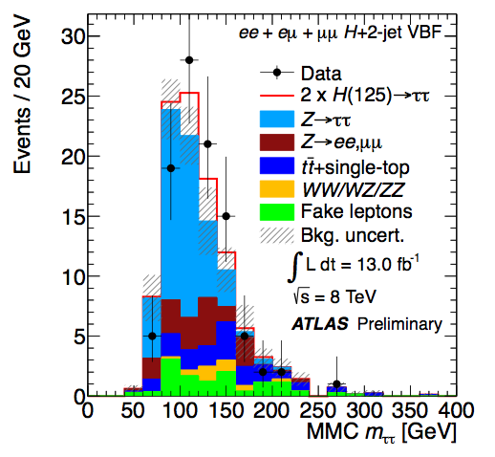


H → ττ
Reoptimised 7+8 TeV analysis
- Search in exclusive categories: lep-lep, lep-had, had-had and jets: 0, 1 (boosted or not), 2 (VBF, VH)
- Background modeling is critical especially in specific environments such as VBF production : Use embedding
- Use of MMC mass
σ(m_{ττ}) = 13% ∼ 20%
- Most powerful channel VBF
μ(125) = 0.7 ± 0.7
95% CL limit (125): 1.9 [ exp: 1.2 ] × SM
Significance (125): 1.1σ [ exp: 1.7σ ]

Slide 28

VH production with H → bb
Combined and reoptimised 7+8 TeV analysis
VH(bb) channel basic facts sheet :
Signal (SM) | Signal purity s/b | Main backgrounds | Production | 7 & 8 TeV
~50 | ~1% - 10% | Wbb,Zbb, top, etc… | VH | 4.9 & 13 fb⁻¹

Slide 29
ATLAS-CONF-2012-161
VH production with H → bb
Reoptimised 7+8 TeV analysis
Also new 7 TeV analysis of tt+H, with H → bb [ATLAS-CONF-2012-135]
Require 2 b-tags and distinguish 0, 1, 2 lepton channels
Higgs discrimination based on m_{bb}, resolution of ∼16%, improved by including muons and partial neutrino correction
Categories in boost (w/o sub structure)
μ(125) = −0.4 ± 0.7(stat) ± 0.8(syst)
95% CL limit (125): 1.8 [ exp: 1.9 ] × SM

Slide 30

H → 4l Update
Impact of Mass on Coupling measurements

Slide 31

Combination of All Channels
Updated with up to 25 fb⁻¹ of 20111 and 2012 data
H → 4l Update
ATLAS-CONF-2013-034
Summary of the signal strength in all SM Higgs search channels
Overall agreement with the SM Higgs boson hypothesis
(5 channels w/SM ~8%)
Current observed significance :

Slide 32



The Gift of Nature
Slight modification to the combination fit
Assuming a single narrow resonance at a mass m_{X} ~ 125 GeV/c²
Assume the same tensor structure of the SM Higgs boson : J^{CP} = 0⁺⁺
Link to an effective Lagrangian and use scale factors (parametrizing yields in various channels)
Fit 2 or at most (for the time being) 3 factors under different assumptions to test well motivated models
e.g. κ_{g}² = σ(gg→H)/ σ(gg→H)_{SM} , κ_{γ}² = Γ(H→γγ)/Γ(H→γγ)_{SM}, κ_{H}² = Γ_{H}/Γ_{H,SM}
Rewrite
with these scale factors

Slide 33




- Custodial symmetry (two models investigated)
custodial symmetry is respected

Slide 34




- Indirect evidence of coupling to fermions
A single fermion κ_{F} and weak boson κ_{V} scale factors
One overall not observable sign, (choose κ_{V} > 0)
Difference between κ_{F} > 0 and κ_{F} < 0
from interference between top and W in H → γγ
BTW: A large μ in the γγ is not simple
Fermiophobic scenario strongly disfavoured

Slide 35



- Direct coupling to fermions
H → τ⁺τ⁻ still no probing evidence
(very mild excess for the time being)
Eagerly waiting for (better) direct evidence in
H → τ⁺τ⁻ and H → bb !
- Probing (heavy) new particles in the loops not directly affecting total width

Slide 36





- Probing new particles in the loops and potentially affecting the total width
- Direct search for (truly) Invisible Decays

Slide 37


- Testing production modes independently from the decays (VBF+VH and VBF only)
Observation of a non vanishing VBF production at more than 3 standard deviations!

Slide 38
Low mass is less a gift of nature for J^{P} …
The overall qualitative (and to a certain extent quantitative) experimental profile of the observed boson is consistent with a SM Higgs boson:
- Observation in the diphoton channel implies C = 1
- Observation in the diphoton channel (Landau-Yang theorem) implies J=0 or 2
- Observation in the ZZ and WW channels disfavors P=-1
- Observation in WW channel favors J=0

Slide 39



WW* (lvlv) Spin Analysis
H → WW : Spin 0 hypothesis is explicitly included in the search analysis
(along with the V-A nature of the W decay)
Charged leptons close-by in space
- small azimuthal separation Δφ(ll)
- small di-lepton mass
Needs to change analysis strategy to measure the spin

Slide 40





WW* (lvlv) Spin Analysis
p-values SM 54%
γγ2⁺ 0.5%
p-values SM 62%
γγ2⁺ 0.7%
p-values SM 73%
γγ2⁺ 1.4%

Slide 41




ZZ* Spin and Parity Analyses
4 body final state, fully reconstructed :
- 3 angles from the Z^{(*)} decays (θ₁,θ₂,Φ)
- 2 angles for Z^{(*)} production (θ*, Φ₁)
- Two masses
Combine all variables with two methods:
- Matrix element (J^{P}-MELA)
- BDT

Slide 42



p-values SM 40%
γγ2⁺ 0.2%
p-values SM 51%
γγ2⁺ 0.3%
p-values SM 38%
γγ2⁺ 11%

Slide 43



DiPhoton Spin Analysis
Relevant variable : photon production angle θ*
Good shape discrimination between SM and
gg → X(2⁺) → γγ
Very large background!
Bkg subtracted
p-values SM 58%
γγ2⁺ 0.3%
1-CL_{S} = 99.3%

Slide 44


Strong dependence of the of H → γγ for spin
p-values SM 80%
γγ2⁺ 3%
p-values SM 90%
γγ2⁺ 3%
p-values SM 71%
γγ2⁺ 8%
p-values SM 61%
γγ2⁺ 2%

Slide 45


Summary of Spin Results
Diphoton
ZZ Four leptons
WW (lvlv)
Spin 0⁺ favored in all scenarios and all channels
Spin 2⁺ excluded at high CL_{S} in all scenarios

Slide 46
Conclusions
Confirmation with single channel discovery in yy and 4l Channels, and an observation in the WW (lvlv) channel
Coupling analysis shows :
1.- The ratio of W to Z couplings consistent with CS
2.- Ratio of F to V consistent with SM
3.- No signs of new physics in loops or decay
Parity analysis in the ZZ (4l) favors 0⁺ state
Spin analysis in yy, ZZ (4l) and WW (lvlv) strongly favors 0⁺ state
(w.r.t. specific graviton-like minimal couplings spin 2 models)
ATLAS data supports the removal of the « like »

Slide 47



The Birth of a Particle
Diphoton
ZZ Four leptons
WW (lvlv)

