Slide 1
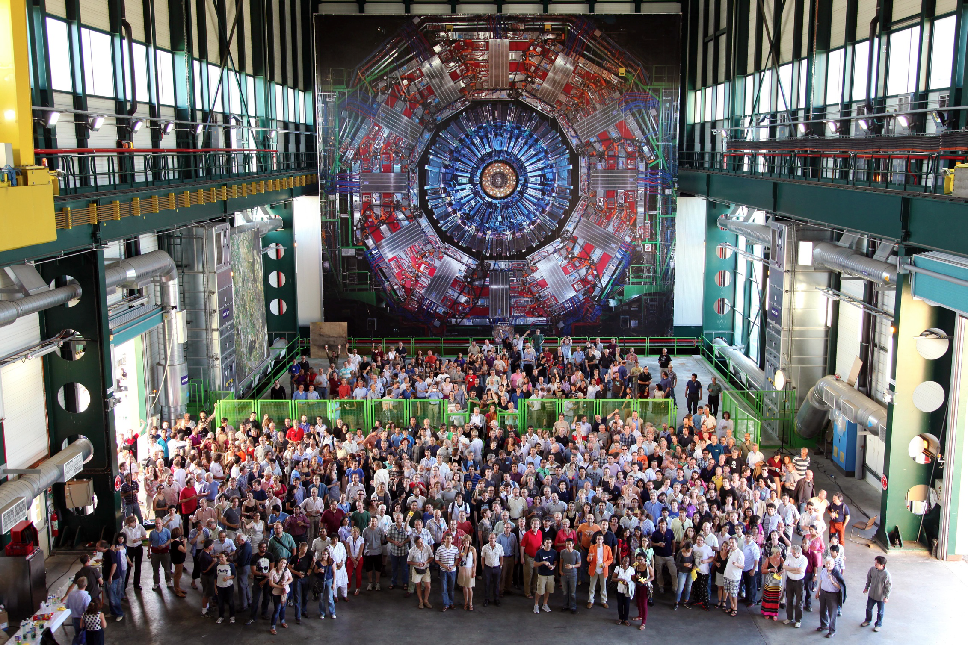


39 countries -- 169 institutes
3170 scientists & engineers
Status of Higgs Boson work at CMS
Grenoble Workshop
Mayda Velasco
March 17, 2013

Slide 2
CMS: A New Boson
Exploration in the Post-Discovery Era
2012 Data in CMS
Updates on Signals in Individual Channels
Post Discovery Progress
  Is it the SM Higgs Boson ?
  Is there just one ?
Properties
  The Mass
  Couplings to Fermions
  as well as Vector Bosons
  Spin/Parity
Summary

Slide 3
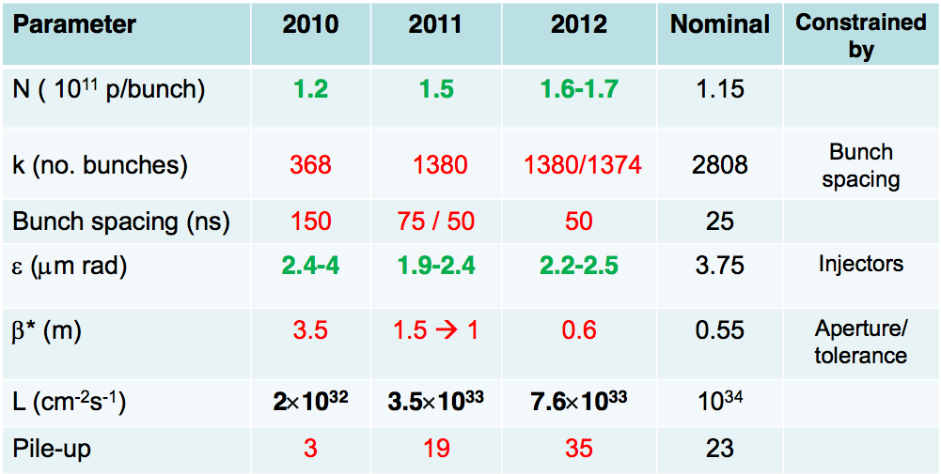
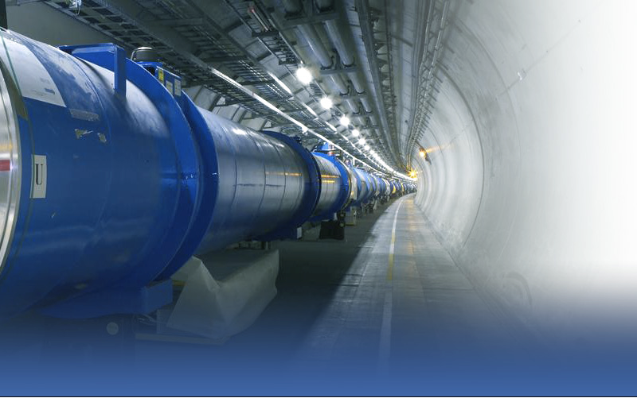
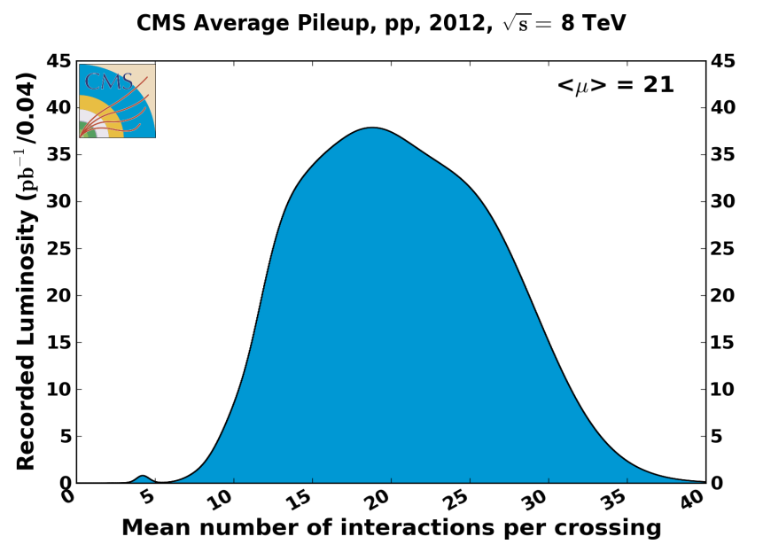
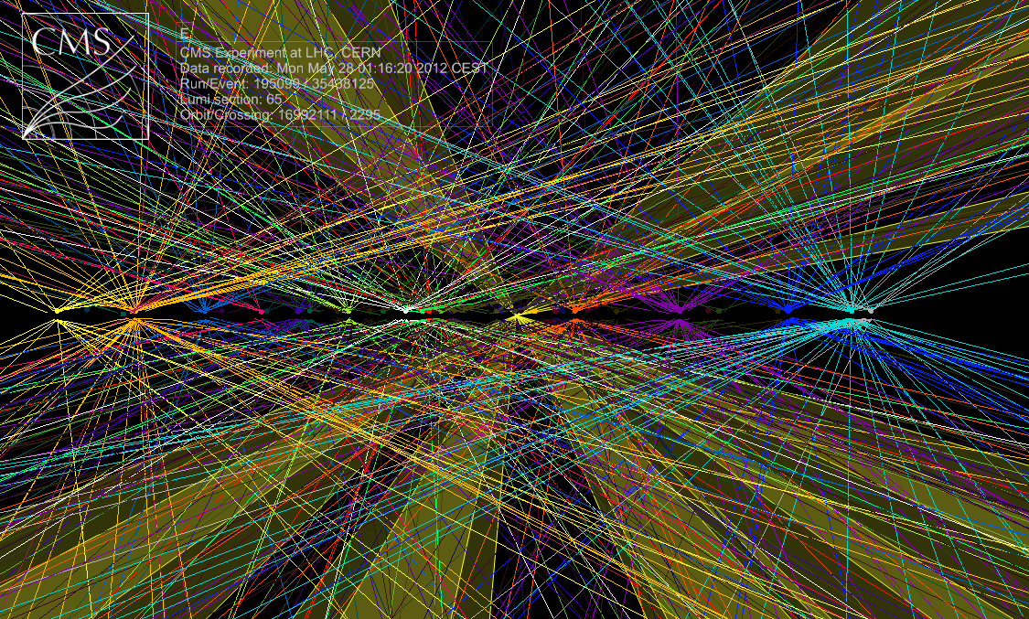
High Luminosity from the LHC
Pileup Challenges
1 fb⁻¹ on a good week
94% of luminosity recorded
~20 fb⁻¹ total in 2012
~50 Vertices, 14 Jets, 2 TeV

Slide 4

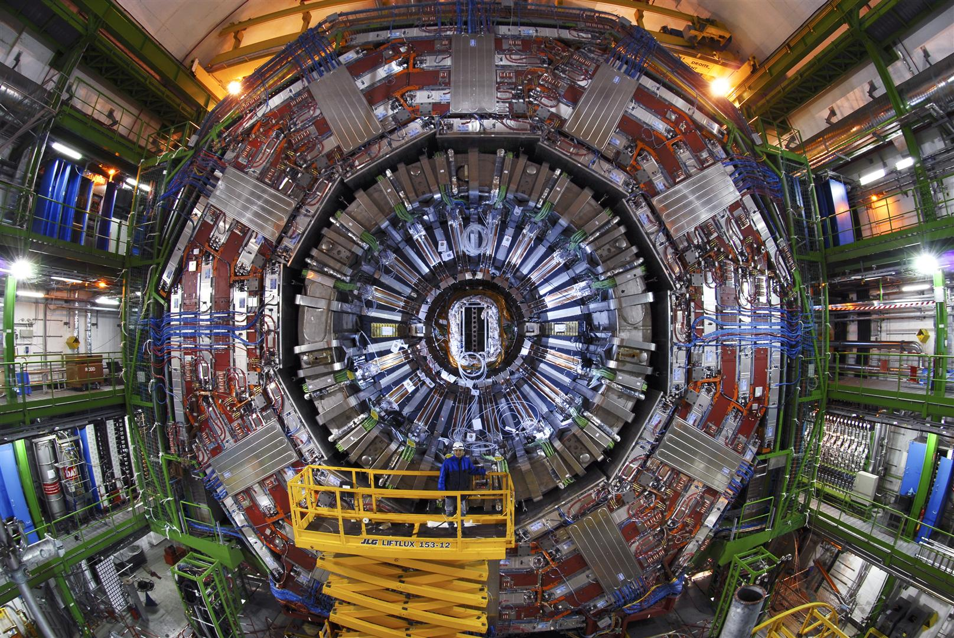
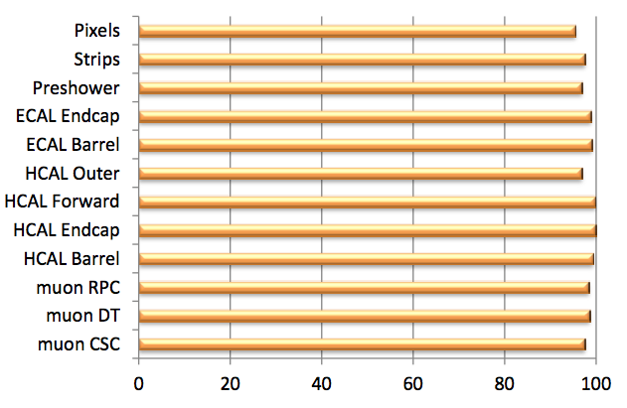
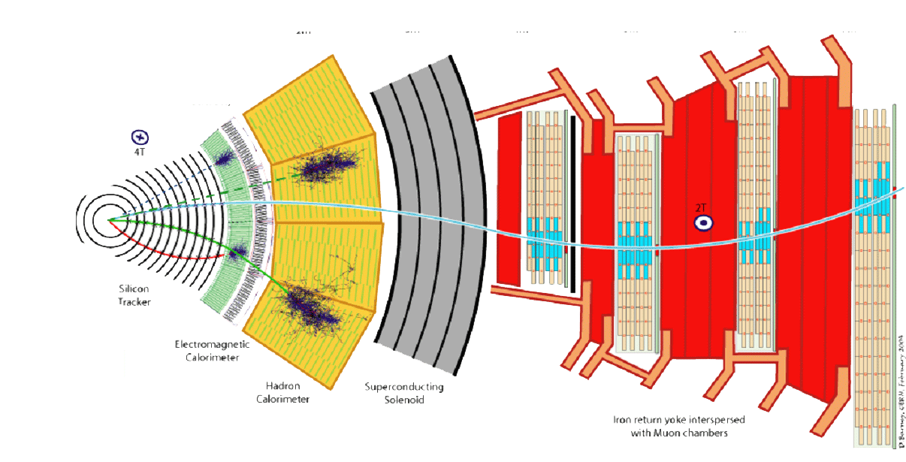
CMS
Compact, hermetic, solenoidal design.
All central tracking & calorimetry inside solenoid
Powerful external muon spectrometer
Transverse
view

Slide 5
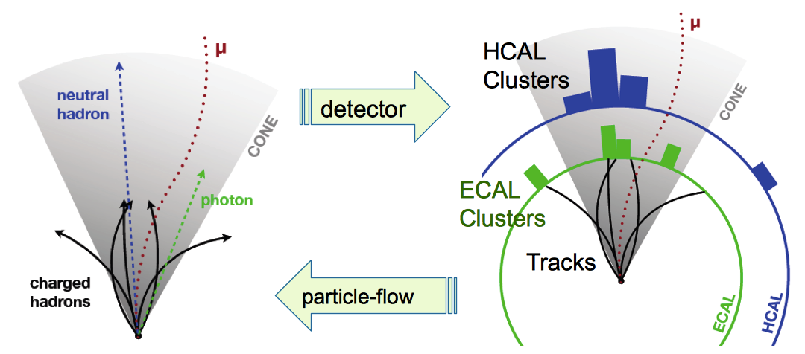
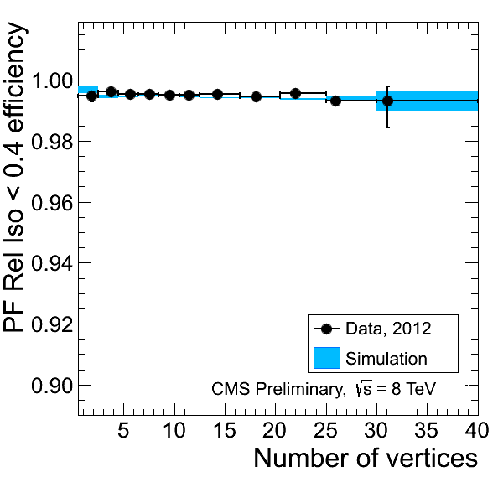
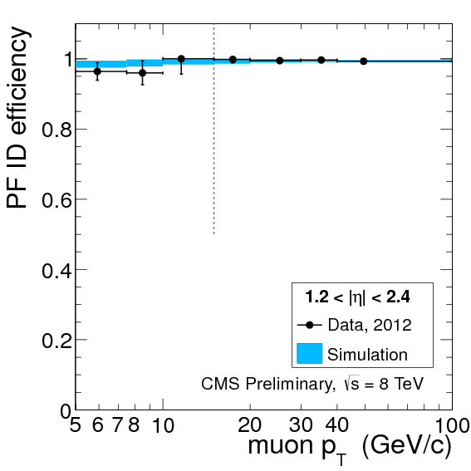
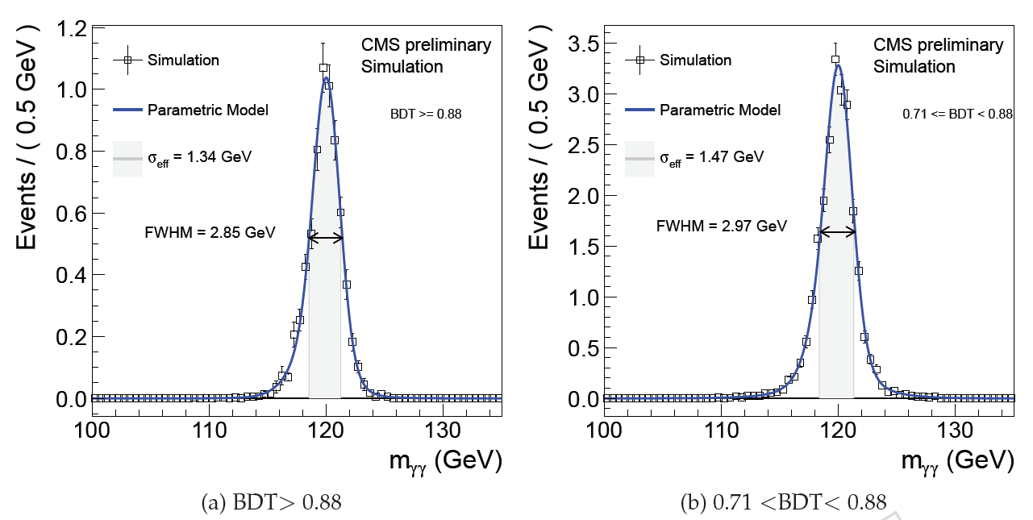
CMS Global Event Reconstruction
Made possible by CMS granularity and high magnetic field
Particle-flow based Muon isolation
Particle-flow based Muon identification
Optimal combination of information from all sub-detectors
Returns reconstructed “particles”: e, μ, γ, Charged & Neutral Hadrons
Used as building blocks for jets, τs, Missing E_{T}, lepton isolation
Tags charged particles from pile-up
Minimized Impact: on jet-reco,
lepton & photon ID, isolation
➔ Restored 2011 performance
Photon Resolution in ECAL Barrel
σ_{eff} 1.1%
σ_{eff} 1.2%
Using 8 TeV Prompt Calibration
Notes:
5

Slide 6
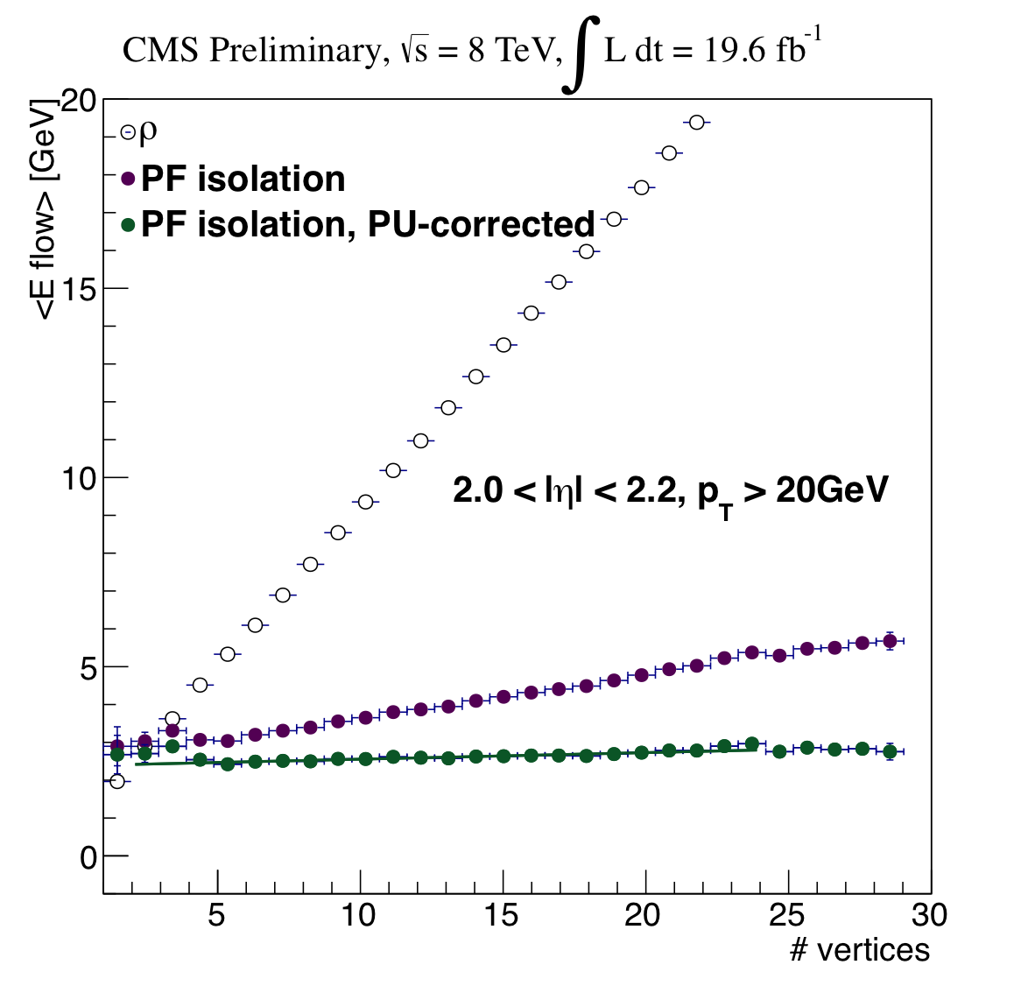
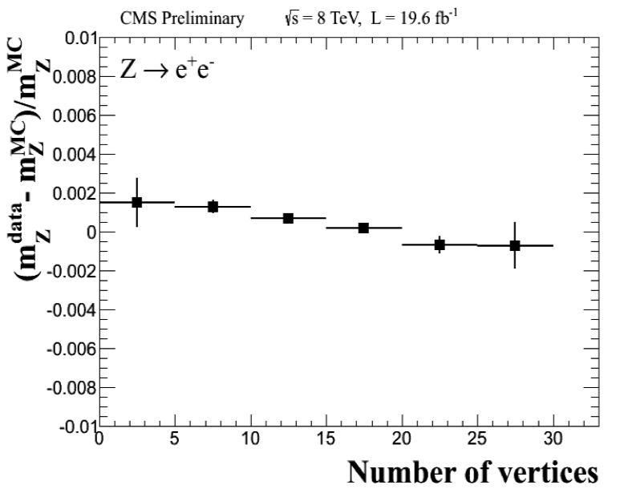
Stability Against Pileup
Electron Isolation and Energy Scale
Electron isolation in data
with Z➞e⁺e⁻ events
Momentum scale in data
with Z➞e⁺e⁻ events
Charged: consistency with vertex
Neutrals: Average energy subtraction
Effect within 0.2% in [0-30] reconstructed vertices in the event

Slide 7
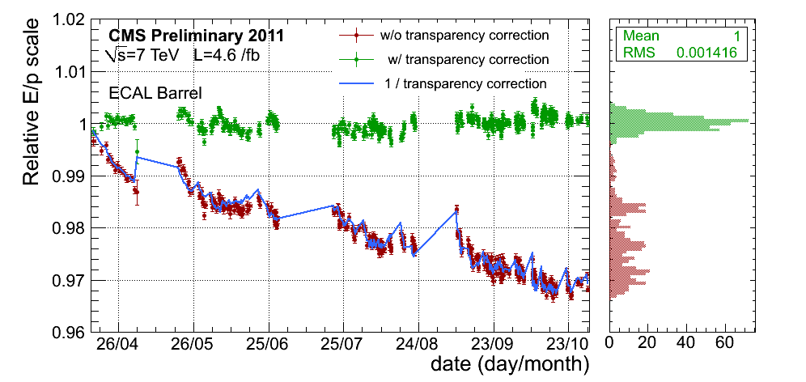
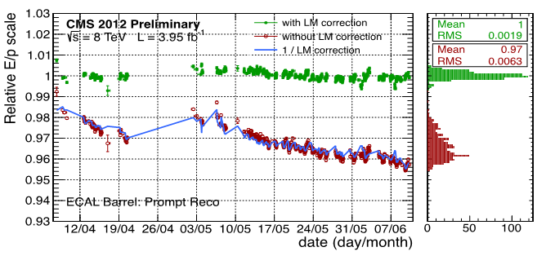
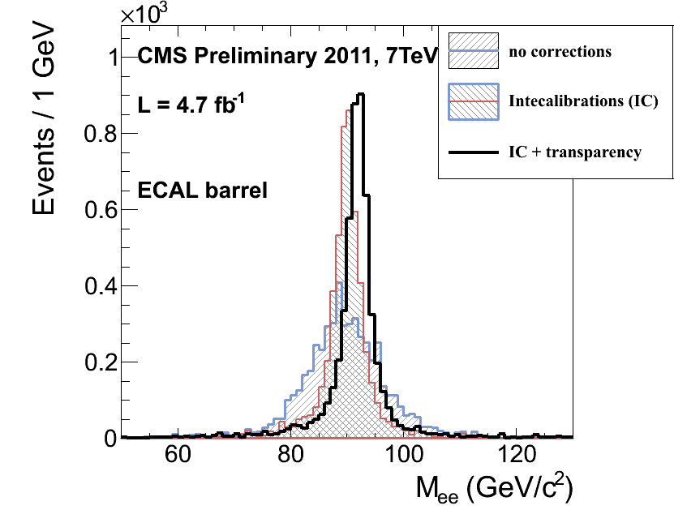
Photon Energy Resolution
Comprehensive Monitoring and Calibration
Laser runs every 40 minutes: crystal by crystal transparency corrections
With π⁰,η Intercalibration + Z → ee + W → eν (E/p) scale corrections
RMS=0.19%
Z → ee: Effect of
IC + Laser Corrections
Excellent Stability with prompt calibration for 2012: 0.19%
  Instrumental resolution: from Z → e⁺e⁻ , W → eν with ECAL energies
  and electron track directions: 1.0 GeV in ECAL Barrel

Slide 8
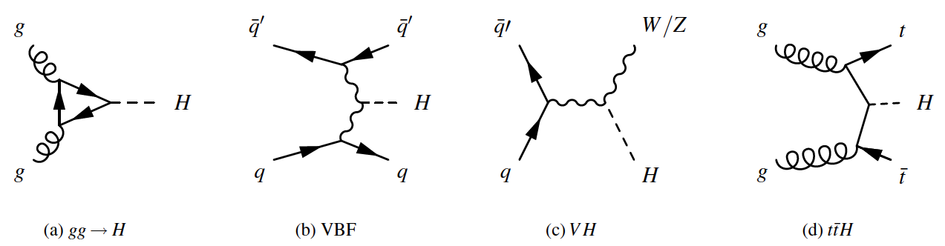
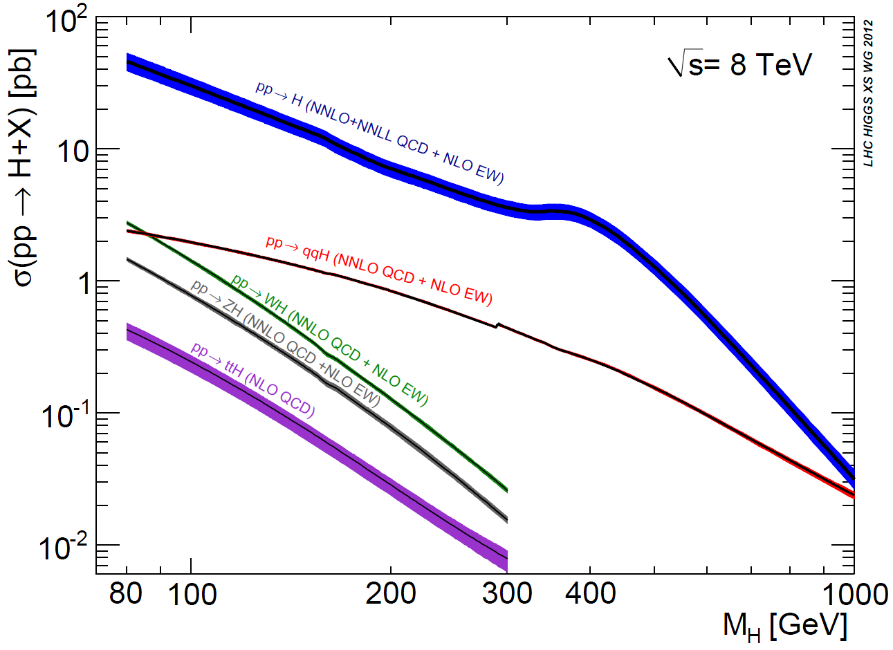
Higgs Production at the LHC
7-8 TeV pp CollIsions (8 TeV +25%)
gg fusion
fusion (VBF)
Assoc Prod: WH, ZH
Assoc. Prod: t-tbar H
NNLO QCD + NLO Elwk
Dominant production
at 125 GeV
gg→ H
Subdominant but
with Larger S/B:
VBF: ~13×Less
WH + ZH: ~18× Less
ttH ~150× Less
gg fusion
qqbar H
t-tbar H
Assoc WH
Assoc ZH

Slide 9
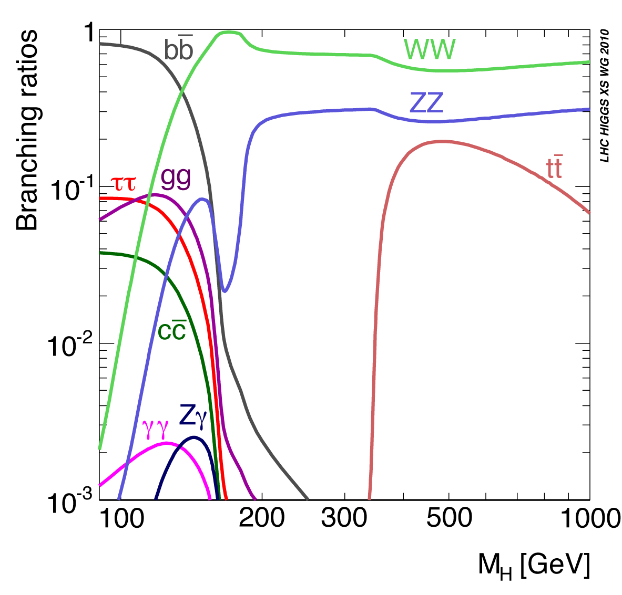
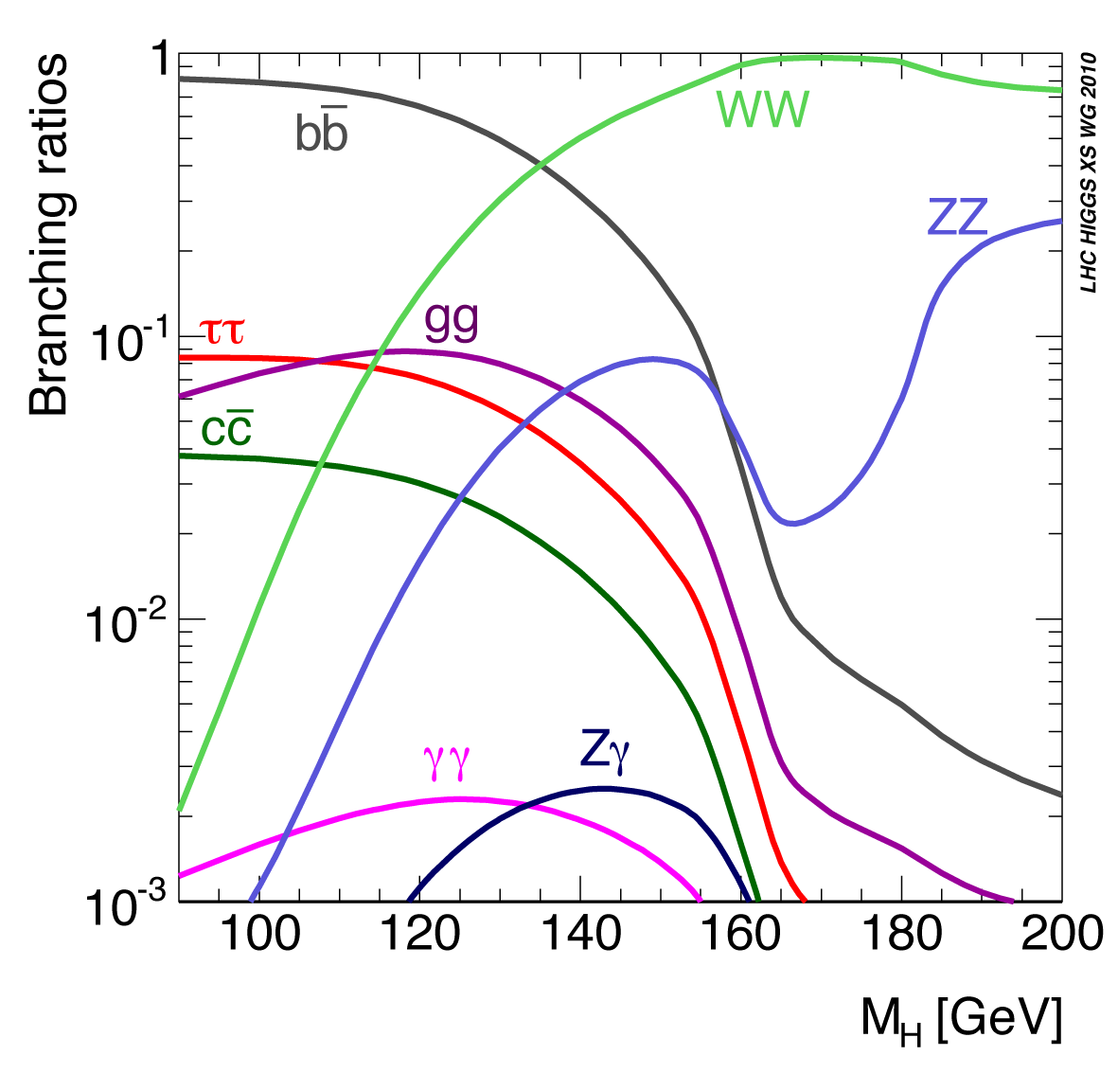
Higgs Boson Decays
Access directly to Higgs partial widths to: γγ, ZZ, WW, bb, ττ and Zγ & even μμ
Access indirectly to: gg ( t-tbar )
High Mass Resolution Channels H→ γγ and H→ ZZ→ 4L
Focus on high sensitivity channels γγ, ZZ, WW

Slide 10
Characteristics of Channels
CMS-HIG-12-028;
13-001, 002, 003, 004, 006
✔ 5+12 fb⁻¹
✔ 5+19 fb⁻¹
✔ 5 fb⁻¹
 | Untagged | VBF-tag | VH-tag | ttH-tag | S/B | Mass Res. | Mass Range | Used For
H→γγ | ✔ | ✔ | ✔ | ✔ | Low O(0.1) | 1-2% | 110 – 150 | M_{h}, C_{F} , C_{V}
H→bb |  |  | ✔ | ✔ | Low O(0.1) | 10% | 110 – 135 | C_{F}
H→ττ | ✔ | ✔ | ✔ |  | Low O(0.1) | 15% | 110 – 145 | C_{F}
H→WW | ✔ | ✔ | ✔ |  | Medium O(1) | 20% | 110 – 160 | C_{V} , J^{P}
H→ZZ | ✔ |  |  |  | High O(>1) | 1-2% | 110 – 1000 | M_{h}, C_{V} J^{P}
H→Zγ | ✔ |  |  |  | Low O(0.1) | 2-3% | 120 – 150 | C_{F} , C_{V}
Updates (Low Mass): W/Z + H  WWW  3l 3ν & WH + ZH  qq′ 2l 2ν
Update (High Mass): H  ZZ 2l2τ & ZZ  2l 2ν; qq′ 2l; WW  qq′ lν

Slide 11

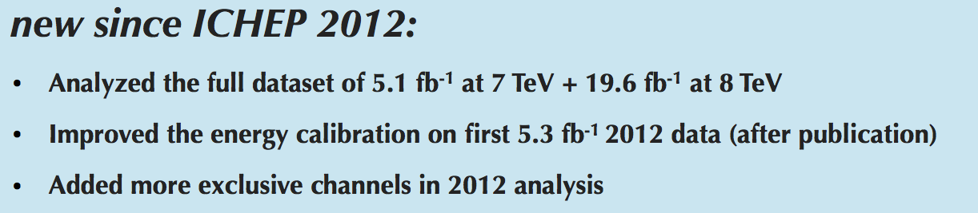
H ➔γγ
candidate
CMS HIG-13-001

Slide 12
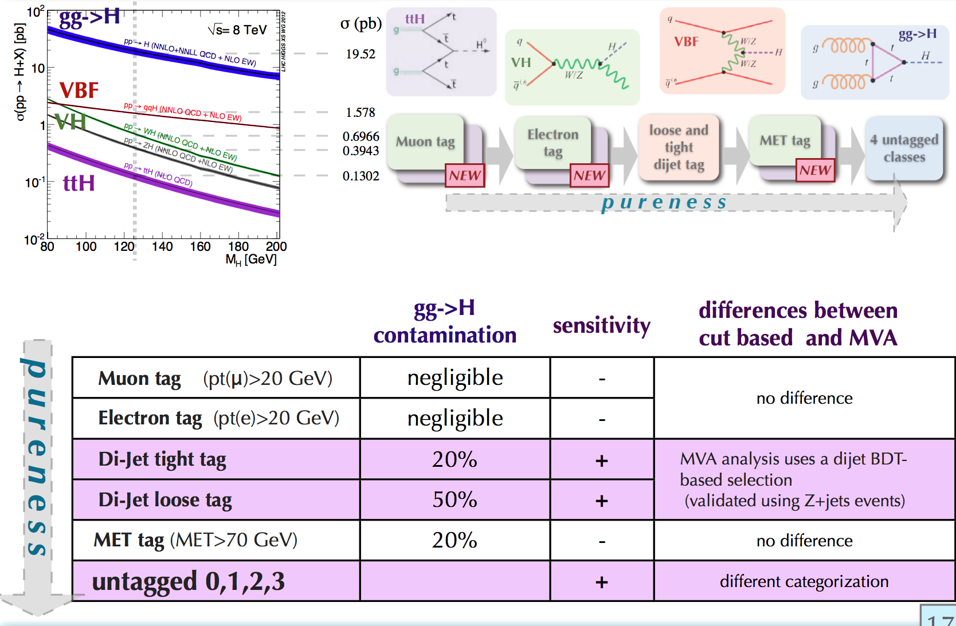
Changes in event classification: H → γγ

Slide 13
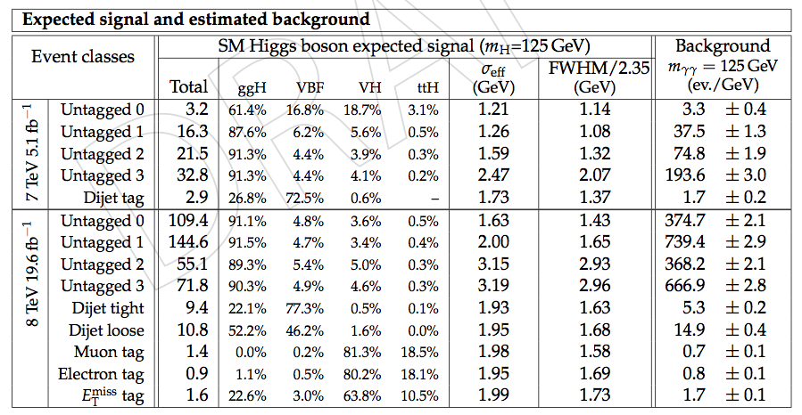
Expected Yields in H → γγ

Slide 14
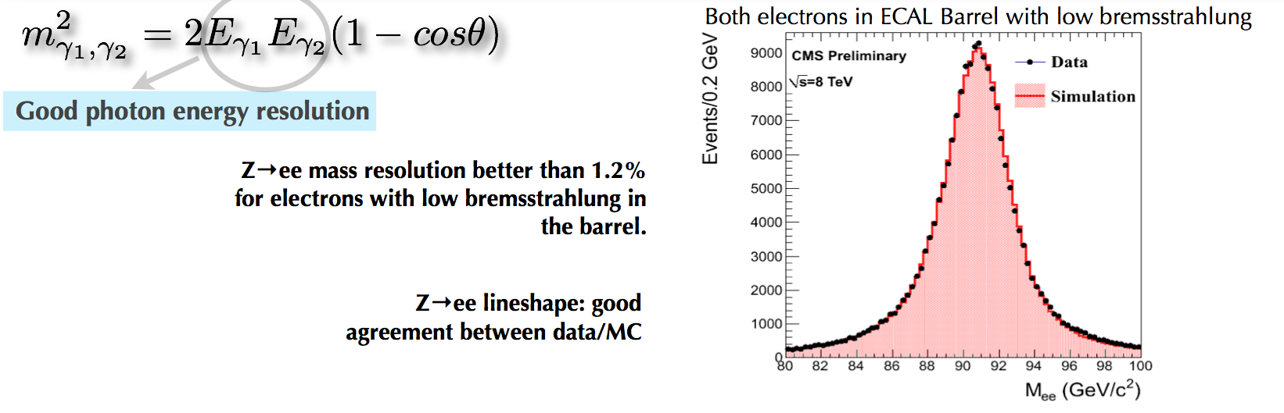
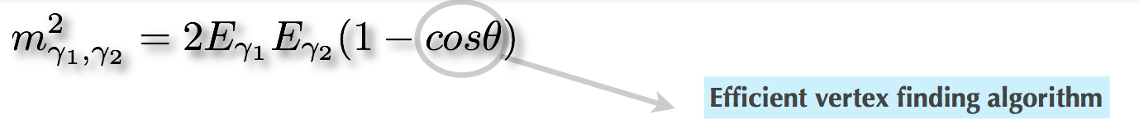
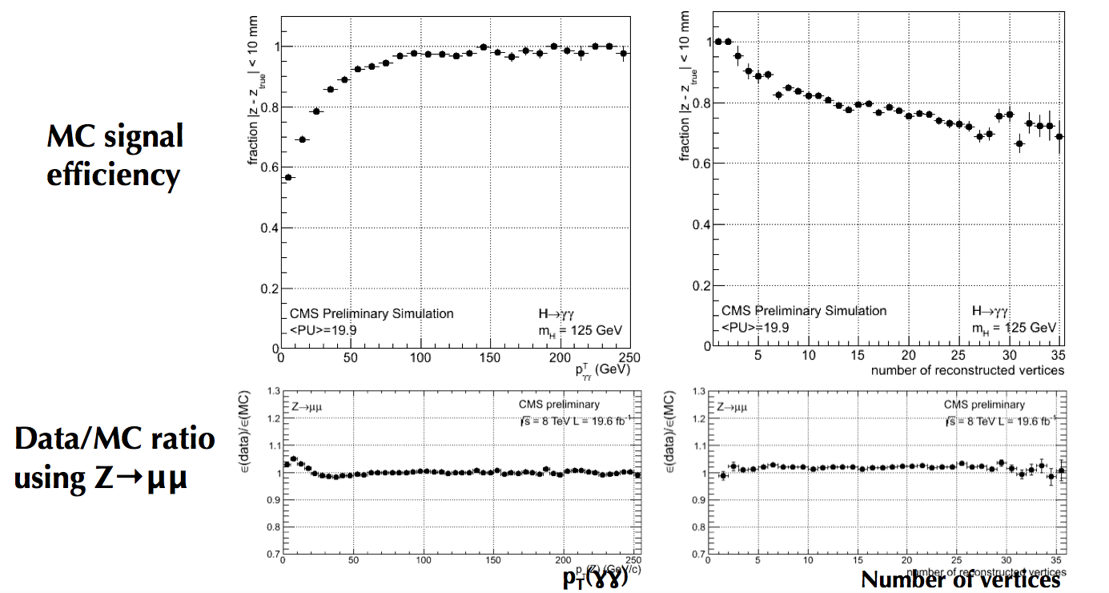
Basic issues not change

Slide 15
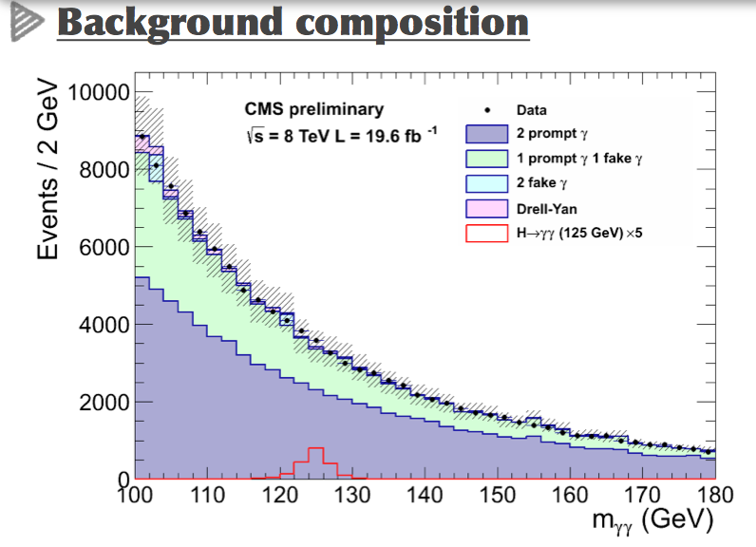
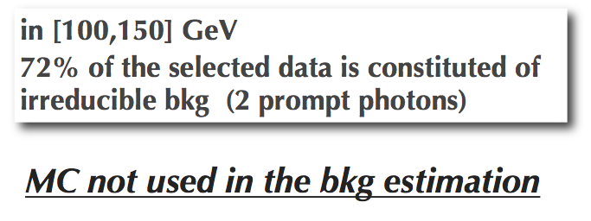
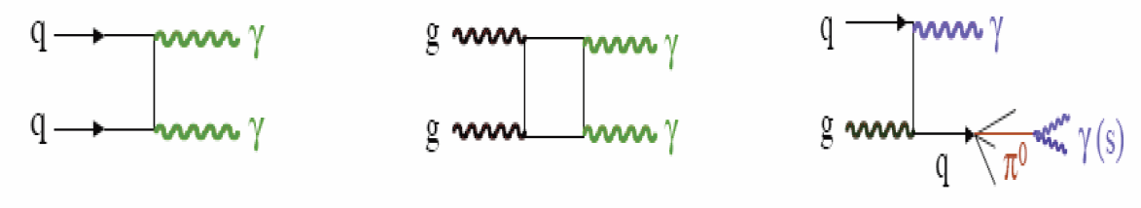
Background Modeling Data Driven not Changed
    γ Identification: Separate prompt γ from reducible background from misidentified neutral mesons in QCD γ+Jet & multi-jet events

Slide 16
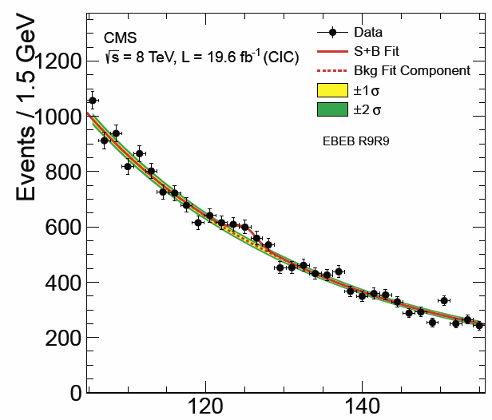
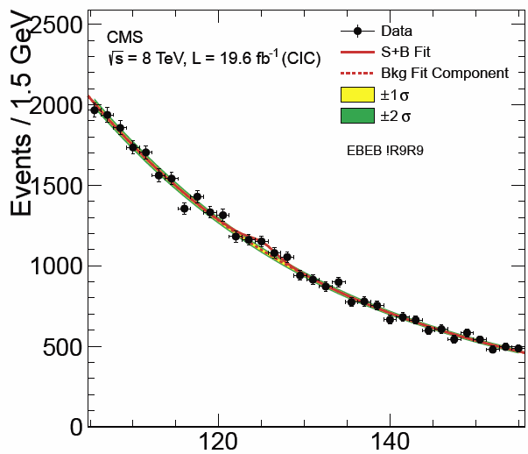
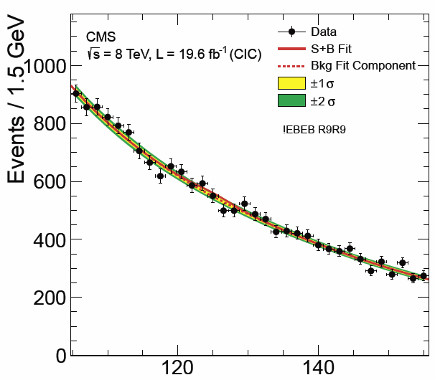
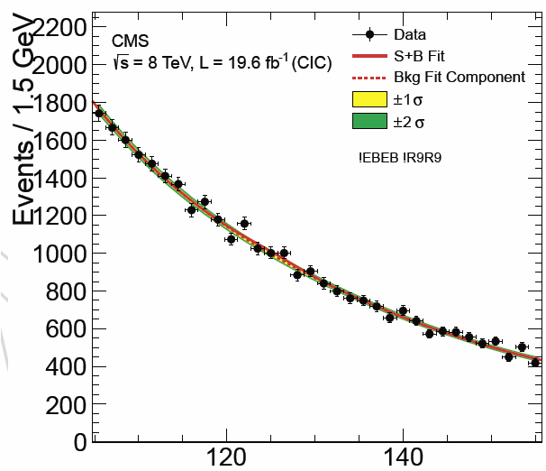
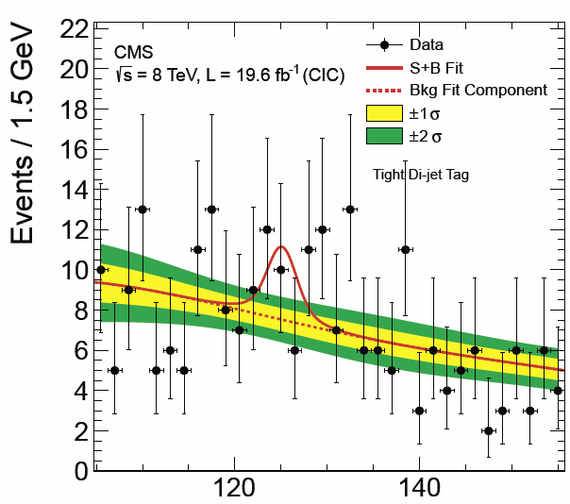
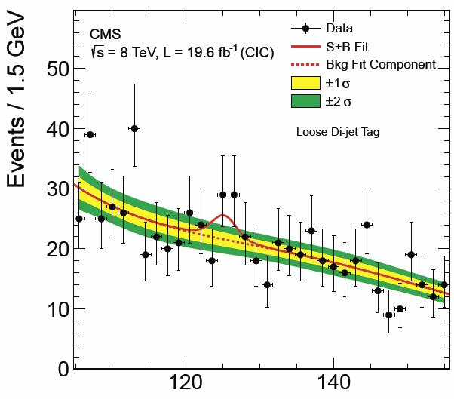
8 TeV Diphoton Mass Distributions
S+B Mass Fits to 4 Inclusive and 2 Dijet Classes
  Mass distribution in each category fitted with a 3rd to 5th order polynomial
  Order: bias below 20% of stat. fit error
  Causes some loss
  of performance due to the number of fit function parameters
Untagged 0
Untagged 1
Untagged 2
Dijet tight
Dijet Loose
Dijet Tight
Untagged 3
16

Slide 17
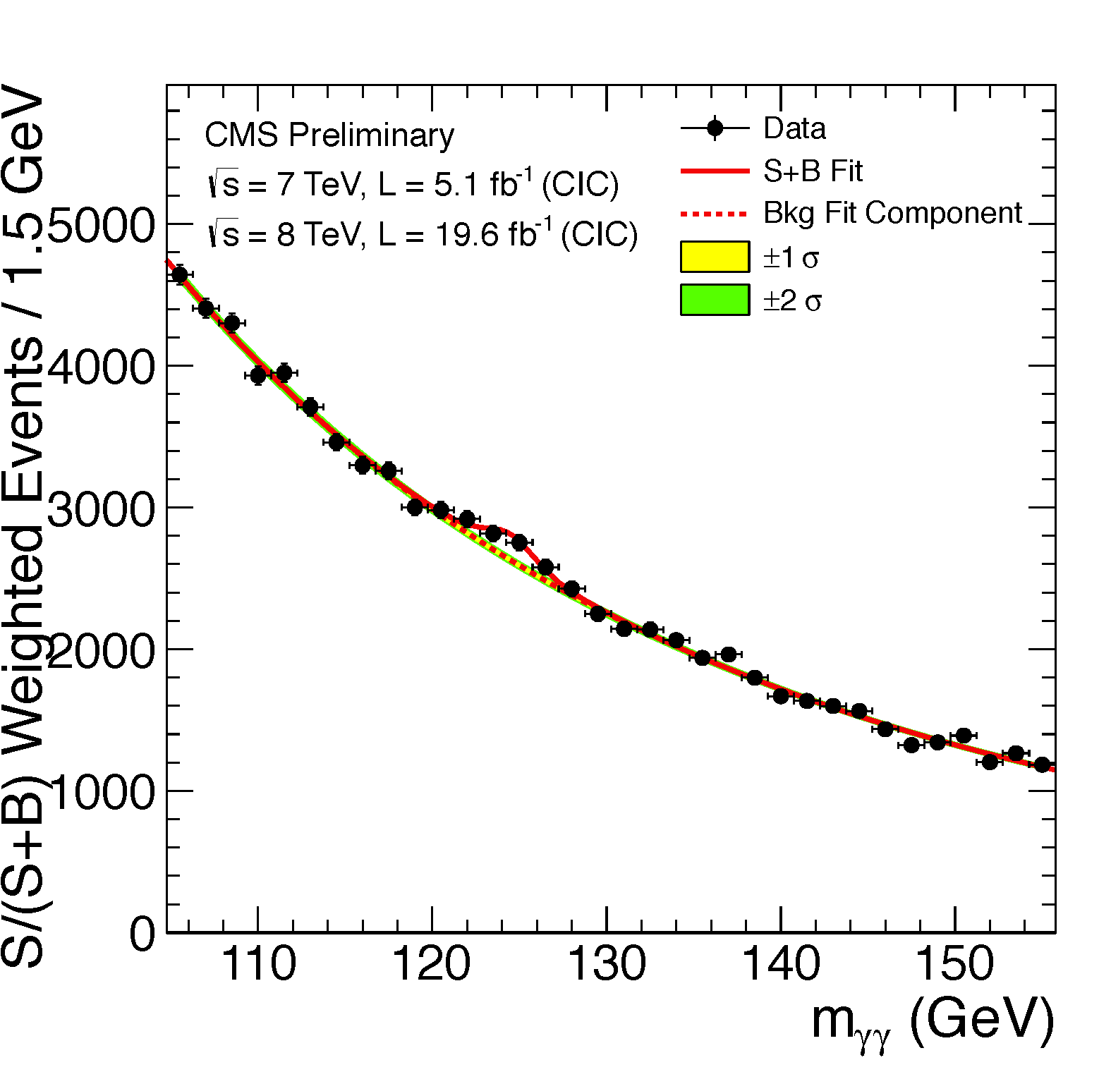
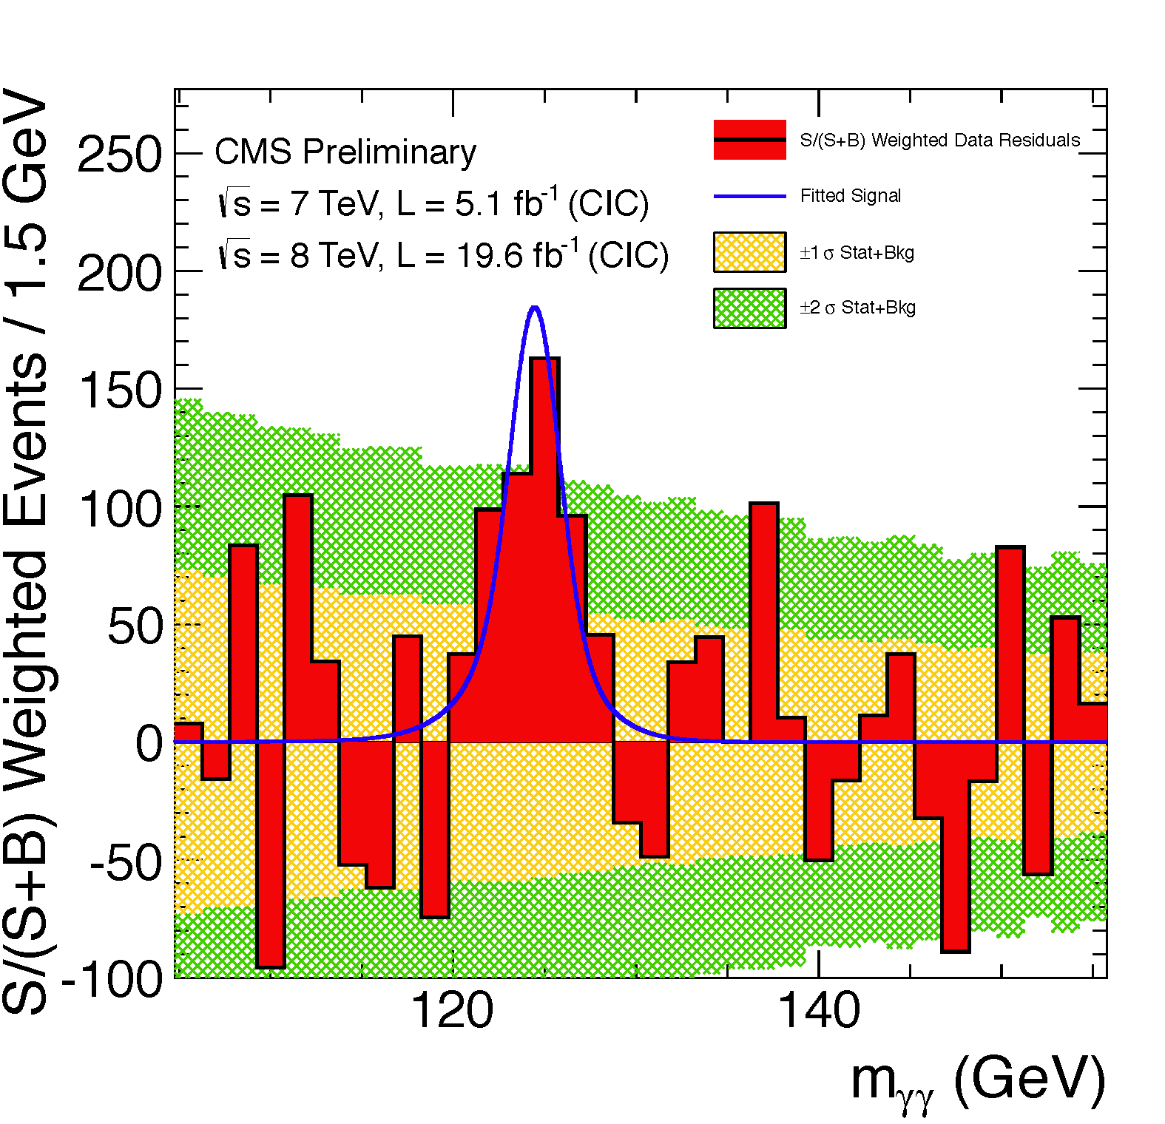
S/(S+B) Weighted Mass Distribution
Sum of mass distributions for each event class, weighted by S/(S+B)
  B is integral of background model over a constant signal fraction interval
Weighting
to Correctly
Show
S/(S+B)
Weighted;
Background Subtracted
An illustration:
Not used to derive the quantitative Results
S/(S+B) Weighted
R.J. Barlow, “Event Classification Using Weighting Methods”, J. Comput. Phys. 72 (1987) 202
Notes:
The weighting of events is similar to what is used in the final significance extraction

Slide 18
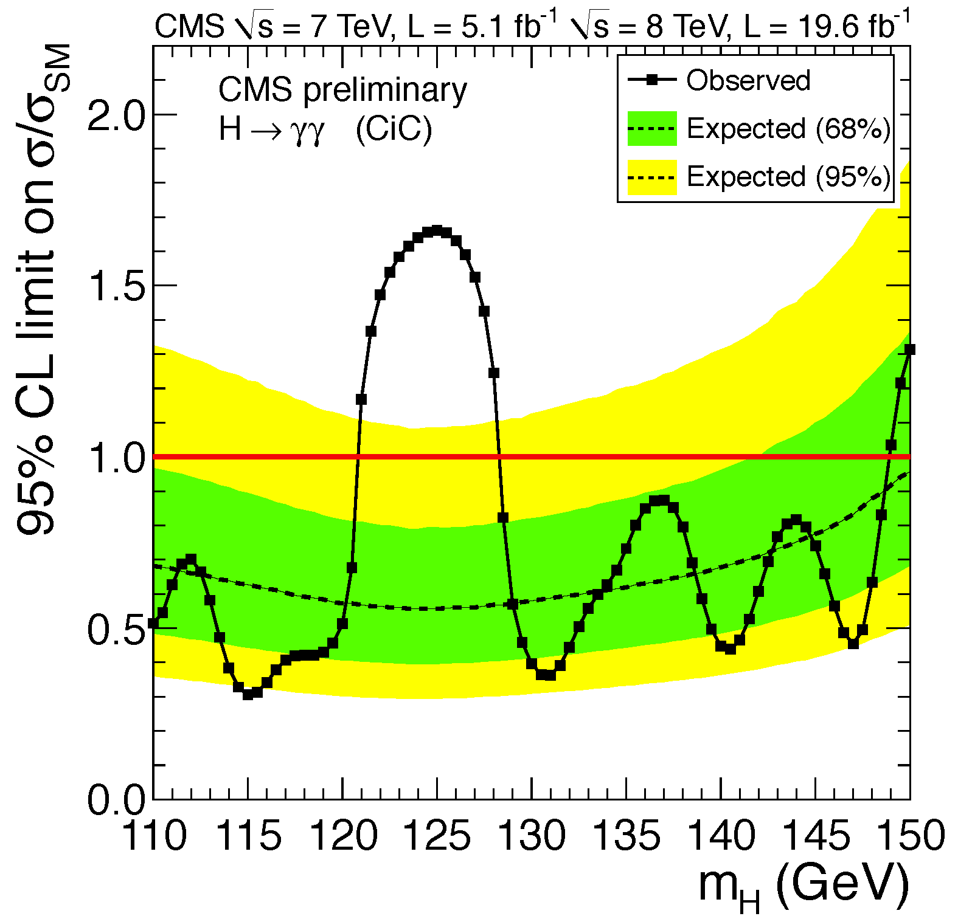
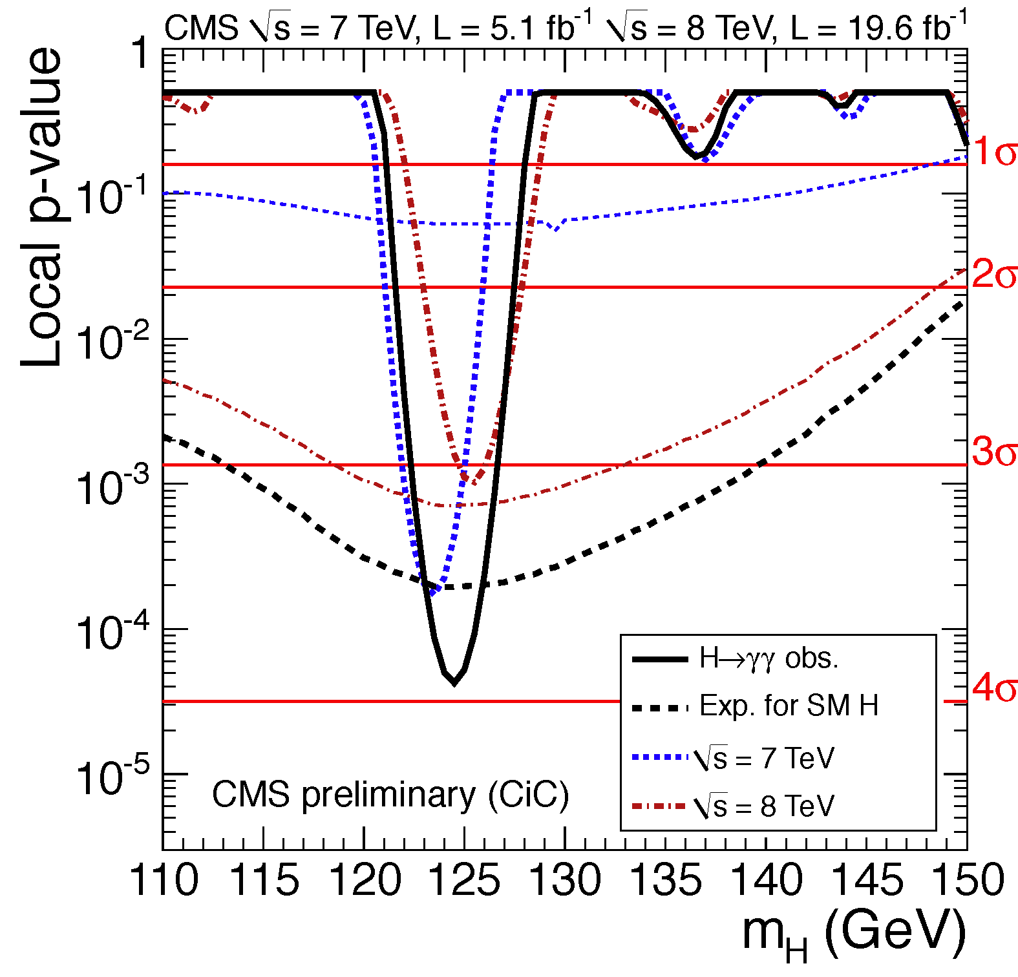
H →γγ 95% CL Exclusion on σ/σ_{SM} and p-Values for SM Higgs
95% CL Limit on σ/σ_{SM}
P-Values
Largest excess at 125 GeV
  Excesses both in 2011 & 2012
Expected 95% CL exclusion
0.52 times SM at 125 GeV
Minimum p-value at 125 GeV
with local significance 4.2 σ
  (Expected from SM Higgs: 3.7 σ)

Slide 19
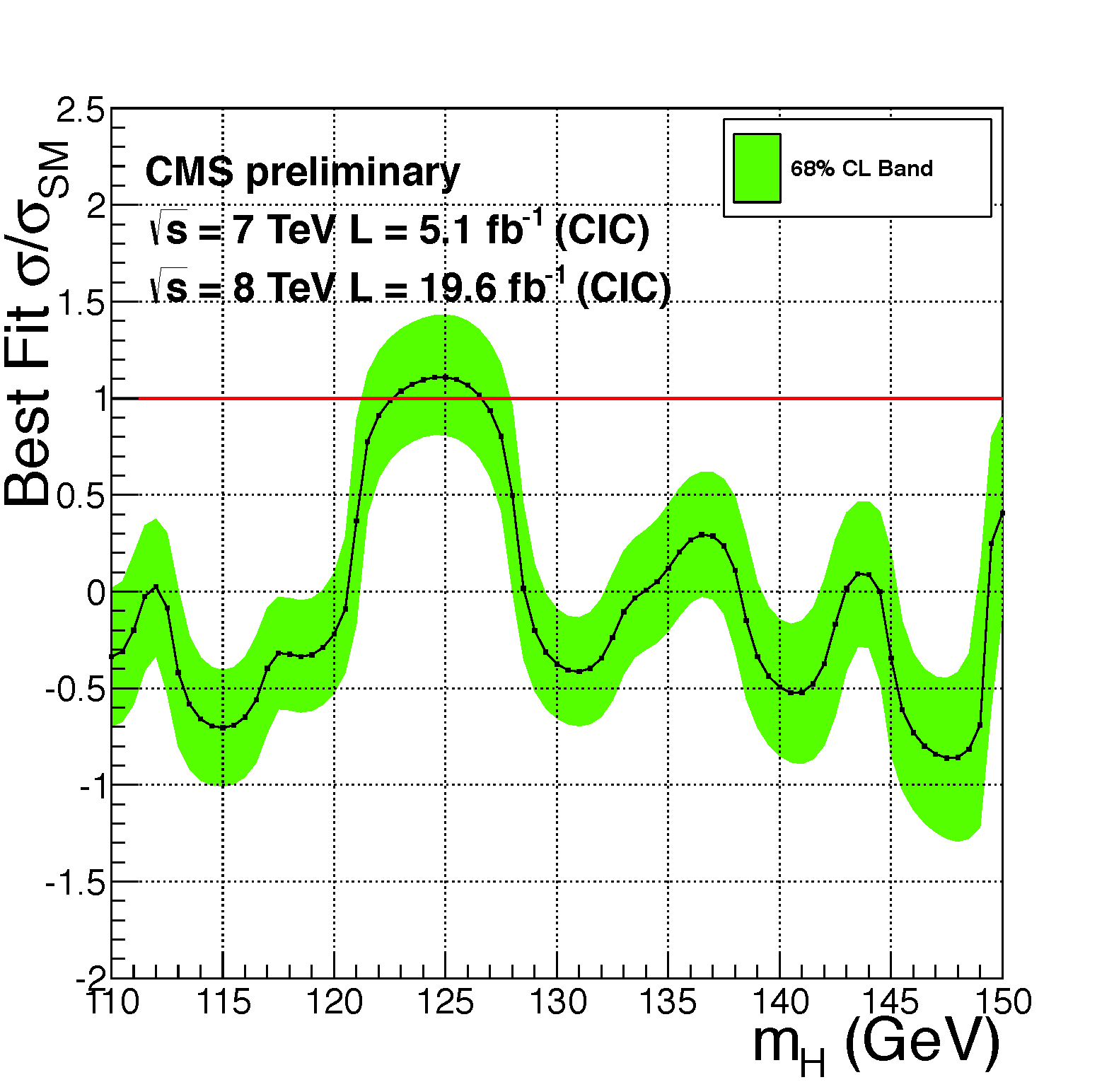
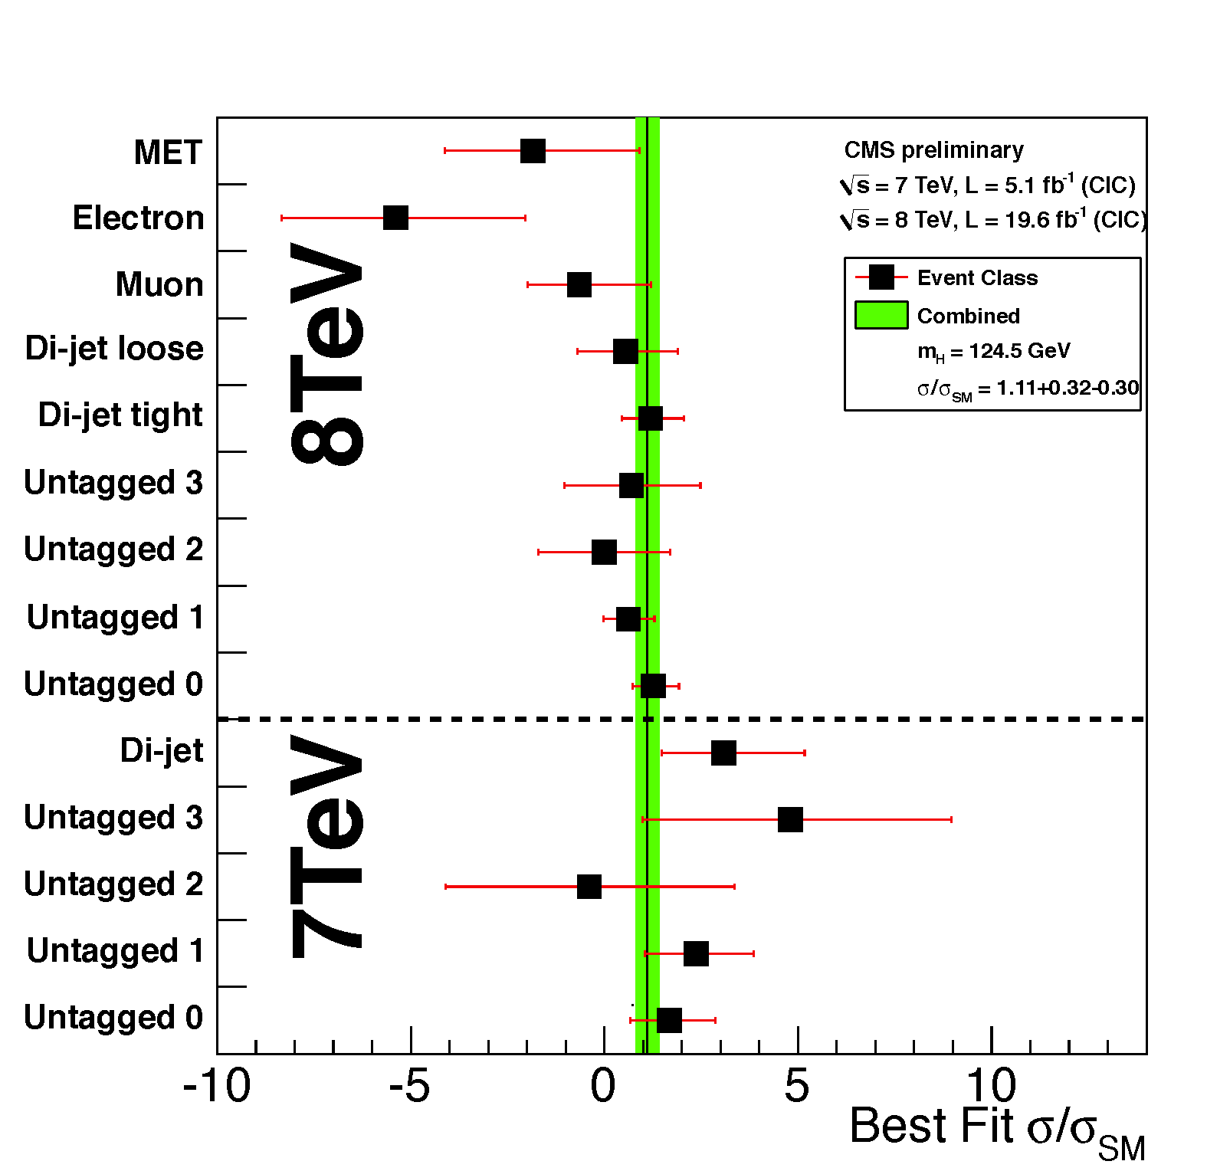
H → γγ Fitted Signal Strength and compatibility among classes
Combined best fit signal strength σ/σ_{SM} = 1.11 ± 0.31 consistent with SM
Best fit signal strength
σ/σ_{SM} is consistent
among different classes
19

Slide 20
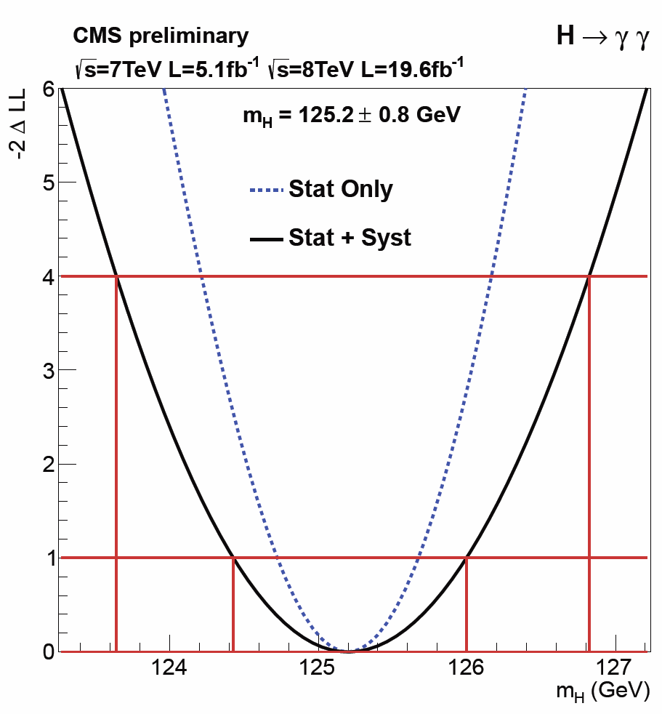
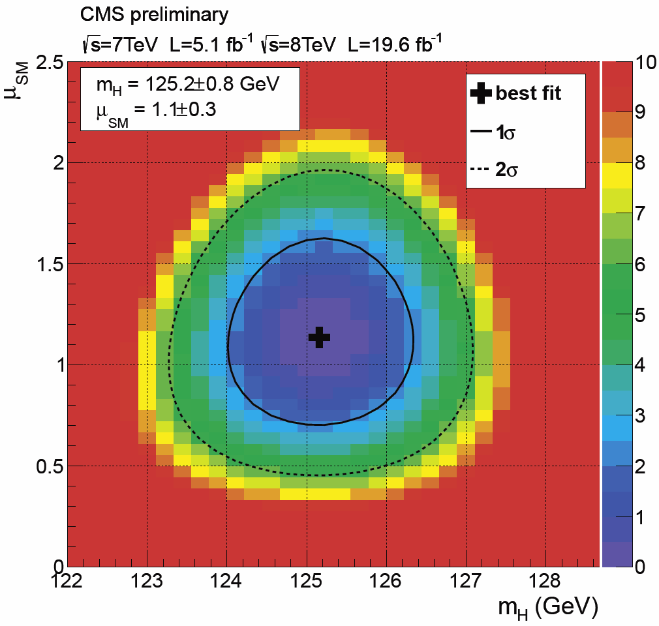
H → γγ : Mass Versus Fitted
Signal Strength Modifier μ_{SM}
Main Systematics
(Energy scale: Z → ee)
Imperfect simulation
of e vs. γ interactions
with matter
Extrapolating
the scale from
M_{Z} to M_{H} ~125 GeV
Best Fit: M = 125.2 GeV ± 0.5 (stat) ± 0.6 (syst.) GeV

Slide 21
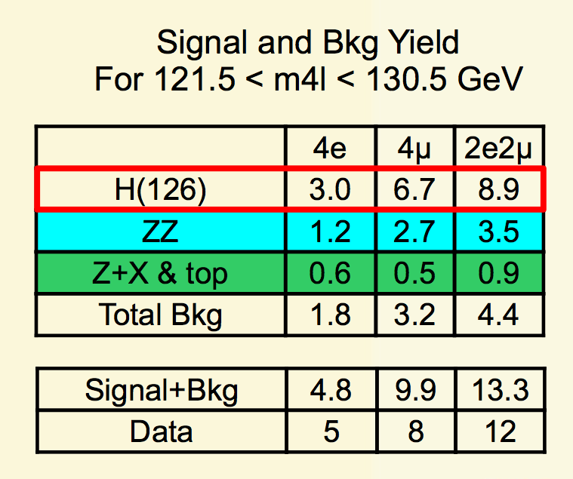
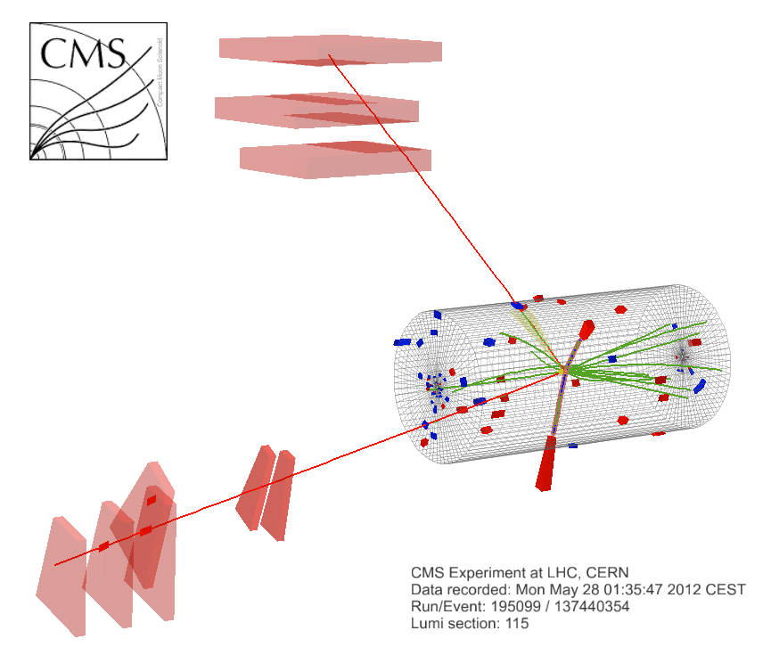
H → ZZ →4L and 2L 2τ (L = e,μ)
The Golden Channels
CMS HIG-13-002
8 TeV DATA
4-lepton Mass = 126.9 GeV
S/B = 2:1
μ⁺(Z₁) p_{T} :
43 GeV
e⁻(Z₂)
p_{T} : 10 GeV
μ⁻(Z₁) p_{T} :
24 GeV
e⁺(Z₂) p_{T} : 21 GeV
21

Slide 22
H → ZZ(*) → 4 Leptons
Analysis Improvements in 2012-13
Improvements in 2012 (I)
Up to HCP:
New lepton selection,
extending the p_{T} range
Muon reconstruction
Recovery of photons
from final state radiation
Blind low mass “signal” region.
Kinematic Discriminant
Exploit angular information
to discriminate signal from irreducible ZZ background
~20% gain in sensitivity
with respect to 2011 analysis
Pure Scalar 0+ compared,
favored over pure 0-
Improvements in 2012 (II)
Since HCP:
Dijet categories: gg H + 2Jets Also search for VBF
In 2l 2τ events: Constrain ττ mass to the nominal Z mass;
τ isolation requirements retuned
Improved K_{D}: take interference among identical leptons fully into account
Compare pure 0⁺ hypothesis
to more alternative J^{P}
hypotheses

Slide 23
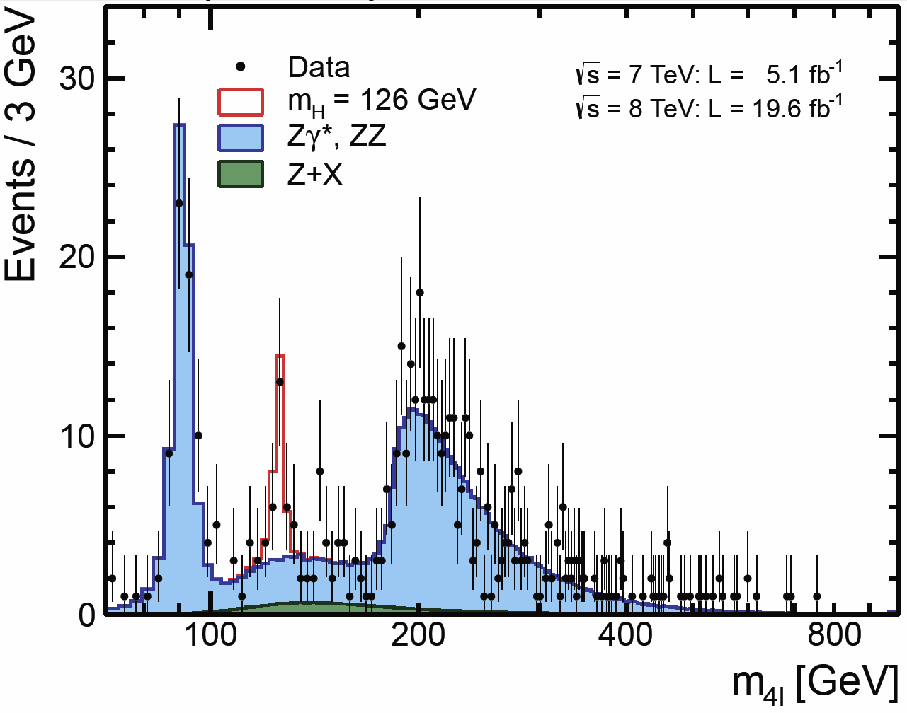
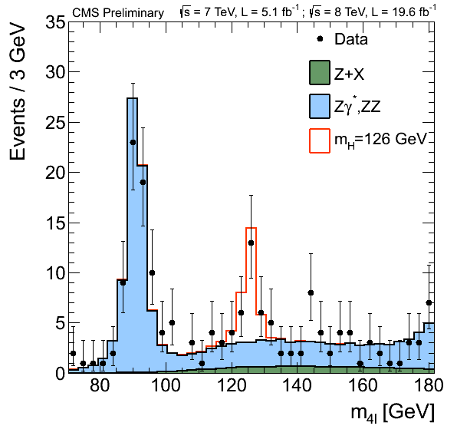
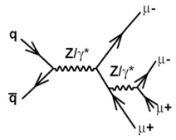
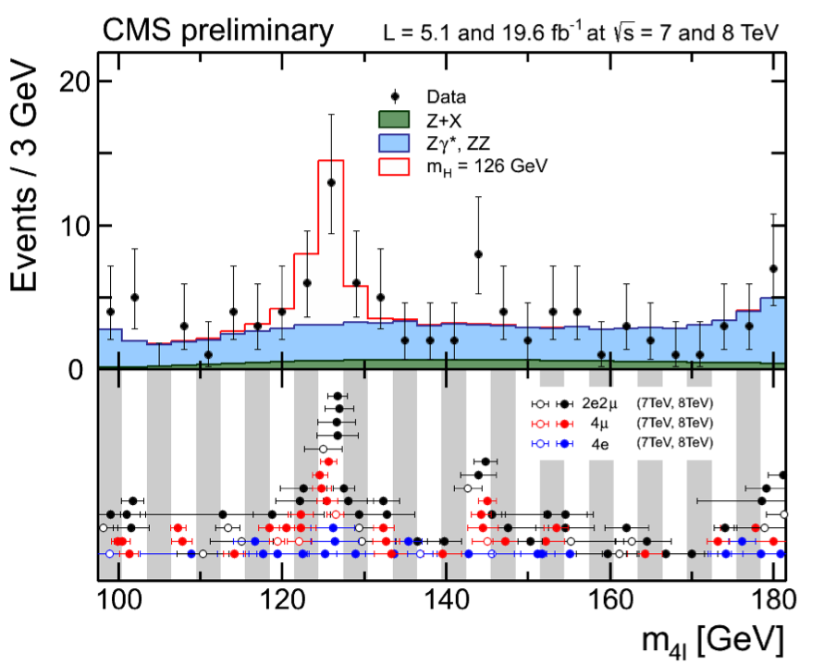
H  ZZ Results
ZZ  4e, 4μ, 2e2μ Candidates
Low Mass Region
Clear Signal Peak Near 126 GeV
Z 4l Peak Provides Cross Check

Slide 24

More Details on Higgs to 4L Resonance
M_{Z1} exhibits a few more events off-shell compared to SM Higgs expectation
➔ But statistically not very significant

Slide 25






H → ZZ → 4 Leptons
K_{D}: Matrix Element Kinematic
Discriminant
signal
background
template
background
template
Signal
template
K_{D}
K_{D} =
High mass data w/error bars
Superimposed on background
Low mass data with error bars
Superimposed on background
Low mass data: Signal-like clustering near 126 GeV

Slide 26


H → ZZ(*) → 4l Results
P-values (1D, 2D, 3D best fits)
2σ
4σ
5σ
6σ
7σ

Slide 27


H → ZZ → 4l Mass Fit
3D Fit (M_{4l}, K_{D}, δM_{4l}) for mass: M = 125.8 ± 0.5 (stat) ± 0.2 (syst) GeV
Momentum Scale and Resolution: Studied and tuned in several
dilepton control samples

Slide 28

H → ZZ → 4l
Cross section and Coupling Factors: μ_{V} and μ_{F}

Slide 29


Alternative
Spin and Parity
Models Tested

Slide 30


H → ZZ → 4l
Spin and Parity Test Statistics Results

Slide 31


H → ZZ → 4l and 2l2τ
M (2l2τ) and Upper Limits Over the Full Range
SM Higgs is excluded at 95% CL in the range 130 – 827 GeV
expected exclusion 130 – 778 GeV
M(2l2τ): No Excess at High Mass
95% CL on σ/σ_{SM}

Slide 32



H to Zγ search

Slide 33


H  Zγ l⁺l⁻γ (l = e, μ)
CMS PAS-HIG-13-006
Still room for improvements:
  Further rejection of ISR and Z+Jets
  VBF topology
  Matrix element analysis

Slide 34

H  WW  2l 2ν (l = e, μ)
High Sensitivity, Low Resolution
CMS HIG-13-003

Slide 35

Searches for Higgs to WW
➔ 2D M_{ll} versus M_{T}

Slide 36



H → WW Cut-and-Count Analysis: DF 0 Jet
Optimized Selections per mass point are applied on
leptons’ p_{T}, M_{ll}, M_{T} (WW), ΔΦ_{ll} to enhance a Higgs signal
M_{ll}
M_{T} (WW)
ΔΦ_{ll}
MH | signal | WW | WZ+ZZ | Top | W+jets | Wγ | All bkg. | Data
125 | 90±19 | 310±29 | 11.4±1.1 | 20.0±4.3 | 48±13 | 40±13 | 429±34 | 505

Slide 37


H → WW 2D Shape Analysis DF 0 and
1 Jet: Data
8 TeV Data - Expected Background
0-Jet DF
8 TeV Data - Expected Background 1-Jet DF
Clear Excess observed in signal-enriched region (low M_{ll}, M_{T}~100 GeV)

Slide 38


H → WW → 2l 2ν (l = e, μ) Results
Combined σ/σ_{SM} 95% CL Limits
7+8 TeV Limits (95% CL) on σ/σ_{SM}
σ/σ_{SM} Including M_{H}=125 GeV) as backgrd
Observed limit matches expected background + H(125) signal injection
  ✴ Masses of 128-600 GeV are excluded at 95% CL
  + Limits on additional Higgs-like bosons above 113 GeV

Slide 39


H  WW  2l 2ν Signal Significance
7+8 TeV: Signal Significance vs M_{H}
Signal strength μ=σ/σ_{SM} vs M_{H}
For M_{H} = 125 GeV:
Observed Significance = 4.0 σ
Expected Significance = 5.1 σ
  Mass resolution of this channel
  (~30 GeV) gives a wide
  minimum in the Likelihood

Slide 40


H  WW  2l 2ν Signal Strength
Best Fit Signal Strength μ vs M_{H}
  Best fit Signal Strength
  for M_{H} = 125 GeV:
  μ = σ/σ_{SM} = 0.76 ± 0.21
Best Fit on μ = σ/σ_{SM} by channel
Consistent results
among the channels

Slide 41

H → WW → 2l 2ν Spin Hypotheses
Hypothesis |  | Expected |  | Observed
Assuming σ/σ_{SM}=1
0⁺ | 1.9 |  | 0.9
2⁺_{m} | 2.4 |  | 1.3
Assuming Prefit σ/σ_{SM} on Data
0⁺ | 1.5 |  | 0.5
2⁺_{m} | 1.8 |  | 1.3
Expected separation between 0⁺ and 2⁺_{m} (minimal couplings): 2σ
Data is consistent with both hypotheses

Slide 42


WH  WWW  3l 3ν (l = e, μ)
New Sensitive Channel
CMS PAS-HIG-13-009
  95% CL Limits
  on σ/σ_{SM}
  3.3σ Observed
  (3.0σ Expected
  for MH = 125 GeV)
  Three high p_{T} isolated leptons with moderate E_{T}^{Miss}
  Z Veto and anti b-tagging to reject WZ and Top backgrounds
  Smallest m_{ll} < 100 GeV and smallest ΔR (l+l-) < 2
  Two Approaches: Cut-Based and shape-based using ΔR (l+l-)
    Shape-based has 20% better performance

Slide 43




Searches for Higgs to ττ
CMS PAS-HIG-13-004
Signatures: eμ μτ_{h} eτ_{h} μμ τ_{h}τ_{h}

Slide 44



H  ττ: Signal Extraction
Combine 1-Jet and VBF
  Combine channels
  and categories
  Each channel in each category weighted by its expected S/B
Combined
2 Jet (VBF)
1 Jet (VBF)

Slide 45


H  ττ: Statistical Interpretation Limits and Signal Injection
95% CL Limits on σ/σ_{SM} vs M_{H}
compared to background expectations
95% CL Limits on σ/σ_{SM} vs M_{H}
compared to background + M_{H} (125)
Results are consistent with the expectations for background Plus a SM boson at M_{H} = 125 GeV
Notes:
Left plot shows iterations of analysis from last year’s summer conferences to now. Scaling by sqrt(N) last year’s result would give us roughly 3x SM sensitivity; we are now at 1.28 x SM at 125 GeV

Slide 46

H  ττ Results Significance
Broad excess is observed
over the low mass M_{H} range
Maximum local significance
is 2.93σ at 120 GeV
  Consistent with the presence
  of a 125 GeV SM scalar boson
Observed significance
is 2.85σ for M_{H} = 125 GeV
  Expected
Strong indication of decay
to Taus
46
Notes:
Left plot shows iterations of analysis from last year’s summer conferences to now. Scaling by sqrt(N) last year’s result would give us roughly 3x SM sensitivity; we are now at 1.28 x SM at 125 GeV

Slide 47



H → ττ Results: Signal Strength vs Mass, by Channel, by Category
Results are consistent across channels and categories
Combined Best Fit μ = 1.1 ± 0.4 (M_{H} = 125 GeV)
Notes:
Left plot shows iterations of analysis from last year’s summer conferences to now. Scaling by sqrt(N) last year’s result would give us roughly 3x SM sensitivity; we are now at 1.28 x SM at 125 GeV

Slide 48

Searches for Higgs to bb
CMS PAS-HIG-
12-046 (HCP)

Slide 49


VH  V bb Associated Production
Many Analysis Improvements
MVA for better b-jet P_{T} 
M_{bb} mass resolution
8-9% for M_{H} = 125 GeV
Split events in medium and high boost (P_{TV})
Reconstruct Jet Energy
using BDT regression:
15-20% improvement
Use full shape of final MVA discriminator
Gain in sensitivity ~50% overall, already on 2011
dataset
Extensively validated
in data using Z(ll) + bb, ttbar, and
single top events
M_{bb}
1
Large P_{TV}  Larger S/B
W(μν)H BDT Output
2
4
VH (125)

Slide 50

Searches for Higgs to bb in VH

Slide 51



VH Vbb: Results
Local Significance and signal strength
95% CL Limits on σ/σ_{SM}
Best Fit σ/σ_{SM}
Channels are compatible
within errors (M_{H} = 125 GeV)
Observed Limit on
σ/σ_{SM} is 2.5 at 125 GeV
  Expected Limit eith
  no SM Higgs is 1.2
Observed local significance is 2.2σ
    Expected Limit is 2.1σ with presence of SM
    H at 125 GeV
    Compatible with SM
Combined best fit
signal strength σ/σ_{SM} is
μ = 1.3
With H(125) Injected
Local p-values Vs. M_{H}
+0.7
- 0.6

Slide 52



Summary – Consistent Picture and Compatible with SM Higgs

Slide 53
CMS Combination
Still Based on 5+12 fb⁻¹
Expect to have more later this week…

Slide 54


Coupling Measurement (1)
Similarly for vector & fermion couplings C_{V} & C_{F} into 2 scale factors, κ_{V} & κ_{F}
Fermiophobic scenario exclude at >4σ level

Slide 55

Coupling Measurement (2)
Photon and gluon couplings mapped into 2 scale factors, κ_{γ} & κ_{g}

Slide 56



Mass measurement
Current mass measurements done without making any assumption on individual σ·BR
2σ
1σ
M = 125.8 ±
0.4 (stat) ± 0.4 (syst)

Slide 57

Full Mass Range

Slide 58
Summary and Conclusion
The examination of the new boson in CMS has advanced rapidly; many analyses have been improved; some new ones have begun
  ➔ More improvements are expected
We have made more accurate measurements of the boson’s mass
    M = 125.8 ± 0.4 (stat) ± 0.4 (syst)
The boson’s signal strength and couplings, measured in several channels, are compatible with SM expectations – that is the Signal strength is close to 1 and we known to 15%
The boson’s spin and parity is compatible with 0+, while other alternative pure J^{P} states are disfavored at 95% CL

