Slide 1
Damped C-Band RF structures for ELI-NP proposal
D. Alesini
(LNF-INFN, Frascati, Italy)
RFTech 4th workshop
25-26 March 2013
Imperial Palace, Annecy

Slide 2
OUTLINE
(The C-Band history at LNF: C-Band accelerating structures for SPARC energy upgrade)
C-Band structures for the ELI-NP proposal:
-ELI-NP gamma source and the European proposal
-design of the C-band structures:
BBU study and choice of the type of damping
electromagnetic design (HFSS/GdfidL)
beam loading compensation
-mechanical design criteria: simplify the fabrication and reduce the cost

Slide 3
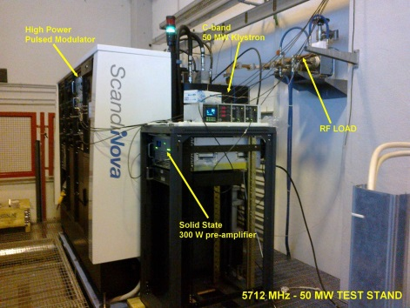
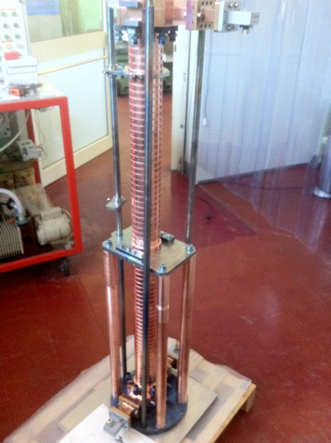
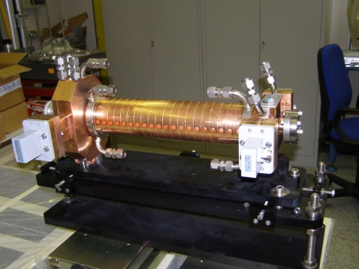
THE C-BAND @ LNF: SPARC ENERGY UPGRADE
The SPARC energy will be upgraded from ≅170 to >240 MeV by replacing a low gradient S-band traveling wave section with two C-band units.
We decided to implement this system at SPARC to explore the C Band acceleration (RF components, construction at LNF TW sections, SLED, syncronization) in hybrid scheme with S Band:
-Higher gradients
-Very promising from the beam dynamics point of view
Klystron
N°1
3 dB
splitter
ATT
E ≈ 170 MeV
20 ÷ 22 MV/m ≈ 130 MeV
ACC. SECTION
ACC. SECTION
ACC. SECTION
GUN
≈ 13 MV/m
PULSE
COMPRESSOR
Klystron
N°2
C-band acc. structures
> 35 MV/m
E > 240 MeV
1.4 m
1.4 m
≈ 50 MW
≈ 50 MW
C-band
Station
2.5 μs
≈ 100 MW/0.20μs
5712 MHz – 50 MW
C-band
ENERGY
COMPRESSOR
Notes:
3

Slide 4
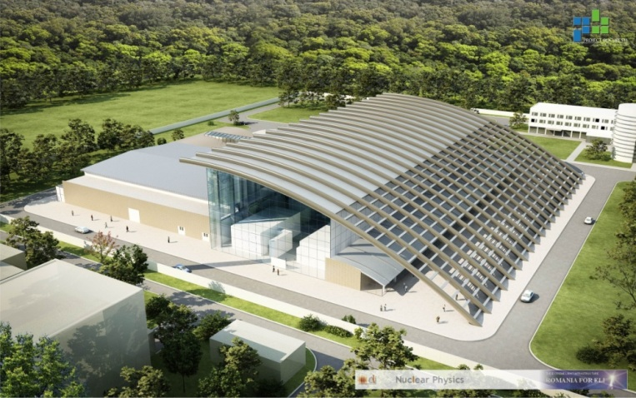
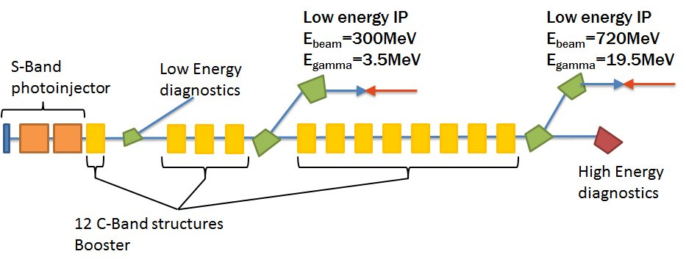
In the context of the ELI-NP Research Infrastructure, to be built at Magurele (Bucharest, Romania), an advanced Source of Gamma-ray photons is planned, capable to produce beams of mono-chromatic and high spectral density gamma photons. The Gamma Beam System is based on a Compton back-scattering source. Its main specifications are: photon energy tunable in the range 1-20 MeV, rms bandwidth smaller than 0.5% and spectral density larger than 10⁴ photons/sec.eV, with source spot sizes smaller than 10-30 microns.
Bunch charge | 250 pC
Number of bunches | 32
Bunch distance | 16 ns
C-band average accelerating gradient | 33 MV/m
Norm. emittance | 0.2-0.6 mm⋅mrad
Bunch length | <300 μm
RF rep Rate | 100 Hz

Slide 5
C-BAND STRUCTURE DESIGN: BBU STUDIES
ELI-NP operates in multi-bunch mode. The passage of electron bunches through accelerating structures excites electromagnetic wakefield. This field can have longitudinal and transverse components and, interacting with subsequent bunches, can affect the longitudinal and the transverse beam dynamics.
LONGITUDINAL EFFECTS ⇒ beam loading
TRANSVERSE EFFECTS ⇒ Cumulative beam break-up (BBU)
-Analytical approaches can be used to evaluate the beam breakup effects (for example Mosnier theory).
-Tracking codes
Beam output positions
(y_{OUT},y’_{OUT})
E_{acc}=average accelerating field
Injector S-band
Ideal axis
E_{inj}=beam energy after injector
Booster LINAC (C-band)
y’_{OUT}
1st bunch of the train
Beam injection conditions at the entrance of the linac booster (y_{IN},y’_{IN})
Phase space @ LINAC exit
Other bunches
Equivalent beam emittance increase
y_{OUT}

Slide 6
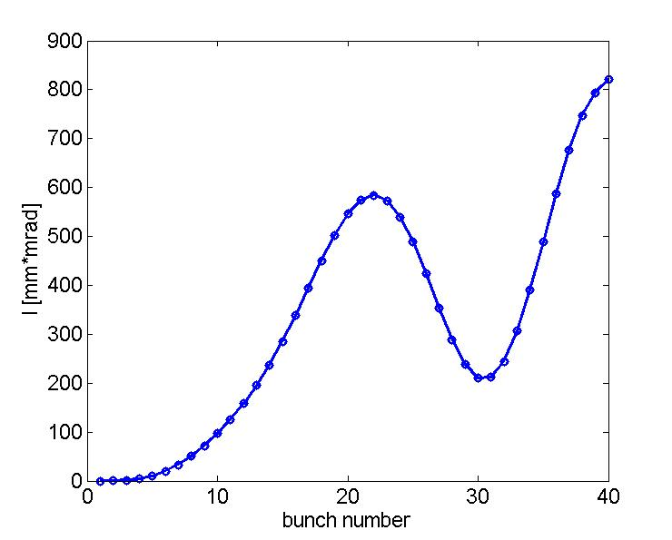
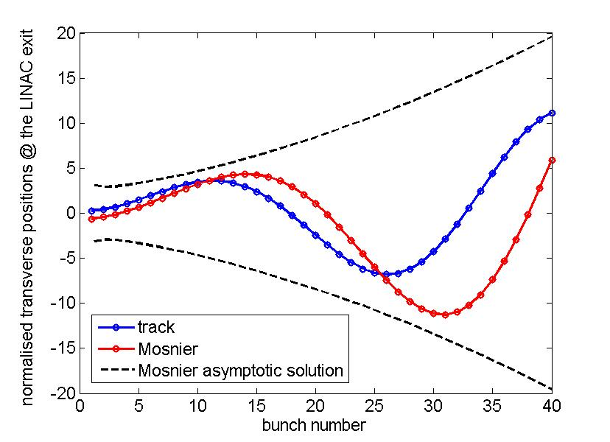
BBU Results
Hypothesis:
Initial condition at linac injection equal for all bunches
Constant β-function
all transverse wakes that decays with the quality factor of the mode
One single mode trapped in each cell
R_{T}/Q | 26 Ω
Q | 11000
f_{res} | 8.398 GHz
W_{T} (∝f²) | 245 V/m/pC
w_{T}=W_{T}/L (∝f³) | 14 kV/m²/pC
tracking
Tracking & Mosnier

Slide 7
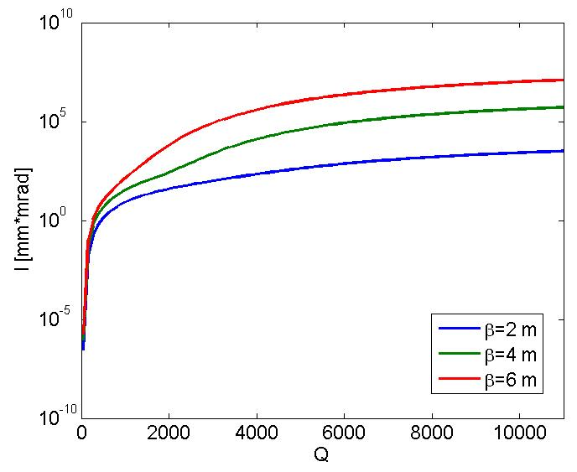
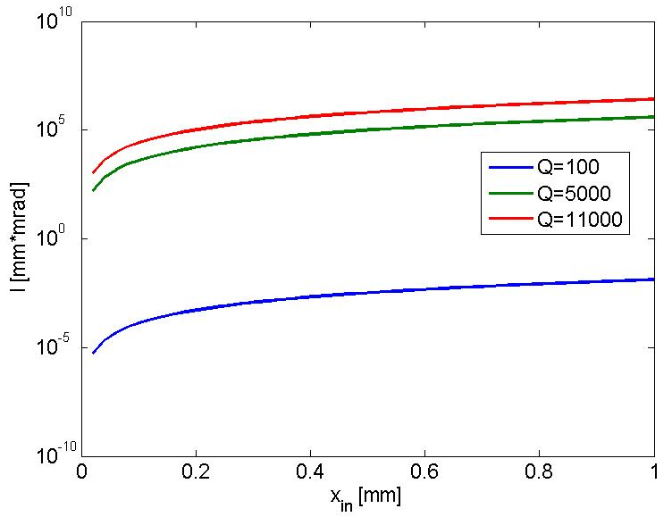
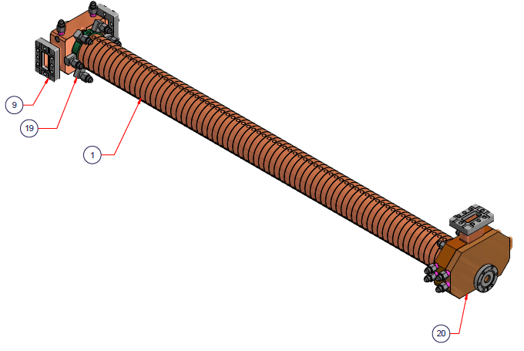
Mitigation of multi-bunch effect with damped structures
DAMPED STRUCTURES
C-band non damped
SPARC energy upgrade

Slide 8
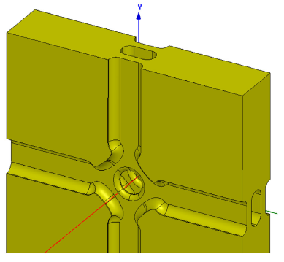
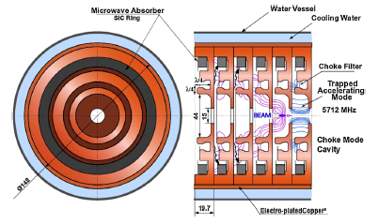
Damping of dipole modes choice
Dipoles modes propagate in the waveguide and dissipate
into a load
CLIC structures X-band, high gradient
C-Band structures Spring-8
Advantages
1. Strong damping of all modes above waveguide cut-off
2. Possibility of tuning the cells
3. Good cooling possibility
Disadvantages
Machining: need a 3D milling machine
Multipole field components (octupole) but not critical at least for CLIC
Advantages
Easy machining of cells (turning)
2D geometry: no multipole field components
Disadvantages
1. Critical e.m. design: notch filter can reflect also other modes.
2. Not possible to tune the structure
4. Cooling at 100 Hz, long pulse length (?)

Slide 9
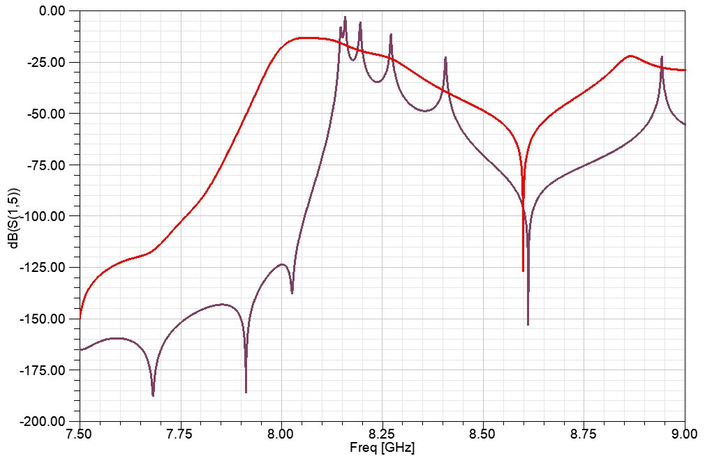
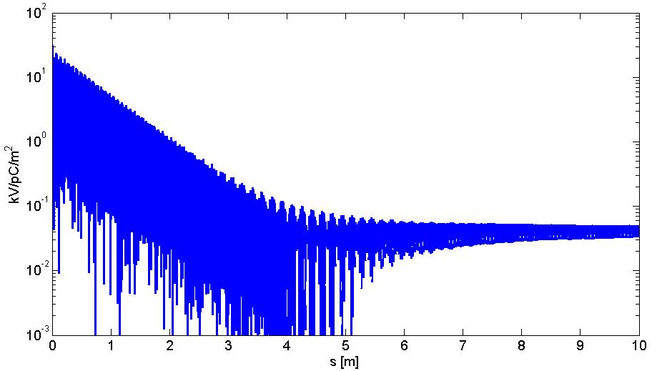
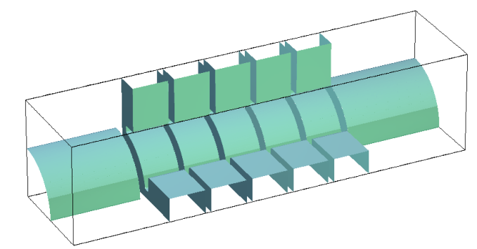
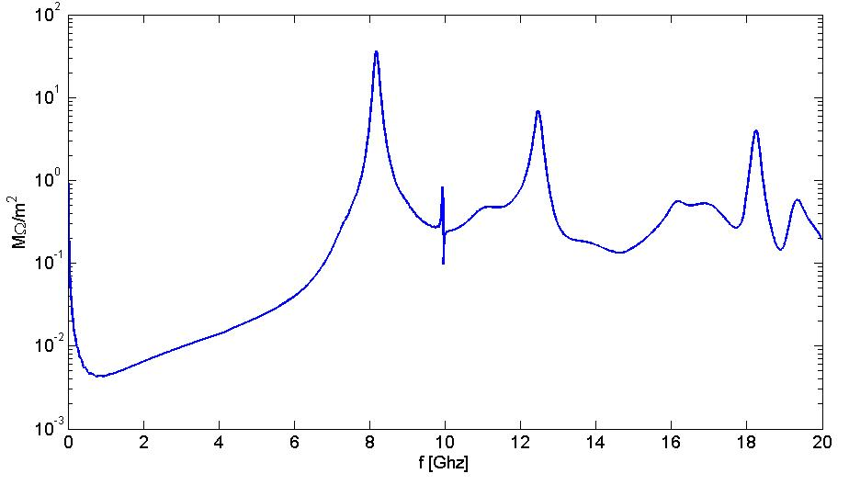
ELI Damped structure HFSS and GdFidL simulations
w=13 mm
w=7 mm
w
First dipole mode passband

Slide 10
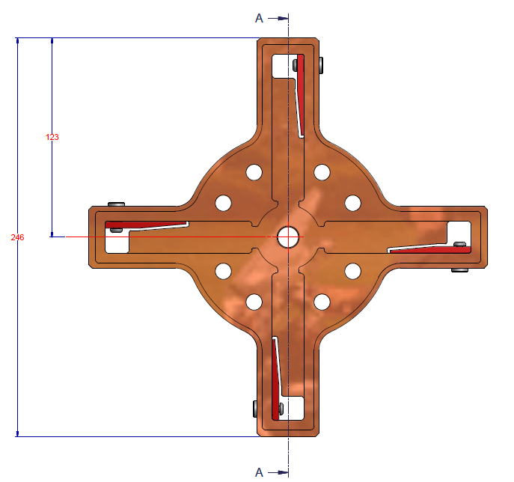
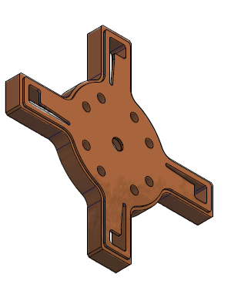
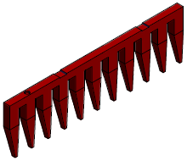
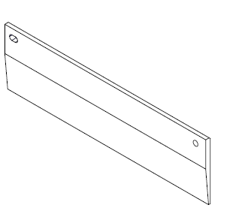
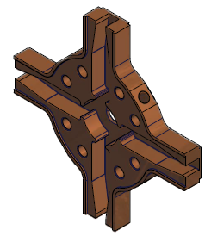
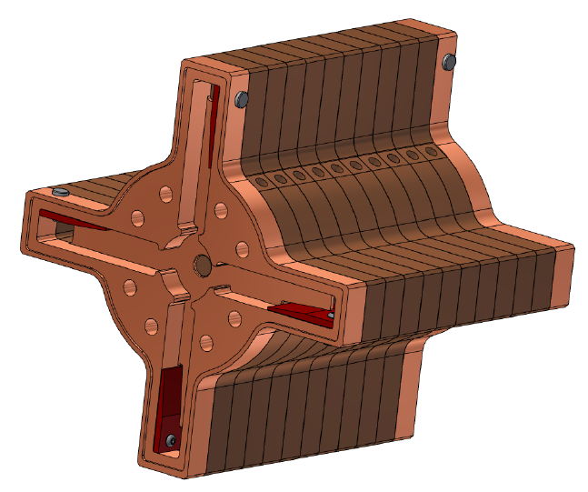
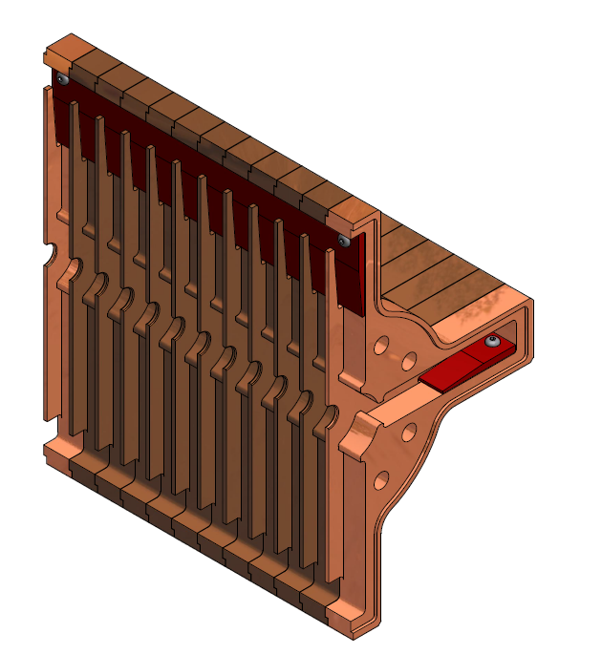
Damping system design
The power released by the beam on the dipole modes is dissipated into SiC absorbers. Several different solutions are possible to design the absorber. The final geometry has been optimized to simplify the realization procedure and the overall cost of the structures . From the e.m. point of view this is not the «ideal» solution but is is still very good from the point of view of HOM damping.
Previous solution
old absorber
New absorber

Slide 11
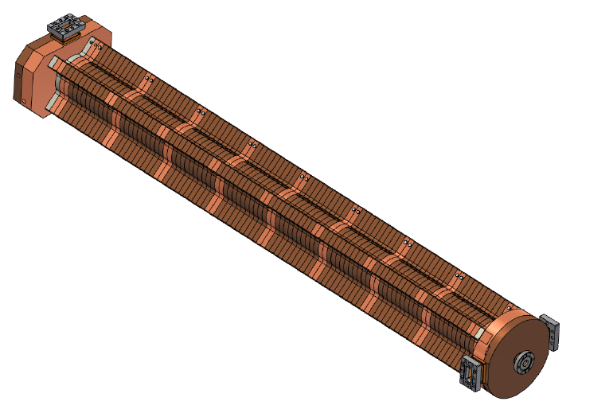
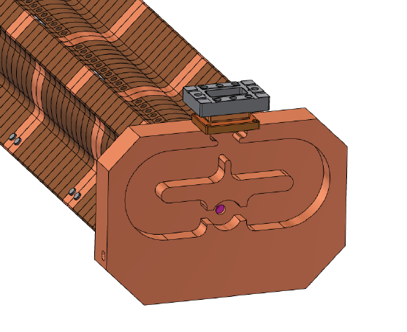
Input/output couplers
Integrated splitter

Slide 12
ELI Damped structure: parameters
PARAMETER | VALUE
Type | TW- constant gradient 102 cells
Frequency (f_{RF}) | 5.712 [GHz]
Phase advance per cell | 2π/3
Structure Length included couplers (L) | 1.8 m
Iris aperture (a) | 7.3-5.8 mm
group velocity (v_{g}/c): | 0.034-0.013
Quality factor (Q) | 8800
Field attenuation (α) | 0.2-0.5 [1/m]
series impedance (Z) | 27-81 [MΩ/m²]
Shunt impedance per unit length (r) | 69 [MΩ/m]
Filling time (τ) | 280 [ns]
E_{s peak}/E_{acc} | 2.1
H_{s peak}/E_{acc} | 4.3⋅10⁻³ [A/V]
Minimum RF pulse length (τ_{IMP}) | 0.800 [μs]
Output power | 0.33⋅P_{in}
E_{ACC_average}@ P_{IN}=40 MW | 33 MV/m
Pulsed heating @ P_{IN}=40 MW | 9 ºC
Average dissipated power @ 100 Hz, P_{IN}=40 MW | 2.1 [kW]

Slide 13
C-BAND STRUCTURE DESIGN: BBU STUDIES
ELI-NP operates in multi-bunch mode. The passage of electron bunches through accelerating structures excites electromagnetic wakefield. This field can have longitudinal and transverse components and, interacting with subsequent bunches, can affect the longitudinal and the transverse beam dynamics.
LONGITUDINAL EFFECTS ⇒ beam loading
TRANSVERSE EFFECTS ⇒ Cumulative beam break-up (BBU)
-Analytical approaches can be used to evaluate the beam breakup effects (for example Mosnier theory).
-Tracking codes
Beam output positions
(y_{OUT},y’_{OUT})
E_{acc}=average accelerating field
Injector S-band
Ideal axis
E_{inj}=beam energy after injector
Booster LINAC (C-band)
y’_{OUT}
1st bunch of the train
Beam injection conditions at the entrance of the linac booster (y_{IN},y’_{IN})
Phase space @ LINAC exit
Other bunches
Equivalent beam emittance increase
y_{OUT}

Slide 14
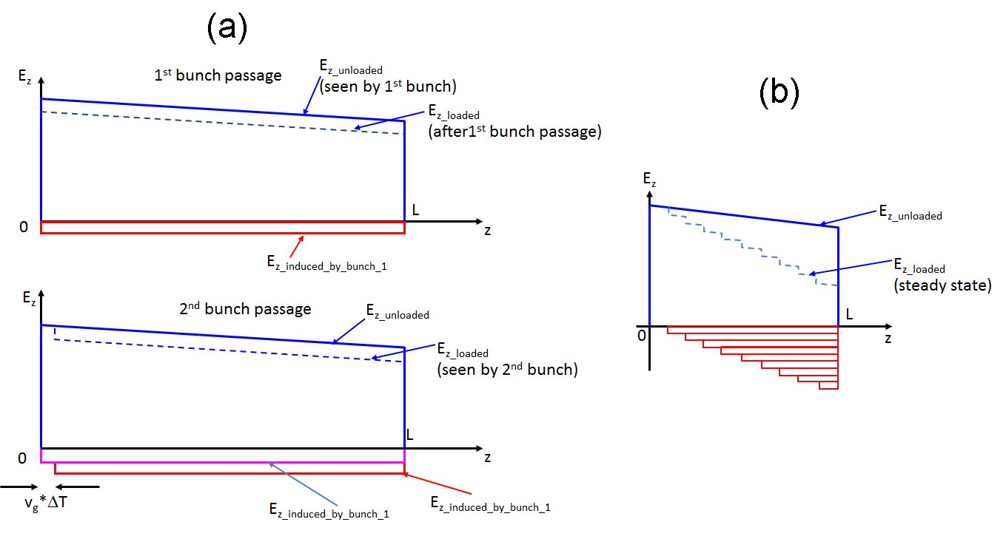
Beam loading: approach
The external voltage given by the RF generator and the beam induced voltage in CI structure can be analytically calculated un the frequency domain [Wang,…] and they are given by the following expressions:

Slide 15
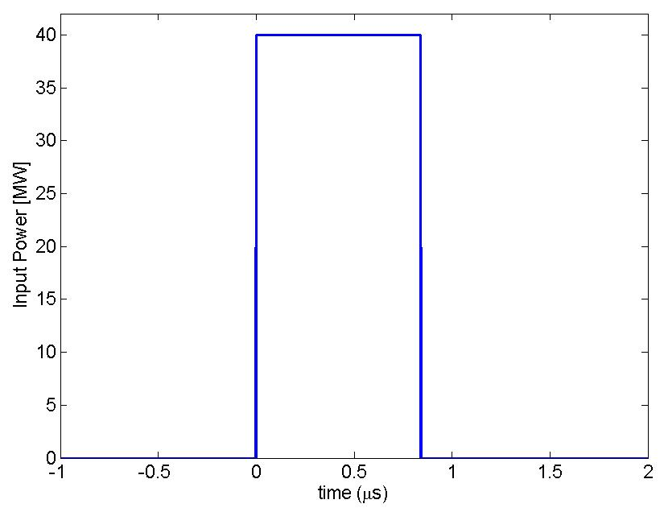
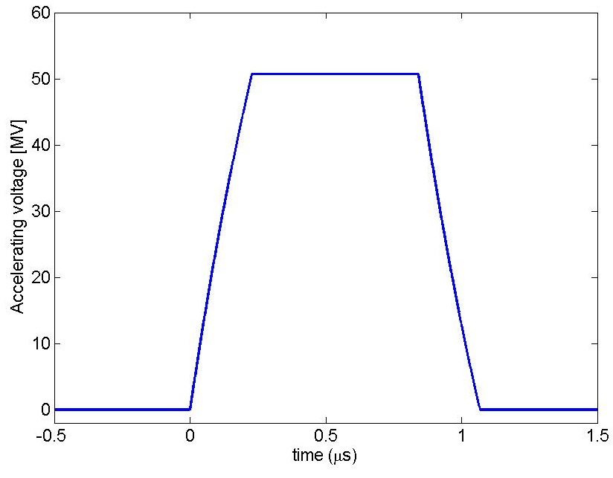
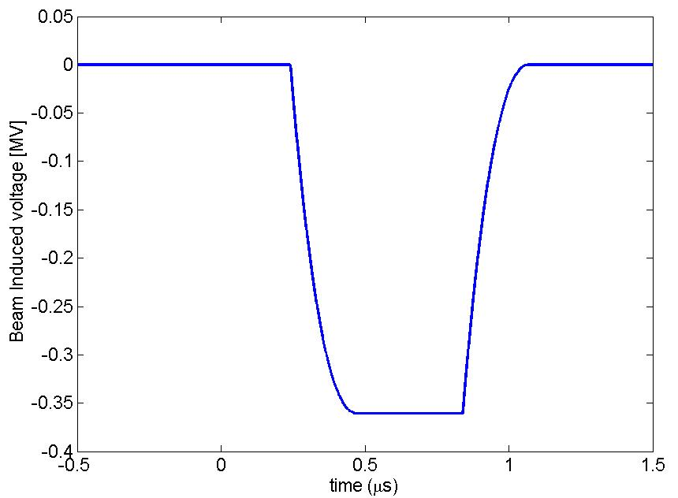
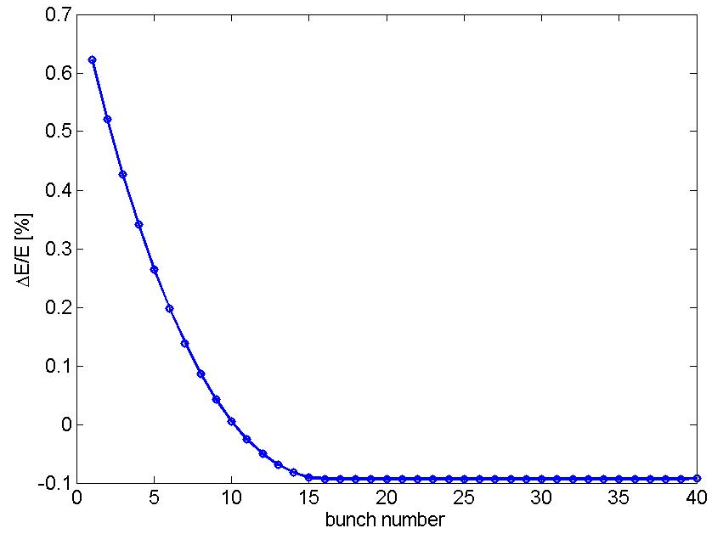
Beam loading: results

Slide 16
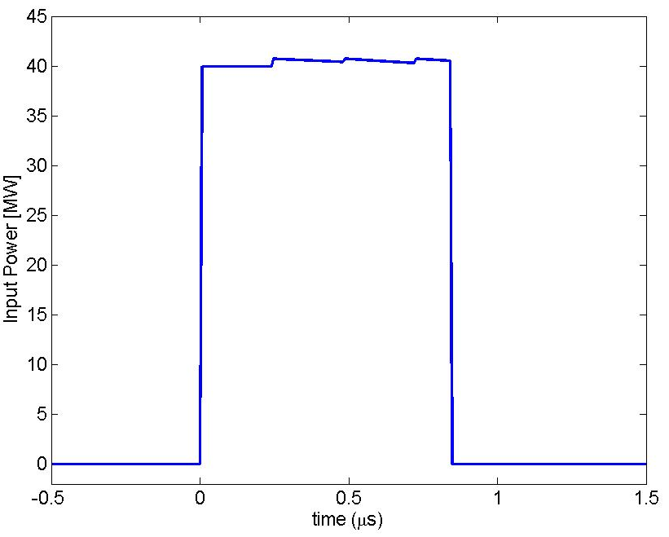
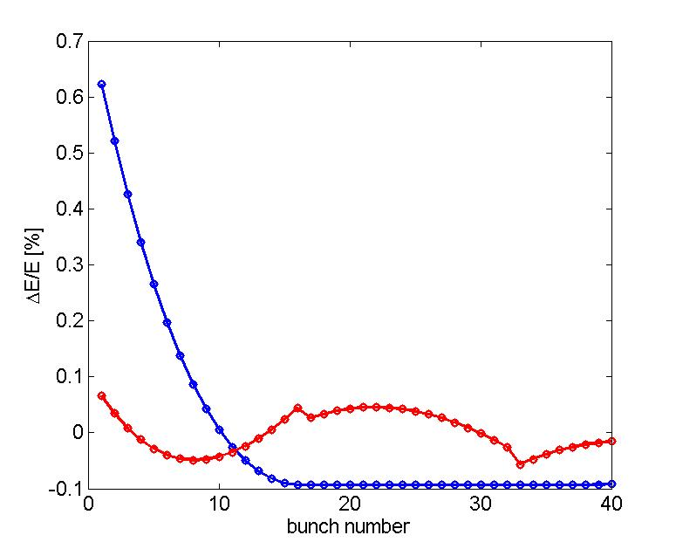
Beam loading: possible compensation

Slide 17
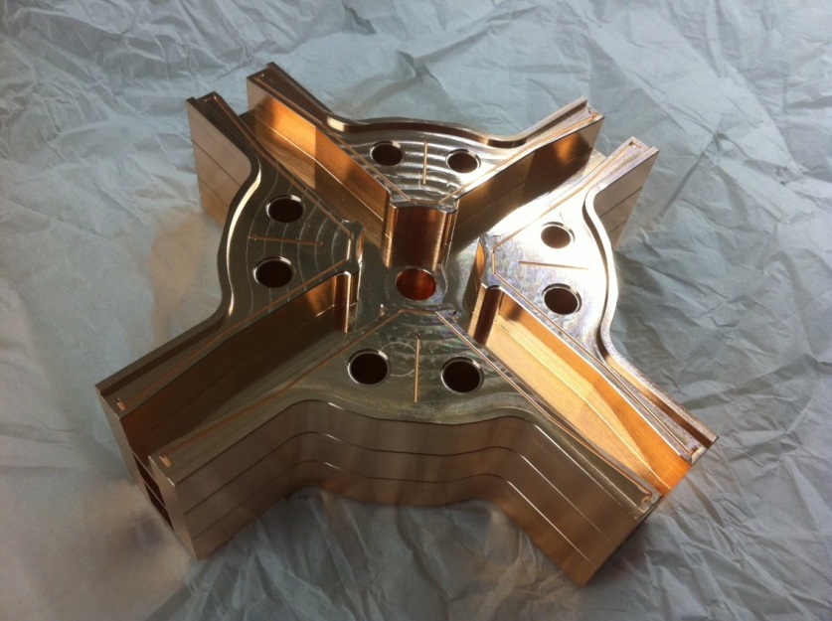
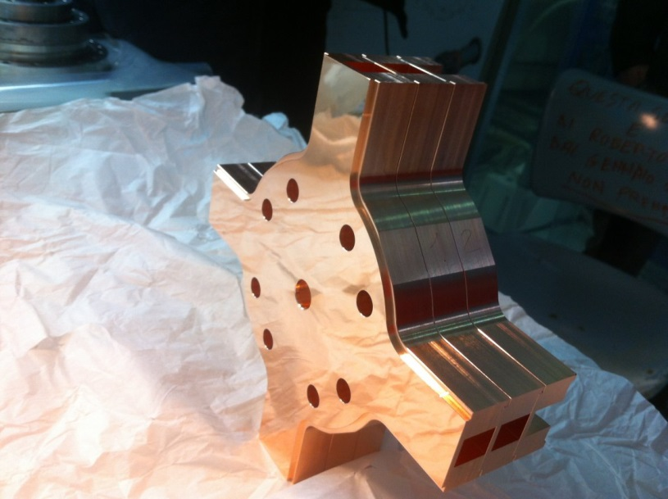
Realization and prototyping
Two lines of main activity:
-prototype with a reduced number of cells to:
⇒Test the effectiveness of the dipole mode damping including the test the absorbing material performances
⇒ Test the vacuum properties of the structure with absorbing material
⇒ Perform the low power RF tests and the tuning of the structure
⇒Test the high gradient performances of the structure
-prototype full scale w/o RF only for brazing/mechanical test
First complete prototype
(end 2013)

Slide 18
Conclusions
-C-Band structure adventure started @ LNF for the SPARC energy upgrade- single bunch operation
-For the ELI-NP proposal Damped structures (waveguide absorbers) have been proposed to prevent BBU
-EM design has been completed
-Mechanical drawings almost completed
-Prototyping phase
THANK YOU

Slide 19
THANKS TO ALL CONTRIBUTORS
M. Migliorati, A. Mostacci, C. Vaccarezza, M. Ferrario (Beam Breakup and wake-field calculation)
V. Lollo, R. Di Raddo, (mech. Design of damped structures)
S. Tocci, L. Palumbo (Univ. La Sapienza) (GdFidL simulations of damped structures)
G. Riddone and her collaborators (CERN) (mechanical construction)
A. Grudiev (CERN) (design of damped structures)

