Slide 1
Costing high-energy accelerator systems
Philippe Lebrun
CERN, Geneva, Switzerland
4th RFTech Workshop
Annecy, 25-26 March 2013

Slide 2
Contents
Cost & performance of high-energy accelerators
Cost estimate methods, organization & tools
Large series, manufacturing techniques & learning curves
Elements of cost risk analysis
Coping with exchange rates & cost escalation

Slide 3
Contents
Cost & performance of high-energy accelerators
Cost estimate methods, organization & tools
Large series, manufacturing techniques & learning curves
Elements of cost risk analysis
Coping with exchange rates & cost escalation

Slide 4

Development of circular accelerators
80 years
10⁵ increase in size
10⁸ increase in beam energy
Lawrence’s first cyclotron (1930)
Large Hadron Collider (2009)

Slide 5
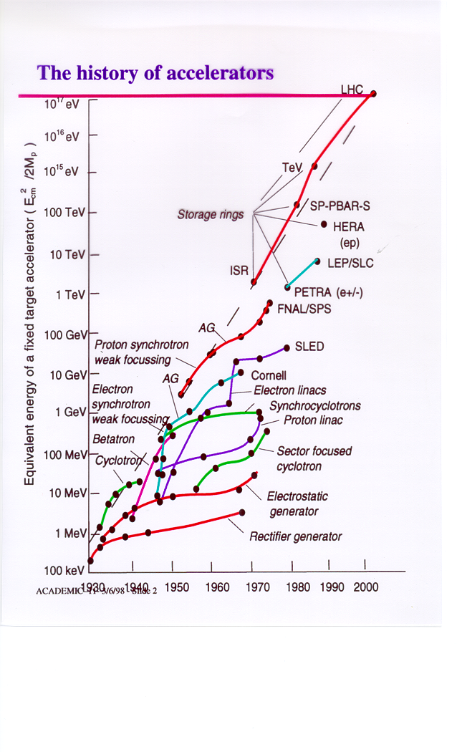
sustained exponential development for 80 years
could not have been obtained only by increase in size (cost)
progress achieved through repeated jumps from saturating to emerging technologies

Slide 6
A sustained decrease in specific cost
Cost ~ Ecm ^{0.28}

Slide 7
Contents
Cost & performance of high-energy accelerators
Cost estimate methods, organization & tools
Large series, manufacturing techniques & learning curves
Elements of cost risk analysis
Coping with exchange rates & cost escalation

Slide 8
Cost estimate methods
Analytical
  Based on project/work breakdown structure
  Define production techniques
  Estimate fixed costs
  Establish unit costs & quantities (including production yield and rejection/reprocessing rates)
  In case of large series, introduce learning curve (see later)
Scaling
  Establish scaling estimator(s) and scaling law(s), including conditions & range of application
    Empirical
    « First-principles » based
  Define reference project(s) and fit data
In most cases, hybrid between these methods

Slide 9
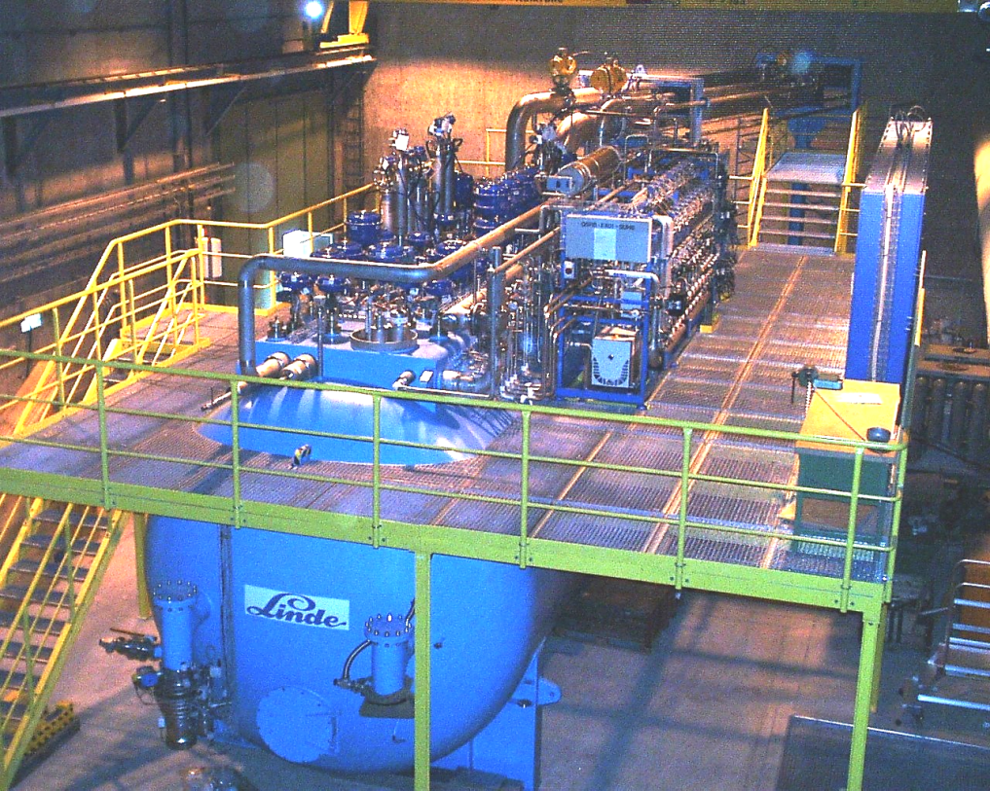
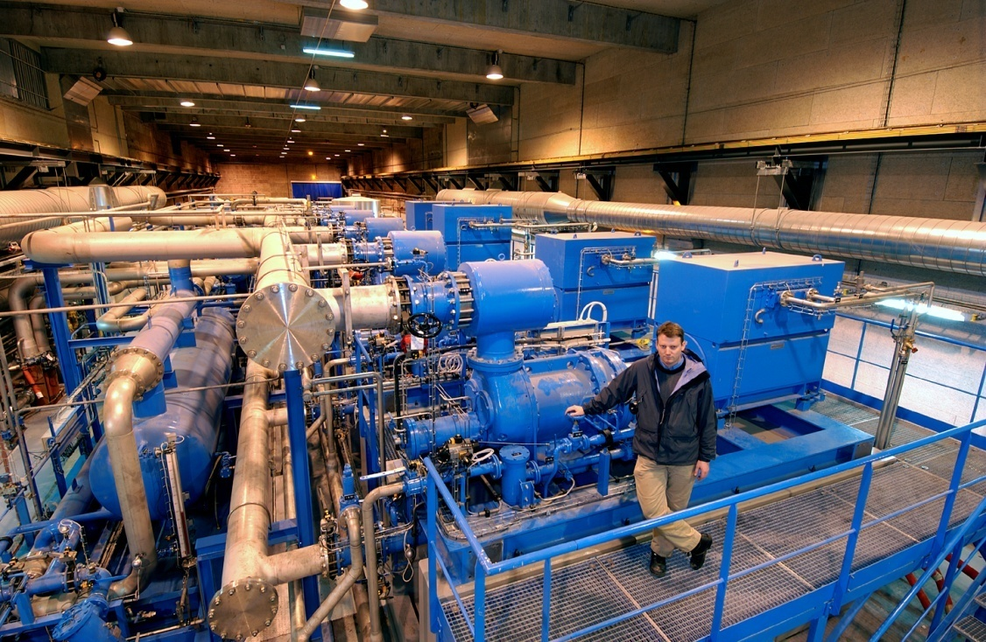
Semi-empirical scaling
Cost structure of cryogenic helium refrigerators
Compressor station
Modular
Cost ~ linear with capacity
Cold box
Cost < linear with capacity

Slide 10
Semi-empirical scaling
Cost of cryogenic helium refrigerators

Slide 11
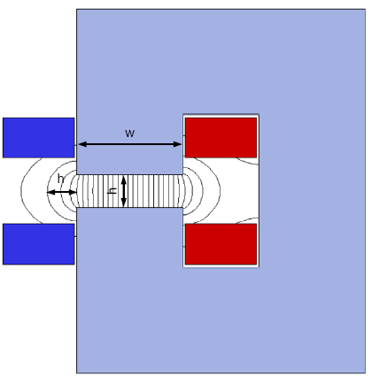

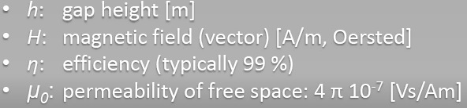
“First-principles” scaling
Normal-conducting magnets
Basics
Yoke sizing
Coil sizing
T. Zickler

Slide 12
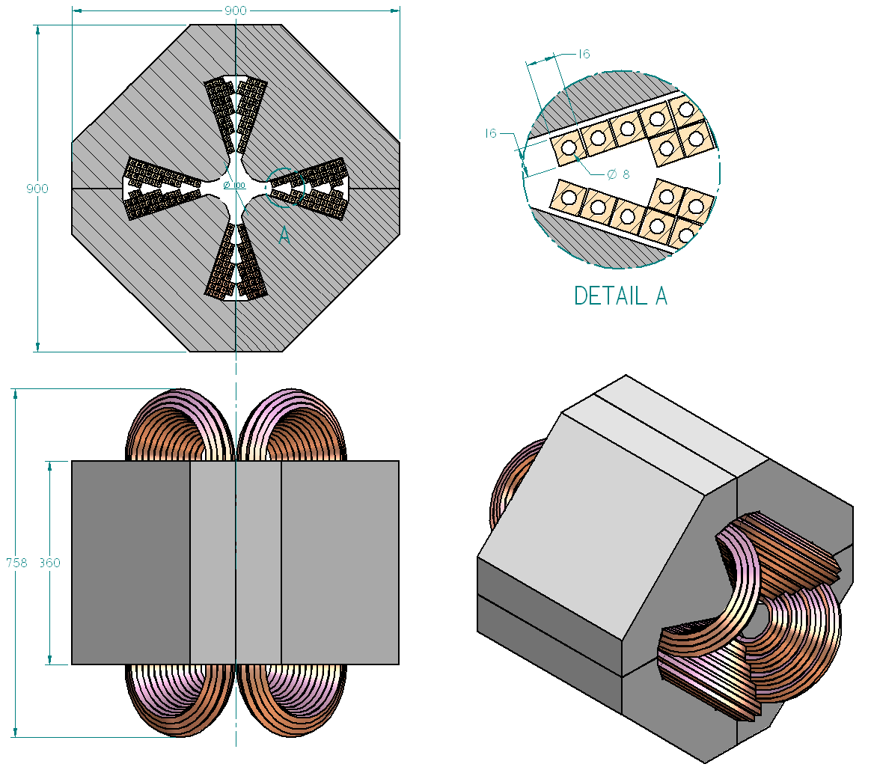
Preliminary design for costing
Normal-conducting magnets
PBS 1.2.1 and 2 Pre-Damping Ring | QUADRUPOLE 30 T/m
Length | 758 mm
Weight | 1720 kg
Power | 17.4 kW
N. of units | 408
Cost/unit | 148 kCHF
TOTAL COST | 60384 kCHF
M. Modena & A. Vorozhtsov

Slide 13
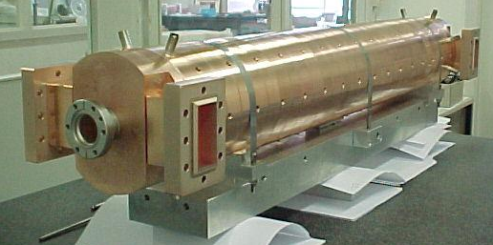
Cost of RF accelerating structures
3 GHz fully beam-loaded structure from industry
Cost breakdown
f_{acc}= 3 GHz
P_{in}= 33 MW
n_{cell}= 33
Length= 1.22 m
Ø_{outside}= 17.4 cm
weight ≈ 200 kg
Knowing the cost breakdown enables «intelligent» scaling to a similar structure of different frequency
E. Jensen & R. Wegner

Slide 14
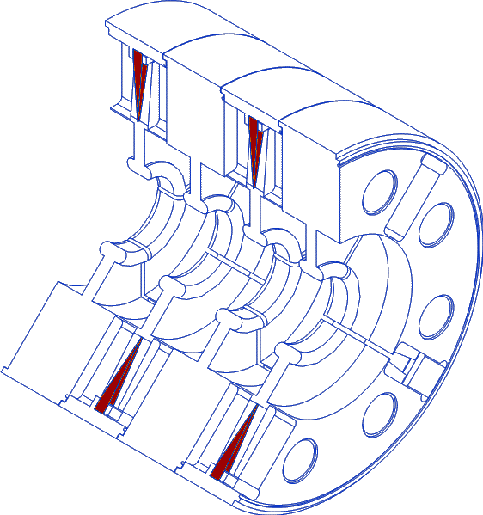
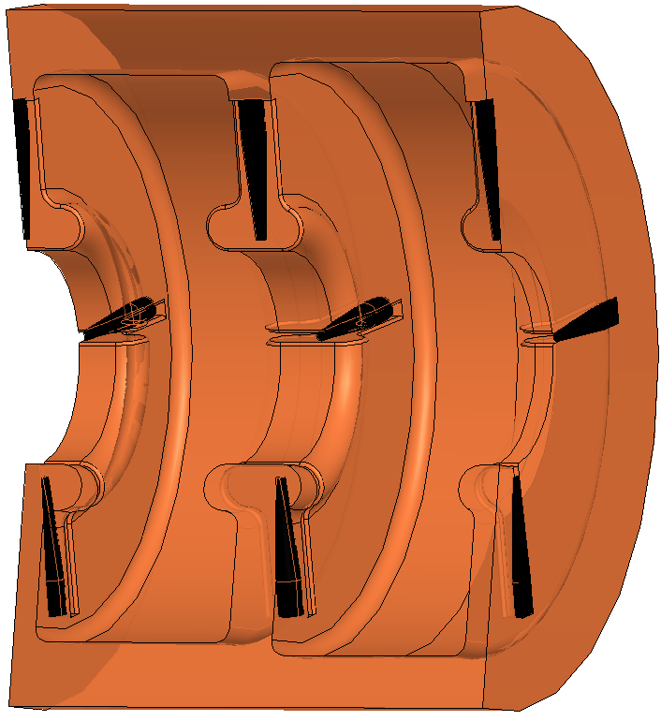
Cost of RF accelerating structures
Scaling from 3 GHz to 1 GHz
34 cells, mass: 200 kg
Material: 260 kg Cu-OFE 2001: 18 kCHF
Manufacturing: 128 kCHF
+ other cost: 24 kCHF
=========================
Total 170 kCHF (2001)
21 cells, mass: 700 kg
Material: 1.2 t Cu-OFE 2012: 120 kCHF
Manufacturing 100 kCHF
+ other cost: 80 kCHF
=========================
Total: 300 kCHF (2012)
+ larger series: apply learning curve
E. Jensen & R. Wegner

Slide 15
Costing multi-MW klystrons
Reference data

Slide 16
Scaling klystron cost
E. Jensen

Slide 17
Optimizing klystron initial cost
E. Jensen

Slide 18
Optimizing klystron cost with replacement
E. Jensen

Slide 19
Organization for CLIC cost estimate
Squeeze information from technical experts
Develop a comprehensive cost picture
Provide feedback to project design
Share methods and results
CLIC Steering Committee
CLIC Technical Committee
reports to
ILC GDE Cost Team
PBS, developments & alternatives
Information, methodology
Other CLIC WG
CLIC Cost & Schedule WG
Technical design
Configuration
Other CLIC WG
System group
Analytical costing
Other CLIC WG
System group
System group

Slide 20
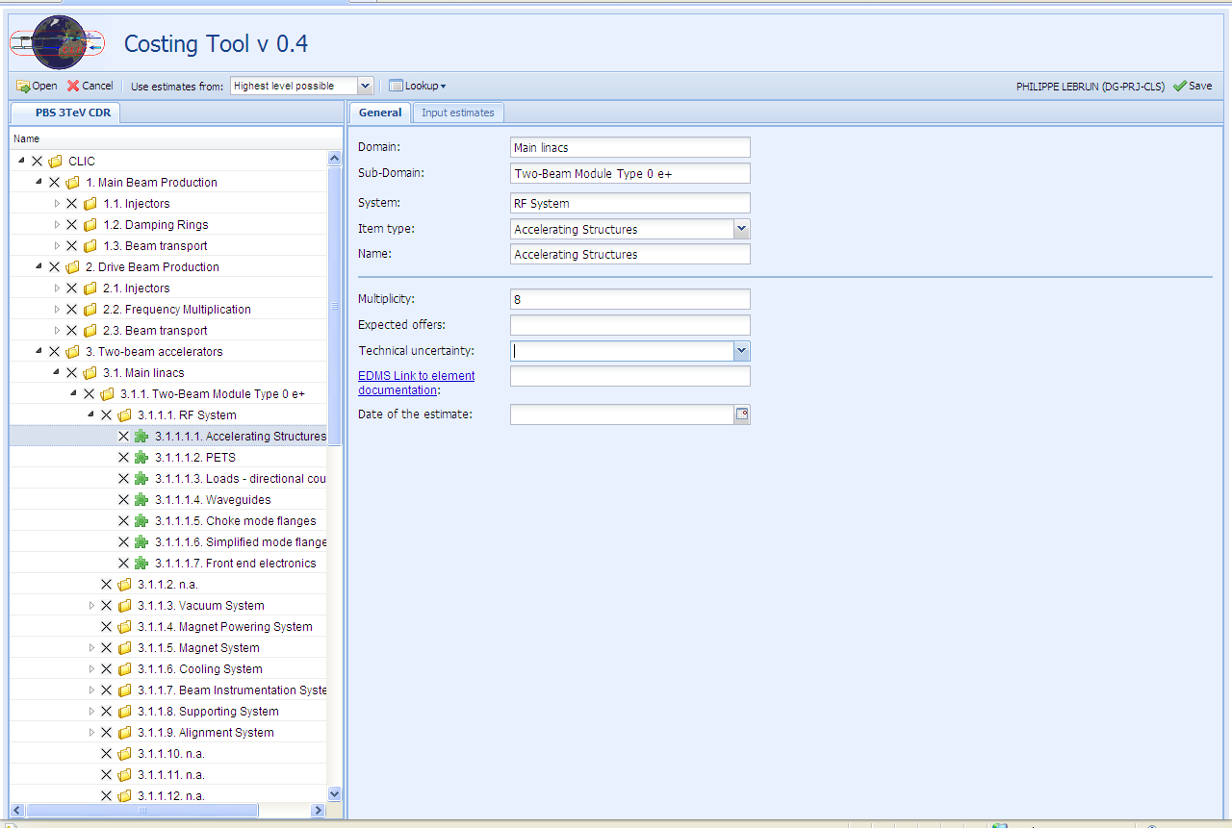
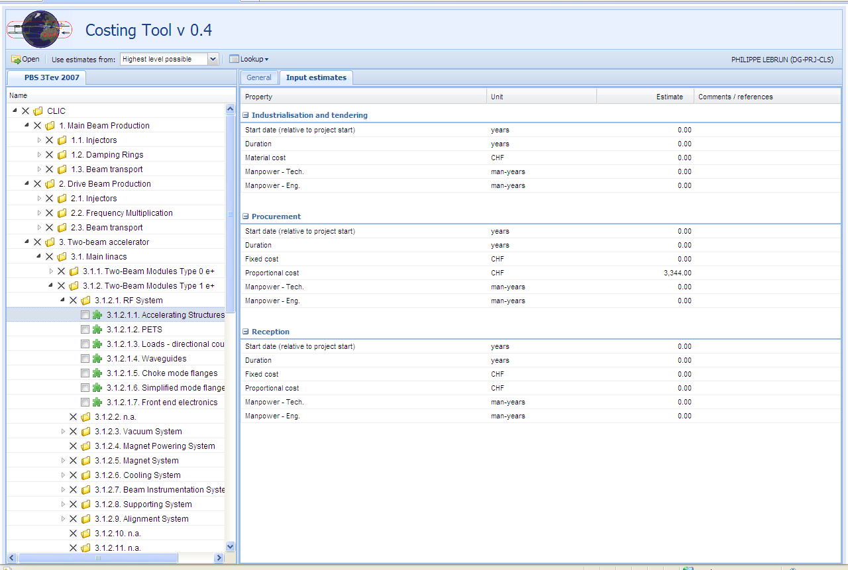
CLIC Study Costing Tool
CLIC Study Costing Tool developed & maintained by CERN GS-AIS
Operational, on-line from C&S WG web page (access protected)
Includes features for currency conversion, price escalation and uncertainty
Production of cross-tab reports exportable to EXCEL
Full traceability of input data
Applicable to other projects

Slide 21
Contents
Cost & performance of high-energy accelerators
Cost estimate methods, organization & tools
Large series, manufacturing techniques & learning curves
Elements of cost risk analysis
Coping with exchange rates & cost escalation

Slide 22
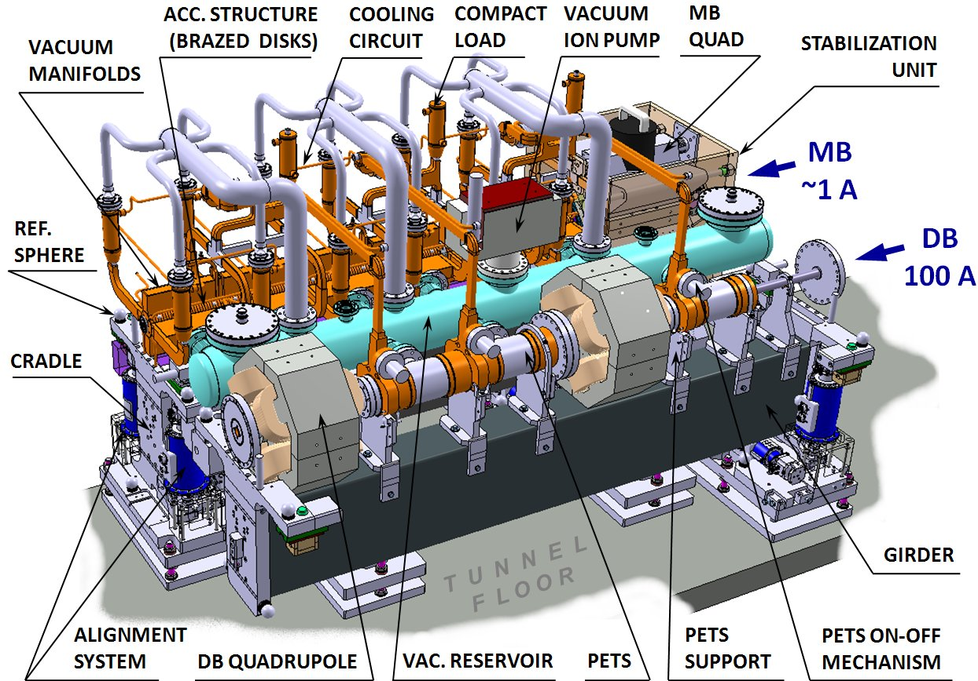
CLIC two-beam modules
Complexity, number, integration
CLIC at 500 GeV (4’232 modules)
26’920 Accelerating Structures
13’460 PETS
~ 70’000 RF components
CLIC at 1.5 TeV (10’730 modules)
71’380 Accelerating Structures
35’690 PETS
~ 200’000 RF components
G. Riddone

Slide 23
CLIC vs LHC components
Different solutions for different series numbers
Automatic chains
AS discs
AS quadrants
CLIC AS
CLIC PETS
CLIC Quads
CLIC TBM
Flexible workshops
Flexible cells, manual work

Slide 24
Learning curves
From airplanes to accelerator components
T.P. Wright, Factors affecting the cost of airplanes, Journ. Aero. Sci. (1936)
J.R. Crawford, Learning curve, ship curve, ratios, related data. Lockheed Aircraft Corporation (1944)
Unit cost c(n) of nth unit produced
c(n) = c(1) n^{log}₂ª
with a = « learning percentage », i.e. remaining cost fraction when production is doubled
Cumulative cost of first nth units
C(n) = c(1) n^{1+log}₂ª / (1+log₂a)
with C(n)/n = average unit cost of first nth units produced
n = number per production line ≠ total number in project
⇒ verified on LHC main magnets up to series of ∼400 units/manufacturer

Slide 25
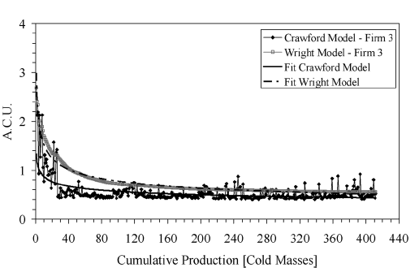
Experimental learning curves
LHC superconducting dipole magnets
Collared coils
Cold masses
P. Fessia

Slide 26
Who is «learning» and what is «learnt» in a learning curve?
The simple Wright-Crawford model is an attempt to represent mathematically the combined effect of several incremental factors, not easily separable, e.g.
  Individual learning
  More effective labor force
  Better control of the production process
  More effective work organization
  Introduction and running-in of new production methods
  New technology alternatives
  Redesign/reengineering of the product
  Standardization
  Automatization
  Increase of capacity of production unit
  Improved logistics
In a compound manufacturing process, the model can be refined by applying to each sequential stage an individual learning curve corresponding to the specific technical operation and rank concerned

Slide 27
Example of compound learning curve
Manufacturing of CLIC accelerating structures
1. Raw material
a:1
2. Machining
~4.3⋅10⁶ disks (including HOM, manifolds), QC and cleaning
a: 0.93
3. Assembly and brazing ~285000 couplers
Sequence of the main fabrication steps
8 couplers /cycle
[35690 cycles]
a: 0.85
Alignment and bonding 71380
disk stacks
4 ss/cycle
[17845 cycles]
a: 0.85
5. Final bonding and assembly (HOM, manifolds), incl. RF check - 71380 ss
4 ss/cycle
[17845 cycles]
a: 0.85
6. Baking
71380 ss
4 ss/cycle
[17845 cycles]
a: 0.9
G. Riddone

Slide 28
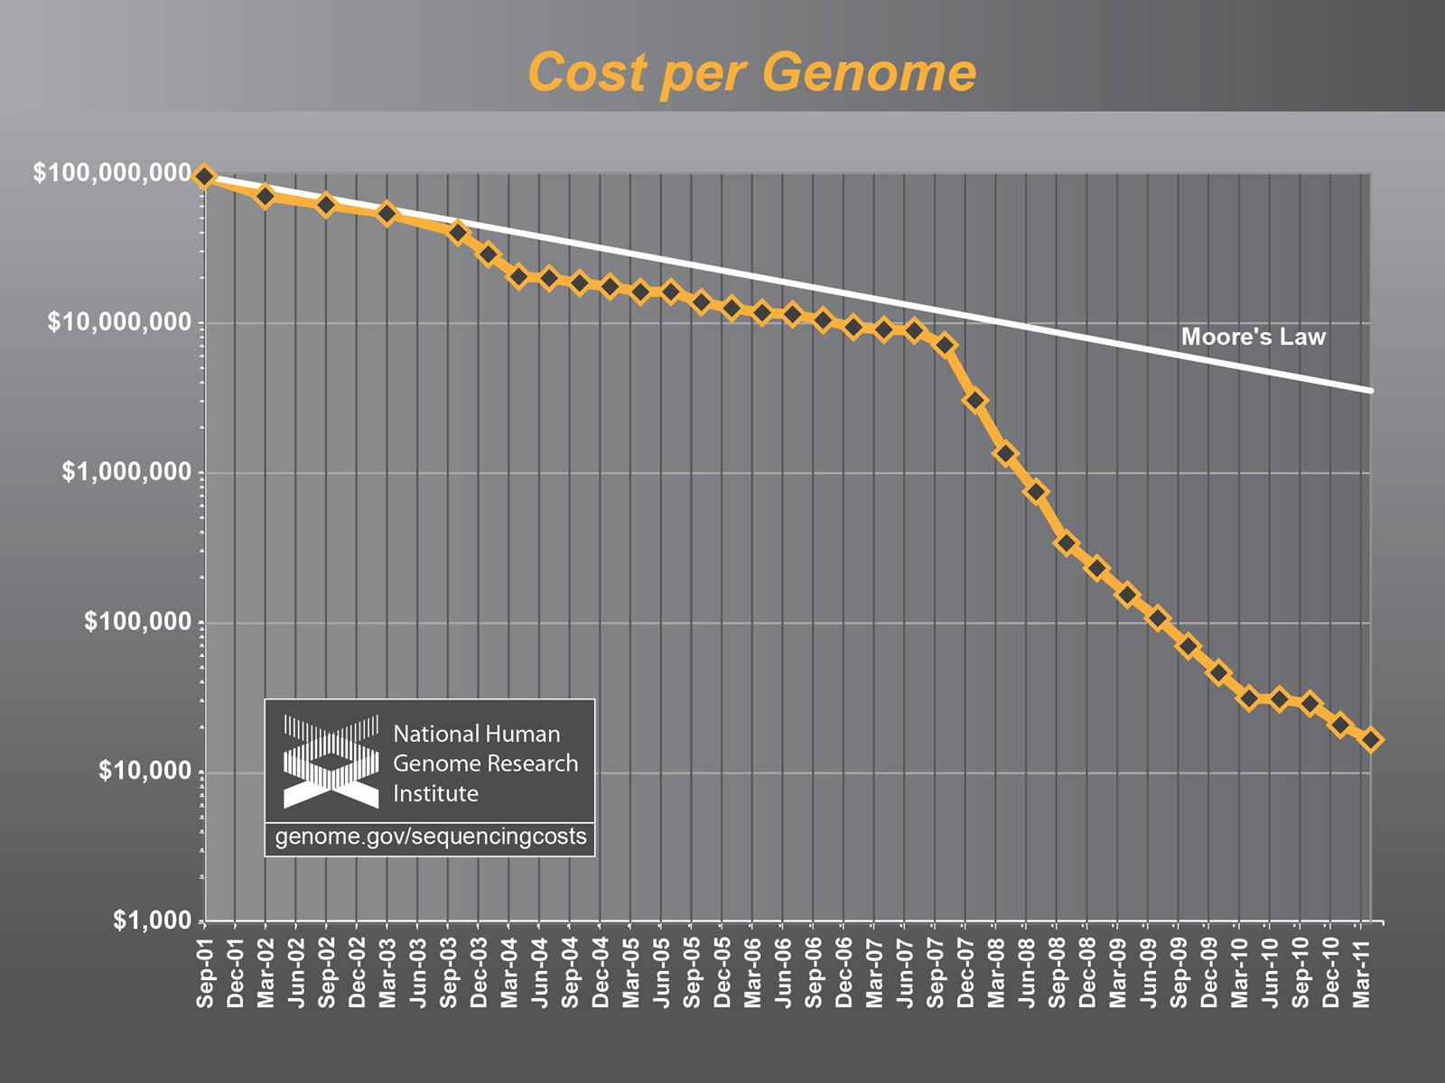
The learning curve is not everything
Breakthrough vs gradual progress in genome sequencing
Sanger-based chemistry
Capillary-based instruments
learning curve
Ligation chemistry
Nanopore technology

Slide 29
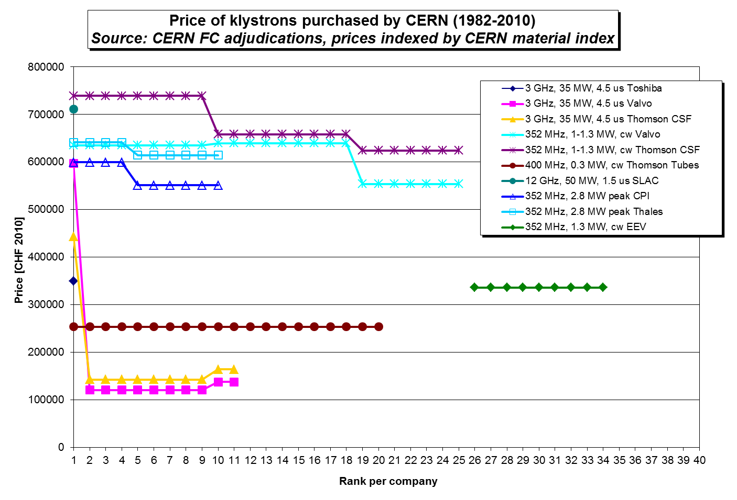
The learning curve is not everything
Commercial competition remains a prime mechanism for cost reduction
Learning curve
a = 0.95
New entrant

Slide 30
Contents
Cost & performance of high-energy accelerators
Cost estimate methods, organization & tools
Large series, manufacturing techniques & learning curves
Elements of cost risk analysis
Coping with exchange rates & cost escalation

Slide 31
Cost variance factors
Technical definition
Technical design
  Evolution of system configuration
  Maturity of component design
  Technology breakthroughs
  Variation of applicable regulations
Industrial execution
  Qualification & experience of vendors
  State of completion of R&D, of industrialization
  Series production, automation & learning curve
  Rejection rate of production process
Structure of market
  Mono/oligopoly
  Mono/oligopsone
Commercial strategy of vendor
  Market penetration
  Competing productions
Inflation and escalation
  Raw materials
  Industrial prices
International procurement
  Exchange rates
  Taxes, custom duties
Decreasing control of project responsible
Engineering judgement of responsible → σ_{technical}
Contract adjudication
Procurement
Reflected in scatter of offers received from vendors (LHC experience) → σ_{procurement}
Tracked and compensated
Outside project control

Slide 32
Observed tender prices for LHC accelerator components
Adjusted to mean (1.46) and total number (218) of sample

Slide 33
Lowest-bidder from n valid offers
Analytical solution
  Consider two valid offers X1, X2 following same exponential distribution with P(Xi<x) = F(x) = 1 – exp[-a(x-b)]
  ⇒ m = b + 1/a and σ = 1/a
  Price paid (lowest valid offer) is Y = min(X1, X2): what is the probability distribution of Y?
  Estimate P(Y<x) = P(X1<x or X2<x) = G(x)
  Combined probability theorem
  P(X1<x or X2<x) = P(X1<x) + P(X2<x) – P(X1<x and X2<x)
  If X1 and X2 uncorrelated, P(X1<x and X2<x) = P(X1<x) * P(X2<x)
  Hence, P(X1<x or X2<x) = P(X1<x) + P(X2<x) – P(X1<x) * P(X2<x) and thus G(x) = 2 F(x) – F(x)² = 1 – exp[-2a(x-b)]
  ⇒ Y follows exponential distribution with m = b + 1/2a and σ = 1/2a
  By recurrence, if n uncorrelated valid offers X1, X2,…Xn are received, the price paid Y = min (X1, X2,…Xn) will follow an exponential distribution with m = b + 1/na and σ = 1/na
Monte Carlo simulation
  Produce 400 random drawings of sets of n values of X distributed according to F(x)
  For each set, take Y = min(X1, X2,..Xn) and estimate mean and std dev of 400 realizations of Y
  Monte Carlo simulation in accordance with analytical solution

Slide 34
Sampling from LHC tender price distribution to estimate lowest-bidder price vs number of offers

Slide 35
plus r.m.s. sum of σ_{technical} and σ_{procurement}
minus σ_{technical}

Slide 36
Contents
Cost & performance of high-energy accelerators
Cost estimate methods, organization & tools
Large series, manufacturing techniques & learning curves
Elements of cost risk analysis
Coping with exchange rates & cost escalation

Slide 37
Exchange rates and cost escalation
Currency A
Time 1
Exchange rate 1
Currency B
Time 1
?
Escalation
Index a
Escalation
Index b
Currency A
Time 2
Exchange rate 2
Currency B
Time 2
Exchange rate fluctuations should ideally reflect evolution of purchasing power of currencies, but
  Economic parities offset by financial effects
  Variety of escalation indices in each currency
Choose « reference currency » (CHF) and apply relevant escalation indices in reference country (Office Fédéral de la Statistique, Bern)

Slide 38
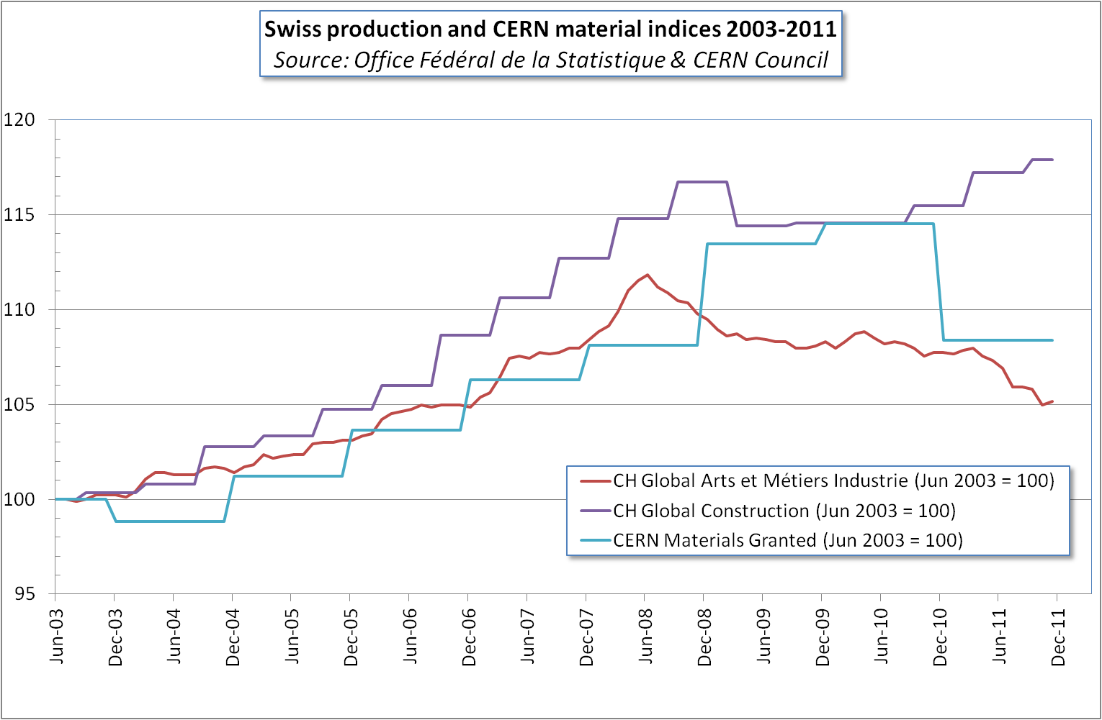
Swiss vs CERN indices

Slide 39
OECD PPP indices vs exchange rates
Yearly averages (Euro/USD)
Const: PPP based on civil construction
Equip: PPP based on machinery and equipment
EX: exchange rate
Full PPP determinations were done for 2005 and 2008; other year points extrapolated using relative inflation rates
G. Dugan

Slide 40
PPPs vs exchange rates
Advantages
Drawbacks
Exchange rates are determined by the supply and demand for different currencies, which are influenced by factors such as capital flows between countries and currency speculation, independently of international trade
Using estimates in PPP-based units and converting to local currency using the appropriate PPPs theoretically enables to translate elements of the cost estimate for in-kind contributions
PPPs are used to compare prices for the same goods/services in different countries constituting separate markets. They are therefore not good comparative indicators of the value, i.e. the lowest reasonable estimate of the price of goods and services procured from industry on the world market
  Example 1: commodities
    World prices usually quoted in single currency, often USD ⇒ relevant is the exchange rate to the USD
  Example 2: specialized products
    Accelerator components with oligopolistic market (e.g. klystrons) have a single world price

Slide 41
Conclusion
Costing a new project in advanced technology is not just an accounting task, but rather an attempt to organize complexity and uncertainty
Complexity, uncertainty and organization are at the heart of project management, and indeed of most of man’s endeavours
The elaborate organizations that human beings have constructed in the modern world to carry out the work of production and government can only be understood as machinery for coping with the limits of man’s abilities to comprehend and compute in the face of complexity and uncertainty
Herbert A. Simon
Rational decision-making in business organizations Nobel lecture (1978)
La pensée complexe est, essentiellement, la pensée qui intègre l’incertitude et qui est capable de concevoir l’organisation
Edgar Morin
Introduction à la pensée complexe (1990)

Slide 42
A few references
I. Chvidchenko, Gestion des grands projets, Cours de Sup’Aéro, CEPADUES Editions, Toulouse (1992)
C. Roche, Government, industry, accelerators, Frontiers of Accelerator Technology, World Scientific (1996) pp. 743-757
Ph. Lebrun, Estimation du coût marginal de l’énergie consommée par la cryogénie du LHC, LHC Project Note 92 (1997)
S. Claudet et al., Economics of large helium cryogenic systems: experience from recent projects at CERN, Adv. Cryo. Eng. 45B Plenum Publishers (2000), pp. 1301-1308
Management de projet: gestion du risque, norme FD X 50-117, AFNOR, Saint Denis (2003)
Project Risk Management, in PMBOK® Guide, 3rd edition, Project Management Institute, Newton Square (2004), pp. 237-268
P. Fessia et al., Industrial learning curves: series production of the LHC main superconducting dipoles, IEEE Trans. Appl. Superconductivity 17 2 (2007) pp. 1101-1104
GAO Cost Estimating & Assessment Guide, United States Government Accountability Office, GAO-09-3SP (2009)
P. Garbincius & Ph. Lebrun, Assessing risk in costing high-energy accelerators: from existing projects to the future linear collider, Proc. IPAC’2010, Kyoto (2010)
P. Lebrun et al. (editors), The CLIC programme: towards a staged e+ e- linear collider exploring the Terascale, CERN-2012-005 (2012)

