Slide 2
Chiara Marrelli
Design and simulation of a high efficiency klystron for the CLIC drive beam
RFTech 4th workshop
25-26 March 2013, Annecy

Slide 3
Outline: High efficiency klystron for the CLIC drive beam
Introduction: motivation and main design guidelines
Klystron simulations and optimization with disk code
Cavity RF design
PIC simulations
Output cavity study
Conclusions

Slide 4
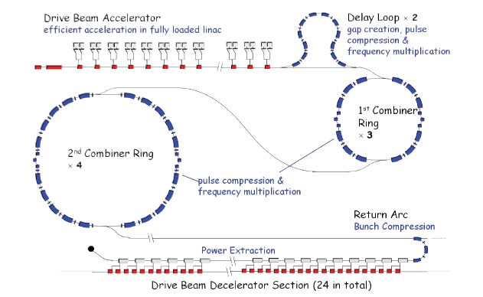
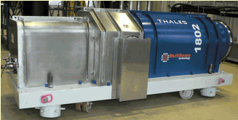
Introduction
CLIC drive beam complex @ 3 TeV:
1638 accelerating structures with 1 GHz RF pulses of 15MW: total pulsed RF power of 24.57GW required
Pulse length of 150 ms and repetition rate of 50 Hz
average RF power at the accelerating structure input is
184 MW with challenging specifications in terms of stability:
± 0.05° in phase
0.2% in amplitude
Very high efficiency sources needed to provide this power at affordable cost (efficiency>70%)
80% klystron efficiency could lead to an enhancement of the overall accelerator efficiency of almost 10%
Multibeam Klystrons proposed:
15 MW output power with small current per beamlet
low perveance – good efficiency (state of the art around 65%)
“multibeam” cavities: all beams interact in
one cavity
Example: TH1802 ILC multibeam klystron

Slide 5
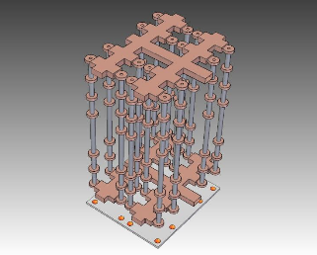
Introduction
R&D on single beam device:
Single beam klystrons may have advantages in terms of reliability and phase noise
Efficiency can be pushed too, by:
using low perveance (<0.25)
careful optimization of the cavity parameters (easier on single beam cavities)
use of higher harmonic cavities (2nd and 3rd)
Low perveance low output power many devices in parallel.
Combining the output of many separated devices can be an interesting option too:
Example (presented by S. Tantawi during last CLIC workshop - Jan. 2013):

Slide 6
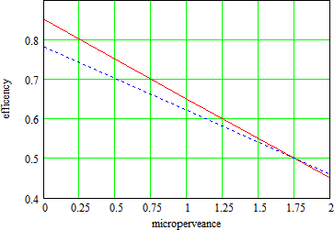
High efficiency klystron for CLIC
Perveance: K=I₀/V₀^{3/2}
Perveance determines to a large extent the power conversion efficiency.
The RF output current due to the input modulating voltage is a maximum when the klystron transconductance g is a maximum (g=I_{out}/V_{in} ∝ b’/K^{1/2} where b’ is the normalized beam radius and K the perveance).
It has been shown [*] that g is maximum for an optimized beam radius when the perveance is at a minimum. High efficiency klystrons (> 70 %) therefore require low perveance. [**]
Chosen parameters:
η = 85-0.2xμK – Igor Syratchev
η = 78-0.16xμK - Thales
I₀=8.21 A
V₀=115 kV
μP= 0.21
[*]R. R. Warnecke and P. R. Guenard, Tubes A Modulation Vitesse, Paris:Gauthier-Villars, 1951
[**] E. Jensen, I. Syratchev, CLIC 50 MW L-Band Multi-Beam Klystron, 2005

Slide 7
High efficiency klystron for CLIC
Already in the 40s Guénard et al. suggested that if an electron beam could be bunched with a sawtooth voltage it should be possible to arrange matters so that nearly all the electrons passing through the input cavity within one cycle arrive together at the output gap.
In a simplified model efficiency can be also expressed as:
[*]
τ(φ)=electron transit time from input to output
Maximum η for τ(φ) periodic function of φ (sawtooth):
n=1 η ≈ 0.58
n=2 η ≈ 0.73
n=3 η ≈ 0.80
n=4 η ≈ 0.83
[*] R. Warnecke, J. Bernier, P. Guénard, “Groupement et dégroupement au sein d’un faisceau cathodique injecté dens un espace exempt de champs extérieurs après avoir été modulé dans sa vitesse”.

Slide 8
High efficiency klystron for CLIC: AJDisk simulations
Main parameters
Nr of disks 50
Nr steps 32
Nr iterations(max) 70
Perveance (uK): 0.2118
v/c: 0.5764
BetaE(rad/m): 36.3363
Lambda(m): 0.1729
LambdaP(m): 0.4671
Io(A): 8.2100
Vo(kV): 115
f(MHz): 1000.0000
Pin(W): 96.0000
Beam radius b (mm): 5.5000
Fill Factor: 0.687
Cavity RQ(ohms) M Qe Qo f(MHz) z(cm) Harmonic
1 180.00 0.9400 485.00 9593.48 1000.000 2.000 1
2 211.00 0.9378 95000.00 9464.26 1005.000 17.000 1
3 101.90 0.8528 95000.00 15300.00 1981.000 45.500 2
4 118.00 0.8850 95000.00 12300.00 2983.000 72.000 3
5 84.60 0.9358 95000.00 17407.90 1011.000 1.29000 1
6 185.00 0.9400 50.00 9593.48 1000.000 1.58000 1
AJDisk doesn’t do Traveling Waves

Slide 9
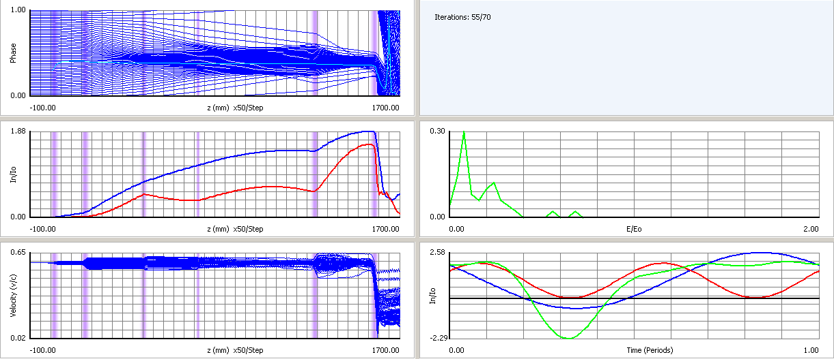
High efficiency klystron for CLIC: AJDisk simulations
Kinetic efficiency
Efficiency ( Electric ) = 0.8274
Efficiency ( Kinetic ) = 0.9948
Efficiency ( Total ) = 0.8231
Electric efficiency

Slide 10
High efficiency klystron for CLIC: AJDisk simulations
** FOURIER COMPONENTS AND PHASES OF INDUCED CURRENT **
Cavity DC Component 1st Harmonic 2nd Harmonic 3rd Harmonic 4th Harmonic
1 8.2100 ( 0.00) 0.0300 ( 53.45) 0.0006 ( 1.50) 0.0000 ( -63.90) 0.0000 (-140.13)
2 8.2100 ( 0.00) 0.8492 ( 130.49) 0.0796 ( 100.88) 0.0075 ( 63.42) 0.0006 ( 13.64)
3 8.2105 ( 0.00) 6.1237 (-106.70) 3.5066 ( -24.28) 2.0460 ( 55.13) 1.1283 ( 133.95)
4 8.2103 ( 0.00) 9.2259 ( 60.23) 2.8703 ( -58.41) 0.9138 ( 40.80) 1.4758 ( -81.21)
5 8.2090 ( 0.00) 11.1993 ( -48.66) 3.6345 ( 79.91) 0.7066 ( 149.85) 0.7714 (-141.83)
6 8.2109 ( 0.00) 13.0042 ( 56.54) 8.0792 ( -56.29) 4.1670 (-162.37) 2.1012 ( 98.50)
...................................................................................................................................
********************** Simulated Power by Cavity ********************
Cavity Pexternal (kW) Pohmic (kW) Pohmic/A (kW/cm^2)
1 0.00000 0.00267 0.00000
2 0.00000 0.07345 0.00000
3 0.00000 48.94864 0.00000
4 0.00000 12.62419 0.00000
5 0.00000 0.53801 0.00000
6 774.04160 4.03421 0.00000
Sum 774.04160 66.22117
Cavity Voltages
Simulated Analytic
Cavity V(kV) Phase(deg) V(kV) Phase(deg)
1 6.1969 ( 0.00) 6.1969 ( 0.00)
2 17.9608 ( 39.88) 17.9803 ( 43.12)
3 18.7168 ( 65.91) 30.4073 ( -6.65)
4 9.4870 ( 131.21) 104.3860 ( 162.74)
5 43.3017 (-138.81) 64.2788 (-128.27)
6 119.6652 (-123.46) 283.7368 (-103.70)
Min v/c: 0.0221
z (Min v/c): 1.5917 m
Max I1/I0: 1.8833
z (Max I1/I0): 1.5536 m
Gain (dB): 46.3868
Output Max E-Field (kV/cm): 59.8326

Slide 11
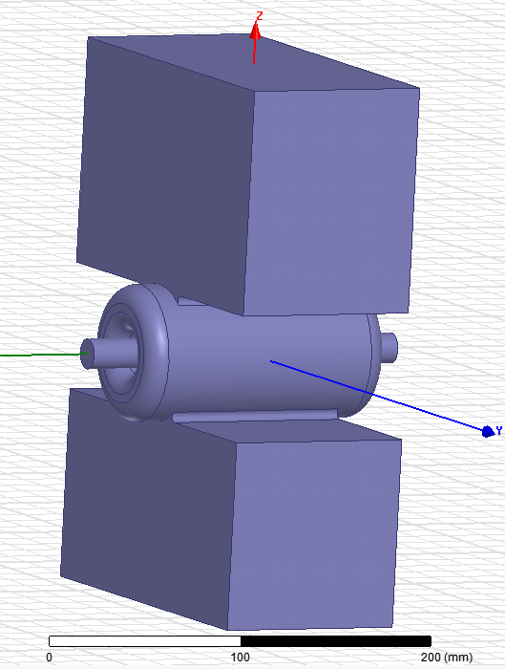
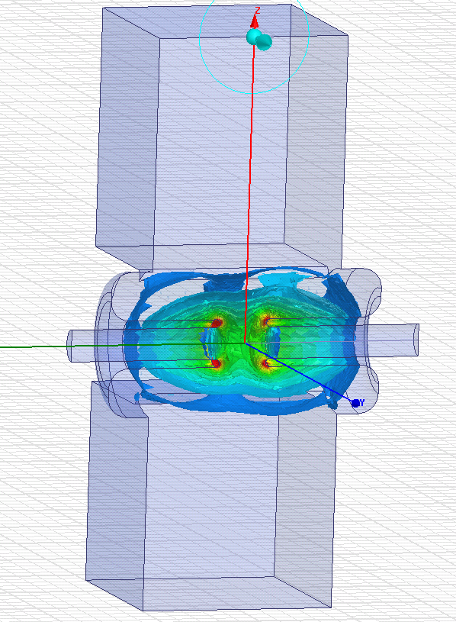
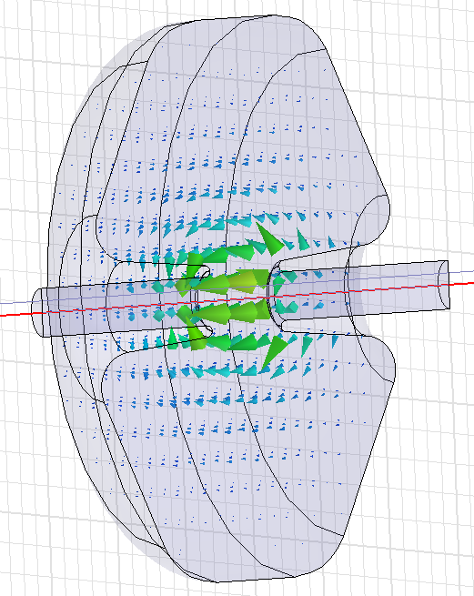
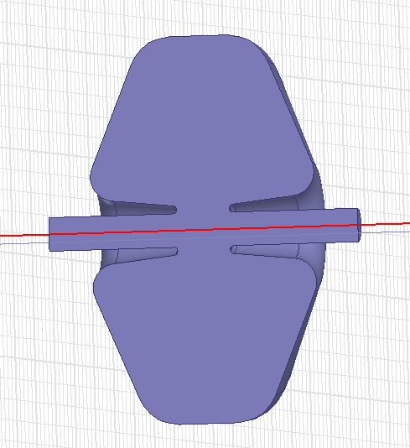
Cavity RF design
Input cavity with coupler:
Coupler: standard L-band waveguide WR770
Q_{ext}=485
R/Q=180
f=1000 MHz
M=0.94
Second cavity (1005 MHz):
9.25
Idler cavities:
R/Q=211
f=1005 MHz
M=0.938
Q=9464
1.1

Slide 12
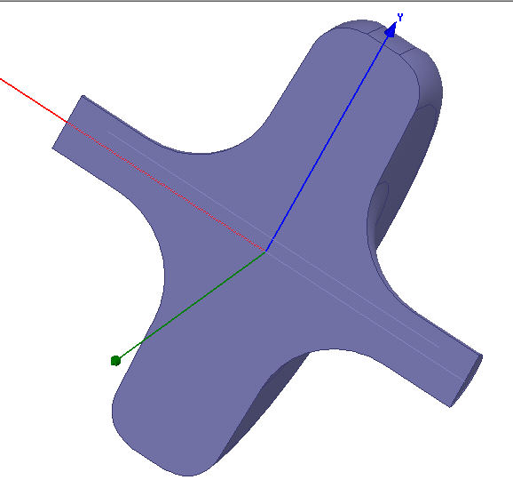
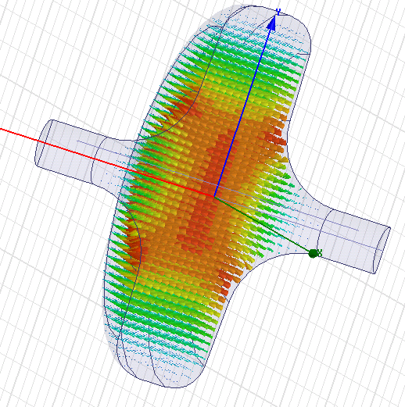
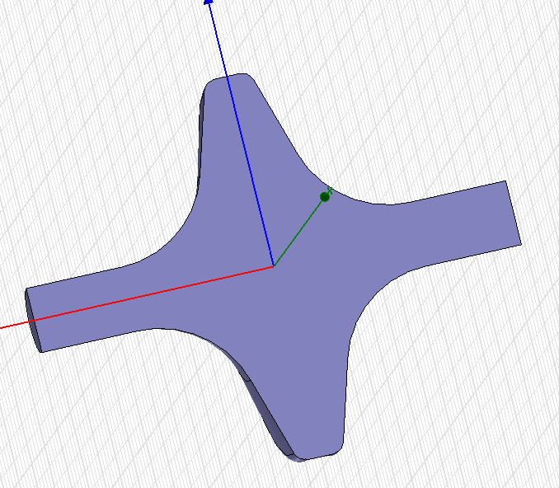
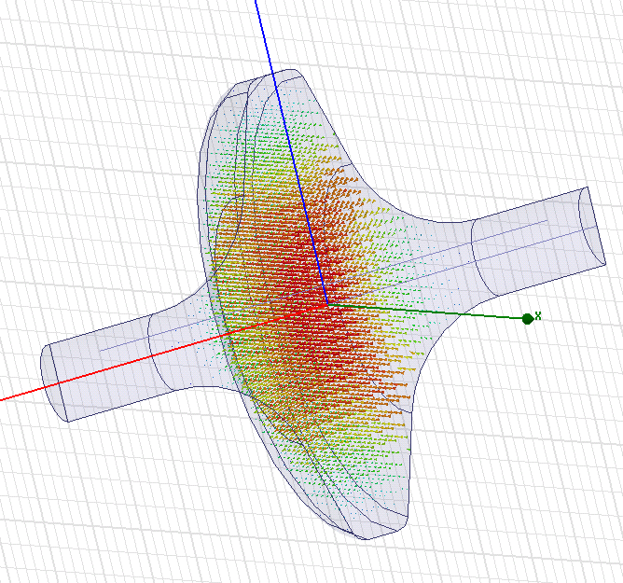
Cavity RF design
Third cavity (1981 MHz):
TM mode at 5 GHz to be
shifted in previous design
6.37
3.4
R/Q=102
f=1981 MHz
M=0.85
Q=15300
Fourth cavity (2983 MHz):
4.76
R/Q=118
f=2983 MHz
M=0.885
Q=12300
3.5

Slide 13
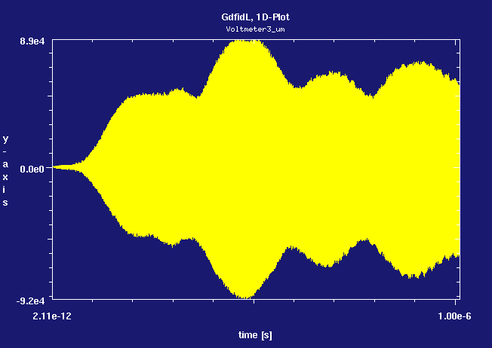
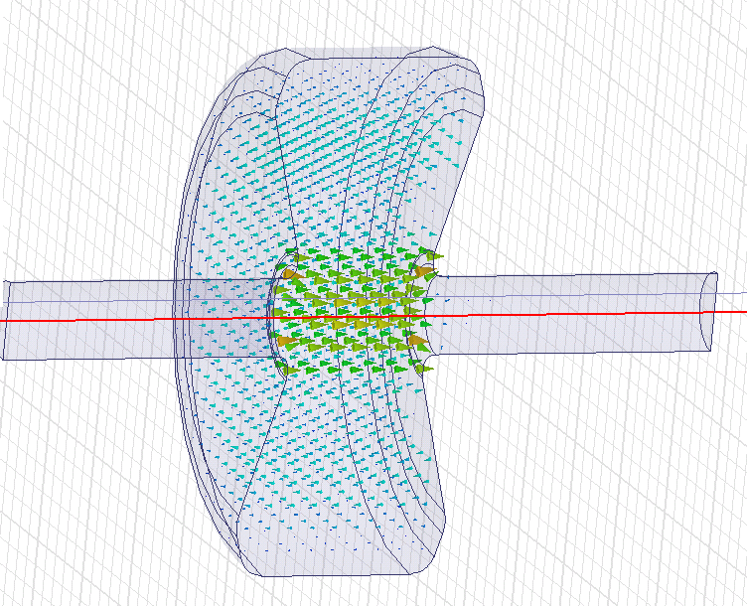
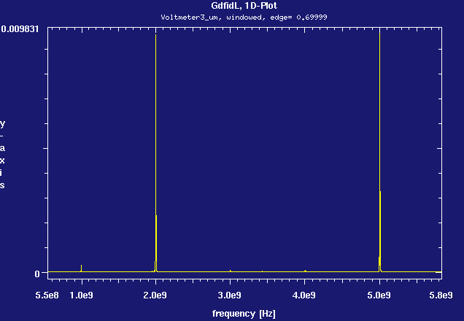
Cavity RF design
Voltage in third cavity (1981 MHz – previous design)
TM mode at 5 GHz

Slide 14
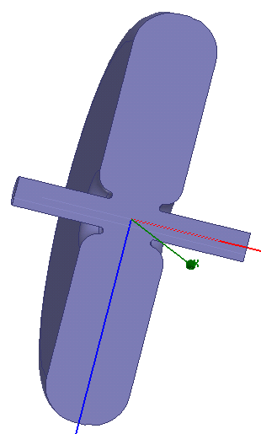
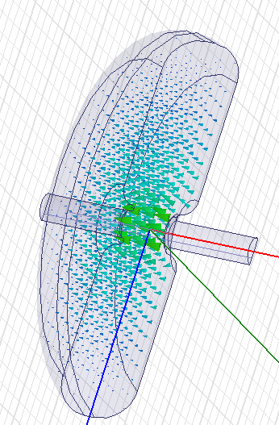
Cavity RF design
Fifth cavity (1011 MHz):
low R/Q
high M
11.38
2.65
From HFSS:
R/Q=84
f=1011 MHz
M=0.936
Q=17408

Slide 15
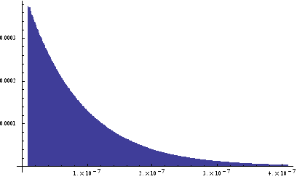
GdfidL simulations
Time domain and Particle In Cell simulations
Time domain (input cavity):
To tune the input cavity: since we can’t use ports in eigenmode simulation (PEC on the port) we need to check the frequency by loading the eigenmode field and letting it ring
To calculate the external Q from field decaying:
P₁
P₂
t₁
t₂
Particle In Cell (all cavities):
To simulate the complete interaction between particles and cavities,
transient and beam focusing

Slide 16
GdfidL PIC simulations
Setup of PIC simulation with GdfidL:
GdfidL doesn’t simulate losses in copper; we need to introduce some loss mechanism in cavities and pipes (to avoid high frequency modes excited by the beam – pipe is closed at the end)
2. We have to use a large mesh to reduce simulation time, so if we keep the same geometry as in HFSS for cavities we are off in frequency: this is why we have to introduce tuners, and if it is not enough, we also have to change a bit the geometry; this means that we can’t import the geometry from HFSS but build the whole structure point-by-point

Slide 17
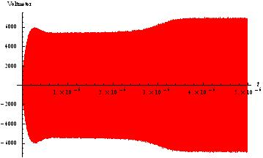
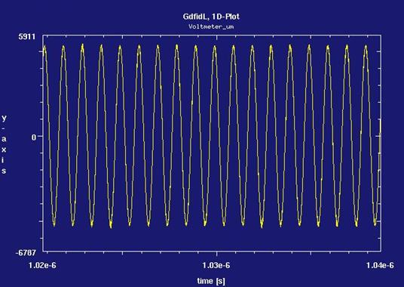
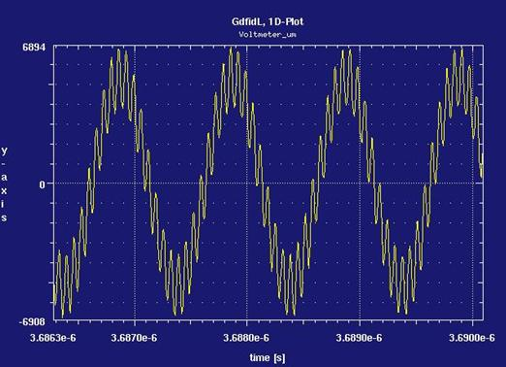
GdfidL PIC simulations
First set of simulations with GdfidL (input cavity only):
running on one single machine (8 cores)
large mesh (2 mm)
simulation time ~ 1 week (for t=10 μs)
Example: input cavity with coupler (without any damping mechanism)
Gap voltage
f1= 1 GHz
f2≈ 14.3 GHz
f= 1 GHz
14.3 GHz mode excited in the pipe by the beam

Slide 18
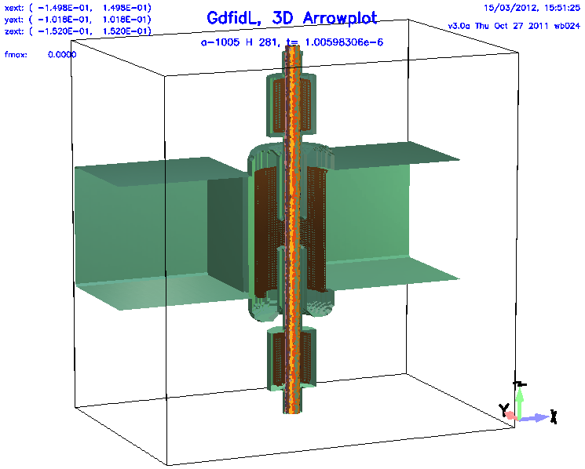
GdfidL PIC simulations
Input cavity with coupler - PIC
Damping rings on the pipe:
To damp high frequency modes excited by the beam in the pipe (closed at the end)
we introduce Mkappa (magnetic conductivity)
in the cylinder material.
Losses are due to orientation of magnetic dipoles
(magnetic current - variations of B)
Tuner inside the cavity:
μ_{r} slightely different from 1 (to change frequency)
mkappa to introduce ohmic losses

Slide 19
GdfidL PIC simulations
Input + idler cavities and dampers
Shot @ t=0.851 us
running on one single machine (8 cores)
mesh 1.25 mm
timestep= 2.1142e-12 s
20 particles emitted per timestep
simulation time ~ 5 days (for 0.85 μs only!!!)
longitudinal constant B field = 3*Brillouin field = 0.07 T

Slide 20
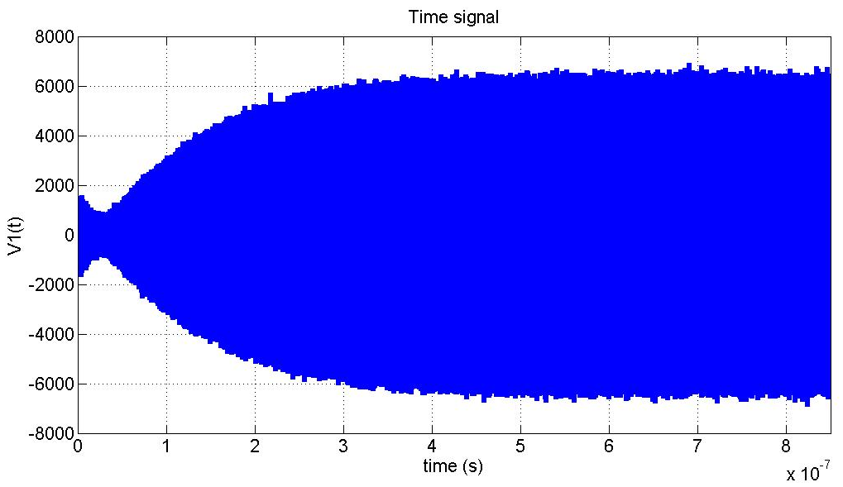
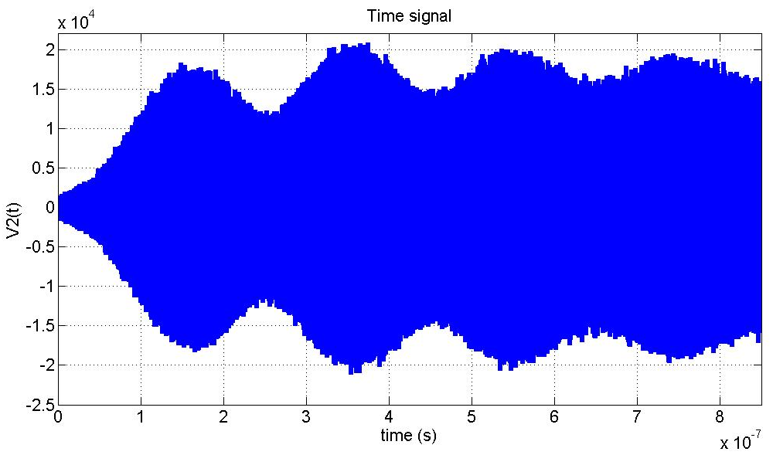
GdfidL PIC simulations
Voltage as a function of time in input cavity
GdfidL:
Peak voltage ~ 6.5 kV
From AJDisk:
Peak voltage = 6.07 kV
Voltage as a function of time in second cavity (1005 MHz)
Beating due to cavity detuning
GdfidL:
Peak voltage ~ 17 kV
Phase=34 deg
From AJDisk:
Peak voltage =17.5 kV
Phase=39.9 deg

Slide 21
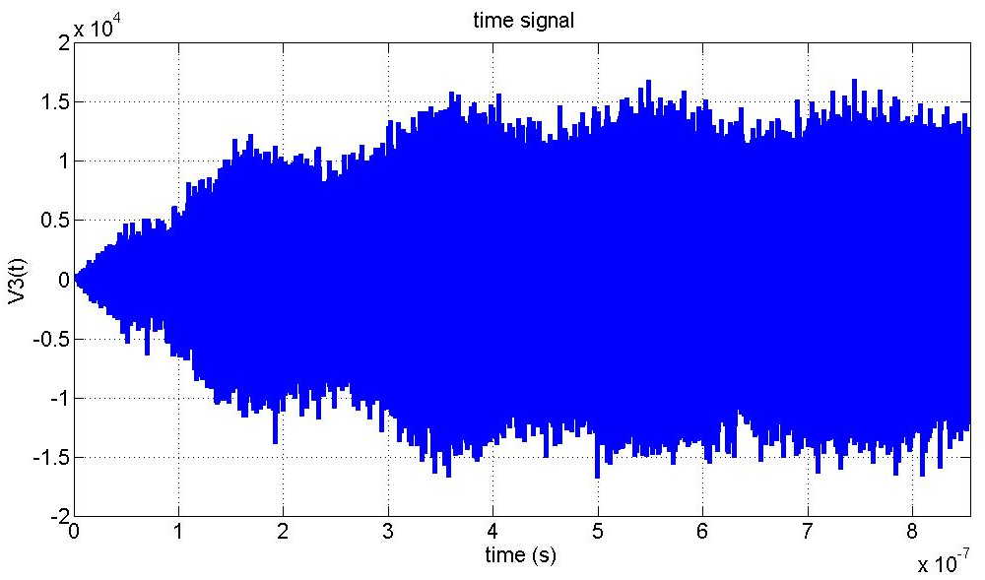
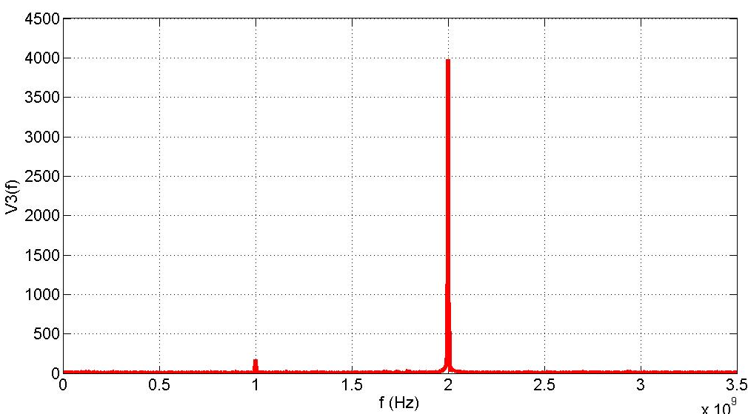
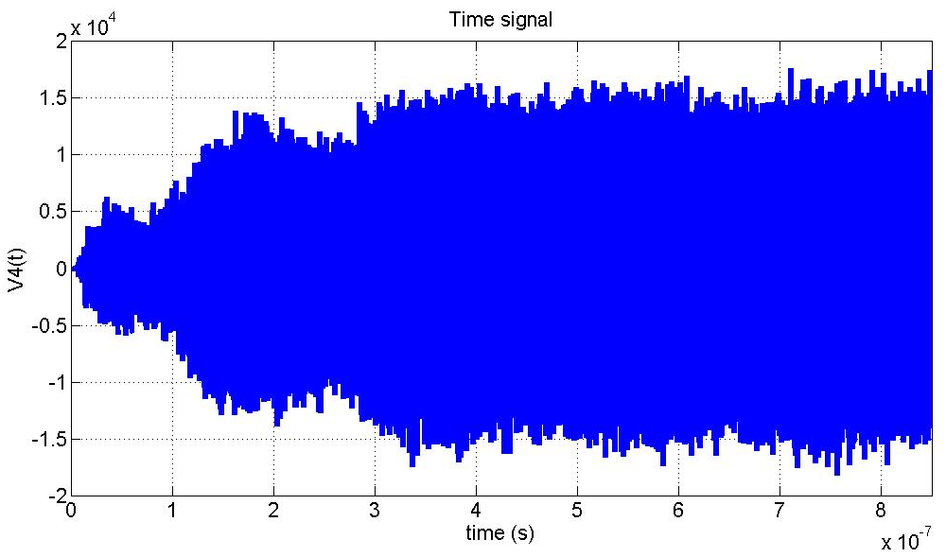
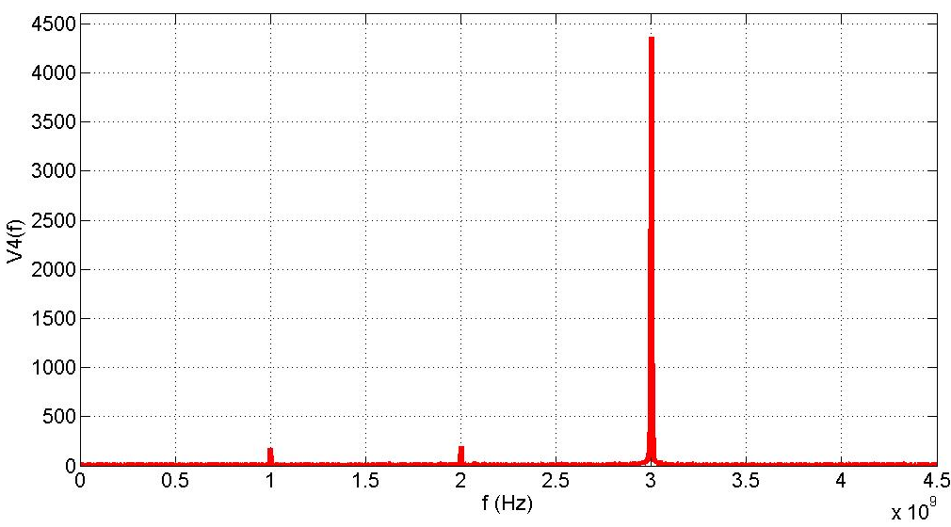
GdfidL PIC simulations
Voltage in third cavity (second harmonic – 1981 MHz)
GdfidL:
Peak voltage ~ 13 kV
Phase=14 deg
From AJDisk:
Peak voltage =18.1 kV
Phase=66.2 deg
Voltage in fourth cavity (third harmonic – 2983 MHz)
GdfidL:
Peak voltage ~ 13kV
Phase= 92 deg
From AJDisk:
Peak voltage = 9 kV
Phase= 134 deg

Slide 22
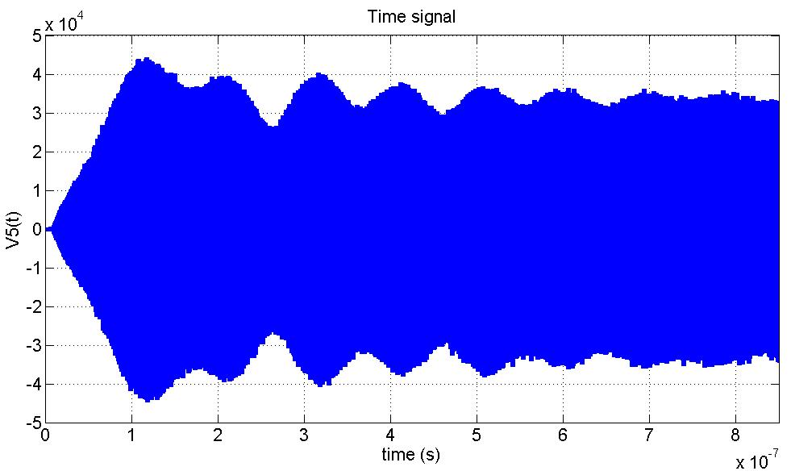
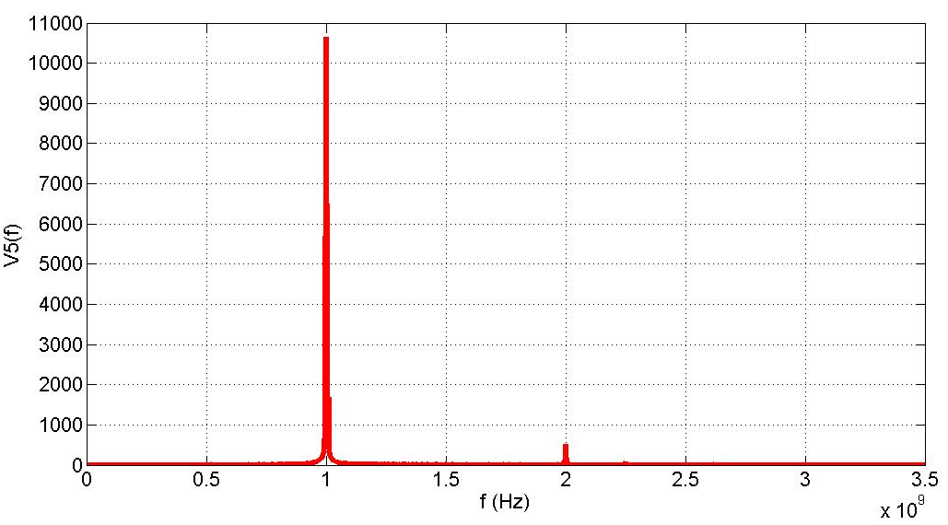
GdfidL PIC simulations
Voltage in fifth (penultimate) cavity (1011 MHz)
GdfidL:
Peak voltage ~ 35kV
Phase= -146.5 deg
From AJDisk:
Peak voltage = 43 kV
Phase= -138 deg

Slide 23
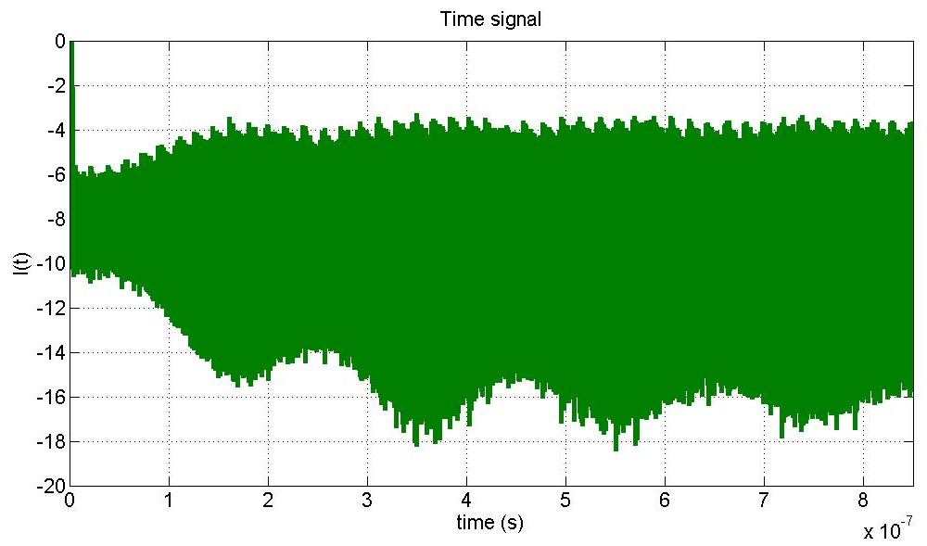
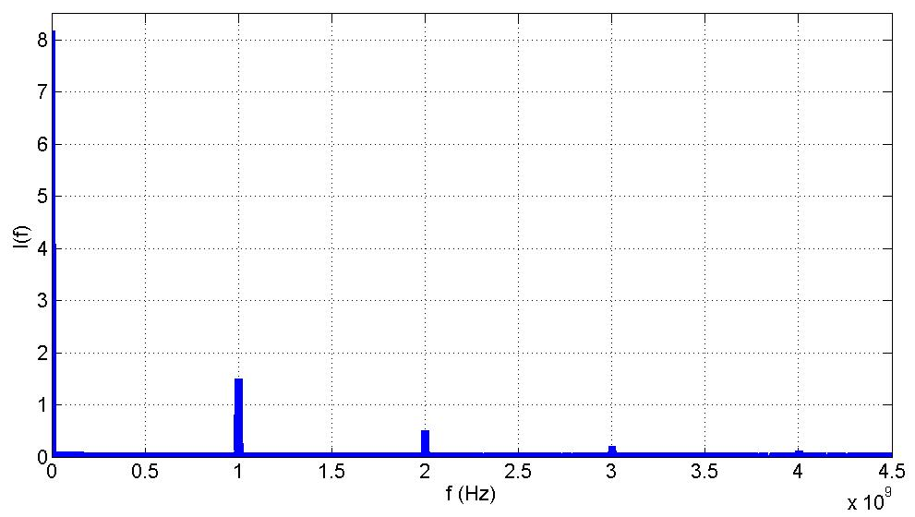
GdfidL PIC simulations
Beam current
Convection current between cavity 2 and 3 (z=0.31 m)

Slide 24
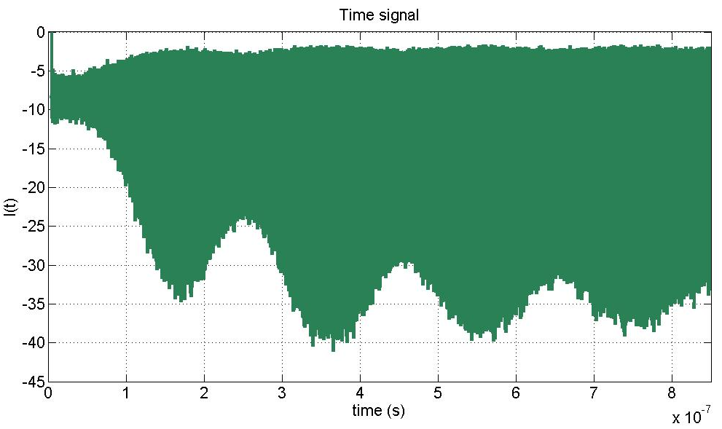
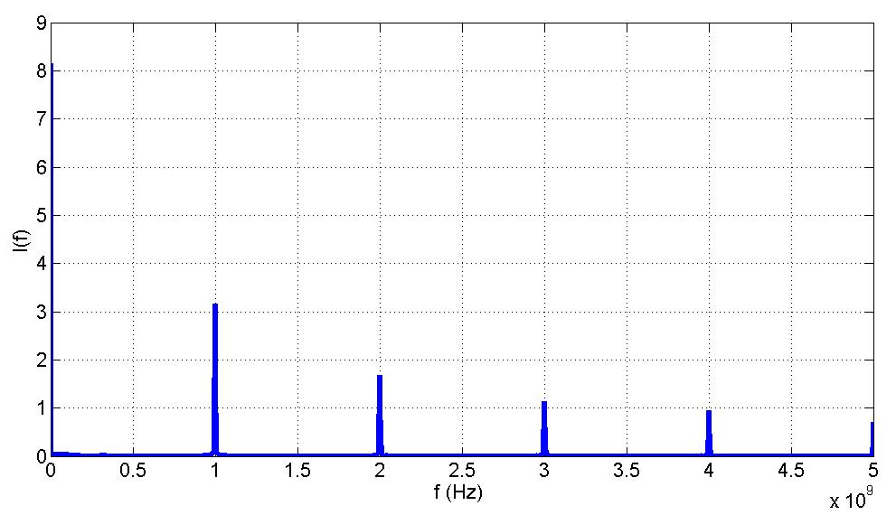
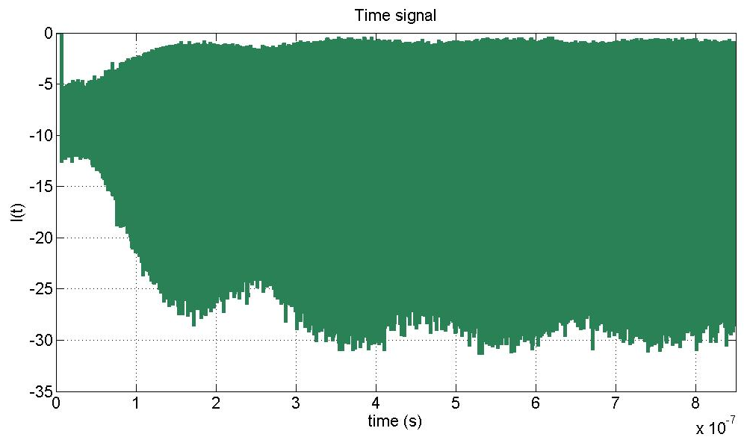
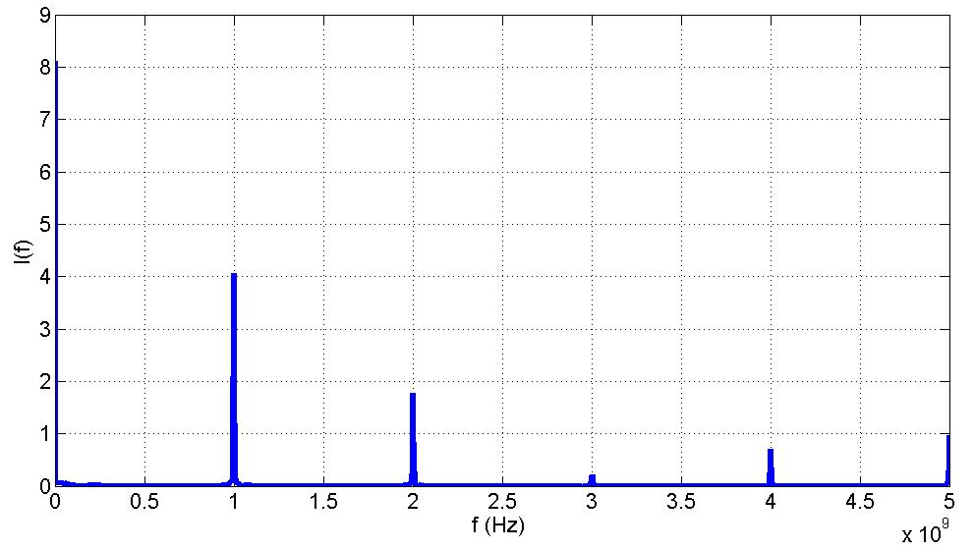
GdfidL PIC simulations
Convection current between cavity 3 and 4 (z=0.59 m)
Convection current between cavity 4 and 5 (z=1 m)

Slide 25
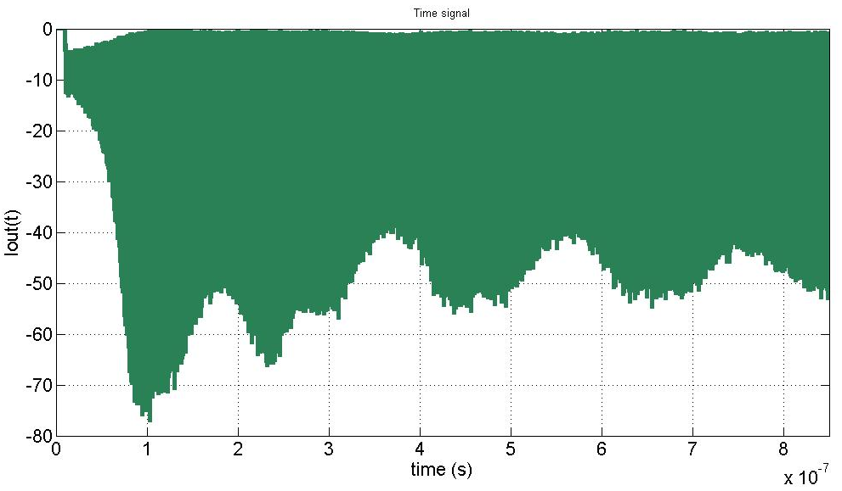
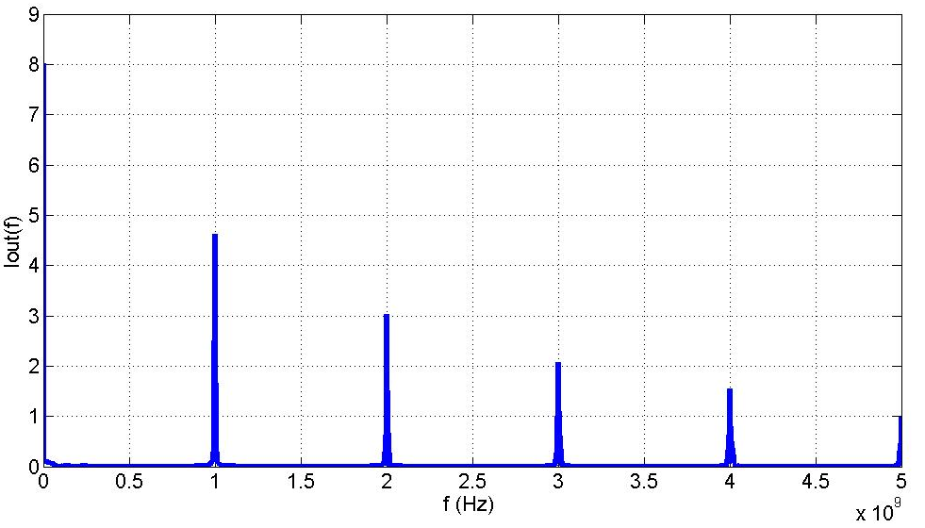
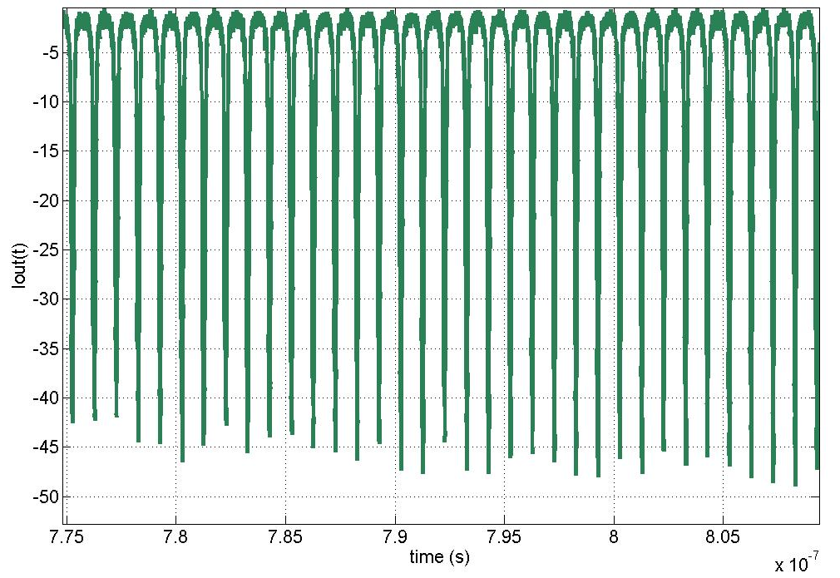
GdfidL PIC simulations
Convection current at output (z=1.58 m)

Slide 26
GdfidL PIC simulations
Longer simulations needed: this would require a large amount of time and memory
1. Careful implementation of losses is required
2. Tuning is long
3. PIC simulation is slow and it requires a lot of memory
The PIC code is very important to study and optimize the output cavity, since we can’t use the 1D code for the optimization of parameters.

Slide 27
Output cavity
The Klystron global efficiency depends on the output cavity efficiency
Electrons have to slow down (ideally) until they give their kinetic energy
fully to the RF field
Main issues:
The beam slows down while energy is removed from it, so we have to be sure that particles do not slip on the accelerating crest of the field (taking energy from the field);
We need to match beam speed and phase velocity multicell structure
Electrons are not relativistic
Space charge forces become dominant at very low beta
We are limited by the speed of slowest electrons (to avoid reflected electrons)
Study of a traveling wave cavity in progress

Slide 28
Output cavity
Design method:
We start with some approximations:
steady state regime
single particle model
no space charge
in this kind of model beam current is assumed constant along the structure
Gradient along the structure (V/m)
[*]
With:
Where:
ρ = R/Q per unit length
I = first harmonic current
[*] A. Lunin, V. Yakovlev, A. Grudiev, “Analytical solutions for transient and steady state beam loading in arbitrary traveling wave accelerating structures”, PRST-AB 14 (2011)

Slide 29
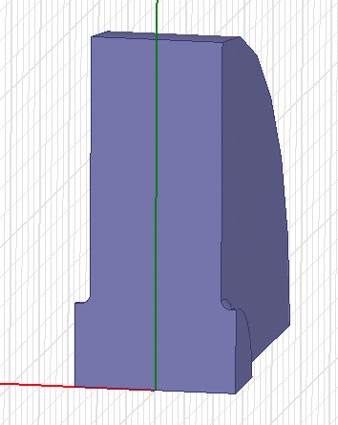
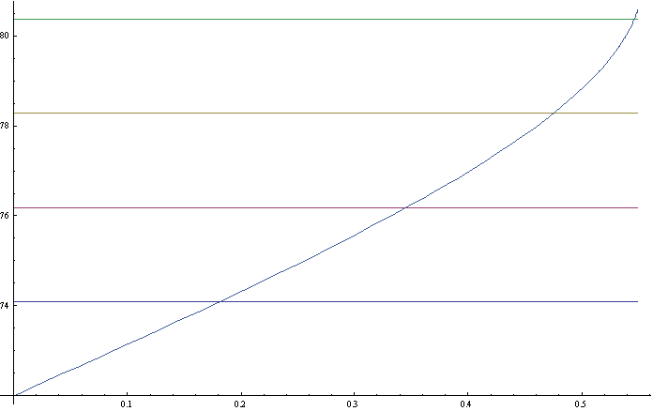
Output cavity
1) constant impedance structure, 4 cells, 120 deg phase advance
(1)
Length of first cell set from
initial beam speed:
b
h/2
a
Integration of equations of motion for the particle in gradient (1) gives:
L1
ωt
We get:
L₁=5.424 cm
L₂=4.938 cm
L₃=3.873 cm
L₄=2.138 cm
z/λ
We then design the four cells with these lengths trying to keep ρ and v_{g} constant and we iterate the procedure
L₁
L₂
L₃
L₄

Slide 30
Output cavity
Constant impedance structure is not a good choice:
Last cell is very short
It is not easy to get by design the same impedance and group velocity in all cells
2) We assume a linear group velocity:
R/Q per unit length and Q assumed constant.
We still have an analytical expression for the gradient along the structure:

Slide 31
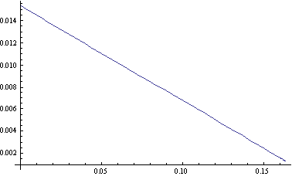
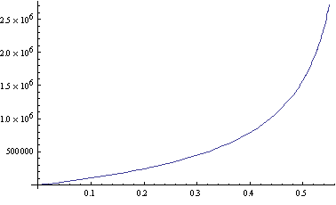
Output cavity
We design last cell trying to keep ρ constant (varying iris aperture and thickness)
We get the fit for the group velocity as a function of z
Vg/c
z
And gradient:
G(z)
z

Slide 32
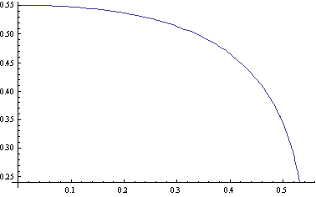
Output cavity
We integrate equations of motion to get the new cell lengths and we iterate
β(z)
z
Decreasing group velocity is not very convenient: particles are loosing too much energy at the
end of the structure
A structure with increasing group velocity would be better; in this case ρ will
not stay constant and the expression of the gradient becomes more complicated [*].
Next steps:
Set cell lengths, iris apertures and thickness
Coupler design
Simulation with beam
Optimization to increase efficiency and see what we can get
[*] G. Guignard, J. Halev, “Closed analytical expression for the electric field profile in a loaded rf structure with arbitrary varying v_{g} and R’/Q”, PRST-AB 3 (2000)

Slide 33
Conclusions
Single beam klystrons can be further investigated as possible power sources for CLIC; efficiency can be improved and parallel configurations can be studied to reach the desired power levels
The development is under study, and there is still a lot of work to be done: the use of a dedicated code for the 3D simulation would significantly help
Once the design of the output cavity and coupler will be ready we could check with 3D simulations the efficiency that we can get and optimize

Slide 34
Thanks to:
Warner Bruns
Alessandro D’Elia
Alexej Grudiev
Aaron Jensen
Erk Jensen
Rolf Wegner
Thank you for your attention!

