Slide 1



RF system for TLEP
Andy Butterworth (CERN)
Thanks to E. Ciapala, R. Calaga, E. Montesinos, O. Brunner, P. Baudrenghien, S. Claudet, D. Nisbet
EuCARD RFTech 4th Workshop 25.03.2013

Slide 2
Overview
Introduction: TLEP
RF requirements
  total accelerating voltage
  beam power
Technology
  Cavities
  Power couplers
  HOMs
  Power sources and efficiency
  Low level RF & feedbacks
Conclusions

Slide 3

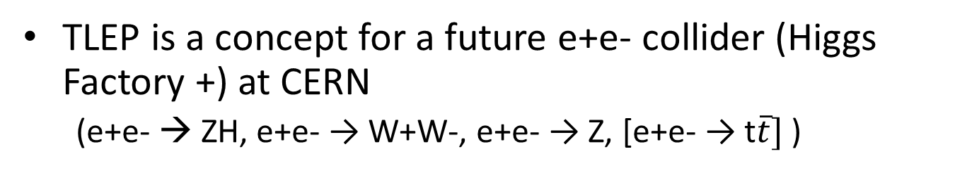
Introduction: TLEP
TLEP is a concept for a future e+e- collider (Higgs Factory +) at CERN
  (e+e- → ZH, e+e- → W+W-, e+e- → Z, [e+e- → t$\overline{t}]$ )
Key parameters | TLEP
circumference | 80 km
max beam energy | 175 GeV
wall-plug power | 200-250 MW
max no. of IPs | 4
luminosity at 350 GeV c.m. | 0.7x10³⁴ cm⁻²s⁻¹
luminosity at 240 GeV c.m. | 5x10³⁴ cm⁻²s⁻¹
luminosity at 160 GeV c.m. | 2.5x10³⁵ cm⁻²s⁻¹
luminosity at 90 GeV c.m. | 10³⁶ cm⁻²s⁻¹
t$\overline{t}$
ZH
W+W-
Z

Slide 4
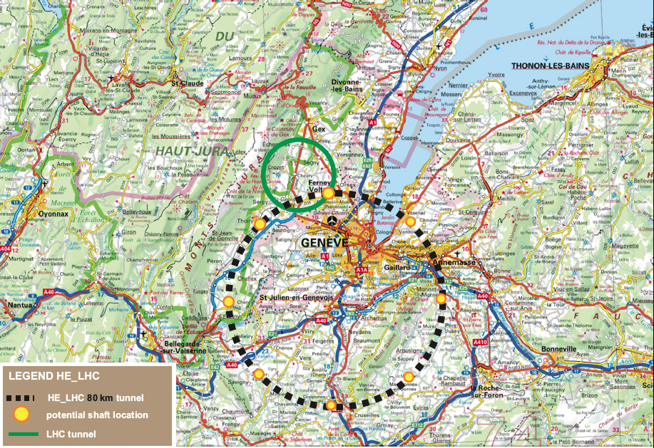
TLEP 80km tunnel

Slide 5
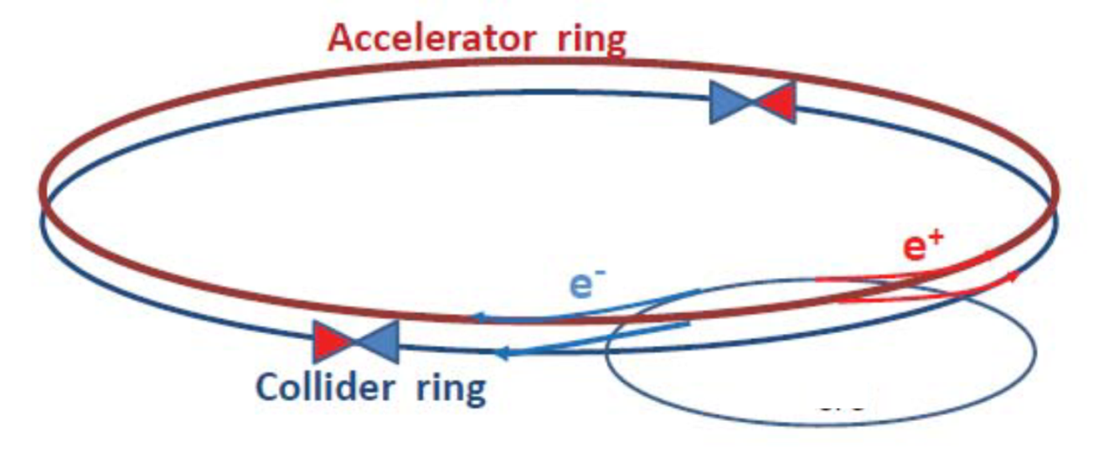
Double ring for top-up injection
Beam lifetime is dominated by radiative Bhabha scattering
  τ_{beam} as short as 15 mins
  frequent refilling reduces operational efficiency
Solution: double ring with top-up injection
  supports short lifetime & high luminosity
top-up experience: PEP-II, KEKB, light sources

Slide 6
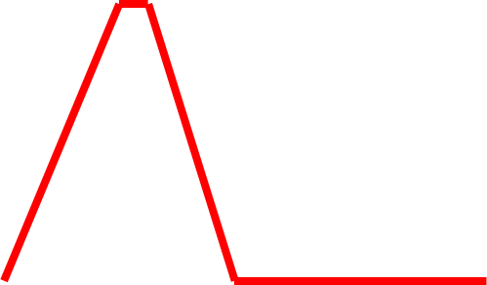
Top-up injection: schematic cycle
beam current in collider (15 min. beam lifetime)
100%
99%
almost constant current
energy of accelerator ring
175 GeV
injection into collider
injection into
accelerator
20 GeV
F. Zimmermann
10 s

Slide 7
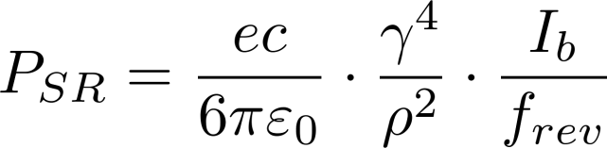
RF requirements: voltage
replace the energy lost U₀ at each turn by synchrotron radiation
  total power needed by the beam = U₀ x I_{beam}
maintain longitudinal focusing with sufficient momentum acceptance |δ|_{max,RF} to keep a good beam lifetime, given
  the equilibrium energy spread due to quantum excitation/radiation damping (quantum lifetime)
  the energy spread (tail) due to beamstrahlung

Slide 8
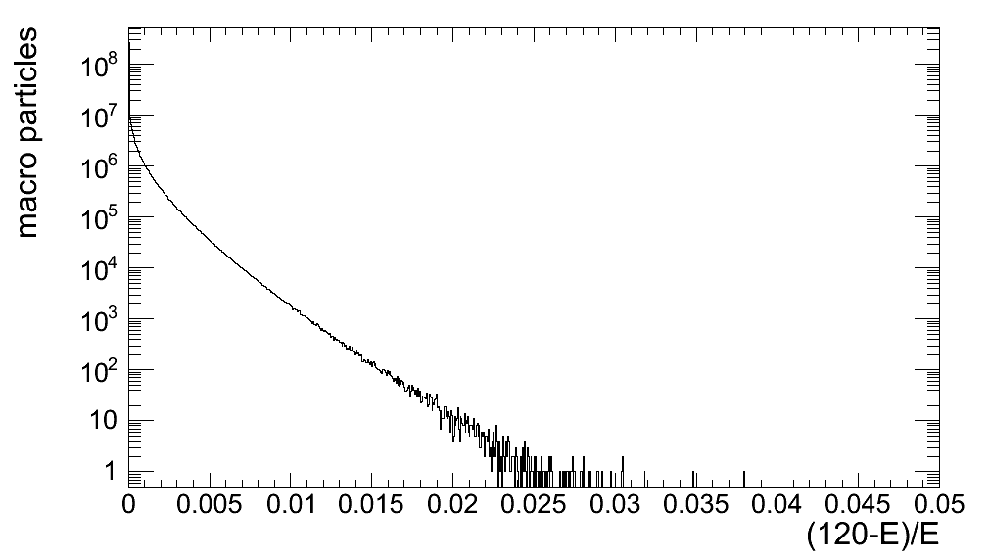
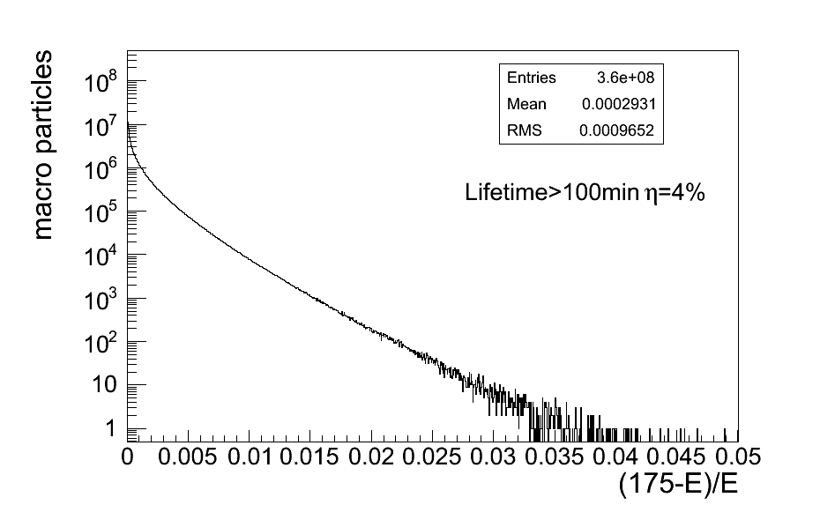
Beamstrahlung energy tails
Particles lose energy in collision region via photon emission due to interaction with e.m. field of oncoming bunch
simulation with 360M macroparticles
τ varies exponentially with energy acceptance η
TLEP @ 120GeV
TLEP @ 175 GeV
τ>20 s at η=1.0%
τ>3 min at η=1.5%
τ>20 min at η=2.0%
τ>4h at η=3%
Lifetime>100min η=4%
M. Zanetti (MIT)
Required RF momentum acceptance δ_{max,RF}
  3.0% @ 120 GeV
  4.5% @ 175 GeV

Slide 9
RF voltage TLEP @ 175 GeV
Quantum lifetime is a very steep function of V_{RF}
RF voltage is defined by the momentum acceptance needed to cope with beamstrahlung
  3.0% for TLEP @ 120 GeV
  4.9% for TLEP @ 175 GeV
U₀ = 9.3 GeV
α_{p} = 1.0 x 10⁻⁵
E₀ = 175 GeV
J_{z} = 1.0
f_{RF} = 352 MHz
f_{RF} = 704 MHz
f_{RF} = 1300 MHz
Machine | RF frequency [MHz] | V_{RF} [GV] for τ_{q} = 100h | V_{RF} [GV] for δ_{max,RF} = 4.5%
TLEP 120 GeV | 352 | 2.18 | 2.5
 | 704 | 2.23 | 2.7
 | 1300 | 2.30 | 3.1
TLEP 175 GeV | 352 | 9.5 | 10.4
 | 704 | 9.7 | 11.2
 | 1300 | 9.8 | 12.2
f_{RF} = 352 MHz
f_{RF} = 704 MHz
f_{RF} = 1300 MHz
δ_{max,RF} ~ f_{RF}^{-1/2} for a given RF voltage

Slide 10
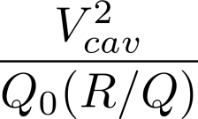
General considerations
RF frequency:
  higher is better, for short bunch length (hourglass effect)
Gradient:
  higher is better: space, cost
  but tradeoff with cryogenic power:
  Power dissipation =
Higher order mode power:
  cavity loss factors, bunch length, bunch charge, beam current
  power limits of HOM damping
  beam break-up from transverse modes
RF power sources:
  klystrons, IOTs, solid state amplifiers?
  available power, efficiency, cost

Slide 11
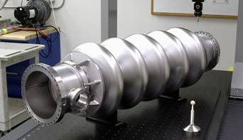
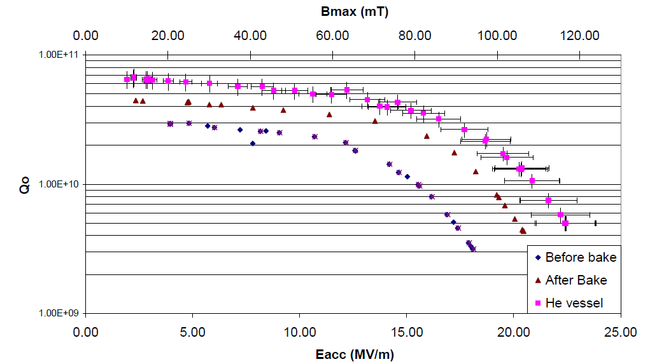
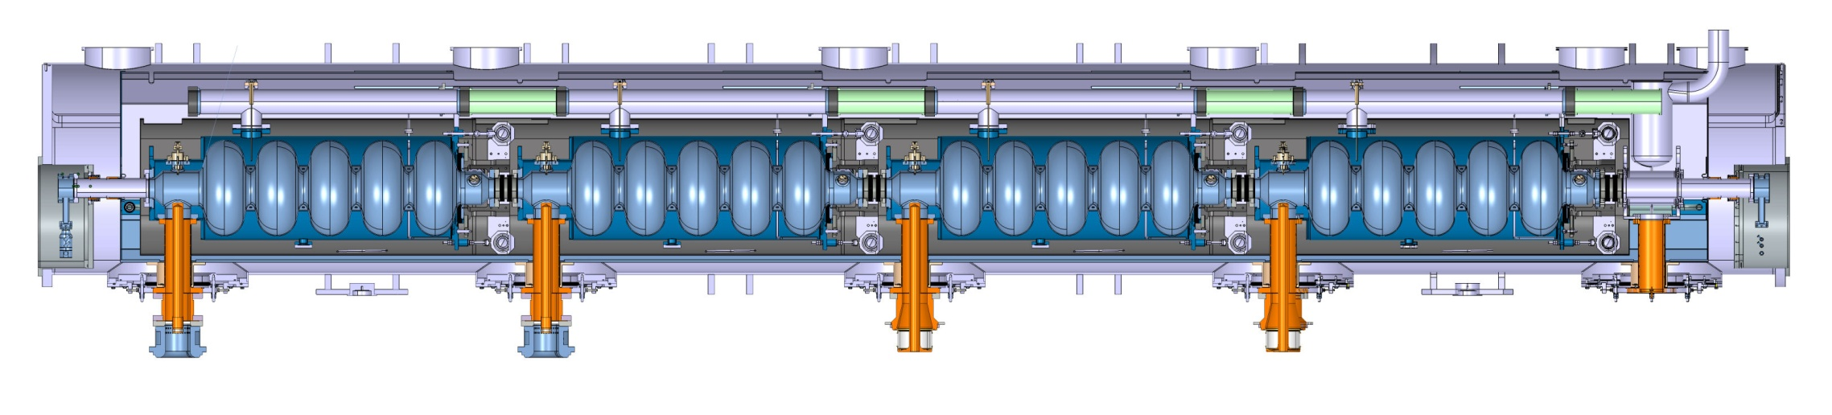
Cavities: 704 MHz eRHIC/SPL
BNL 5-cell 704 MHz test cavity
  (A. Burill, AP Note 376, 2010)
SPL/ESS design value
2.0 x 10¹⁰ @ 20MV/m
First cavities, lots of room for improvement
Measurement after only BCP surface treatment (no EP cf. TESLA cavities)
BCP only
SPL type cryomodule (4-cavity prototype)

Slide 12
704 MHz (TLEP 175 GeV)
 | 704 MHz 5-cell
Gradient [MV/m] | 20
Active length [m] | 1.06
Voltage/cavity [MV] | 21.2
Number of cavities | 567
Number of cryomodules | 71
Total cryomodule length [m] | 902
V_{RF} = 12 GV
P_{beam} = 100 MW
cf. LEP2: 812 m
R/Q [linac ohms] | 506
Q₀ [10¹⁰] | 2.0
Dynamic heat load per cavity [W] | 44.4
Total dynamic heat load [kW] | 25.2
cf. LHC cryoplant capacity @ 1.9K of 18 kW
RF power per cavity [kW] | 176
Matched Q_{ext} | 5.0E+06
Input power couplers at 700 MHz for these power levels?
Notes:
704 MHz has higher heat load despite higher Q₀ because of lower R/Q.

Slide 13
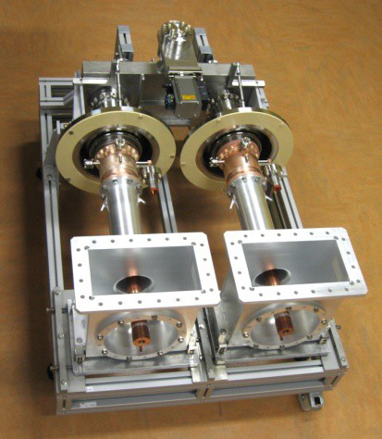
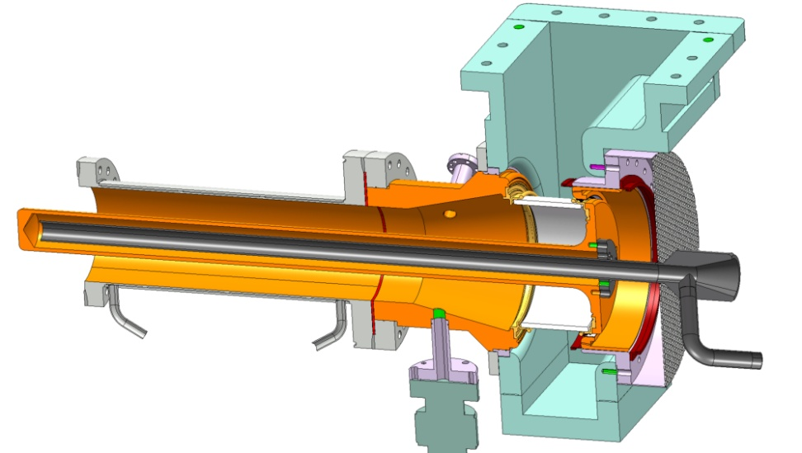
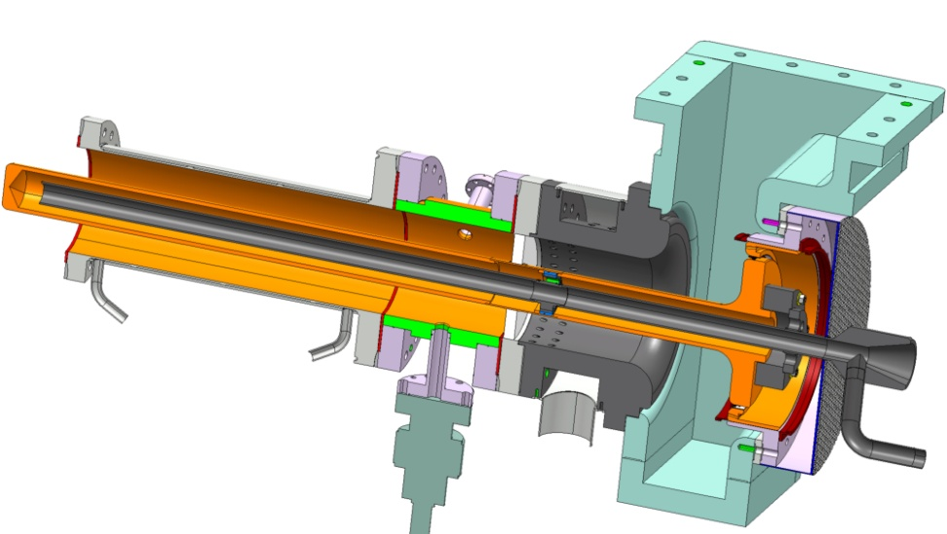
700 MHz power couplers
CEA Saclay HIPPI water cooled coupler (SPL/ESS)
  tested up to 1.2 MW 10% duty cycle in travelling wave, and 1 MW in standing wave
CERN SPL air-cooled single window coupler
  2 designs currently under test: cylindrical and planar disk windows
  design goal: 1 MW 10% duty cycle for SPL
  cylindrical window design uses LHC coupler ceramic window with tapered outer conductor
  LHC windows are routinely tested to > 500 kW CW
Cylindrical
ceramic window
Coaxial disk
ceramic window
E. Montesinos

Slide 14

700 MHz power couplers
Latest R&D results
High average power air cooled couplers (CERN BE-RF-PM)
Cylindrical window :
  TW : 1000 kW 2 ms 20 Hz
  SW : 550 kW 500 us 8 Hz
Coaxial disk window :
  TW : 1000 kW 2 ms 20 Hz
  SW : 1000 kW 1.5 ms 20 Hz
40 kW average power
Limited by arcing on air side of window
→ Improvements in window air flow and screen at braze
40 kW average power
Limited by losses in uncoated outer double walled tube
→ Improvements in coating

Slide 15
Top-up injector rings
V_{RF} = 9.8 GV
  (only for quantum lifetime)
SR power very small
  (beam current ~ 1% of collider ring)
Average cryogenic heat load very small
  (duty cycle < 10%)
Power is dominated by ramp acceleration:
  for a 1.6 second ramp length:
 | TLEP-t
Beam current [mA] | 0.054
Energy swing [GeV] | 155
Max. SR power/cavity [kW] | 6.2
Acceleration power [kW] | 18
Max. power per cavity [kW] | 24
Well within our 200 kW budget

Slide 16
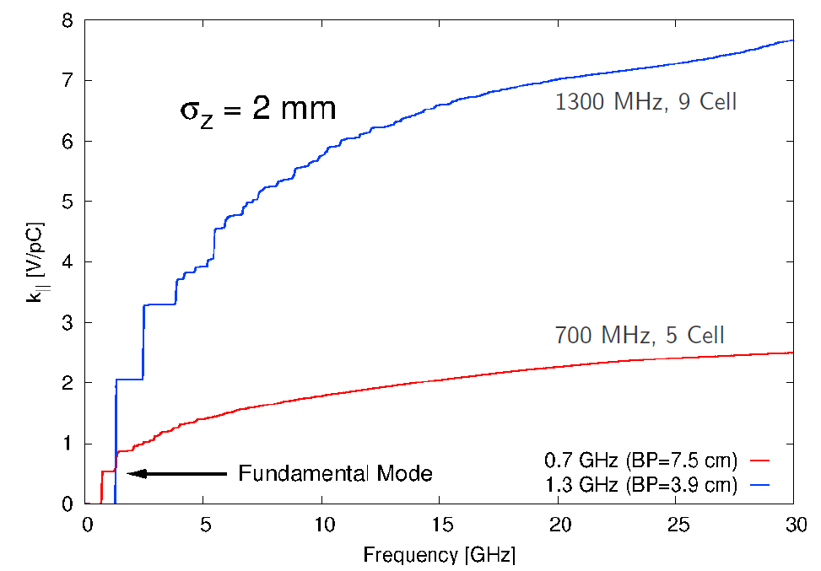
Higher order mode power
R. Calaga
Cavity loss factors
Average P_{HOM} = k||.Q_{bunch}.I_{beam}
k|| = 8.19 V/pC
 | TLEP-H | TLEP-t
Beam current [mA] | 48.6 | 10.8
Num. bunches | 160 | 24
Bunch charge [nC] | 41 | 60
HOM power (704 MHz cavities) [kW] | 5.2 | 0.85
HOM power (1.3 GHz cavities) [kW] | 16.1 | 5.3
k|| = 2.64 V/pC
Challenge: HOM powers in the kW range to remove from the cavity at 2K

Slide 17
HOM power “league table”
Project | Beam current [mA] | Average HOM power per cavity [W]
CEBAF 12GeV | 0.10 | 0.05
Project X | 1 | 0.06
XFEL | 5 | 1
SPL | 40 | 22
APS SPX | 100 | 2,000
BERLinPro | 100 | 150
KEK-CERL | 100 | 185
Cornell ERL | 100 | 200
eRHIC | 300 | 7,500
KEKB | 1,400 | 15,000
TLEP-H 704 MHz 49 5,200
TLEP-t 704 MHz 11 850
After M. Liepe, SRF2011

Slide 18
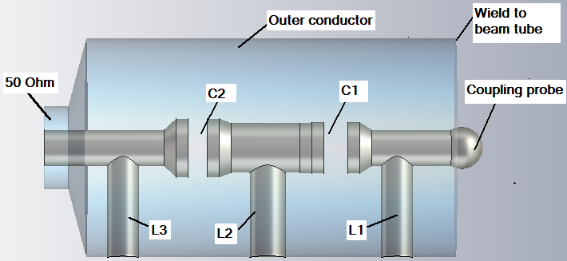
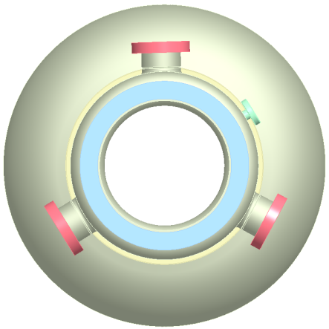
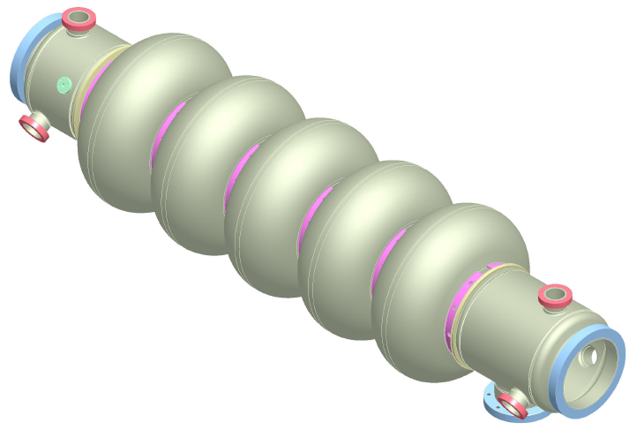
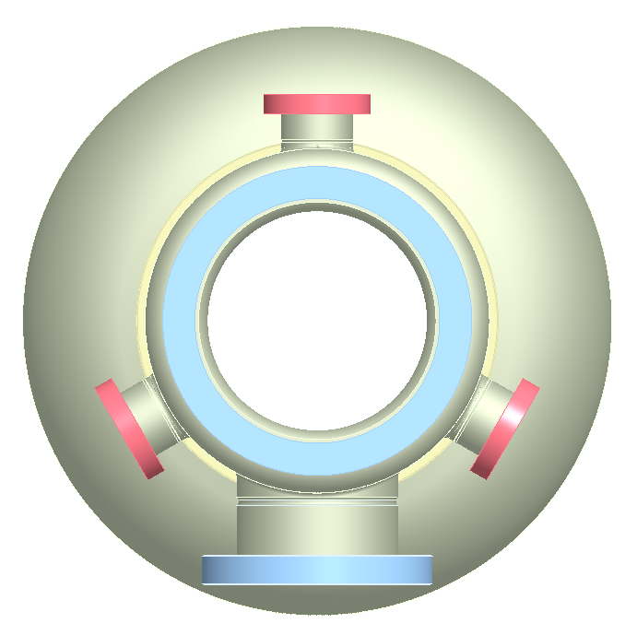
5-cell SRF cavity with strong
HOM damping for eRHIC at BNL
HOM high-pass filter
HOM ports
F = 703.5MHz
HOM couplers: 6 of antenna-type
Fundamental supression: two-stage high-pass filters
E_{acc} = 20 MV/m
Design HOM power: 7.5 kW
FPC port
BNL3 cavity optimized for high-current applications such as eRHIC and SPL.
Three antenna-type HOM couplers attached to large diameter beam pipes at each end of the cavity provide strong damping
A two-stage high-pass filter rejects fundamental frequency, allows propagation of HOMs toward an RF load.
M. Tigner, G. Hoffstaetter, SRF2011, W. Xu et al, SRF2011

Slide 19

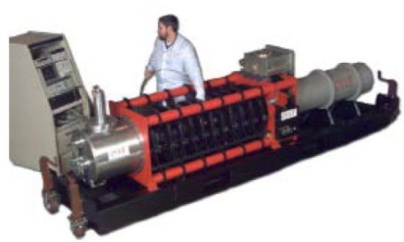
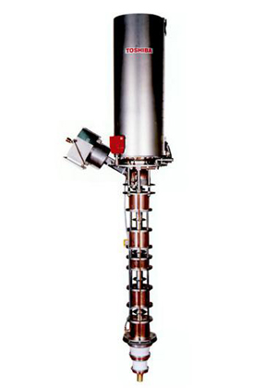
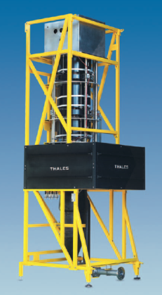

RF power sources
“Super-power” klystrons at 700 MHz
Multiple cavities per klystron
  4 for collider ring?
  16 or more for accelerator ring?
  cf. 8 in LEP2
Type | Frequency (MHz) | Output Power (kW) | Efficiency (%)
VKP-7952B | 704 | 1000 | 65
Type | Frequency (MHz) | Output Power (kW) | Efficiency (%)
E3732 | 508.6 | 1200 | 63
E37701* | 1071.8 | 1200 | 63
Type | Frequency (MHz) | Output Power (kW) | Efficiency (%)
TH2178 | 508.6 | 1200 | 62

Slide 20
Power efficiency
High voltage power converter
  thyristor 6 pulse: 95%
    AC power quality, DC ripple @ multiples of 50 and 300Hz
  switched mode: 90%
    lower ripple on the output, and/or smaller size
Klystron: 65%
  if run at saturation as in LEP2
  i.e. no headroom for RF feedback
RF distribution losses: 5%
  waveguides, circulators
Overall efficiency (wall to beam) between 52% and 55% without margin for RF feedback

Slide 21
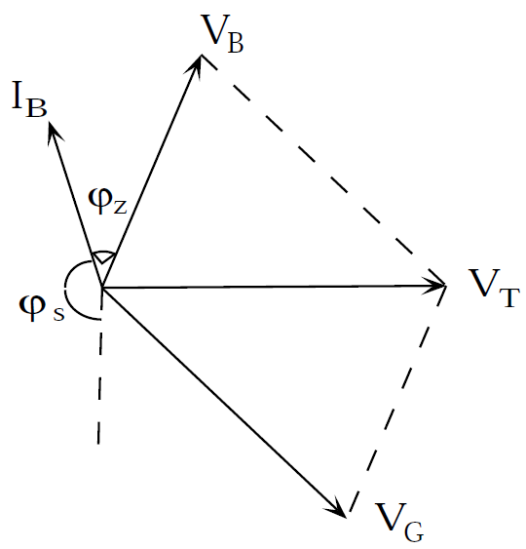
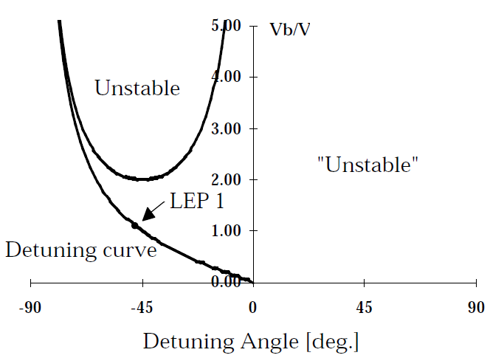
LLRF: instabilities and feedbacks
LEP2:
  slow scalar sum feedback acting on the klystron modulation anode, with the klystrons operated at saturation for maximum efficiency
Is fast RF feedback necessary?
  if the detuning due to beamloading is sufficiently large it can drive coupled bunch modes
  however: f_{rev} = 3750 Hz, f_{s} = 430 Hz, cavity BW = 100 Hz
  → cavity BW << f_{rev} – f_{s}
Microphonics/ponderomotive oscillations
  “cured” at LEP2 by cavity detuning
  better handled by feedback on Piezo tuners
Beamloading: “second Robinson” instability
  loss of longitudinal focusing due to large detune angle under strong beamloading
  occurs at low RF voltage with high beam current
  seen in LEP2 at injection energy
  cured by using fast RF feedback on a few RF stations
  an issue if we don’t have top-up injection
Becomes unstable when V_{G} is in antiphase with I_{B}
Second Robinson
1st Robinson
Notes:
LEP2:
- Beam loading
- Coupled bunch instabilites
- 2nd Robinson
- Ponderomotive oscillations

Slide 22
Conclusions
An RF system for TLEP based on 700 MHz SC cavities such as those being developed for eRHIC, SPS, ESS seems feasible
  ongoing R&D at BNL, CERN, ESS for 704 MHz cavities and components
  fundamental power couplers look feasible at > 200 kW CW
  compatible with HOM damping scheme for eRHIC
  high-power klystrons available
Open questions and R&D necessary
  power coupler design
  HOM damping
  low level RF & feedback requirements

Slide 23
Thank you for your attention!

Slide 24
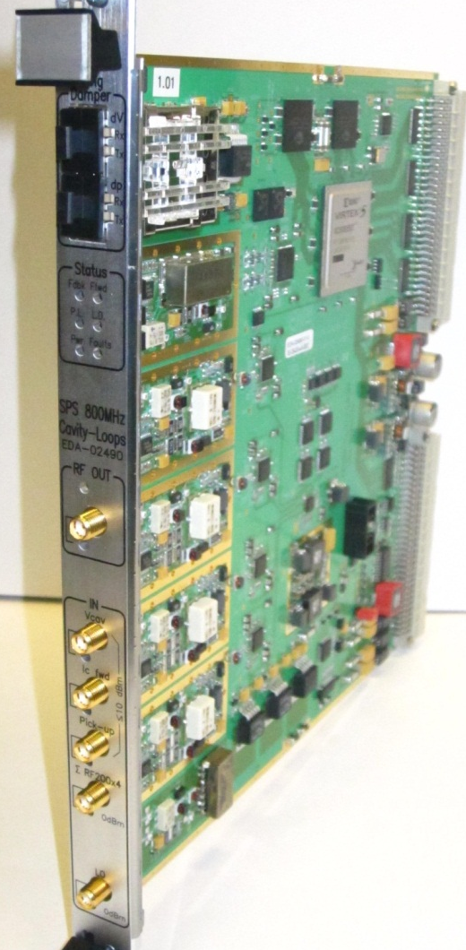
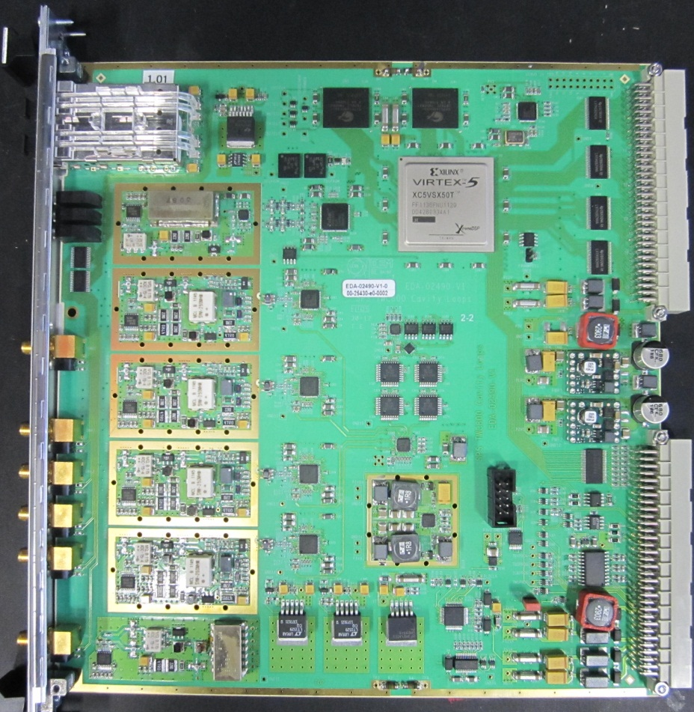
SPS 800 MHz TWC prototype feedback board
G. Hagmann BE-RF-FB
designer

Slide 25
LEP3/TLEP parameters -1
soon at SuperKEKB:
β_{x}*=0.03 m, β_{Y}*=0.03 cm
 | LEP2 | LHeC | LEP3 | TLEP-Z | TLEP-H | TLEP-t
beam energy Eb [GeV] circumference [km] beam current [mA] #bunches/beam #e−/beam [10¹²] horizontal emittance [nm] vertical emittance [nm] bending radius [km] partition number J_{ε} momentum comp. α_{c} [10⁻⁵] SR power/beam [MW] β∗_{x} [m] β∗_{y} [cm] σ∗_{x} [μm] σ∗_{y} [μm] hourglass F_{hg} ΔE^{SR}_{loss}/turn [GeV] | 104.5 26.7 4 4 2.3 48 0.25 3.1 1.1 18.5 11 1.5 5 270 3.5 0.98 3.41 | 60 26.7 100 2808 56 5 2.5 2.6 1.5 8.1 44 0.18 10 30 16 0.99 0.44 | 120 26.7 7.2 4 4.0 25 0.10 2.6 1.5 8.1 50 0.2 0.1 71 0.32 0.59 6.99 | 45.5 80 1180 2625 2000 30.8 0.15 9.0 1.0 9.0 50 0.2 0.1 78 0.39 0.71 0.04 | 120 80 24.3 80 40.5 9.4 0.05 9.0 1.0 1.0 50 0.2 0.1 43 0.22 0.75 2.1 | 175 80 5.4 12 9.0 20 0.1 9.0 1.0 1.0 50 0.2 0.1 63 0.32 0.65 9.3
SuperKEKB:ε_{y}/ε_{x}=0.25%

Slide 26
LEP3/TLEP parameters -2
LEP2 was not beam-beam limited
 | LEP2 | LHeC | LEP3 | TLEP-Z | TLEP-H | TLEP-t
V_{RF,tot} [GV] δ_{max,RF} [%] ξ_{x}/IP ξ_{y}/IP f_{s} [kHz] E_{acc} [MV/m] eff. RF length [m] f_{RF} [MHz] δ^{SR}_{rms} [%] σ^{SR}_{z,rms} [cm] L/IP[10³²cm⁻²s⁻¹] number of IPs Rad.Bhabha b.lifetime [min] ϒ_{BS} [10⁻⁴] n_{γ}/collision Δδ^{BS}/collision [MeV] Δδ^{BS}_{rms}/collision [MeV] | 3.64 0.77 0.025 0.065 1.6 7.5 485 352 0.22 1.61 1.25 4 360 0.2 0.08 0.1 0.3 | 0.5 0.66 N/A N/A 0.65 11.9 42 721 0.12 0.69 N/A 1 N/A 0.05 0.16 0.02 0.07 | 12.0 5.7 0.09 0.08 2.19 20 600 700 0.23 0.31 94 2 18 9 0.60 31 44 | 2.0 4.0 0.12 0.12 1.29 20 100 700 0.06 0.19 10335 2 74 4 0.41 3.6 6.2 | 6.0 9.4 0.10 0.10 0.44 20 300 700 0.15 0.17 490 2 32 15 0.50 42 65 | 12.0 4.9 0.05 0.05 0.43 20 600 700 0.22 0.25 65 2 54 15 0.51 61 95
LEP data for 94.5 - 101 GeV consistently suggest a beam-beam limit of ~0.115 (R.Assmann, K. C.)

Slide 27
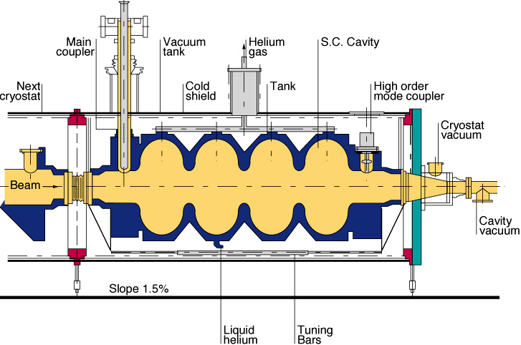
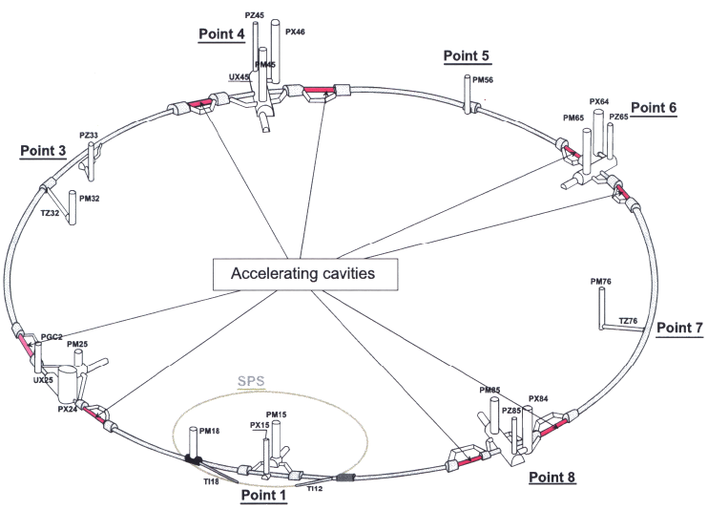
LEP2 SC RF system
Circumference | 26.7 km
Beam energy | 104.5 GeV
Energy loss per turn | 3.4 GeV
Beam current | 5 mA
Synchrotron radiation power | 17 MW
Available cooling power | 53 kW @ 4.5K
RF frequency | 352 MHz
Number of cavities * | 288
Total accelerating voltage * | 3500 MV
Number of klystrons * | 36
Total cryomodule length | 812 m
Cavities per klystron | 8
Average (nom.) power per klystron | 0.6 (1.3) MW
Average power per cavity | 90 kW
* Plus 56 copper cavities (130 MV) driven by 8 klystrons

Slide 28
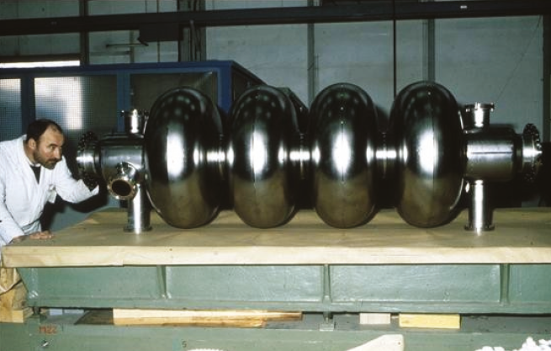
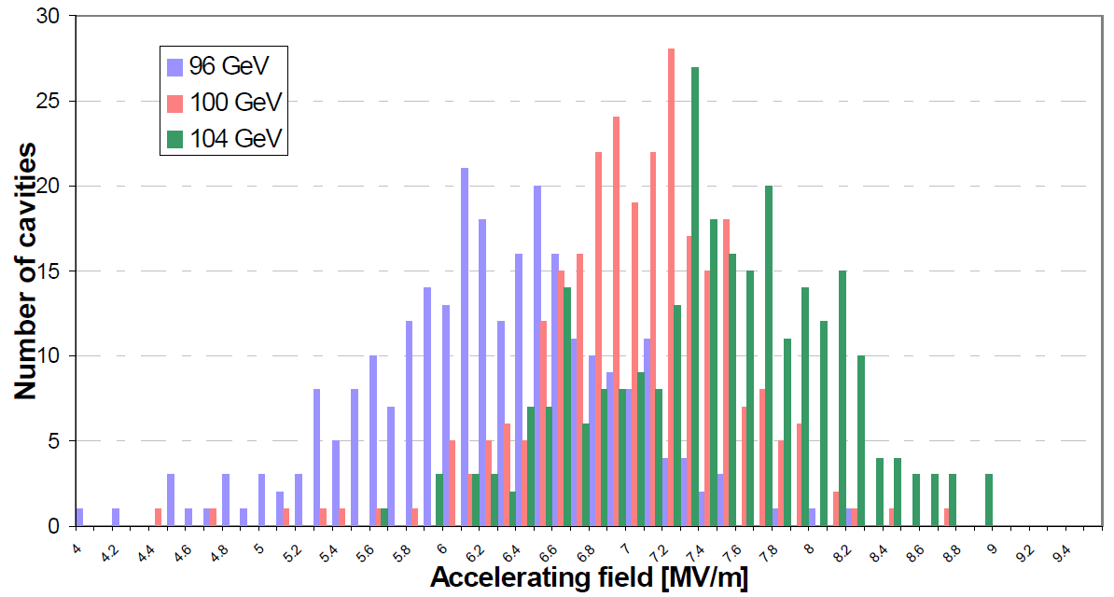
LEP2 SC RF system
Circumference | 26.7 km
Beam energy | 104.5 GeV
Energy loss per turn | 3.4 GeV
Beam current | 5 mA
Synchrotron radiation power | 17 MW
Available cooling power | 53 kW @ 4.5K
Design gradient 6 MV/m
RF frequency | 352 MHz
Number of cavities * | 288
Total accelerating voltage * | 3500 MV
Number of klystrons * | 36
Total cryomodule length | 812 m
Cavities per klystron | 8
Average (nom.) power per klystron | 0.6 (1.3) MW
Average power per cavity | 90 kW
1999
2000
1998
* Plus 56 copper cavities (130 MV) driven by 8 klystrons

Slide 29
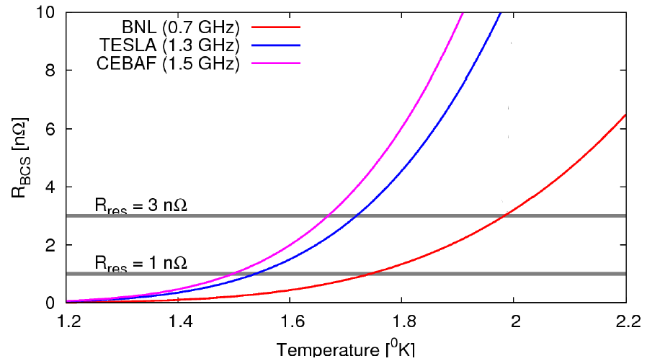
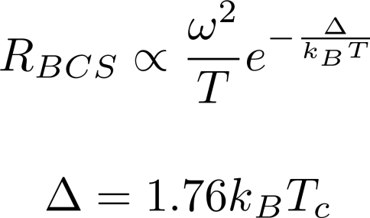
Temperature: Why 2K not 4.5?
RF surface resistance R_{surf} = R_{res} + R_{BCS}
BCS surface resistance
Residual resistance (impurities, trapped flux, etc.)
Increases with frequency
Increases with temperature

Slide 30
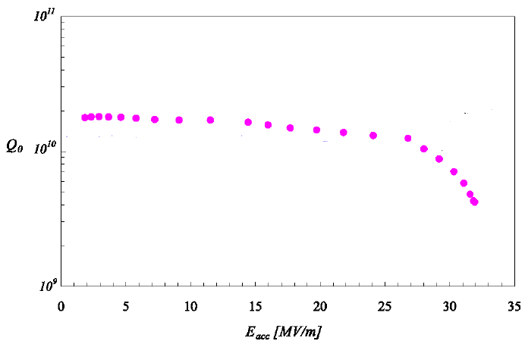
Gradient and dynamic heat load
Shorter RF sections ☺
Q-slope
Lower Q₀, higher dissipation ☹
margin for microphonics etc.
Power dissipation =
R/Q depends only on cavity geometry
Q₀ depends on losses in cavity walls

Slide 31
RF voltage TLEP 120 GeV
Quantum lifetime is a very steep function of V_{RF}
RF voltage is defined by the momentum acceptance needed to cope with beamstrahlung
  3.0% for TLEP @ 120 GeV
  4.9% for TLEP @ 175 GeV
U₀ = 2.1 GeV
α_{p} = 1.0 x 10⁻⁵
E₀ = 120 GeV
J_{z} = 1.0
f_{RF} = 352 MHz
f_{RF} = 704 MHz
f_{RF} = 1300 MHz
Machine | RF frequency [MHz] | V_{RF} [GV] for τ_{q} = 100h | V_{RF} [GV] for δ_{max,RF} = 3%
TLEP 120 GeV | 352 | 2.18 | 2.5
 | 704 | 2.23 | 2.7
 | 1300 | 2.30 | 3.1
f_{RF} = 352 MHz
f_{RF} = 704 MHz
f_{RF} = 1300 MHz
δ_{max,RF} ~ f_{RF}^{-1/2} for a given RF voltage

Slide 32
LEP2 vs. TLEP SC RF systems
 | LEP2 | TLEP
Circumference | 26.7 km | 80 km
Beam energy | 104.5 GeV | 175 GeV
Energy loss per turn | 3.4 GeV | 9.3 GeV
Beam current | 5 mA | 5.4 mA
Synchrotron radiation power | 22 MW | 100 MW
RF frequency | 352 MHz | 700 MHz
Total accelerating voltage | 3500 MV * | 12 GV
Nominal gradient | 6 MV/m | 20 MV/m
Number of cavities * | 288 * | 567
Number of cryomodules | 72 | 71
Number of klystrons | 36 * | 142
Total cryomodule length | 812 m | 902 m
Cavities per klystron | 8 | 4
Average (nom.) power per klystron | 0.6 (1.3) MW | 0.7 (1.0)
Average power per cavity | 90 kW | 176 kW
* Plus 56 copper cavities (130 MV) driven by 8 klystrons

Slide 33
Parameters: LEP3 (27 km ring) and TLEP (80 km ring)
 | LEP2 | LEP3 | TLEP-Z | TLEP-H | TLEP-t
beam energy E_{b} [GeV] | 104.5 | 120 | 45.5 | 120 | 175
circumference [km] | 26.7 | 26.7 | 80 | 80 | 80
beam current [mA] | 4 | 7.2 | 1180 | 24.3 | 5.4
#bunches/beam | 4 | 4 | 2625 | 80 | 12
#e⁻/beam [10¹²] | 2.3 | 4 | 2000 | 40.5 | 9
bending radius [km] | 3.1 | 2.6 | 9 | 9 | 9
partition number J_{ε} | 1.1 | 1.5 | 1 | 1 | 1
momentum comp. α_{c} [10⁻⁵] | 18.5 | 8.1 | 9 | 1 | 1
SR power/beam [MW] | 11 | 50 | 50 | 50 | 50
ΔE^{SR}_{loss}/turn [GeV] | 3.41 | 6.99 | 0.04 | 2.1 | 9.3
V_{RF,tot} [GV] | 3.64 | 12 | 2 | 6 | 12
δ_{max,RF} [%] | 0.77 | 4.2 | 4 | 9.4 | 4.9
f_{s} [kHz] | 1.6 | 3.91 | 1.29 | 0.44 | 0.43
E_{acc} [MV/m] | 7.5 | 20 | 20 | 20 | 20
eff. RF length [m] | 485 | 600 | 100 | 300 | 600
f_{RF} [MHz] | 352 | 1300 | 700 | 700 | 700
δ^{SR}_{rms} [%] | 0.22 | 0.23 | 0.06 | 0.15 | 0.22
σ^{SR}_{z,rms} [cm] | 1.61 | 0.23 | 0.19 | 0.17 | 0.25

Slide 34
General considerations (2)
RF frequency:
  higher is better, for short bunch length (hourglass effect)
Higher order mode power:
  cavity loss factors, bunch length, bunch charge, beam current
  power limits of HOM damping
  bunch break-up from transverse modes
RF power sources:
  klystrons, IOTs, solid state amplifiers?
  available power, efficiency, cost
Feedbacks and Low-Level RF:
  beamloading (especially if no top-off injection)
  longitudinal impedance control (coupled bunch modes)

Slide 35
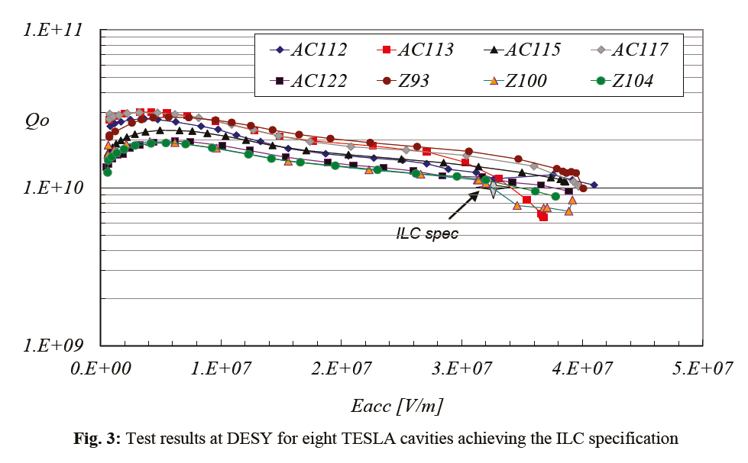
Aside: why not 1.3 GHz?
ILC cavity specifications:
 | Gradient | Q₀
Vertical test (bare cavity) | 35 MV/m | > 0.8 x 10¹⁰
Mounted in cryomodule | 31.5 MV/m | > 1.0 x 10¹⁰
Test results for eight 1.3 GHz 9-cell TESLA cavities achieving the ILC specification (DESY)
(mounted)
BCP + EP
Notes:
High gradients 31.5 MV/m, Q0 > 10¹⁰ Fruit of 10 years of R&D, very mature technology being used for XFEL etc.

Slide 36
1.3 GHz (TLEP 175 GeV)
LEP3 | 1300 MHz 9-cell
Gradient [MV/m] | 20 | 25
Active length [m] | 1.038 | 1.038
Voltage/cavity [MV] | 20.76 | 25.95
Number of cavities | 579 | 463
Number of cryomodules | 72 | 58
Total cryomodule length [m] | 927 | 737
V_{RF} = 12 GV
P_{beam} = 100 MW
cf. 1.06 m for 704 MHz 5-cell
R/Q [linac ohms] | 1036 | 1036
Q₀ [10¹⁰] | 1.5 | 1.3
Dynamic heat load per cavity [W] | 27.7 | 50.0
Total dynamic heat load [kW] | 16.1 | 23.2
RF power per cavity [kW] | 173 | 216
Matched Q_{ext} | 2.4E+06 | 3.0E+06
Input power couplers @ 1.3 GHz ??
Notes:
704 MHz has higher heat load despite higher Q₀ because of lower R/Q.

Slide 37
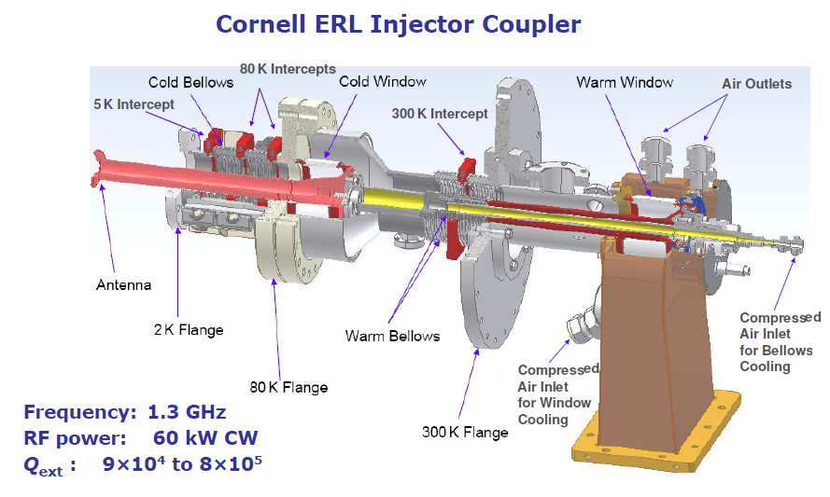
1.3 GHz power couplers
TTF-III couplers tested to 5 kW in CW
  8kW with improved cooling (BESSY)
Some higher power adaptations for ERL injectors
  e.g. Cornell 60 kW CW
2 couplers per 2-cell cavity in ERL injector cryomodule
Gradient: 5-15MV/m
Beam current: 100 mA
V. Vescherevitch, ERL’09
power coupler for 1.3 GHz 200 kW CW looks challenging…
Notes:
Main issue with these couplers for high CW power is the cooling of the cold window which is in vacuum.

Slide 38
2 K Heat Loads (per β=1 cavity)
Operating condition | Value
Beam current/pulse lenght | 40 mA/0.4 ms beam pulse | 20 mA/0.8 ms beam pulse
cryo duty cycle | 4.11% | 8.22%
quality factor | 10 x 10⁹ | 5 x 10⁹
accelerating field | 25 MV/m | 25 MV/m
Source of Heat Load | Heat Load @ 2K (per cavity)
Beam current/pulse lenght | 40 mA/0.4 ms beam pulse | 20 mA/0.8 ms beam pulse
dynamic heat load per cavity | 5.1 W | 20.4 W
static losses | <1 W (tbc) | ~ 1 W (tbc)
power coupler loss at 2 K | <0.2 W | <0.2 W
HOM loss in cavity at 2 K | <1 | <3 W
HOM coupler loss at 2 K (per coupl.) | <0.2 W | <0.2 W
beam loss | 1 W | 1 W
Total @ 2 K | 8.5 W | 25.8 W

Slide 39
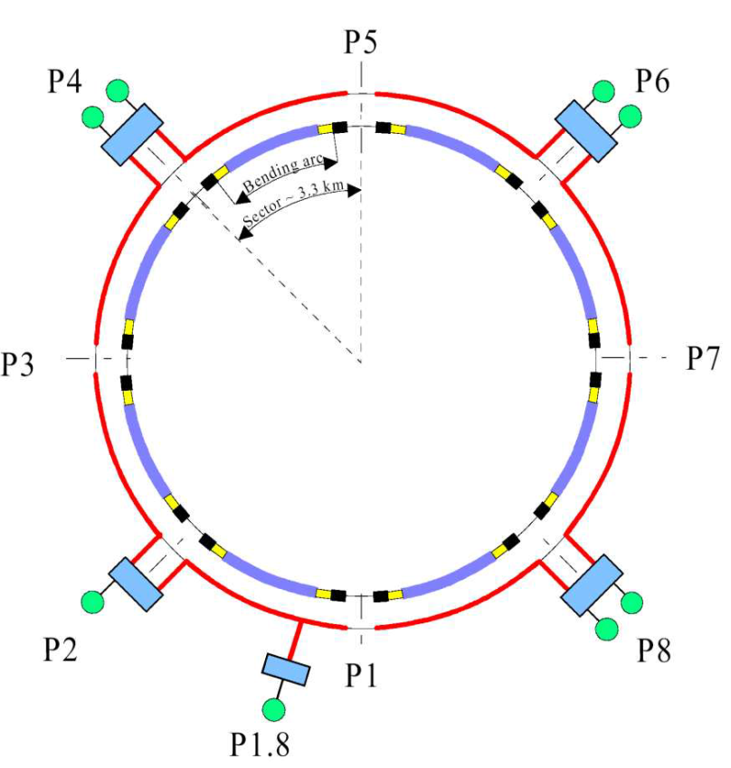
LHC cryogenic plant capacity
For LEP3 it would be very advantageous if the cryogenic power required for the RF could be supplied by the existing LHC cryogenics plants
Installed refrigeration capacity in the LHC sectors
Temperature level |  | High-load sector (1-2, 4-5, 5-6, 8-1) | Low-load sector (2-3, 3-4, 6-7, 7-8)
50-75 K | [W] | 33000 | 31000
4.6-20 K | [W] | 7700 | 7600
4.5 K | [W] | 300 | 150
1.9 K LHe | [W] | 2400 | 2100
4 K VLP | [W] | 430 | 380
20-280 K | [g.s-1] | 41 | 27
Total wall-plug power for LHC cryogenics = 40 MW
LHC cold compressors (125 g/s@15mbar=1.8K) have similar dimensions as the CEBAF ones (250g/s@30mbar=2.0K)
However, piping, motors and so on would not be compatible with a factor 2 in capacity.
A more detailed study would be necessary to evaluate the performance we could have if some parts would be changed (motors, bearings, valves,...)

Slide 40
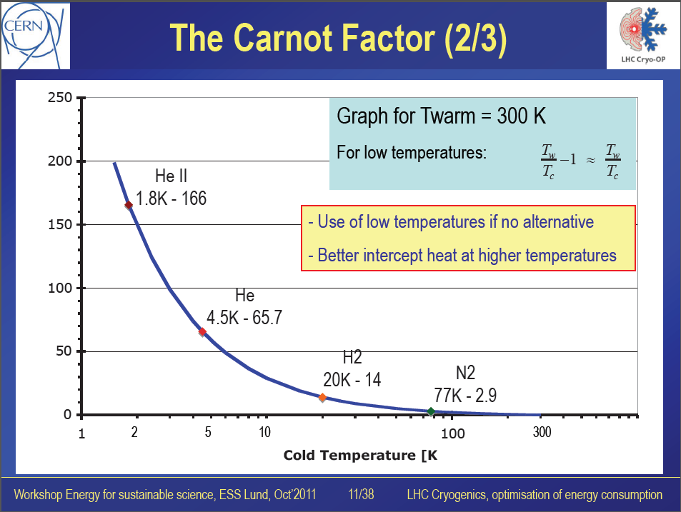
Carnot ~150 @ 2K
Eff. ~ 30% of Carnot
Total wall-plug power for LHC cryogenics = 40 MW

