Slide 2
FPGA Mezzanine Card standard IO-modules for the LLRF beam control system of CERN’s PS Booster and MedAustron synchrotron
M. E. Angoletta, A. Blas, A. Butterworth, A. Findlay, M. Jaussi, P. Leinonen, T. Levens, J. Molendijk, J. Sanchez Quesada, J. Simonin (CERN)
U. Dorda, S. Kouzue, C. Schmitzer‎ (MedAustron)
P. Leinonen, J. Sanchez Quesada RFTech workshop 25th-26th March 2013

Slide 3
Outline
FMC mezzanines and IP cores
    Mezzanine overview
    Mezzanine and IP core relationship
    IP core overview
DAC mezzanine and SDDS
ADC and DDS mezzanines, DDC and MDDS
Test environment and development tools
Conclusion
P. Leinonen, J. Sanchez Quesada RFTech workshop 25th-26th March 2013 3

Slide 4
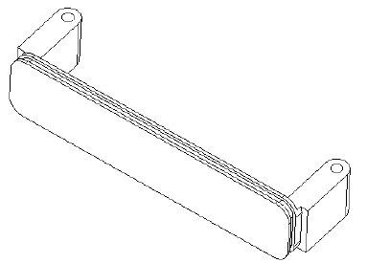
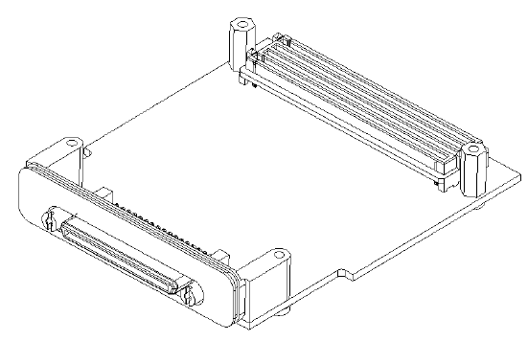
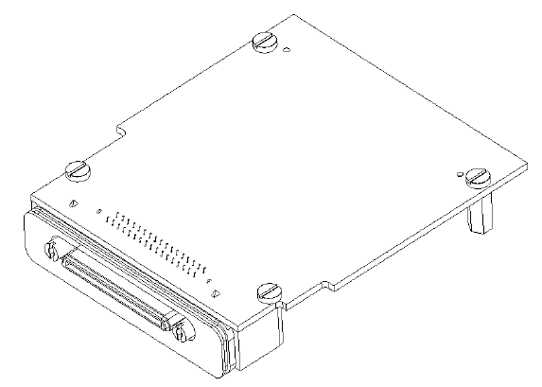
FMC mezzanines: Overview
  FPGA Mezzanine Card (FMC) standard, VITA57.1 [2]
  High speed connector, single-ended and differential signaling, 2Gb/s (10Gb/s via specific pins)
  400-pin HPC or 160-pin LPC connector options, user definable IOs 160-pins and 68-pins, respectively.
  Connector stack heights either 8.5 or 10 mm
  Supports several signaling standards, LVDS, LVCMOS, LVPECL, SSTL, HSTL
  Very small-scale boards, single width module 69 x 76.5mm and double width 139 x 76.5mm
  (the height is 12.4mm for both)
  Improved EMC and RFI interference,
  and heat distribution with the use of
  a front panel
P. Leinonen, J. Sanchez Quesada RFTech workshop 25th-26th March 2013 4

Slide 5
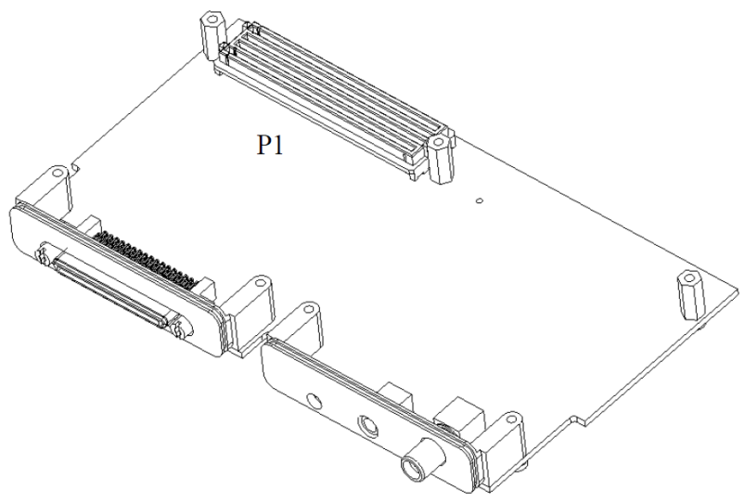
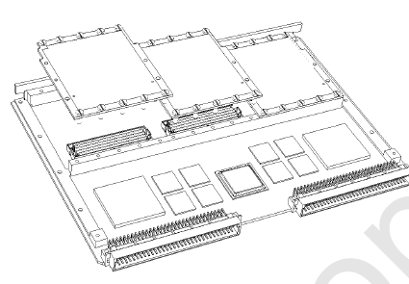
FMC mezzanines: Overview
  FPGA Mezzanine Card (FMC) standard , VITA57.1 [2]
  Mezzanine supported by multiple carriers: VME VXS, PCI, PXI etc.
  Dedicated pins for the clock, JTAG, I2C [3], power, PG indication, module present and multi-gigabit transmission
P. Leinonen, J. Sanchez Quesada RFTech workshop 25th-26th March 2013 5

Slide 6
FMC mezzanine and IP core relationship
FMC mezzanine sits here
FMC IP core socket
P. Leinonen, J. Sanchez Quesada RFTech workshop 25th-26th March 2013 6

Slide 7
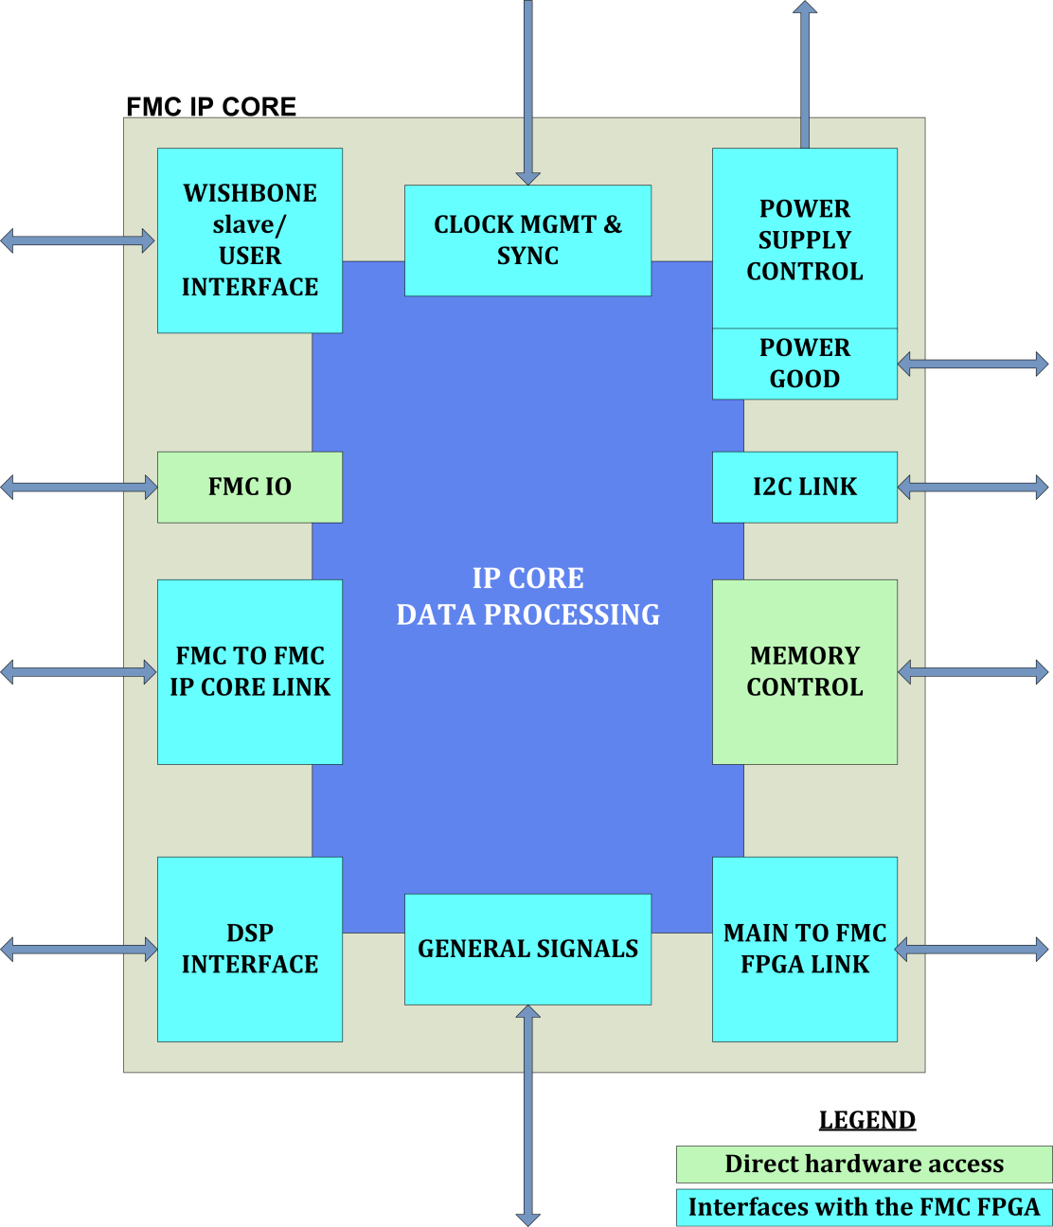
IP core overview
Clocks and TAG
VADJ Power Supply Control and power good
VME wishbone access
Direct access to the FMC I/O, hardware
I2C link for the hardware ICs
IP core communication
Memory access
DSP access
via Gigabit link
Slow Status / Faults Interface to Main FPGA (LED control)
Timings, Function gen etc.
P. Leinonen, J. Sanchez Quesada RFTech workshop 25th-26th March 2013 7

Slide 8
FMC IP cores: Main characteristics
  Each FMC IP Core is connected to the Wishbone slave user interface that is directly mapped to the carriers VME address space and any register can be unconditionally accessed at any time
  Also each of the FMC IP Core is connected to a user interface that is driven from the DSP via a number of dedicated Giga-bit links between the Main FPGA and the FMC FPGA
  Flexible debugging options:
      DSP registers can be mapped to the VME memory map via a multiplexer, no multi-master registers
  An external SRAM, 1M x 72 bits, is directly connected to the FMC IP core and therefore provides full implementation freedom to the designer
  SRAM is clocked at the RFCLK for full rate data storage at the acquisition clock rate
P. Leinonen, J. Sanchez Quesada RFTech workshop 25th-26th March 2013 8

Slide 9
Outline
FMC mezzanines and IP cores
DAC mezzanine and SDDS
    Hardware
    FMC SDDS IP core
    Test results
ADC and DDS mezzanines, DDC and MDDS
Test environment and development tools
Conclusion
P. Leinonen, J. Sanchez Quesada RFTech workshop 25th-26th March 2013 9

Slide 10
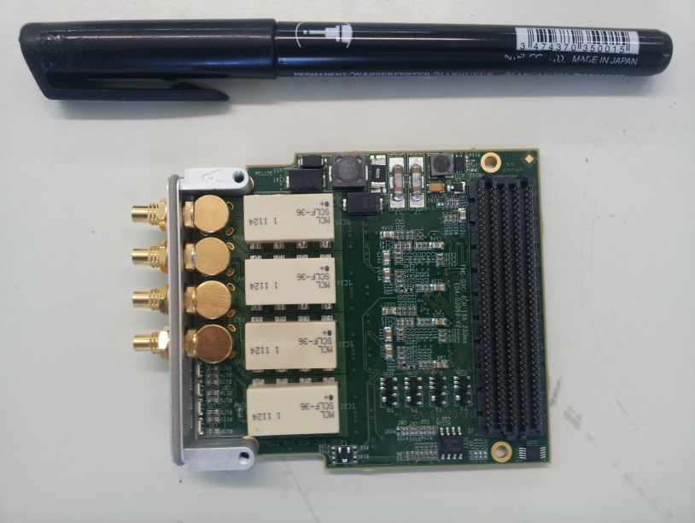
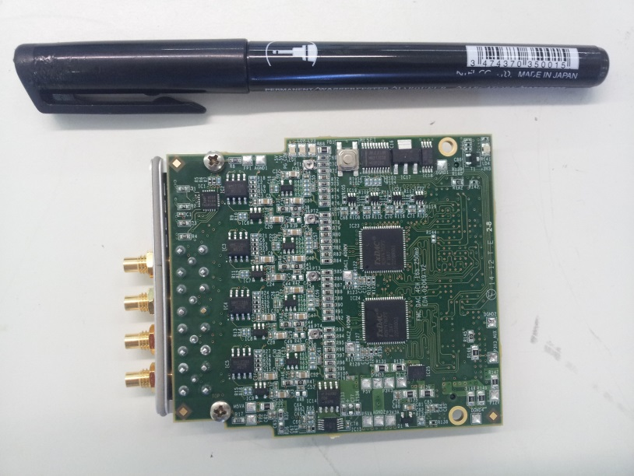
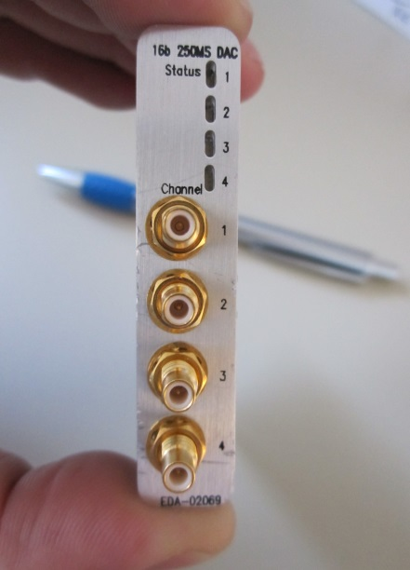
DAC mezzanine: Characteristics
  2 x 16bit Dual DACs (AD9747), Fs = 250MSPS -> 4 identical CHs
  DC coupled output, 40MHz analog bandwidth, peak output voltage 3.6Vp-p
  400-pin FMC connector for parallel data interfacing
  Low noise and low distortion amplifiers
  Compact front-panel for heat dissipation and 3-color status indication LEDs
  Unique PCB identification by silicon ID chip and a system monitor chip
  EEPROM to store HW specific information (FMC type, Version number, operating voltage etc.)
  Programmable digital + analog gains for dynamic range shift
P. Leinonen, J. Sanchez Quesada RFTech workshop 25th-26th March 2013 10

Slide 11
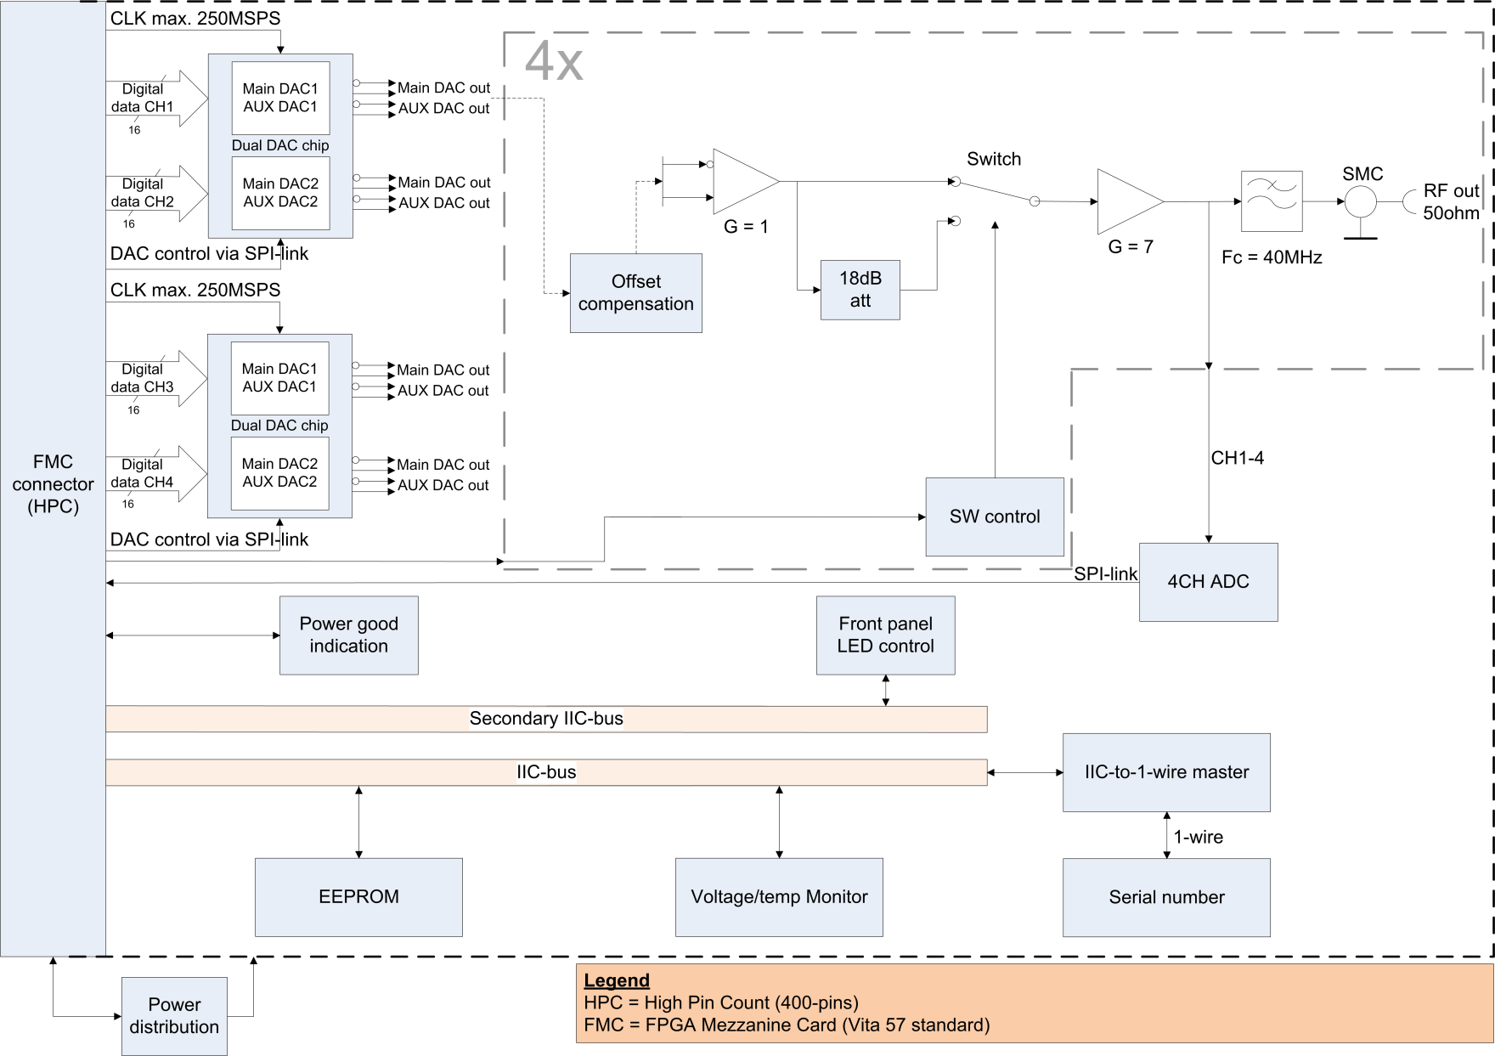
DAC mezzanine: Block diagram
P. Leinonen, J. Sanchez Quesada RFTech workshop 25th-26th March 2013 11

Slide 12
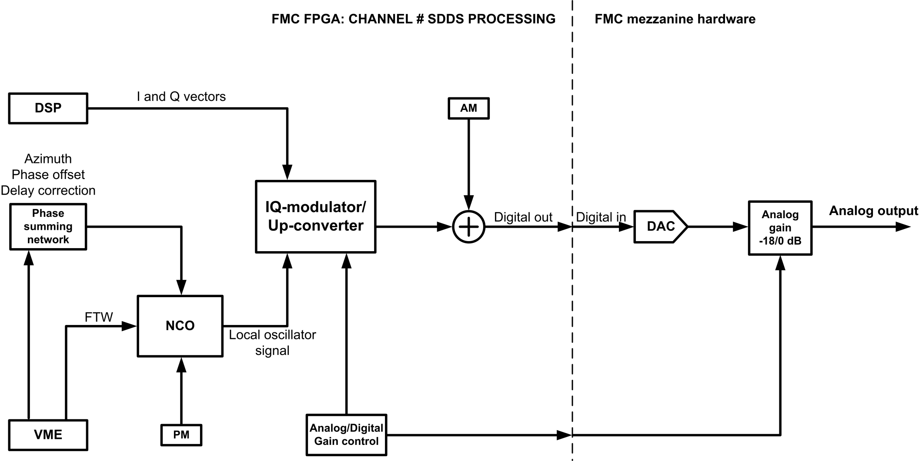
SDDS IP core: Simplified block diagram
P. Leinonen, J. Sanchez Quesada RFTech workshop 25th-26th March 2013 12

Slide 13
SDDS IP core: Main characteristics
  Delay corrector, Azimuth, phase offset compensation and MDDS harmonic number change compensation features
  Selectable amplitude and phase modulations, and noise generation for the controlled beam emittance blow-up
  Comprehensive signal observation through SRAM memory
  Highly flexible signal generator with many features
      Contains SPI, I2C, Memory, power supply and A/D gain processing controllers
      Has a direct VME, DSP and memory access but also FMC to FMC IP core link, main FPGA to FMC FPGA link for status/faults etc., PG indication signals and many more…
      Multiple debugging options
      Amplifier offset compensation manually and automatically according to the preference
  User selectable manual/automatic amplifier DC offset compensation
P. Leinonen, J. Sanchez Quesada RFTech workshop 25th-26th March 2013 13

Slide 14
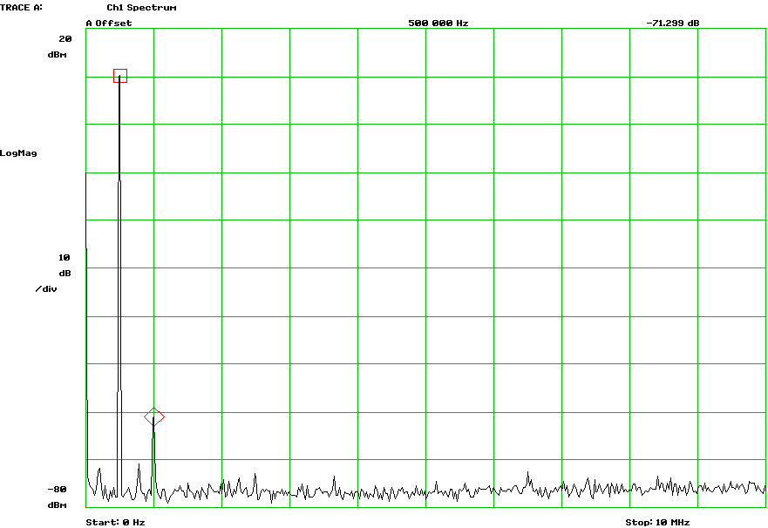
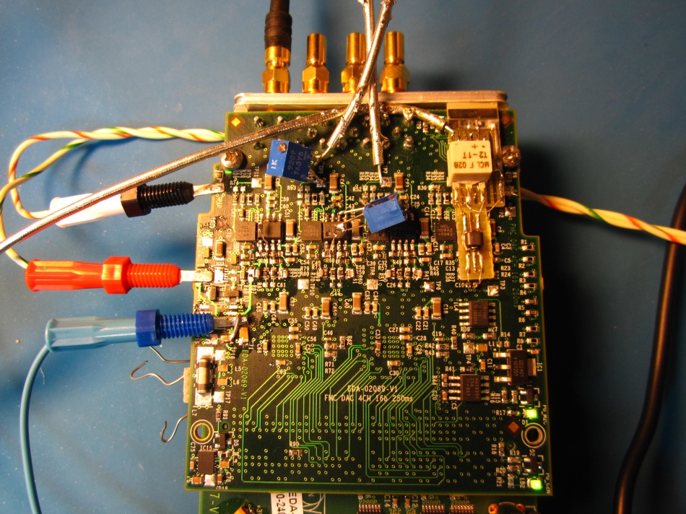
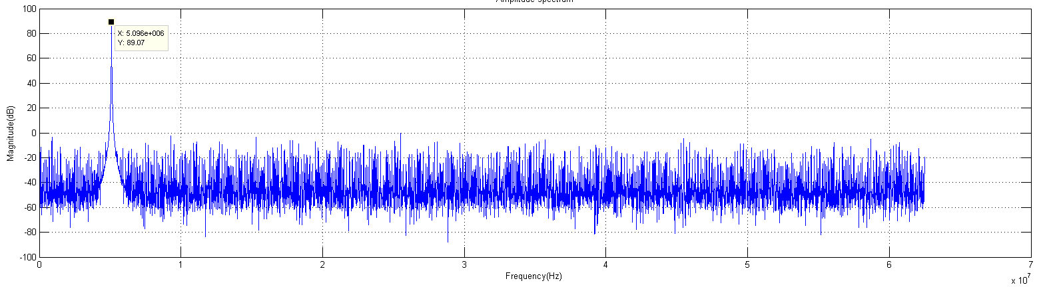
DAC mezzanine/SDDS: Test results
DAC mezzanine output
DAC mezzanine V1 during testing
+10dBm
SFDR ~ 60dB between 3MHz – 40MHz
71dB
SFDR
-61dBm
FFT of the 16-bit NCO signal ~ 5MHz, peak at 89dB (Matlab plot)
All measurements are completely independent and unrelated
P. Leinonen, J. Sanchez Quesada RFTech workshop 25th-26th March 2013 14

Slide 15
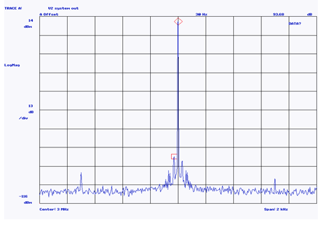
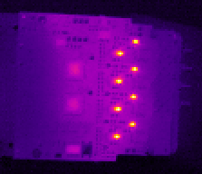
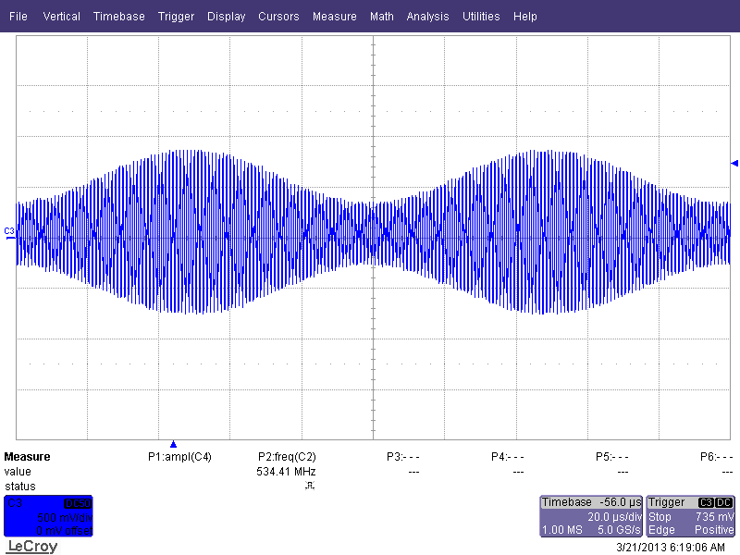
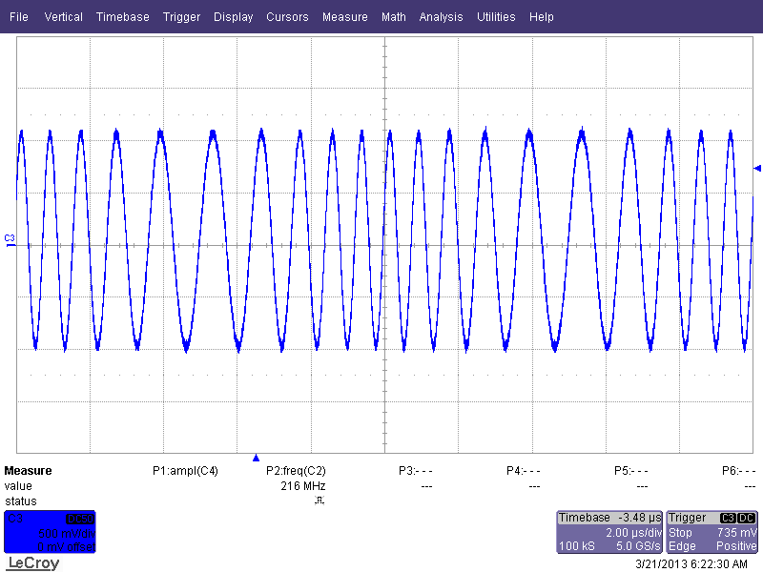

DAC mezzanine/SDDS:
Test results cont’d
+10dBm
HW thermal image
94dB
SFDR
10dBm signal at 3MHz
with a span of 2kHz
around the carrier
+30 °C
-84dBm
All measurements are completely independent and unrelated
+45 °C
AM modulation
PM modulation
P. Leinonen, J. Sanchez Quesada RFTech workshop 25th-26th March 2013 15

Slide 16
Outline
FMC mezzanines and IP cores
DAC mezzanine and SDDS
ADC and DDS mezzanines, DDC and MDDS
  ADC and digital down converter overview
  Test results
  MDDS overview
  Test results
Test environment and development tools
Conclusion
P. Leinonen, J. Sanchez Quesada RFTech workshop 25th-26th March 2013 16

Slide 17
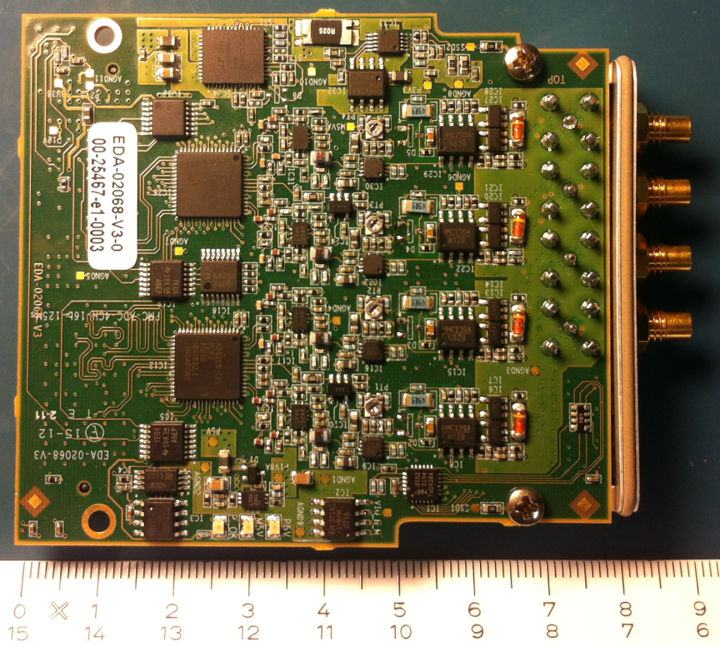
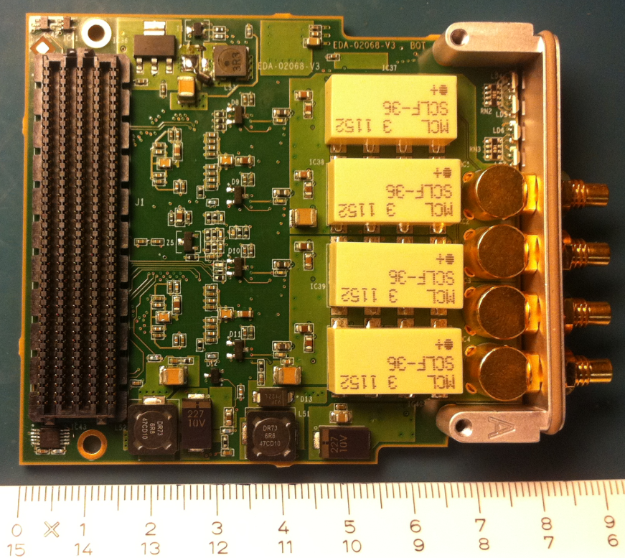
ADC FMC Card
Overview
Characteristics:
General purpose 4 channel, 125MSPS acquisition module with 16bits architecture.
Provides signal conditioning with an analogue front-end featuring DC coupling, low noise, low distortion and gain switching (equivalent to 3 LSB’s).
DC to 40MHz (oversampled) bandwidth. Can be extended by a factor of 10.
SNR > 77dB (12.5 ENOB), SFDR > 70dB
P. Leinonen, J. Sanchez Quesada RFTech workshop 25th-26th March 2013 17
Notes:
Clarification of the hardware and firmware naming used during the presentation

Slide 18
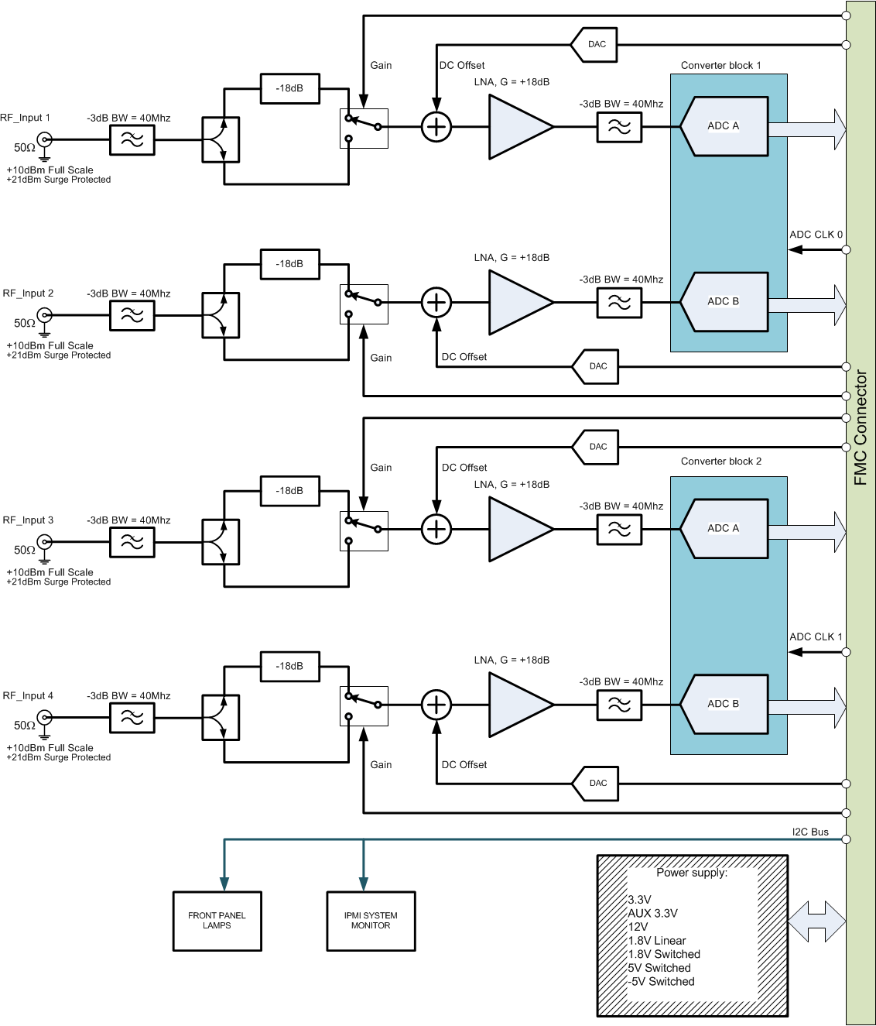
ADC FMC Card
Overview
ADC block diagram (simplified):
P. Leinonen, J. Sanchez Quesada RFTech workshop 25th-26th March 2013 18

Slide 19
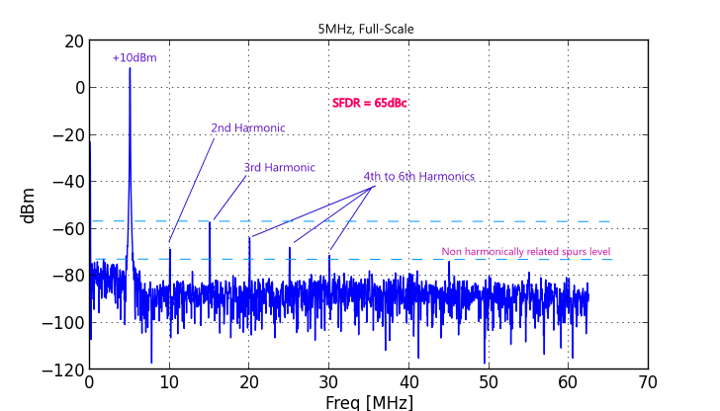
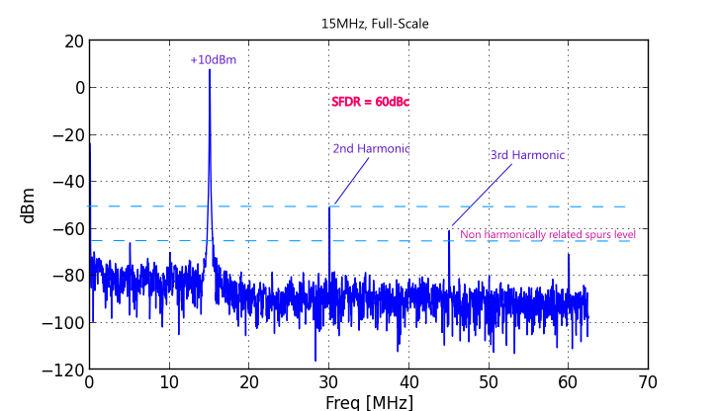
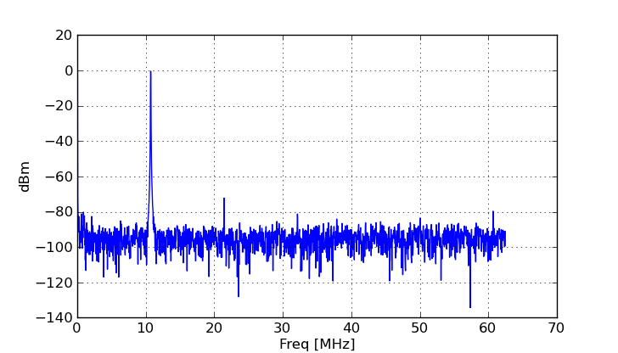
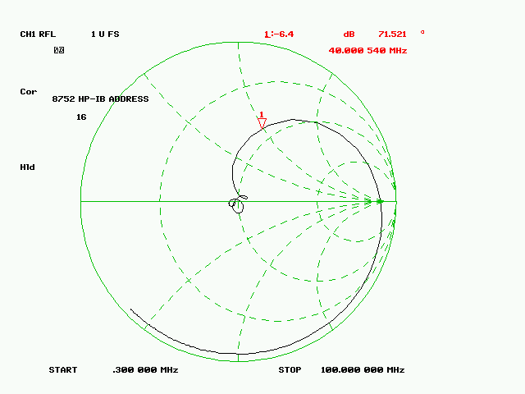
ADC FMC Card
Analog front end tests
Front end test results:
SFDR ~ 60dB from DC to 40MHz
Filtered signal generator, 10.7MHz signal, 0dBm:
Input matching:
P. Leinonen, J. Sanchez Quesada RFTech workshop 25th-26th March 2013 19

Slide 20
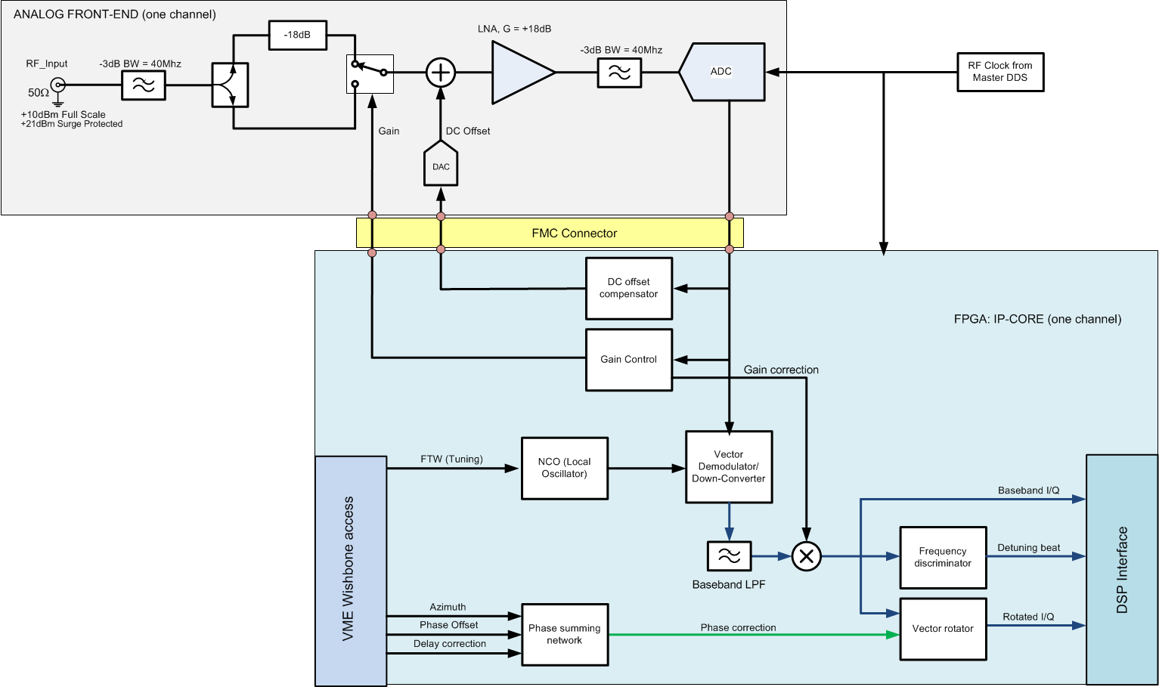
Digital down converter
Overview
Simplified block diagram:
The down converter is an homodyne receiver that converts the selected beam revolution harmonic into a baseband I/Q signal.
It features a multirate fast signal processing hardware embedded into the FPGA IP core.
P. Leinonen, J. Sanchez Quesada RFTech workshop 25th-26th March 2013 20

Slide 21
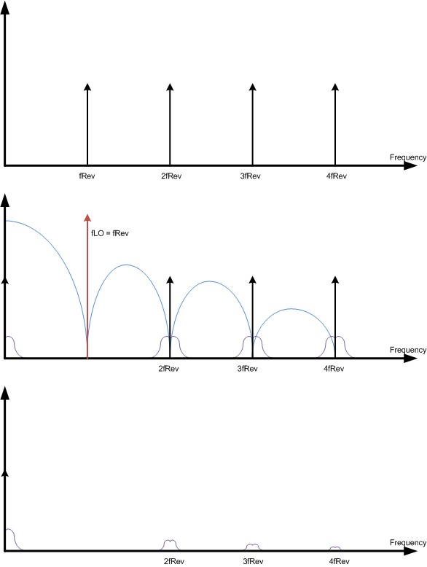
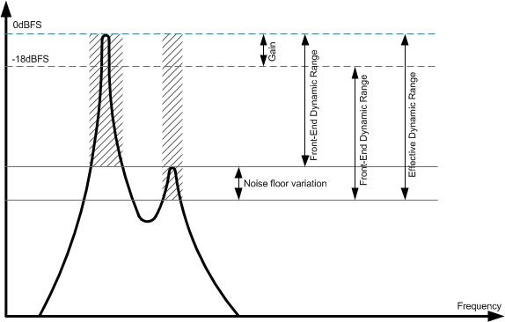
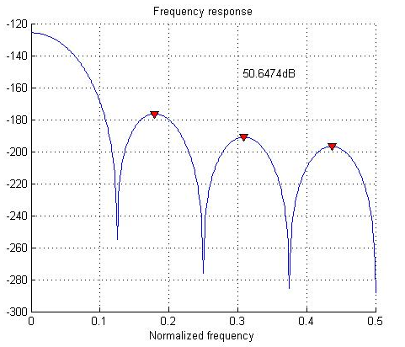
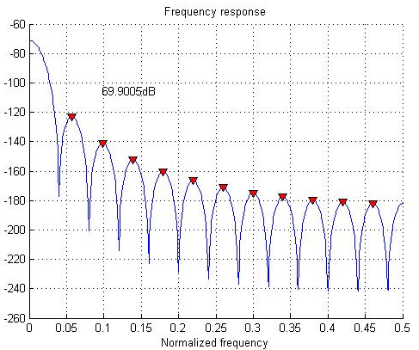
Digital down converter
Overview
Homodyne principle:
The narrowband dynamic range is controlled by an automatic gain control, maximizing the SNR when the input signal power does not fill the ADC range. It adds 18dB to the effective analog dynamic range.
The down-converted spectral component, keeps its phase and amplitude properties.
Further improvement is obtained with process gain:
P. Leinonen, J. Sanchez Quesada RFTech workshop 25th-26th March 2013 21

Slide 22
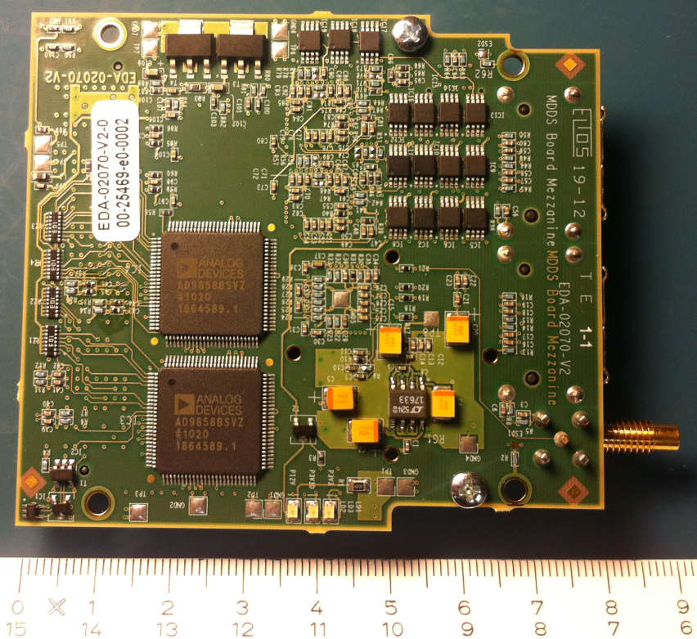
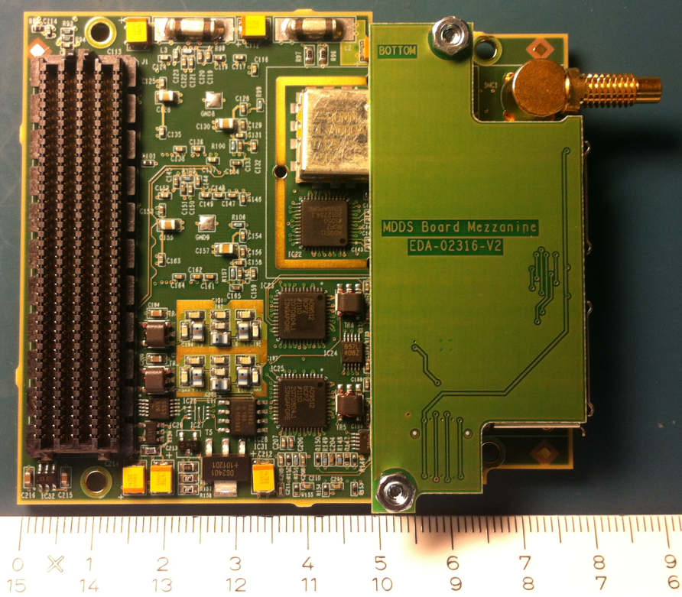
DDS FMC Card
Overview
Characteristics:
High quality compact clock and synchronism generator.
Can generate a clock signal from 62.5MHz to 125MHz, and the associated revolution synchronism signal at any FRev sub-harmonic from 1 to 16535.
It features two independent channels, synchronized to the same reference, with synchronization pulse (tag) generators.
32bit DDS core: 232mHz frequency step resolution.
Compatible with LPC and HPC FMC standard.
P. Leinonen, J. Sanchez Quesada RFTech workshop 25th-26th March 2013 22

Slide 23
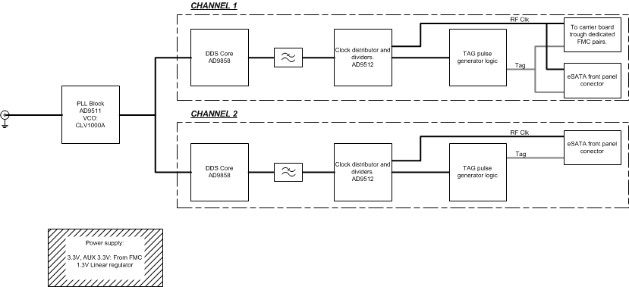
DDS FMC Card
Overview
Simplified block diagram:
P. Leinonen, J. Sanchez Quesada RFTech workshop 25th-26th March 2013 23

Slide 24
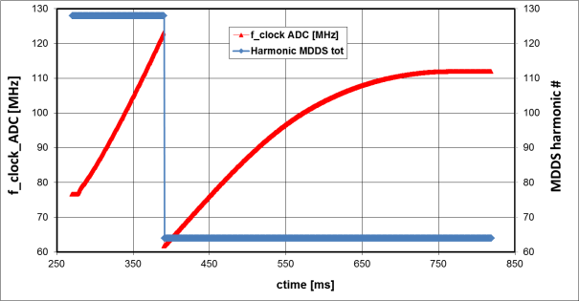
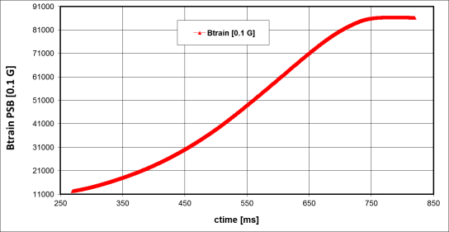
MDDS
System context
Picture from J. Molendijk presentation [1]
(An RF Low-level Beam Control system for PS Booster
built in VME VXS using FMC mezzanines)
P. Leinonen, J. Sanchez Quesada RFTech workshop 25th-26th March 2013 24

Slide 25
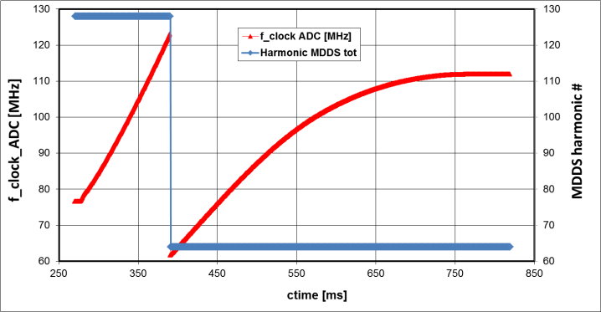
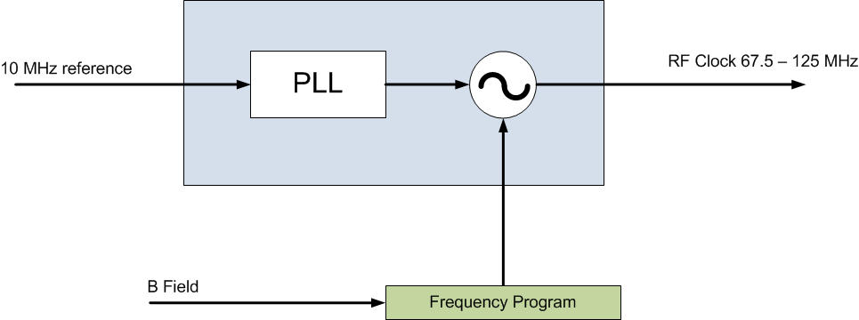

MDDS
Operational principles
The RF Clock follows the frequency program (Frev) at an harmonic such that the output frequency falls always between the maximum sampling frequency and half.
This scheme allows the homodyne system to track the selected Frev harmonic, while maintaining the sampling rate high enough to guarantee a minimum SNR.
P. Leinonen, J. Sanchez Quesada RFTech workshop 25th-26th March 2013 25

Slide 26
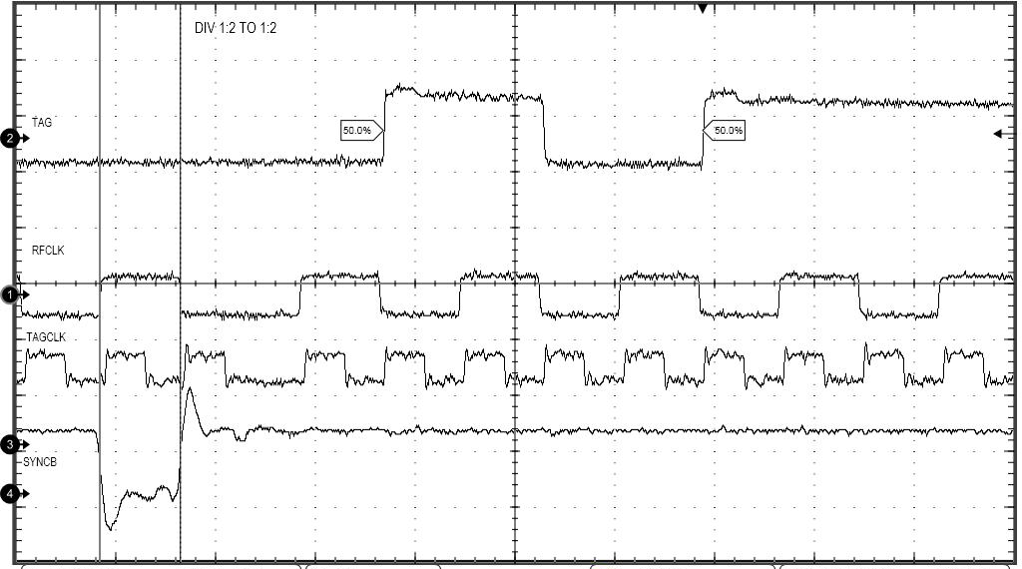
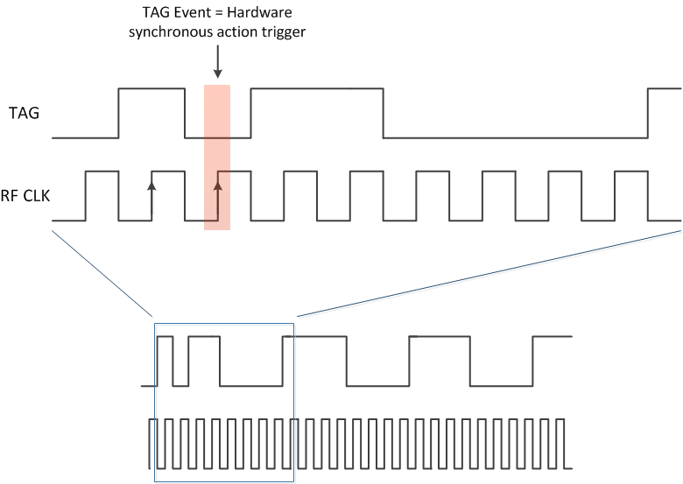
MDDS
Operational principles
The TAG signal is a RF clock synchronous clock at a lower rate.
A TAG event is an embedded pulse that serves to trigger a synchronous action along the entire LLRF system.
Typical actions include a change in the local oscillators.
This includes certain pipeline delay due the signal processing and ADC/DAC.
The MDDS compensates automatically this effect delaying the TAG.
P. Leinonen, J. Sanchez Quesada RFTech workshop 25th-26th March 2013 26

Slide 27
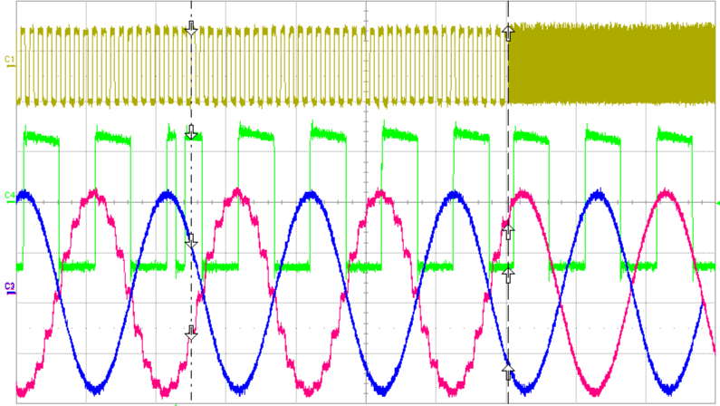
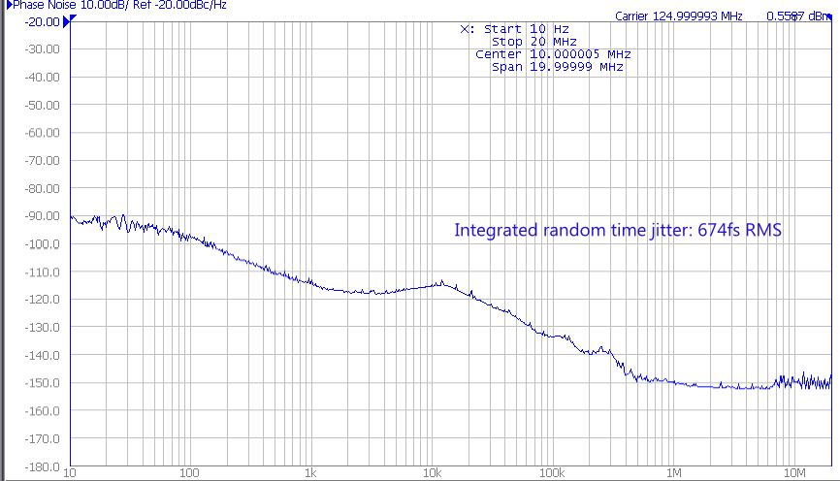
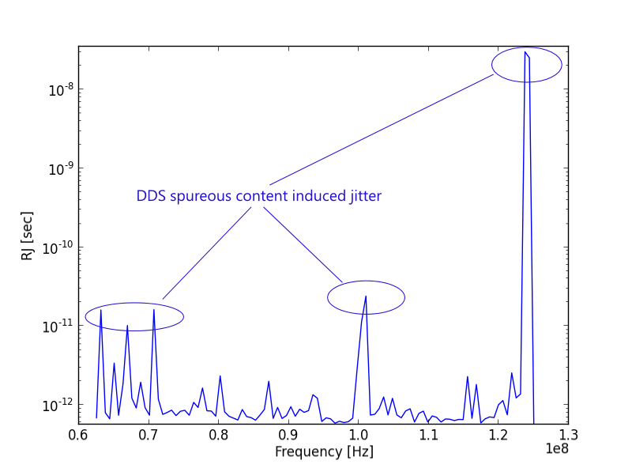
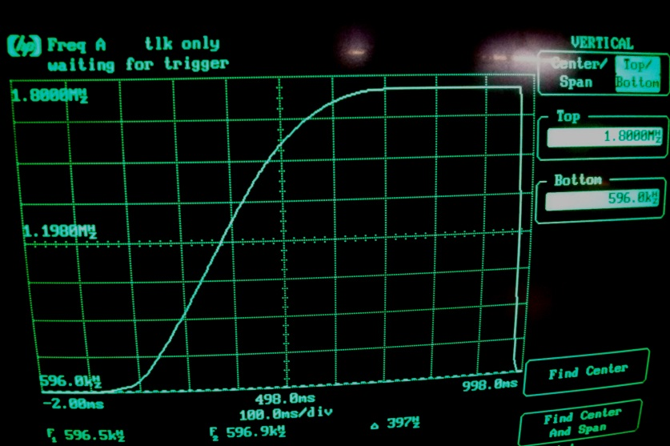
MDDS
Test results
Divider change + Tag synch pulse
125MHz clock phase noise
B-Field frequency ramp
Random jitter at the clock output vs output frequency
P. Leinonen, J. Sanchez Quesada RFTech workshop 25th-26th March 2013 27

Slide 28
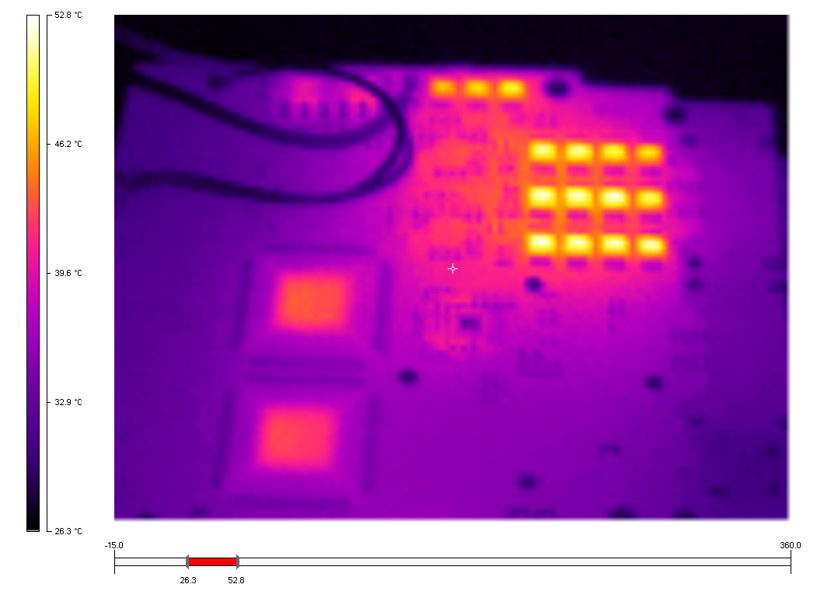
MDDS
Test results
A fast clean clock requires lots of power (= thermal dissipation):
+53°C ->ECL logic!
Good forced airflow:
High flow between the FMC module and the carrier board.
Good thermal conductivity to the front panel.
Extensive ground and power plane, for EMI and signal integrity, also help in dissipating heat.
Unused channels, can be turned off.
P. Leinonen, J. Sanchez Quesada RFTech workshop 25th-26th March 2013 28

Slide 29
Outline
FMC mezzanines and IP cores
DAC mezzanine and SDDS
ADC and DDS mezzanines, DDC and MDDS
Test environment and development tools
  Automatic memory map management
  VHDL firmware test
  Hardware test
Conclusion
P. Leinonen, J. Sanchez Quesada RFTech workshop 25th-26th March 2013 29

Slide 30
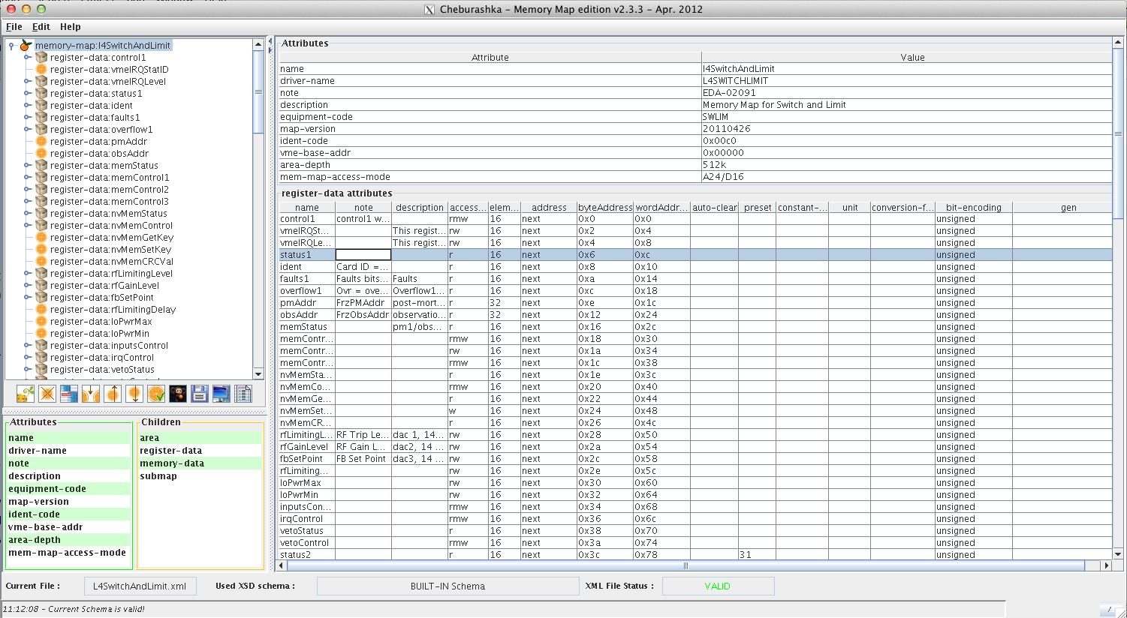

Test environment and development tools
Automatic memory map management
Cheburashka and Gena [4]
As the hardware complexity increases, management of the memory maps that provide access to the hardware registers becomes a key point.
Controls interface is also a complex task, as all the changes in the memory maps must be synchronized also in the different drivers.
A set of tools have been developed in our group to automatically manage memory maps, control drivers and the associated VHDL code implementing the registers in the hardware.
Чебурашка & Гена
P. Leinonen, J. Sanchez Quesada RFTech workshop 25th-26th March 2013 30

Slide 31
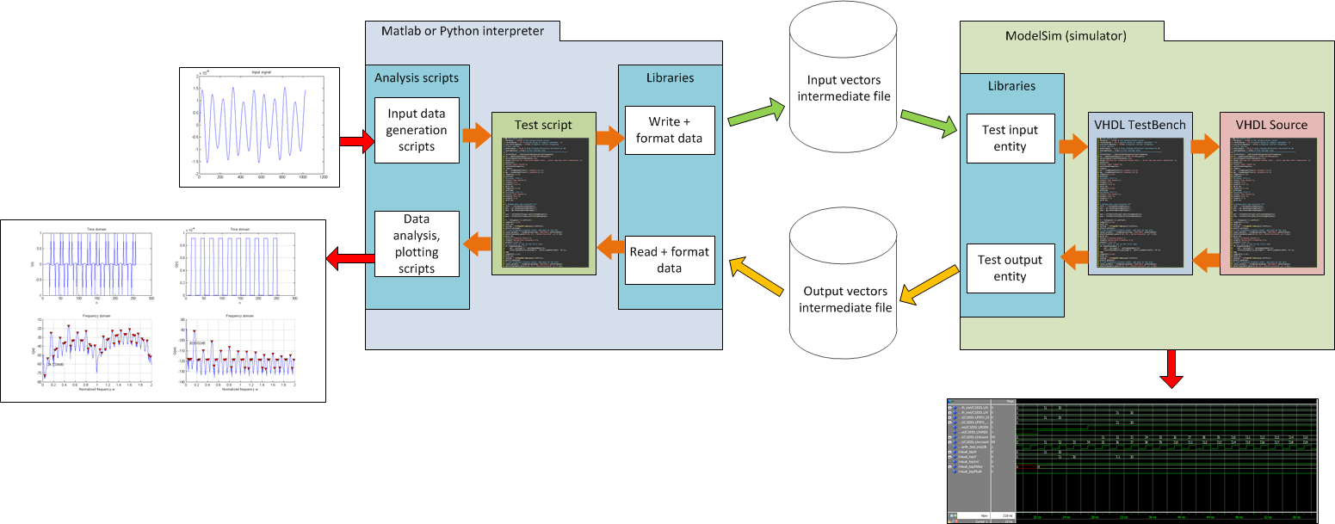
Test environment and development tools
VHDL firmware test
Carrier with ADC and DAC
ML605 as carrier and mezzanine under tests
We simulate all the VHDL critical blocks, prior to the hardware (FPGA) implementation.
In our aim to open our developments and methods, we try to use to open source tools when possible, also integrating common tools (MatLab) with minimum requirements (specific toolboxes).
The use of open source scripting language (Python) with advanced mathematical capabilities, is extensively used to produce test data and analyse the results.
The entire process does not require compilation as is using interpreted scripts. Simulation time is fast.
P. Leinonen, J. Sanchez Quesada RFTech workshop 25th-26th March 2013 31

Slide 32
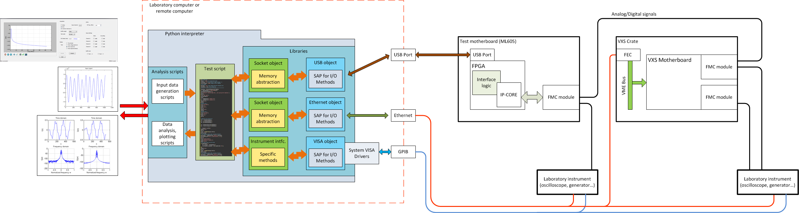
Test environment and development tools
Hardware test
Carrier with ADC and DAC
ML605 as carrier and mezzanine under tests
Hardware tests are carried out in an automatic way.
The test environment allows to test many hardware units using a common virtual bench.
Each hardware module have an unique ‘object’ that virtualizes it.
Hardware changes are automatically track by the automatic memory map management.
P. Leinonen, J. Sanchez Quesada RFTech workshop 25th-26th March 2013 32

Slide 33
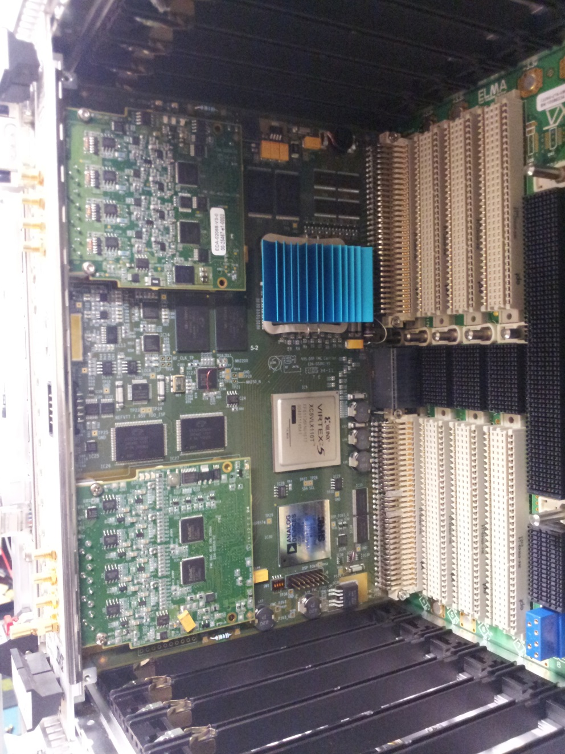
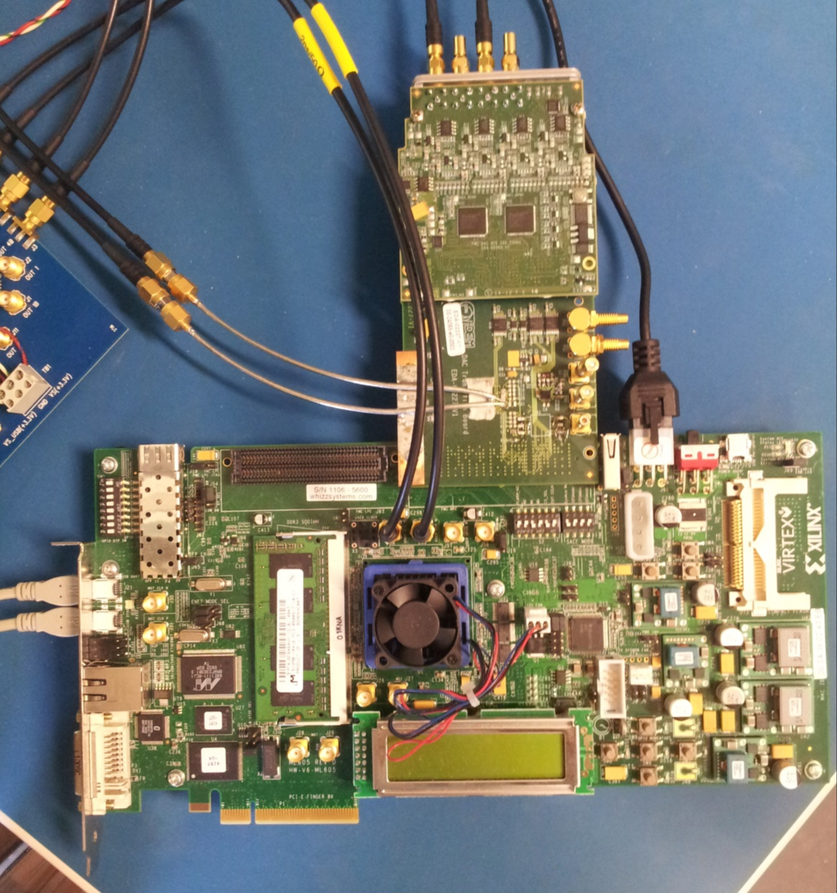
Test environment and development tools
Carrier with ADC and DAC
ML605 as carrier and mezzanine under tests
P. Leinonen, J. Sanchez Quesada RFTech workshop 25th-26th March 2013 33

Slide 34
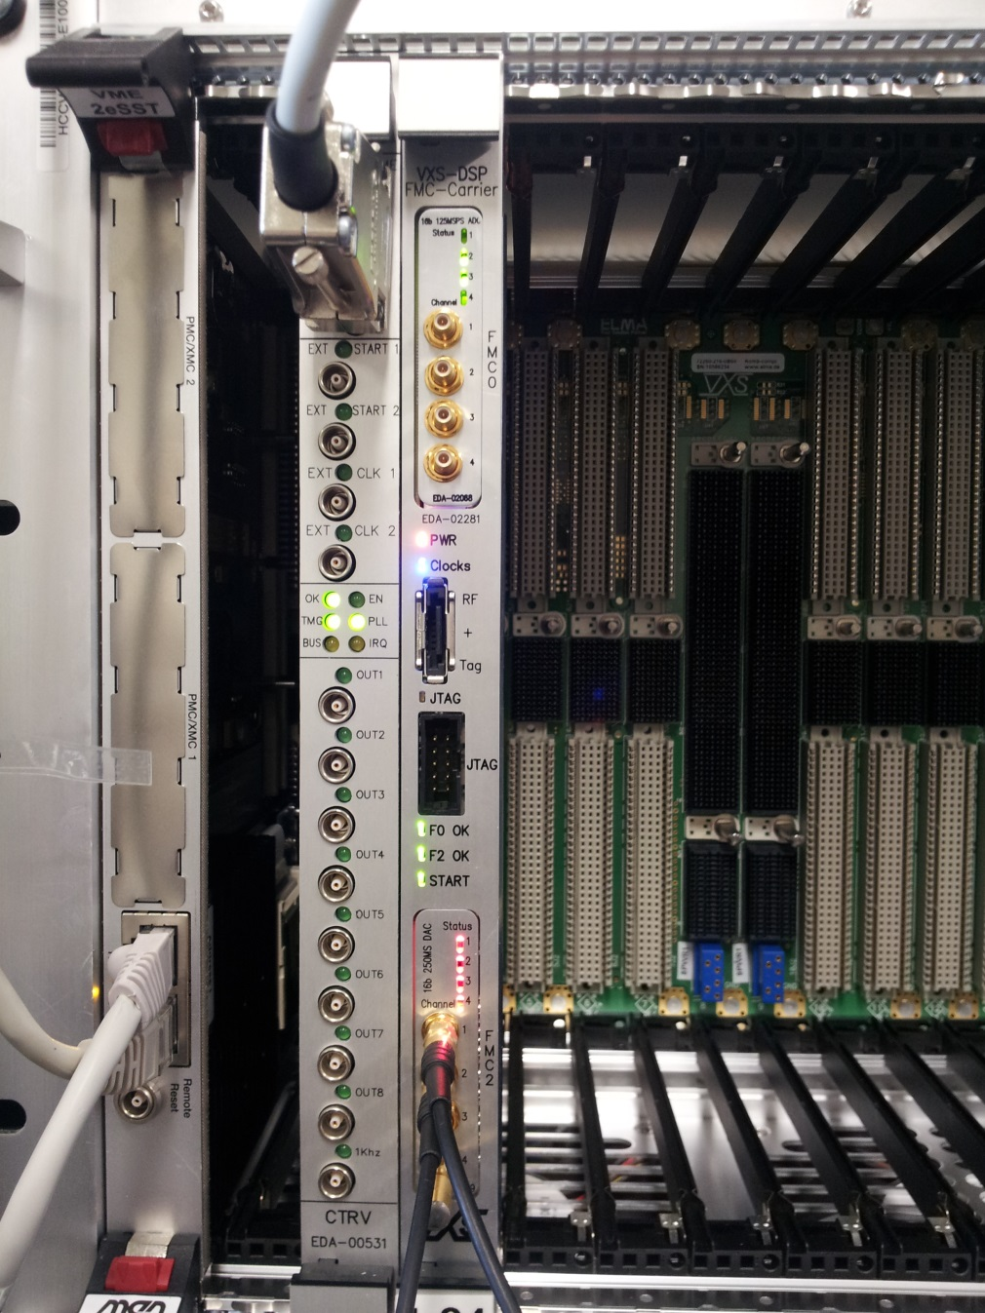
Project Status
Carrier with ADC and DAC
Hardware:
  Laboratory tests have successfully demonstrated the feasibility of the FMC standard to build small form factor analogue modules.
  More work is needed to improve the noise levels due switched mode power supply coupling.
  New pre-series of V3 (DAC, MDDS) and V4 (ADC) are currently under development.
Firmware:
  Stable FPGA code, that need completion for observation buffers and specific features (frequency ramp, noise generation).
  More work is needed to finalize the automatic DC offset compensation and automatic gain control.
P. Leinonen, J. Sanchez Quesada RFTech workshop 25th-26th March 2013 34

Slide 35
References
[1] J. Molendijk. 2013. An RF Low-level Beam Control system for PS Booster built in VME VXS using FMC mezzanines. Annecy, France, RFTech 25th-26th March 2013 (this workshop)
[2] ANSI/VITA 57.1-2008. FPGA Mezzanine Card (FMC) Standard VMEbus International Trade Association. New York, NY, USA : ANSI, 2008. 82 p. Approved in 2008, revised in 2010
[3] NXP 2000. The I2C-bus Specification
URL: http://www.nxp.com/documents/other/39340011.pdf
[4] A. Rey, F. Dubouchet, M. Jaussi, T. Levens, J. Molendijk, A. Pashnin. Cheburashka: A tool for consistent memory map configuration across hardware and software San Francisco, California, USA, ICALEPCS 6th-11th October 2013
P. Leinonen, J. Sanchez Quesada RFTech workshop 25th-26th March 2013 35

Slide 36

THANK YOU FOR LISTENING ☺

Slide 37

Additional material
Cavity | Frequency [MHz] | Functionality
C02 | 0.6 - 1.8 | Acceleration at harmonic 1
C04 | 1.2 - 3.9 | Acceleration at harmonic 2, beam bunch flattening and beam bunch splitting (going from harmonic 1 to harmonic 2)
C16 | 6 - 17 | Controlled emittance blowup
  In injection the revolution frequency is 599 kHz and in extraction
  1.746MHz. The kinetic energies in injection and extraction are 50Mev and 1.4Gev, respectively.
  Beam splitting is done by decreasing the C02 voltage and increasing the C04 voltage after the beam is flattened. The harmonic 2 is needed for high intensity beams.
  Longitudinal or emittance blow-up means that the focused beam bunch
  starts to “smear out” from its wanted area. The idea is to avoid emittance blow-up and therefore keep the particles tightly together. PSB is using a controlled emittance blow-up, just under the instability limitations, for creating the required emittance for the beam and passing it to the next circular machines.
  For example, the PS synchrotron needs the PSB to create a controlled
  emittance blow-up for its high-intensity beams which again will be transferred to LHC
  Beam cycle lasts 1.2s
P. Leinonen, J. Sanchez Quesada RFTech workshop 25th-26th March 2013 37

Slide 38

Additional material
  Numerically Controlled Oscillator
P. Leinonen, J. Sanchez Quesada RFTech workshop 25th-26th March 2013 38

Slide 39

Additional material
System clock distribution context:
P. Leinonen, J. Sanchez Quesada RFTech workshop 25th-26th March 2013 39

