Slide 1
MedAustron Synchrotron RF
MedAustron
C.Schmitzer, M.Paoluzzi, S.Kouzue, W.Pirkl, U.Dorda,and M.Benedikt
CERN
M.-E.Angoletta, A.Butterworth, J.Molendijk, J.Sanchez-Quesada, M.Jaussi, E.Rigutto, R.Claret

Slide 2
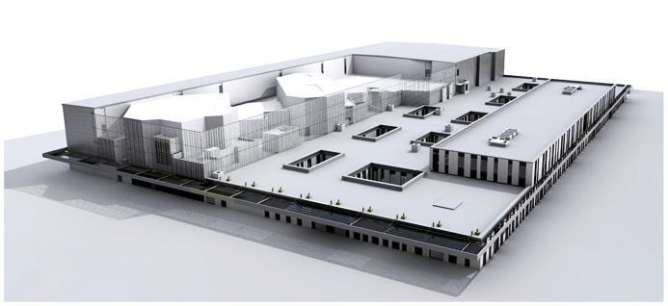
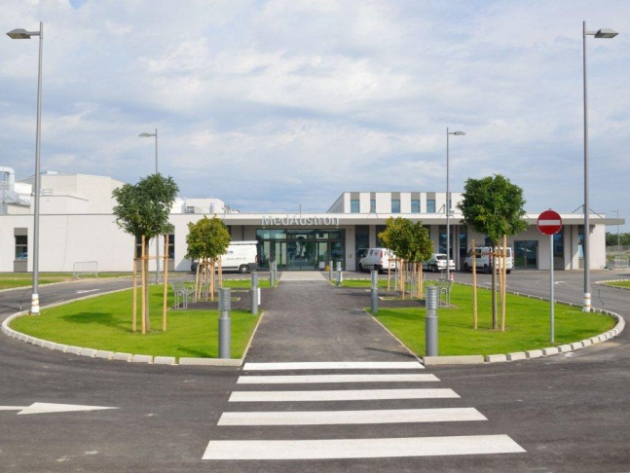
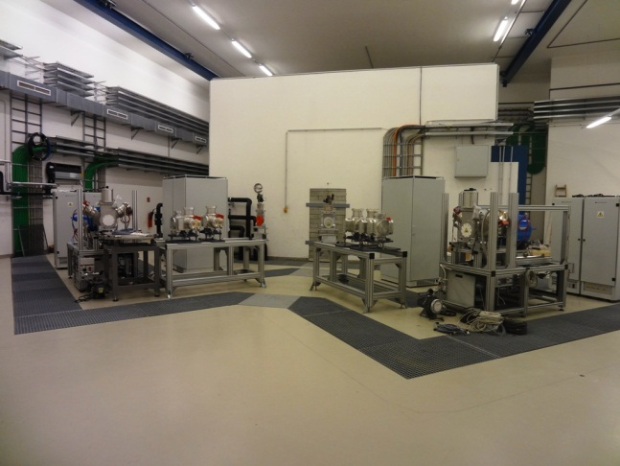
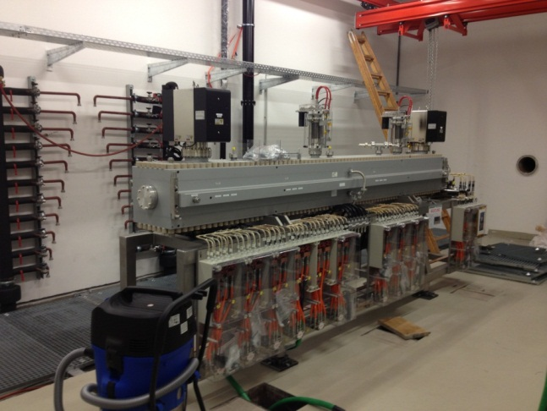
MedAustron Project
Medical Accelerator for Proton/Carbon ion Radiotherapy & non-clinical research in
Wiener Neustadt (1h-Vienna, Austria)
Based on CERN PIMMS
Funded by city of Wr.Neustadt, Country of Lower Austria and the Austrian state
EBG for planning, construction and maintenance of machines and medical operation

Slide 3
CERN Collaboration
The MedAustron accelerator is based on the CERN PIMMS study and its technical implementation by CNAO/IT.
For the design and construction of the accelerator a collaboration between CERN and MedAustron was established
Cavity design based on CERN PS-Booster (PSB) hardware
  Developed and Prototype tested at CERN
  All parts of Cavity produced by CERN Workshop
  Vacuum chamber is completely assembled by CERN WS
LLRF modified version of new PSB LLRF
  Modified by CERN (BE-RF) for MedAustron application
  Amplifier based on CERN design by M.Paoluzzi
Senior RF Workpackage management by W.Pirkl, since mid 2012 by M.Paoluzzi

Slide 4
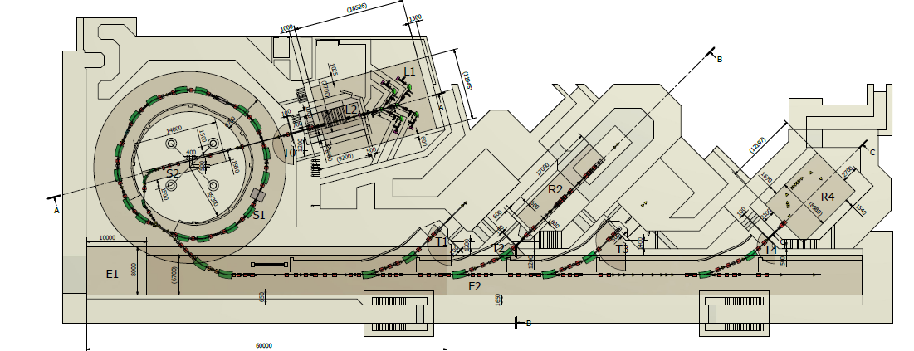
MedAustron Project
MA accelerator complex
10 m
Notes:
Split Fodo
Circumference 77 m
Norm Emitt (1 sig) 0.52 – 0.75 pi mm mrad
Bmax= 1.5 T

Slide 5
MA & LEIR parameters
 | MedAustron | LEIR
Tunes [h/v] | 1.789 / 1.7392 | 1.82/2.72
Injection Energy [MeV/u] | 7 | 4.2
Rigidity Inj/Extr [Tm] | p: 1.137 / 4.881 C: 3.254 / 6.346 | Pb: 1.138 / 4.8
Rev. Period Inj/Extr [ns] | 2170 / 307 | 2760 / 704
Extraction [MeV/u] | p: 60-250 (800) C: 120-400 | Pb: 72.2
Rep Rate [s] | 2 | 3.6
Intensities | 10¹⁰ p⁺ , 4x10⁸ C⁶⁺ | 10⁹ Pb⁵⁴⁺
Notes:
MA extraction resonance: Qx = 1.7392, Qy = 1.779
f = 0.46 - 3.25 MHz
Bmax 1.5 T

Slide 6
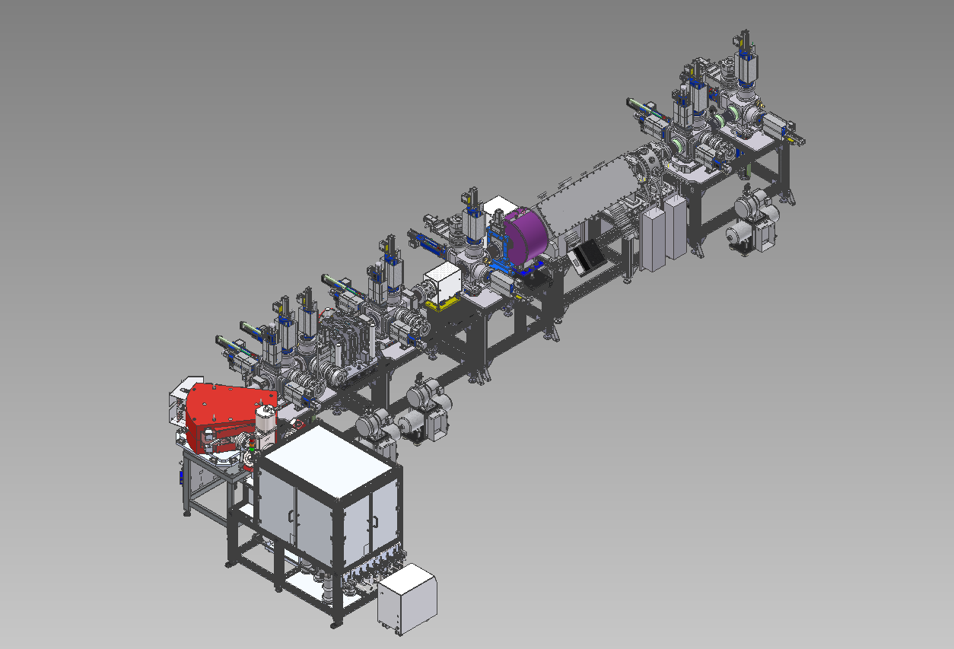
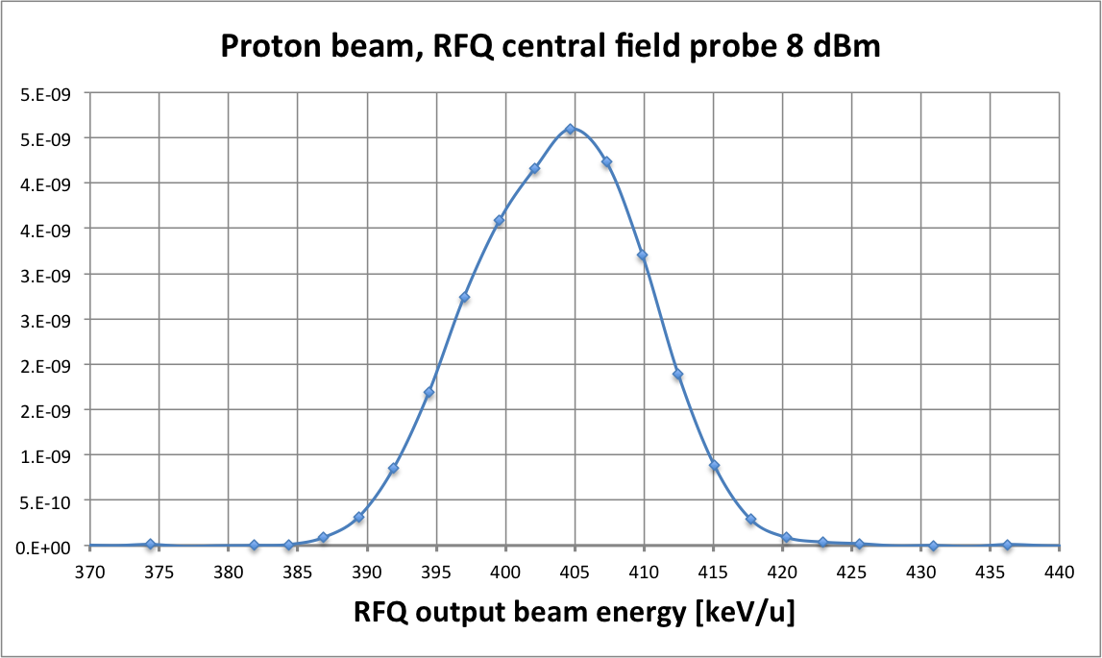
MedAustron ITS at CERN
BD tank: 4 Slits,
2 Wire Scanners,
1 Profile Grid
BD tank:
2 Wire Scanners,
1 Profile Grid,
1 Faraday Cup
Steerer
Fast Deflector
Solenoid
Doublet-Steerer
Quadrupole triplet
Phase Probe
BD tank:
2 Wire Scanners
Current Transformer
RFQ
Steerer
Buncher
BD tank:
2 Wire Scanners,
1 Profile Grid,
1 Faraday Cup
Spectrometer dipole
BD tank: 4 Slits,
2 Wire Scanners,
1 Faraday Cup
ECR Ion Source
Courtesy of W.Prikl
Notes:
RFQ succesfully tested
RFQ 75% at 400 microA with 400 keV,
(500 us pulses)
Separate buncher from RFQ

Slide 7
Existing Cavities
 | CNAO | SIEMENS (3) | MedAustron | LEIR
Origin | Saclay/CNAO | Siemens/GSI | MedAustron | CERN
Frequency [MHz] | 0.4 - 4 (0.3-10) * | 1 – 7 h=2 | 0.46 – 3.25 MHz | 0.35 - 5
Length [m] | 1.50 | 1.70 | 2 * 0.7 | 0.60
Voltage [kV] | 4 (8) * | 2.5 | 2x 2.5 | 2.0 ( 4 @ F > 0.7 MHz)
Core material | A-metal | Ferrite | B- metal | B- metal
Bandwidth | Tuned | Tuned | Wideband | Wideband
Core cooling | Water (plates) | Air | Water (plates) + Air | Direct water
Amplifier kind | Tubes | Transistor | Transistor | Tubes
Amplifier location | Ring | Remote | Remote | Ring
Remarks | * achievable with amplifier upgrade | ESR- Cavity from GSI |  | Data for single cavity (2 in-stalled)
A-metal meaning “Mue-Metall”, Cobalt-alloy, amorphous structure,
B-metal meaning “FINEMET, METGLASS” microcristalline structure.

Slide 8
RF Voltage Requirements
Trapping
Injection
Acceleration
Extraction
MATAC 2011 - W.Prikl
Notes:
Injection efficiency 0.2 -0.25

Slide 9
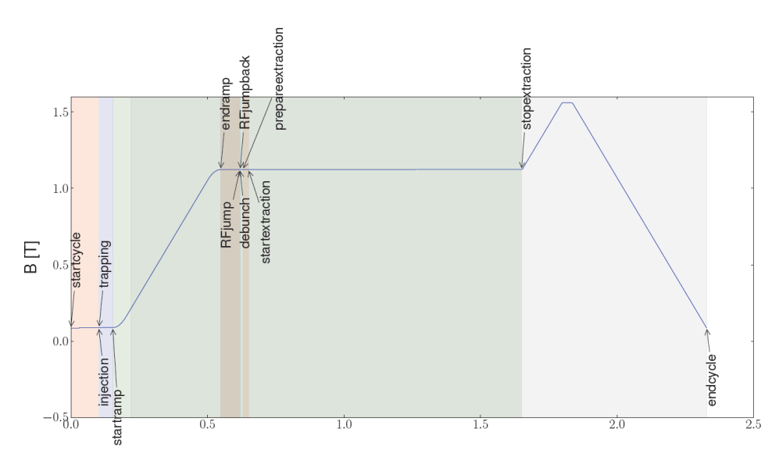
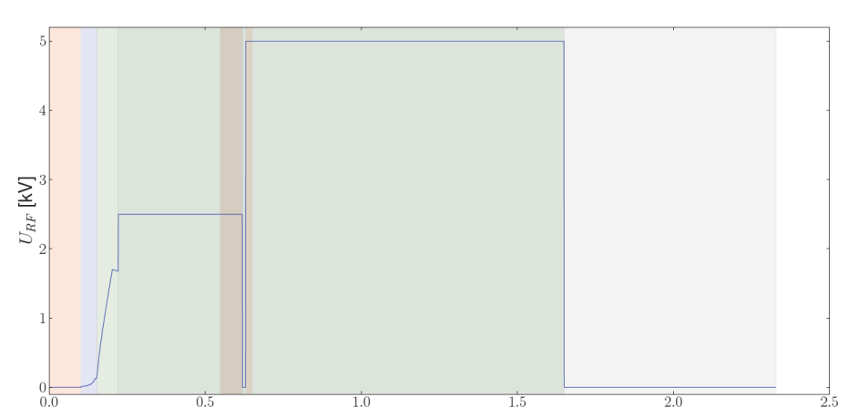
MedAustron Synchrotron Cycle
Horizontal multiturn injection
(coasting beam)
RF trapping
  Adiabatic capture V_{RF}≈ 17 - 170 V
  Filling factor K=0.7
  h=1
Acceleration
  @ low energy Voltage and phase ramped for constant bucket area, then ramp to V_{peak} = 3kV
  3 T/s (~0.5s)
RF jump to unstable phase for ~ 0.1 ms, back to stable phase for T_{Sync}/2
RF-off debunching
Prepare Extraction
Ramp Betatron core for 3rd order
slow resonant extraction
RF channeling for extr. smoothing
U.Dorda
Notes:
No beam loading
adiabatic factor alpha=0.1
Rev. Freq. for X MeV/u is identical p/C
Energy gain per turn for protons x2 higher
To reduce space charge effects (Protons) bunch has large longitudinal extension at low energies
As the phase-space area of the bunch is conserved during the adiabatic voltage ramp, the trapping doubles
the momentum spread (bunch length is halved).
PrepareExtr:
Adjust tune with lattice quads
Adjust chromaticity with lattice sextupoles
Turn on RF for channeling
Ramp resonance sextupole

Slide 10
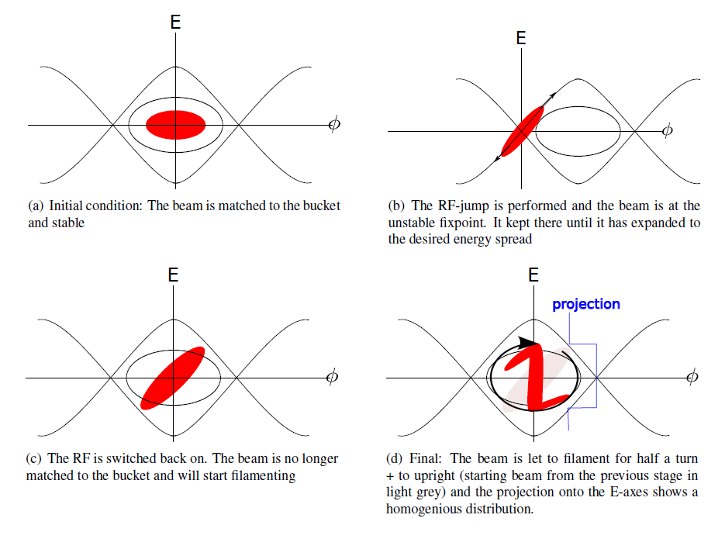
Tuning the Momentum Spread
Notes:
b for Energy spread
D for homogenous distribution
Delta p/p = 4 E-3 needed for extraction (no matter the energy)
Spill 1-10s
0.1 – 10 s (non clinical)
PrepareExtr:
Adjust tune with lattice quads
Adjust chromaticity with lattice sextupoles
Turn on RF for channeling
Ramp resonance sextupole

Slide 11
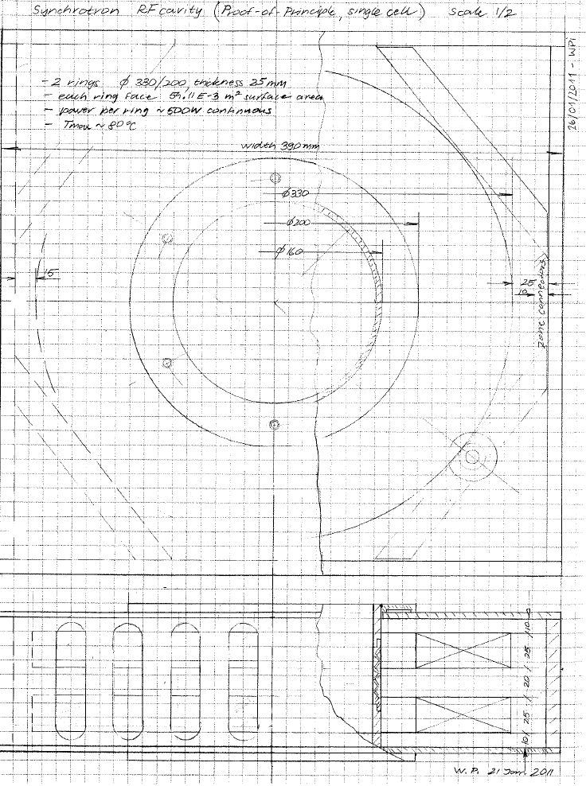
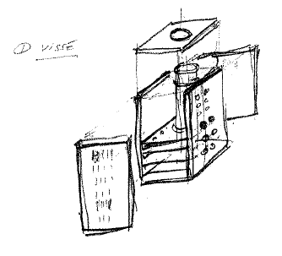
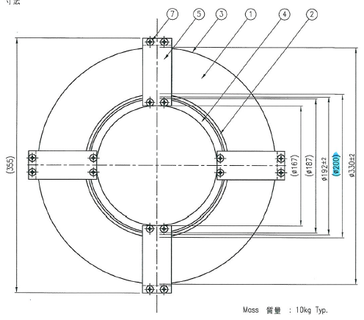
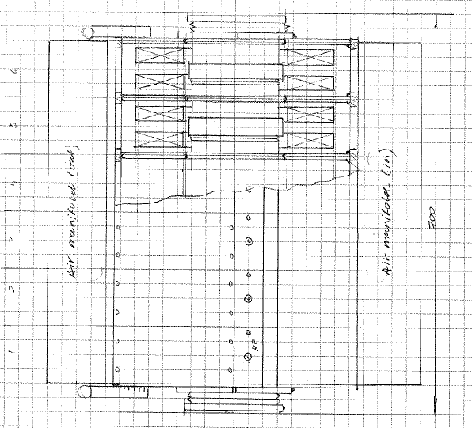
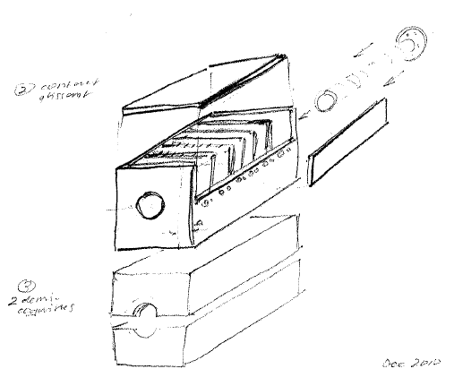
MedAustron Synchrotron Cavity

Slide 12
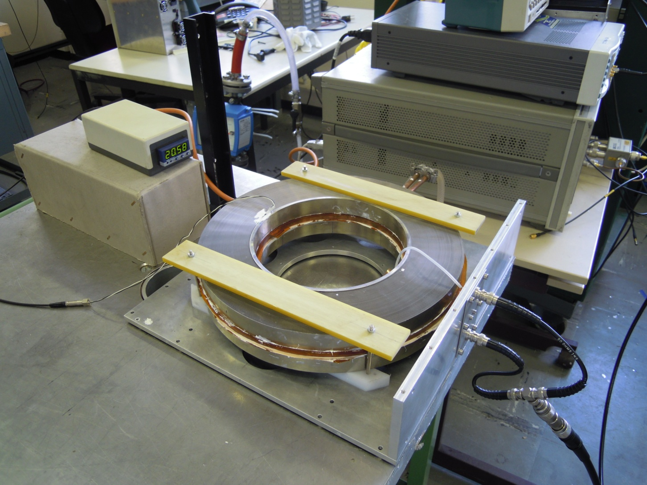
Cavity Cell Protoype

Slide 13
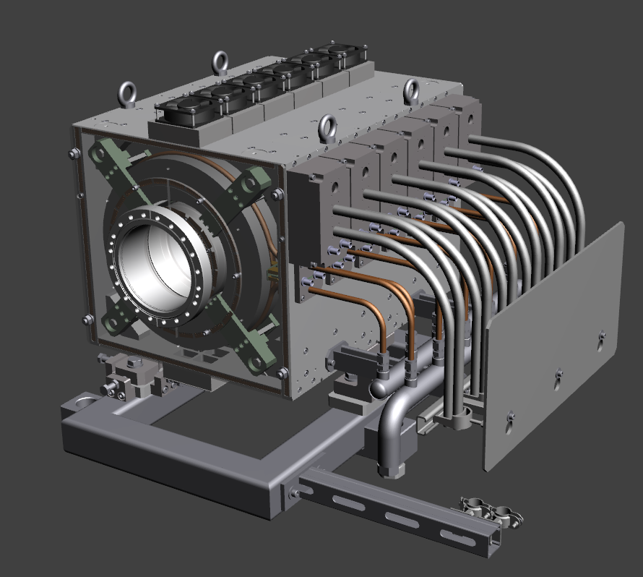
MedAustron Synchrotron Cavity
Joint Venture with Booster C04 upgrade Project
Finemet loaded co-axial resonator
2 blocks à 6 cells
(82-121 mm)
2 Finemet FT-3L rings per cell (per gap)
12x 1 kW transistor Amp.
Water cooled Cu disc
815 W 74 °C @ 1.5 l/min T_{in}= 11.5 °C
Air cooling (cell:58 m³/h)
f = 0.46 - 3.25 MHz
2x 2.5 kV
Notes:
common core size 330 x 192 x 25 mm
Finemet (nanocrystalline soft magnetic)
µ’=4800
µ”=5200
@1 MHz

Slide 14
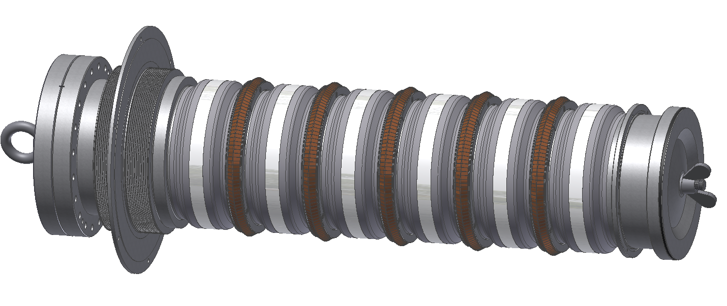
MedAustron Synchrotron Cavity
2x 6-gap vacuum chamber (à 70 cm)
Ceramic Al2O3 97-98%
Mo/Mn+Ni Metalisation for brazing
Titanium doping for R=10 MΩ
< 2.0x10^{‐10} mbar l s^{‐1}
Flexible RF contacts
Constructed at Cern WS
Notes:
Collar : DILVER P1® (FeNi29Co17)
16 (30) mm gap width

Slide 15
CERN 1kW RF Amplifier ( M.Paoluzzi)
-1 dB Bandwidth : 0.5 – 5 MHz
Voltage Gain: 58 dB ± 1.5 dB
Output power at
1dB compression : >1 kW
Harmonic distortion : < -15 dBc @ P_{out}=1 kW
< -18 dBc @ P_{out}=500 W
Gain linearity: ± 1 dB
DC to RF efficiency : >35 %
Input impedance : 50 Ω, VSWR 1.1:1 max
Load impedance : 50 Ω, no damage when operated in O.C or S.C.
Notes:
60db + voltage factor 1000

Slide 16
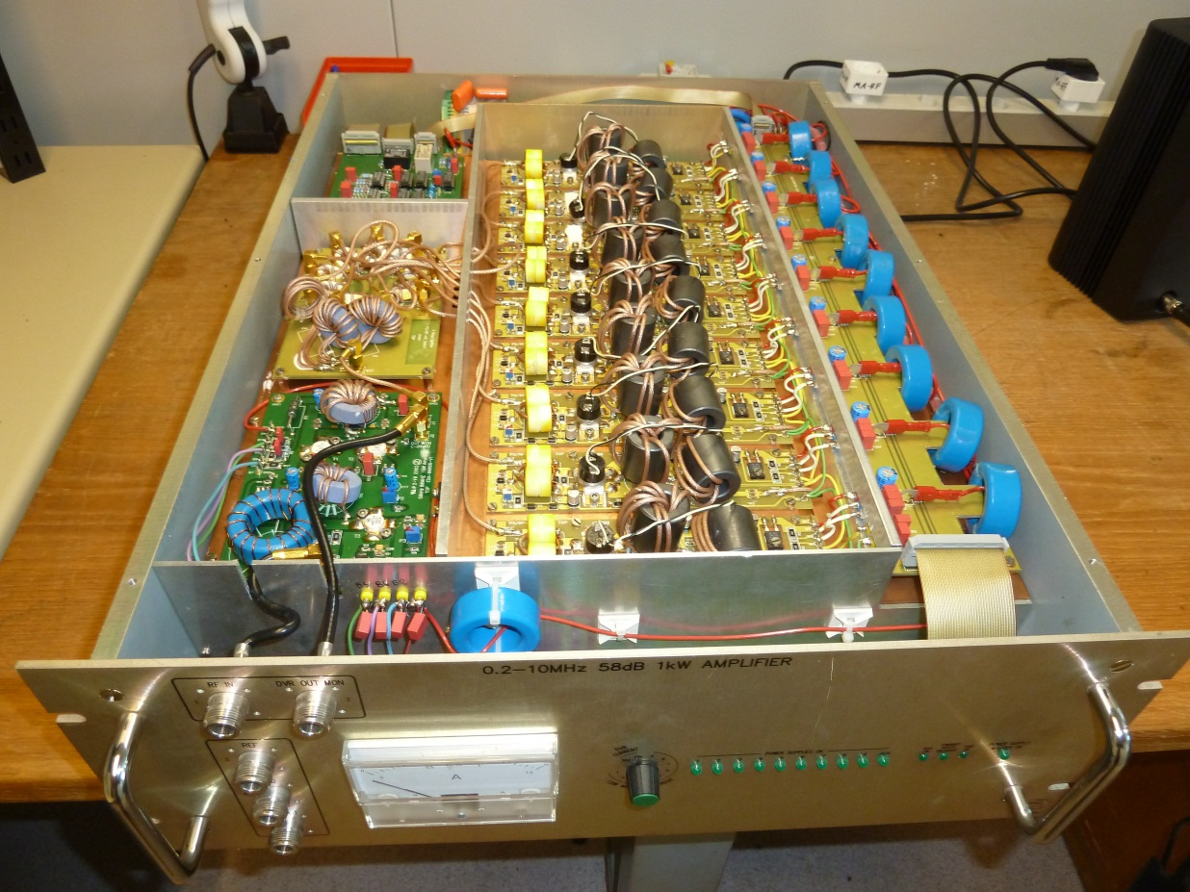
CERN 1kW RF Amplifier ( M.Paoluzzi)
15 W preamplifier
9x 120 W amplifier modules (MRF151G) mounted in push-pull configuration and operated in class B
Signal combiner
Directional coupler
(-46dB)
DB Elettronica Telec.
Used @ LEIR, AD,..
Notes:
Mosfets push pull
Use N Channel to amplify positive part
P channel to amplify negative part of signal

Slide 17
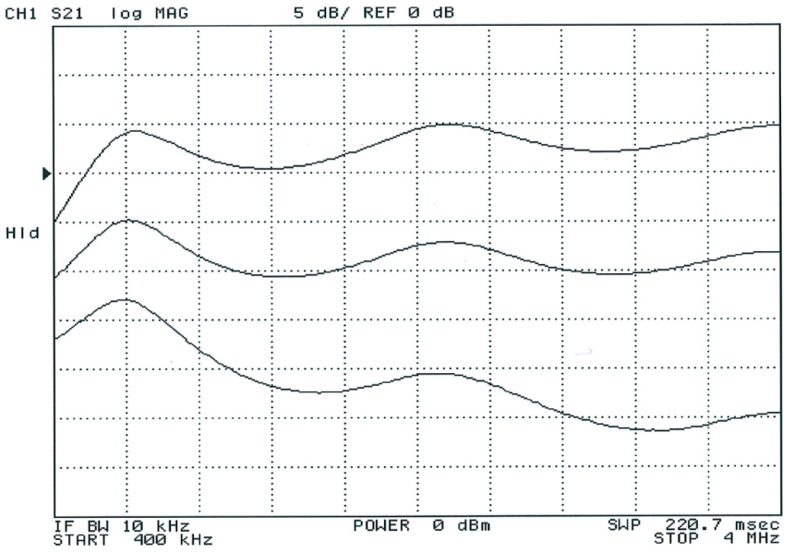
MedAustron Cavity Amplifier Chain
Amplifiers are not next to cavity (35 m)
  Accessible during operation
  Resulting in a gain ripple due to cable length
  LLRF Servo Loop has to compensate
Cell
Cell
:
1kW
1kW
1kW
…
Gap Voltage
Splitter
0 dB
Forward Voltage
4W driver
Reflected Voltage
LLRF
frequency
Notes:
2mW for full power
16 times splitter
4 W driver

Slide 18
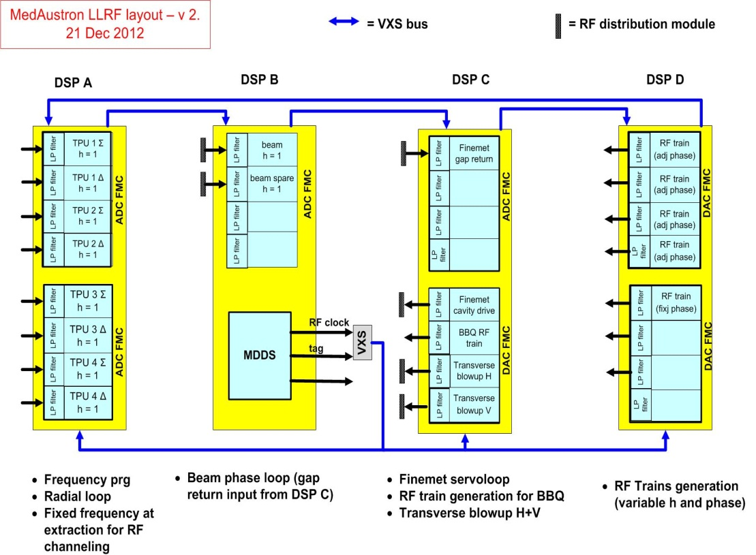
MedAustron LLRF - CERN
Developed in Collaboration with Cern BE-RF
Mod. version of PSB LLRF
3-4 DSP boards (VME64x)
VITA57.1 standard FPGA Mezzanine Card (FMC)
Each motherboard with
Virtex5 FPGA
Daughtercards 16-bit ADCs and DACs
See other talks by
J.Molendijk,
P.Leinonen & J.Sanchez Quesada
M.-E.Angoletta et al.
Notes:
VME Switched Serial (VXS) enhancement
high-speed P0 connector
BBQ ?

Slide 19
MedAustron LLRF - Modifications
No synchronisation Loop
Fixed f_{INJ} and f_{EXTR}
Fixed h=1
Additional hardware timings (Extraction, EndDSP,..)
# TPUs, LPUs
12 cells seen as one voltage gap (redundancy)
Tune Kicker output
(Ramp up/down timing)
B-field information
timing inputs
f_{REV}
output
reference function inputs
cavity
cavity return signal
beam diagnostics inputs
Notes:
NO acceleration after the synchrotron
Synchrotron Energy output has to be correct ( Fextr fixed)

Slide 20
sRF - Slow Control
-Manages Cavity and sRF equipment
-Controls main Power supply (400 VAC & 230 VAC)
-Status and control of
12x PCO and
12x Amplifiers
-Watercooling flowmeters (RFCC & Amps)
-Electrovalves (RFCC & Amps)
-Ventilators
-Thermal switches

Slide 21
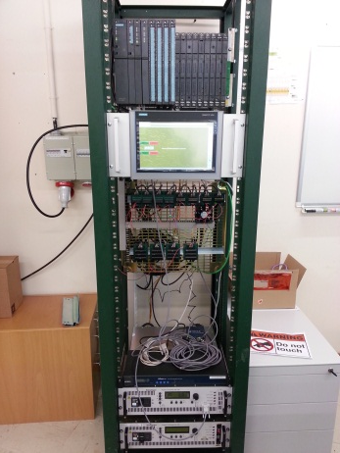
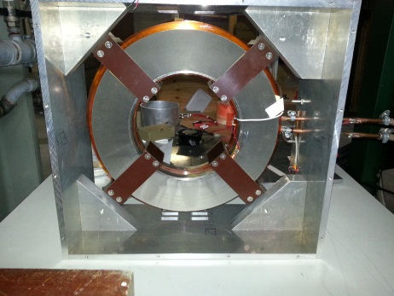
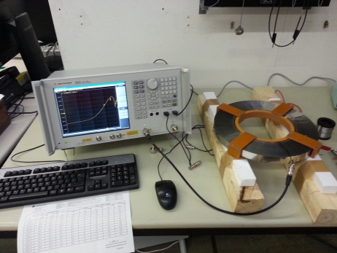
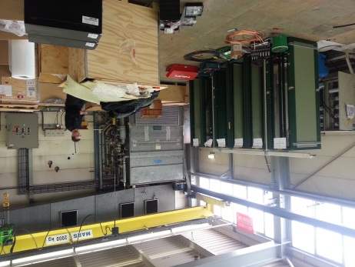
Cavity Test Stand - CTS
Cavity is currently being assembled
Dedicated test stand at Cern (June-Oct.)
  MedAustron control system integrated
  CERN/MA LLRF system
  MA Slow Control
  Beam Interlock System integrated
  Full amplifier chain integrated in Slow Control
  MA Cavity with vacuum chamber

Slide 22
Thank you for your attention!

Slide 23
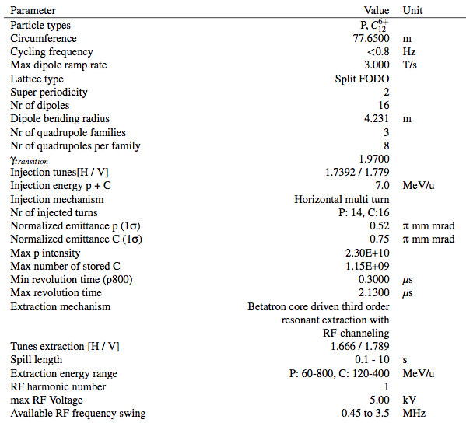

Slide 24
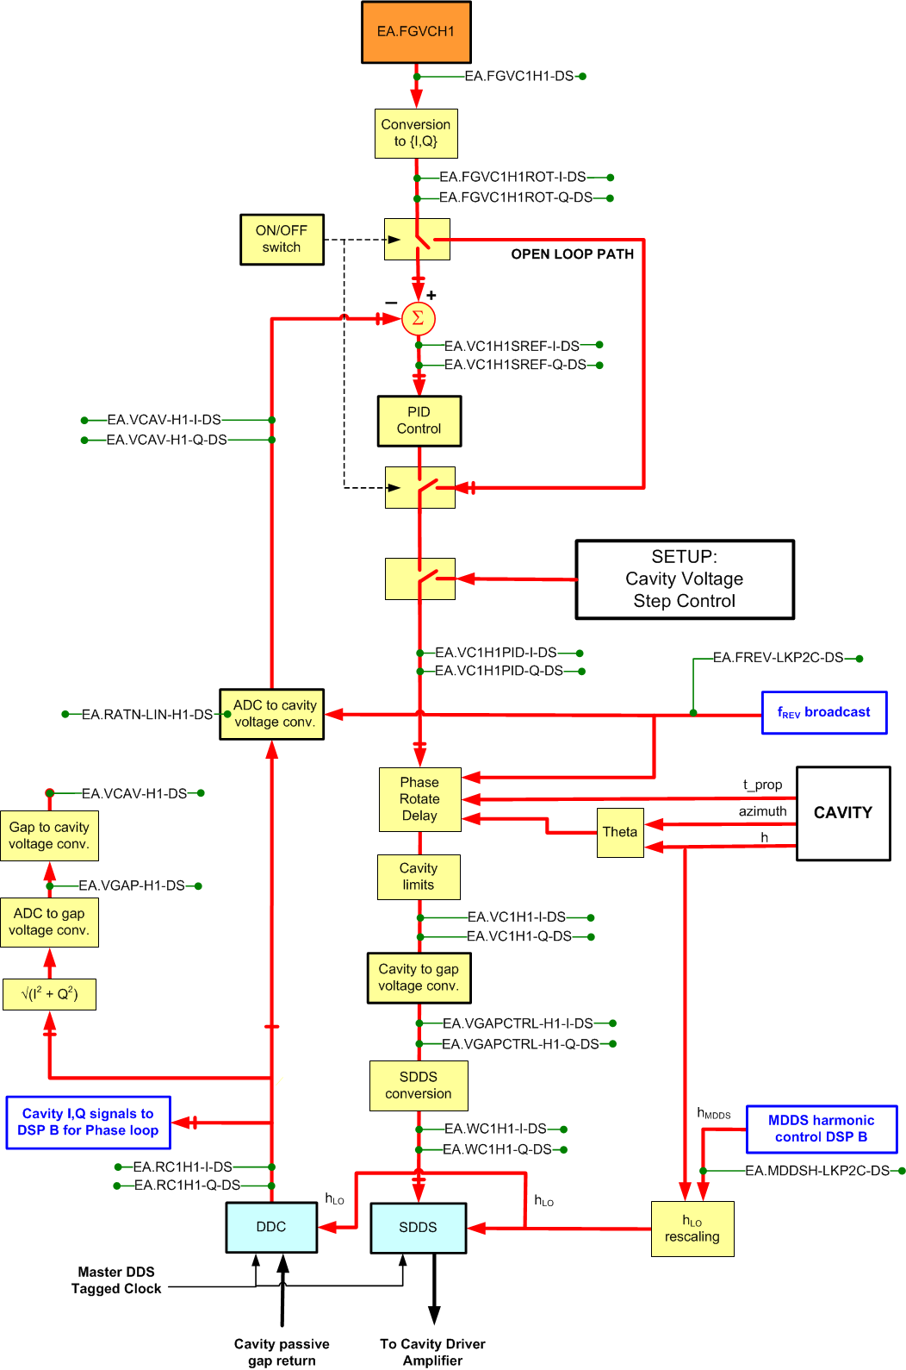
Cavity Voltage step control for calibration
Cav.to gap voltage conversion factor (operator action
if cell fails)
ADC to cavity voltage conversion (freq. dependent calibration curve)

Slide 25
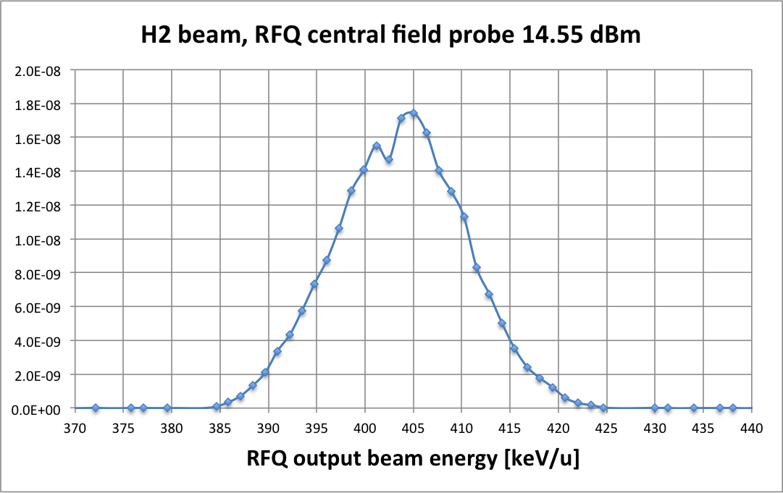
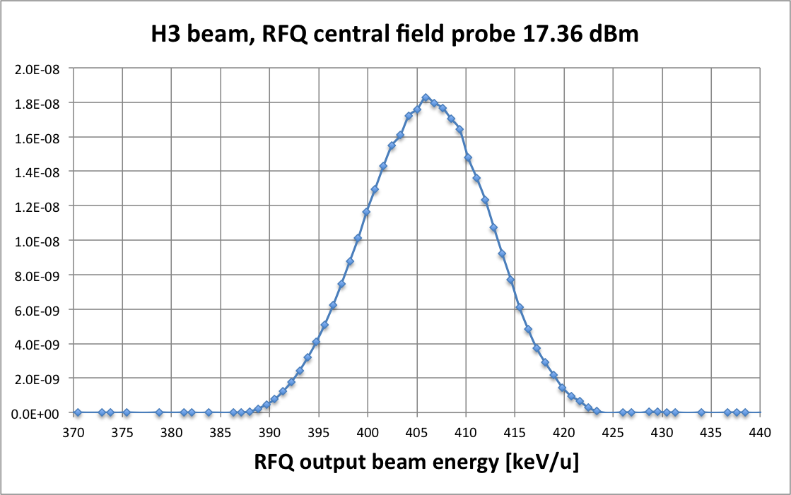
RFQ output beam energy spectrum
H3 beam transmission through the RFQ 75% at 400 microA with 400 keV

Slide 26
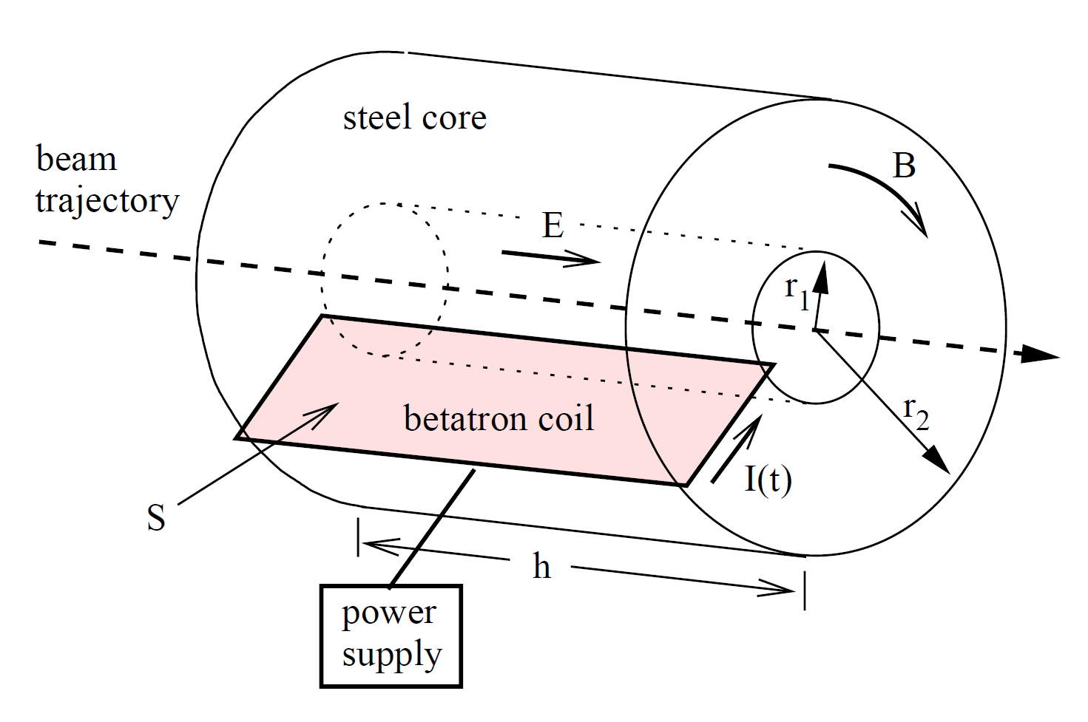
Betatron core
Notes:
A BETATRON CORE FOR OPTIMISED SLOW EXTRACTION IN A
PROTON/ION MEDICAL SYNCHROTRON
P.Knauss

