Slide 1

Annecy, March 26th 2013 - RFTech 4th Workshop
Status of the RF SYSTEMS
of the Spiral2 accelerator
Marco Di Giacomo
Linac RF System coordinator
On behalf of the Accelerator Team

Slide 2
Contents
Quick overview of the
  Project
  Cavities
  LLRF
Experience on power systems
  Solid State Amplifier (SSA) acceptance tests
  Effect of T-Line length on amplifier and circulator
  Effect of circulator drift on the cavity Q_{ext}.

Slide 3
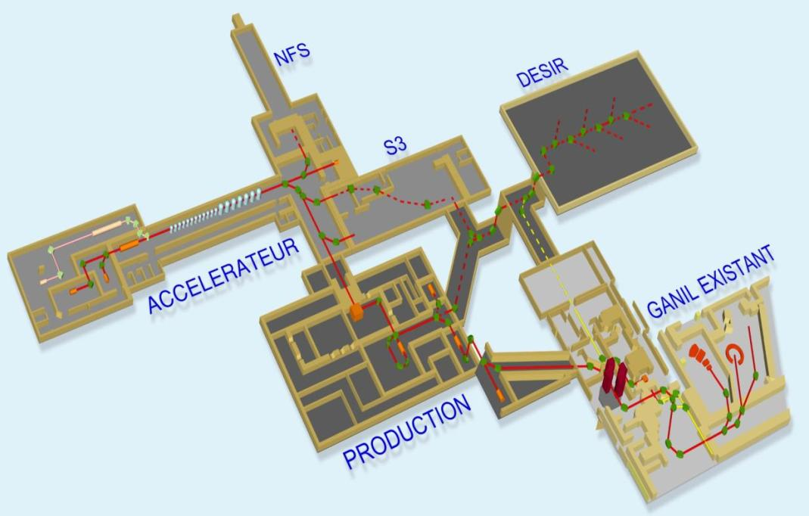
Project
Construction in 2 phases
due to the different design status of the driver accelerator and
of the RIB production system
Spiral2 Accelerator:
SC linac for ions
(88,0525 MHz)
Currents: from µA to mA
200 kW, D⁺ and H⁺, 5 mA
40 kW, q/a ≥ 1/3, 1 mA
Phase 1
Phase 2

Slide 4
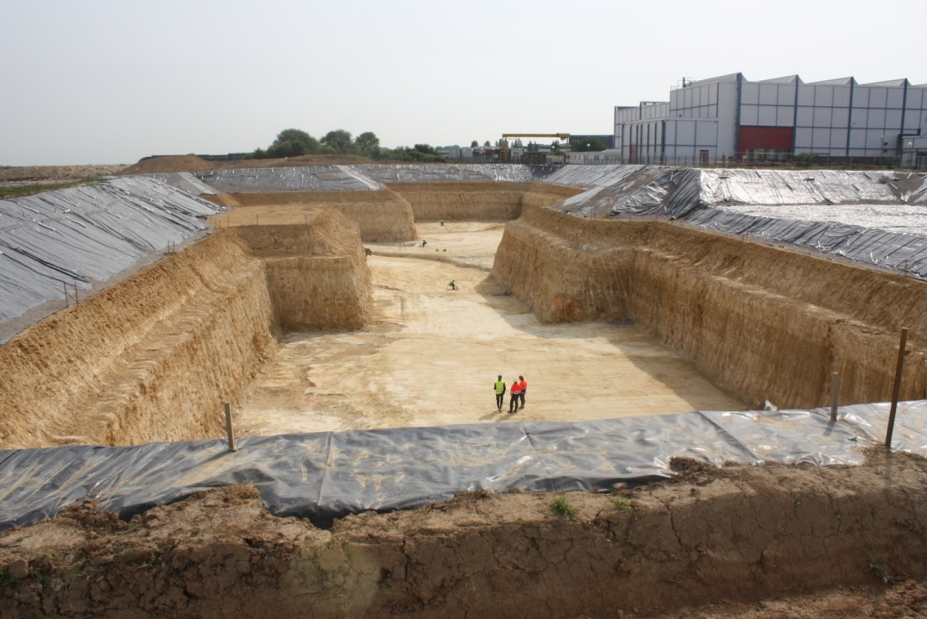
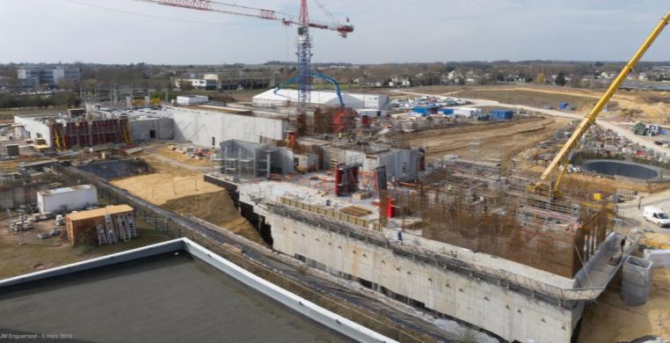
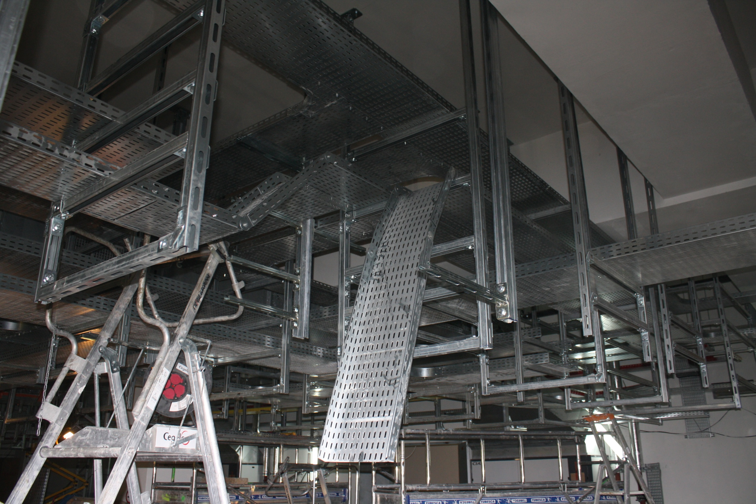
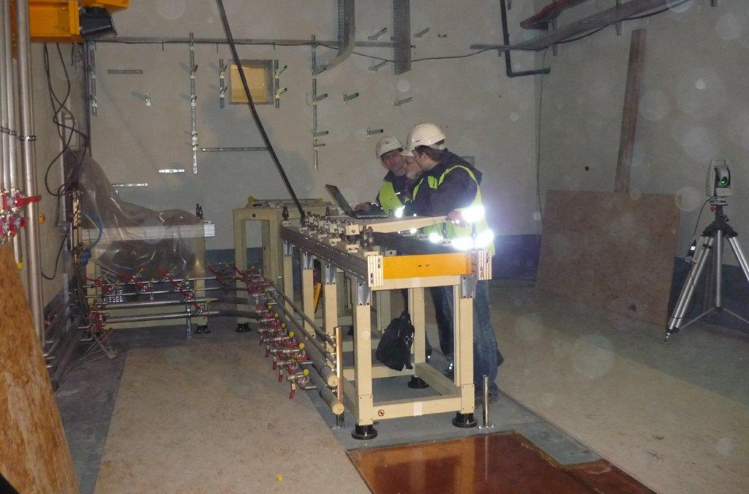
Project Status: Phase 1 building
Underground halls completed October 2012
=> Begin installation of beam line devices, cable trails, water pipes.
Ground floor completed by Feb 2014
=> Availability of ancillary systems, Mai 2014 Injector beam commissioning: Summer 2014
20 Mai 2011
March 2013
Installation started in October 2012

Slide 5
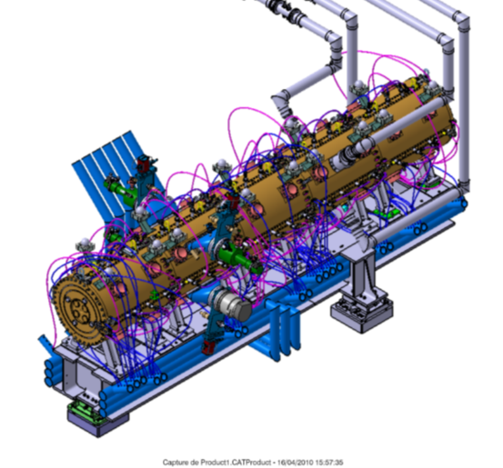
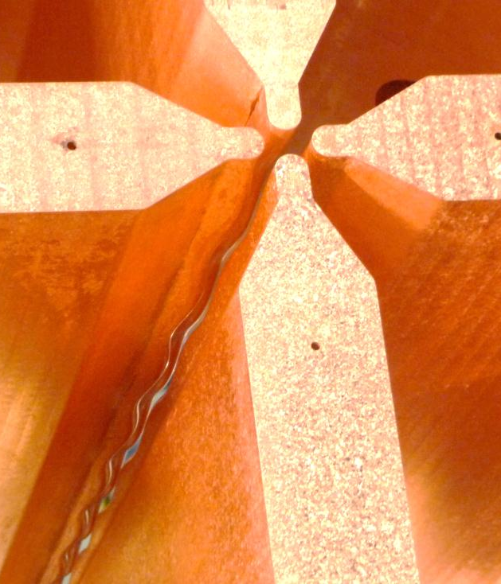
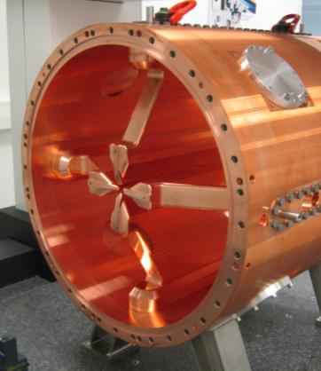
Cavity Status: RFQ (Irfu-CEA Saclay)
5m cavity, 5 segment of 1 m.
2x4 plungers /segment
RF couplers on S4.
RFQ cavity
Vacuum tightness problems
observed on S5 but solved on S4
S4 3D measurement under analysis
S4 being delivered next month to Saclay.
Single elements of all segments machined, final precision milling of the vanes of 3 segments still to be performed.
Two segment assembling tests foreseen as soon as a second segment is delivered
Tuning of the voltage profile planned at Ganil beginning of 2014.
LLRF: 4-channel tests foreseen next June on S4
S4:
vane modulation
S5:
vane ends

Slide 6
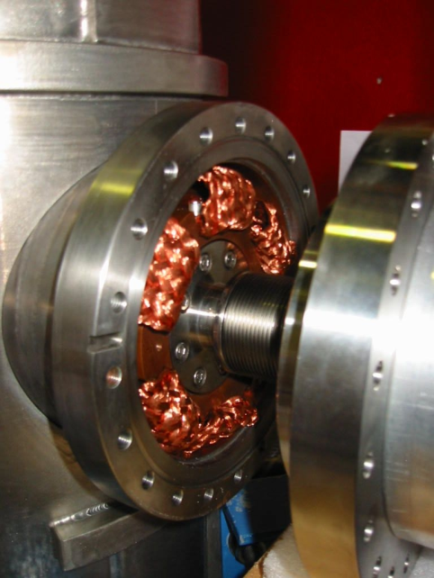
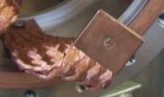
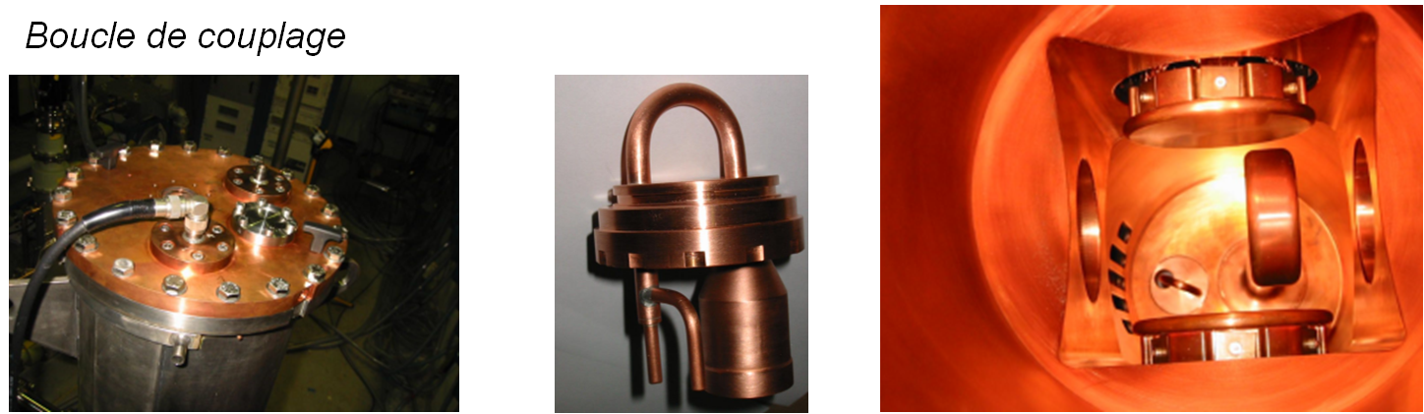
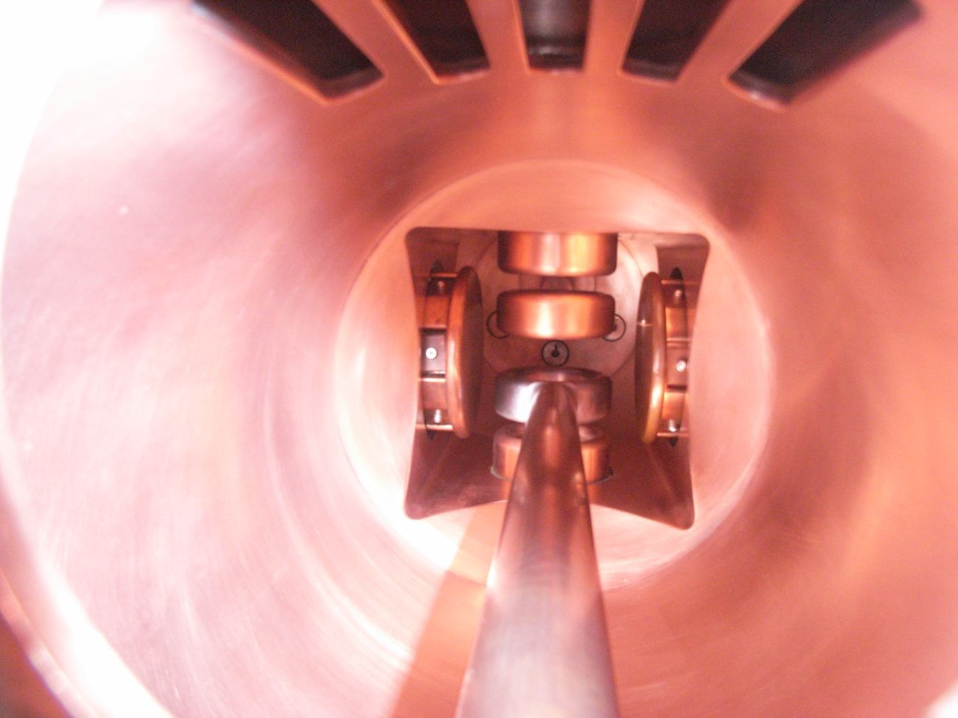
Cavity Status: MEBT Rebunchers (GANIL)
3-gap cavities, 120 kV beam @ 5 kW.
New, water cooled tuners for the 3 cavities under construction, delivery expected April 2013.
Other two cavities under construction,
delivery expected June 2013.
capacitive tuners using Cu braids as contacts
Power coupler

Slide 7
Cavity Status: CMA (CEA Saclay) and CMB (IPNO)
(couplers from LPSC)
CMA: 1 QWR - CMB: 2 QWRs
Cleanliness problems encountered after first CM assemblies are solved now.
Electro-polished coupler (ref. Yolanda’s talk)
4 CMA already qualified and ready for shipment to Ganil
First CMB almost qualified
Some qualifying criteria:
Static loss < 10 W
RF loss < 10 W/cav
Field > 6.5 MV/m (900 and 1600 kV) (9MV/m usually)
Fo @ 4.2 K, 1200 bar (He pressure)
Fo sensibility < 5 Hz/mbar
Tuner course (10 kHz) and backslash (< 20 Hz)
Q ext : Qext ±20% (A:5·10⁻⁵ ,B: 1·10⁻⁶)
Cavity alignment better than 1,5 mm (cylindricity)
…

Slide 8
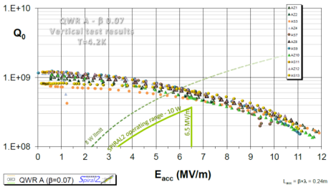
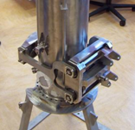
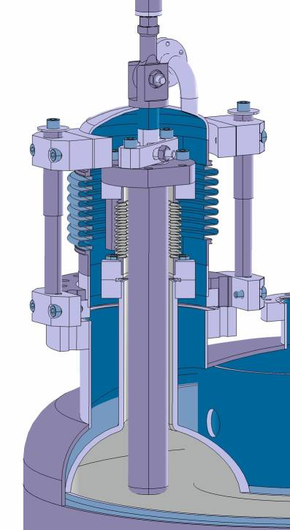
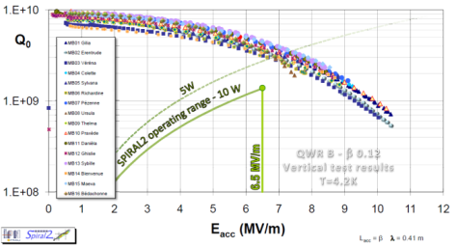
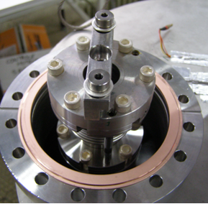
Cavity Status: CMA (CEA Saclay) and CMB (IPNO)

Slide 9
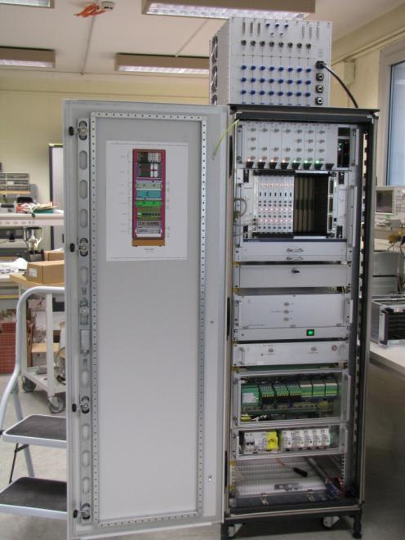
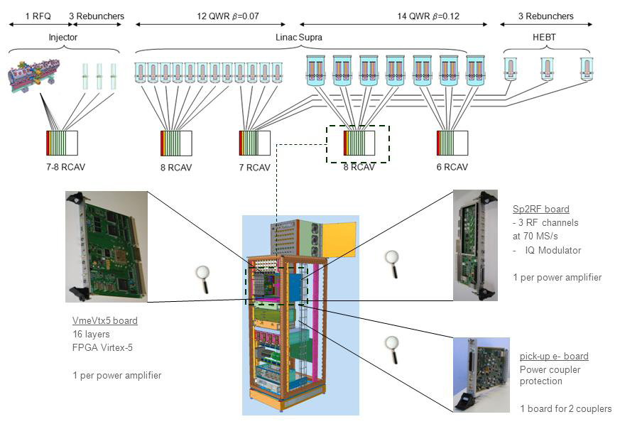
Digital LLRF (Irfu-CEA Saclay)
5 cabinets containing cards and interfaces for up to eight control modules
Direct sampling at 4/5 fo. Control bandwidth > 100 kHz.
All cabinets almost assembled
Series RF boards still under construction
Whole cabinet test starting next June

Slide 10
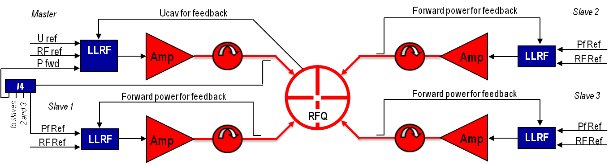
POWER RF : Remind of main choices
88,0525 MHz
RFQ
3 rebunchers (NC) (beta=0,04)
12 SC QWR beta 0,07
14 SC QWR beta 0,12
60 kW tube amps for the RFQ (DB ELETTRONICA)
2.5, 5, 10 and 19 kW SSA for the other cavities (BRUKER)
10, 20 and 60 kW circulators (AFT)
VSWR L1 < 1.5 (Prvs < 4% Pfwd)
VSWR L2 > 100 (for SC cavities, max power for coupler conditionning only)

Slide 11
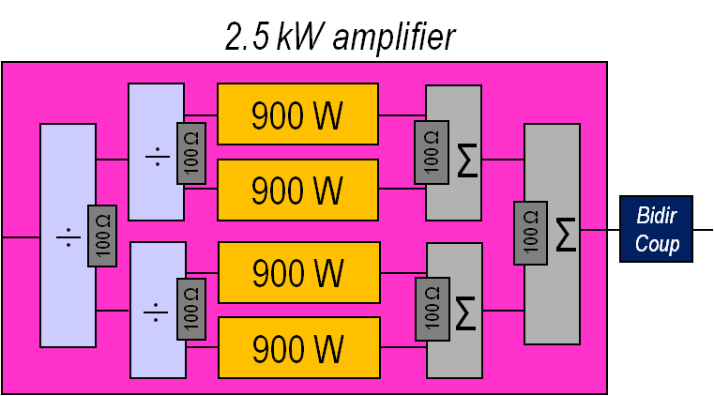
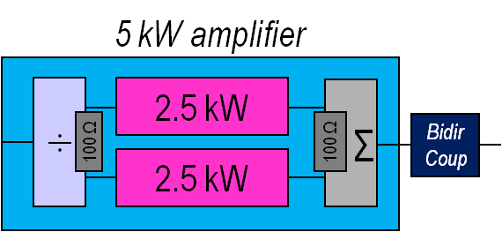
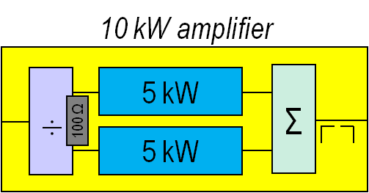
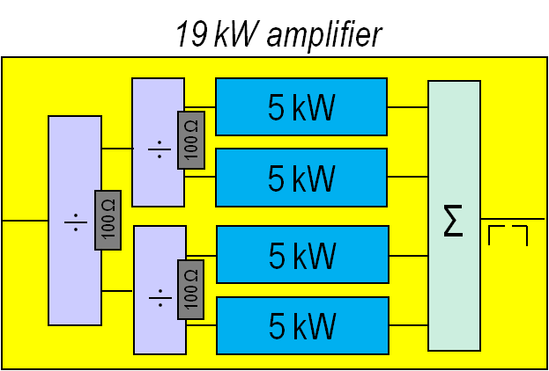
SSA – Acceptance tests
2.5 kW Base module
NXP, BLF 578, 48V-2A bias
Isolated combiners up to 5 kW
Star combiners for the 10
and 20 kW units
First units qualified recently
2nd phase of the contract under signature
Transistor cooling problem disclosed, solved modifying
brazing process

Slide 12
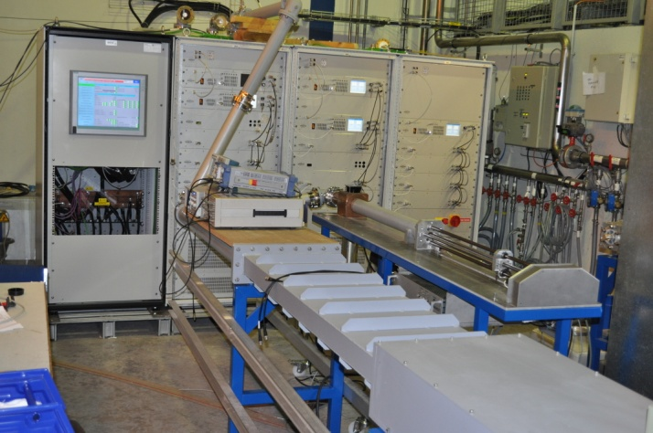
SSA – Acceptance Tests
Test conditions
  50 Ω
  VSWR=1.5, ΦImax
  VSWR=1.5, ΦImin
VSWR =1.5, constant reduced power: search for phases giving Imax and Imin.
Full power plot probably deformed by amplifier compression.
Span plots correct up to 80% of nominal power.
distance from max to min = 90°
Good correspondence VSWR=1.5=Imax/Imin.
ΦImax
ΦImin

Slide 13
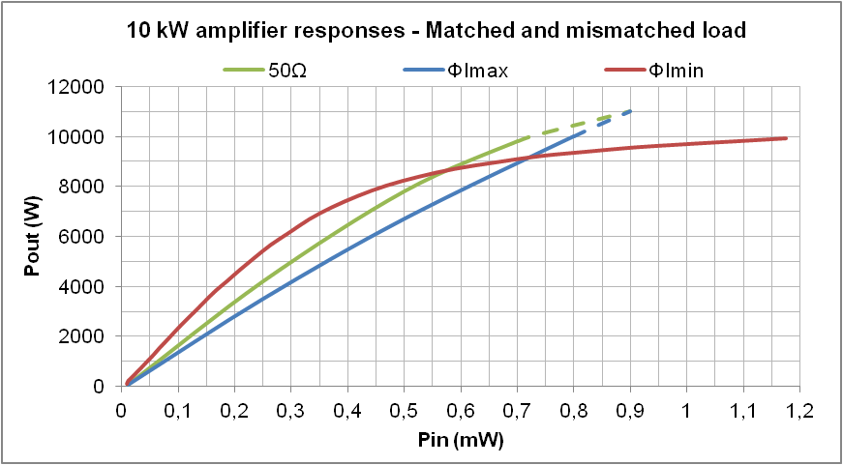
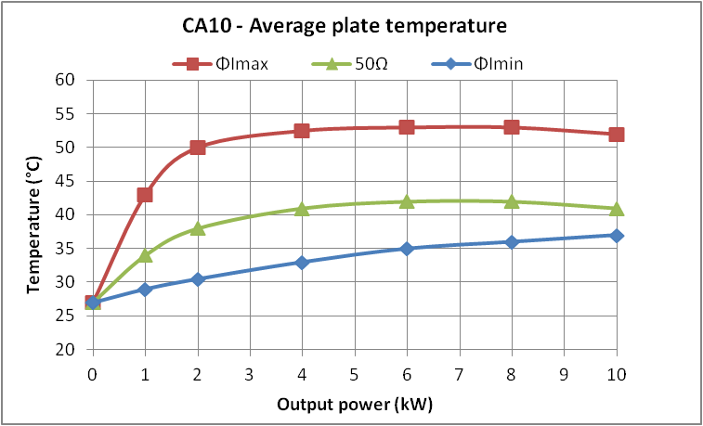
SSA – Acceptance tests
Test procedure
Gain and phase responses,
stability, harmonics, efficiency ...
Maximum operating temperature (Θ).
Long time test with long ON/OFF cycles
VSWR =1.5, ΦImax, @ P_{max} and P_{θmax}
(to check endurance at maximum current and temperature
and to have stressing cycles of thermal interfaces)
Long time test with long ON/OFF cycles
VSWR =1.5, Φimin, @ P_{max}
(to check endurance at maximum voltage)
Stability: better than 3% and 6°
Harmonics: better than -35 dB
Efficiency: better than 65% on 50Ω

Slide 14
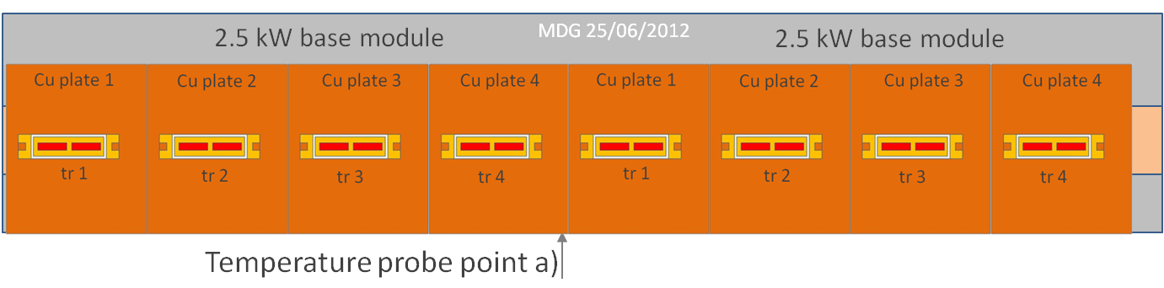
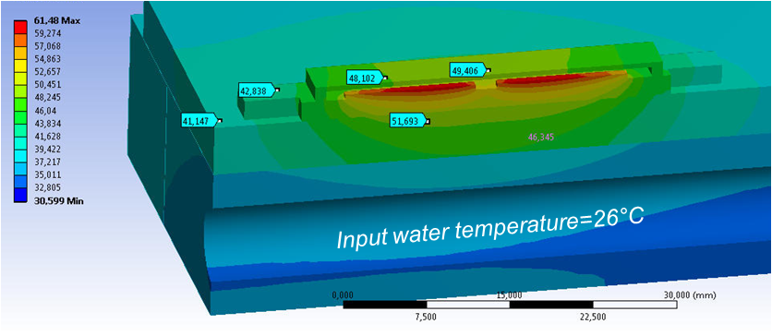
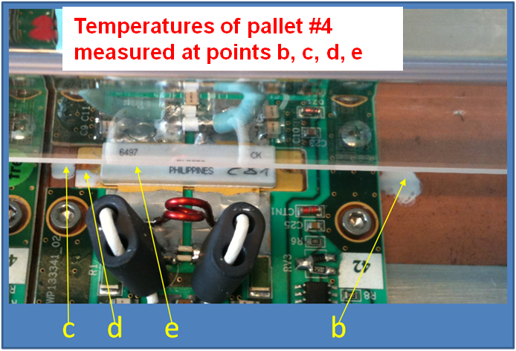
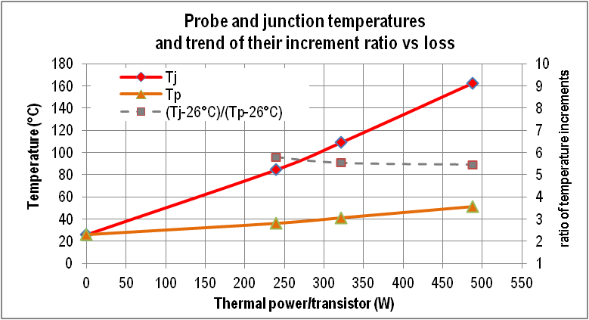
SSA – Acceptance tests
Junction operating T
Only plate temperature available
Max temperatures already reached at half power
Flange temperature measured
Temperature below dies simulated
Junction temperature calculated

Slide 15
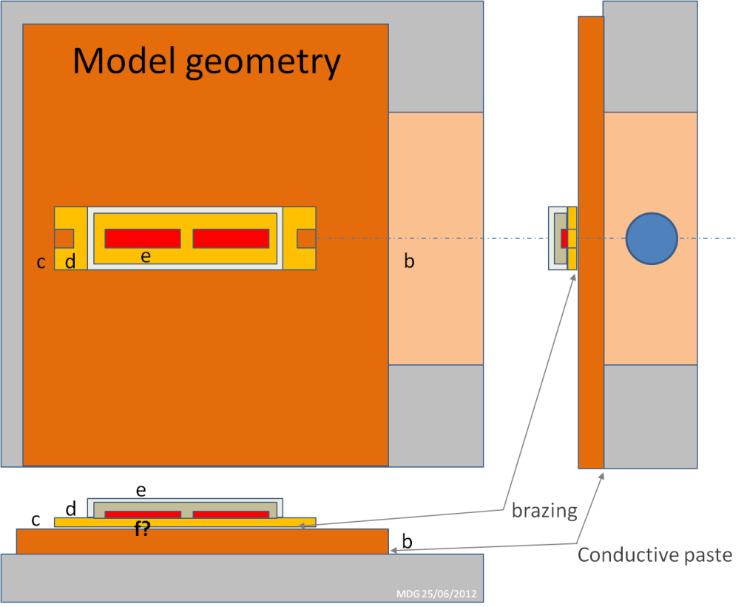
SSA – junction temperature
Thermal model
1 Cu thick base brazed under each transistor
8 transistors (2x4) on 1 water cooled plate
Cu stripe under the transistor region

Slide 16
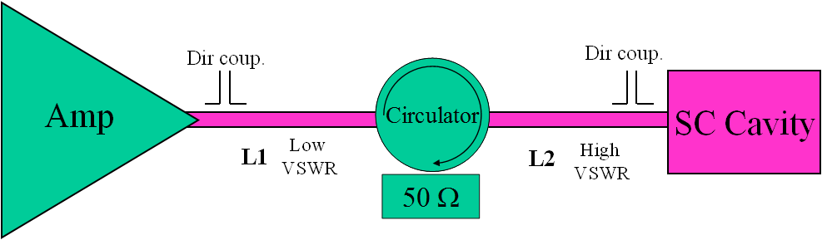
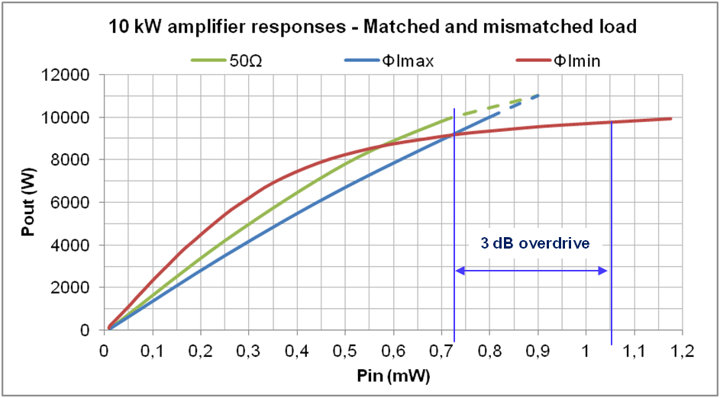
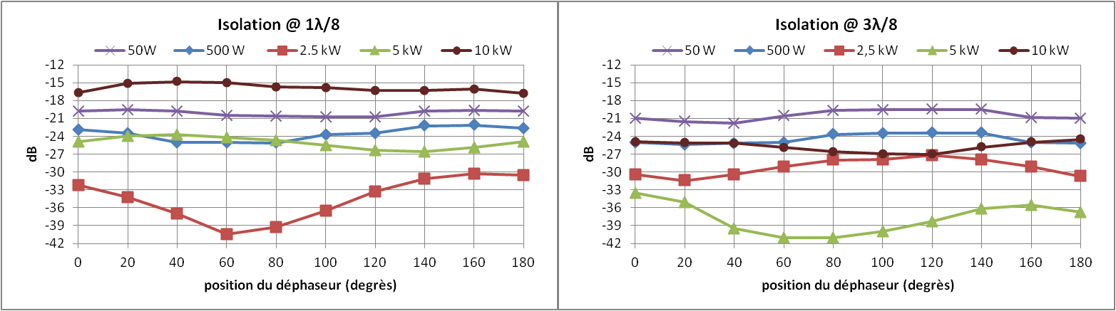
T-Line effect L1
Significant effect on the amplifier response
L1 = ΦImax =>
~75% acceptable phase range with reduced overdrive
Small effect on the circulator
Isolation diagrams obtained with two values of L2 shorted at the end

Slide 17
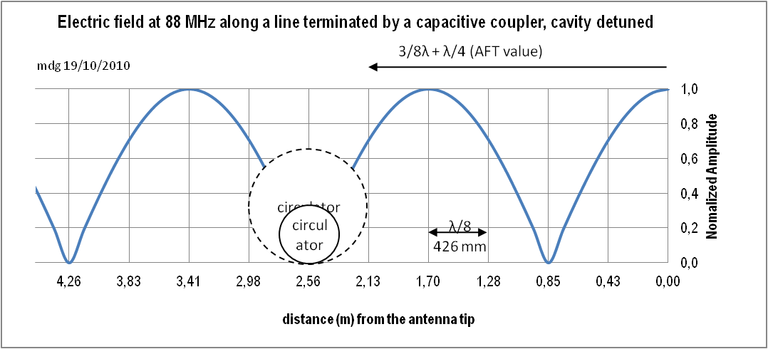
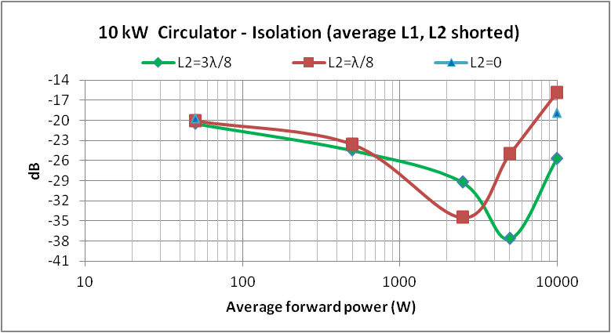
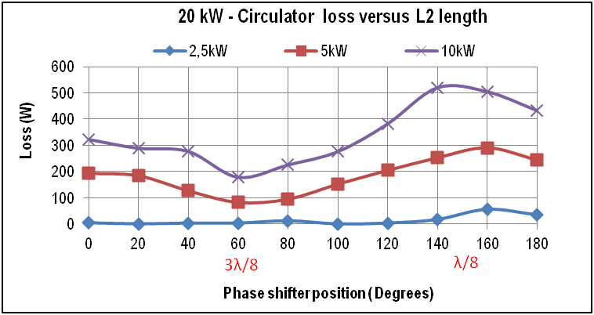
T-Line effect L2
3λ/8 and λ/8
min and max loss lengths on shorted line
defined on λ/8 steps :
Same values for the 3 circulators?
Confirmed for the 20kW
Less losses => less thermal drift

Slide 18
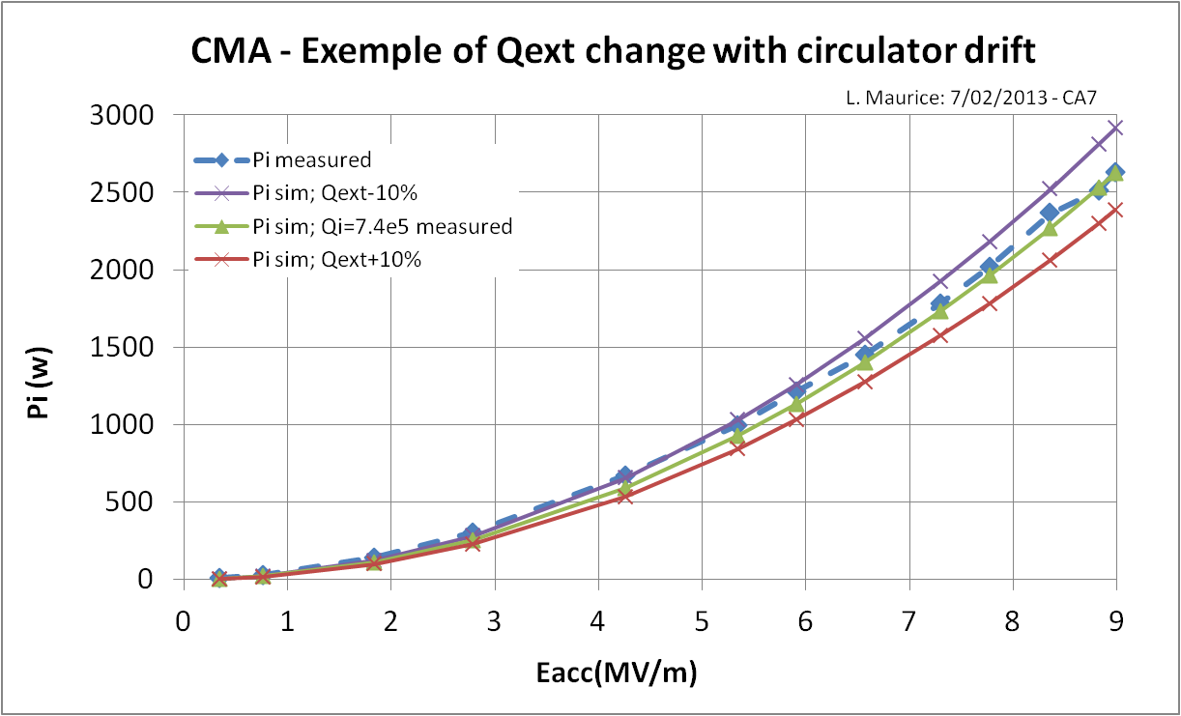
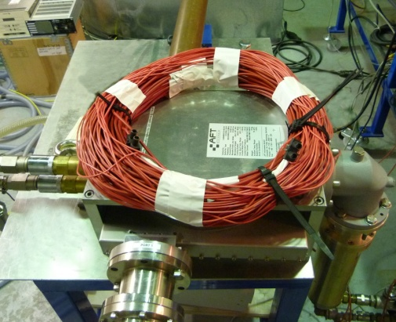
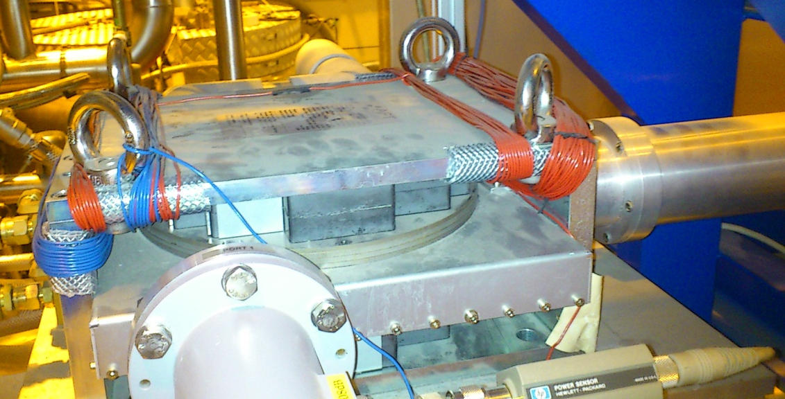
Effect of circulator drift on the cavity Q_{ext}
Thermal drift of the circulator output impedance changes the cavity Qext.
>10% effect already observed with only 3 kW.
Need for additional tuning?
~150 kHz/A
Home made 100 turn coils
>550 kHz/A

Slide 19
Conclusion
Time for installation is approaching quickly and
all teams are working hard to be on time as the problems we have been encountering permanently remind us that reliability is a long struggle.
Lessons we learned on power systems:
Cycled, long time tests useful at half power to stress the transistor and at full power for the other components.
Amplifier response strongly affected by only few percent
of reflected power all phases.
Compensation is possible tuning T-line lengths (+Nλ/2)
Need for variable tuning of the circulators to be investigated.

Slide 20
END
Thank you for your attention
ACKNOWLEDGEMENTS
Ph Galdemard: LLRF and RFQ
P. E Bernaudin: Cryomodules
L. Maurice: RF measurements on CMA test bench
S. Bonneau: SSA commissioning measurements
and to the different teams for their every day work

Slide 21
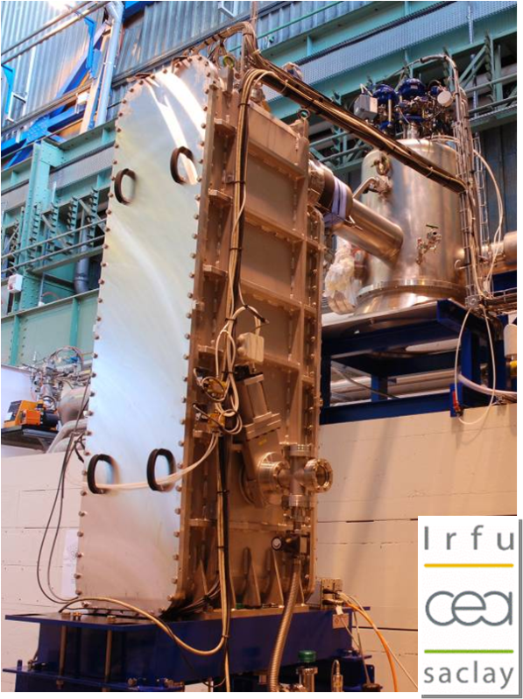
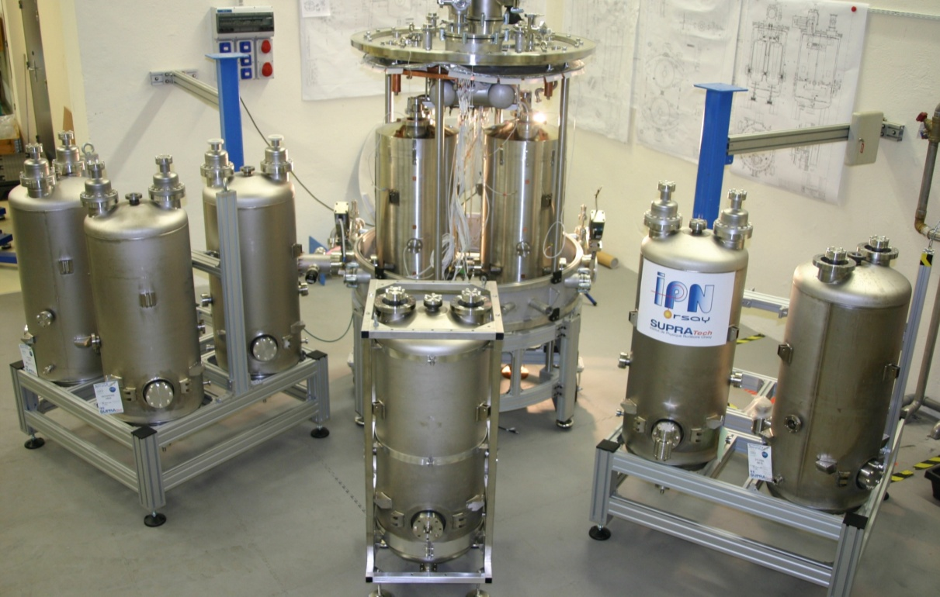
CMA, CMB
Low beta cryomodule
High beta cavities and open cryomodule

