Slide 1
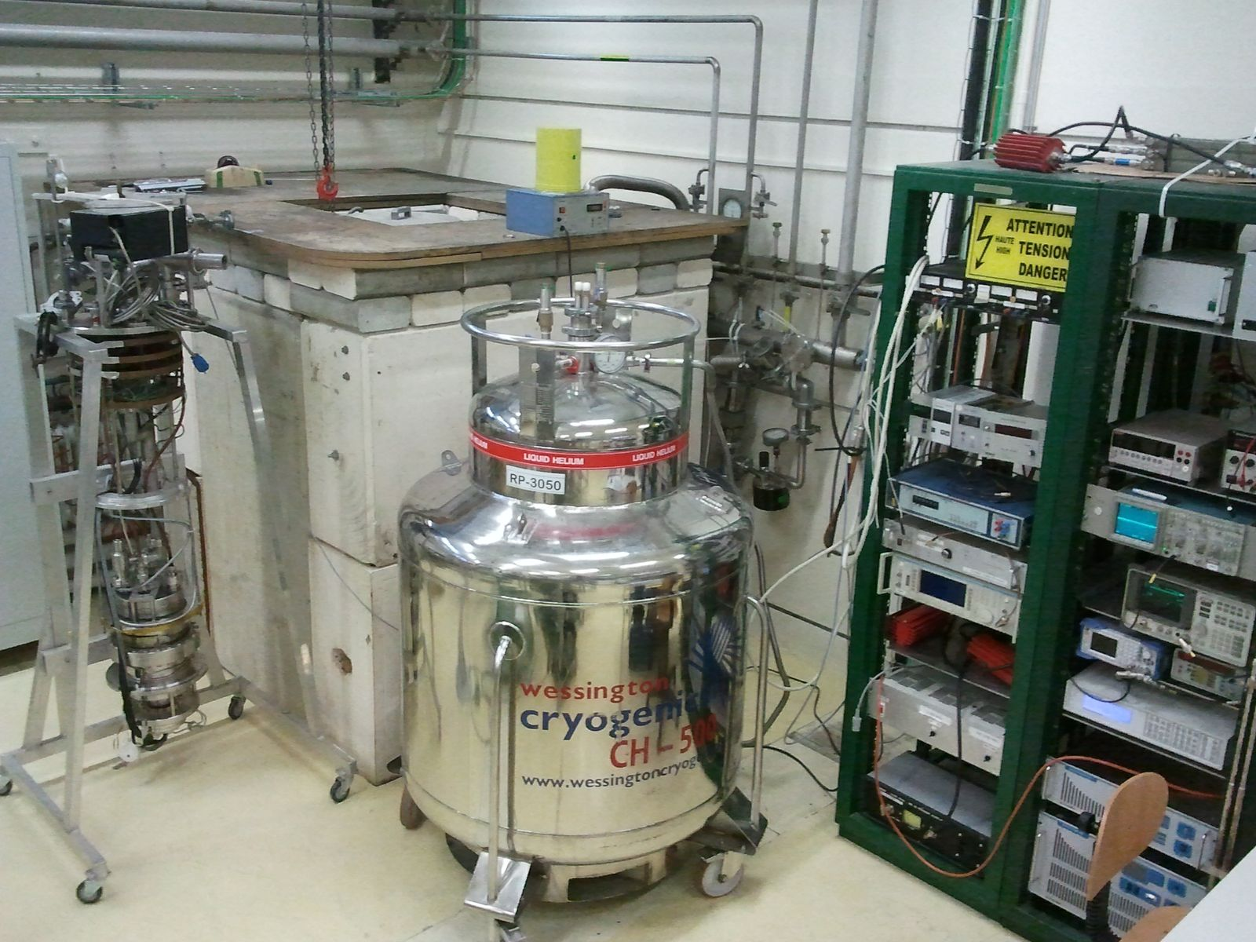
R&D at CERN for superconducting radiofrequency cavities

Slide 2
Motivation
Power consumption in a superconducting cavity is proportional to its surface resistance R_{S}
R_{S} shows a complex behavior on external parameters, such as temperature, frequency, magnetic and electric field
Some open questions:
Origin of the residual resistance
Origin of the field-dependent resistance
Stronger field-dependent resistance of niobium films compared to bulk niobium
Influence of magnetic and electric field
Relation to the surface properties
Possibilities and limitations of materials other than niobium

Slide 3
Motivation
PhD Project 1 - Sarah Aull (Univ. Siegen):
RF characterization of samples over a wide parameter range using a Quadrupole Resonator to test surface resistance models on different materials
PhD Project 2 - Giovanni Terenziani (Univ. Sheffield):
Develop High Power Impulse Magnetron Sputtering (HIPIMS) coatings to overcome limitations of standard Direct Current Magnetron Sputtering (DCMS) coatings

Slide 4
Insert with Quadrupole Resonator
150 liter lHe cryostat
X-ray detector connected to interlock system
Concrete bunker
200 W RF system 400-1500 MHz
Manostat
Helium Dewar

Slide 5
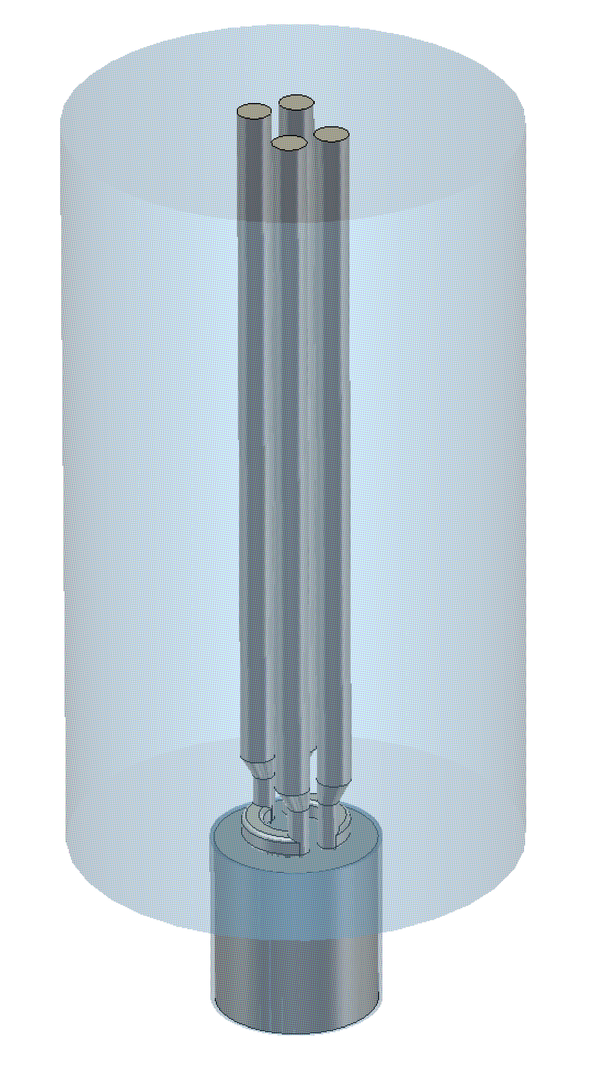
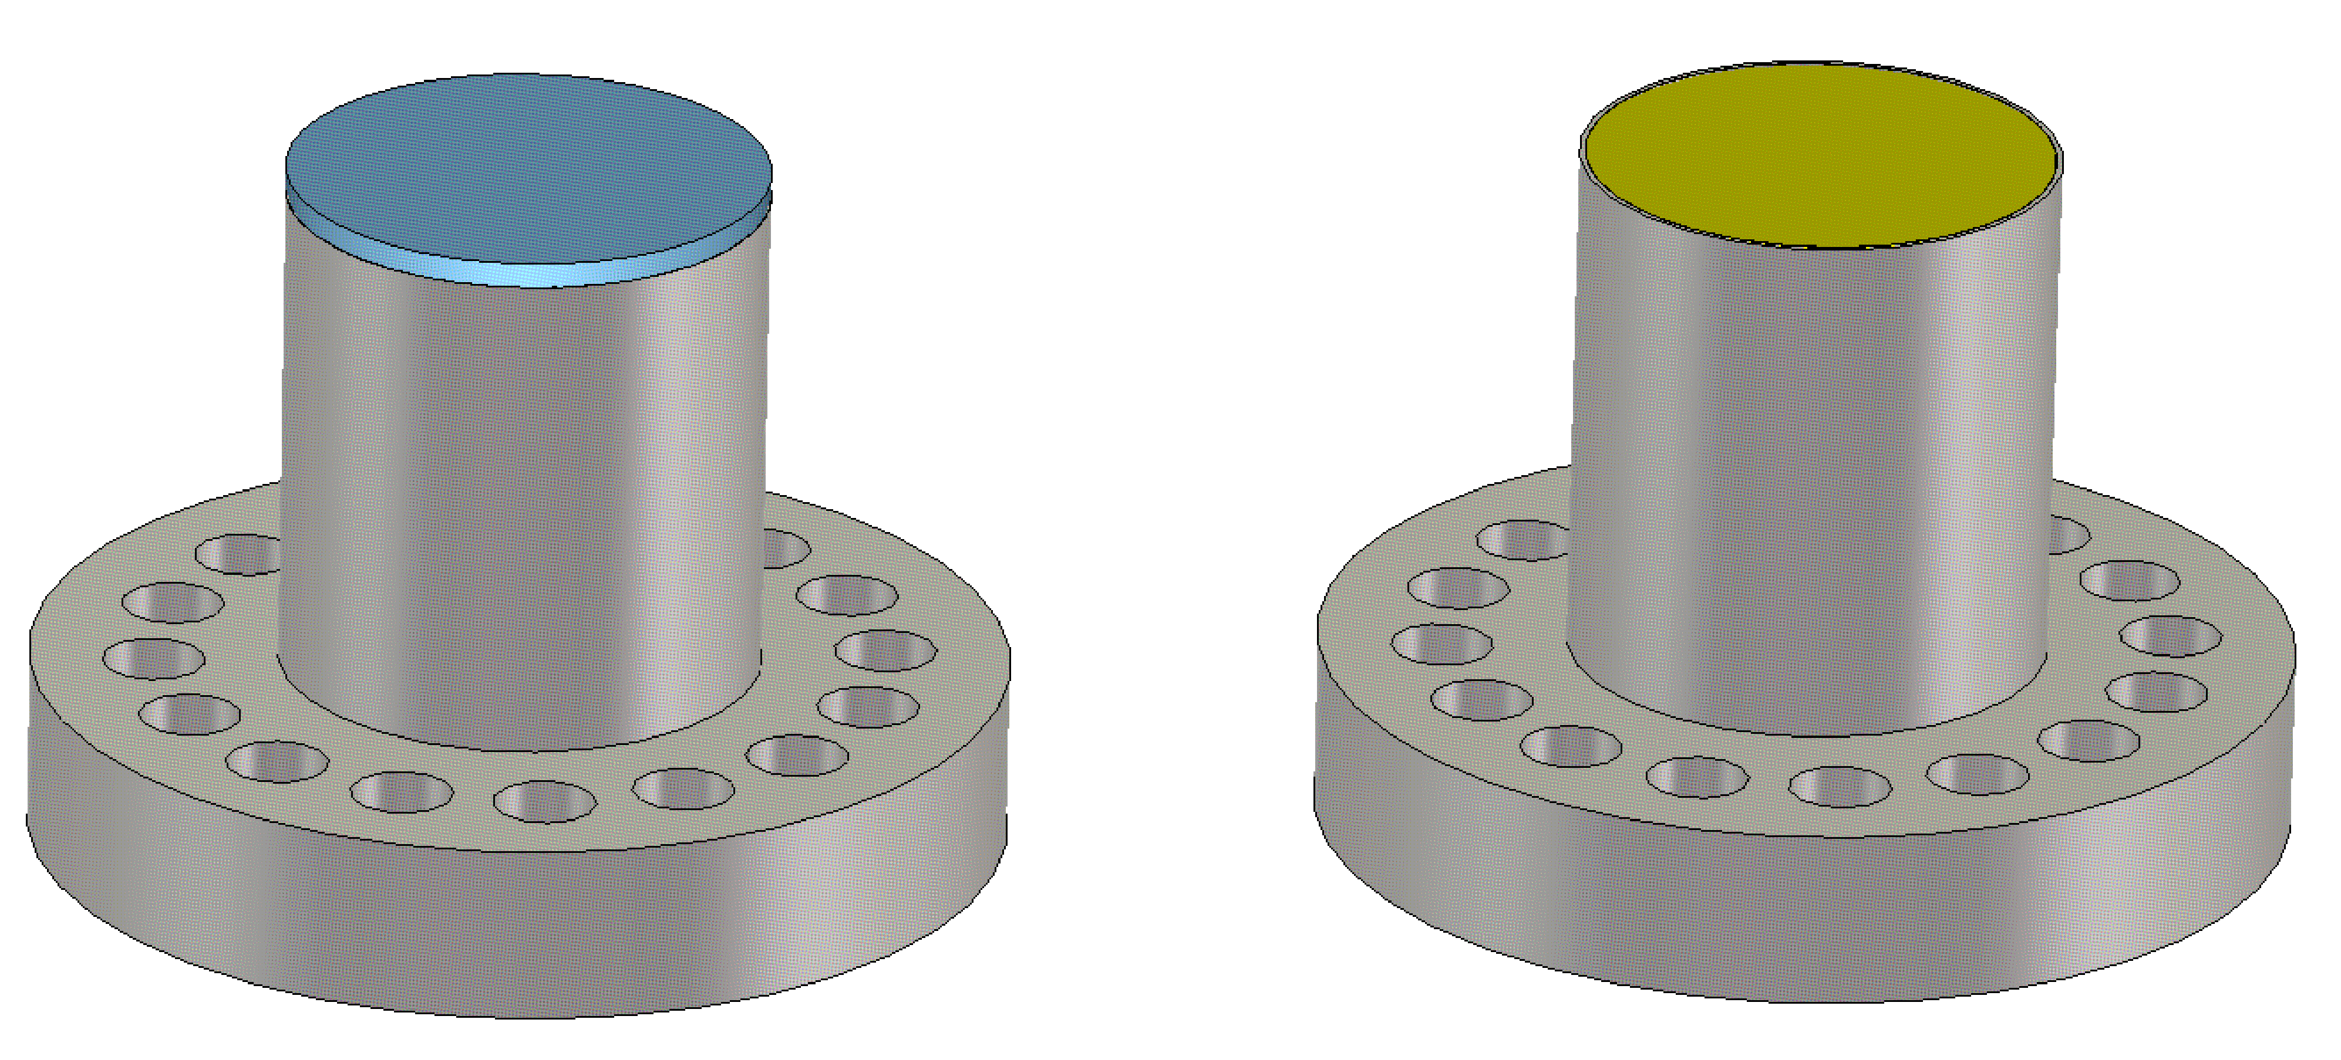
Design of the Quadrupole Resonator
Niobium Sample
Niobium Cylinder
Copper Sample
361 mm
Stainless Steel Flange
Sample diameter: 75 mm
The sample needs to be EB-welded to the sample cylinder
Bulk niobium and copper samples are available

Slide 6
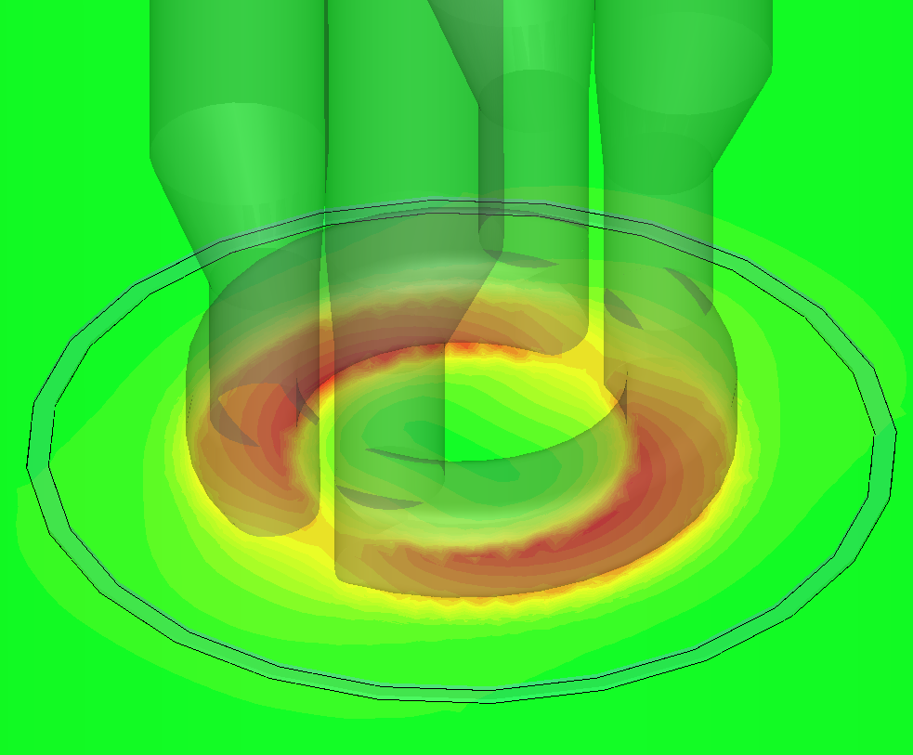
Field Configuration & Features
Resonant frequencies:
400, 800, 1200 MHz
Almost identical magnetic field configuration
Ratio between peak magnetic and electric field proportional to frequency
B׀׀
max
50 mm
0

Slide 7
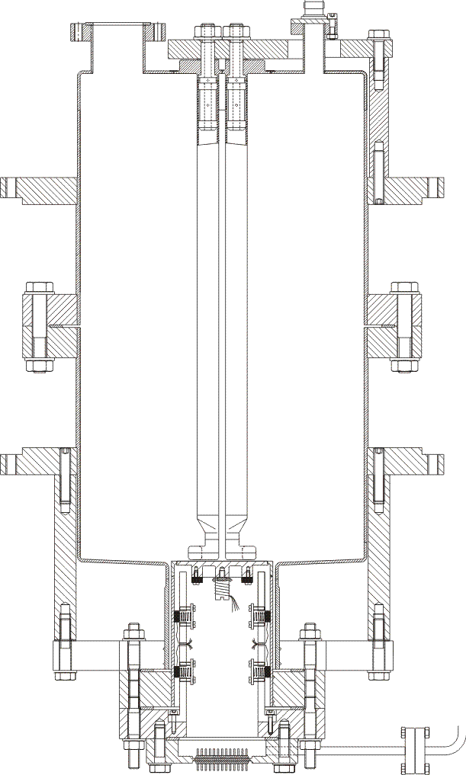
The Calorimetric Technique
Niobium
Rods
Sample Surface
Quadrupole Resonator

Slide 8
The Calorimetric Technique
Measuring the temperature on the sample surface
Precise Calorimetric measurements over wide temperature range
DC Heater
Temperature
Sensors
Heat Flow
Sample Surface
Quadrupole Resonator
Thermometry Chamber

Slide 9
The Calorimetric Technique
DC Heater
Temperature
Power
Temperature
of Interest
P_{RF}
Heat Flow
Bath
Temperature
P_{DC,1}
P_{DC,2}
Temperature
Sensors
time
DC on
RF on
≈60 s
≈40 s

Slide 10
The Calorimetric Technique
DC Heater
Temperature
Power
Temperature
of Interest
P_{RF}
Heat Flow
Bath
Temperature
P_{DC,1}
P_{DC,2}
Temperature
Sensors
time
DC on
RF on
≈60 s
≈40 s
Measured directly
Measurement of transmitted power P_{t}
P_{t}=c∫H²ds, c from computer code

Slide 11
Flux Trapping

Slide 12
Flux Trapping
Sample
DC Coil

Slide 13
Flux Trapping
$$\vec{B}$$
DC Coil

Slide 14
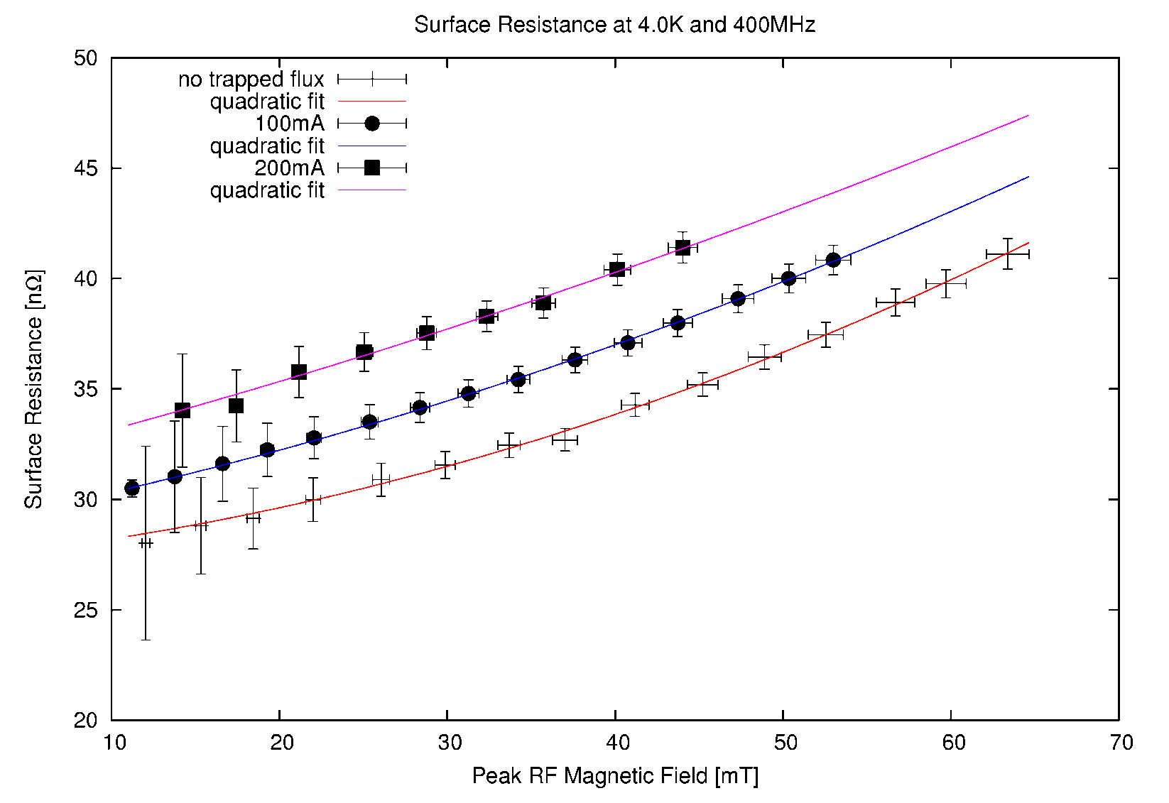
Trapped Flux at 400MHz and 4K
Bulk niobium sample
Reactor grade, RRR $≈65$
Standard BCP, no bake out
$Rres ≅11.5 n\text{Ω}$

Slide 15
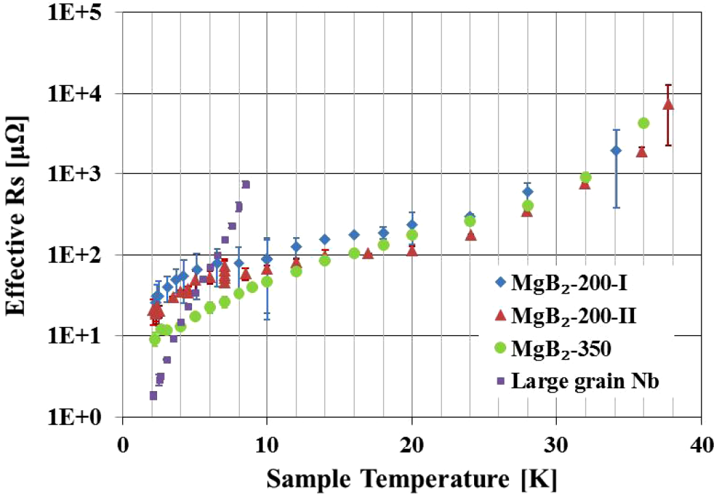
Magnesiumdiboride MgB₂
Material | Bulk Niobium | MgB₂
R_{res} | A few nΩ | ?
dR/dT (theoretically well understood) | Lowest for all elements | Better
dR/dB | Lowest increase, best studied material | So far worse, very few measurements
B_{c1} | Close to Bc ≈ 200 mT | Worse
B_{sh} | Above Bc | Better
B. Xiao et al. - Supercond. Sci. Technol. 25 (2012)
7.5 GHz
Only magnetic field

Slide 16
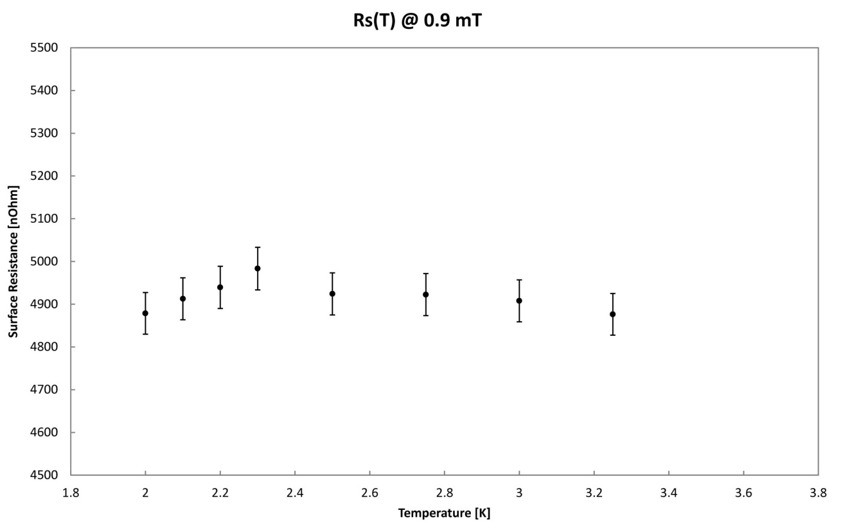
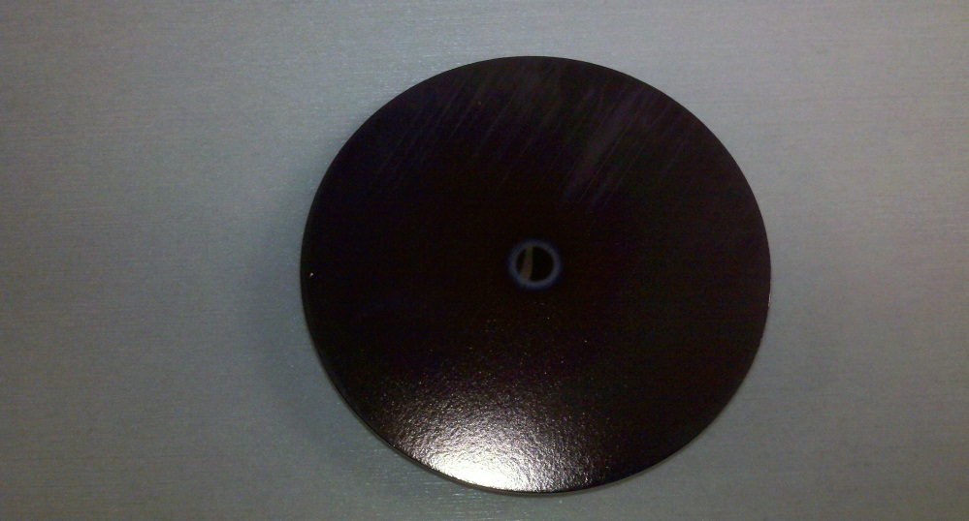
Magnesiumdiboride MgB₂
Barrier in transmitted power above 1.3 mT
Multipacting?
B
f=400 MHz
B=1 mT
t

Slide 17
Quadrupole Resonator - Summary and Outlook
Sample tests over a parameter range inaccessible to elliptical cavities:
Three different RF frequencies, with almost identical magnetic field configuration
Frequency dependent electric field configuration
Wide temperature range
Accuracy of about 0.05 nΩ
Study the influence of trapped magnetic flux
Unique possibilities to test surface resistance models and study new materials
Next sample to be tested: Niobium on Copper deposited by HIPIMS technology

Slide 18
Lessons learned with sputtered films
288 Nb/Cu cavities installed in LEP
16 Nb/Cu cavities installed in LHC
About 300 coatings on 1.5 GHz for R&D
Low-beta studies, several 10’s of coatings
Advantages of films
Lower losses at 4.2 K and moderate accelerating gradient compared to bulk niobium
Reduced sensitivity to earth magnetic field, x100 less than bulk Nb: no need for magnetic shielding
Cheaper material
Major disadvantage of films
Steep R_{S} increase with RF field

Slide 19
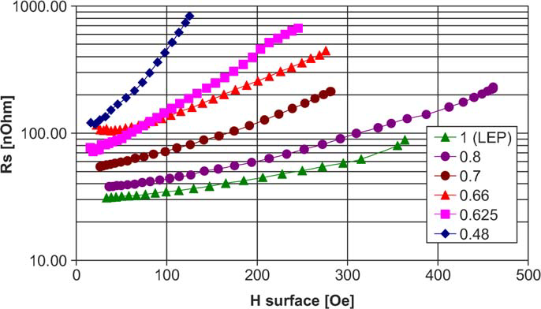
From dcms to HIPIMS
dcms
352 MHz
4 K
By applying pulses of high power the sputtered target material
atoms are ionized and applying biasing potential we can achieve:
target material ions can be accelerated towards the substrate, higher kinetic energy upon arrival
ions are directed to the surface, thus non-flat surfaces can be sputtered with good uniformity of the film

Slide 20
Reproducing old dcms results
No field emission up to 11 MV/m, but residual resistance of 100 nΩ and strong Q-slope
dcms
1.5 GHz

Slide 21
Reproducing old dcms results
Is the residual resistance caused by uncoated areas?
R_{S} of copper at 1.5 GHz is about 1 mΩ
R_{res}=100 nΩ
$R_{Res}=R_{N}\frac{Uncoated Surface Area}{Total Surface Area}$ ?
Total Surface Area=670 cm2
→ Uncoated surface area=6.7 mm2
Should be detectable with optical inspection system

Slide 22
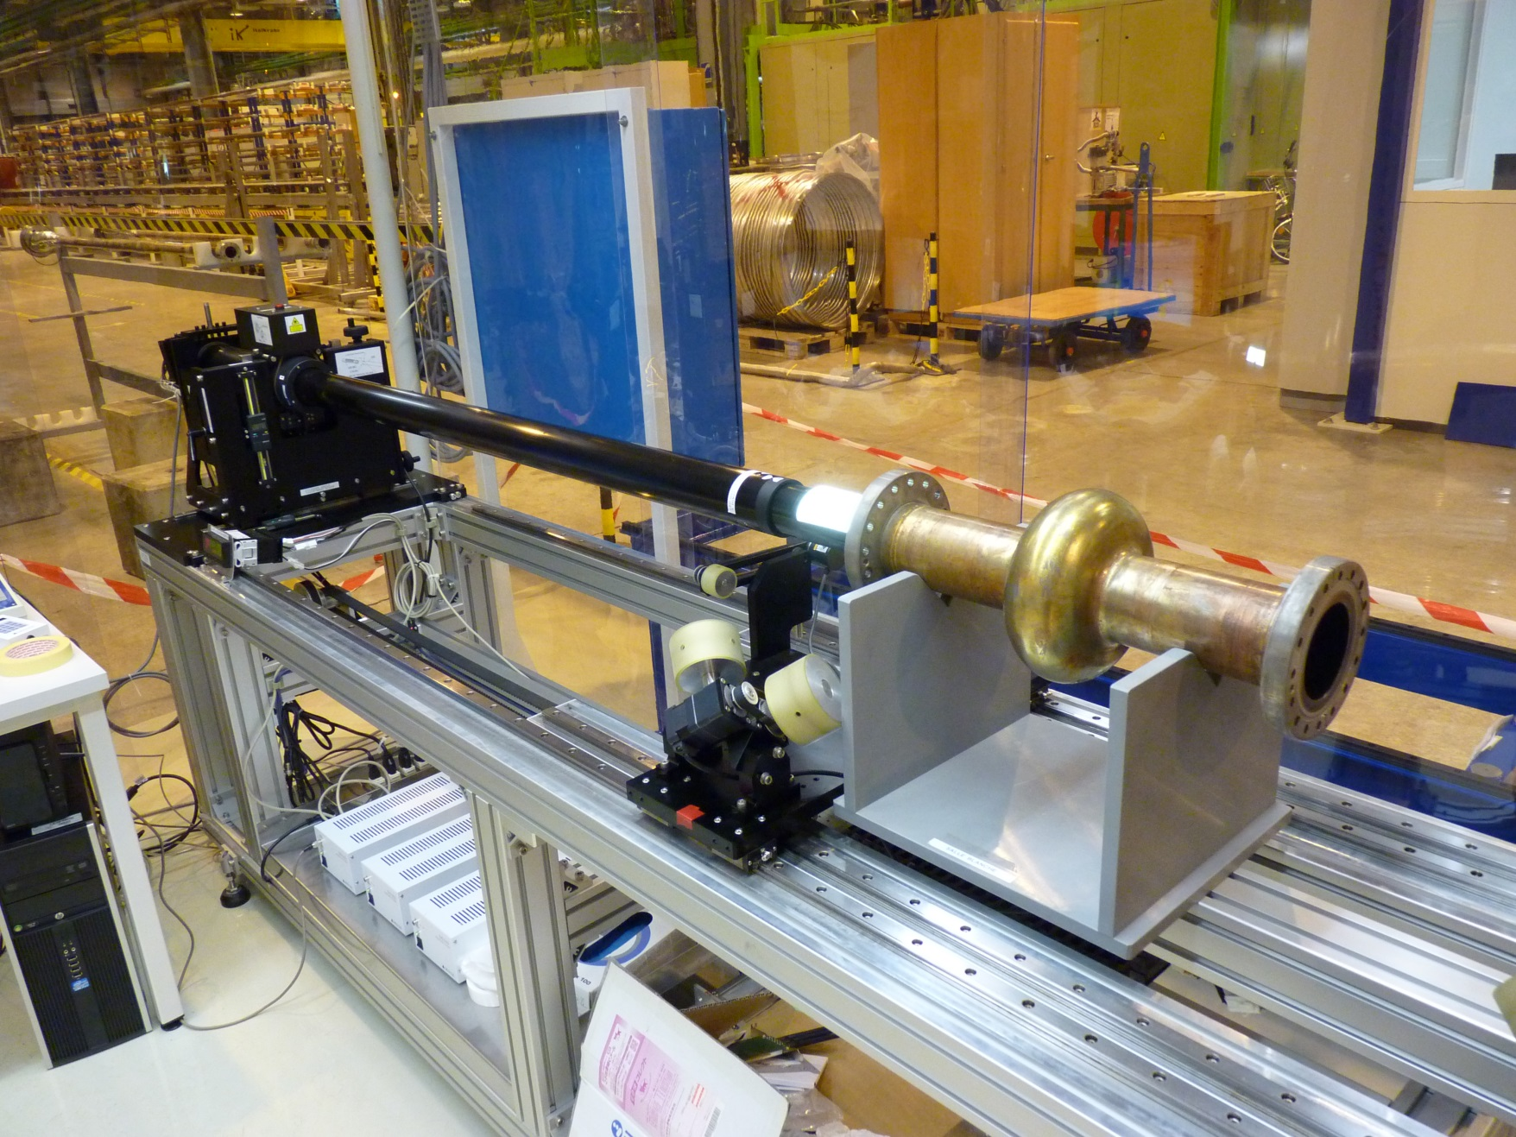
Optical Inspection

Slide 23
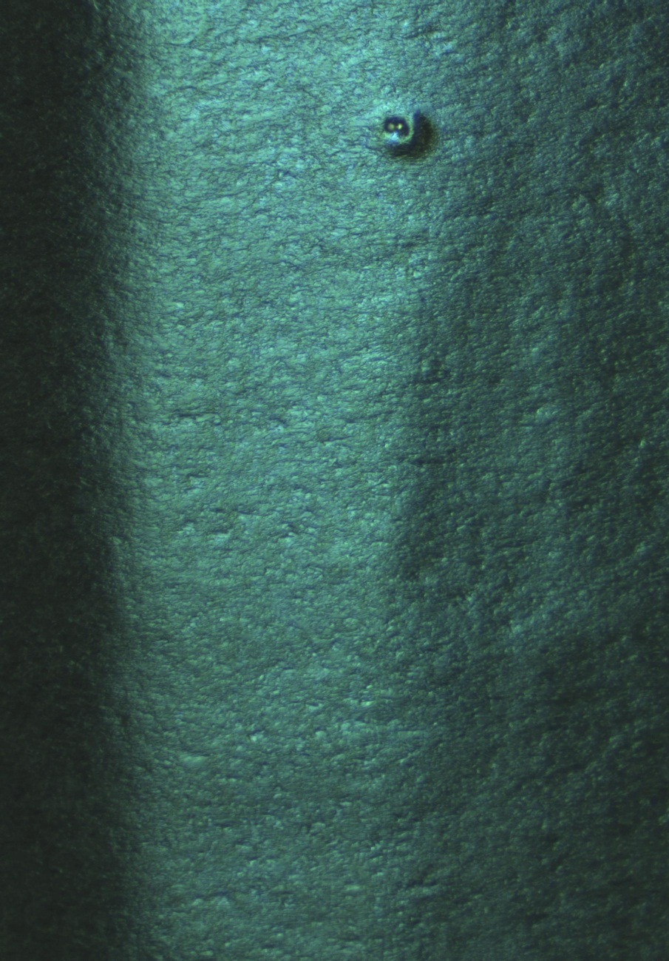
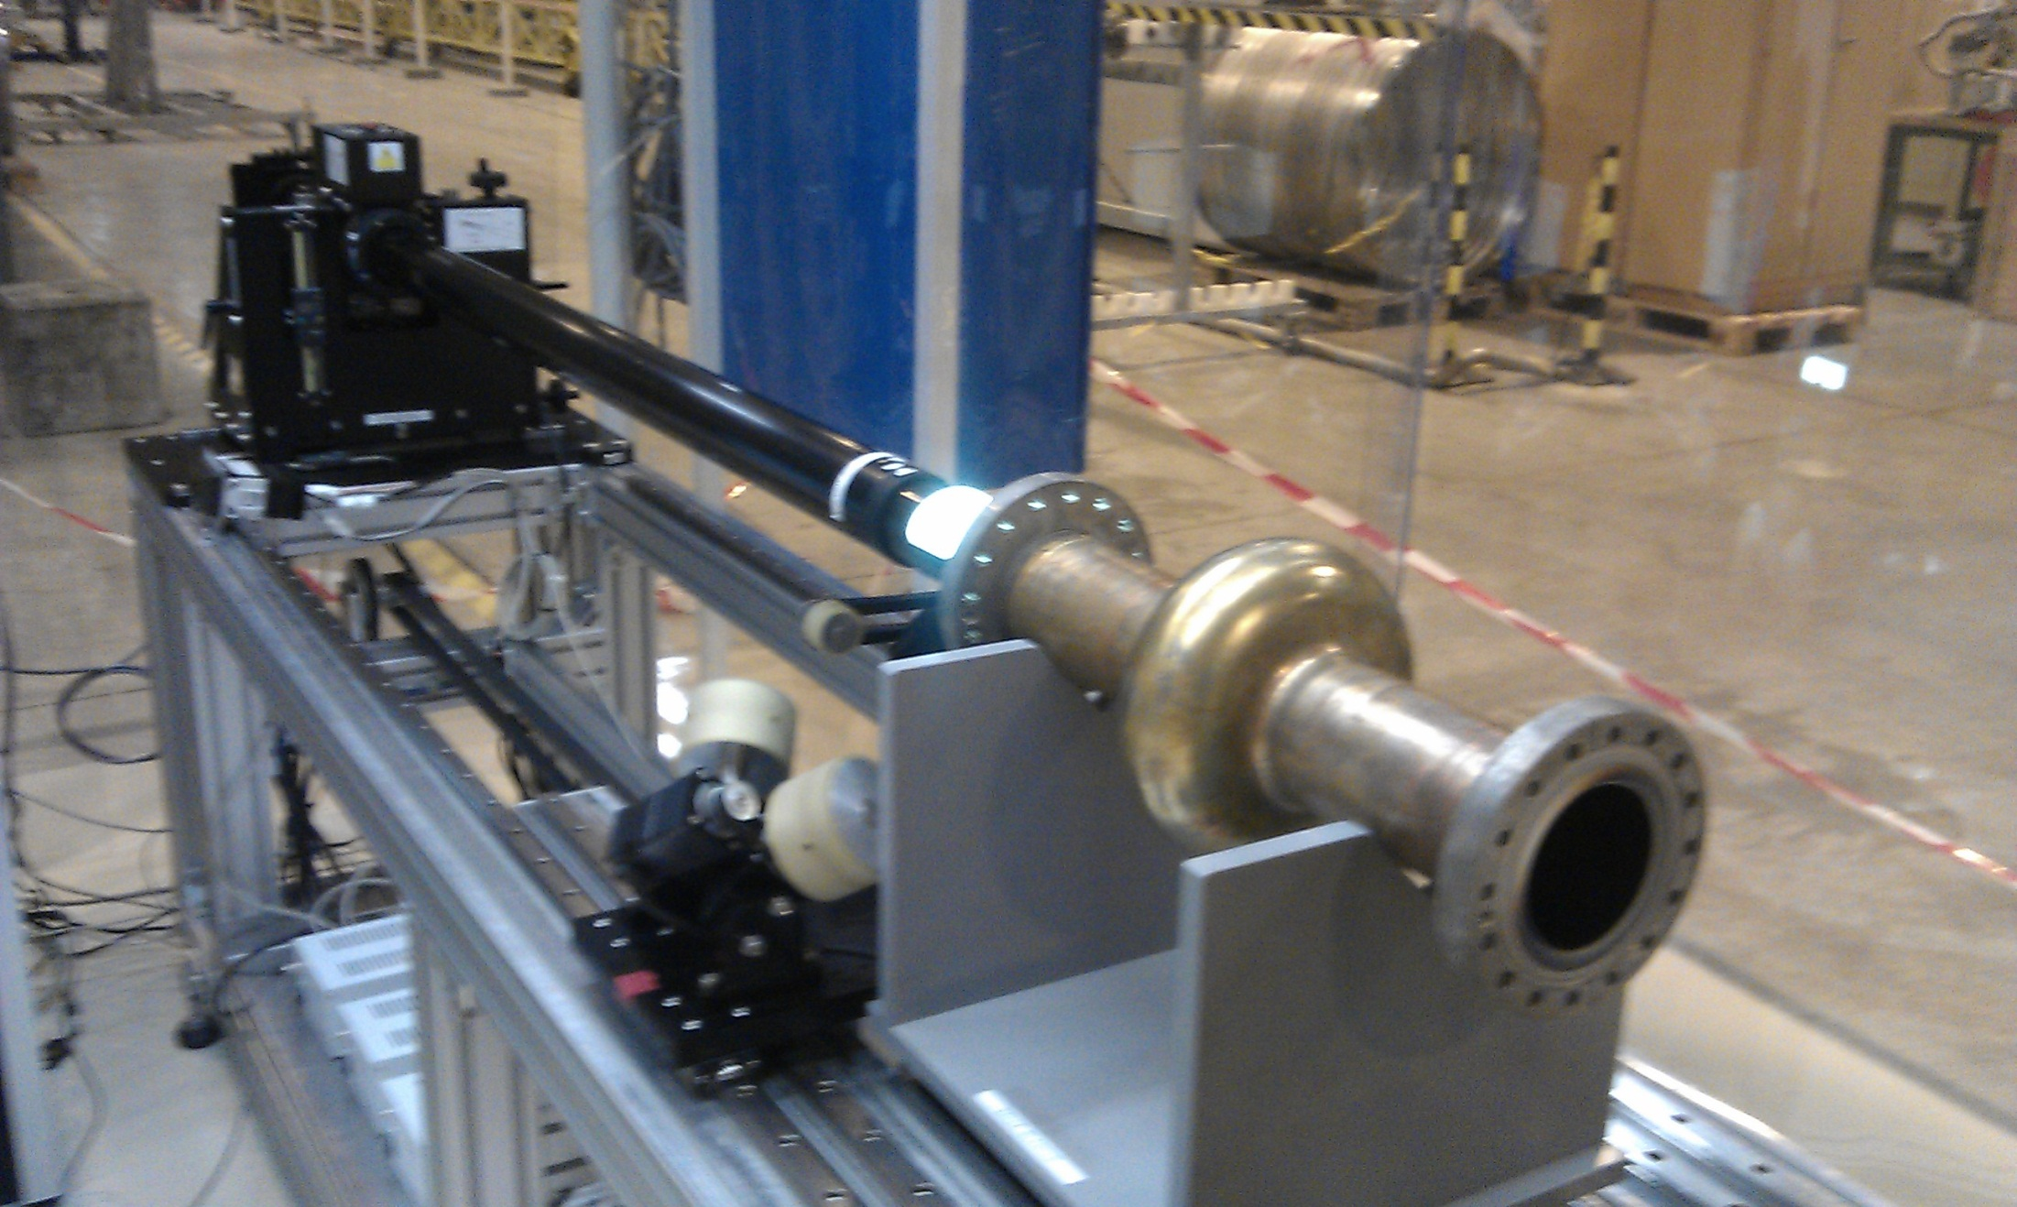
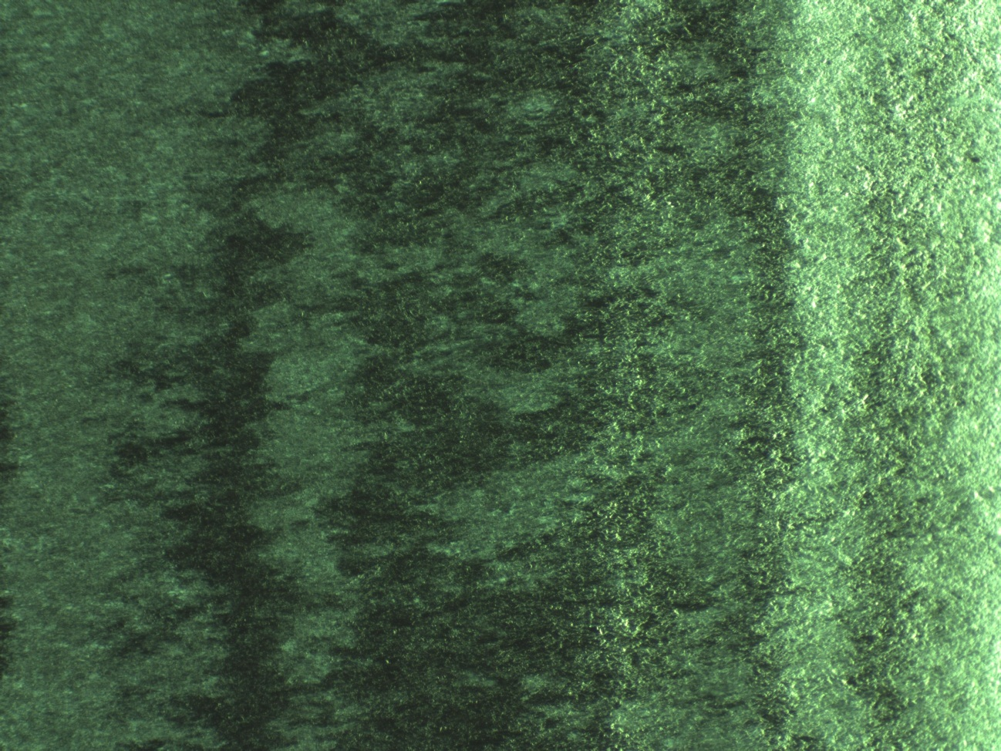
Optical Inspection
≈1 mm

Slide 24
Acknowledgement
Quadrupole Resonator: S. Aull, S. Doebert, J. Knobloch
Coating of cavities: G. Terenziani, S. Calatroni, A. P. Ehiasarian
Optical Inspection: Janic Chambrillon
After 50 years of experience with superconducting cavities, we are approaching the fundamental limitations of niobium by recipes for which the underlying physics is not completely understood. For some accelerator applications SRF technology is the only choice. For reliable production, building compacter machines and cheaper electricity bills basic R&D and material studies are necessary!

