Slide 1
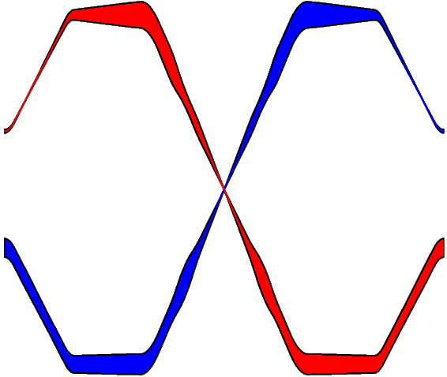
Crab CAVITY LLRF architecture for SPS and LHC
P. Baudrenghien
CERN BE-RF
RFTech 2013, Annecy, March 25,2013
Thanks a lot to R. Calaga and
A. Mc Pherson for help and comments

Slide 2
Content
Impedance and coupled bunch instability
Keeping crabbing and un-crabbing kicks equal
LLRF architecture
RF noise
A word on RF power
Operational scenario
Hardware
Conclusions

Slide 3
Coupled Bunch (IN)stability
Reduction of Cavity Impedance at the fundamental mode

Slide 4
Machine Impedance
The HighLumi LHC will accelerate 1.1 A DC current per beam (compared to 0.4 A DC in 2012)
The Crab Cavities will introduce a series of Narrow-Band resonators in the machine (fundamental plus HOMs)
Calculations have been done to derive a threshold on the acceptable impedance at each frequency, in Ω (longitudinal) or Ω/m (transverse) [1]
Control of the HOMs involve both cavity design (to minimize the corresponding R/Q) and HOM passive damper design (to reduce the corresponding Q_{L})
Control of the fundamental is the responsibility of the LLRF. A major limitation in PEPII
At the fundamental one cavity presents a transverse impedance around 2.5 GΩ/m
to be reduced below 1.5 MΩ/m ([1], 4 cavities, 60 ms transverse damping time )

Slide 5
RF feedback
With accelerating cavities, in high beam current machines, the problem of (in)stability caused by the cavity impedance at the fundamental is now routinely cured by active feedback [2]. The amplifier driven by a feedback system feeds a current into the cavity which just cancels the beam current
The cavity impedance is effectively reduced by the feedback gain
The limitation comes from the unavoidable delay in the loop. Above some gain level the delay will drive the feedback into electrical oscillations (not related to the beam)

Slide 6
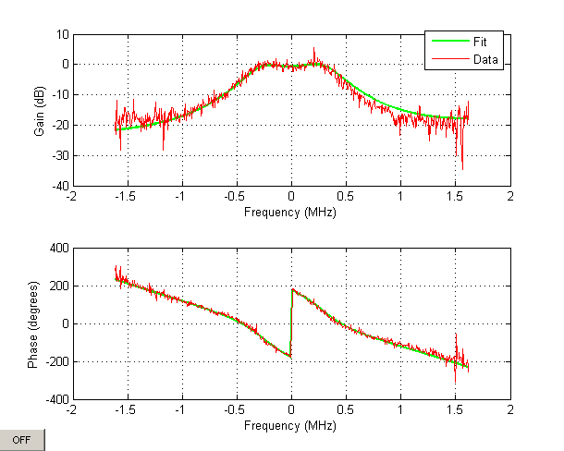
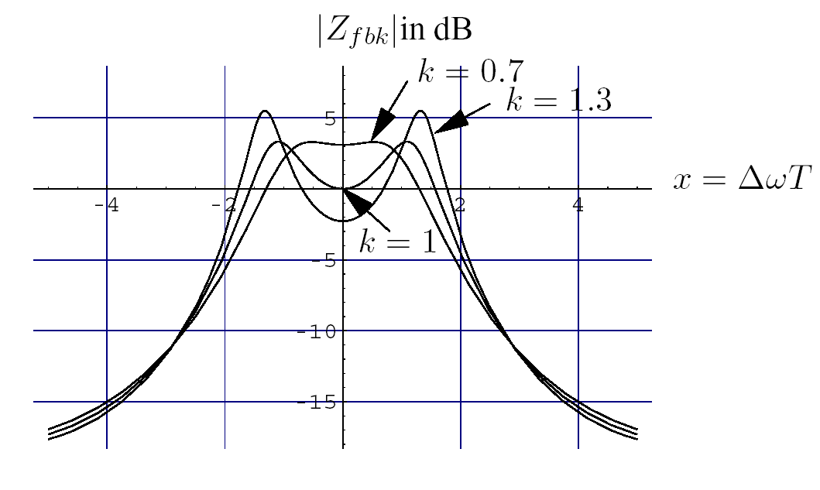
Strong RF feedback. The LHC ACS
With an RF feedback the minimal effective impedance R_{min} and closed-loop single-sided bandwith Δω scale with loop delay T
For the LHC, we have T=650 ns
R_{min} = 75 kΩ/cavity , 0.6 MΩ total
Δω/2π = 320 kHz
Measured Closed Loop response with the RF feedback. Q_{L}=60000 without feedback (~7 kHz 2-sided BW). With feedback we get 700 kHz BW. The effective impedance is reduced by ~ 35. The LHC cavities are equipped with movable couplers and Q_{L} can be varied from 10000 to 100000. But, with feedback, Q_{eff} ~600 in all positions.
With the RF feedback we have reduce the ACS cavity impedance at resonance by ~35 linear (Q_{L}=60k). The 21.6 MΩ are reduced to 0.6 MΩ.
The loop delay T was kept low in the LHC

Slide 7
Similarly for the Crab Cavities
With strong RF feedback, the minimal effective transverse impedance scales with the loop delay T
Assume 300 Ω R/Q and 1μs loop delay, we get
R_{min} = 6.3 MΩ/m per cavity
The impedance is reduced by 400 linear bit still way too much compared to the instability threshold

Slide 8
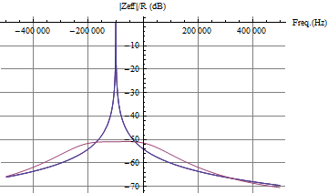
RF feedback on the Crab Cavity
1 μs loop delay
RF feedback gain = 400 linear
The open loop phase must be changed with the detuning. Not a problem. We do similar adjustment for the ACS, when changing Main Coupler Position
Cavity impedance with and without RF feedback.
Left: situation in physics with CC on tune
Right: situation with CC detuned by -100 kHz

Slide 9
The critical parameter is the loop delay!

Slide 10
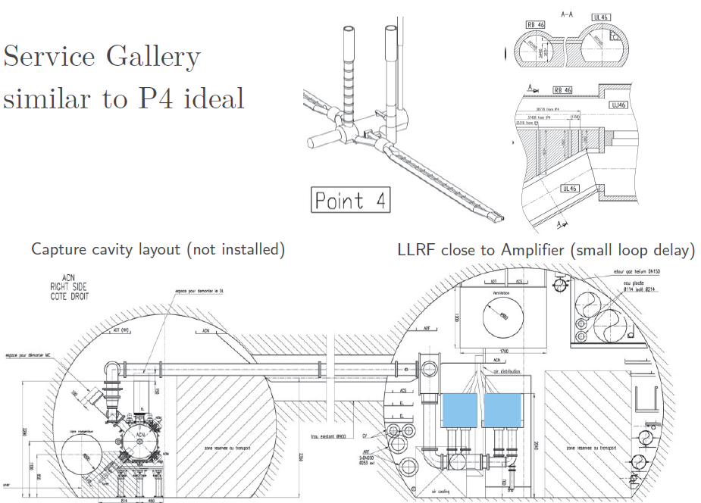
TX and LLRF in new service galleries?
Dig-out a short gallery running parallel to the CC on both sides of IP1 and IP5 for the RF power and LL

Slide 11
Fortunately The instability threshold used above is very conservative

Slide 12
NB resonator, coupled bunch instability growth rate
Transverse resonator impedance (Ω/m)
The growth rate and tune shift of coupled-bunch mode l (dipole only) can be computed from the cavity impedance
With ω=(p M+l) ω_{rev}+ω_{b}
With 25 ns bunch spacing (M=3564, h=35640), and a resonance around 400 MHz, with BW well below 40 MHz, the infinite sum reduces to two terms only: ω ≈ ±ω_{RF} (p= ±10)

Slide 13
The infinite sum reduces to
Using the symmetry of the transverse impedance
We can rewrite
The growth rate is the difference between real impedance on the two ±(l ω_{rev}+ω_{b}) sidebands of the ω_{RF}
For example, with Q_{b}=60.3, the growth rate of mode l = -60 is computed from the difference between the real part of the impedance at ±0.3 ω_{rev}
The growth rate is much reduced if the effective impedance is symmetric around ω_{RF}

Slide 14
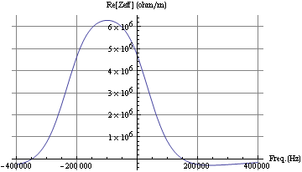
RF feedback on the Crab Cavity
Q_{L}=10⁶, R/Q=300 Ω, 1 μs loop delay
RF feedback gain = 400 linear
Real part of the cavity impedance with RF feedback.
Left: situation in physics with CC on tune
Right: situation with CC detuned by -100 kHz
Very important reduction to be expected in physics
Smaller reduction when the cavity is detuned

Slide 15
More PRECISE calculations needed… So what if the impedance is still too high?
Risky when moving the cavity from detuned to tune.
SPS commissioning will give experimental data

Slide 16
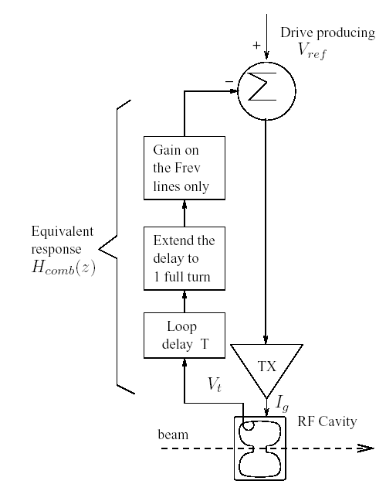
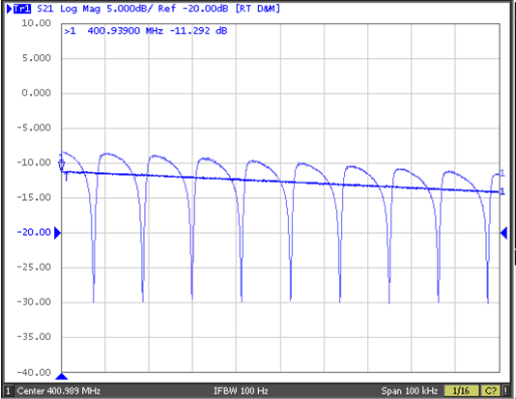
Longitudinal: One-Turn delay feedback (OTFB)
The One-Turn delay Feedback (OTFB) produces gain only around the revolution frequency harmonics
It further reduces the transient beam loading and effective cavity impedance (factor of 10)
With the One-Turn delay feedback on the LHC ACS cavities we have gained another factor 10 in impedance reduction on the revolution sidebands resulting in a 350-fold reduction (Q_{L}=60k). The 21.6 MΩ are reduced to 0.06 MΩ.
Effective Cavity Impedance with RF feedback alone (smooth trace) and with the addition of the OTFB (comb). The cavity centre frequency is 400.789 MHz. We look at a band offset by +200 kHz to +300 kHz. Frev= 11 KHz. The OTFB provides ~ 20 dB additional impedance reduction on the Frev lines.

Slide 17
CAN this be used on the crab cavities?
Yes…. the Betatron Comb filter

Slide 18
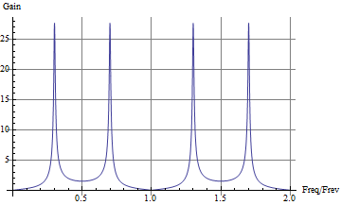
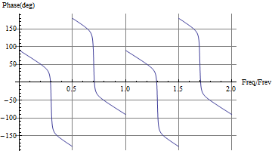
Transverse: Betatron Comb filter
One-turn delay filter with gain on the betatron bands
To keep 10 dB gain margin, the gain on the betatron lines is limited to ~ 6 linear (16 dB)
2 N Poles on the betatron frequencies
Reduction of noise PSD where the beam responds
Reduction of the effective cavity impedance thereby improving transverse stability
Zeros on the revolution frequency lines
No power wasted in transient beam loading compensation with off centered beam
Betatron comb filter response with a=31/32 and non-integer Q=0.3. Observe the high gain and zero phase shift at (n ±0.3) frev
Some details in CC11 presentation. Study ongoing…
Will be tested in the SPS

Slide 19
Keeping crabbing and uncrabbing kicks equal
Improve precision and compensate for a single-cavity fault

Slide 20
Coupled feedback
For perfect closure of the tilt and to minimize the overall effect of one-cavity fault, we look at the possibility of coupled feedback
Taking a pair of cavities on each side of a given IP (crabbing and un-crabbing), we wish to keep the two voltages equal
That can be done if the FDBK for a given TX considers also the voltage difference V₂-V₁
Two cavities on opposite sides of an IP: We wish to regulate the individual voltages AND the voltage difference.
Some details in CC11 presentation. Study ongoing…
Commission in the SPS with 2 cavities

Slide 21
LLRF Architecture

Slide 22
LHC layout
Main (ACS)
RF system
Crab Cavity
RF
Crab
Cavity
RF

Slide 23
The accelerating (ACS) system (IP4)

Slide 24
The Crab Cavity systems (IP1 and IP5)

Slide 25
RF noise

Slide 26
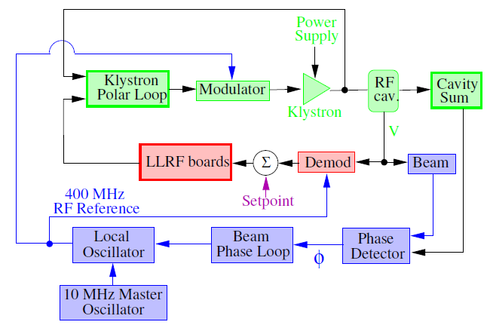
Beam Control plus Cavity Controller
Two major noise sources:
The RF reference noise from the Beam Control, introduced during the modulation/demodulation process in the Cavity Controller. This noise is coherently injected in all eight cavities. It will be the reference 400 MHz for CC as well
The noise injected in the Cavity Controller electronics and the Klystron noise. This noise is uncorrelated from cavity to cavity

Slide 27
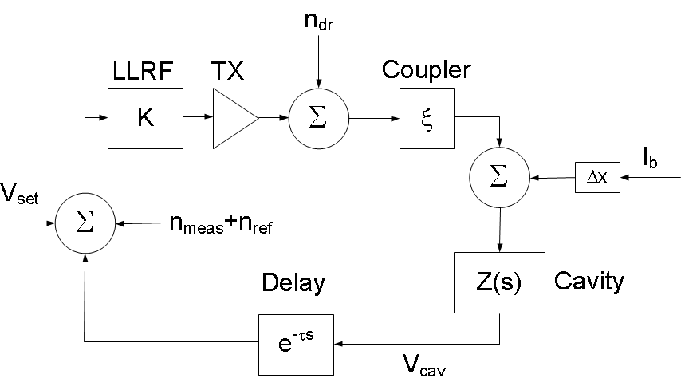
Cavity RF Noise
RF feedback noise sources:
The RF reference noise n_{ref}
The demodulator noise (measurement noise) n_{meas}
The TX (driver) noise n_{dr} (process noise). It includes also the LLRF noise not related to the demodulator
The Beam Loading I_{b} Δx
We get
Main coupler
Closed Loop response CL(s)
Equal to ~1 in the CL BW
Increase of K increases the BW
Within the BW, reference noise and measurement noise are reproduced in the cavity field
Beam Loading response = effective cavity impedance Zeff(s)
Equal to ~1/KG in the CL BW
Increase of K decreases Zeff within the CL BW
Within the CL BW, TX noise and beam loading are reduced by the Open Loop gain KG

Slide 28
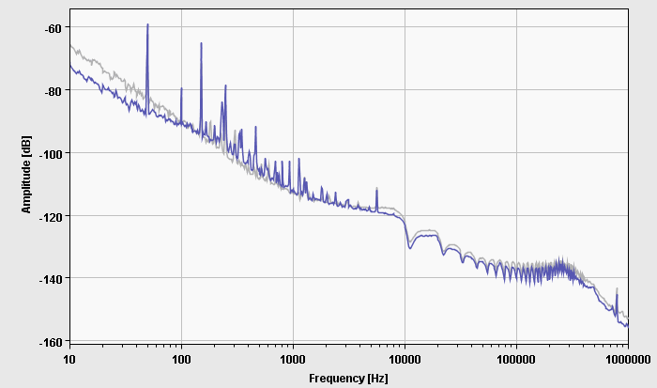
RF phase noise without beam. ACS
In the 10kHz-400 kHz range the noise level is defined by the demodulation of the antenna signal in the RFfdbk and OTFB loops. Flat between -135 and -140 dBc/Hz. n_{meas} noise
Noise in the 10Hz-1kHz range is caused by the VCXO limited Q (-20 dB/decade). n_{ref} noise
50 Hz and harmonics come from the klystron HV ripples. The klystron loop reduces them by 50 dB up to 600Hz. Fs crosses 50 Hz during the ramp [55 Hz – 26 Hz]. n_{dr} noise
The dips at multiple of Frev are the action of the OTFB that increases regulation gain and decreases noise level
SSB phase noise Power Spectral Density in dBc/Hz. RF sum of the 8 cavities beam 1. No beam but physics conditions (12 MV). The grey trace corresponds to injection conditions (6 MV). Out of loop measurement [3].
In the transverse plane the first betatron band is at 3 kHz. Reference noise is not an issue. The performances will be defined by TX noise and measurement noise

Slide 29
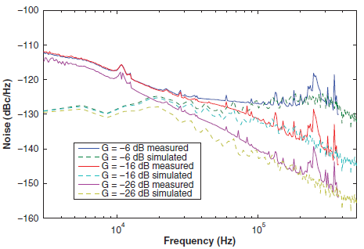
Scaling the ACS to crab
The beam will sample the noise in all betatron side-bands
The integrated effect of the measurement noise increases with the closed loop BW, that is proportional to the feedback gain
SSB phase noise in an ACS cavity with varying feedback gains. Measured and calculated [3]
Assume a SSB phase noise of L= -135 dBc/Hz or S= 6.3E-14 rad²/Hz
Now summing the noise PSD from DC to + 300 kHz over all betatron bands, we get 300/11 x 2 x 6.3E-14 rad²/Hz =3.4E-12 rad²/Hz from DC to the revolution frequency
Conclusion: a “copy” of the LHC ACS design (300 kW klystron !) would generate 3.7E-8 rad² white noise
That is 2E-4 rad rms or 1.1E-2 deg rms phase noise @ 400 MHz

Slide 30
Trade-off
A weak coupling (large Q_{L})
Reduces the effect of TX and LLRF noise. Good
A large feedback gain
Reduces the instability growth rates. Good
Limits the effect of TX and LLRF noise. Good
Increases the integrated effect of measurement noise by increasing the BW. Bad
Trade-off required
Will depend on the TX noise
Importance of the SPS test-bench

Slide 31
A WORD ON RF POWER
Choice of Q_{L}

Slide 32
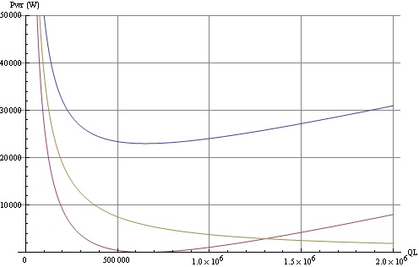
RF Power vs. Q_{L}
For 1 mm offset, the range of acceptable Q_{L} (P < 30 kW) is
2.5 10⁵< Q_{L} <1.8 10⁶ for R/Q=300 Ω
8 10⁴< Q_{L} <6 10⁵ for R/Q=900 Ω
Low values preferred for tuning (microphonics). BW should span at least 10 tuning steps
TX linked to the cavity via a circulator. 3 MV RF. R/Q = 300 Ω. 1.1 A DC current, 1 ns 4σ bunch length (1.8 A RF component of beam current). Cavity on tune.
Yellow trace: beam centered
Blue trace: x=+1 mm offset
Red trace: x=-1 mm offset

Slide 33
Operational scenario

Slide 34
Operational scenario (revisited)
Strong RF feedback and tune controls are ON at all time
During filling, ramping or operation with transparent crab cavities, we detune the cavity but keep a small field requested for the active Tuning system. As the crabbing kick is provided by three cavities we can use counter-phasing to make the total field invisible to the beam. The RF feedback is used with the cavity detuned to provide stability and keep the Beam Induced Voltage zero if the beam is off-centered. We can use the demanded TX power as a measurement of beam loading to guide the beam centering.
ON flat top
Reduce the detuning while keeping counter-phasing so that the total voltage is zero. The RF feedback keeps the cavity impedance small (beam stability) and compensates for the beam loading as each cavity moves to resonance
Once the cavity detuning has been reduced to zero, we drive counter-phasing to zero. Any luminosity leveling scheme is possible by synchronously changing the voltage in all crab cavities as desired.

Slide 35
HARDWARE

Slide 36
Interconnection with the paired cavity(ies) Coupled feedback
Gain increased on the betatron bands
Measurement of bunch phase modulation
Field control fully integrated with the rest of the LHC by using standard FGCs (slides 22-23)
For each Crab Cavity we have a Cavity Controller including:
An RF Feedback Loop for noise and beam loading control
A TX Polar Loop to reduce the TX noise and stabilize its gain/phase shift
A Tuner Loop to shift the cavity to a detuned position during filling and ramping. Then smoothly bring the cavity on-tune with beam for physics
A field Set Point for precise control of the cavity field.

Slide 37
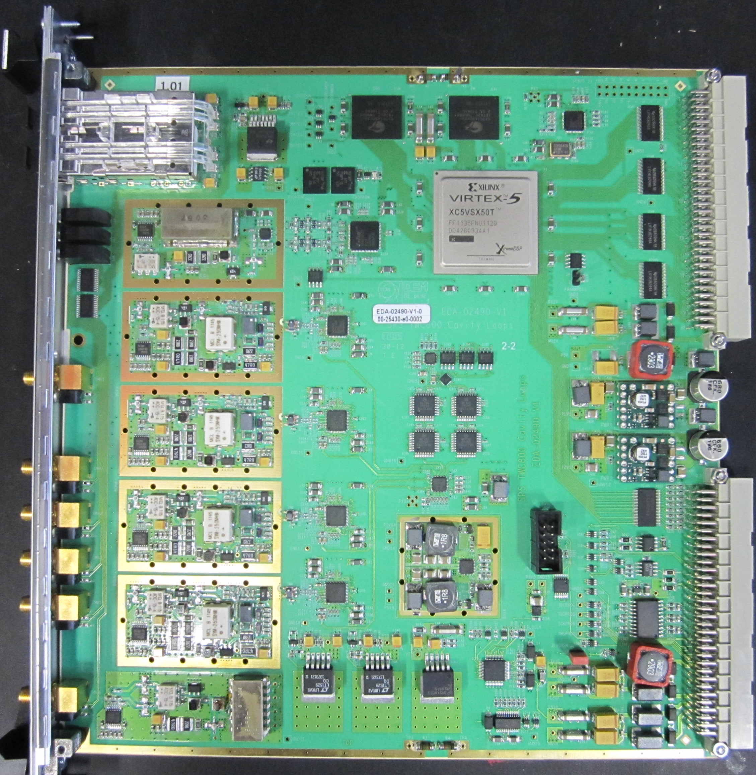
SPS 800 MHz TWC prototype
G. Hagmann BE-RF-FB
designer
SRAM 2x8 Mbyte for diagnostics
2 x Duplex Optical Serial Links
2 in & 2 out
2Gbits/s
(≤3.2Gbits/s)
Xilinx Virtex 5 SX
VME P1 backplane for slow controls/readout
SSB Modulator
IF (I & Q) ≈25MHz
Dual TxDac 16 bits
Dedicated backplane (P2):
Power Supply
Clocks
Interlocks
…
RF Demodulator
RF&LO mixing
IF ≈25MHz
14 bits ADC
Fs=4·IF ≈100MHz
4x
LO Distribution

Slide 38
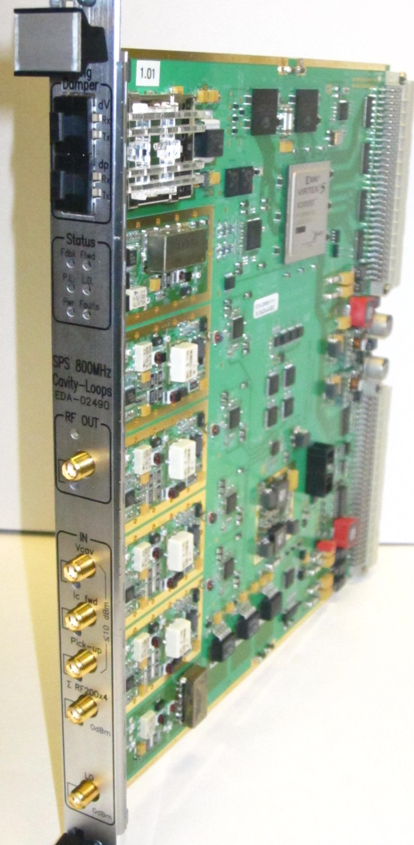
SPS 800 MHz TWC prototype
2 x Duplex Optical Serial links
2 inputs
2 outputs
Status LED
RF output
RF inputs (4x)
G. Hagmann BE-RF-FB
designer
LO input

Slide 39
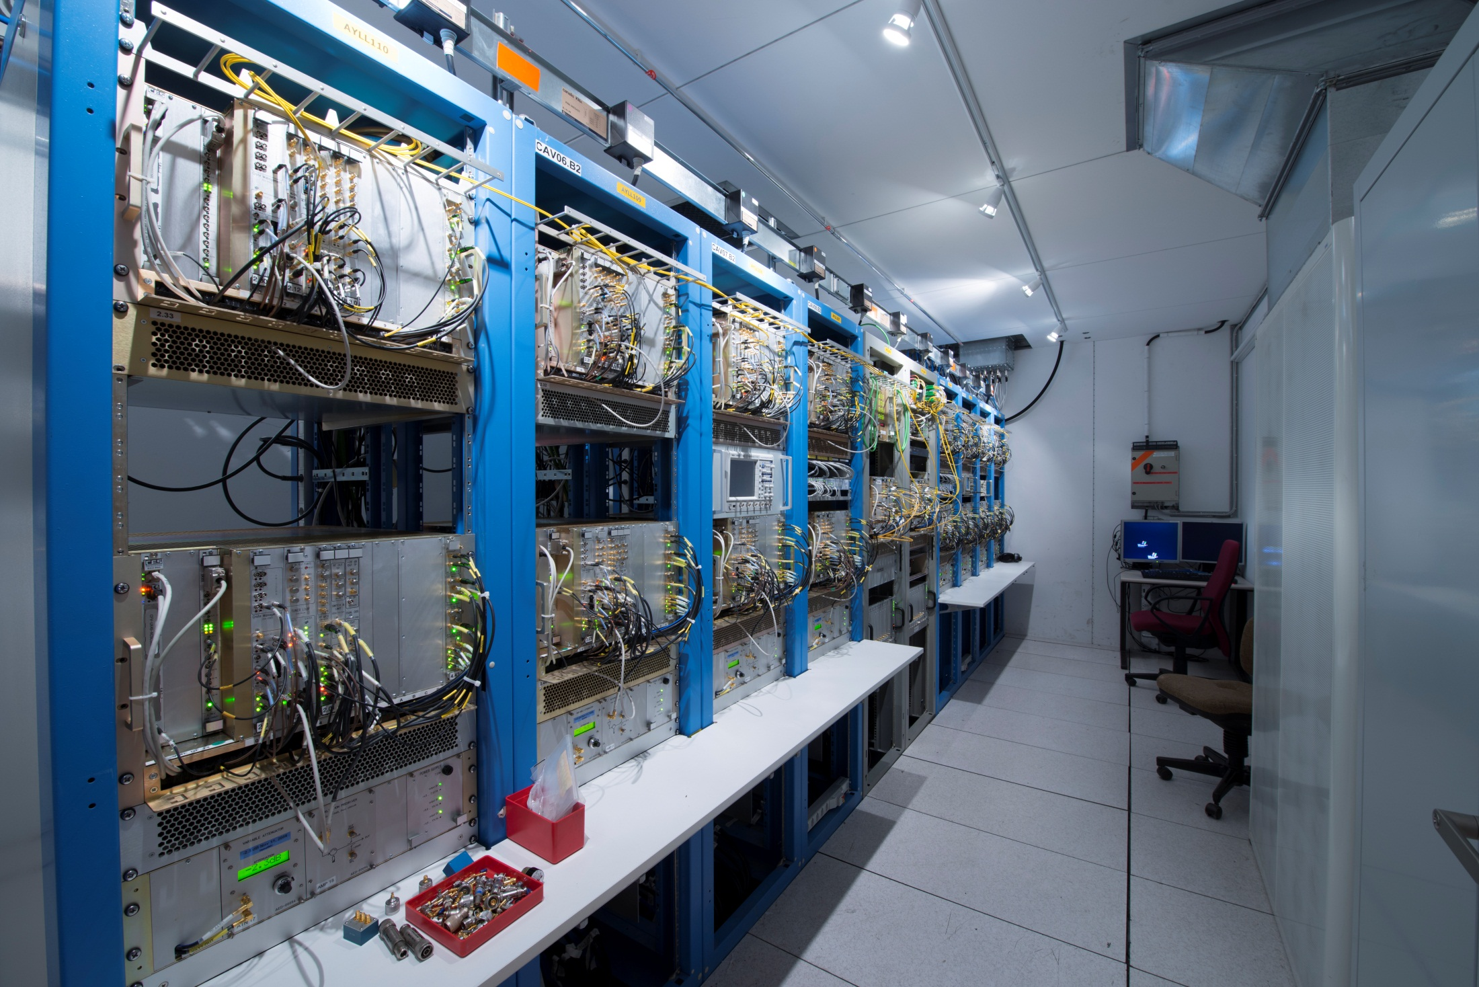
ACS LLRF. 1 rack/ 2 VME crates, per cavity in a Faraday Cage in the UX45 cavern

Slide 40
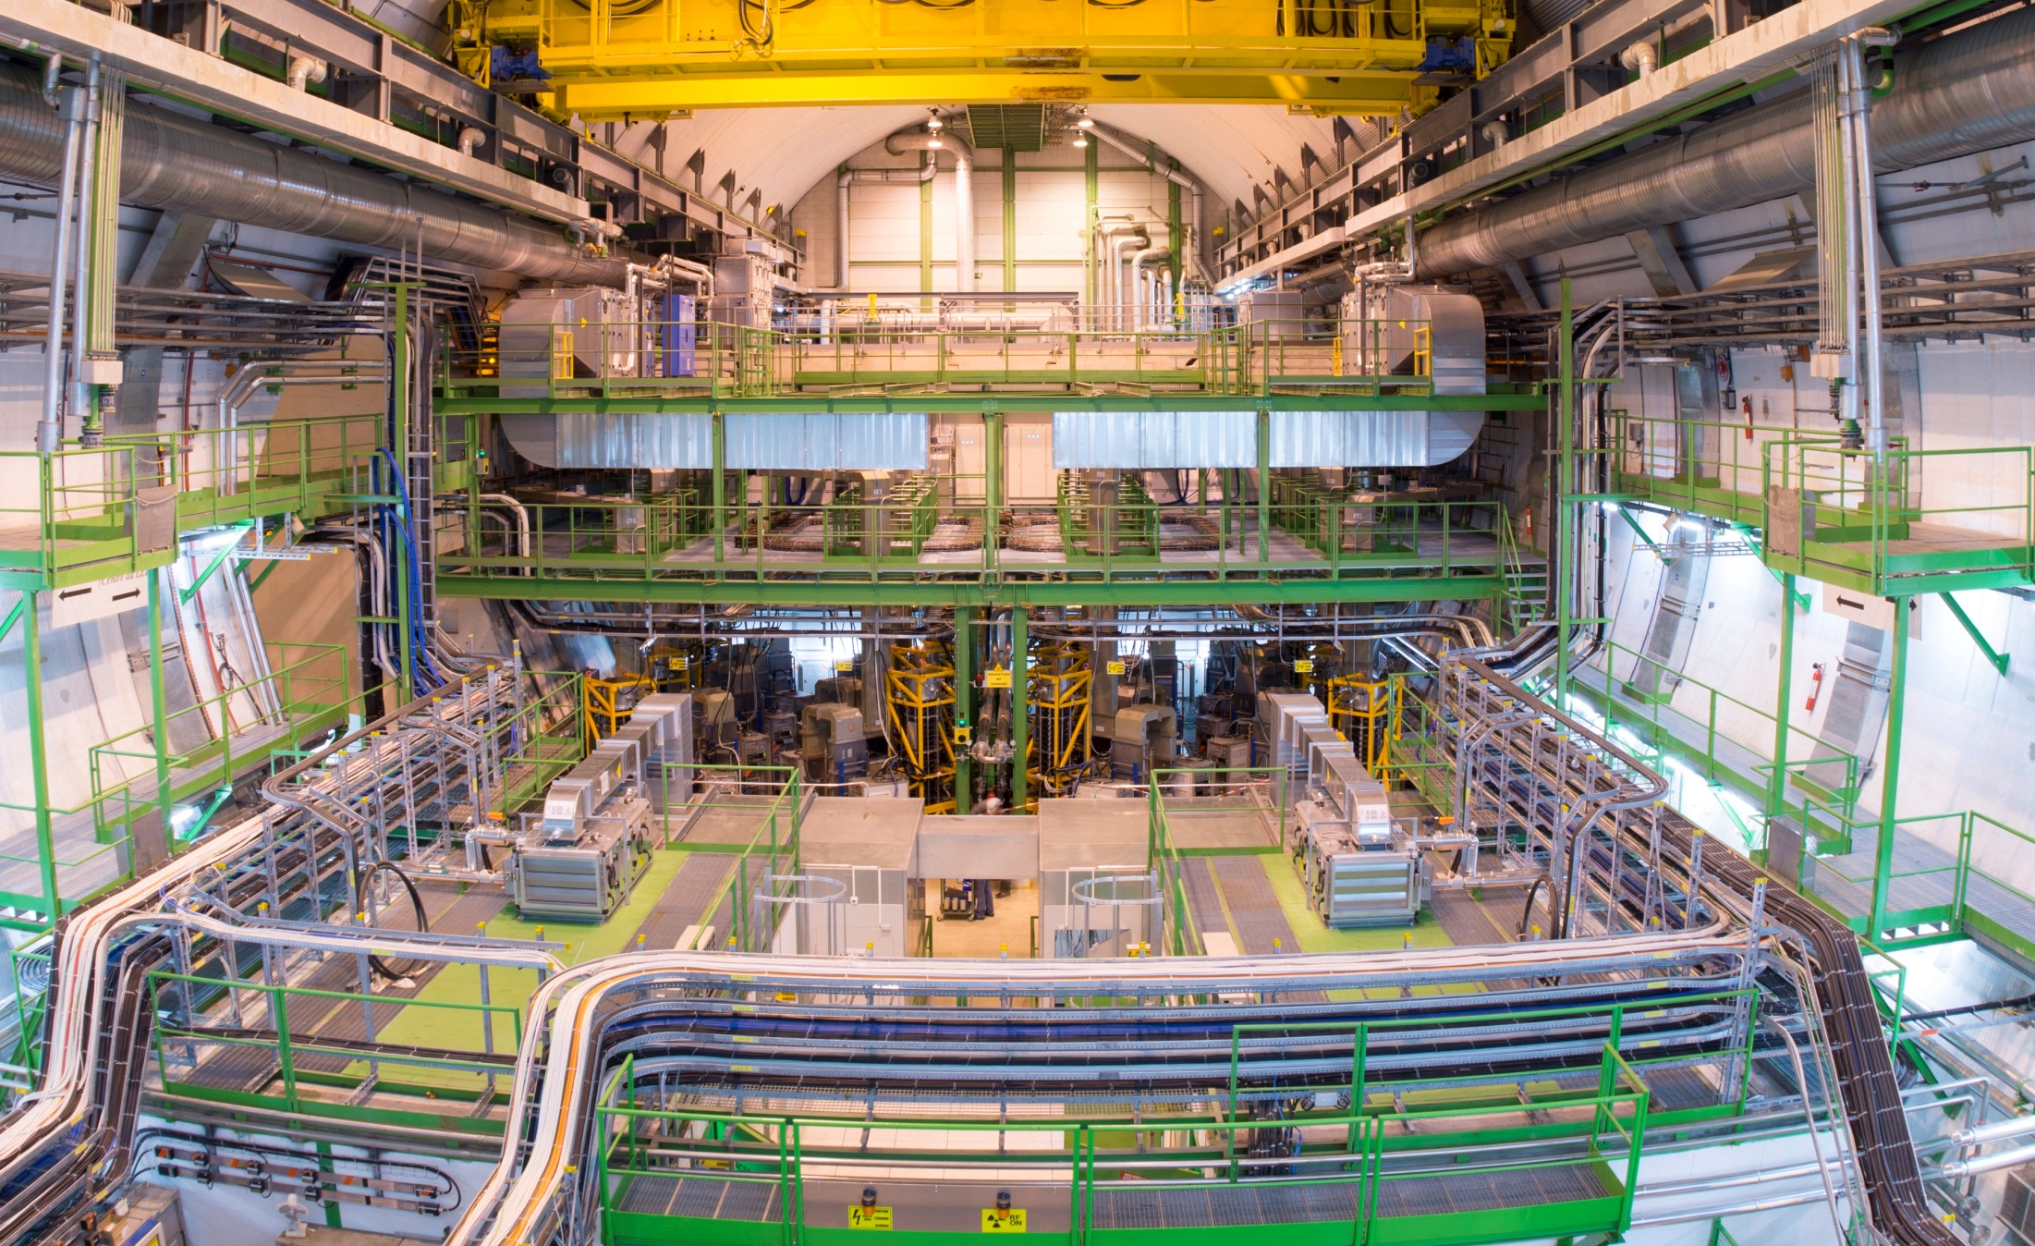
Concrete shielding around the beam line
Waveguides to cavities
Klystrons
Faraday cages with LLRF electronics
ACS RF in the UX45 cavern

Slide 41
conclusions

Slide 42
We propose to use a strong RF feedback around each CC
It decreases the effective impedance. Precise calculations needed.
It strongly reduces the TX noise
It provides for precise control of the crabbing voltage
It calls for a compact layout: “service” galleries
A MIMO feedback combines the signal from crabbing and un-crabbing cavities for perfect closure of the tilt, and “some” compensation in case of one-cavity failure
RF noise optimization depends on the importance of TX noise compared to measurement (Antenna demodulation) noise
The tuning with very low field (much smaller than the beam loading) must be studied
The SPS test is essential

Slide 43
Thank you for your attention

Slide 44
References

Slide 45
[1] A. Burov, Beam Stability with Crab Cavities, LHC-CC11
[2] D. Boussard, Control of Cavities with High Beam Loading, IEEE Transaction on Nuclear Sciences, Oct. 1984
[3] T. Mastoridis et al., Radio Frequency noise effects on the CERN Large Hadron Collider beam diffusion, PRST AB, 14, 092802 (2011)

Slide 46
Back-up slides

Slide 47
State-space model
We start with the simplest model
Cavities on-tune represented as first order linear difference equation (LPF)
TX represented by a constant gain
In matrix form
We want to design a linear regulator (matrix K) , that is a proportional feedback generating corrections on I(n) from measurement of V(n)
With the regulator, the state equations become
The feedback changes the state-transition matrix
The choice of the K matrix coefficients can be done using the Linear Quadratic Regulator (LQR) theory

Slide 48
Linear Quadratic Regulator LQR
Assume that the state is displaced at time zero (non-zero initial cavity voltage), and observe the transient while the system is brought back to the zero state
Let us define a cost function that is a quadratic function of the state variables (V) and the regulation input (I)
With the matrix Q and R, we give different weight to the state error (Q) and the needed regulation power (R)
We will use a diagonal R matrix so that the second term is proportional to the klystron power needed in the restoring transient
With the Q matrix elements we can give more or less coupling between the two feedbacks. With a diagonal matrix, the feedbacks are fully decoupled
By balancing q₀ and q₁ in the matrix below, we give more importance to the voltage difference

Slide 49
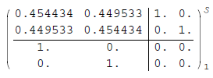
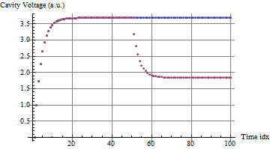
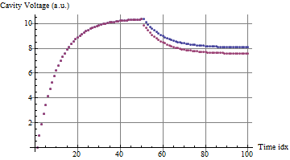
Independent feedbacks
Strongly coupled feedbacks
Diagonal A matrix
Large off-diagonal values -> strong coupling
Kly1 ignores Cav2 voltage drop
Kly1 tries to track Cav2 voltage drop
Cavity 1
Cavity2
Cavity voltage following a unit step of both klystrons at time zero, and a half-unit step reduction of klystron 2 alone at time 50.
When observing one loop at the time, the regulation with independent klystrons is better: It is 3 times faster and the static error is three times smaller.
When the transient is on one klystron only (kly2, red), there is no compensation on cavity 1 for the independent feedbacks, resulting in a static error of ~2. With the coupled feedbacks, kly1 (blue) reacts to the drop in cavity 2 voltage and the final voltage difference is ~ 0.5.
Study ongoing…
Commission in the SPS

Slide 51
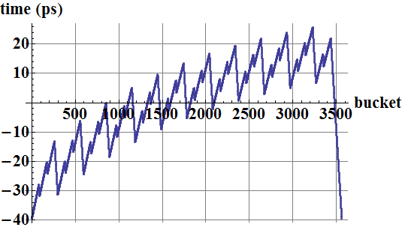
RF phase modulation
In physics
We will accept the modulation of the cavity phase by the beam current (transient beam loading) and adapt the voltage set point for each bunch accordingly
The klystron drive is kept constant over one turn (amplitude and phase)
The cavity is detuned so that the klystron current is aligned with the average cavity voltage
Needed klystron power becomes independent of the beam current. For Q_{L}=60k, we need 105 kW only for 12 MV total
Stability is not modified: we keep the strong RFfdbk and OTFB
The resulting displacement of the luminous region is acceptable
During filling
It is desirable to keep the cavity phase constant for clean capture. Thanks to the reduced total voltage (6 MV) the present scheme can be kept with ultimate.
Modulation of the cavity phase by the transient beam loading in physics. 2835 bunches, 1.7 10¹¹ p/bunch, 1.5 MV/cavity, QL=60k, full detuning (-7.8 kHz).

Slide 52
emittance growth Measurement

Slide 53
Scaling the ACS to crab
The beam will sample the noise in all betatron side-bands
The integrated effect of the measurement noise increases with the closed loop BW, that is proportional to the feedback gain
SSB phase noise in an ACS cavity with varying feedback gains. Measured and calculated [3]
Assume a SSB phase noise of L= -135 dBc/Hz or S= 6.3E-14 rad²/Hz
Now summing the noise PSD from DC to + 300 kHz over all betatron bands, we get 300/11 x 2 x 6.3E-14 rad²/Hz =3.4E-12 rad²/Hz from DC to the revolution frequency
Conclusion: a “copy” of the LHC ACS design (300 kW klystron !) would generate 3.7E-8 rad² white noise
That is 2E-4 rad rms or 1.1E-2 deg rms phase noise @ 400 MHz

Slide 54
How can we measure the effect of RF noise if it is not dominant in the emittance growth?
We faced a similar problem in the LHC as longitudinal emittance growth driven by IBS is much stronger than the growth caused by RF noise
Measurements were done with ions at 3.5 Z TeV in Nov 2010 with four equi-distant bunches per ring

Slide 55
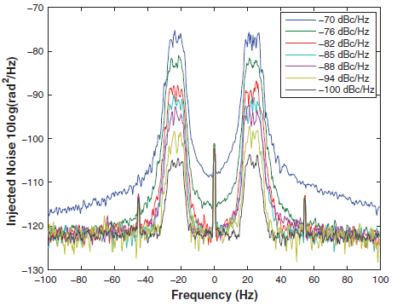
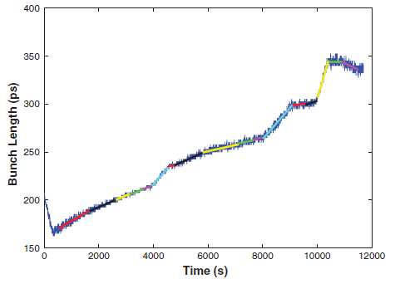
Phase noise was injected in one RF cavity, with a bandwidth of 10 Hz, centered on the first revolution band: f_{rev}±f_{s}
The power of the injected noise was varied during the test
Bunch length was monitored
With large noise power, the effect became dominant, allowing for a good calibration of emittance growth (slope of bunch lengthening) vs RF noise power
f_{rev}
Will be done on the SPS test-bench

