Slide 2
An RF Low-level Beam Control system for PS Booster built in VME VXS using FMC mezzanines
M. E. Angoletta, A. Blas, A. Butterworth, A. Findlay, M. Jaussi, P. Leinonen, T. Levens, J. Molendijk, J. Sanchez Quesada, J. Simonin (CERN)
U. Dorda, S. Kouzue, C. Schmitzer‎ (MedAustron)
J. Molendijk, RFTech, March 27th 2013

Slide 3
Outline
Digital LLRF Principle
Hardware Architecture
  VXS Standard
  FMC Standard
  VXS Switch
  VXS-DSP-FMC Carrier
Firmware Architecture
  Wishbone SoC Interconnection Architecture for Portable IP Cores
  Memory map management
  Generic DSP to VME interface
  Sushi Train
  FMC IP-cores
Project Status

Slide 4
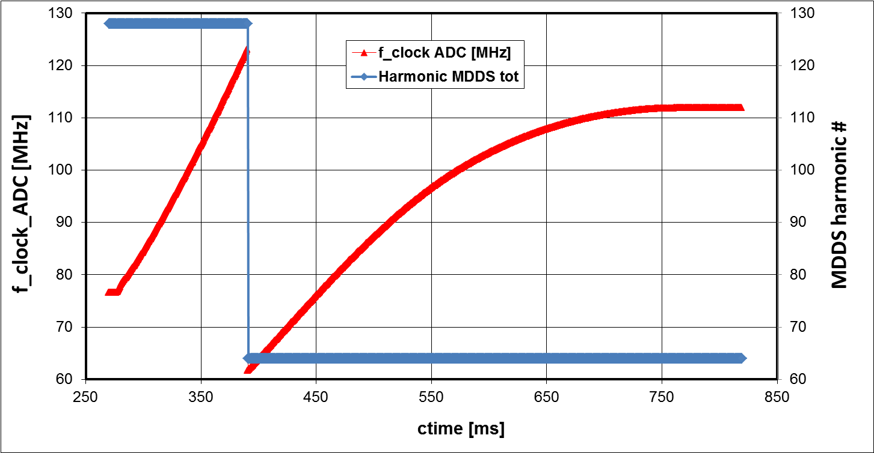
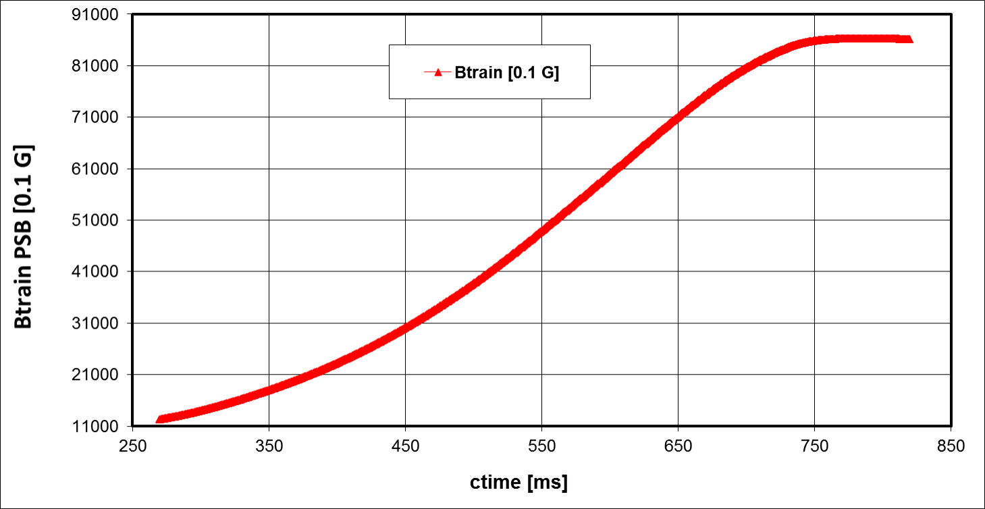
Digital LLRF
Principle

Slide 5
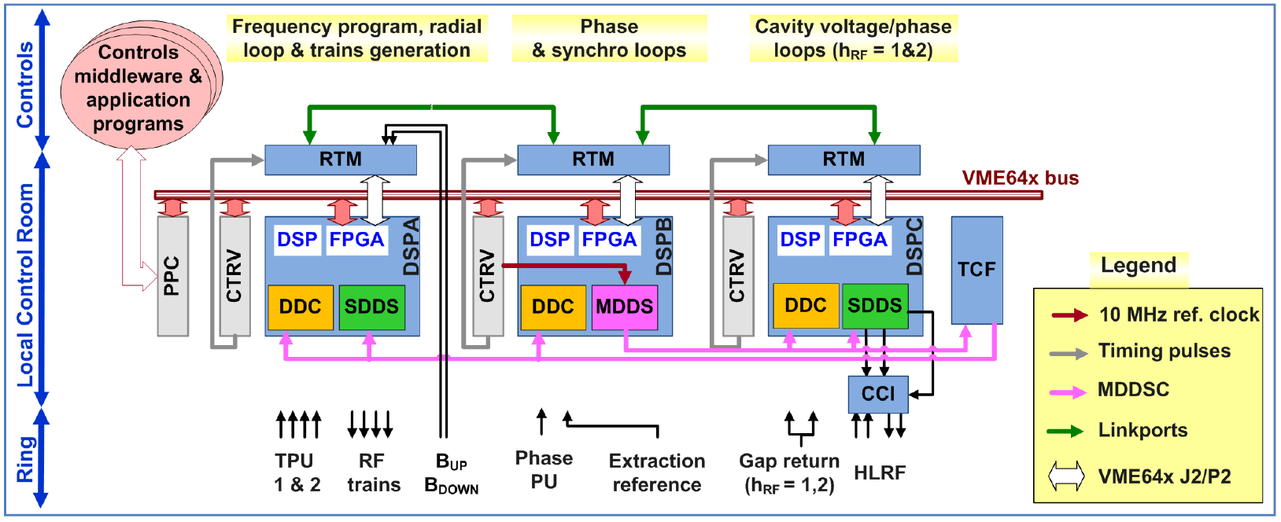
Digital LLRF Principle
The original DSP based Beam Control system [1, 2, 3, 4]
Until long shutdown 1 successfully operational in LEIR
Weak points:
Inter DSP communication through panel mounted link-ports
DSP memory and VME share the same bus (conflicts operation)
Moderate DSP “Fast loop” cycle time 15 μs (DSP Clock 80 MHz + Assembly programming).
RF Clock and TAG distribution through external distribution
The electronics has become obsolete (DSP FPGAs ~2003)
Non standard mezzanine solution with (too) limited on-board FPGA resources

Slide 6

Digital LLRF Principle
The new Beam Control system
Characteristics:
Unlimited inter DSP communication through Standard VXS [5] backplane
All players DSP etc. have independent control interfaces
DSP “Fast loop” cycle time 5 μs (DSP Clock 400 MHz + C programming).
RF Clock and TAG distribution through VXS fabric
Recent electronics (DSP FPGAs etc.)
Standard FMC [7] mezzanine solution using powerful carrier FPGA resources (Virtex 5 specialized for DSP tasks)
Built-in remote flashing capability for both the FPGAs as well as the DSP

Slide 7
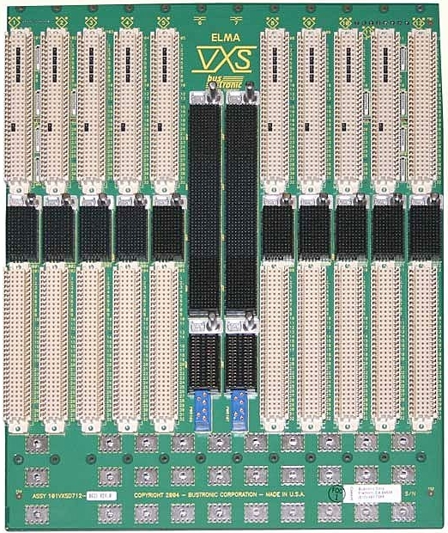
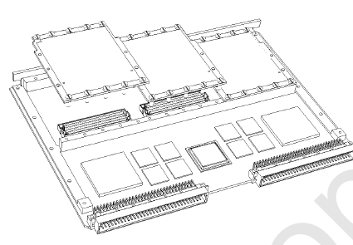
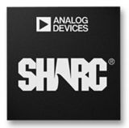
Hardware Architecture
VXS [5]
+
+
= VXS-DSP-FMC-Carrier

Slide 8
VXS Standard
VXS = VMEbus Switched Serial Standard
  Standard ANSI / VITA 41.0 [5]
  Interconnect from payload slots to switch slot(s)
    High bandwidth up-to 3.125 Gbps supported
    Low latency point to point
    Reduced real-estate for interconnects
VXS Topology

Slide 9
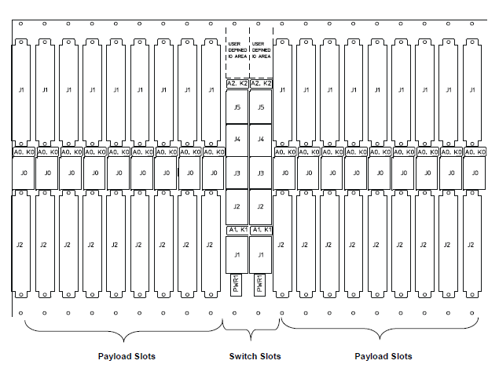
VXS Standard
  2 (A and B) x 4 full-duplex Giga-bit Serial links per payload slot
  Switch Slot A connects to all “A” links of all Payload slots.
  Similar for B
  16 full-duplex interconnects between both Switch Slots
A
B
A
B

Slide 10
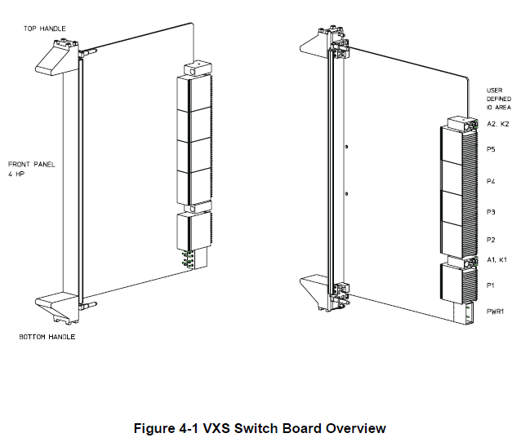
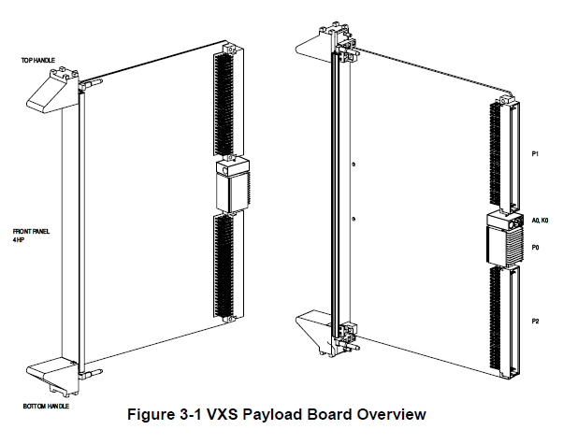
VXS Payload & Switch Board
No VME interface
  The Connectors support
    High-speed differential signaling +
    I²C [6] Control link (Payload to Switch board)

Slide 11
VXS Switch
Agnostic X-bar
With Multicast

Slide 12
Clock & TAG routing across VXS
  Typical Configuration
    The Payload ports with the MDDS is driving RF Clock and TAG towards the X-bar switch
    RF Clock & TAG is driven to all used Payload ports by X-bar switch (Multicast)
    RF Clock & TAG distributors (eSATA outputs) driven by X-bar switch

Slide 13
FMC Standard
  FPGA Mezzanine Card standard ANSI / VITA 57.1 [7]
  Two flavors
    Low-pin count connector
      80 pins = 34 diff pairs* (68 single-ended) single bank IO voltage.
    High-pin count connector
      400 pins = Bank A: 58 diff pairs* AND Bank B: 22 diff pairs* with separate IO voltage per Bank
    FMC Bank A IO (and FPGA VCCO) programmable voltage is supplied by the FMC Carrier (VAdj) as requested by mezzanine IPMI [8] ROM.
    FMC Bank B IO (and FPGA VCCO) is powered from the FMC mezzanine (VIO_B_M2C). Also declared by the mezzanine IPMI ROM.
Notes:
* Or: single-ended = 2 * number of diff pairs
IPMI = Intelligent Platform Management System

Slide 14
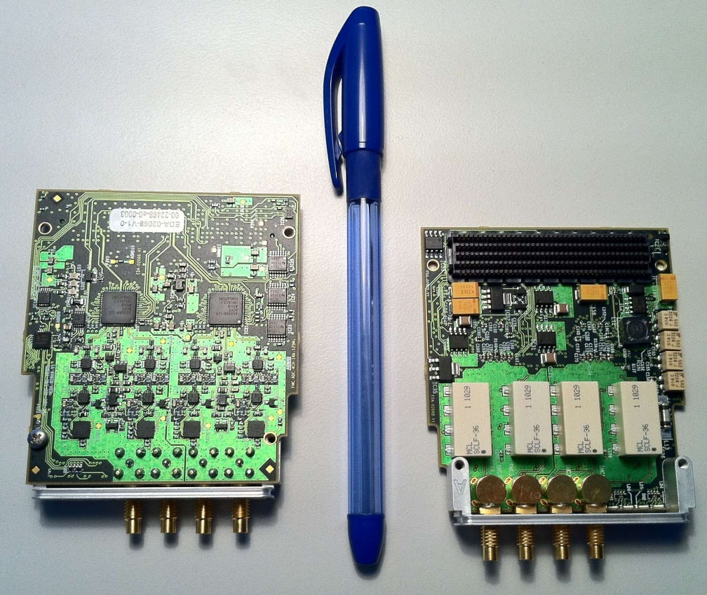
FMC Modules for RF Low-level
  High Pin Count FMCs
    ADC 16 bit 125 MSPS (DDC)
    DAC 16 bit 250 MSPS (SDDS)
    MDDS (Master Direct Digital Synthesizer)
  See presentation:
  FPGA Mezzanine Card standard IO-modules for the LLRF beam control system of CERN’s PS Booster and MedAustron synchrotron [11].
  P. Leinonen, J. Sanchez Quesada (CERN), RFTech 2013

Slide 15
VXS DSP FMC Carrier
  A VME64x board with VXS
    VXS bank A banks fully equipped with 4 full-duplex channels, bank B with 2
    Link-speed 2 Gbps.
  Two High-pin count FMC sites
    Both with independently programmable Vadj
    ~80 differential I/O pairs per FMC site +
    4 full-duplex Serial Giga-bit links to FMC_FPGA per FMC site.
  Two Virtex5 FPGAs: XC5VLX110T / XC5VSX95T (FF1136)
    Main FPGA manages the communication with: FMC FPGA, VME64x, DSP, VXS.
    FMC FPGA hosts the FMC related code, interfaces with both FMCs, communicates to the Main FPGA via 8 Serial Giga-bit links and a parallel bus.
  A Sharc DSP 400MHz: ADSP-21369
    A16 / D32 interface with Main FPGA.
    Alternate communication ports connected to Main FPGA.
  Memory Banks
    Two 4 M x 18 @ 100 MSPS (CY7C1472V33)
    Two 1 M x 4 x 18 @ F-RF MSPS (CY7C1474V33)
  RF Clock and Tag distribution.

Slide 16
VXS DSP FMC Carrier
Power Supplies
& Trigger in / out
Via RTM

Slide 17
VXS DSP FMC Carrier

Slide 18
FMC FPGA Power Domains
Giga-bit
Interface
Pins in white

Slide 19
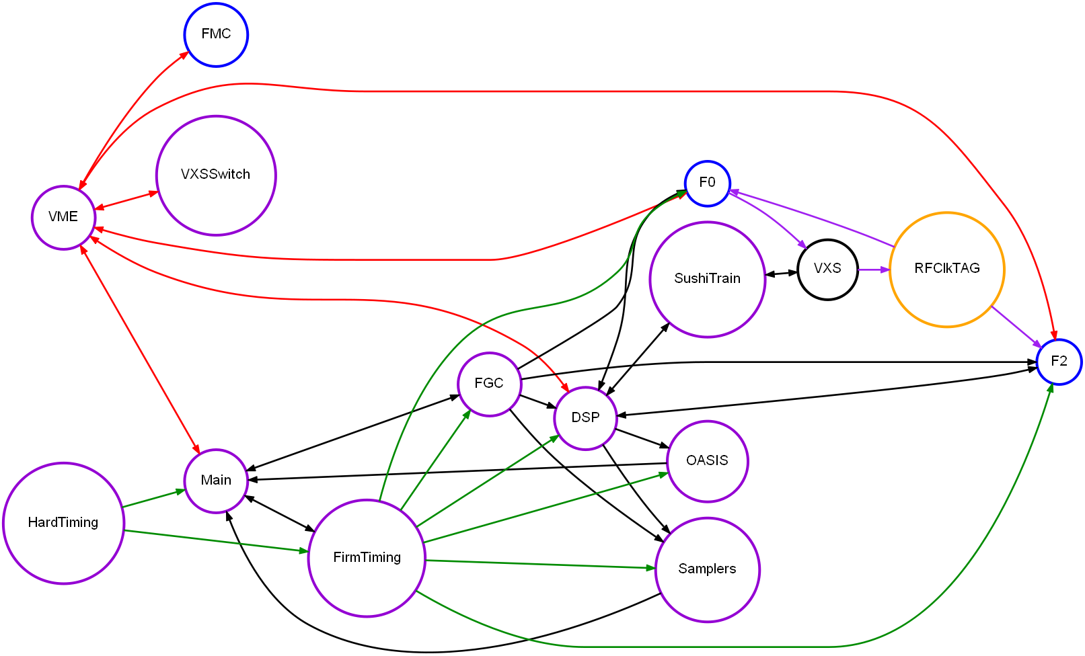
Firmware Architecture
Links:
VME Wishbone
Timing
Data
RF Clock & TAG
Nodes:
Main FPGA
FMC FPGA
Clock Distributor
VXS Backplane
Functional interconnections
Controls
Inter-board
Communication
Function
Generators
Observation
Systems

Slide 20


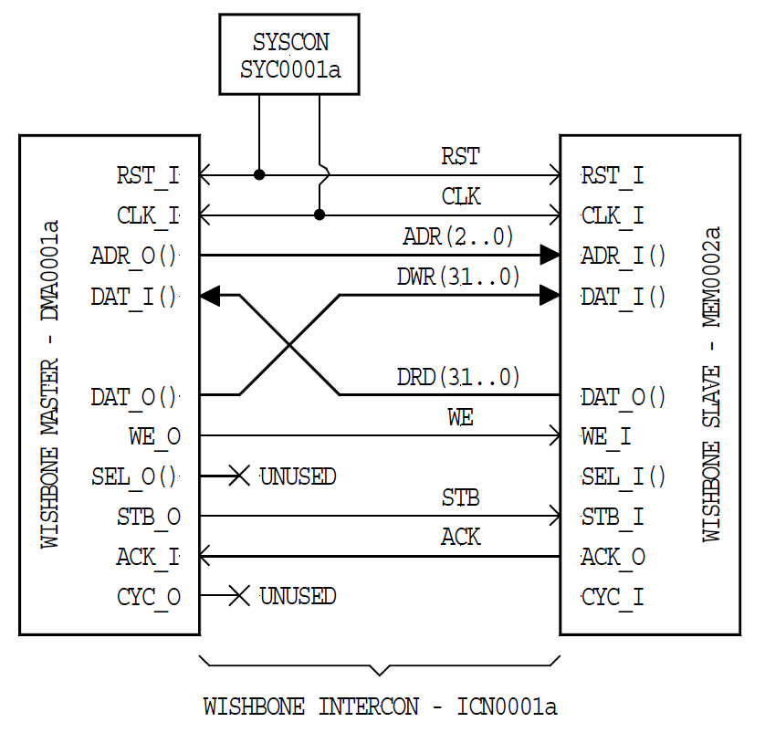
Wishbone
SoC Interconnection Architecture for Portable IP Cores [9]
Simplifies design reuse & integration
Common standardized GP interface
Decouples IP cores
Divide & Rule: more control interfaces easier to manage
Easily extendable to seamlessly interconnect FPGAs
Enables individual software driver (per core) support
Master
Slaves
VME

Slide 21
Memory Map management
The Cheburashka memory map tool [10] has been created to achieve:
  Common definition of memory maps for FPGAs, CPU Software, DSPs
  Automatically generate the memory map VHDL package as well as the register control block VHDL (using GENA [10]).
  Automatic creation of the Linux CPU device driver configuration
  Automatic creation of a FESA class for debugging
  Support for construction nested memory maps
  Support for interface reversal (read-only to read-write and visa-versa)
  Automatic creation of DSP header files
  Integrated documentation: XML files from Cheburashka can be displayed on a web browser

Slide 22
  Generic DSP to VME interface
The FPGA implements “mail boxes”
Detailed register layout
In these memory maps
Same maps on
Either side
Interface reversed here

Slide 23
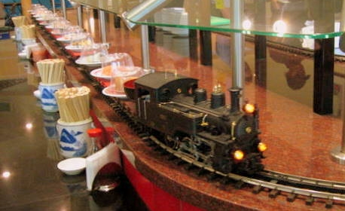
  Sushi Train
Sushi Train is a method to share information across the VXS between DSPs of different carriers
The VXS Switch daisy-chains all carriers in 2 directions with double channel bonded Giga-bit links: 32 bit@100MSPS.
A shared trigger line synchronizes the start of transmission
Each node then transmits it’s own data block (wagon) to both neighbors
Successive transmissions forward received neighbor wagons
When all nodes have all data, they retrigger a new round
During an initial (long) round the system discovers the node count
Wagons are fixed size 32 words.
Data distribution interval with 3 carriers = 540 ns
Interval with N nodes = L+(W+Sp)T x trunc(N/2)
L = Latency = 200 ns,
W = words / wagon = 32,
Sp = Spacing between wagons = 2,
T = transmission clock period = 10 ns.

Slide 24
  Sushi Train

Slide 25
FMC IP Cores
IP Cores are developed in independent version controlled libraries (collaborative design)
The FMC FPGA generic common firmware is held in a separate library
The FMC FPGA design instantiates the required IP Cores in each slot
An overall VHDL compile and generate will create the customized FMC FPGA source
Separate logic Synthesis and Place & Route projects are used for each IP Core configuration to allow using specific constraints for each case
These IP Cores are instantiated
by reference pointing at a library.
Like plugging an IC into a socket
Common FMC FPGA firmware

Slide 26
Project Status
Hardware
  Laboratory and successive tests on CERN PSB Ring 4 with a 2 board system, built in V1 hardware (VXS-DSP-FMC Carrier and VXS-Switch) have successfully demonstrated the feasibility of the new digital Low-level RF system.
  At present the 2 board system has been transferred to a MedAustron test stand where software developers start specific MedAustron software developments
  A pre-series of V2 hardware is currently under production
Firmware
  The developed FPGA firmware has now reached a workable state, much work left in the details
  Remote updating of FPGA firmware and DSP to be added
  IPMI for FMC developments has started
  Issues affecting giga-bit interface initialization success, will need attention
Software
  Test DSP code has demonstrated successful. Much more code needs to be developed for the full PSB system
  The device drivers and test FESA classes generated with help from Cheburashka work nicely in synchronism with the firmware
  A control room application will be created this year.

Slide 27
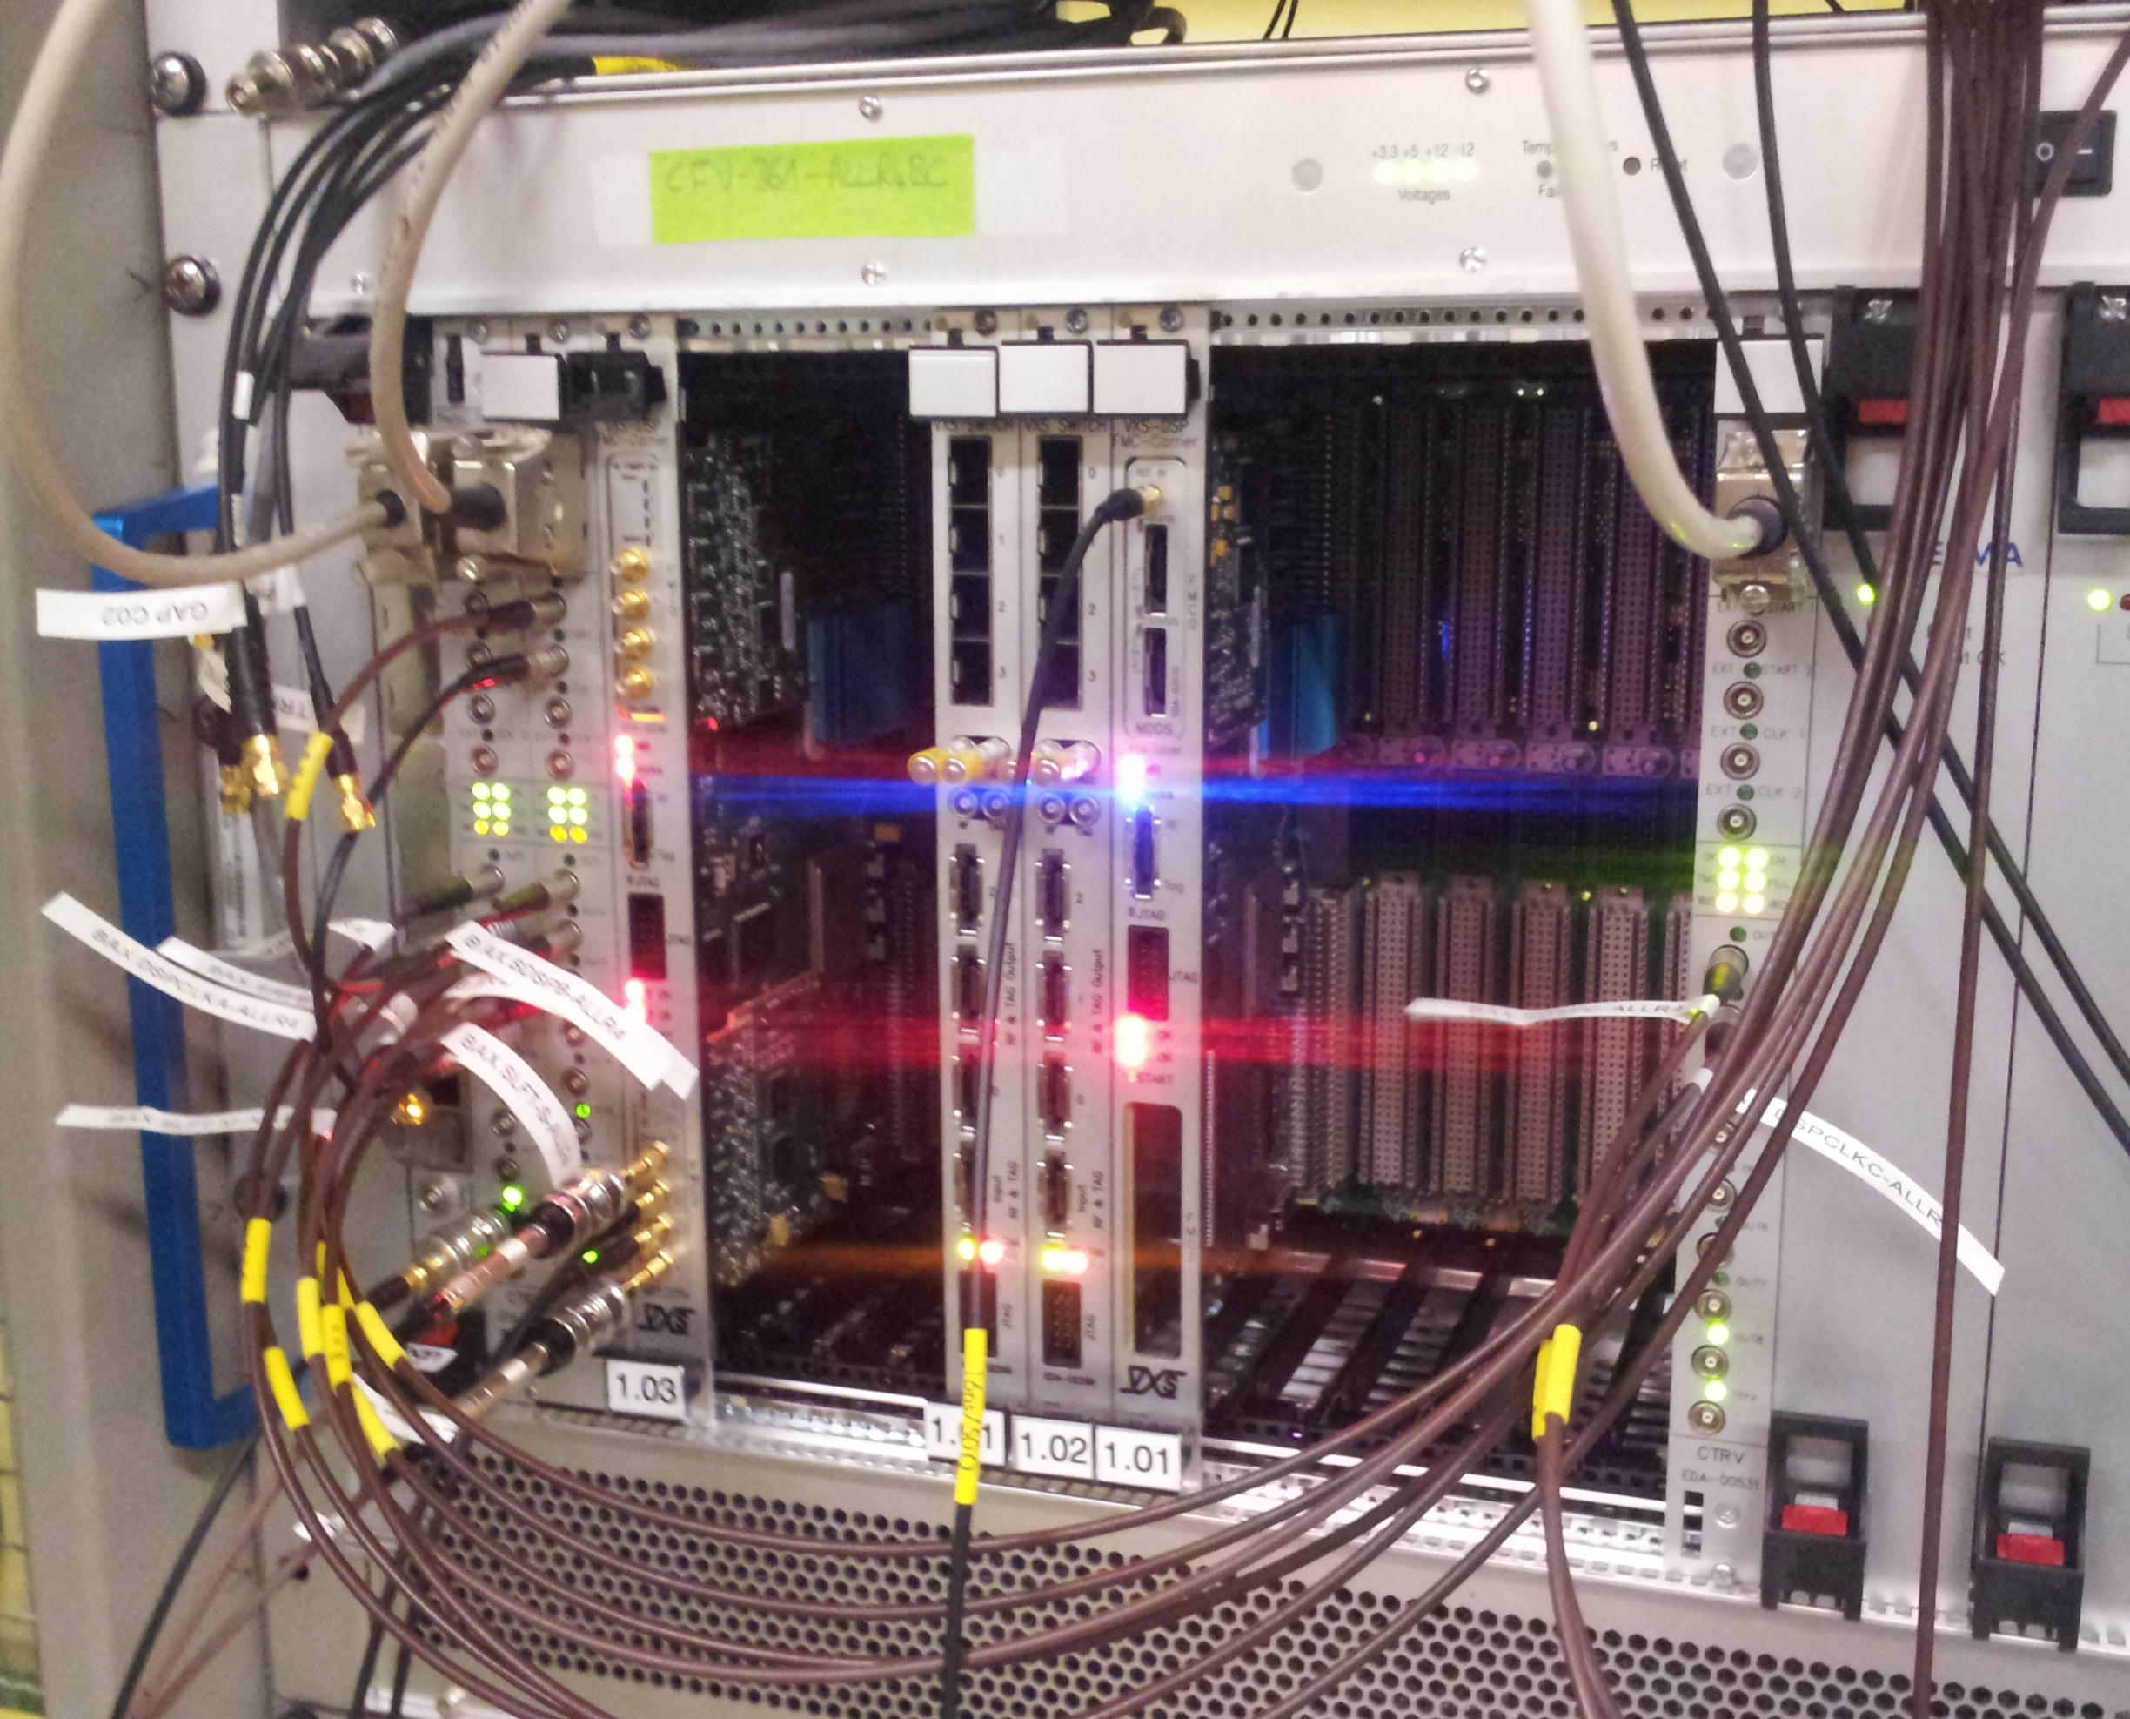
Two board test setup in CERN PSB Feb. 2013

Slide 28


Thank you for your attention.

Slide 29
References
[1] J. DeLong et al., “Topology for a DSP-Based Beam Control System in the AGS Booster”, PAC’03, Portland, May 2003, p. 3338.
[2] M. E. Angoletta et al., “Feasibility Tests of a New All-Digital Beam Control Scheme for LEIR”, CERN/AB-Note-2004-004-RF.
[3] M. E. Angoletta et al., “PS Booster Beam Tests of the New Digital Control System for LEIR”, CERN/ABNote-2005-017-RF.
[4] M. E. Angoletta et al., “Beam tests of a new digital Beam Control System for the CERN LEIR Accelerator“, PAC’05, Knoxville TN.
  [5] ANSI / VITA 41.0, “VXS VMEbus Switched Serial Standard”.
  [6] NXP (http://www.nxp.com/documents/other/39340011.pdf) “The I²C-bus Specification”
  [7] ANSI / VITA 57.1, “FPGA Mezzanine Card (FMC) Standard”.
  [8] Intel (http://www.intel.com/content/www/us/en/servers/ipmi/ipmi-specifications.html ) ”Intelligent Platform Management Interface”
[9] OpenCores (www.opencores.org), “WISHBONE System-on-Chip (SoC)Interconnection Architecture for Portable IP Cores”.
[10] A. Rey, F. Dubouchet, M.Jaussi, T. Levens, J. Molendijk, A. Pashnin CERN, “A tool for consistent memory map configuration across hardware and software” ICALEPCS 2013, San Francisco CA.
[11] P. Leinonen, J. Sanchez Quesada(CERN) , “FPGA Mezzanine Card standard IO-modules for the LLRF beam control system of CERN’s PS Booster and MedAustron synchrotron”, RFTech 2013, Annecy.

