Slide 1

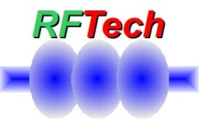





Direct sampling of RF signals in accelerators
Samer Bou Habib
Notes:
How to edit the title slide
Upper area: Title of your talk, max. 2 rows of the defined size (55 pt)
Lower area (subtitle): Conference/meeting/workshop, location, date,
your name and affiliation,
max. 4 rows of the defined size (32 pt)
Change the partner logos or add others in the last row.

Slide 2
Agenda
Introduction
Under Sampling
DS vs DWC
Projects
Summary

Slide 3
Introduction - Downconversion
Master Oscillator (Reference)
CLK generation and distribution
LO generation and distribution
LO
LO
CLK
ADC
LO
ADC
To Digital System
ADC
ADC
IF
RF

Slide 4
Introduction – Direct Sampling
Master Oscillator (Reference)
CLK generation and distribution
LO generation and distribution
CLK
LO
To Digital System
ADC
RF

Slide 5
Introduction – Direct Sampling
Master Oscillator (Reference)
CLK generation and distribution
CLK
To Digital System
ADC
RF

Slide 6
Introduction – Direct Sampling
Master Oscillator (Reference)
Reference distribution
CLK generation
To Digital System
ADC
RF

Slide 7
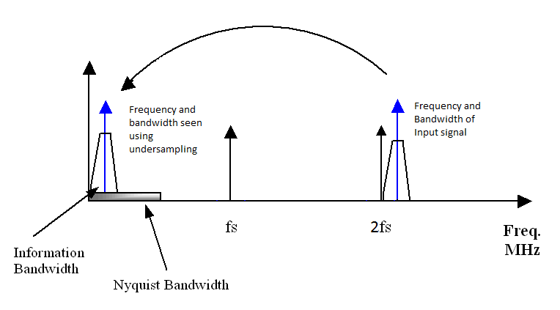
UnderSampling
ADC BW > Fin
Fs > 2*BW

Slide 8
DS vs. DWC
Main advantages
No LO generation or distribution, No down-converters
Simpler system
Smaller system
Cheaper system
High Sampling rates
Faster system clock
Faster calculations
Much lower Latency
Main disadvantages
Limited resolution of Fast ADCs (partially to be compensated digitally at the cost of latency)
More careful design needed for CLKs and input circuits
Elimination of problems related to LO and DWC
Drifts
Nonlin-earities
Matching
Noise
Drifts
More time for processing

Slide 9
R&D and Implementations at DESY
ATCA Fast ADC board
DAMC-DS800
  KLM
  HOM
  LLRF?
...

Slide 10
FastADC ATCA board
ATCA Fast Digitizer Card
8 analog channels
  14-bit, 1.4GHz BW@ 400 MSPS
  12-bit, 2.3GHz BW@ 500 MSPS

Slide 11
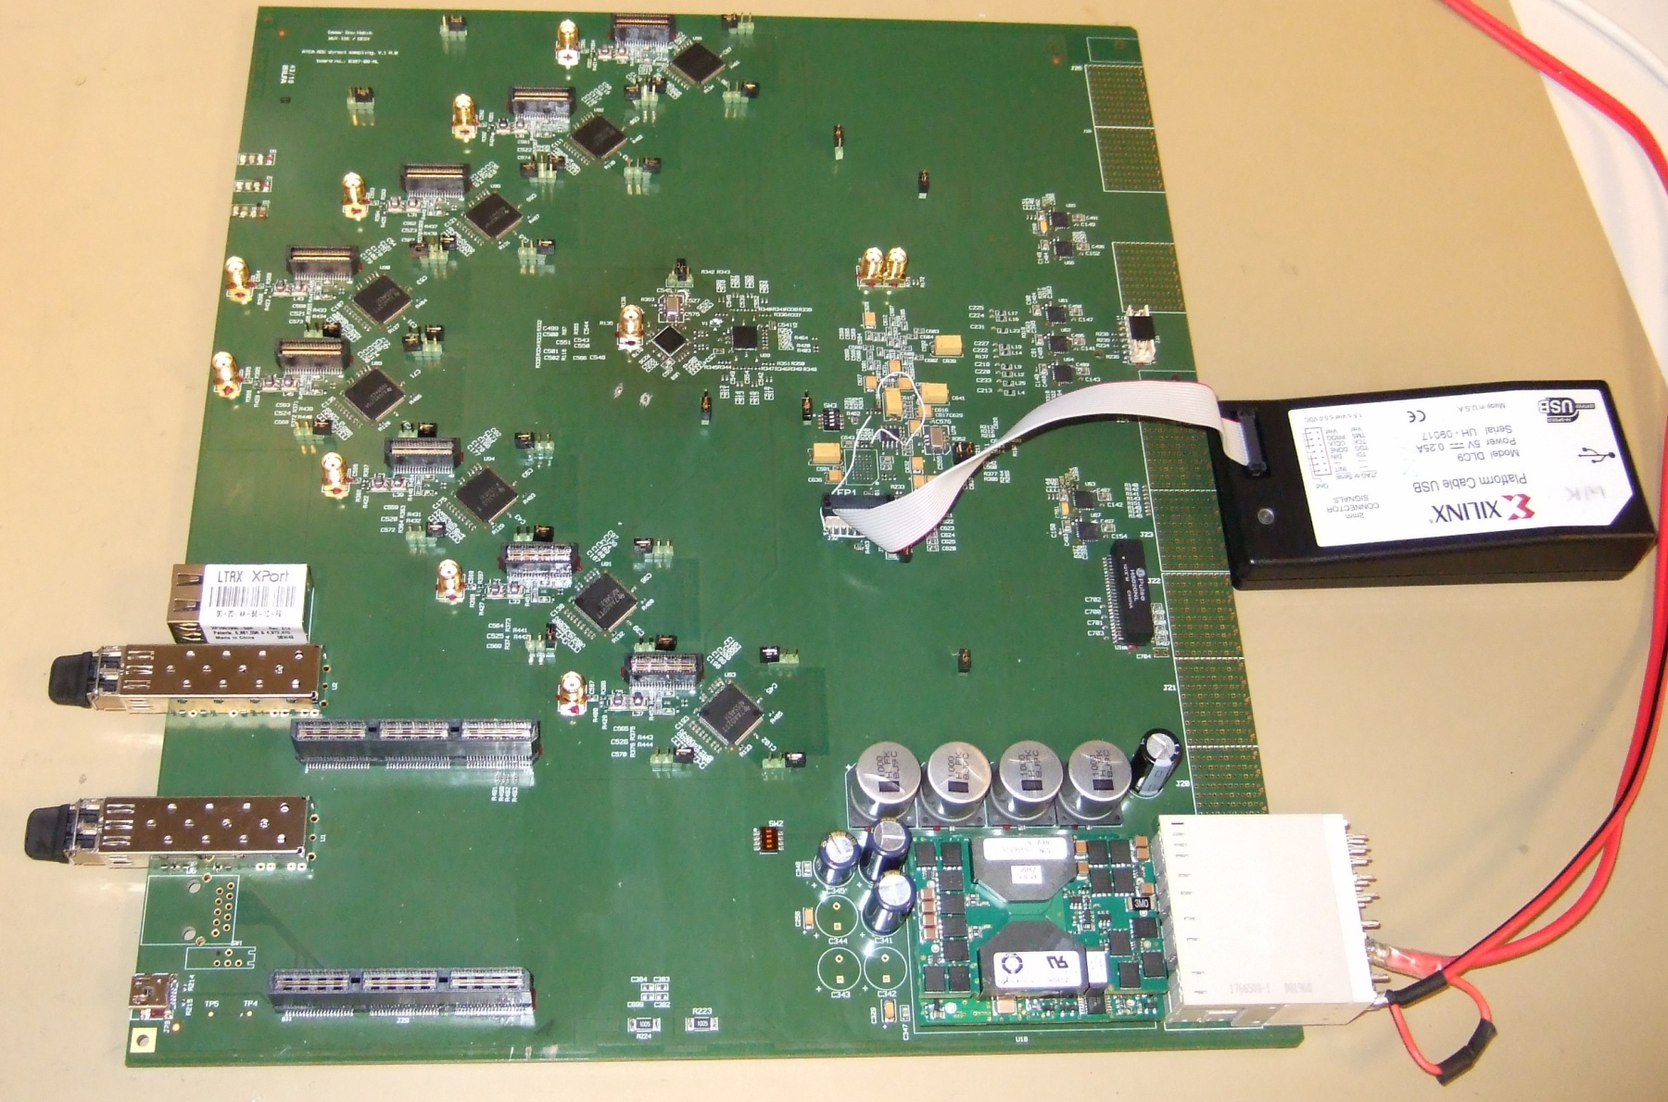
FastADC ATCA board

Slide 12
FastADC - Measurements
1MHz BW measurement:
  14-bit, 1.3GHz input @365.625 MSPS
    <0.011% relative amplitude accuracy
    <0.07˚ phase accuracy
  12-bit, 1.3GHz input @487.5 MSPS
    <0.012% relative amplitude accuracy
    <0.021˚ phase accuracy

Slide 13
DAMC-DS800
AMC Fast Digitizer Card
8 analog channels (AC or DC) up to 2.7GHz @ 800 MSPS 12-bit ADCs
4 DACs
SRAMs for all ADC channels

Slide 14
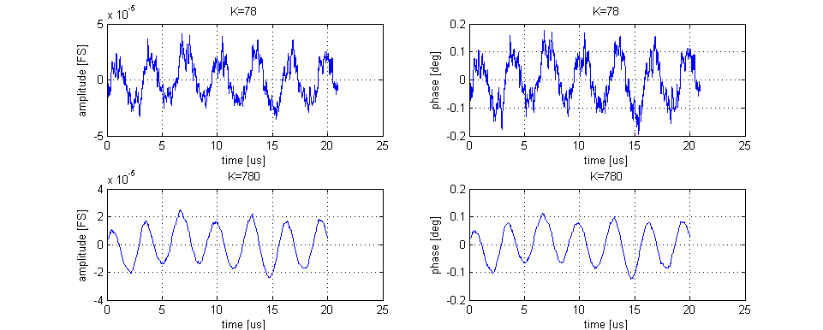
ADC tests (Evaluation board)
Rms avg demodulation (10 MHz BW) |  | Rms avg demodulation (1 MHz BW) |  | Rms avg demodulation (100 kHz BW)
Amplitude | Phase | Amplitude | Phase | Amplitude | Phase
0,0016% | 0,077˚ | 0,0013% | 0,062˚ | 0.0001% | 0.0045˚

Slide 15
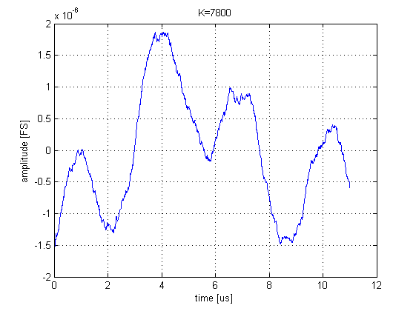
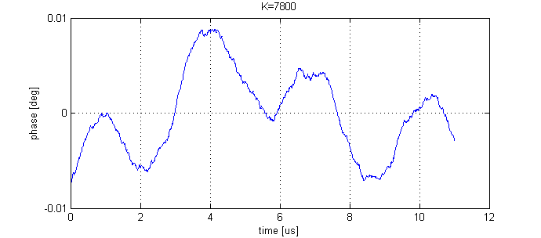
ADC tests (Evaluation board)
Rms avg demodulation (10 MHz BW) |  | Rms avg demodulation (1 MHz BW) |  | Rms avg demodulation (100 kHz BW)
Amplitude | Phase | Amplitude | Phase | Amplitude | Phase
0,0016% | 0,077 ˚ | 0,0013% | 0,062˚ | 0.0001% | 0.0045˚

Slide 16
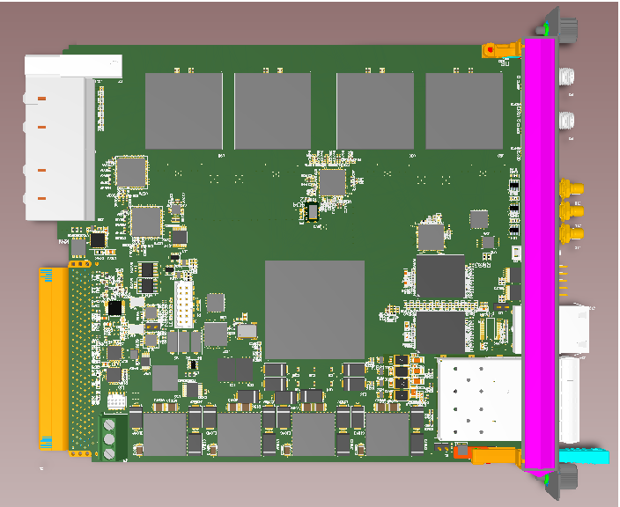
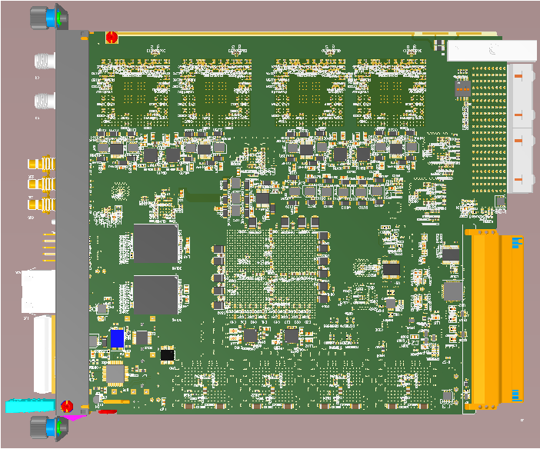
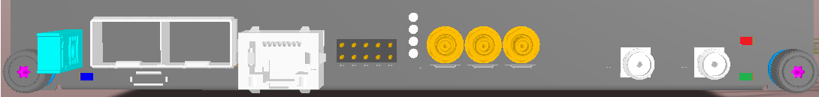
DAMC-DS800

Slide 17
DRTM-KLM
12-bit Fast ADCs (DS800) @ 780 MSPS
  6 RF Channels @ 1.3GHz
  2 DC Channels
2 „Fast” signals with low resolution requirements
2 „Slow” signals

Slide 18
DRTM-KLM
RF Channel
RF Channel
RF1
..
..
RF8
RF Channel
RF Channel
8
RF Channel
RF Channel
FPGA
6
DC Channel
DC Channel
„Slow „DC Channel
10MSPS 16-bit
„Slow” DC Channel
Fast Channel
~200MSPS 8-bit
Fast Channel
RF- Gate
PLL
+Distribution
REF (RF-backplane)

Slide 19
DRTM-HOM
8 Channels
1.3, 1.7 and 2.4 GHz each

Slide 20
DRTM-HOM
HOM
FILTER
HOM
FILTER
RF1
..
..
RF8
8
6
HOM
FILTER
HOM
FILTER
REF FP
PLL
+Distribution
CLK out
REF (RF-backplane)

Slide 21
HOM Filter Design
2.4 GHz
Attenuator
VIA
1.3 GHz
IN
1.7 GHz
OUT

Slide 22
HOM Filter Characteristics

Slide 23
Usage in LLRF
Feasibility
Performance Tests

Slide 24
Thank you for your attention
S.BouHabib@stud.elka.pw.edu.pl

Slide 25
HOM Filter Design
f₁=1300 MHz, BW=37 MHz (at RL=-20 dB), IL₀=4 dB, n=4 stripline, substrate height 0.204 mm, size 35x35 mm
f₂=1700 MHz, BW=55 MHz (at RL=-20 dB), IL₀=4.5 dB, n=4 microstrip, substrate height 0.204 mm, size 45x35 mm
f₃=2400 MHz, BW=74 MHz (at RL=-20 dB), IL₀=4 dB, n=4 microstrip, substrate height h₁=0.204 mm, h₂=0.25 mm size 45x25 mm
(2 and 3 together on the same layer) size 45x60 mm
all filters (2 and 3 up, 1 down) size needed 55x70 mm - (max)

