Slide 1
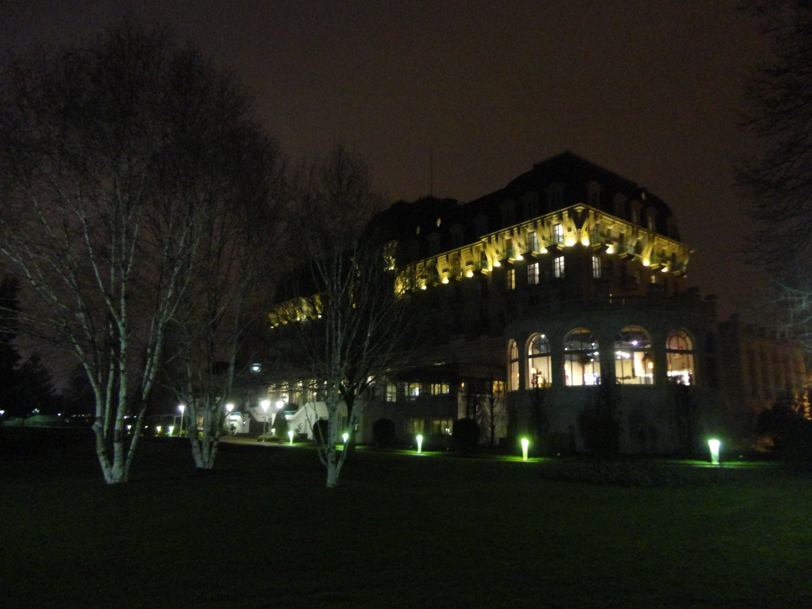
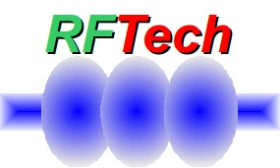
RF questions for LHeC & TLEP RFTech deliverables
Frank Zimmermann
4th & final RFTech meeting
Annecy, Imperial Palace
work supported by the European Commission under the FP7 Research Infrastructures project EuCARD, grant agreement no. 227579

Slide 2
possible long-term strategy
TLEP (80 km,
e⁺e⁻, up to
~350 GeV c.m.)
HE-LHC
(pp, 33 TeV c.m.)
PSB
PS (0.6 km)
SPS (6.9 km)
LHC (26.7 km)
LHeC & SAPPHiRE
(9 km)
VHE-LHC
(pp, up to
100 TeV c.m.)
same detectors!
also: e± (120 GeV) – p (7 & 50 TeV) collisions
(E. Meschi)
≥50 years of e⁺e⁻, pp, ep/A physics at highest energies

Slide 3
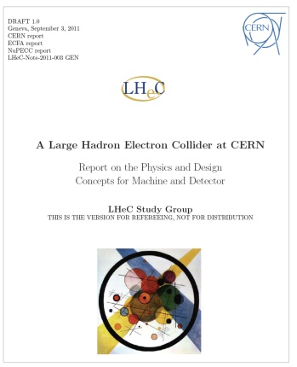
LHeC Conceptual Design Report
LHeC CDR published in
J. Phys. G: Nucl. Part. Phys. 39
075001 (2012)
~600 pages

Slide 4
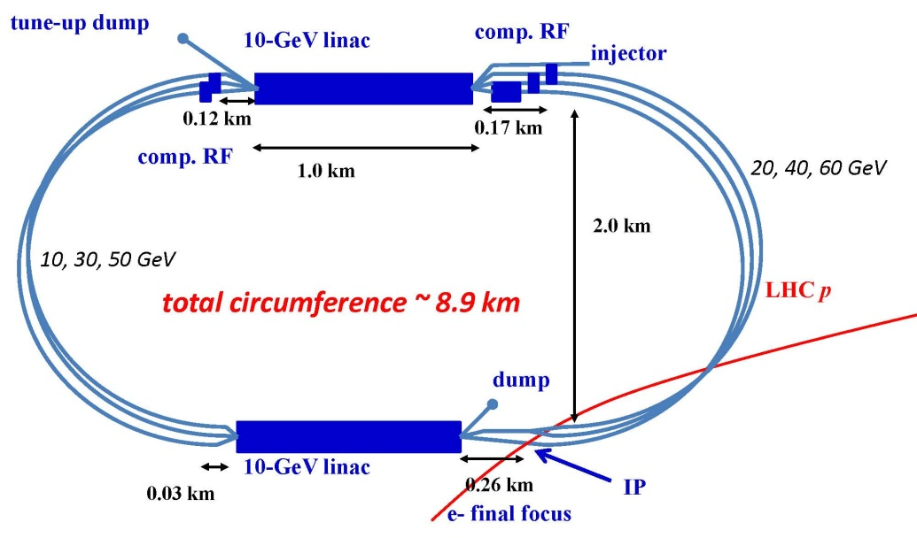
LHeC layout
two 10-GeV SC linacs, 3-pass up, 3-pass down; 6.4 mA, 60 GeV e⁻’s collide w. LHC protons/ions
A. Bogacz, O. Brüning,
M. Klein, D. Schulte,
F. Zimmermann, et al
(C=1/3 LHC allows for ion clearing gaps)

Slide 5
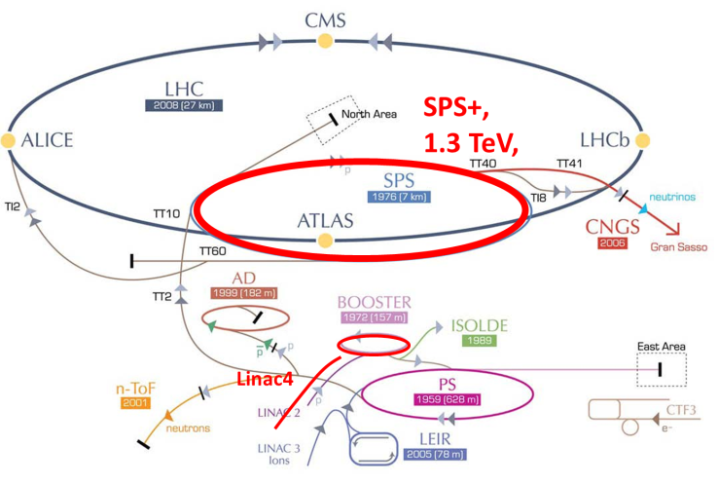
TLEP & VHE-LHC
VHE-LHC
VHE-LHC-LER
=TLEP!
(Lucio Rossi)

Slide 6
RF system parameters – 1
 | LHeC | TLEP collider | TLEP inj.
beam energy [GeV] | 60 | 175 | 175
frequency [MHz] | 720 or 800
total voltage [GV] | 20 | 12 | 12
av gradient [MV/m] | 20 | 20 | 20
eff. RF length [km] | 1 | 0.6 | 0.6
#cavities | 1000 | 600 | 600
RF efficiency (wall→beam) | 55% | 55% | 55%
power throughput [MW] | 17 | 117 | 17 (peak)
power / cavity [kW] | 17 | 200 | 28

Slide 7
RF system parameters – 2*
 | LHeC | TLEP collider | TLEP inj.
beam energy [GeV] | 60 | 120 | 120
frequency [MHz] | 720 or 800
total voltage [GV] | 20 | 6 | 4
av gradient [MV/m] | 20 | 10 | 7
eff. RF length [km] | 1 | 0.6 | 0.6
#cavities | 1000 | 600 | 600
RF efficiency (wall→beam) | 55% | 55% | 55%
power throughput [MW] | 17 | 40 | <4 (peak)
power / cavity [kW] | 17 | 65 | <10
*low power version of TLEP with 20 MW total SR power

Slide 8
RF efficiency (cw SRF, 620 or 800 MHz)
from LHeC design report:
power converters: 95%;
klystron efficiency: 65%;
transmission losses 7%;
→ overall 55%
how much margin for feedback?
what do RFTech experts think?

Slide 9
RF power / cavity
from Andy Butterworth –
3rd TLEP workshop 10 January
fundamental power couplers look feasible at > 200 kW CW
HOM damping is open question

Slide 10
cost of the RF system?
JLAB upgrade (B. Rimmer) – US accounting
~$176M/GeV (excluding tunnel )
~$17.6/watt beam power
energy: 12 GV $→$ 2.1 B$$→$ 0.8 GEuro
power: 100 MW $→$ 1.8 B$$→$ 0.7 GEuro
injector ring:
XFEL linac (17.5 GeV) ~230 Meuro
total: 1 GEuro
question to RFTech

Slide 12
RFTech organized or co-sponsored events, 2009-11
16.-18.09.2009 |  | LHC-CC09, 3rd LHC crab cavity workshop, CERN
19-22.10.2009 |  | LLRF09, Low-Level Radio Frequency Workshop, KEK
24-27.06.2010 |  | MIXDES2010, Wroclaw
29.03. 2010 |  | First Annual RFTech Meeting, DESY
19-22.10.2009 |  | LLRF09, Low-Level Radio Frequency Workshop, KEK
16-18.09. 2009 |  | LHC Crab Cavities "LHC-CC09", CERN
02-03.12.2010 |  | Second Annual RFTech Meeting, PSI
15-17.12. 2010 |  | LHC-CC10, 4th LHC Crab Cavity Workshop, CERN
6-8.06.2011 |  | Linac Operation with Long Bunch Trains, DESY
16-18.06.2011 |  | AccNet co-sponsored MIXDES 2011, Gliwice
21.023.09.2011 |  | MulCoPim'11, Valencia, 21-23 September 2011

Slide 13
RFTech organized or co-sponsored events, 2011-13
17.-21.10.2011 |  | LLRF-2011, DESY
14-15.11.2011 |  | LHC-CC11 on LHC Crab Cavities, CERN
12.-13.12.2011 |  | Third Annual RFTech Meeting, Rostock
24-26.05.2012 |  | MixDes2012, Warsaw,
11-15.06.2012 |  | IEEE RT2012, Berkeley
25.-27.06.2012 |  | HOMSC2012 workshop, Daresbury
06.-08.008.2012 |  | LLRF collaboration meeting, Lodz
19.25.08.2012 |  | ICAP’12, Warnemünde
11..-12.12.2012 |  | uTCA workshop for Industry and Research, Hamburg
24-26.03. 2013 |  | Fourth Annual RFTech Meeting, Annecy

Slide 14
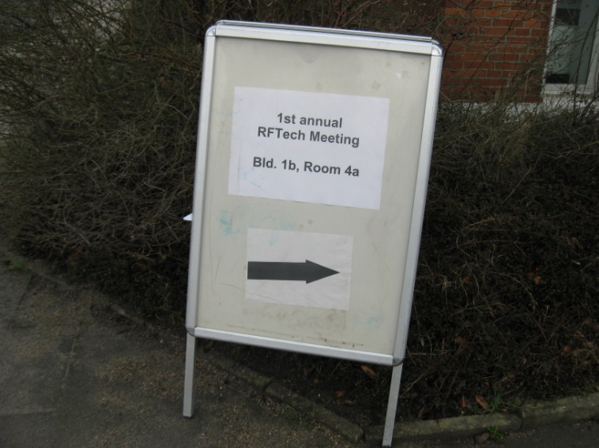
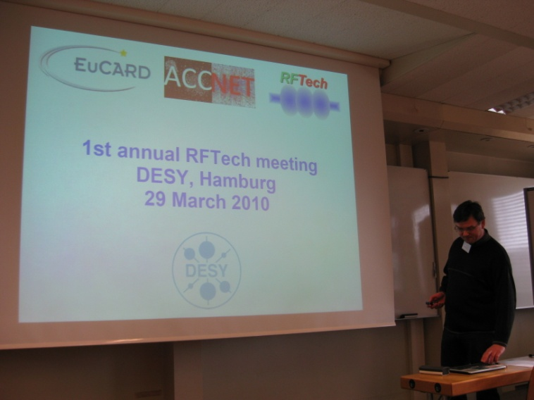
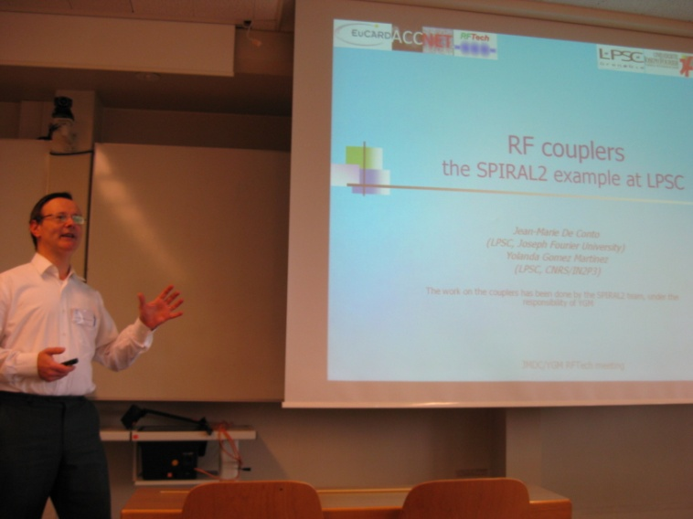
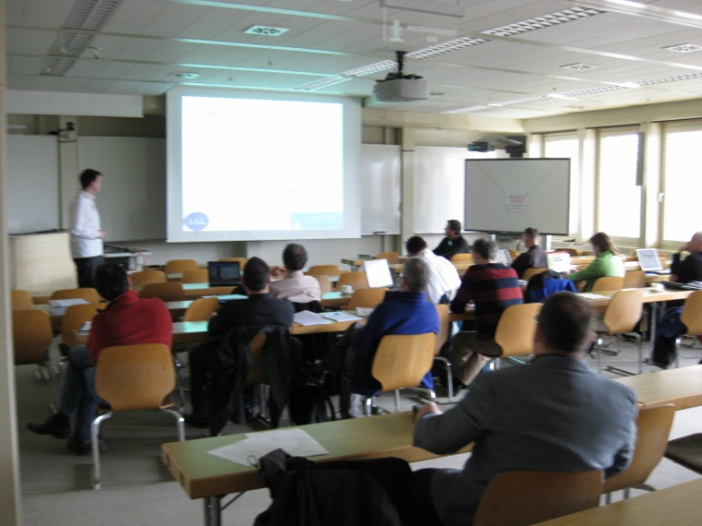
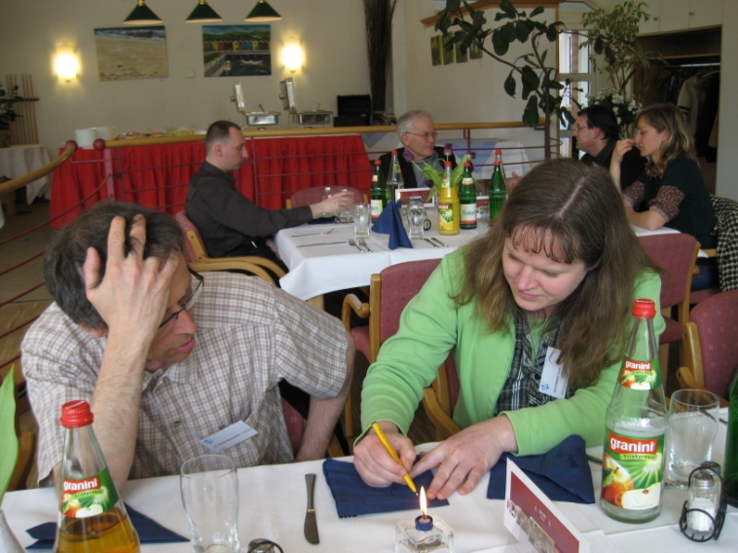
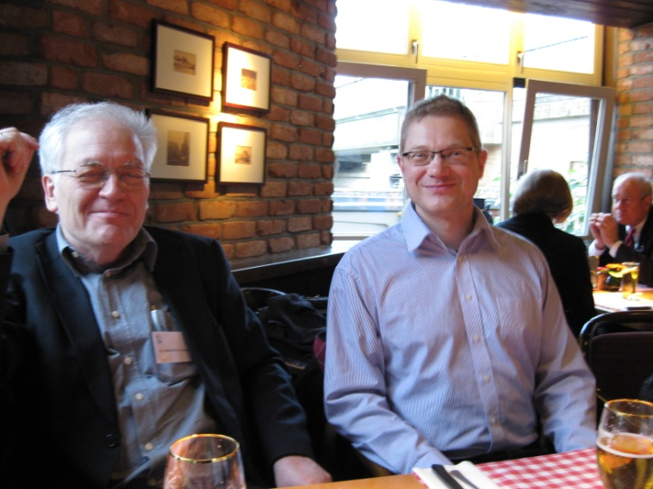
First Annual RFTech Meeting
DESY, 29 March 2010
https://indico.desy.de/conferenceDisplay.py?confId=2831
17 participants (DESY, CERN, TUD, UROS, ASTeC, LPSC, UJF, ESS, U London, TUL, UG, SINS) organized by M. Grecki, J.-M. De Conto, W. Weingarten & DESY
Spiral-2 couplers, SPL simulations & measurements, FLASH full beam loading, LHC LLRF, xTCA, high reliability digital system, HIE ISOLDE cavity & test cryostat, TUD SRF test stand, LHC crab cavities, RF costing tools, SRF test & R&D infrastructure

Slide 15
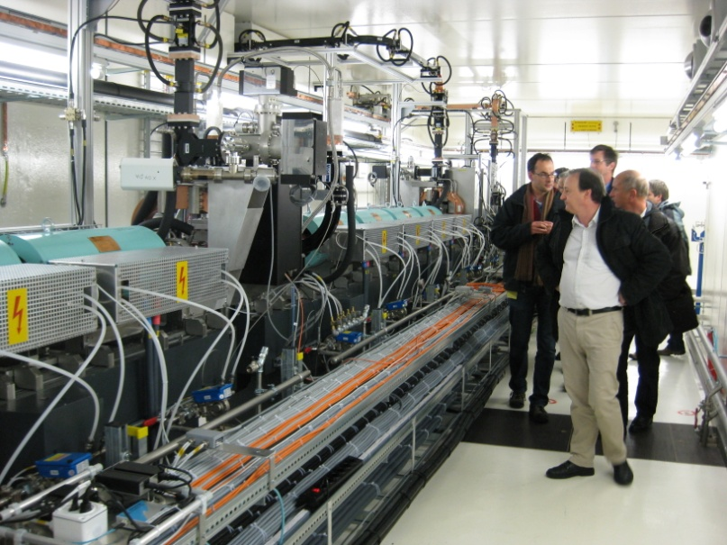
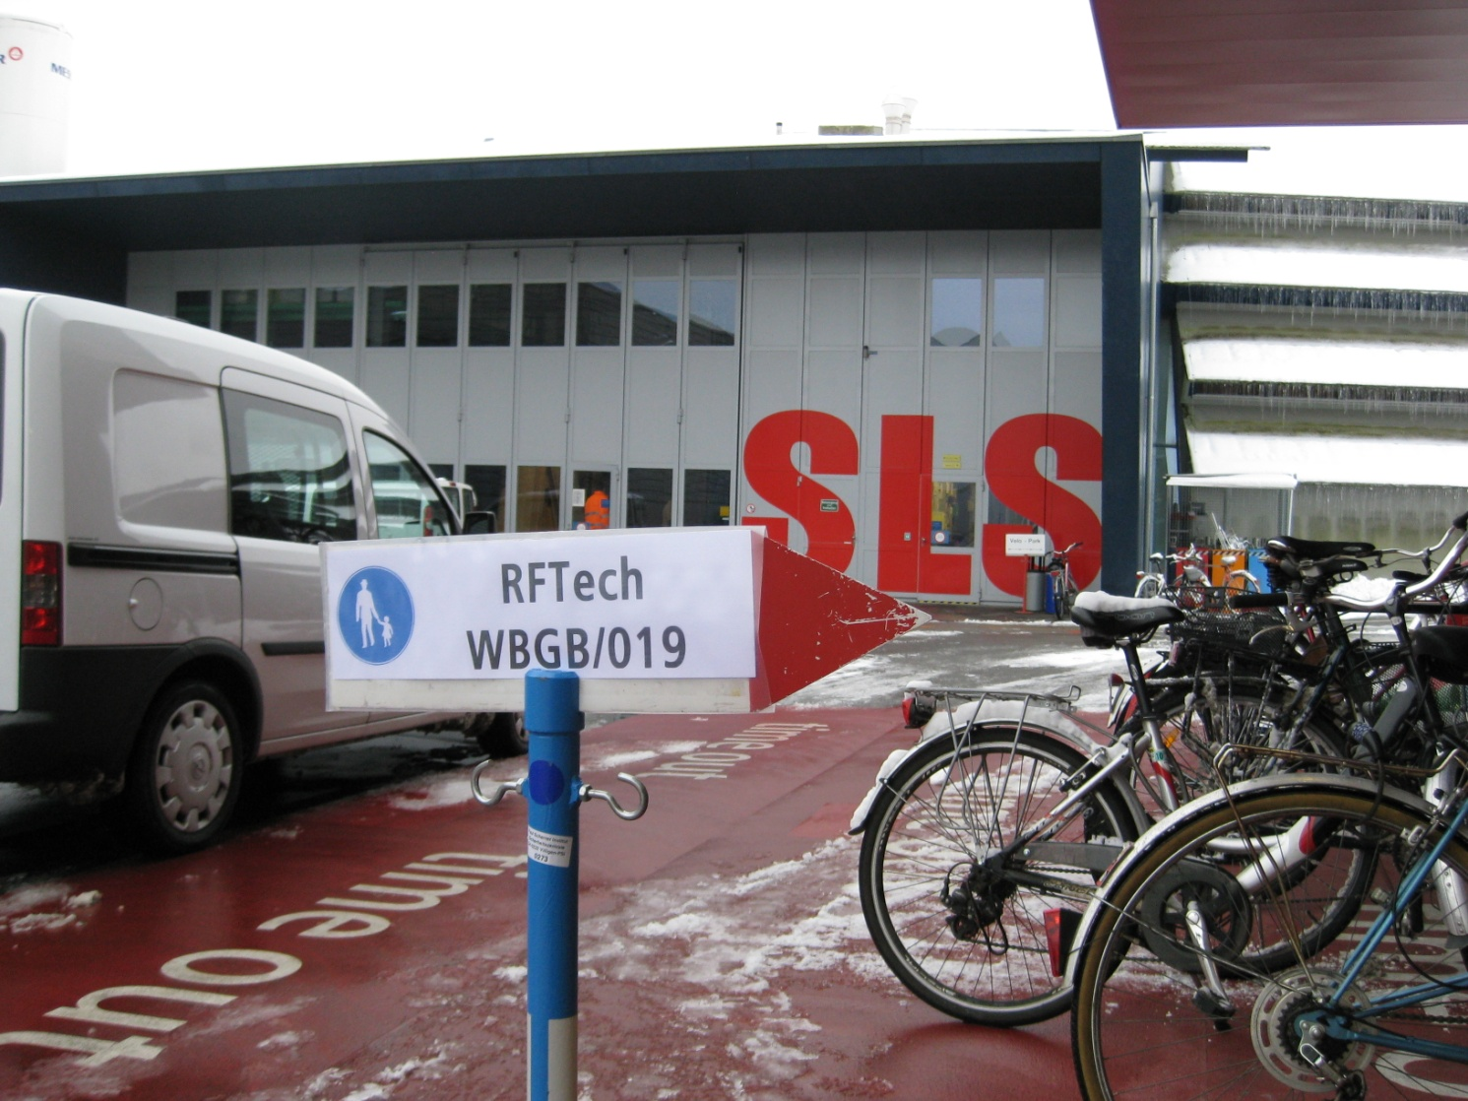
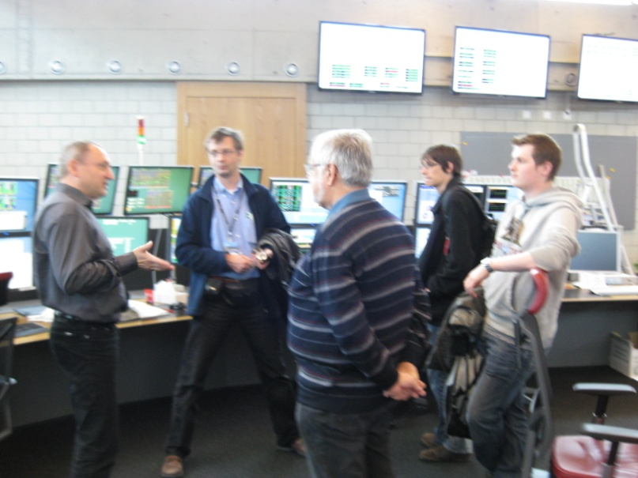
Second Annual RFTech Meeting
PSI, 2-3 December ‘10

Slide 16
Second Annual RFTech Meeting
PSI, 2-3 December ‘10
https://indico.desy.de/conferenceDisplay.py?confId=2831
30 participants, ~2x 1st meeting! (BNL, DESY, CERN, CNRS, CEA, ESRF, IPJS, LU, LPSC, PSI, RHUL, SBT, SOLEIL, UJF, TUD, TUL, WU, …) organized by T.Garvey, M.Grecki, J.-M.DeConto, W.Weingarten & PSI ; sharing experience among several fields of RF technology!
Low Level RF: CERN's PS complex LLRF renovation, SuperB project, FLASH system, as well as use of specific components like uTCA for XFEL machines
Solid State Amplifiers, both in general and particular techniques as well as some specific developments, like at PSI, ESRF and SOLEIL
RF technology for FELs: normal- and superconducting RF aspects (X Band structures, the Swiss FEL project, cryomodule technology) , summary of XFEL RF synchronization workshop
RF limitations related to LHC ultimate beam
Cavity optimization: crab-cavity design for the LHC, HOM free copper cavities
Superconducting RF, e.g. cryomodule assembly in Saclay, SRF infrastructures in Saclay/Orsay, SBT in Grenoble, with analysis and round-table discussion on the need of a European SRF test infrastructure for R&D and test of cavities & cryomodules. Presenting work of young scientists, about cavity design & modelling

Slide 17
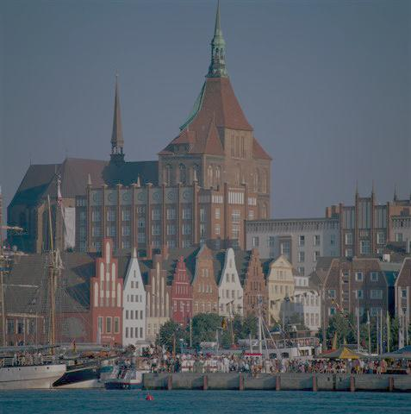
Third Annual RFTech Meeting
U Rostock, 12-13 December ‘11
http://lpsc.in2p3.fr/Indico/internalPage.py?pageId=2&confId=646
17 (young) participants (DESY, CERN, TUD, UROS, GANIL, PSI, LPSC/CNRS, UJF, TUL) organized by Ursula van Rienen, Jean-Marie De Conto, Mariusz Grecki, & UROS
RF cavity and couplers design
• Perturbation methods for cavity calculation, Finite integration Maxwell solvers and FEM schemes, Progress of crab-cavities (HL-LHC + general)
HOM based diagnostics
Diagnostic via Beam excited HOMs models and experiment
Cavity tuning
Tuning issues for flat fields (FLASH)
LLRF
associated software, instrumentation, workshops FLAH, develpopments
RF systems highlights
CERN, SPIRAL2, Large CERN panorama, Review of Darmstadt activities
SRF infrastructure: completed
Reliability
may be strengthened?
Costing tools?

Slide 18
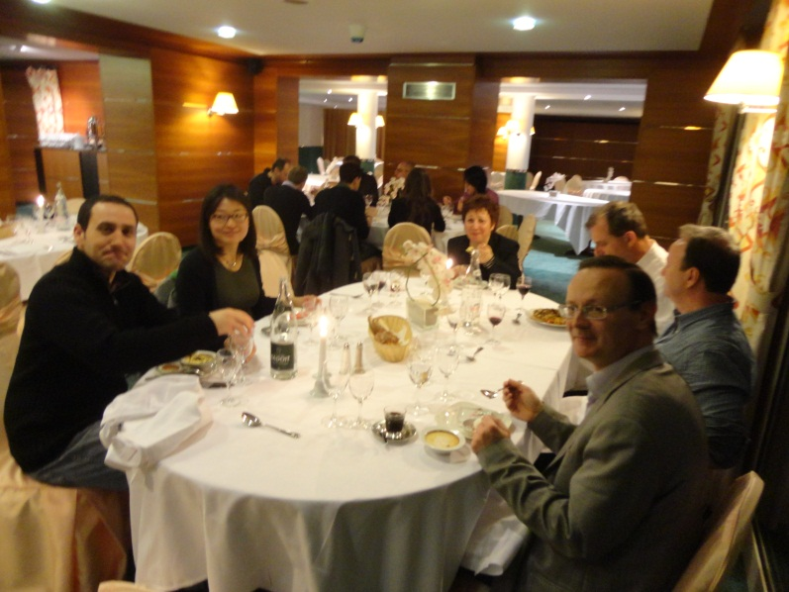
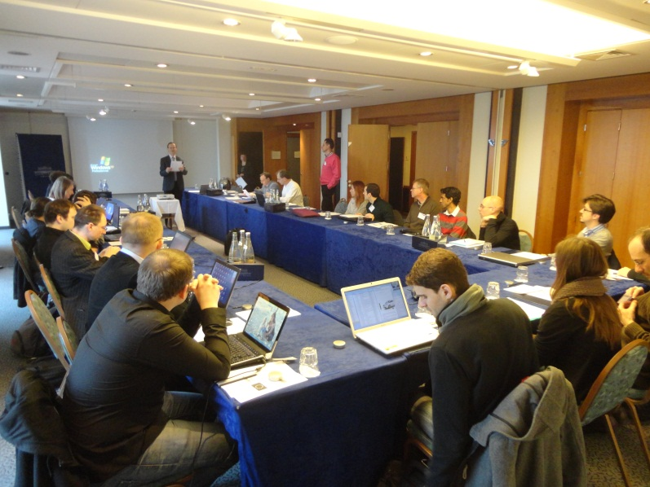
4th & Final Annual RFTech Meeting
Annecy, 24-26 March ‘13
http://lpsc.in2p3.fr/Indico/internalPage.py?pageId=2&confId=862
33 participants (DESY, CERN, INF-INFN, TUD, UROS, GANIL, PSI, LPSC/CNRS,
UJF, TUL, ISE-WUT) organized by U. van Rienen, J.-M. De Conto, M. Grecki, & UROS
Projects: SPIRAL2, MYRRHA/MAX, CLIC, TESLA, ELI-NP, LHeC ERL, TLEP, LHC, FLASH, PS Booster, MedAustron, SwissFEL
RF topics: C-band RF, X-band RF, reliability, LLRF, RF diagnostics, reliability, costing,breakdown, operaton, klystton lifetime, efficiency,…

Slide 19
AccNet-RFTech deliverables
yes there are!
Deliverables of tasks | Description/title | Nature | Delivery month | Status
4.3.1 | Continually updated RFTECH web site | O | M2 | DONE, OK
4.3.2 | strategy/result for SRF test infrastructures | R | M24 | Published
4.3.3 | RFTECH strategy/result for cavity design, LLRF & HPRF systems and design integration, and costing tools | R | M48 | to come soon!

Slide 20
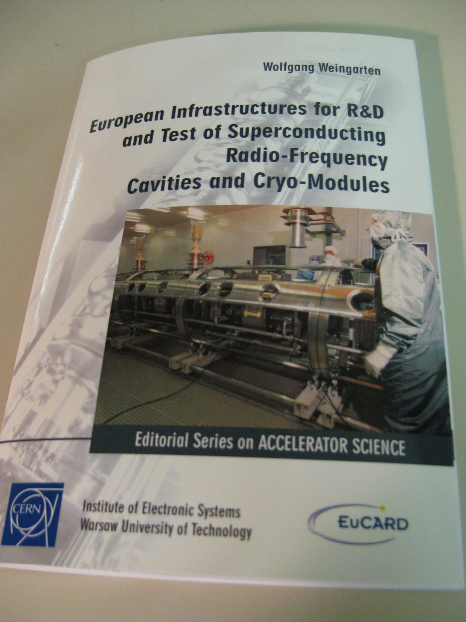
AccNet Deliverable
D4.3.2
– “Strategy/result for SRF test infrastructures” –
published as EuCARD
monograph!

Slide 21
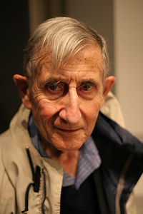
[RF] Technology is a gift of God.
It is the mother of civilizations, of arts and of sciences.
Freeman Dyson

Slide 22
appendix
illustrations of some RFTech
co-organized events
TLEP/LEP3/LHeC parameters

Slide 23
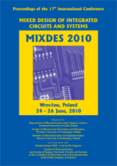
MIXDES 2010
Foreword in Proceedings
"The xTCA for Instrumentation session has been organized in collaboration with the RFTech network of Work-Package 4 "AccNet" of the “European Coordination for Accelerator Research and Development” (EuCARD). EuCARD is an Integrating Activity co-funded by the European Commission under the Framework Programme 7, grant agreement no. 227579. The session has been partially sponsored by RFTech."
Proceedings of the 17th International Conference Mixed Design of Integrated Circuits and Systems Wrocław, 24-26 June 2010
Format: A4 Language: English ISBN (Book): 978-83-928756-3-5 ISBN (CD): 978-83-928756-7-3 IEEE Catalog Number (Book): CFP10MIX-PRT IEEE Catalog Number (CD): CFP10MIX-CDR

Slide 24
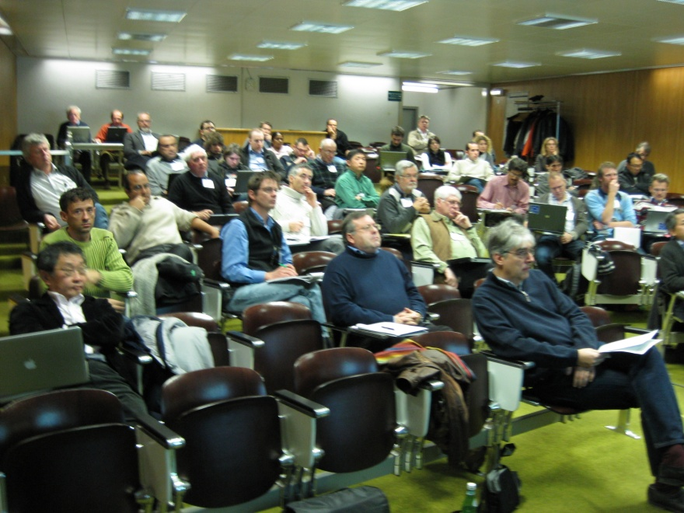
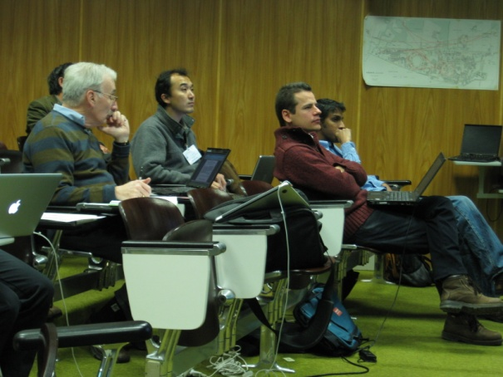
LHC-CC10 workshop
LHC Crab Cavity Workshop, jointly organized by CERN, EuCARD-ACCNET, US-LARP, KEK, & Daresbury Lab/Cockcroft Institute, CERN, 15-17 December 2010
http://indico.cern.ch/conferenceDisplay.py?confId=100672
~50 participants
local crab crossing with compact 400 MHz deflecting SRF cavities has become HL-LHC baseline scheme for geometric luminosity-loss compensation and luminosity leveling
further studies on machine protection and beam-dynamics or technology limits
recommendation to test future LHC prototype cavities with & without beam out- &inside LHC
refined roadmap by summer 2011
workshop summary: R. Calaga (BNL), S. Myers (CERN), F. Zimmermann (CERN), Summary of the 4th LHC Crab Cavity Workshop "LHC-CC10", EuCARD-REP-2011-001 (2011)

Slide 25
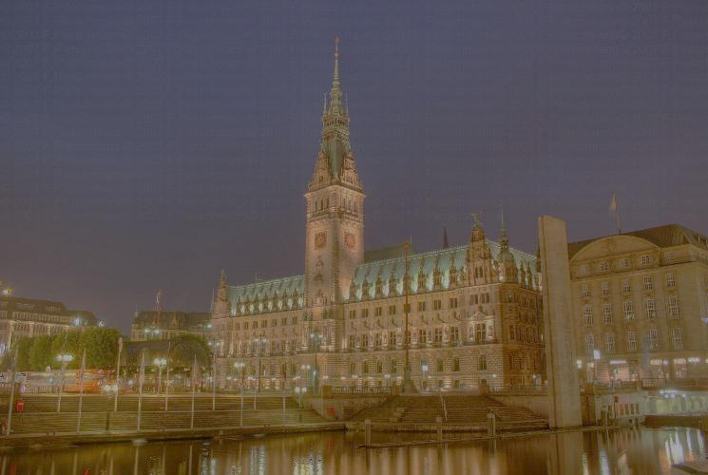
AccNet-RFTech workshop on linac operation with long bunch trains
6-8 June 2011, DESY, Hamburg
http://indico.desy.de/conferenceProgram.py?confId=3007
Participants: about 40 persons (DESY, US, Japan, UK, TUL, …)
About 35 presentations
Thematic sessions:
1. Results and analysis from the 9mA studies
2. Toward future 9mA studies
3. Operations modes for FLASH2
4. Feedback and control of longitudinal phase space
5. Machine protection for long bunch-train operation
6. Beam-based feedback systems
Organizers: Nicholas Walker, Siegfried Schreiber, John Carwardine

Slide 26
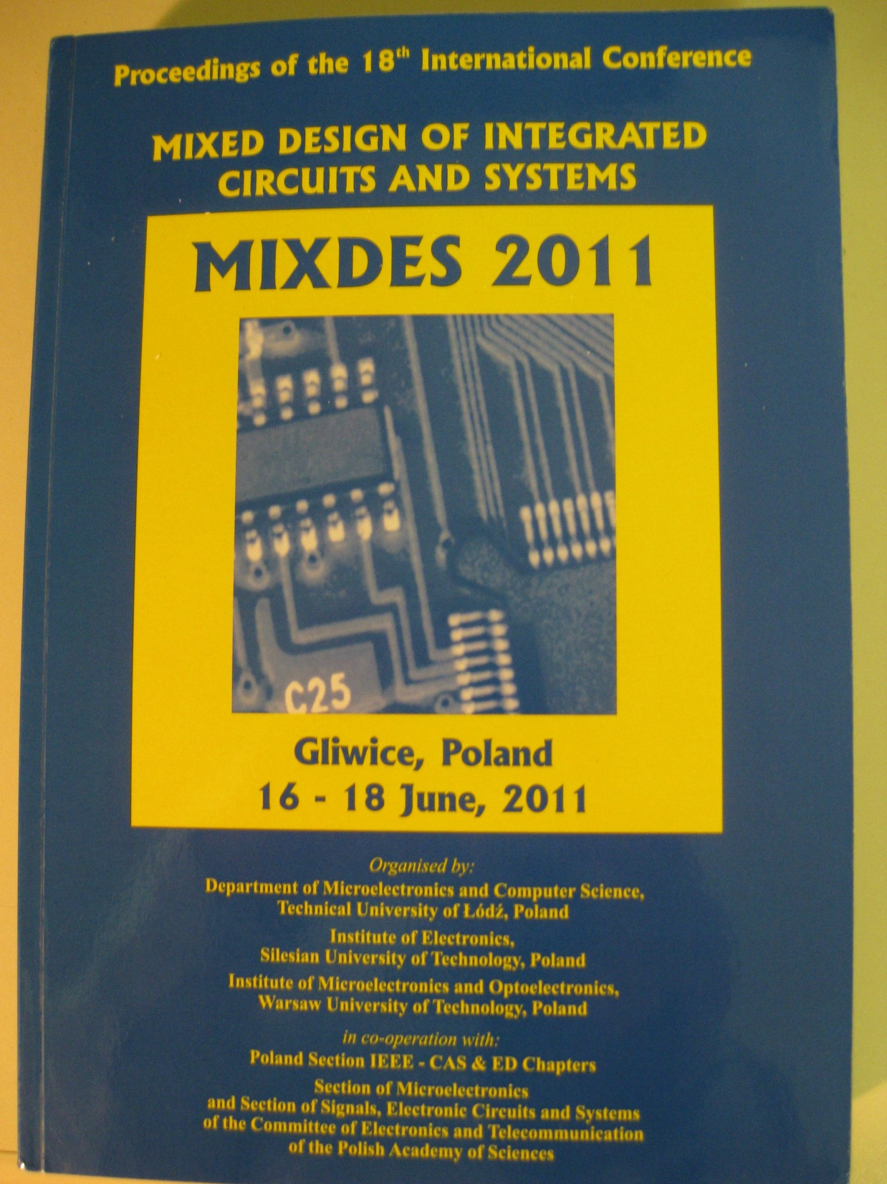
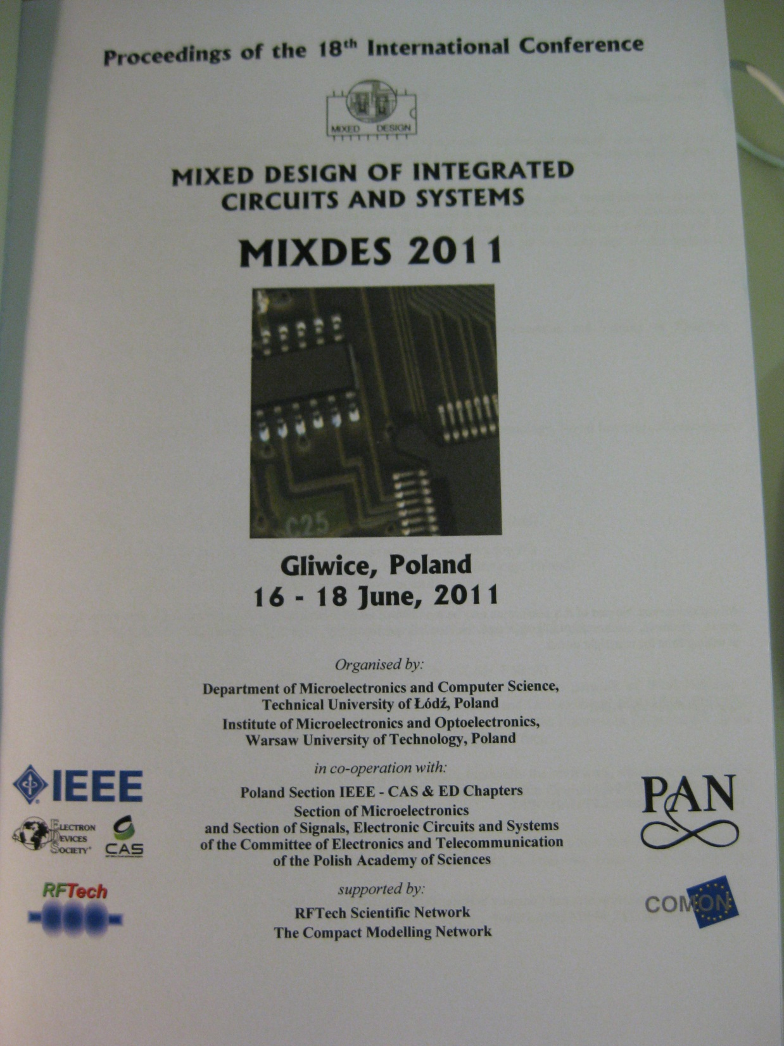
Accnet RFTech co-sponsored MIXDES2011
Proceedings

Slide 27
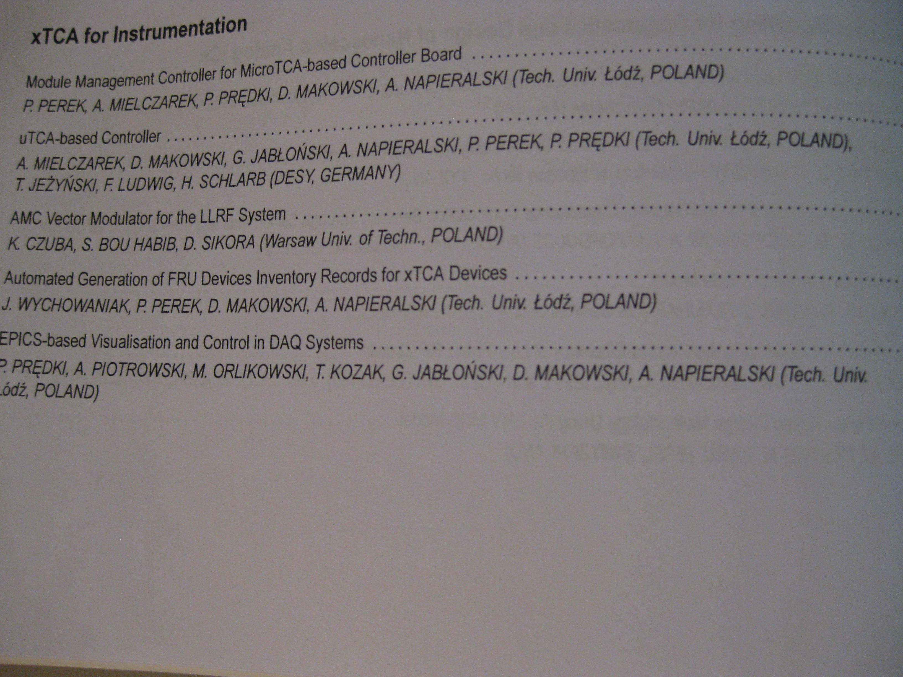
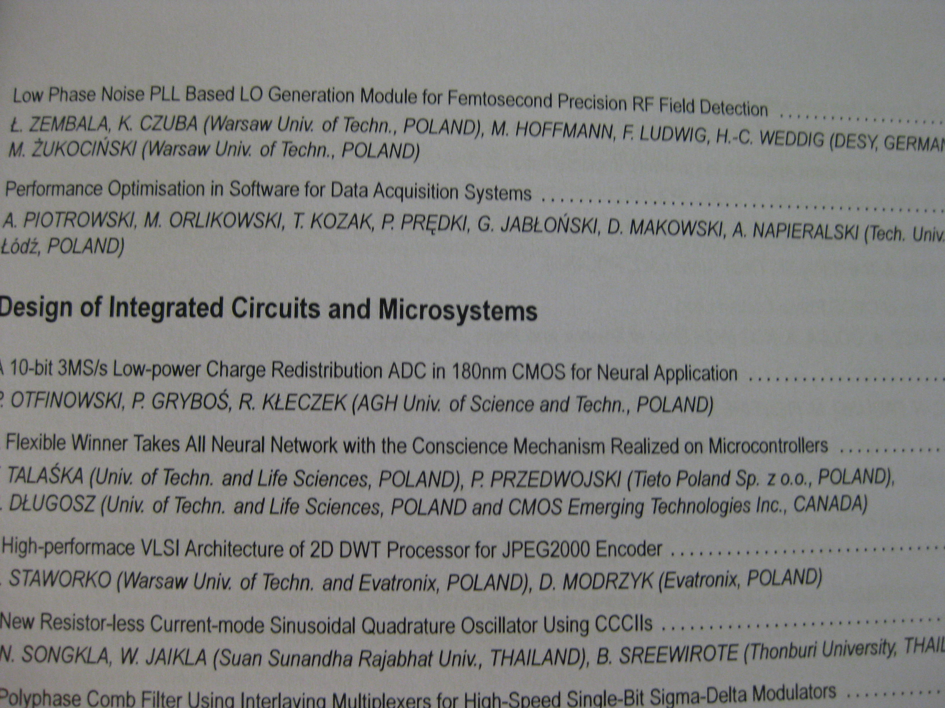
AccNet-RFTech “xTCA” session @ MIXDES2011
Organizer: Adam Piotrowski

Slide 28
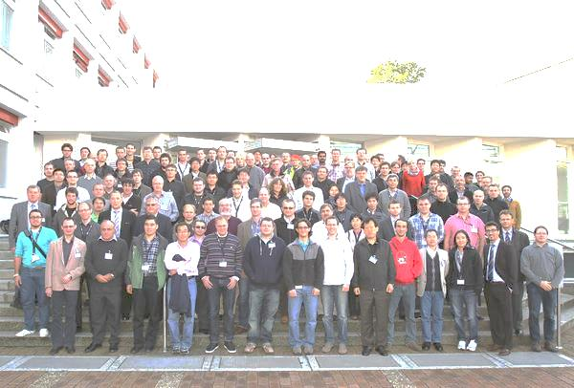
AccNet-EuCARD Low-Level RF Workshop http://llrf2011.desy.de
17-20 October 2011, DESY Hamburg
Topics:
- Reviews of the low-level RF system at various laboratories
- Fast and/or digital low-level RF control for pulsed and CW operation
- Applications of the digital signal processing at accelerator
- Software development
- LLRF systems (requirements, performance reached, modeling)
Highlight: Linear Technology on the ADCs technology edge and their current performance
>118 participants from 16 countries , 9 industrial companies
44 talks including: 10 invited presentations ; 4 tutorials (on Control System Fundamentals, Receiver Fundamentals, FPGA Programming, Embedded system development); 6 lab-talks: CERN, DESY, KEK, FNAL, JLAB, Cornell; 1 industry talk (Linear Technology),;1 welcome talk (Reinhard Brinkmann on DESY accelerator activities); 22 contributed talks (7 hardware, 7 software, 8 systems); 49 posters
Visit of DESY facilities (FLASH and PETRA) - FLASH was overbooked!
9 participants supported by RFTech
Organizer: Mariusz Grecki

Slide 29
Advanced Techniques in LLRF for XFEL Workshop, Cracow 18-20.04.2011
36 participants from Poland, Germany & US, 35 talks including 2 invited talks
topics:
towards CW operation of XFEL,
summary of 9 mA test at FLASH,
developement of uTCA based LLRF system (several talks)
RF synchronization system for XFEL (several talks)
LLRF software developement for XFEL
quality management

Slide 30
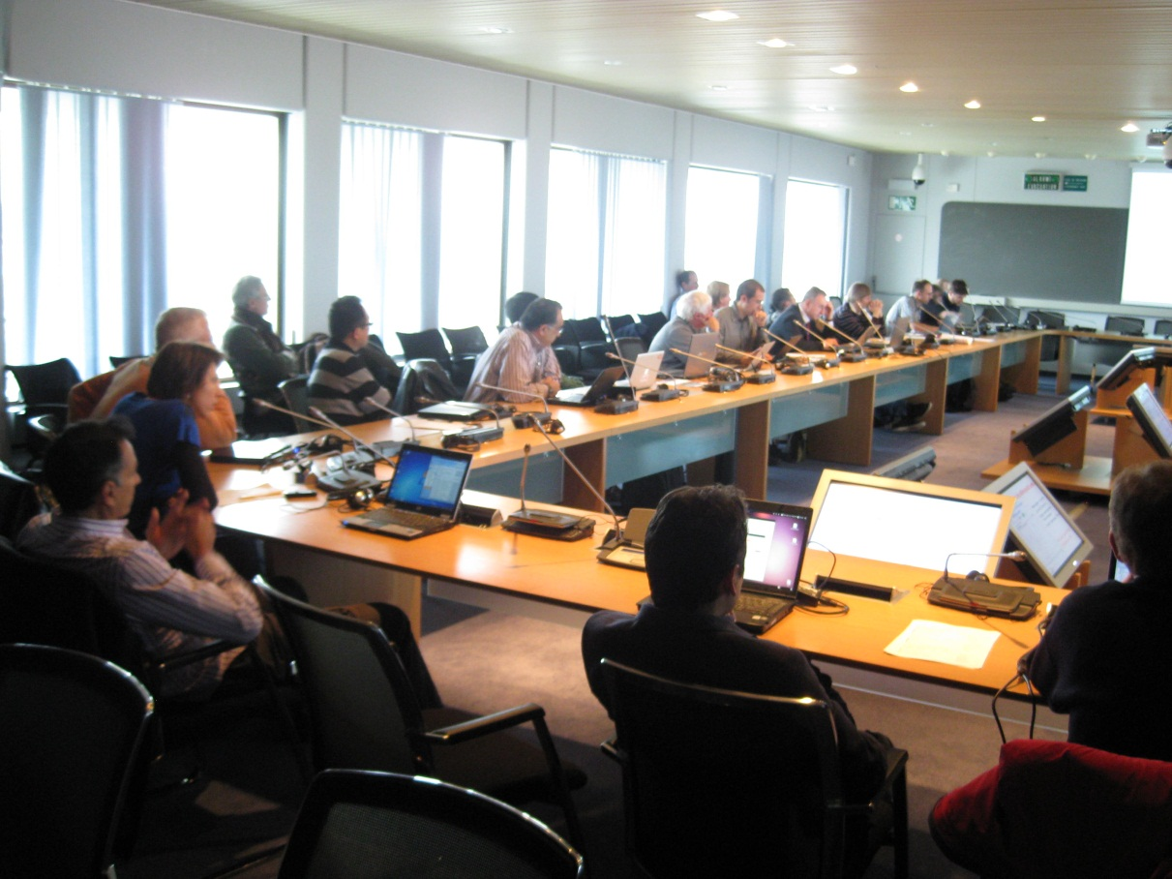
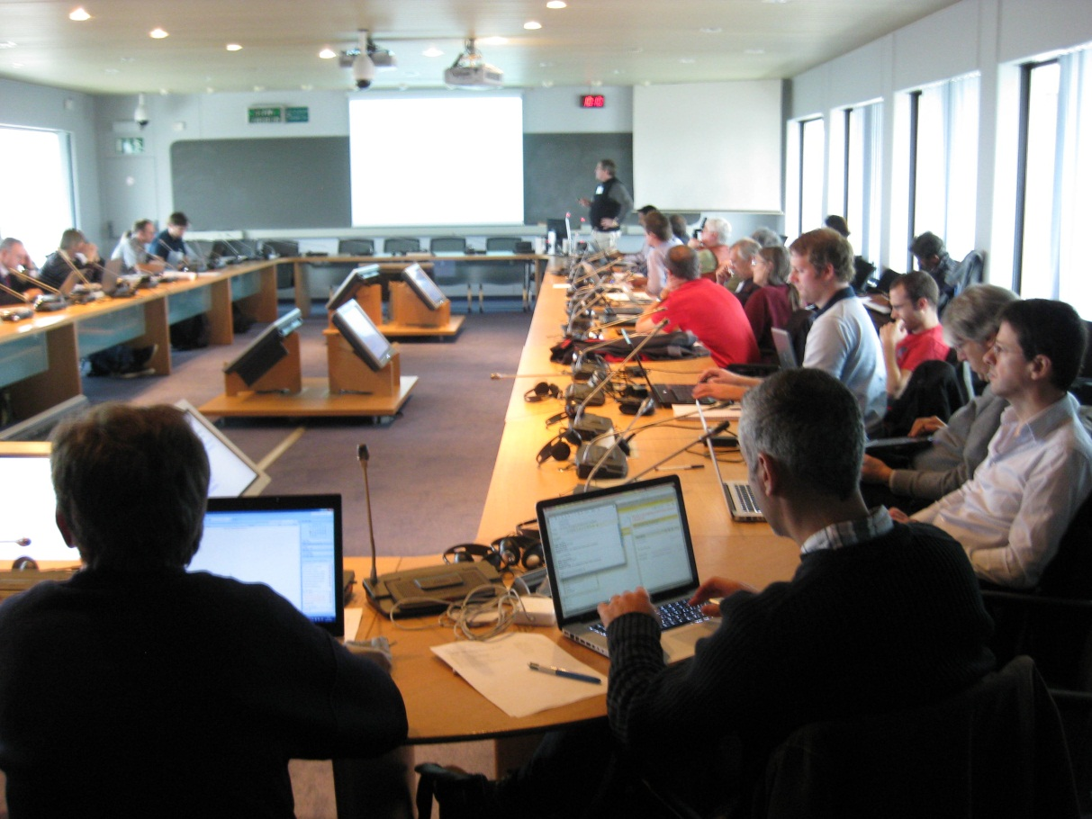
5th Joint EuCARD-AccNet – LARP – KEK – CI/DL workshop on LHC crab cavities
14-15 November 2011, CERN
https://indico.cern.ch/conferenceDisplay.py?confId=149614
draft summary to be finalized and published
Participants: about 52 persons (many institutes in Europe, US, and Japan)
46+3 presentations
Main results: convergence to 2 (3) compact crab-cavity designs; first Al prototypes; detailed cavity specifications will be prepared by April 2012 based on initial set of HL-LHC parameters; beam test of the compact design in the SPS and the LHC are pre-requisites for a final installation in LHC Points 1 and 5.
Organizers:
Rama Calaga, Rogelio Tomas, Frank Zimmermann

Slide 31
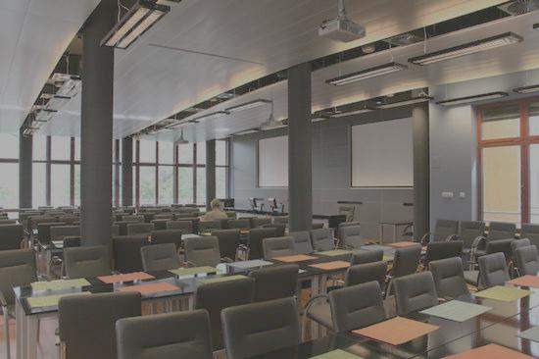
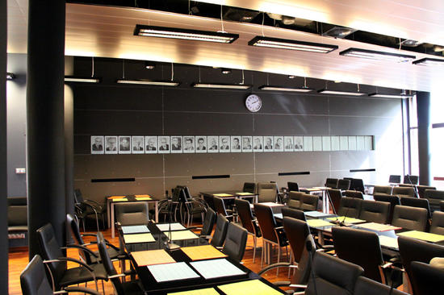
EuCARD-AccNet LLRF Collaboration meeting
14-16 December 2011, Warsaw University of Technology
https://indico.desy.de/conferenceDisplay.py?confId=4991
Programme under construction
Participants: about 35 persons (DESY, WUT, TUL,NCBJ,…)
RFTech will support all participants of this meeting
About 40 presentations
Main topic: integration of LLRF activities.
Virtual tour of main University building is here:
http://www.wirtualnapolitechnika.pl/
Organizer: Krzysztof Czuba

Slide 32
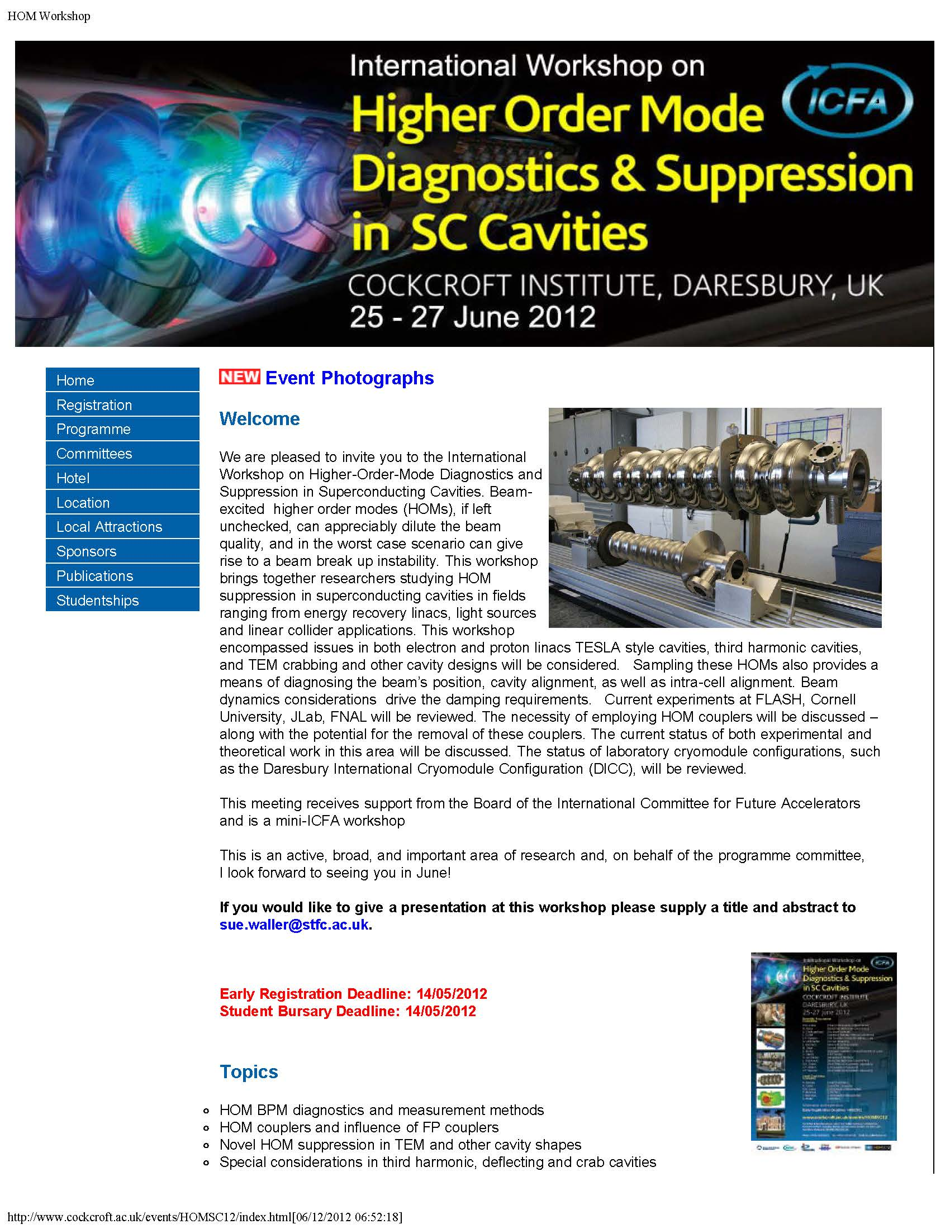
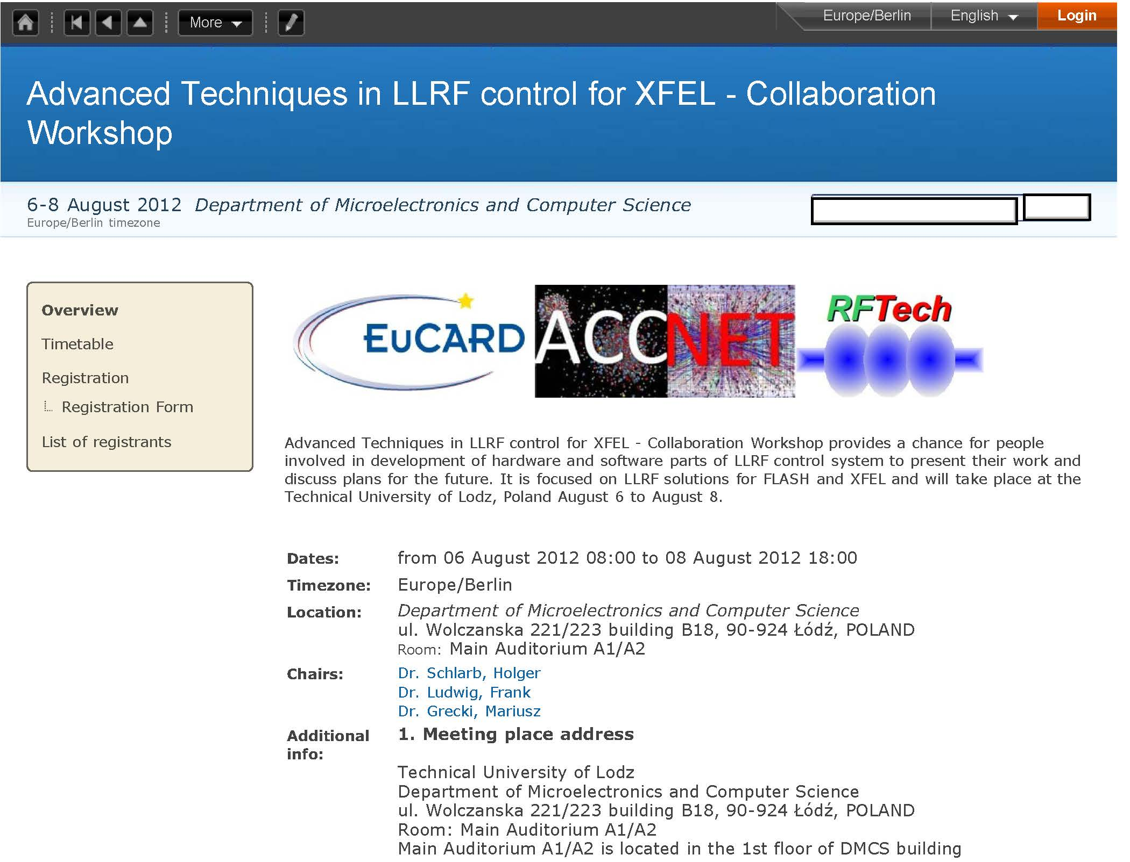
RFTech co-sponsored events, 2012

Slide 33
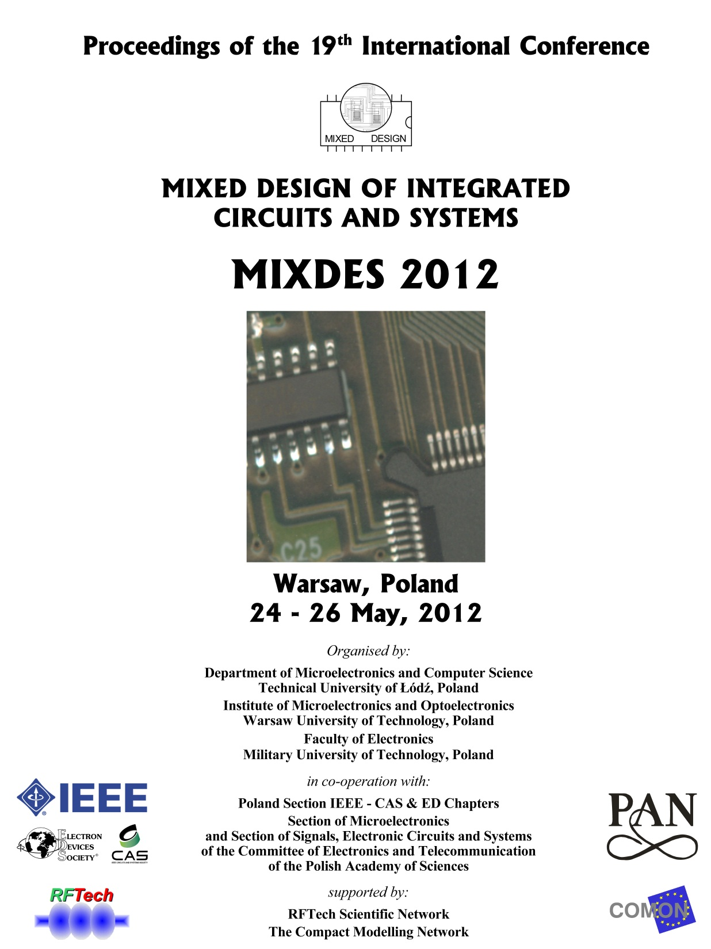
MixDes2012 proceedings

Slide 34
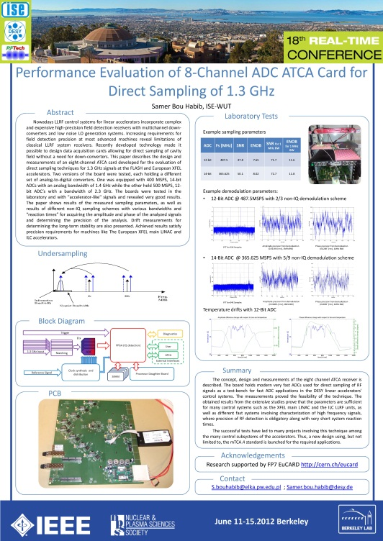
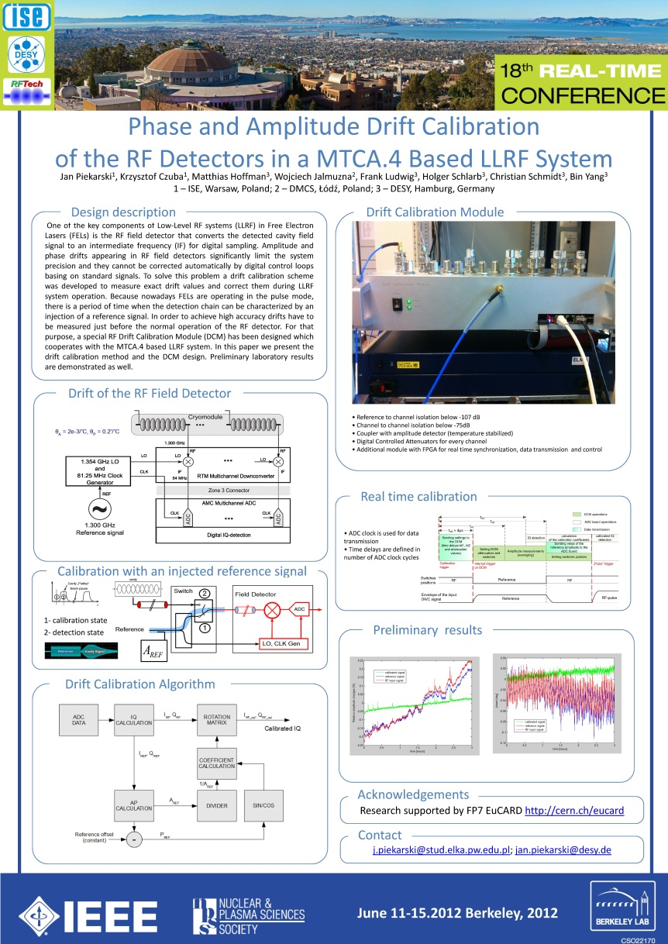
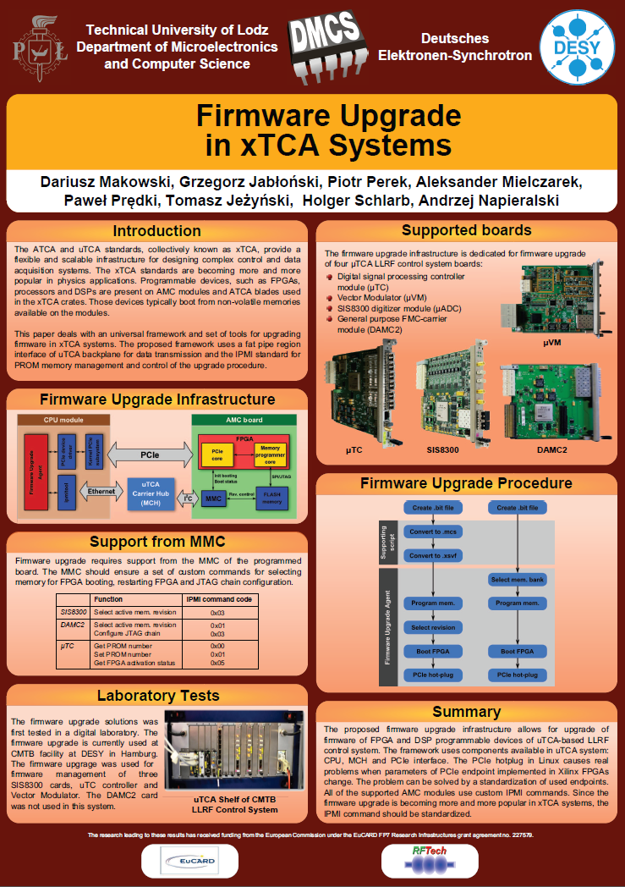
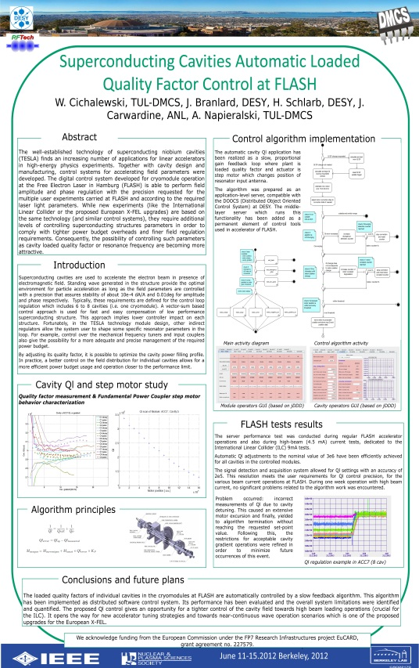
some RT2012 RFTech posters

Slide 35
parameter [unit] | LHeC
species | e± | p, ²⁰⁸Pb⁸²⁺
beam energy (/nucleon) [GeV] | 60 | 7000, 2760
bunch spacing [ns] | 25, 100 | 25, 100
bunch intensity (nucleon) [10¹⁰] | 0.1 (0.2), 0.4 | 17 (22), 2.5
beam current [mA] | 6.4 (12.8) | 860 (1110), 6
rms bunch length [mm] | 0.6 | 75.5
polarization [%] | 90 (e⁺ none) | none, none
normalized rms emittance [μm] | 50 | 3.75 (2.0), 1.5
geometric rms emittance [nm] | 0.43 | 0.50 (0.31)
IP beta function β*_{x,y} [m] | 0.12 (0.032) | 0.1 (0.05)
IP rms spot size [μm] | 7.2 (3.7) | 7.2 (3.7)
synchrotron tune | - | 0.0019
hadron beam-beam parameter | 0.0001 (0.0002)
lepton disruption parameter D | 6 (30)
hourglass reduction factor H_{hg} | 0.91 (0.67)
pinch enhancement factor H_{D} | 1.35 (0.3 for e⁺ )
luminosity/ nucleon [10³³ cm⁻²s⁻¹] | 1 (10), 0.2
LHeC baseline (& pushed) parameters

Slide 36
LEP3/TLEP parameters -1
 | LEP2 | LHeC | LEP3 | TLEP-Z | TLEP-H | TLEP-t
beam energy Eb [GeV] circumference [km] beam current [mA] #bunches/beam #e−/beam [10¹²] horizontal emittance [nm] vertical emittance [nm] bending radius [km] partition number J_{ε} momentum comp. α_{c} [10⁻⁵] SR power/beam [MW] β∗_{x} [m] β∗_{y} [cm] σ∗_{x} [μm] σ∗_{y} [μm] hourglass F_{hg} ΔE^{SR}_{loss}/turn [GeV] | 104.5 26.7 4 4 2.3 48 0.25 3.1 1.1 18.5 11 1.5 5 270 3.5 0.98 3.41 | 60 26.7 100 2808 56 5 2.5 2.6 1.5 8.1 44 0.18 10 30 16 0.99 0.44 | 120 26.7 7.2 4 4.0 25 0.10 2.6 1.5 8.1 50 0.2 0.1 71 0.32 0.59 6.99 | 45.5 80 1180 2625 2000 30.8 0.15 9.0 1.0 9.0 50 0.2 0.1 78 0.39 0.71 0.04 | 120 80 24.3 80 40.5 9.4 0.05 9.0 1.0 1.0 50 0.2 0.1 43 0.22 0.75 2.1 | 175 80 5.4 12 9.0 20 0.1 9.0 1.0 1.0 50 0.2 0.1 63 0.32 0.65 9.3

Slide 37
LEP3/TLEP parameters -2
 | LEP2 | LHeC | LEP3 | TLEP-Z | TLEP-H | TLEP-t
V_{RF,tot} [GV] δ_{max,RF} [%] ξ_{x}/IP ξ_{y}/IP f_{s} [kHz] E_{acc} [MV/m] eff. RF length [m] f_{RF} [MHz] δ^{SR}_{rms} [%] σ^{SR}_{z,rms} [cm] L/IP[10³²cm⁻²s⁻¹] number of IPs Rad.Bhabha b.lifetime [min] ϒ_{BS} [10⁻⁴] n_{γ}/collision Δδ^{BS}/collision [MeV] Δδ^{BS}_{rms}/collision [MeV] | 3.64 0.77 0.025 0.065 1.6 7.5 485 352 0.22 1.61 1.25 4 360 0.2 0.08 0.1 0.3 | 0.5 0.66 N/A N/A 0.65 11.9 42 721 0.12 0.69 N/A 1 N/A 0.05 0.16 0.02 0.07 | 12.0 5.7 0.09 0.08 2.19 20 600 700 0.23 0.31 94 2 18 9 0.60 31 44 | 2.0 4.0 0.12 0.12 1.29 20 100 700 0.06 0.19 10335 2 74 4 0.41 3.6 6.2 | 6.0 9.4 0.10 0.10 0.44 20 300 700 0.15 0.17 490 2 32 15 0.50 42 65 | 12.0 4.9 0.05 0.05 0.43 20 600 700 0.22 0.25 65 2 54 15 0.51 61 95

