Slide 1

@ESS
Christine Klauser^{1,2}
¹Institut Laue-Langevin, Grenoble, France
²Atominstitut, Technische Universität Wien, Austria

Slide 2
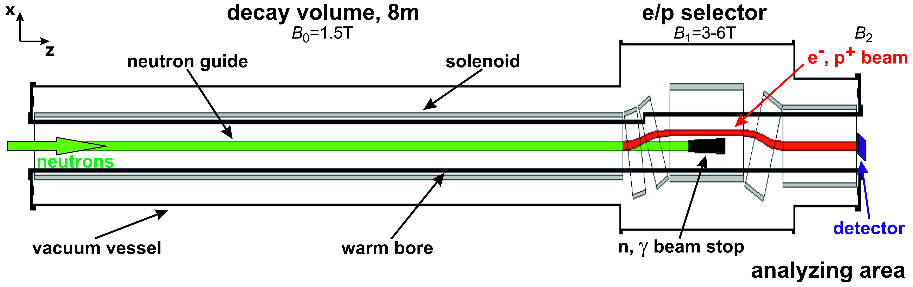
The Set-up
Goal: maximal statistics (well-defined flux)
chopper
Condition:
Final pulse length 2 m

Slide 3
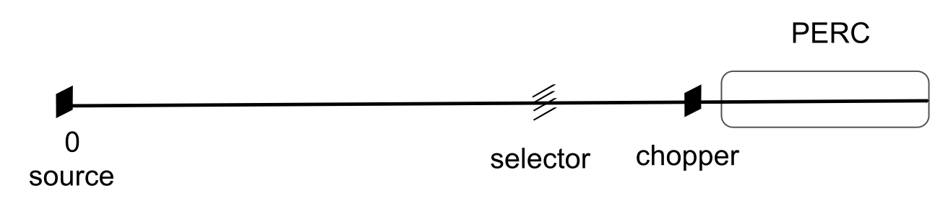

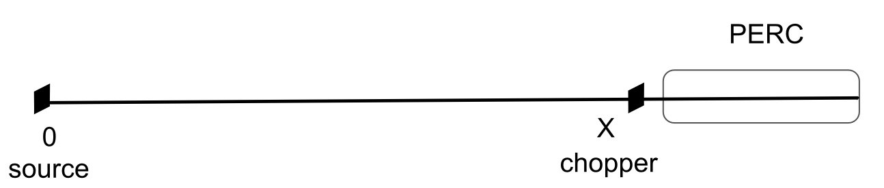

The Sources
4.5 - 5.5 Å
75 Hz
Peakflux ratio: 30
14 Hz
2.86 ms pulse length

Slide 4
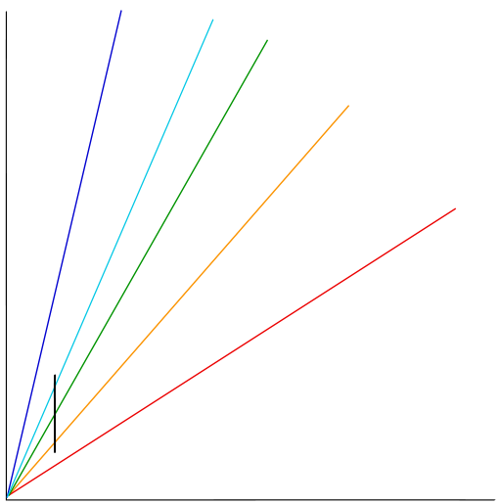
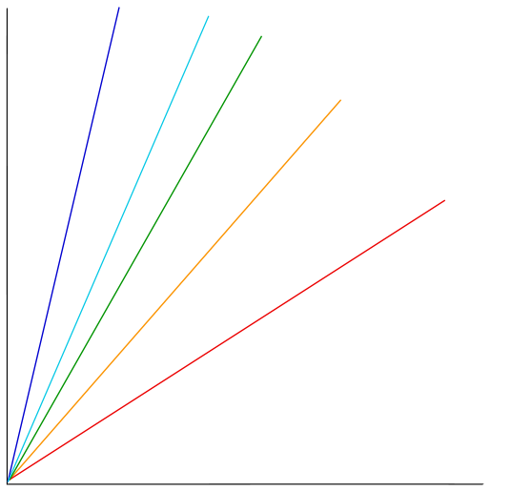
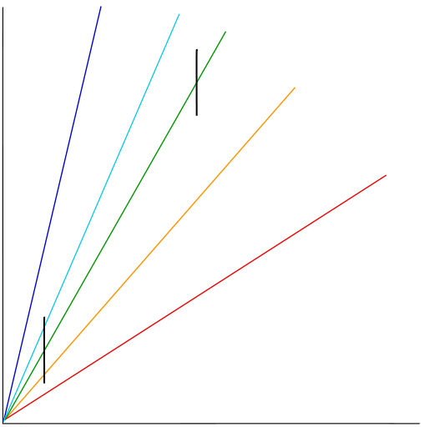
space
time

Slide 5
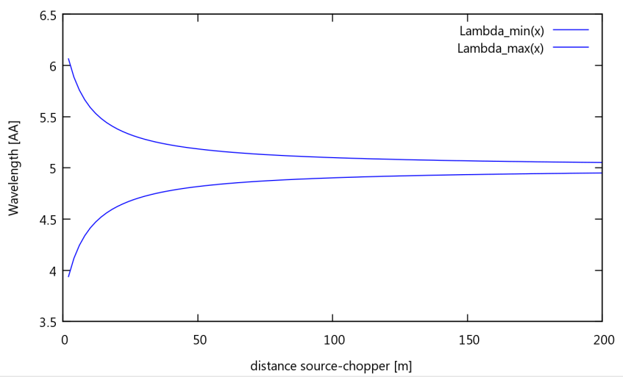
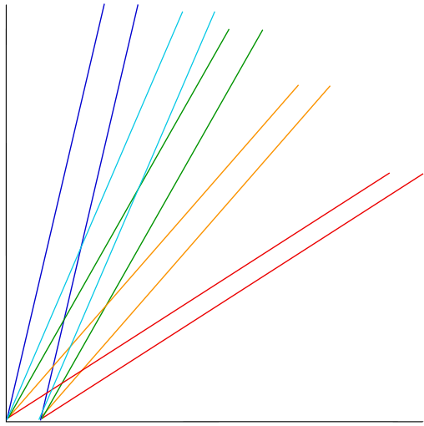
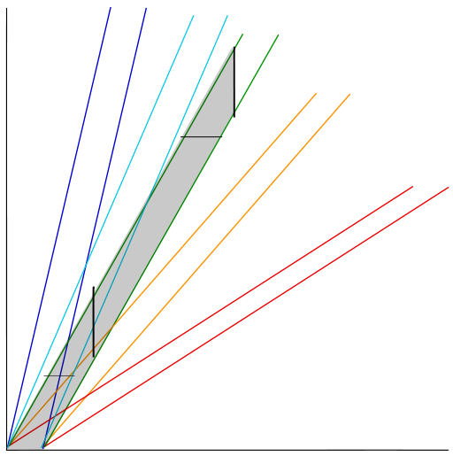
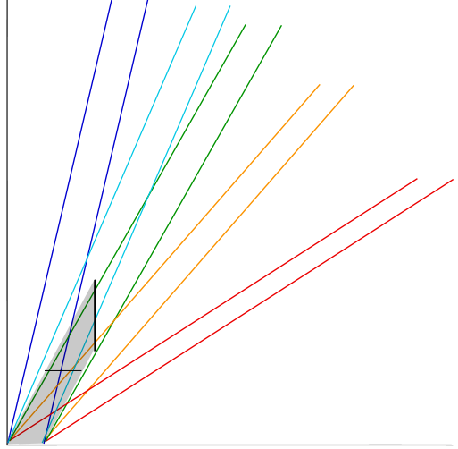
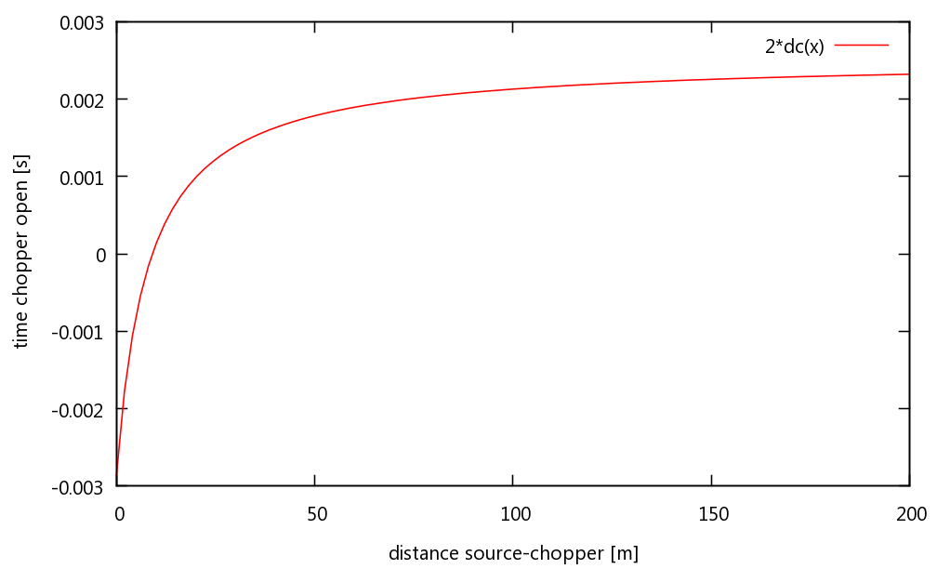
spectrum
space
Chopper opening time
time

Slide 6
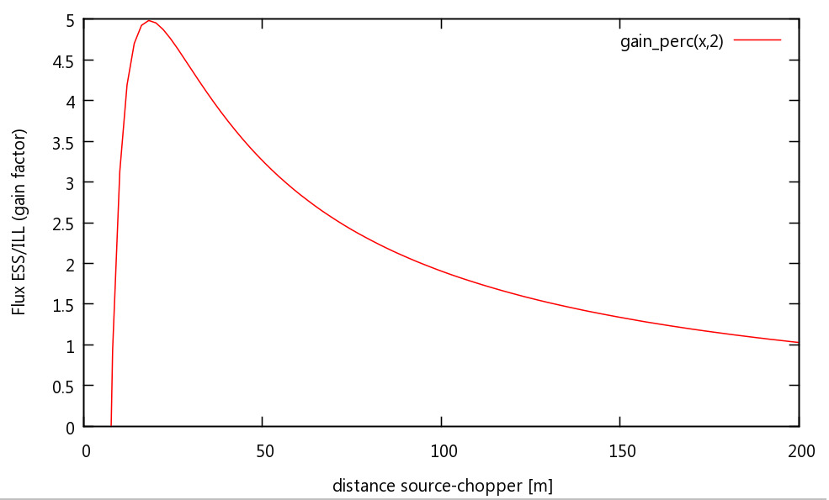
Comparison

Slide 7
spectrum
space
Chopper opening time
time

Slide 8
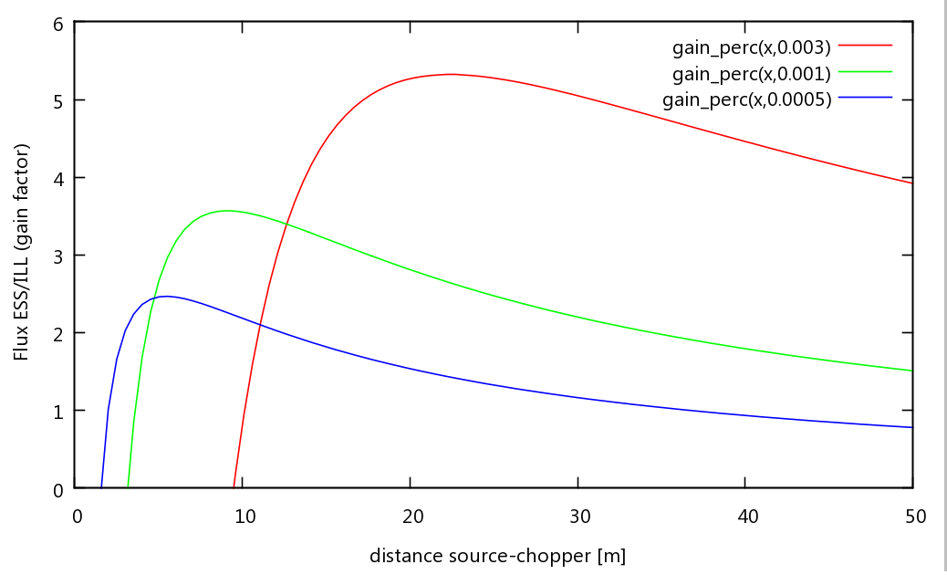
Initial Pulse Length

Slide 9
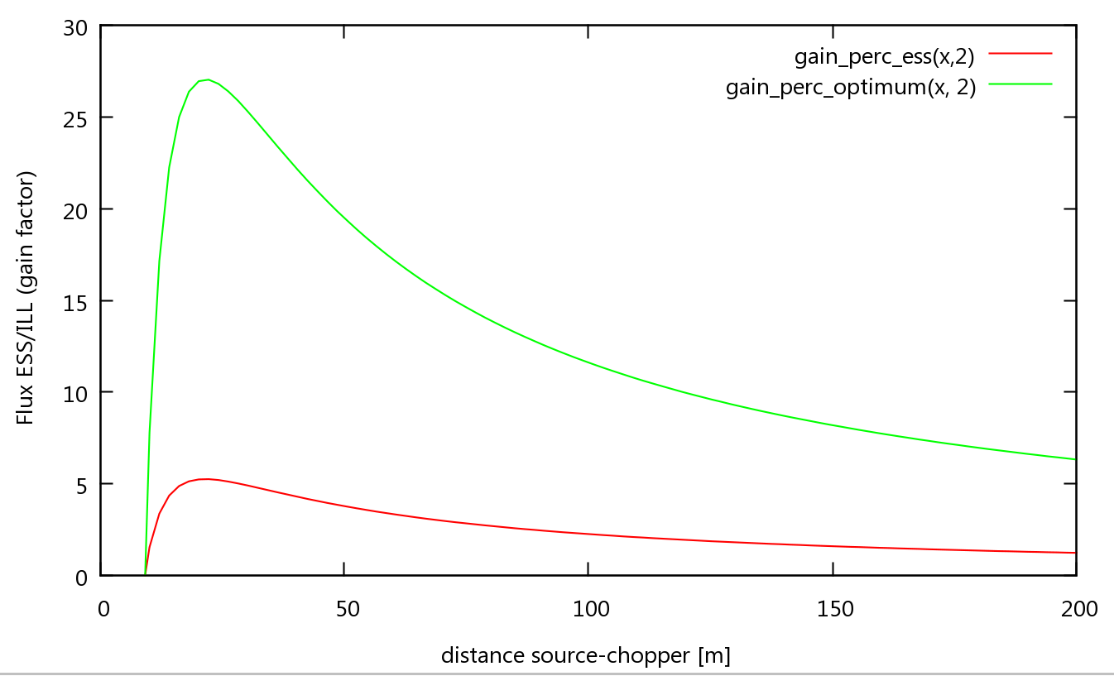
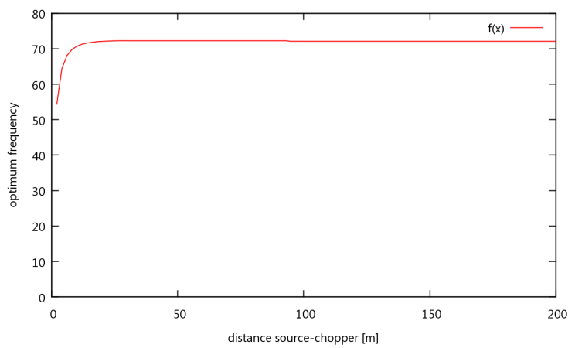
Optimised Frecquency

Slide 10
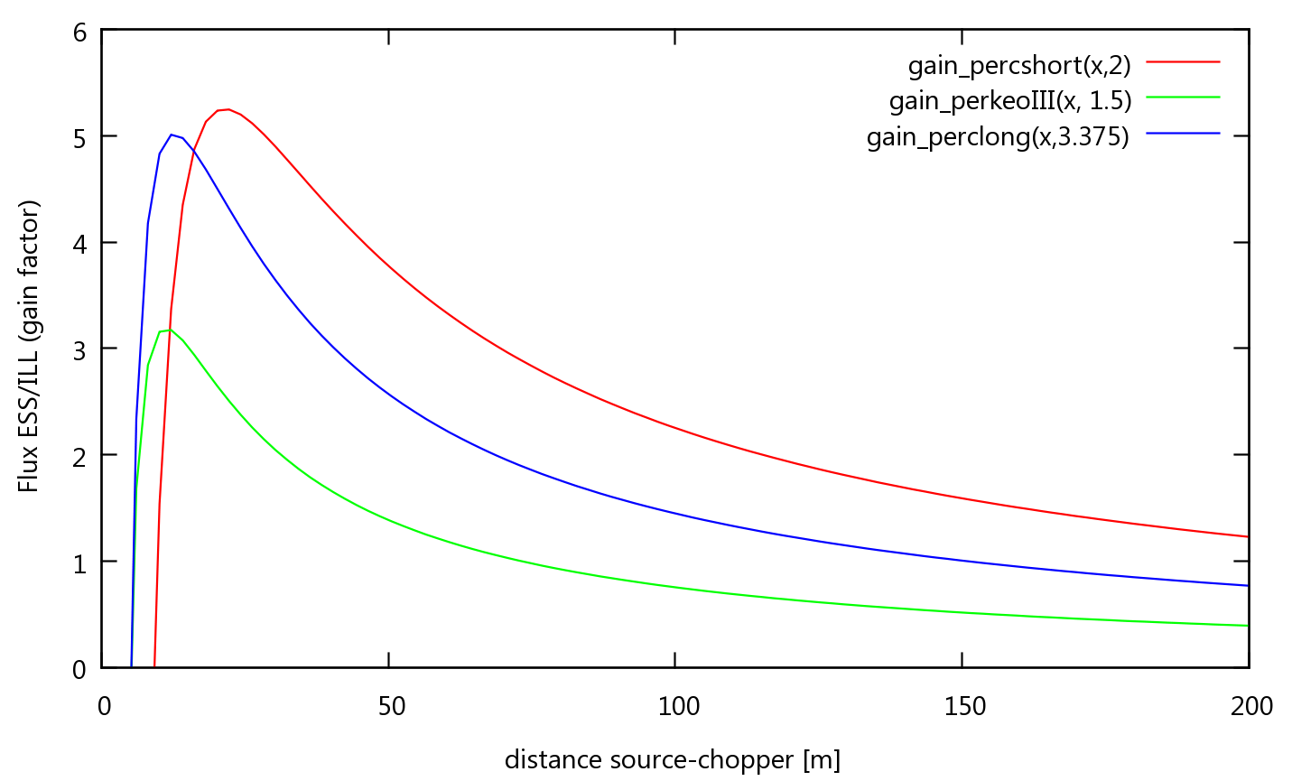
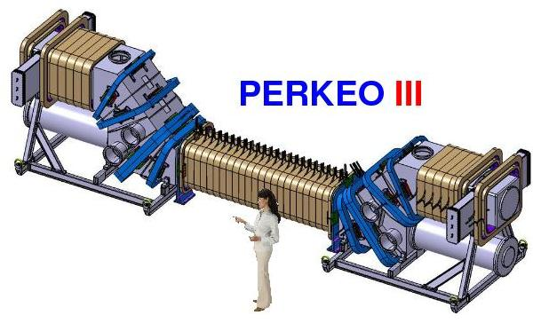
Ratio Decay Volume/Final Pulse Length
Gain PERC “normal”
Gain PERKEO
Gain PERC long pulse

Slide 11
Conclusion
ESS has a gain factor up to 5 for PERC compared to ILL
Gain varies considerably with distance
Ideal placement close to source

Slide 12
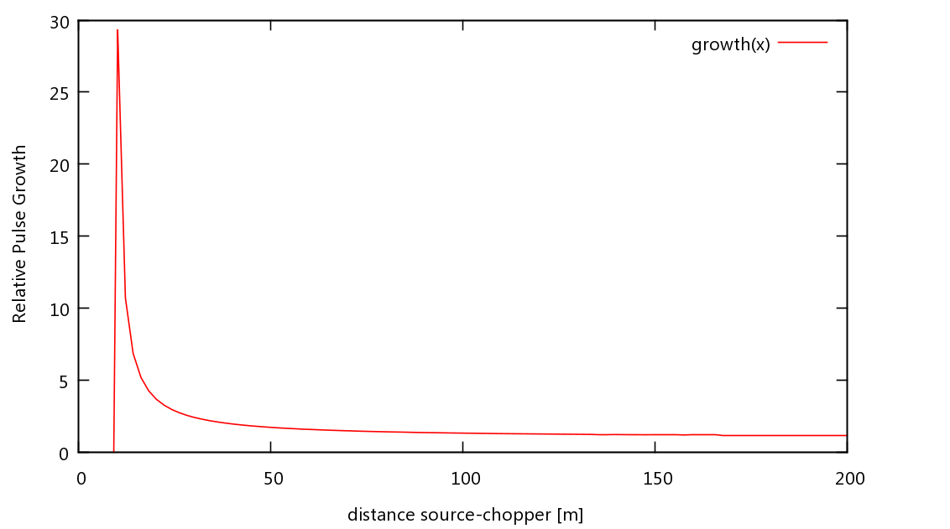
Pulse Growth In Decay Volume

