Slide 1
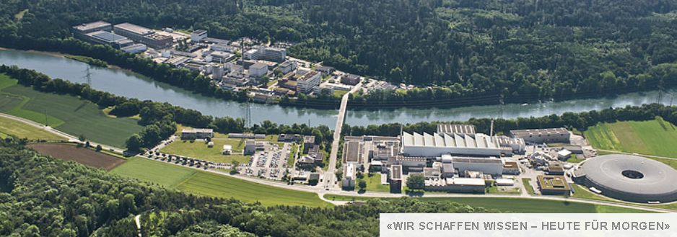
Ultracold neutron production at the second spallation target of the Paul Scherrer Institute
Bernhard Lauss
Paul Scherrer Institute
on behalf of the PSI UCN Project Team
Paul Scherrer Institute
Villigen, Switzerland

Slide 2
Contents
- Introduction to the PSI ultracold neutron source
- How we make the D2 crystal
- UCN measurements and specific tests

Slide 3
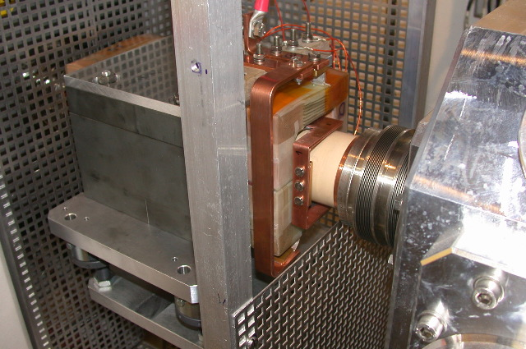
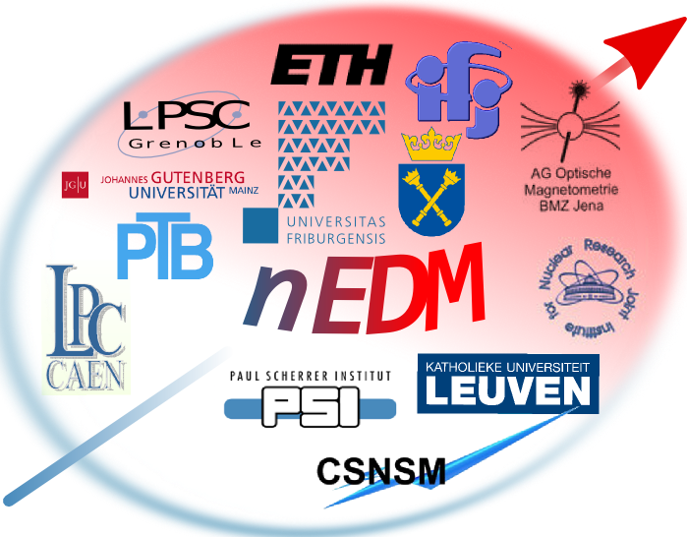
Neutron production via proton spallation on lead
kicker to UCN
Proton Accelerator
590 MeV Cyclotron
2.2 mA beam current
2.4 mA regular test operation days
UCN Source
2 experimental areas / 3 beamlines
nEDM
installed

Slide 4
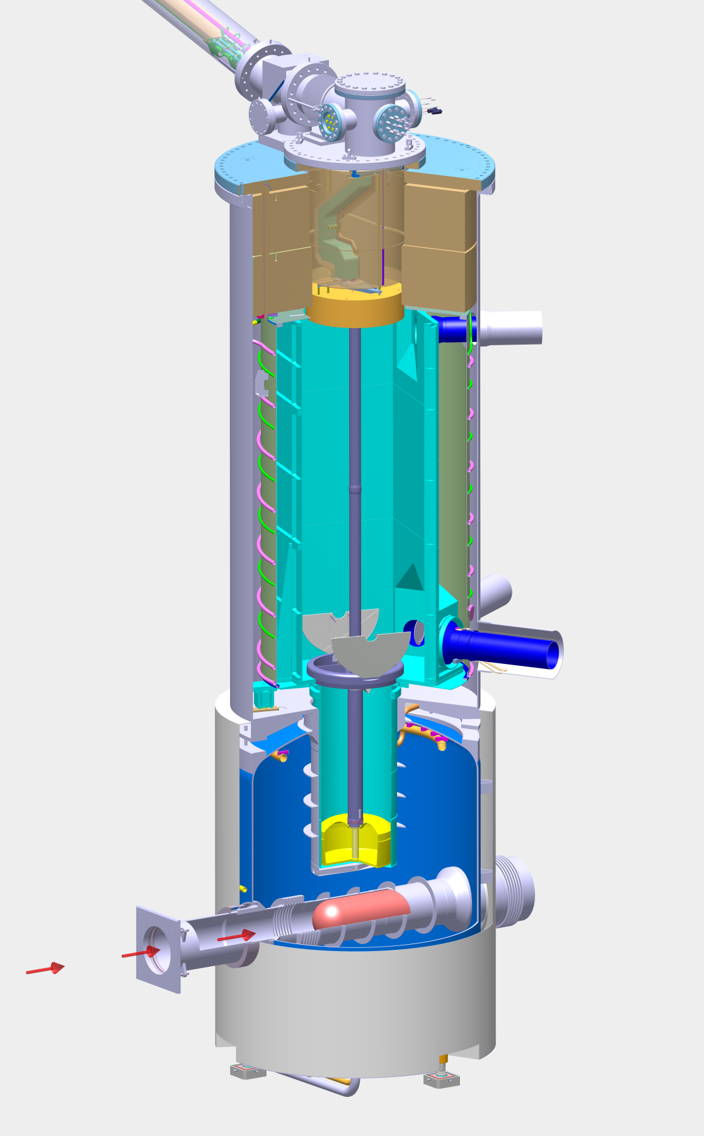
Sketch of the PSI UCN source
tank
cryo-pump
DLC coated
UCN storage vessel
height 2.5 m, ~ 2 m³
UCN guides towards
experimental areas
8.6m(S) / 6.9m(W)
7 m
heavy water moderator
→ thermal neutrons
3.6m³ D₂O
SV-shutter
cold UCN-converter
~30 dm³ solid D₂ at 5 K
pulsed
1.3 MW p-beam
590 MeV, 2.2 mA,
1% duty cycle
spallation target (Pb/Zr)
(~ 8 neutrons/proton)

Slide 5
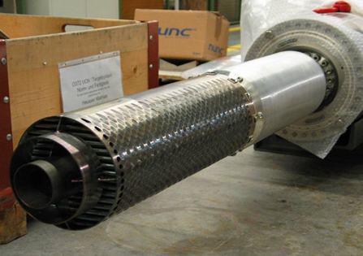
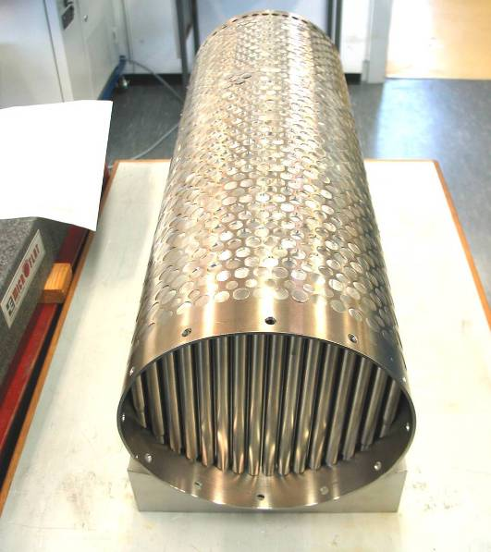
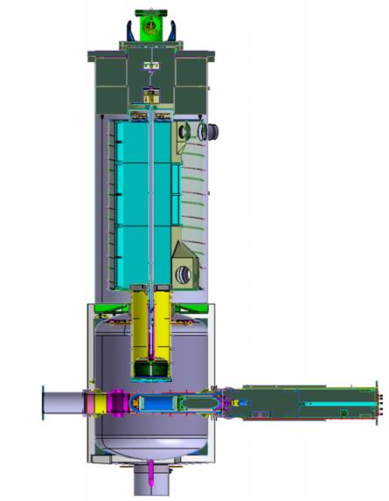
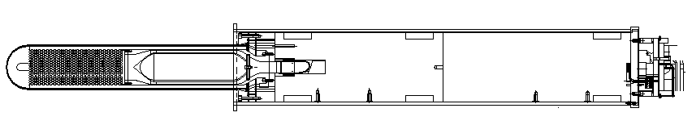
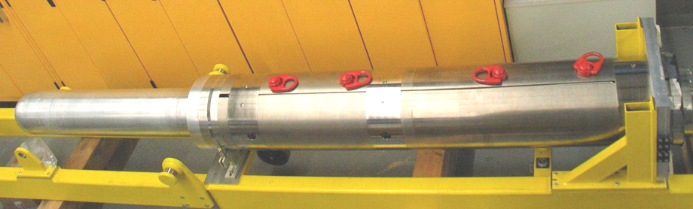
The lead spallation target
756
Zr/Pb
Canneloni
length = 390 cm weigth = 2000 kg cooling = 10 kg D₂O / sec
Target array
AlMg₃ Container
Steel shielding
Pb
Fe
p
Beam window
Pb structure

Slide 6
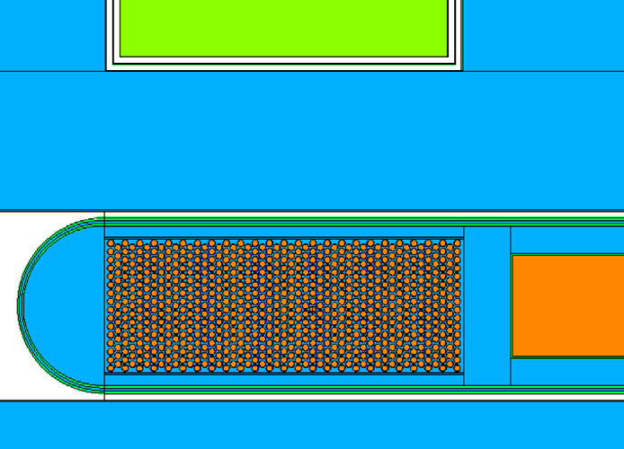
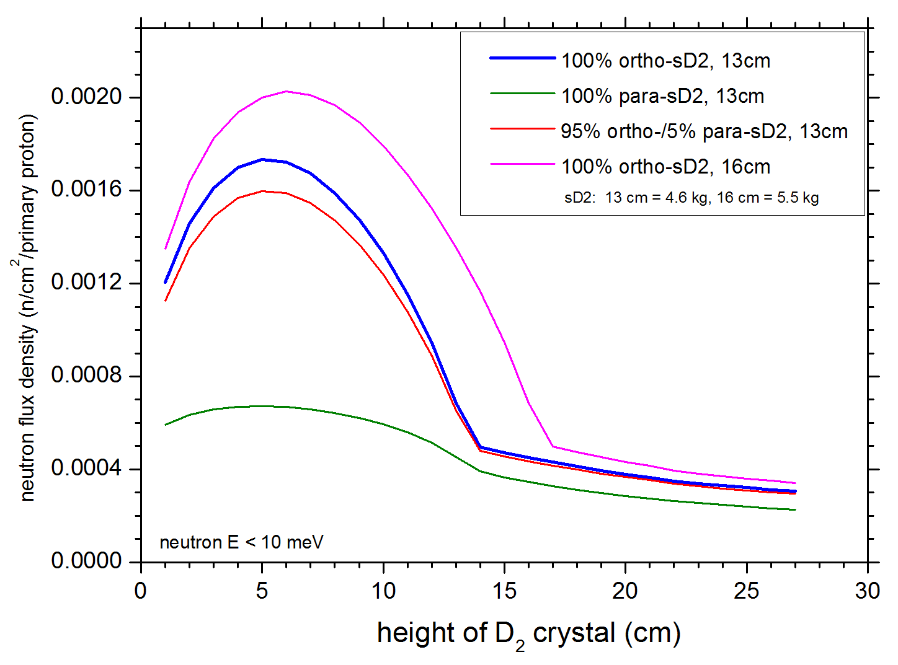
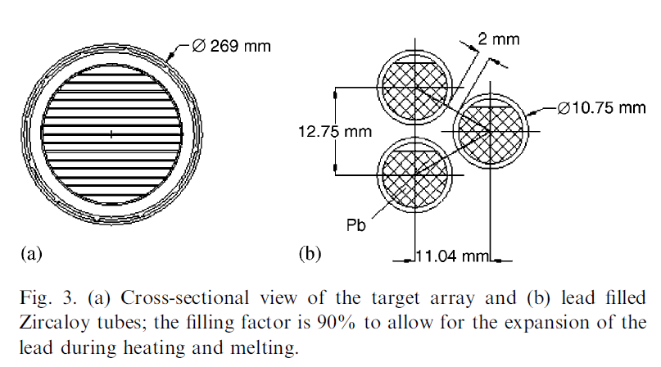
Initial neutron yield ~7 n per primary proton
M. Wohlmuther, G. Heidenreich / Nuclear Instruments and Methods in Physics Research A 564 (2006) 51–56
first MCNP-X simualtions
10¹⁶p/s
Now technical details of the spallation target,
lead-block versus cannelloni type target,
and more accurate model (as built).
-> total cold n flux ~ factor 2 lower than in original estimate
MCNPX calculations by
Vadim Talanov,
Michael Wohlmuther

Slide 7
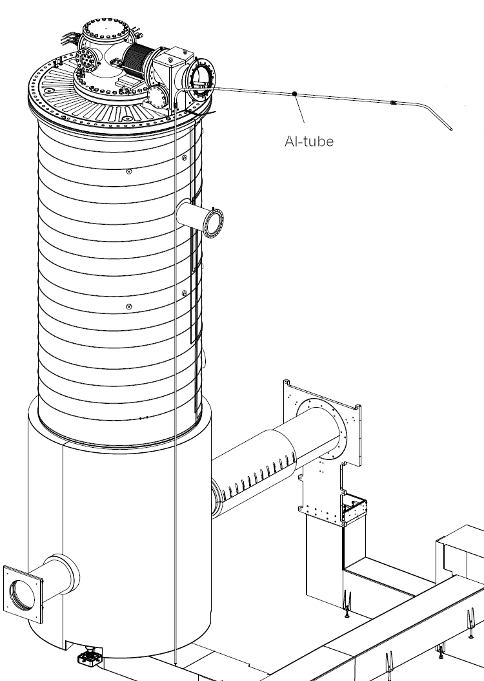
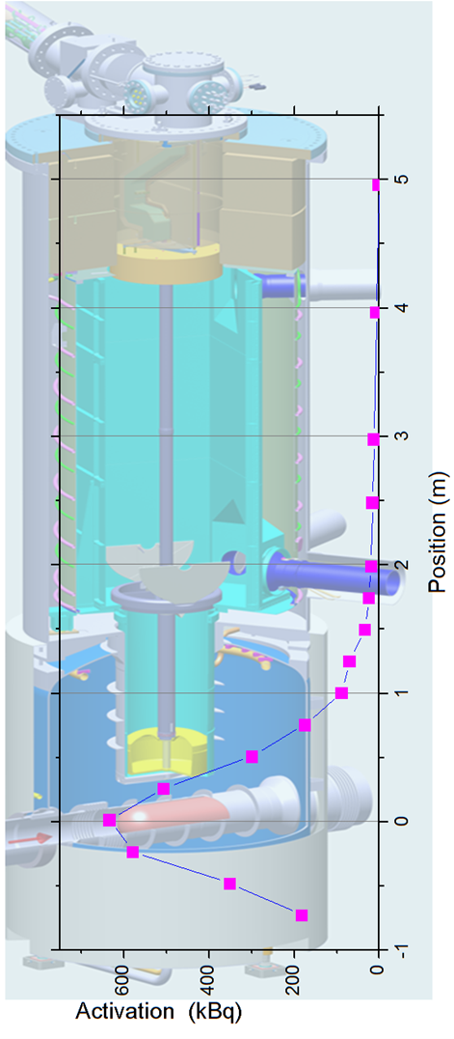
Activation measurement
- gold foil activation measurement
- first full Monte Carlo Simulation and measurement agree at beam height within 30%. (15% uncertainty from foil position)
- tritium activation measurement, development of new method, first analysis ongoing
MCNPX calculations update underway (Michael Wohlmuther, Vadim Talanov)

Slide 8


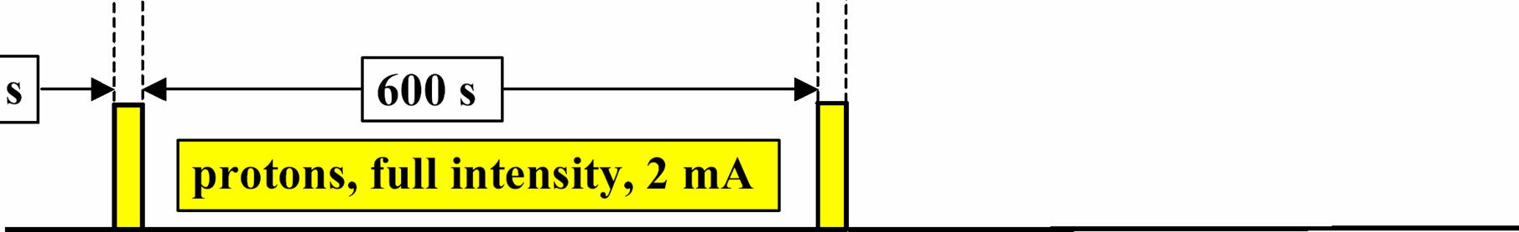
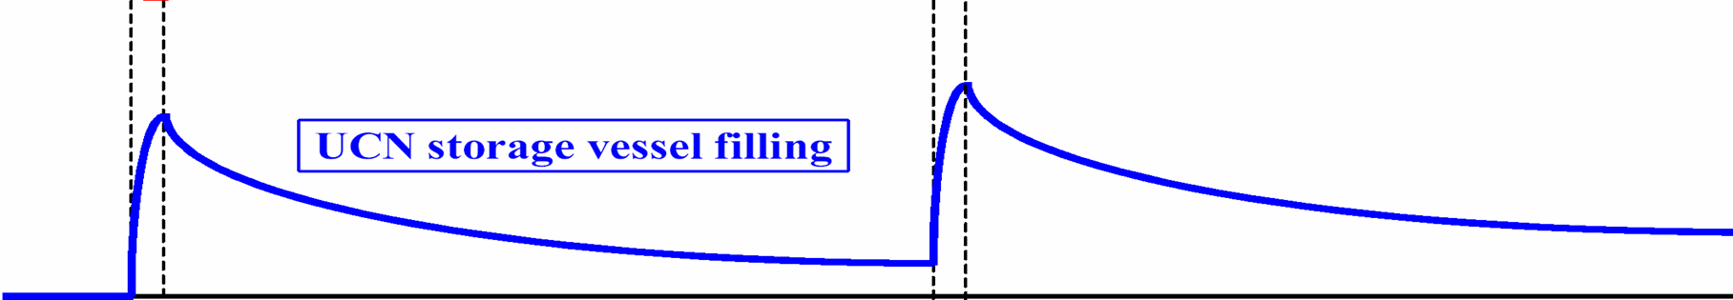
Beam operation scheme
1% duty cycle
8s
800s
full proton beam up to 2.4 mA
tested operation of pulses from 7ms, 50ms to 8s
and beam currents from 100 to 2400 μA
continuous mode operation possible with beam current <20 μA

Slide 9
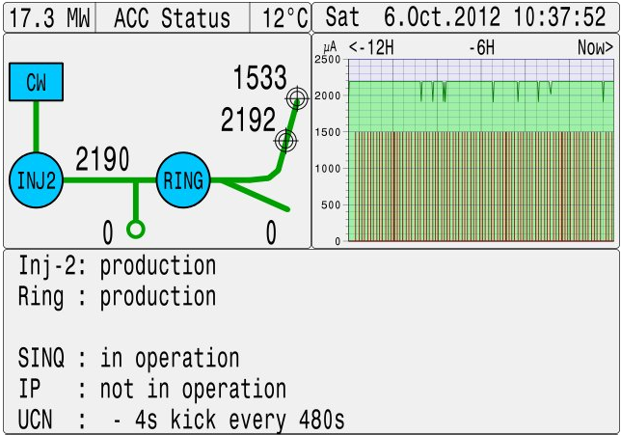
Beam operation scheme
1% duty cycle
8s
800s
full proton beam up to 2.4 mA
tested operation of pulses from 7ms, 50ms to 8s
and beam currents from 100 to 2400 μA
continuous mode operation possible with beam current <20 μA

Slide 10
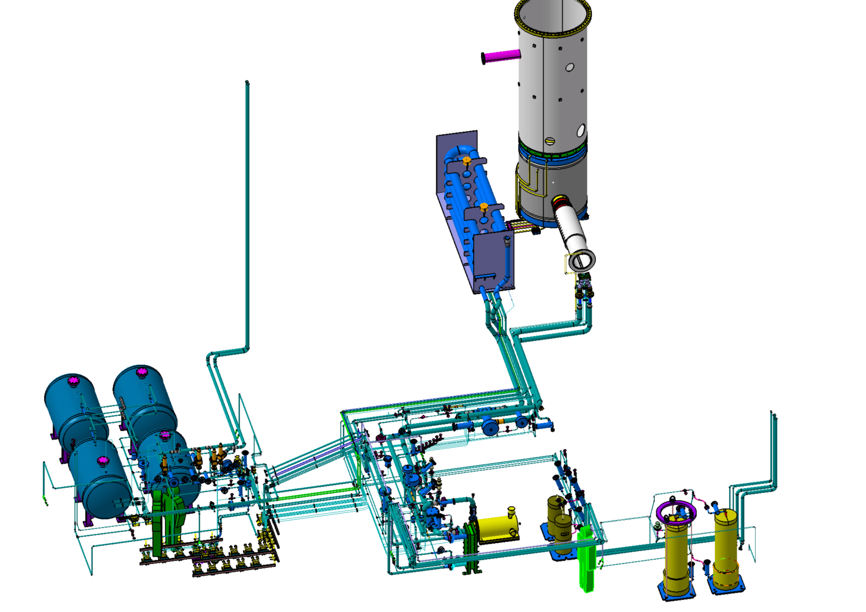
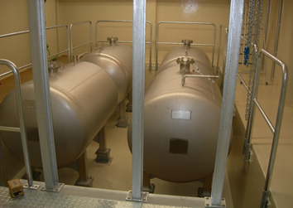
Heavy water system for
neutron moderation and target cooling
- D₂O purity checked in Jan 2012 - good as expected
delay column

Slide 11
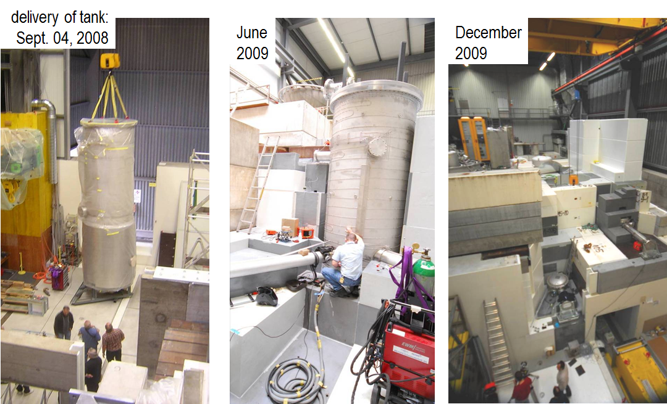
UCN Tank

Slide 12
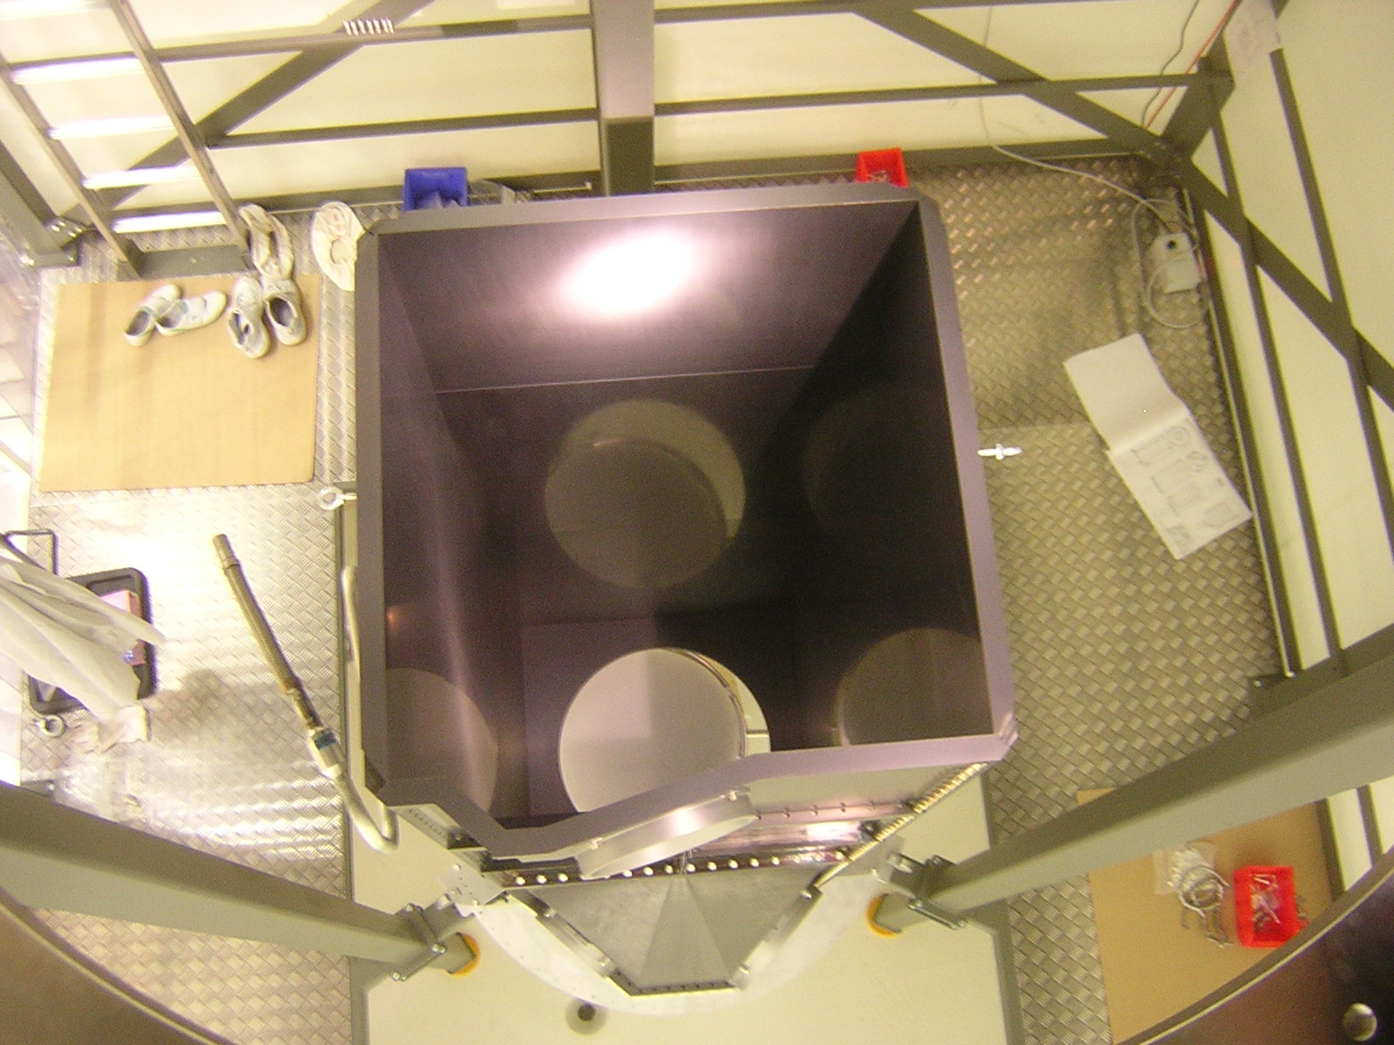
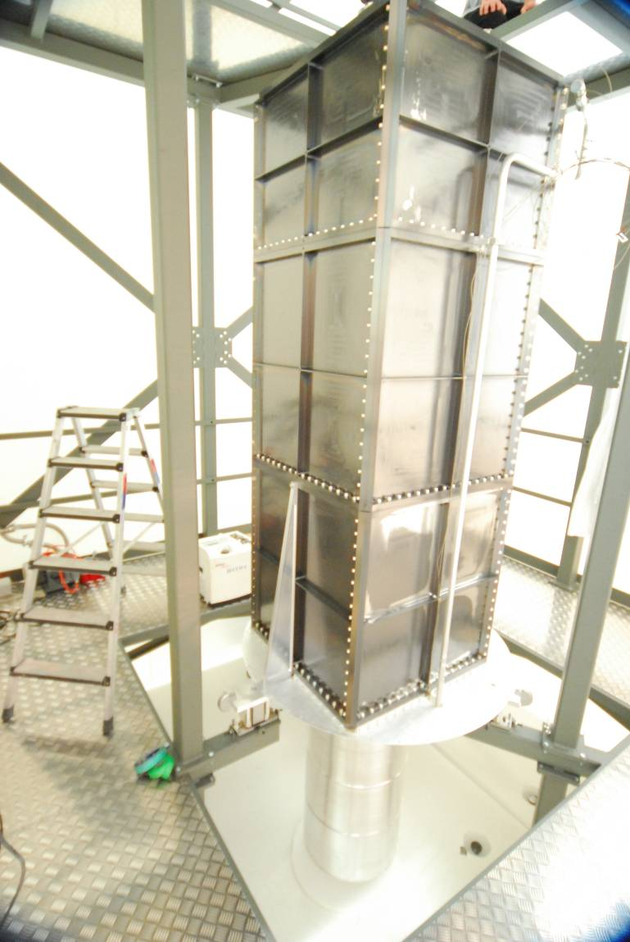
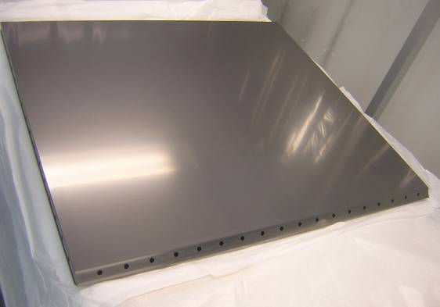
UCN storage volume
1 m
DLC coating
vertical
UCN guide
2 - 6 mm thick
ultrapure Al

Slide 13
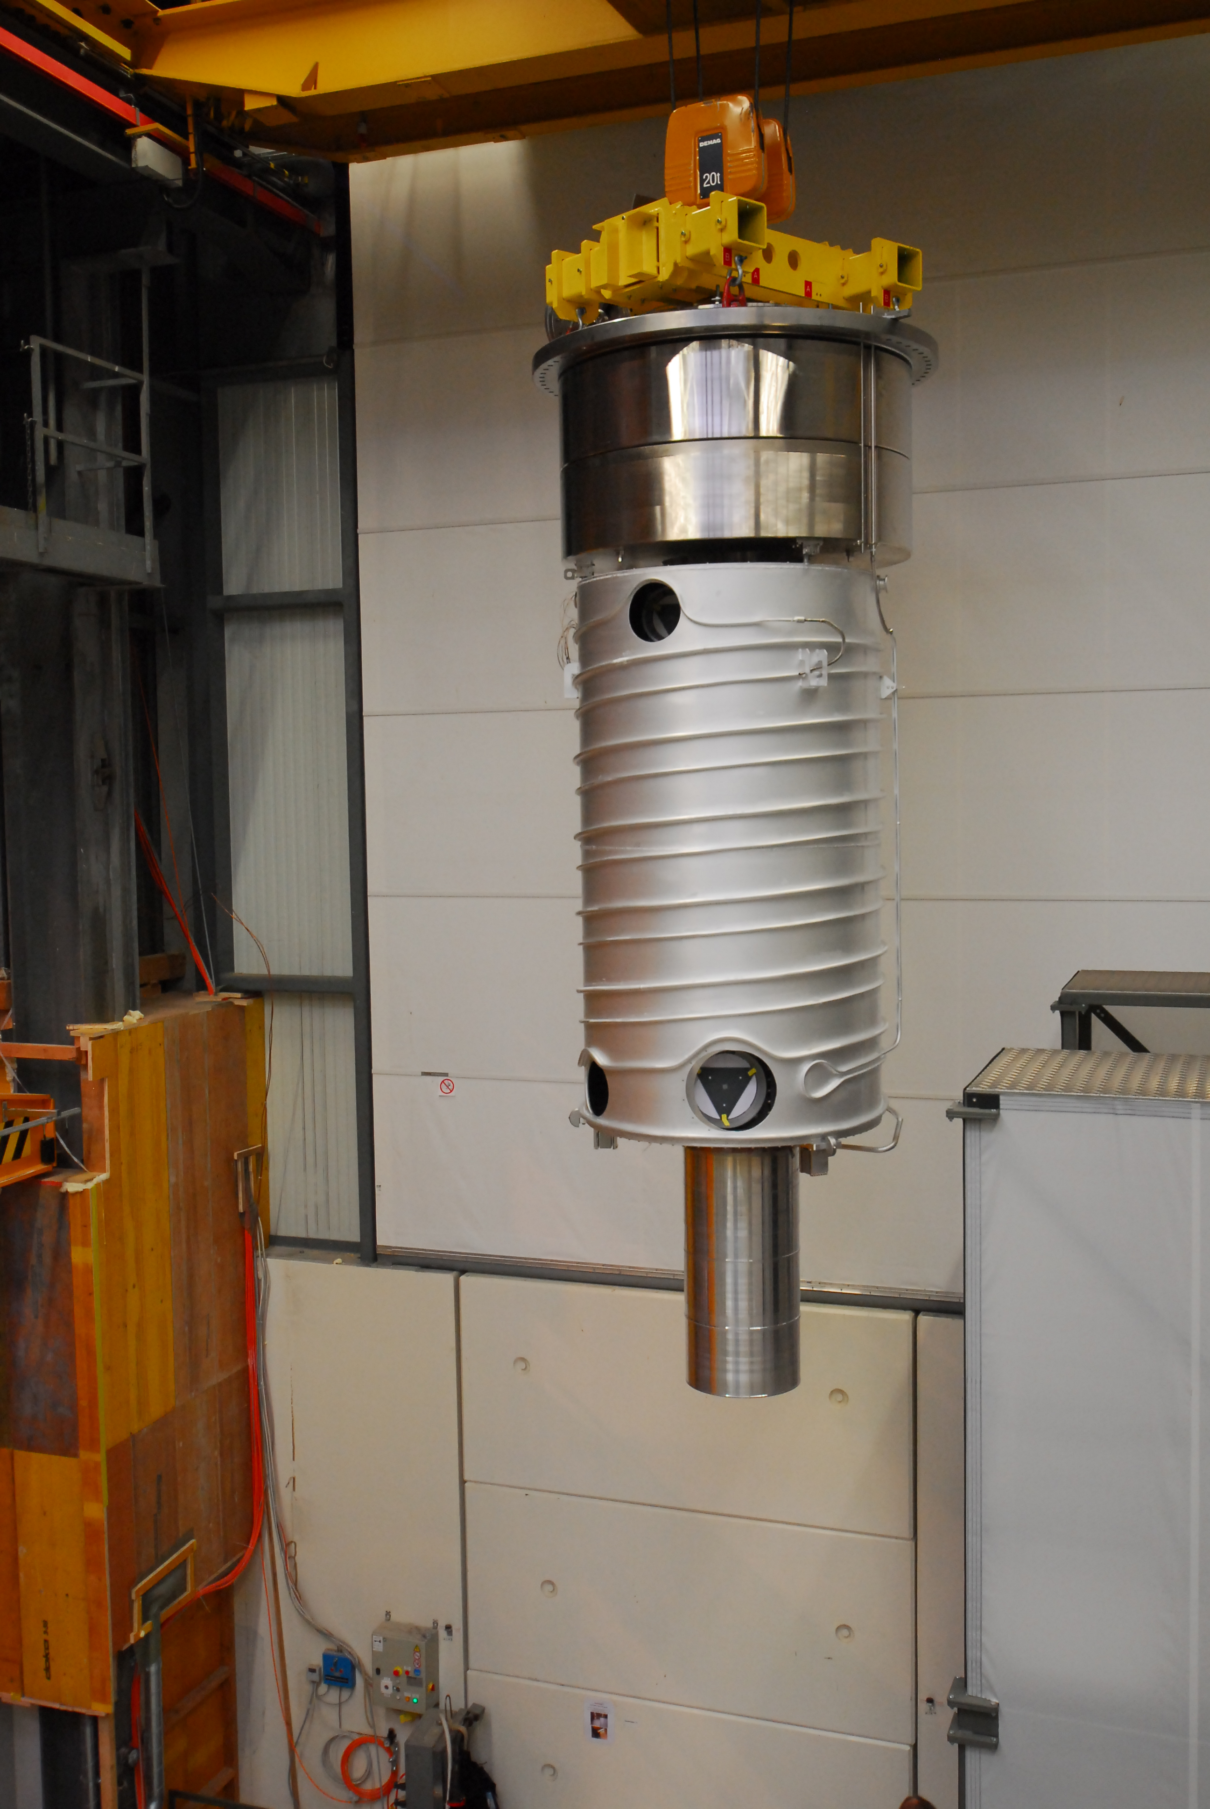
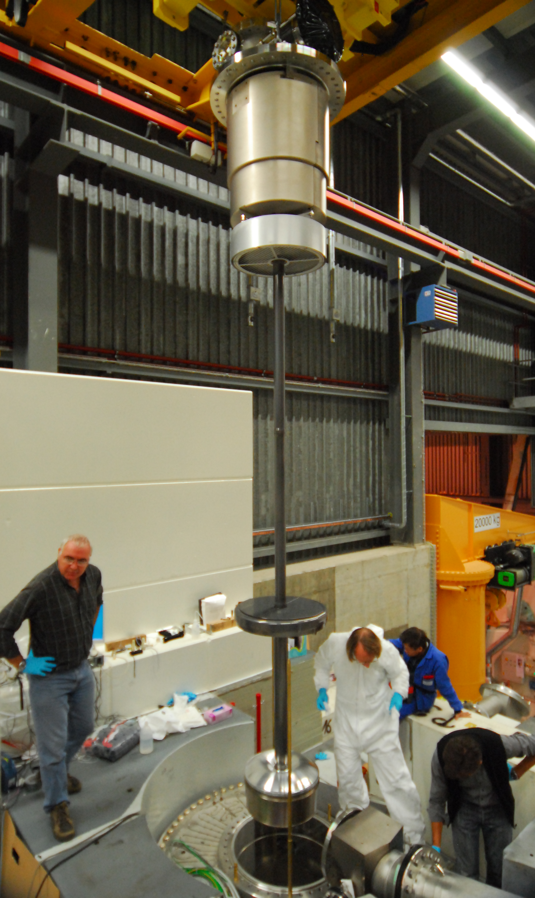
Installation of the storage volume unit
and the deuterium unit
fall 2010
10 tons
steel
cryo pump
~5m
thermal shield 70K (surrounding the storage volume)
vertical UCN guide
2 - 6 mm thick
ultrapure Al
main shutter
←±15mm

Slide 14
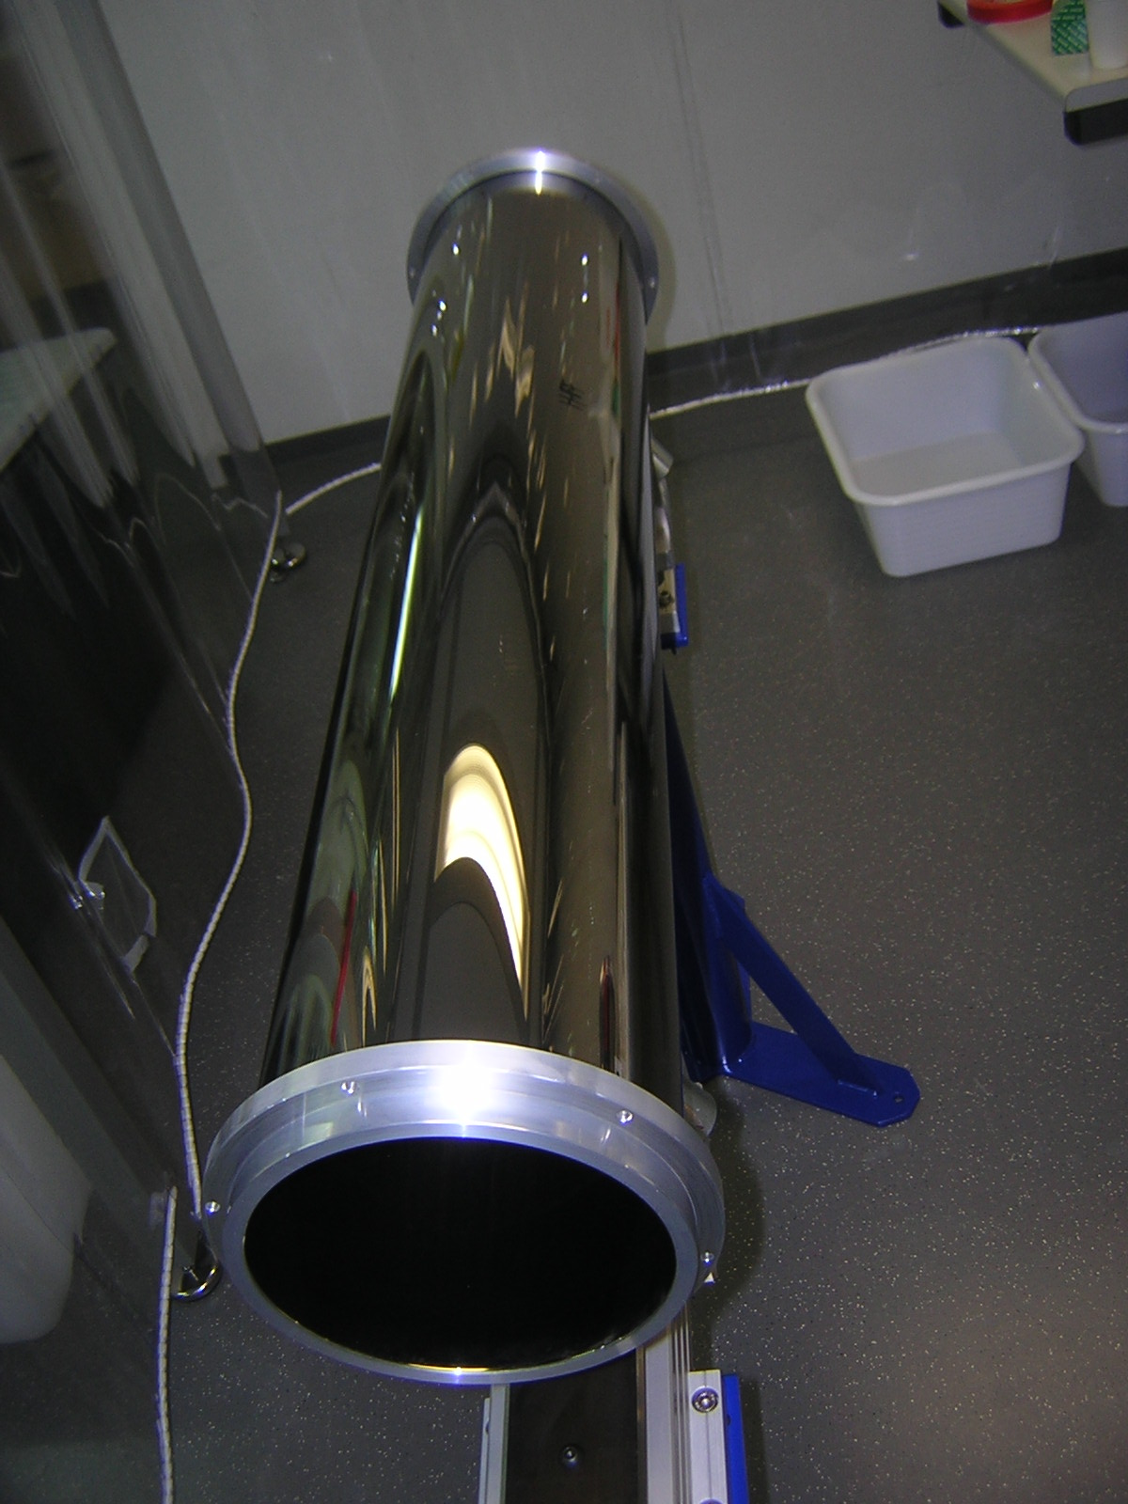
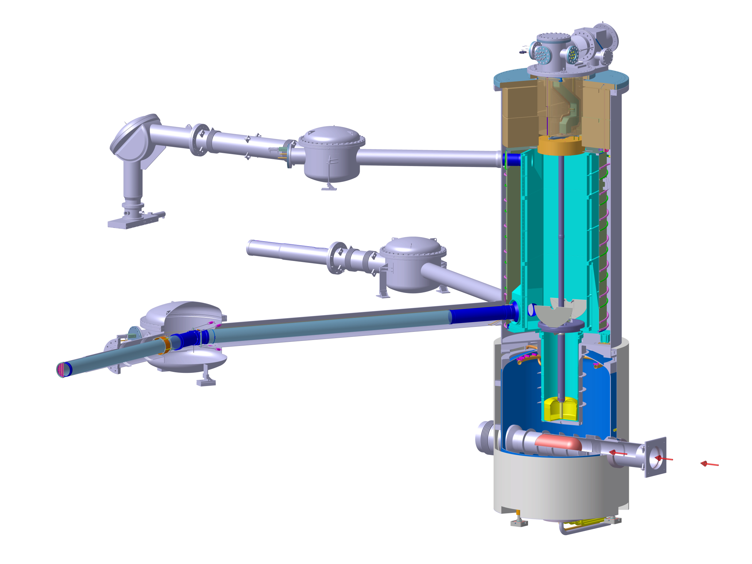
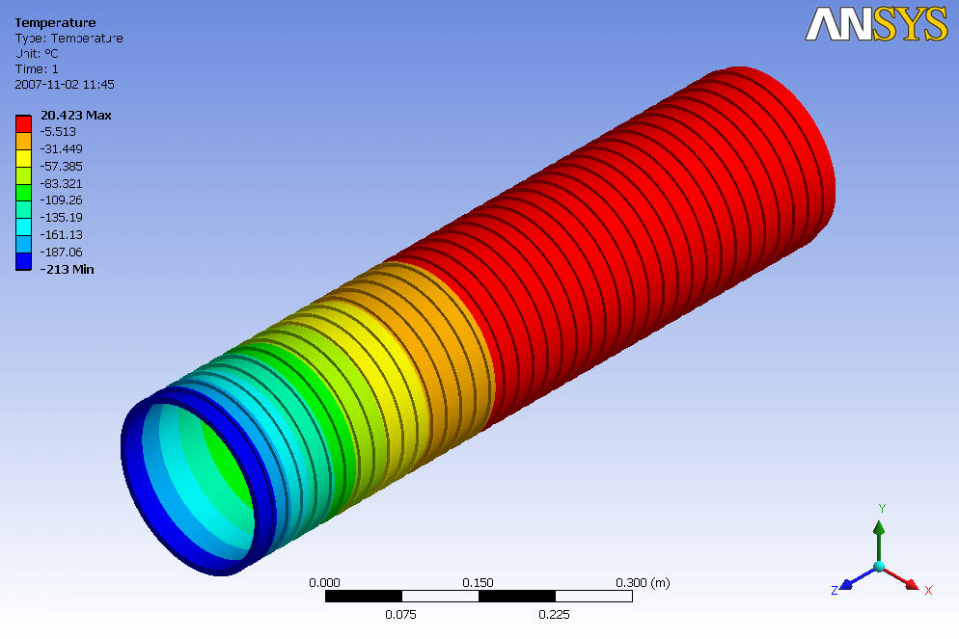
Neutron guides pass the biological shield and guide the UCN to the experimental areas
~8 m length from storage volume to experiment port passing through the shield
glass parts
-ID=180mm
surface roughness better than 1nm
coated with NiMo
nEDM
>98% UCN transmission per meter measured for all guide parts
- sample for every guide measured with cold n reflectometer ~ 217 neV
- every installed guide was tested with UCN at PF2,
cordial thanks to Peter Geltenbort and Thomas Brenner

Slide 15
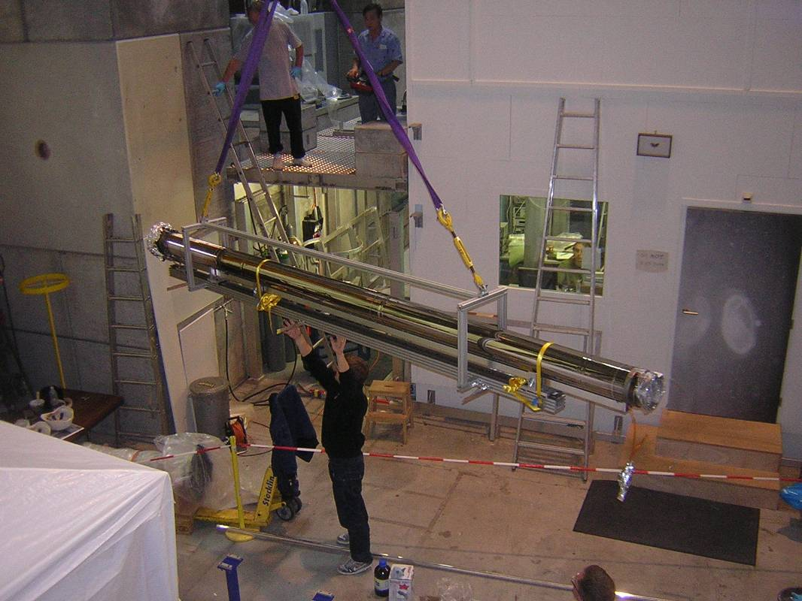
Installation of longest UCN guide towards nEDM
nEDM thermohouse

Slide 16
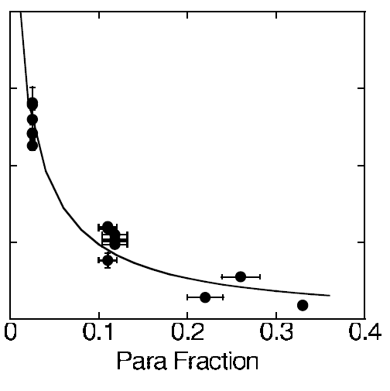
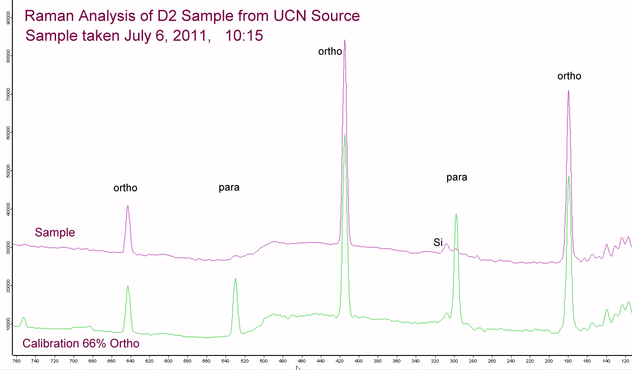
Check conversion of Ortho-to Para-Deuterium
at 98% ortho-D2 τ_{ucn} dominated by: Nuclear absorption σ(H) =0.3barn σ(D)=0.0005barn
rotational Raman peaks
S₀(2)
S₀(0)
ortho/para fraction
S₀(1)
S₀(4)
S₀(3)
LANL /
C.Morris et al,
Phys.Rev.Lett.89(2002)272501
30
20
10
UCN lifetime in D₂ (ms)
⇨ 98 ± 2 % ortho-D₂
reconfirmed in several measurements

Slide 17
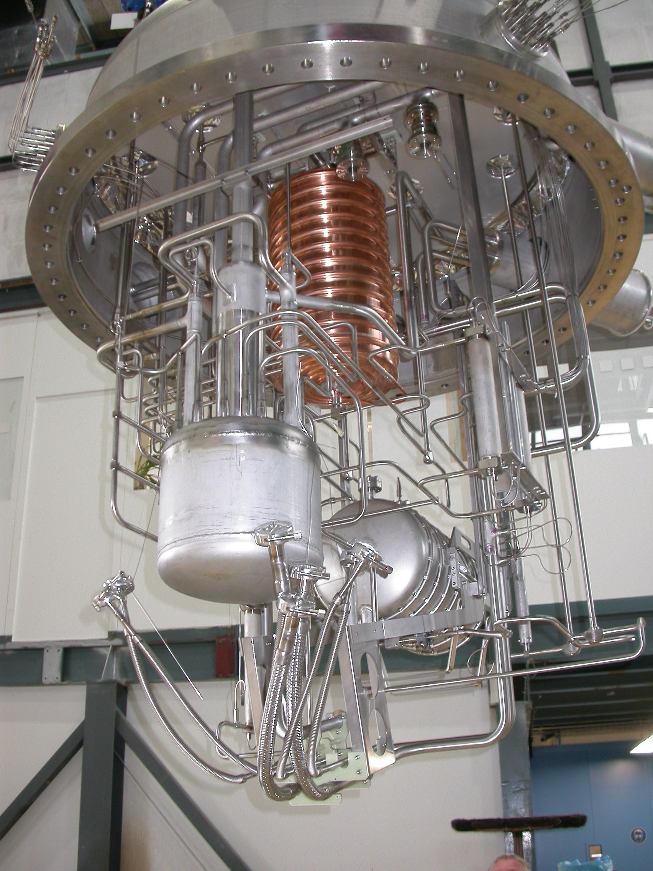
He-refrigerator cooling power: 370W @4.2K
and 2500W @ 80K
Preparation of the deuterium crystal
30m³
slow condensation
slow transfer

Slide 18
Preparation of the deuterium crystal
D2 Transfer ~1% / hour
20 K
cool-down:
para-ortho conversion
(using Oxisorb)

Slide 19
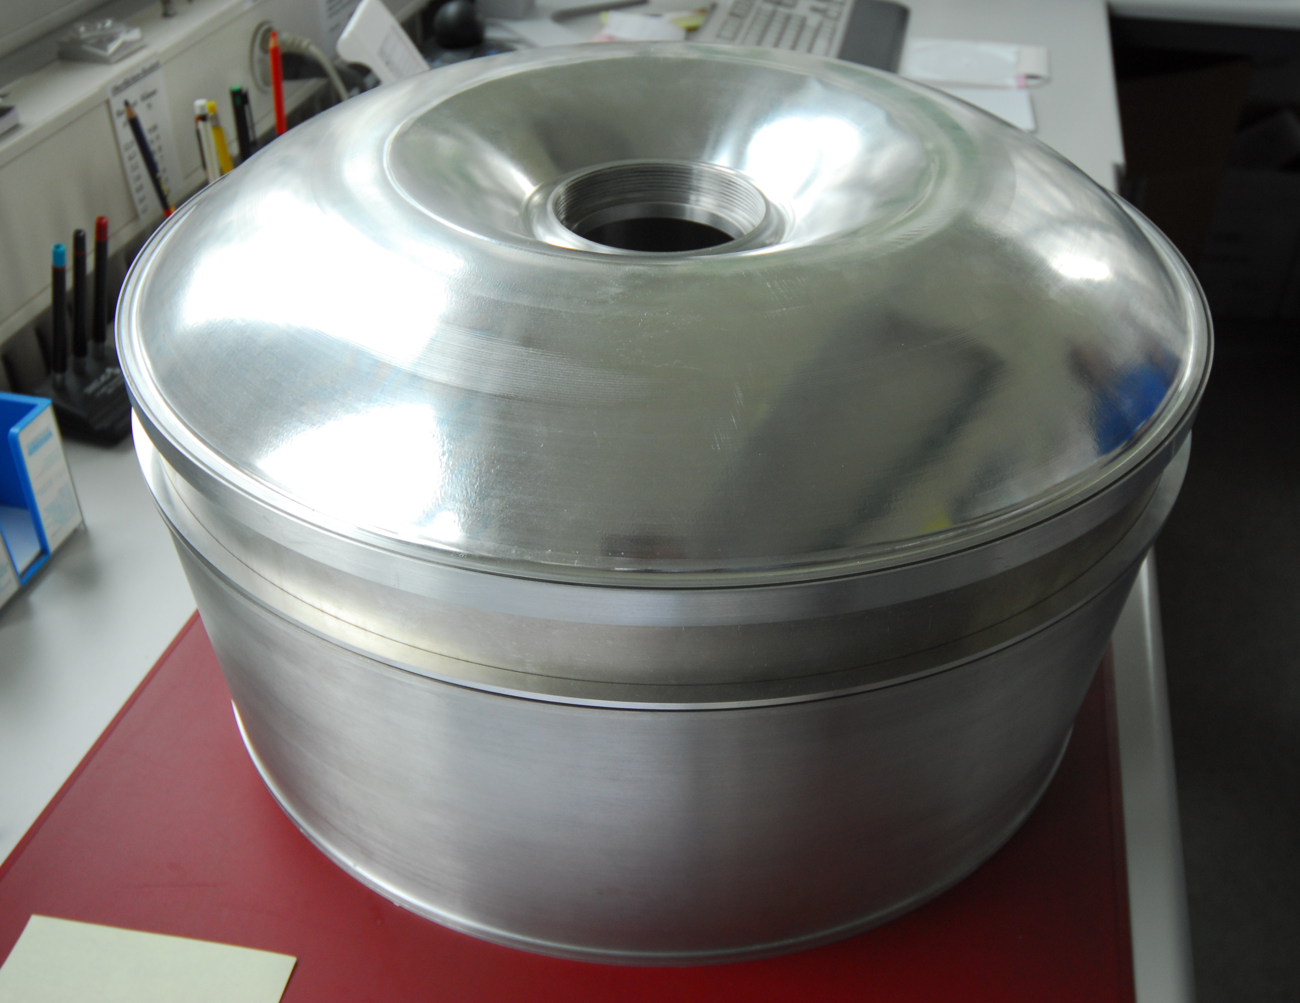
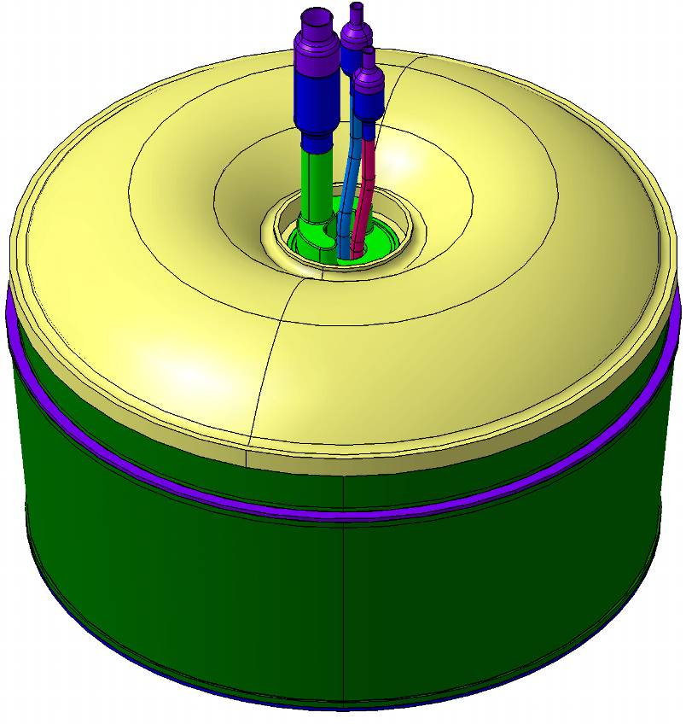
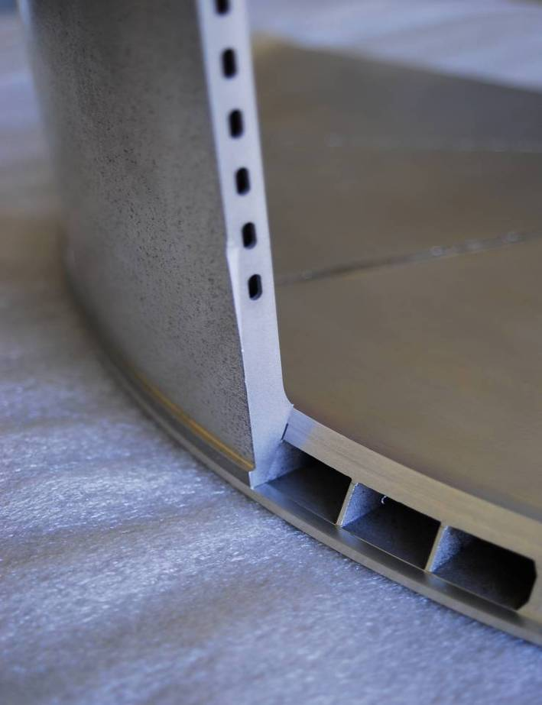
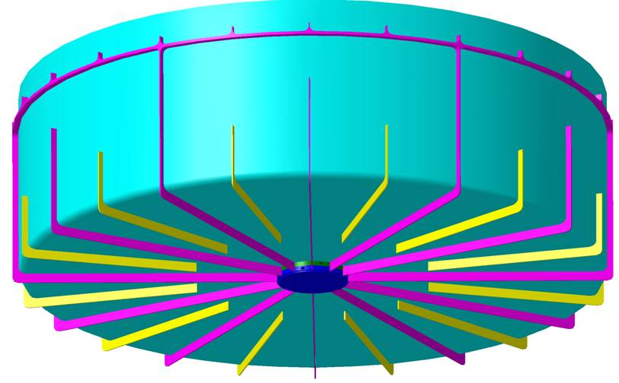
Solid deuterium at 5K
0.5 mm AlMg3
500 mm
200 mm
2 × 1.5 mm AlMg4.5Mn
Cooling Agent: Supercritical Helium

Slide 20
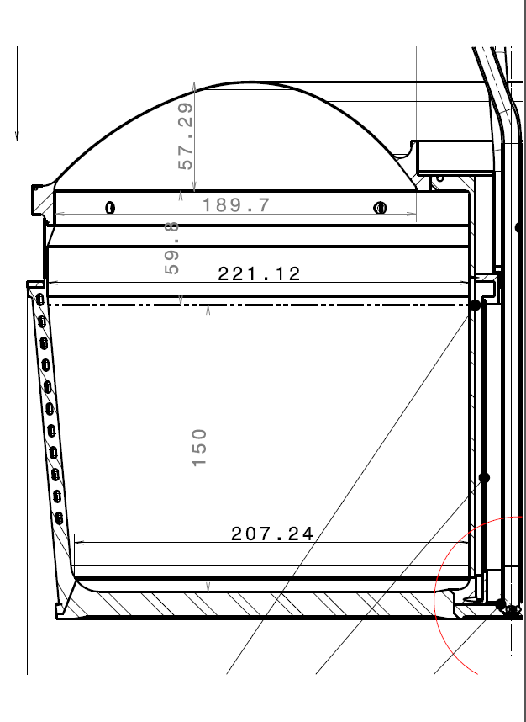
Solid deuterium at 5K
saturated vapor pressure indicates
D2 temperature
- solid/liquid/gas level
- lid transmission
0.5 mm AlMg3
500 mm
D2
D2
200 mm
100
Cooling Agent:
Supercritical Helium
2 × 1.5 mm AlMg4.5Mn

Slide 21
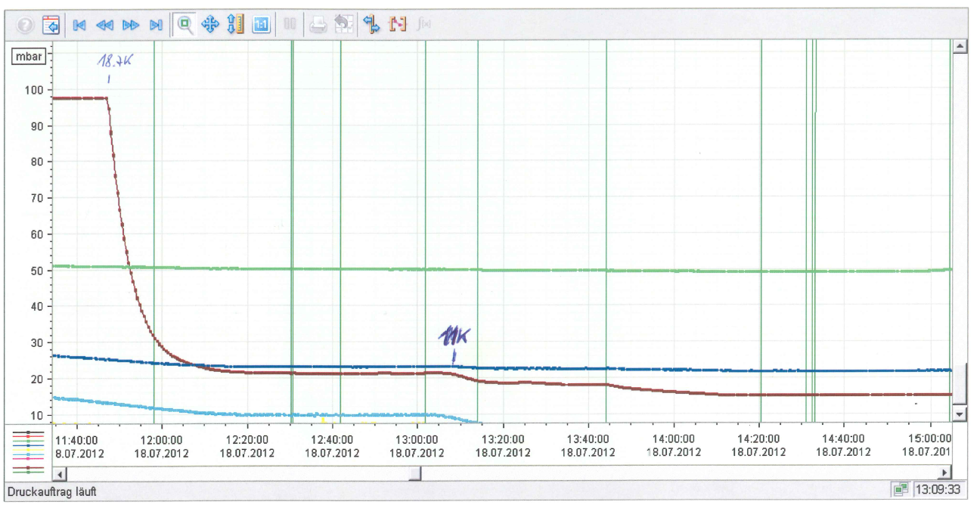
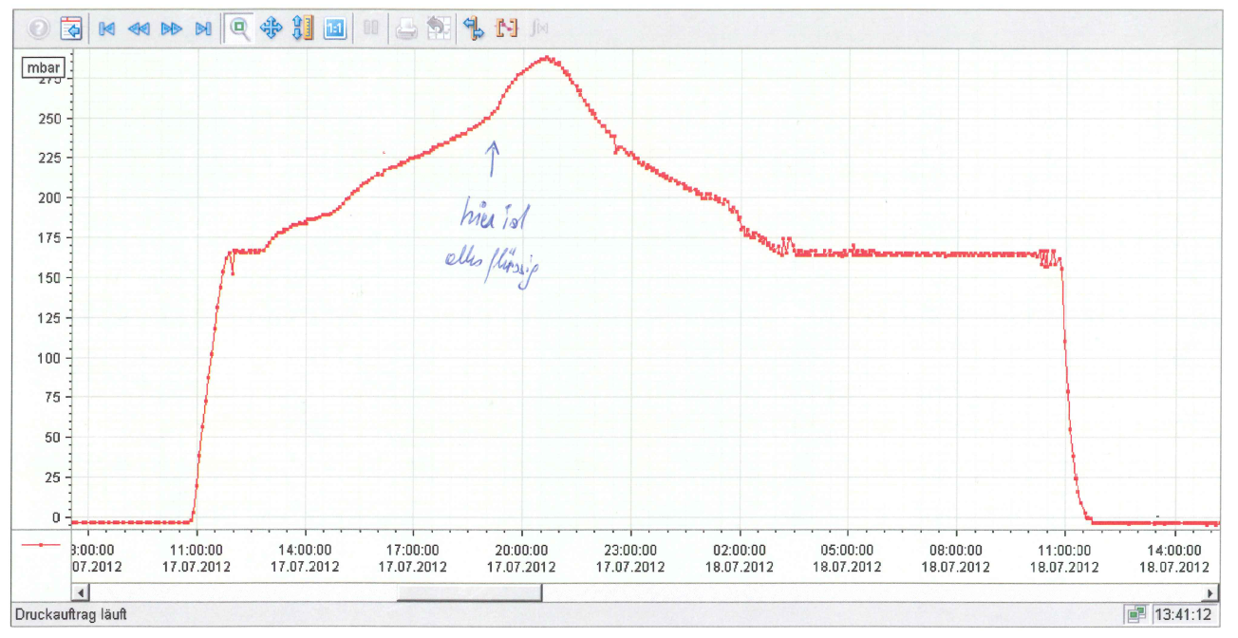
Vapor pressure for crystal #2012-2
this example:
7 hours at triple-point,
tried up to 24 hours
mbar
warming up
Triple-Point
all D2 is liquid
start cooling
Triple-Point
solid
full cooling to final pressure
Pa

Slide 22
Operations History
- Construction and commissioning of the source was completed in 2010
- Federal authorities` operation approval obtained in June 2011
- Start-up with first beam August 3, 2011 - up to PSI shutdown Dec.2011
- Full operation in 2012 with nEDM data taking up to winter shutdown

Slide 23
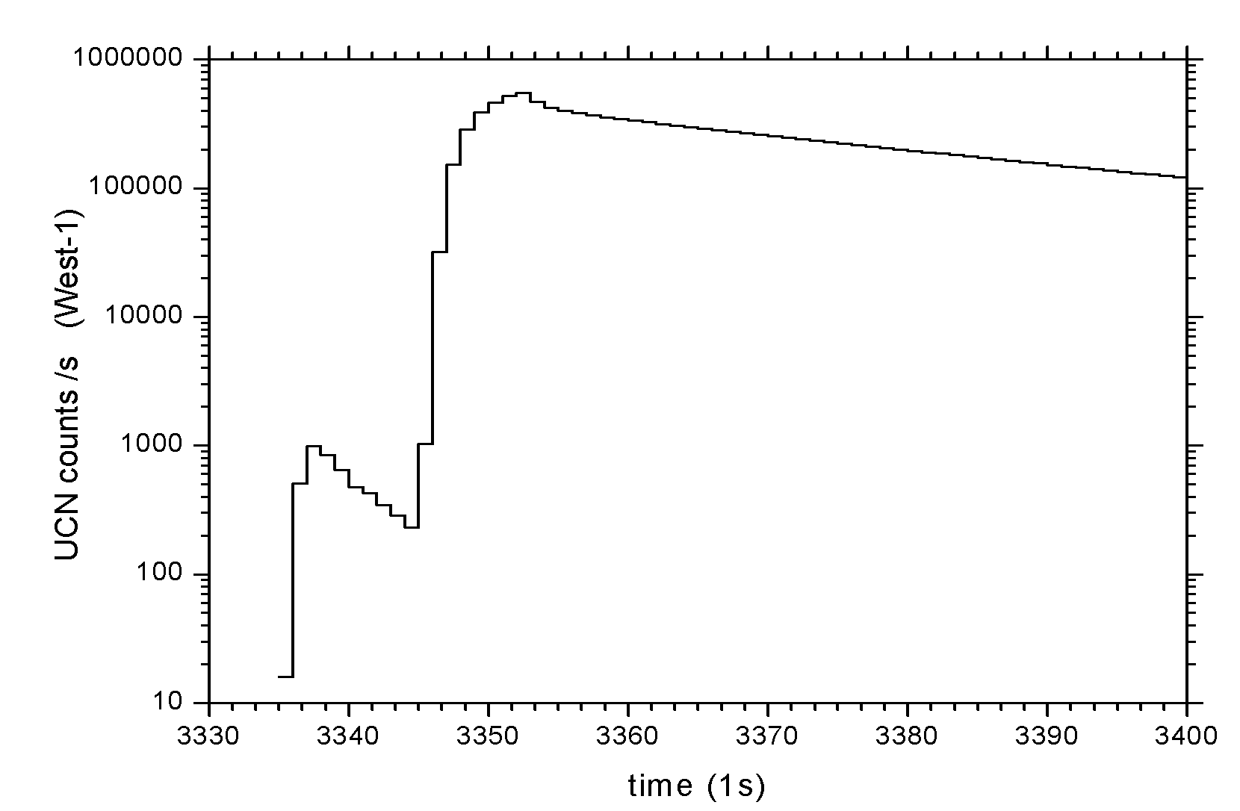
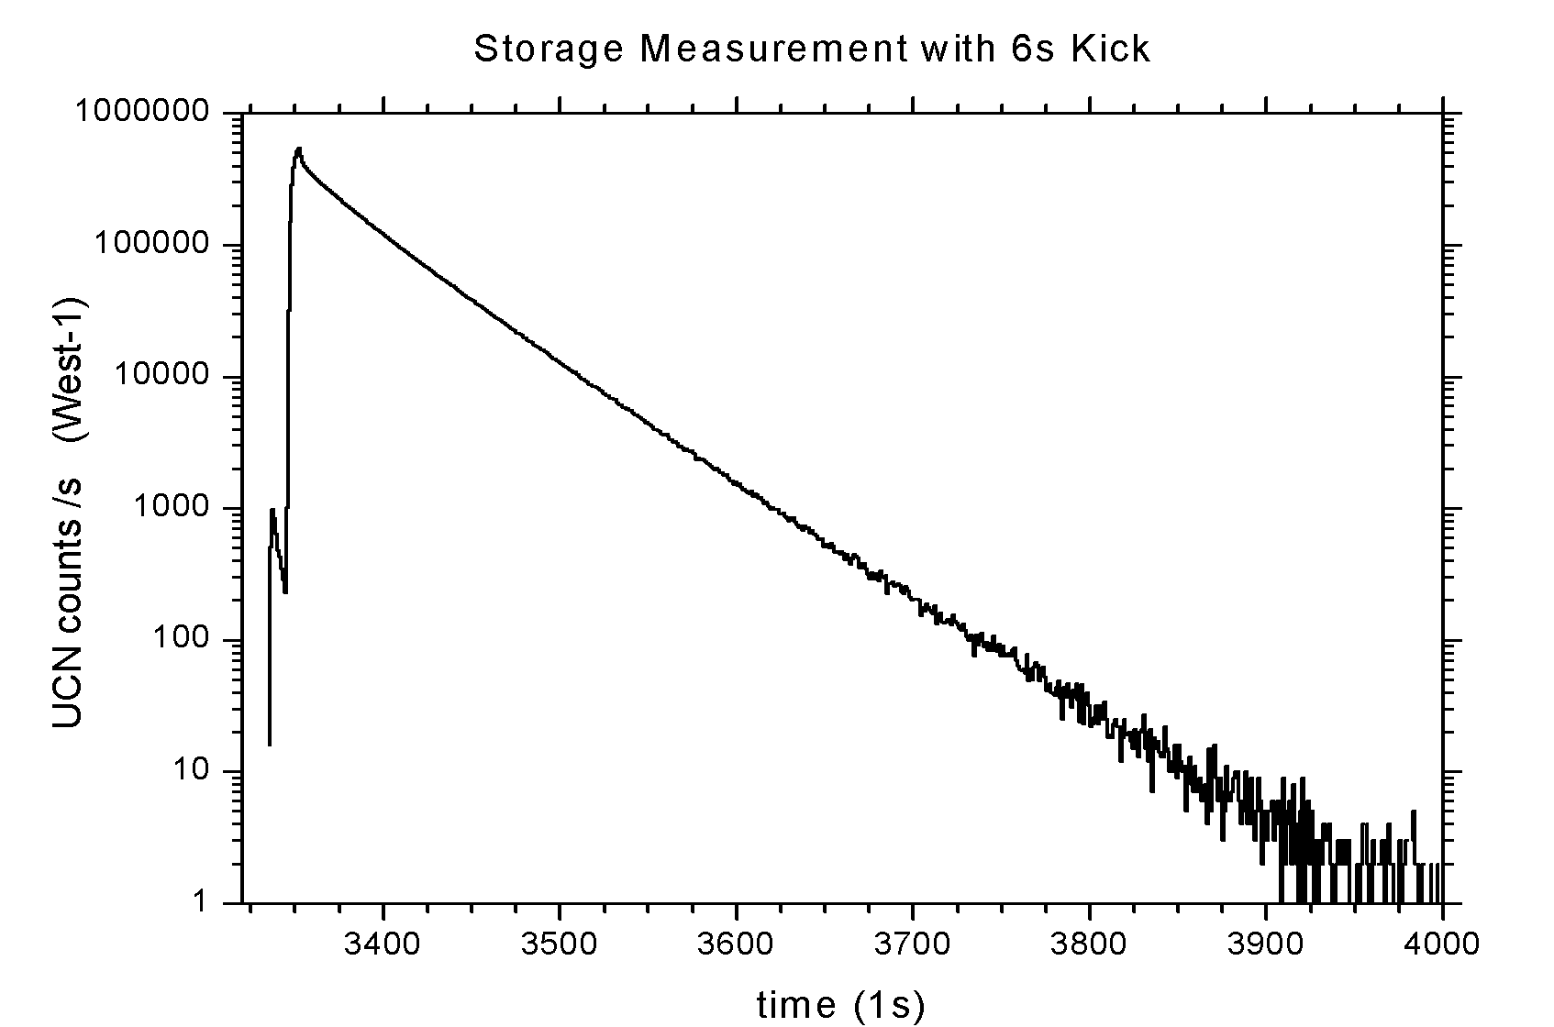
Measurement in area West
with detector at beam-port
ZOOM
closing
shutter
pilot
pulse
filling
storage
vessel
emptying
storage
vessel
>2x10⁷ UCN /pulse

Slide 24
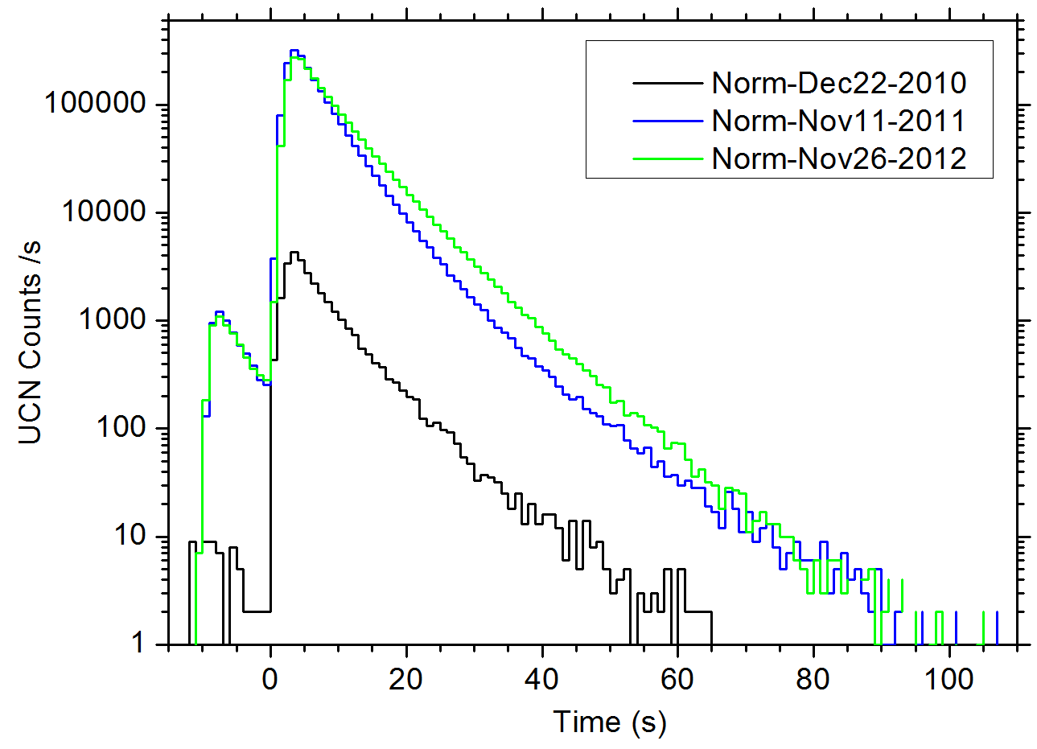
Compare UCN intensity over time - normpulses
-no mechanical shutter movement
best normpulse performance in
2010: 30,000 2011: 2,020,000
2012: 2,600,000
preliminary

Slide 25
Characterization of D2 crystals
record high with 2.4mA
2012
2011
surface
liquefaction
UCN per normpulse
take out
50 mbar
super
fast
>15Pa
first fill from
tanks
best normpulse performance in
2010: 30,000 2011: 2,020,000
2012: 2,600,000
only 50% differences in UCN output
with crystal growing times between
30min and 2days
preliminary

Slide 26

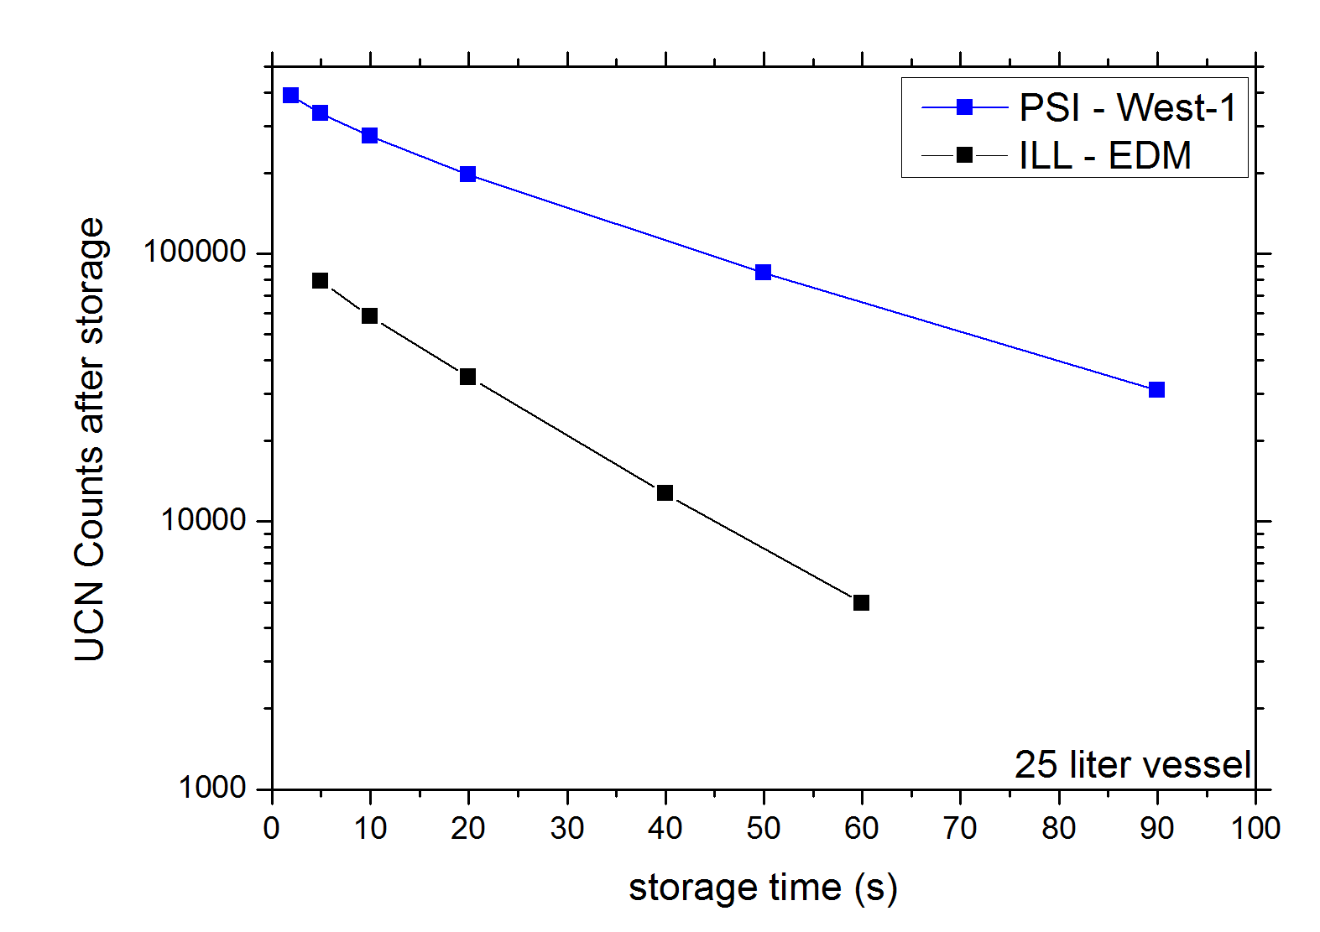
A benchmark: UCN density
1m glass tube ~25000 cm³ comparable to nEDM precession chamber ~2100 cm³
VAT
VAT
Cascade
Detector
UCN
- NiMo coating
- Stainless
steel flanges
- shutter DLC coated
UCN density measured in a 25l volume
extrapolated to t=0
at PSI area West-1
2010 ~0.15 UCN/cm3
2011 ~18 UCN/cm3
2012 ~23 UCN/cm3
=> correct for detector foil transmission
present status >33 UCN/cm3 in storage experiment
preliminary

Slide 27
A benchmark: UCN density
One could imagine to do common measurements of densities in the same bottle at different UCN sources to compare source performances.
VAT
VAT
1m glass tube ~25000 cm³
- nEDM precession chamber ~2100cm³
Cascade
Detector
UCN
- NiMo coating
- Stainless
steel flanges
- shutter DLC coated
UCN density measured in a 25l volume
extrapolated to t=0
at PSI area West-1
2010 ~0.15 UCN/cm3
2011 ~18 UCN/cm3
2012 ~23 UCN/cm3
=> correct for detector foil transmission
present status >33 UCN/cm3 in storage experiment
preliminary

Slide 28
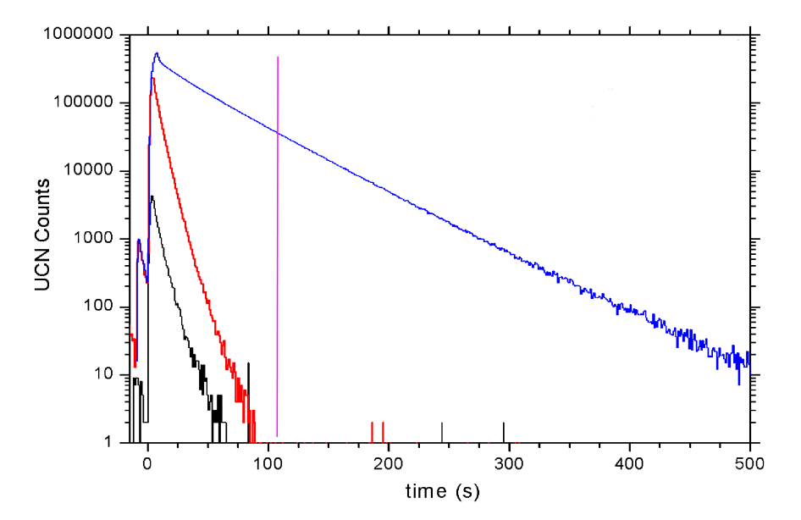
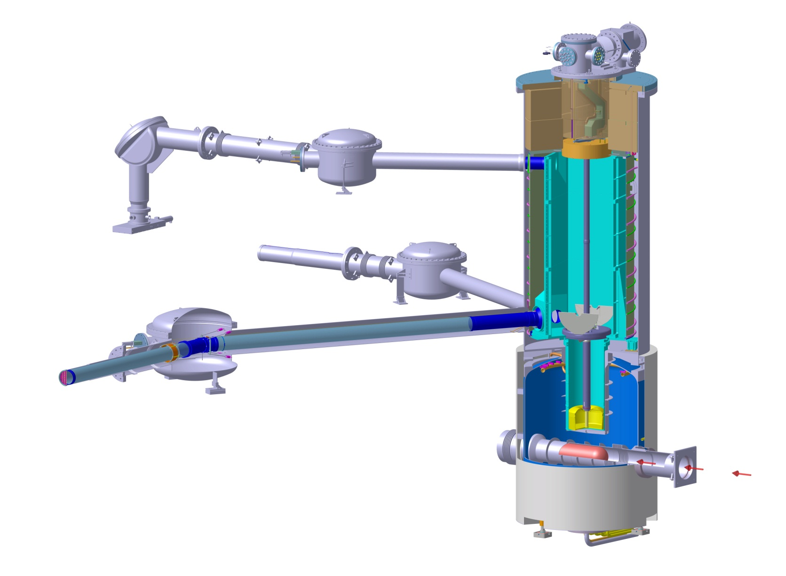
UCN Ping Pong
Test of guides and storage vessel
- kick beam onto target
- fill small storage vessel in West-1
- open source storage vessel shutter after 10 s
- UCN stored in West-1 for 100s - can be directly measured
- open W1 storage vessel shutter - towards W1 -> measure
- open W1 storage vessel shutter - towards South -> send UCN from West to South
- measure UCN arriving in South
negligible Background
detector
1
detector
2
superconducting magnet
as polarizer

Slide 29
UCN Ping Pong tests
guides and storage vessel
full simulation reproduces measurements well (~30%)
➔ no 'big' unknowns in storage vessel or guides
UCN transmission
from West to South
measured = 2.9 ± 0.4%
simulated = 3.3 ± 0.3%
UCN Counts / pulse
preliminary

Slide 30
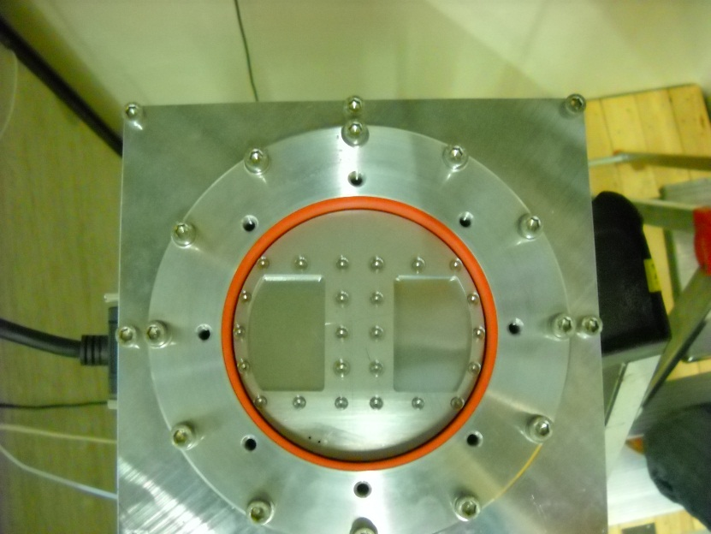

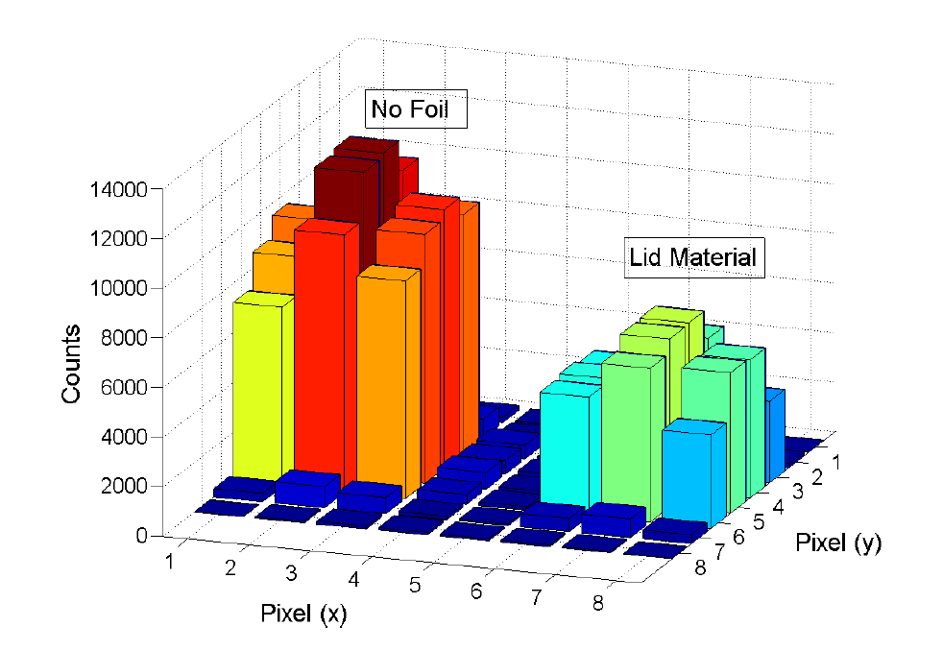
Moderator lid UCN transmission
holder with 2 samples
- use lid material from pressure test vessel
- 50% transmission of 0.5mm thick AlMg3 as expected from previous measurements of the material finally used

Slide 31
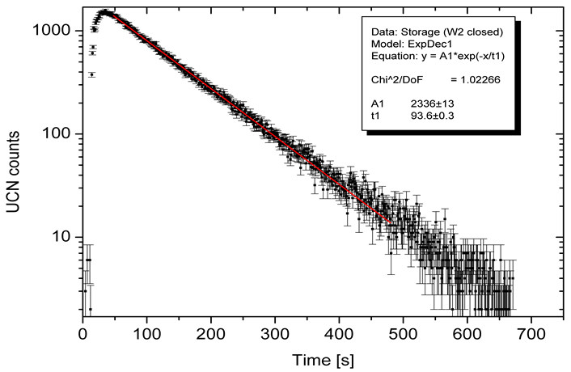
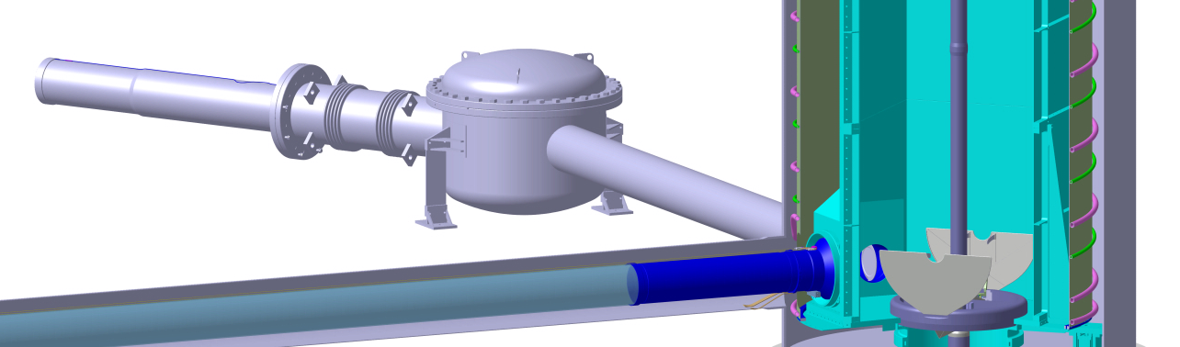
UCN Storage Time via leak method
preliminary

Slide 32
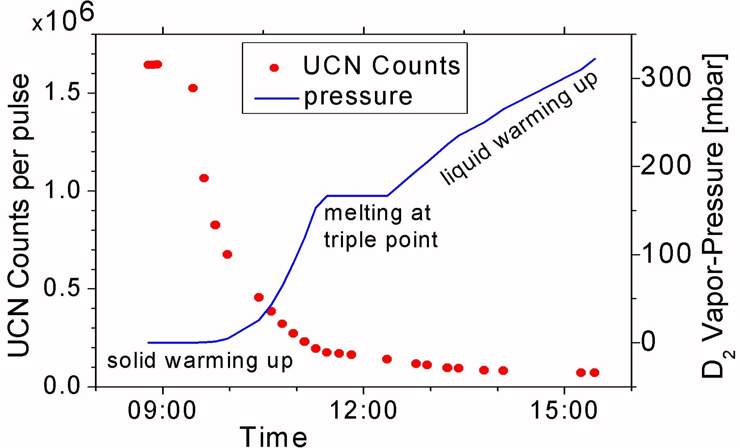
Deuterium Crystal Conditioning
2012: very good Temperature control
up to 2 days at Triple Point

Slide 33


D₂ gas measurements
[can potentially provide an unambiguous calibration]
work in progress
Simulation of neutron flux:
Simulation: energy dependent neutron flux (MCNPX) and UCN transport.
Calculate from first principles energy dependent UCN production on individul D₂ molecules and loss cross sections, compare to published measurements from FUNSPIN
verification by
experiment
done or under way
calculate UCN production:
prompt
background
0.5s proton kick
D2 gas moderator
compare!
UCN counts
simulate UCN extraction and transport through full system to detector.

Slide 34

Summary
- The components of the UCN source are commissioned and operating well.
- We are exploring the different parameters necessary in crystal freezing.
- PSI UCN source has regular beam operation to supply UCN to the nEDM apparatus and other users.
- UCN density improved by factor of 80 since start-up. Still about 15 times below design. Further optimization of all source parameters is under way

Slide 35


Thanks for your attention
the Paul Scherrer Institute
UCN source
location

