Slide 1




Flowing Gluon Fields
Collective Phenomena in Classical QCD
Rainer J. Fries
Texas A&M University
9th Workshop High P_{T} @ LHC
Grenoble, September 27, 2013

Slide 2
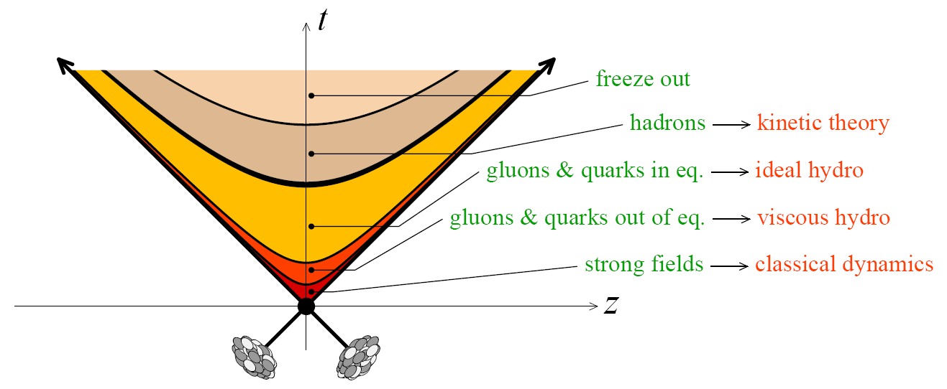
The Standard Model of URHICs
Bulk of produced particles (< 2 GeV/c)
  Local thermal equilibrium during QGP phase
  Expansion and cooling via viscous hydrodynamics
  Maybe transport in the hadronic phase?
Bulk time evolution:
Hydro initial conditions:
  Some constraints from data on ellipticity and fluctuations in the transverse energy density: IP-Glasma = leading candidate
  Poor constraints on initial flow and other variables.
  What does color glass say about the global event shape?
[B. Schenke, P. Tribedy, R. Venugopalan, PRL108 (2012)]

Slide 3
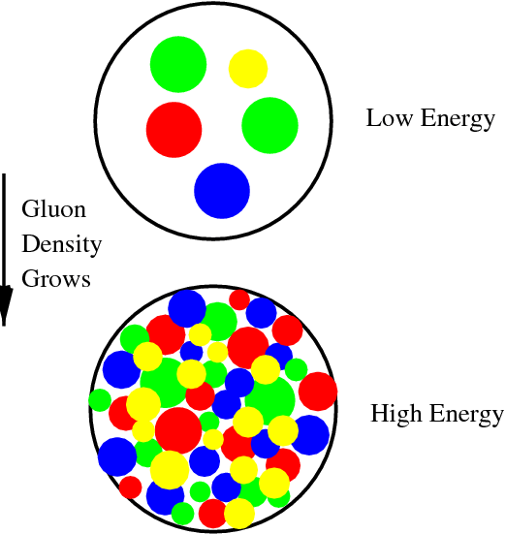
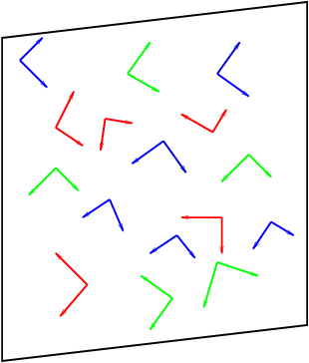
Color Glass: Single Nuclei
Nuclei/hadrons at asymptotically high energy:
  Saturated gluon density ~ Q_{s}⁻² → scale Q_{s} >> Λ_{QCD}
  Probes interact with many quarks + gluons coherently.
  Large occupation numbers → quasi-classical fields.
  Large nuclei are better: Q_{s} ~ A^{1/3}
Effective Theory a la McLerran & Venugopalan
  Solve Yang-Mills equations for gluon field A^{μ}(ρ).
  Sources = light cone currents J (given by SU(3) charge distributions ρ = large-x partons).
  Calculate observables O(ρ ) from the gluon field A^{μ}(ρ).
  Compute O event by event or the expectation value of O by sampling or averaging over ρ , resp. ρ = random frozen color fluctuations of a color-neutral object.
  MV: weight W = Gaussian
[L. McLerran, R. Venugopalan]

Slide 4
Color Glass: Colliding Nuclei
Yang-Mills equations: two sources ρ ₁, ρ₂
  Intersecting light cone currents J₁, J₂ (given by ρ ₁, ρ₂) solve Yang-Mills equations for gluon field A^{μ}(ρ ₁, ρ₂).
Forward light cone (3): free Yang-Mills equations for fields A, A^{i}⊥
Boundary conditions on the forward light cone:
MV setup is boost-invariant, but not symmetric between + and – direction.
[A. Kovner, L. McLerran, H. Weigert]

Slide 5
Gluon Fields in The Forward Lightcone
Goals:
  Calculate fields and energy momentum tensor of early time gluon field as a function of space-time coordinates.
  Analyze energy density and flow field.
  Derive constraints for further hydrodynamic evolution of equilibrating QGP.
Small-time expansion
Results: recursive solution for gluon field:
Numerical solution
[T. Lappi]
[RJF, J. Kapusta, Y. Li, 2006]
[Fujii, Fukushima, Hidaka, 2009]

Slide 6
Result: Fields
Before the collision: color glass = pulse of strictly transverse (color) electric and magnetic fields, mutually orthogonal, with random color orientations, in each nucleus.

Slide 7
Result: Fields
Before the collision: color glass = pulse of strictly transverse (color) electric and magnetic fields, mutually orthogonal, with random color orientations, in each nucleus.
Immediately after overlap (forward light cone, τ → 0): strong longitudinal electric & magnetic fields. Non-abelian effect!
E₀
B₀
[L. McLerran, T. Lappi, 2006]
[RJF, J.I. Kapusta, Y. Li, 2006]

Slide 8
Result: Fields
Before the collision: color glass = pulse of strictly transverse (color) electric and magnetic fields, mutually orthogonal, with random color orientations, in each nucleus.
Immediately after overlap (forward light cone, τ → 0): strong longitudinal electric & magnetic fields. Non-abelian effect!
Transverse E, B fields start linearly in time τ
[RJF, J.I. Kapusta, Y. Li, 2006]
[G. Chen, RJF, PLB 723 (2013)]

Slide 9

Energy Momentum Tensor
Initial (τ = 0) structure of the energy-momentum tensor vs hydrodynamics.
Toward equilibrium: pressure isotropization (in local rest frame)
Gauge fields:
Particle distributions f:
Δτ≈ 1 fm/c
Transverse pressure
P_{T} = ε₀
Longitudinal pressure
P_{L} = –ε₀
Later: Ideal plasma
(local rest frame)
$$ε_{0}=\frac{1}{2}\left(E_{0}^{2}+B_{0}^{2}\right)$$
p
T
τ
L

Slide 10
Energy Momentum Tensor
General structure up to order τ²:
Transverse Poynting vector gives transverse flow.
Example for second order:
[RJF, J.I. Kapusta, Y. Li, (2006)]
[G. Chen, RJF, PLB 723 (2013)]
Like hydrodynamic flow, determined by gradient of
transverse pressure P_{T} = ε₀; even in rapidity.
Non-hydro like; odd in rapidity ??
Depletion/increase of energy density due to transverse flow
Due to longitudinal flow

Slide 11
Modelling Color Charges
So far everything written in terms of color charge densities ρ ₁, ρ₂
MV: Gaussian distribution around color-neutral average
  Sample distribution to obtain event-by-event observables.
  Here: calculating expectation value as function of average color charge densities μ₁, μ₂.
MV: μ = const. But flow comes from gradients in nuclear profiles.
  Relax this condition: keep μ approximately constant on length scales 1/Q_{s} , allow variations on larger length scales: where m is an infrared scale m << Q_{s}.
  Theory well-behaved: typically results = classical MV result + small corrections involving gradients of μ.
  Important cancellation of singularities still go through: (γ ~ <A⁺_{cov}A⁺_{cov}> )
  Applicability of this condition typically ok ~ 1 fm or more inside the surface of a large nucleus.
[G. Chen, RJF, PLB 723 (2013)]
[G. Chen et al., in preparation]

Slide 12
Averaging
Take expectation values.
Energy density ~ product of nuclear gluon distributions ~ product of color source densities
“Hydro” flow:
“Odd“ flow term:
[T. Lappi, 2006]
[RJF, Kapusta, Li, 2006]
[Fujii, Fukushima, Hidaka, 2009]
[G. Chen, RJF, 2013]
[G. Chen et al., in preparation]

Slide 13
Transverse Field: Abelian Arguments
Once the (non-abelian) longitudinal fields E₀, B₀ are seeded, the averaged transverse flow field is an abelian effect.
Can be understood in terms of Ampere’s, Faraday’s and Gauss’ Law.
  Longitudinal fields E₀, B₀ decrease in both z and t away from the light cone
Gauss at fixed time t:
  Long. flux imbalance compensated by transverse flux
  Gauss: rapidity-odd radial field
Ampere/Faraday as function of t:
  Decreasing long. flux induces transverse field
  Ampere/Faraday: rapidity-even curling field
Full classical QCD:
[Guangyao Chen, RJF]

Slide 14
Averaging: From Fields To Flow
Calculating the transverse Poynting vector to first order in τ :
Averaging over source configurations: what are and ?
With we have
Symmetry and dimensionality dictate shape of
[G. Chen, RJF, 2013]

Slide 15
Transverse Field: Visualization
Transverse fields for randomly seeded longitudinal fields.

Slide 16
Transverse Flow: Visualization
Transverse Poynting vector for randomly seeded longitudinal fields.

Slide 17
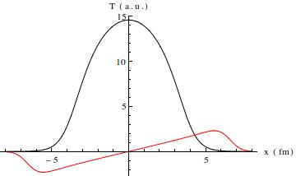
Phenomenology: b ≠ 0
Odd flow needs asymmetry between sources. Here: finite impact parameter
Flow field for Au+Au collision, b = 4 fm.
Radial flow following gradients in the fireball at η = 0.
Clearly: directed flow away from η = 0.
Fireball tilted, angular momentum.
|V| ~ 0.1 at the surface @ τ ~ 0.1

Slide 18
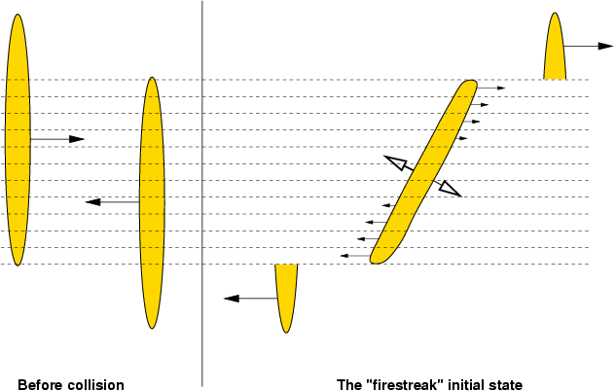
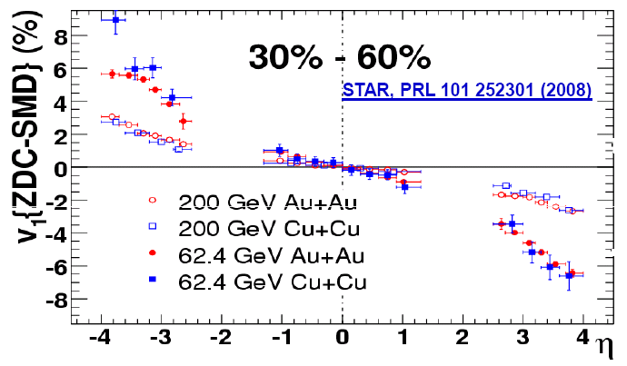
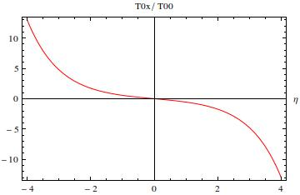
Phenomenology: b ≠ 0
Angular momentum is natural: some old models have it, most modern hydro calculations don’t.
  Some exceptions
  Do we determine flow incorrectly when we miss the rotation?
Directed flow v₁:
  Compatible with hydro with suitable initial conditions.
[L. Csernai et al. PRC 84 (2011)] …
[Gosset, Kapusta, Westfall (1978)]
MV only, integrated over transverse plane, no hydro

Slide 19
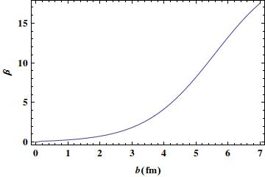
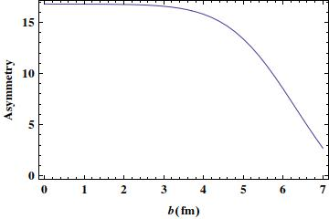

Phenomenology: A ≠ B
Odd flow needs asymmetry between sources. Here: asymmetric system
Flow field for Cu+Au collision:
Odd flow increases expansion in the wake of the larger nucleus, suppresses flow on the other side ⇒ characteristic flow patterns in asymmetric systems.
Example: Forward-backward asymmetries. (here p+Pb)
Similar:
$$\frac{\left\langle T^{0x}\right\rangle }{\left\langle T^{00}\right\rangle }\left(η=−2\right)−\frac{\left\langle T^{0x}\right\rangle }{\left\langle T^{00}\right\rangle }\left(η=+2\right)$$
Directed flow asymmetry
Radial flow asymmetry

Slide 20
Event-By-Event Picture
Numerical simulation of β in Au+Au, sampling charge distributions in the nuclei.
Individual events dominated by fluctuations.
Averaging N > 100 events: recover directed flow.
PRELIMINARY

Slide 21
Matching to Hydrodynamics
No equilibration in clQCD.
Pragmatic solution: extrapolate from both sides (r(τ) = interpolating fct.)
, enforce
and other conservation laws.
Fast equilibration assumption:
Analytic solution available for matching to ideal hydro.
  4 equations + EOS to determine 5 fields in ideal hydro. Up to second order in time:
  Odd flow β drops out: we are missing angular momentum.
p
T
τ
L

Slide 22
Matching to Hydrodynamics
Instantaneous matching to viscous hydrodynamics using in addition
  Mathematically equivalent to imposing smoothness condition on all components of T_{μν}.
Numerical solution of the matching:
Tilting and odd flow terms translate into hydrodynamics fields.

Slide 23
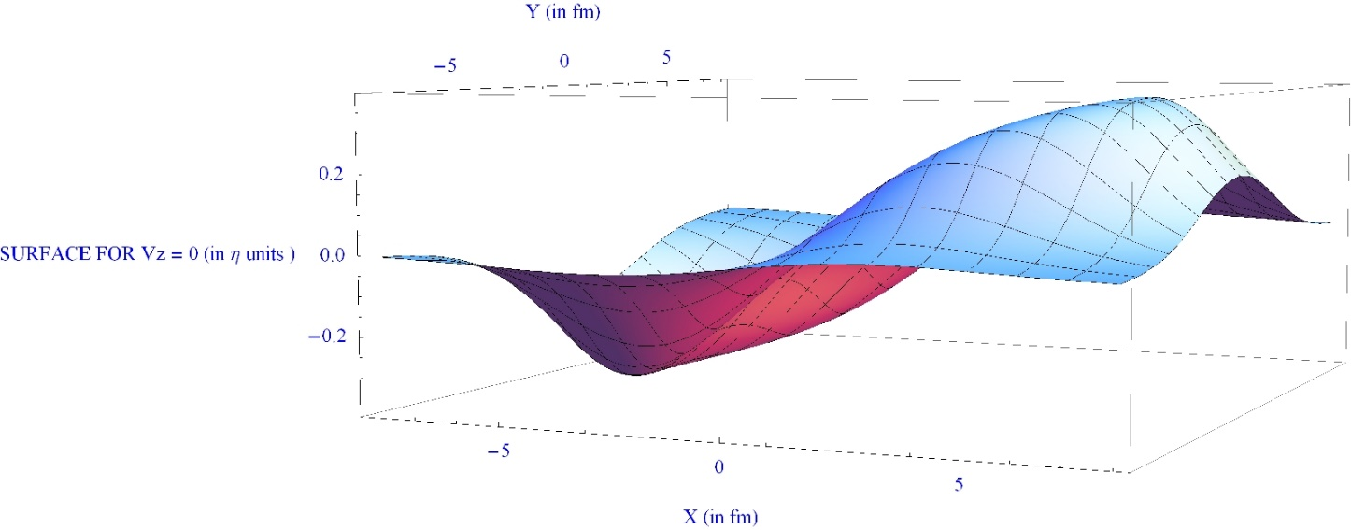
Initial Event Shape
Intricate 3+1 D structure emerges
Example: nodal plane of longitudinal flow, i.e. v_{z} = 0 in x-y-η space
Further analysis: Need to run viscous 3+1-D hydro with large viscous corrections.
Nothing to show yet, but work in progress.

Slide 24
Summary
We can calculate the fields and energy momentum tensor in the clQCD approximation for the early stage of high energy nuclear collisions.
Transverse energy flow shows interesting and unique (?) features: directed flow, A+B asymmetries, etc.
Interesting features of the energy flow are naturally translated into their counterparts in hydrodynamic fields in a simple thermalization model. These features are often not included in hydrodynamic simulations.
Future phenomenology needs hydrodynamics with large dissipative corrections.
3 Questions:
  Are there corrections to well-studied observables (like elliptic flow)?
  Are there phenomena that we completely miss with too simplistic state-of-the art initial conditions?
  Are there flow signatures unique to CGC initial conditions that we can observe?

