Slide 1
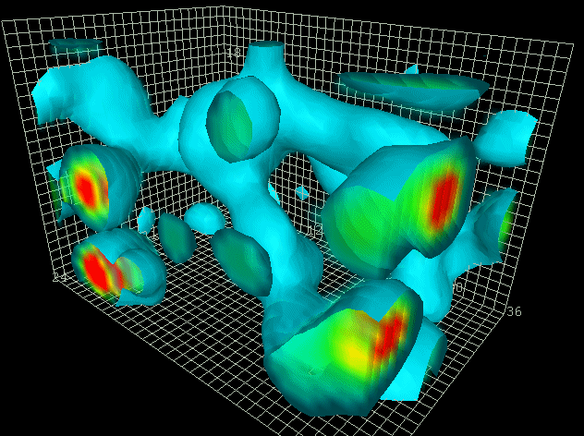
Event structure and color reconnection - possible relevance for heavy ion physics
GuyPaić
Instituto de Ciencias Nucleares
In c ollaboration with A. Ortiz, P. Christiansen, I.Maldonado and E. Cuautle,
Simulation from
D. B. Leinweber, hep-lat/0004025
gluon action density: 2.4 x 2.4 x 3.6 fm

Slide 2
The message
the LHC has allowed us to investigate the pp collisions in great details: an opportunity we have not yet fully exploited
In spite of the good statistics we remain steadfastly in the averaging process
applying the analysis of the event structure of pp events in function of multiplicity may have relevance to heavy ion results on parton energy loss
The hydrodynamic flow confronted with partonic level interactions like color reconnection in pp sharpens the debate

Slide 3
Underlying event in Pythia:
MPI (CR), ISR, BR
Notes:
3

Slide 4
The Inelastic Non-Diffractive Cross-Section
Occasionally one of the parton-parton collisions is hard
(p_{T} > ≈2 GeV/c)
From Rick Field
Majority of “min-bias” events!
“Semi-hard” parton-parton collision
(p_{T} < ≈2 GeV/c)
+
+
+
the pp collision is ~ an average of all processes
Multiple-parton interactions (MPI)!

Slide 5
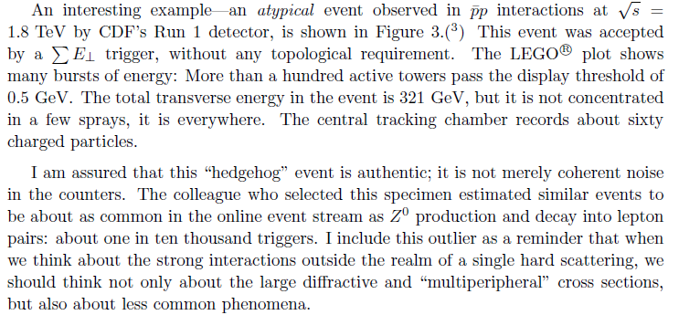
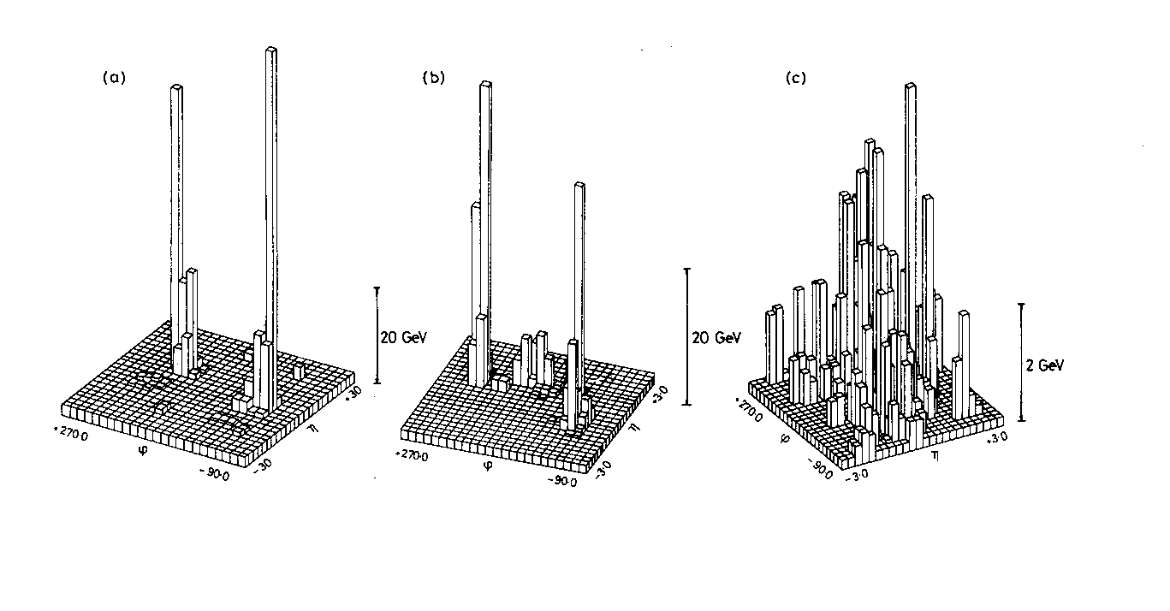
from earlier experiments: how wrong we can be
CDF
Chriss Quigg: arXiv:1004.0975v1 [hep-ph]
Albajar, C., et al. (UA1 Collaboration). Analysis of the Highest Transverse Energy Events Seen in the UA1 Detector at the SppS Collider. Z. Phys. C36 (1987),
UA1

Slide 6
Introducing the event structure variable transverse velocity

Slide 7
The transverse sphericity from a pencil to a hedgehog

Slide 8
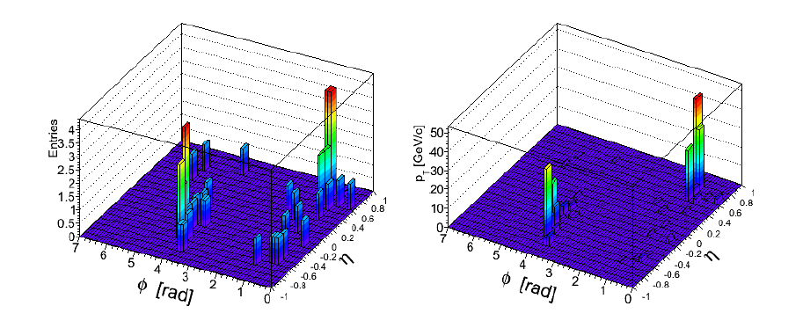
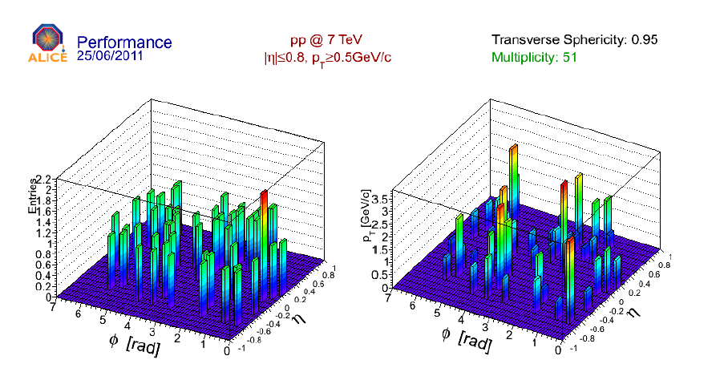

Slide 9
Multiparton interactions and multiplicity distribution
A clear dependence on multiplicity
From A. Ortiz
central
peripheral
What can be expected in the tail of the MPI/multiplicity? Collectivity?

Slide 10
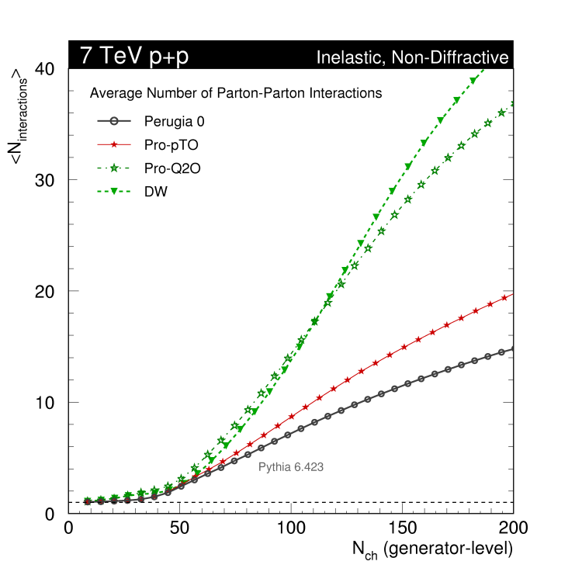
http://home.fnal.gov/~skands/leshouches-plots/lhc07m-19-1.png
The multiplicity is strongly dependent on the MPI
At low multiplicity the effect is negligible.
We need to study the high multiplicities in detail!
Note: the MB is dominated by the low multiplicities.
Not seeing the high multiplicities occults the importance of MPI

Slide 11
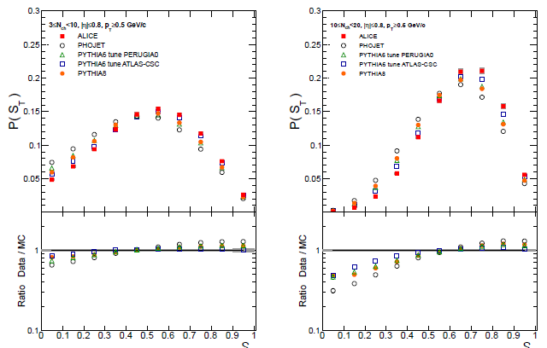
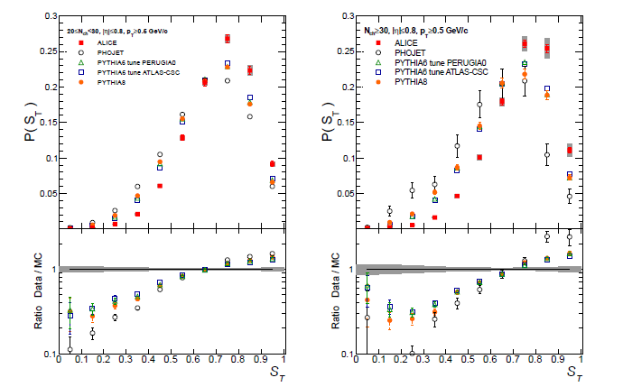
The sphericity spectrum in bins of multiplicity
The general trend with multiplicity is trivial: more multiplicity – > sphericity rises
Detail: do the generators reproduce the trend? Actually not!
The generator sphericity spectra CROSS the experimental spectrum at ST of ≈ 0.5 at low multiplicity and 0.7 at the highest multiplicities
ALICE Collaboration Eur.Phys.J. C72 (2012) 2124
“We show here that the higher sphericity of high-multiplicity events compared to
MC predictions is due to an apparent reduction of the relative jet yields in such type of events” (from properties in low and high multiplicity events in p-p collisions at 7 TeV CMS Collaboration CMS-PAS-FSQ-12-022

Slide 12
Questions
Can we talk of “ fluctuations” in the pp events or we do have two very distinct mechanisms which may be connected with the number of multiparton interactions and or centrality dependence of the pp collisions (like in heavy ions)?

Slide 13
The next big question: is flow existing in pp collisions?
Ortiz et al. Phys. Rev. Lett. 111, 042001 (2013)
Notes:
13

Slide 14
From pp to PbPb not much change!
Can the theory coherently explain???

Slide 15
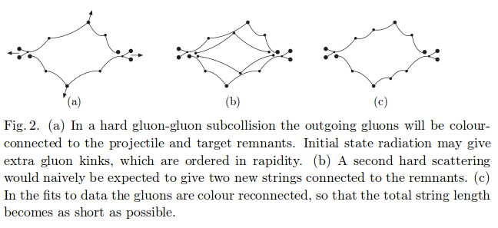
Color reconnection
In Pythia, the final step at parton level before the
hadronization is the color reconnection CR,
its aim is to describe the hadronization of a
many parton system in a single event with
multiple hard sub collisions.
Toy model of (non-perturbative) color reconnections, applicable to any final state
at hadronisation time, each string piece has a probability to interact with the vacuum / other strings:
P_{reconnect} = 1 – (1-χ)^{n}
χ = strength parameter: fundamental reconnection probability (free parameter)
n = number of multiple interactions in current event ( ~ counts # of possible interactions)
G. Gustafson, Acta Phys.Polon.B40:1981-1996,2009
Notes:
15

Slide 16
Effect of multiparton interactions and color reconnection on observables with identified hadrons
Notes:
16

Slide 17
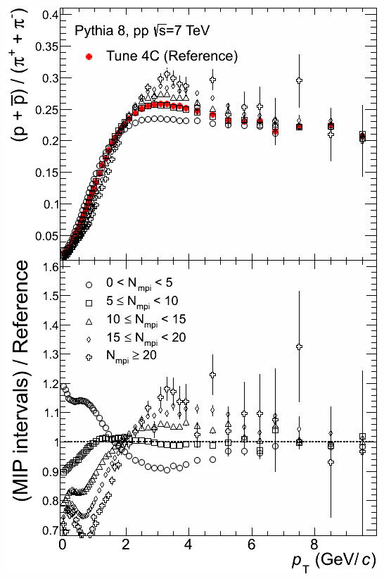
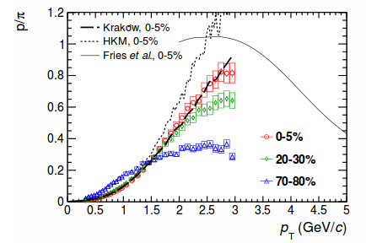
p/π vs p_{T} and MPI
The dependence with MPI (multiplicity) resembles the evolution of the p/pi vs p_{T} from peripheral to central Pb-Pb collisions.
Dependence of the non-strange baryon-to-meson ratio with the number of MPI's, N_{mpi}.
For with N_{mpi}>5 the ratios exhibit the peak.
The peak is enhanced w.r.t. reference when N_{mpi} increases, N_{mpi}>10. Also the peak is pushed up to higher p_{T} (characteristic of flow).
ALICE Collaboration, http://arxiv.org/abs/1303.0737
Notes:
17

Slide 18
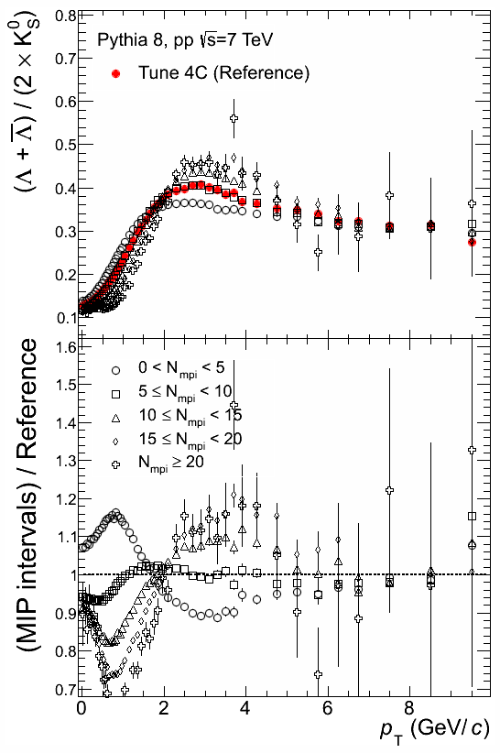
Λ/K⁰_{S} vs p_{T} and MPI
Same for Lambda-to-K⁰_{S} ratio as a function of p_{T}
Notes:
18

Slide 19
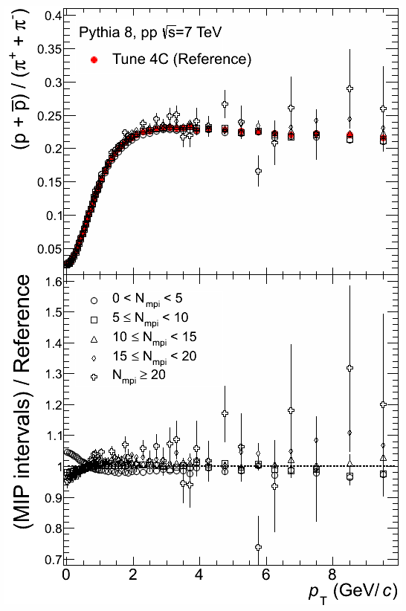
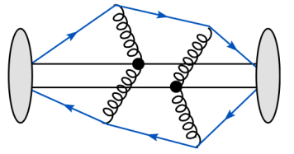
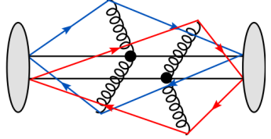
Effect of CR on the p/π ratio vs p_{T}
The peak on p/π is due to color reconnection
4/17/2013
guy paic
19
Notes:
19

Slide 20
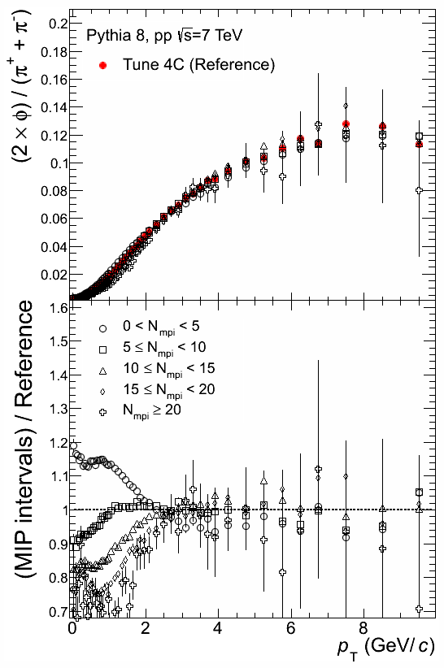
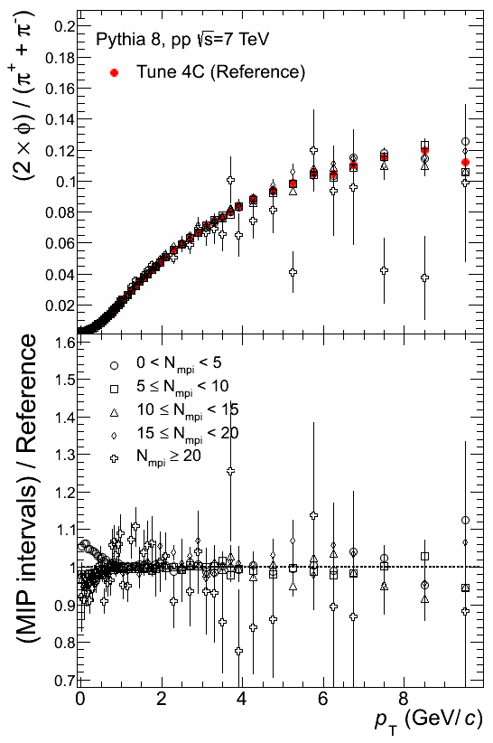
Is this just a baryon effect?
Is this just a baryon effect?
Test with
φ
No! We have a
mass effect=flow-like
Notes:
20

Slide 21
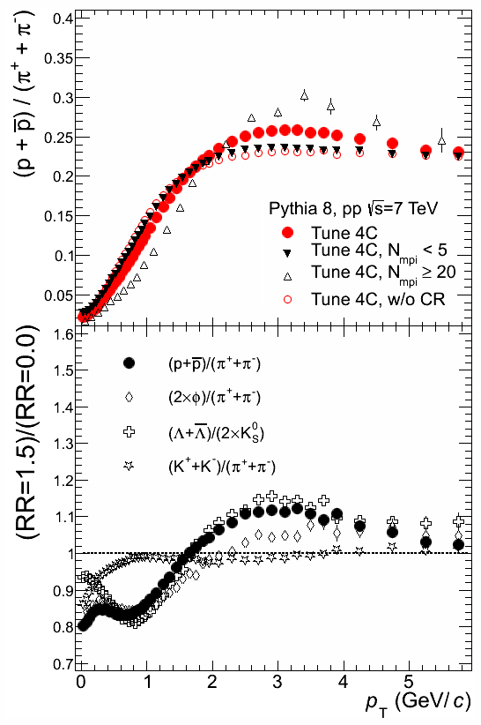
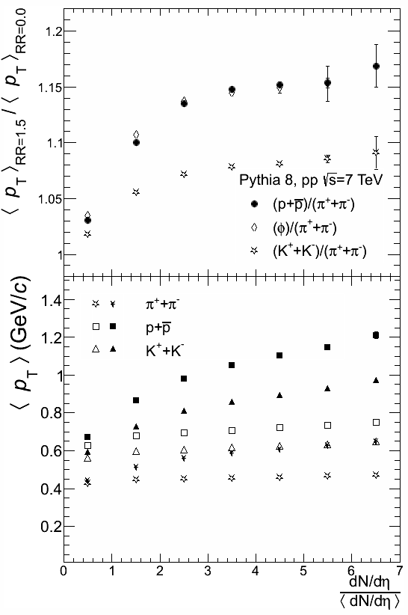
Other observables with identified hadrons
The behavior of the double ratios indicates that we have a mass
effect since the φ/π and the p/π ratios exhibit a much larger “bump” than the K/π ratio.
We know that Pythia underestimates the strange particle production, specially at intermediate p_{T}. To avoid this problem we can look at the <p_{T}> vs Nch.
4/17/2013
guy paic
21
Notes:
21

Slide 22
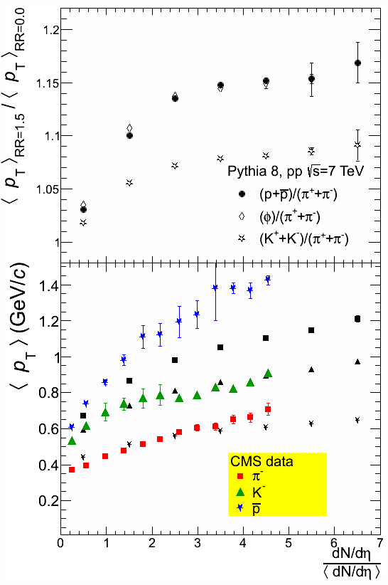
<p_{T}> as a function of
multiplicity
Pythia describes the data when CR is implemented, i.e. a flow-like effect is necessary.
So far we know that MC generators are too hard, very jetty-like. See transverse sphericity as a function of the event multiplicity. More MPI activity best describes data -> more isotropic ->larger flow-like effect.
CMS Collaboration, Eur. Phys. J. C 72 (2012) 2164
Notes:
22

Slide 23
Conclusion
For the first time (unknown to the author of Pythia 8) we have proven that color reconnection does produce effects similar to flow but only up to a limit in pt.
The effect of the CR does weaken at higher momenta as also requested by the data,
The fact of having some kind of collectivity without the introduction of often complicated hydrodynamics arguments (thermalisation, temperature time sequence etc) seems interesting and its application to heavy ion collisions could be full of surprises!!
Notes:
23

Slide 24
speculations
we seem to have pinpointed a mechanism that can generate flow like patterns. However a priori I do not see a mechanism that prevents having something similar – a color reconnection that throws particles in eta.
Ridge? The ridge spectra lie in the same pt range where CR is present

Slide 25
A short excursion in heavy ions
The similarities observed in the p/pi and T-beta behavior asks an obvious question: is all what we have seen and liked so far in heavy ion already present in pp!?
One of the “sacred cows” of the field is the parton energy loss…
If one takes a view from the side of pp one may say that the effect is already seen in pp!!

Slide 26
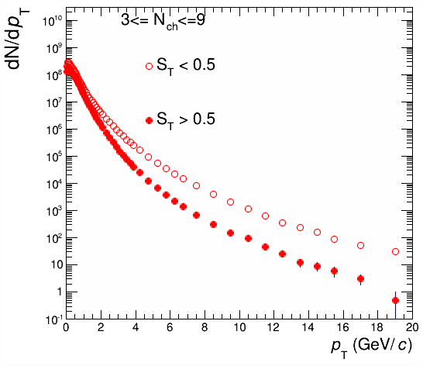
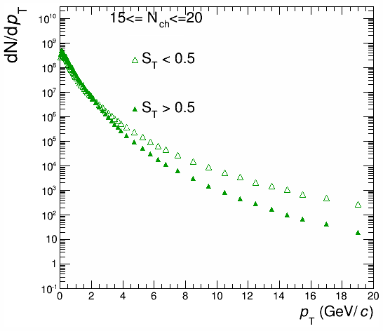
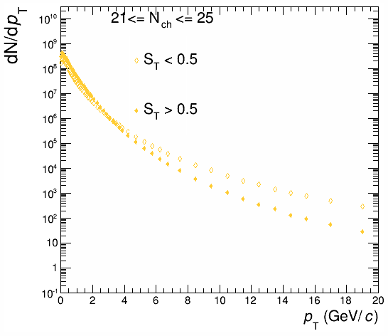
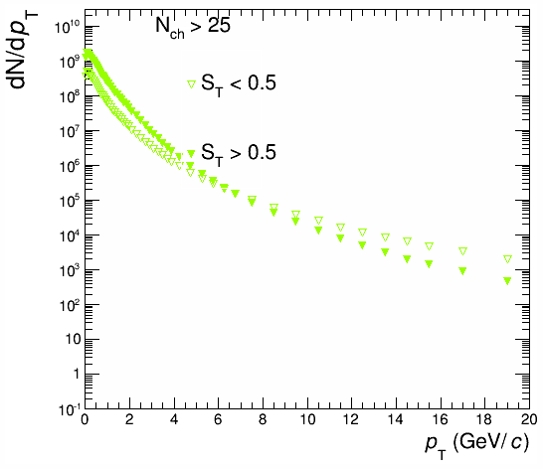
Comparison of high and low sphericity spectra in Pythia 8 4C
By now it is well established by LHC experiments that in high multiplicity events the jets are suppressed at high multiplicities in pp collisions
We have made a simulation with Pythia 8. The simulations show the same trend although in real data it is yet more marked…

Slide 27
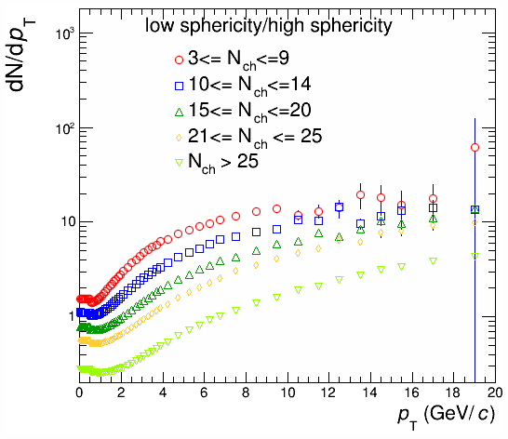
Ratio of low sphericity to high sphericity pt spectra
The ratios show an interesting pattern that bears some similarities to what is observed in Heavy ion collisions and is attributed to parton energy loss
Are we witnessing two different mechanisms of suppression or we witness the same in pp and heavy ions???

Slide 28
The elliptic flow – could it be MPI dependent.
Less MPI
coordinate space
y
More MPI
More MPI
x
One should take in account that also the initial state is different with respect to the number of interaction if a collective effect like MPI and color reconnection takes place it should be taken into account.

Slide 29
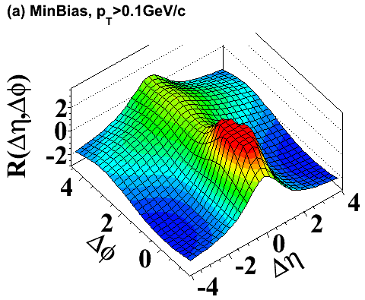
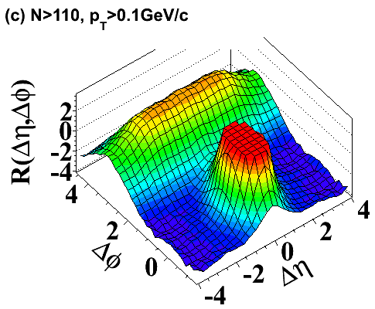
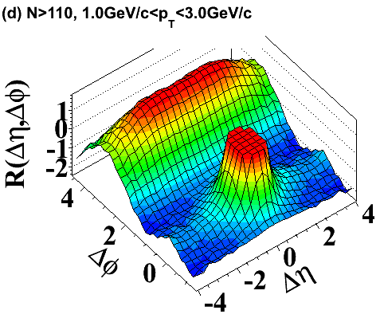
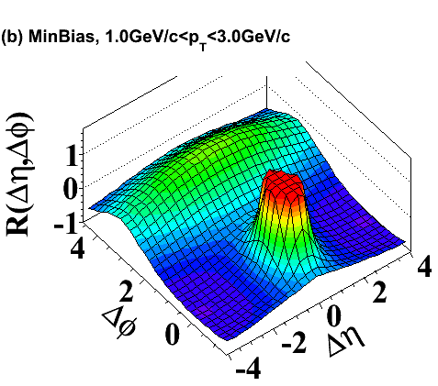
Long-range near-side angular correlations
7 TeV
Peaks are truncated !
new ridge-like structure at Δφ ~ 0

Slide 30
Final comments
We have seen that the pp collisions should be studied not only in minimum bias and/or multiplicity – the event shapes should be taken into account
Some features of the heavy ion collisions can be observed in the pp collisions at high multiplicity
The pp collisions with a good statistics should be planned for the next LHC run in 2015 in good conditions with low pileup and high stats top reach higher multiplicities

Slide 31
