Slide 1
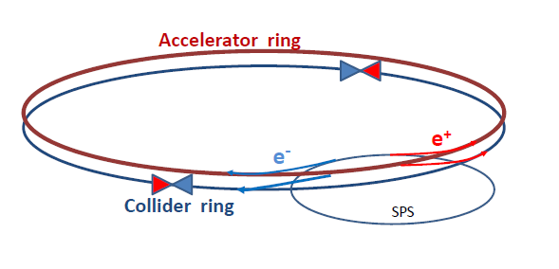
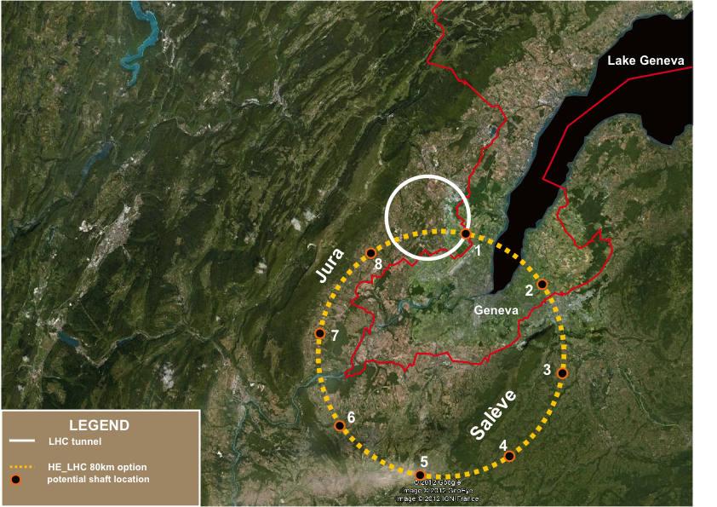
TLEP: A first step in a long-term vision for HEP
TLEP Design Study : 2013 - 2018
Supported by CERN strategy, in the context of a global project
See Design Study Proposal at http://tlep.web.cern.ch/
Most recent workshop 4-5 April 2013 (CERN)
https://indico.cern.ch/conferenceDisplay.py?ovw=True&confId=240814
Next workshops : 25-26 July 2013 (FNAL) and 16-18 October 2013 (CERN)
https://indico.cern.ch/conferenceDisplay.py?confId=246137 Register !
Design Study kick-off workshop in December 2013 or January 2014
CERN implementation
A. Blondel
J. Osborne and C. Waajjer

Slide 2
TLEP: A first step in a long-term vision for HEP
Recommendations from European Strategy Group
High-priority large-scale scientific activities
Recommendation #2
Excerpt from the CERN Council deliberation document (22-Mar-2013)
d) To stay at the forefront of particle physics, Europe needs to be in a position to propose an ambitious post-LHC accelerator project at CERN by the time of the next Strategy update, when physics results from the LHC running at 14 TeV will be available.
CERN should undertake design studies for accelerator projects in a global context, with emphasis on proton-proton and electron-positron high-energy frontier machines. These design studies should be coupled to a vigorous accelerator R&D programme, including high-field magnets and high-gradient accelerating structures, in collaboration with national institutes, laboratories and universities worldwide.
The two most promising lines of development towards the new high energy frontier after the LHC are proton-proton and electron-positron colliders. Focused design studies are required in both fields, together with vigorous accelerator R&D supported by adequate resources and driven by collaborations involving CERN and national institutes, universities and laboratories worldwide. The Compact Linear Collider (CLIC) is an electron-positron
machine based on a novel two-beam acceleration technique, which could, in stages, reach a centre-of-mass energy up to 3 TeV. A Conceptual Design Report for CLIC has already been prepared. Possible proton-proton machines of higher energy than the LHC include HE-LHC, roughly doubling the centre-of-mass energy in the present tunnel, and V-LHC, aimed at reaching up to 100 TeV in a new circular 80km tunnel. A large tunnel such as this could also host a circular electron-positron machine (TLEP) reaching energies up to 350 GeV with high luminosity.

Slide 3
A compendium of misconceptions about TLEP
Heard repeatedly
TLEP is more expensive than the ILC
TLEP parameters are stretched by many-order-of-magnitude extrapolations
TLEP will come later than ILC
TLEP is superfluous once ILC is approved and starts construction
TLEP will delay VHE-LHC
TLEP RF power is unacceptable (600 MW?!)
TLEP physics case is the same as that of ILC (at low energy)
TLEP can only do Higgs couplings / TLEP does not cover the physics case
We need a machine upgradeable beyond 350 GeV to make discoveries beyond LHC
TLEP precision is an overkill
Higgs couplings do not need to be measured so precisely
All are wrong
With the upgrade path to a 100 TeV machine (unique to TLEP)
TLEP is the first step in a long-term vision for particle physics
And might be the only way to secure high-energy physics in Europe

Slide 4
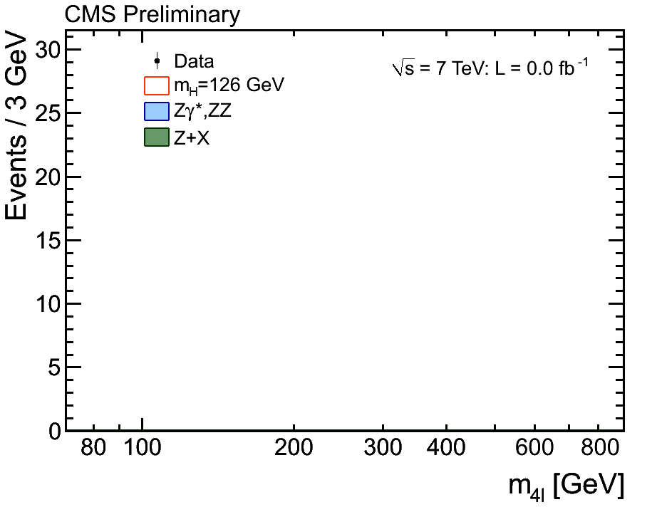
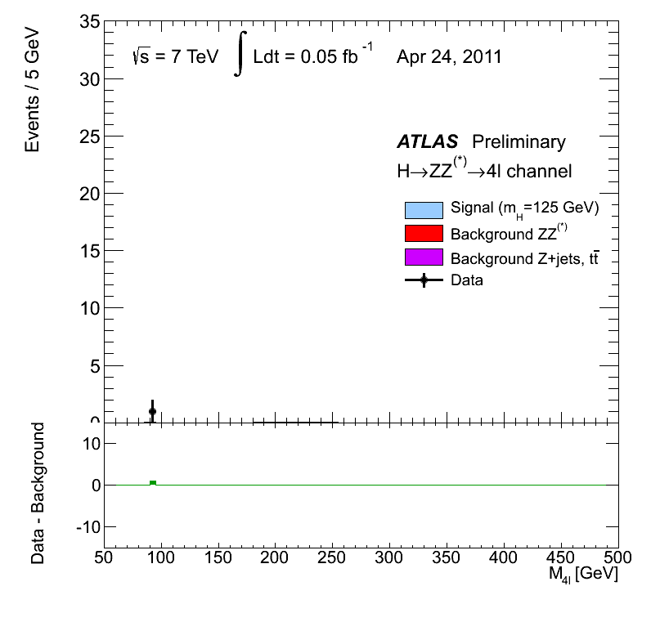
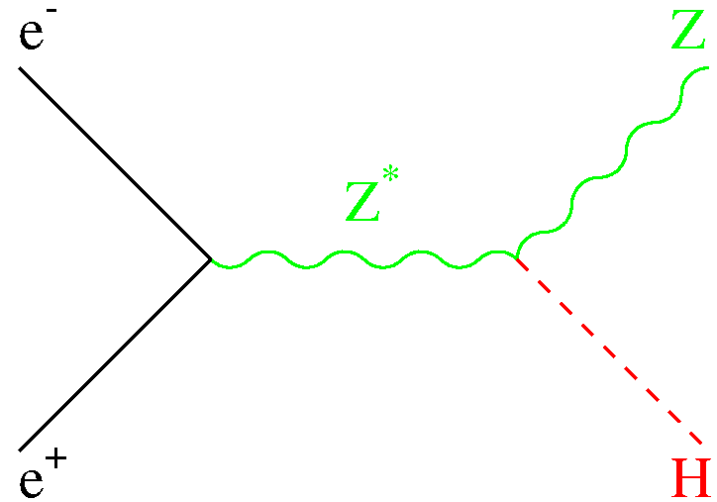
Scientific Motivation (1)
A new boson with mass ~ 126 GeV, and with SMS properties
Example : H(126) → ZZ → 4 leptons in CMS and ATLAS
H(126) couples to the Z boson : important for e⁺e⁻ colliders
g_{HZZ} compatible with SM prediction (within ±30%)
Scalar hypothesis favoured
m_{H} known to ~ 400 MeV
σ_{HZ} largest at √s = 250 GeV
Moriond EW ’13

Slide 5
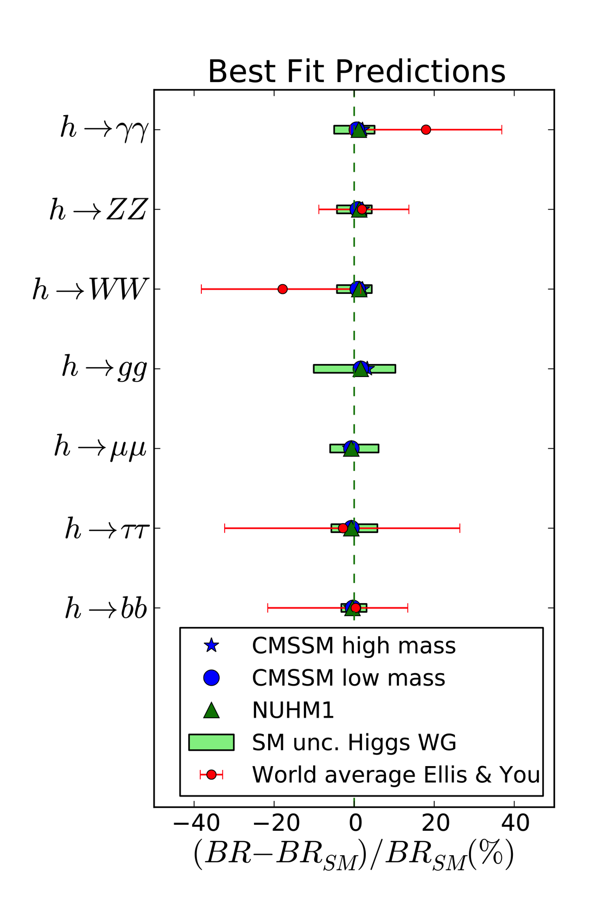
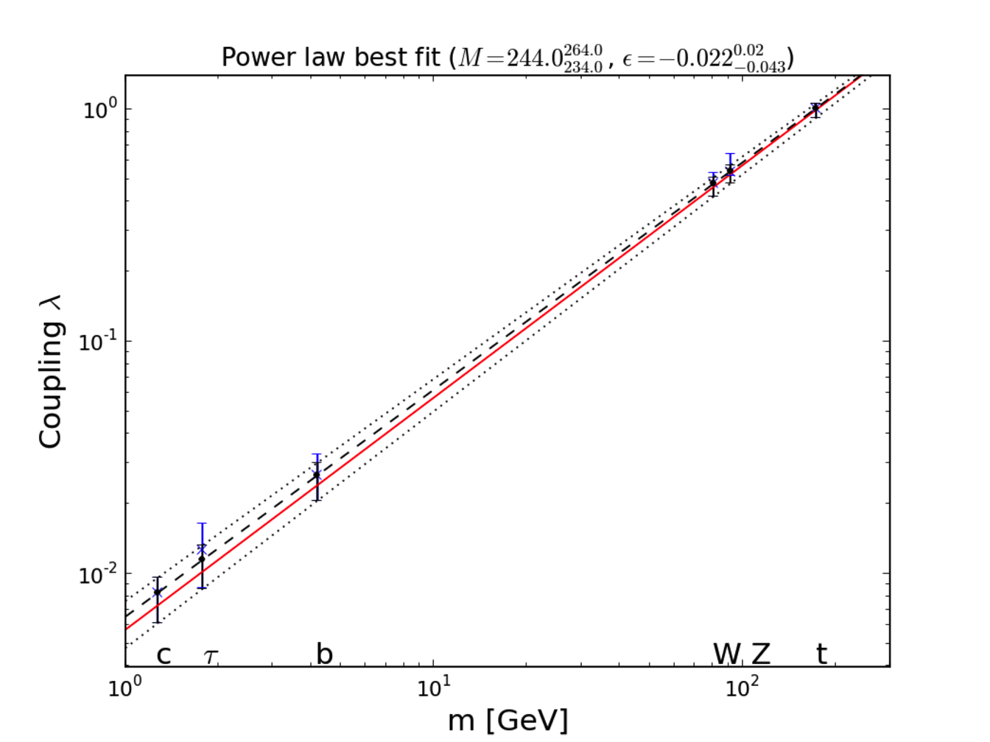

Scientific Motivation (2)
Today’s situation
A (very) Standard Higgs boson
Very strong motivation to measure all couplings with high precision
What precision ?
J. Ellis et al.

Slide 6
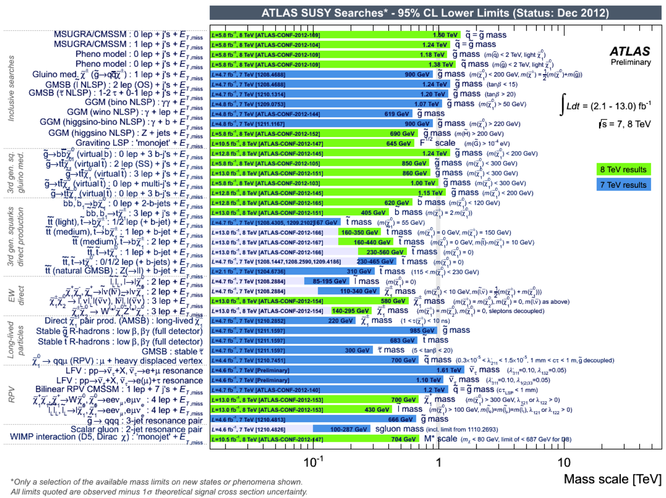
Scientific Motivation (3)
No sign of new physics below a scale of several 100’s GeV
Supersymmetry (ATLAS) Exotics (CMS)
Data at higher √s will extend the coverage to ~500 GeV for SUSY
Will know in 2017 : might need to look for (multi-)TeV New Physics
Air is getting very thin for Linear Colliders with √s = o(TeV)
We need a machine upgradeable beyond several TeV
Moriond EW ’13

Slide 7
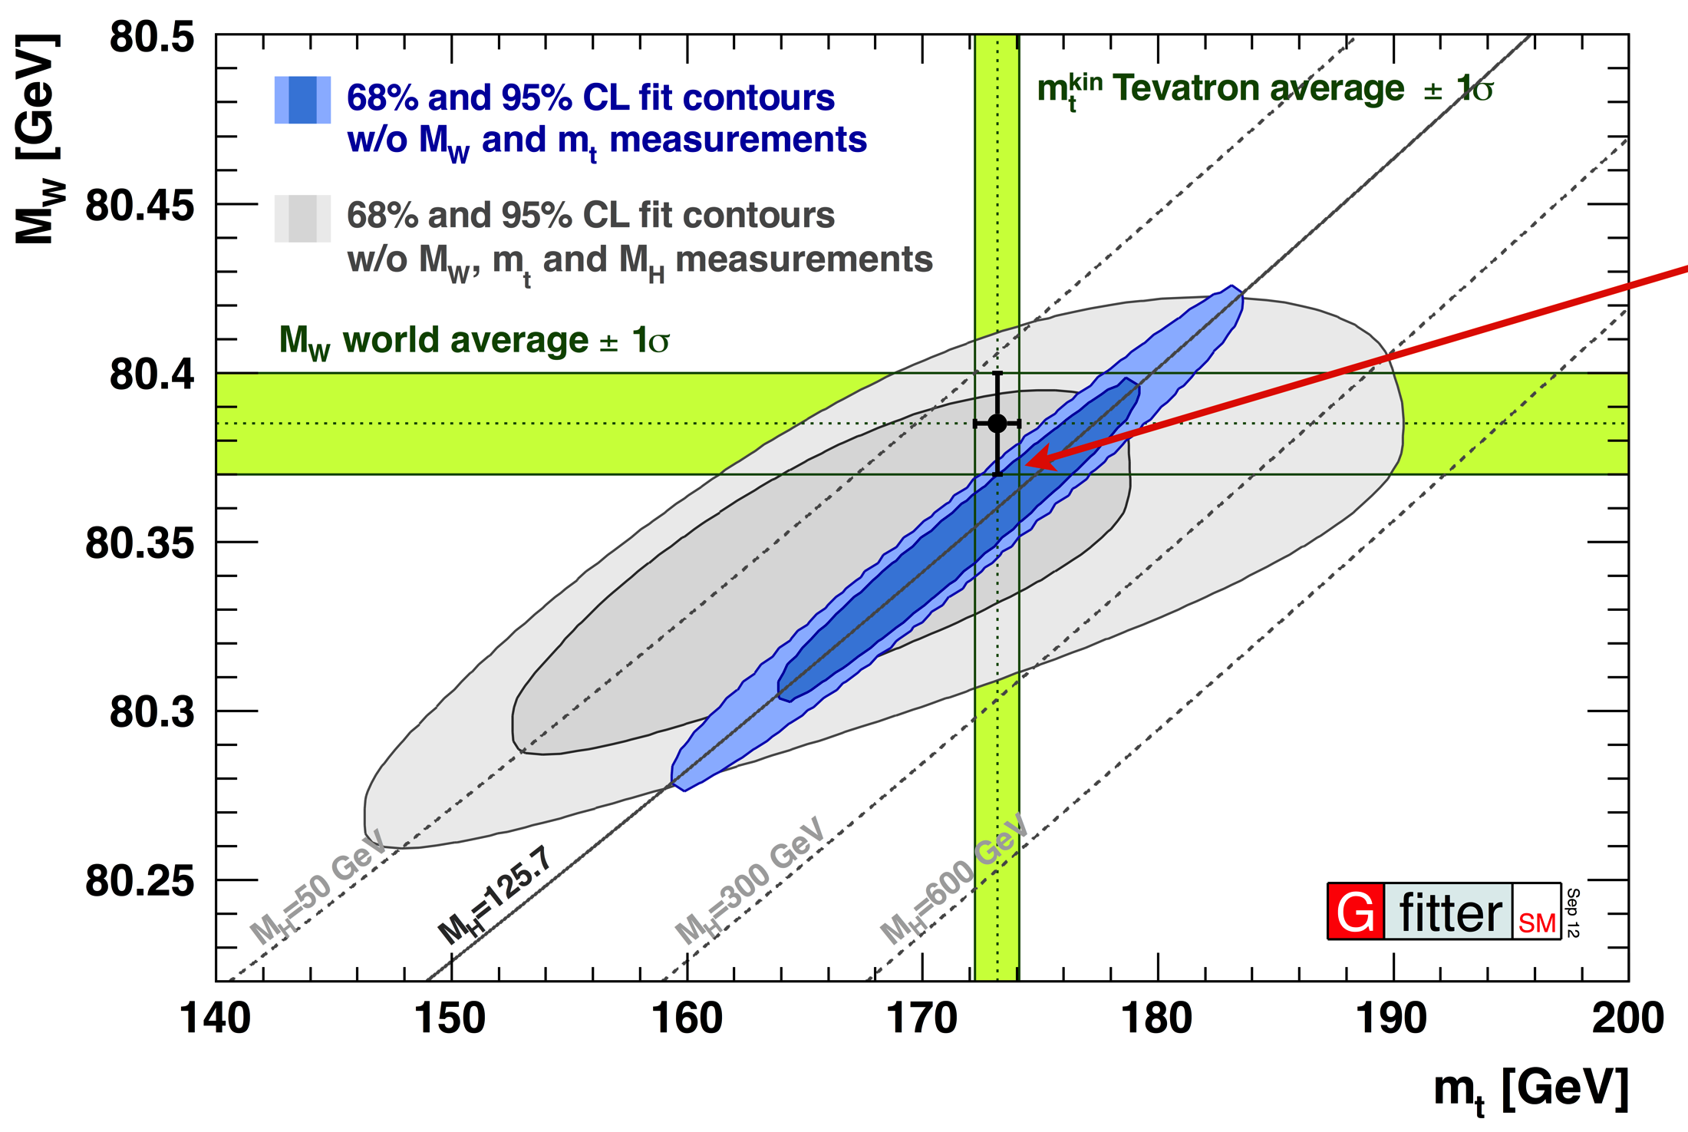
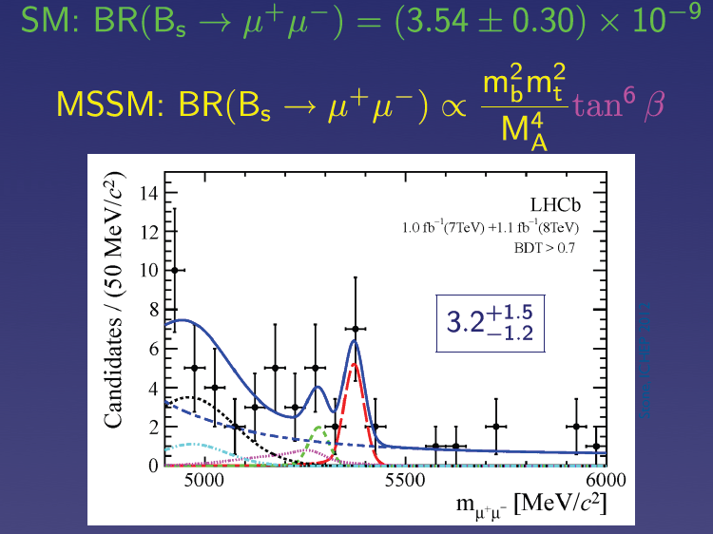
Scientific Motivation (4)
If no new physics is found, what next ?
Once m_{H} is known, the standard model has nowhere to go !
Very strong incentive to revisit and improve all precision measurements
Z pole, WW threshold
Higgs couplings
Top quark properties
Rare decays (B_{s} → μμ, etc.)
With the precision needed to become sensitive to (multi-)TeV New Physics
LHCb 2013
R. Kogler et al.
→ Programme unique to TLEP
→ Integrated luminosity unique to TLEP
→ Integrated luminosity unique to TLEP
→ Also at the Z pole, unique to TLEP

Slide 8
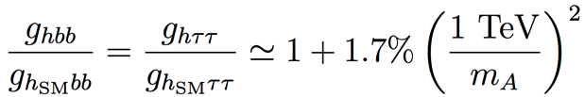
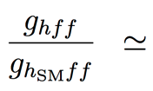
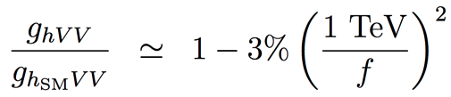
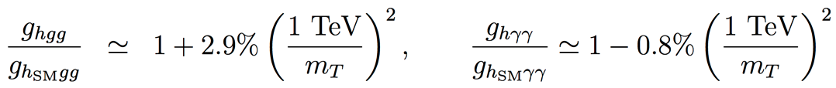
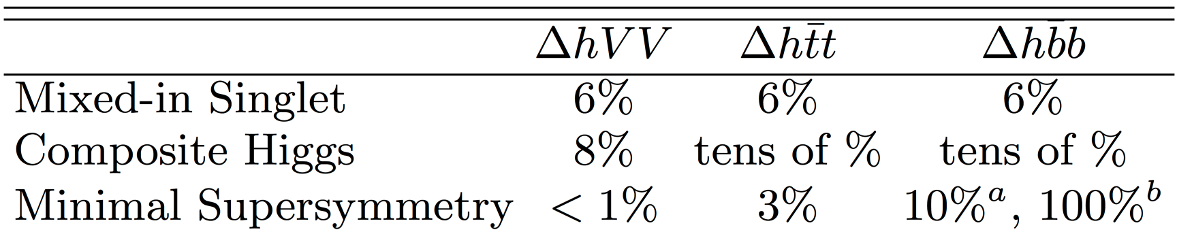
Scientific Motivation (5)
Example : Precision for Higgs couplings
Maximal deviations with respect to SM couplings, as a function of new physics scale
SUSY , for tanβ = 5
Composite Higgs
Top partners
Other models may give up to 5% deviations with respect to the Standard Model
Maximal deviations for the new physics scale still allowed by LHC results
Strongly influences the strategy for Higgs factory projects
Need at least a per-cent accuracy on couplings for a 5σ “observation”
And sub-percent precision if new physics is at the (multi-)TeV scale
H. Baer, M. Peskin et al.
J.D. Wells et al.

Slide 9
Precision at existing colliders : (HL-)LHC (1)
Executive summary
Approved LHC, 300 fb⁻¹ at 14 TeV :
Higgs mass at 100 MeV
Disentangle Spin 0 vs Spin 2 and main CP component in γγ/ZZ*
Coupling precision / Experiment
ZZ, WW, 5-6%
bb, ττ 10-15%
tt, μμ 3-2 σ effect
γγ , gg 5-11%
HL-LHC, 3000 fb⁻¹ at 14 TeV:
Higgs mass at 50 MeV
More precise studies of Higgs CP sector
Coupling precision / Experiment
ZZ, ZW, 1-5%
bb, ττ, tt, μμ 3-10%
γγ and gg 2-7%
HH >3 σ (2 Expts)
Assuming sizeable reduction of theory errors
CMS (#177) and ATLAS (#174) contributions to the European Strategy (2012)

Slide 10
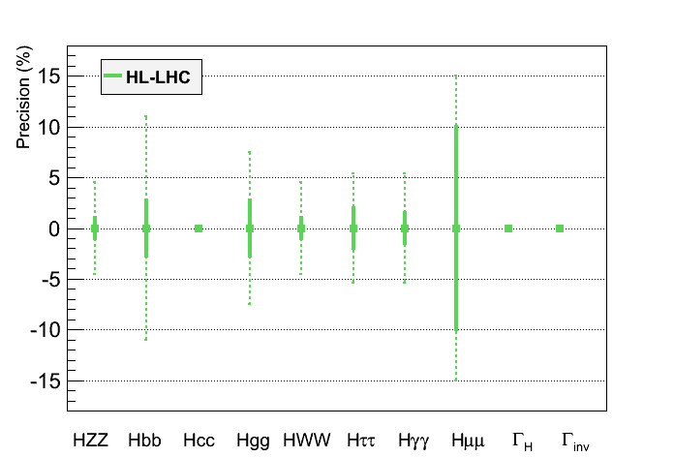
Precision at existing colliders : HL-LHC (2)
Graphic representation of HL-LHC projected performance
Much better than originally expected before LHC started
Will need vigorous upgrade of CMS and ATLAS detectors
Per-cent to sub-percent precision will require new collider(s)
From CMS (#177) contribution to the European Strategy (2012)
Assumptions :
No new decay
SM corr. for BR(cc) )
?
?
?
In bold, theory uncertainty are assumed to be divided by a factor 2,
experimental uncertainties are assumed to scale with 1/√L,
and analysis performance are assumed to be identical as today
ATLAS upper limit at 65%
(Moriond EW 2013)
[11]

Slide 11
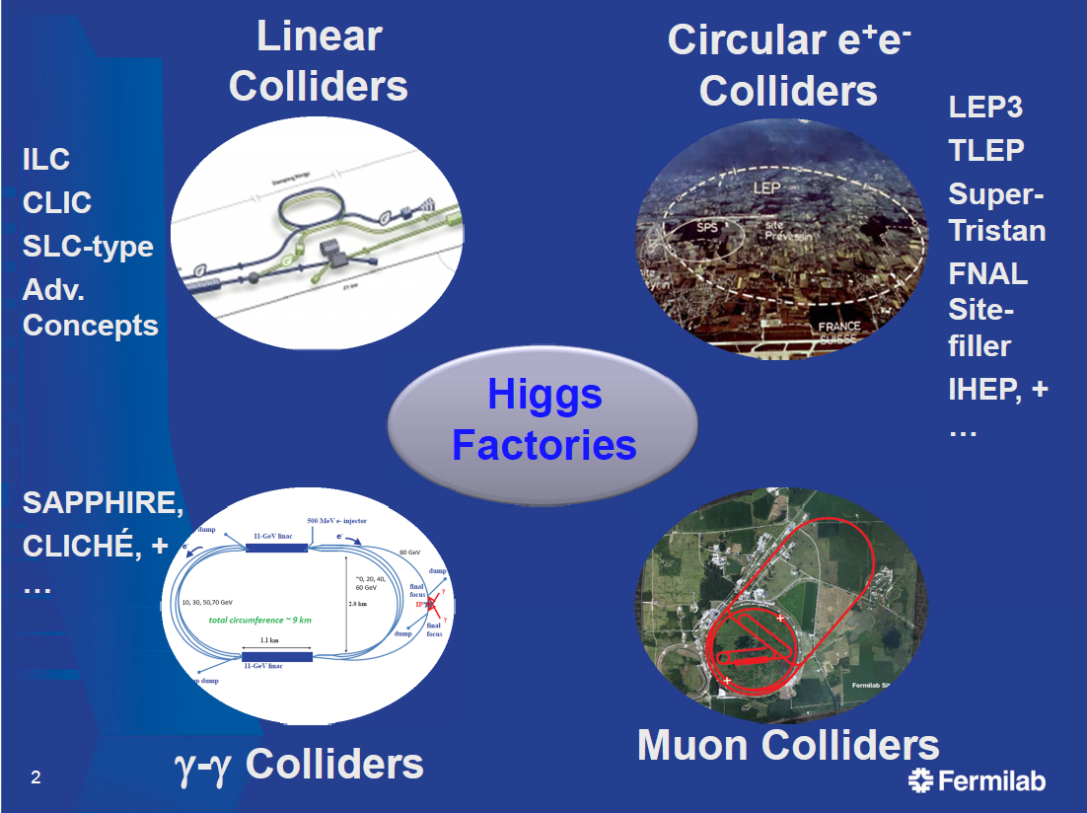
P0ssible paths towards the future
Several options for Higgs factories are being studied
Studied for decades
This talk
(mostly TLEP)
Not encouraged by
European Strategy
Smaller Physics
Potential
e⁺e⁻ colliders have largest potential
as Precision Higgs Factories

Slide 12
The Visionary Solution : TLEP + VHE-LHC (Worst case solution : LEP3+HE-LHC)
Build a new 80-100 km circular tunnel :
TLEP Physics case : Precision measurements sensitive to multi-TeV New Physics
TeraZ (√s~m_{Z}), MegaW (√s~2m_{W}), Higgs Factory (√s~240 GeV), top (√s~350 GeV)
With luminosity 5-1000 × larger than projects of similar timescale and cost
Followed by VHE-LHC : Direct search for New Physics in the 10-100 TeV range
√s ~ 100 TeV with 20T magnets
Also allows the HHH coupling to be measured to a few %
TLEP : e⁺e⁻, up to
√s ~350 GeV
F. Zimmermann
(CERN implementation)
PSB
PS (0.6 km)
LHC (26.7 km)
SPS (6.9 km)
HE-LHC (33 TeV)
LEP3 : e⁺e⁻, up to
√s ~ 240 GeV
VHE-LHC : pp,
√s ~ 100 TeV

Slide 13
80-km tunnel in Geneva area – “best” option
«Pre-Feasibility Study for an 80-km tunnel at CERN»
John Osborne and Caroline Waaijer,
CERN, ARUP & GADZ, submitted to ESPG
even better
100 km?

Slide 14
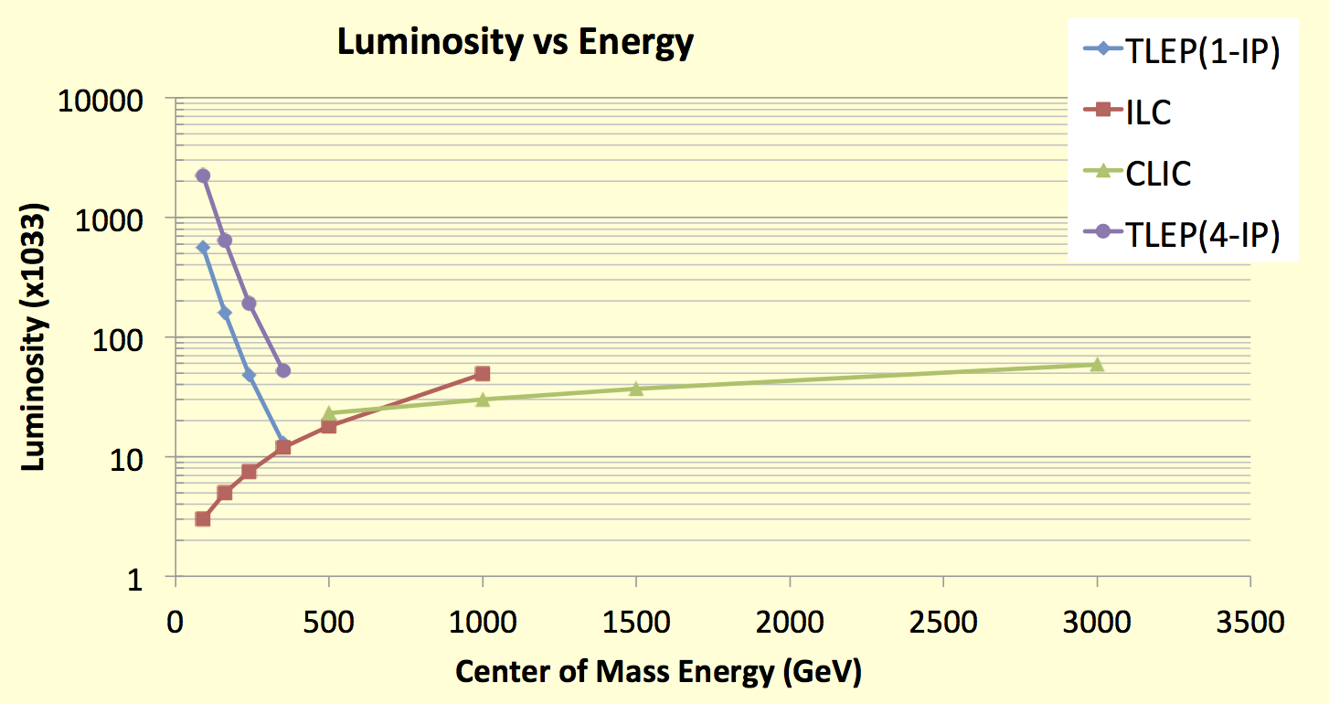
Luminosity at TLEP (1)
Luminosity increases when √s decreases at circular colliders
By optimal use of the RF power to collide more bunches when SR decreases (1/E⁴)
Ultimate precision measurements are therefore made possible at circular colliders
Crossing point with linear colliders ~ 450 GeV
Luminosity upgrade (×3) now envisioned at ILC : luminosity is the key !
TLEP : Instantaneous lumi at each IP (for 4 IP’s)
Z, 2.10³⁶
With LHeC-inspired
optics/parameter
WW, 6.10³⁵
HZ, 2.10³⁵
tt , 5.10³⁴
√s (GeV) | # Bunches
91 | 4000
240 | 80
350 | 12
R. Aleksan

Slide 15
Luminosity at TLEP (2)
Luminosity achieved by reducing the vertical β*
From 5 cm (LEP2) to < 1 mm (TLEP)
Note : 0.3 mm soon to be realized at SuperKEKB
Vertical beam size < 200 nm
Note : 1 to 5 nm for Linear Colliders
Hence negligible Beamstrahlung for Physics, beam energy well known
 | TLEP-H | TLEP-t | ILC (250) | ILC (350)
beam energy [GeV] | 120 | 175 | 125 | 175
disruption D_{y} | 2.2 | 1.5 | 23.4 | 84.5
ϒ_{BS} [10⁻⁴] | 15 | 15 | 207 | 310
n_{γ}/collision | 0.50 | 0.51 | 1.17 | 1.24
Δδ^{BS}/collision [MeV] | 42 | 61 | 1265 | 2670
Δδ^{BS}_{rms}/collision [MeV] | 65 | 95 | 1338 | 2760
F. Zimmermann

Slide 16
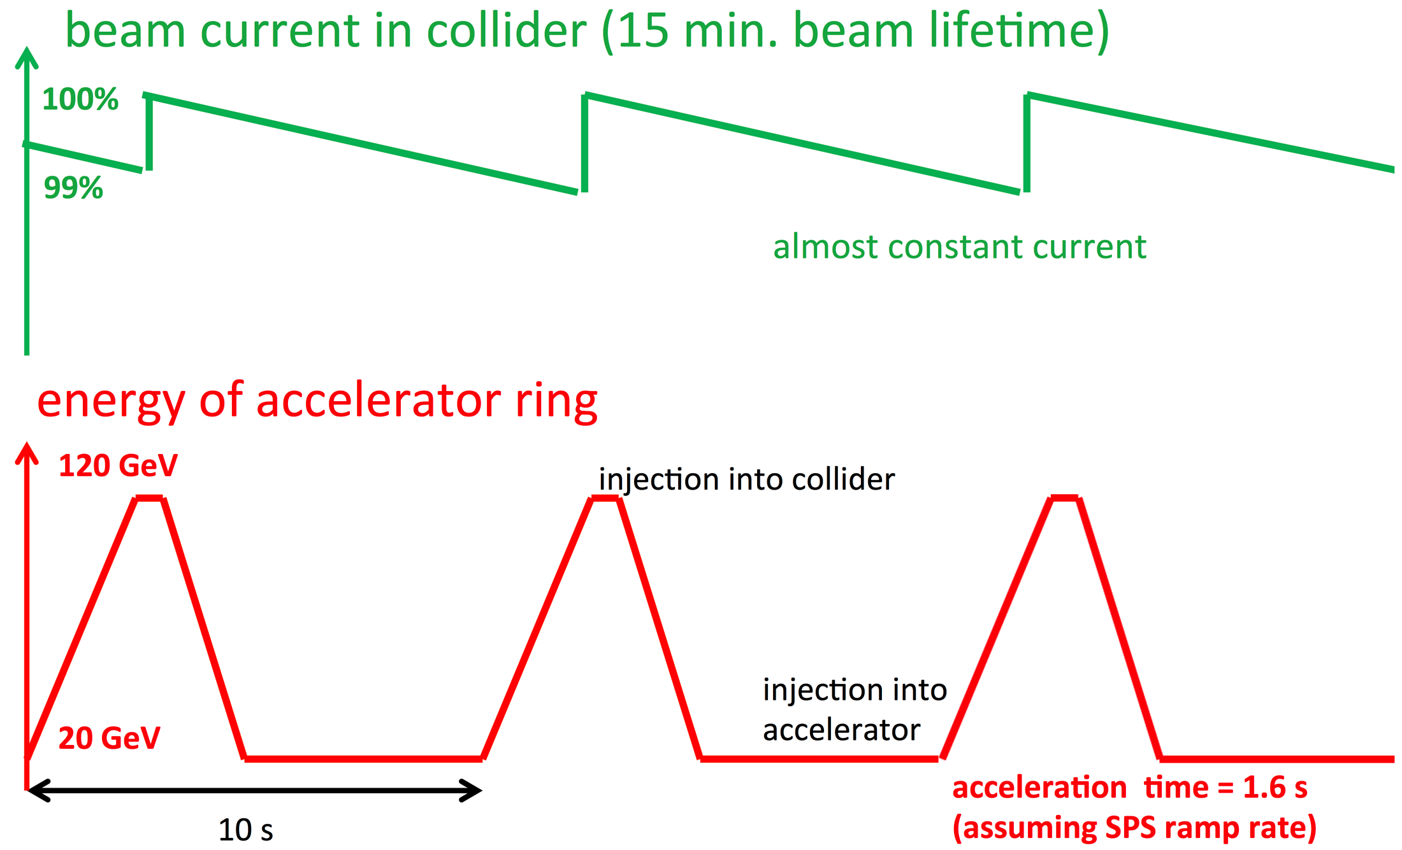
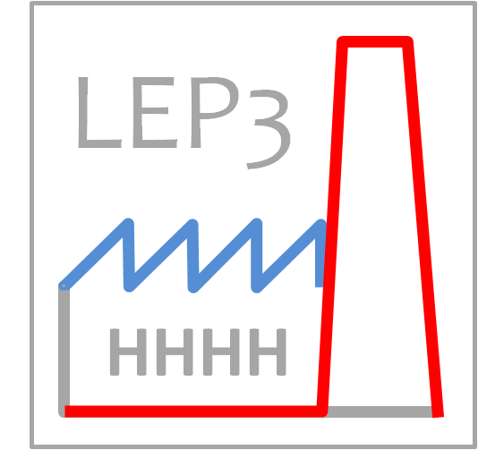
Luminosity at TLEP (3)
At these luminosities, beam lifetime ~ 15 minutes (Bhabha scattering)
Solution : double ring and continuous top-up injection, as at PEP-II
Note : Soon to be realized at Super-KEKB, beam lifetime ~ 5 minutes
Top-up injection : Schematic cycle
(Provisional logo)
Contest to be organized !
A. Blondel
F. Zimmermann
TLEP
M. Koratzinos

Slide 17
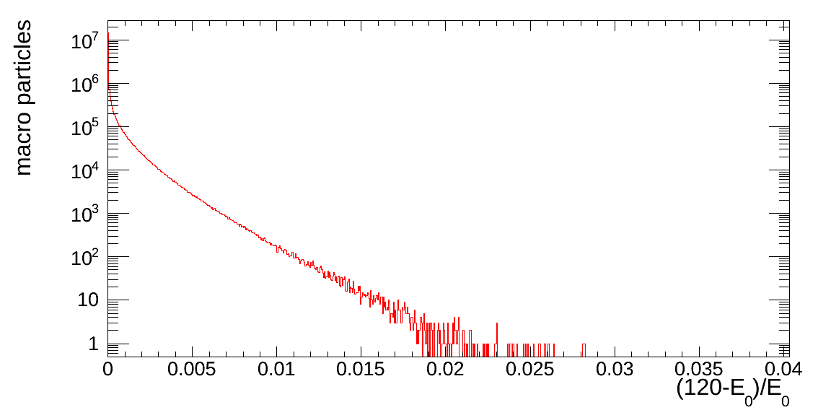
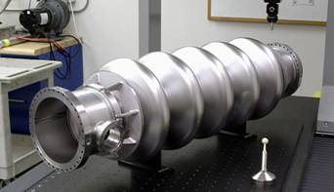
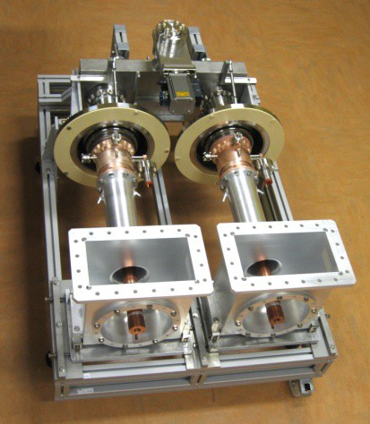
Challenges (A subset)
Beamstrahlung
Radiating e± pushed outside the acceptance
Reduces the beam lifetime significantly
Need to design an achromatic optics at the IPs
with 2-3% momentum acceptance
Efficient RF system
Need 12 GeV/turn at 350 GeV
~900 m of SC RF cavities @ 20 MV/m
LEP2 had 850 m at 7 MV/m
Very high power : up to 200 kW / cavity in the collider ring
Power couplers similar to ESS – 700-800 MHz preferred
Small vertical emittance
Can/should further reduce beamstrahlung by minimizing σ_{y}/σ_{x}
Aim is to reach 0.1% (LEP2 had 2%, SuperKEKB plans 0.2%)
Operation at the Z pole
4000 bunches : e⁺ source, impedance effects, parasitic collisions
May need two rings designed to separate e⁺ and e⁻ beams
M. Zanetti
BNL 5-cell 700 MHz cavity
RF Coupler
(ESS/SPL)

Slide 18
“TLEP RF Power is unacceptable (600 MW?!)”
RF parameters and total power consumption at 350 GeV
RF Parameters : TLEP RF ~ LHeC RF
Total Power Consumption (MW)
F. LeDiberder : 55% should be 17% (like ILC)
LEP2 already reached 42%
CLIC Drive Beam foresees 55%
CEBAF enjoys 55%
Difference between CW and Pulsed
 | LHeC | TLEP collider | TLEP inj.
beam energy [GeV] | 60 | 175 | 175
frequency [MHz] | 720 or 800
total voltage [GV] | 20 | 12 | 9
av gradient [MV/m] | 20 | 20 | 20
eff. RF length [km] | 1 | 0.6 | 0.6
#cavities | 1000 | 600 | 600
Efficiency (wall→beam) | 55% | 55% | 55%
power throughput [MW] | 17 | 110 | 10 (peak)
power / cavity [kW] | 17 | 183 | 17
E. Jensen, A. Butterworh, F. Zimmermann, M. Koratzinos
 | TLEP
Wall-plug RF power | 181
RF cryo power | 24
Magnet system power | 6
Cooling and ventilation | 60
Experiments | 25
General services | 15
SPS & PS as pre-injectors | 5
e-/e+ source & pre-pre-injector | 1
Total | 318

Slide 19
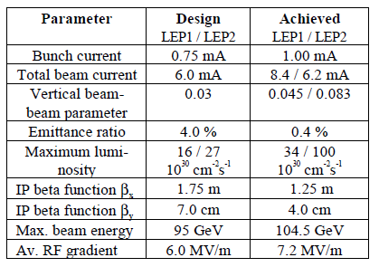
“TLEP parameters are stretched by huge extrapolations”
Extrapolation from past experience
Example : beam size @ IP
SuperKEKB will be an excellent test-bench for TLEP
In many respects
Will also learn a lot from ATF2
Lot of work ahead to reach ILC beam dimensions
Estimates for circular colliders historically reliable
F. Zimmermann
 | LEP2→TLEP-H | SLC→ILC 250
peak luminosity | × 400 | × 2500
energy | × 1.15 | × 2.5
vertical geom. emittance | × 1/5 | × 1/400
vert. IP beam size | × 1/15 | × 1/150
e⁺ production rate | × 1/2 ! | × 65
commissioning time | <1 year → ? | >10 years →?
LEP2 | 3500
KEKB | 940
SLC | 500
LEP3 | 320
TLEP-H | 220
ATF2, FFTB | 72, 65
SuperKEKB | 50
SAPPHiRE | 18
ILC | 5 – 8
CLIC | 1 – 2

Slide 20
“TLEP is more expensive than the ILC (1)”

Slide 21
“TLEP is more expensive than the ILC (2)”
Very rough estimate (Giga-CHF)
ILC cost (2012 re-evaluation) : 7.8 Giga-$
Many items not included
Site construction, infrastructure engineering, detectors, coming R&D, …
Bare tunnel | 3.1 ⁽¹⁾
Services & Additional infrastructure (electricity, cooling, service cavern, RP, ventilation, access roads …) | 1.0⁽²⁾
RF system | 1.0 ⁽³⁾
Cryo system | 0.2 ⁽⁴⁾
Vacuum system & RP | 0.5⁽⁵⁾
Magnet system for collider & injector ring | 0.8⁽⁶⁾
Pre-injector complex SPS reinforcements | 0.5
Total | 7.1
(1): J. Osborne, Amrup study
(2): Extrapolation from LEP
(3): B. Rimmer, SRF cost per GeV or
per Watt for CEBAF upgrade, 2010
O. Brunner, complete evaluation, 2013
preliminary – not endorsed by anybody
(4): F. Haug, 4th TLEP Days, 5 April 2013
(5): K. Oide : factor 2.5 higher than KEK,
estimated for 80 km ring
(6): 24,000 magnets for collider & injector;
cost per magnet 30 kCHF (LHeC);
10% added; no cost saving from mass
production assumed
Note: detector costs not included – can count 0.5 per detector (CMS/ATLAS)

Slide 22
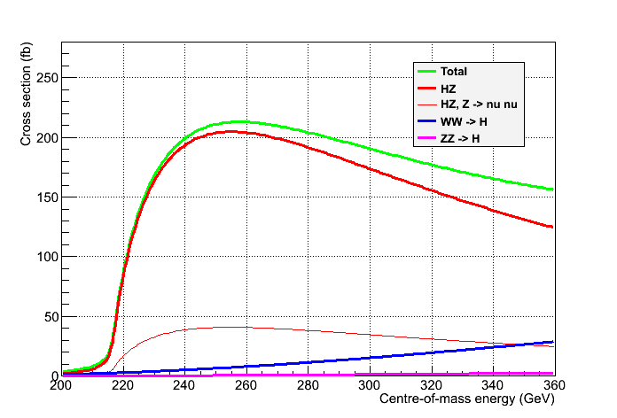
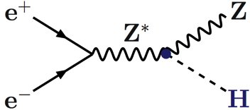
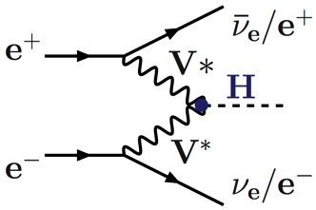
TLEP Physics case as a Higgs Factory (1)
Physics case not driven by the fact that the collider is linear or circular
Scan of the HZ threshold : √s = 210-240 GeV Spin
Maximum of the HZ cross section : √s = 240-250 GeV Mass, σ_{HZ,} BRs, Width, Decays
Just below or at the tt threshold : √s ~ 340-350 GeV Width
Unpolarized cross sections
PJ and G. Ganis
Need 100’s fb⁻¹
Z → All
Z → νν
[7]

Slide 23
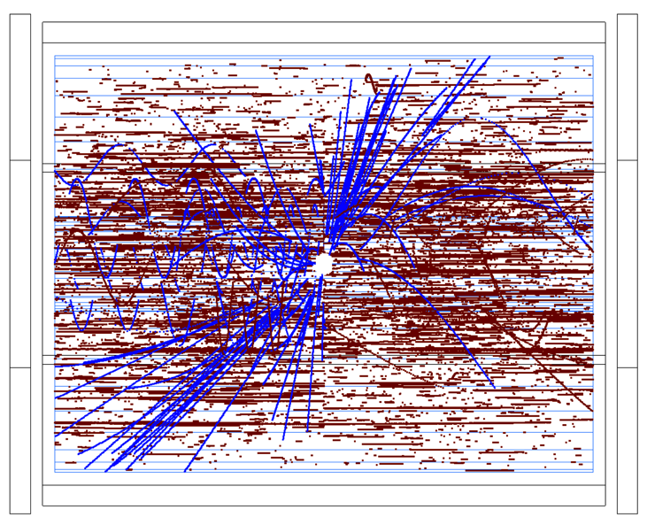
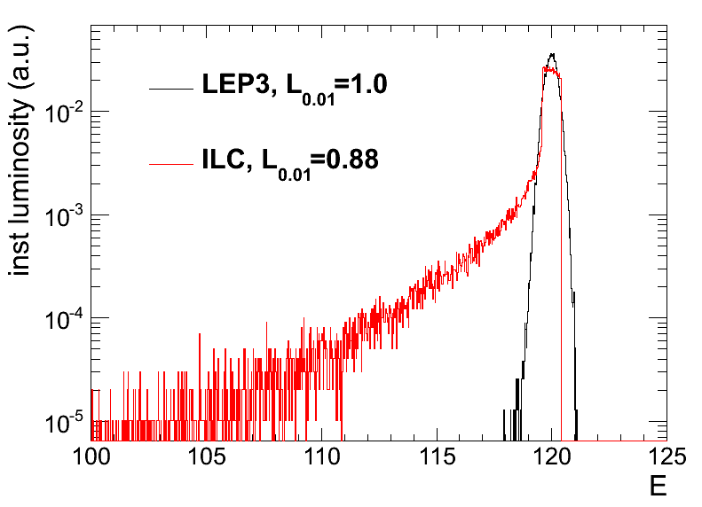
TLEP Physics case as a Higgs Factory (2)
A few specificities, though :
e⁻ (e⁺) beam polarization is easy at the source (possible) for a linear collider.
Not critical for Higgs studies.
No beam disruption from Beamstrahlung for a circular collider (σ_{y} ~ 300 nm vs. 5 nm @ ILC)
No EM backgrounds in the detector (photons, e+e- pairs);
No beam energy smearing – energy spectrum perfectly known (lumi measurement)
Negligible pile-up from γγ interactions
No drastic requirements for the detector and the background simulation
Possibility of operating several IP’s simultaneously in circular collider
vs. only one IP in linear collider
ILD TPC at 500 GeV
M. Zanetti
ILD LoI

Slide 24
TLEP Physics case as a Higgs Factory (3)
Number of Higgs bosons produced at √s = 240-250 GeV
In a given amount of time, Higgs coupling precisions scale like
e.g., for g_{HZZ} : 1.5% for ILC : 0.65% for LEP3 : 0.2% for TLEP
Five years of TLEP = 75-150 years of ILC (at 240 GeV)
Note : measure total Higgs boson width Γ_{H}
At 240 GeV : With σ_{HZ} (~ g²_{HZZ}) and σ_{HZ} × BR(H→ ZZ) (~ g⁴_{HZZ}/Γ_{H})
At 350 GeV : With σ_{WW→H} (~ g²_{HWW}) and σ_{HZ} × BR(H→ WW) (~ g²_{HZZ}g²_{HWW}/Γ_{H})
 | ILC-250 | LEP3-240 | TLEP-240
Lumi / IP / 5 years | 250 fb⁻¹ | 500 fb⁻¹ | 2.5 ab⁻¹
# IP | 1 | 2 - 4 | 2 - 4
Lumi / 5 years | 250 fb⁻¹ | 1 - 2 ab⁻¹ | 5 - 10 ab⁻¹
Beam Polarization | 80%, 30% | – | –
L_{0.01} (beamstrahlung) | 86% | 100% | 100%
Number of Higgs | 70,000 | 400,000 | 2,000,000
Upgradeable to | ILC 1TeV CLIC 3 TeV ? | HE-LHC 33 TeV | VHE-LHC 100 TeV

Slide 25
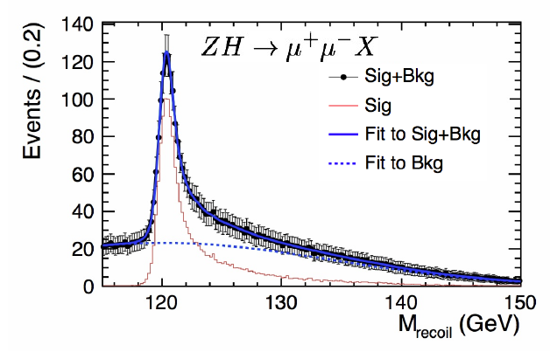
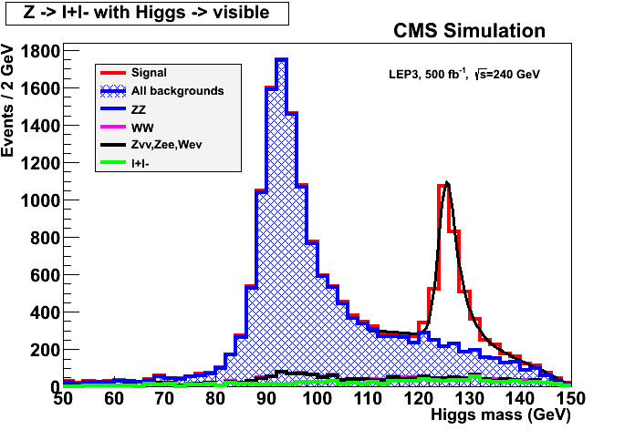
Higgs measurements at √s ~ 240 GeV (1)
With e⁺e⁻ → ZH → e⁺e⁻X and μ⁺μ⁻X events
Measure HZ cross section in a model independent way
Find m_{H} peak from the leptons and E,p conservation
Determine spin with three-point threshold scan
10 fb⁻¹ / point suffice
Determine σ_{HZ} and g_{HZZ} coupling at 240 GeV
3% (1.5%) precision on σ_{HZ} (g_{HZZ})with 250 fb⁻¹
Good tracker needed, but details mildly depend on the actual performance
Plots below with ILD@ILC and CMS@TLEP
e⁻
H
Z*
e⁺
g_{HZZ}
Z
e⁻, μ⁻
e⁺, μ⁺
[9,10,11]
e⁺e⁻ → ZH → e⁺e⁻X and μ⁺μ⁻X
e⁺e⁻ → ZH → μ⁺μ⁻X
e⁺e⁻ → ZH → μ⁺μ⁻X
Δp/p ~ 0.2%
Δp/p ~ 2%
ILC TDR
P. Azzi et al.

Slide 26
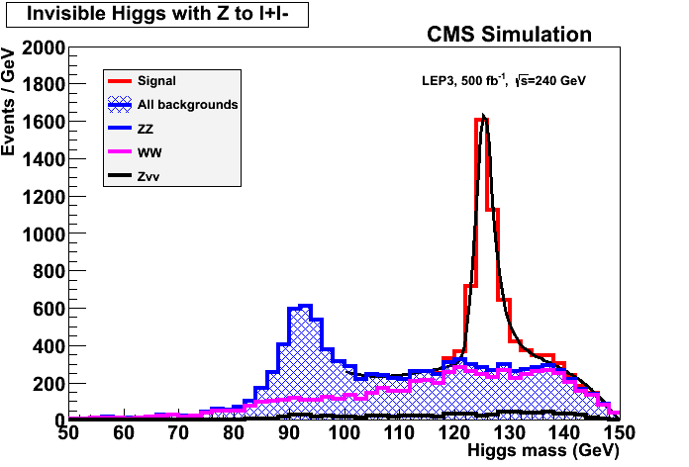
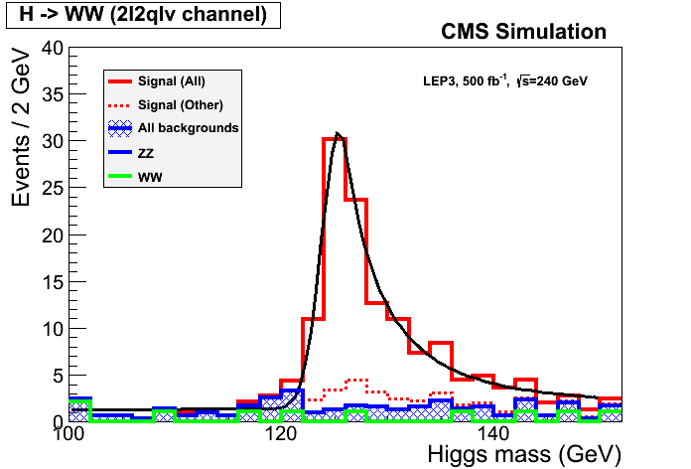
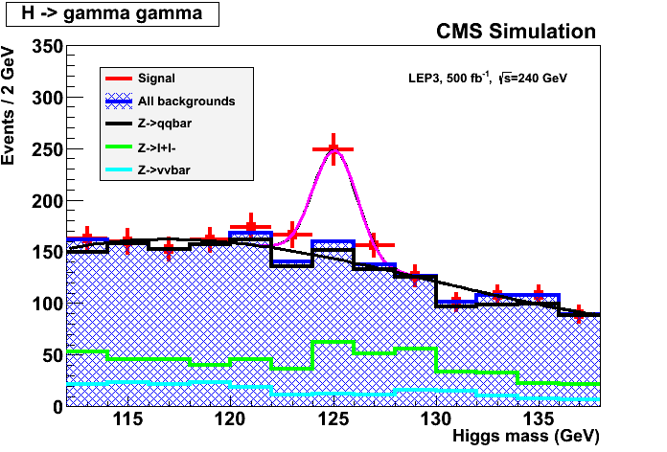
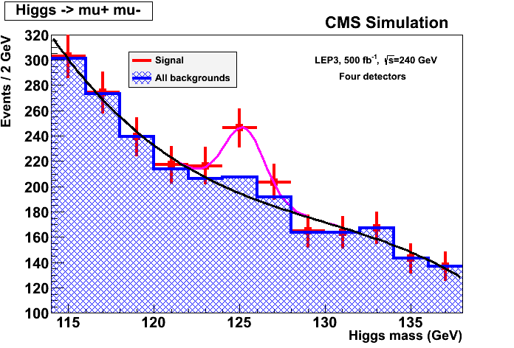
Higgs measurements at √s ~ 240 GeV (2)
With ZH → e⁺e⁻X and μ⁺μ⁻X events (cont’d)
Measure invisible decay branching ratio (X = nothing)
Precision on BR_{INV} ~ 1% with 250 fb⁻¹
Or exclude BR_{INV} > ~2% at 95% C.L.
Measure other σ_{HZ}×BR(H→ ff,VV)
With exclusive selections of Z and H decays
Precision of 1.5% to 8% with 250 fb⁻¹ for the copious decays (bb, WW, gg, ττ, cc)
Need more luminosity for rare decays (γγ, Zγ, μμ)
Particle flow, b and c tagging, lepton and photon capabilities needed
ZH→ qqbb, 250 fb⁻¹ ZH→ llWW→ lllνqq, 500 fb⁻¹ ZH→ Xγγ, 500 fb⁻¹ ZH→ Xμμ, 2 ab⁻¹
H. Baer et al.
P. Azzi et al.

Slide 27
Higgs measurements at √s ~ 240 GeV (3)
Higgs width from the ZZZ final state
Number of ZZZ events ~ σ_{HZ} × BR(H→ ZZ)
σ_{HZ} ~ g²_{HZZ}
BR(H→ZZ) = Γ_{H→ZZ}/Γ_{H} ~ g²_{HZZ} / Γ_{H}
Number of ZZZ events ~ g⁴_{HZZ} / Γ_{H}
Select l⁺l⁻ l^{’+}l^{’−} X events ( ~ background and H →WW free)
Number of events in 250 fb⁻¹ @ 240 GeV :
250 fb⁻¹ × 200 fb × BR(H→ZZ) × BR(Z→ll)² × 3
→ About 40 events, of which ~25 selected
Hence measure the total width Γ_{H} with a precision of 21% with 250 fb⁻¹
Could be further reduced with other Z decays
e⁻
Z
Z∗
H
Z
e⁺
Z∗
Known to 6%
from l⁺l⁻X events
with 250 fb-1

Slide 28
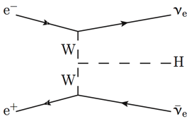
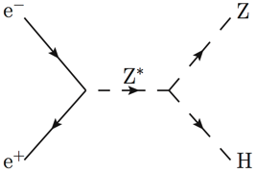
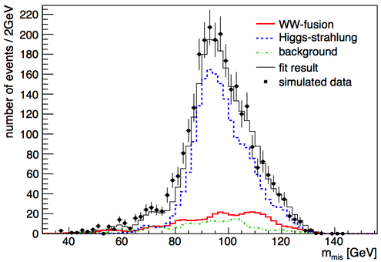
Higgs measurements at √s ~ 240 GeV (4)
Higgs width from the Hνν final state
From σ_{WW→H} and BR(H→ WW)
σ_{WW→H} ~ g²_{HWW}
BR(H→ WW) = Γ_{H→WW} / Γ_{H} ~ g²_{HWW} / Γ_{H}
Γ_{H} ~ σ_{WW→H} / BR(H→ WW)
Contribution to Hνν from HZ ~ 40 pb
Known from ZH → e⁺e⁻X and μ⁺μ⁻X
Contribution from WW fusion ~ 6 pb
To be measured
Select ννbb events from ZH and WW fusion
Needs adequate b tagging and particle flow
Fit the missing mass distribution for N_{WW→H→bb}
σ_{HZ} x BR(H→ bb) known to ~1.5% or better
σ_{WW→H} = N_{WW→H→bb} / BR(H→ bb)
Precision on σ_{WW→H} ~ 14% with 250 fb⁻¹
Γ_{H} ~ σ_{WW→H} / BR(H→ WW), measured up to 15% precision with 250 fb⁻¹
g_{HWW}
C.F. Duerig, LCWS’12

Slide 29
Higgs measurements at √s ~ 240 GeV (5)
Precision on H(125) branching fractions, width, mass, … after 5 years
LEP3 numbers obtained from a CMS simulation x 4, except (*) extrapolated from ILC
Need a refined vertex detector for gg and cc BR accurate measurements
TLEP numbers extrapolated from LEP3 column – ILC numbers with super-duper ILC detector
 | ILC | LEP3 (4) | TLEP (4)
σ_{HZ} | 2.5% | 1.3% | 0.4%
σ_{HZ} ✕BR(H→bb) | 1.0% | 0.5% | 0.1%
σ_{HZ} ✕BR(H→cc) | 6.9% | 4% (*) | 1.3%
σ_{HZ} ✕BR(H→gg) | 8.5% | 4.5% (*) | 1.4%
σ_{HZ} ✕BR(H→WW*) | 8.0% | 3.0% | 0.9%
σ_{HZ} ✕BR(H→ττ) | 5.0% | 3.0% | 0.9%
σ_{HZ} ✕BR(H→ZZ*) | 28% | 7.1% | 3.1%
σ_{HZ} ✕BR(H→γγ) | 27% | 6.8% | 3.0%
σ_{HZ} ✕BR(H→μμ) | – | 28% | 13%
σ_{WW→H} | 11% | 5% (*) | 2.2%
Γ_{H} , Γ_{INV} | 10% , < 1.5% | 4% , < 0.7% | 1.8% , < 0.3%
m_{H} | 40 MeV | 26 MeV | 8 MeV
HF2012 Worskshop

Slide 30
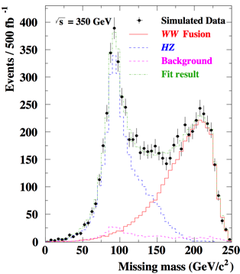
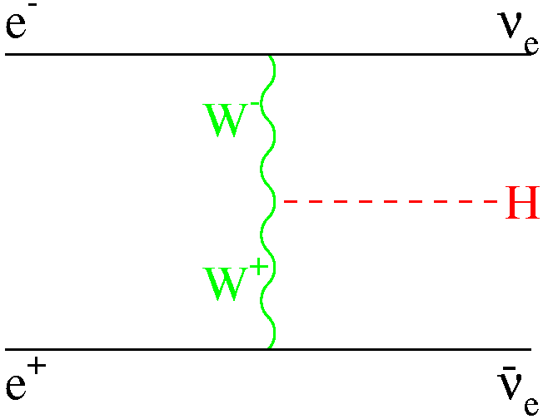
Higgs Measurements at √s ~ 350 GeV
Luminosity for TLEP ~ 5 x ILC @ 350 GeV
At each IP : 500 fb⁻¹ over 5 years
With possibly 4 detectors at TLEP
More study of the Hνν final state with H→bb
Contribution from HZ : ~ 25 fb
Contribution from WW→H : ~ 25 fb
Improves precision on Γ_{H} and HWW coupling
Smaller improvement (by ~20%) of all other σ✕BR measurements
C.F. Duerig, LCWS’12
 | ILC (250+350) | TLEP (240+350)
σ_{WW→H} | 12% → 3% | 2.2% → 0.5%
Γ_{H} | 10% → 5.5% | 1.8% → 1.1%
ILC TDR, June 2013 (to appear)

Slide 31
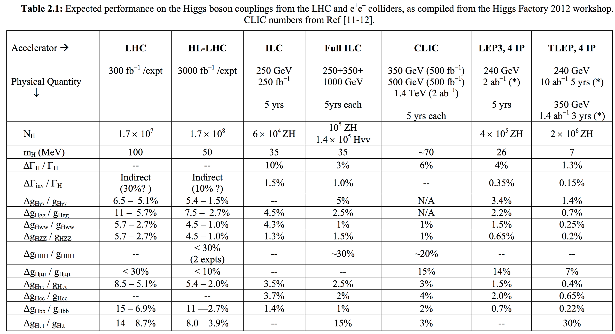
TLEP Physics case as a Higgs Factory (4)
Summary of the ICFA Higgs Factory Workshop (FNAL, Nov. 2012)
Best
precision

Slide 32
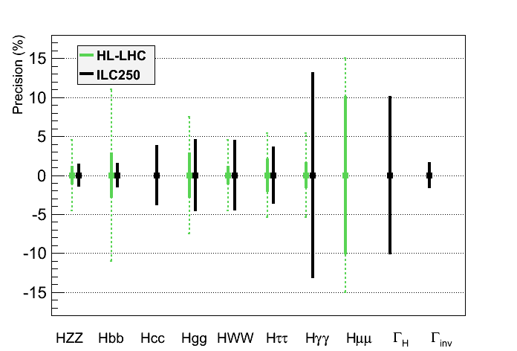
TLEP Physics case as a Higgs Factory (5)
Same assumptions as for HL-LHC for a sound comparison
Total width fixed to the sum of the visible partial widths + correction (Δg/g ~ 1/2 ΔBR/BR)
ILC250 would complement LHC (esp. for Γ_{H} , Γ_{inv} , g_{Hcc} , g_{Hbb})

Slide 33
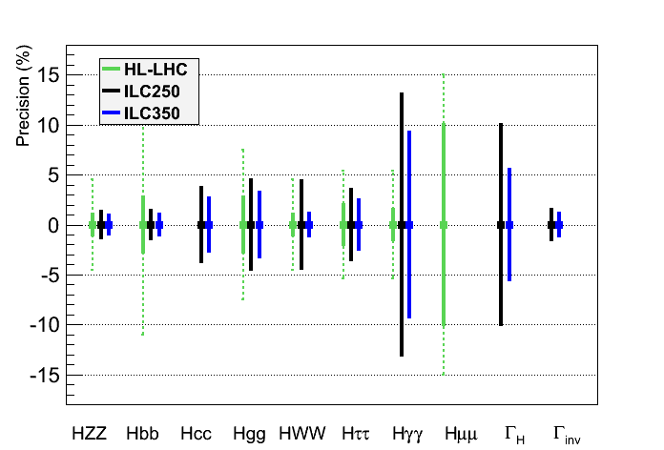
TLEP Physics case as a Higgs Factory (5)
Same assumptions as for HL-LHC for a sound comparison
Total width fixed to the sum of the visible partial widths + correction (Δg/g ~ 1/2 ΔBR/BR)
ILC250/350 would further complement LHC, but does not cover the physics case

Slide 34
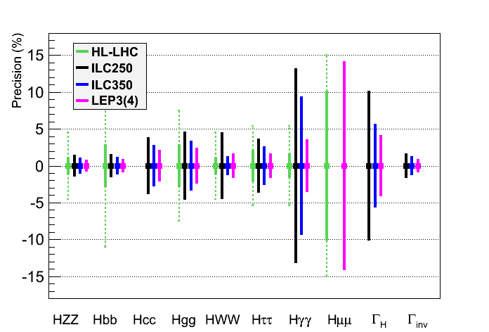
TLEP Physics case as a Higgs Factory (5)
Same assumptions as for HL-LHC for a sound comparison
Total width fixed to the sum of the visible partial widths + correction (Δg/g ~ 1/2 ΔBR/BR)
LEP3 would be an advantageous back-up : larger lumi, several IPs, smaller cost

Slide 35
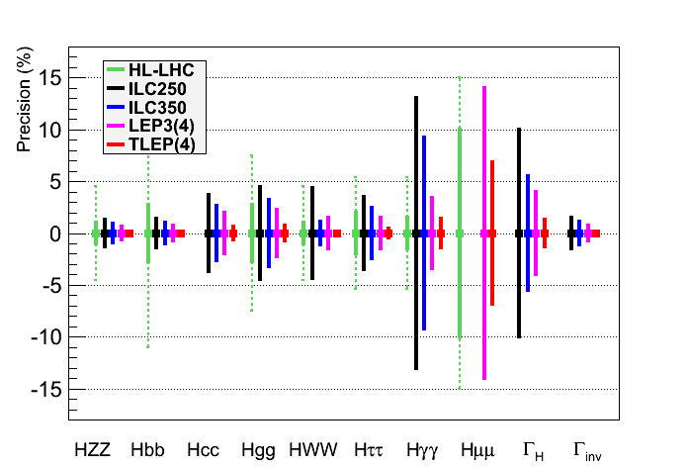
TLEP Physics case as a Higgs Factory (5)
Same assumptions as for HL-LHC for a sound comparison
Total width fixed to the sum of the visible partial widths + correction (Δg/g ~ 1/2 ΔBR/BR)
TLEP would be a superior option (see zoom next page)
See zoom
Next page

Slide 36
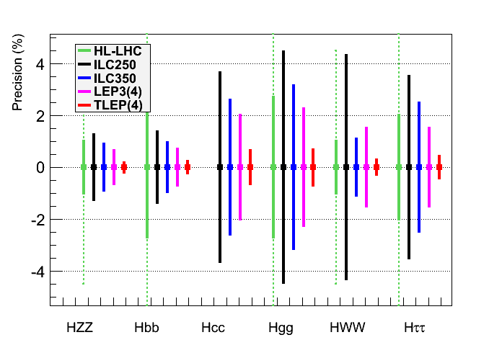
TLEP Physics case as a Higgs Factory (6)
Need sub-percent precision for a sensitivity to multi-TEV New Physics
Total width fixed to the sum of the visible partial widths + correction
Summary : TLEP reaches the needed accuracy
ILC prospects similar to HL-LHC’s
Much theoretical work also needed
HF2012
J. Ellis et al.

Slide 37
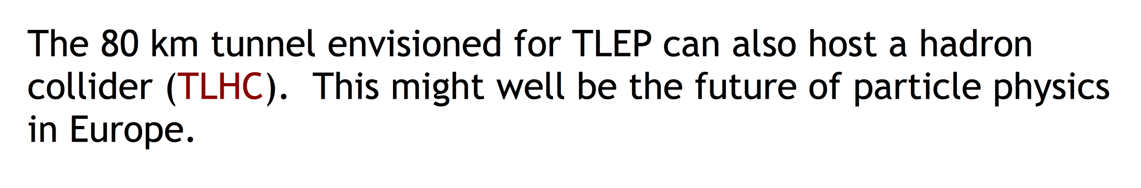
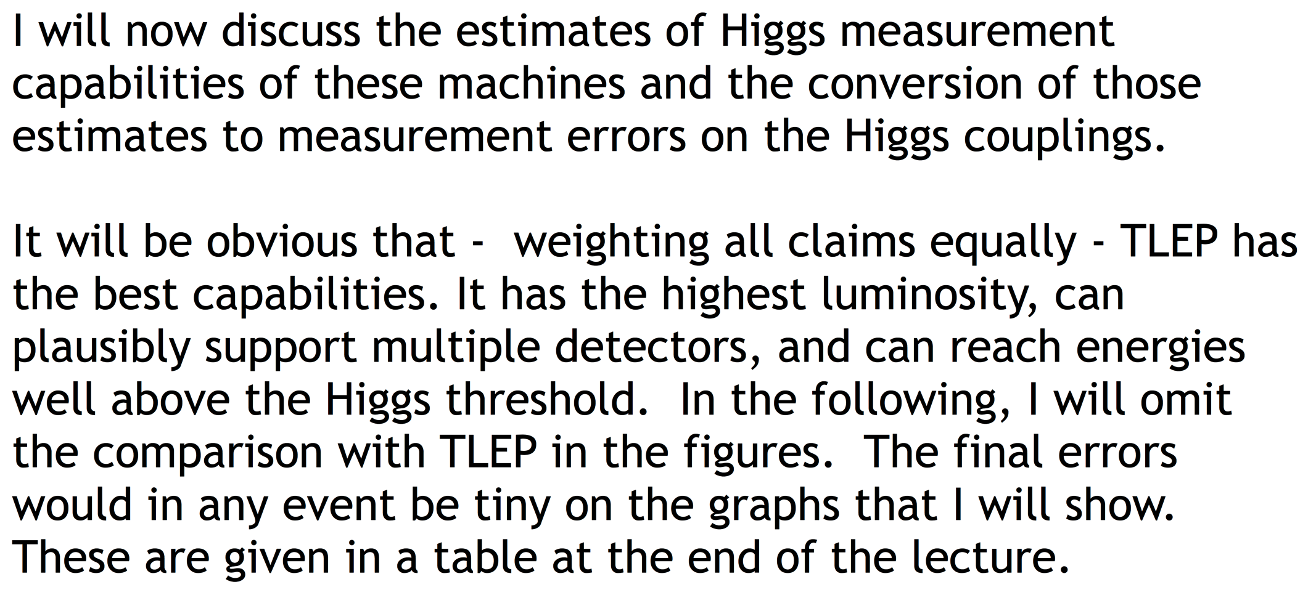
TLEP Physics case as a Higgs Factory (7)
A slide from M. Peskin at the 3rd TLEP/LEP3 Worskshop (10-Jan-2013)

Slide 38
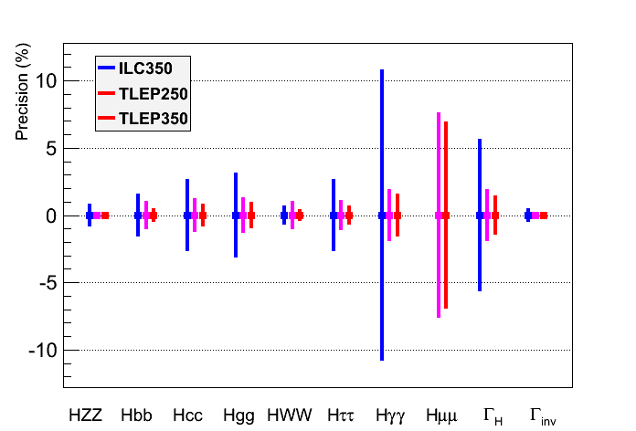
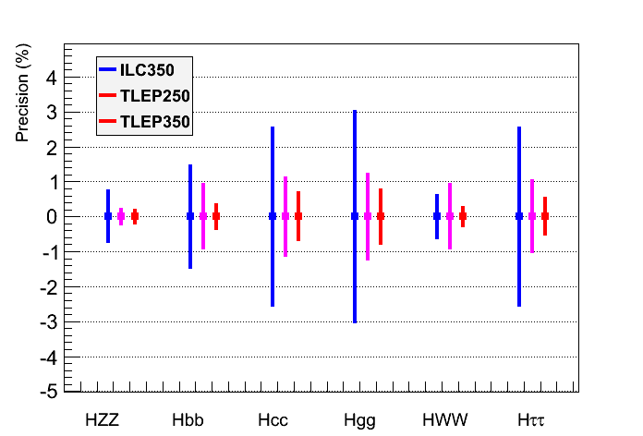
TLEP Physics case as a Higgs Factory (8)
Same conclusion when Γ_{H} (measured) is a free parameter in the fit
Plot shown only for ILC350 and TLEP, with an accurate width measurement
TLEP : sub-percent precision, adequate for NP sensitivity beyond 1 TeV
M. Peskin’s fit

Slide 39

Top Measurements at √s ~ 350 GeV (1)
Scan of the tt threshold
Observables σ_{tt}, A_{FB} and <p^{@max}> sensitive to m_{top} , Γ_{top} , and λ_{top} (ttH Yukawa coupling)
Experimental precision (for ILC, 300 fb⁻¹)
No beamstrahlung and luminosity x 4 at TLEP
Expected sensitivity for TLEP with 500 fb⁻¹ /IP in five years (full study to be done)
Studies of rare top decays
m_{top} = 175 GeV
σ_{tt}
p^{@max}
A_{FB}
 | Δm_{top} | ΔΓ_{top} | Δλ_{top}/λ_{top}
TLEP | 15 MeV | 17 MeV | 15%
ILC | 30 MeV | 35 MeV | 40%
M. Martinez and R. Miquel, 2003

Slide 40
Top Measurements at √s ~ 350 GeV (1)
Scan of the tt threshold
Observables σ_{tt}, A_{FB} and <p^{@max}> sensitive to m_{top} , Γ_{top} , and λ_{top} (ttH Yukawa coupling)
Experimental precision (for ILC, 300 fb⁻¹)
No beamstrahlung and luminosity x 4 at TLEP
Expected sensitivity for TLEP with 500 fb⁻¹ /IP in five years (full study to be done)
Studies of rare top decays
Δλ_{t}/λ_{t} = 0.25
ΔΓ_{t} = 200 MeV
ΔΓ_{t} = 200 MeV
σ_{tt}
p^{@max}
A_{FB}
 | Δm_{top} | ΔΓ_{top} | Δλ_{top}/λ_{top}
TLEP | 15 MeV | 17 MeV | 15%
ILC | 30 MeV | 35 MeV | 40%
M. Martinez and R. Miquel, 2003

Slide 41




Physics case of the energy upgrades (1)
All existing proposals have access to larger √s
To discover New Physics in a direct manner (beyond the scope of this talk)
To measure more difficult Higgs couplings : g_{Htt} and g_{HHH}
ILC350 can be upgraded to ILC500/ILC1TeV, or even to CLIC (3 TeV) [?]
LEP3 can be upgraded to (or preceded by) HE-LHC (33 TeV)
TLEP can be upgraded to VHE-LHC (100 TeV)
Cross sections in e⁺e⁻ collisions
H
H
M. Mangano
Cross sections in pp collisions

Slide 42




VHE-LHC + TLEP
L. Rossi
HE-LHC-LER (0.17→1.5 T)
TLEP collider (0.07 or 0.05T)
TLEP injector (0.007→0.05/7 T)
transmission line magnet
(B. Foster, H. Piekarz)
20 mm thick shield around cable
Gaps: 2 x V30xH60 mm
HE-LHC
(20 T)
super-resistive cable
multipurpose tunnel

Slide 43

Physics case of the energy upgrades (2)
Summary for Htt and HHH couplings
Other Higgs couplings benefit only marginally from high energy
TLEP + VHE-LHC looks like a winning team
(NP=New Physics reach)
√s, NP
√s, NP
HF2012
ILC500, HL-LHC ILC1TeV, HE-LHC CLIC3TeV, VHE-LHC

Slide 44



Measurements at smaller √s (1)
Revisit and improve the LEP precision measurements
TLEP can do the entire LEP1 physics programme in 5 minutes
Important : Polarization up to the WW threshold with TLEP
Very precise beam energy determination (10 keV) : unique to circular colliders
Measure m_{Z}, Γ_{Z} to < 0.1 MeV, m_{W} to < 1 MeV, sin²θ_{W} to 2.10⁻⁶ from A_{LR}
 | LEP | ILC | LEP3 | TLEP
√s ~ m_{Z} | Mega-Z | Giga-Z | ~Tera-Z | Tera-Z
Lumi (cm⁻²s⁻¹) #Z / year Polarization vs LEP1 | Few 10³¹ 2x10⁷ no 1 | Few 10³³ Few 10⁹ easy ~5-10 | Few 10³⁵ Few 10¹¹ yes (T, L) ~50 | 10³⁶ 10¹² yes (T,L) ~100
√s ~ 2m_{W} |  |  |  | ¼ Oku-W
Lumi (cm⁻²s⁻¹) Lumi / IP / year Error on m_{W} | Few 10³¹ 10 pb⁻¹ 220 MeV | Few 10³³ 50 fb⁻¹ 7 MeV | 5x10³⁴ 500 fb⁻¹ o.7 MeV | 1.5x10³⁵ 1.5 ab⁻¹ 0.5 MeV
√s ~ 200-250 GeV |  |  |  | Oku-W
Lumi (cm⁻²s⁻¹) Lumi / IP / 5 years Error on m_{W} | 10³² 500 pb⁻¹ 33 MeV | 5x10³³ 250 fb⁻¹ 3 MeV | 10³⁴ 500 fb⁻¹ 1 MeV | 5x10³⁴ 2.5 ab⁻¹ 0.5 MeV
Asymmetries, Lineshape
WW threshold

Slide 45


Measurements at smaller √s (2)
Case 1 : Only SM physics in EW Radiative Corrections – Stringent SM Closure test
Set stringent limits on weakly interacting new physics (m_{H}, m_{W} and m_{top} known)
Much theoretical work also needed
Case 2 : Some weakly interacting new physics in the loops ?
Will cause inconsistency between the various observables
Become sensitive to multi-TeV WINP
LEP1 was sensitive to ~ 200 GeV (m_{top})
M. Grunewald
m_{H} = 126 GeV
+
Circular
(LEP3)
m_{W}
Linear
(ILC)
Circular
(TLEP)
?

Slide 46
Measurements at smaller √s (3)
Experimental challenges are numerous : TLEP(Z)
At TLEP(Z), the hadronic Z event rate will be 15 kHz
Rate of bunch crossings similar to that at LHC (400o bunches over 80 km)
CMS current high-level trigger rate is about 1 kHz
(But hadronic Z events typically 20 times smaller than typical LHC event)
Need to design a detector and a DAQ system able to cope with these rates
A clever mixture of LHC detector (rate) and ILC detector (precision)
Need to study what is the precision needed for each sub-detectors
Is a CMS-like detector sufficient ? (~OK for Higgs studies)
Small angle Bhabha event rate (lumi measurement) will be even larger : 60 kHz
Essential to measure cross sections, hence the Z lineshape (m_{Z}, Γ_{z})
Negligible beamstrahlung is a great advantage
No background in the luminometers
Energy spectrum perfectly known (hence Bhabha cross section)
Will need theoretical developments to understand σ_{e+e−} to better than 5 x 10⁻⁵
Limiting uncertainties on α_{QED}(m_{Z}) and α_{s}(m_{Z}) must be overcome
Possible with the billions of e⁺e⁻ → e⁺e⁻(γ) , μ⁺μ⁻(γ) and qq(g) events ?
Will affect all Z peak asymmetries, and m_{Z} vs m_{W} interpretation
PJ, A. Blondel
N_{ν}
-

Slide 47


Measurements at smaller √s (4)
Experimental challenges are numerous : TLEP(Z)
Z lineshape needs a precise beam energy measurement
Resonant depolarization unique @ circular machines
Intrinsic precision ~ 100 keV (LEP1) / measurement
Decreases like 1 / √#(Measurements)
Requires beam transverse polarization
In one non-colliding bunch, during operations
Continuous energy measurement
No extrapolation needed (tides, trains, rain…)
Will require installation of polarization wigglers
Natural polarization time ~ 150 h at TLEP …
But only 15h for 10% polarization…
Polarized asymmetry (A_{LR}) requires longitudinal polarization
Hence spin rotators and polarimeters at each IP
Then need to keep polarization in collisions
That’s the main unknown
Dedicated operations with lower luminosity ?
Dedicated study is needed here

Slide 48
Measurements at smaller √s (5)
Experimental challenges are numerous : m_{W} at TLEP(W) and TLEP(H)
With 1.5 ab⁻¹ at TLEP(W) and 6. 10⁶ WW events/expt at threshold : σ(m_{W}) ~ 0.5 MeV
With 2.5 ab⁻¹ at TLEP(H), 4x10⁷ W pairs/expt : σ(m_{W}) ~ 0.2 MeV
Need to know beam energy to a fraction of MeV
Use the precision Z mass measurement from the Z pole
With 3x10⁷ Z(γ) events (Z ➔ e⁺e⁻, μ⁺μ⁻) / expt at TLEP(W)
With 2x10⁶ Z pairs and 5x10⁶ Z(γ) events (Z ➔ e⁺e⁻, μ⁺μ⁻) / expt at TLEP(H)
Can reach combined statistical precision on E_{beam} of 0.3 MeV and 0.4 MeV
Beam transverse polarization possible at TLEP(W) : precision better than 0.1 MeV
Need to understand both theoretical and experimental uncertainties…

Slide 49
Possible Timescale
Similar timescales for TLEP and LEP3
TLEP
Design study : 2013-2017
Next European Strategy Workshop : 2017-2018
Decision to go and start digging : 2018-2019
Start installation in parallel with HL-LHC running : 2023 - …
Start running at the end of HL-LHC running : 2030 - …
LEP3
Design study : 2013-2017 (spin-off of TLEP design study)
Next European Strategy Workshop : 2017-2018
Decision to go : 2018-2019
Start installation at the end of LHC running : 2022 - …
Tunnel probably irradiated at the end of HL-LHC
LEP3 is an alternative of HL-LHC, and could be followed by HE-LHC in 2040
Start running when ready : 2027 - …
 | 2010 |  |  |  |  |  | 2015 |  |  |  |  | 2020 |  |  |  |  | 2025 |  |  |  |  | 2030 |  |  |  |  | 2035 |  |  |  |  | 2040
LHC
HL-LHC | R&D + constr
TLEP* |  |  |  | Design + R&D + construction
VHE-LHC* | Design + R&D + construction

Slide 50
“TLEP is more expensive than the ILC”
LEP3 : A cost-effective option
Tunnel : 0 $ - Cryoplant : 0$
Two detectors : 0$ - Four detectors : 1 G$ Total : 1 – 2 G$
RF + Magnets + Injector Ring : 1 G$
100,000 Higgs boson / detector / 5 years @ 240 GeV : 5 k$ / Higgs boson
TLEP : A long-term vision
Tunnel : 4 G$
Four detectors : 2 G$ Total : 9 G$
RF + Cryo + Magnet + Injector Ring : 3 G$
500,000 Higgs boson / detector / 5 years @ 240 GeV : < 4.5 k$ / Higgs boson
Comparison with ILC
Total Cost : > 10 G$
70,000 Higgs boson / 5 years @ 240 GeV
of which 5 G$ in common
with SHE-LHC
> 150 k$ / Higgs boson

Slide 51



Design Study : 2013 – 2018 (1)
R. Aleksan, A. Blondel, J. Ellis, P. Janot, M. Koratzinos, M. Zanetti, F. Zimmermann ad interim
F. Zimmermann
ad interim
P. Janot
ad interim
J. Ellis
ad interim

Slide 52

Design Study : 2013 – 2018 (2)
Experimental Studies : Preliminary Structure (Being discussed)
11 working groups
WG1 : Electroweak Physics at the Z pole
WG2 : Di-boson physics : W mass measurement, …
WG3 : H(126) properties
WG4 : Top Quark Physics
WG5 : b, c and τ physics
WG6 : QCD and γγ physics
WG7 : Rare Physics
WG8 : Experimental environment
WG9 : Offline software and computing
WG10 : Online software and computing
WG11 : Detector designs

Slide 53
Conclusions
We believe TLEP to be the best complementary machine to LHC
Higgs properties precision measurements; Stringent test of the SM closure.
TLEP is based on a well-known technology
Supported by much progress in e⁺e⁻ circular factories for 20 years (and counting)
LEP, LEP2, (super) b factories, synchrotron light sources
Based on this experience, luminosity, power and cost predictions will be reliable
It is a first step in a long-term vision for high-energy physics
Many synergies with VHE-LHC (pp collisions at 100 TeV)
Tunnel, accelerator, experiments, physics
The design study is starting up as we speak, supported by CERN strategy
Join us at http://tlep.web.cern.ch/contribute-to-the-design-study
196 people registered as of today, 10:30am, … and counting
The goal is to have a technically-ready proposal by 2018
So that the community can take a fully-informed decision
with the LHC Run2 results at √s = 13-14 TeV in hand
We aim for physics in 2030

Slide 54







Free the donkeys!
?!?
?!?
F. LeDiberder
Revu par R. Aleksan

