Slide 1
Quantum levitation of nanoparticles
Physical adsorption of nanoparticles; properties of van der Waals/ Casimir-Polder potential wells; properties of nanoparticles trapped in the wells
« Small heating » of ultracold neutrons (UCNs) in collisions with such levitating nanoparticles: Theory versus Experiment
Applications: studies of surface potentials; surface physics, chemistry, biology; systematics in neutron-lifetime and other precision experiments with UCNs
A. Lambrecht (LKB), E.V. Lychagin (JINR), A.Yu. Muzychka (JINR), G.V. Nekhaev (JINR), S. Reynaud (LKB), A.V. Strelkov (JINR), A.Yu. Voronin (LPI), and V.V.N (ILL): Crystallography Reports 58 (2013) 743.
07.03.14
V.V. Nesvizhevsky

Slide 2
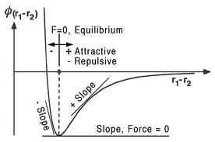
Physical adsorption
Surface diffusion of atoms, molecules and clusters, physically adsorped in the potential well associated with van der Waals/ Casimir-Polder potential (vdW/CP), plays a key role in various phenomena in physics, chemistry, biology, in applications.
The interaction is affected at the nanometer scale by « close to contact » effects depending on roughness and surface state
This quantum dispersion force, originating from vacuum fluctuations, is attractive above the molecular scale and is usually repulsive at the molecular scale so that the potential well exhibits a minimum at the nanometer distance
07.03.14
V.V. Nesvizhevsky

Slide 3
Physical adsorption of nanoparticles
,
The shape of the vdW/CP potential well could be calculated from a general expression involving only scattering properties of the surface and the nanoparticle
[the talk of Serge Reynaud]
Thus we get two limiting cases: van der Waals (near-field) and Casimir (far-field) interactions:
As long as the nanoparticle size is significantly smaller than so-called plasma wavelength (all practically interesting cases), the interaction of each atom in the nanoparticle is not significantly affected by the presence of other atoms
07.03.14
V.V. Nesvizhevsky

Slide 4
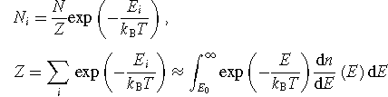

Properties of nanoparticle quantum states
Quantum states are well established, however: very large number of quantum states
Quasi-classical behaviour due to very large number of quantum states involved
Nanoparticles spend most of time in their « turning points », far from surface: Casimir-Polder interaction might be essential
distribution over quantum states:
normalization at short distances:
07.03.14
V.V. Nesvizhevsky

Slide 5
Physical adsorption of nanoparticles
The thermal kinetic energy is ,
while the depth of the potential well is proportional to the nanoparticle mass (if the mass is small enough)
Very deep potential well in the direction perpendicular to surface;
Diffusion along surface;
Roughness mixing velocity components
07.03.14
V.V. Nesvizhevsky

Slide 6
Properties of nanoparticle quantum states
Characteristic distance to surface
Characteristic energy spacing
07.03.14
V.V. Nesvizhevsky

Slide 7
UCN scattering on nanoparticles
[The talk of Alexei Voronin]
07.03.14
V.V. Nesvizhevsky

Slide 8
Operation of the gravitational spectrometer
[The talk of Egor Lychagin]
07.03.14
V.V. Nesvizhevsky

Slide 9
Resonance character of the UCN-nanoparticle interaction
;
.
Note: also large nanoparticles are slow, therefore
Existing data for the case of diamond nanoparticles levitating above copper surface, or above « sand » of other diamond nanoparticles:
Existing data for stainless steel surafaces:
Masses are equal !
07.03.14
V.V. Nesvizhevsky

Slide 10
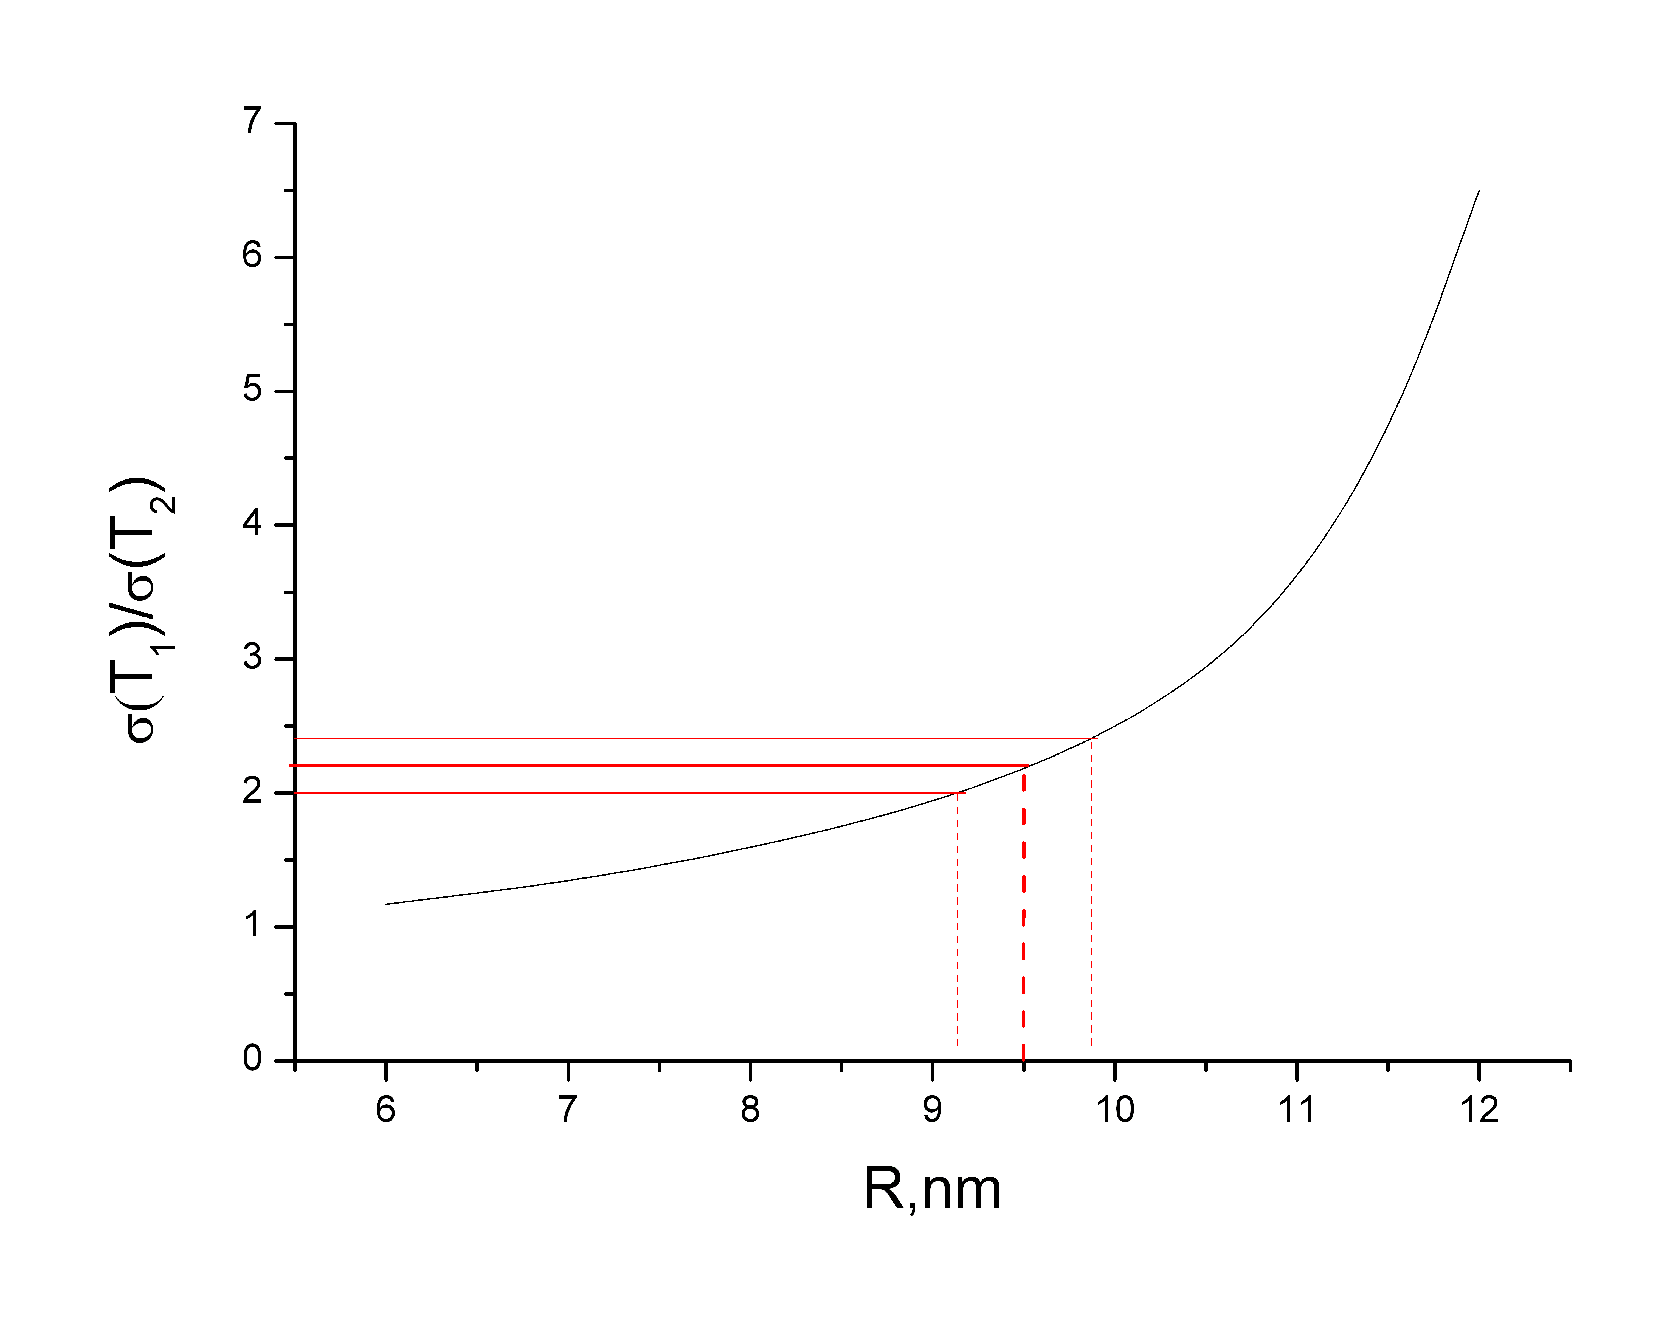
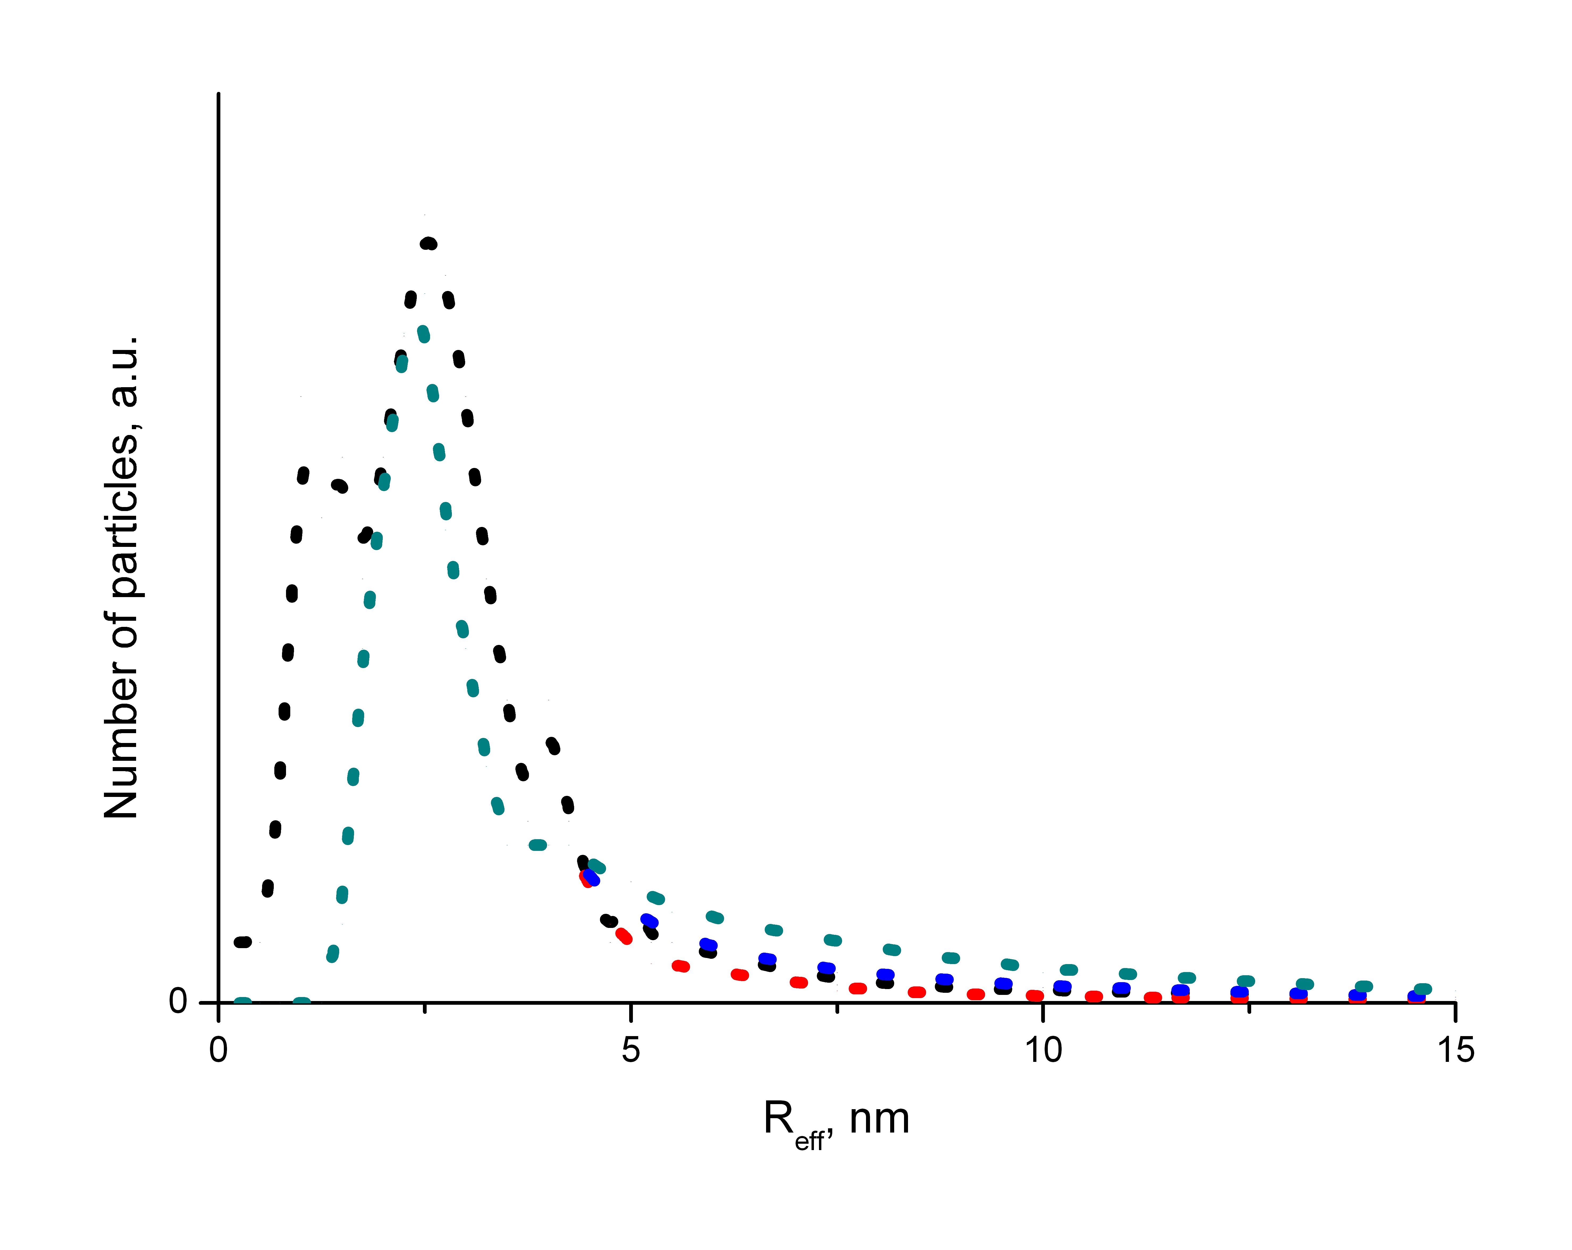
Resonance character of the UCN-nanoparticle interaction
;
.
07.03.14
V.V. Nesvizhevsky

Slide 11
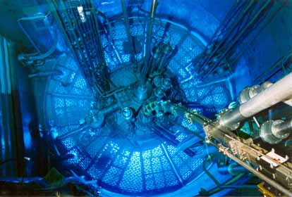
Experimental method
07.03.14
V.V. Nesvizhevsky

Slide 12
Spectromter
The internal storage volume for UCN
(copper inside)
The bottom for the internal storage volume and the external storage volume
07.03.14
V.V.Nesvizhevsky

Slide 13
Spectrometer
The bellow of the sample changer is decompressed
(a sample is inside the internal storage volume)
07.03.14
V.V.Nesvizhevsky

Slide 14
Spectrometer
A sample can be placed here
The bellow of the sample changer is compressed
07.03.14
V.V.Nesvizhevsky

Slide 15
Spectrometer
The valve with a small calibrated window
The bottom neutron absorber
The internal storage volume
The external storage volume
The entrance neutron valve
The exit neutron valve
07.03.14
V.V.Nesvizhevsky

Slide 16
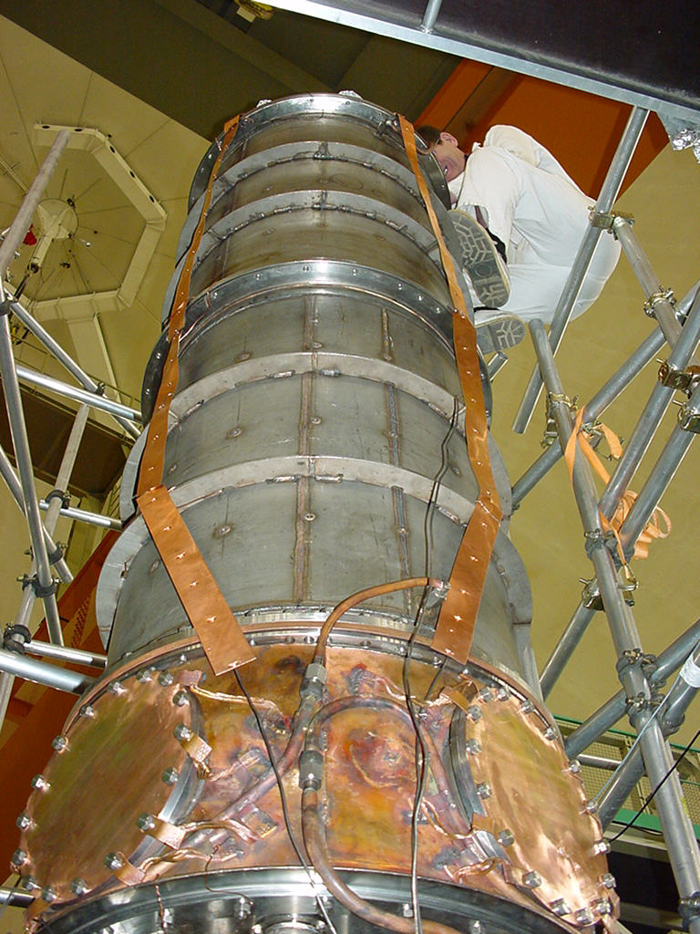
Spectrometer
The external storage volume is assembled
07.03.14
V.V.Nesvizhevsky

Slide 17
Spectrometer
The titanium absorber with highly developed surface
07.03.14
V.V.Nesvizhevsky

Slide 18
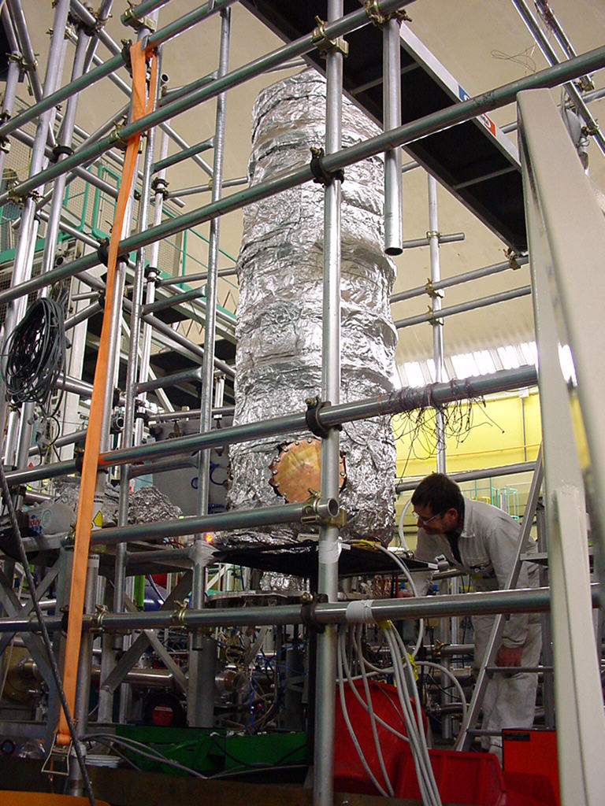
Spectrometer
A multi-layer thermal screen is installed in order to allow for measurements of temperature dependencies
07.03.14
V.V.Nesvizhevsky

Slide 19
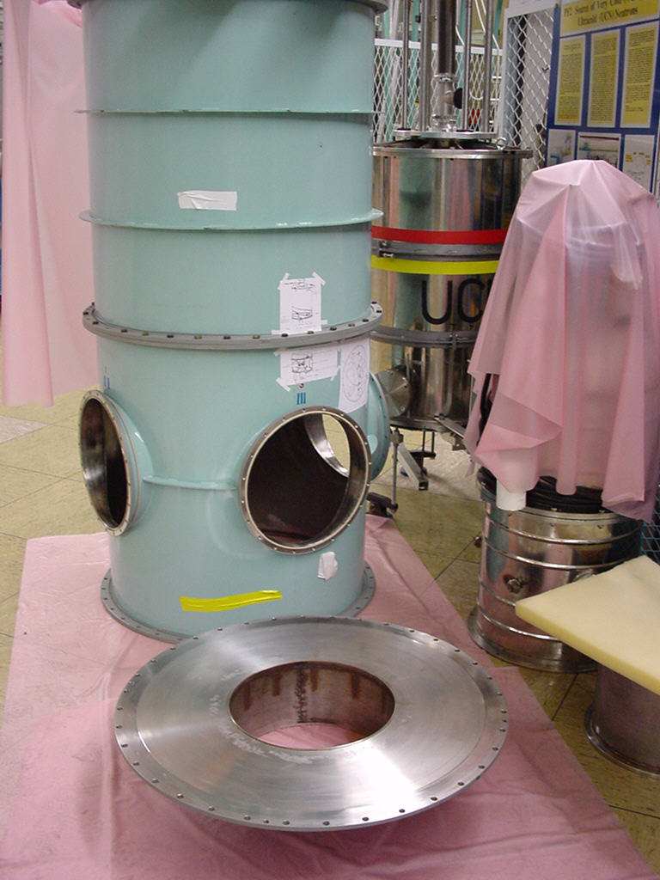
Spectrometer
The vacuum chamber
07.03.14
V.V.Nesvizhevsky

Slide 20
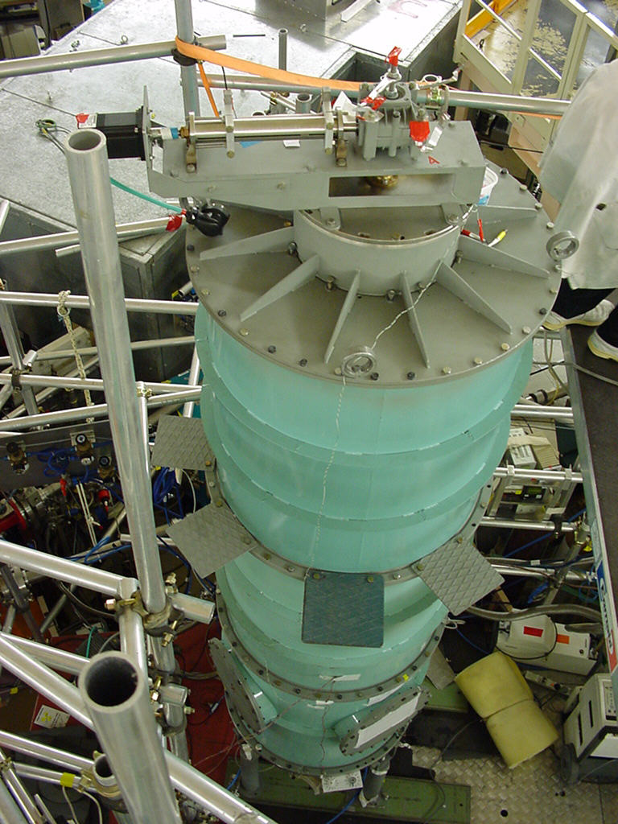
Spectrometer
Movement of the absorber
The spectrometer is assembled
Access to the sample changer
07.03.14
V.V.Nesvizhevsky

Slide 21
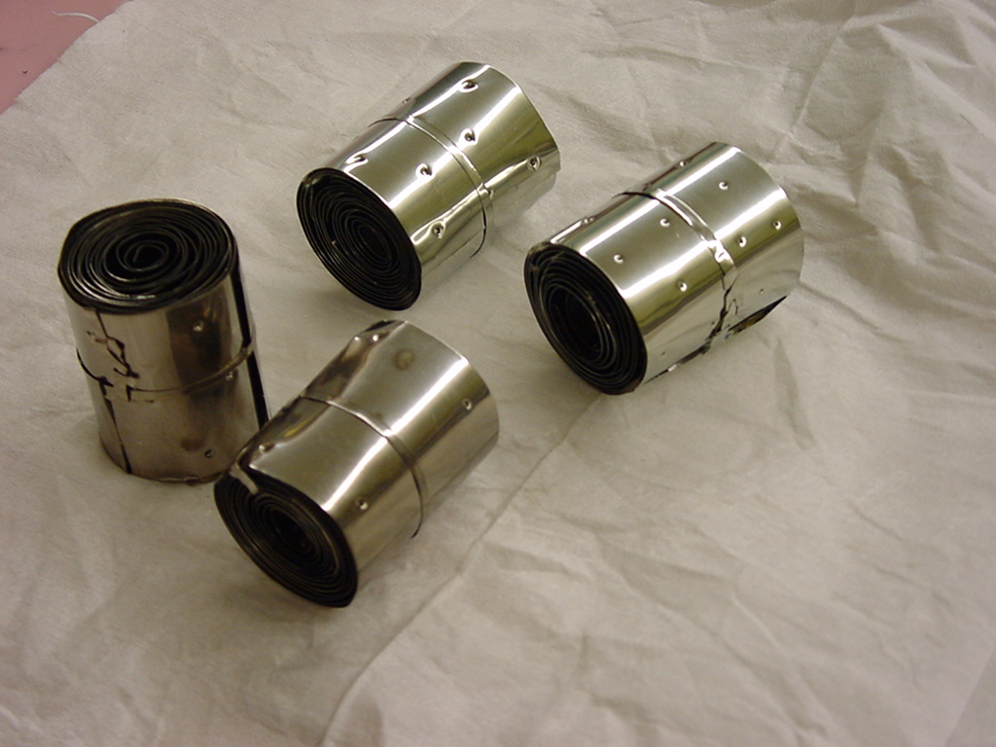
Samples
A sample
07.03.14
V.V.Nesvizhevsky

Slide 22
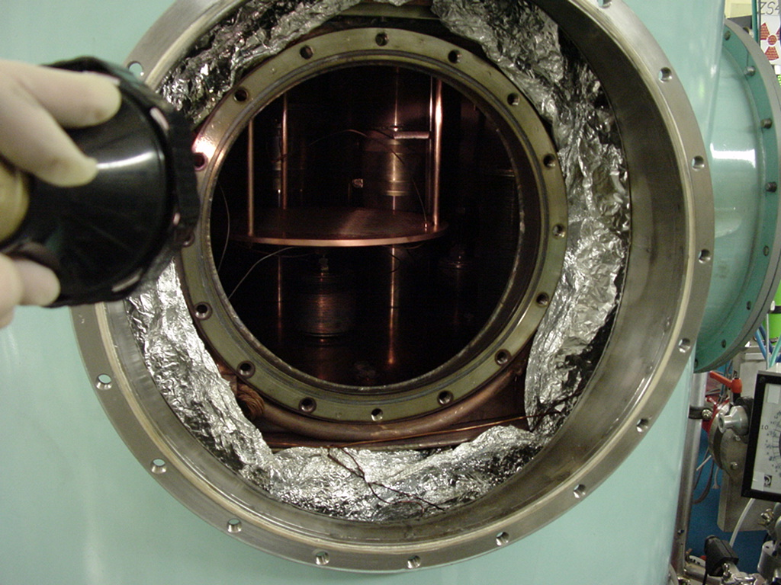
Spectrometer
Access to the sample changer, when the setup is assembled
07.03.14
V.V.Nesvizhevsky

Slide 23
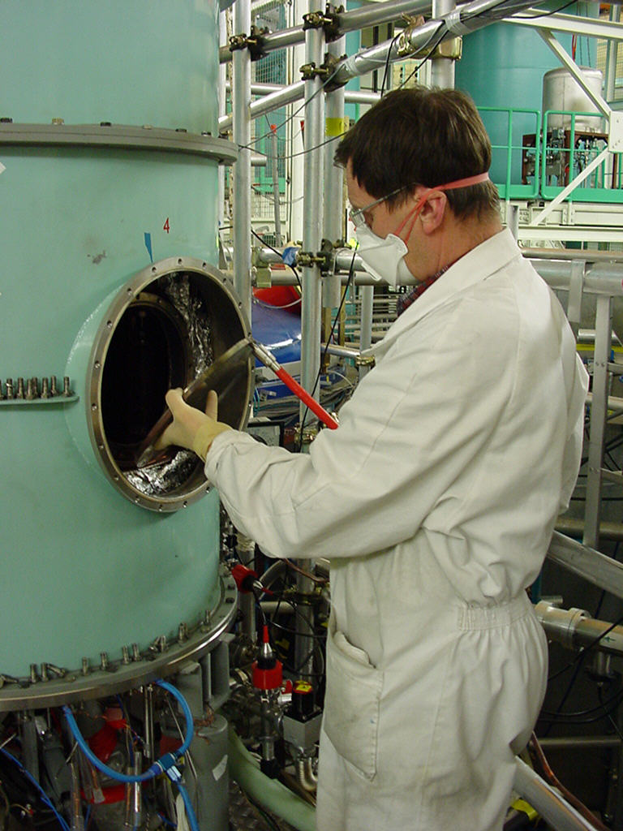
Spectrometer
Installation of a sample
07.03.14
V.V.Nesvizhevsky

Slide 24
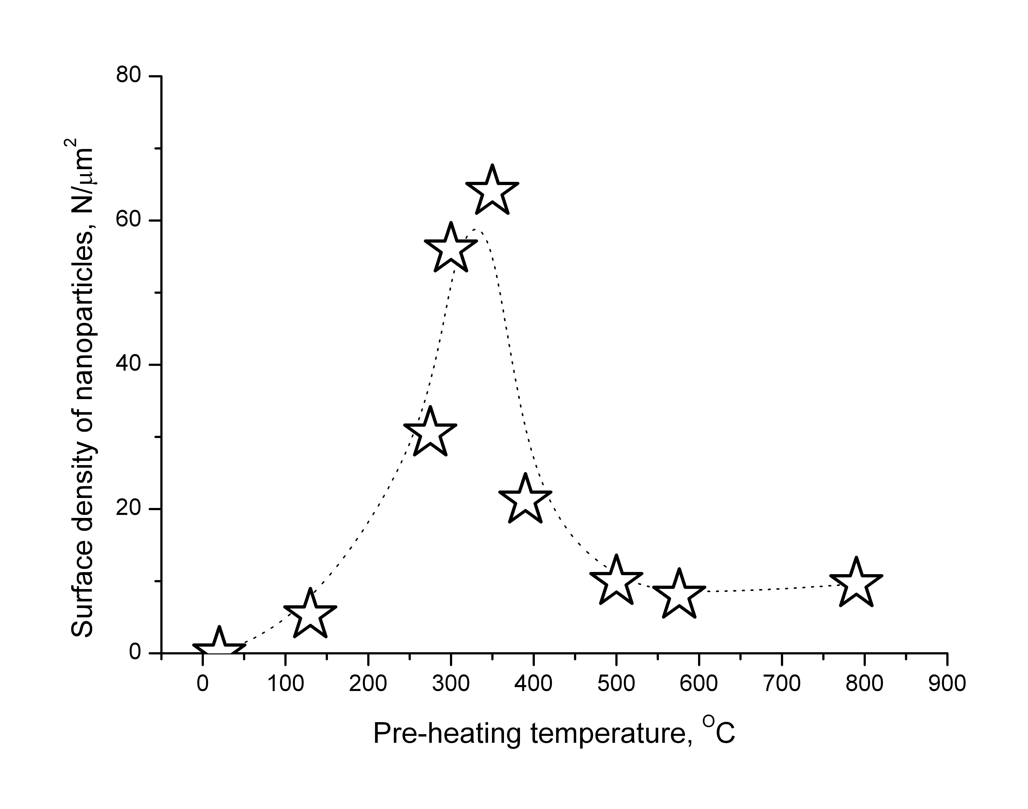
« Temperature resonance »
;
.
The probability of « small heating » of UCN (on the left side) and the population of nanoparticles of « right » size as a function of temperature of the surface outgasing
07.03.14
V.V. Nesvizhevsky

Slide 25
Stainless steel A-304, no heating
07.03.14
V.V.Nesvizhevsky

Slide 26
Stainless steel A-304, heating 280 C
07.03.14
V.V.Nesvizhevsky

Slide 27
Stainless steel A-304, heating 390 C
07.03.14
V.V.Nesvizhevsky

Slide 28
Stainless steel A-304, heating 590 C
07.03.14
V.V.Nesvizhevsky

Slide 29
Copper,
heating 250 C
Copper,
heating 350 C
07.03.14
V.V.Nesvizhevsky

Slide 30
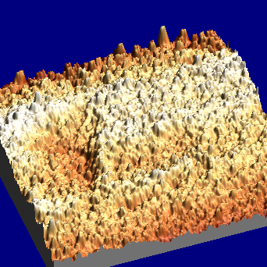
Copper, heating 250 C
07.03.14
V.V.Nesvizhevsky

Slide 31
Lead, no heating
07.03.14
V.V.Nesvizhevsky

Slide 32
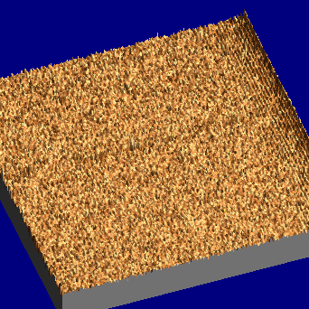
Polished sapphire, no heating
07.03.14
V.V.Nesvizhevsky

Slide 33
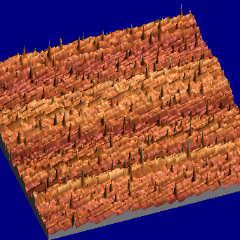
Polished sapphire, heating 1550 C
07.03.14
V.V.Nesvizhevsky

Slide 34
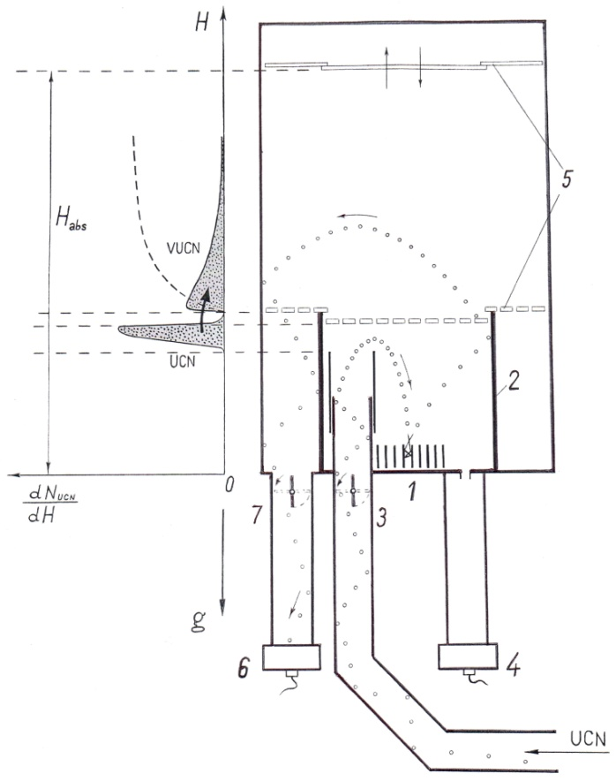
Experimental method; new measurements
Layout of the BGS gravitational spectrometer of the total UCN energy: (1) sample, (2) gravitational barrier, (3) entrance valve, (4) UCN monitor detector, (5) UCN absorber, (6) VUCN detector, and (7) exit valve. The principle of the procedure to measure small energy transfers is sketched in the insert on the left side. From bottom to top (in scale): initial differential UCN spectrum (the mean energy is 31 neV, the half-width of the spectral mono-line is 3 neV), a dead-zone of insensitive to VUCNs, the differential and integral (dashed line) spectra of VUCN. The differential efficiency of VUCN detection is calculated using precisely measured values of UCN and VUCN storage times as a function of their energy; decrease in the detection efficiency, caused by partial losses of neutrons in samples, is taken into account.
07.03.14
V.V. Nesvizhevsky

Slide 35
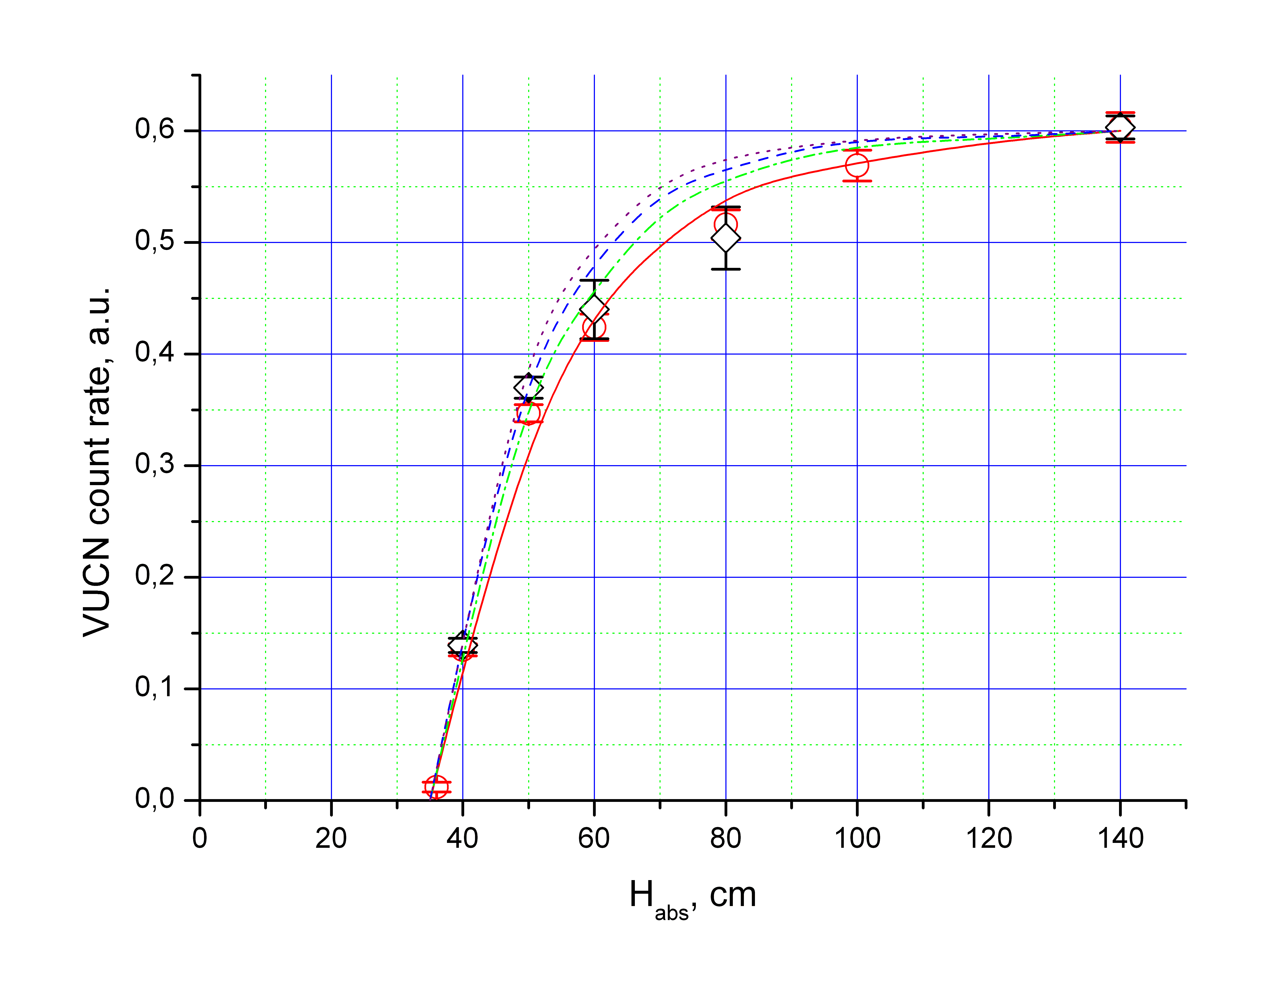
Integral VUCN spectra
;
-Circles show results measured with various solid nanoparticles: diamond, sapphire, copper.
-Rhombuses indicate data measured with a Fomblin oil sample.
-Four lines correspond to calculations of VUCN spectra on the Fomblin surface, within our model, for four hypothesizes on the size distribution of nano-droplets:
More details in the talk of Egor Lychagin
07.03.14
V.V. Nesvizhevsky

Slide 36
Some observations
;
On “hydrogen” hypothesis:
- In experiments with diamond nanoparticles: removal of 99% of hydrogen does not affect considerably the probability of “small heating”;
In experiments with metallic surfaces: outgasing removes hydrogen but increases the probability of “small heating”;
In experiments with Fomblin oil: some admixture of hydrogen-containing oil does not affect the probability of “small heating”.
Also, anyway the spectrum of neutrons up-scattered on hydrogen as well as the total probability of scattering to the UCN energy range are by far too low
A.A. Fedorets et al :
07.03.14
V.V. Nesvizhevsky

Slide 37
Simplifications of the model used
;
Neglected effects:
Rotations of nanoparticles;
Non-sphericicity and non-uniformity of nanoparticles;
Interference of scattering on neighbour nanoparticles;
Consequent scatterings on one nanoparticle.
This effect might be visible in new data; it modifies the spectrum shape. However, other effects should be considered carefully in order to make final conclusions
07.03.14
V.V. Nesvizhevsky

Slide 38
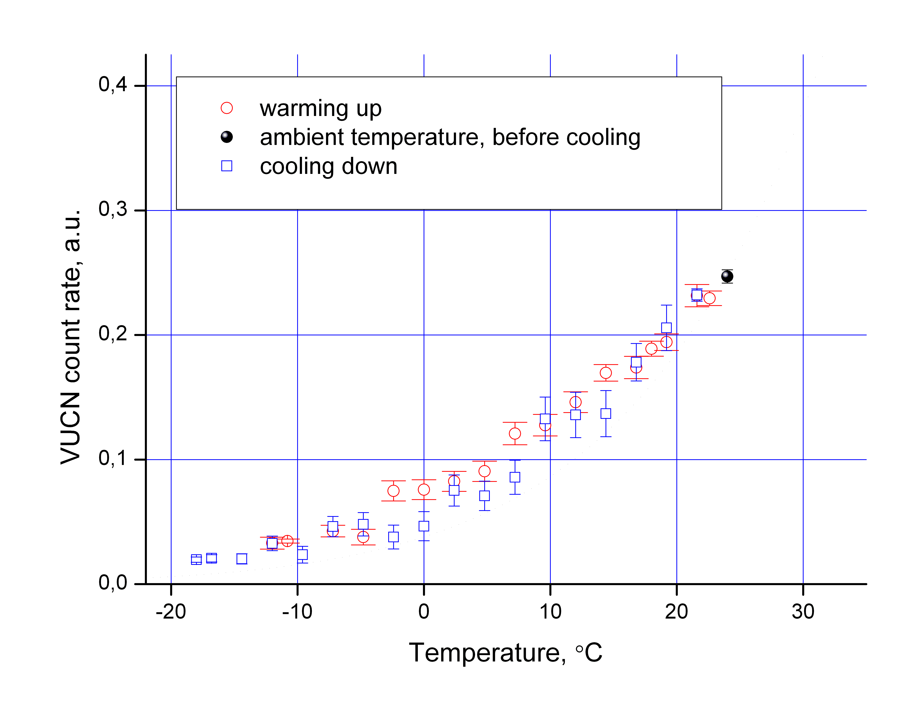
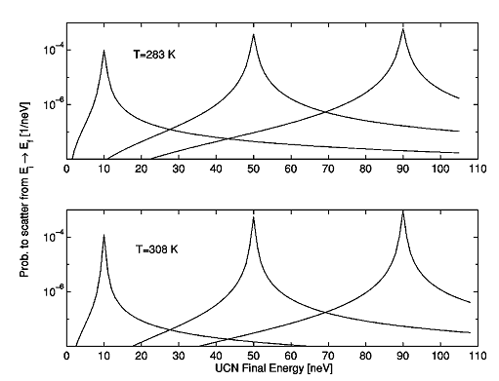
Integral VUCN spectra
;
-
Dead-zone in the detection efficiency is “forgotten”
New data
[S.K. Lamoreaux, R. Golub, Phys. Rev. C 2002, Vol. 66, 044309]
07.03.14
V.V. Nesvizhevsky

Slide 39

Applications
Studies of the vdW/CP interaction between nanoparticles and surface;
Nanoparticle’s mobility study (complementary to decorating surface defects, edges, boundaries, elastic strain fields);
Surface chemistry;
Knowledge of details of this process allows one making proper corrections to precision experiments with UCN, in particular to neutron lifetime experiments
07.03.14
V.V. Nesvizhevsky
Notes:
39

Slide 40

Applications
The total probability of “small heating” is comparable to the total probability of losses
As confirmed by the model AND experimentally:
The probability and spectrum of “small heating” depend on
Temperature (vapor pressure),
Time of degassing,
thus on the trap geometry
etc
In a typical experiment, main losses
are in the invisible « underwater » part
of spectrum
07.03.14
V.V. Nesvizhevsky
Notes:
40

Slide 41
Conclusion
Physical adsorption of nanoparticles/ nanodroplets is manifested in experiments with stored UCNs
It explains « small heating » of UCNs
It results to false effects in precision experiments with UCNs, in particular in neutron lifetime experiments
It can be used to study surface potentials
07.03.14
V.V. Nesvizhevsky
Notes:
41

