Slide 1

GBAR
Gravitational Behaviour of Antihydrogen at Rest
Measurement of the free fall of antihydrogen atoms
Motivation
Principle of the experiment
Experimental technique
Perspectives

Slide 2
MOTIVATION
A direct test of the Equivalence Principle with antimatter:
The acceleration imparted to a body by a gravitational field is independent of the nature of the body :
Inertial mass = gravitational mass

Slide 3
Gravitation and cosmology
Matter-antimatter asymmetry in the Universe ???
Is there a repulsive antimatter-matter interaction ???
A. Benoît-Lévy, G. Chardin A&A 537 (2012) A78
No quantum theory of gravitation
  new theories may contain additional interaction terms different for matter and antimatter

Slide 4
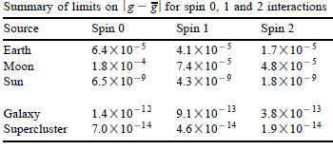
Experimental limits
Limits on gravitational acceleration (call it g ) for antimatter:
Arrival time of one (? : 90 % CL) neutrino and 18 antineutrinos from SN1987a
S. Paksava et al. Phys Rev D 39 (1989) 1761
CPLEAR: CP violation in K⁰-K⁰ as a function of time depends on δm A. Apostolakis et al., Phys Lett B 452 (1999) 425
Cyclotron frequency measurement of
p (H⁻) and p in the same B field
G. Gabrielse et al. Phys Rev Lett 82 (1999) 3198
Alpha: location of annihilation of antihydrogen atoms
Nature Comm 4, 1785 (2013)

Slide 5

GBAR principle: cool H⁺ to get ultra-slow H
Produce first H⁺
Capture H⁺ in trap
Cooling with Be⁺
→ 10 µK
Photodetachment of excess e⁺
Time of flight
H⁺ = p e⁺e⁺
detector
Cooling 10 µK
gravity
H⁺
Laser (t₀)
H in free-fall
h = 1/2 g (t₁-t₀)²
detector (t₁)
J.Walz & T. Hänsch,
General Relativity and Gravitation, 36 (2004) 561.
Uncertainty dominated by temperature of H ⁺

Slide 6
Why antihydrogen ?
Charged antiparticles (e⁺ or p):
gravity force on e⁺ ~ force from 1 e⁻ at 5 m !
Antineutrons:
difficult to slow down and keep enough
Positronium (e⁺e⁻ ):
lifetime, cooling, ionisation
project by D. Cassidy

Slide 7
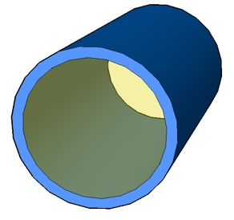
H⁺ production
e⁺ trap
accumulate ~ 2 10¹⁰ e⁺
every p burst ~ 2’
Dump ~10¹⁰ e⁺ in Ps converter
in < τ_{Ps}=142 ns
Linac
3 10⁸ slow e⁺/s
Yield of o-Ps :~ 30-40 %
p | + | Ps | → | H | + | e –
H | + | Ps | → | H⁺ | + | e –
_
_
+
H
H
o
P
s
SiO₂ coating
closed geometry to keep density
(SiO₂ reflects Ps)
_
p
1- 6 keV
e + ~ 3 keV

Slide 8
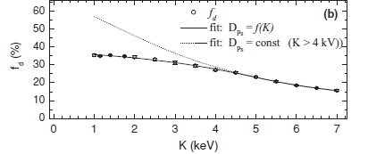
Yield of o-Ps : 30-40 % !
Measurement
at CERN
~ 3.5 x 10⁵ e⁺ cm⁻²s⁻¹
L.Liszkay et al., Appl. Phys. Lett. 92 (2008) 063114
e⁺ flux
x
~10¹¹
Measurement
at UCR
~ 5.6 x 10¹⁶ e⁺ cm⁻²s⁻¹
D. B. Cassidy et al., Phys. Rev. A 81 012715 (2011)
No loss in conversion efficiency in spite of the 10¹¹ intensity factor

Slide 9
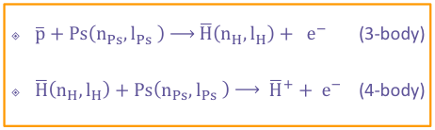
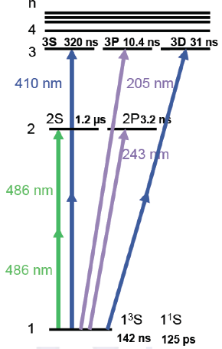
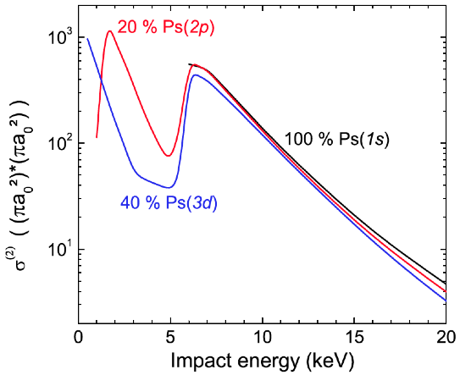
A possibility to enhance H⁺ production
P. Comini and P.-A. Hervieux, New Journal of Physics 15 (2013) 095022

Slide 10
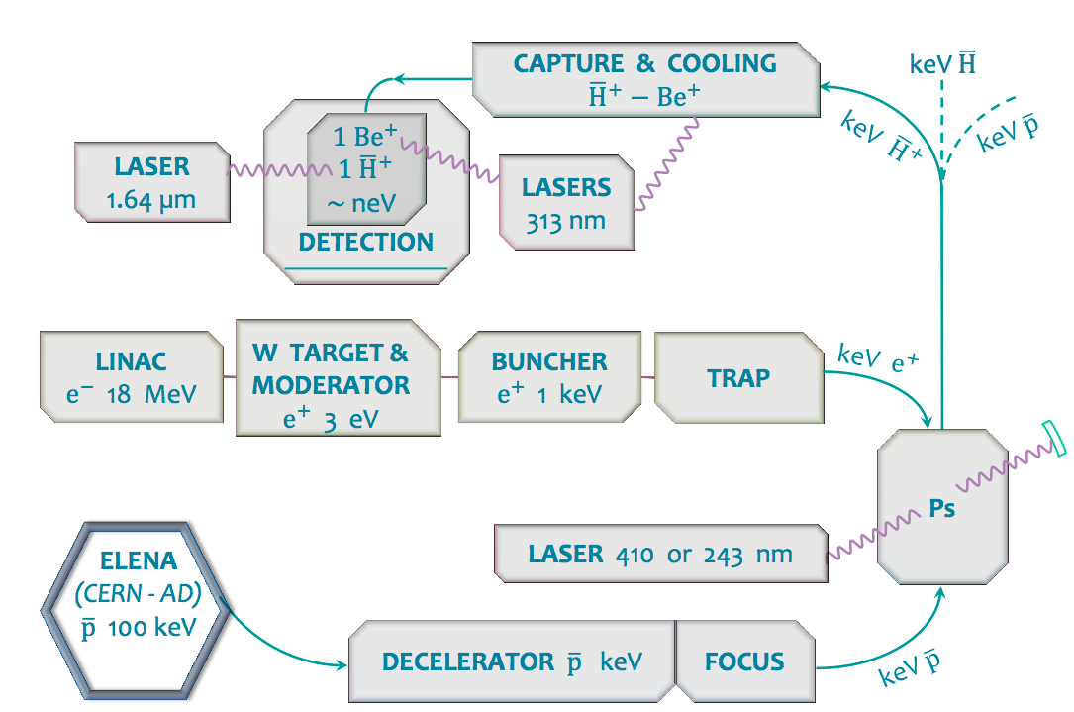
Overall GBAR scheme

Slide 11
Overall GBAR scheme

Slide 12
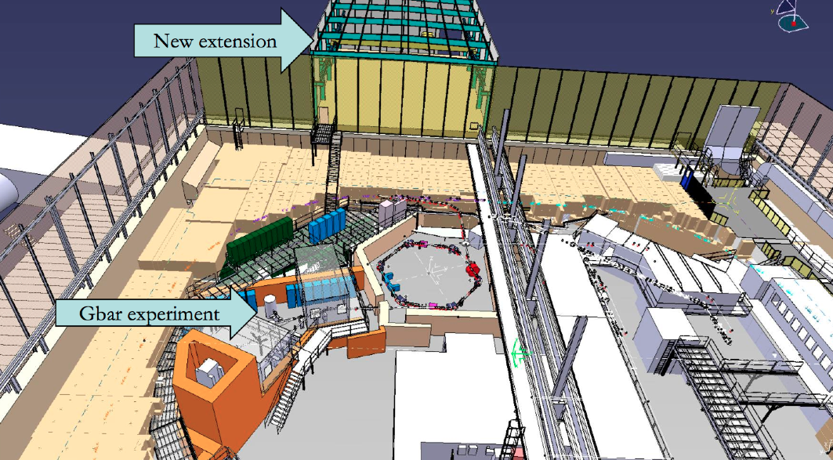
Future installation at CERN

Slide 13
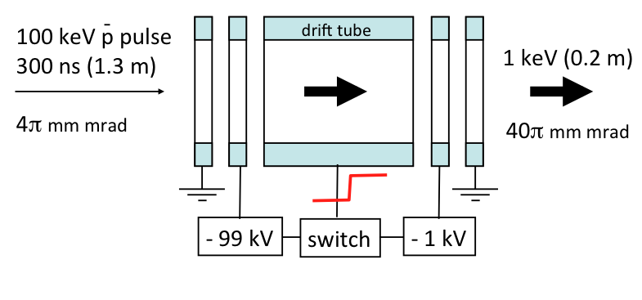
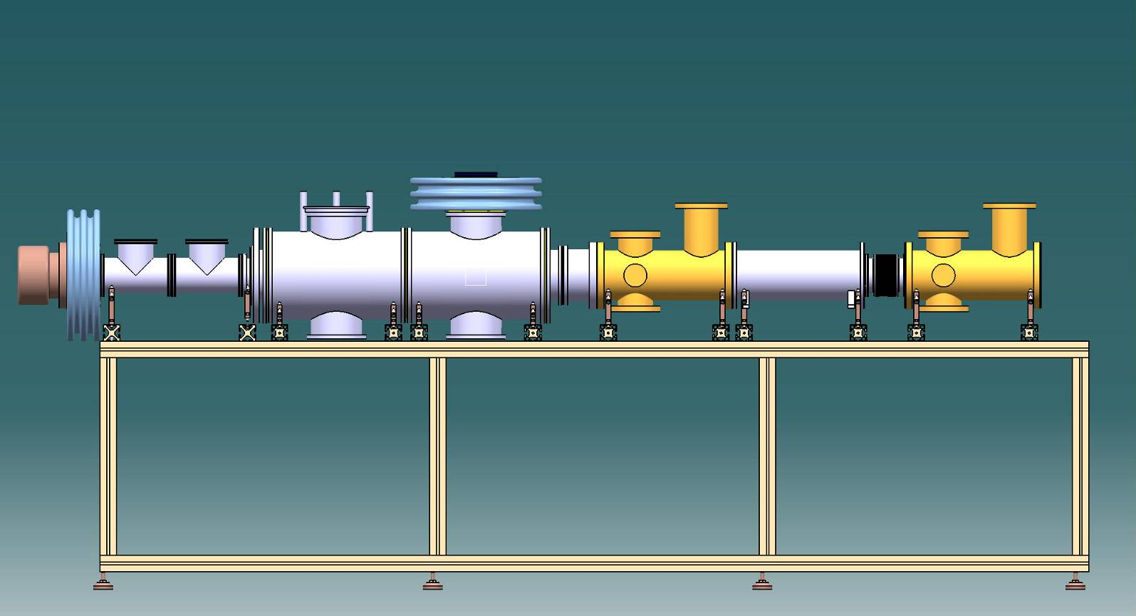
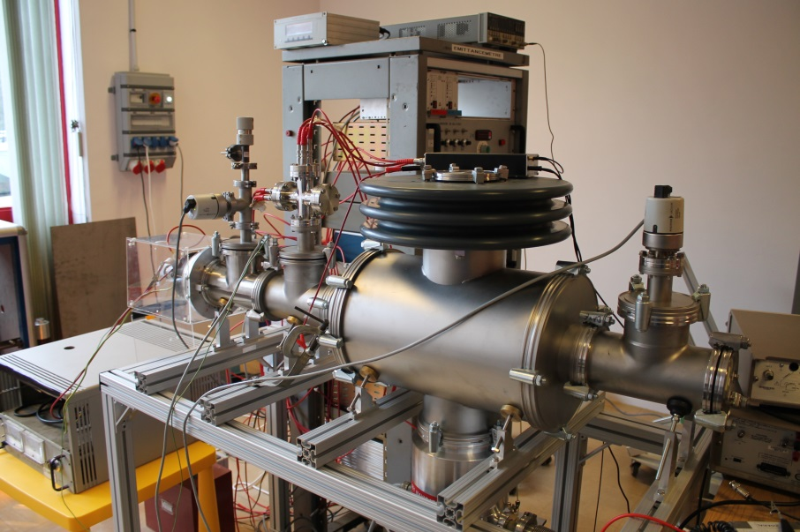
p decelerator
CSNSM Orsay

Slide 14
Overall GBAR scheme

Slide 15
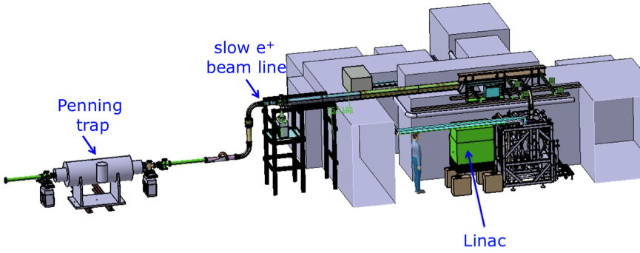
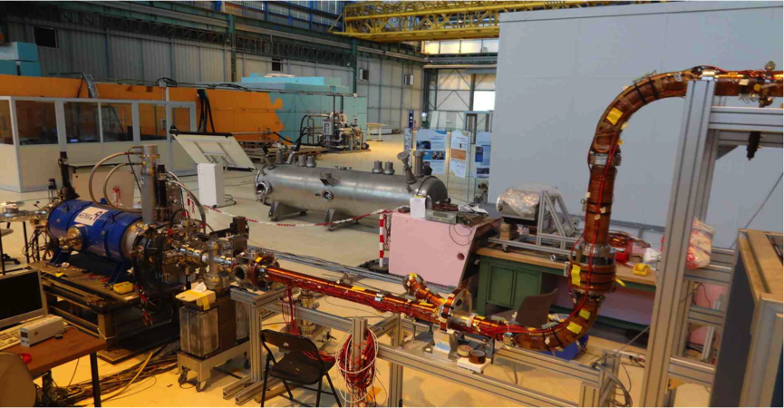
e⁺/Ps demonstrator at Saclay
e⁻ LINAC :
4.3 MeV / 200 Hz / 2.5 μs / 120 μA
3 10⁶ slow e⁺/s
with W mesh moderator
Penning trap on beam line
from RIKEN
First e⁺ accumulation trials
Ps* laser being prepared at LKB (Paris)

Slide 16
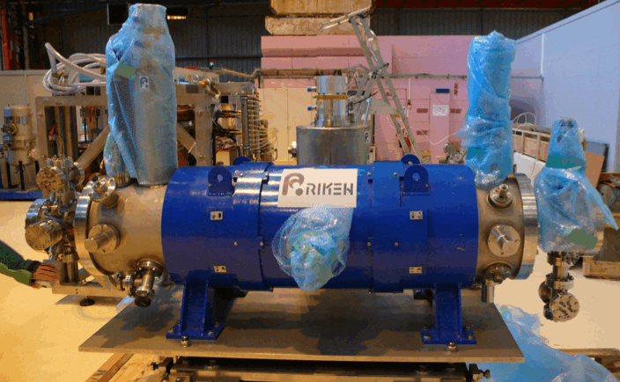
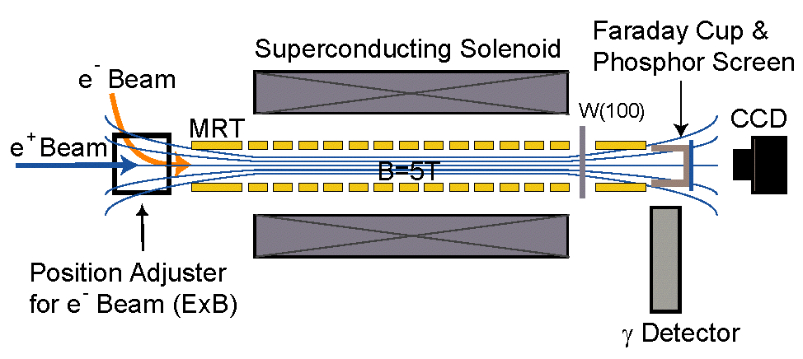
RIKEN Multi-Ring Trap

Slide 17
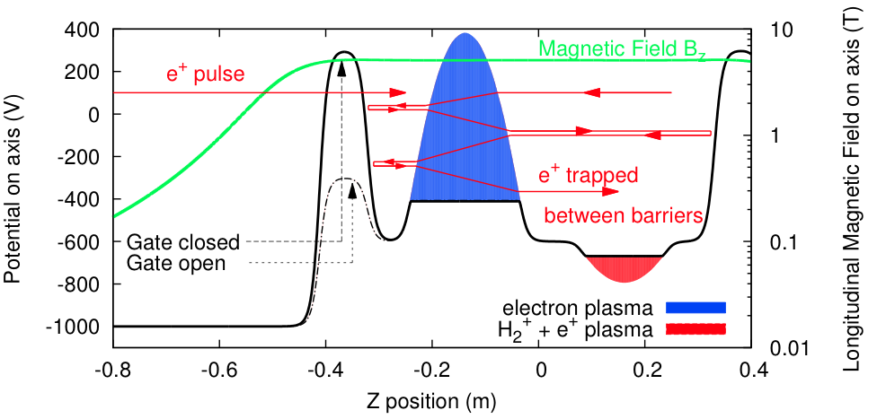
New e⁺ trapping mechanism
e⁻ density 10¹⁷ m⁻³ → e⁺ cooling time 3 ms

Slide 18
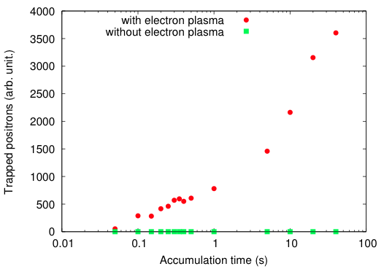
First e⁺ accumulation
Thèse de P. Grandemange, Université Paris-Sud, 12 décembre 2013

Slide 19
Overall GBAR scheme

Slide 20

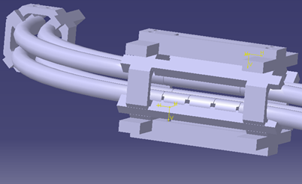
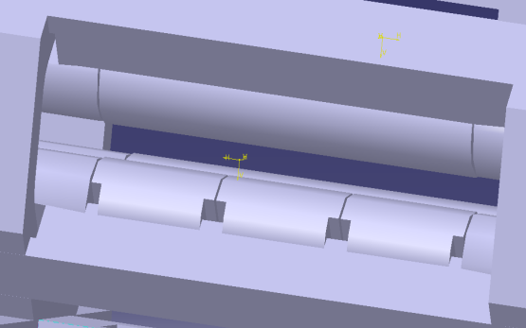

Two Cooling Steps
First step
Capture and sympathetic Doppler cooling by laser cooled positive ions
in a linear capture trap (Paul trap, r₀ = 3.5 mm, W = 13 MHz)
H⁺
few mm
313 nm laser
300 eV, T = 240 000 K
T
÷ 3 10⁹
> 10 000 laser cooled Be⁺ ions
100 neV, T ~ mK
Second step
Transfer and ground state cooling ~ 10 µK
of a Be⁺/H⁺ ion pair in the precision trap
Tests with a H₂⁺ / H⁺ REMPI source
Mainz

Slide 21
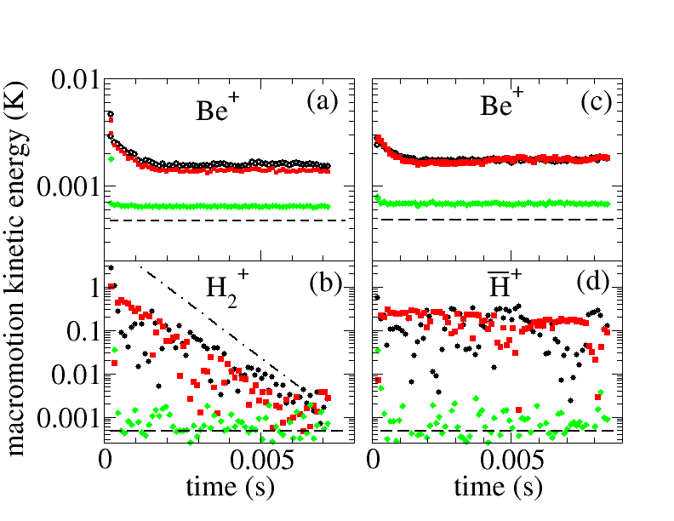
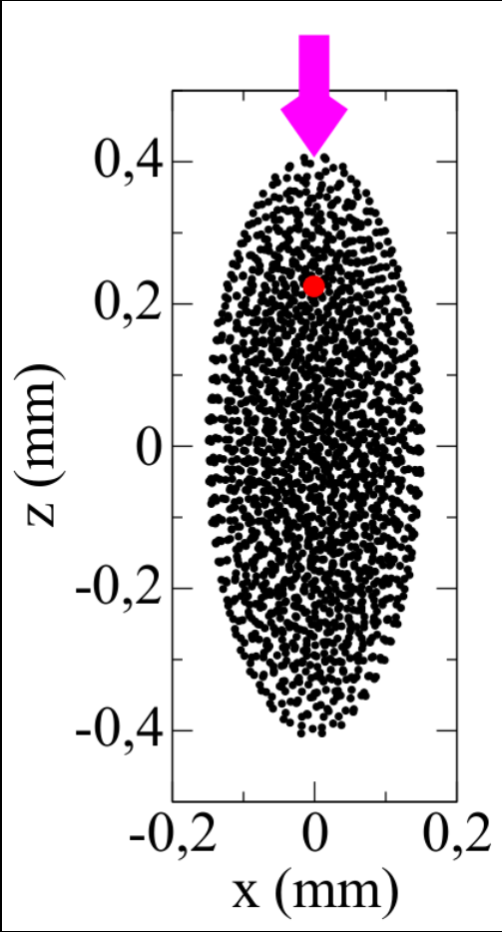
Two Cooling Steps
Sympathetic Doppler cooling
L. Hilico, J-P. Karr, A. Douillet, P. Indelicato, S. Wolf, F. Schmidt-Kaler, to be published in IJMPCS

Slide 22
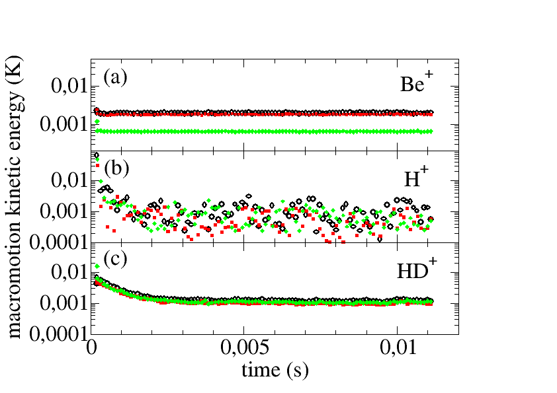
Two Cooling Steps
Sympathetic Doppler cooling
L. Hilico, J-P. Karr, A. Douillet, P. Indelicato, S. Wolf, F. Schmidt-Kaler, to be published in IJMPCS

Slide 23
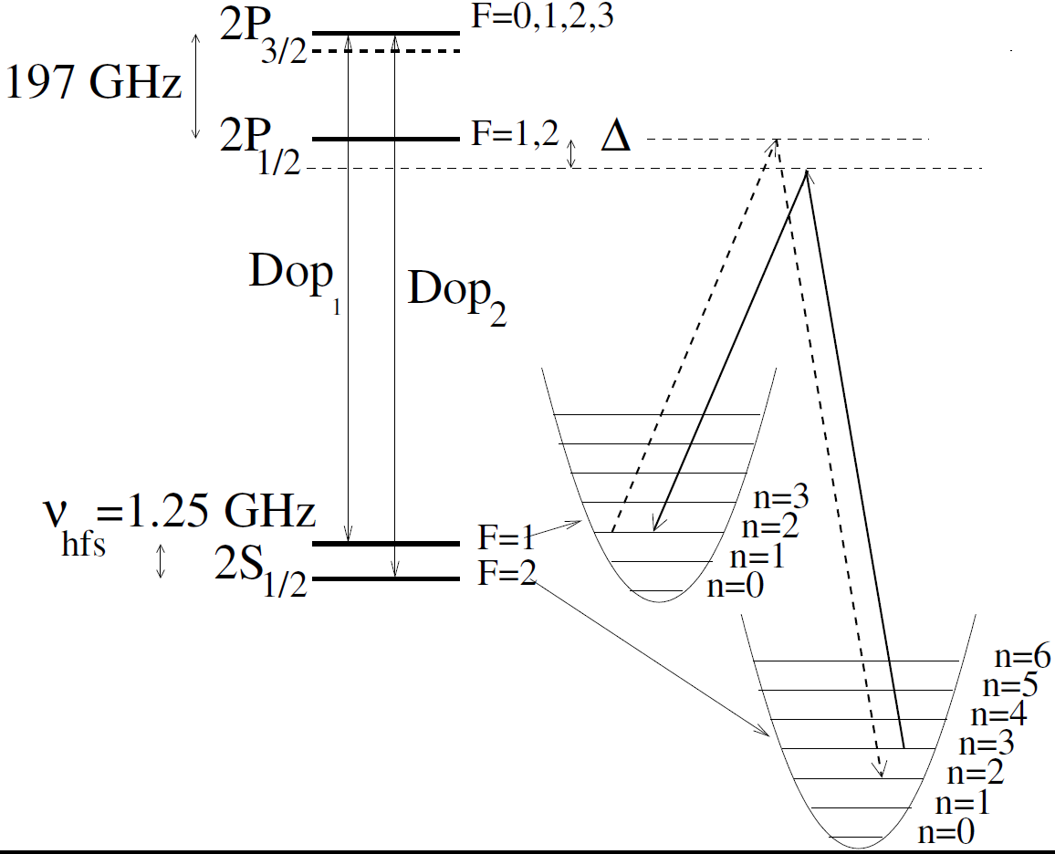
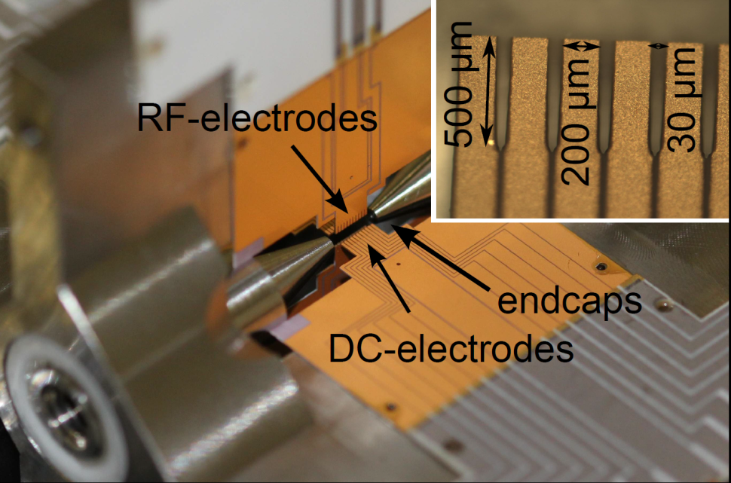
Two Cooling Steps
Ground state cooling
L. Hilico, J-P. Karr, A. Douillet, P. Indelicato, S. Wolf, F. Schmidt-Kaler, to be published in IJMPCS
Ground state sympathetic cooling
of a Be⁺/H⁺ ion pair

Slide 24
Overall GBAR scheme

Slide 25
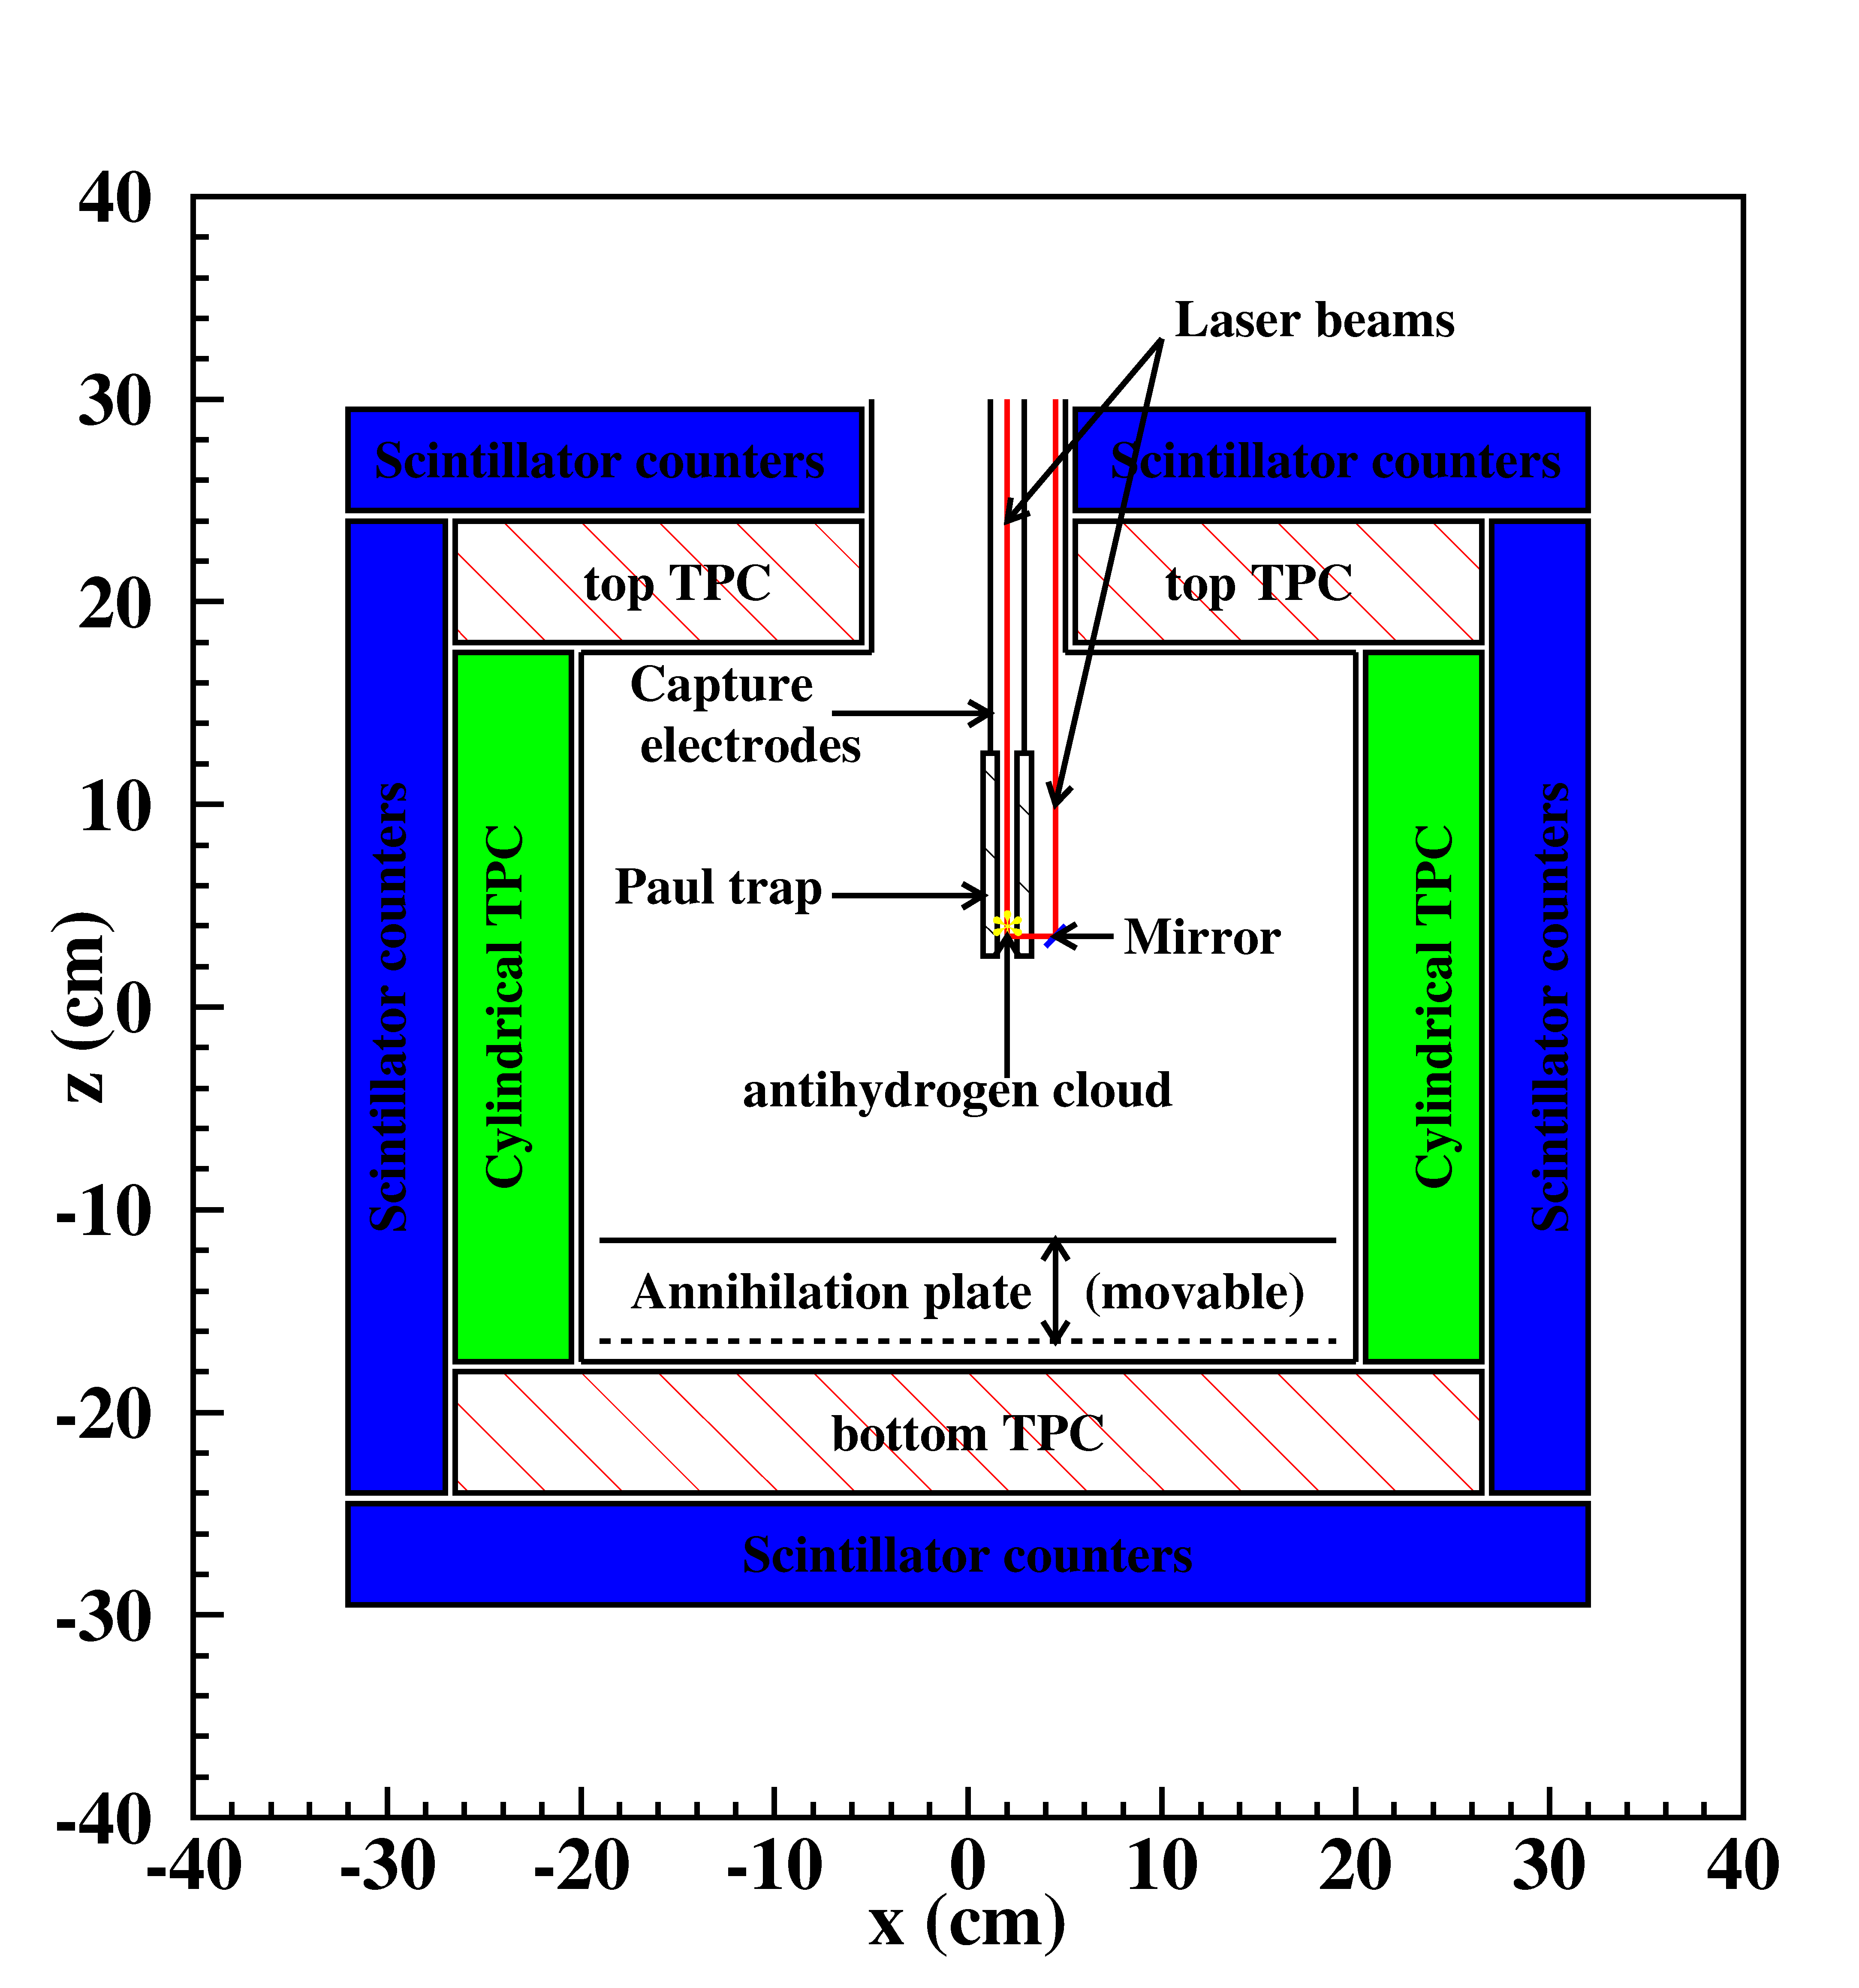
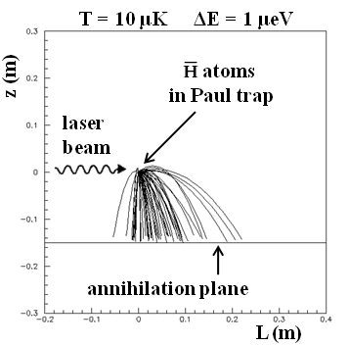
H free fall detection
H⁺
Aim : measure g to
1 % precision (first phase)
~ 1500 events needed

Slide 26
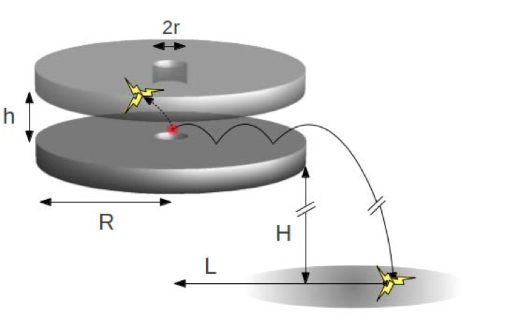
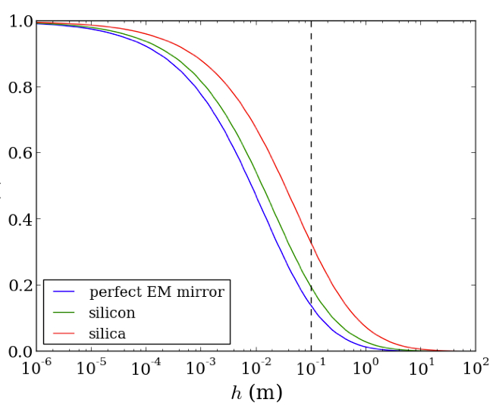
Perspective : Velocity selector
G. Dufour, P. Debu, A. Lambrecht, V. Nesvizhevsky, S. Reynaud, A. Voronin Eur. Phys. J. C 74 (2014) 2731
Reflection probability
Idea : keep only atoms with a small initial vertical velocity
The gain in precision outweighs the loss in statistics
See G. Dufour’s talk

Slide 27
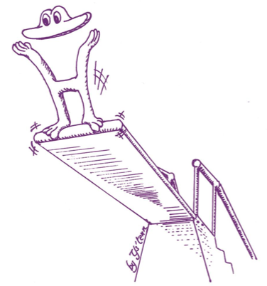
Spectroscopy of gravitational states
A. Yu. Voronin, P. Froelich, and V. V. Nesvizhevsky, Phys. Rev. A 83, 032903 (2011)
H source:
  very low temperature
  high phase-space density
  compact system
Improve the precision on g with the spectroscopy of gravitational levels of H above the annihilation plane: similar method as for UCN neutrons
(GRANIT spectrometer)
See A. Yu. Voronin talk

Slide 28










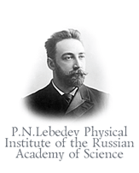



15 institutes
~ 50 researchers
2015 start installation
2016 ELENA commissioning with p & H⁻
2017 first antiprotons for GBAR
SPSC-P-342, Proposal to measure the Gravitational Behaviour of Antihydrogen at Rest, GBAR, CERN (2011)

