Slide 1

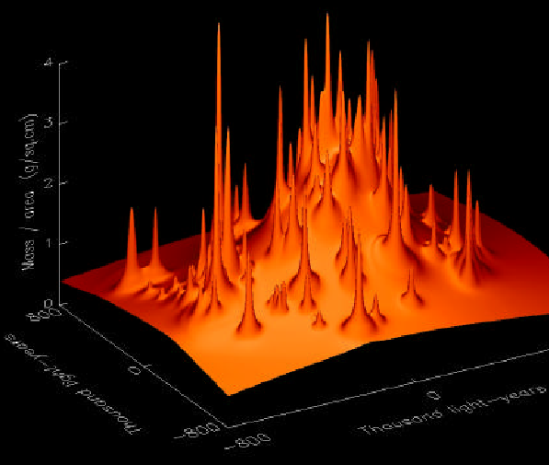
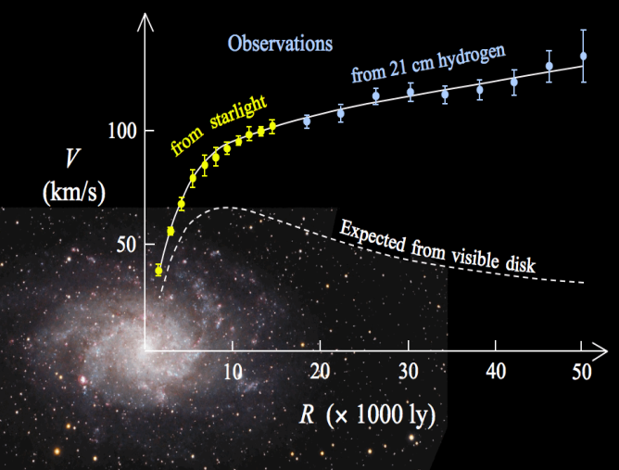

GRANIT 2014
2-7 March 2014 Ecole de Physique des Houches (France)
Outline
What’s the problem?
Describing galaxy halo particles in QM
Dark halo formation
Dark matter vs. hot gas in halo structures
How QLCDM views some halo interactions
Dark gravitational quantum states and their relation to galactic centre black holes and the X-ray emission of halos
dark states
  ← l
?
?
n →
Allan D. Ernest and Matthew P. Collins
Notes:
Slide I: Last year I outlined an approach to understanding the nature and origin of the dark matter content of the universe, what you might call a “quantum lambda cold dark matter” or at the risk of acronym overload QLCDM.
In this talk I want to
(1) First give a brief outline of the QCDM/QLCDM theory to refresh your memory, but explaining the physical basis on which it works rather than detailed mathematics
and,
(2) But mostly, try and look at some of the so-called “mysteries” of astrophysics that it potentially could solve because many of the major mysteries in astrophysics may be better understandable with the QLCDM model

Slide 2

Outline
What’s the problem?
Describing galaxy halo particles in QM
Dark halo formation
Dark matter vs. hot gas in halo structures
How QLCDM views some halo interactions
Dark gravitational quantum states and their relation to galactic centre black …
Allan D Ernest and Matthew P Collins, Charles Sturt University
2
Notes:
Slide 2 DON’T TALK ON THIS FOR LONG!!! I don’t have all the answers and I certainly don’t think that QLCDM in its present form can necessarily solve every major problem in astrophysics but QLCDM seems to solve a lot of them, and today I hope to sufficiently convince you that it is worth pursuing and testing the idea further. There is no doubt that although LCDM works great on very large scales, it has presently hit some fairly difficult obstacles:
There is no detected particle candidate, despite the LHC finding the Higgs, and in fact the result was too good because it fits so well that there doesn’t seem to be any hint at the moment, of physics beyond the standard model, that is required for candidates such as the neutralino etc. (pic from Sky and Telescope article)
Yes we (DAMA) have detected some annual change but it’s not the type of WIMP people were looking for and no other detectors can see it…
On the galactic halo scale the cusp problem (from the FNW profile) is still with us (pic of cusp predicted by NFW compared to smooth DM profile measurements), yet there are no signs of the WIMP decay signalling the WIMP-WIMP annihilation that is needed to solve this problem.
The satellite problem looks worse than ever – the simulations produce lumpy matter models of the Milky Way with thousands of satellite galaxies (pic of simulation see richard’s course versus a neat, “no or one-satellite” spheroidal galaxy) and we just can’t seem to make anything that looks like the observed relatively smooth spherical halo.

Slide 3
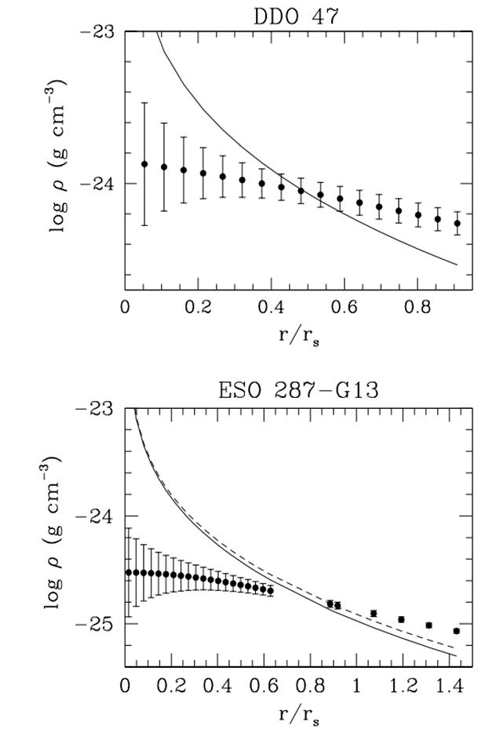
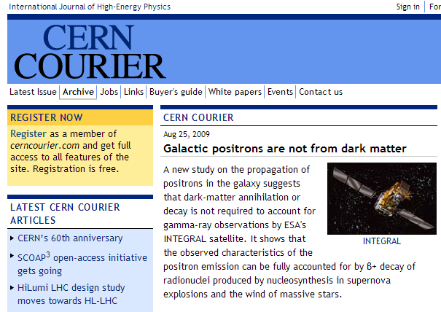
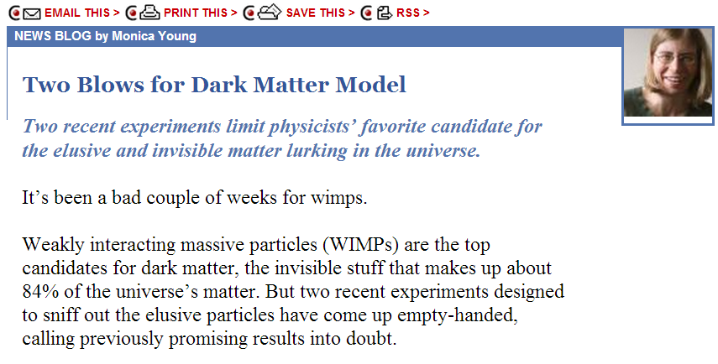
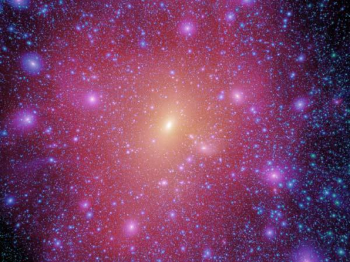
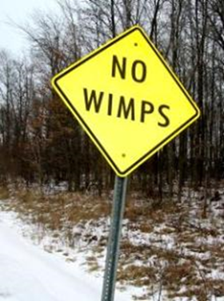
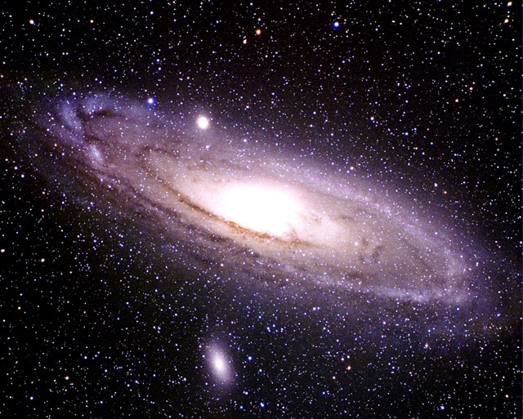
Why bother? – don’t we have LCDM?
Ben Moore, Phil. Trans. R. Soc. Lond. A (1999)
LCDM is great on large scales but…
predicted
Where is the particle?
observed
predicted
No cusps?
Dark gravitational quantum states and their relation to galactic centre black …
predicted
Where are the decays?
observed
observed
Satellite problem still with us…
(Salucci and Martins, 2009)
Allan D Ernest and Matthew P Collins, Charles Sturt University
3
Notes:
Slide 2 DON’T TALK ON THIS FOR LONG!!! I don’t have all the answers and I certainly don’t think that QLCDM in its present form can necessarily solve every major problem in astrophysics but QLCDM seems to solve a lot of them, and today I hope to sufficiently convince you that it is worth pursuing and testing the idea further. There is no doubt that although LCDM works great on very large scales, it has presently hit some fairly difficult obstacles:
There is no detected particle candidate, despite the LHC finding the Higgs, and in fact the result was too good because it fits so well that there doesn’t seem to be any hint at the moment, of physics beyond the standard model, that is required for candidates such as the neutralino etc. (pic from Sky and Telescope article)
Yes we (DAMA) have detected some annual change but it’s not the type of WIMP people were looking for and no other detectors can see it…
On the galactic halo scale the cusp problem (from the FNW profile) is still with us (pic of cusp predicted by NFW compared to smooth DM profile measurements), yet there are no signs of the WIMP decay signalling the WIMP-WIMP annihilation that is needed to solve this problem.
The satellite problem looks worse than ever – the simulations produce lumpy matter models of the Milky Way with thousands of satellite galaxies (pic of simulation see richard’s course versus a neat, “no or one-satellite” spheroidal galaxy) and we just can’t seem to make anything that looks like the observed relatively smooth spherical halo.

Slide 4
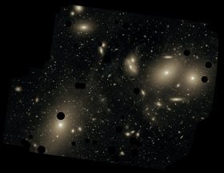
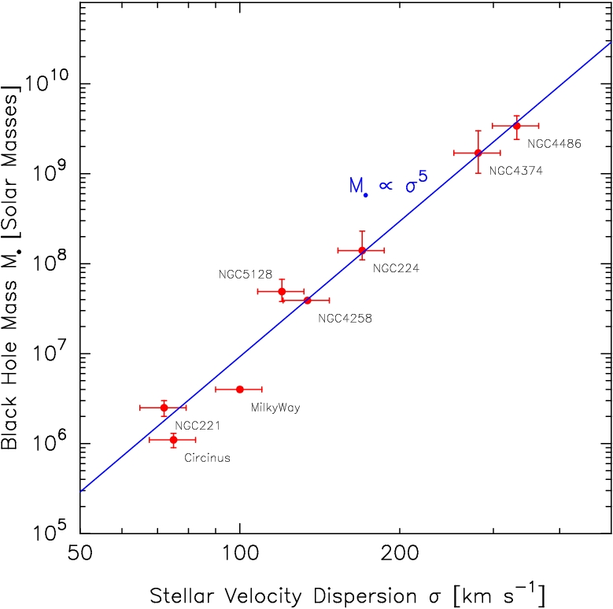
Other related issues…
Dark and visible matter almost always coexist - why?
T~0.3-1 keV
"The dark matter seems to 'know' how the visible matter is distributed. They seem to conspire with each other” …
"This is extremely surprising …”
the individual Dr. Benoit Famaey (Universities of Bonn and Strasbourg)
Where does the baryonic matter come from to keep making new stars?
Background cluster
T~3-20keV
(www2011.mpe.mpg.de)
… a pace that by now should have used up all the available gas.
... “It’s got to get gas from somewhere,”
Ken Freeman, Australian National University
http://www.nature.com/news/galaxy-formation-the-new-milky-way-1.11517
Dark gravitational quantum states and their relation to galactic centre black …
X-ray halos: constant temperatures, well correlated with the mass of their host systems - why?
Cool galactic halos in hot cluster halos – how come?
Galactic black holes – how did they get so massive and
why such a strong correlation with the bulge mass?
Allan D Ernest and Matthew P Collins, Charles Sturt University
4
Notes:
Slide And there are other related issues… Why is there a visible-dark conspiracy – wherever we see gas there seems to be dark matter and vice versa – why is there such an intimate connection?
Why do hot gas and dark matter follow almost the same radial density profiles?
Why are the x-ray temperatures of halos so well correlated with the masses of their host systems?
And why are the temperatures so constant and independent of radius, i.e. so well virialised despite the turbulent galaxy processes going on?
And can the Milky Way still keep making stars, when the density of its gaseous halo says that it should have run out of gas billions of years ago – to quote a recent article in nature: “The problem is that the Milky Way turns gas into stars at the rate of a few solar masses every year, a pace that by now should have used up all the available gas. But the Galaxy has been forming stars for at least the past 10 billion years. “It’s got to get gas from somewhere,” says Ken Freeman in Canberra.
And how can you keep relatively cold galactic halos inside a cluster halo that has a temperature of at least an order of magnitude higher? How does the Sun do the same sort of thing with its corona? (make pic of simulated cluster halo and show pic of sun?)
Why are the measured halos all so smooth and regular (pic of grav lensing)
Why is there such a strong link between the galactic centre black hole masses and the bulge mass/ dispersion?
Where did all the gas mass come from in the bullet cluster (pic)
Why are there no intermediate mass black holes?
How did the galactic centre black holes form and why are they so big?

Slide 5
Outline
What’s the problem?
Describing galaxy halo particles in QM
Dark halo formation
Dark matter vs. hot gas in halo structures
How QLCDM views some halo interactions
Dark gravitational quantum states and their relation to galactic centre black …
Allan D Ernest and Matthew P Collins, Charles Sturt University
5
Notes:
Slide 2 DON’T TALK ON THIS FOR LONG!!! I don’t have all the answers and I certainly don’t think that QLCDM in its present form can necessarily solve every major problem in astrophysics but QLCDM seems to solve a lot of them, and today I hope to sufficiently convince you that it is worth pursuing and testing the idea further. There is no doubt that although LCDM works great on very large scales, it has presently hit some fairly difficult obstacles:
There is no detected particle candidate, despite the LHC finding the Higgs, and in fact the result was too good because it fits so well that there doesn’t seem to be any hint at the moment, of physics beyond the standard model, that is required for candidates such as the neutralino etc. (pic from Sky and Telescope article)
Yes we (DAMA) have detected some annual change but it’s not the type of WIMP people were looking for and no other detectors can see it…
On the galactic halo scale the cusp problem (from the FNW profile) is still with us (pic of cusp predicted by NFW compared to smooth DM profile measurements), yet there are no signs of the WIMP decay signalling the WIMP-WIMP annihilation that is needed to solve this problem.
The satellite problem looks worse than ever – the simulations produce lumpy matter models of the Milky Way with thousands of satellite galaxies (pic of simulation see richard’s course versus a neat, “no or one-satellite” spheroidal galaxy) and we just can’t seem to make anything that looks like the observed relatively smooth spherical halo.

Slide 6
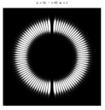
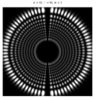
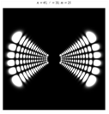
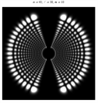
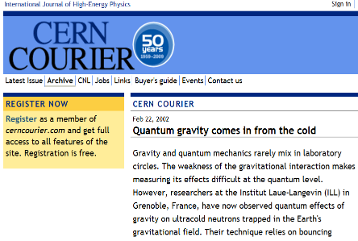
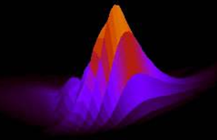

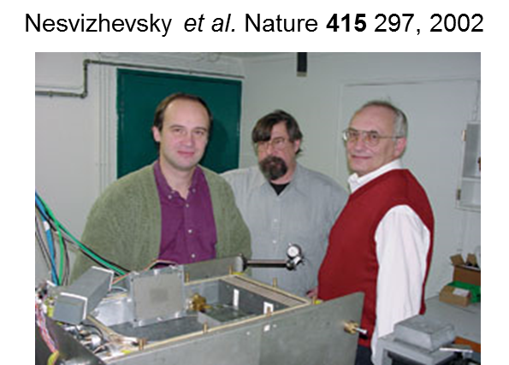
Quantum LCDM
ψ =
...
+
+
+
+
...
Quantum approach
...
F
Classical approach
Dark gravitational quantum states and their relation to galactic centre black …
The quantum theory of dark matter* is one that comes from considering baryons in the gravitational wells of galaxies and clusters from a quantum mechanical point of view.
* Ernest, A. D. J. Phys. A 42 115207, 2009; Ernest, A. D. J. Phys. A 42 115208, 2009; Ernest, A. D., Collins, M. P., G&C, 18, 242-248, 2012
Ernest, A. D., Advances in Quantum Theory, ed. Cotaescu, I, Rijeka, 2012.
Allan D Ernest and Matthew P Collins, Charles Sturt University
6
Notes:
Most astrophysical processes are analysed using Newtons Laws. However the quantum theory of dark matter* is one that comes from considering the gravitational wells of galaxies and clusters from a quantum mechanical point of view. In this view instead of analysing the particle behaviour in terms of forces and velocities, we calculate the eigenfunctions of the potential well, and predict the behaviour of a particle by the sum of its eigenspectral components.
Of course if the particle was an electron in an electric/magnetic field we would expect to get the same result as in the classical approach, but gravity is geometric – does a gravity well even have eigenstates? Well of we know, thanks to Valery, that we analyse gravity wells this way

Slide 7
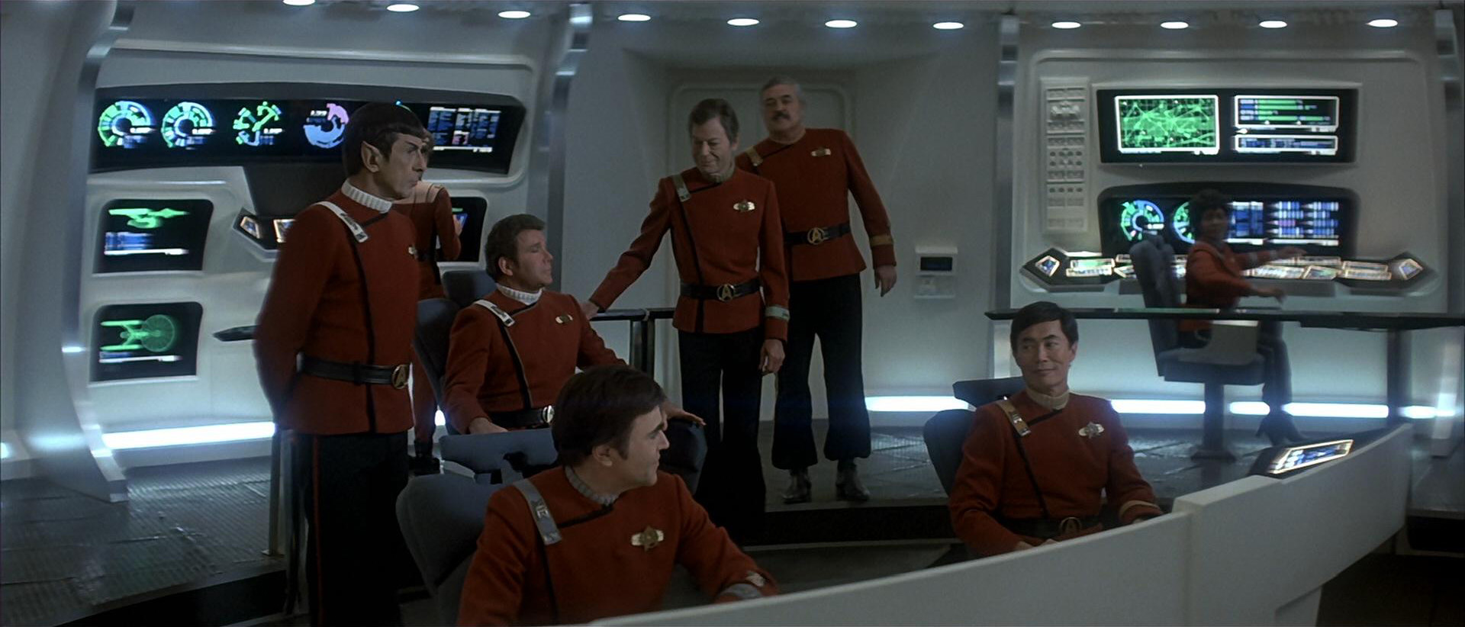
Quantum LCDM
Hey Bones, what do you make of these dark matter halos?
They’re protons Jim, but not as we know them.
QM predicts the existence of ‘dark’ eigenstates (Rydberg equivalent)
Larger, deeper wells ⇒ larger % dark states
Enables baryons to ‘hide’ in dark eigenspectral compositions and provides for an all-baryonic dark matter scenario consistent with WMAP and BBN
Dark gravitational quantum states and their relation to galactic centre black …
(Credit: http://en.memory-alpha.org/wiki/)
7
Allan D Ernest and Matthew P Collins, Charles Sturt University
7
Allan D Ernest, Matthew P Collins and Graeme L White
Notes:
Slide 8: Thus as the crew of startrek will tell you, an ensemble of ordinary baryonic particles with dark eigenspecta could form a ‘dark matter’ halo. We would normally expect that the quantum approach should yield the same result as the classical one because of the macroscopic scale of the halo, but the presence of long-lived dark states has a profound influence on the properties of these particles when compared to those observed in laboratories on earth.

Slide 8
Cross sections in deep gravity wells
…
l = 2
l = 1
l = 0
  ← l value
low-p, dark
(Rydberg-type)
states
(p ≡ n – l)
n
✗
visible
eigenspectral
composition
n - 1
even darker
eigenspectral
composition!
n value →
n - 2
✗
n - 3
✓
Strong interaction?
Dark gravitational quantum states and their relation to galactic centre black …
…
✓
dark
eigenspectral
composition
visible
eigenspectral
composition
yes
✗ ⁺✓
✗
increasing p
(p=n-l)
no
Particles containing dark eigenspectral compositions have lower cross sections than particles having visible distributions (e.g. lab)
Allan D Ernest and Matthew P Collins, Charles Sturt University
8
Notes:
In order to understand the reduced cross sections you need to look at an eigenstate diagram of a gravity well. N runs up the page, l across from right to left and a new parameter p that relates to the number and spatial tightness of the eigenfunction’s oscillations, p = n – l.
A localised particle has a wavefunction that involves mainly states on the right (low/high n, low-l, and its classical interaction properties, as observed in labs, results from the summed interaction of its eigenspectra of states in this case dominated by these visible states.
As you go to the left and up (high-n, high-l) however, states start to behave like dark states. I have summarised on here what this means for particles in regions of the diagram that try to interact with each other. The least interacting states are in the upper left corrner
(It takes about 10²¹ states to localise a particle in the galactic halo to within 1 m)

Slide 9
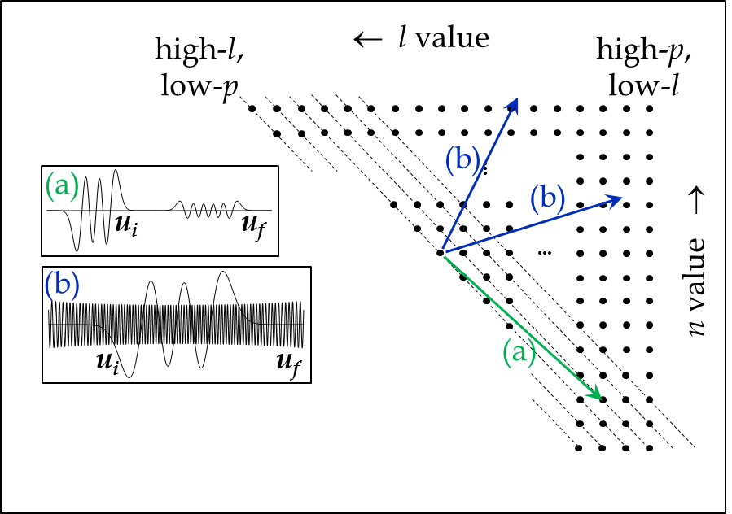
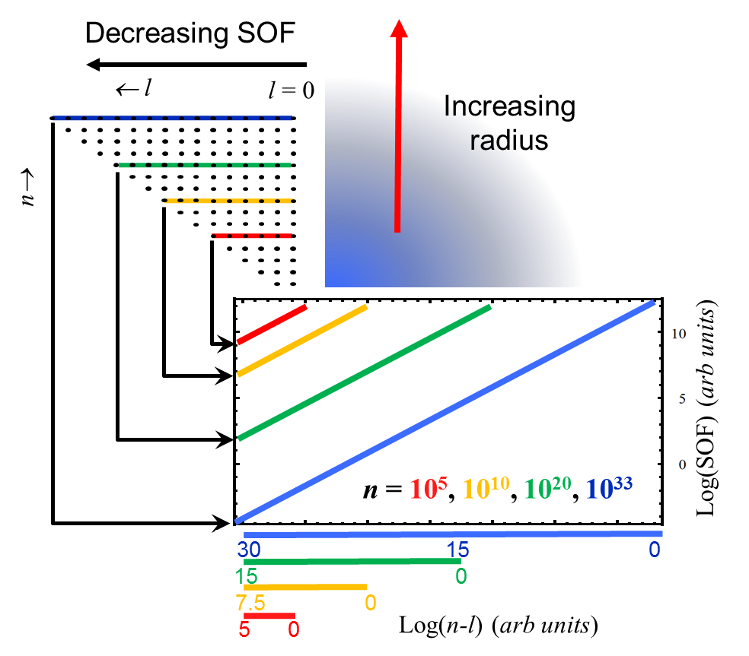
How dark is ‘dark’?
Depends on differences in radial spatial oscillation frequencies (SOF’s)
Dark gravitational quantum states and their relation to galactic centre black …
Deeper wells
⇒ larger n
⇒ Larger SOF
differences
⇒ ‘darker’
Allan D Ernest and Matthew P Collins, Charles Sturt University
9
Notes:
It is really the SOF that isolates the left hand side from the right hand side of the state diagram. Since SOF is so important in determining interaction rate, how does it vary across the state diagram?
Each coloured line shown here on the state diagram represents sets of states with approximately the same average radial position. Clearly the higher we go up the state diagram (larger n’s and further out in a deeper halo, the more high l-states there are. More importantly however is that because each horizontal line begins with the same SOF it means that for higher states there is a much greater range of SOF values and the SOF’s extend to much lowere values. This is why we don’t see dark states in smaller wells with lower masses. Dark states really start to show up in wells like the sun where large enough well-bound n-states are available.

Slide 10
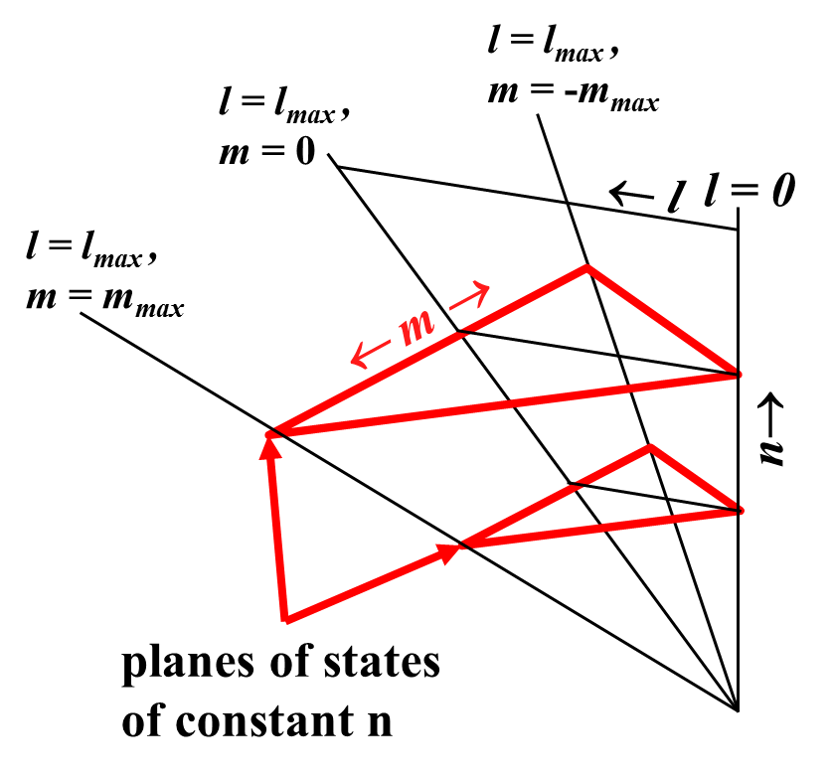
How dark is ‘dark’?
How different can an interaction rate be?
Weight over two factors:
10³⁴
(i) Occupation probability
(Boltzmann dist.)
(ii) Change in cross section for
a given state with l - hard!
low T
occupation likelihood
relative to l = 0
0
high T
← l
Dark gravitational quantum states and their relation to galactic centre black …
Rough estimate(!): Cross sections for stimulated transitions can be 10⁻¹⁷ times lower than expected from fully overlapping wavefunctions
Allan D Ernest and Matthew P Collins, Charles Sturt University
10
Notes:
It is really the SOF that isolates the left hand side from the right hand side of the state diagram. Since SOF is so important in determining interaction rate, how does it vary across the state diagram?
Each coloured line shown here on the state diagram represents sets of states with approximately the same average radial position. Clearly the higher we go up the state diagram (larger n’s and further out in a deeper halo, the more high l-states there are. More importantly however is that because each horizontal line begins with the same SOF it means that for higher states there is a much greater range of SOF values and the SOF’s extend to much lowere values. This is why we don’t see dark states in smaller wells with lower masses. Dark states really start to show up in wells like the sun where large enough well-bound n-states are available.

Slide 11
Outline
What’s the problem?
Describing galaxy halo particles in QM
Dark halo formation
Dark matter vs. hot gas in halo structures
How QLCDM views some halo interactions
Dark gravitational quantum states and their relation to galactic centre black …
Allan D Ernest and Matthew P Collins, Charles Sturt University
11
Notes:
Slide 2 DON’T TALK ON THIS FOR LONG!!! I don’t have all the answers and I certainly don’t think that QLCDM in its present form can necessarily solve every major problem in astrophysics but QLCDM seems to solve a lot of them, and today I hope to sufficiently convince you that it is worth pursuing and testing the idea further. There is no doubt that although LCDM works great on very large scales, it has presently hit some fairly difficult obstacles:
There is no detected particle candidate, despite the LHC finding the Higgs, and in fact the result was too good because it fits so well that there doesn’t seem to be any hint at the moment, of physics beyond the standard model, that is required for candidates such as the neutralino etc. (pic from Sky and Telescope article)
Yes we (DAMA) have detected some annual change but it’s not the type of WIMP people were looking for and no other detectors can see it…
On the galactic halo scale the cusp problem (from the FNW profile) is still with us (pic of cusp predicted by NFW compared to smooth DM profile measurements), yet there are no signs of the WIMP decay signalling the WIMP-WIMP annihilation that is needed to solve this problem.
The satellite problem looks worse than ever – the simulations produce lumpy matter models of the Milky Way with thousands of satellite galaxies (pic of simulation see richard’s course versus a neat, “no or one-satellite” spheroidal galaxy) and we just can’t seem to make anything that looks like the observed relatively smooth spherical halo.

Slide 12
Supermassive primordial black holes
SMPBH’s form at e^{+/-} phase transition (Carr,1975)
overdensity regions
black holes form
during phase transition
Dark gravitational quantum states and their relation to galactic centre black …
Size: up to ~ 10³⁵ - 10³⁶ kg;
Number density: 10^{-73±6} m⁻³ (present epoch)
Present epoch galaxy number density: 10⁻⁶⁹ m⁻³
Assertion: all galactic centre black holes were originally primordial ‘Carr’ black holes
Shell model shows halos can form in < 1000 s
Allan D Ernest and Matthew P Collins, Charles Sturt University
12
Notes:
When I first realised that there were so many dark states it seemed such a useful way to explain DM but I couldn’t see how these states could be populated. I then read an interesting paper by Carr who showed that during phase changes in the early universe over-density regions could collapse to black holes. Carr was envisaging early phase transitions but his theory applies at any time, and therefore at the e+/e- phase transition at t = 1 s the mass of the PBH potentially could be > 10³⁵ kg. I am guessing that the collapse time is of the order of the horizon time – still need to read this is detail. Comes about because equation of state can be different during phase transitions
My assertion was then, and still is now, that the supermassive black holes that centres of galaxies are in fact these “Carr black holes” produced at t = 1 s. This is also supported not only by them having large mass but also by the observation that Carr’s equation can potentially yield number densities of back holes consistent with the present day number density of galaxies.
But it was also exciting because such sized black holes could produce the sufficiently deep seed potential wells that I needed to capture baryons (if it were not for the radiation that prevents collapse via acoustic oscillations). So what does the radiation do?
Shell model:
- Compton and Rayleigh cross sections will be smaller for particles
in the potential well of the Carr black holes
- baryons are trapped when well depth ~ f E_{k(particle)} where f is a free
parameter, typically 10 by analogy with the atomic case (Saha eq.)
- capture increases the contrast density/well depth and promotes
further
- can form 10⁴⁰ kg halo before completion of nucleosynthesis
- halo size/mass is determined by SPBH spacing
- ~20% of the particles remain in the field-free inter-halo region
- why WMAP yields about 1/5 as the baryon/matter fraction?
- small halos grow, in size by excitation (probably 3 body collisions),
and mass by merging.
- for small r, density $ρ∝1/{r^{n}}$ where $n\sim 0$ when $r<r_{0}$ and $n\sim 0.4−3$
when $r<r_{0}$.
($r_{0}$ is the initial radius where the well depth satisfies f E_{k(particle)}).

Slide 13
Outline
What’s the problem?
Describing galaxy halo particles in QM
Dark halo formation
Dark matter vs. hot gas in halo structures
How QLCDM views some halo interactions
Dark gravitational quantum states and their relation to galactic centre black …
Allan D Ernest and Matthew P Collins, Charles Sturt University
13
Notes:
Slide 2 DON’T TALK ON THIS FOR LONG!!! I don’t have all the answers and I certainly don’t think that QLCDM in its present form can necessarily solve every major problem in astrophysics but QLCDM seems to solve a lot of them, and today I hope to sufficiently convince you that it is worth pursuing and testing the idea further. There is no doubt that although LCDM works great on very large scales, it has presently hit some fairly difficult obstacles:
There is no detected particle candidate, despite the LHC finding the Higgs, and in fact the result was too good because it fits so well that there doesn’t seem to be any hint at the moment, of physics beyond the standard model, that is required for candidates such as the neutralino etc. (pic from Sky and Telescope article)
Yes we (DAMA) have detected some annual change but it’s not the type of WIMP people were looking for and no other detectors can see it…
On the galactic halo scale the cusp problem (from the FNW profile) is still with us (pic of cusp predicted by NFW compared to smooth DM profile measurements), yet there are no signs of the WIMP decay signalling the WIMP-WIMP annihilation that is needed to solve this problem.
The satellite problem looks worse than ever – the simulations produce lumpy matter models of the Milky Way with thousands of satellite galaxies (pic of simulation see richard’s course versus a neat, “no or one-satellite” spheroidal galaxy) and we just can’t seem to make anything that looks like the observed relatively smooth spherical halo.

Slide 14
X-ray temperatures and eigenstate energies of large halo structures
Structure | Typical longest radiative lifetime (s) | Typical eigenstate ‘E_{K}’ (eV) | X-ray temperature (eV) | ‘Dark matter’ present? | Hot gas present?
Sun | 10¹¹ | 1 x 10³ ✓ | 1.3 x 10³ ✓ | small? | yes
Milky Way | 10²⁰ | 350 ✓ | ~ 200 ✓ | yes | yes
Typical galaxy cluster | 10²¹ | (4 – 9) x 10³ ✓ | (3 – 10) x 10³ ✓ | yes | yes
Typical globular cluster | not calculated (probably >t_{H}) | ~3 ✓ | none, stripped by orbits ✓ through disk ? | little/ none | little/ none
Dwarf spheroidal | not calculated (probably >t_{H}) | ~0.1 – 2 ✓ | no diffuse ✓ component | yes, lots | none seen
Dark gravitational quantum states and their relation to galactic centre black …
Allan D Ernest and Matthew P Collins, Charles Sturt University
14
Notes:
What I have calculated here is the eigenstate equivalent kinetic energy and compared it with the x-ray temperature of various structures. We can see that if the observed energy of a halo comes from and follows the energy of its eigenstates then we can see how it is possible for the Sun to have its photosphere aat 5000K while its corona sits at a much hotter ~1 keV. Also how galaxy halos at anything from 0.1 to 300 eV can sit inside much hotter cluster halos at 3 – 10 keVbecaus ethe populations are isolated and the energy determined by their local well structure.
If we compare dwarf spheroids with normal galaxies we see that they have lower temperature halos, in keeping with their lowere M0/R0 ratio and eigenstate kinetic energies. However similar processes must surely go on in dwarf spheroidals as in larger galaxies and one might therefore expect to see similar amounts of hot gas to there larger counterparts but we see no hot gas – why? In the eigenstate picture the dark storage eigenstates available have low energy so they do not emit x-rays and the fraction of dark matter remains high. We do not see the diffuse component of x-rays only discrete sources. (i.e. If the mechanisims producing the hot particles are still active then this hot gas is dissipated and stored only in the low energy dark states which have insufficient Ek to emit x-rays)
Hot gas and DM are not seen in clusters because of stripping. Dwarf galaxies which are similar in size and mass have lots of DM but no hot gas. This is clear again from the eigenstate energies.

Slide 15
A unified (but simplistic!) hypothesis of dark matter and hot gas halos
Primordial Carr black holes and their halos form early, > ~1000 s
Left undisturbed, infalling baryons statistically trend toward a ‘dark’ eigenspectral distribution - x-ray fraction varies
Carr black holes: today’s galactic centre black holes
Primordial halos: ancestors of bulges - PBH-bulge relation
Dark gravitational quantum states and their relation to galactic centre black …
Disturbing a halo (e.g. merging) provides a fresh source of more highly interacting baryons for new star formation
Ellipticals potentially reborn as spirals and undisturbed spirals eventually return to ellipticals
Allan D Ernest and Matthew P Collins, Charles Sturt University
15
Notes:
Primordial SMPBHs and halos form early, < t ~ 1000 s – radiation density much larger + 3 body collisions relaxes selection rules
Compton and Rayleigh cross sections will be smaller for particles
in the potential well of the Carr black holes
To check nucleosynthesis and anisotropy calculations need to be redone treating the cross sections as variables
Baryons rain down on halos and trend to dark eigenspectral mixes with occupation numbers appropriate to the coupling temperature
When halos is disturbed in some way the progress to any sort of equilibrium is interrupted and states are redistributed making eigenspectral mixes that are more visible and star formation can proceed
Thus a elliptical with can come back to life if its halo is agitated in some way
The hot gas halos we observe contain much more matter than we can see

Slide 16
Outline
What’s the problem?
Describing galaxy halo particles in QM
Dark halo formation
Dark matter vs. hot gas in halo structures
How QLCDM views some halo interactions
Dark gravitational quantum states and their relation to galactic centre black …
Allan D Ernest and Matthew P Collins, Charles Sturt University
16
Notes:
Slide 2 DON’T TALK ON THIS FOR LONG!!! I don’t have all the answers and I certainly don’t think that QLCDM in its present form can necessarily solve every major problem in astrophysics but QLCDM seems to solve a lot of them, and today I hope to sufficiently convince you that it is worth pursuing and testing the idea further. There is no doubt that although LCDM works great on very large scales, it has presently hit some fairly difficult obstacles:
There is no detected particle candidate, despite the LHC finding the Higgs, and in fact the result was too good because it fits so well that there doesn’t seem to be any hint at the moment, of physics beyond the standard model, that is required for candidates such as the neutralino etc. (pic from Sky and Telescope article)
Yes we (DAMA) have detected some annual change but it’s not the type of WIMP people were looking for and no other detectors can see it…
On the galactic halo scale the cusp problem (from the FNW profile) is still with us (pic of cusp predicted by NFW compared to smooth DM profile measurements), yet there are no signs of the WIMP decay signalling the WIMP-WIMP annihilation that is needed to solve this problem.
The satellite problem looks worse than ever – the simulations produce lumpy matter models of the Milky Way with thousands of satellite galaxies (pic of simulation see richard’s course versus a neat, “no or one-satellite” spheroidal galaxy) and we just can’t seem to make anything that looks like the observed relatively smooth spherical halo.

Slide 17
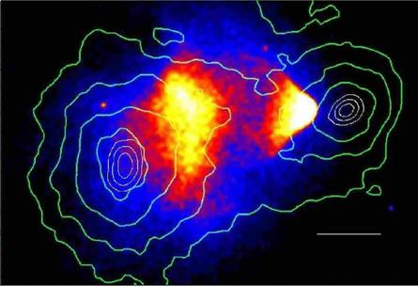
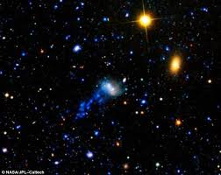
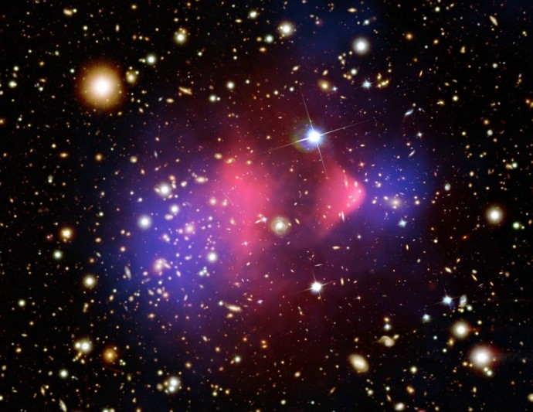
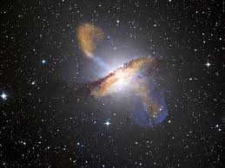
Some halo interactions from a dark eigenstate perspective
Dark gravitational quantum states and their relation to galactic centre black …
Allan D Ernest and Matthew P Collins, Charles Sturt University
17
Notes:
I would like to finish by briefly looking at some halo interactions and how they might be viewed in the dark eigenstate scenario. Halos progress toward a ‘quasi-equilibrium’ in which the halo becomes less and less visible if left undisturbed.
In the bullet cluster we see a small cluster pass through a large one. The observed mass of gas after the interaction is possibly 2-3 times more than observed in a typical cluster (as far as I can see from reading) so the dark eigenstate scenario would explain this in terms of increased particle density and a shift the more visible eigenspectral distributions initiated by the enhanced and directed collisions. The gas is drawn from the dark state population but is only about a tenth of that mass so does not have a large effect on very dark states left behind
In the next picture we can see the precessing PBH jets. The SOF of the rapidly outflowing material decreases as it climbs out of the well. Eventually as it approaches the SOFs of the halo particles interaction can occur and the gas is diffused
Lastly the jellyfish galaxies. In the eigenstate scenario the galaxy would be moving radially away from the ‘tenticles’. As per the bullet cluster, a trail of baryons has been made more interactive by virtue of state transfer to the visible side of the state diagram

Slide 18
Summary
Fits dark matter particle requirements
Does not need new particles or new physics
Explains Ω_{baryon} ~ Ω_{dark} coincidence & missing baryons
Consistency with CDM on large scales, BBN and WMAP
Dark gravitational quantum states and their relation to galactic centre black …
Number of SMPBHs consistent with number of galaxies
Consistency with M-sigma relation?
Particle masses consistent with halo size and mass
Solves the cusp problem, satellite problem
Explains ‘cold’ galactic halos in hot cluster halos
Eliminates cooling flow issues and cool cores
Allan D Ernest and Matthew P Collins, Charles Sturt University
18
Notes:
Slide

Slide 19
THE END, Thank you!
Dark gravitational quantum states and their relation to galactic centre black …
Allan D Ernest and Matthew P Collins, Charles Sturt University
19
Notes:
Slide

